Slide 1
Active Magnetic Compensation
Jeff

Slide 2
Active Magnetic Compensation
Requirements: make the field small, homogeneous, and stable. Do not restrict access to experiment within.
  How small? Make sure the passive shields don’t saturate.
  How homogeneous? Probably don’t care too much – the passive shields will remove gradients.
  How stable?
    Stable enough that passive shield still does its job and keeps the comagnetometer happy – 10 fT in 100 s averaging.
    Stability of gradient set by “R-1” correction scheme inside passive shielding factor – somewhat related to int. mag. function.
  The belief is that the happier the outermost passive shield is, the less time we will spend degaussing. This belief is not quantified, to my knowledge.
  How invisible? No conflicts with any access to anything. Easy to rip apart for access, if necessary. => “Open” geometry.
Deficiency: how to answer why this is better than another layer of mu-metal.

Slide 3
The new state-of-the-art is defined by PSI, in my opinion
Reported in Michal Rawlik’s thesis (2018)
Main innovations:
  Coil design based on patch coils
  Multidimensional PID, revisited
  Field mapping in the experimental area

Slide 4
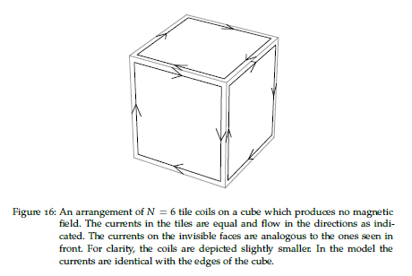
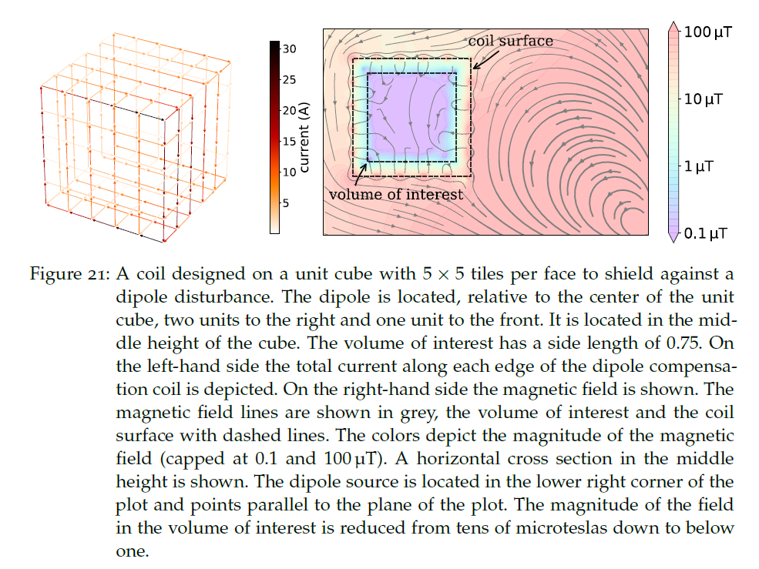
Coil design

Slide 5
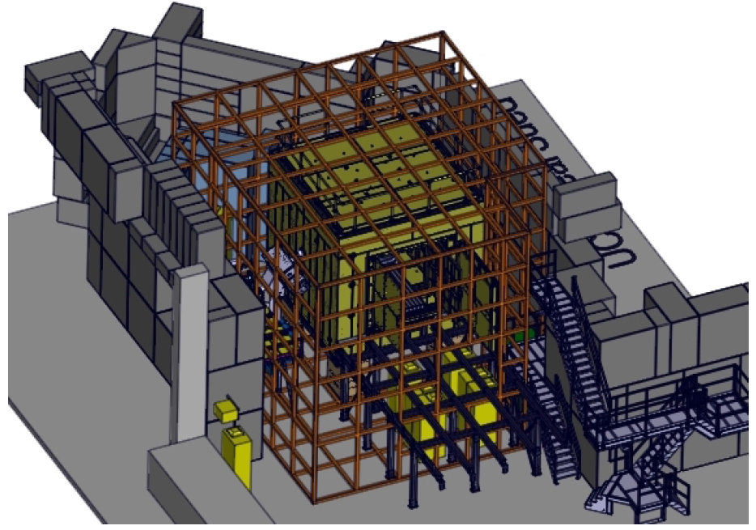
Coil design
Design for n2EDM:
Efficiencies for counterpropagating currents in winding patterns flexible enough to generate gradients to some order.

Slide 6
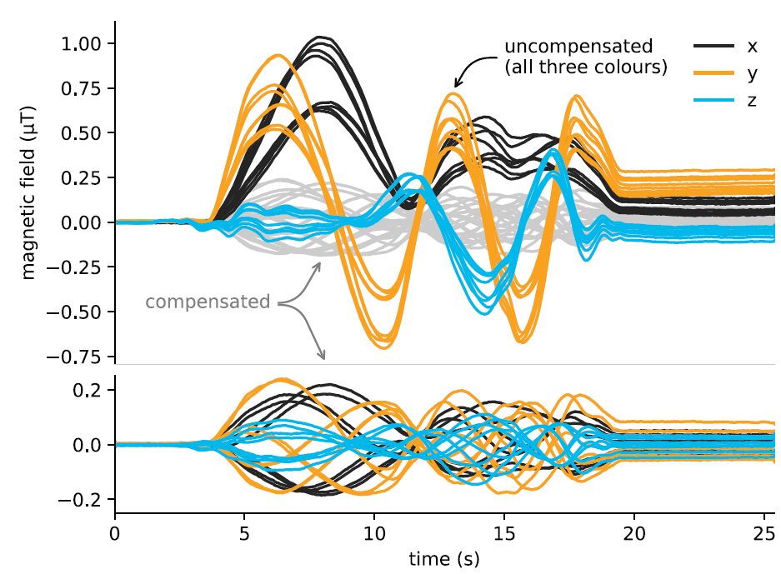
Multidimensional PID revisited
No PID? – not exactly…
Prototype system at ETH Zurich, with condition number ~1
Rotating dipole stimulus 7.5 m distant

Slide 7
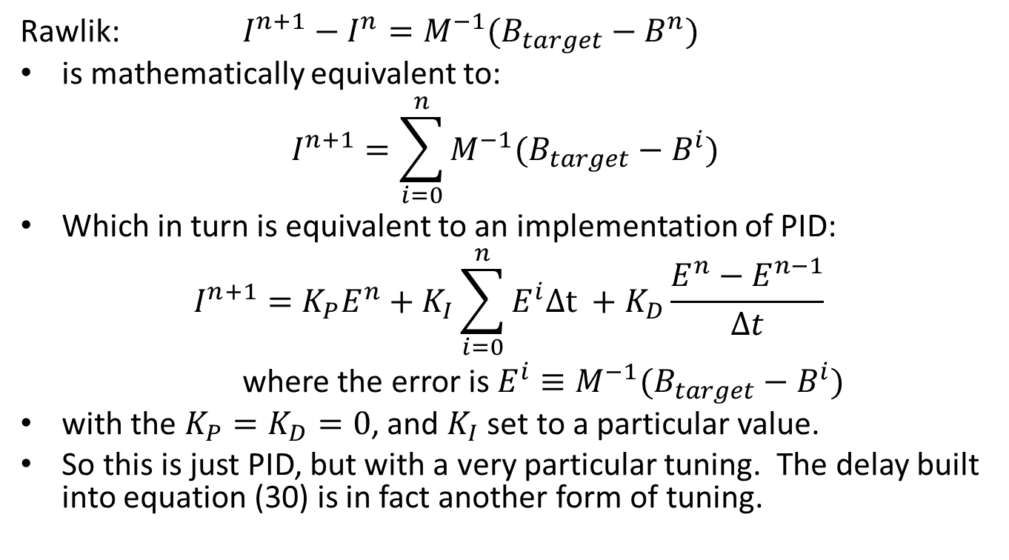
No PID?
Actually, it is PID, just not as general
Rawlik: $I^{n+1}−$ $I^{n}=M^{−1}(B_{target}−B^{n})$
is mathematically equivalent to:
$$I^{n+1}=\sum_{i=0}^{n}{M^{−1}(B_{target}−B^{i}) }$$
Which in turn is equivalent to an implementation of PID:
$$I^{n+1}=K_{P}E^{n}+K_{I}\sum_{i=0}^{n}{E^{i}∆\text{t} }+K_{D}\frac{E^{n}−E^{n−1}}{∆t}$$
where the error is $E^{i}≡M^{−1}(B_{target}−B^{i})$
with the $K_{P}=K_{D}=0$, and $K_{I}$ set to a particular value.
So this is just PID, but with a very particular tuning. The delay built into equation (30) is in fact another form of tuning.

Slide 8
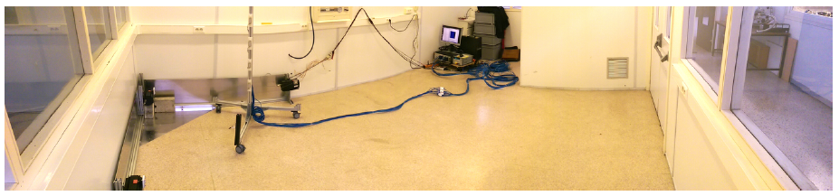
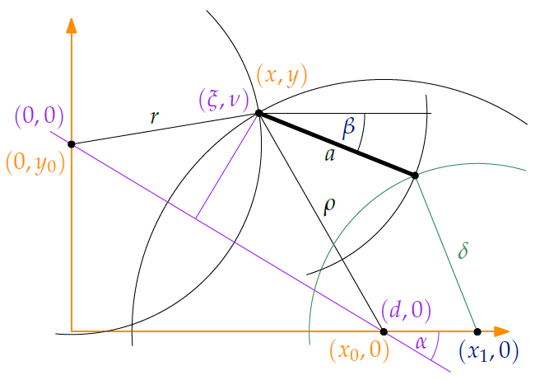
Mapping
At ETHZ: robot-belt system (like at UWpg)
At LSPC: manual multifluxgate tower
At PSI: scaled up version of LSPC system

Slide 9
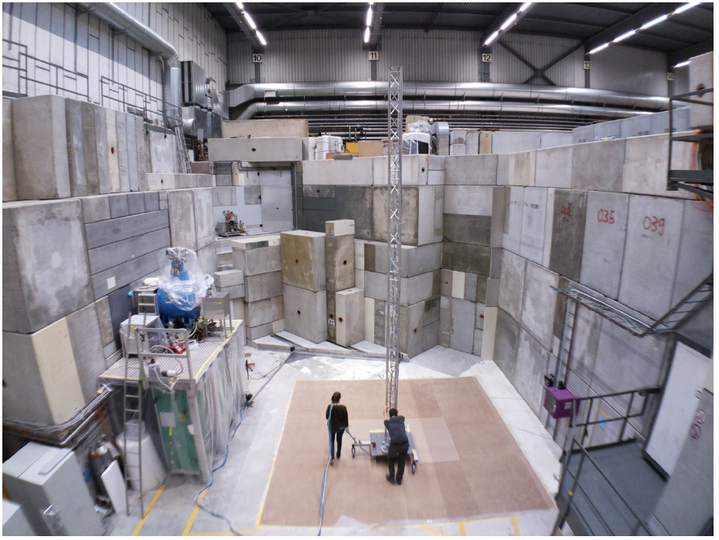
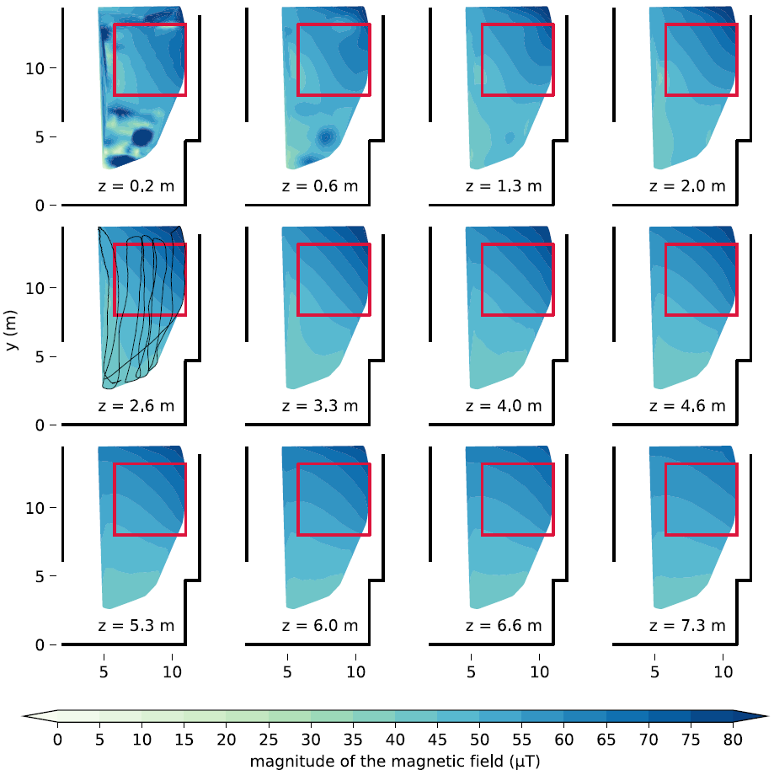
January 2018: Maps made for all conditions of nearby superconducting magnets

Slide 10
Who of us is working on this?
To be at state-of-the-art:
  Coil design (based on patch coils)
  Multidimensional PID, revisited
  Field mapping in the experimental area
Basic definition of Shomi’s MSc thesis: learning about multidimensional PID systems
Opportunity
Shomi
Elspeth, Beatrice

Slide 11
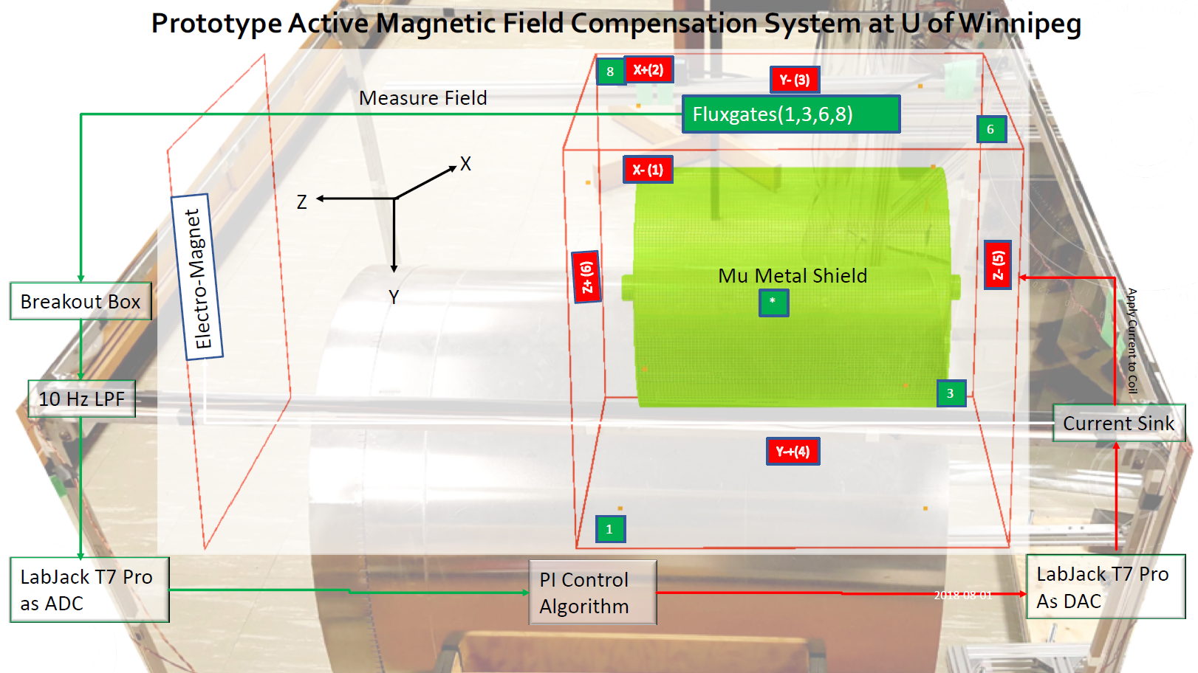
Recent results from Shomi

Slide 12
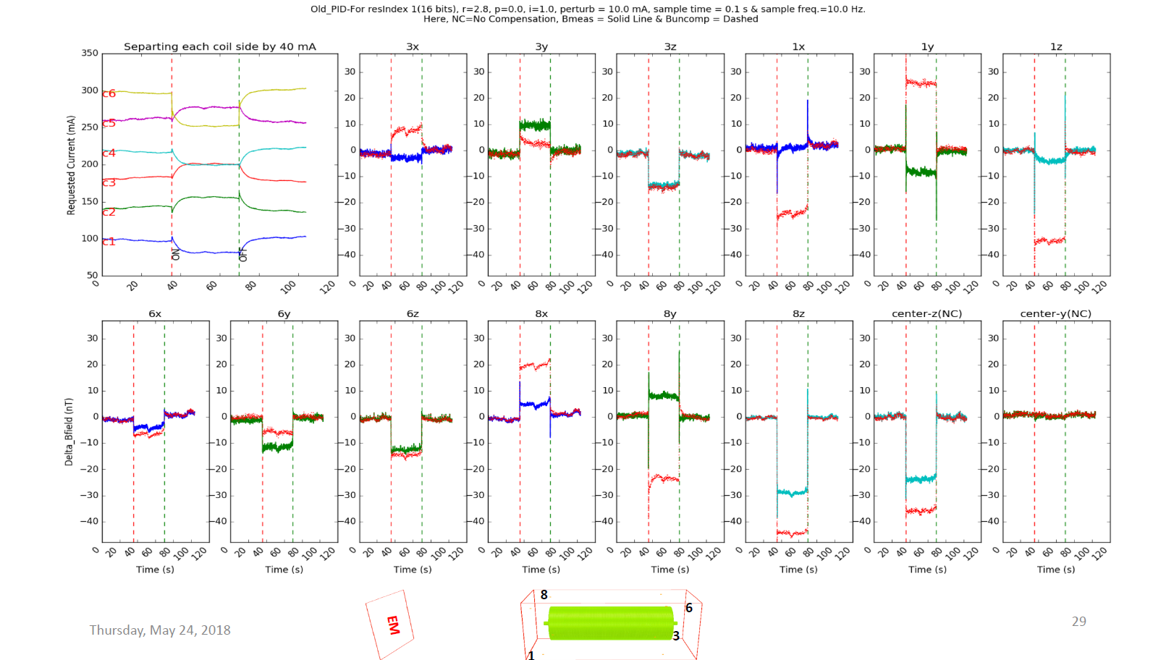
Recent results from Shomi

Slide 13
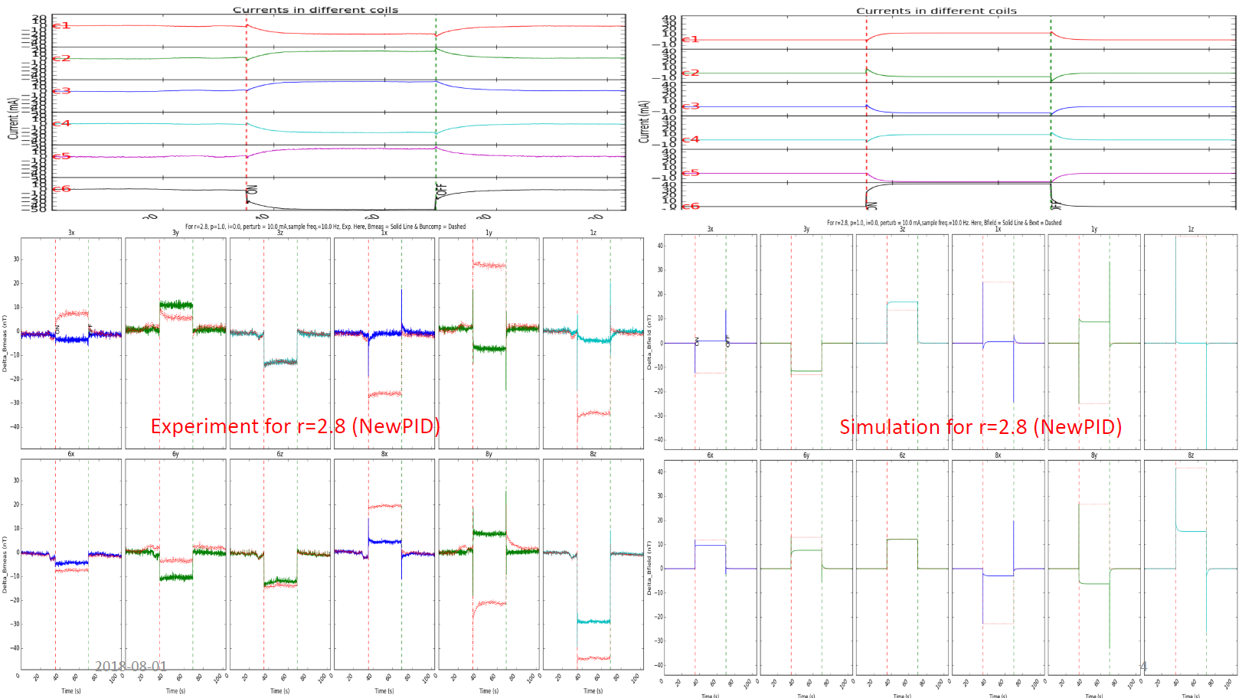
New: Time-dependent simulation
Experiment
Simulation: 100% FEA + PID loop
A few sign errors – otherwise very similar

Slide 14
Recent results from Shomi
Better understanding of PID (feedback) parameters via PID-simulation:
  M and B_{ext}(t) from FEA (or measurement)
  M⁻¹ (r) and PID parameters adjusted
  Feedback loop with adjustable delays
Conclusion: system performs as expected (simulation and data see similar time behavior for similar parameters/delays).
Somewhat open question: what are the “best” parameters for the feedback loop? Define metrics and characterize.
Otherwise, quantify system performance and write up. Leave further improvements to the future students (Beryl?)

