Slide 1
UCN handling for UCN source and EDM experiment
R. Picker
Picture: ³He gas panel

Slide 2
UCN handling components for the source
Polarized RT
guides
UCN source RT
guides
UCN source cryo guides
Pump out port
Pressure bypass
EDM port
RT guides
Burst disk guide
Y switch
UCN valve
SC
polarizer
HEX to thermal
transition guide
UCN production volume
(bottle)
shielding
HEX
1.2 K
UCN guide bottle to HEX
2nd port
Warm bore guide with
vacuum separation foil
Thermal transition guide
Vacuum tight valve

Slide 3
UCN handling components for the source
polarizer
polarizer
SSA guide
⁶Li detector
SSA
EDM ground electrode
EDM guides
Spin flipper
EDM-y guide
EDM cell insulator
EDM switch
EDM HV electrode
from EDM port
EDM cell valve

Slide 4
All requirements are recursive.
Requirements
General UCN guide requirements
UCN source cryo guides
Wall Fermi potential: 212 neV (NiP) or higher (NiP coating) (except for EDM cell)
Smooth inner surfaces (mirror finish surface, very few scratches allowed, will we do acceptance test on the surfaces?)
  In the simulation we assumed 3% diffuse reflection - how does this correlate with any measured surface roughness…?
Vacuum level inside guides better than 10⁻⁶ mbar
Temperature range: 0.8 K to 450 K
Superfluid tight (Helicoflex delta seals?)
Wall Fermi potential: 212 neV (NiP) or higher (NiP coating)

Slide 5
Requirements and questions?
UCN production volume (bottle)
Bottle to HEX guide
Owners: CM (mechanical), SK, RM (coating), RP (AlBeMet)
Owners: CM (mechanical), RM (coating)
Base material shall have low beam heating and low neutron absorption (Al or better AlBeMet or Be)
Inside surface shall be smooth (better for baking)
Metal sealed flange to HEX to bottle guide
Size: ca 340 mm diameter, ca 490 mm long (from moderator optimization)
Superinsulation necessary on outside? (cryogen relief calcs will inform)
Heaters necessary around bottle?
Base material should have low beam heating and low neutron absorption (Al)
Inside surface shall be smooth (better for baking)
diameter: 150 mm? (see Steve’s presentation)
Length: ??
Superinsulation necessary on outside? (cryogen relief calcs will inform)
Heaters on the outside
Extraction height from bottle (see Steve’s presentation)

Slide 6
Requirements
HEX
HEX to thermal transition guide
Owners: SK
Owners: CM (mechanical), RM (coating), ? (film flow suppression), ? (thermal anchors)
Base material should provide best conductivity (OHFC copper, which grade?)
Inner diameter: 150 mm?
Length: 600 mm?
Can the HEX be baked?
Contains liquid helium surface
Diameter shall neck down to reduce film flow above liquid surface (Which diameter? Need PENTrack sims and film-flow heat-input estimation)
Film burner required? Knive edge required?
Elevation gain? (PENTrack simulations…) Height of liquid level? (Pressure head calcs…)
Pump-out port and burst disk shall be located along its length
Thermal anchors are necessary to reduce heat input into superfluid
Thermal radiation should be minimized through its design
Thermal transition guide must have low thermal conductivity (either thin walled stainless or titanium?)

Slide 7
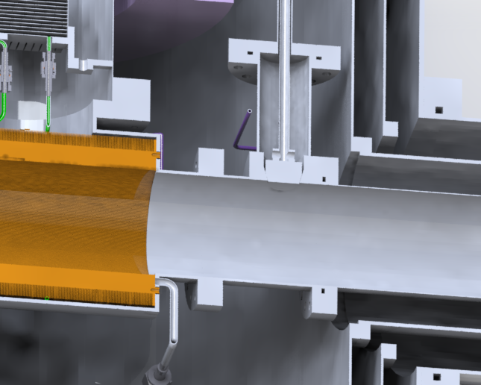
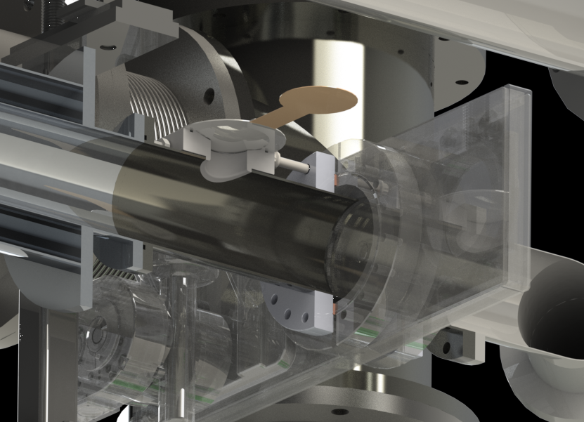
Requirements
Burst disk
Pump-out port
Owners: CM
Owners: CM?, SK?
Required since there is a vacuum tight valve downstream and the guides contain a cryogen
Diameter required (relief calcs…)
Current vertical source design good enough? (Fall 2018 experiments!)
Required to pump the UCN source guides out well to achieve long UCN storage lifetimes
Required opening? (How to determine?)
Similar design as horizontal source?

Slide 8
UCN valve
Requirements
SC
polarizer
Source UCN vacuum valve
SCM warm bore guide, vacuum separation
Owners: FK?, RP?
Owners: WS, KH?
Stores UCN in source during irradiation so that they don’t have to pass through foil which lowers storage lifetime.
Needs to be vacuum tight in case of problems with the window or when pumping out downstream section of UCN guides.
Shall facilitate a good storage lifetime in closed and good transmission in open position.
Body shall have pumping port to facilite pumping of UCN guide at least while in motion.
VAT valve with spreadable protection ring good enough? (Fall 2018 experiments!)
Above valve has CF flanges, adapters to UCN guide are necessary
Can we make it better?
With current SCM, guide diameter probably restricted to 85 mm with warm bore. (Fall 2018 experiments!)
Guide downstream of foil shall be polarization conserving.
SCM guide incl. foil shall be exchangeable without lifting shielding blocks.
Foil and foil mount have to be vacuum tight (leak rate < 10⁻⁷ mbar l/s)
Foil shall withstand 100 mbar? pressure difference?
Fermi potential lower than 54 neV (Al or better)
Need pressure equalisation line with pressure activated valve to avoid foil failure.

Slide 9
UCN source Requirements
Y-switch
Polarized RT source guides
Owners: RP
Owners: RM?
Horizontal two way switch for EDM and 2nd port.
Shall be compact enough to minimize shielding cavity.
Needs to be service free. (100 000 cycles?)
Good transmission (>80%), virtually no leakage (<0.1%?)
Opening angle < 30^{O}
Needs to be polarization conserving.
Possibility to pump guides through switch housing.
Polarization conserving!
2nd port should have a vacuum tight UCN valve, since switch cannot be UCN tight.
Is NiP on SS good enough? How about NiP on Al?
How about EDM port?
Diameter?

Slide 10
EDM Requirements
General EDM guide requirements
Smooth surface very important due to their length!
Shall be polarization conserving. Less than 10% loss of polarization to EDM cell, less than 5% loss of polarization from EDM cell to SSA.
Diameter upstream and downstream of Y?
Need to be non-magnetic, at least inside MSR. (How to measure? What’s the criterion?)

Slide 11
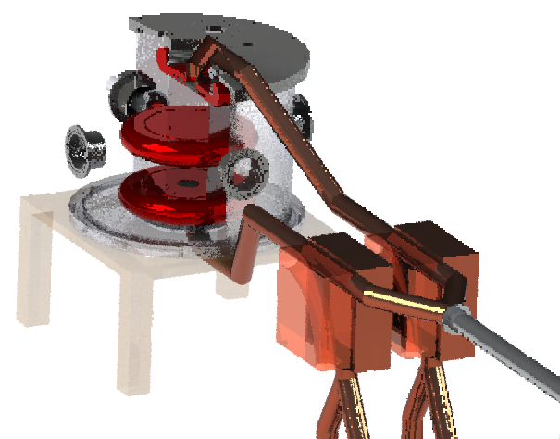
EDM Requirements
Spin flipper
Spin flipper
EDM Y guide
Owners: SHR?, BJ?
Owners: RM?
Needs non-conducting UCN guide. (NiMo on glass from Movatec? Torsten’s company?)
Spin-flip efficiency > 95%? Or higher? (Fall 2018 experiments!)
Could incorporate diameter change. (PENTrack simulation needed).
Split guides horizontally?

Slide 12
EDM Requirements
polarizer
polarizer
SSA guide
⁶Li detector
SSA
EDM switch
SSA
Owners: RP, CM
Owners: BJ, SHR
Three way switch: source to EDM, source to detector, EDM to detector.
Polarization conserving!
Transition speed? 2 s?
Pumping position?
Shall have end switches
Spin flip efficiency > 95% (99%?)
Analysing power > 90% (95%?)
Detection efficiency (just Li6 detector) > 90%
Rate capability: 100 kHz? (2.5 x 10⁶ UCN detected after Ramsey cycle)

Slide 13
EDM Requirements
EDM cell valve (see Sean’s presentation)
EDM cell electrodes and insulator
(see Florian’s presentation)
Owners: SV, RP
Owners: FK, RP
Good transmission > 95%
Vacuum tight (leak rate < 10⁻⁶ mbar l/s?)
Low UCN loss during storage (storage lifetime in EDM cell > 120 s)
Totally non-magnetic (How to measure? What is the criterion?)
Transition time < 2 s?
High voltage compatibility. (12 kV/cm)
Cavity created by valve in EDM electrode shall be small (< 5 mm)
Reliability: > 100000 cycles
Shall have end switches
Abrasion free movement
HV compatible
Non-magnetic
Fermi potential should be bigger than 170 neV (dPS)
Openings for gas inlet, UCN valve in electrode
UV transparent windows for comag lasers (ca 250 nm) and photo detection (850 nm?)

Slide 14
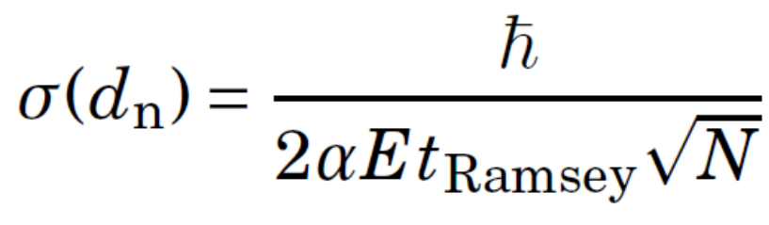
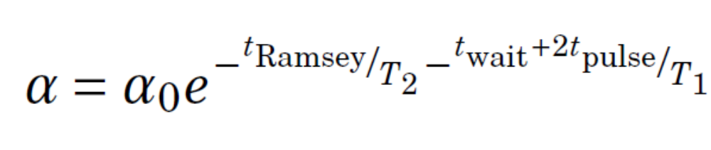
EDM sensitivity intro & parameters
Sensitivity formula
Visibility
α: visibility – 62%
E: electric field strength – 12kV/cm
t_{Ramsey}: free spin precession time – 124 s
N: UCN detected – ca 10⁶
α₀: polarization at beginning of Ramsey cycle – 95%
t_{wait}: time before Ramsey cycle starts – 2 s
t_{pulse}: π/2 flip duration – 2 s
T₁: longitudinal depolarization time – 1000 s
T₂: transverse depolarization time – 500 s
Storage lifetime in EDM cells – 120 s
16 h of useable average time on beam days
Size of each EDM cell r = 18 cm, h = 16 cm
Time to reach 10⁻²⁷ ecm: roughly 400 beam days

Slide 15
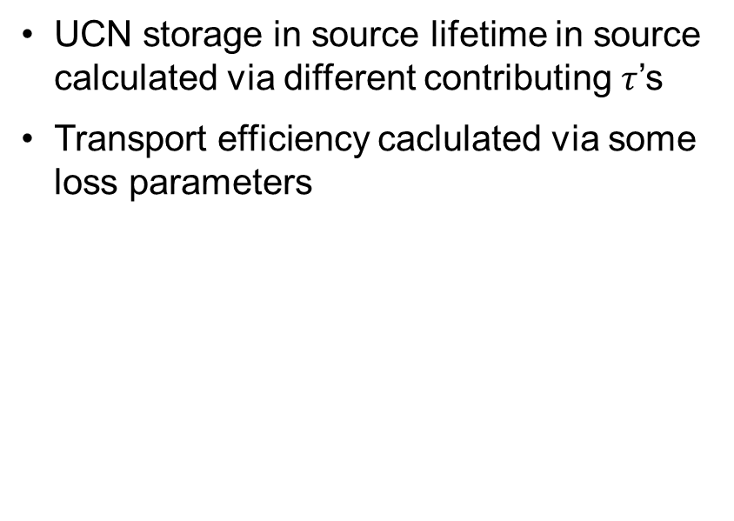
Two streams to estimate sensitivity
Analytical
Simulation
UCN storage in source lifetime in source calculated via different contributing $τ$’s
Transport efficiency caclulated via some loss parameters
PENTrack MC simulation from UCN creation in source to closing of EDM cell door
See Steve’s presentation

Slide 16
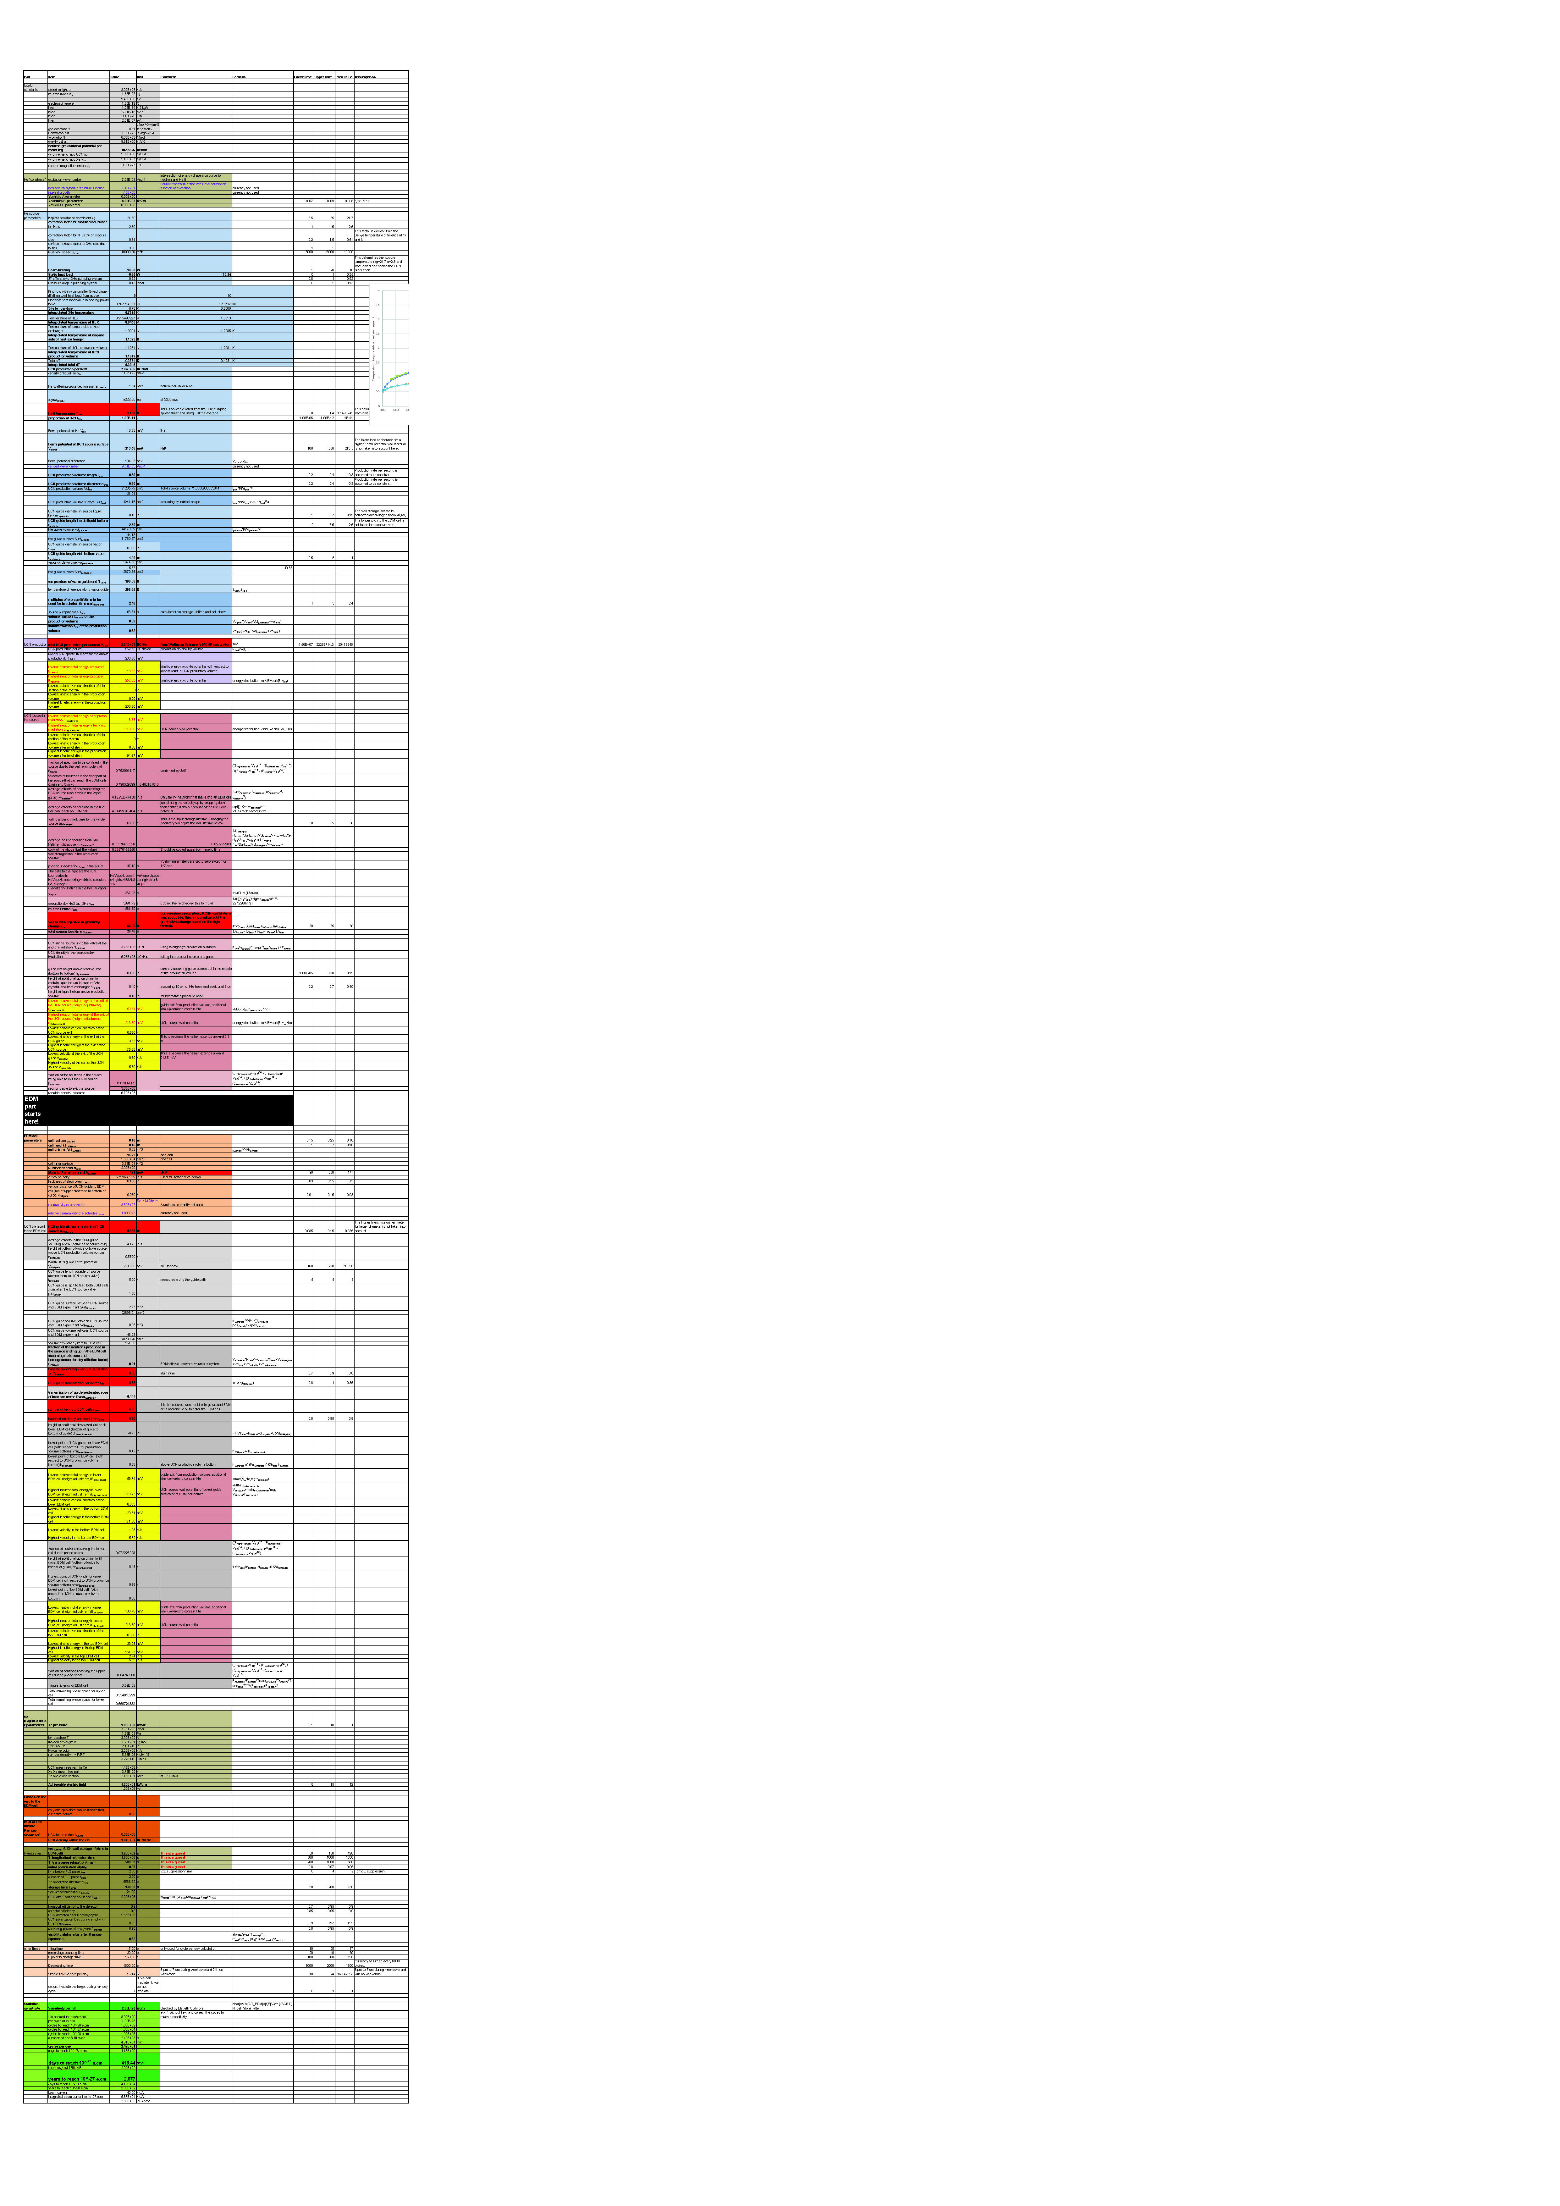
What is taken into account in the analytical model?
Analytical model useful to study many more parameter options than possible in simulation.
This is taken into account…
This is not… or not so well…
UCN production/heat input from MCNP simulations
Cryostat performance (pumps, pressure drop, HEX, heat conductivity)
Neutron storage lifetime in source (He liquid + vapor)
Phase space reduction due to wall Fermi potential and height differences
Dilution of neutron “gas”
Simple model of Ramsey cycle
Probable stable daily measurement period
Times for E field change, degaussing etc
Magnetic field of polarizer (it is in MC)
Transport is only modelled via loss per meter, bend, foil etc
Depolarization of UCN during transport (assuming 5% total)
Any systematic effects ⇒ nEDM CDR
https://ucn.triumf.ca/resources/proposals/ucn-cdr-2018/EDMsensitivity2018CDRv12.xlsm

Slide 17
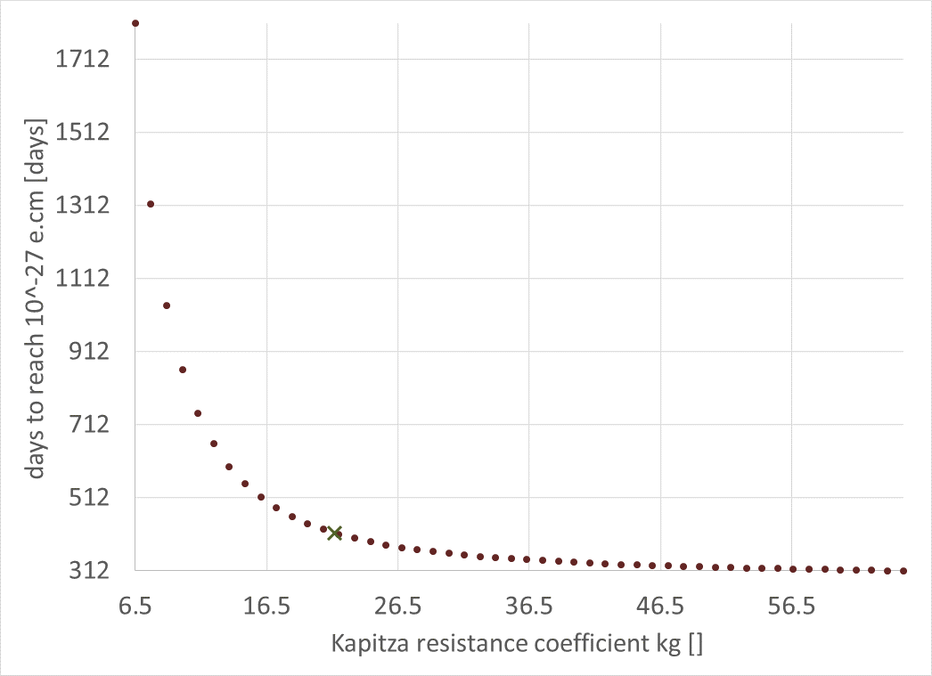
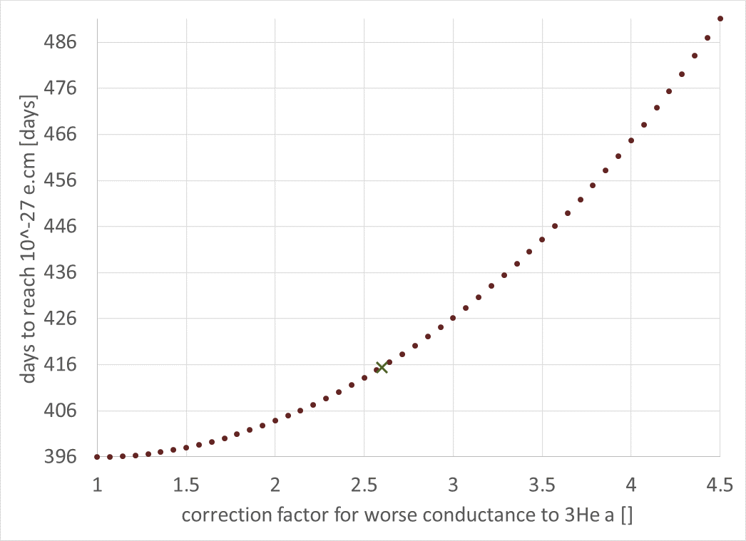
Robustness and mitigations (I)
The analytical model is adjusted to fit the simulation and then parameters are varied.
Kapitza resistance parameter K_{G}
³He Kapitza correction factor
We need K_{G} to be above 20.
Not so critical…

Slide 18
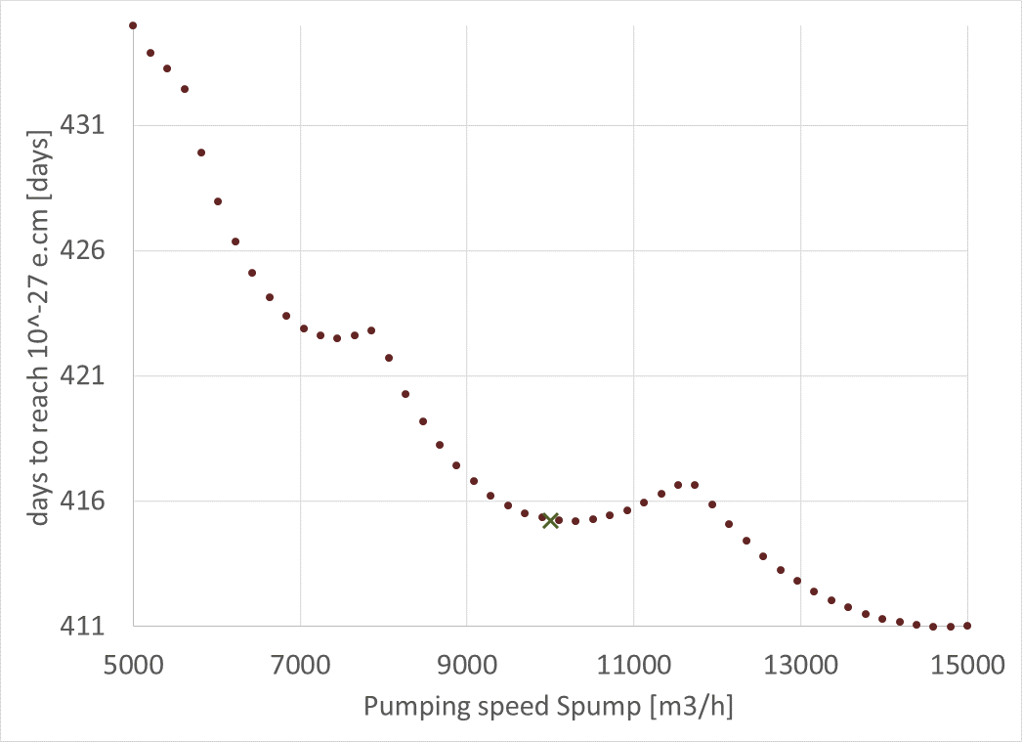
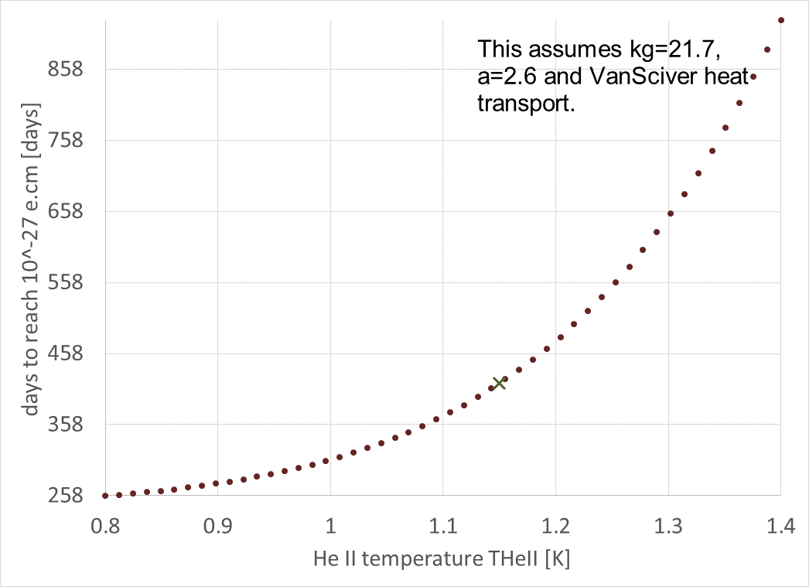
Robustness and mitigations (II)
Pumping speed
⁴He temperature (³He cryostat)
The wiggles are Excel rounding errors…
³He pump performance requirement is relaxed
Need < 1.2 K

Slide 19
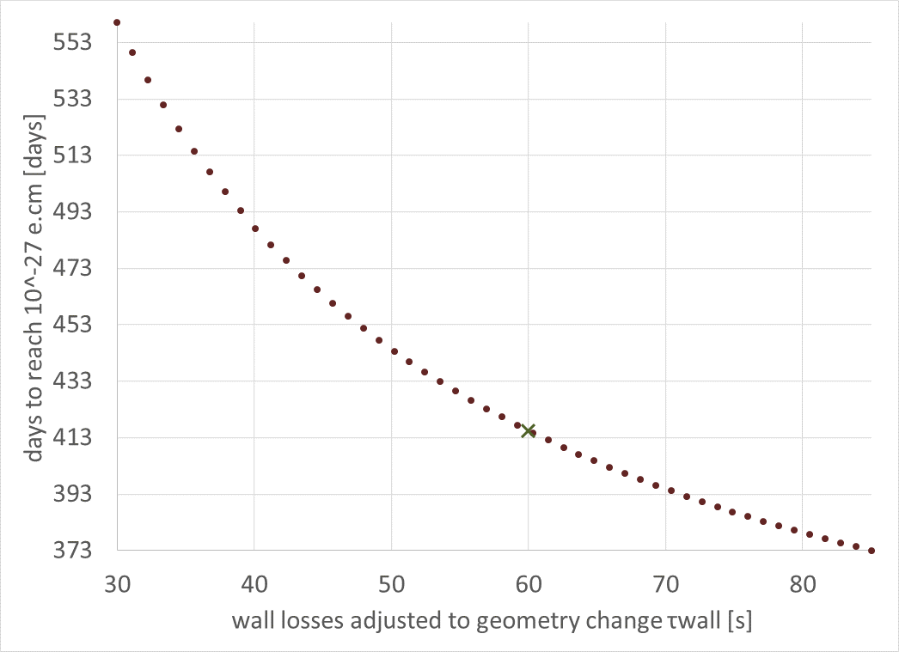
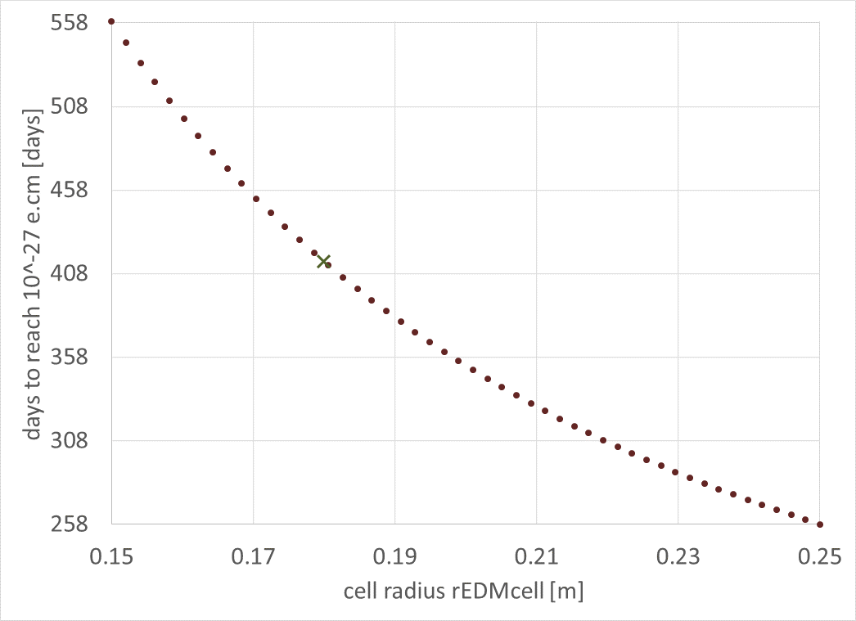
Robustness and mitigations (III)
UCN source wall storage lifetime
EDM cell size
Above 40 s is fine.
Source contamination less critical.
Decided against exchangeable UCN bottle.
Risk mitigation strategy in case of lower production

Slide 20
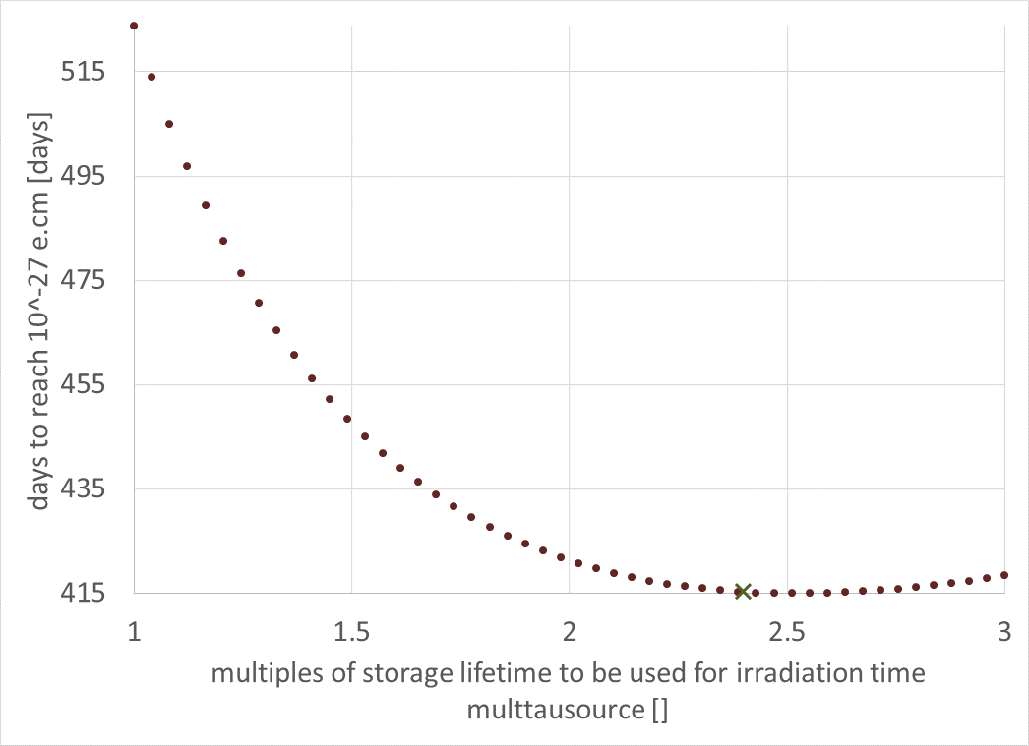
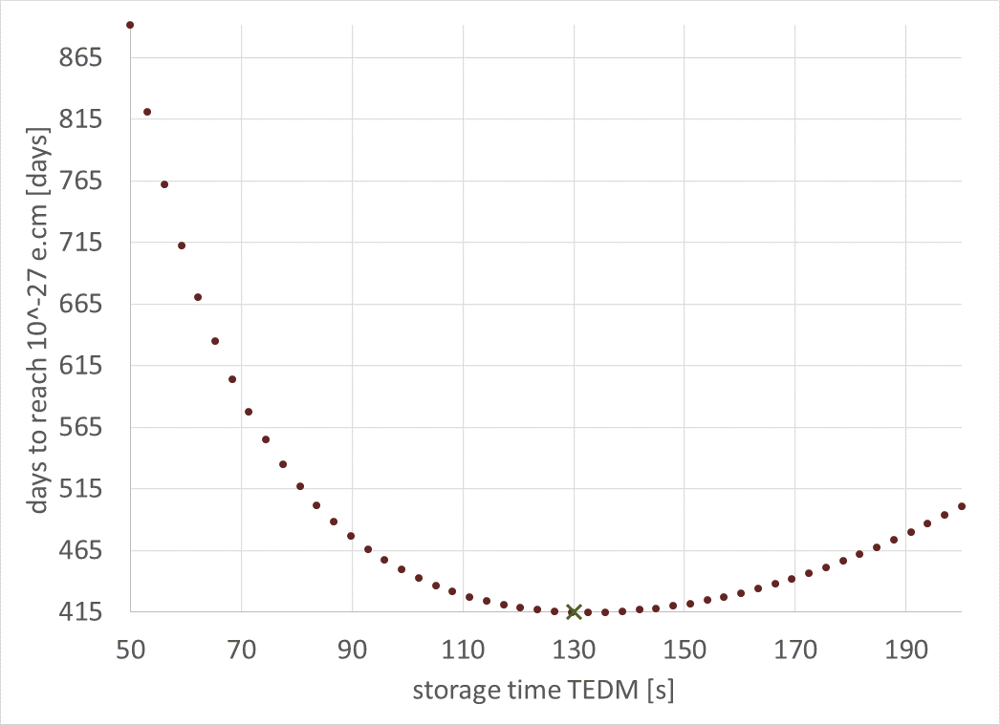
Robustness and mitigations (II)
Irradiation time (batch mode)
UCN storage time (observation time)
Optimum times can be predicted this way…

Slide 21
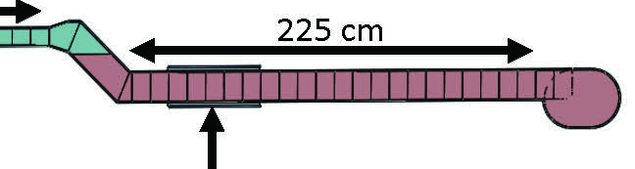
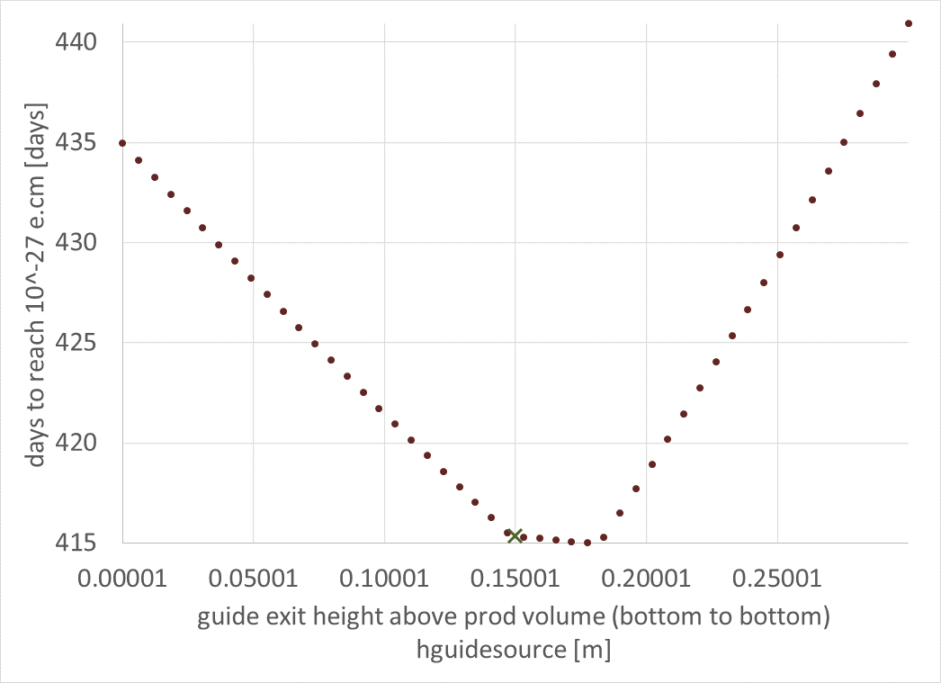
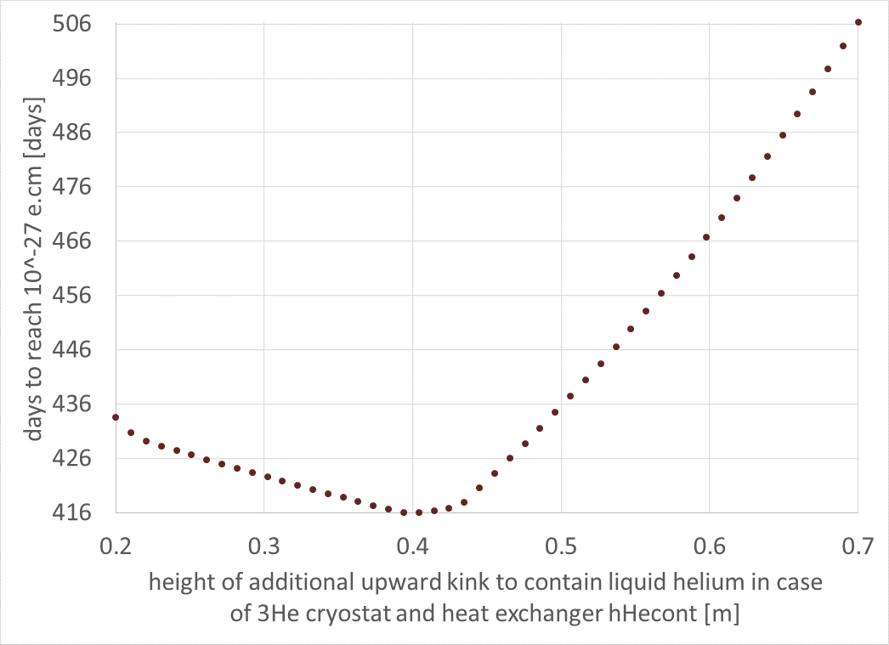
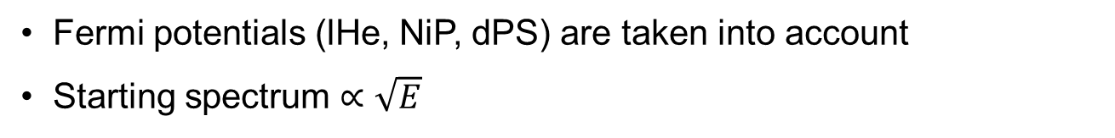
Height of EDM cell
… can be optimized with this simple analytical model.
2
1
Extraction height out of prod. vol.
Height of upward kink
1
2
x
Fermi potentials (lHe, NiP, dPS) are taken into account
Starting spectrum $∝\sqrt{E}$

Slide 22
Thank you for your attention.

Slide 23
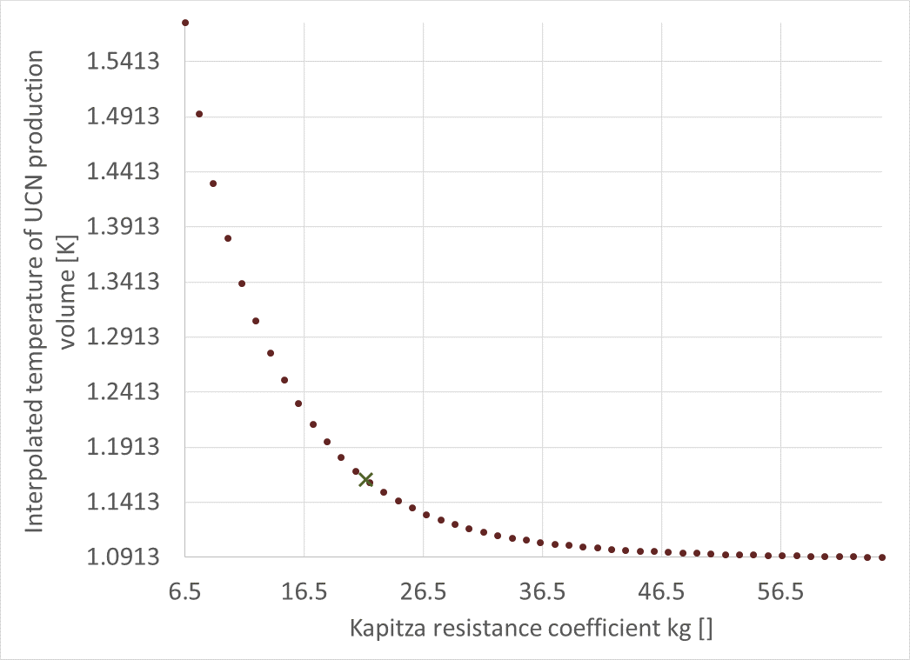
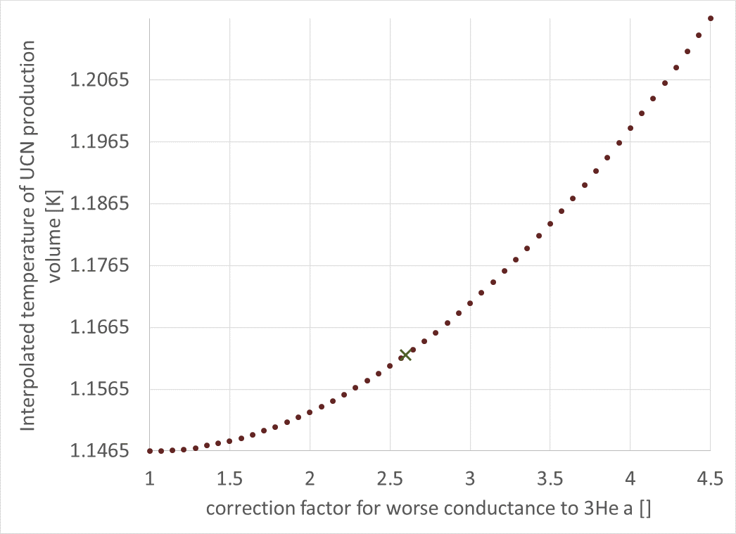
Influence on production volume temperature (I)
Kapitza K_{g}
³He Kapitza correction factor a

Slide 24
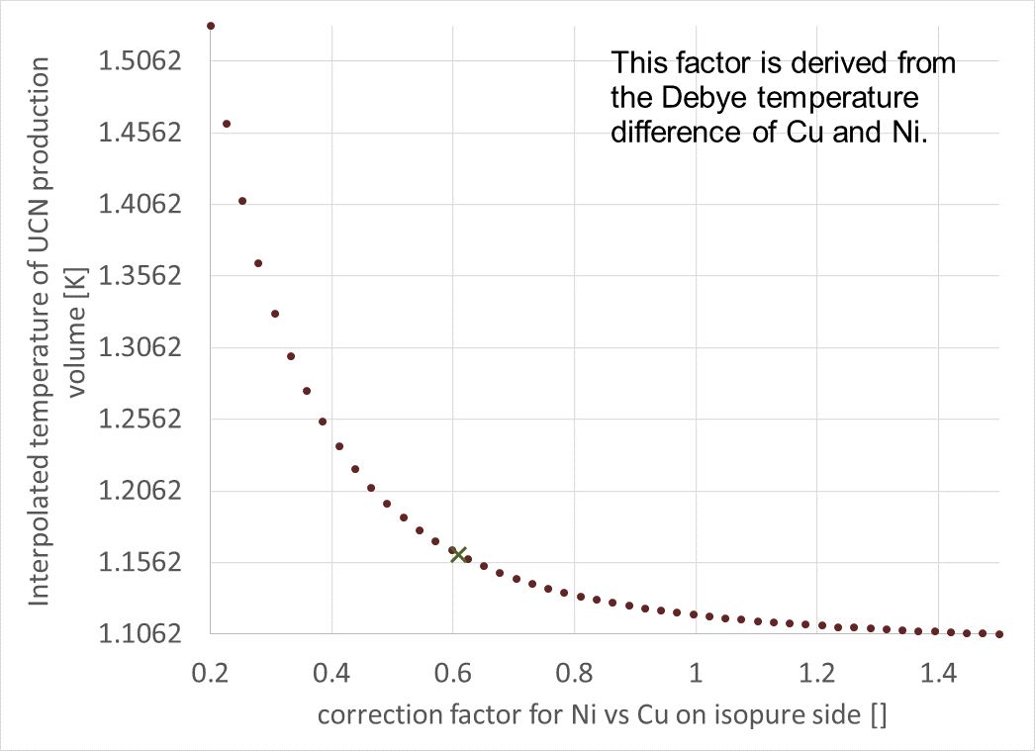
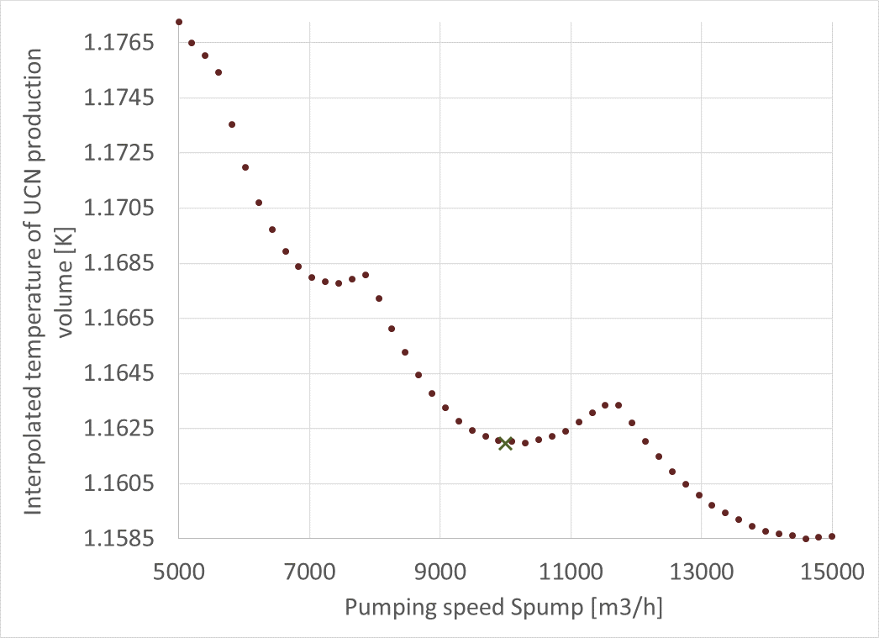
Influence on production volume temperature (II)
Correction factor for Ni
Pumping speed

Slide 25
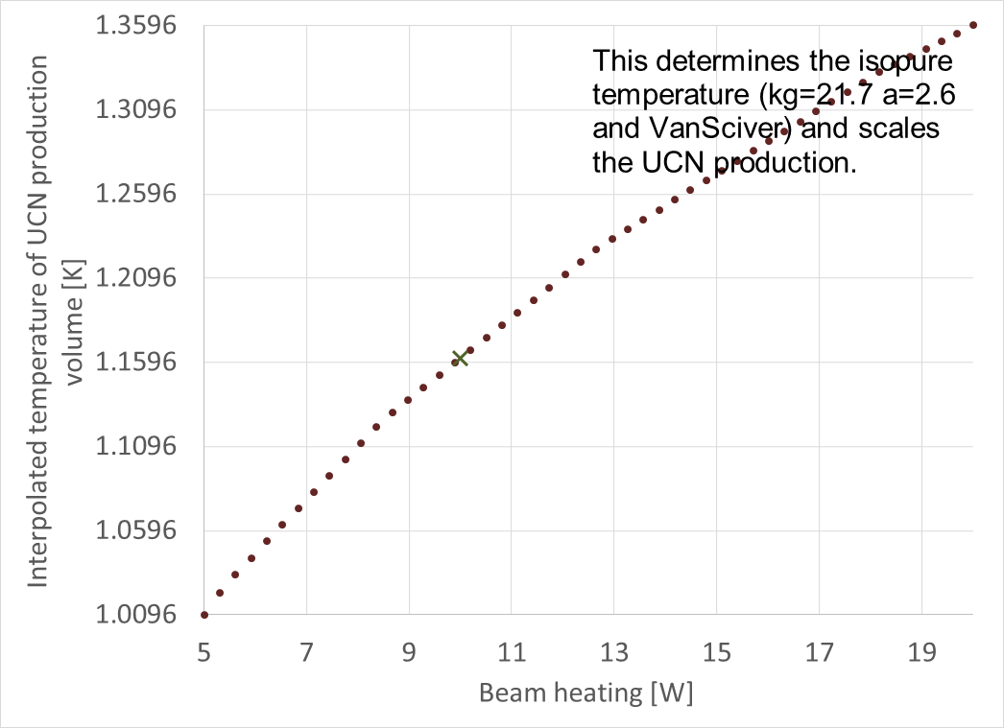
Influence on production volume temperature (III)
Heat input
Pumping speed

Slide 26
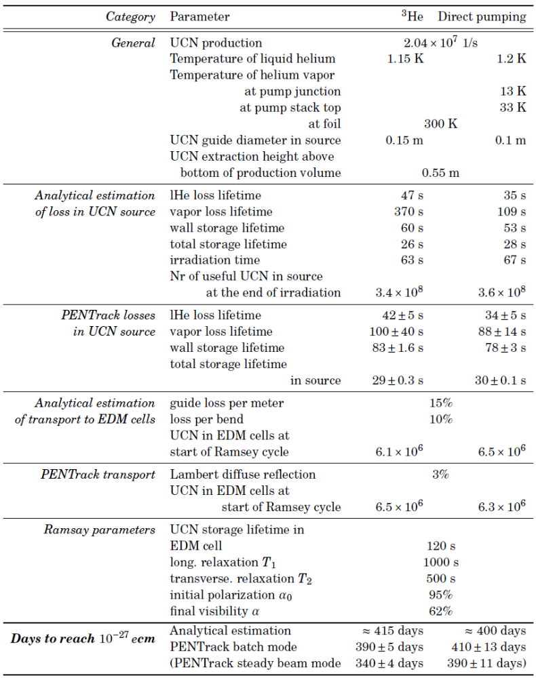
Parameters used

