Slide 1
P0407 UCN Electric Dipole Moment – Project Management Update for TUCAN Collaboration Meeting
August 7, 2018
Chris Gibson

Slide 2
Contents
Project Metrics
Upcoming deliverables
Requirements Documents Discussion
Conclusions

Slide 3
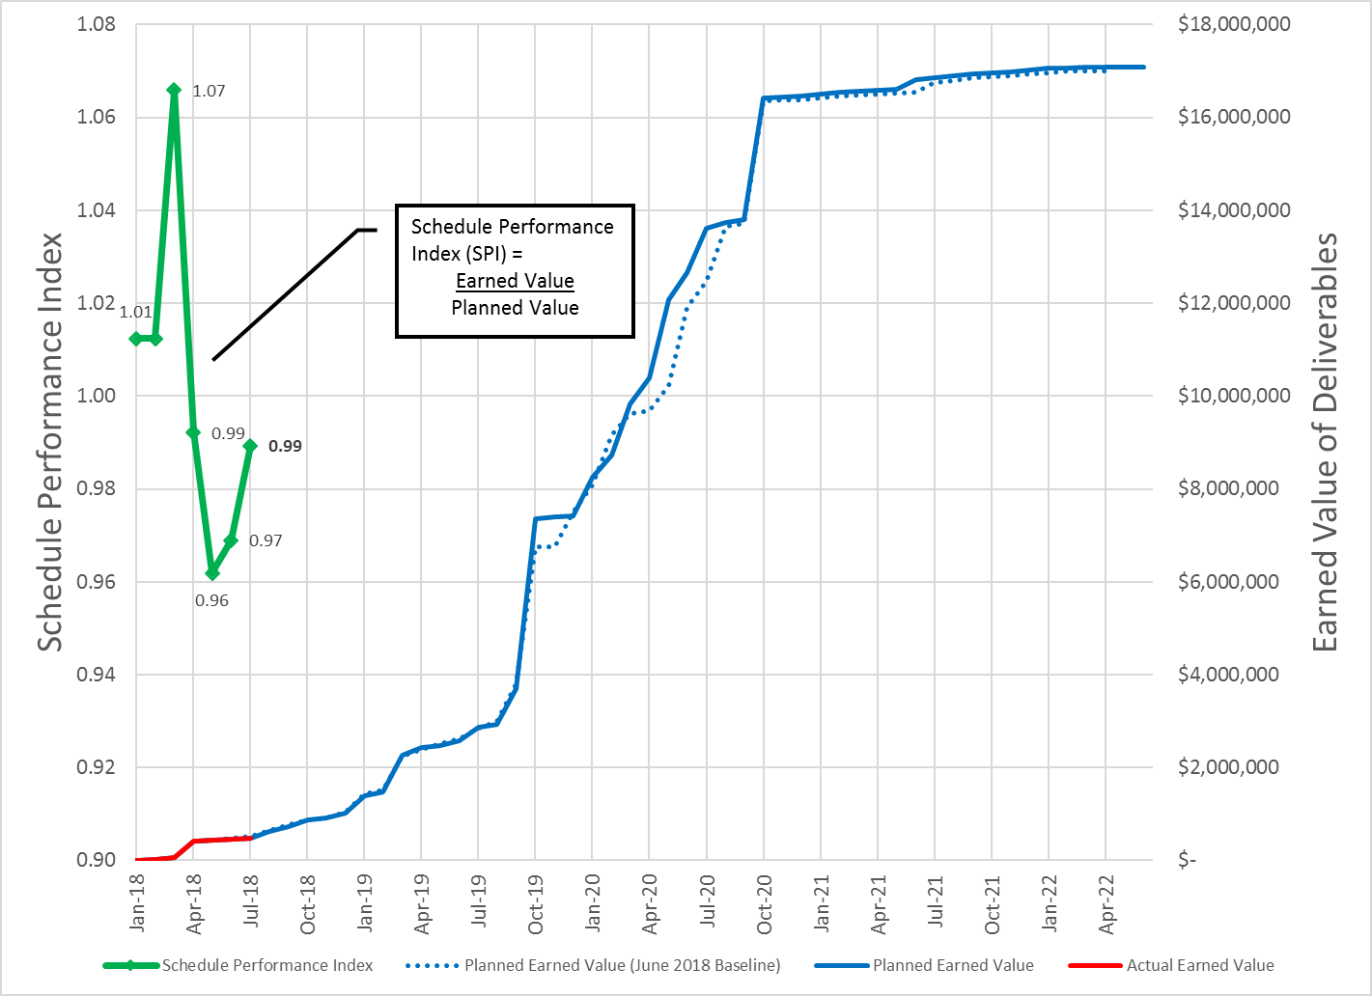
Project Metrics*
* Includes non-CFI labour and expenses (e.g. physicist labour costs).
Contingencies not included.
Now showing June 2018 Baseline (dotted) and updated plan (solid)
SPI from July onwards is against updated plan

Slide 4
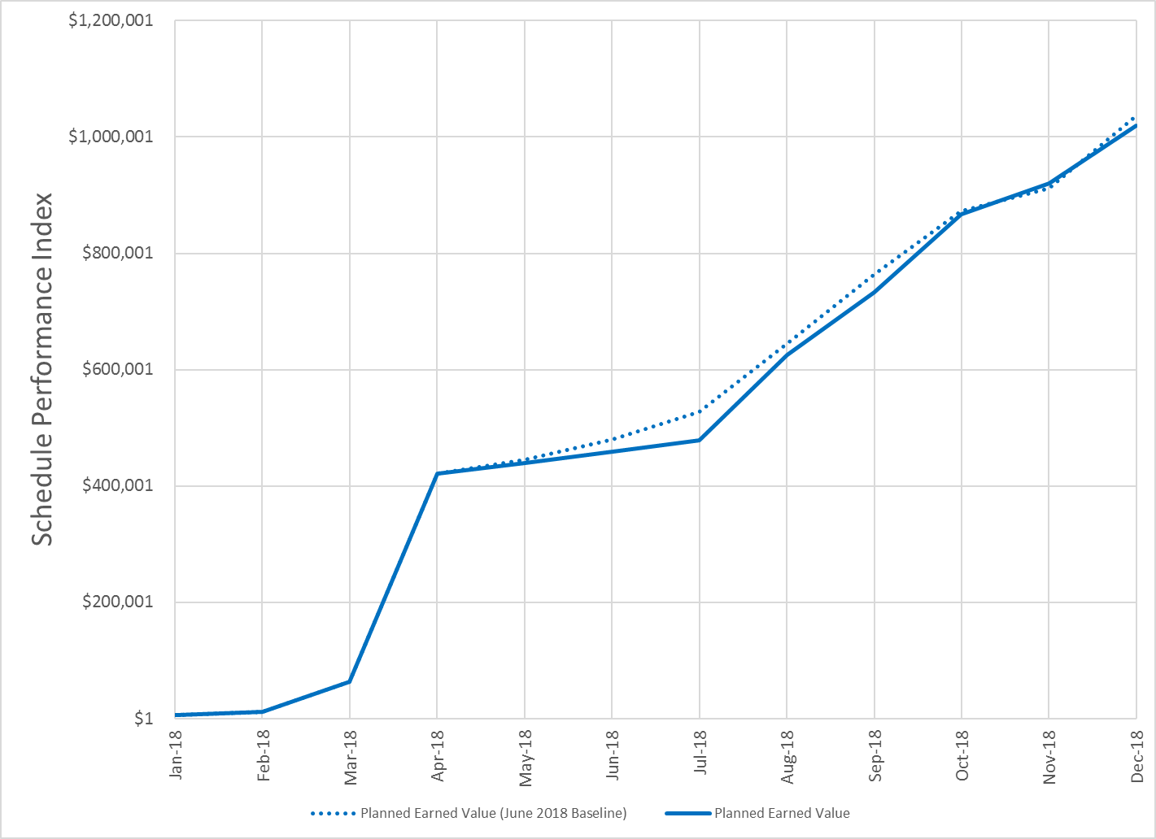
Project Metrics (Zoomed-In)
What constitutes “Earned Value”?
A deliverable can be tied to its budgeted cost to achieve (hours + expenses)
When:
  Deliverable is “done”
  document created or
  part received
  Deliverable is accepted
  document reviewed and accepted/released or
  part inspected and approved
  Then the budgeted value is earned
July re-plan

Slide 5
Upcoming Deliverables
Deliverable(s) | WBS | Comments
Remaining requirements documents | 1.4.2.x | Rescheduled August-September
Interface requirements | 1.4.2.6 | Rescheduled to be completed end-August – Important He cryostat interfaces still being discussed and negotiated
LD2 and He-II detailed design calcs. | various | Higher risk calcs. due before Concept Design Reviews in September. Some He-II calculations behind baseline schedule; still working on recovery
Memorandum Of Understanding | 1.1.6 | MOU between KEK, UBC, TRIUMF, UW, RCNP. This is a predecessor for removal of CFI conditions & finalization of funding. Target for completion moved to end-August.
Drawings for 2018 Fall Test Hardware | 1.7.1.1.1 | New parts modelled. Drawings to be created during early-August
Source design notes | various | All source design notes due between late August and early-September
3D Model of source area including biological shielding | 2.10.1 | Design review to take place during August 7-9 TUCAN collaboration meeting

Slide 6
Requirements Documents
1.4.2 | Requirements Documents | For Hardware WBS:
1.4.2.1 | 407 UCN Electric Dipole Moment System Requirements | 0
1.4.2.2 | nEDM Experiment Subsystem Requirements | 3
1.4.2.3 | He-II Subsystem Requirements | 2.2
1.4.2.4 | He Cryostat Subsystem Requirements | 2.1
1.4.2.5 | 407 - Other Substem Requirements | 2.4-2.8, 4.2
1.4.2.6 | 407 - Interface Requirements Document | All
1.4.2.7 | LD2 Subsystem Requirements | 2.3
1.4.2.8 | Simultaneous Spin Analysing Subsystem Requirements | 3.1
1.4.2.9 | nEDM Cell, HV, & Vacuum Subsystem Requirements | 3.2
1.4.2.10 | Internal Magnetometry Subsystem Requirements | 3.3.1
1.4.2.11 | Comagnetometry Subsystem Requirements | 3.3.2
1.4.2.12 | Ambient magnetic field control Subsystem Requirements | 3.4
1.4.2.13 | Inner-B Field Coils Subsystem Requirements | 3.6
1.4.2.14 | Passive Magnetic Shielding Subsystem Requirements | 3.7
Questions:
3.5 (nEDM guides) missing. Make a Requirement Doc for ALL UCN guides (2.6,2.7,3.5)?
Separate Requirement Document for Tail and Moderator Assembly (2.5)
3.8 nEDM Services missing. Add to "Other"?

Slide 7
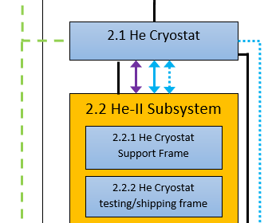
Requirements Documents (cont’d)
Example Requirement:
RS 2.1-1. Shall liquify and deliver Isopure helium to the UCN source bottle. Temperature, Pressure, and purity constraints as specified in Document-157233.
Document-157233 (Spec Sheet), Interfaces Tab
Will reference Requirement #, From/To Subsystems, and provide quantitative requirement and further information as required
Avoids having same number in 2 documents, provides single document for looking-up key numbers

Slide 8
Conclusions
Project Metrics & Upcoming deliverables
  Completing near-term deliverables will help us keep on-track for detailed design and build
Requirements Documents Discussion
  Work with team to propose/release requirements and to negotiate interface definitions

Slide 9
Appendices

Slide 10
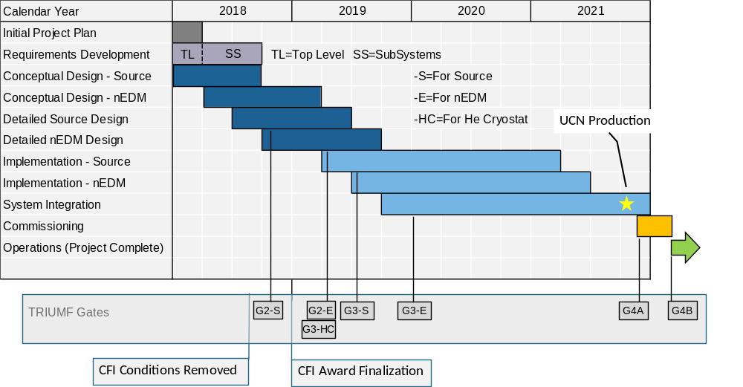
Preliminary High-Level Schedule (Gate-Centric)
Gate 2 for UCN source at risk due to July re-plan, which removed schedule slack. Gate now coincides with start of Fall experiments (Nov 6, key team members busy until early December)

Slide 11
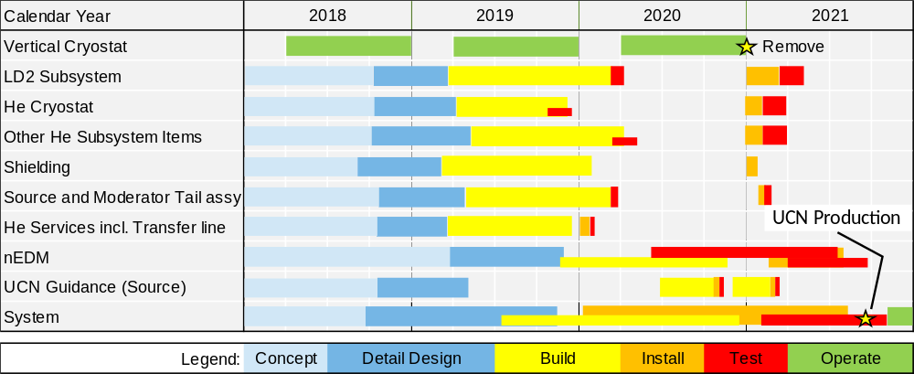
Preliminary High-Level Schedule (Subsystem-Centric)

Slide 12
Estimated Cost vs CFI Budget (CAD)
CFI Item # | Item Description | CFI | Current* | Change
1 | UCN Source Upgrade | 3,170,000 | 3,633,399 | 463,399
2 | UCN transport and detectors | 1,680,000 | 1,630,995 | -49,005
3 | Environment and services | 1,150,000 | 1,029,873 | -120,127
4 | Data acquisition and controls | 640,000 | 425,507 | -214,493
5 | Magnetic fields | 5,580,000 | 4,937,359 | -642,641
6 | Comagnetometer | 1,470,000 | 3,331,443 | 1,861,443
7 | Electric field system and EDM cell | 360,000 | 663,030 | 303,030
8 | Engineering and Technical Support | 1,650,000 | 986,829 | -663,171
 | TOTAL | 15,700,000 | 16,638,435 | 938,435
* Includes contingencies calculated using Monte-Carlo methods
Reduced ~300K since June

Slide 13




Thank you
Merci
www.triumf.ca
Follow us @TRIUMFLab

