Slide 1
Next generation UCN source overview and
CDR review outcome
Shinsuke Kawasaki
KEK

Slide 2
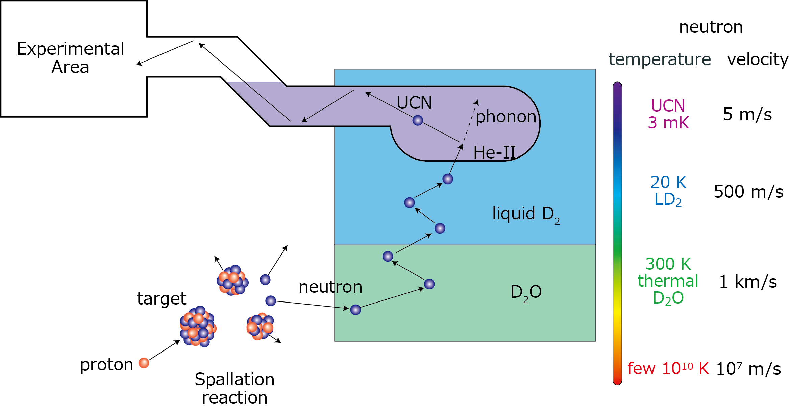
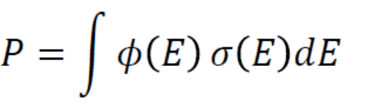
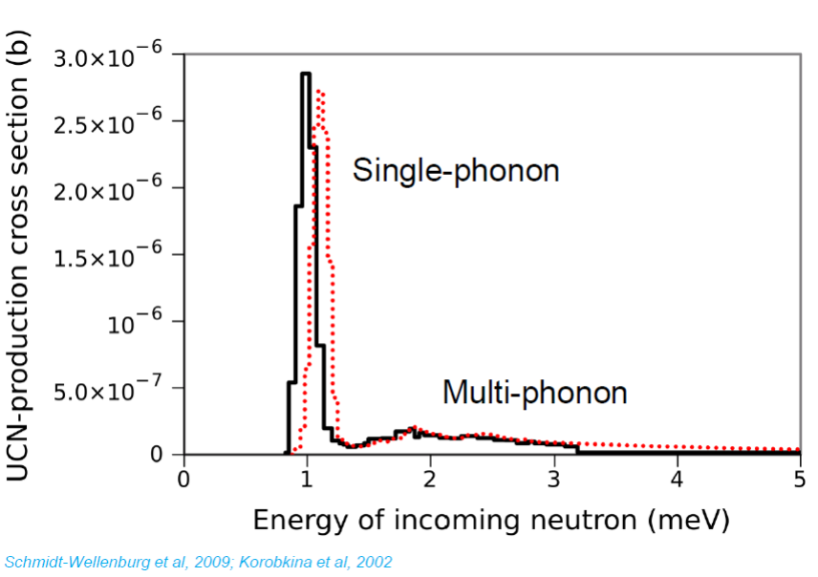
UCN production
UCN density = Pτ (1 – exp(-t/τ))
  P : UCN production rate
  τ : Storage time
  t : proton irradiation time
High cold neutron flux
  High proton current
  Good neutron moderation
    resonant energy : 1 meV
Low super-fluid helium temperature
  UCN storage life time ∝ T⁻⁷
  Remove radiation heat
UCN production cross section

Slide 3
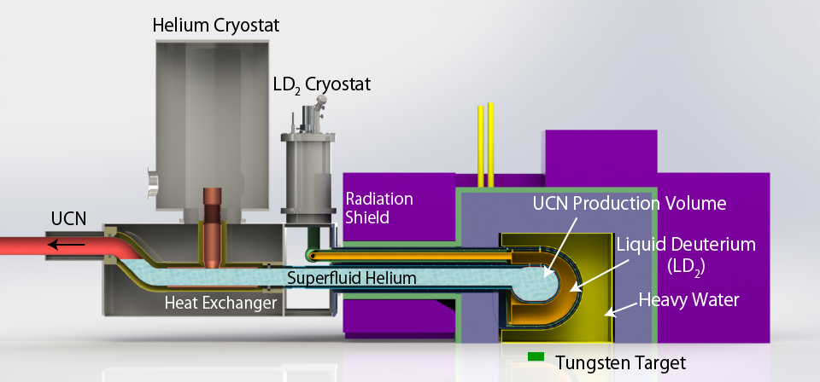
Next Generation UCN source
LD2 cold neutron moderator
  Get more 1 meV neutron flux
High cooling power helium cryostat
  Enable to use proton current of 500 MeV × 40 µA = 20 kW
Second UCN port
  R&D and other
Very Cold Neutron port
  See the LD2 moderator directly

Slide 4
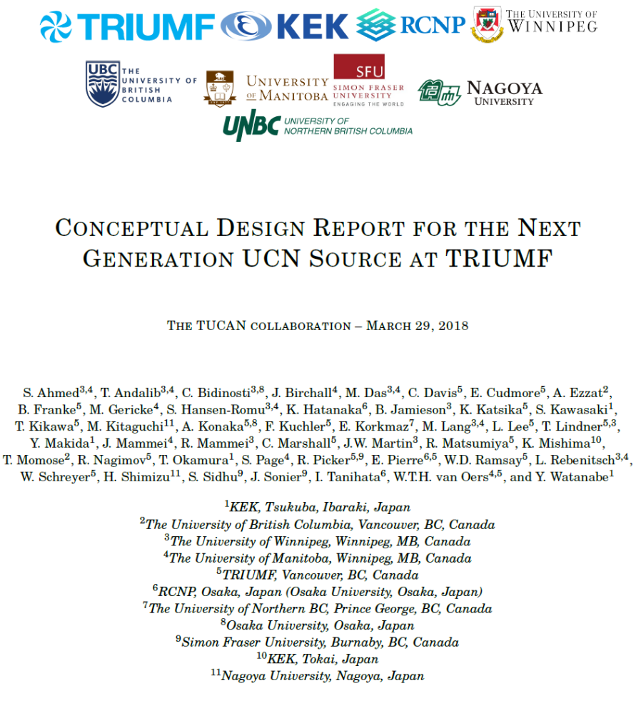
Executive Summary
Introduction and overview
Project Management Plan
UCN production and beam heating
The cold neutron moderation system
The superfluid 4He cryostat
UCN transport
Cryogenic service for the UCN source
Sensitivity reach for the neutron electric dipole moment experiment
A very cold neutron beam line at TRIUMF
Commissioning and performance monitoring
Conclusions

Slide 5
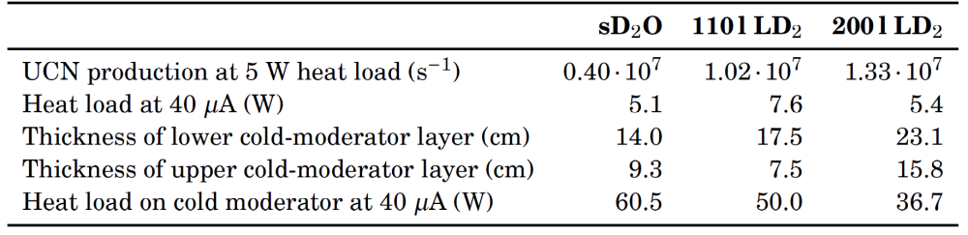
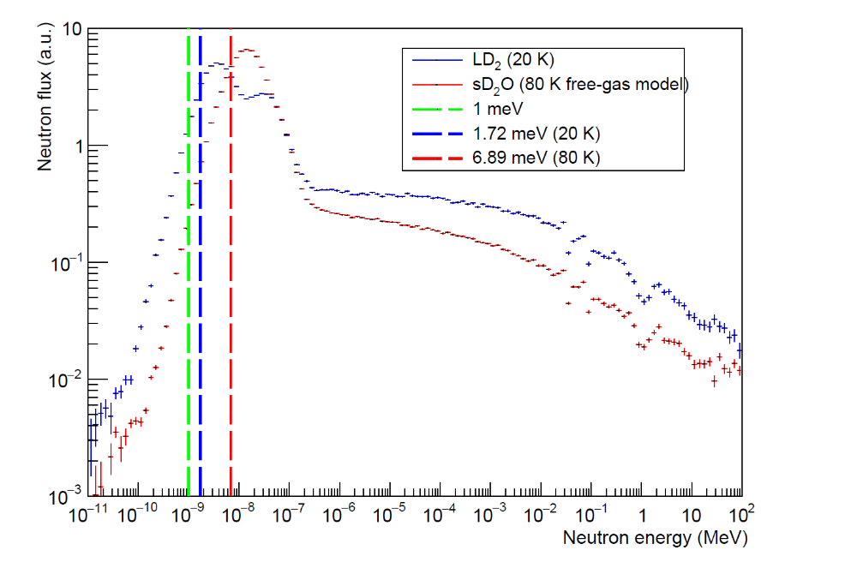
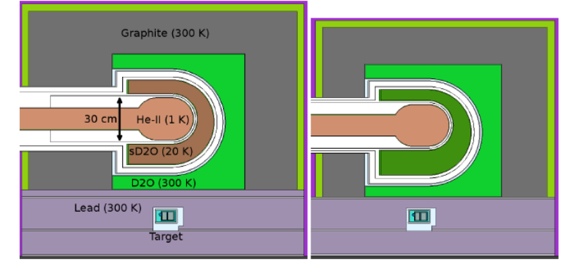
4. UCN production and beam heating
5. The cold neutron moderation system
Heat load to superfluid
  5 – 10 W
Comparison of sD₂O and LD₂
  LD₂ has better performance
Neutron Spectrum
Moderator geometry

Slide 6
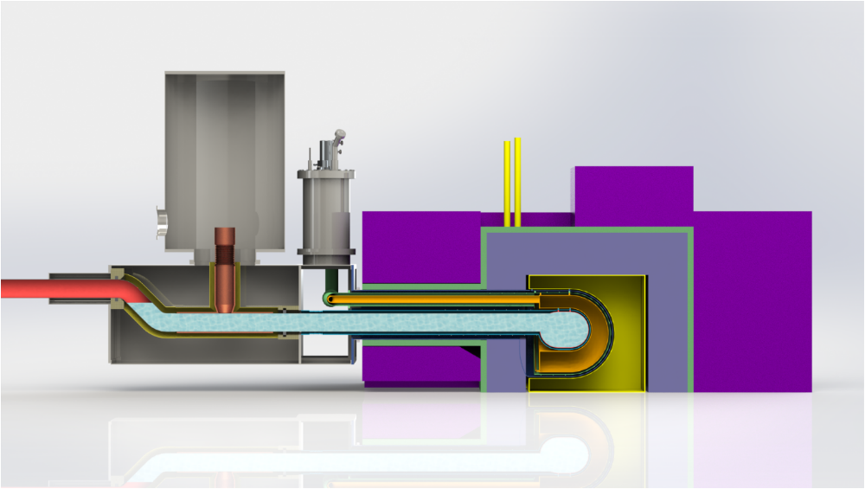
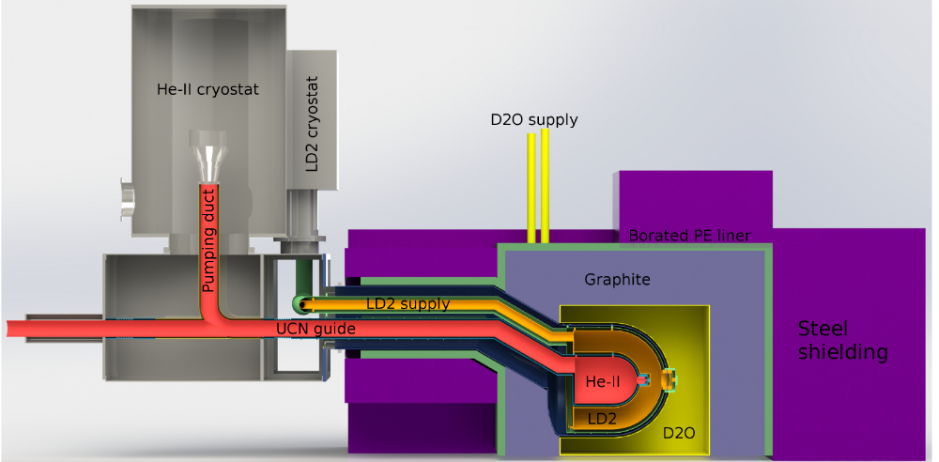
6. Superfluid Helium-4 cryostat
Two options
³He pumping with a heat exchanger
  +Higher cooling power
Isopure ⁴He direct pumping
  +Simpler
    Without a heat exchanger
³He cryostat
LD₂ cryostat
Pumping duct
He-II
He-II
Heat exchanger
LD₂
D₂O

Slide 7
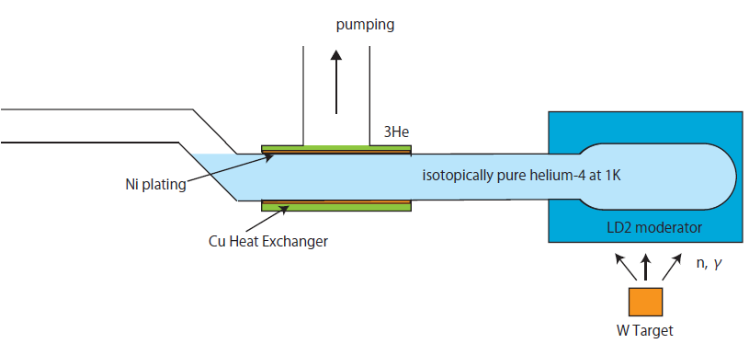
Important items to be considered
To pump suction
UCN guide diameter 150mm
Distance bet production volume and HEX =1.5m
3He-HEX
1. Kapitza conductance (resistance) between solid and IPHe-II
2. He-II heat transfer of IPHe-II through the UCN guide diameter
3. 3He pumping duct conductance with baffles
4. 3He HEX design (fin shape etc..)
  From the view point of thermo-fluid behavior of IPHe-II and liquid 3He.

Slide 8
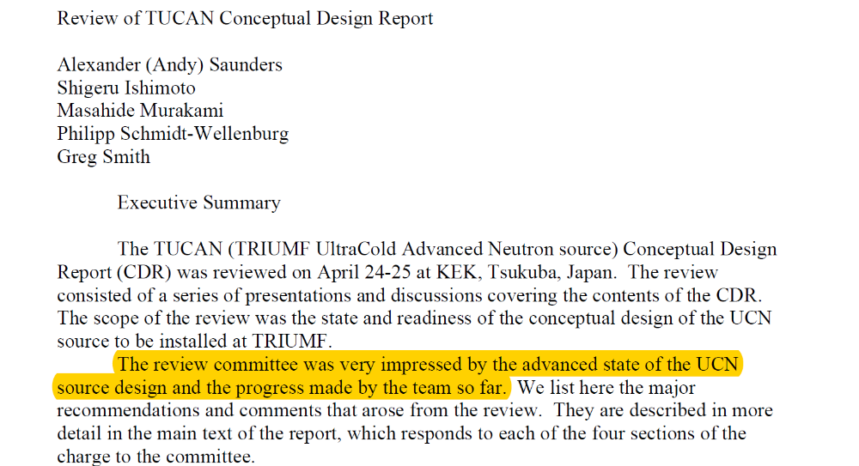
CDR review
April 24 – 25 at KEK, Japan
Report from Committee

Slide 9
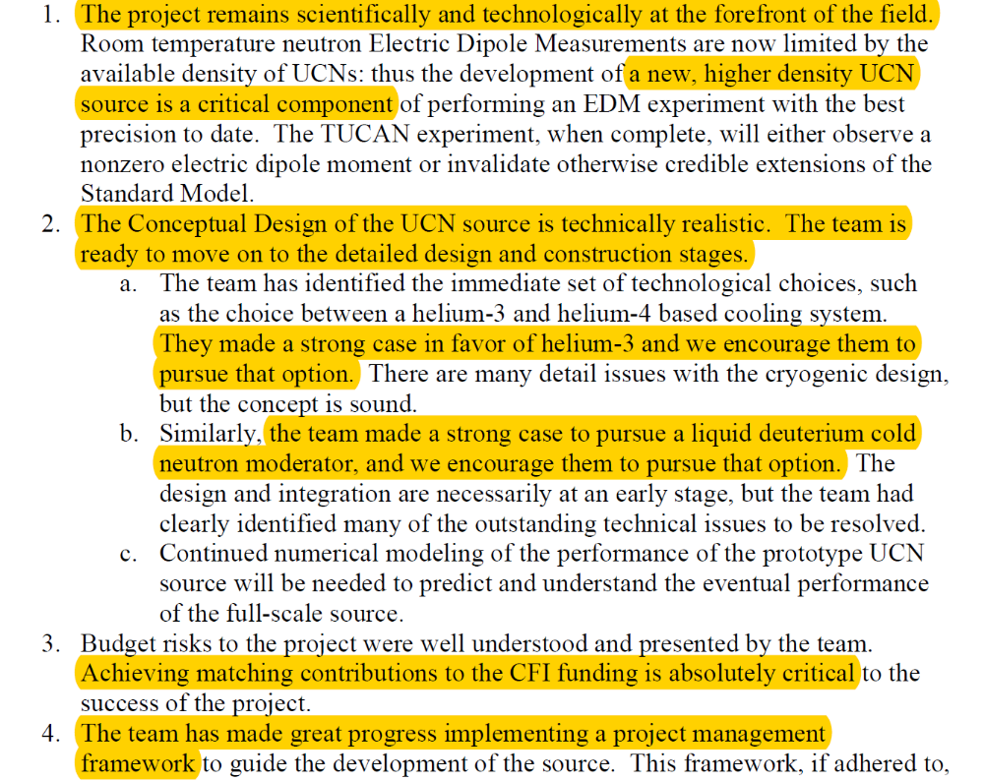
After the review,
JSPS grand was funded about
  152 MJPY ≒ 2 MCAD
KEK agree to support the helium cryostat development
Thanks to Chris!!

Slide 10
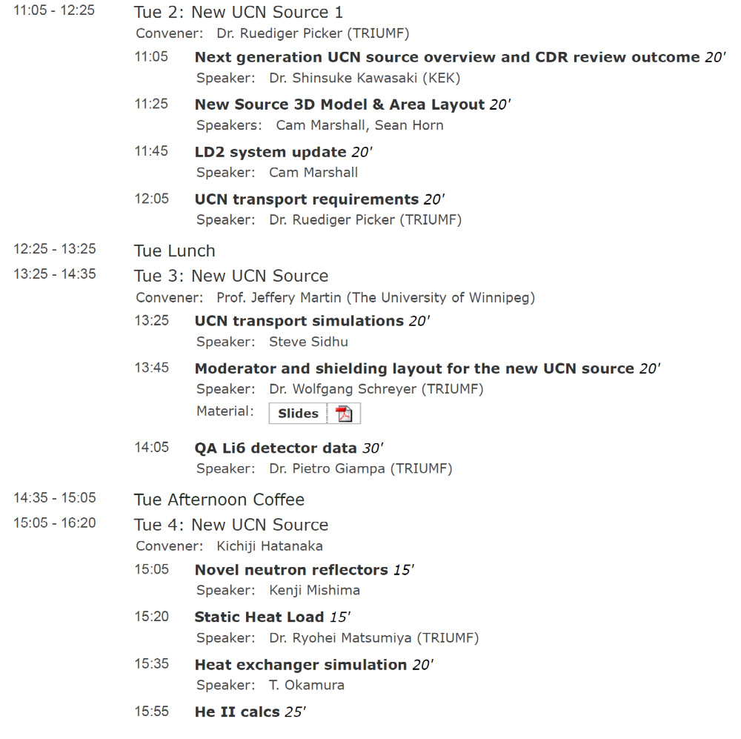
Today’s topics

