Slide 1
Helium Cryostat Calculation
Shinsuke Kawasaki
KEK

Slide 2
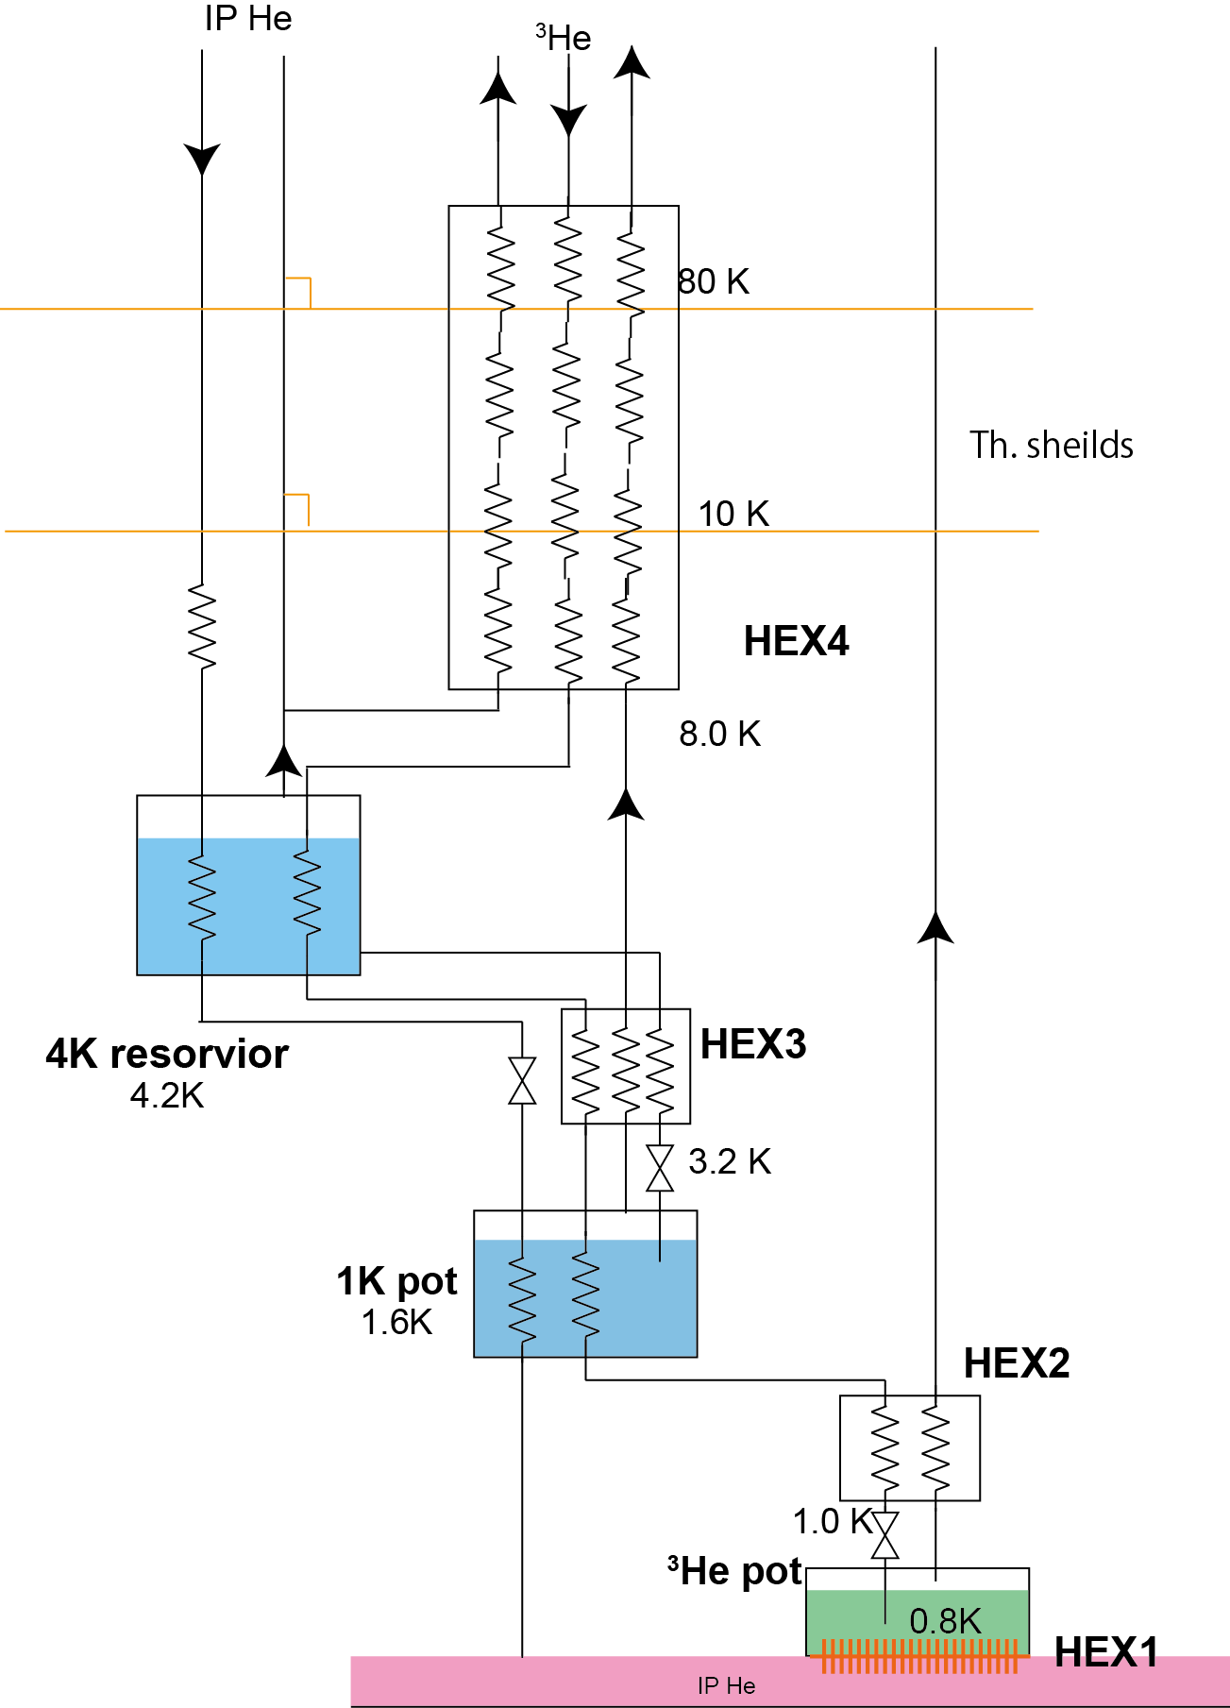
Helium Flow
For given condition
Kapitza conductance
Necessary surface area of HEX1
3He loop
Necessary 3He mass flow
-> requirement for 3He pot
1K pot mass flow
  -> requirements for 1K pot
4K evaporation mass flow
Thermal shield
Necessary 4He mass flow
  -> total 4He consumption
  -> requirements for 4K reservoir
Condition
Heat load
  Static
    He-II system : 0.5 W
    10 K shield : 1.0 W
    80 K shield : 30 W
  Beam
    He-II system : 10 W
Temperature assumption
 | T [K] | P_{3He}
3He pot | 0.8 | 377.8 Pa
before 3He JT | 1.0 | 50 kPa
1K pot | 1.6 | 50 kPa
after HEX3 | 3.2 | 50 kPa
4K reservoir | 4.5 | 50 kPa
after HEX4 | 8.0 | 50 kPa
Helium flow diagram

Slide 3
List of calculation (WBS)
2.1.1.1 | Finalized Concept (Deleted)
2.1.1.2 | Heat transport from Bottle
2.1.1.3 | Required cryogen flow rates
2.1.1.3.1 | Deleted
2.1.1.3.2 | > 4He & 3He pot fill rates
2.1.1.3.3 | > Sized Heat Shield and Required Shield cooling flows
2.1.1.3.4 | > 4K bath fill rate
2.1.1.3.5 | > Loss of Vacuum relief sizing
2.1.1.4 | Schematic-internal vessels, shields, piping, valves & sensors
2.1.1.5 | Heat exchanger sizing (7? Exchangers)
2.1.1.6 | Sizing of internal vessels
2.1.1.7 | Sizing of Needle valve impedances.
2.1.1.8 | Superinsulation spec
2.1.1.9 | Static and Beam heat loads
2.1.1.10 | Sizing of Vacuum pumps & Connected piping
2.1.1.11 | Specification of sensors
2.1.1.12 | Specification of 4He and 3He gas storage volume & Pressure

Slide 4
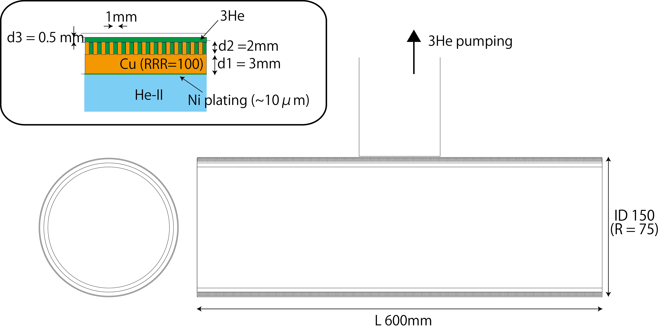
³He pot and HEX 1 (WBS 2.1.1.6)
Temperature of ³He: 0.8 K
Pressure : 378 Pa (Saturated)
Volume : > 0.67 L
  1.5 times larger than necessary volume to fill the heat exchanger
  Necessary volume : 0.44 L
    Equivalent volume in gas : 294 L
Temperature change for 10 W heat load
( K_{G} = 40, a = 2.6)
  T_{3He} : 0.80 K
  T_{HEX1} : 0.87 K
  T_{He-II} : 0.98 K
Kapitza conductance
h_{K}(T) ~ 20 *K_{G*}T³ [W/m²K]
Kapitza conductance between Ni and He-II
h_{K Ni} (T) = f*h_K_{K_Cu}(T) f = 0.61
Kapitza conductance between Cu and 3He
h_{K}(HeII) = a* h_{K}(3He)

Slide 5
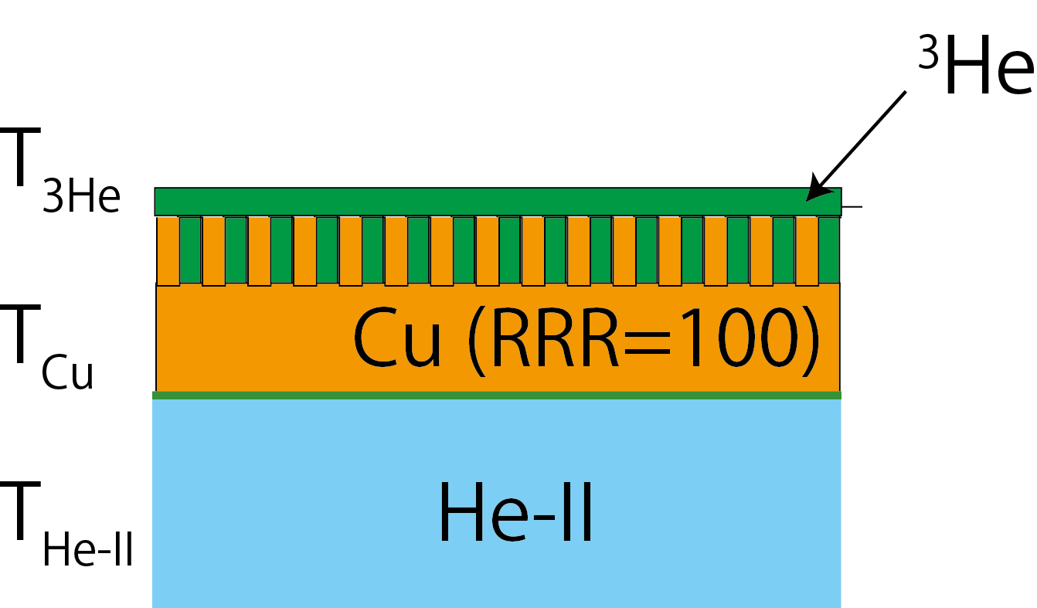
Kapitza conductance
Temperature difference in Cu can be neglected.

Slide 6
Helium consumption
Helium consumption
  Static
    3He pot : 0.05 g/sec
      0.8 K, 378 Pa
    1K pot : 0.07 g/sec
      1.6 K, 746 Pa
    4K reservoir : 4.17 L/hour
      Include 1K pot fill
  Static + Beam
    3He pot : 1.02 g/sec
      0.8 K, 378 Pa
      Necessary pumping speed : 7843 m³/hour
    1K pot : 1.53 g/sec
      1.6 K, 746 Pa
      Necessary pumping speed : 3566 m³/hour
    4K reservoir : 87.6 L/hour
      Include 1K pot fill
  Consumption of helium-4 is strongly depend on 3He gas temperature before 4K reservoir
Cooling power of liquid evaporation
L * m
L : latent heat of liquid
m : mass flow
3He gas temp | Helium consumption [L/hour]
 | Static | With beam
6 K | 3.06 | 64.26
8 K | 4.17 | 87.60
10 K | 5.27 | 110.70

Slide 7
Fill rate (WBS 2.1.1.3.2 & 2.1.1.3.4)
3He pot
  1.02 g/sec
1K pot
  0.68 g/sec
4K reservoir
  41.42 L/hour
1K pot and 4K reservoir : 50 % of consumption rate
  Considering duty cycle of proton beam is 35%
3He pot : 100 % of consumption rate
  Reduce necessary 3He amount as small as possible
  Whole volume of the heat exchanger should be in liquid 3He

Slide 8
4K reservoir (WBS 2.1.1.6)
Temperature : 4.5 K
Pressure : 1.3 bar
  Not to exceed 2 bar in case of total vacuum loss
Volume : > 180 L
  Ex ) Φ600 mm × L650 mm = 184 L
  Last 36 hours without filling
    Static condition
      Heat load < 500 mW for He-II system
      < 1 W for 10K system
      < 10 W for 80 K system
      4K Helium consumption : 4.17 L/hour
  In case of static condition, 4K reservoir has enough helium to maintain the system more than 36 hours without helium supply
    12 hours for decision making
    24 hours for safe shutdown
  Safety factor : 20%

Slide 9
1K pot (WBS 2.1.1.6)
Temperature : 1.6 K
Pressure : 746 Pa (Saturated)
Volume : > 9.4 L
  Ex ) Φ300mm × L150 mm = 10.6 L
  Last 10 min without filling
    Consumption rate with beam
      1.53 g/sec
    Density : 0.145 kg/L
  Safety factor : 150%

Slide 10
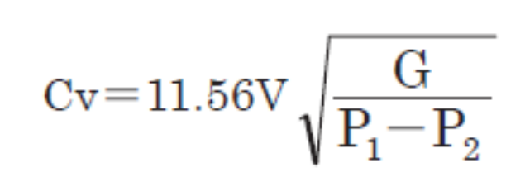
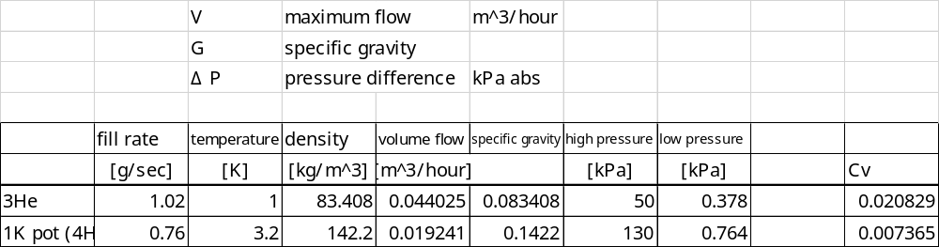
Needle Valve impedance (WBS 2.1.1.7)
Requirement for Cv of needle valves
4 times larger than calculated Cv
Cv
  0.083 for the needle valve at the 3He line
  0.029 for the needle valve between 4K reservoir and 1K pot

Slide 11
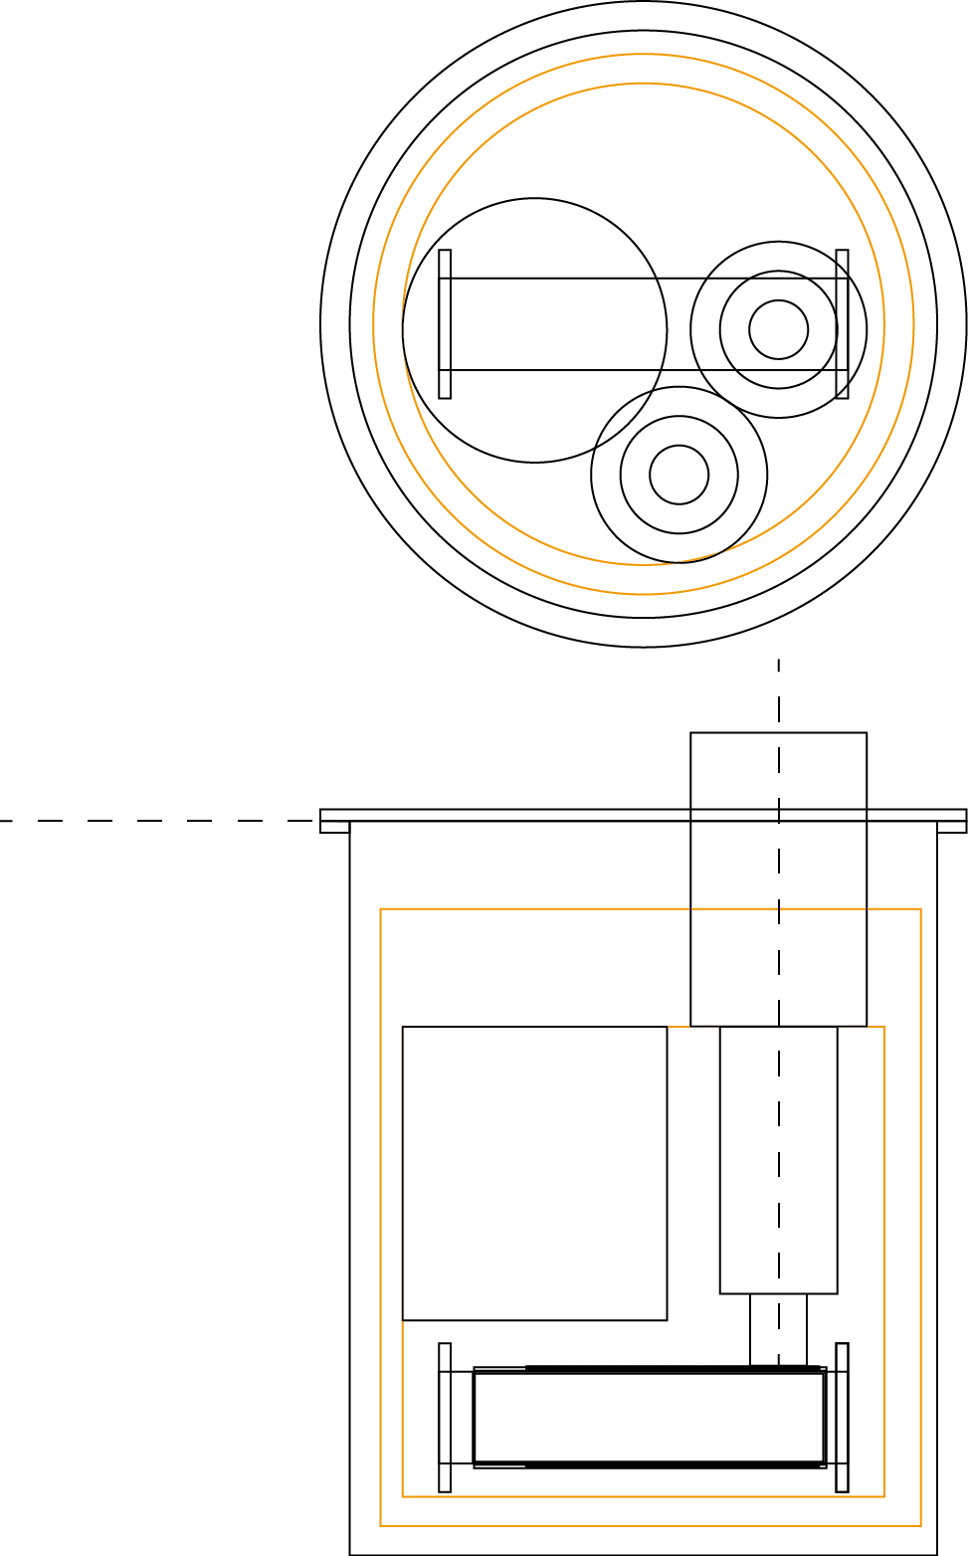
Layout of cryostat
Top flange φ1100
Vacuum chamber φ1000 x L1250
100 K shield φ920 x L1050
20 K shield φ820 x L800
4K reservoir φ450 x L500
Heat exchanger φ150 x L600
3He pumping duct φ300 (max)
1K pot φ200 x L150
4He pumping duct φ300 (max)

Slide 12
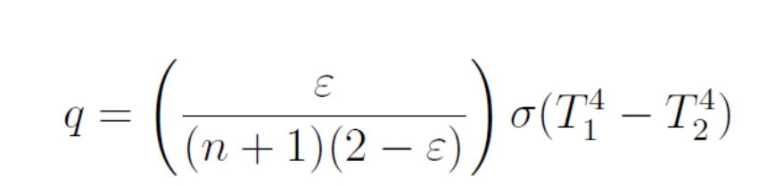
Radiation Heat (WBS 2.1.1.9)
n : number of super insulator
ε: emissivity
σ: 5.67E⁻⁸ 「W/m^2/K^4]
 | surface area |  |  |  | Temp. |  | Super insulator |  | emissivity | radiation heat
position | symbol | m^3 | D[m] | L[m] | T1[K] | T2[K] | # of SI | effecttive # | ε | W
1st layer | S1 | 0.70 | 0.92 | 1.05 | 300 | 100 | 30 | 10 | 0.1 | 2.17
2nd layer | S2 | 0.42 | 0.82 | 0.8 | 100 | 20 | 30 | 10 | 0.1 | 0.03

Slide 13
Necessary helium flow
Temperature assumption
 | Temperature |  |  | Enthalpy
position | symbol | Temp. [K] | Temp. [K] | symbol | J/g
4K reservoir | T0 | 4.5 | 4.5 | H(T0) | 11.64
1st layer | T1 | 10 | 10 | H(T1) | 65
2nd layer | T2 | 100 | 100 | H(T2) | 535
Room temperature | Tr | 300 | 300 | H(Tr) | 1574
mass flow of evaporation gas from 4K reservoir to thermal shield
 | m | 0.01 |  | g/sec
 |  | 8.41E-05 |  | L/sec
 |  | 0.30 |  | L/hour
radiation heat
 | W
1st layer | 2.17
2nd layer | 0.03
Cooling capacity of the thermal shield
position | symbol | W
1st layer | C_{2nd} | 4.7
2nd layer | C_{1st} | 0.5336
other available enthalpy | C_{other} | 10.39
Mass flow of 0.01 g/sec
2 times larger cooling capacity for 1st layer
Need to be evaluate other source of heat load (radiation heat, conduction of pipe, support, …)

Slide 14
Cooling test at KEK
Liquid helium supply : butch mode
Use helium-4 instead of helium-3
Item to be checked
  Operation process
  Cold leak
  superleak
    ～ 1.5 K
      Depend available pump
    Static heat load estimation
      Evaporation & pumping rate
      How to estimate film flow effect?

Slide 15
Next step
Detail estimation of heat load
  He-II : should be assume 1 W?
  Thermal shield
    Estimate
      radiation heat
      conduction heat
  Re-calculate by new number
Necessary coil length HEX (-> TO)
  above 4K, 4K reservoir, above 1K pot and 1K pot
  Calculate
    pressure drop in the coil
    3He amount in the coil
Loss of vacuum relief size (-> RMat)
  Cold ?
    smaller diameter
  Room temperature ?
    Easy maintenance

