Slide 1
UCN Experiments 2018
R. Picker

Slide 2
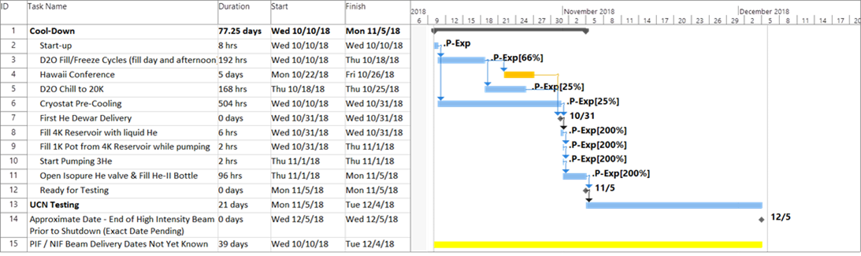

Slide 3
What is most important for the next generation source?
UCN source cryostat
UCN handling hardware
Static heat load ⇒ let isopure boil off to measure (results from 2017?)
Heat conduction in isopure He ⇒ heater tests (better now with better PG9L)
???
burst disk effect on source storage lifetime ⇒ make duplicate and perform storage lifetime measurements
VAT valve storage lifetime ⇒ use the two we have to store UCN (both sides?) and its transmission
SCM transmission (warm bore and cold bore) ⇒ build UCN guide bores with foil holder and measure
NiP production volume ⇒ SK to build one and test baking temperature dependence
NiP guides on different substrates, from different companies? ⇒ NSERC grant money can be used
Li6 detector improvement (connections, vacuum) and studies (see Pietro’s talk)
non-de-polarizing guides ⇒ see above partly
non-conducting guides for spin flipper ⇒ NiMo on on glass from Torsten?
Fe foil polarizer and spin flipper ⇒ SHR data
EDM cell valve ⇒ SV is pushing this…
Am I missing your experiment? Please complain!!!
MUST | Experiments that impact new source design, or new source tail assembly
HIGH | plays a role for new UCN source (ie before the 300K gate valve) OR to be installed in V source in 2019 e.g. for simulation benchmarking OR nEDM stuff we need to know early OR mature design with clear requirements that are testable
MEDIUM | refers to nEDM setup and guides, won't hurt if we learn it later
OPTIONAL | or to be installed in V source in 2019, or material tests (can be done elsewhere, which requires less manpower!)

Slide 4
Important leftovers and questions from fall 2017
Leftover measurements
Questions to be answered by data analysis before finalizing experimental program
Al foil in front of Li6 detector ⇒ do we want to measure with and without this time to understand efficiency better
I would say yes!
3He and Li6 detector (w/o Al foil)?
We should do this as well! Especially since we might have new housing.
Did transmission measurements work? Make sense? Statistical precision? Do we need another method?
Did the pinhole storage lifetime measurement work?
What is the result of the detector comparison? Remember that the Li6 had an Al foil in front…
Were the measurements at different temperatures conclusive enough? Or do we need to repeat some?
Were the high current measurements conclusive enough? ⇒ steady state measurements?

Slide 5
Draft Plan
https://docs.google.com/spreadsheets/d/12iO6hu25ZMQOD9K_dDpwM9qMbBwxHZVU2lDZXy9OBCk/edit?usp=sharing

Slide 6
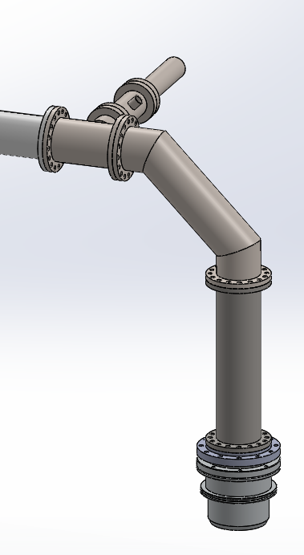
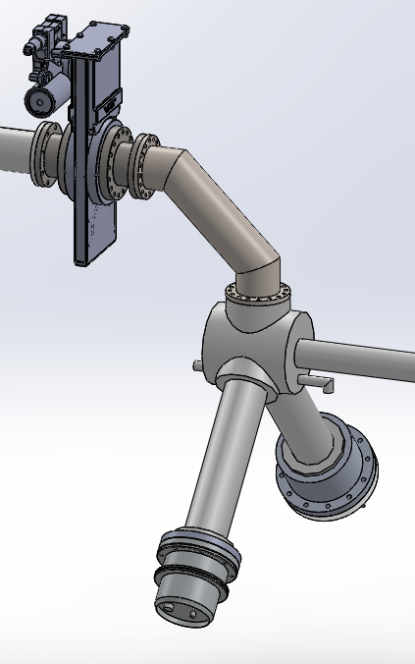
Start-up: simplest possible configuration
or detector comparison with VAT valve in place
Champions: BJ for new detector housing, TL for UCN DAQ, RMat for UCN source, FK for cryo services
TCN18-000 Simple start
TCN18-005 Start with VAT valve and detector comparison
Simplest possible configuration: less sources for errors
Compare to last year’s best UCN yield numbers
Need to vent guides inside shielding right after the first day
Experiments possible:
  UCN yield
  Storage lifetime
More complicated first setup
No direct comparison to last year’s best run
One less configuration change
Guides inside shielding don’t have to be vented
Experiments possible:
  UCN yield (not directly comparable)
  Storage lifetime
  Detector comparison
  Storage lifetime up to VAT valve
Reason for experiments: start up and checks of source – checking detectors

Slide 7
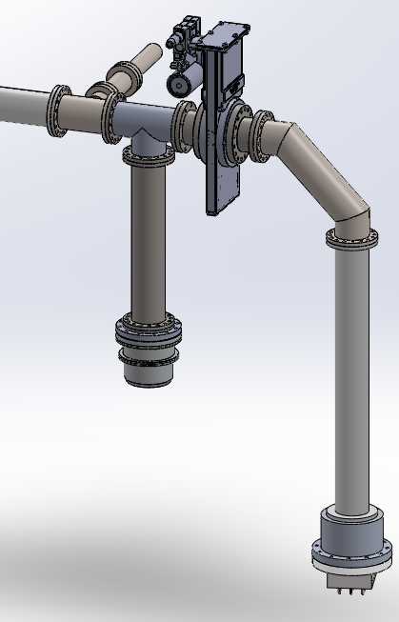
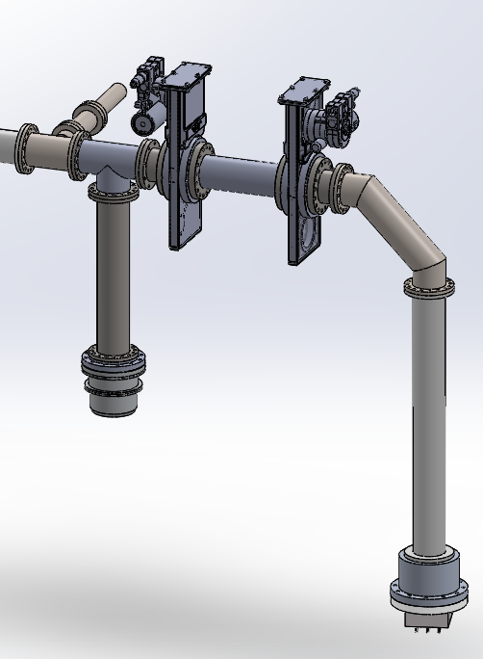
³He as monitor detector and VAT valve tests
Champions: EP for monitor port, FK for UCN valves
TCN18-030 Upgraded monitor guide test and zero expt for VAT valve transmission
TCN18-035 VAT valves characterization - storage between two valves, first side and transmission through VAT valve
We should install a guide here…
Install VAT valve now to vent the UCN guides in the shielding as less often as possible
New monitor detector connection should give better statistics for storage measurements
Zero measurement for VAT valve transmission (VAT valve should be O-ring downstream)
Storage lifetime between two O-ring sides of VAT valves
Compare to left to get transmission measurement of VAT valve
If time permits: could store in source up to second VAT valve…(optional)
Reason for experiments: qualify VAT valve for New UCN source (or not)

Slide 8
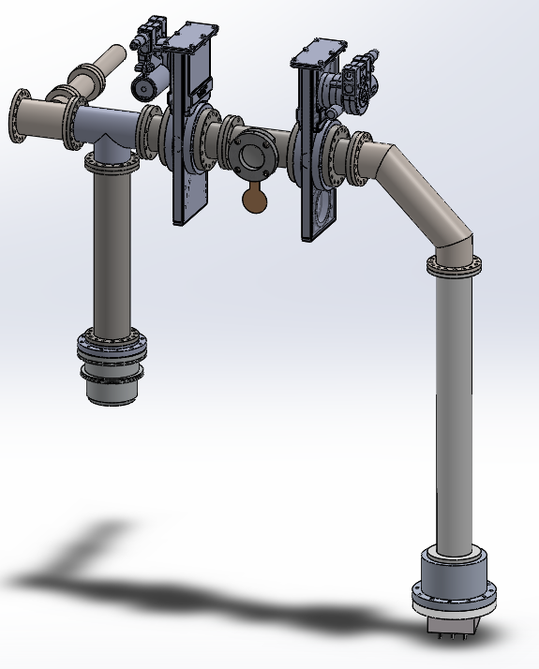
Burst disc and other side of VAT valve
Champions: RP for burst disc
TCN18-055 Burst disc holder qualification
TCN18-045 Other side of VAT valves
Burst disc holder UCN storage lifetime
Cam has an alternative idea:
  Burst disc would be on top of the cryostat
  UCN guide would be closed by thin foil that blows out easily
  This would need to be qualified with UCN this fall, as well!
Is it clear enough that the O-ring side of the VAT valve is the better storage side???
If not, we should turn them around and measure again.
Need to vent inside guides for this…
Reason for experiments: qualify burst disc and second side of VAT valves for NEW UCN source

Slide 9
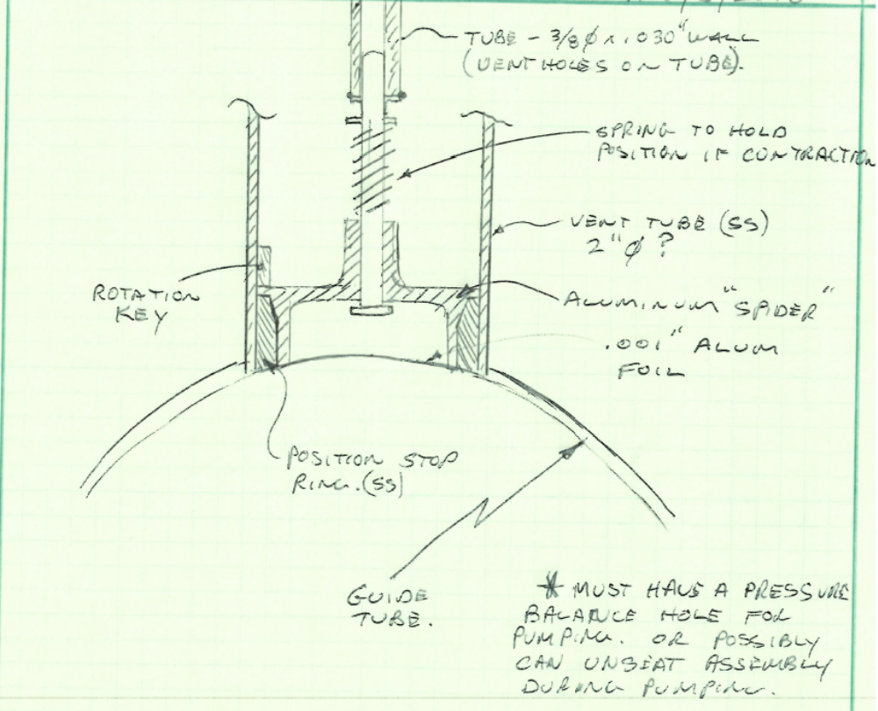
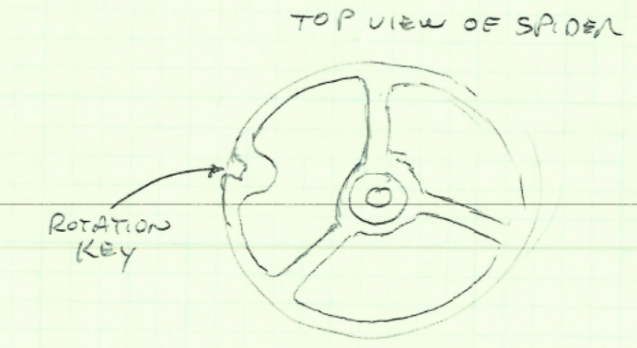
Cam’s UCN relief
Could double as pumping port…
Al foil of 25 μm would blow out at low pressures
Keeps burst disc accessible at top of cryostat
Saves space along UCN guide
Not so easy to exchange
How to sense it it has blown (other than UCN source yield and storage lifetime)? varnished, thin Cu wire could be glued to foil

Slide 10
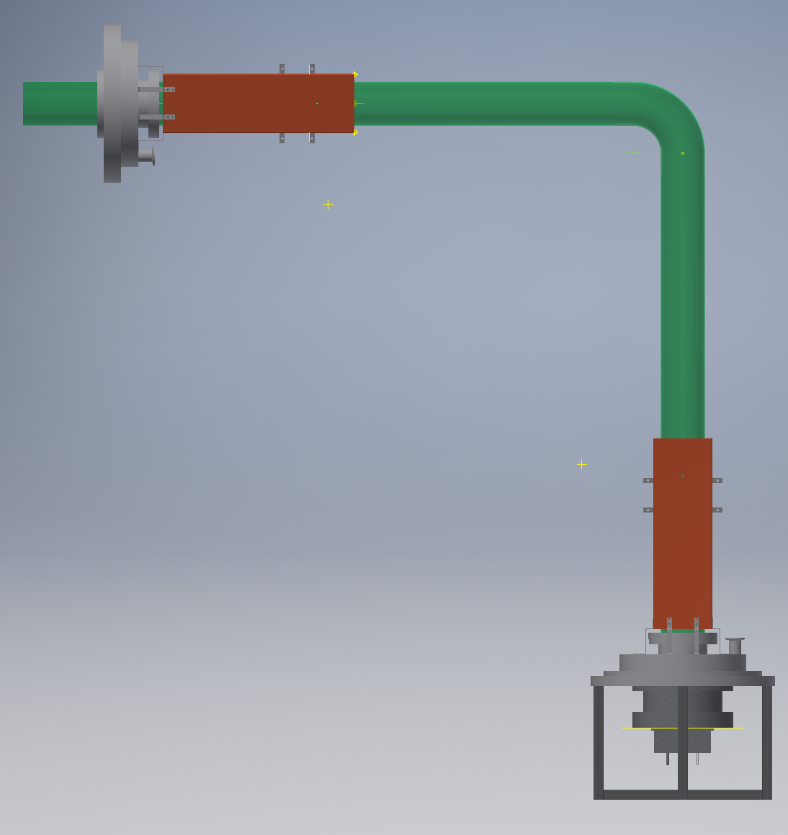
SCM polarizer warm bore tests and polarized UCN
See Wolfgang’s presentation
Champions: WS for SCM, SHR for polarization
TCN18-065 Transmission and storage lifetime of SC polarizer with Al foil
TCN18-070 Polarization measurement
Put SCM plus 2 35 cm guides here
Could be SCM
Measure transmission and storage lifetime of SCM as a function of magnetic field
Need to plan this accordingly to have enough time for cooldown of the magnet.
Put spin flipper after SCM, and analyzer before Li6 detector
How about holding fields?
Measure polarization as a function of spin flipper frequency for nominal SCM current
Reason for experiments: qualify SCM for NEW UCN source, give SHR thesis data

Slide 11
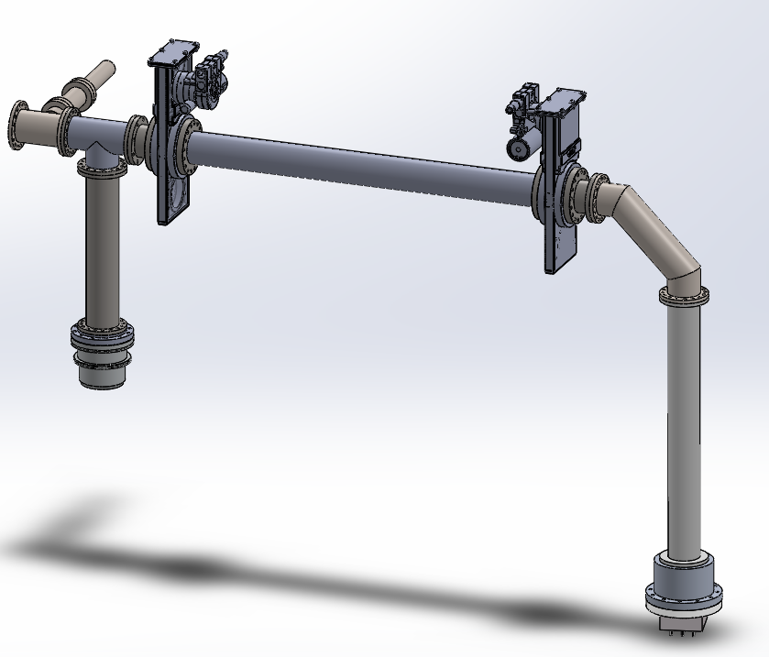
UCN guide transmission and storage litetime tests
Champions: EP for existing guides, RM for new guides
TCN18-075 Zero measurement for guide transmission
TCN18-075 to TCN18-??? Transmission and storage lifetime of UCN guides
Take guide out
Put different guides here
Baseline measurement for guide transmission
Does a storage lifetime make sense in this configuration?
List of guides to test:
  1 m SS polished guide (how polished?)
  1 m NiP coated guide in comparison to above (same surface finish?)
  NiMo coated glass guide for spin flipper
  Winnipeg NiP on glass, maybe
  Winnipeg NiP glass elbow, maybe
Reason for experiments: guide development, especially of NiP coated guides required for the NEW UCN source

Slide 12
Ti foil transmission
Champions: EP?
TCN18-115 Transmission through Ti foil
Put foil holder with Ti here, maybe between two 35 cm guides?
Test transmission and storage lifetime for thinnest foil
Reason for experiments: we could provide unpolarised neutrons to experiments and put polarizer outside shielding

Slide 13
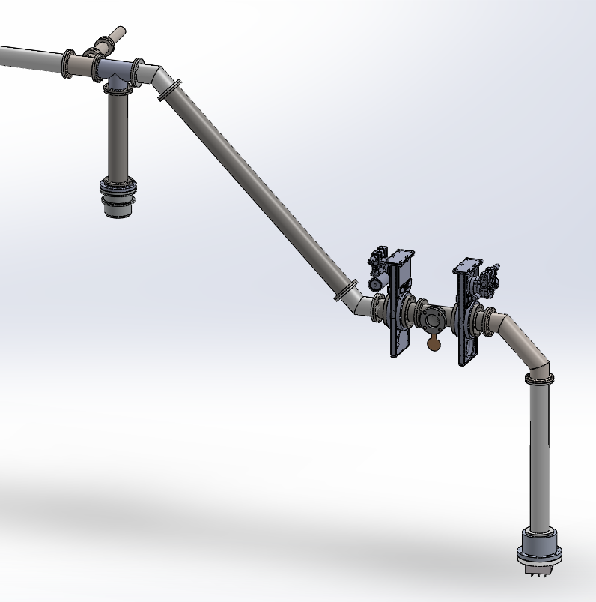
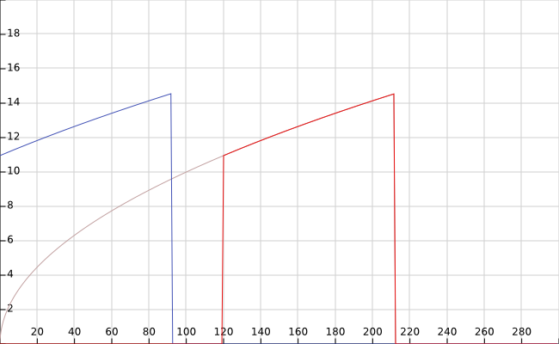
Do we need to repeat the tests above at lower elevation?
Provides second data point…
…but both are not the spectrum of the new source…
Which spectrum do we care more about?
It would definitely interesting to compare both, but is it worth the time?
Required time: > 1 week
Measurement that should be repeated:
  VAT valves, both sides
  Burst disc
  SCM
  Guide transmission
  EDM cell valve?
at source exit
shifted upwards
in source
UCN kinetic energy [neV]

Slide 14
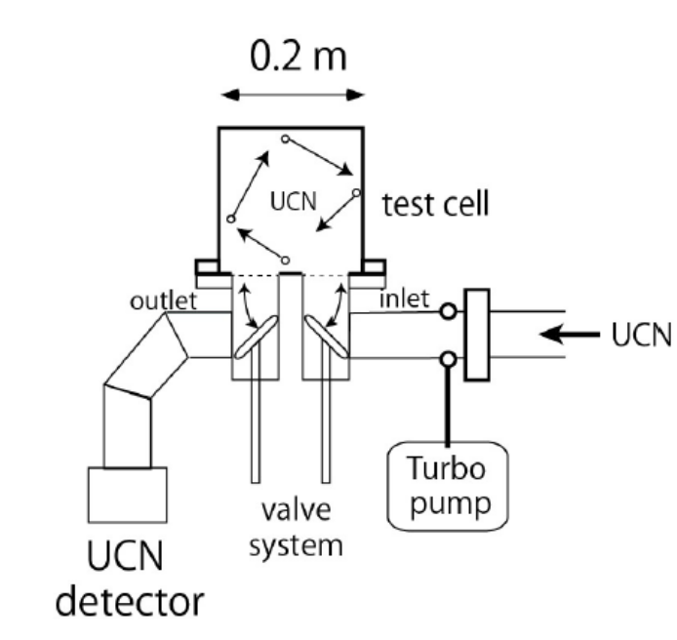
NiP coated UCN production volume mock-up
Champions: SK
TCN18-125 bake out tests with NiP coated bottle
Install gravity spectrometer here
Start with unbaked bottle perform storage lifetime measurement
Then bake at 100°C, perform storage lifetime measurement
Then bake at 150°C, perform storage lifetime measurement
Reason for experiments: determine baking temperature requirements for new UCN source

Slide 15
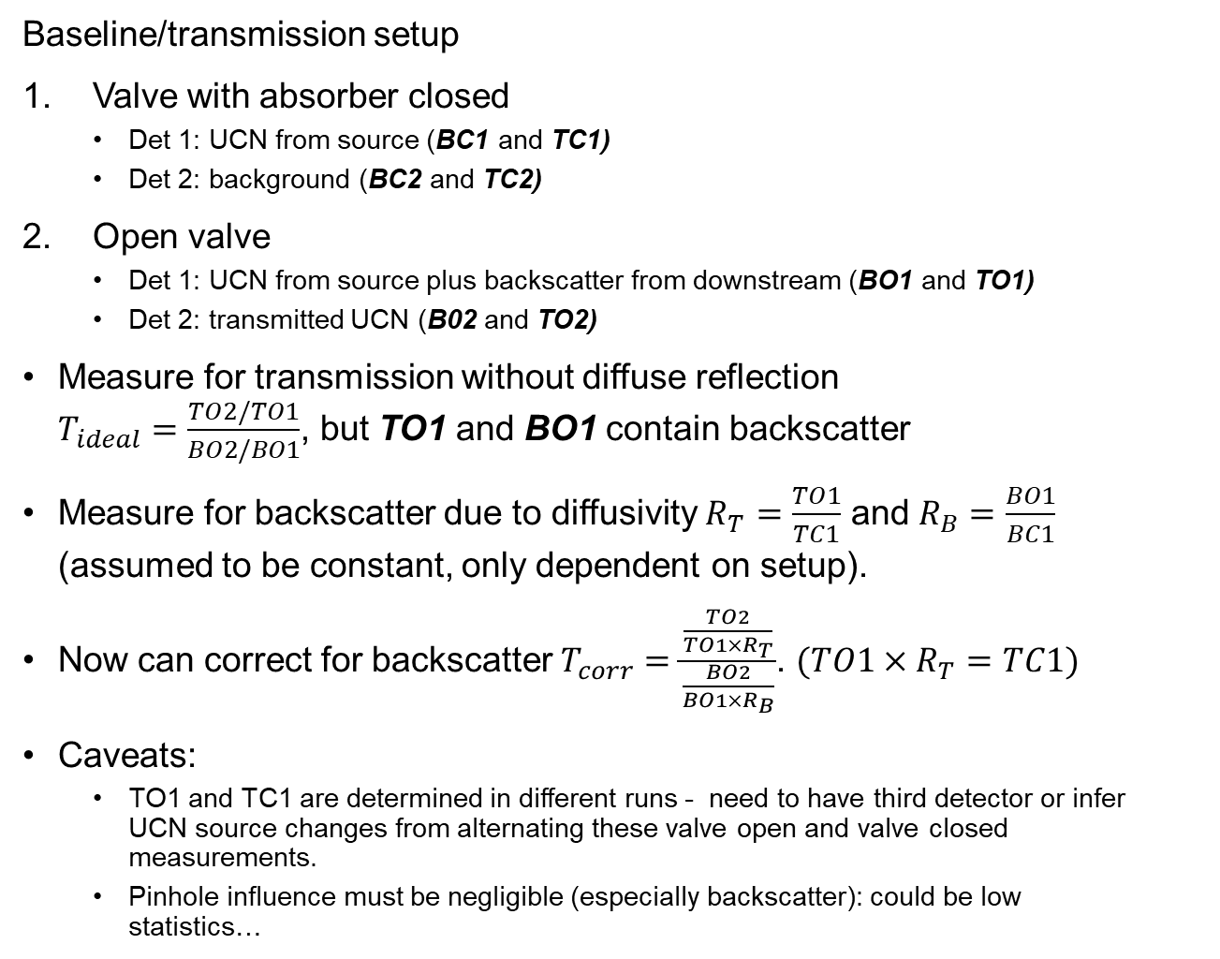
How about this setup for diffuse reflection estimation?
UCN absorber
Baseline/transmission setup
Valve with absorber closed
  Det 1: UCN from source (BC1 and TC1)
  Det 2: background (BC2 and TC2)
Open valve
  Det 1: UCN from source plus backscatter from downstream (BO1 and TO1)
  Det 2: transmitted UCN (B02 and TO2)
Measure for transmission without diffuse reflection $T_{ideal}=\frac{TO2/TO1}{BO2/BO1}$, but TO1 and BO1 contain backscatter
Measure for backscatter due to diffusivity $R_{T}=\frac{TO1}{TC1}$ and $R_{B}=\frac{BO1}{BC1}$ (assumed to be constant, only dependent on setup).
Now can correct for backscatter $T_{corr}=\frac{\frac{TO2}{TO1×R_{T}}}{\frac{BO2}{BO1×R_{B}}}$. $(TO1×R_{T}=TC1)$
Caveats:
  TO1 and TC1 are determined in different runs - need to have third detector or infer UCN source changes from alternating these valve open and valve closed measurements.
  Pinhole influence must be negligible (especially backscatter): could be low statistics…
Baseline
setup
UCN valve
UCN
Pinhole ports
1
2
UCN detectors
Transmission
setup
UCN
guide test piece
1
2

Slide 16
Other questions
Do we want to make a few Wilson flanges and test them? Will be done with glass guides if available…
Do we want a platform underneath the UCN guide so that it is at breast height? Non-magnetic 80/20 or Bosch profiles?
Do we need a UCN spectrum shaper for the storage lifetime measurements? I presume not, due to the large vertical rise out of the vertical source.

Slide 17
Conclusion
There are lots of things to test, questions to answer
Many require some new hardware
We need people to take ownership of a set of experiments and make them happen! Volunteers, please!
Please comment on the experimental program draft!

Slide 18
Thank you for your attention.

Slide 19
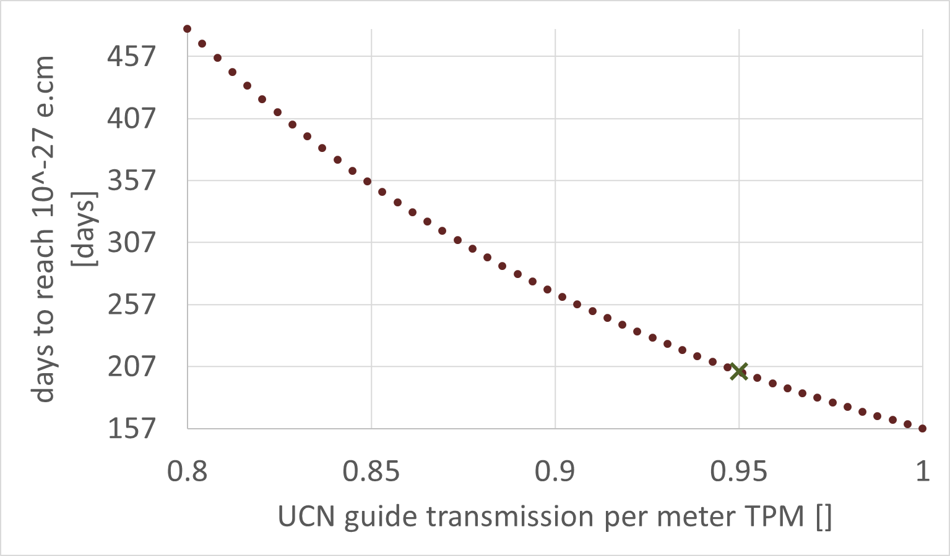
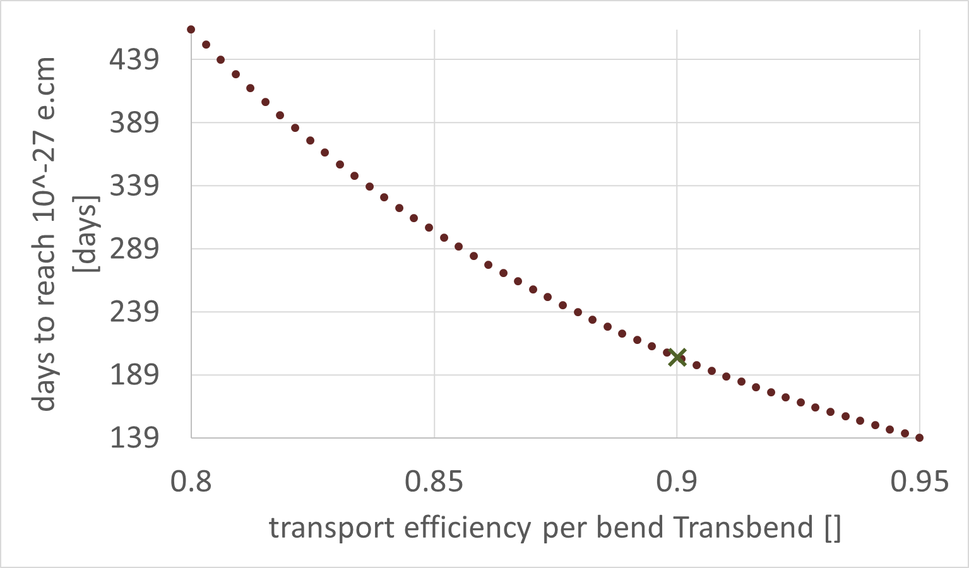
Sensitivity

