Slide 1
UCN Area Magnetic Monitoring at TRIUMF
Elspeth Cudmore
TUCAN Collaboration Meeting
Thursday August 9th, 2018

Slide 2
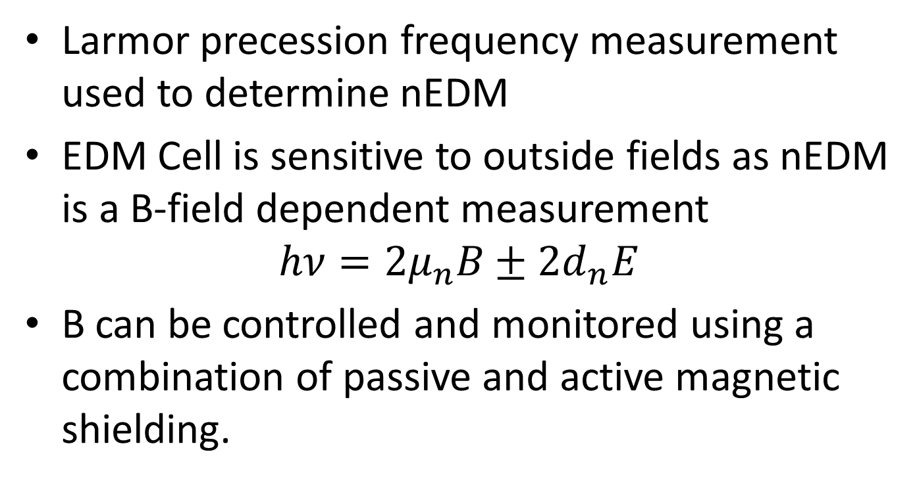
The Need for Magnetic Management
Larmor precession frequency measurement used to determine nEDM
EDM Cell is sensitive to outside fields as nEDM is a B-field dependent measurement
$$hν=2μ_{n}B±2d_{n}E$$
B can be controlled and monitored using a combination of passive and active magnetic shielding.

Slide 3
Overview of the Meson Hall Ambient Magnetic Field Measurement System
Cyclotron surrounding experiment produces stray magnetic fields, long-term stability not well known
Placement of fluxgates around Meson Hall, with one central DAQ point connected to the network
Coordinate system referencing all fluxgates to the centre of the cyclotron (Work in Progress)

Slide 4
System Components
Fluxgates and Cabling
Active Filtering & Instrumentation
  Same as Gradiometer
Analog-to-digital Conversion
  Similar to Gradiometer
Power Distribution and Grounding
DAQ Rack-Mount Box

Slide 5
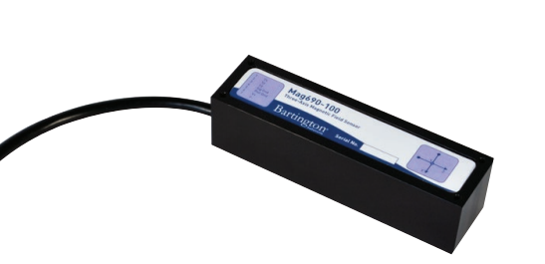
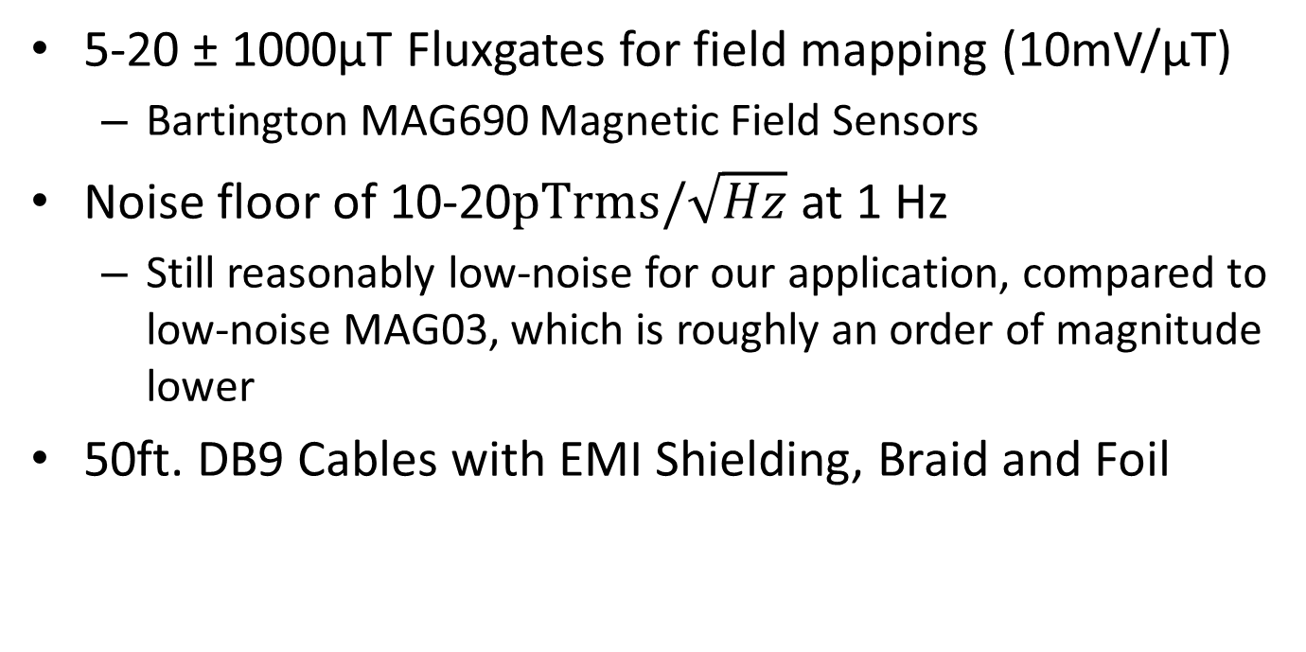
Fluxgates and Cabling
System Components
1. Fluxgates and Cabling
2. Active Filtering and Instrumentation
3. Analog-to-digital Conversion
4. Power Dist. and Grounding
5. DAQ Rack-Mount Box
5-20 ± 1000µT Fluxgates for field mapping (10mV/µT)
  Bartington MAG690 Magnetic Field Sensors
Noise floor of 10-20$pTrms/\sqrt{Hz}$ at 1 Hz
  Still reasonably low-noise for our application, compared to low-noise MAG03, which is roughly an order of magnitude lower
50ft. DB9 Cables with EMI Shielding, Braid and Foil

Slide 6
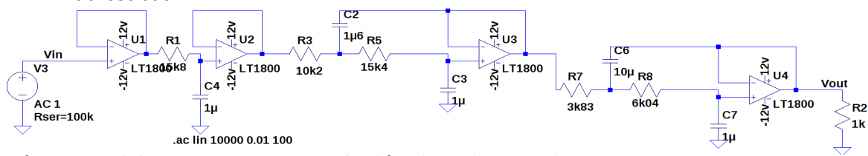
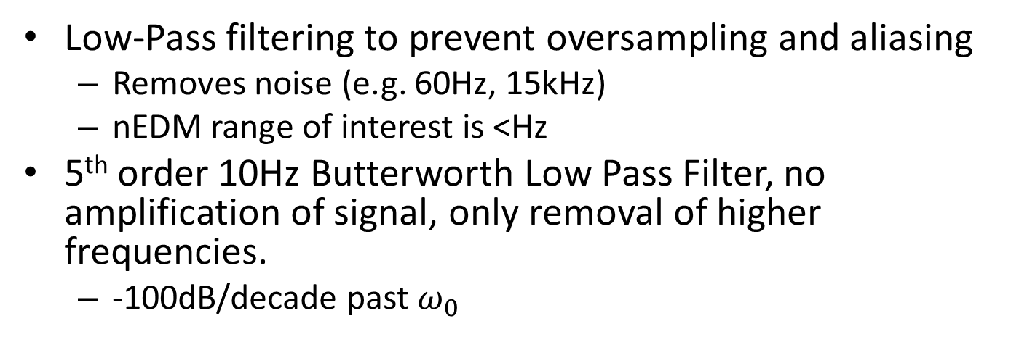
Active Filtering and
Instrumentation
System Components
1. Fluxgates and Cabling
2. Active Filtering and Instrumentation
3. Analog-to-digital Conversion
4. Power Dist. and Grounding
5. DAQ Rack-Mount Box
Low-Pass filtering to prevent oversampling and aliasing
  Removes noise (e.g. 60Hz, 15kHz)
  nEDM range of interest is <Hz
5th order 10Hz Butterworth Low Pass Filter, no amplification of signal, only removal of higher frequencies.
  -100dB/decade past $ω_{0}$

Slide 7
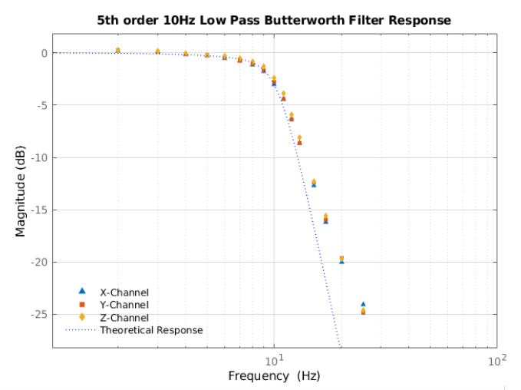
Active Filtering and
Instrumentation
System Components
1. Fluxgates and Cabling
2. Active Filtering and Instrumentation
3. Analog-to-digital Conversion
4. Power Dist. and Grounding
5. DAQ Rack-Mount Box
System limits, 16 Bit Resolution = SINAD of -98dB
With 10Hz LPF, this corresponds to ~27Hz, meaning that minimum sampling frequency must be >54Hz for 16 Bit
(Shannon-Nyquist Sampling Theorem)
Frequency response on the left shows theoretical predictions and measured values for constructed low pass filters. All channels acting similarly.
Data from 2V peak to peak signal created by frequency generator

Slide 8
Active Filtering and
Instrumentation
System Components
1. Fluxgates and Cabling
2. Active Filtering and Instrumentation
3. Analog-to-digital Conversion
4. Power Dist. and Grounding
5. DAQ Rack-Mount Box
Bartington Instruments recommends using Instrumentation Amplifiers when creating a fluxgate power source
  Losses in long cables can skew fluxgate signal and signal GND
  Convert a differential signal into a single-ended one without losing magnetic field values

Slide 9
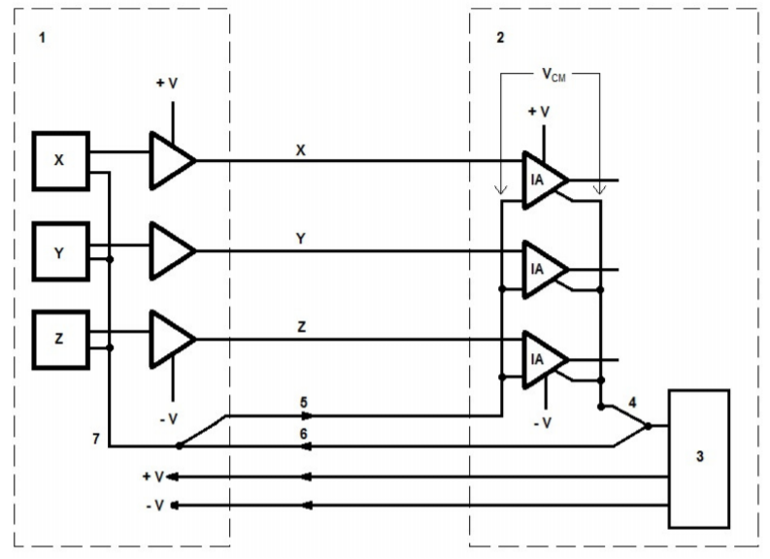
Active Filtering and
Instrumentation
System Components
1. Fluxgates and Cabling
2. Active Filtering and Instrumentation
3. Analog-to-digital Conversion
4. Power Dist. and Grounding
5. DAQ Rack-Mount Box
Fluxgate Internal
Host
Host Power Supply
Host Local 0V
Signal Ground
Fluxgate Ground
Common Ground

Slide 10
Analog-to-Digital
Conversion
System Components
1. Fluxgates and Cabling
2. Active Filtering and Instrumentation
3. Analog-to-digital Conversion
4. Power Dist. and Grounding
5. DAQ Rack-Mount Box
Allows analog voltages from Fluxgates to be digitized and timestamped
Long term ambient measurements means low frequency sampling, or higher frequency sampling with averaging.
Labjack T7-Pro used, High Resolution ADC (16-22 effective number of bits, ENOB)

Slide 11
Analog-to-Digital
Conversion
System Components
1. Fluxgates and Cabling
2. Active Filtering and Instrumentation
3. Analog-to-digital Conversion
4. Power Dist. and Grounding
5. DAQ Rack-Mount Box
Paired with MUX80, allowing up to 84 Analog inputs
  MUX80 allows for up to 28 Fluxgates to be sampled at a time, the physical upper limit of this system
  30AINS to be used with 10 fluxgate system
Maximum sampling frequencies up to 100kHz (1CH 16b), so 3.3kHz with 10 FGs
Enabled with network capabilities – connected via Ethernet to TRIUMF Cluster
  Data taking driven with MIDAS

Slide 12
Power Distribution and Grounding
System Components
1. Fluxgates and Cabling
2. Active Filtering and Instrumentation
3. Analog-to-digital Conversion
4. Power Dist. and Grounding
5. DAQ Rack-Mount Box
120V AC Enters Box, Stepped down to 15V DC via DIN rail Power Supply
15V Supplied to DAQ Board where it is converted to ±12V DC (Fluxgates and filters) and 5VDC (Labjack, MUX80)
  Common Ground through entire board, avoiding grounding loops

Slide 13
Power Distribution and Grounding
System Components
1. Fluxgates and Cabling
2. Active Filtering and Instrumentation
3. Analog-to-digital Conversion
4. Power Dist. and Grounding
5. DAQ Rack-Mount Box
120V AC Power Input
15V DC Power from DIN Supply
5V Power from On-board DC-DC Converter
±12V Power From On-Board DC-DC Converters
Instrumentation Amplifiers
Low Pass Filters
Fluxgates
MUX80
Labjack T7-PRO
Single-point grounding mechanism to reduce likelihood of ground issues
All grounds referenced to input power ground, with the exception of Signal Gnd from Fluxgates

Slide 14
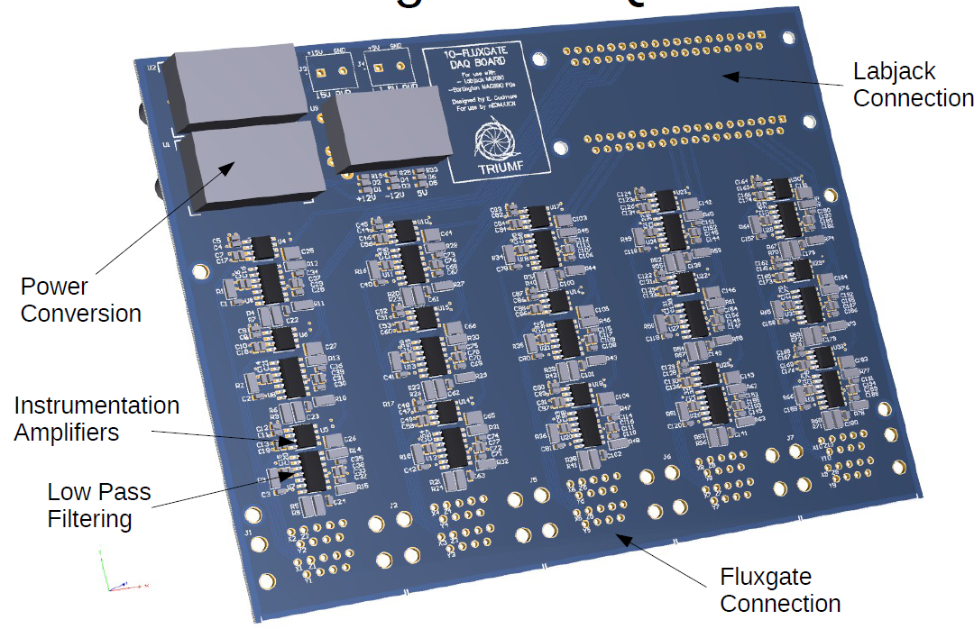

Slide 15
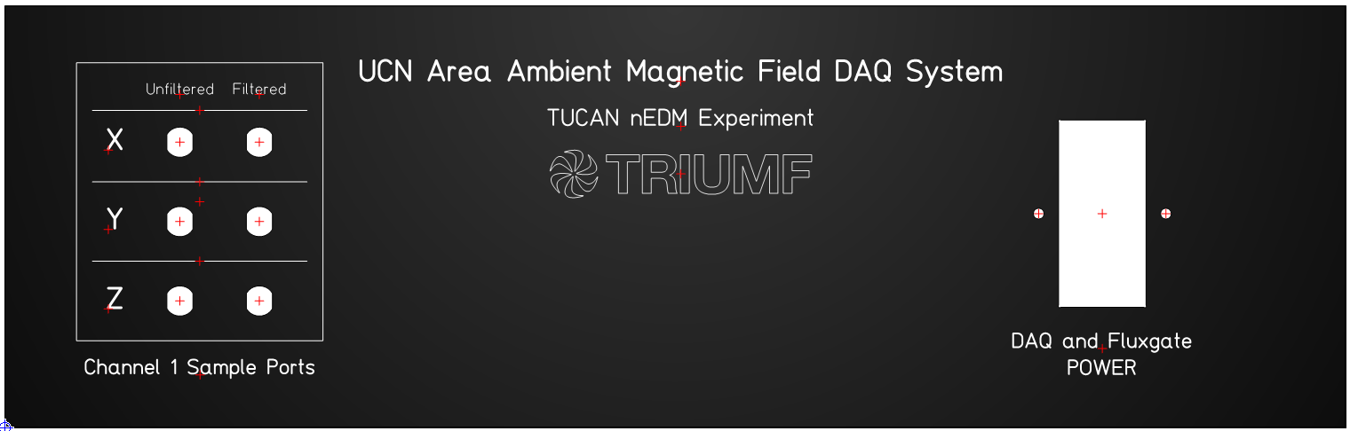
DAQ Rack-Mount Box
System Components
1. Fluxgates and Cabling
2. Active Filtering and Instrumentation
3. Analog-to-digital Conversion
4. Power Dist. and Grounding
5. DAQ Rack-Mount Box
Setup will be able to be mounted in a Computer Rack at TRIUMF, standard 19” Box
Front Panel Express Custom Front/Back Panels
  I/O: 120VAC, Ethernet, Fluxgate Signals (10 – 20 DB9) and 6 BNC Sample Ports

Slide 16
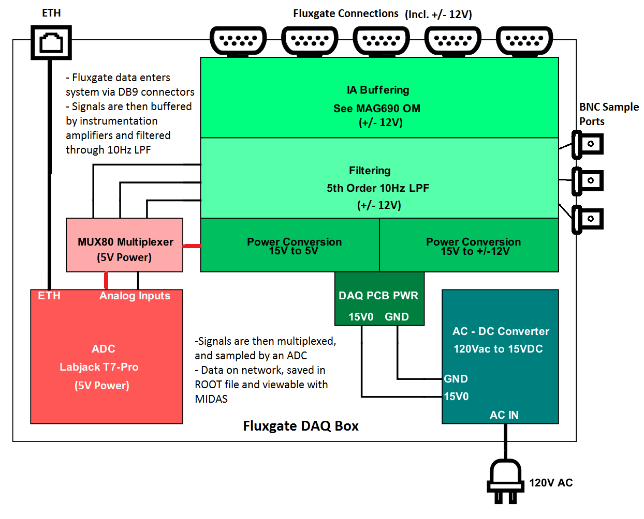

Slide 17
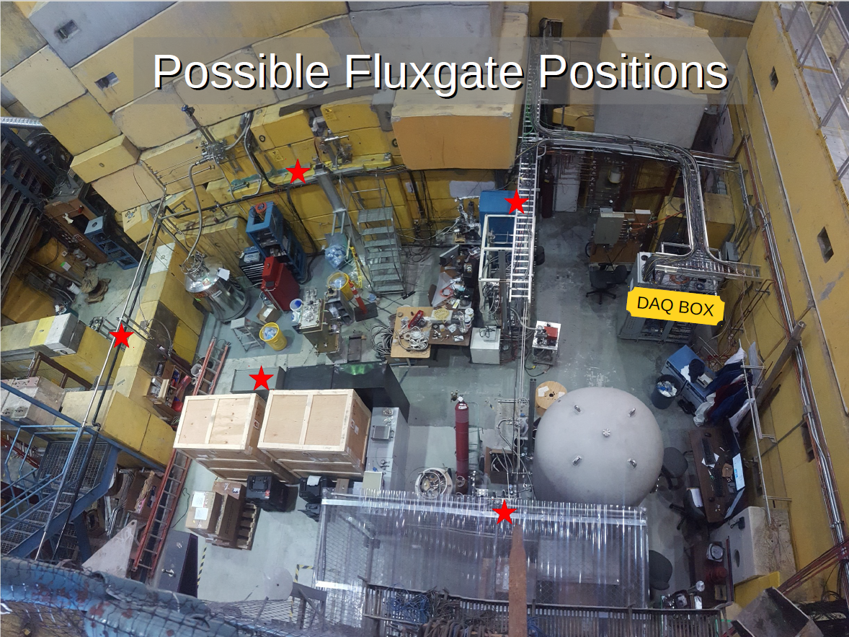

Slide 18
Final Steps/Future Considerations
Damping Vibration Effects, Determining how to properly mount these devices
Position Calibration using Levels or Accelerometer
Expansion to 20 Fluxgates – the creation of another complimentary Filtering PCB
Full Design Report for Meson Hall Ambient Magnetic Field Measurement System can be found here (currently being updated)

