Slide 1
nEDM open questions
& general brainstorm
Beatrice Franke,
TUCAN collaboration meeting August 2018

Slide 2
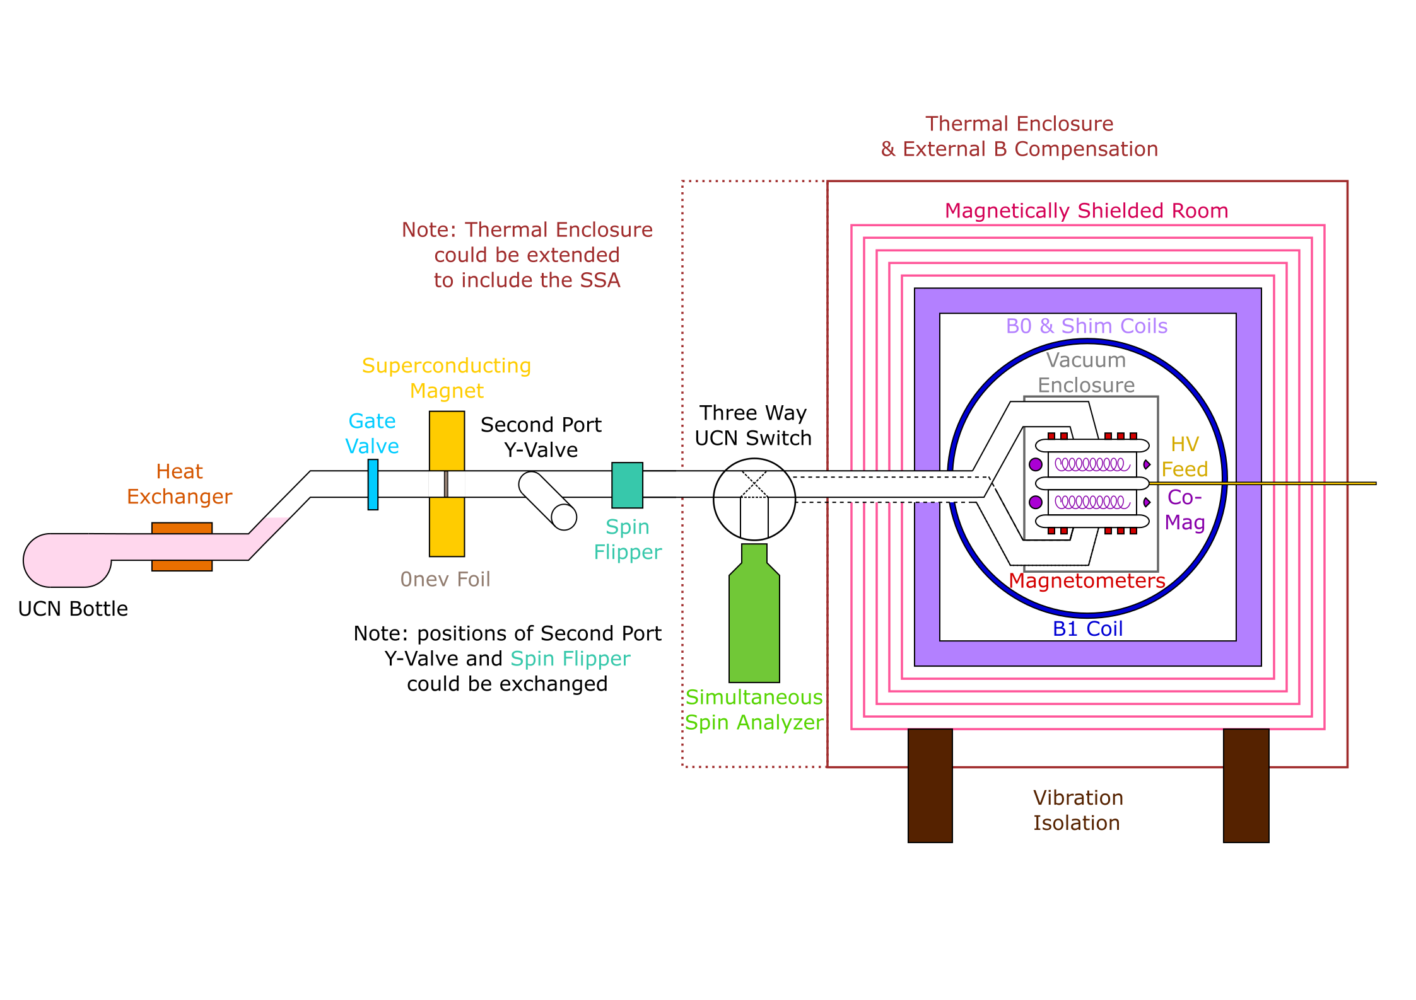
nEDM layout sketch

Slide 3
nEDM open questions: subsystem & interfaces
Guiding fields
Mapper internal and external
Vibration damped support for MSR?
Thermal enclosure inside or outside bucking coils?
”RF” shield? Like extra copper or aluminum layer?
Spinflipper “SF0” before or after Source Y-valve
(provide high-field-seeker UCN and low-field-seeker UCN to nEDM and other experimental port)
nEDM Y-valve to feed two chambers (there is a design idea for a Source Y-valve, can we reuse that?)
nEDM switch: three way switch?! We actually need two!

Slide 4
nEDM brainstorm
SQUIDs?
Degaussing system?
How many magnetometers? (Jeff looking into that)
DAQ: fast control & slow control; midas, root?
High precision system clock
Slow control data quality check: alarms for bad events (temperature change, magnetic field glitches, HV discharges, comag failure/loss of laser lock)
Blinding??
Shim coil system, how many?

Slide 5




Thank you
Merci
www.triumf.ca
Follow us @TRIUMFLab

