Slide 1
Particle Physics at TRIUMF in next Five-Year Plan 2025-2030
Oliver Stelzer-Chilton (for the PP group)
Science Week 2022
July 18th–July 22nd, 2022

Slide 2
Particle Physics within the Physical Sciences Division
The departments of Particle Physics, Science & Technology and Scientific Computing address the areas:
High Energy Frontier
Neutrinos and Dark Matter
Precision Tests of Fundamental Interactions
Lead in Scientific Discovery through focus projects
Projects where we are involved in all areas
detector design/construction, operations, data analysis
Ensure critical mass is established
Maintain leadership in all areas
Current experiments
ATLAS, T2K/Hyper-K, ALPHA, TUCAN, SuperCDMS
New experiments expected to reach that point in the future
DarkLight, nEXO, PIONEER
TRIUMF@SNOLAB covered in talk by Jocelyn Monroe

Slide 3
Enable Particle Physics in Canada and Abroad
TRIUMF is part of a network of laboratories and partner institutions
Leverage TRIUMF key expertise in accelerator, computing, detector and DAQ technologies
Unique expertise in e.g. cryomodules, SiPM, TPC, gaseous detectors, DAQ, etc…
Support for Accelerator and Engineering, Science Technology and Computing are crucial
SNOLAB: detector, facility and DAQ systems through Science and Technology involvement
-> SuperCDMS, nEXO, ARGO, DEAP, SNO+
CERN: In kind contributions to LHC and HL-LHC, share in detector upgrades -> ATLAS, ALPHA
KEK/J-PARC: beam monitoring accelerator contributions
share in detector upgrades -> T2K/Hyper-K
Gran Sasso: DAQ systems -> DarkSide
Future involvement
Ocean Networks Canada: -> P-One
Future Collider

Slide 4
Particle Physics Next 5YP Planning
Particle Physics Planning
Dedicated meetings (mini-retreat) during March and April
Presentations from all research groups + new future initiatives
Contributions from: ATLAS, Hyper-K, ALPHA, HAICU, TUCAN, SuperCDMS, nEXO, PHAAR, DarkLight, PIONEER, P-ONE, Future Collider
Hiring Priorities in short talks in dedicated meetings in May and June in preparation for PSD retreat
New initiatives under discussion in dedicated task forces
Center/platform/hub for detector development - joint with Nuclear Physics, SciTech
Center/platform/hub for AMO/Quantum/Precision/ physics (HAICU, radioactive molecules, UCN, Francium…) - joint with Nuclear Physics and CMMS
These are meant to 1) strengthen and refresh critical specialized technical expertise and give a means to retain that expertise over time that is existential to the core of the laboratory and our research while 2) also fostering existing synergies and leveraging new capabilities that are appealing to our community and the government as part of the next Five-Year Plan

Slide 5
Next Five-Year Plan
Impact on Focus Projects

Slide 6
ATLAS

Slide 7
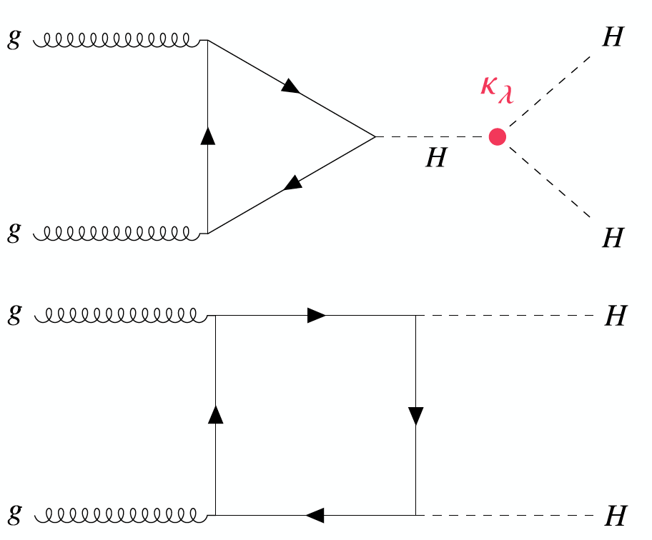
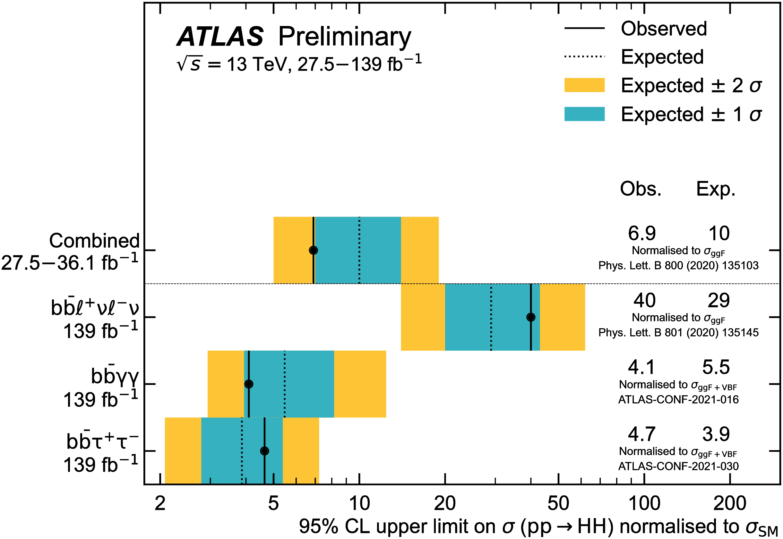
ATLAS
Physics with 3x the dataset: huge range of interesting physics options
Higgs and Standard Model measurements become more precise
Search program - higher energy, new signatures, new detector
A flagship analysis for future runs of the LHC
Measuring κ_{λ} by measuring HH production
Κ_{λ} gives direct information on the Higgs potential
Potentially evidence of HH before Run-4
But clearly will be a HL-LHC legacy!

Slide 8
ATLAS

Slide 10
Hyper-K

Slide 11
Hyper-K

Slide 12
Hyper-K

Slide 13
Hyper-K

Slide 14
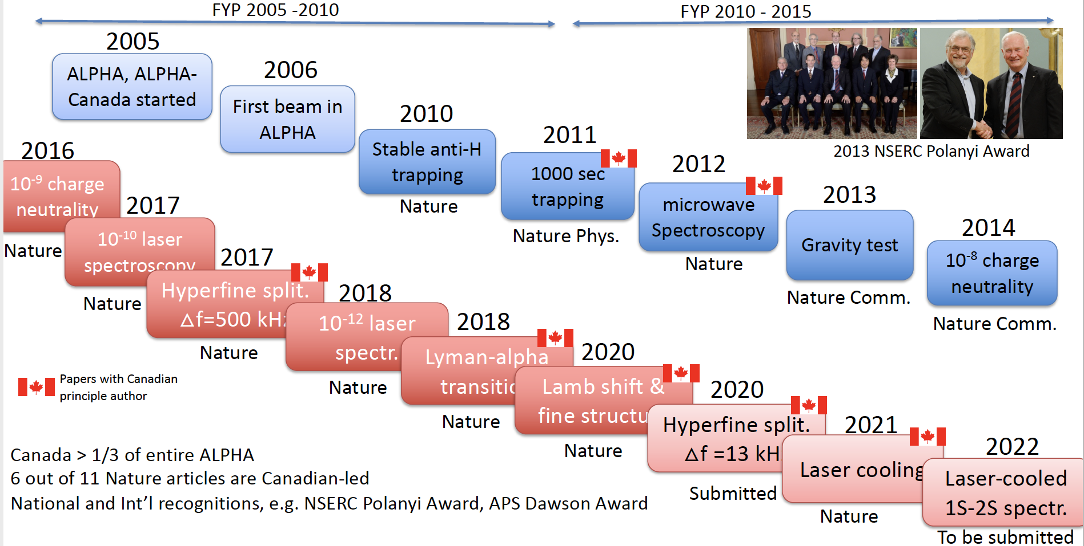
ALPHA

Slide 15
ALPHA

Slide 16
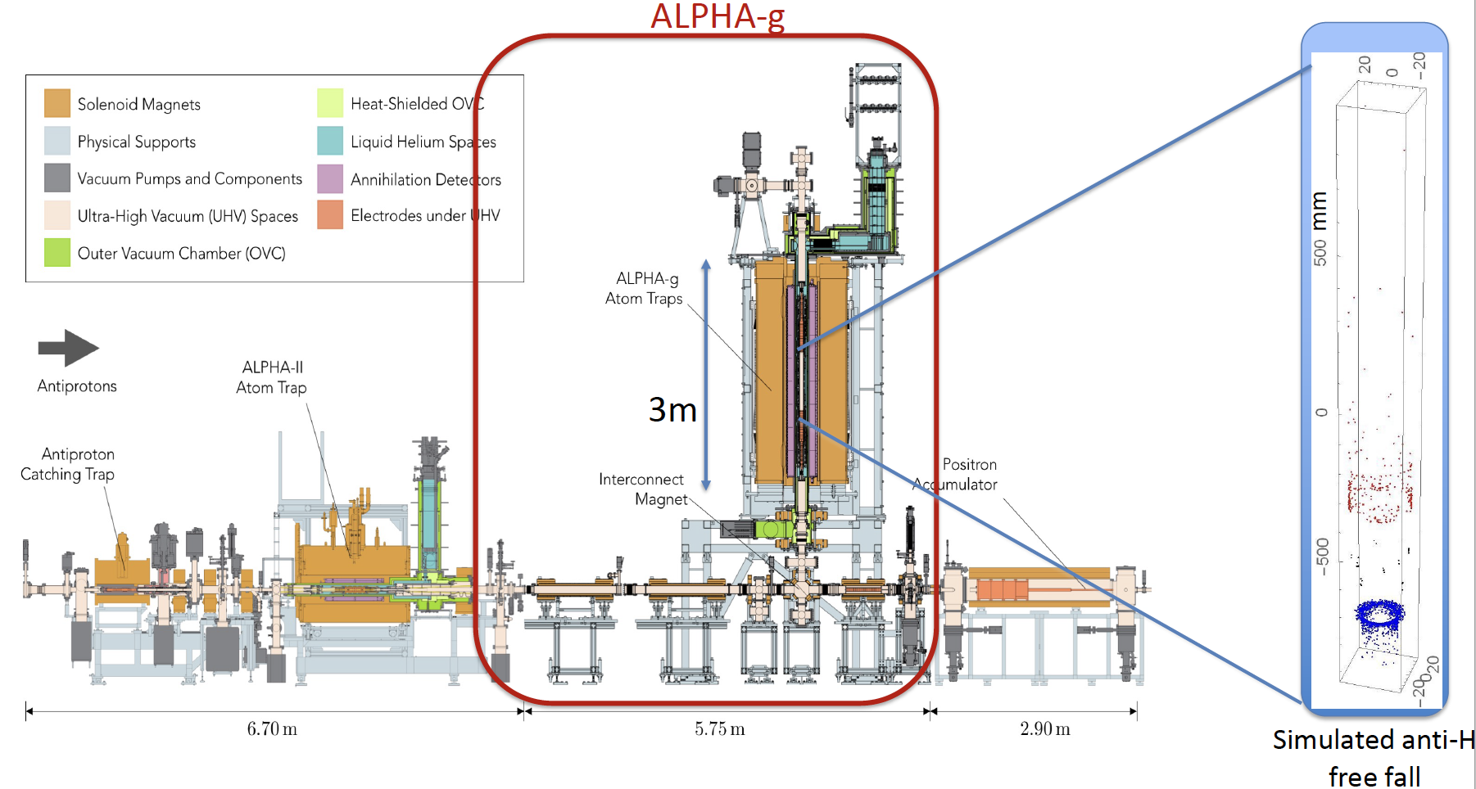
ALPHA

Slide 17
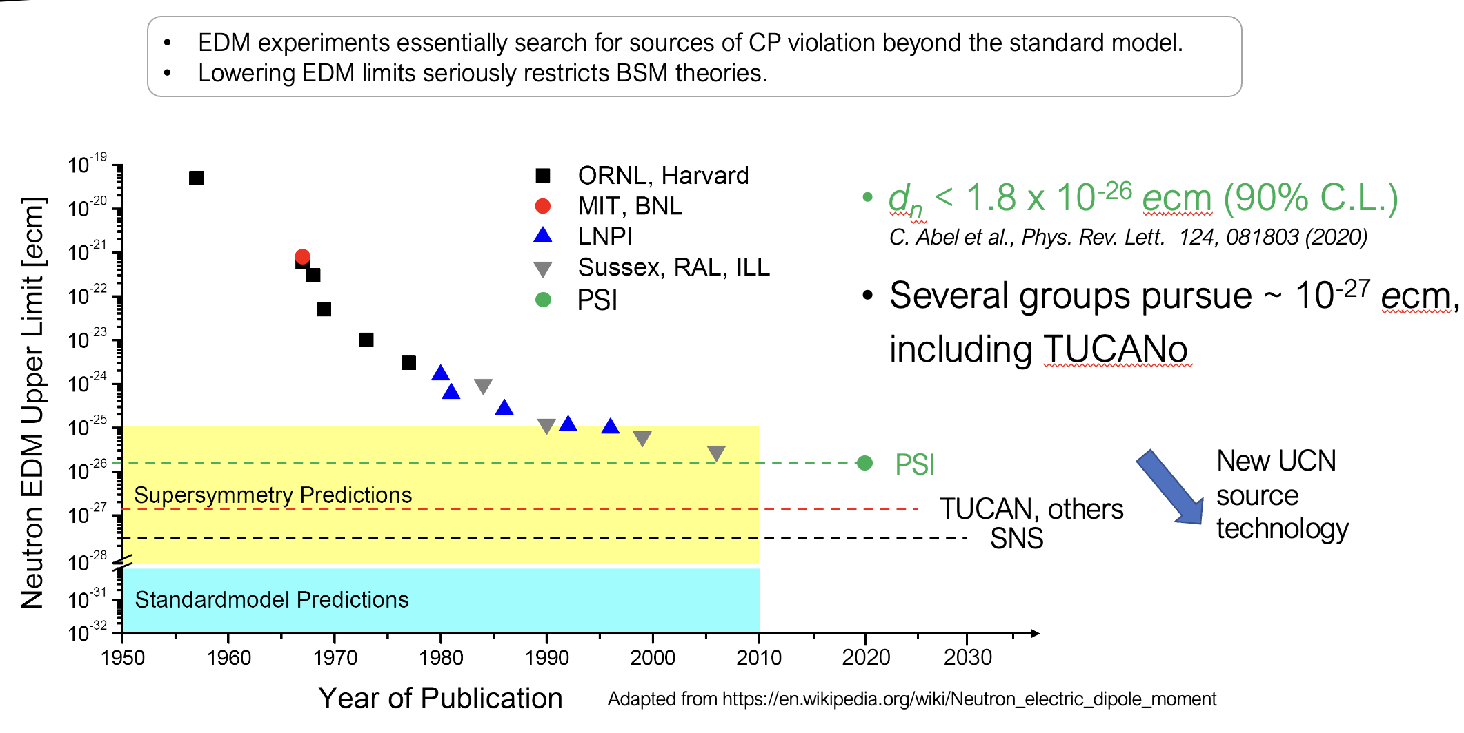
TUCAN

Slide 18
TUCAN

Slide 19
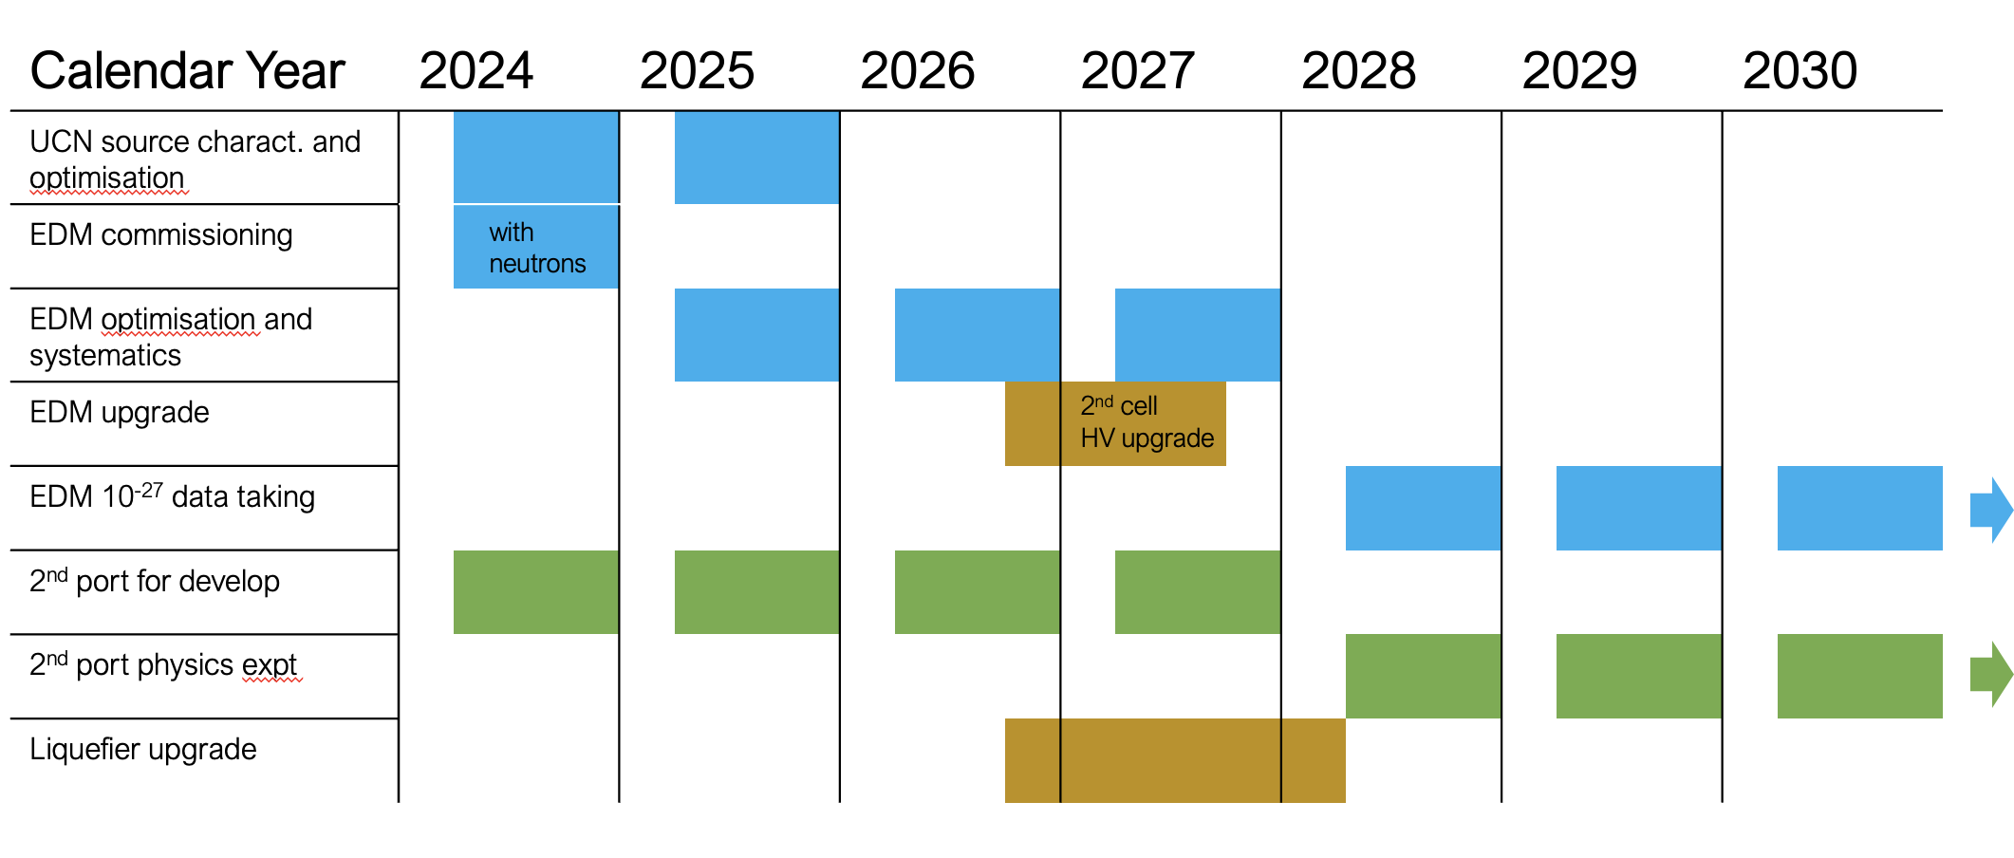
TUCAN

Slide 20
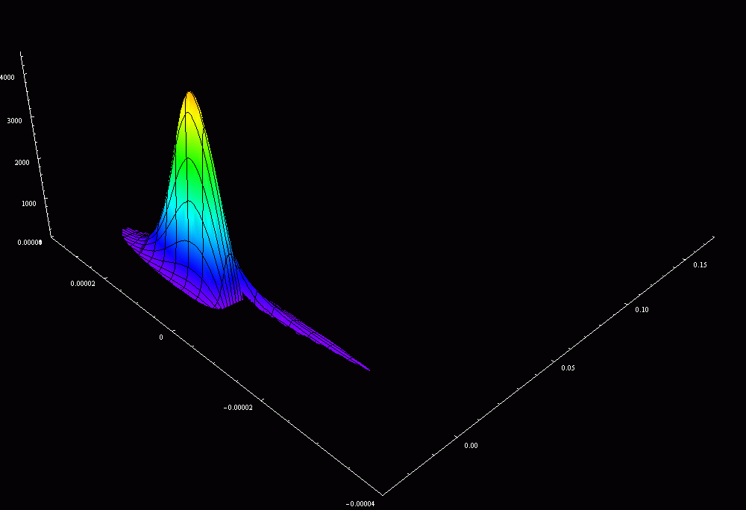
TUCAN

Slide 21
Next Five-Year Plan
New Projects

Slide 22
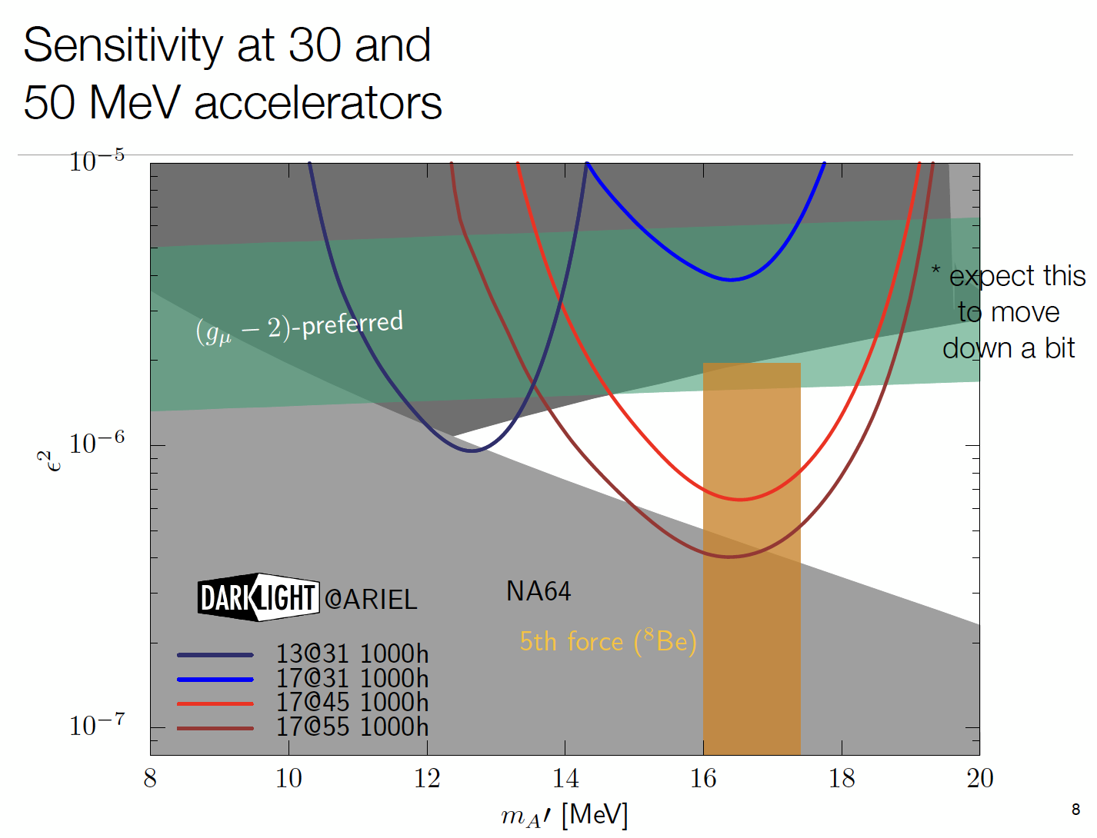
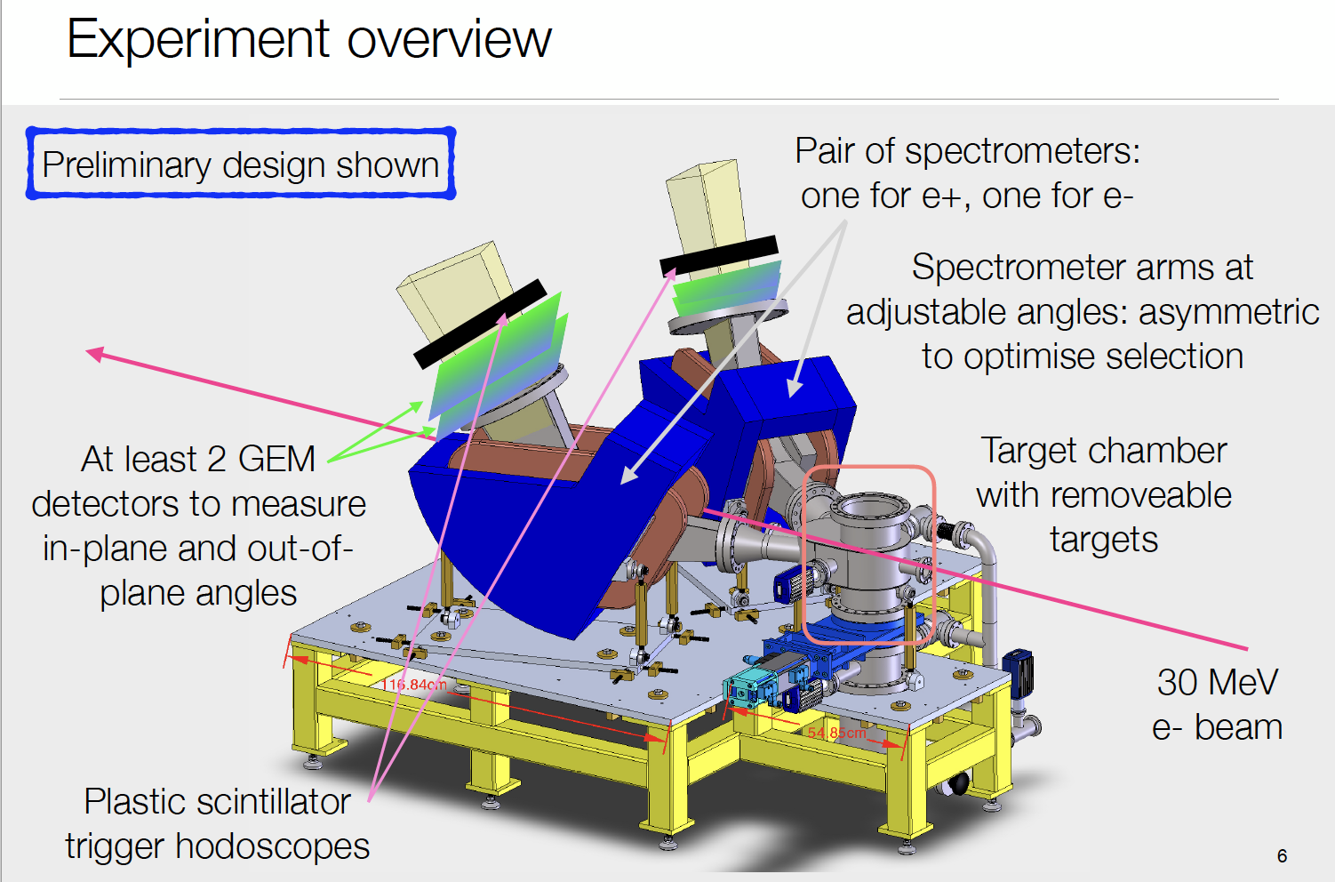
DarkLight
See talk by Kate Pachal

Slide 23
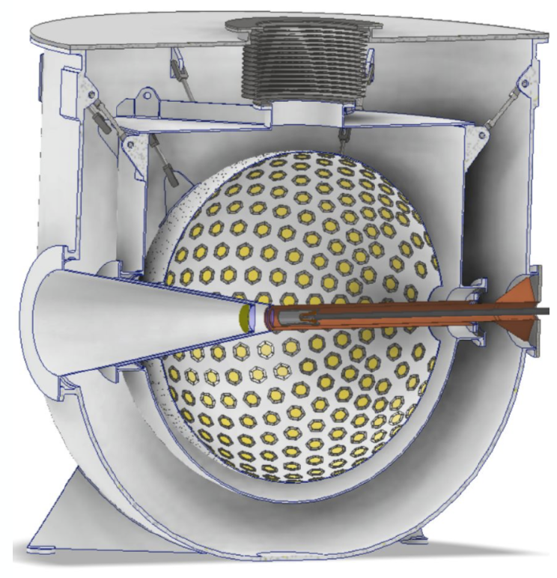
PIONEER

Slide 24
Next Five-Year Plan
Future Projects

Slide 25
P-ONE
See talk by Felix Henningsen

Slide 26
Future Collider

Slide 27
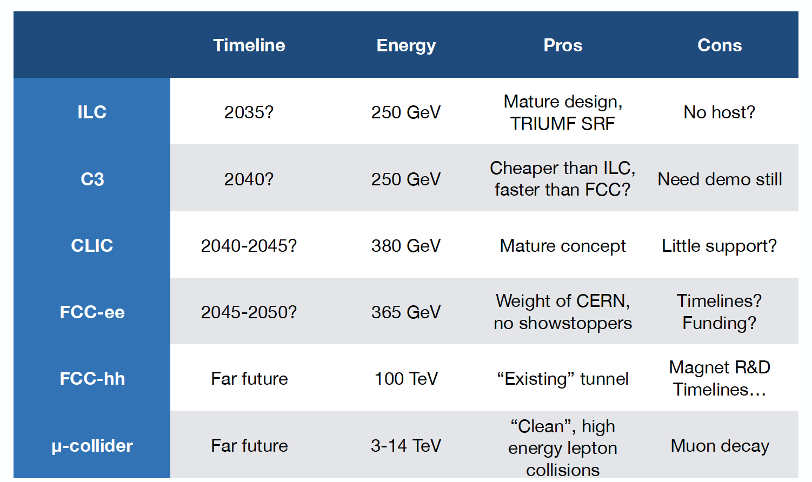
Future Collider

Slide 28
HAICU
See talk by Taka Momose

Slide 29
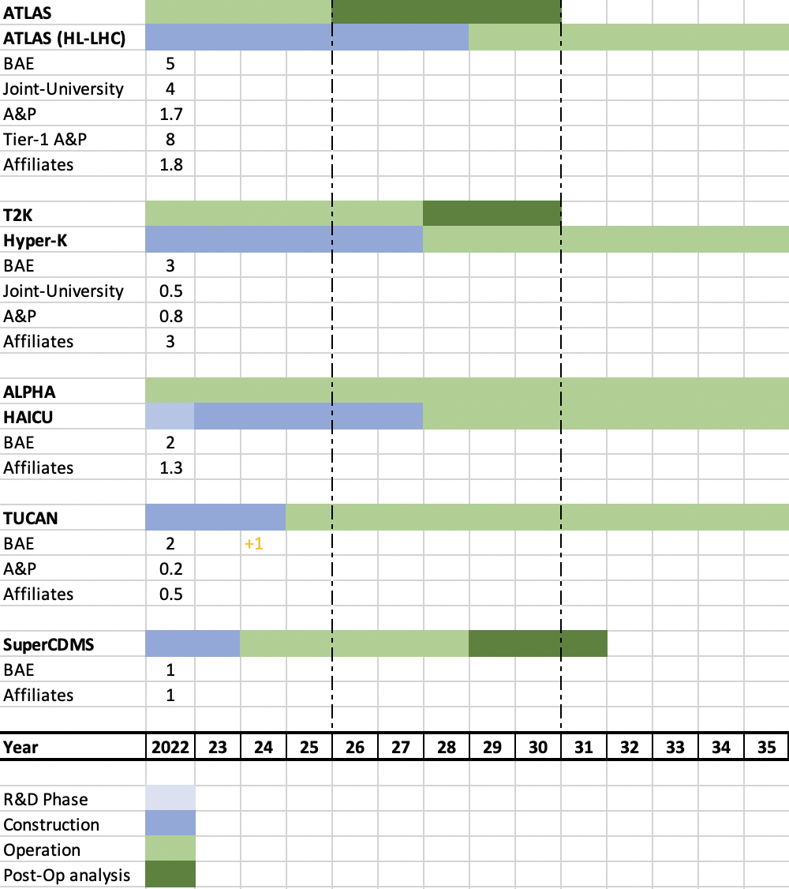
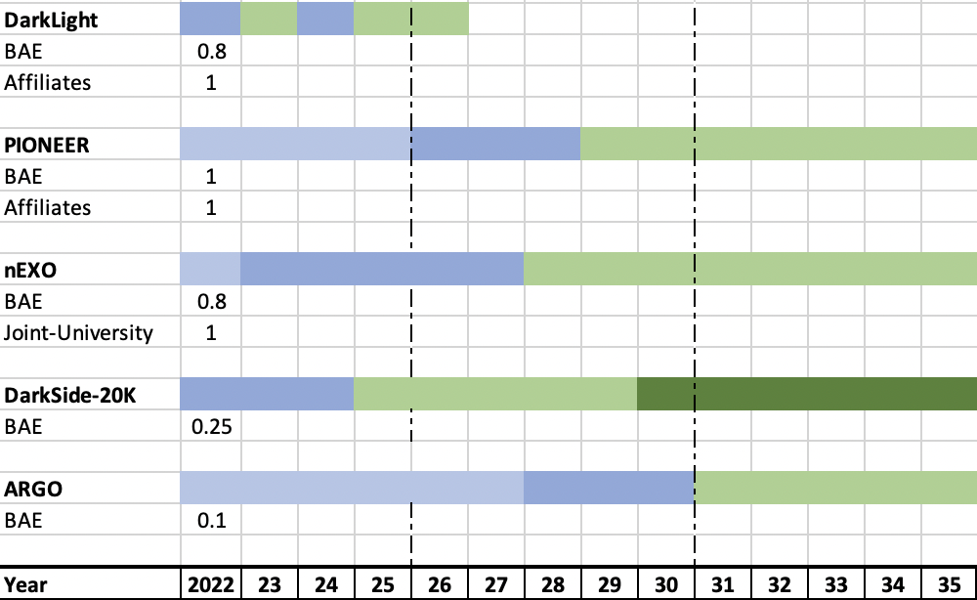
Chart of current and future projects in Particle Physics
Capture the TRIUMF supported local effort with focus on scientific and research contributions
Additional technical support from Science and Technology department crucial
Each group has their complement of students, postdocs
List of future projects and associated personnel will move and grow as we develop the next 5-year plan
E.g. Future Collider, new centers/platforms

Slide 30
Summary
Impact on Focus Projects in the Next Five-Year Plan
Upgrades to ATLAS will be mostly completed – except repairs and commissioning for ITK
Likely will see the start of partial activities towards a future collider
Hyper-K program
Significant requirements on technical and project management personnel from TRIUMF
WCTE: space for assembly of mPMT
IWCD and Hyper-K: Space for electronics testing
TUCAN will move into user facility with the 2nd port – will need more scientific personnel
SuperCDMS will complete its run and make possible upgrades / way for new involvements
New Projects
DarkLight will have completed its physics run – discussions ongoing of future opportunities
nEXO, PIONEER and HAICU will require more resources both technical and scientific
Future collider and P-One involvement will become more concrete
New Initiatives
All our experiments and their successes depend on facilities with key personnel and expertise, available resources in technical aspects + critically new space

Slide 31
Thank you Merci
www.triumf.ca
Follow us @TRIUMFLab

