Slide 1
Electronics and DAQ
T. Lindner
TRIUMF DAQ Group
TSI/GRIDS2018

Slide 2
Outline of Talk
Electronics Overview
Signal Digitization and Triggering
Assorted Electronics Topics:
  Form factors, power, cooling, cabling, slow control
Data Acquisition Software and Frameworks
This talk will try to cover electronics used for small test experiments
up to large LHC experiments… but there will be a focus on
electronics with which I am familiar.
T. Lindner

Slide 3
Questions to Ponder
What are the main pieces of electronics design?
What are our options for digitizing signals?
How do we pick particular solutions?
  Performance
  Power/Cooling
  Money
  Time
Common performance metrics for electronics:
  Charge resolution: how accurately can you measure charge of pulse?
  Time resolution: how accurately can you measure time of pulse?
  Dynamic range: what range of pulses can your electronics measure?
  Deadtime: how quickly after making one measurement can you make another? Is your electronics deadtime-less?

Slide 4
Electronics Components
ADC: analog to digital converter
  Typically turn a voltage into a digital measure
TDC: time to digital converter
  Precision timestamp of a digital signal
FPGA: Field Programmable Gate Arrays
  Programmable set of logic devices;
  FPGA program is called firmware.
  Real-time device, appropriate for precision readout of electronics components (unlike a PC, which has no timing guarantees)
ASIC: Application Specific Integrated Circuit
  Chip designed for a specific purpose
  Can be either analog or digital electronics or a mix
  Typically best performance (compared to discrete components or FPGA)

Slide 5
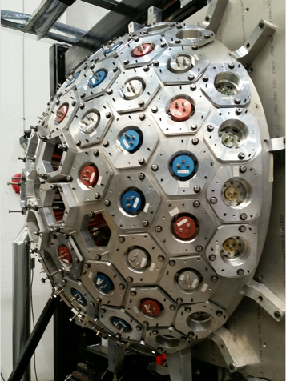
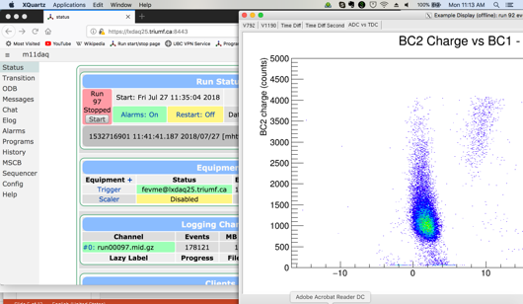
Detector Electronics Overview
Detector
(produces
electrical
signal)
Analog Electronics
(shape, amplify, filter)
Digitization Electronics
(convert to
digits, firmware,
data transport)
Data Acquisition Software, Online Monitoring
Trigger
Generation
Plus power, cooling, cables, slow controls…

Slide 6
Detector Electrical Signals
Lots of difference between signals from different types of detectors.
Characteristic signal time
  Fast signals (<=500ps): MCP, LAPPD
  Slow signals (~100us): TPCs
Characteristic signal amplitude
  Very small intrinsic signals: TPCs
  Large intrinsic signals: PMTs
Much of talk will focus on relatively fast electronics, with typical timescale of ns.

Slide 7
Analog Electronics
Analog electronics are often an integral part of the detector design; difficult to discuss analog electronics generically, since so tied to particular detectors.
Many different goals of analog electronics. Ie:
  Amplify a small signal
    Want to amplify the signal close to its production point.
    Need to choose amplifier that doesn’t cause loss of important signal characteristics.
    For instance, for a very fast pulse, need an amplifier with sufficiently high bandwidth that pulse doesn’t get distorted (unless you want to).
  Shape the signal to better match your digitization.
  Minimize or filter out noise.
If analog signal travels over cable, also need to think carefully about proper signal termination.
  If termination doesn’t match characteristic impedance of cable, then will get reflection of signal.

Slide 8
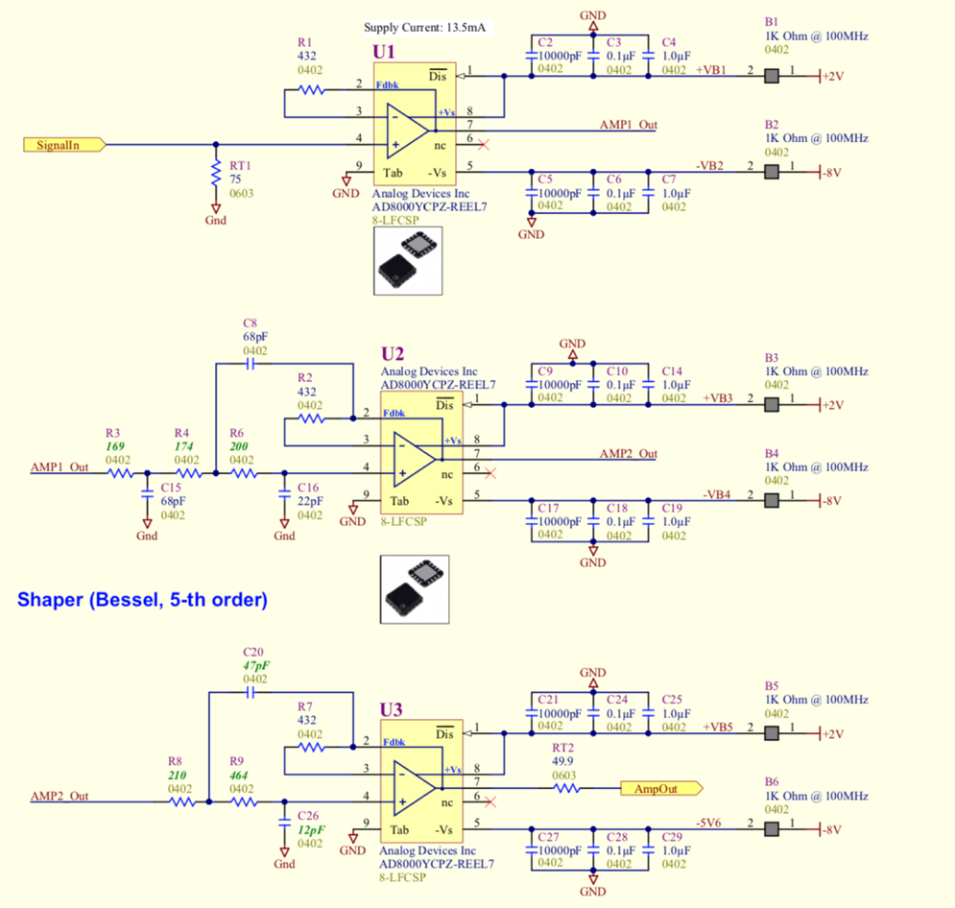
Analog Shaping Example
Stretch fast signal to match slower waveform digitizer.
  Circuit optimized for 100 MSPS system, with rise time = 15 ns or 30 ns.
Raw signal
Shaped signal

Slide 9
Electronics Overview
Signal Digitization and Triggering
Assorted Electronics Topics:
  Form factors, power, cooling, cabling, slow control
Data Acquisition Software and Frameworks
T. Lindner

Slide 10
Digitization Electronics Options
Many different options for digitizing electrical signals.
Will concentrate on two broad classes of measurement:
  Making separate measurements of the charge and time for each pulse: Q/T measurements
  Recording the full signal waveform (voltage vs time) and then analyzing the waveform.
Many possible variations on these ideas.
  Example: Measure Q/T for each channel, but measure the waveform from the sum of the signals from N channels.

Slide 11
Q/T measurement
Analog signal
Split analog signal
One signal into discriminator; gives digital pulse if analog signal goes above pre-set threshold.
  Time of digital pulse is measured with Time-to-Digital Converter (TDC)
  Digital pulse also used to generate a gate.
Other signal gets measured with slower Analog to Digital Converter
  Can be either peak-sensitive or charge-sensitive (integrating) ADC.
  ADC needs a gate
Discriminator
Gate
Generator
TDC
ADC

Slide 12
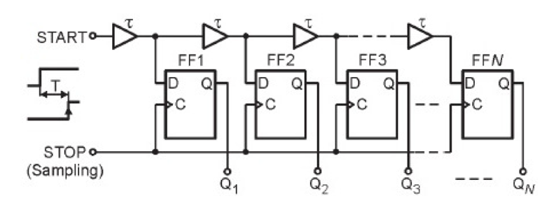
Types of TDC
Historically have used ASIC for TDCs.
  Example : CERN HP TDC, provides 100ps timestamps.
    Used in V1190 board in M11 setup.
More recently has become more common to synthesize TDC with FPGA firmware.
  Coarse time from FPGA clock.
    So 200MHz clock means 5ns coarse time tagging.
  Fine time with other technique.
    For instance, have been testing FPGA-TDC board called TRB3 (made at GSI)
    Fine time based on Tapped Delay Line
    Provides 10ps timing resolution; but requires stable temperature and frequent calibration.
Tapped Delay Line Schematic
From J. Kalisz (2003)
TRB3 FPGA-TDC (GSI)

Slide 13
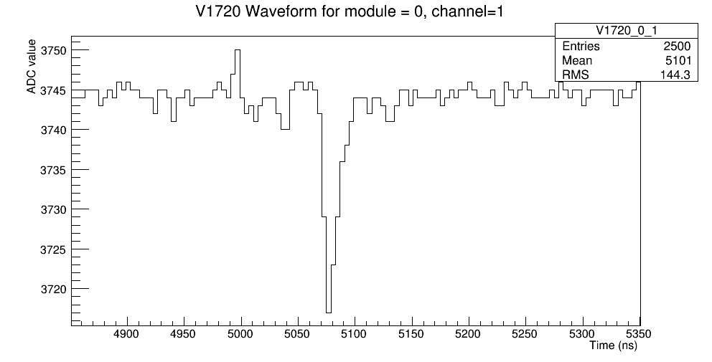
Waveform Digitization
Today, more common to use a fast
(flash) ADC to fully digitize signal
waveform.
Having full waveform gives more information on shape of pulse than Q/T measurement.
Downside to fast ADC digitization:
  Higher cost and higher power.
    Though not always…
  Higher data rate (usually)
Example waveform acquired
with 250MSPS ADC.
ADC sample each 4ns.
(digitizer used for SMD setup)

Slide 14
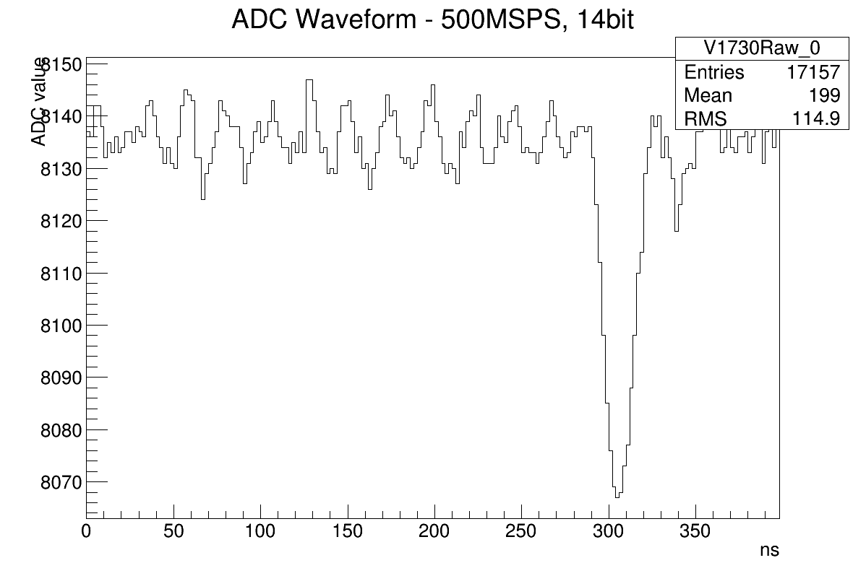
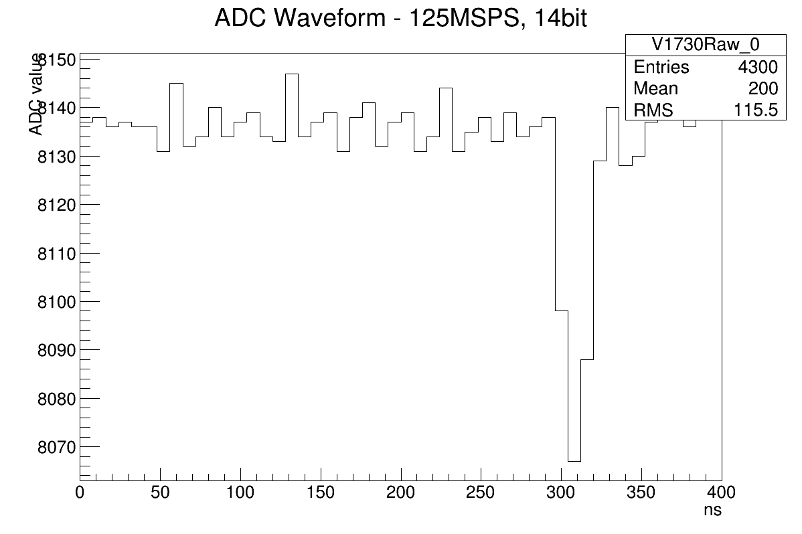
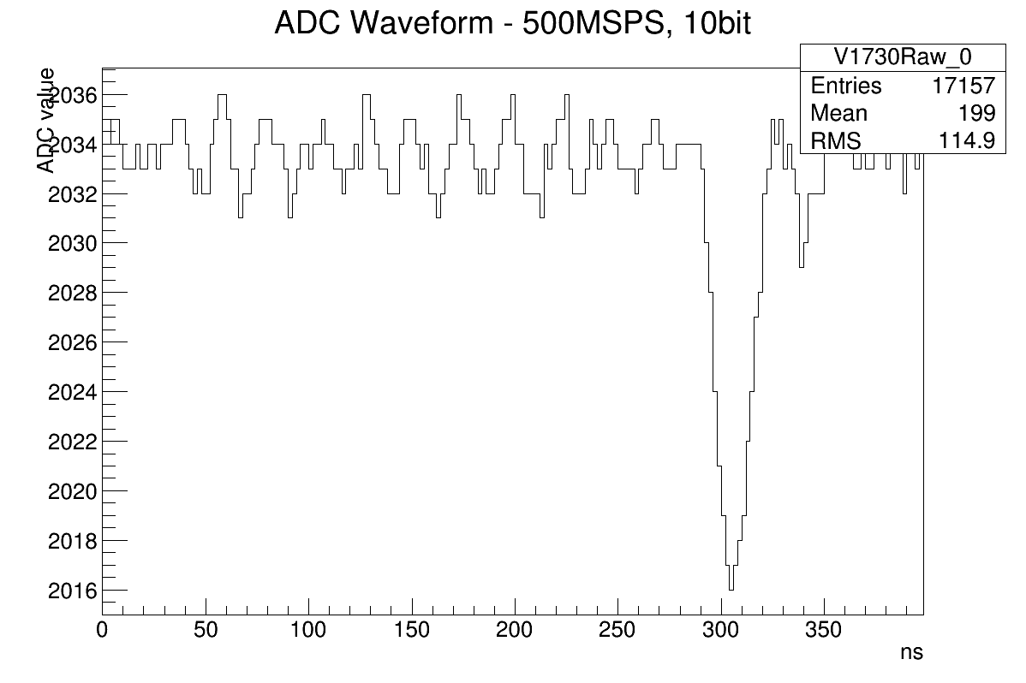
Fast ADCs
Typically using fast ADCs in range of 10MSPS – 10GSPS.
  Fast ADCs often used in RF communication devices. So manufacturers continually producing faster/cheaper/lower-power chips.
Important points to consider when choosing ADCs:
  Sampling rate: faster sampling rate means more information.
  Precision of ADC:
    Some ADCs have non-trivial intrinsic noise: this effectively degrades the precision of the ADC
    Characterize ADC with Effective Number Of Bits (ENOB).
  Higher sampling rate and higher precision
  → Higher power and higher cost

Slide 15
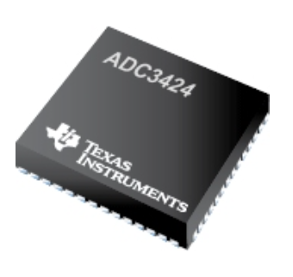
Fast ADCs
Typically using fast ADCs in range of 10MSPS – 10GSPS.
  Fast ADCs often used in RF communication devices. So manufacturers continually producing faster/cheaper/lower-power chips.
Important points to consider when choosing ADCs:
  Sampling rate: faster sampling rate means more information.
  Precision of ADC:
    Some ADCs have non-trivial intrinsic noise: this effectively degrades the precision of the ADC
    Characterize ADC with Effective Number Of Bits (ENOB).
  Higher sampling rate and higher precision
  → Higher power and higher cost
TI ADC 3424
Quad 125MSPS ADC
12 bit (11.4 ENOB)
Power 98mW per channel
~$17 USD per channel
AD ADC 9213
Single 10.25GSPS ADC
12 bit
Power 5W per channel
~$4000 USD per channel

Slide 16
Switched Capacitor Array
Switched Capacitor Arrays: array of capacitors to save waveform in analog memory.
Decouples writing analog samples (which can be done very fast) and reading analog samples (which can be done with slower ADC).
  For instance, the DRS4 ASIC can save analog samples at 5GSPS and read them out with 50MSPS ADC.
So can achieve very high sampling rates for relatively low power and cost.
  Downside is that SCAs typically have very large dead-time.
0.2-2 ns
Switched Capacitor Array
IN
Waveform
stored
FADC
~50 MHz
Clock
Shift Register
S. Ritt, TIPP, 2009

Slide 17
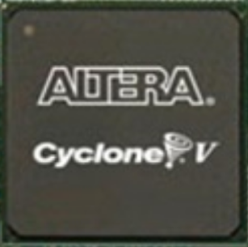
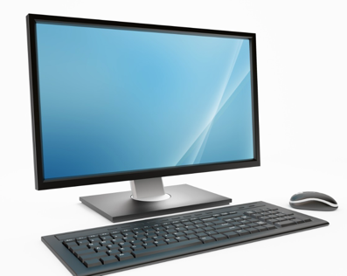
FPGA + Digital Pulse Processing
ADC samples will typically be collected by Field Programmable Gate Array (FPGA).
FPGA will readout all the ADC samples.
Options for dealing with ADC samples:
  FPGA could send all the ADC samples back to computer.
    Requires a very fast network connection.
    100MSPS 12-bit ADC produces 150MB/s.
  FPGA could wait for a global or local trigger to define which ADC samples to send.
  FPGA can do digital pulse processing (next page…)
ADC
External
trigger
FPGA
Computer

Slide 18
FPGA + Digital Pulse Processing
Raw ADC waveform
FPGA can continuously process with ADC samples to:
  Finds hits by applying digital threshold.
  Apply noise filtering technique
  Calculate hit time and charge.
  Calculate more complicated quantities from waveform.
Process FADC waveform
in FPGA on mPMT
Pulse charge/time
or ADC samples
Backend computer

Slide 19

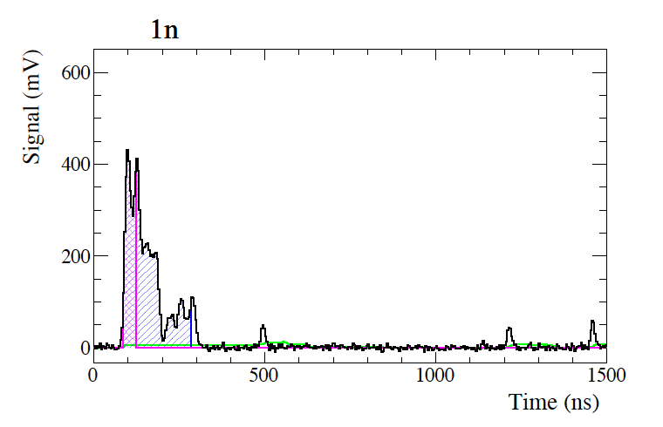
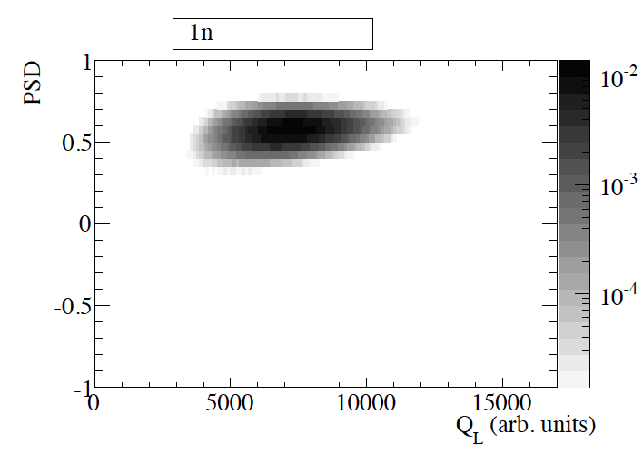
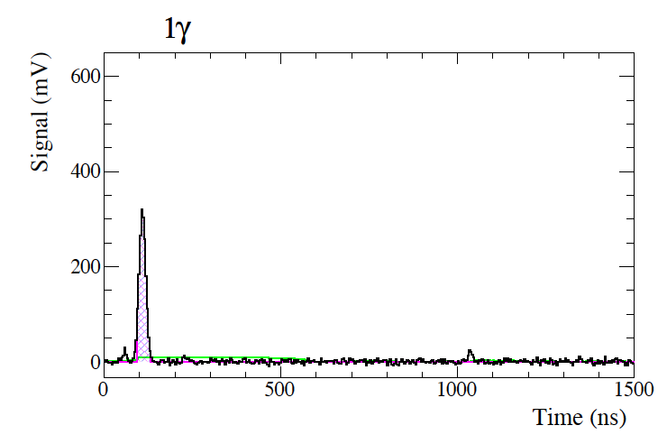
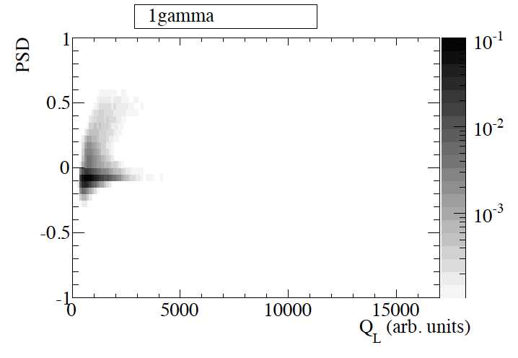
Example Digital Pulse Processing:
Pulse Shape Discrimination
For Ultra-Cold Neutron, use a Li-6 detector to detect the UCNs.
Pulse shape different for neutron and background (gammas).
Can calculate Pulse Shape Discriminant (PSD) in firmware or in offline software.
B. Jamieson,
et al. (2016)

Slide 20
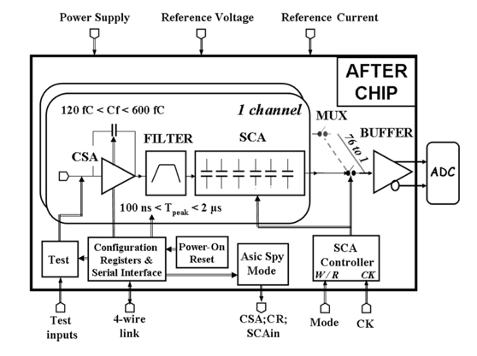
Example: ALPHA-G TPC
Padwing Board
Analog Electronics
ASIC: AFTER
switched capacitor
array
FPGA: Altera
Cyclone-V
Communication:
Fibre optic
transceiver
P. Baron et al., “AFTER, an ASIC for the Readout
of the Large T2K Time Projection Chambers,”
IEEE Trans. Nucl. Sci., vol. 55, pp. 1744–1752, 2008

Slide 21
Commercial vs Custom
For many projects, companies already have electronics that meet requirements.
  Always investigate commercial options.
  CAEN popular here, but there are others.
But in some cases may decide you need custom electronics. Reasons:
  Performance: can design electronics that match exactly your requirements
  Form factor: electronics cards often need to have particular form factors to fit on detector
  Cost: for large orders custom electronics can be cheaper.
    But custom electronics require from engineering time (expensive): initial costs can be high.
    Also, development will take longer.

Slide 22
Firmware Development
Hopefully you all learned lots about firmware and firmware development yesterday.
Though it seems similar, firmware development not as easy as software development.
  It is a real-time system and the effects of clock phase, signal delays, etc are tricky to understand.
  FPGA-TDC is only possible because of delay effects.
Firmware development can be done by grad students and post-docs (very effectively!); but electronics engineers often do this work.
Sometimes, engineering time for firmware development can often exceed engineering time for hardware development.
  Partly because firmware is never finished; one can always think of new ways to make it better; new trigger modes, new pulse filtering techniques (like software development).

Slide 23
Advantages of ASICs
We often use ASICs ( Application Specific Integrated Circuits):
  Typically this means a chip designed by physics laboratory or university group for a specific detector purpose.
ASIC will typically integrate a circuit of analog and/or digital electronics on a single chip, with following advantages:
  Lower power.
  Smaller size (compared to circuit of discrete components)
  Better radiation hardness.
  Lower unit cost (but see next bullet).
First HEP ASIC developed for silicon strip detectors in 1980s.
Both ATLAS and CMS each have ~40 ASIC designs in detector.
G. De Geronimo (BNL) et al.
https://arxiv.org/abs/1307.3241

Slide 24
ASIC Development
But there are substantial challenges in developing ASICs.
Very large up-front cost for ASIC development.
  Typically need several specialized electronics engineers for several years to develop new ASIC (depending on complexity).
  Then a fixed cost of ~$0.3M-$1M to make the photomask for the ASIC foundry (again depending on complexity).
  After that, the cost for each ASIC after that is relatively cheap.
So ASIC development usually only makes sense when you need many chips (~100-1000s of chips) or you have requirements that cannot be met with conventional electronics.

Slide 25
Triggering
Many (most?) experiments initiate the readout of part of the electronics using a global trigger.
Several reasons to use global trigger:
  Reduce rate of background events (reduce overall data rate).
    Triggering is a critical/challenging part of LHC experiments.
  Individual digitizers can’t self-trigger.
  Characterize channels that don’t seem to have hits.
Developing clear global triggers and calibrating them is often a crucial part of understanding detector.
  Easy to devise biased triggers that might hide your physics signal.
  Also important to accurately measure your dead-time.
In some cases don’t need global trigger.
  Individual channels or individual boards can self trigger on hits.
  Then dead-time only occurs at the channel or board level.
  SMD is example.

Slide 26
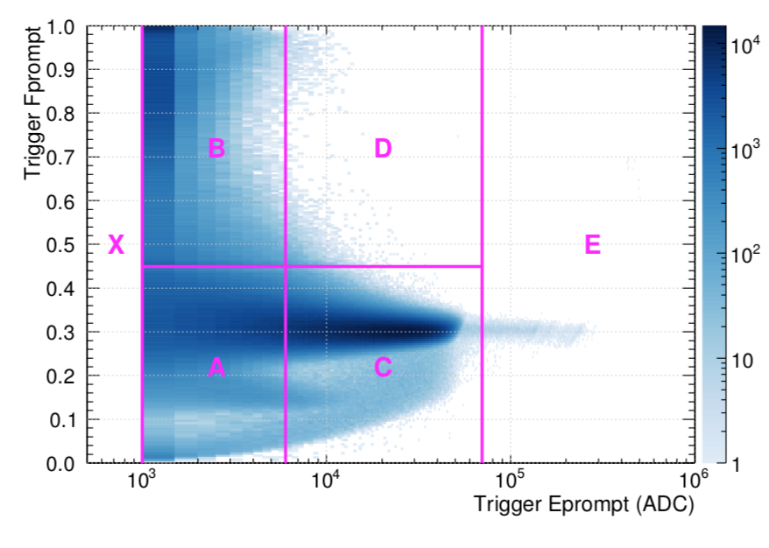
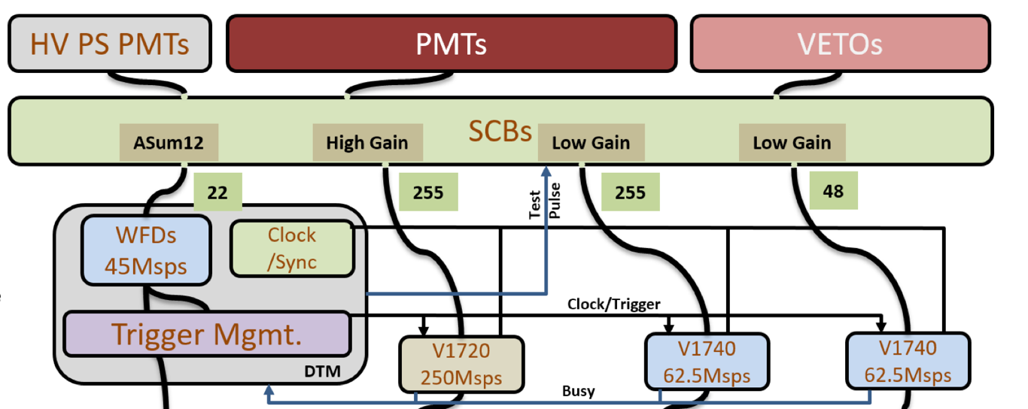
DEAP Triggering
DEAP-3600: 255 PMTs looking at LAr sphere.
  Large background of 39Ar decays.
Signals from groups of 12 PMTs are summed and
digitized by DTM (DEAP Trigger Module.
DTM calculates event energy and pulse shape discriminant in real time and decides when to trigger digitizers.
  most 39Ar events are pre-scaled and do not trigger the digitizers.
DEAP collaboration, 2018
https://arxiv.org/abs/1712.01982
DEAP Trigger Module
Custom VME card

Slide 27
Electronics Overview
Signal Digitization and Triggering
Assorted Electronics Topics:
  Form factors, power, cooling, cabling, slow control
Data Acquisition Software and Frameworks
T. Lindner

Slide 28
Types of Digital Signal
Different ways of encoding a digital signal:
NIM digital signal:
  Single-ended signal (one cable has voltage carrying signal; other cable is ground).
  Logical high: -0.8V, logical low: 0V.
  Not common outside physics!
TTL digital signal:
  Single-ended signal
  Logical high: 2.4-5.0V, logical low: 0-0.8V.
LVDS digital signal:
  Differential signal (signal is carried on both
  wires of pair).
  Low-voltage, less sensitive to noise.
  Typically used for digital signals on
  circuit board.
wikipedia

Slide 29
Clocks and Synchronization
Electronics cards need a clock to run their FPGA and ADCs.
Cards will typically include their own clock chip; but these chips are not very accurate; clock frequencies will vary significantly over time.
So typically need a system to distribute a single master clock (over either optical or copper cable) to all the other cards.
Typical clock frequencies: 10MHz-200MHz.

Slide 30
Electronics Card Form Factors
Providing cooling and power to cards is important (more on that later).
When possible, it is helpful to use standard crates for mounting electronics. Benefits:
  No engineering needed to design electronics mounting
  Crates built at commercial scale: cheaper cost and higher reliability (hopefully!).
  Easier to replace crates or power supply when something breaks.

Slide 31
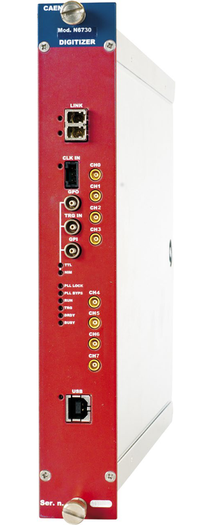
NIM Crates
NIM standard for crates and modules (defined in 1969); NIM crate provides set of standard voltages on backplane.
Typical uses of NIM modules:
  Amplifying analog signal.
  Splitting analog/digital signals.
  Discriminating analog signals to make digital signal.
  Create gates and digital ANDs from multiple signals.
NIM modules allow very quick, cheap & flexible system for handling analog signals and making triggers.
Most physics labs and departments have a lot of old NIM crates and modules. Companies still make new electronics in NIM form factor.

Slide 32
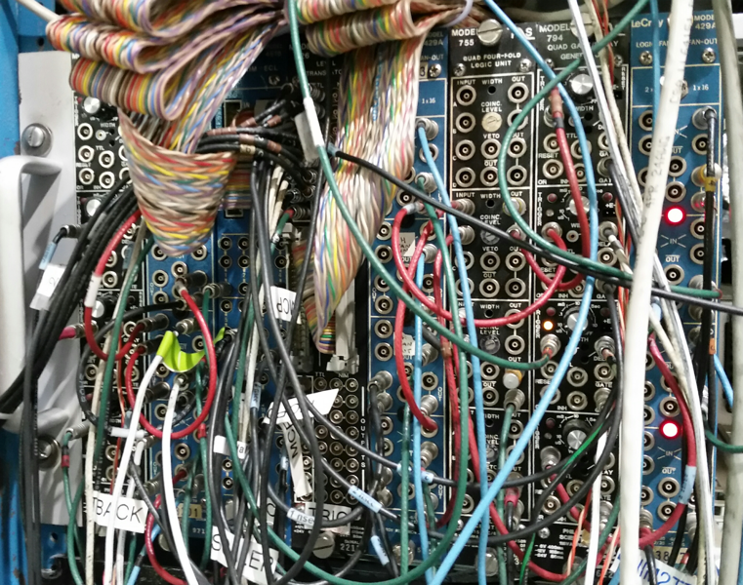
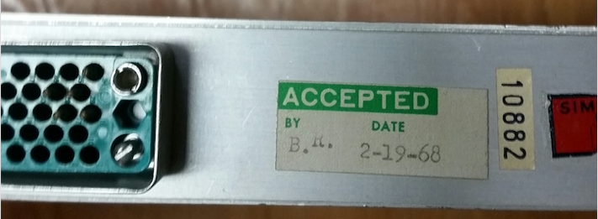
Working with NIM electronics
Can be very hard to interpret the logic of a NIM setup, even if you did the setup yourself.
  Label your cables and write a schematic!
Most NIM modules are very old.
  You must assume that every module, cable and connector is broken.
  You must check each output with a scope as you implement your NIM setup.
Labelling and
writing diagram
are important!
Old!

Slide 33
VME Crates
VME is newer form factor for electronics cards (standard set in 1981).
  Heavily used in military applications.
VME backplane provides communication, as well as power and cooling.
  When using backplane for communication have one master module and many slave modules.
  Master module is often a scaled down PC; we typically run Linux on these PCs.
  Master module will interrogate
  slave modules, checking for data
  to readout.
Recently our VME cards omit the
VME communication bus and
have a separate optical or copper
communication.
TRIUMF designed cards in
VME crate

Slide 34
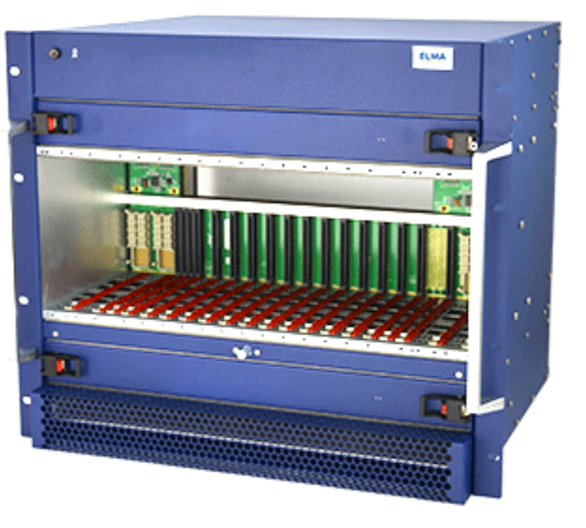
Other Standard Form Factors
CAMAC
Standard set in 1972.
Like VME, the backplane includes a communication path.
Like NIM, many CAMAC crates around labs and departments.
But mostly replaced by VME crates for newer small experiments.
PCIe
For backend: integration with computers easy.
Ie FELIX PCIe card for ATLAS.
uTCA
Standard set in 2006; grew out of telecom market.
  Currently market as large as VME,
  but seems to be growing faster.
More compact, denser than VME.
Faster communication links and higher reliability.
Option for future HEP crate standard.

Slide 35
Custom Form Factors
Often/usually need to build electronics in a custom form factor, usually mounted on detector. Why?
  Signal quality: many detectors produce very small signals; need amplification, shaping close to detector for best performance.
  Cabling: Highly segmented detector have lots of channels; don’t want to run 10,000 cables out of detector.
  Cost: Standard VME crates are expensive, so don’t want to buy a VME crate to power a single card.
One common solution is to have custom form factor analog electronics on the detector and digitizing electronics in a standard crate.

Slide 36
Example: M11 NIM/VME readout
NIM crate for splitting PMT signals and generating trigger/gate.
VME crate for ADC (CAEN V792) and TDC (CAEN V1190) modules.
Question: why these electronics?
Answer:
  Sufficient performance.
  Cheap and easy to setup! ~2 day of work for electronics.

Slide 37
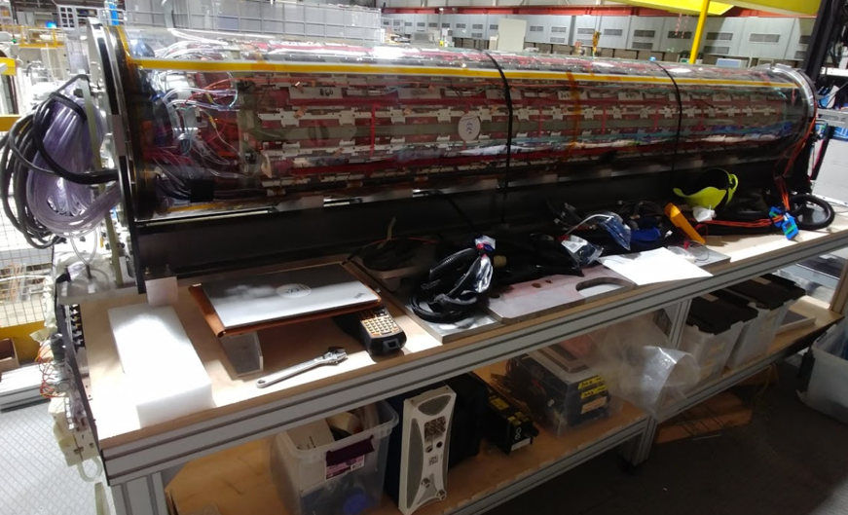
Example Revisited: ALPHA-G TPC
Padwing Board
Question: why these electronics?
Answer:
  TPC pad signals small; electronics need to be right on detector:
  → custom electronics, custom form factor.
  Very limited space inside ALPHA-G magnet.
  → custom form factor.
  Many channels to readout, need to reduce cost, power, space
  → use AFTER ASIC chip

Slide 38
Power
Frontend
Electronics
Typical electronics need <=5V.
  Detector may need higher voltage.
If you provide low voltage directly, then need to worry about resistive losses in cable.
Cables also have a maximum current rating.
Because of cable losses, common to provide a higher voltage and then convert to lower voltage on board.
  48V is popular, because >=50V is limit after which wiring must be done by electrician.
Assume 100W of power
for frontend cards:
20A of current
Using 10AWG cable:
3mΩ/m
0.06Ω cable resistance
1.2V voltage drop
So need to provide
6.2V at supply
Assume 100W of power
for frontend cards:
20A of current
Using 14AWG cable:
8mΩ/m
0.16Ω cable resistance
3.2V voltage drop
So need to provide
8.2V at supply
10m of cable
Power
Supply

Slide 39
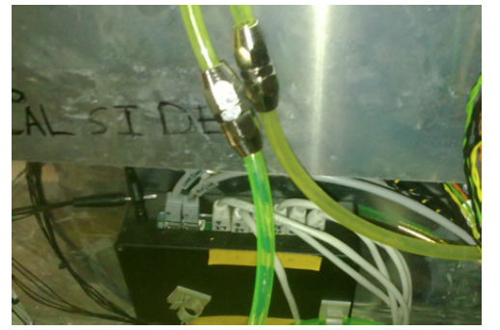
Electronics Cooling
All that electronics power needs to go somewhere;
cooling electronics is usually essential!
Need careful consideration and design of cooling system
  Cooling issues is one of the more common problems seen during commissioning of a detector.
Partly because it is difficult to test the actual performance of the cooling system until the final electronics and detector are in place.
  Coupling between the electronics cards and the cooling elements can be non-trivial to simulate.
Also because water cooling system involve
mechanical pumps and water pressure:
problems tend to develop with time.
  Similarly, air fans also common failure point
Important to monitor cooling system
and interlock on failures.
ND280 faulty water tubing

Slide 40
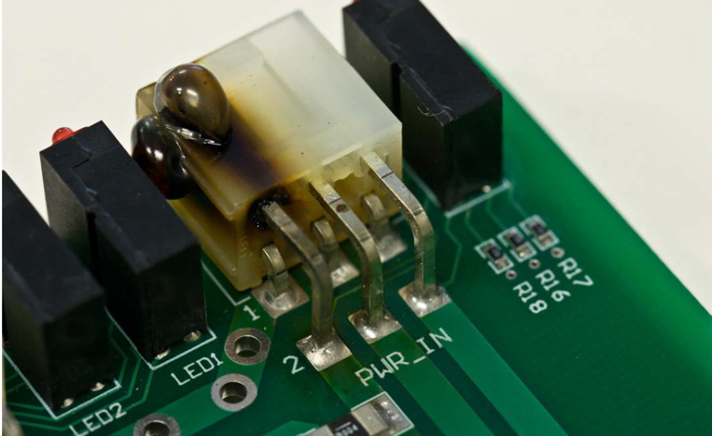
Connectors and Detector Design
Good connectors provide good electrical connections as well as good retention properties.
Connectors (and cabling in general) requires interaction between electronics engineers and people doing mechanical design of detector.
  Need to ensure that there is actually space to insert/remove connectors.
  Good mechanical designer think a lot about how to put together a detector.
Having bad connectors can cause lots of problems:
  Spend several months debugging problems related to having wrong connectors on clock cables. Small vibrations would cause loss of clock synchronization.
  Power connectors need to be rated
  to the appropriate current!

Slide 41
Cable Management
If you have more than 1 cable, need to think about cable management; always harder than you think.
Organize cables logically; use cable trays.
Get a good label maker! There are special label makers that work well for cables.

Slide 42
Electronics Overview
Signal Digitization and Triggering
Assorted Electronics Topics:
  Form factors, power, cooling, cabling, slow control
Data Acquisition Software and Frameworks
T. Lindner

Slide 43
Data Acquisition Framework
Data Acquisition (my definition): software that
  Configures electronics for data taking.
  Receives data packets from electronics cards, builds events and writes data to disk.
  Optionally suppresses uninteresting data.
  Provide a clear way for shift takers to monitor data taking and react to problems.
Other definitions of DAQ possible
  Is firmware part of DAQ or electronics?
  Some say DAQ = whole chain of electronics+firmware+software
Large experiments typically develop a custom DAQ framework.
For smaller experiments there are DAQ frameworks (subatomtic physics specific or otherwise).
  Usually developed by national labs.

Slide 44
MIDAS DAQ Framework
Development started in 1993.
Developed by Stefan Ritt (PSI) and Pierre Amaudruz (TRIUMF).
Used for most experiments at TRIUMF.
Core code in C, with newer parts written in C++.
Mostly used on Linux, though works on MacOS and Windows (in principle).
Recent experiments using MIDAS:
  TRIUMF: GRIFFIN, UCN
  PSI: MEG
  SNOLAB: DEAP-3600, Super-CDMS
  J-PARC: T2K-ND280
  CERN: ALPHA, ALPHA-G
  FNAL: G-2

Slide 45
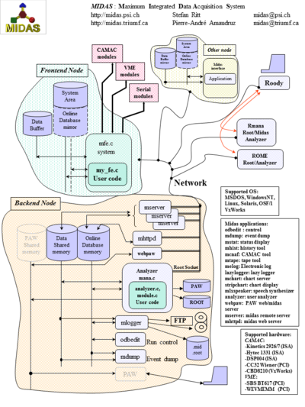
MIDAS Components
Frontends: programs that configure and receive data from equipment (often over network connections).
Event builder: put together event fragments.
  Event building can be trivial or complicated based on experiment triggering scheme.
Logger: logging data to disk in custom MIDAS format.
Online Database (ODB): custom database for all DAQ configuration.
History: system for providing easy environmental monitoring displays.

Slide 46
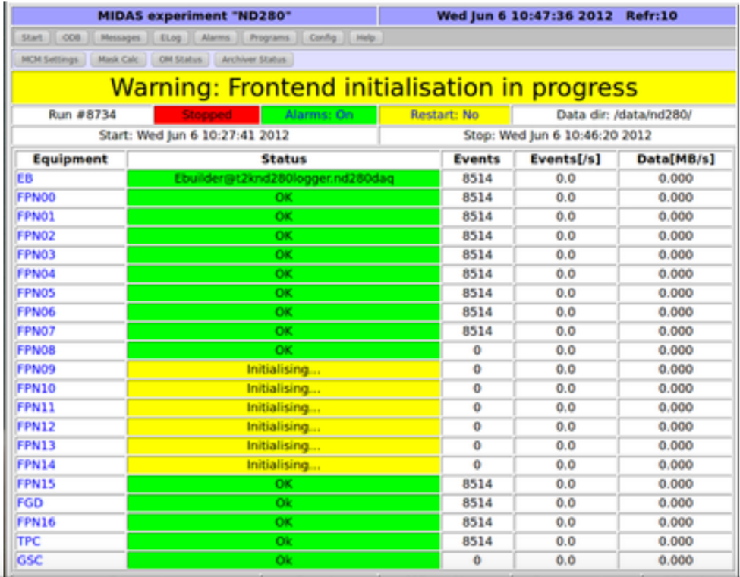
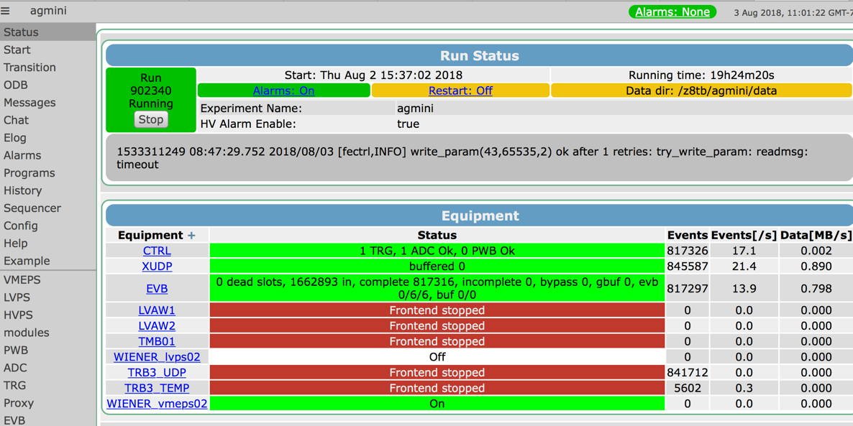
MIDAS web interfaces
Most user interactions with MIDAS can be done through webpage.
  Configure hardware, start runs, check history and alarms.
Have improved MIDAS over last couple years to provide more modern web interface, based on JSON-RPC standard.
New MIDAS page
Old MIDAS page

Slide 47
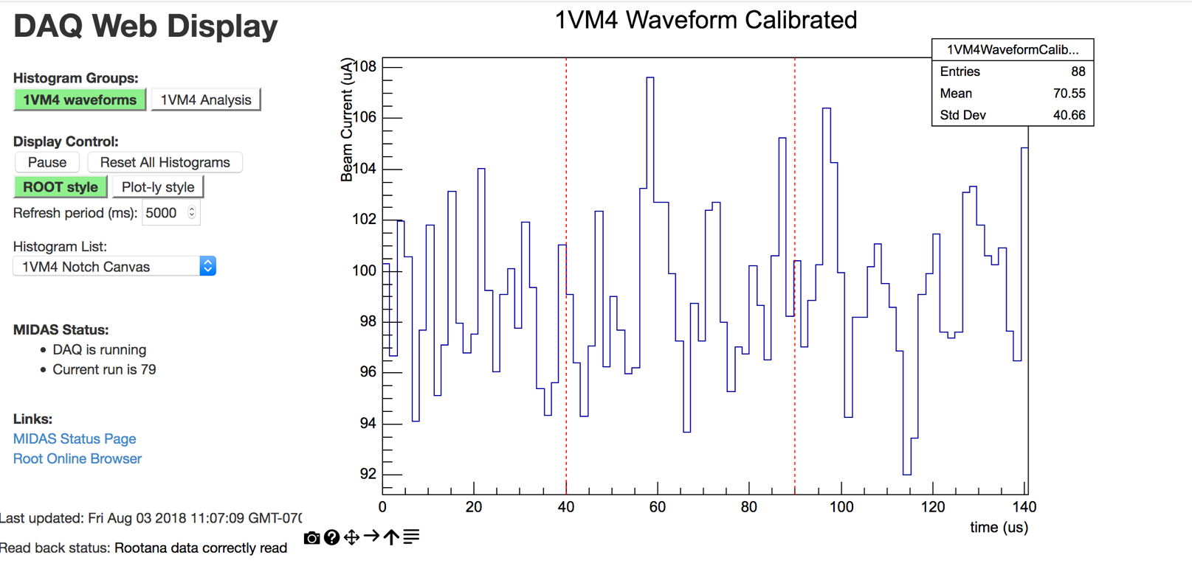
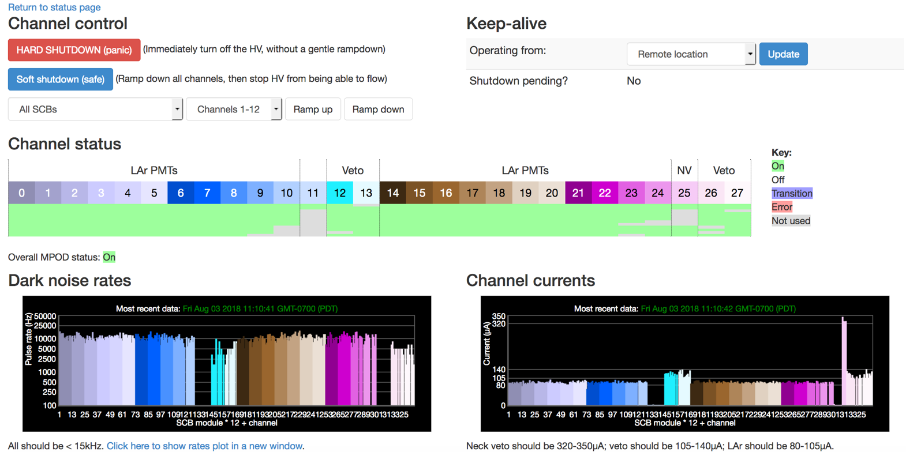
MIDAS Web Interfaces
Larger experiments typically develop custom MIDAS webpages.
New JSROOT libraries provide easy way of embed ROOT-style plots.
UCN Kicker
Magnet Display
DEAP HV Control

Slide 48
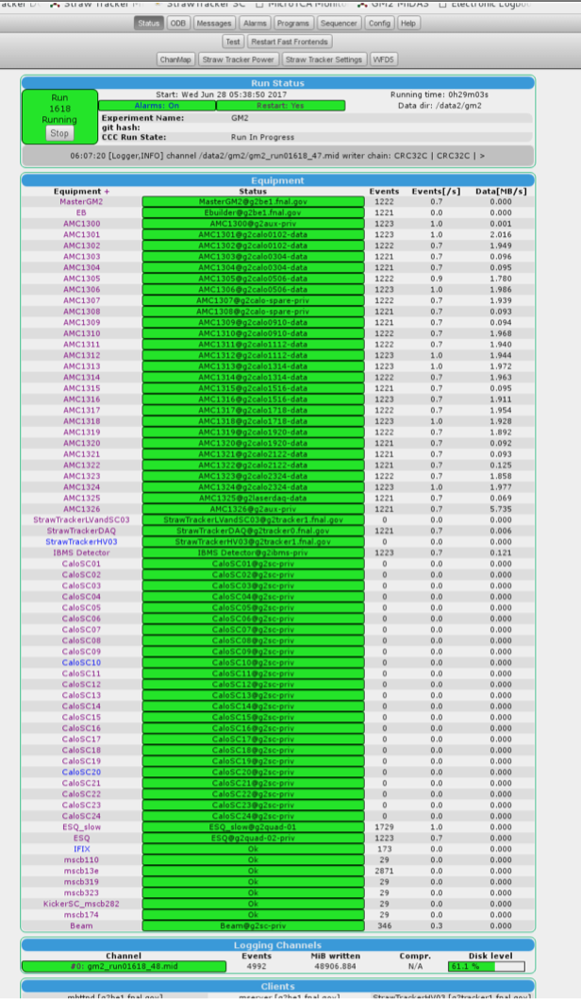
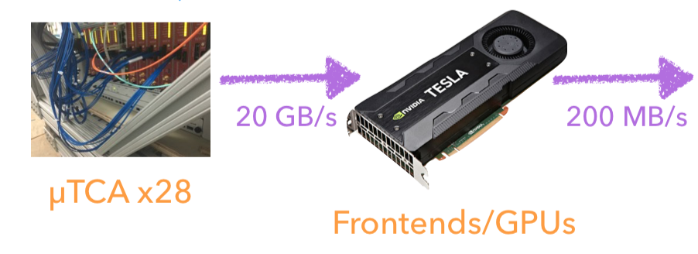
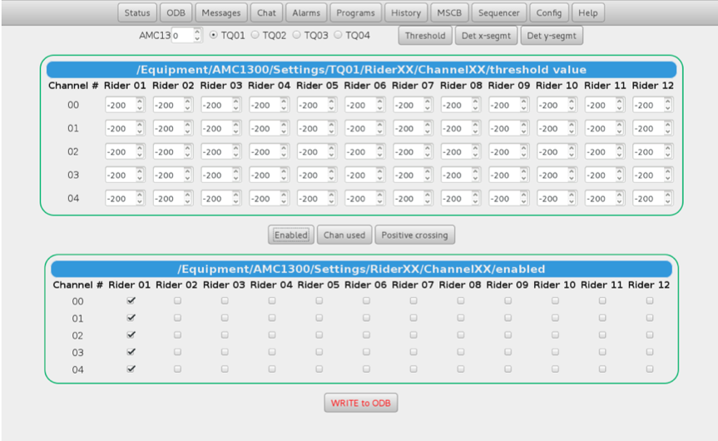
Example MIDAS DAQ: FNAL G-2
800MSPS ADC for 1296 channels.
ADC in uTCA crate
All data readout to computers; raw data rate of 20GB/s (time-averaged)
Reduce data rate with waveform processing with GPUs
MIDAS DAQ, custom webpages.

Slide 49
Other DAQ Frameworks
There are other DAQ options of course...
Labview: works well for many small setups
  Labview drivers provided for many commercial devices.
  Getting generic device drivers for linux can be tricky.
ORCA: developed by group at University of North Carolina
  Runs on MacOS
  Experiments: KATRIN, MAJORANA, SNO+
Artdaq: developed by FNAL
  Based on art offline analysis framework (originally from CMS)
  Experiments: LARiAT, Darkside-50, Mu2E
And many others I don’t know…

Slide 50
Conclusion
Many different options for digitization.
Typically look at custom electronics when dealing with lots of channels or very specific requirements.
Electronics infrastructure issues are important to consider from early in design.
Lots of DAQ frameworks to chose from, but I recommend MIDAS!

Slide 51
Backup

Slide 52
FPGA, SoC, microcontrollers

Slide 53
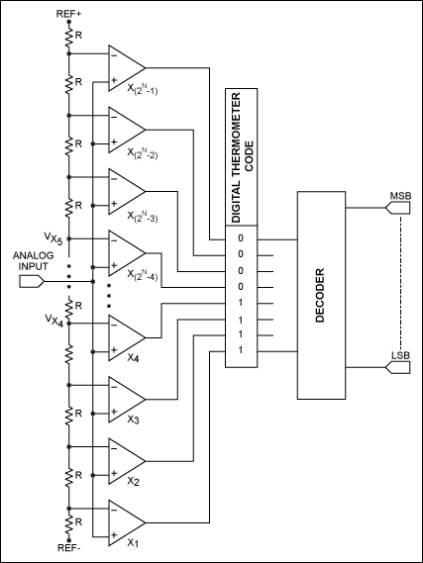
Flash ADC
Flash ADC: made by a set of high-speed comparators.
Measurement gets made by all comparators simultaneously.
Alternative: Successive approximation or pipeline ADC: use less comparators, at cost of taking a longer time to make the measurement.
Need 2^N -1 comparators
for a N-bit FADC.
Maxim Integrated Website

Slide 54
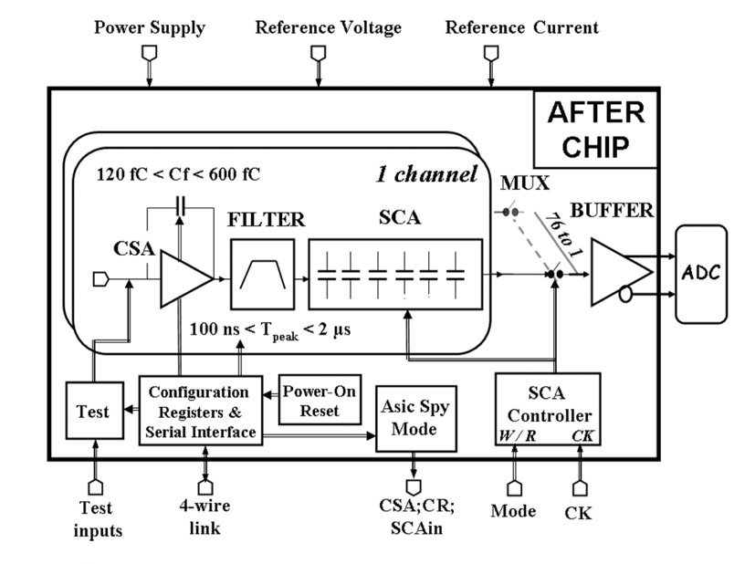
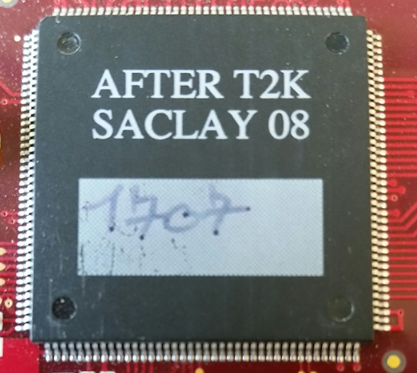
ASIC Example: AFTER ASIC
AFTER: Readout chip developed for T2K Time Projection Chamber (TPC).
  Developed at Saclay
Chip includes analog shaping electronics and Switched Capacitor Array (SCA) waveform digitization.
  Maximum sampling rate: 50MSPS.
SCA buffers are readout by a separate ADC.
P. Baron et al., “AFTER, an ASIC for the Readout
of the Large T2K Time Projection Chambers,”
IEEE Trans. Nucl. Sci., vol. 55, pp. 1744–1752, 2008
Notes:
Consider dropping this slide???

Slide 55
Example: Analog Pulse Shape Discrimination
Similar neutron/gamma discrimination can also be done with analog electronics and integrating ADC.
But the digital discrimination is more flexible.
Input signal
Fan-out
Discriminator
100ns Gate
Generator
800ns Gate
Generator
Charge-Sensitive
ADC (Short)
Charge-Sensitive
ADC (Short)

Slide 56
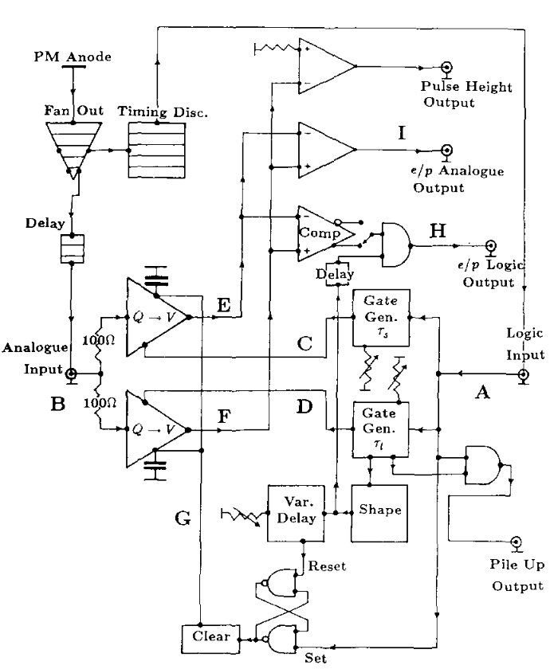
Analog PSD output
Analog online measurement of n/gamma pulse shape discrimination.
Annand 1987

Slide 57
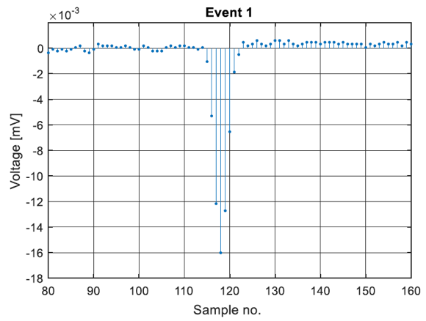
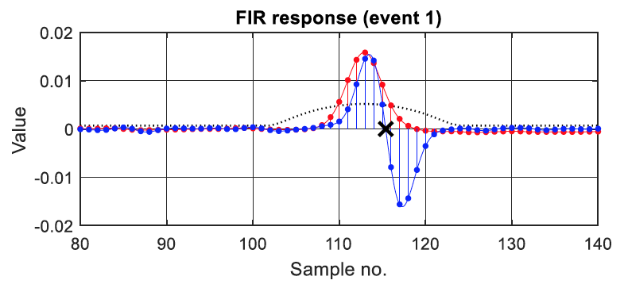
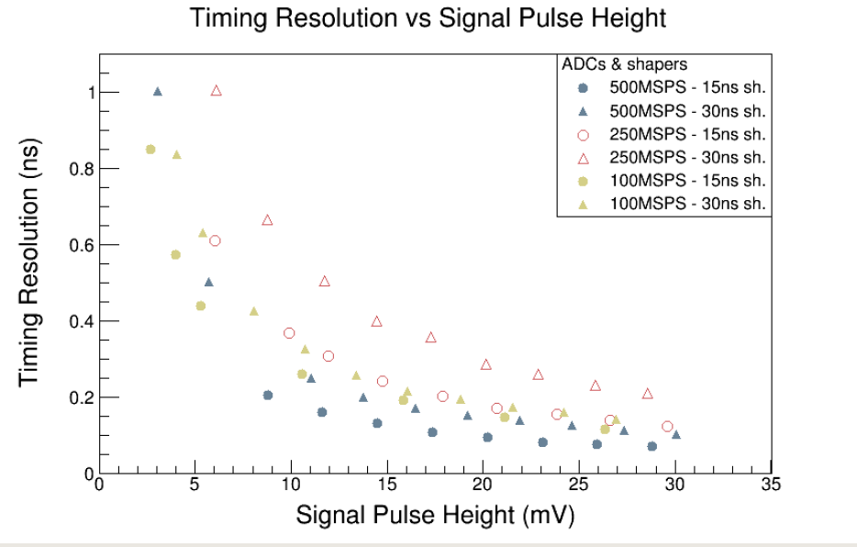
Example Digital Pulse Processing 1:
Extracting Hit Time
Can extract hit time with sub-sample precision using FPGA.
For example, Constant Fraction Discriminator or Finite Impulse Response (FIR) can be implemented in FPGA.
Find that FIR filtering gives timing resolution that is slightly worse than by fitting pulses
Timing resolution for different
digitizer speeds

Slide 58
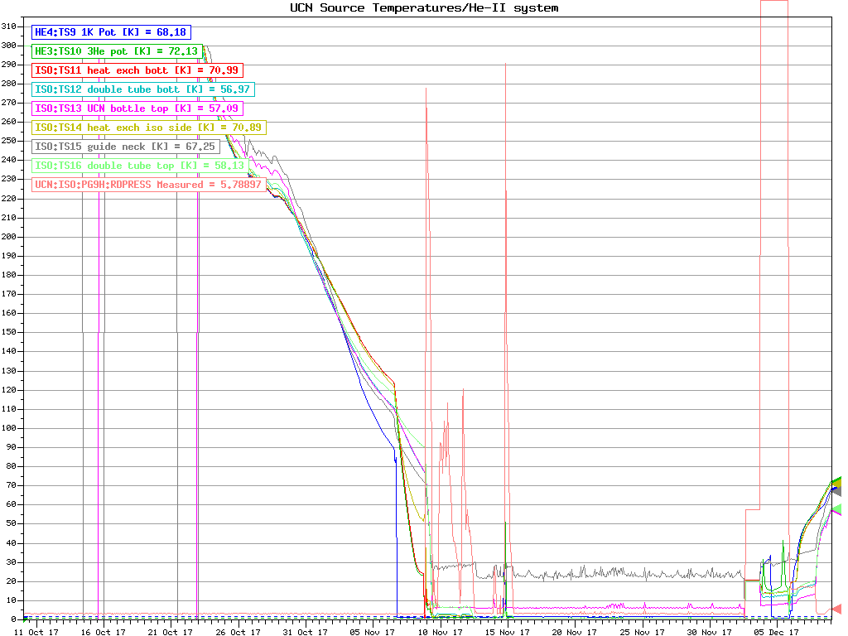
Environmental Monitoring
(aka Slow Control)
Environmental monitoring:
  measurements of temperature, humidity, voltage, pressure, etc
  not triggered as part of main readout
  Usually measurements at slower rate: second to minute timescale.
Environmental monitoring usually doesn’t push the boundaries of electronics.
  Thought there is certainly cases (cryogenics) where the temperature measurements are tricky.
Challenge with environmental
monitoring is more how to
store and present the data
so that shift takers can ensure
high quality data taking.

Slide 59
Data Transport

