Slide 1

An Introduction to Photo-sensors for Scintillation Detectors
Chuck Melcher
Graduate Student Instrumentation and Detector School (GRIDS) 2018
TRIUMF
Vancouver, BC
August 6-17, 2018

Slide 2
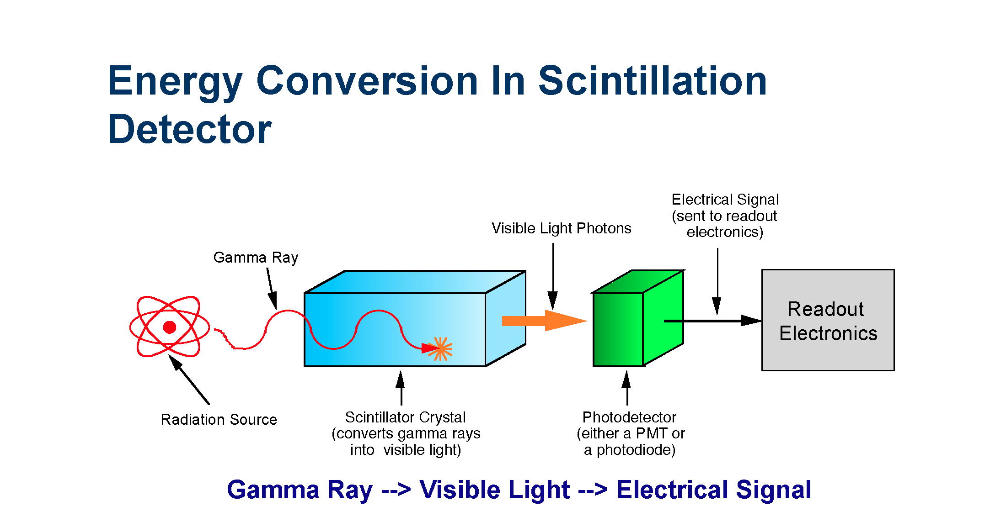
Basic scintillator – photosensor configuration
from Choong, et al. (2013)

Slide 3
Photon transport
How to efficiently move photons from the scintillator to the photodetector?
  Minimize self absorption in the scintillator itself
  Minimize absorption in windows
  Reflect or guide photons that were initially going in the “wrong” direction (internal and external reflection)
  Minimize index of refraction mismatches
  Light guides for remote photodetectors
reflector
scintillator
PMT
Scintillator
window
PMT window
Optical cement

Slide 4
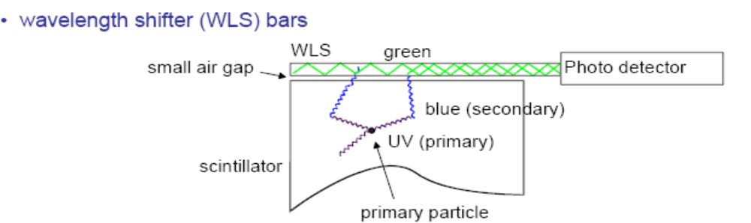
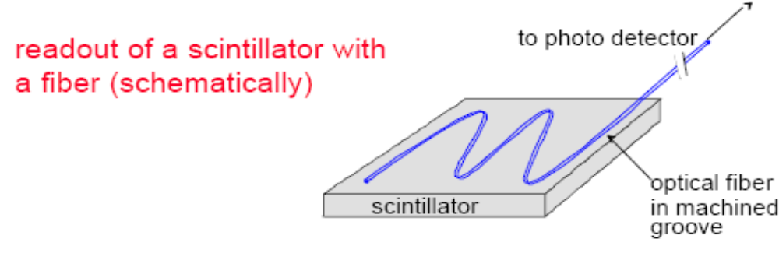
Wavelength Shifters
  Wavelength shifting bars
  Wavelength shifting fibers

Slide 5
Desirable properties of a photodetector
High sensitivity (QE, PDE)
Spectral sensitivity matches scintillator emission
High gain, low noise; i.e. large signal-to-noise
Small size
Low cost
Insensitive to temperature fluctuations
Low power requirement
Low voltage requirement
Minimally distorts the scintillation light pulse

Slide 6
Types of photo-sensors
Vacuum tubes (“photomultiplier tubes”)
Silicon devices
  Photodiode
  Avalanche photodiode
  Charge coupled device (CCD)
  SiPM (silicon photomultiplier) aka MPPC (multi-pixel photon counter)
Photosensitive gas (e.g., TMAE – tetrakis dimethylamino ethylene) - used with BaF₂ scintillator

Slide 7
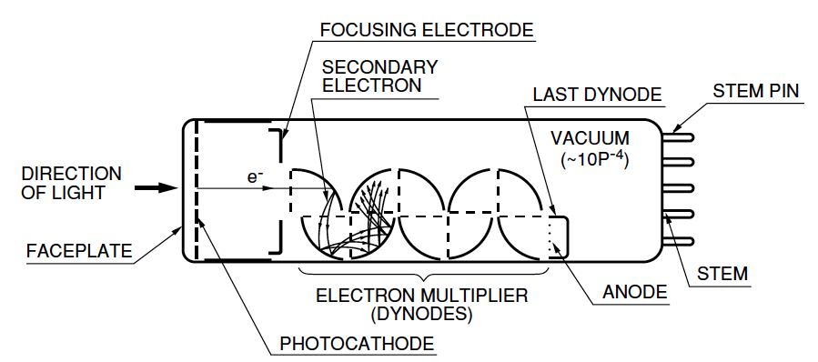
Construction of a photomultiplier tube
A metal structure inside of a glass (usually) vacuum tube

Slide 8
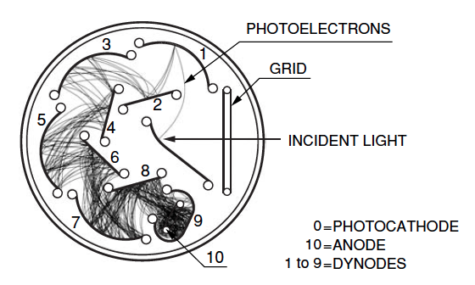
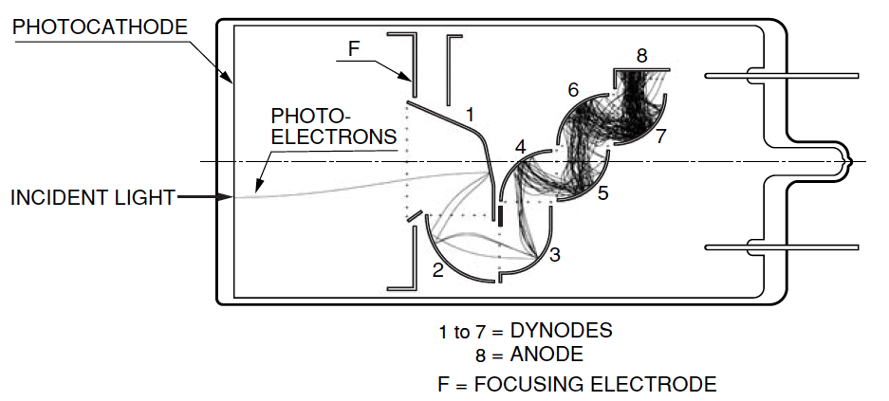
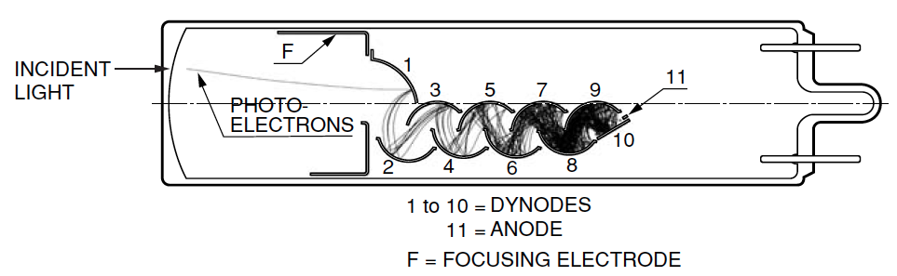
Various photomultiplier geometries

Slide 9
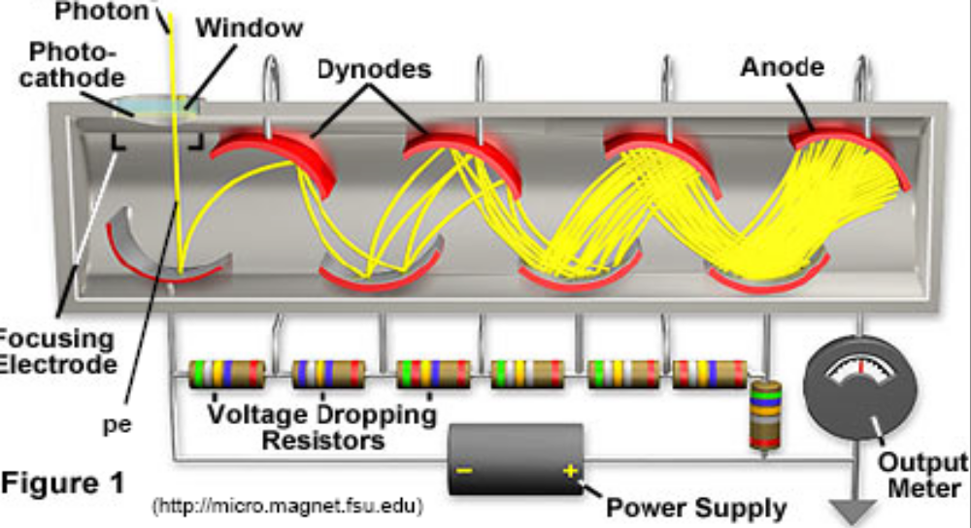
Dynode Structure
The dynode structure multiplies the number of electrons
  Process is similar to photocathodes but here the incident radiation is electrons

Slide 10
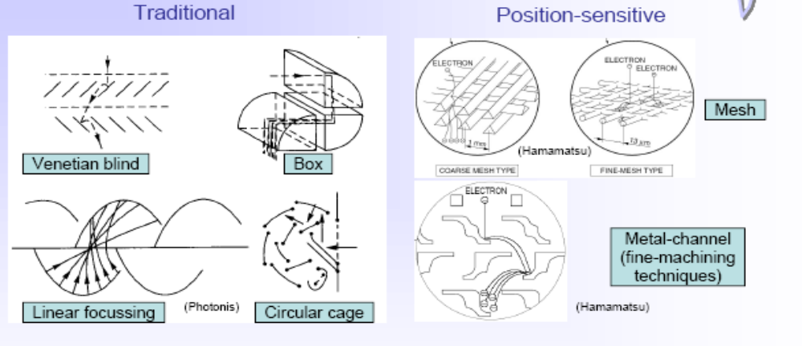
Dynode Structure
There are a variety of dynode structures including some that are position sensitive

Slide 11
Detection steps
Scintillation photons are created
Photons are ‘guided’ to the PMT
Photons pass through optical coupling compound and the PMT window
Photocathode absorbs photons and emits electrons
Electrons are focused onto first dynode
Subsequent dynodes multiple the charge
Electrical signal is created at the anode

Slide 12
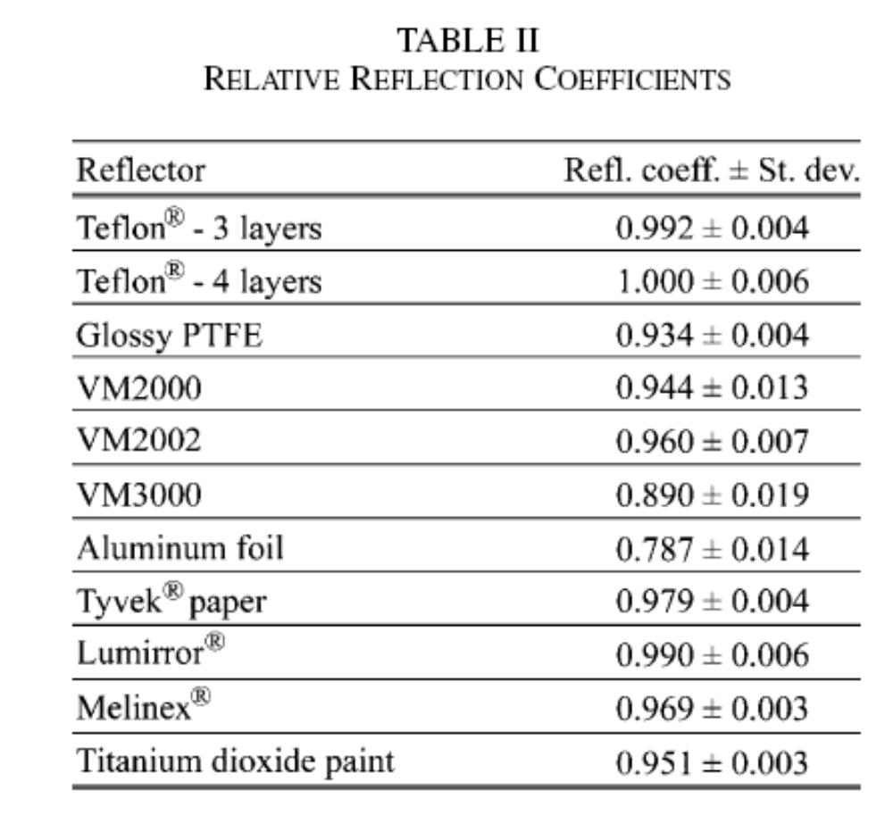
External reflectors
Diffuse or specular reflectors are often used

Slide 13
Window materials
MgF₂ (> 115 nm)
Sapphire: Al₂O₃ (> 150 nm; very rugged and hard)
Synthetic silica (>160 nm; cannot seal to Kovar)
UV glass (>185m)
Borosilicate glass (>300 nm; easy to seal to Kovar)

Slide 14
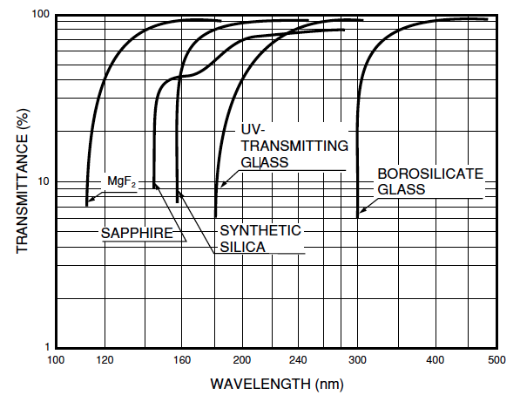
Transmittance of window materials

Slide 15
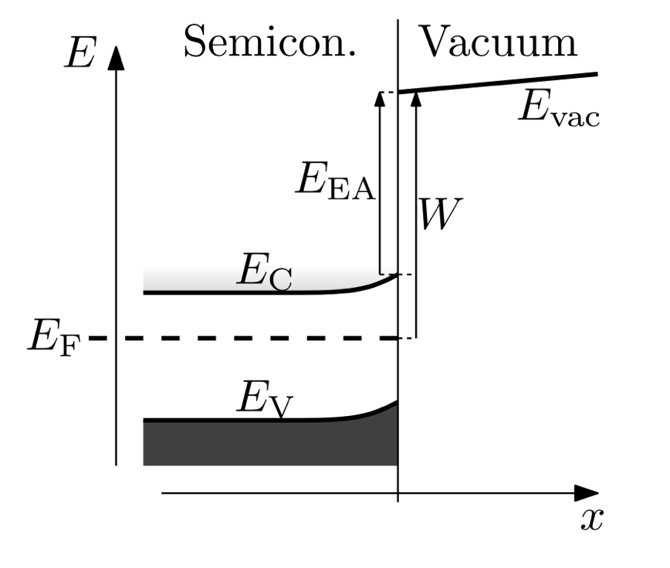
Photocathodes
The important process in the photocathode is the photoelectric effect
  Photons are absorbed and impart energy to electrons, E = hc/λ
  Electrons diffuse through the material losing energy to phonons
  Electrons reaching the surface with sufficient energy (> W) will escape
Note: the probability of electron emission decreases as wavelength decreases (not enough energy), thus limiting the long wavelength sensitivity of the photocathode.

Slide 16
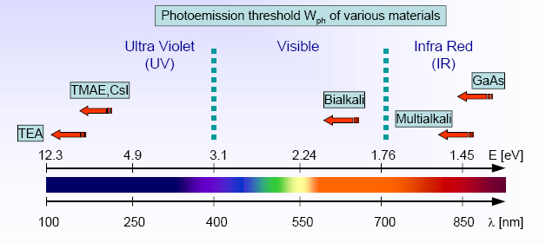
Spectral response is related to the work function

Slide 17
Photocathode materials
Cs-I (solar blind; sensitive below 200 nm)
Cs-Te (sensitive below 300 nm)
Sb-Cs (UV – visible)
Bialkali: Sb-Rb-Cs, Sb-K-Cs (good match to NaI:Tl)
Sb-Na-K (high temperature applications)
Multi-alkali: Sb-Na-K-Cs (wide spectral range)
Ag-O-Cs (visible to NIR)
GaAsP (Cs) (high sensitivity in visible, not UV)
GaAs (Cs) (nearly flat response from UV to NIR)
InGaAs (Cs) (good NIR response)

Slide 18
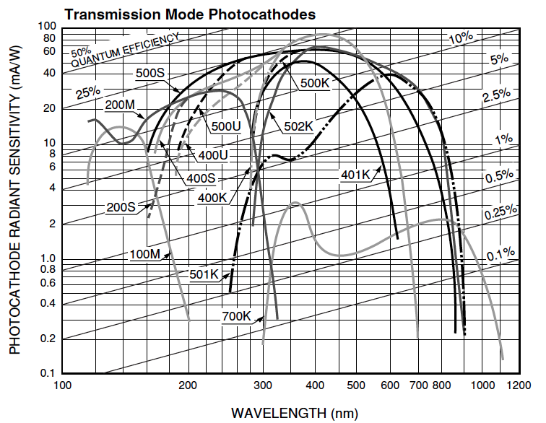
Spectral sensitivity

Slide 19
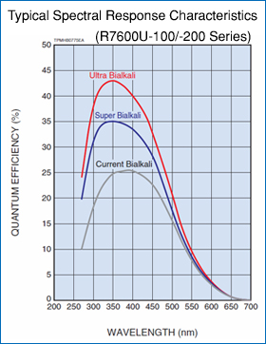
Advanced bialkali photocathodes

Slide 20
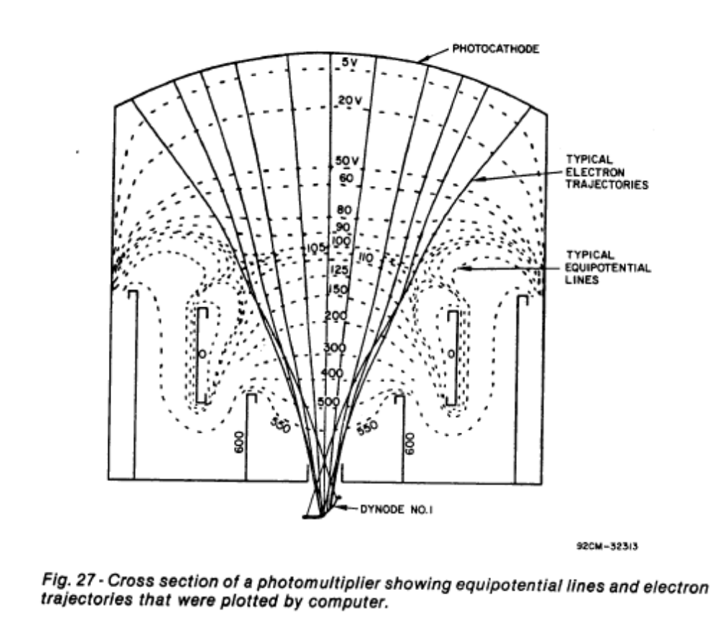
Electron Focusing

Slide 21
Magnetic Shielding
DV between the dynodes is ~100-200V
Low energy electrons traveling from dynode to dynode can be affected by small magnetic fields (e.g. earth B ~ 0.5 G)
  Effect is largest for head-on type PMT’s when the magnetic field is perpendicular to the tube axis
A magnetic shield (e.g. mu-metal) is used to reduce gain changes from magnetic fields

Slide 22
PMT Base
The HV supply must be capable of providing a DC current (to the divider network) as well as average and peak signal currents
  Typical signal current ~ 20 mA
  Typical average current ~ 20 mA
It is possible that at high rates that the HV supply cannot provide enough current to the last dynodes and hence the PMT voltage will “sag”
  Additional charge can be supplied by using capacitors or transistors

Slide 23
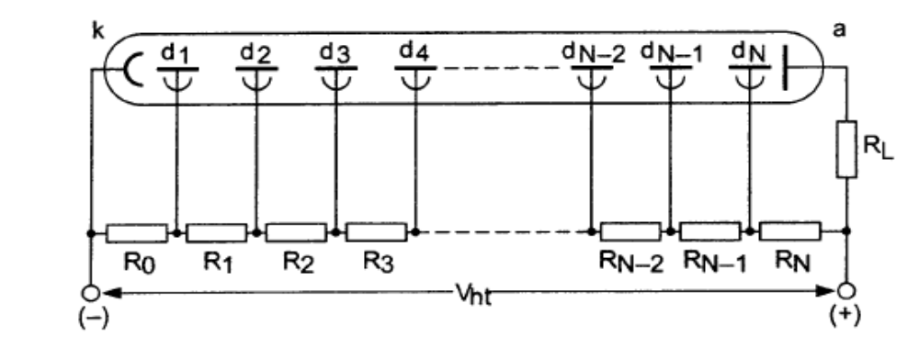
PMT Base
A voltage divider network is used to supply voltage to the dynodes
  Typical supply voltage is 2kV
The manufacturer usually supplies a circuit diagram and often sells the accompanying base

Slide 24
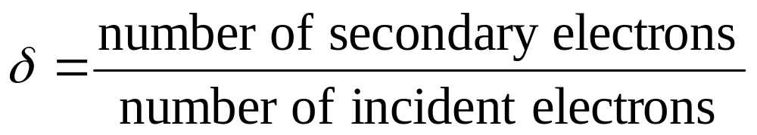
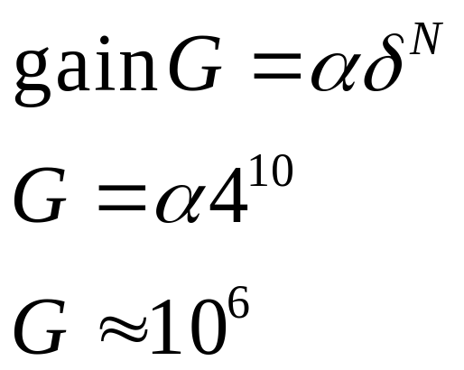
Dynode Structure
δ of 4-6 for most dynode materials
And typically there are 10-12 stages (dynodes)

Slide 25
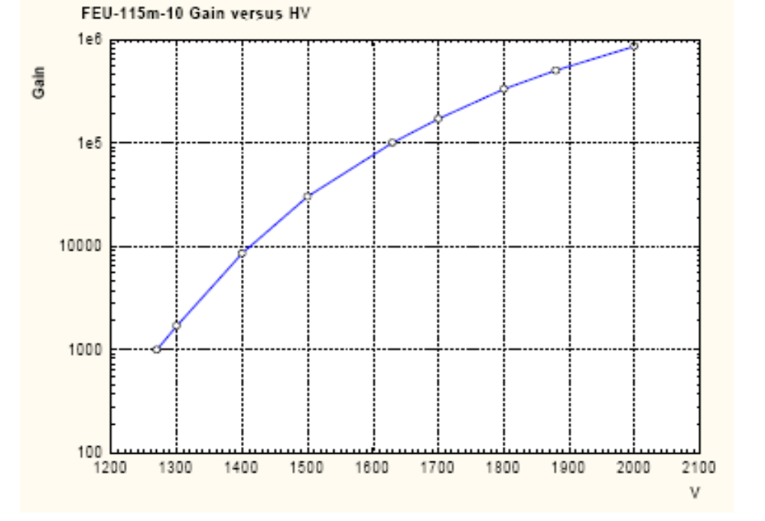
PMT Gain and HV Supply
Typical gain versus high voltage curve
Rule of thumb is DV=100 gives DG=2

Slide 26
Dynode Structure
Typical instantaneous current?
  Assume 10³ photons at the photocathode
  Then there are 2.5x10² electrons at the first dynode
  Then there are 2.5x10⁸ electrons at the anode
  And collected in 5ns gives a peak current of 2.5x10⁸ x 1.6 x 10⁻¹⁹ / 5 x 10⁻⁹ = 8 mA
    Of course the average current is much smaller

Slide 27
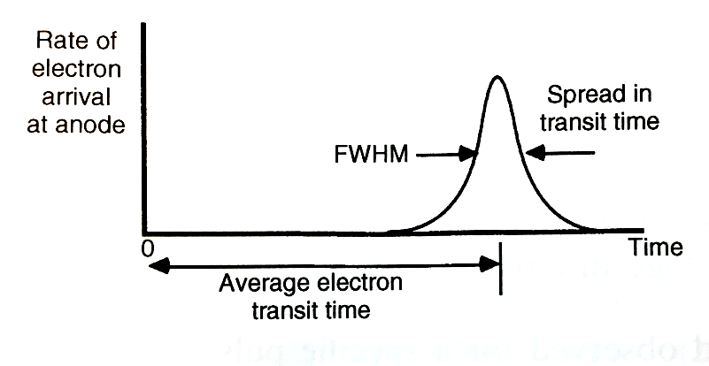
Electron transit time and transit time spread (jitter)
What is the interdynode transit time for electrons? Assume dynode spacing of 12 mm and a potential difference of 150V.
F = ma = Eq (E = electric field)
E = V/d
ma = qV/d
d = ½ at²
a = 2d/t²
qV/d = 2dm/t²
t = (2md²/qV)^{1/2}
t = 3.3 ns
Transit time spread (TTS)
Affected by:
Different path lengths from photocathode to first dynode
Different initial energies of photoelectrons
Number of initial photoelectrons
For a 10 stage PMT, the total transit time would be 33 ns + photocathode to first dynode transit time
Can be < 1 ns for PMTs designed for timing meas.

Slide 28
Dark Current
A small amount of current flows in the PMT even in completely dark state
Causes of dark current include
  Thermionic emission from photocathode and dynodes
  Leakage current (ohmic leakage) between anode and other electrodes
  Photocurrent produced by scintillation from glass or electrode supports
  Field emission current
  Cosmic rays, radioactivity in glass envelope, radioactivity (gamma) from surroundings (cement)
Dark current increases with increasing supply voltage

Slide 29
Energy Resolution
In gamma ray spectroscopy and other applications, the energy resolution is an important quantity
One contribution to the energy resolution is the statistical variance of the produced signal quanta
In the case of a PMT, the energy resolution is determined, to a large degree, by the number of photoelectrons arriving at the first dynode

Slide 30
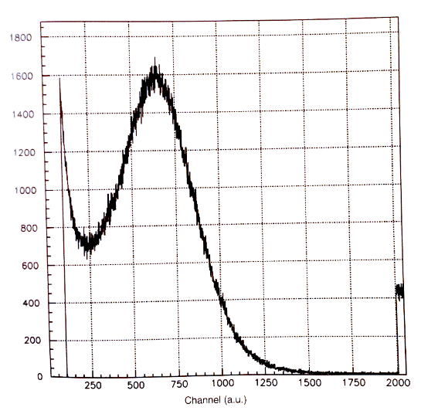
Measurement of absolute light output of a scintillator (i.e. photons/absorbed energy)
Need PMT with good single
photoelectron resolution
Scale (with care) from one
photoelectron to many
Take scintillator emission
spectrum and spectral
response of photocathode
into account

Slide 31
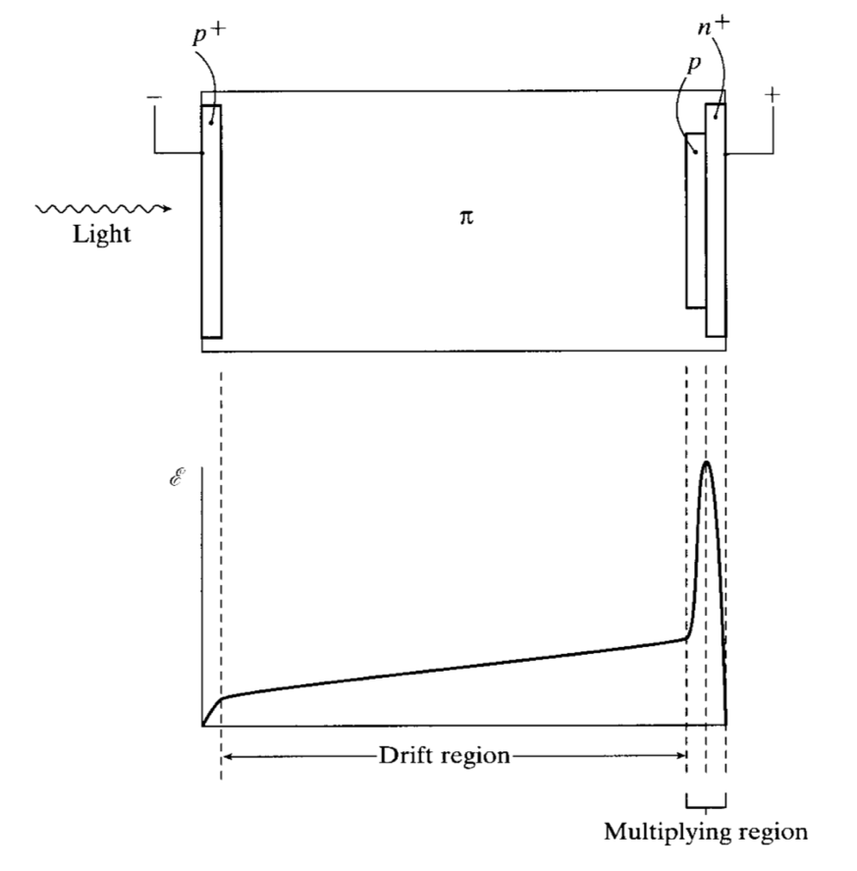
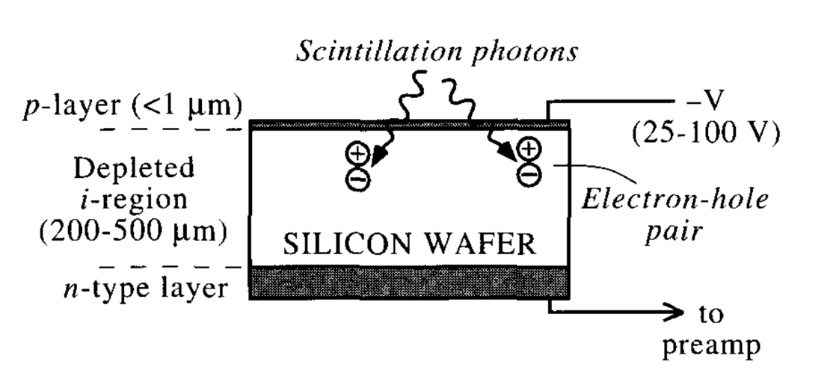
Photodiodes and Avalanche Photodiodes
Photodiode
Avalanche photodiode

Slide 32
Photodiodes/Avalanche Photodiodes
Photodiodes
  Very low bias voltage, unity gain, relatively poor signal-to-noise at room temperature, slow response, good long wavelength response, insensitive to magnetic fields
  Widely used in X-ray CT to read out ceramic scintillators and in hand-held radiation monitors to read out CsI(Tl) crystals
Avalanche photodiodes
  High bias voltage (100-1000 V) to produce electron multiplication; gain of ~100; higher signal to noise, good long wavelength response, insensitive to magnetic fields
  Used in hybrid PET/MR imaging and in high energy physics calorimeters (because insensitive to magnetic fields)
  Very sensitive to fluctuations in temperature and bias voltage
  Will operate as a counter in breakdown mode (high bias voltage)

Slide 33
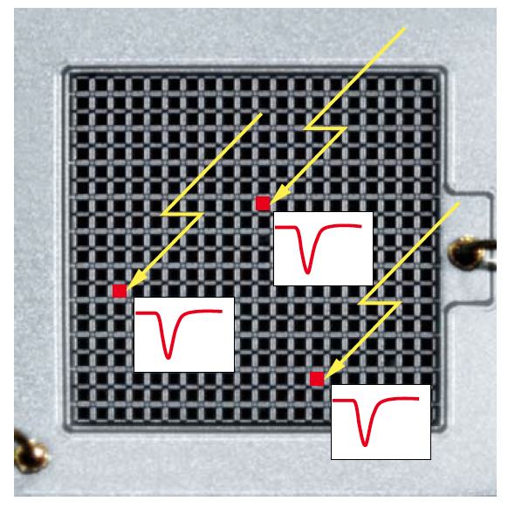
SiPM (MPPC)
An array of APDs operating in Geiger mode
Low bias voltage; high multiplication; insensitive to magnetic fields; fast time response; good efficiency; wide spectral response (like other silicon devices); very good for weak signals
Each pixel outputs the same amplitude pulse for each photon (or photons) it detects. The pulses from multiple pixels superimpose to form the total signal. The linearity of the total output is affected if more than one photon hits a pixel. Solution: lots of pixels, but trade-off with fill factor.

Slide 34
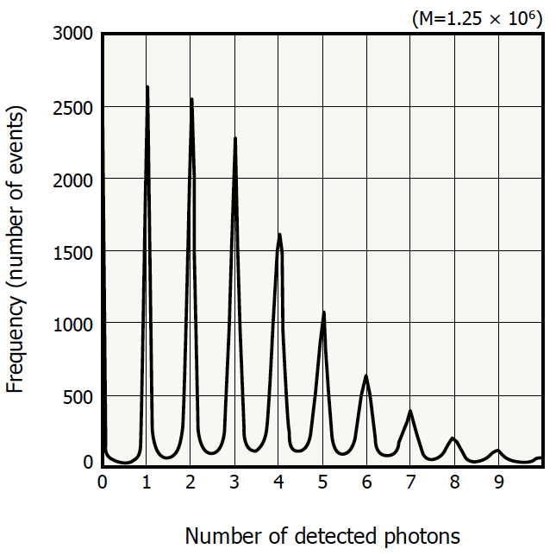
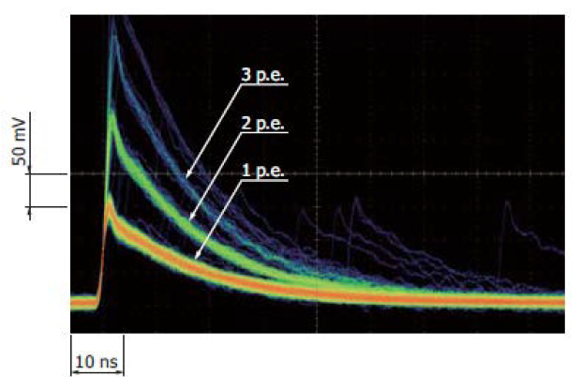
MPPC signals for multiple photons
Photon Detection Efficiency:
PDE = QE x FF x AP
FF = Fill Factor, AP = Avalanche Probability
Cross talk = when a pixel fires, it can affect adjacent pixels

Slide 35
Desirable properties of a photodetector
High sensitivity (QE, PDE) SiPM > PMT
Spectral sensitivity matches scintillator emission PMT > SiPM
High gain, low noise; i.e. large signal-to-noise PMT
Small size SiPM
Low cost PMT
Insensitive to temperature fluctuations neither
Low power requirement SiPM
Low voltage requirement SiPM
Minimally distorts the scintillation light pulse PMT ~ SiPM

