Slide 1
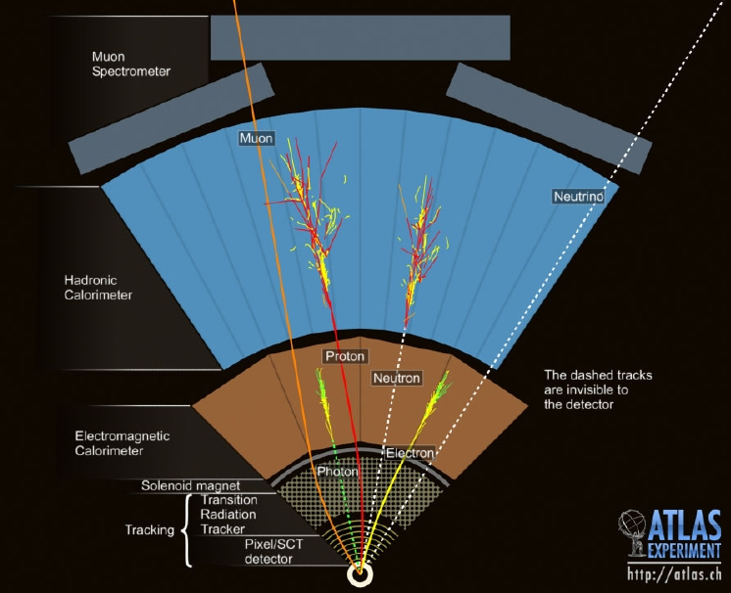
Interactions of Subatomic Particles with Matter
M.C. Vetterli
Simon Fraser University
and TRIUMF
TSI-GRIDS (TRIUMF)
August 7th, 2018

Slide 2
Interactions of Subatomic Particles with Matter
Outline
SM Particles & Interactions
Energy Loss by Heavy Charged Particles
Energy Loss by Electrons
Energy Loss by Photons
Strong & Weak Interactions
There is something wrong with this picture. There will be a test at the end of the lecture. 😄

Slide 3
Interactions of Subatomic Particles with Matter
I have particularly followed reference 1)
1) Fernow, Richard: “Introduction to experimental particle physics”
Cambridge University Press; ISBN 0-521-37940-7
2) Grupen, Claus & Shwartz, Boris: “Particle Detectors”
Cambridge Monographs; ISBN 978-0-521-18795-4

Slide 4
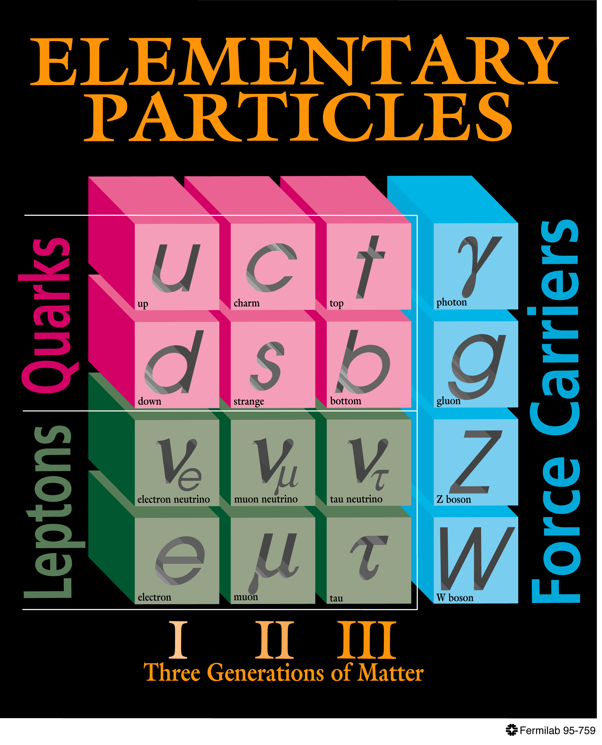
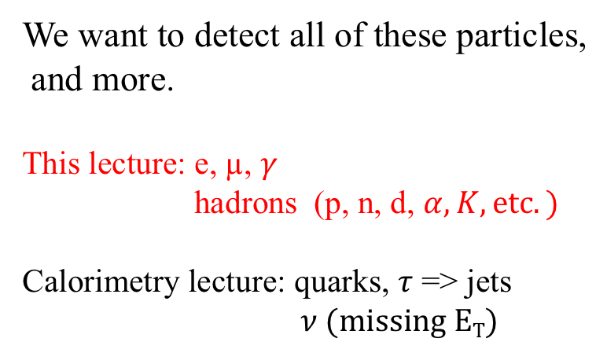
The Standard model of Particle Physics
We want to detect all of these particles,
and more.
This lecture: e, µ, $γ$
hadrons (p, n, d, $α, K, etc.)$
Calorimetry lecture: quarks, $τ$ => jets
$ν (missing ET)$
We use mostly the EM interaction, but also the strong (nuclear) interaction, and the weak int. in some special cases.

Slide 5
The Particle Zoo - 1

Slide 6
The Particle Zoo - 2
Unstable particles detected by measuring their (stable) decay products

Slide 7
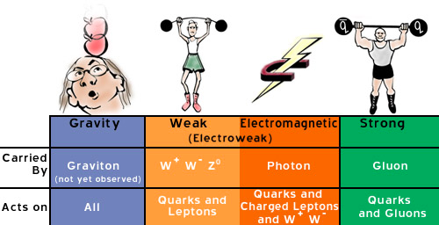
Standard Model Interactions
relative
strength
10⁻³⁷ 10⁻⁸ 10⁻³ 1
The strong force manifests itself as the strong nuclear force for our purposes.
It is short range (meson exchange model)
We will ignore gravity!

Slide 8
Relativistic Kinematics
I am going to assume you know this stuff (and more about Special Relativity!)

Slide 9
Relativistic Kinematics
I am going to assume you know this stuff (and more about Special Relativity!)

Slide 10
Relativistic Kinematics
I am going to assume you know this stuff (and more about Special Relativity!)
c=1 & m=m₀ now

Slide 11
Energy Loss of (heavy) Charged Particles (not electrons)
Do a classical calculation to get a feel for what is happening.
An incident charged particle with charge z₁e creates an electric field at the position of particle 2 in the medium.
By symmetry the net force on 2 is transverse to the trajectory of 1.
If v₁ is small, we can ignore the magnetic field.

Slide 12
Energy Loss of (heavy) Charged Particles (not electrons)
Do a classical calculation to get a feel for what is happening.
An incident charged particle with charge z₁e creates an electric field at the position of particle 2 in the medium.
By symmetry the net force on 2 is transverse to the trajectory of 1.
If v₁ is small, we can ignore the magnetic field.

Slide 13
Energy Loss of (heavy) Charged Particles (not electrons)
Do a classical calculation to get a feel for what is happening.
An incident charged particle with charge z₁e creates an electric field at the position of particle 2 in the medium.
By symmetry the net force on 2 is transverse to the trajectory of 1.
If v₁ is small, we can ignore the magnetic field.

Slide 14
Energy Loss of (heavy) Charged Particles (not electrons)
=>

Slide 15
Energy Loss of (heavy) Charged Particles (not electrons)
=>
1/b²v₁² => energy loss is dominated by close collisions and slow particles.

Slide 16
Energy Loss of (heavy) Charged Particles (not electrons)
=>
1/b²v₁² => energy loss is dominated by close collisions and slow particles.
The energy loss is dominated by the interactions with atomic electrons, not the nuclei.

Slide 17
Energy Loss of (heavy) Charged Particles (not electrons)
There are atomic electrons in the cylinder on slides 11-13.
Adding up the energy transfers in all the cylinders of radius b, we get:
=>

Slide 18
Energy Loss of (heavy) Charged Particles (not electrons)
There are atomic electrons in the cylinder on slides 11-13.
Adding up the energy transfers in all the cylinders of radius b, we get:
=>
Then calculate the range of the incident particle as:
(where some assumptions are made for b_{min} and b_{max})
More math gives us: (h is some universal
function).

Slide 19
Energy Loss of (heavy) Charged Particles (not electrons)
There are atomic electrons in the cylinder on slides 11-13.
Adding up the energy transfers in all the cylinders of radius b, we get:
=>
Then calculate the range of the incident particle as:
(where some assumptions are made for b_{min} and b_{max})
More math gives us: (h is some universal
function).
This gives us a scaling law:

Slide 20
Range of (heavy) Charged Particles (not electrons)
For a given momentum, heavier particles move more slowly and so have a larger dE/dx.
dE/dx drops as 1/v².
We will see why this flattens out
at high energy soon.
The scaling law for the range (Z²/M) is seen qualitatively for the range curves.
Lighter particles go further.

Slide 21
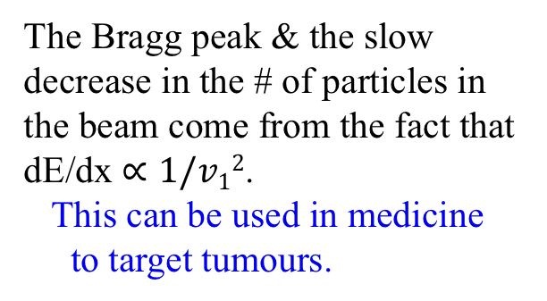
Range of (heavy) Charged Particles (not electrons)
N: # of heavy charged particles in a beam incident on a material
The Bragg peak & the slow decrease in the # of particles in the beam come from the fact that dE/dx $∝1/v12$.
This can be used in medicine
to target tumours.

Slide 22
Full Energy Loss Calculation
This requires us to use quantum mechanics but the features should agree with the classical calculation.
Also include the possibility of atomic excitation for far-away interactions where b is so large that the incident particle interacts with the atom as a whole.

Slide 23
Full Energy Loss Calculation
This requires us to use quantum mechanics but the features should agree with the classical calculation.
Also include the possibility of atomic excitation for far-away interactions where b is so large that the incident particle interacts with the atom as a whole.
Where:
(classical electron radius)

Slide 24
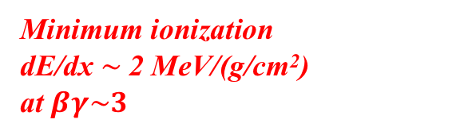
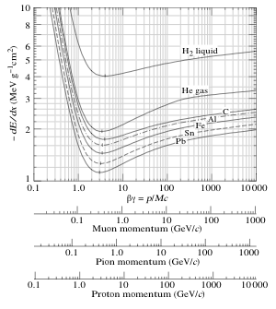
Energy Loss of Charged Particles
Charged particles (not electrons) lose energy by ionization and atomic excitation.
Bethe-Bloch formula:
β = v/c
Materials with higher charge stop particles faster (in n_{e})
Particles with larger charge lose energy faster
Fermi Plateau:
Screening of the Coulomb field by atomic electrons for large b.
Energy loss is inversely proportional to the square
of the velocity
Heavier materials do not stop particles as fast
Relativistic rise
(due to the relativistic deformation of the Coulomb field, which makes b_{max} larger)
Minimum ionization
dE/dx $\sim$2 MeV/(g/cm²)
at $βγ\sim 3$

Slide 25
Properties of Materials

Slide 26
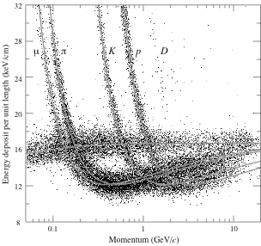
Remember This?
e.g. isolate kaons
Can be used for
particle identification
(measure momentum
and energy deposited)
Make two-dimensional “cuts” to select the particles of interest
e

Slide 27
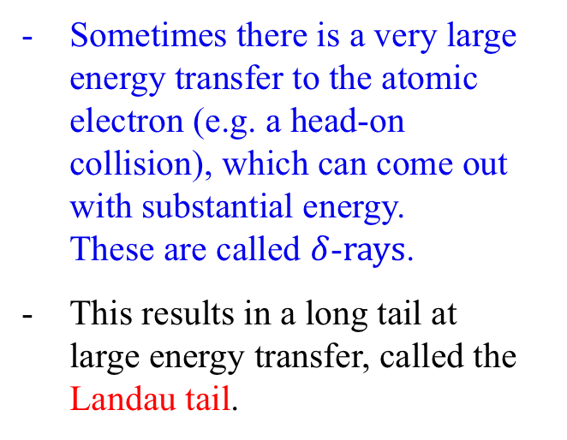
Fluctuations in Energy Loss
There are substantial fluctuations in the energy loss of charged particles because there are a huge number of collisions as they penetrate the material and each interaction has a wide variation in outcome.
Sometimes there is a very large energy transfer to the atomic electron (e.g. a head-on collision), which can come out with substantial energy.
These are called $δ$-$rays$.
This results in a long tail at
large energy transfer, called the Landau tail.

Slide 28
Energy Loss by Electrons/Positrons
The cross-section for distant collisions is the same for all charged particles.
However, the close collisions for electrons are given by Moller scattering, which modifies the dE/dx equation:
- For positrons, there is also annihilation with an atomic electron.
The cross-section is modified to Bhabha scattering

Slide 29
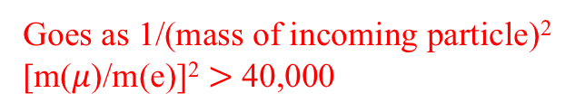
Bremsstrahlung
Charged particles accelerated in an electric field radiate photons with wave number/momentum k (Bremsstrahlung).
Electrons are the lightest charged particles. In practice, they are the only ones to radiate photons and this is the main energy-loss mechanism at high-energy.
Goes as 1/(mass of incoming particle)²
[m($μ$)/m(e)]² $>$ 40,000
The cross-section drops off with increasing photon energy as 1/k
(but at the LHC, we do have to worry
about brems for high-energy muons)
Heavy elements are more efficient at producing brems.
Brems is forward peaked.

Slide 30
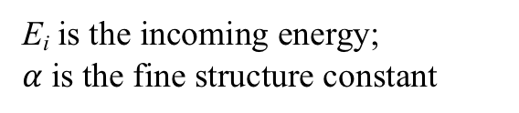
More on Bremsstrahlung
E_{i} is the incoming energy;
$α$is the fine structure constant
See table on slide 25 for values.
The radiation length L_{R} is the distance over which the initial electron loses all but 1/e of its energy.
It is also 7/9 of the mean-free-path for pair-production by a high-E photon.

Slide 31
More on Bremsstrahlung
E_{i} is the incoming energy;
$α$is the fine structure constant
See table on slide 24 for values.
The radiation length L_{R} is the distance over which the initial electron loses all but 1/e of its energy.
It is also 7/9 of the mean-free-path for pair-production by a high-E photon.
Energy at which E_{rad} = E_{coll}

Slide 32
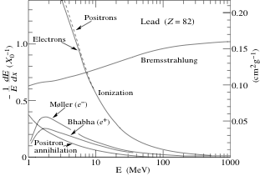
The Situation is Different for Electrons
Accelerated charged particles radiate photons ➔ Bremsstrahlung
Electrons are light and are therefore more affected by EM fields
➔ Most important process for high-energy electrons
Electrons in
E_{crit}
E_{crit}
e- γ e-
Not really an issue for heavier particles

Slide 33
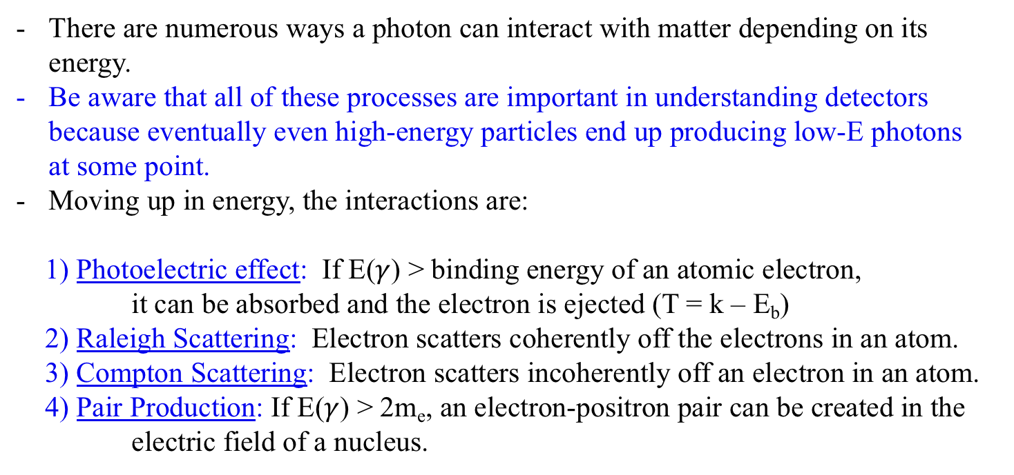
Energy Loss by Photons
There are numerous ways a photon can interact with matter depending on its energy.
Be aware that all of these processes are important in understanding detectors because eventually even high-energy particles end up producing low-E photons
at some point.
Moving up in energy, the interactions are:
1) Photoelectric effect: If E($γ$) > binding energy of an atomic electron,
it can be absorbed and the electron is ejected (T = k – E_{b})
2) Raleigh Scattering: Electron scatters coherently off the electrons in an atom.
3) Compton Scattering: Electron scatters incoherently off an electron in an atom.
4) Pair Production: If E($γ$) > 2m_{e}, an electron-positron pair can be created in the
electric field of a nucleus.

Slide 34
And Yet Again Different for Photons
High-energy photons produce
e⁺e- pairs
γ e⁺e⁻
κ_{nuc}: pair production in the field
of a nucleus
κ_{e}: pair production in the field
of an atomic electron
Notice the jumps in the photoelectric cross-section as the energy of the photon reaches the binding energy of the next nuclear shell.

Slide 35
Brief Description of Elastic Nuclear Scattering
Calculated by Rutherford:
(spin-0 particles)
dominated by small-angle scattering
Mott calculated the case of spin-1/2 particles:
We will talk a bit more about nuclear reactions in the lecture on calorimetry.

Slide 36
Other Interactions
I just barely scratched the surface of nuclear interactions
Cerenkov radiation (threshold detectors, RICHs, DIRCs)
Transition Radiation (threshold detectors, energy detectors)
Weak interactions (e.g. neutrino detection)

Slide 37
Summary
We examined the wide variety of possible interactions of subatomic particles with matter
Remember that all of these interactions are active always but they depend differently on energy so we can focus on 1-2 at a time.
However, it is important that you remember that you need to know all of this if you are to understand how subatomic particles are absorbed and detected in subatomic physics experiments.
You can’t turn interactions on and off (more about this in the calorimetry lecture).
I am not going to summarize the details of the lecture because I am sure you have had enough equations for this early in the morning!☹️

