Slide 1
Particle Physics Faculty Meeting
Agenda
News/Update
Peer Review Plenary slides for Particle Physics – Isabel Trigger
ACOT Research highlights – Kate Pachal
ACOT Intro talk - OSC

Slide 2
ALPHA BAE Hire
Missed out on top candidate
A ”dual career opportunity” was offered in the end agreed on by the director
Waiting for green light by the director to make offer to next candidate

Slide 3
Remote Work
From Ian D.
I would like to remind you that we would like to receive all Remote Work agreements by the end of today (October 12, 2022). Please ensure that your Remote Work Agreement has been reviewed, approved and signed by your manager and your Leadership Team (Divisional Director) representative. They will then submit the completed and signed PDF to humanresouces@triumf.ca with Subject: Remote WorkAgreement - Employee Name

Slide 4
NRC Budget
Due tomorrow
For Particle Physics, included relocation costs for expected new postdocs
7 in total, 4K each
Hyper-K *2
UCN
DarkLight
PIONEER
NA62
SuperCDMS

Slide 5
ACOT and IPR

Slide 6
ACOT
Posters
ACOT posters will be the practice for the Peer Review
Thank you for all the suggestions for presenters
Tiger team made the final selection
Callum McCracken (ATLAS)
Nick Prouse (Hyper-K)
Wolfgang Schreyer (UCN)
Eleanor Fascione (SuperCDMS)

Slide 7
ACOT
Hybrid format
Parallel Session: Joint PP/SciTech/SciComp session Tuesday Oct 25th 9:00-11:00
YKK will attend in person
Propose to have “practice talk” next Thursday October 20th 12:30
Introductory talk – OSC
Will circulate draft end of weekend
Need input from SciTech and SciComp
Research Highlights - Kate Pachal
Include HQP highlights (as in previous talks)
Discussion - All

Slide 8
Questions to address
The past ACOT recommendation for PP/SciTech/SciComp was
“Present five-year plans and priorities for various funding scenarios at the next ACOT meeting”
The initial response on this was:
“Input has been solicited from all departments in PSCI; Plans will be presented at the next ACOT meeting”
And the final response to be shared with ACOT is:
“The five-year plans and priorities will be presented by the three departments at their next joint ACOT parallel session.”
Solicited input from SciTech and SciComp

Slide 9
From PSD retreat: Hiring Priorities
Baseline highest priority for 2025-2030
TUCAN (1+)
Hyper-K (succession)
Strengthening Science & Technology capabilities (2+ A&P)
Growth area (depending on funding and green light for the projects - not ranked)
Astro-particle / DarkSide-20k / nEXO (SNOLAB connection)
PIONEER (secure critical mass?)
P-One (potentially big local experiment)
Future Collider (joint-position with university)
UCN (joint-position with university)
Quantum/Precision (joint-position with university)
New hires (scientist + technical expertise for newly proposed centers)
flat-flat
+10%
Blue sky

Slide 10
From PSD retreat: Particle Physics Next 5YP Planning
Particle Physics Planning in March and April in preparation for this Physical Sciences retreat
Dedicated meetings (mini-retreat) during week of March 28th and April 4th
Presentations from all research groups + new future initiatives
Contributions from: ATLAS, Hyper-K, ALPHA, HAICU, TUCAN, SuperCDMS, nEXO, PHAAR, DarkLight, PIONEER, P-ONE, Future Collider
Hiring Priorities in short talks on May 12th, 26th and June 2nd
New initiatives under discussion in dedicated task forces
Center/platform/hub for detector development - joint with Nuclear Physics, SciTech
Center/platform/hub for AMO/Quantum/Precision/ physics (HAICU, radioactive molecules, UCN, Francium…) - joint with Nuclear Physics, CMMS
These are meant to 1) strengthen and refresh critical specialized technical expertise and give a means to retain that expertise over time that is existential to the core of the laboratory and our research while 2) also fostering existing synergies and leveraging new capabilities that are appealing to our community and the government as part of the next Five-Year Plan

Slide 11
New Initiatives
Particle Physics Planning results in impact on existing and future experiments and
New initiatives under discussion in dedicated task forces
Center/platform/hub for detector development (with Science and Technology)
Center/platform/hub for AMO/Quantum/Precision/physics (HAICU, radioactive molecules, UCN…), across Particle & Nuclear Physics departments
With no formal LOI process in place
Informal discussion with director, can still submit positioning documents within division
A 1-2 page summary would certainly not do any harm and likely be appreciated
Detector development writeup in preparation
What is the status for the AMO/Quantum/Precision center?

Slide 12
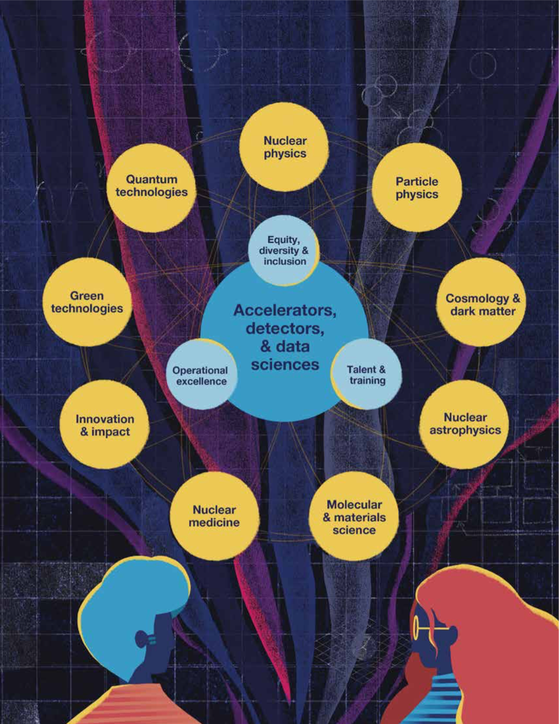
20 Year Vision
Discovery and Innovation for a Better World

Slide 13
Peer Review

Slide 14
PRC
Particle Physics, with SciTech, SciComp, theory talk at Plenary given by Isabel Trigger
Will review slides today, deadline for first submission tomorrow
No information/constraints on Parallel sessions yet
Expect talks from Theory, ATLAS, Hyper-K, ALPHA, TUCAN, TRIUMF@SNOLAB

Slide 15
Round Table
ATLAS
T2K/HyperK
TUCAN
ALPHA
SuperCDMS
DarkLight
PIONEER
NA62
n-EXO / PHAAR
SNO+
HALO
g-2
Belle 2
Theory

