Slide 1
Overview and Latest Physics Results from PICO
Minya Bai
Supervisor: Tony Noble
PICO Collaboration
WNPPC 2023

Slide 2
Dark Matter and Dark Matter Interactions
Weakly Interacting Massive Particles (WIMPs) are a popular candidate for dark matter
Spin-dependent:
WIMP-neutron, WIMP-proton couplings are different
Proportional to spin
Spin-independent:
Scales with A^2
Notes:
Cross-section -> interactions

Slide 3
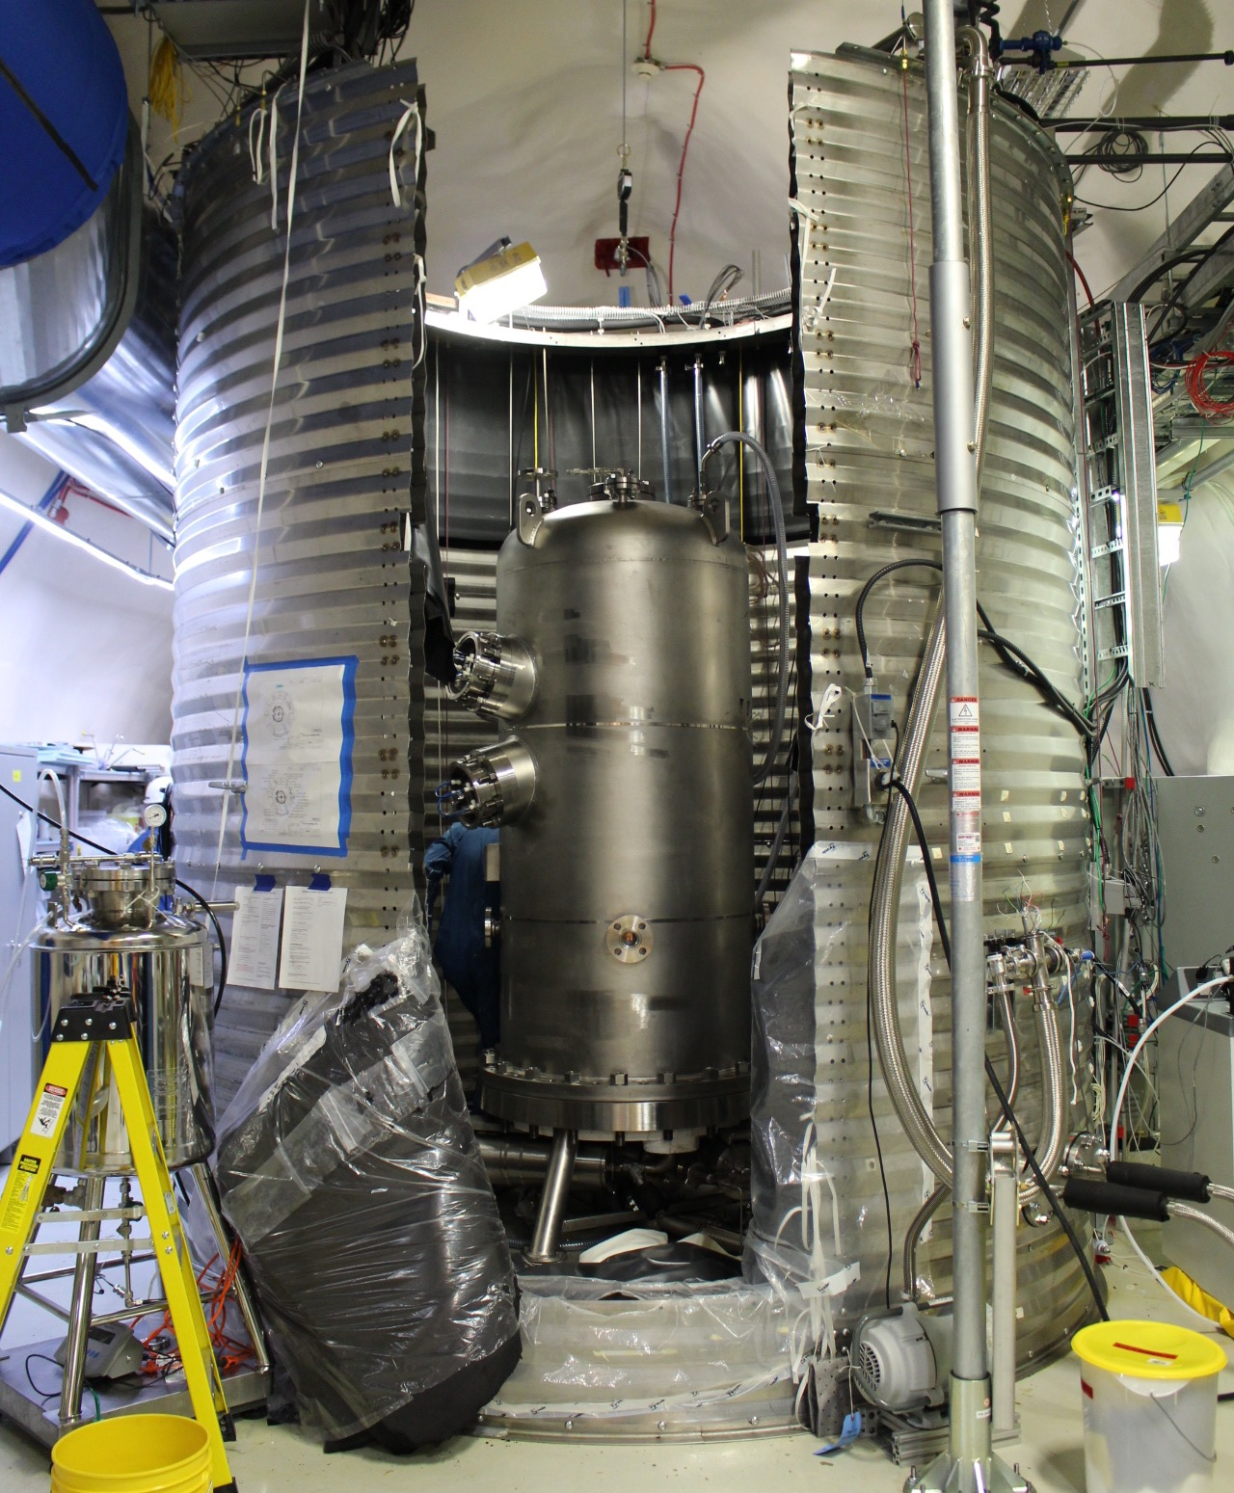
PICO
Operates in the spin-dependent proton regime
Bubble chamber to search for WIMPs
Uses superheated fluids
Currently using C3F8
Unique background rejection using acoustics and visual analysis

Slide 4
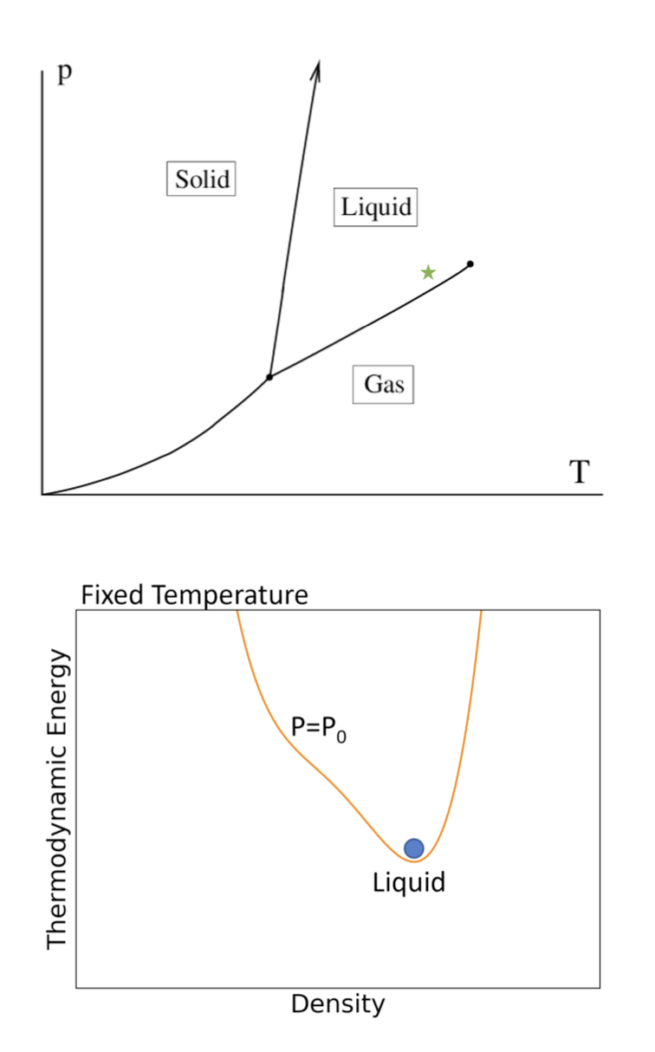
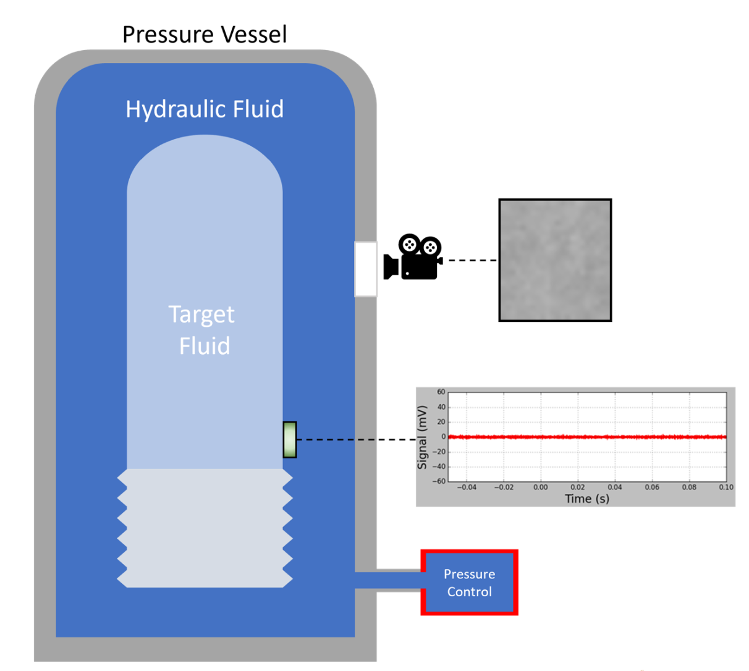
Bubble Chambers
Detector is filled with freon that is heated and pressurized to be in liquid state
Detector diagrams taken from Colin Moore
Notes:
Fill once as a liquid

Slide 5
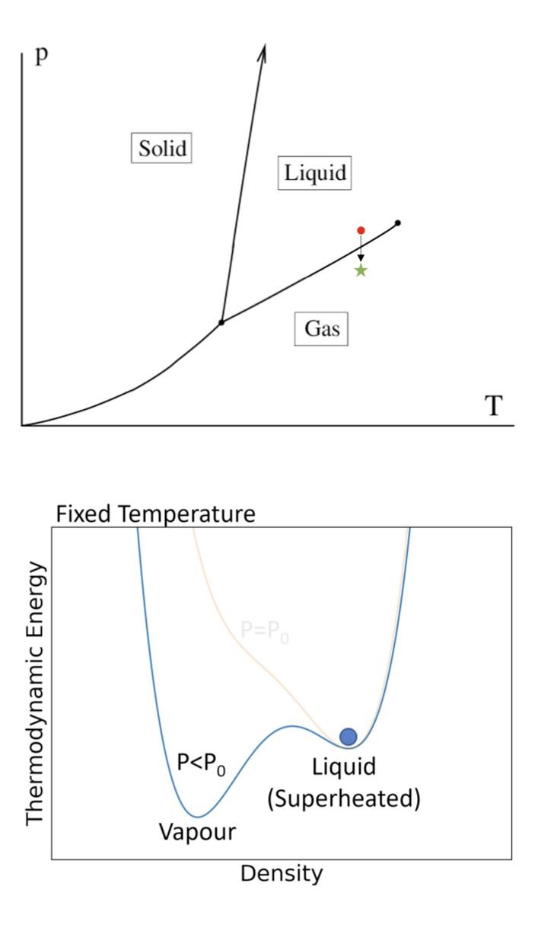
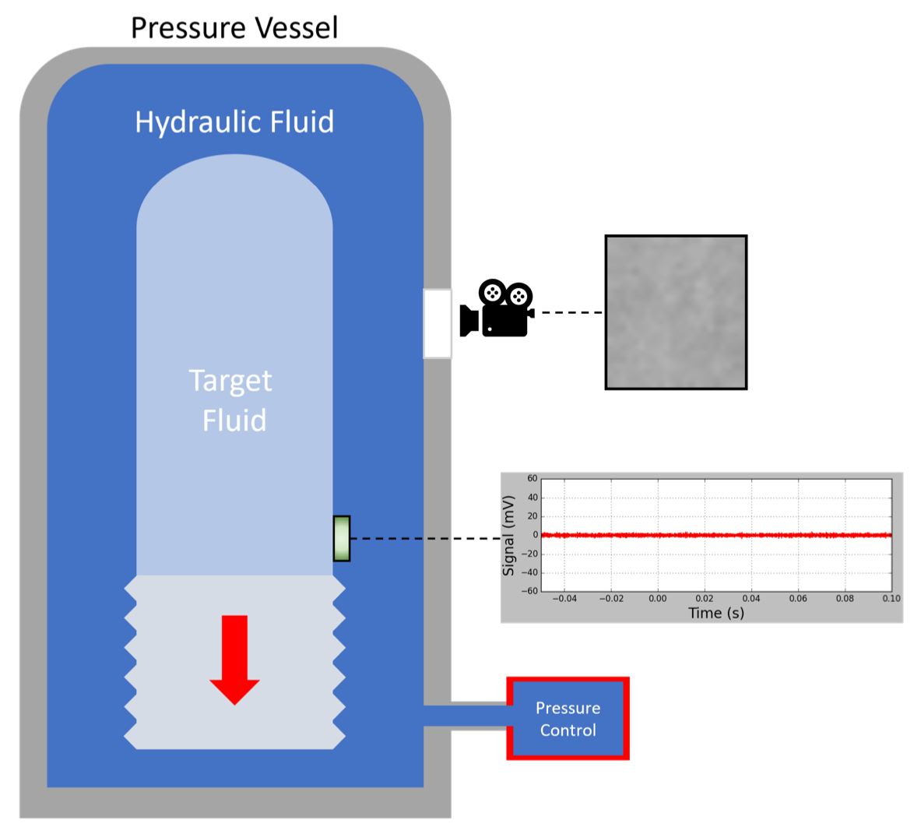
Bubble Chambers
Decrease in external pressure lowers the internal pressure
Superheated Liquid:
temperature of the liquid is higher than the boiling point, but not boiling
Detector diagrams taken from Colin Moore
Notes:
- Pressure is decreased, temperature is kept constant

Slide 6
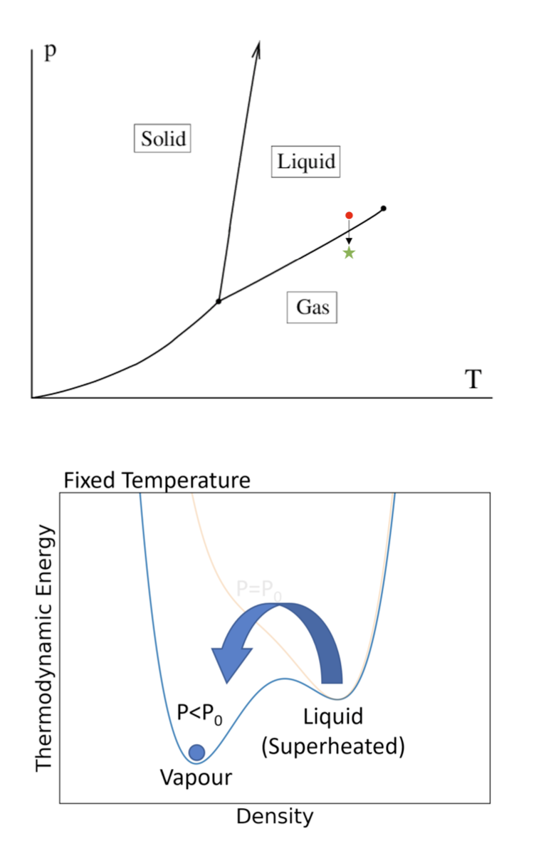
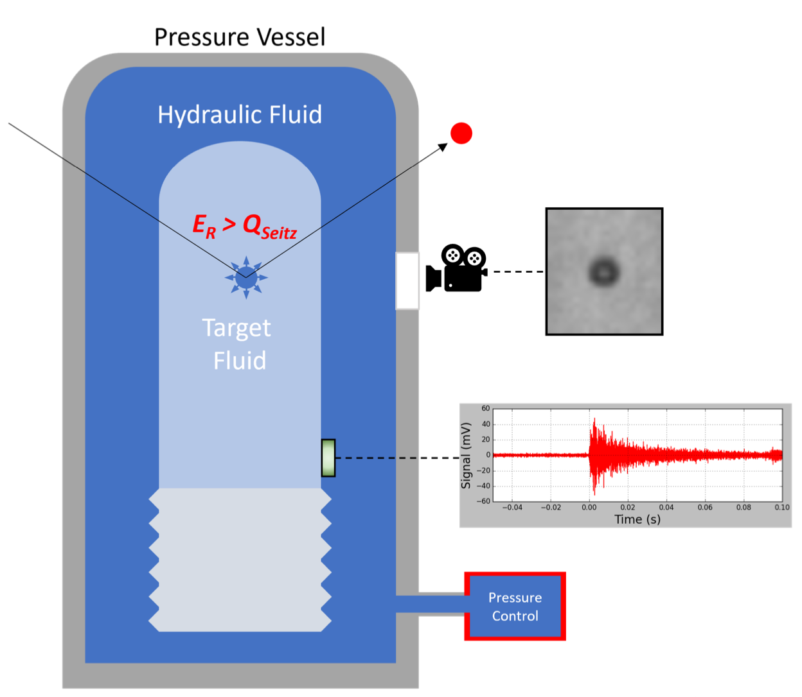
Bubble Chambers
Enough energy deposited locally by particle cause phase change
Bubble forms in detector
Detector diagrams taken from Colin Moore
Notes:
- Bubbles formed if enough energy is deposited to change phase to gas

Slide 7
PICO - Backgrounds
Alpha:
Heavy, charged particles
EM force
Neutron:
Scatters off nucleus
Can cause multi-bubble events
Gamma/Electron:
Electron recoil events
Very rare O(10^-10)
Acoustics
Statistics
Large insensitive in detector
Notes:
Alpha - interacting EM (charged particle passing through) -> acoustics
Neutron - interacting with nucleus (scattering off nucleus) -> statistics
Electron recoil events (gamma, electron) - interacting with electron (not producing enough energy on short enough scale to produce bubble) -> generally don’t need to worry about

Slide 8
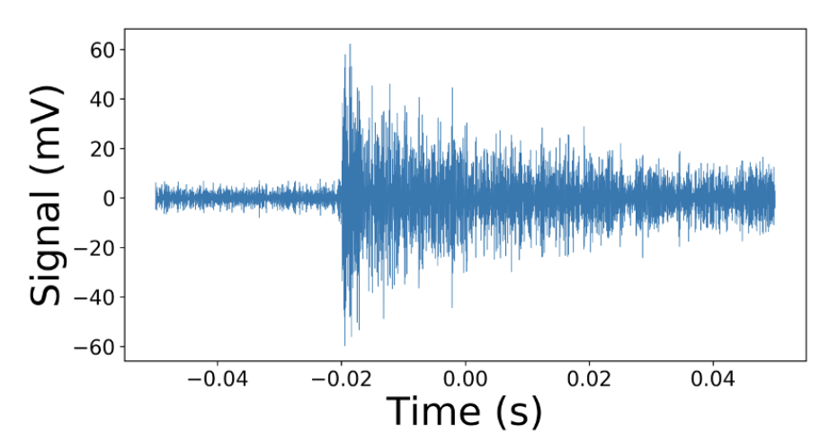
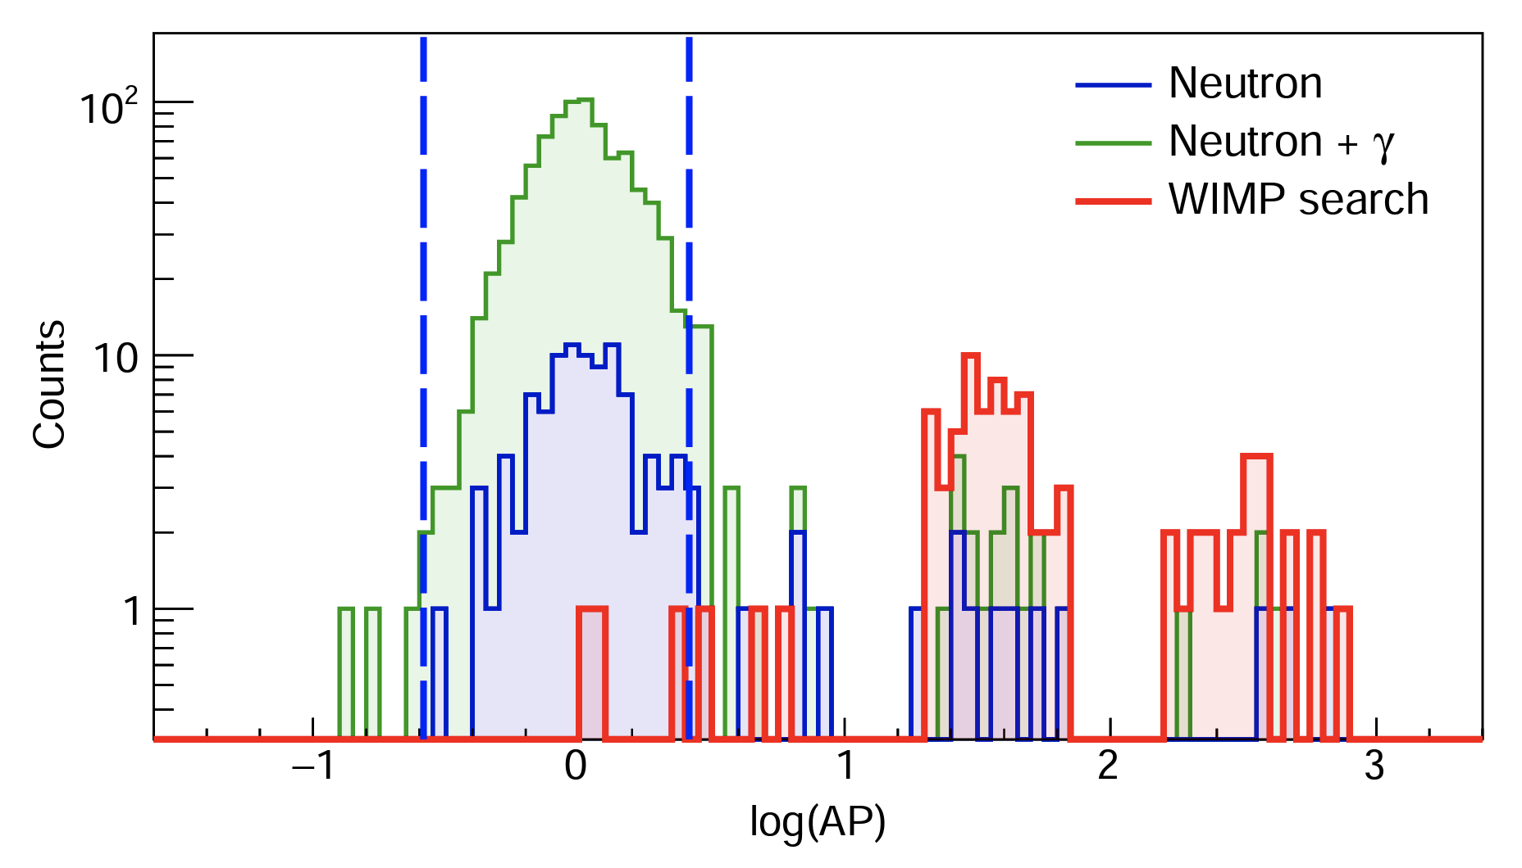
PICO - Acoustic Data
Piezoelectric sensors are mounted on the jar to record the sound of bubbles popping
Alpha events are much louder than other events (e.g. neutrons)
WIMPs are predicted to be similar to neutrons
*AP - Acoustic Parameter
https://doi.org/10.48550/arXiv.1902.04031
Notes:
AP parameters is calibrated to center neutrons around 0
We expect WIMPs to have nuclear recoils -> similar to neutrons

Slide 9
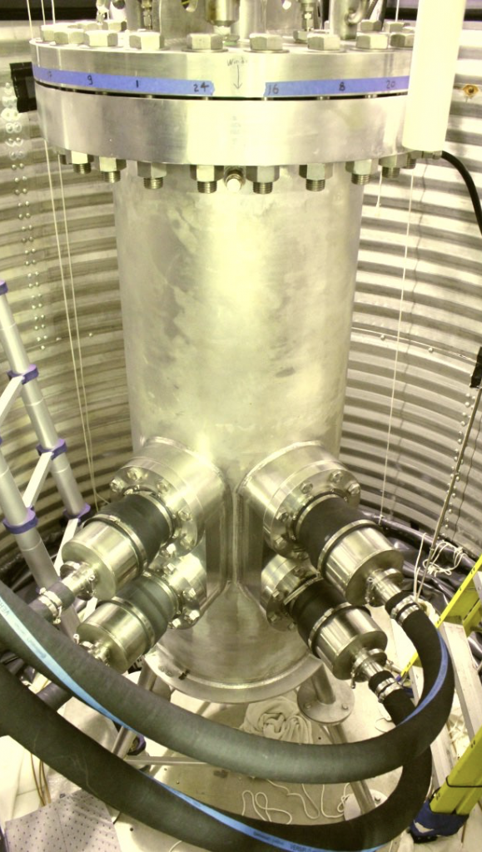
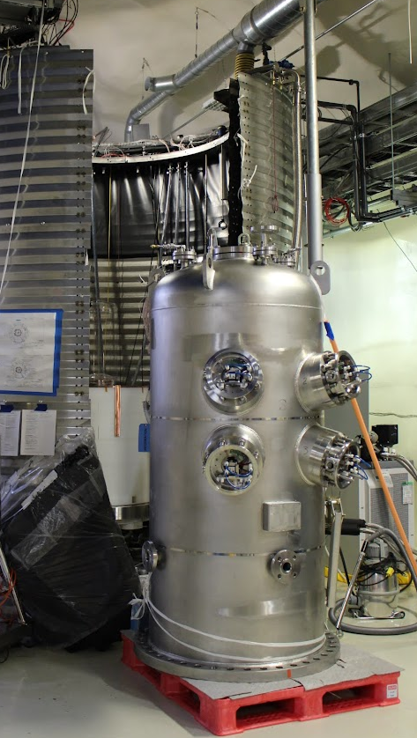
PICO - Optical Data
Cameras
4 camera mounted on the outside of the detector
Allows for 3D reconstruction of events inside the chamber
PICO-60
PICO-40L
Notes:
Cameras to see things

Slide 10
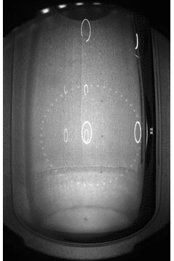
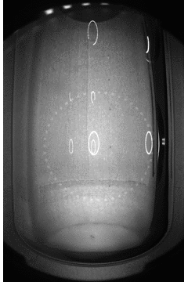
PICO - Optical Data
From simulations, the ratio of multi-bubble to single bubble neutron events is ~3:1
Can estimate the expected number of single bubble neutron events
Events from PICO-60
Notes:
Statistics is a verification of the acoustic data
So in the plot shown earlier, we can assume the events seen in the bounds were not WIMPs

Slide 11
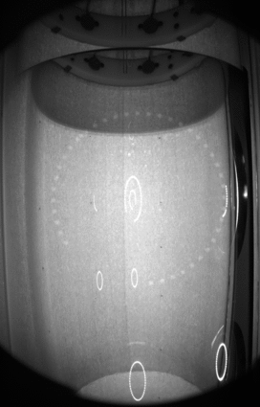
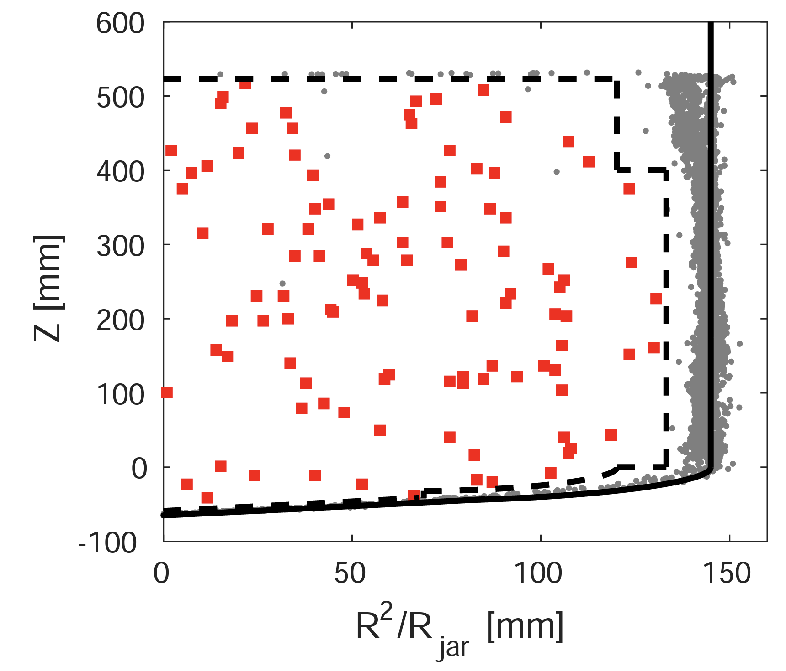
PICO - Optical Data
Event rates near walls will be higher -> reject these cases
Water
(PICO-60) more wall events near the interface
https://doi.org/10.48550/arXiv.1702.07666
Multi-bubble event from PICO-60
Notes:
Issues with PICO-60 -> wall events
Water buffer and wall interface has more backgrounds

Slide 12
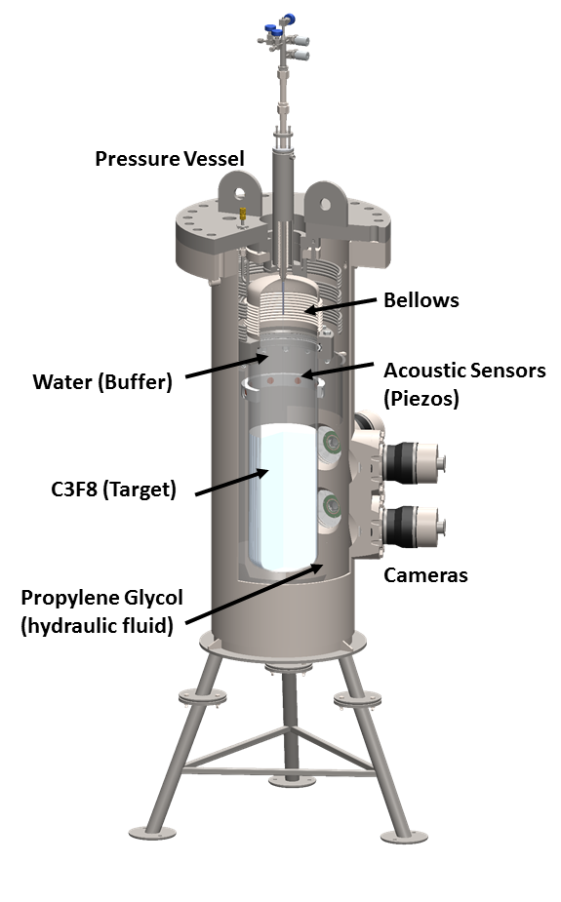
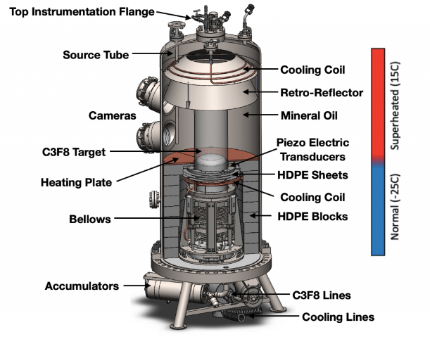
PICO-40L
Engineering run for PICO-500
Right side up chamber
Wall events rejection
Requires higher thermal stability
PICO-60
PICO-40L
Notes:
PICO-60 40L are the same size
Lower region cold to keep inert (40L)
Pico-60 operated at single temperature
Water buffer to avoid boiling on the bellows
PICO-60 orientation -> debris falls into volume
In exchange for water buffer, flip it (no longer have weird events at boundary)
Add picture of PICO-60 for comparison

Slide 13
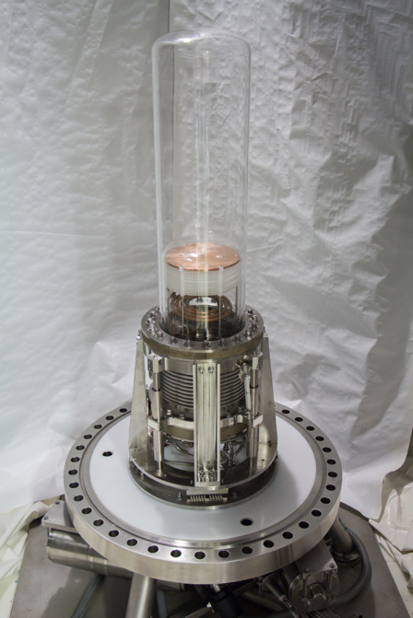
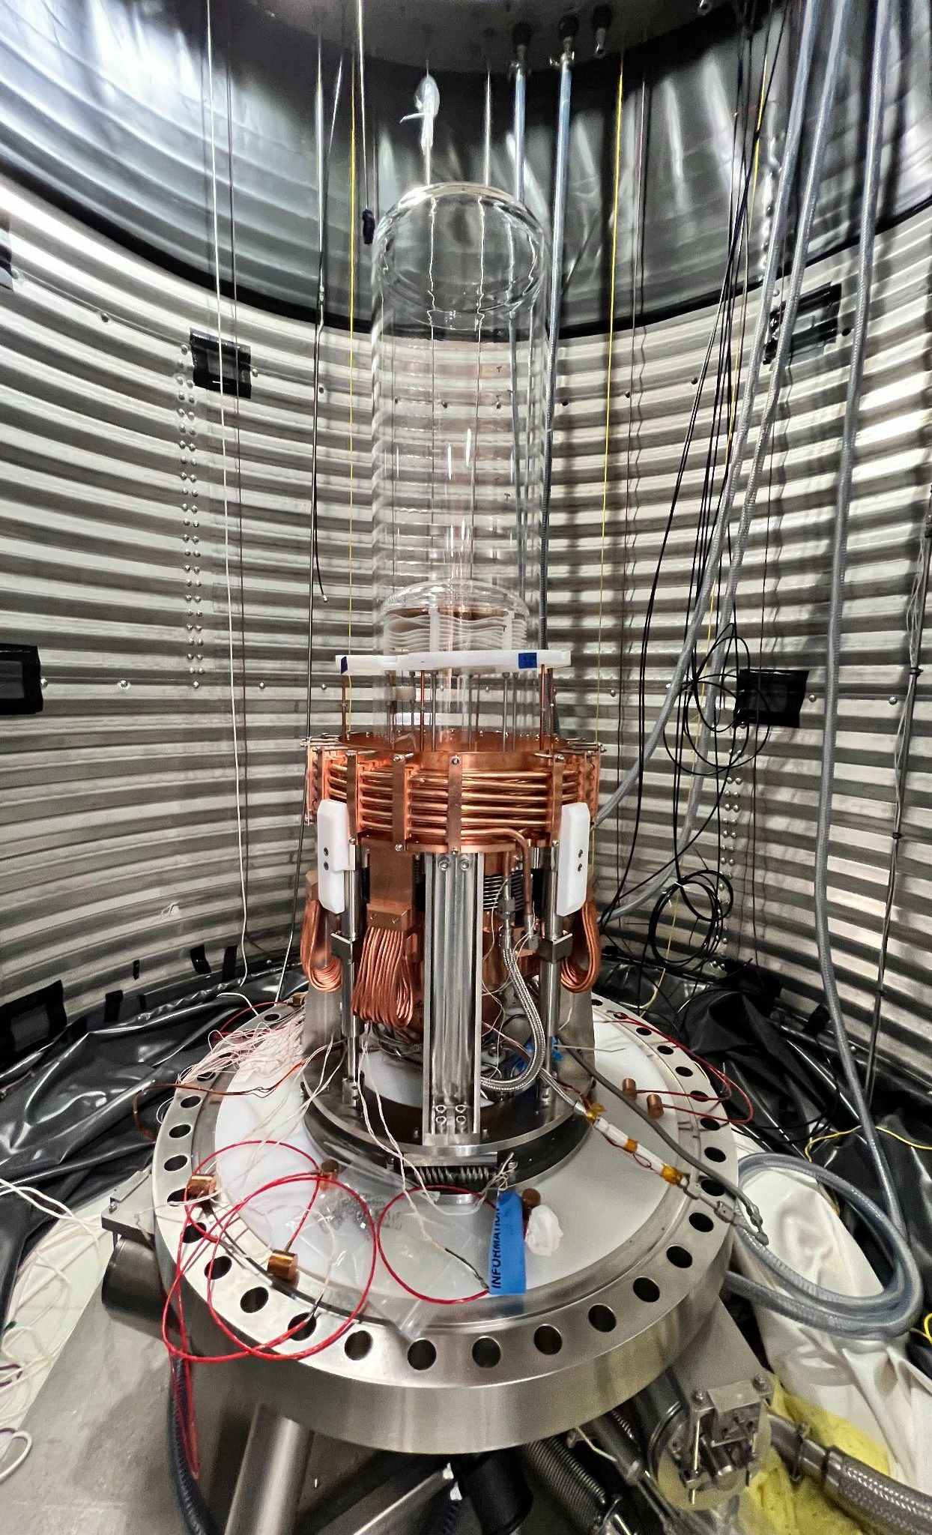
PICO-40L - Design Upgrades
Initial runs showed issues with the cooling
Design updated for better cooling in the bellows
Old design
New design
Notes:
Had one run successful in pointing in issues
Thermal capacity was insufficient for what we needed -> designed a better one
Fluid runs through crown to cool down from the top, braided side pieces to cool from below

Slide 14
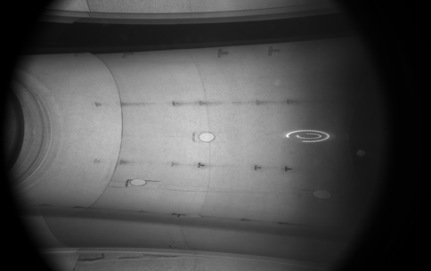
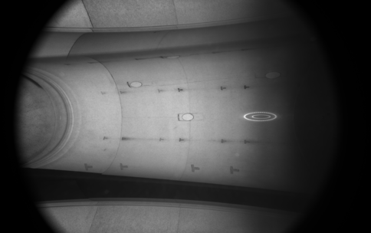
PICO-40L Trial Runs
Camera 1
Camera 3
Notes:
From different cameras can tell not wall event
Is operating at a higher pressure (why bubbles are much bigger)
Currently still in the commissioning phase -> hope to be operational soon (stay tuned!)

Slide 15
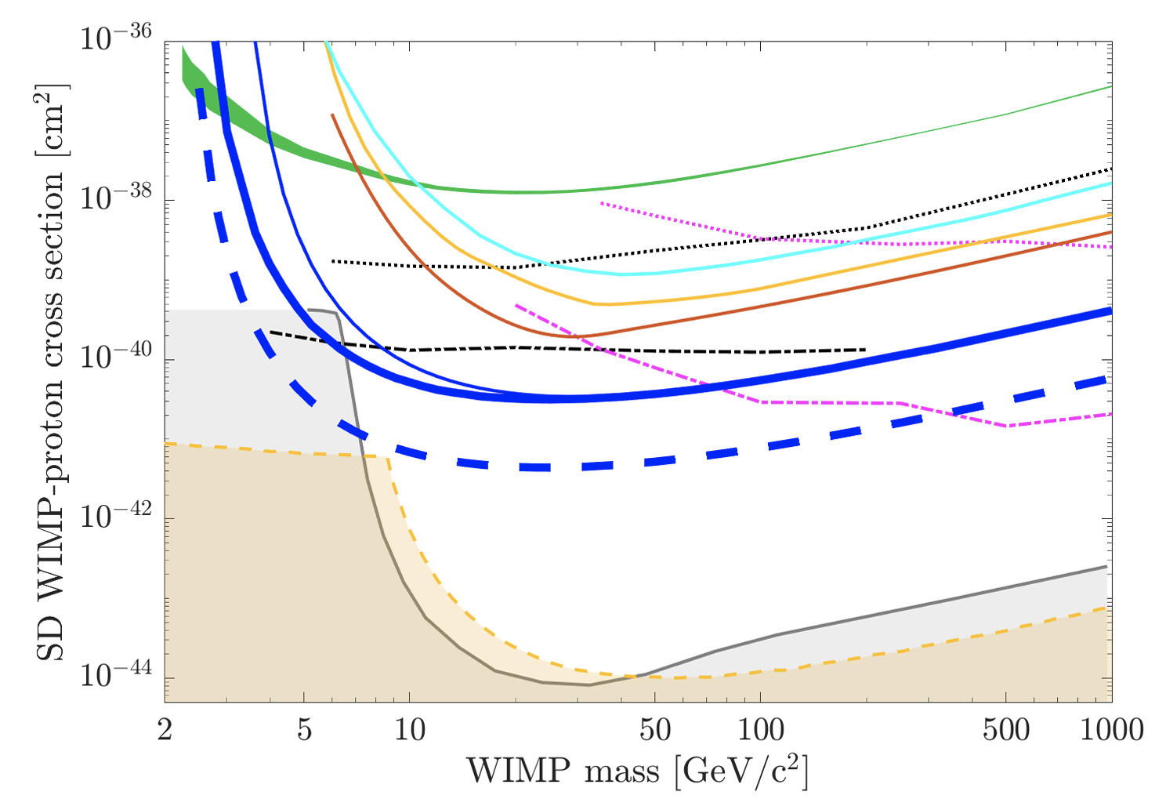
Projected Limits for PICO-40L
Spin-Dependent Limit
LUX
PICASSO
PandaX-II
Xenon1T
PICO-60
PICO-40L
C3F8 neutrino-nucleus fog
Xe neutrino-nucleus fog
https://doi.org/10.48550/arXiv.1905.12522
Notes:
PICO-60 dominated by backgrounds
More shielding in PICO-40

Slide 16
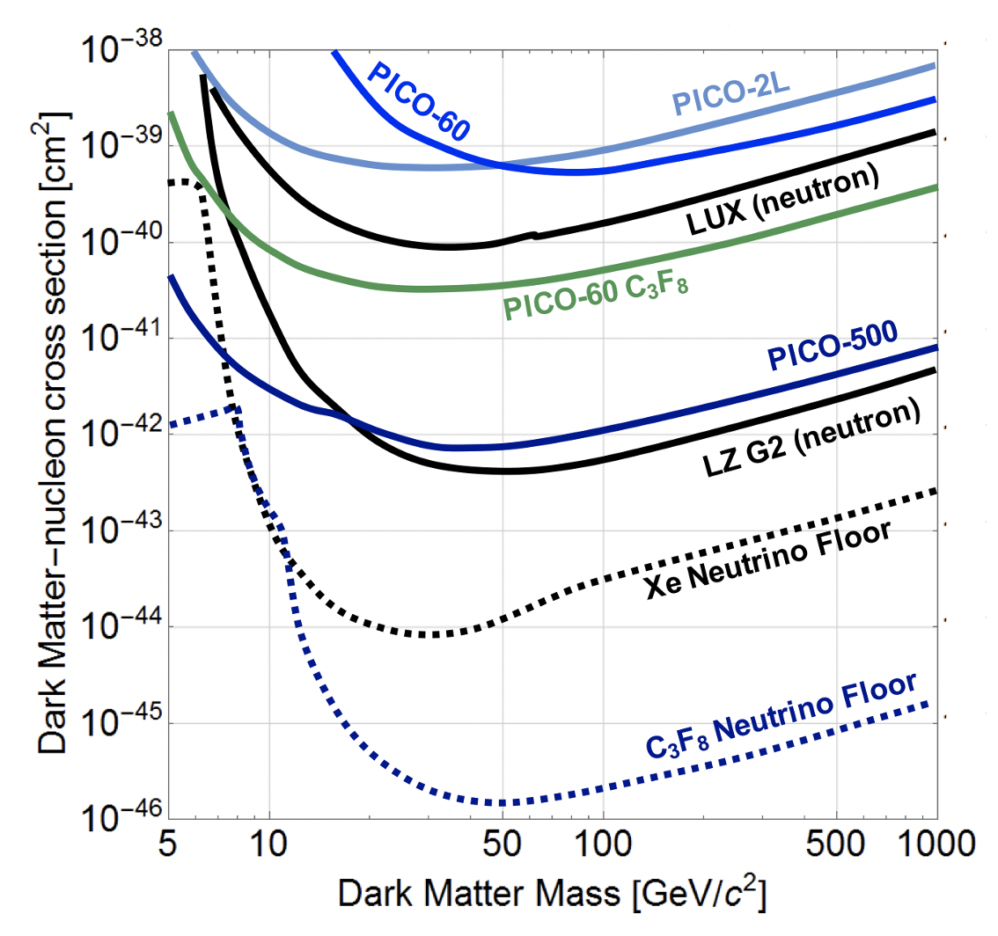
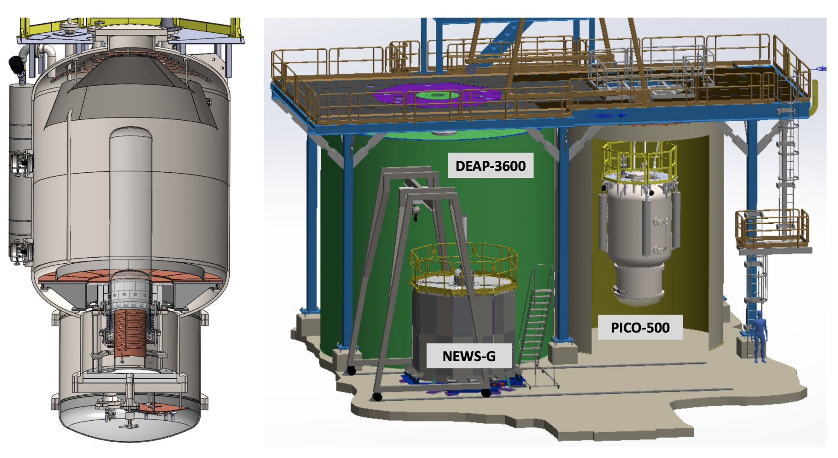
PICO-500
Detector volume filled with 250L of C3F8
Will be located in the SNOLab Cube Hall
https://www.doi.org/10.1088/1742-6596/2156/1/012068
Notes:
- Larger active fluid

Slide 17
Conclusion
PICO-40L is in commissioning stage, to be operational soon
Will be looking for a new world-limit for limit on dark matter

Slide 18
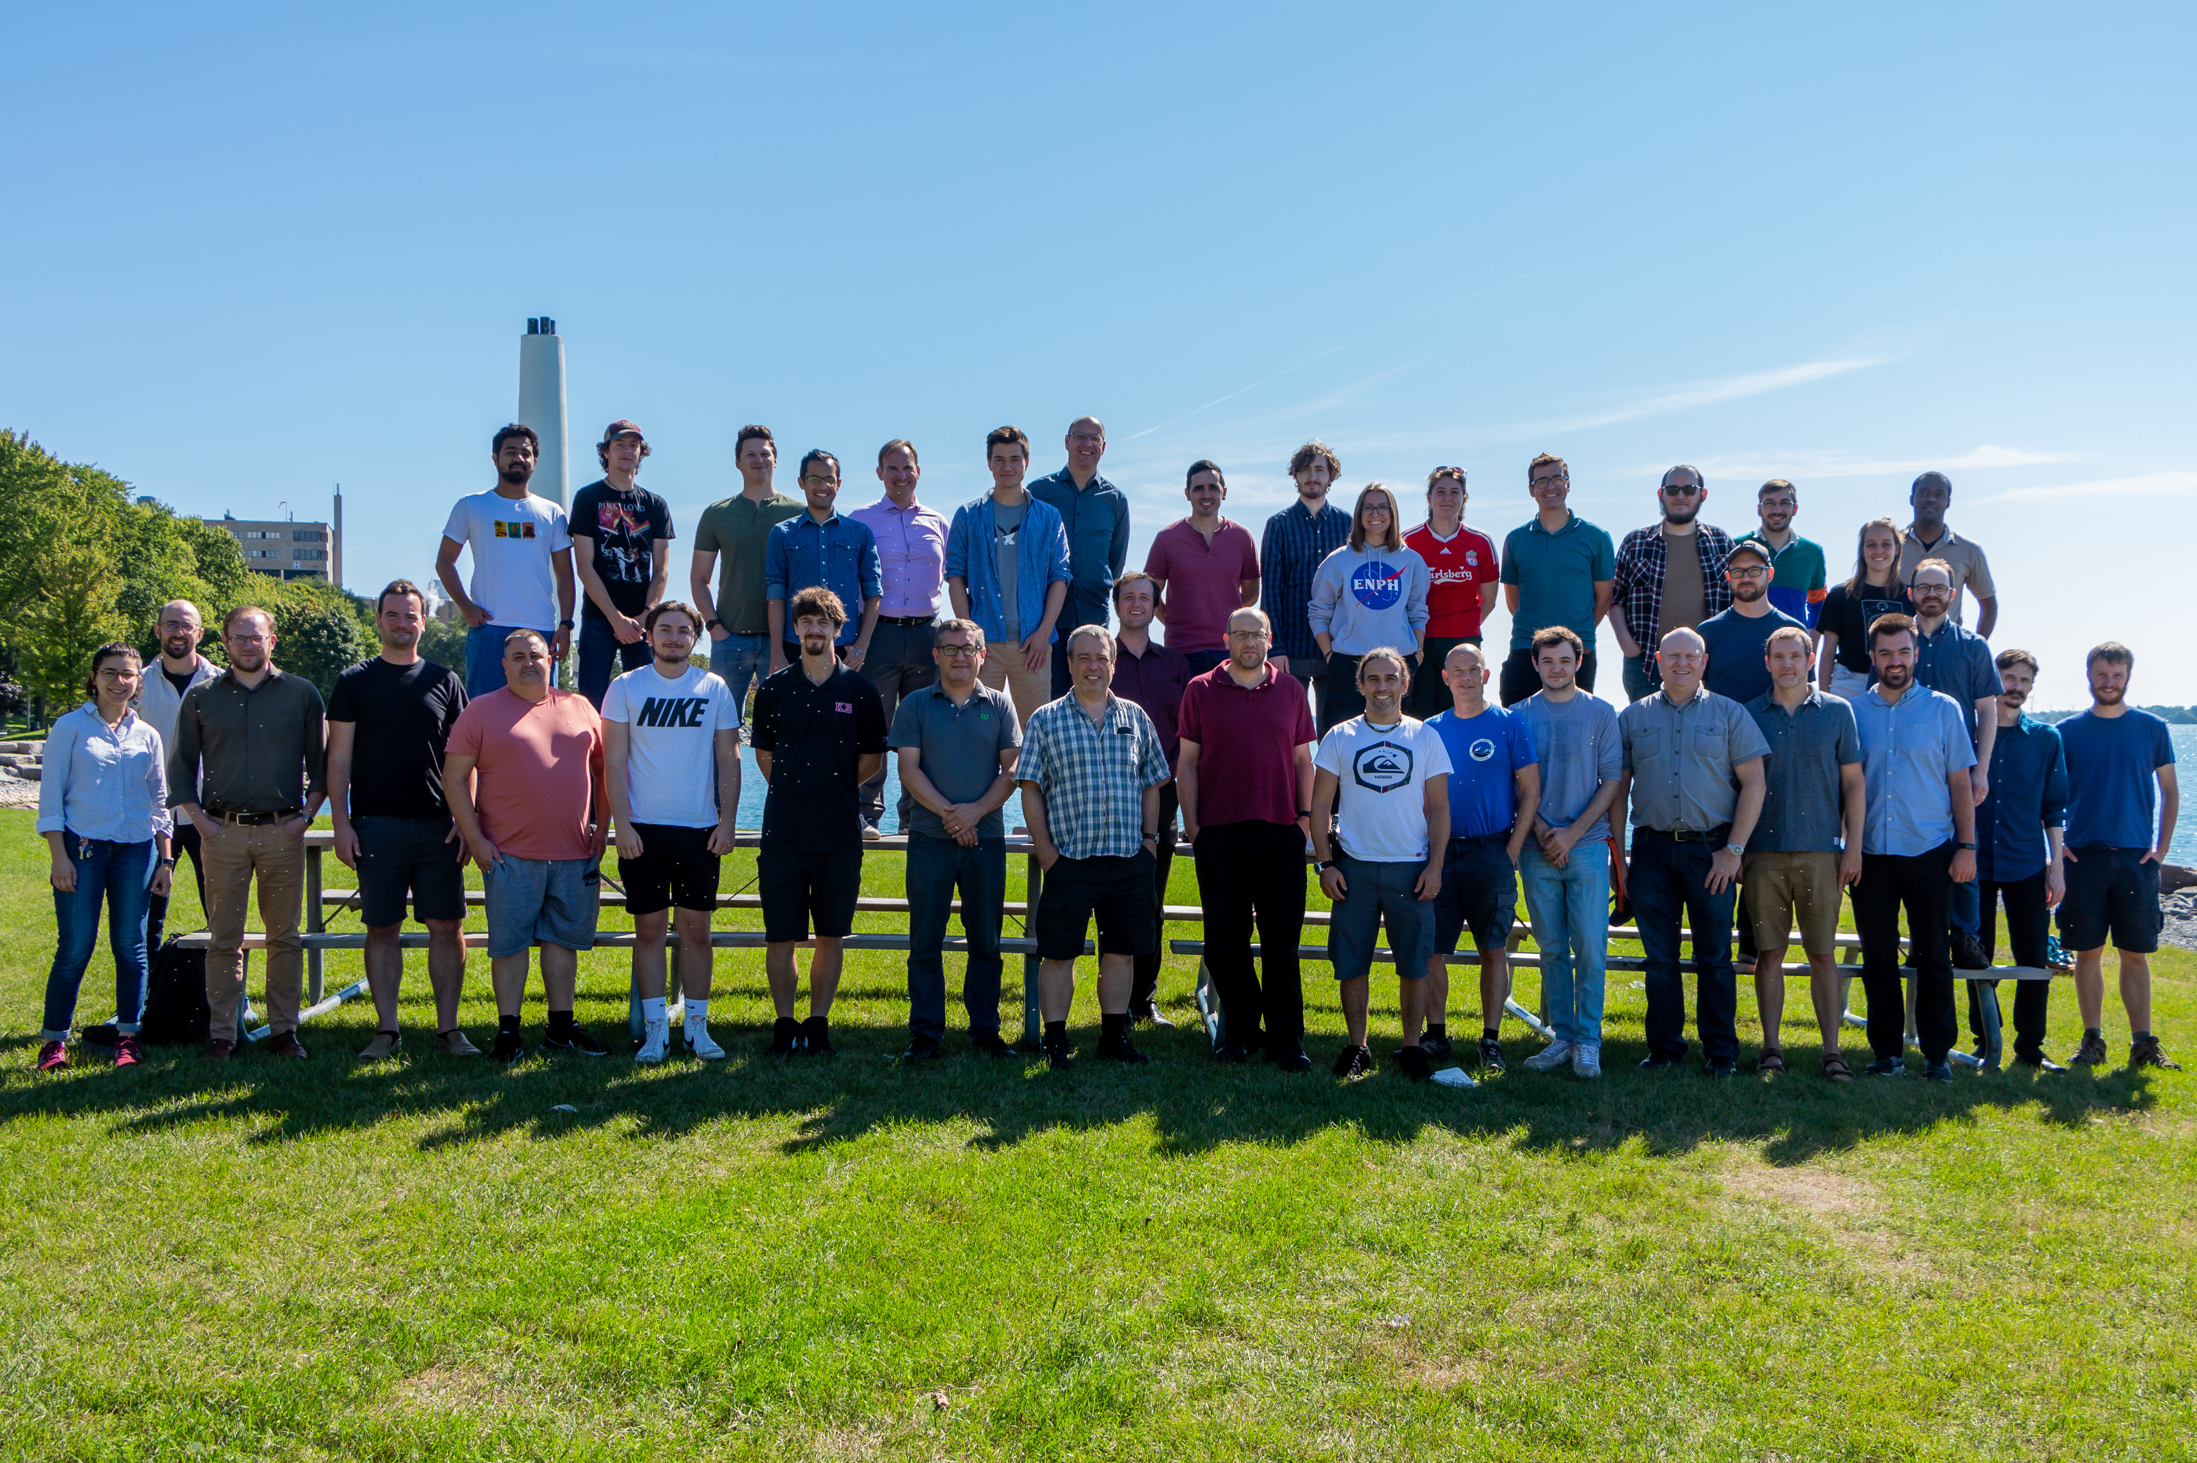
Thank you

Slide 19
Extra Slides

Slide 20
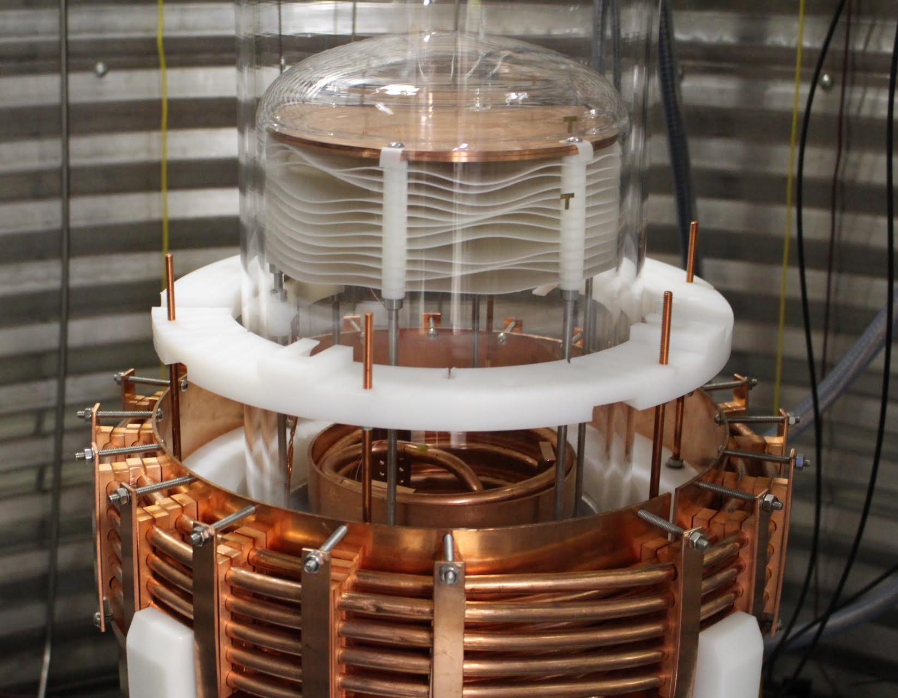
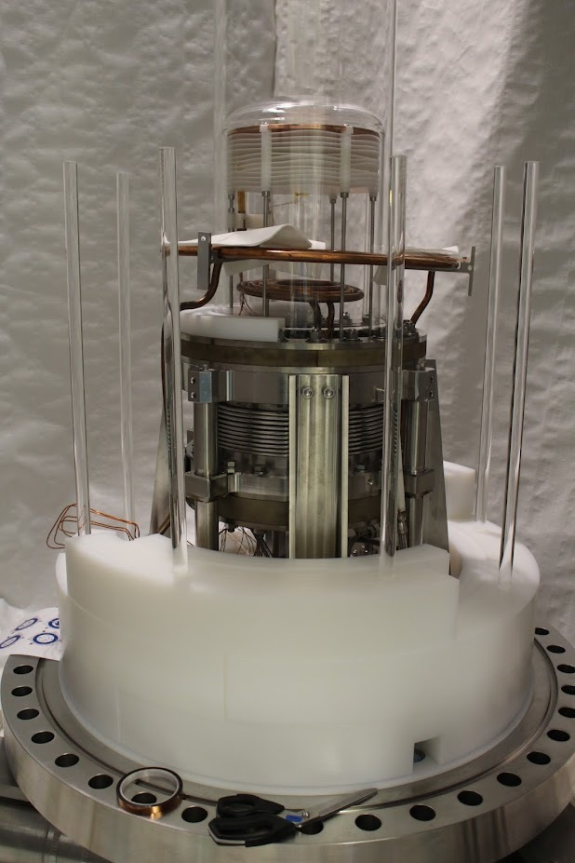
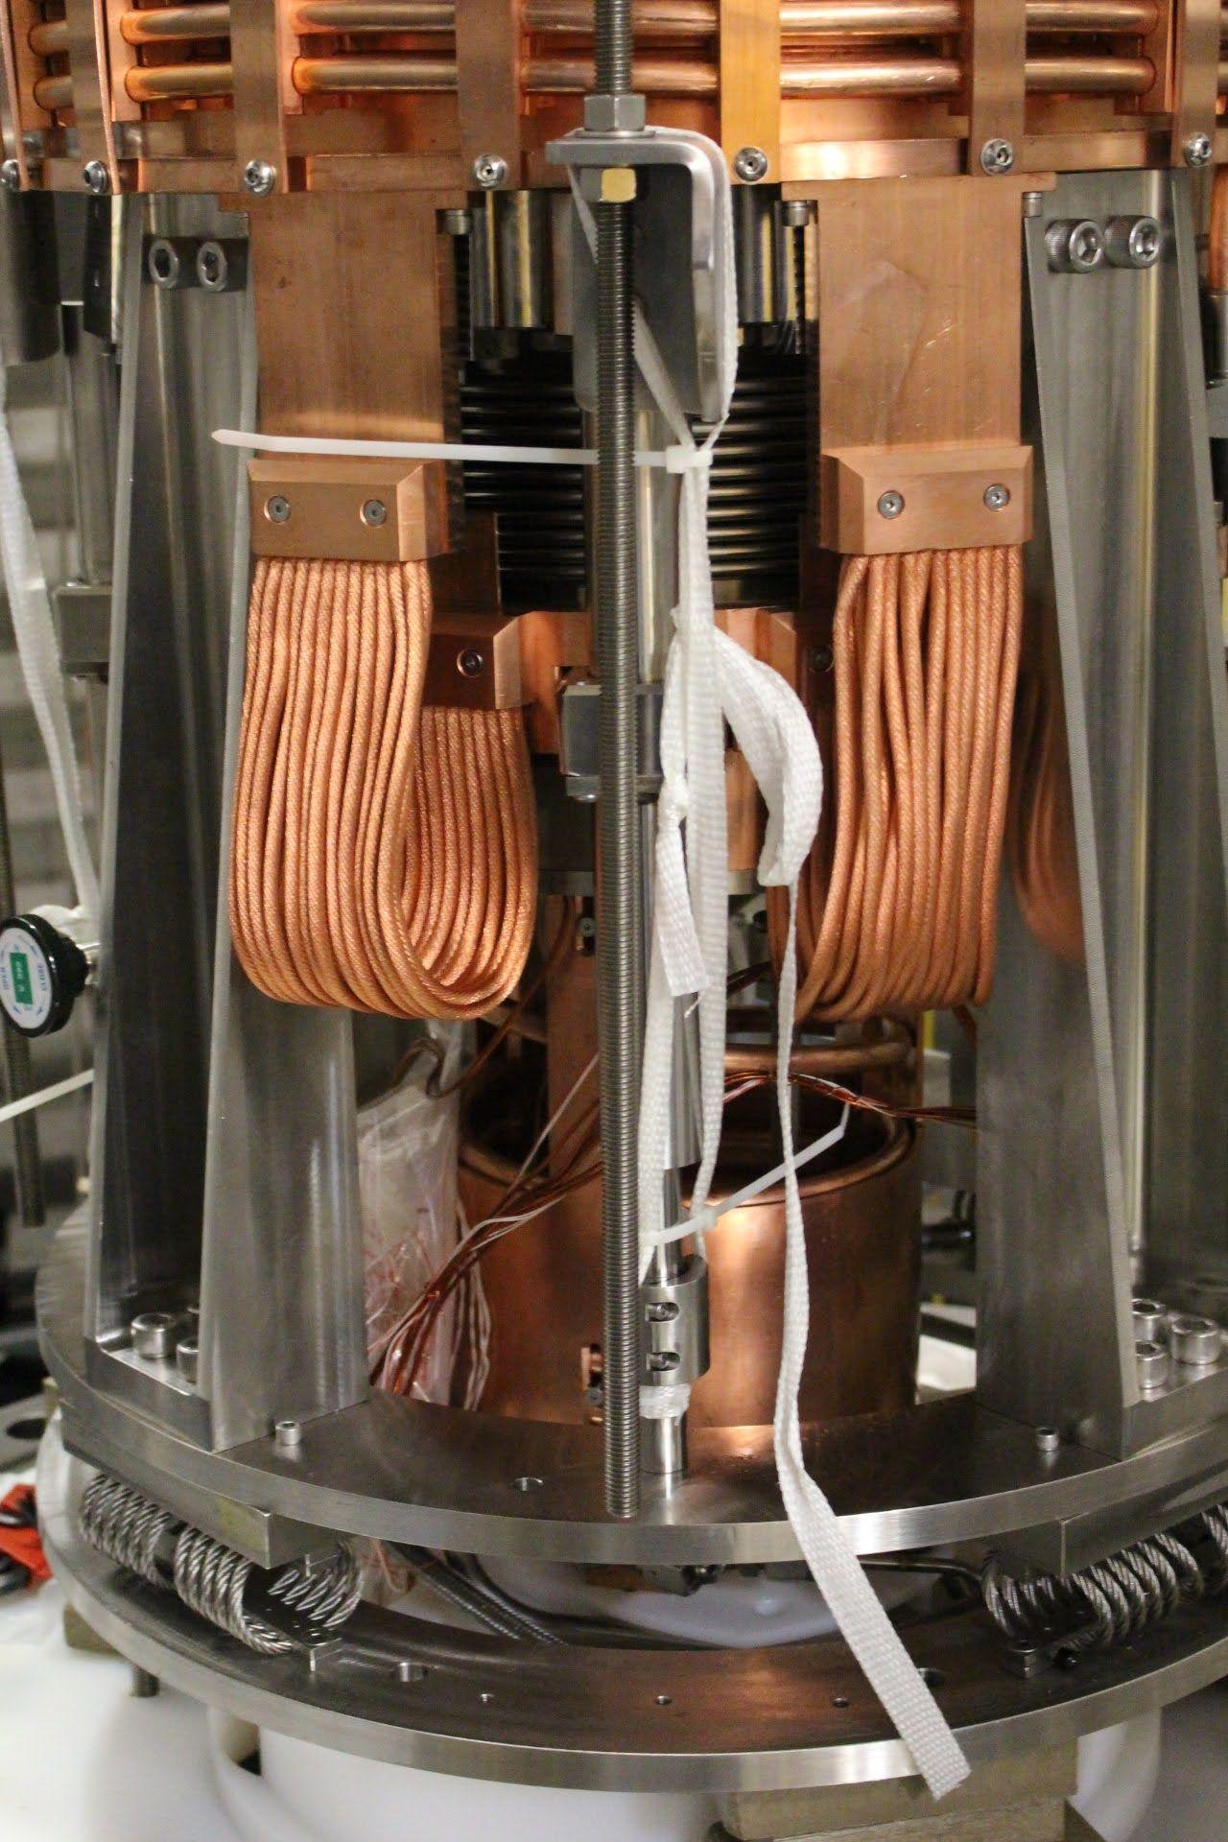
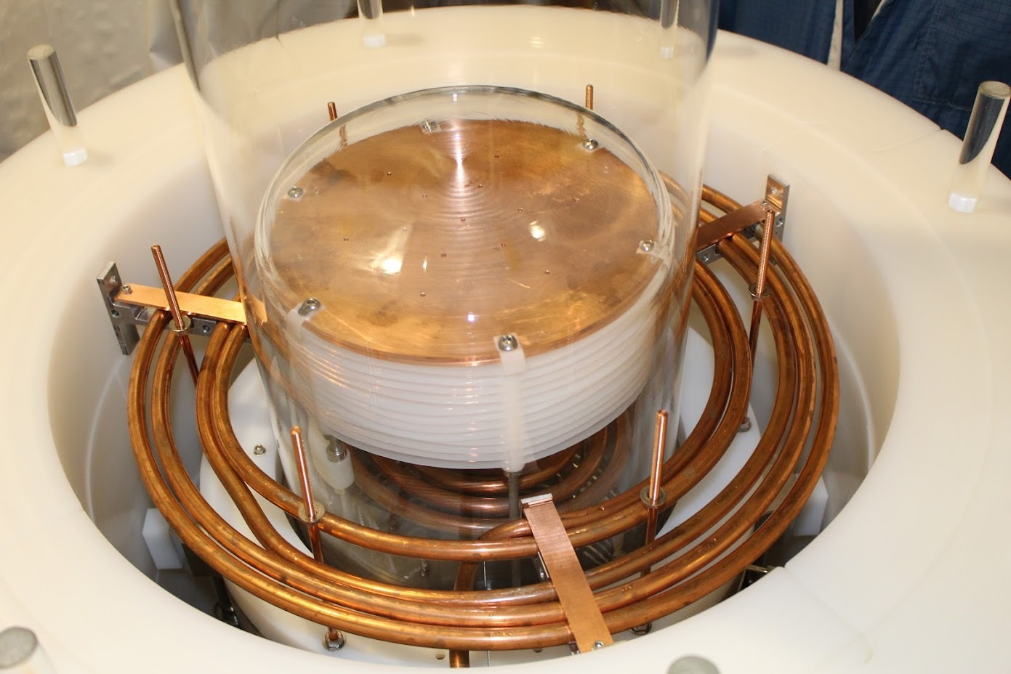
Cooling Coils Design
Old Design
New Design

Slide 21
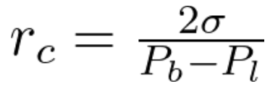
Bubble Formation
Threshold Energy
The critical radius is a property of the fluid
Notes:
Pb – pressure of bubble expanding
Pl – pressure of the liquid compressing against the bubble

