Slide 1
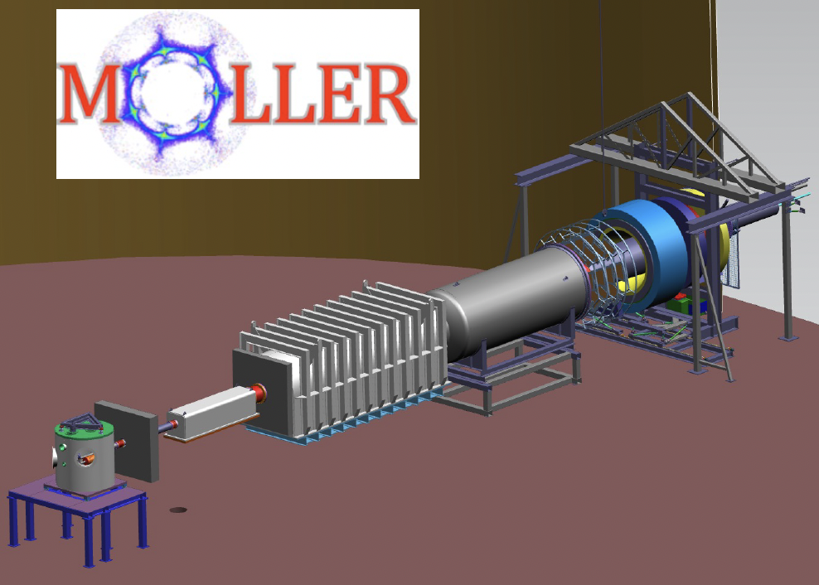
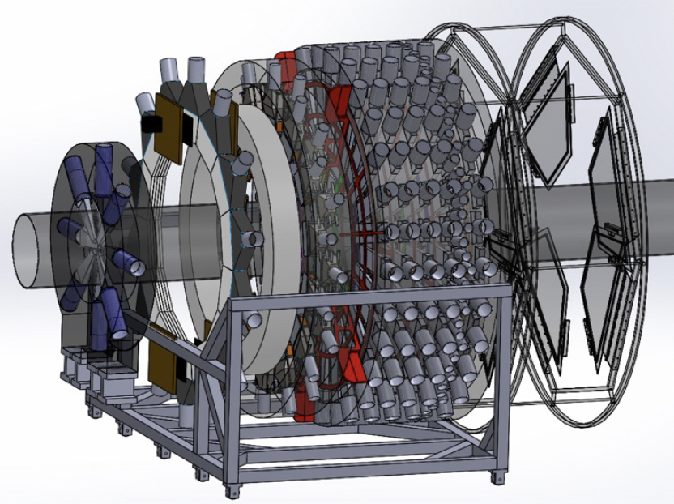
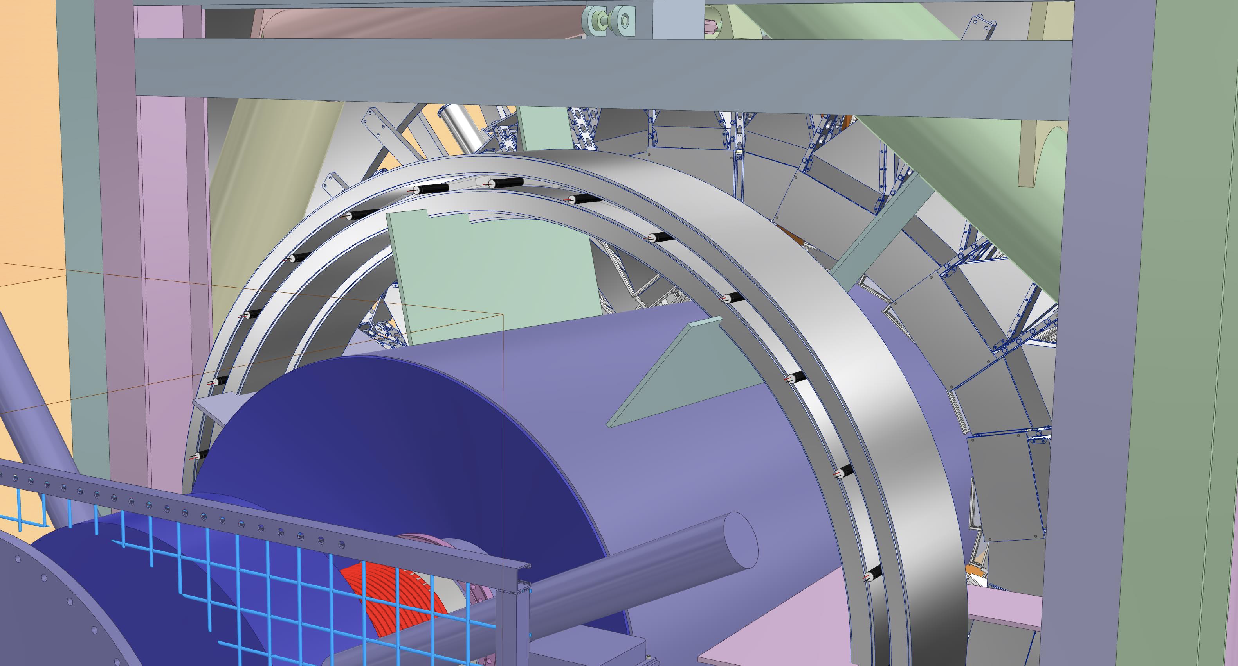



Validation of the design for a background detector
in the MOLLER experiment
Elham Gorgannejad
Dr. Wouter Deconinck
The MOLLER Collaboration
Winter Nuclear and Particle Physics Conference, 2023

Slide 2

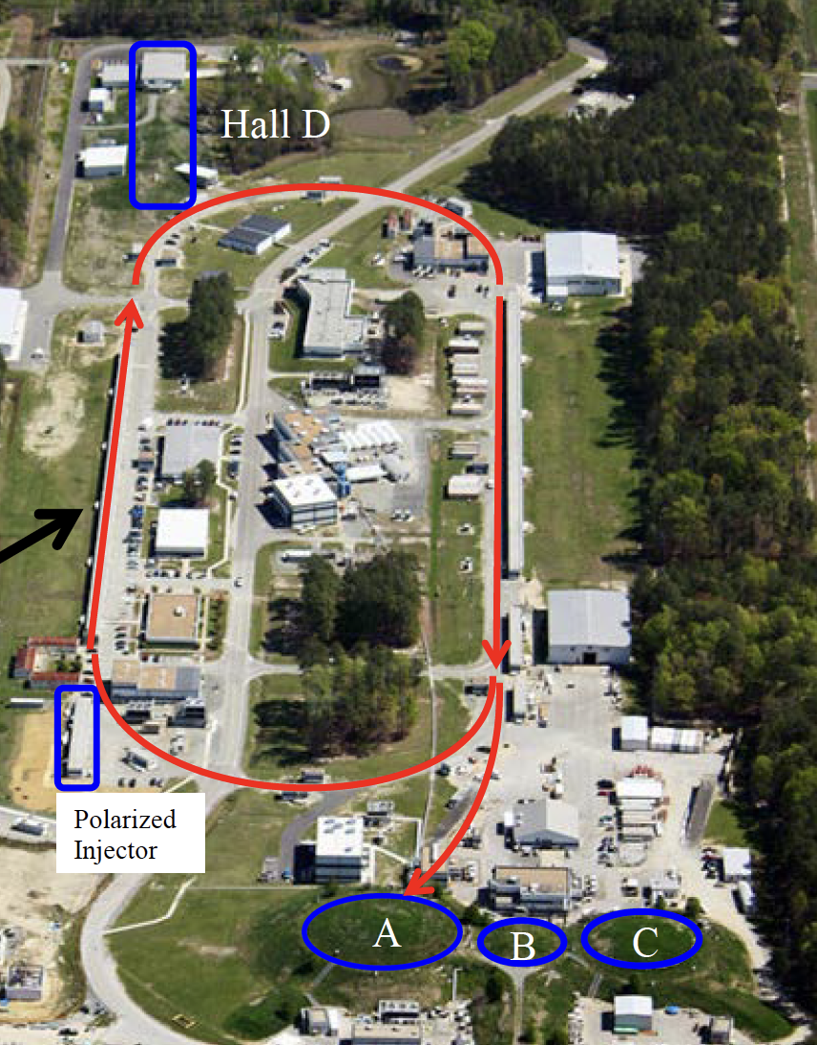

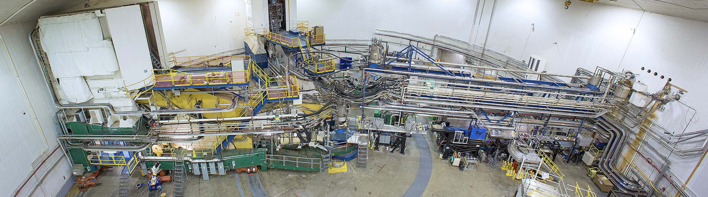
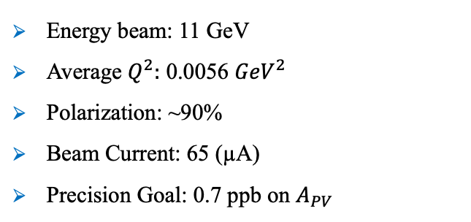
MOLLER experiment at Jlab
Measurement Of a Lepton Lepton Electroweak Reaction (MOLLER)
MOLLER kinematics:
Collaboration:
~ 120 authors,
30 institutions,
5 countries
In the advanced design phase
Physics run 2025-2027
Energy beam: 11 GeV
Average $Q^{2}:$ 0.0056 ${GeV}^{2}$
Polarization: ~90%
Beam Current: 65 (µA)
Precision Goal: 0.7 ppb on $A_{PV}$
Thomas Jefferson National Accelerator Facility (JLab), Newport News, Virginia (USA)
1/10

Slide 3
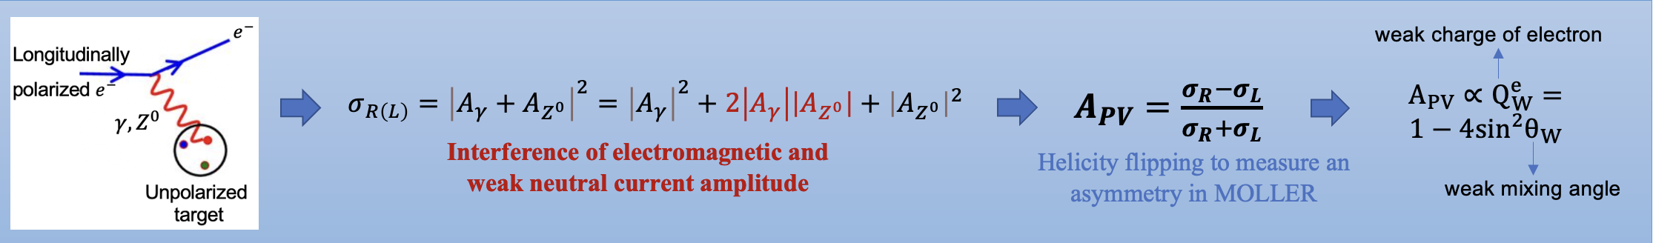
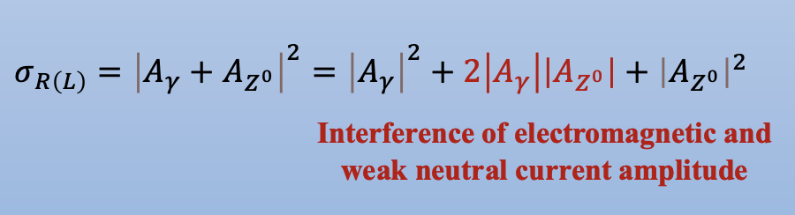

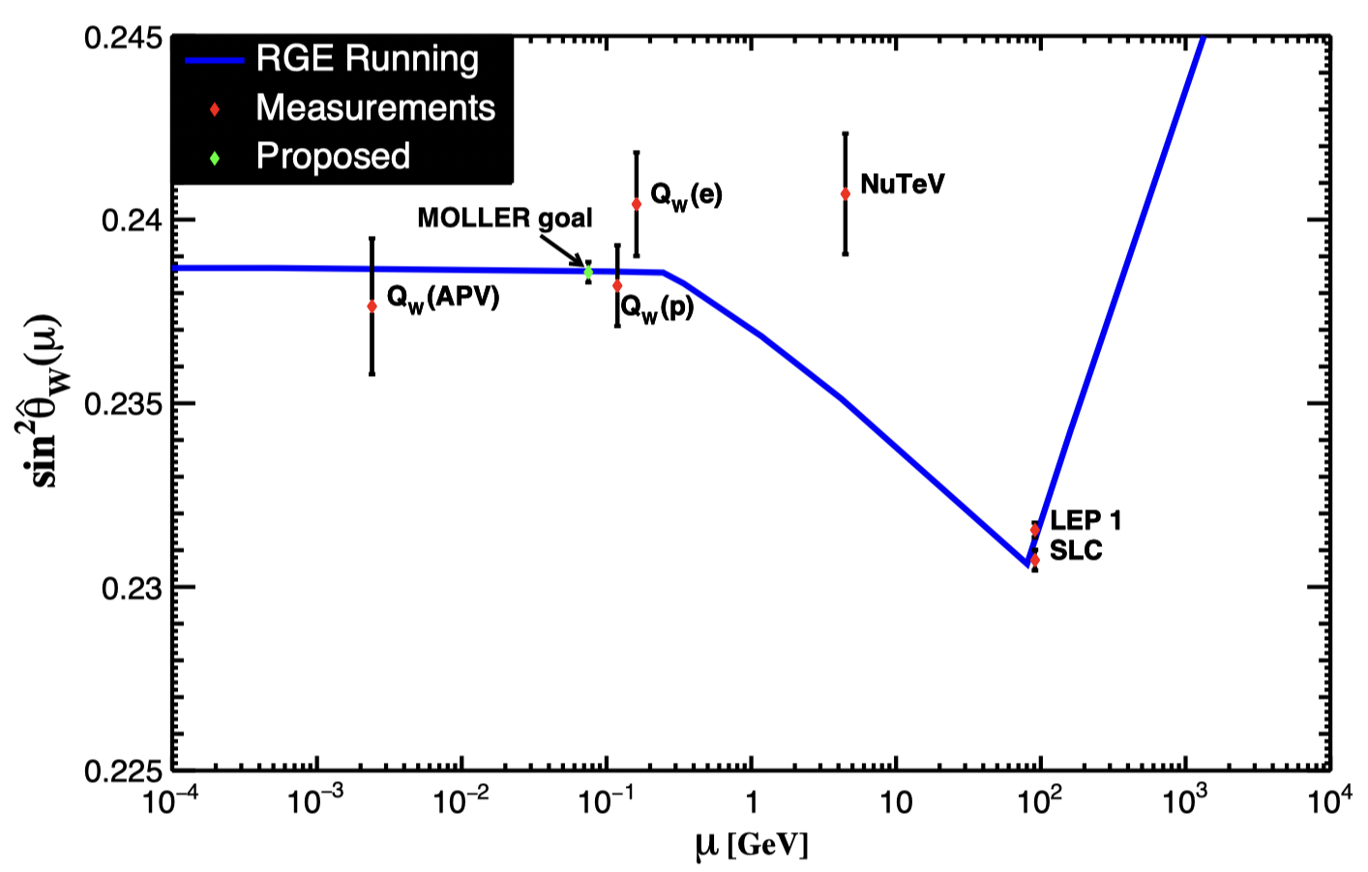
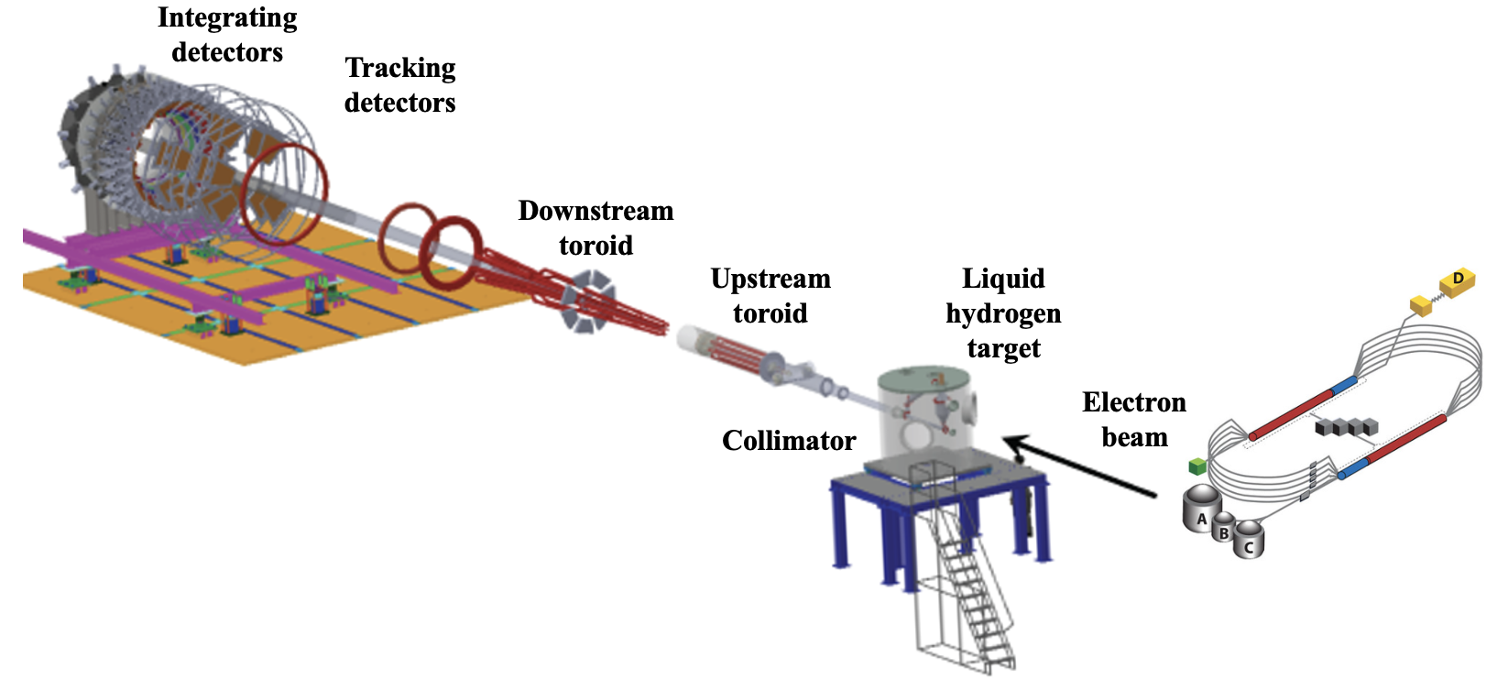
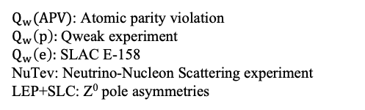
MOLLER experiment: Motivation
Background
detectors
Accelerator
$Q_{w}(APV)$: Atomic parity violation
$Q_{w}\left(p\right):$Qweak experiment
$Q_{w}\left(e\right):$SLAC E-158
NuTev: Neutrino-Nucleon Scattering experiment
LEP+SLC: Z⁰ pole asymmetries
2/10

Slide 4
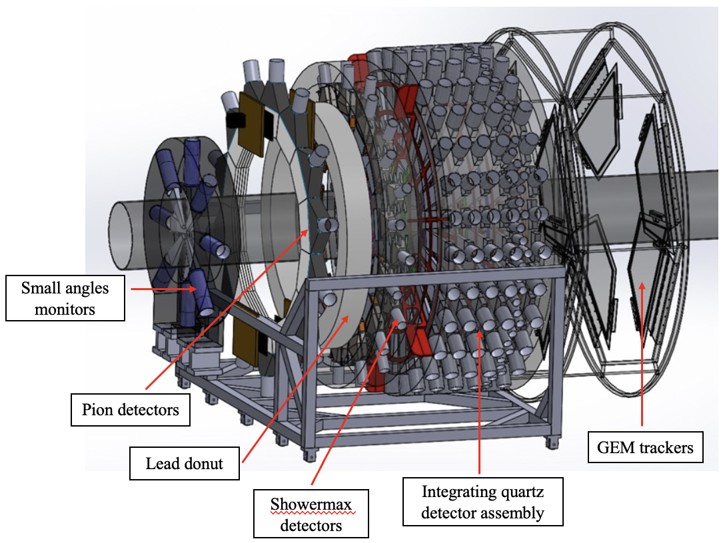
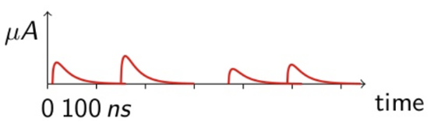
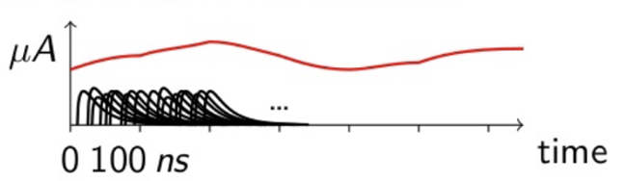
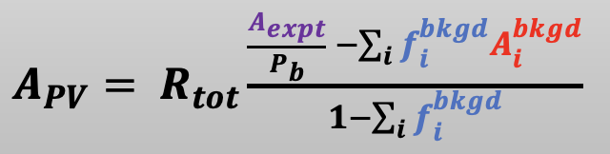

MOLLER experiment: Detector Overview
Background (counting mode) detectors:
Measure the background processes ($f_{i}^{bkgd}$)
Integrating (current mode) detectors:
Measure the asymmetry of both signal and background
($A_{expt},\text{, }A_{i}^{bkgd}$)
Electron
Beam
Showermax
detectors
3/10

Slide 5
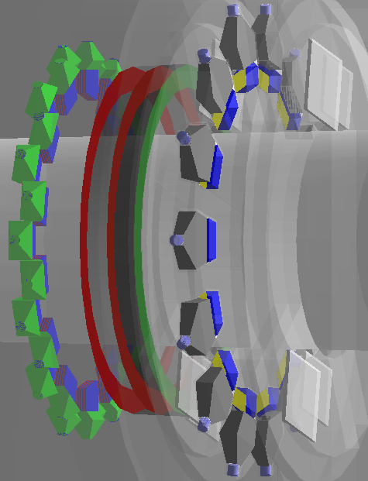
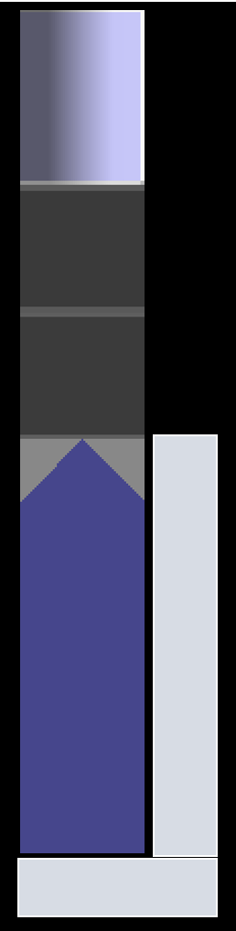
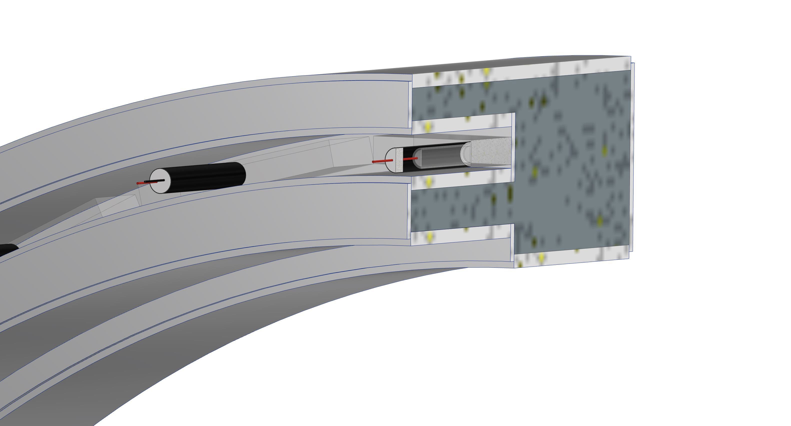
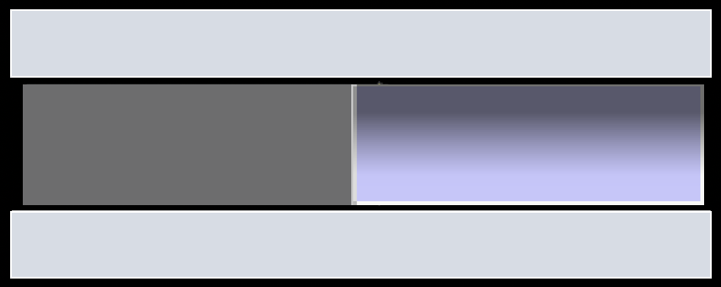
MOLLER experiment: Pion Detector System
Correction of $A_{expt}$ for pion background f^{π}A^{π}
Suppress the Møller electrons by more than a factor of 10³
2020 improvement:
Optimize geometry
Reduce Lucite thickness
Shielding
2021 improvement:
Rotate detector 90 degrees
Read out Lucite with directly-coupled
PMT (no lightguide)
Optimize optical design of Lucite
Final design (2022)
Integrating pion detector with Pb donut
28 segments instead of 14
One PMT/segment
Maintain rectangular shape for Lucite
Results:
pi/e photo-electron ratio:
10⁻³ > 5*10³ (meets design goal)
4/10

Slide 6
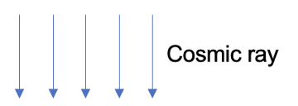
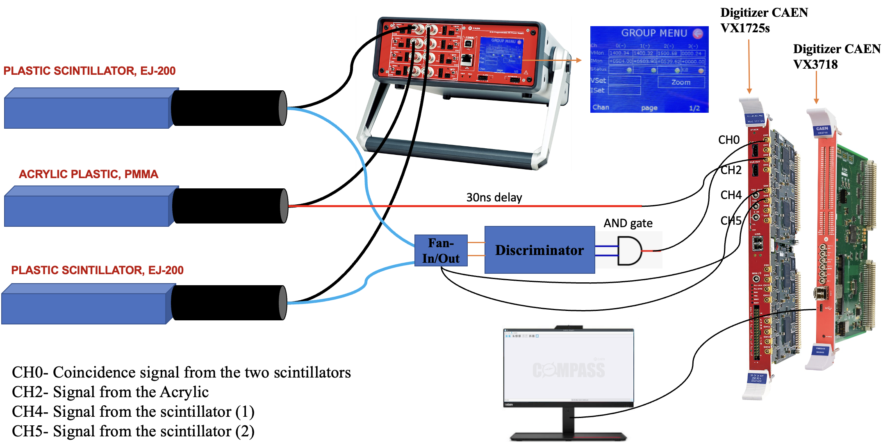
Pion Detector System: Cosmic test
VME to USB 2.0/
Optical Link Bridge
5/10

Slide 7
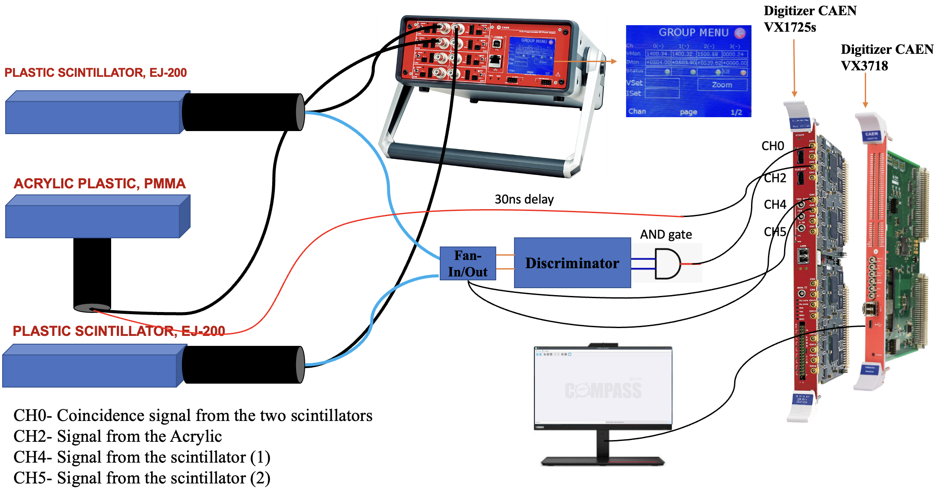
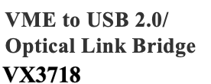
Pion Detector System: Cosmic test
6/10

Slide 8
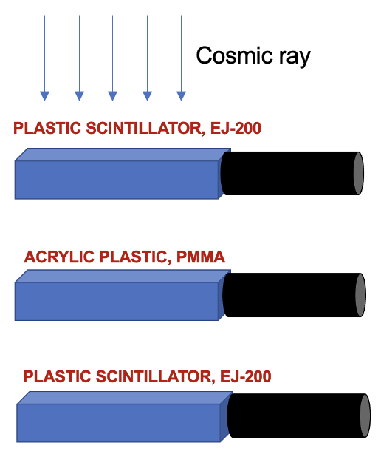
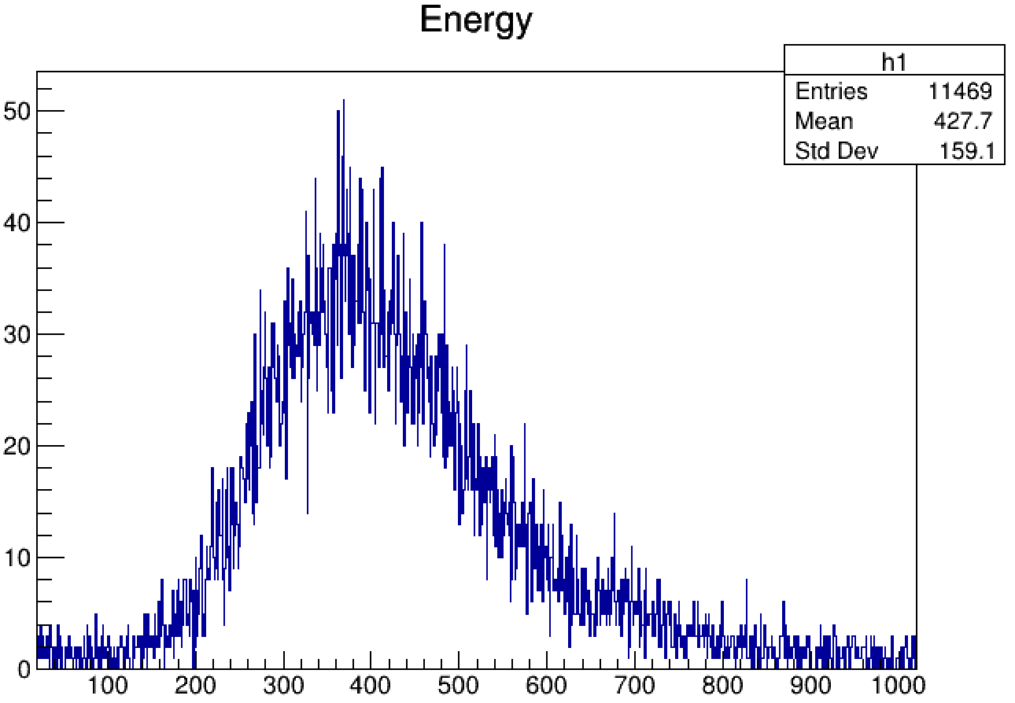
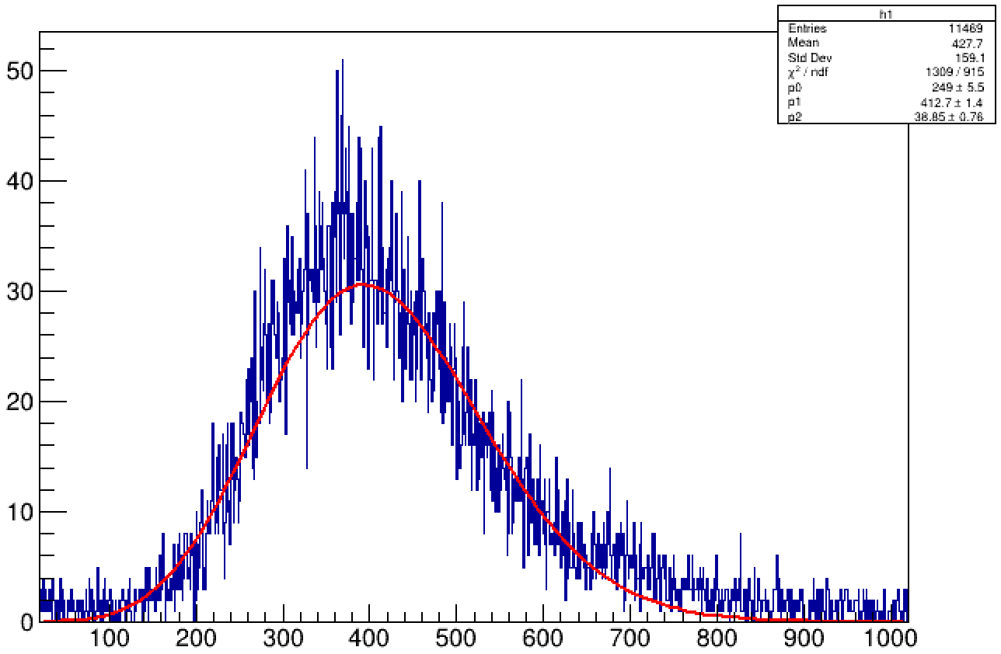
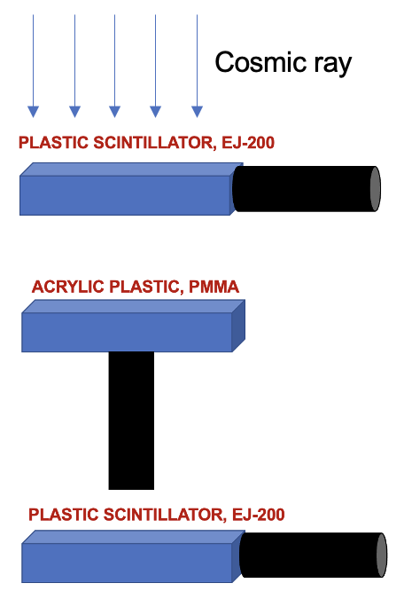
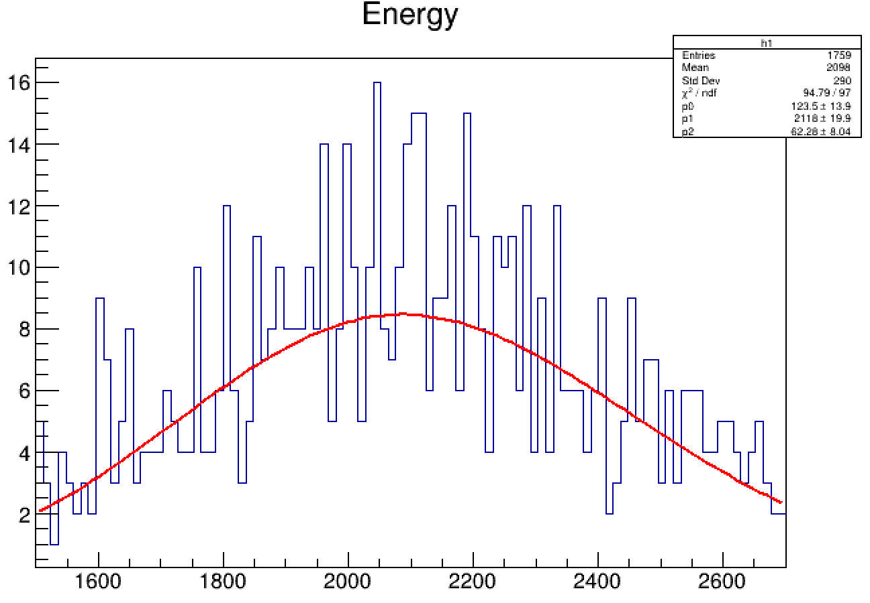
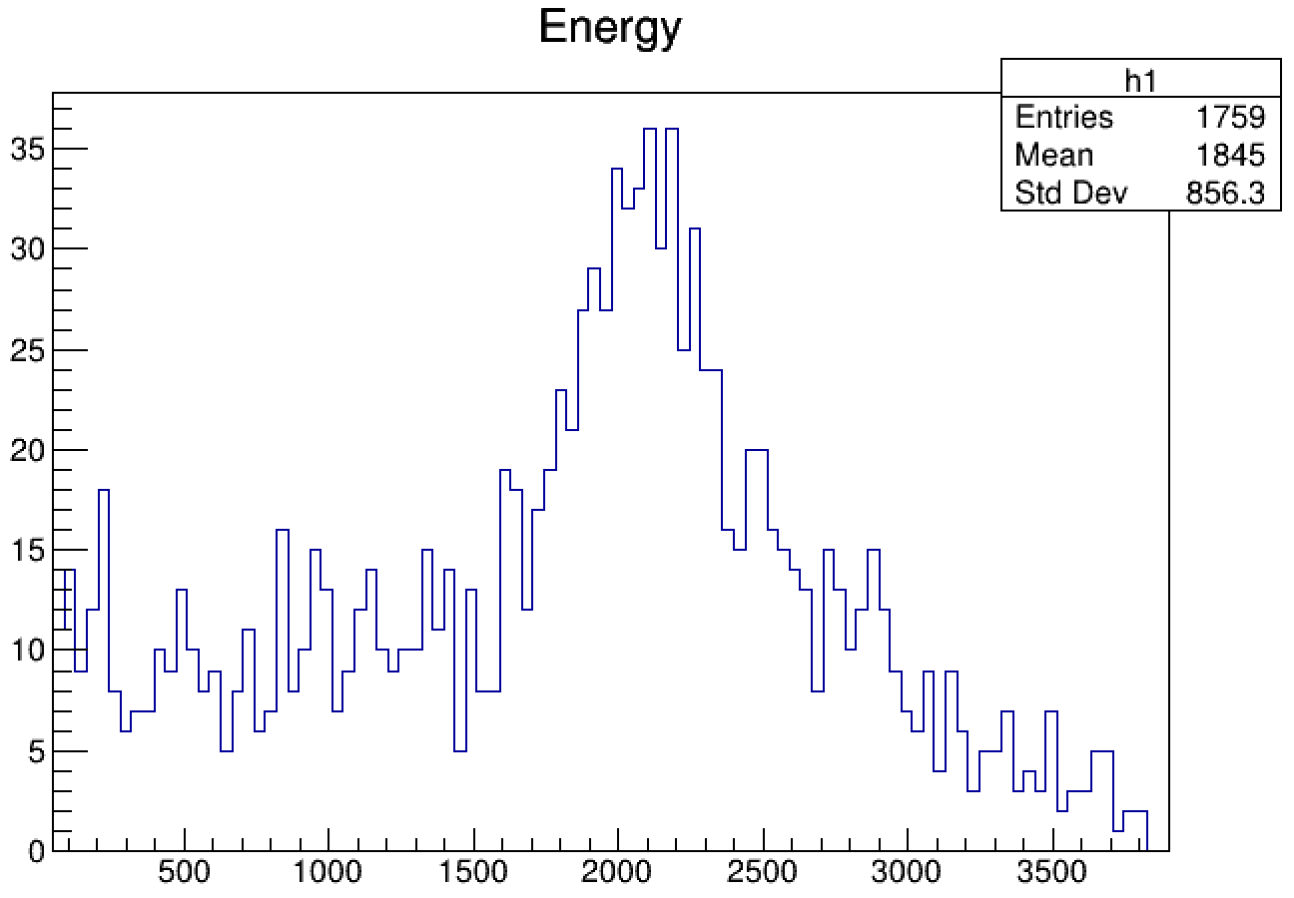


Pion Detector System: Cosmic test
(a.u.)
#PEs=10.6$±$0.3
Rotating the pion detector system in the simulations
Pi/e: 5.5% to 16.8%
#ADC
channel
#PEs= 34.2 $±$4.4
(a.u.)
#ADC
channel
7/10

Slide 9
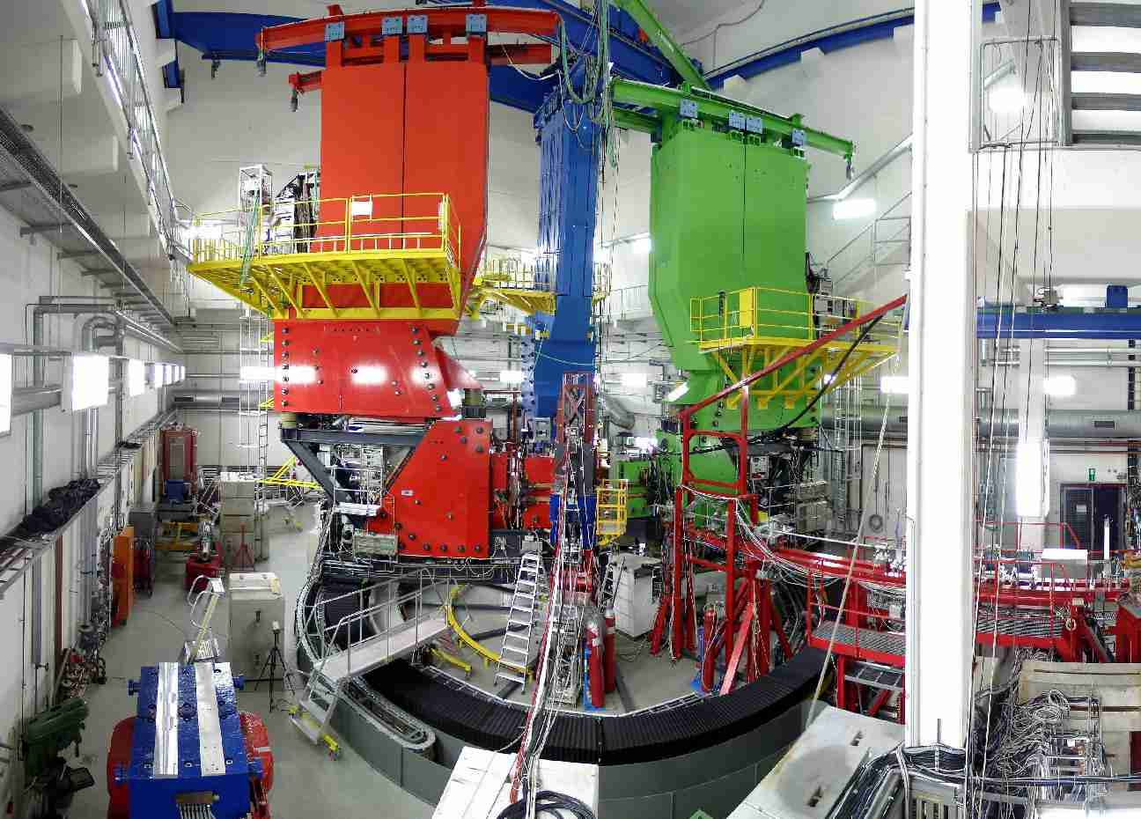
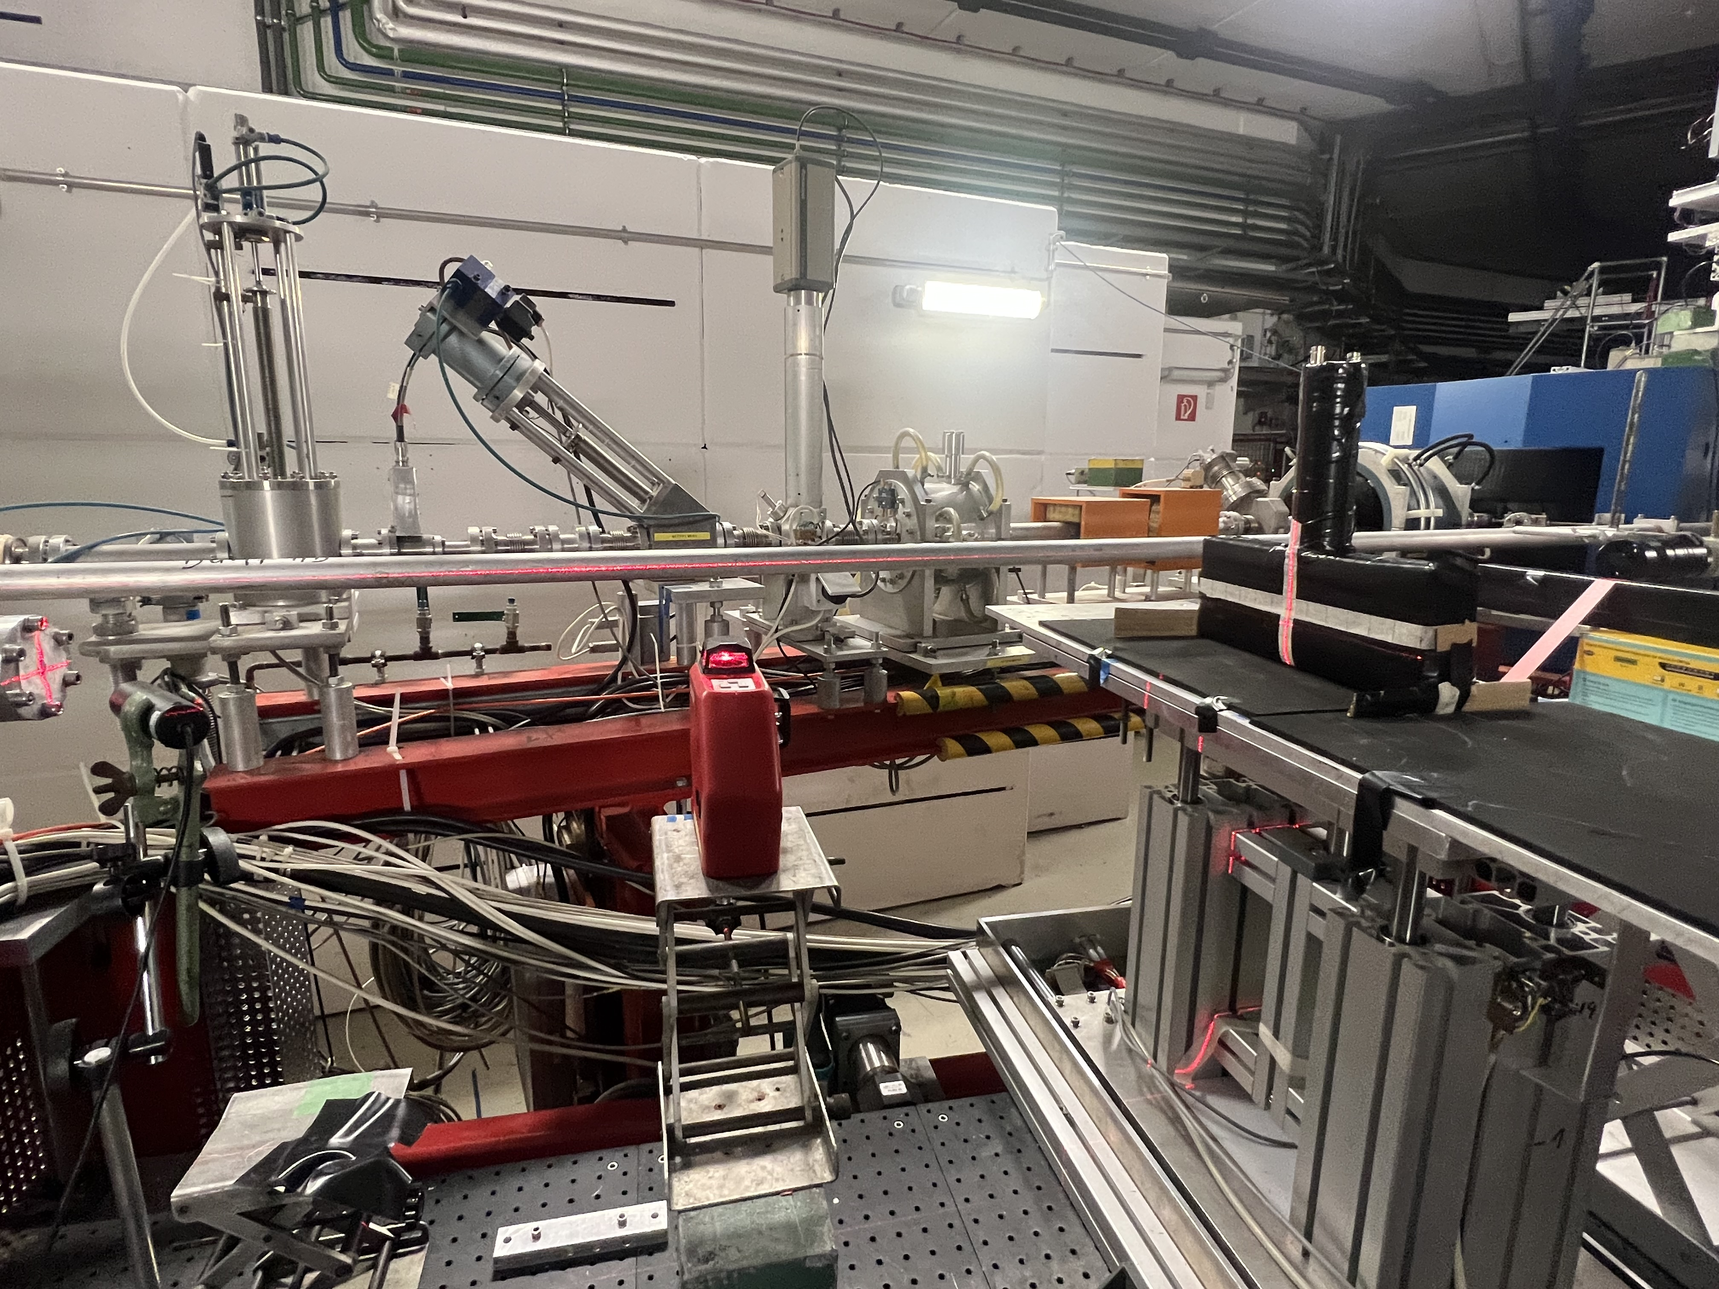
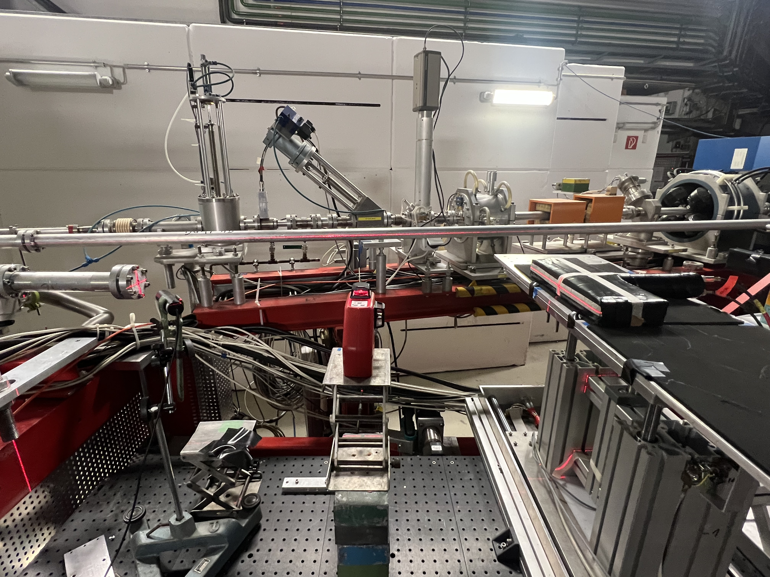
Pion Detector System: Beam test at Mainz Microtron (MAMI)
https://en.wikipedia.org/wiki/Mainz_Microtron
8/10

Slide 10
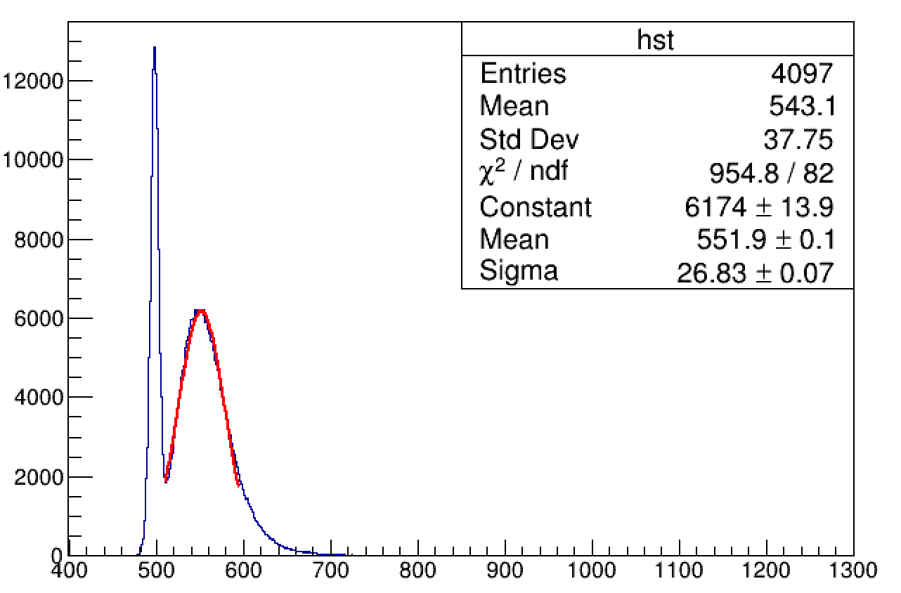
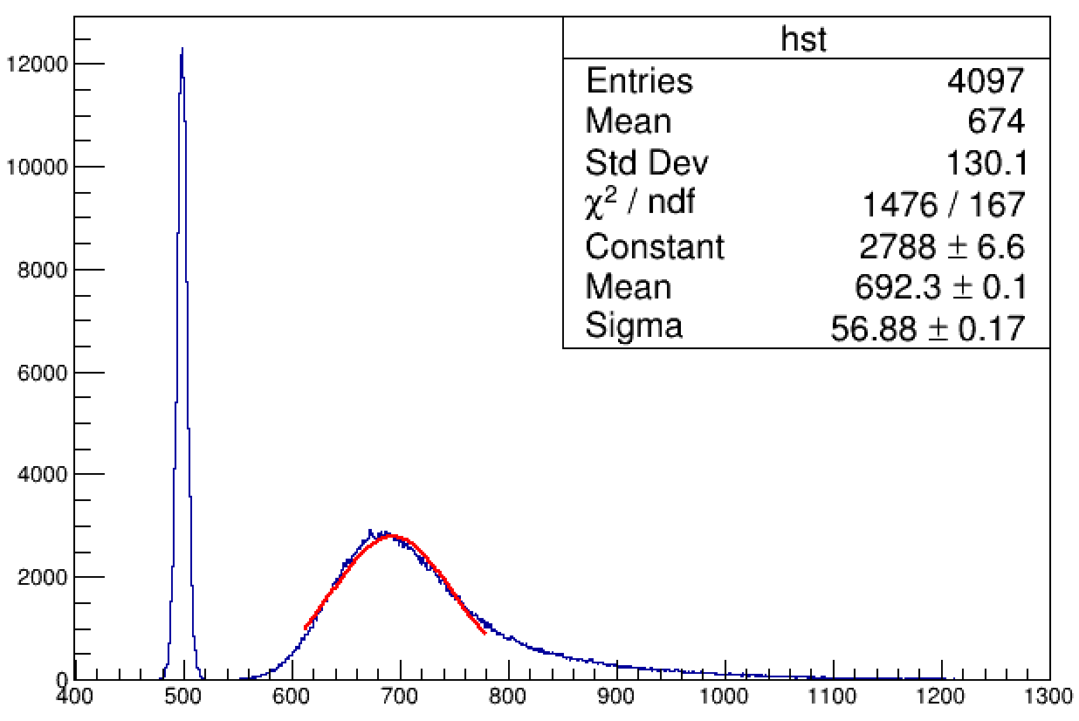
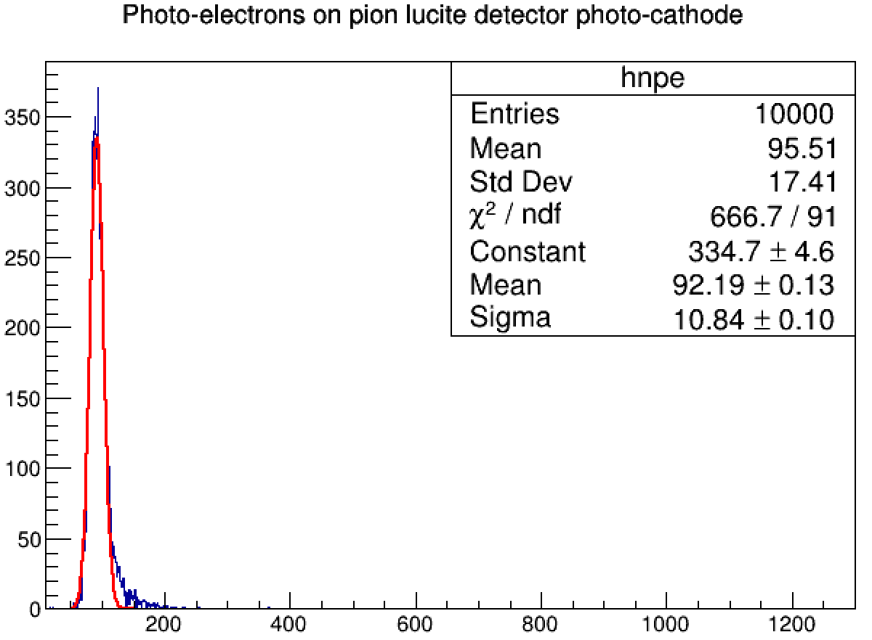
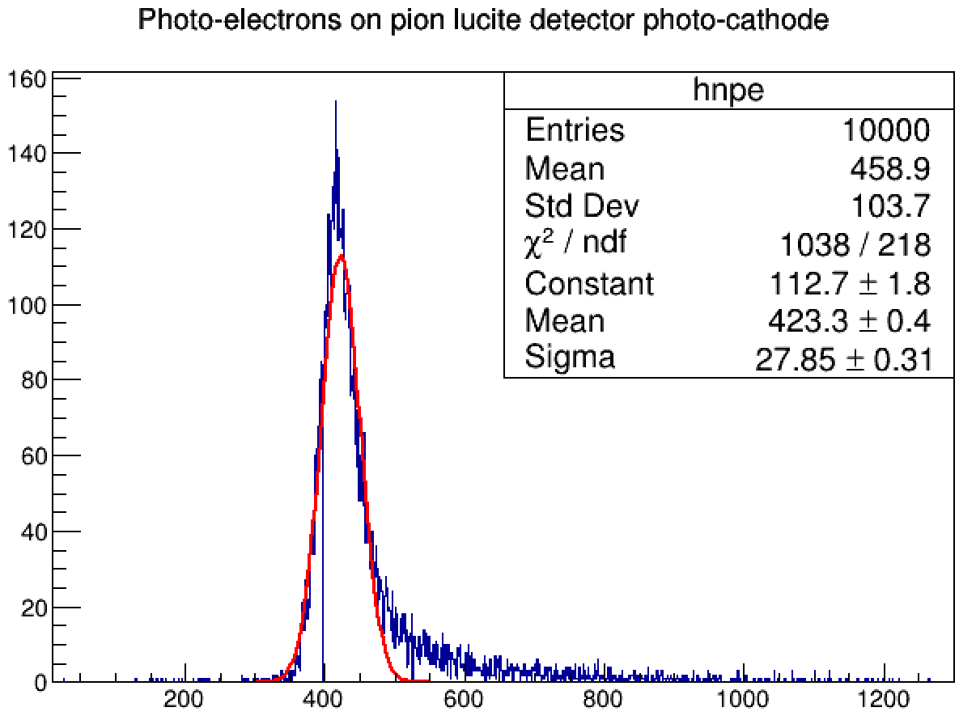
Pion Detector System: Beam test at Mainz Microtron (MAMI)
Configuration (1)- vertical
Beam tests
Configuration (2)- horizontal
Pedestal
Pedestal
(a.u.)
Ratio of
Min#PEs=3.3
(a.u.)
Signal
Signal
#PEs
#PEs
Simulations
Signal
Signal
(a.u.)
Ratio of
Min#PEs=3.5
(a.u.)
Pedestal peak at zero
Pedestal peak at zero
#PEs
#PEs
9/10

Slide 11
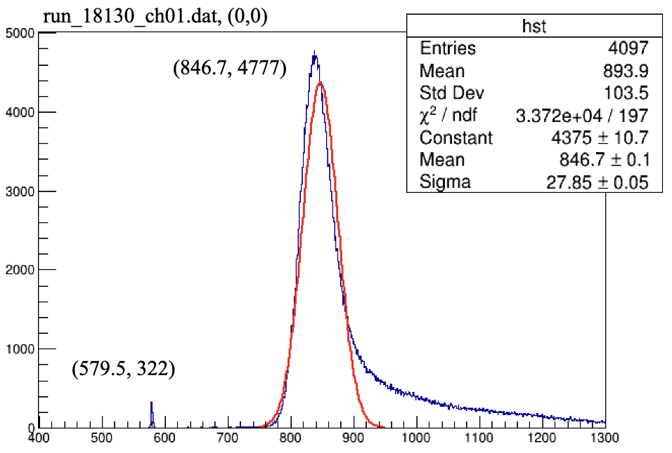
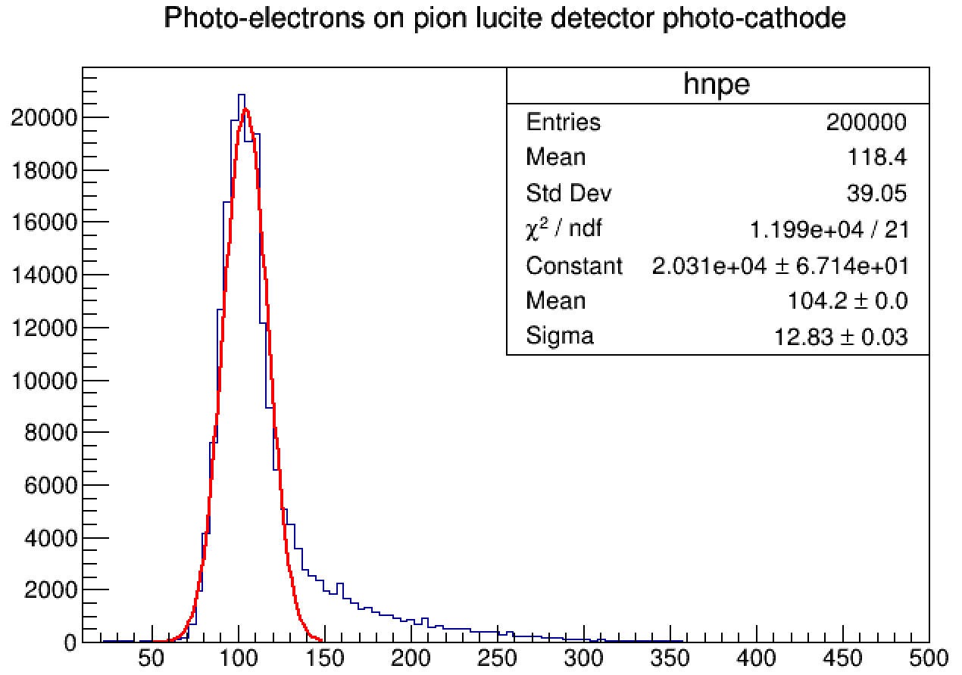
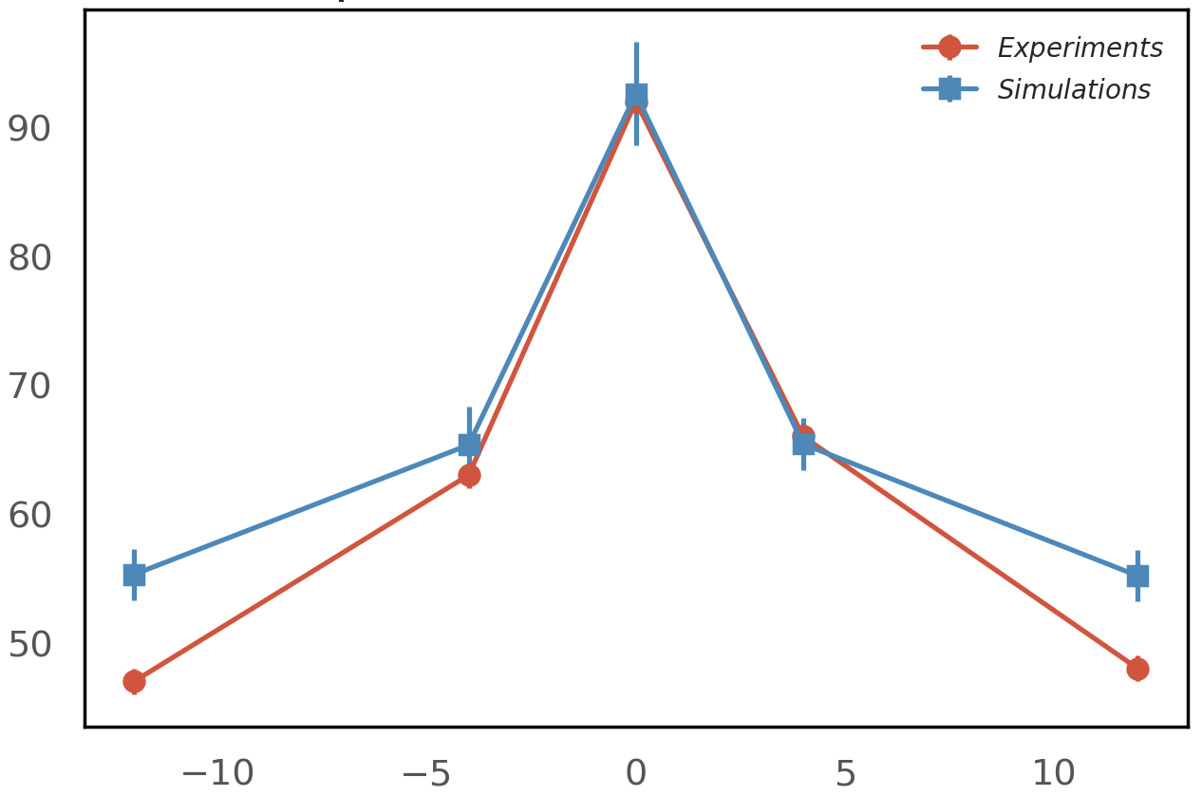
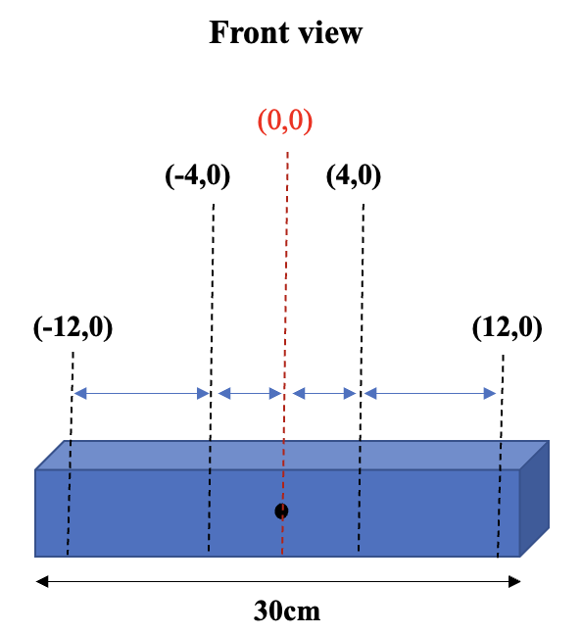
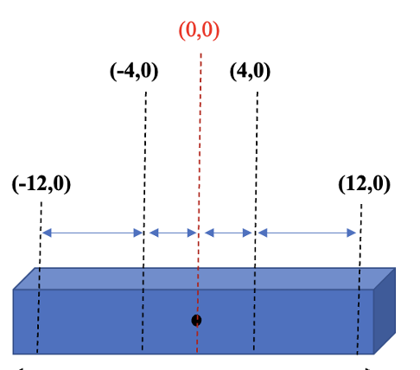
Pion Detector System: Beam test at Mainz Microtron (MAMI)
The signal from the beam test
The signal from the simulation
(a.u.)
(a.u.)
Min#PEs=92
#PEs=118
#PEs
#PEs
#PEs in different positions
(a.u.)
Simulations scaled to experiment at (0,0)
#PEs
10/10

Slide 12


Conclusion & Acknowledgement
Conclusion
Team Members:
Elham Gorgannejad (U. Manitoba)
Dr. Wouter Deconinck (U. Manitoba)
Dr. David Armstrong (William & Mary)
High-precision detector system in the MOLLER experiment
Background corrections with background detectors
Pion detector for pion correction (f_{π}A_{π})
Pion detector design has reached > 50% ( in π/e p.e. ratio)
Integrating pion detector with Pb donut
Consistency between the simulations and the cosmic tests
Consistency between the simulations and the beam tests
Funding sources:
Natural Sciences and Engineering Research Council of Canada (NSERC)
Canada Foundations for Innovation (CFI)
Canadian Institute of Nuclear Physics (CINP) graduate fellowship
Next steps
Adding the current mode to the counting mode
Finish the mechanical design

Slide 13
Backup slides

Slide 14
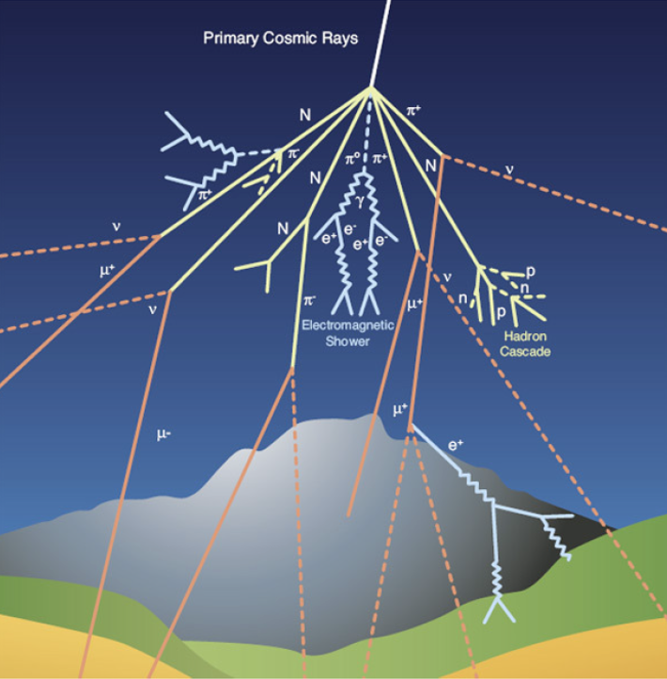
Pion Detector: Prototyping (Cosmic rays detection)
Fundamentals
The muons, produced by the decay of pions and kaons generated by the hadronic interaction of the primary cosmic rays with atmospheric nuclei, are the most cosmic rays at sea level.
Mass ∼ 200 times the electron mass
Average energy at sea level ~ 4 GeV
long lifetime ~ 2,2x10⁻⁶ s
allow muons to cross the atmosphere and reach the Earth's surface
Secondary cosmic Ray Decay
Pion Lifetime (ns) Kaon Lifetime (ns) Muon Lifetime (ns)
26.033 12.38 2196.98

Slide 15
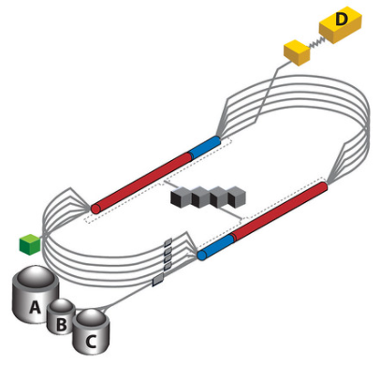
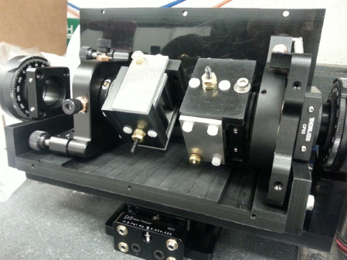
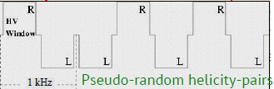
MOLLER experiment: Electron beam preparation
Polarized Beam Requirements
GaAs
photocathode
Accelerator and Hall A
Laser
light
Linear
polarizer
Pockels cell
The RTP Pockels cell developed to support 2 kHz flipping and precise control of beam asymmetries for MOLLER.
consider neighboring windows of opposite helicity
window-pairs occurring at a frequency of about 1 kHz.

Slide 16
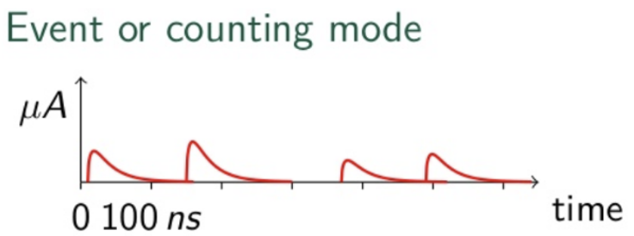
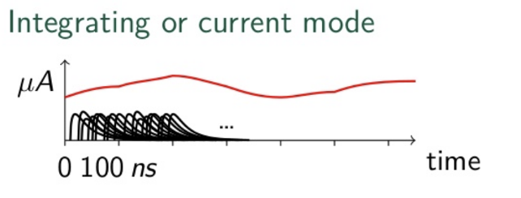



MOLLER experiment: Data acquisition
Event data taking mode:
Integrating data taking mode :
$A_{PV}= R_{tot}\frac{\frac{A_{expt}}{P_{b}} −\sum_{i}{f_{i}^{bkgd}A_{i}^{bkgd}}}{1−\sum_{i}{f_{i}^{bkgd}}}$
$R_{tot}$: overall normalization factor,
$P_{b}:$beam polarization
$A_{expt}$: experimentally measured asymmetry
$f_{i}^{bkgd}:$fractional dilution factors
$A_{i}^{bkgd}:$asymmetries
Background measurements ($f_{i}^{bkgd}$)
Asymmetry measurements ($A_{expt},\text{, }A_{i}^{bkgd}$)

Slide 17
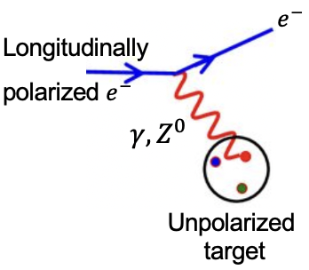



MOLLER experiment: Conceptual Design Overview
Accelerator
$Q_{w}(APV)$: Atomic parity violation
$Q_{w}\left(p\right):$Qweak experiment
$Q_{w}\left(e\right):$SLAC E-158
NuTev: Neutrino-Nucleon Scattering experiment
LEP+SLC: Z⁰ pole asymmetries
weak charge of electron
$$σ_{R\left(L\right)}={\left|A_{γ}+A_{Z^{0}}\right|}^{2}={\left|A_{γ}\right|}^{2}+2\left|A_{γ}\right|\left|A_{Z^{0}}\right|+{\left|A_{Z^{0}}\right|}^{2}$$
$A_{PV}=\frac{σ_{R}−σ_{L}}{σ_{R}+σ_{L}}$
$$A_{PV}∝Q_{W}^{e}=$$
$$1−4\sin^{2}θ_{W}$$
Interference of electromagnetic and
weak neutral current amplitude
Helicity flipping to measure an asymmetry in MOLLER
weak mixing angle
2/10

