Slide 1

Investigation of States Populated in the ¹⁰²Ru(p,t)¹⁰⁰Ru Two Neutron Transfer Reaction
Samantha Buck
WNPPC : February 18, 2023
Caption

Slide 2


Overview
Background
Topics of Discussion
Project Motivation
Experiment
Results & Discussion
Summary
Notes:
So just a quick overview of the itinerary we’ll be going through :
I’ll start us off with some background theory to lay down the conceptual theoretical framework upon which the experimental research of this thesis sits
Then I’ll move onto the specific motivating factors for why this particular nucleus, 100 Ruthenium , is of interest, and what we can hope to garner from a better understanding of it’s structure
Next I’ll outline the experimental procedure that was employed in order to carry out our objectives for 100Ru, and take a birds eye view look at the experimental setup, in particular the Q3D magnetic spectrograph that was the used to detect the two neutron transfer reaction
Then we move into the analysis and results section were we’ll have a look at the how the collected data was analyzed and used in order to produce a spectra from which we could construct our desired angular distributions, which is the analytical probe that offers us the information we’re after in this particular context
And finally we’ll wrap it up with a quick summary at the end.
Okay, so from the top

Slide 3
Overview
Background
Topics of Discussion
Project Motivation
Experiment
Analysis
Results & Discussion
Summary
Notes:
These magic numbers can be explained in terms of the Shell Model of the nucleus, which considers each nucleon to be moving in some potential and classifies the energy levels in terms of quantum numbers \(n l j\), in the same way as the wavefunctions of individual electrons are classified in Atomic Physics.
Following the discoveries of the neutron by Chadwick in 1932 \cite{Chadwick1932} and fission by Meitner, Frisch, Hahn and Strassman in 1938 \cite{Meitner1939}, the discovery of $\beta$-delayed neutron emission was published by Roberts et al. \cite{Roberts1939, Roberts2_1939}.
Studying the neutron emitted following $\beta$-decay has a range of applications which includes characterizing the nuclear structure of short-lived neutron-rich nuclei and obtaining experimental inputs to be used for astrophysical r-process calculations and nuclear reactor modelling.
Fully understanding the r process is a challenge that involves detailed knowledge of nuclear masses, …
to be described in Section \ref{ch:BR}.
An efficiency curve was produced using calibration sources to correct fitted peak areas for Compton scattering effects. This was done using the $Radware$ programs $encal$ and $effit$ \cite{radware}, and the process is fully described in \cite{radich2015Thesis}.

Slide 4
Background : Nuclear Models
- shell model
-Collective model can accommodate deformed behaviour (deformations) of nucleus by employing a non spherically symmetric potential : we get vibrators and rotators
-Expected Ru was a vibrator, however new info lead to possible alternative explanations (shape coexistence ?)
Notes:
These magic numbers can be explained in terms of the Shell Model of the nucleus, which considers each nucleon to be moving in some potential and classifies the energy levels in terms of quantum numbers \(n l j\), in the same way as the wavefunctions of individual electrons are classified in Atomic Physics.
Following the discoveries of the neutron by Chadwick in 1932 \cite{Chadwick1932} and fission by Meitner, Frisch, Hahn and Strassman in 1938 \cite{Meitner1939}, the discovery of $\beta$-delayed neutron emission was published by Roberts et al. \cite{Roberts1939, Roberts2_1939}.
Studying the neutron emitted following $\beta$-decay has a range of applications which includes characterizing the nuclear structure of short-lived neutron-rich nuclei and obtaining experimental inputs to be used for astrophysical r-process calculations and nuclear reactor modelling.
Fully understanding the r process is a challenge that involves detailed knowledge of nuclear masses, …
to be described in Section \ref{ch:BR}.
An efficiency curve was produced using calibration sources to correct fitted peak areas for Compton scattering effects. This was done using the $Radware$ programs $encal$ and $effit$ \cite{radware}, and the process is fully described in \cite{radich2015Thesis}.

Slide 5
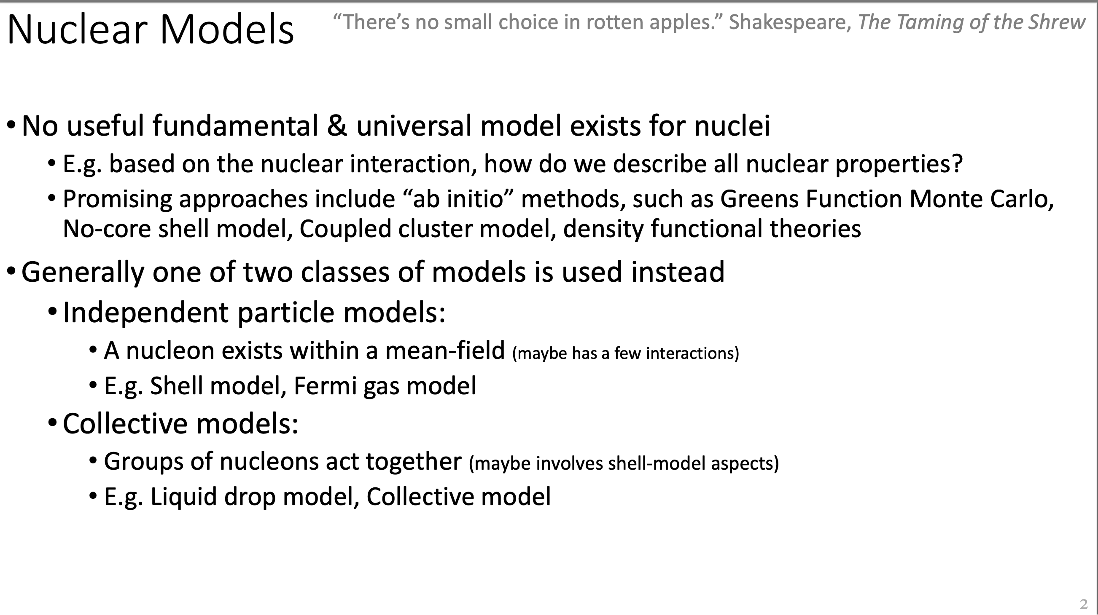
Background : Nuclear Models
Shell Model
Background
Project Motivation
Experiment
Analysis
Results & Discussion
Summary
Notes:
No universal fundamental model exists that can capture all of the nuclear properties involved in describing nuclei across the entirety of the chart of nuclides. However, towards the initiative of figuring out the best was possible to achieve this, generally one of two classes of models is used
The Nuclear Shell Model is successful in predicting:
- Origin of magic numbers
- Spins and parities of ground states
- Trend in magnetic moments
- Some excited states near closed shells, small excitations in odd \(A\) nuclei

Slide 6

Background : Nuclear Models
Shell Model
Collective Model
Notes:
One of the foremost goals of nuclear physics is to provide an understanding of how nuclei are assembled from the basic constituent building blocks of protons and neutrons. Studies attempt to achieve this by observing the excitation's of nuclei under fine-tuned experimental conditions with, however, this initiative continues to present as extraordinarily non-trivial in nature, as these complex nucleic systems exhibit unique characteristics and trends in different areas of the chart of nuclides, many of which are yet to be fully understood and parameterized.
As such, from a theoretical standpoint, no universal fundamental model currently exists that can capture all of the nuclear properties involved in describing nuclei across the entirety of the chart of nuclides. However, towards the initiative of figuring out the best was possible to achieve this, generally one of two classes of models is used
A prime example of one such characteristic is the behaviour of collective states within the context of the shell model, and how this feature evolves in different Z areas of the chart of nuclides.

Slide 7


Background : Nuclear Models
Shell Model
Collective Model
Independent particle model
Groups of nucleons act together
Designed to account for quantal properties of nuclei, such as spins, quantum states, magnetic moments, and magic numbers.
Integration of Shell Model and Liquid Drop Model
Explains both global properties and quantal properties of nuclei
Fundamental assumption that all the nucleons are different ; i.e. nucleons are fermions and must occupy different quantum states as a result of the Pauli exclusion principal
Two major types of collective motion:
Rotations: Rotations of a deformed shape
Vibrations: Surface oscillations
Notes:
One of the foremost goals of nuclear physics is to provide an understanding of how nuclei are assembled from the basic constituent building blocks of protons and neutrons.
However, needless to say nuclei are complicated structures to understand.
Studies attempt to achieve this by observing the excitation's of nuclei under fine-tuned experimental conditions with, however, this initiative continues to present as extraordinarily non-trivial in nature, as these complex nucleic systems exhibit unique characteristics and trends in different areas of the chart of nuclides, many of which are yet to be fully understood and parameterized.
As such, from a theoretical standpoint, no universal fundamental model currently exists that can capture all of the nuclear properties involved in describing nuclei across the entirety of the chart of nuclides. However, towards the initiative of figuring out the best was possible to achieve this, generally one of two classes of models is used
A prime example of one such characteristic is the behaviour of collective states within the context of the shell model, and how this feature evolves in different Z areas of the chart of nuclides.

Slide 8
Background : Nuclear Models
Shell Model
Collective Model
Independent particle model
Groups of nucleons act together
Designed to account for quantal properties of nuclei, such as spins, quantum states, magnetic moments, and magic numbers.
Integration of both global properties and quantal properties of nuclei
Fundamental assumption that all the nucleons are different ; i.e. nucleons are fermions and must occupy different quantum states as a result of the Pauli exclusion principal
Two major types of collective motion:
Rotations: Rotations of a deformed shape
Vibrations: Surface oscillations
Notes:
One of the foremost goals of nuclear physics is to provide an understanding of how nuclei are assembled from the basic constituent building blocks of protons and neutrons.
However, needless to say, nuclei are pretty complicated structures to understand.
Experimentally speaking, studies attempt to achieve this by observing the excitation's of these nuclei under fine-tuned conditions with, however, this initiative continues to present as extremely non-trivial in nature, as these complex systems exhibit unique characteristics and trends in different areas of the chart of nuclides, many of which are yet to be fully understood and parameterized.
As such, from a theoretical standpoint, no universal fundamental model currently exists that can capture all of the nuclear properties involved in describing nuclei across the entirety of the chart of nuclides. However, towards the initiative of figuring out the best was possible to achieve this, there are several phenominological models that have been developed, and generally Generally, one of two classes of models is used
to achieve this. Either an independent particle model, such as the shell model, where a
nucleon exists within a mean-field, or a collective model, which characterizes the structure
of nuclei as being governed by groups of nucleons that act collectively together.
Of the
several phenomenological models which have evolved to this end, perhaps one of the most
well adapted is known as the shell model
y they all approach the interaction picture from either a quantum perspective, one which is governed by the so called quantal properties of the nuclei, such as the spins, quantum states, and magic numbers - features that treat all the nucleons as “different” and distinct from one another …
A global properties perspective, which focuses on the so called macroscopic extreme of nucleic features, such as binding energies, sizes, and shapes of nucleon distributions, which assumes that all nucleons are alike (other than charge)
OR, one which approaches the problem from a collective point of view that integrates both the quantal and global properties.
Today we will briefly look at the shell model and then move onto the collective model which is the theoretical framework that this experimental investigation is understood within, specifically the excitation modes of collective vibration and rotations.
A prime example of one such characteristic is the behaviour of collective states within the context of the shell model, and how this feature evolves in different Z areas of the chart of nuclides.

Slide 9
Background : Nuclear Models
Shell Model
Collective Model
Independent particle model
Groups of nucleons act together
Designed to account for quantal properties of nuclei, such as spins, quantum states, magnetic moments, and magic numbers.
Integration of both global properties and quantal properties of nuclei
Fundamental assumption that all the nucleons are different ; i.e. nucleons are fermions and must occupy different quantum states as a result of the Pauli exclusion principal
Two major types of collective motion:
Rotations: Rotations of a deformed shape
Vibrations: Surface oscillations
Notes:
One of the foremost goals of nuclear physics is to provide an understanding of how nuclei are assembled from the basic constituent building blocks of protons and neutrons.
However, needless to say, nuclei are pretty complicated structures to understand.
Experimentally speaking, studies attempt to achieve this by observing the excitation's of these nuclei under fine-tuned conditions with, however, this initiative continues to present as extremely non-trivial in nature, as these complex systems exhibit unique characteristics and trends in different areas of the chart of nuclides, many of which are yet to be fully understood and parameterized.
As such, from a theoretical standpoint, no universal fundamental model currently exists that can capture all of the nuclear properties involved in describing nuclei across the entirety of the chart of nuclides. However, towards the initiative of figuring out the best was possible to achieve this, there are several phenominological models that have been developed, and generally they all approach the interaction picture from either a quantum perspective, one which is governed by the so called quantal properties of the nuclei, such as the spins, quantum states, and magic numbers - features that treat all the nucleons as “different” and distinct from one another …
A global properties perspective, which focuses on the so called macroscopic extreme of nucleic features, such as binding energies, sizes, and shapes of nucleon distributions, which assumes that all nucleons are alike (other than charge)
OR, one which approaches the problem from a collective point of view that integrates both the quantal and global properties.
Today we will briefly look at the shell model and then move onto the collective model which is the theoretical framework that this experimental investigation is understood within, specifically the excitation modes of collective vibration and rotations.
A prime example of one such characteristic is the behaviour of collective states within the context of the shell model, and how this feature evolves in different Z areas of the chart of nuclides.

Slide 10
Background : Nuclear Models
Shell Model
Collective Model
Notes:
The Nuclear Shell Model is successful in predicting:
- Origin of magic numbers
- Spins and parities of ground states
- Trend in magnetic moments
- Some excited states near closed shells, small excitations in odd \(A\) nuclei

Slide 11
Background : Nuclear Models
Collective Model
Notes:
Perform the 102Ru(p,t) reaction to locate the natural parity states in 100Ru, and examine the relative strengths of the excited 0+ states.
Project Focus: Study of 100Ru via a two-neutron transfer reaction experiment performed using the Q3D magnetic spectrograph at the Maier-Leibnitz Laboratory, in Garching, Germany.

Slide 12
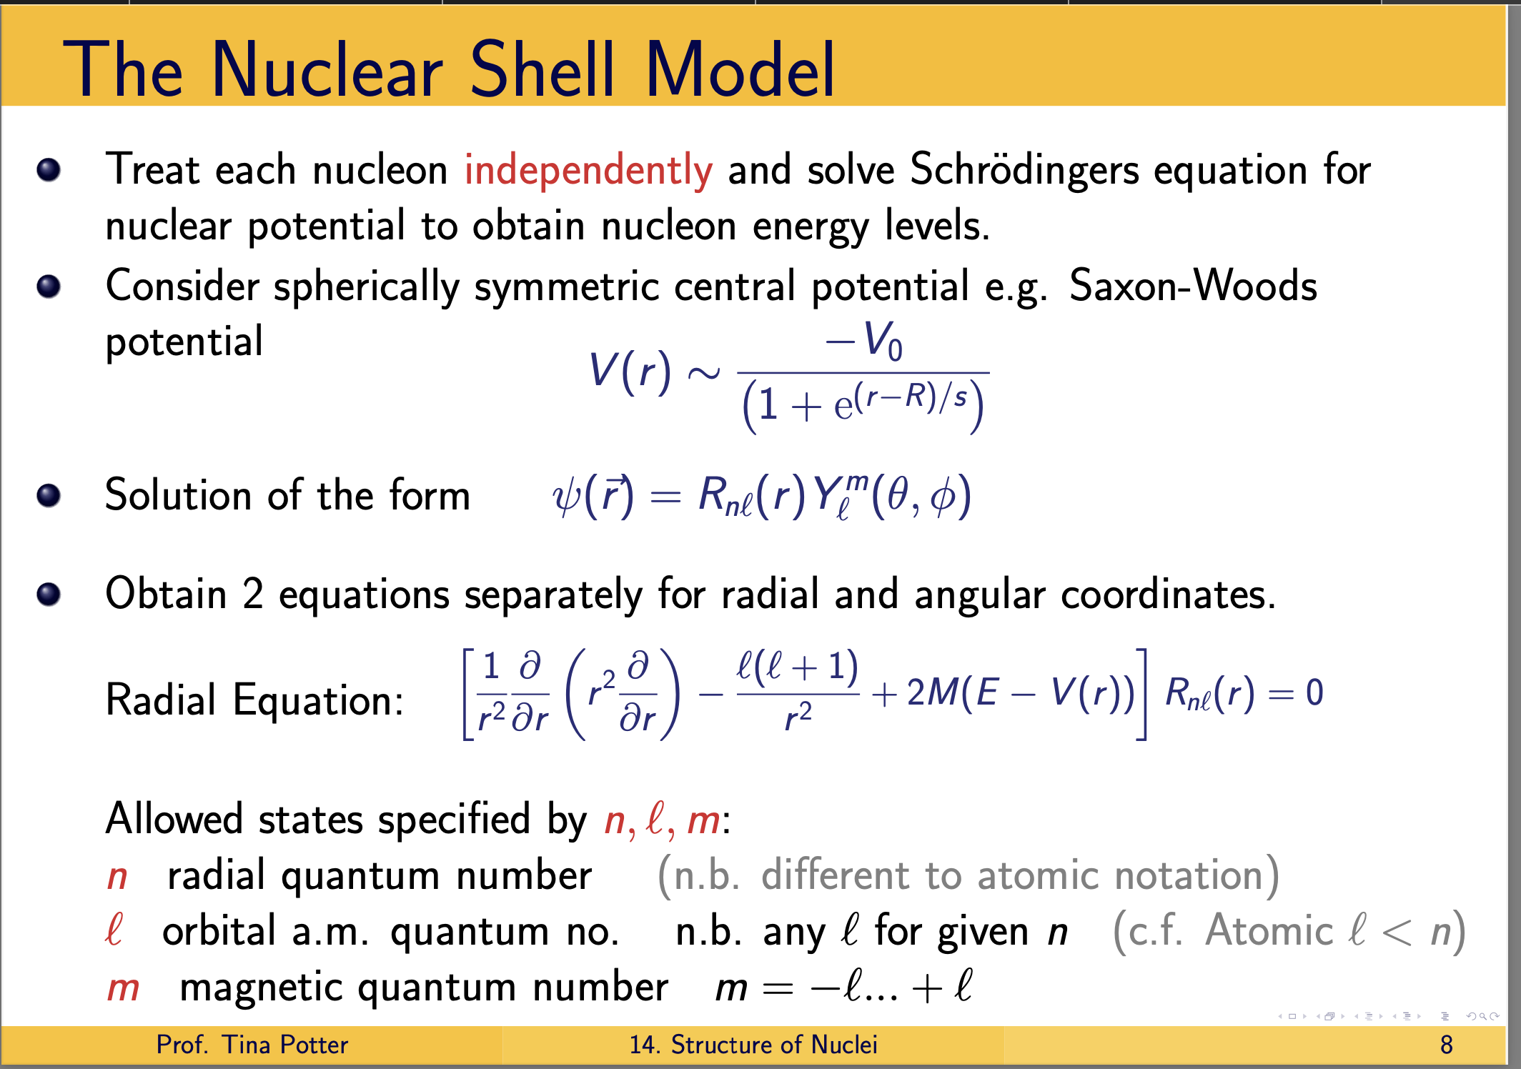
Background: Shell Model
Notes:
From a qualitative standpoint, the shell model captures how the motions of nucleons are governed by assuming that the particles themselves are “non-interacting”.
What does this mean
By adopting this premise, the individual interaction terms in the Hamiltonian of the system outlined in equation 1.2 can instead be replaced by an approximation where the nucleons move in some short, attractive, mean-field potential, V (⃗ri)
This mean field technique is typically employed with a simplistic potential, such as an infinite square well or a spherically symmetric quantum harmonic oscillator, but as it were, the characteristics of the shell model potential can be vastly better captured by implementing a potential with what is known as a “Woods-Saxon” form shown :
where V0 (having dimension of energy) represents the potential well depth, r is the dis- tance from the center of nucleus, a is a length representing the ”surface thickness” of the nucleus, and R = r0A1/3 is the nuclear radius where r0 = 1.25fm and A is the mass number.
The effect of using this mean field approach is that the interactions of the inner nucleons of the nucleus are “smoothed out” and represented by a central potential (which itself is then used in the Schro ̈dinger equation in place of individual two body and three body interaction terms of the Hamiltonian). This renders the valence nucleons - those closest to the surface of the nucleus - as responsible for the residual interactions of the nucleons in the nucleus. In this way, the nucleons in the inner core represented by the central potential are treated as inert, and the distinguishing characteristics of the nucleus are thought to arise predominately from the features of the valence nucleons interacting with the central potential.

Slide 13

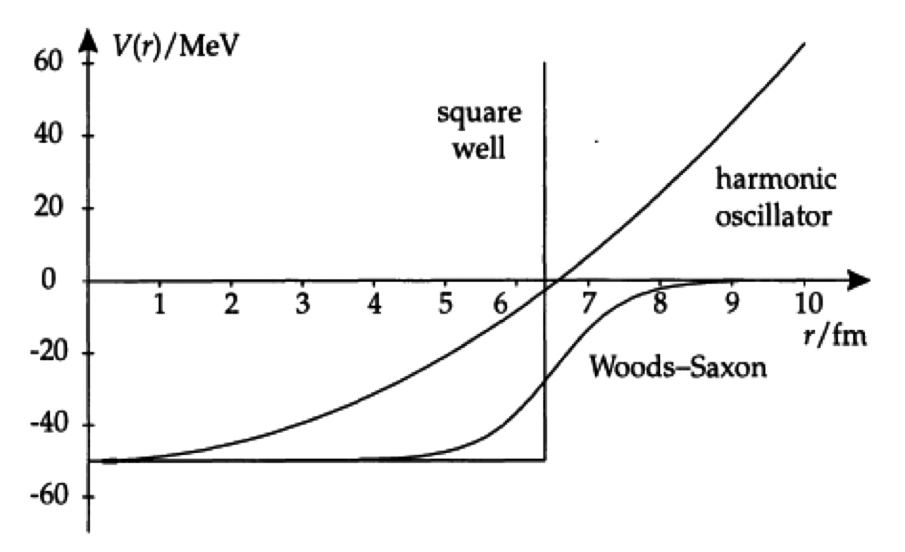
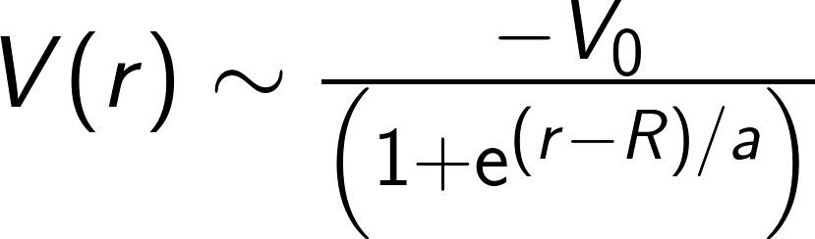
Background: Shell Model
Takeuchi, K., and P. A. Moldauer. "Neutron single particle levels in a Wood-Saxon potential." Physics Letters B 28.6 (1969): 384-386.
Notes:
From a qualitative standpoint, the shell model captures how the motions of nucleons are governed by assuming that the particles themselves are “non-interacting”.
What does this mean?
Well, by adopting this premise, the individual interaction terms in the Hamiltonian of the system, we can instead be replaced by an approximation where the nucleons move in some short, attractive, mean-field potential
This mean field technique is typically employed with a simplistic potential, such as an infinite square well or a spherically symmetric quantum harmonic oscillator, but as it turns out, the characteristics of the shell model potential can be vastly better captured by implementing a potential with what is known as a “Woods-Saxon” form shown in the schematic as well as in the equation:
where V0 (having dimension of energy) represents the potential well depth, r is the dis- tance from the center of nucleus, a is a length representing the ”surface thickness” of the nucleus, and R = r0A1/3 is the nuclear radius where r0 = 1.25fm and A is the mass number.
The effect of using this mean field approach is that the interactions of the inner nucleons of the nucleus are “smoothed out” and represented by a central potential (which itself is then used in the Schro ̈dinger equation in place of individual two body and three body interaction terms of the Hamiltonian). This renders the valence nucleons - those closest to the surface of the nucleus - as responsible for the residual interactions of the nucleons in the nucleus. In this way, the nucleons in the inner core represented by the central potential are treated as inert, and the distinguishing characteristics of the nucleus are thought to arise predominately from the features of the valence nucleons interacting with the central potential.

Slide 14

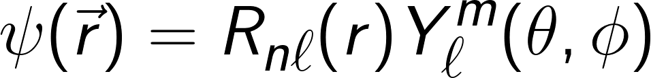
Background: Shell Model
Notes:
From a qualitative standpoint, the shell model captures how the motions of nucleons are governed by assuming that the particles themselves are “non-interacting”.
What does this mean
By adopting this premise, the individual interaction terms in the Hamiltonian of the system, we can instead be replaced by an approximation where the nucleons move in some short, attractive, mean-field potential, V (⃗ri)
This mean field technique is typically employed with a simplistic potential, such as an infinite square well or a spherically symmetric quantum harmonic oscillator, but as it were, the characteristics of the shell model potential can be vastly better captured by implementing a potential with what is known as a “Woods-Saxon” form shown in the schematic as well as in the equation:
where V0 (having dimension of energy) represents the potential well depth, r is the dis- tance from the center of nucleus, a is a length representing the ”surface thickness” of the nucleus, and R = r0A1/3 is the nuclear radius where r0 = 1.25fm and A is the mass number.
The effect of using this mean field approach is that the interactions of the inner nucleons of the nucleus are “smoothed out” and represented by a central potential (which itself is then used in the Schro ̈dinger equation in place of individual two body and three body interaction terms of the Hamiltonian). This renders the valence nucleons - those closest to the surface of the nucleus - as responsible for the residual interactions of the nucleons in the nucleus. In this way, the nucleons in the inner core represented by the central potential are treated as inert, and the distinguishing characteristics of the nucleus are thought to arise predominately from the features of the valence nucleons interacting with the central potential.

Slide 15
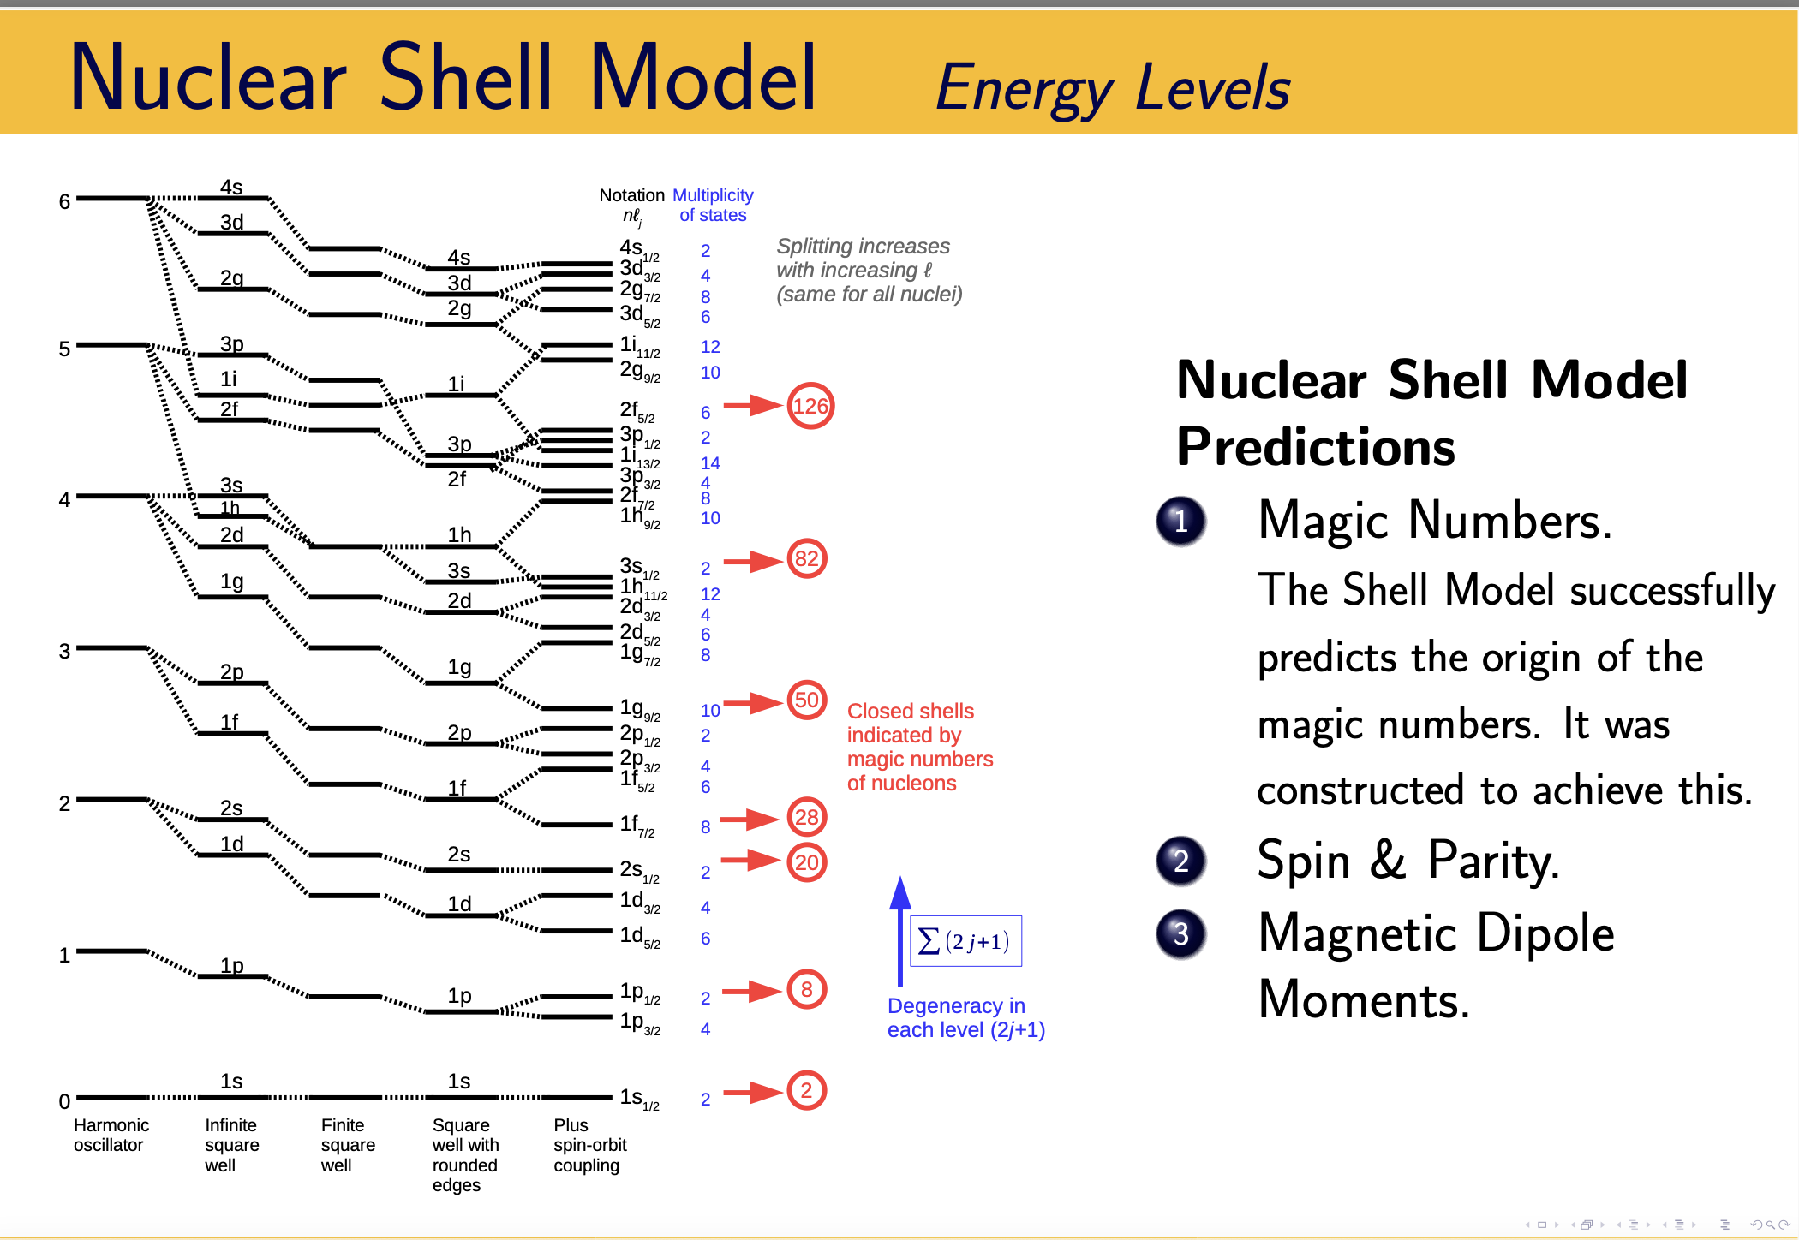
Project Motivation
Notes:
Electrons confined by Coulomb potential in atoms possess a well-known shell structure. Shell-like phenomena also ap- pear in finite nuclear system. Almost 70 years ago, Mayer and Jensen succeeded to create a theoretical model to describe the nuclear shell structure [1, 2], which was formed by placing the single nucleon (proton or neutron) in a mean field created by all other nucleons. According to the well-established mean field theory, nucleons fill in the single-particle orbitals grouped into shells characterized by the conventional magic numbers, referred to as 2, 8, 20, 50, 82, 126. However, for nuclei far from the β-stability line, especially those in the light mass region where the concept of a mean field is less robust, the exotic rearrangement of the single-particle configuration often appears to result in the shifts of single-particle energies (or orbtials), which further affect essentially all features of the nuclear structure, like deformation
In general, it is not good far from closed shells and for non-spherically symmetric potentials.

Slide 16
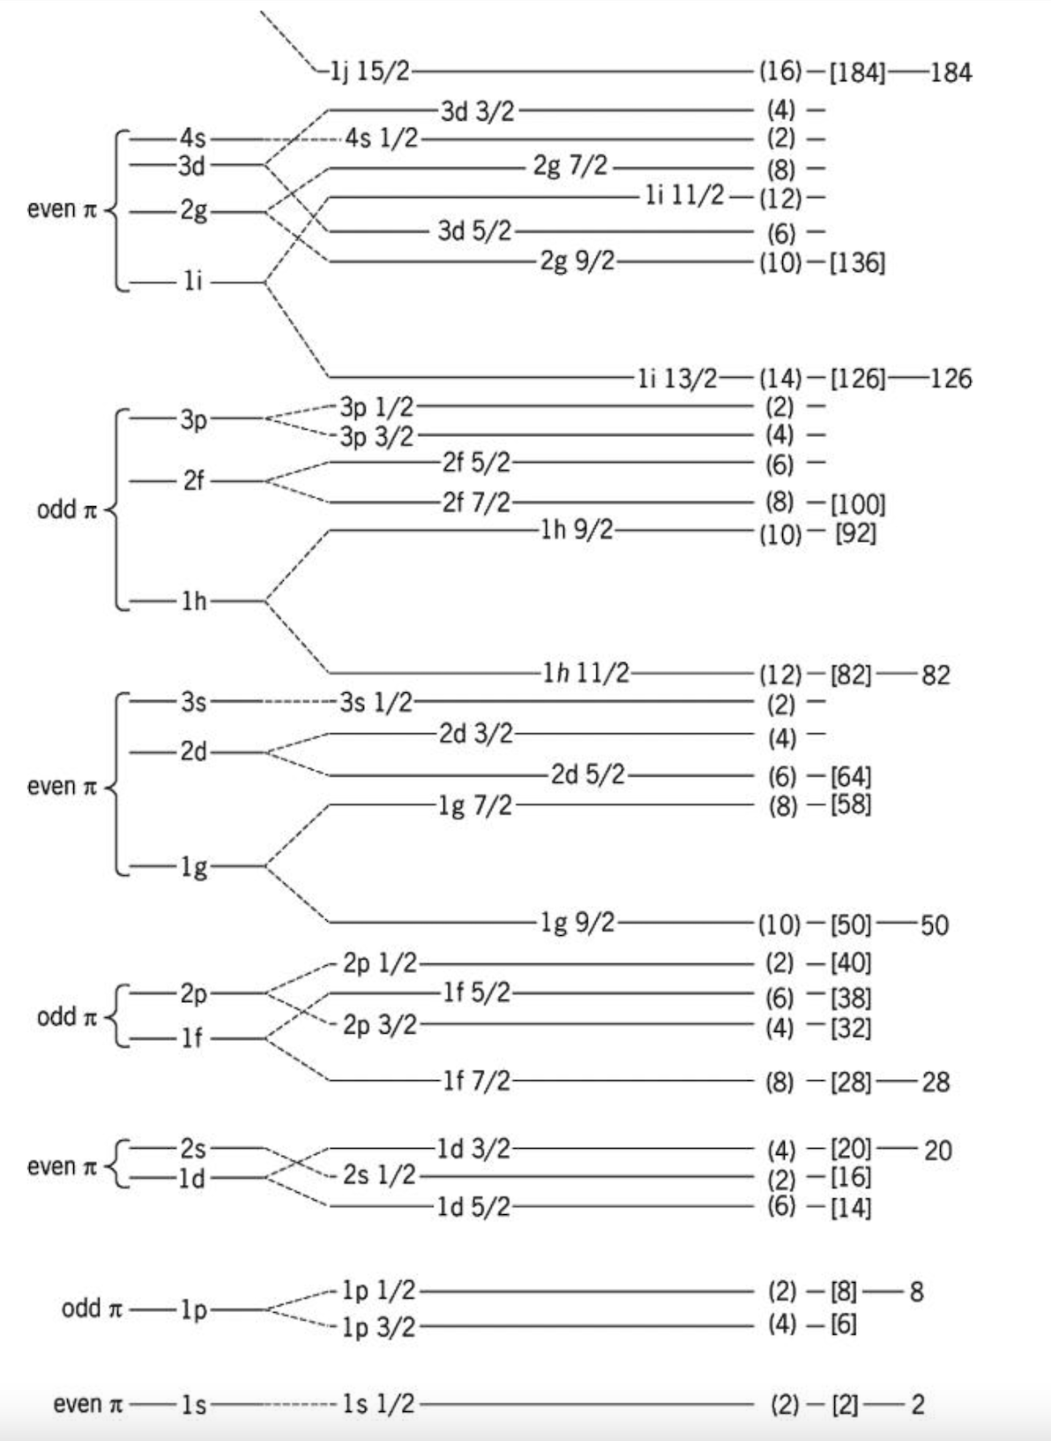
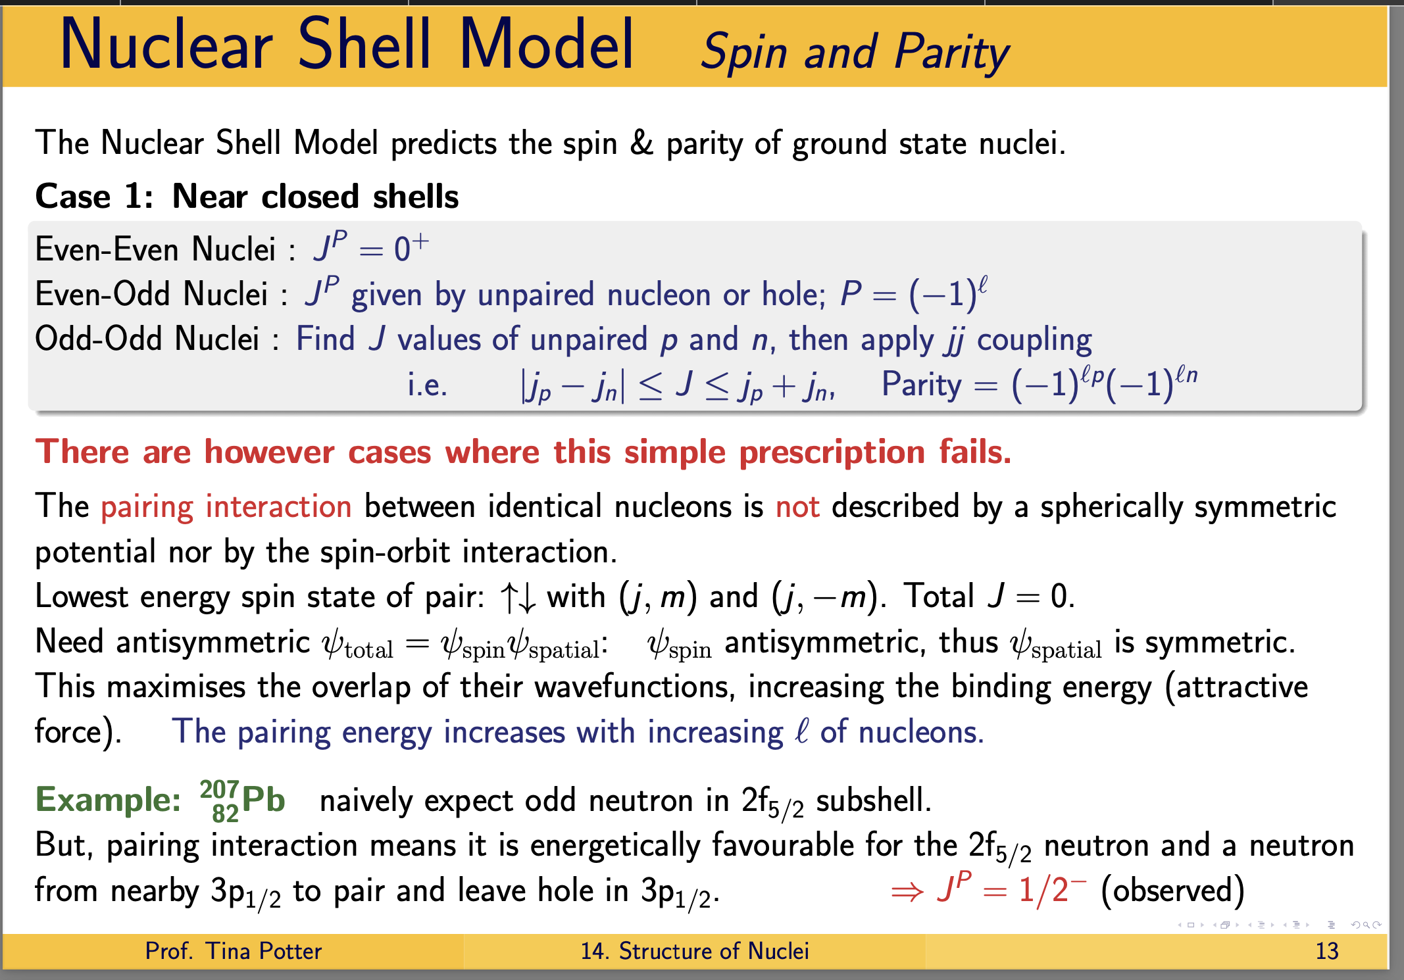
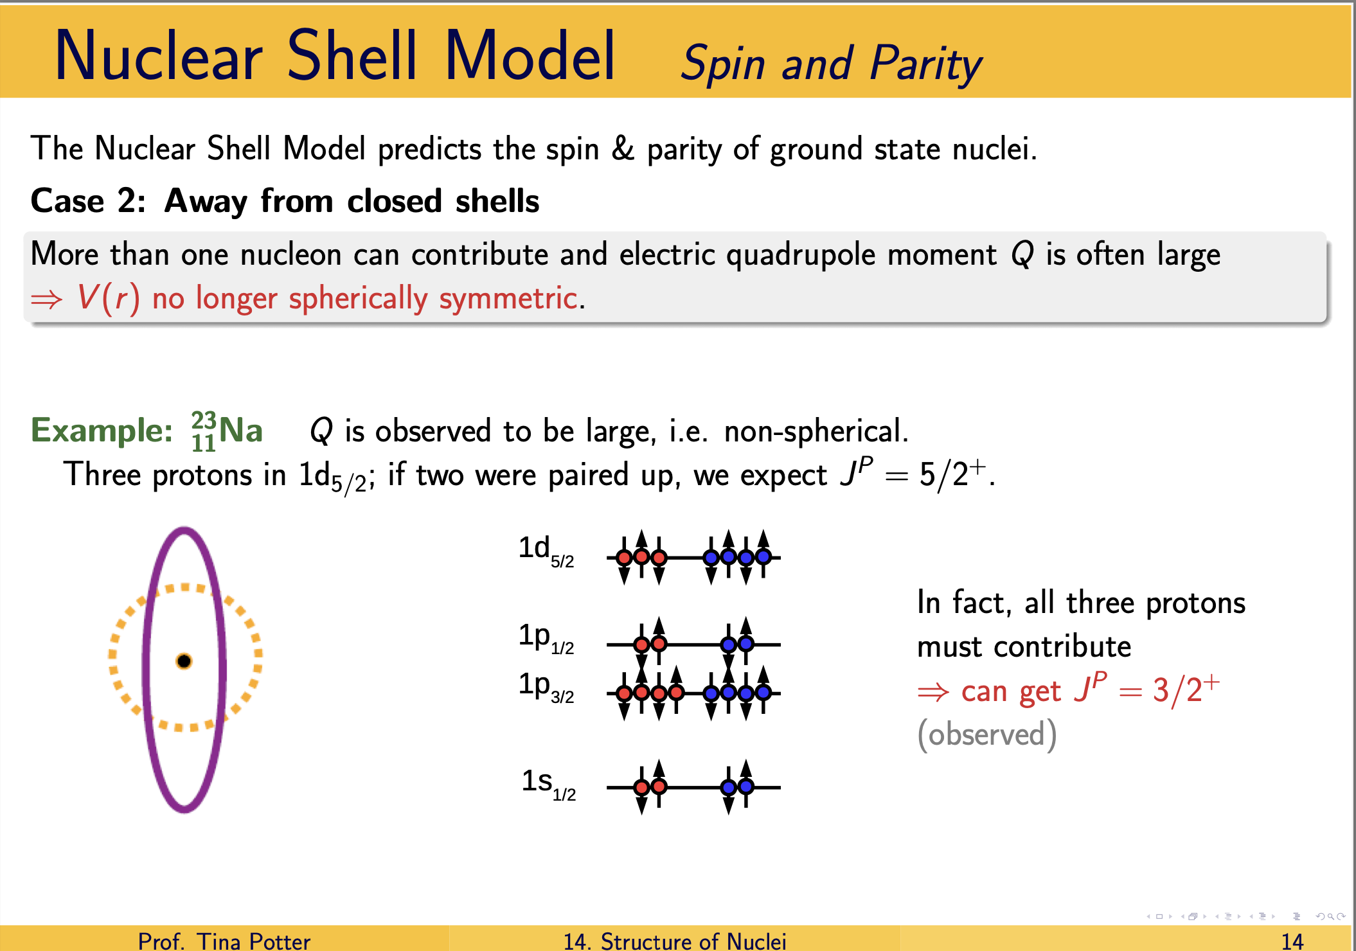
Background: Shell Model
Notes:
No two identical fermionic particles (i.e. particles with half-integer spins) can simultaneously occupy the same quantum state within their quantum system - in other words, at least one of the quantum numbers must be different. Two nucleons with the same set of quantum numbers, other than the projection of their angular momentum in order to obey the Pauli exclusion principle, will have highly overlapping wavefunctions and will thus have greater strong interactions between them, and since the nuclear force is attractive, they will have stronger binding energy. This makes it energetically favourable (meaning having lower energy) for nucleons to form pairs of opposite spin to maximize their wavefunction overlap. This behaviour is what’s characterized as “pairing” interaction.
Effectively what this indicates is that within the shell model regime, which expresses the systems allowed energies as discreet quantized energy levels instead of a continuum of energies for nucleons to occupy, that in order not to violate the Pauli exclusion principal, the spins of paired fermionic nucleons in the same quantum state (i.e. a shared energy level) must therefore possess opposite spins to each other. This feature leads even–even nuclides, such as our 100Ru, to have spin 0 in their ground state; a key behaviour which is leveraged and will be highlighted next in the motivations portion of this presentation project.
The Nuclear Shell Model is successful in predicting:
- Origin of magic numbers
- Spins and parities of ground states
- Trend in magnetic moments
- Some excited states near closed shells, small excitations in odd \(A\) nuclei
s.

Slide 17



Background: Shell Model
Otsuka, Takaharu, A. Arima, and F. Iachello. "Nuclear shell model and interacting bosons." Nuclear Physics A 309.1-2 (1978): 1-33.
Notes:
No two identical fermionic particles (i.e. particles with half-integer spins) can simultaneously occupy the same quantum state within their quantum system - in other words, at least one of the quantum numbers must be different. Two nucleons with the same set of quantum numbers, other than the projection of their angular momentum in order to obey the Pauli exclusion principle, will have highly overlapping wavefunctions and will thus have greater strong interactions between them, and since the nuclear force is attractive, they will have stronger binding energy. This makes it energetically favourable (meaning having lower energy) for nucleons to form pairs of opposite spin to maximize their wavefunction overlap. This behaviour is what’s characterized as “pairing” interaction.
Effectively what this indicates is that within the shell model regime, which expresses the systems allowed energies as discreet quantized energy levels instead of a continuum of energies for nucleons to occupy, (which we can see an energy level diagram for on the left hand side), that in order not to violate the Pauli exclusion principal, the spins of paired fermionic nucleons in the same quantum state (i.e. a shared energy level) must therefore possess opposite spins to each other. This feature leads even–even nuclides, such as our 100Ru, to have spin 0 in their ground state; a key behaviour which is leveraged and will be highlighted next in the motivations portion of this presentation project.
The Nuclear Shell Model is successful in predicting:
- Origin of magic numbers
- Spins and parities of ground states
- Trend in magnetic moments
- Some excited states near closed shells, small excitations in odd \(A\) nuclei
s.

Slide 18




Background: Shell Model
Notes:
No two identical fermionic particles (i.e. particles with half-integer spins) can simultaneously occupy the same quantum state within their quantum system - in other words, at least one of the quantum numbers must be different. Two nucleons with the same set of quantum numbers, other than the projection of their angular momentum in order to obey the Pauli exclusion principle, will have highly overlapping wavefunctions and will thus have greater strong interactions between them, and since the nuclear force is attractive, they will have stronger binding energy. This makes it energetically favourable (meaning having lower energy) for nucleons to form pairs of opposite spin to maximize their wavefunction overlap. This behaviour is what’s characterized as “pairing” interaction.
Effectively what this indicates is that within the shell model regime, which expresses the systems allowed energies as discreet quantized energy levels instead of a continuum of energies for nucleons to occupy, that in order not to violate the Pauli exclusion principal, the spins of paired fermionic nucleons in the same quantum state (i.e. a shared energy level) must therefore possess opposite spins to each other. This feature leads even–even nuclides, such as our 100Ru, to have spin 0 in their ground state; a key behaviour which is leveraged and will be highlighted next in the motivations portion of this presentation project.
The Nuclear Shell Model is successful in predicting:
- Origin of magic numbers
- Spins and parities of ground states
- Trend in magnetic moments
- Some excited states near closed shells, small excitations in odd \(A\) nuclei
s.

Slide 19
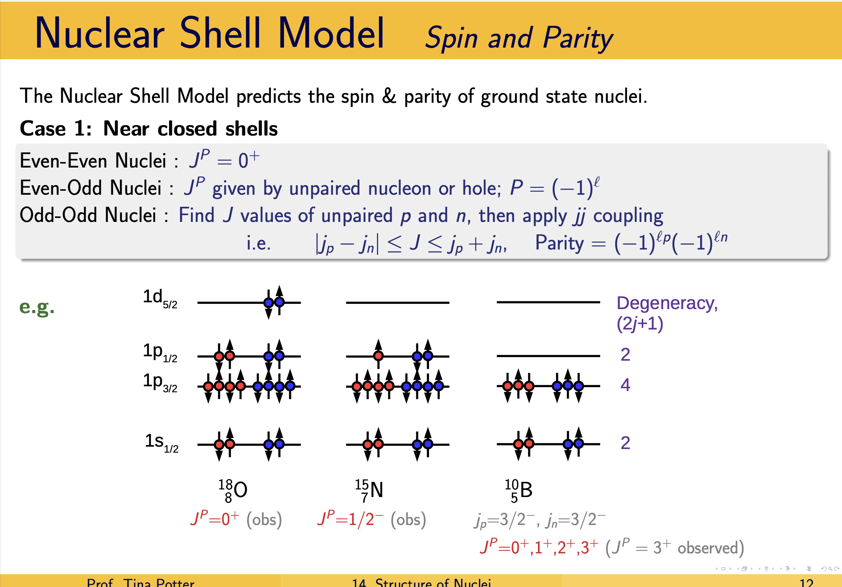
Project Motivation
Notes:
Perform the 102Ru(p,t) reaction to locate the natural parity states in 100Ru, and examine the relative strengths of the excited 0+ states.
Project Focus: Study of 100Ru via a two-neutron transfer reaction experiment performed using the Q3D magnetic spectrograph at the Maier-Leibnitz Laboratory, in Garching, Germany.

Slide 20
Project Motivation
Notes:
Perform the 102Ru(p,t) reaction to locate the natural parity states in 100Ru, and examine the relative strengths of the excited 0+ states.
Project Focus: Study of 100Ru via a two-neutron transfer reaction experiment performed using the Q3D magnetic spectrograph at the Maier-Leibnitz Laboratory, in Garching, Germany.

Slide 21
Project Motivation
Notes:
Perform the 102Ru(p,t) reaction to locate the natural parity states in 100Ru, and examine the relative strengths of the excited 0+ states.
Project Focus: Study of 100Ru via a two-neutron transfer reaction experiment performed using the Q3D magnetic spectrograph at the Maier-Leibnitz Laboratory, in Garching, Germany.

Slide 22
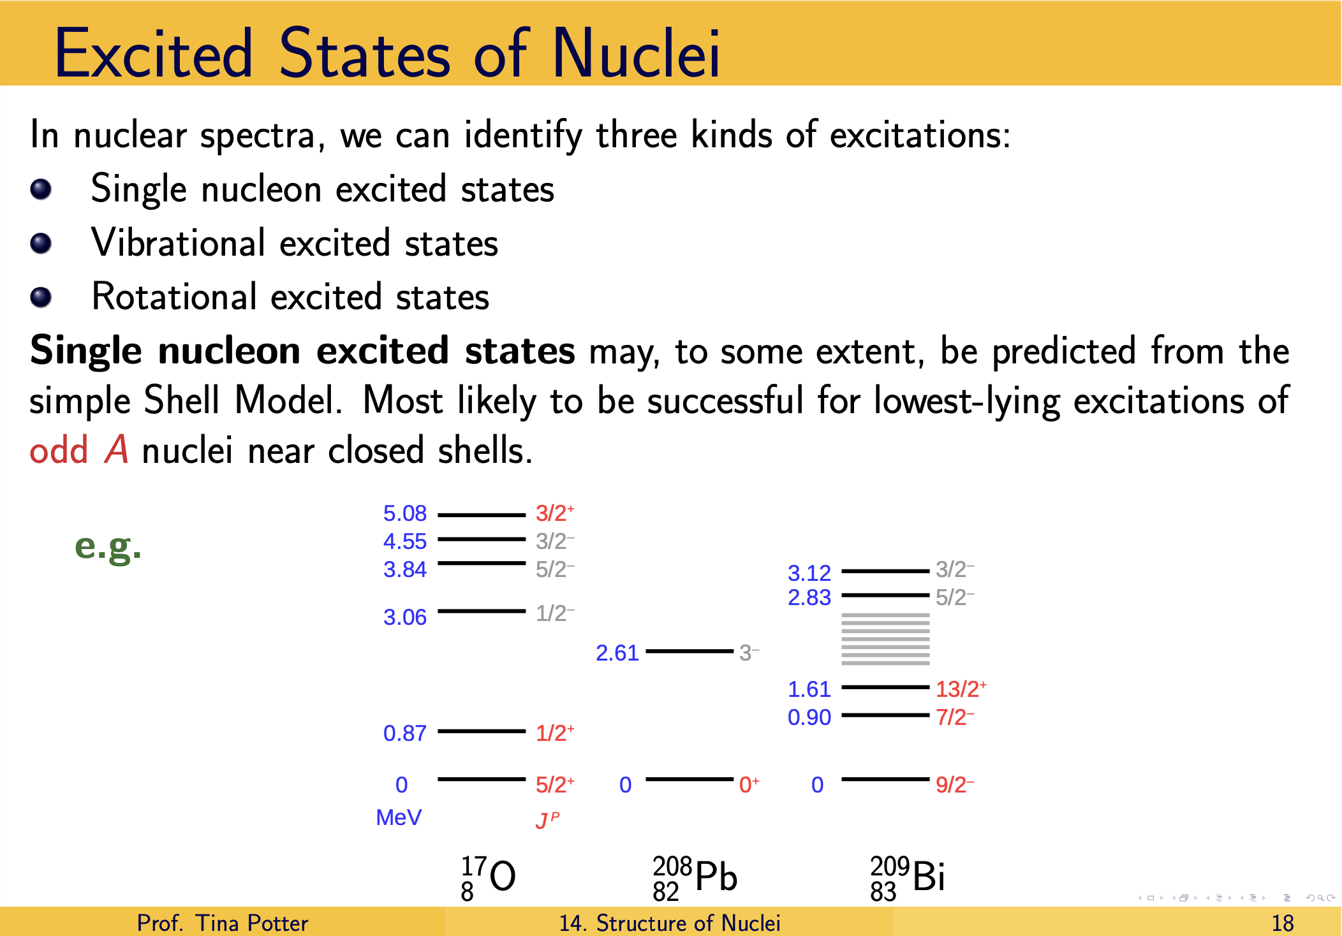
Project Motivation
Notes:
Perform the 102Ru(p,t) reaction to locate the natural parity states in 100Ru, and examine the relative strengths of the excited 0+ states.
Project Focus: Study of 100Ru via a two-neutron transfer reaction experiment performed using the Q3D magnetic spectrograph at the Maier-Leibnitz Laboratory, in Garching, Germany.

Slide 23
Project Motivation
Notes:
Perform the 102Ru(p,t) reaction to locate the natural parity states in 100Ru, and examine the relative strengths of the excited 0+ states.
Project Focus: Study of 100Ru via a two-neutron transfer reaction experiment performed using the Q3D magnetic spectrograph at the Maier-Leibnitz Laboratory, in Garching, Germany.

Slide 24
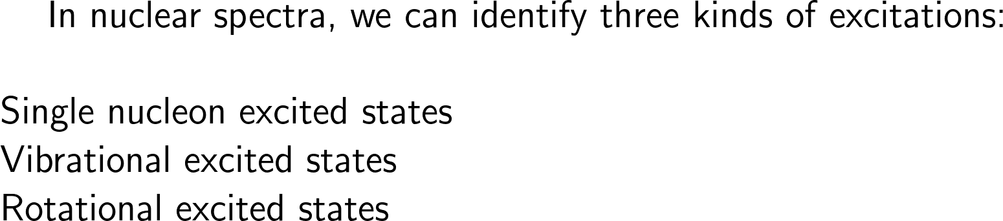

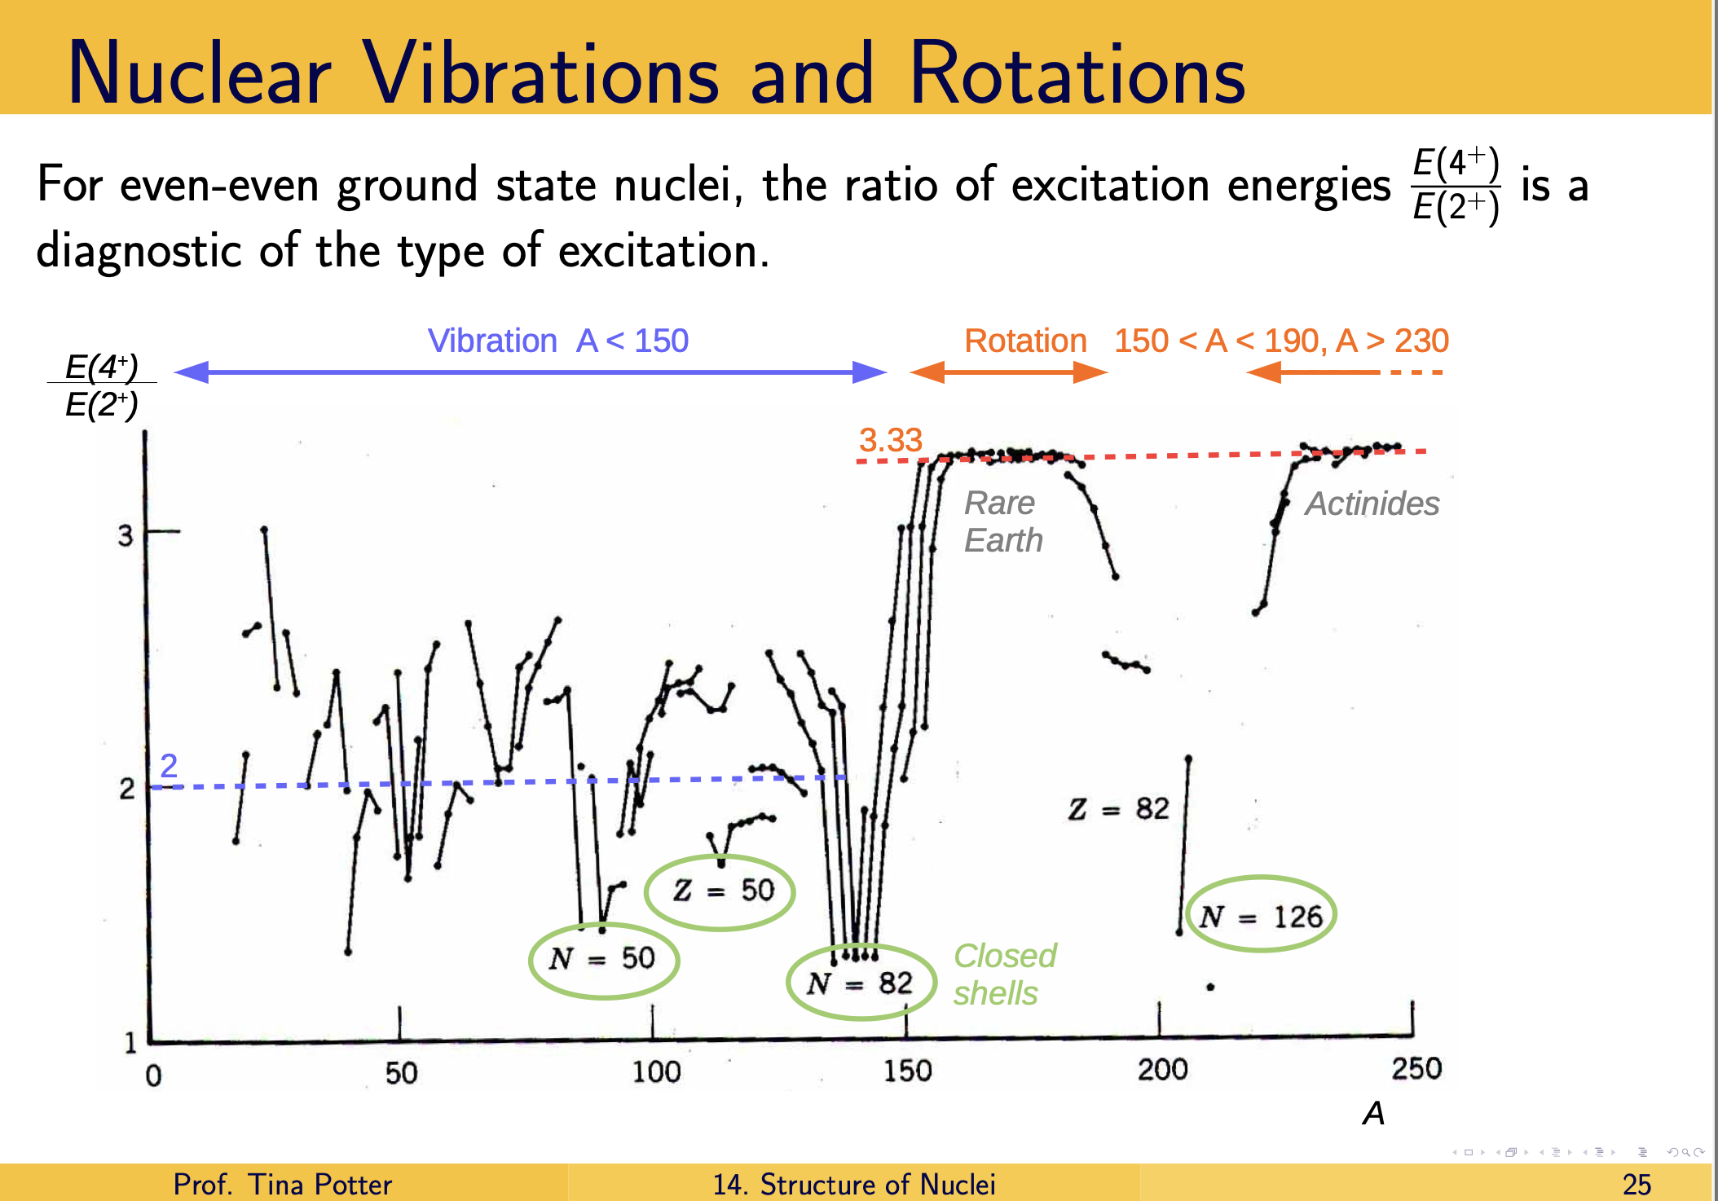


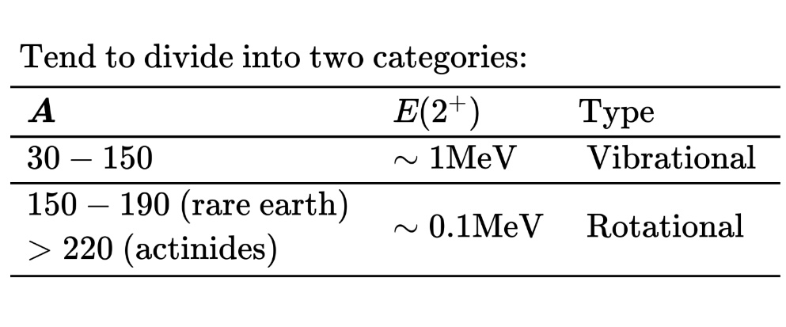
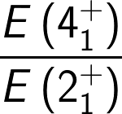
Background: Collective Model
Notes:
However, even though the shell model has enjoyed tremendous success at describing the properties of light nuclei, it does experience shortcomings when it comes to describing the behaviour of heavier nuclei, particularly those away from the closed shells. In fact, some heavier nuclei have low-lying excited states that are better described as collective motions, where the motion of many nucleons are considered rather than the single-particle orbits .
This is where the Collective Model comes into play - the Collective model generalises the result of the Shell Model by considering the effect of a non-spherically symmetric potential, which leads to substantial deformations for large nuclei, improved descriptions of even A excited states. In terms of it’s explanation of low-lying excited states of heavy nuclei, the collective model predicts two main types, vibrational states and rotational states, which we will look into now
The collective properties of nuclei can be incorporated into the Nuclear Shell Model by replacing the spherically symmetric potential by a deformed potential. Improved description for: -Even \(A\) excited states and -Electric quadrupole and magnetic dipole moments.

Slide 25
Background: Collective Model
1)
2)
3)
Notes:
However, even though the shell model has enjoyed tremendous success at describing the properties of light nuclei, it does experience shortcomings when it comes to describing the behaviour of heavier nuclei, particularly those away from the closed shells. Why? due to the largeness of the model space for heavier nuclei which we would have to complete the calculations in that the shell model faces it’s limitations, as Diagonalizing a Hamiltonian with that many particles would be extremely computationally costly
not a fundamental issue with the potentials it employs
In fact, some heavier nuclei have low-lying excited states that are better described as collective motions, where the motion of many nucleons are considered rather than the single-particle orbits .
This is where the Collective Model comes into play - the Collective model generalises the result of the Shell Model by considering the effect of a non-spherically symmetric potential, which leads to substantial deformations for large nuclei, improved descriptions of even A excited states. In terms of it’s explanation of low-lying excited states of heavy nuclei, the collective model predicts two main types, vibrational states and rotational states, which we will look into now
The collective properties of nuclei can be incorporated into the Nuclear Shell Model by replacing the spherically symmetric potential by a deformed potential. Improved description for: -Even \(A\) excited states and -Electric quadrupole and magnetic dipole moments.

Slide 26
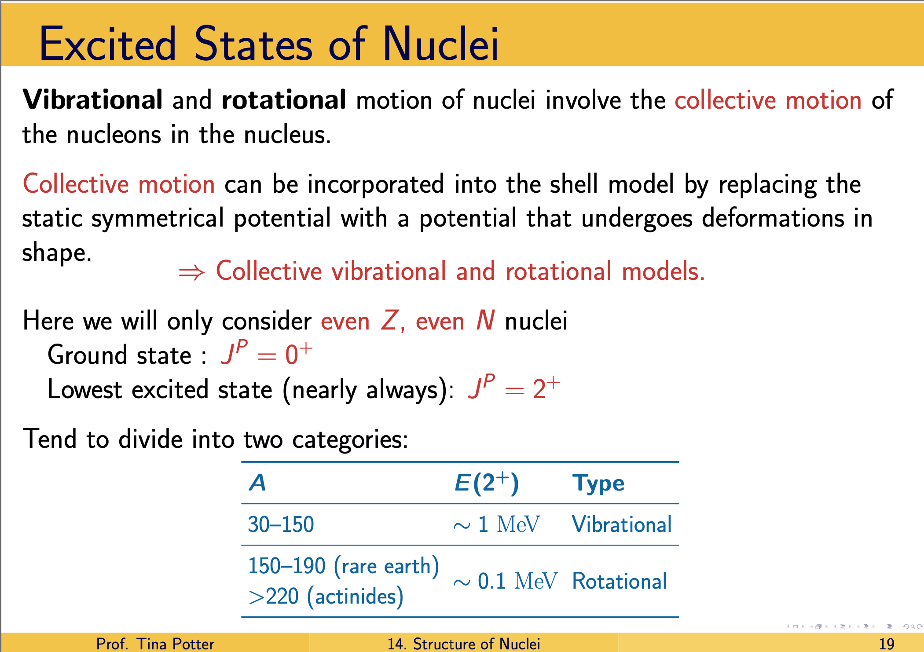
Background: Collective Model
Nuclear Vibrations and Rotations
Notes:
Although the shell model has enjoyed tremendous success at describing the properties of light nuclei, it does experience shortcomings when it comes to describing the behaviour of heavier nuclei, particularly those away from the closed shells. In fact, some heavier nuclei have low-lying excited states that are better described as collective motions, where the motion of many nucleons are considered rather than the single-particle orbits .
This is where the Collective Model comes into play - the Collective model generalises the result of the Shell Model by considering the effect of a non-spherically symmetric potential, which leads to substantial deformations for large nuclei, improved descriptions of even A excited states, and consequently, large electric quadrupole moments. In terms of it’s explanation of low-lying excited states of heavy nuclei, the collective model predicts two main types, vibrational states and rotational states, which we will look into now
The collective properties of nuclei can be incorporated into the Nuclear Shell Model by replacing the spherically symmetric potential by a deformed potential. Improved description for: -Even \(A\) excited states and -Electric quadrupole and magnetic dipole moments.

Slide 27
Background: Collective Model
Nuclear Vibrations and Rotations
Notes:
Although the shell model has enjoyed tremendous success at describing the properties of light nuclei, it does experience shortcomings when it comes to describing the behaviour of heavier nuclei, particularly those away from the closed shells. In fact, some heavier nuclei have low-lying excited states that are better described as collective motions, where the motion of many nucleons are considered rather than the single-particle orbits .
This is where the Collective Model comes into play - the Collective model generalises the result of the Shell Model by considering the effect of a non-spherically symmetric potential, which leads to substantial deformations for large nuclei, improved descriptions of even A excited states, and consequently, large electric quadrupole moments. In terms of it’s explanation of low-lying excited states of heavy nuclei, the collective model predicts two main types, vibrational states and rotational states, which we will look into now
The collective properties of nuclei can be incorporated into the Nuclear Shell Model by replacing the spherically symmetric potential by a deformed potential. Improved description for: -Even \(A\) excited states and -Electric quadrupole and magnetic dipole moments.

Slide 28
Background: Collective Model
Notes:
Although the shell model has enjoyed tremendous success at describing the properties of light nuclei, it does experience shortcomings when it comes to describing the behaviour of heavier nuclei, particularly those away from the closed shells. In fact, some heavier nuclei have low-lying excited states that are better described as collective motions, where the motion of many nucleons are considered rather than the single-particle orbits .
This is where the Collective Model comes into play - the Collective model generalises the result of the Shell Model by considering the effect of a non-spherically symmetric potential, which leads to substantial deformations for large nuclei, improved descriptions of even A excited states, and consequently, large electric quadrupole moments. In terms of it’s explanation of low-lying excited states of heavy nuclei, the collective model predicts two main types, vibrational states and rotational states, which we will look into now
The collective properties of nuclei can be incorporated into the Nuclear Shell Model by replacing the spherically symmetric potential by a deformed potential. Improved description for: -Even \(A\) excited states and -Electric quadrupole and magnetic dipole moments.
So, how do we deal with characterize nuclei that are not amenable to description using spherically symmetric potentials?
As mentioned above, one type of collective excitation that generates time-dependent deformation of a nucleus is known as a vibrational excitation. Nuclear vibrations cause the shape of the nucleus to oscillate over time about its spherical average, or equilibrium shape. In other words, its instantaneous shape changes as it undergoes various vibrational modes.

Slide 29
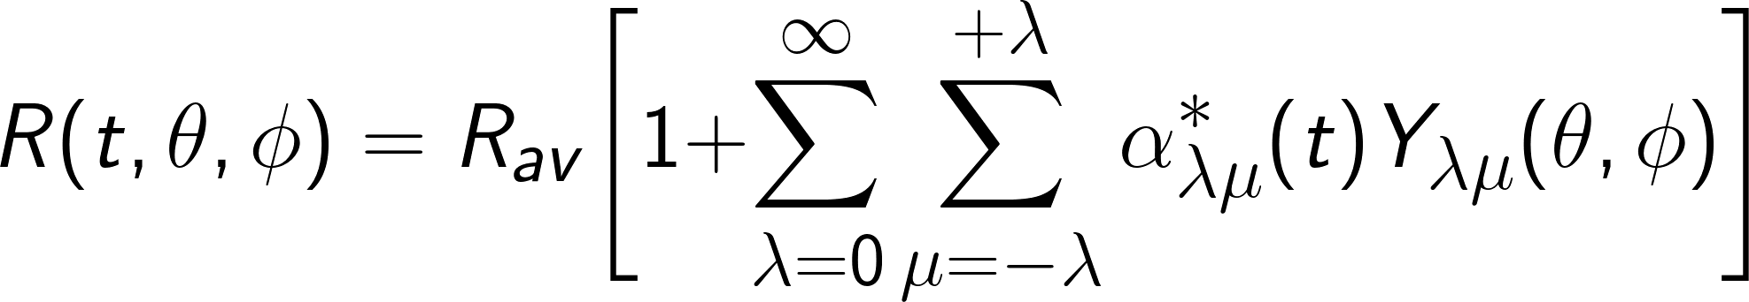
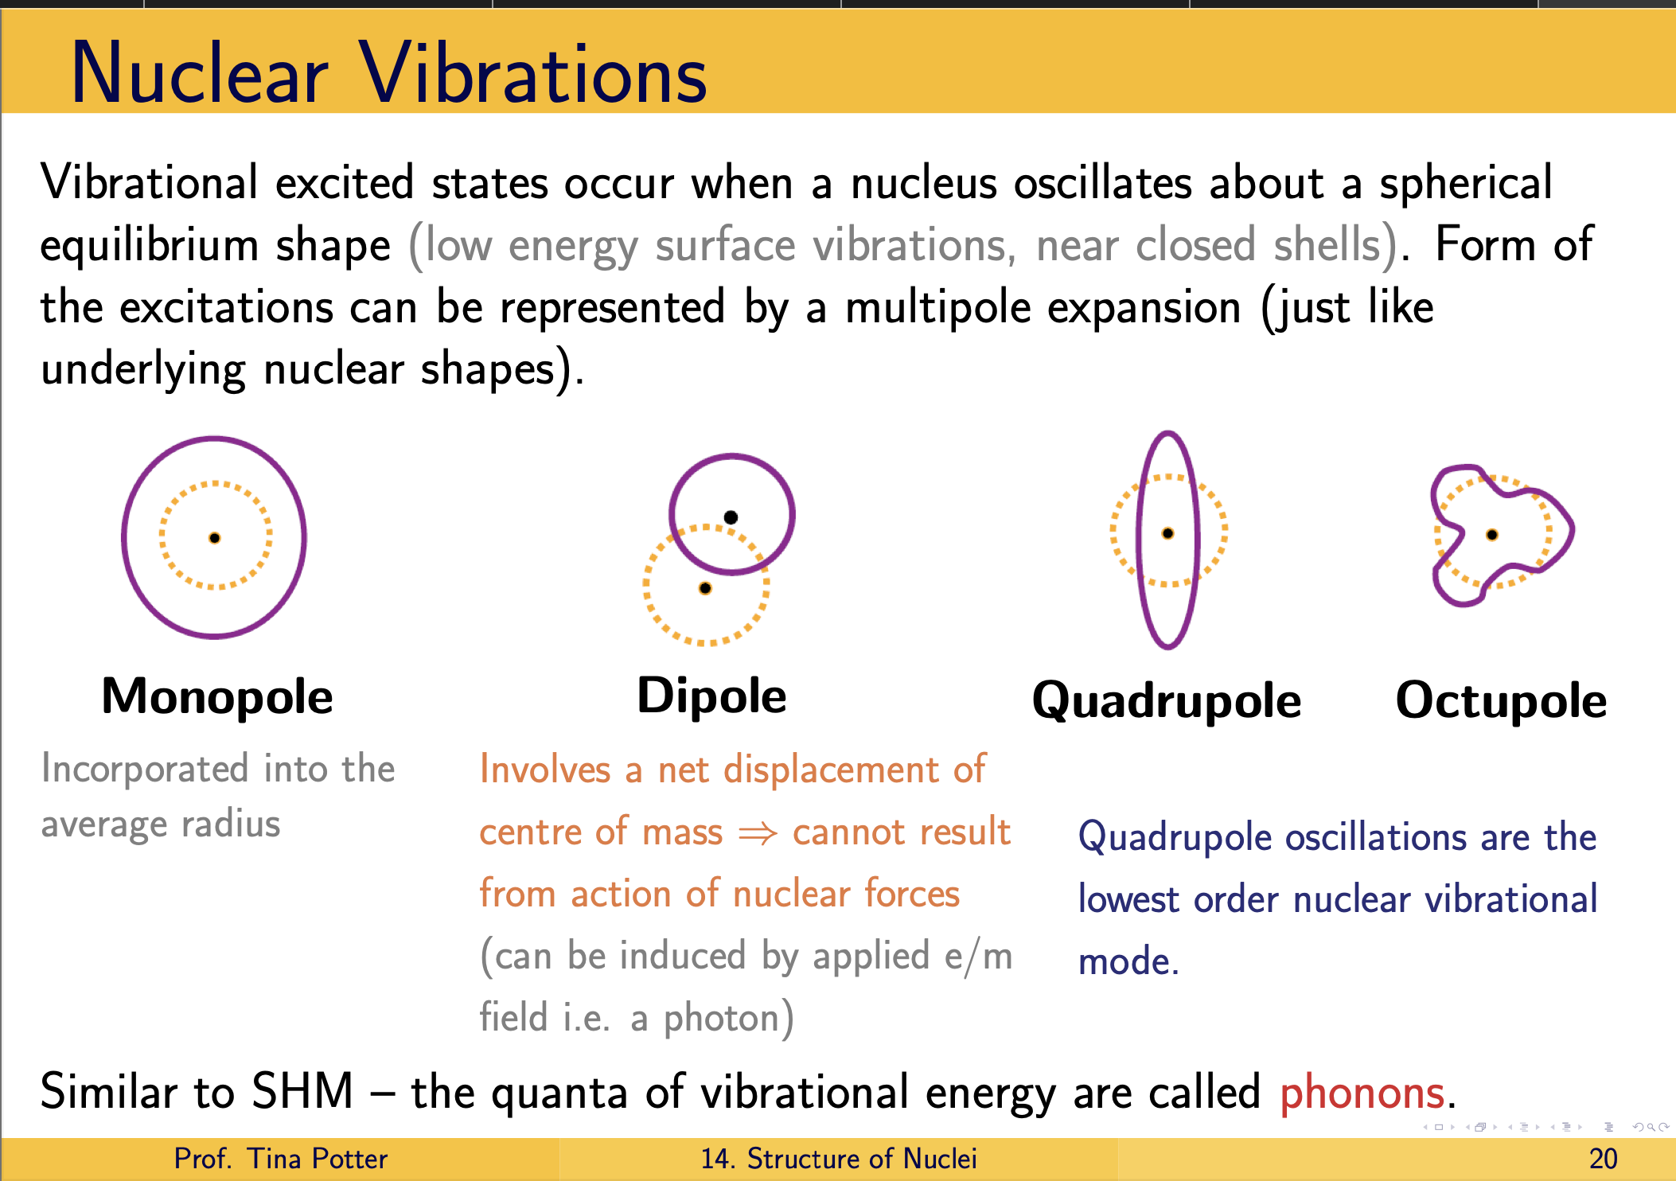
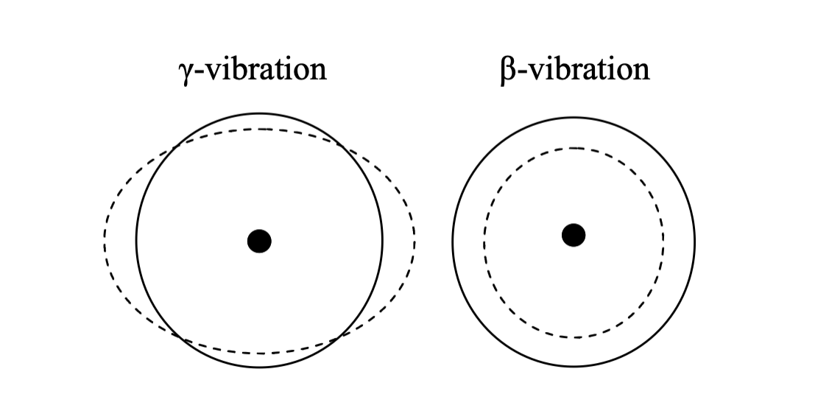
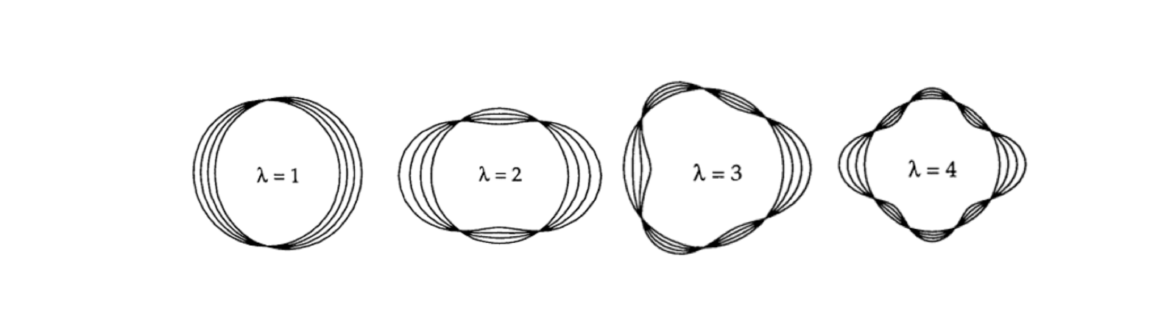
Project Motivation
Notes:
Alright so as mentioned, one type of collective excitation that generates time-dependent deformation of a nucleus is known as a vibrational excitation. Nuclear vibrations cause the shape of the nucleus to oscillate over time about its spherical average, or equilibrium shape. In other words, its instantaneous shape changes as it undergoes various vibrational modes.
As such, the vibrational motion can be quantified by tracking the motion of a point on the nuclear surface through space as a function of time using the equation seen here:
Rav is the average radius of the nucleus given by Rav = R◦A1/3,
Yλμ(θ, φ) are the aforementioned spherical harmonics, αλμ(t) are expansion coefficients relating to the time-dependent amplitude of the deformation/oscillation describing the variation of the nuclear surface (which gives rise to the vibrational mode), λ represents the multipole order of the deformation (λ = 0,1, 2, . . . being monopole, dipole, quadrupole, etc.) and μ represents the magnetic substate of the multipolarity, μ = −λ, −λ + 1, . . . λ − 1, λ.
The μ subscript varies from −λ to λ, which defines the degeneracy of the vibration or deformation, and while the most common form of deformation is quadrupole deformation (i.e. λ = 2) [1], it’s also possible for nuclei to exhibit higher order types of deformation, such as octupole or hexadecapole, for example, whose shapes are plotted in the figure .
Figure 1.5: Vibrational deformation for the lowest four multipole orders. [3].
As mentioned in the preceding paragraph, the Yλμ(θ, φ) functions are the spherical har-
monics which describe the orbital motion of the nucleons for given angular momentum, λ,
and magnetic quantum number, μ, which satisfy

Slide 30


Background: Collective Model
Notes:
Alright so as mentioned, one type of collective excitation that generates time-dependent deformation of a nucleus is known as a vibrational excitation. Nuclear vibrations cause the shape of the nucleus to oscillate over time about its spherical average, or equilibrium shape. In other words, its instantaneous shape changes as it undergoes various vibrational modes.
As such, the vibrational motion can be quantified by tracking the motion of a point on the nuclear surface through space as a function of time using the equation that we see on the slide here:
Where :
Rav is the average radius of the nucleus given by Rav = R◦A1/3,
Yλμ(θ, φ) functions are the spherical harmonics which describe the orbital motion of the nucleons for given angular momentum, λ, and magnetic quantum number, μ,
αλμ(t) are expansion coefficients relating to the time-dependent amplitude of the deformation/oscillation describing the variation of the nuclear surface (which gives rise to the vibrational mode), λ represents the multipole order of the deformation (λ = 0,1, 2, . . . being monopole, dipole, quadrupole, etc.) and μ represents the magnetic substate of the multipolarity, μ = −λ, −λ + 1, . . . λ − 1, λ.
Notice how the μ subscript varies from −λ to λ; this defines the degeneracy of the vibration or deformation, and while the most common form of deformation is quadrupole deformation ( which has lambda λ = 2) , it’s also possible for nuclei to exhibit higher order types of deformation, such as octupole or hexadecapole, for example, whose shapes can be seen in the figure at the bottom of the screen.

Slide 31
Background: Collective Model
Notes:
Alright so as mentioned, one type of collective excitation that generates time-dependent deformation of a nucleus is known as a vibrational excitation. Nuclear vibrations cause the shape of the nucleus to oscillate over time about its spherical average, or equilibrium shape. In other words, its instantaneous shape changes as it undergoes various vibrational modes.
As such, the vibrational motion can be quantified by tracking the motion of a point on the nuclear surface through space as a function of time using the equation that we see on the slide here:
Where :
Rav is the average radius of the nucleus given by Rav = R◦A1/3,
Yλμ(θ, φ) functions are the spherical harmonics which describe the orbital motion of the nucleons for given angular momentum, λ, and magnetic quantum number, μ,
αλμ(t) are expansion coefficients relating to the time-dependent amplitude of the deformation/oscillation describing the variation of the nuclear surface (which gives rise to the vibrational mode), λ represents the multipole order of the deformation (λ = 0,1, 2, . . . being monopole, dipole, quadrupole, etc.) and μ represents the magnetic substate of the multipolarity, μ = −λ, −λ + 1, . . . λ − 1, λ.
Notice how the μ subscript varies from −λ to λ; this defines the degeneracy of the vibration or deformation, and while the most common form of deformation is quadrupole deformation ( which has lambda λ = 2) , it’s also possible for nuclei to exhibit higher order types of deformation, such as octupole or hexadecapole, for example, whose shapes can be seen in the figure at the bottom of the screen.
Figure 1.5: Vibrational deformation for the lowest four multipole orders. [3].
As mentioned in the preceding paragraph, the Yλμ(θ, φ) functions are the spherical har-
monics which describe the orbital motion of the nucleons for given angular momentum, λ,
and magnetic quantum number, μ, which satisfy

Slide 32
Background: Collective Model
Notes:
Alright so as mentioned, one type of collective excitation that generates time-dependent deformation of a nucleus is known as a vibrational excitation. Nuclear vibrations cause the shape of the nucleus to oscillate over time about its spherical average, or equilibrium shape. In other words, its instantaneous shape changes as it undergoes various vibrational modes.
As such, the vibrational motion can be quantified by tracking the motion of a point on the nuclear surface through space as a function of time using the equation seen here:
Rav is the average radius of the nucleus given by Rav = R◦A1/3,
Yλμ(θ, φ) are the aforementioned spherical harmonics, αλμ(t) are expansion coefficients relating to the time-dependent amplitude of the deformation/oscillation describing the variation of the nuclear surface (which gives rise to the vibrational mode), λ represents the multipole order of the deformation (λ = 0,1, 2, . . . being monopole, dipole, quadrupole, etc.) and μ represents the magnetic substate of the multipolarity, μ = −λ, −λ + 1, . . . λ − 1, λ.
The μ subscript varies from −λ to λ, which defines the degeneracy of the vibration or deformation, and while the most common form of deformation is quadrupole deformation (i.e. λ = 2) [1], it’s also possible for nuclei to exhibit higher order types of deformation, such as octupole or hexadecapole, for example, whose shapes can be seen in the figure at the bottom of the screen.
Figure 1.5: Vibrational deformation for the lowest four multipole orders. [3].
As mentioned in the preceding paragraph, the Yλμ(θ, φ) functions are the spherical har-
monics which describe the orbital motion of the nucleons for given angular momentum, λ,
and magnetic quantum number, μ, which satisfy
As such, the vibrational motion can be quantified by tracking the motion of a point on the nuclear surface through space as a function of time using the equation that we see on the slide here:
Where :
Rav is the average radius of the nucleus given by Rav = R◦A1/3,
Yλμ(θ, φ) are the aforementioned spherical harmonics, λμ(θ, φ) functions are the spherical harmonics which describe the orbital motion of the nucleons for given angular momentum, λ, and magnetic quantum number, μ,
αλμ(t) are expansion coefficients relating to the time-dependent amplitude of the deformation/oscillation describing the variation of the nuclear surface (which gives rise to the vibrational mode), λ represents the multipole order of the deformation (λ = 0,1, 2, . . . being monopole, dipole, quadrupole, etc.) and μ represents the magnetic substate of the multipolarity, μ = −λ, −λ + 1, . . . λ − 1, λ.
Notice how the μ subscript varies from −λ to λ; this defines the degeneracy of the vibration or deformation, and while the most common form of deformation is quadrupole deformation ( which has lambda λ = 2) , it’s also possible for nuclei to exhibit higher order types of deformation, such as octupole or hexadecapole, for example, whose shapes can be seen in the figure at the bottom of the screen.
Figure 1.5: Vibrational deformation for the lowest four multipole orders. [3].
As mentioned in the preceding paragraph, the Yλμ(θ, φ) functions are the spherical har-
monics which describe the orbital motion of the nucleons for given angular momentum, λ,
and magnetic quantum number, μ, which satisfy

Slide 33
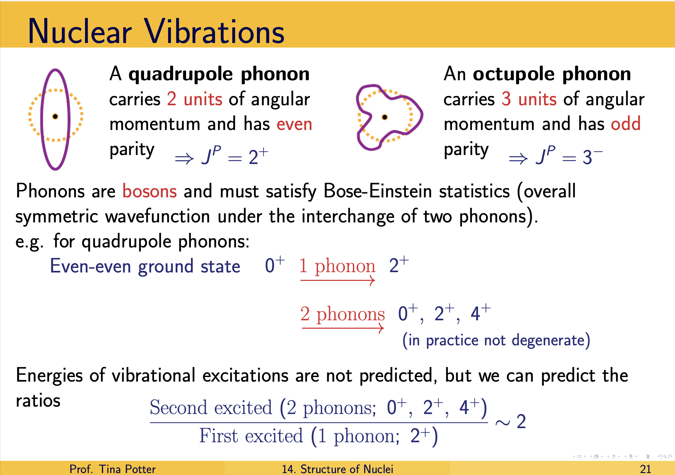
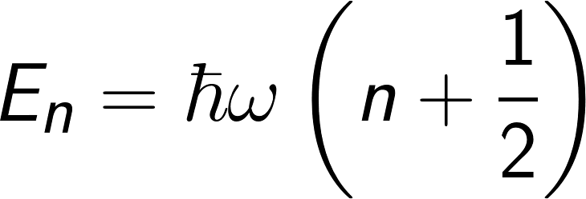
Collective Model: Vibrations
Notes:
- while there isn’t a clear prescription for how to predict the absolute energies of vibration excitations, we can predict the relative values by taking the ratios of the second excited state to that of the first excited state E4/E2 which we can see here. The equation for energies of the vibrational states is also given, and it is therefore straightforward to understand how to find the relative relationship between the second and first excited states.

Slide 34
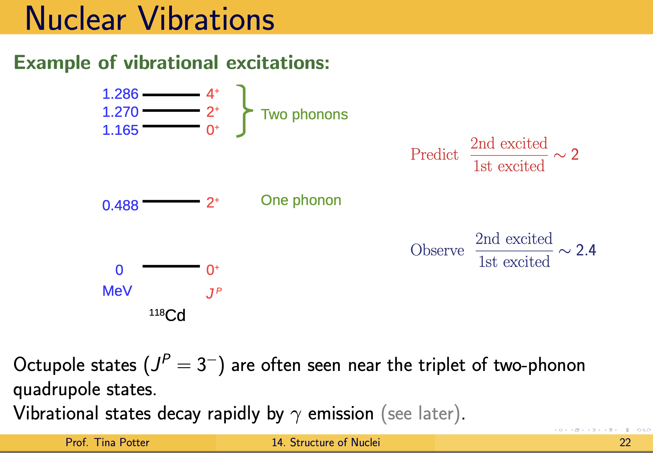
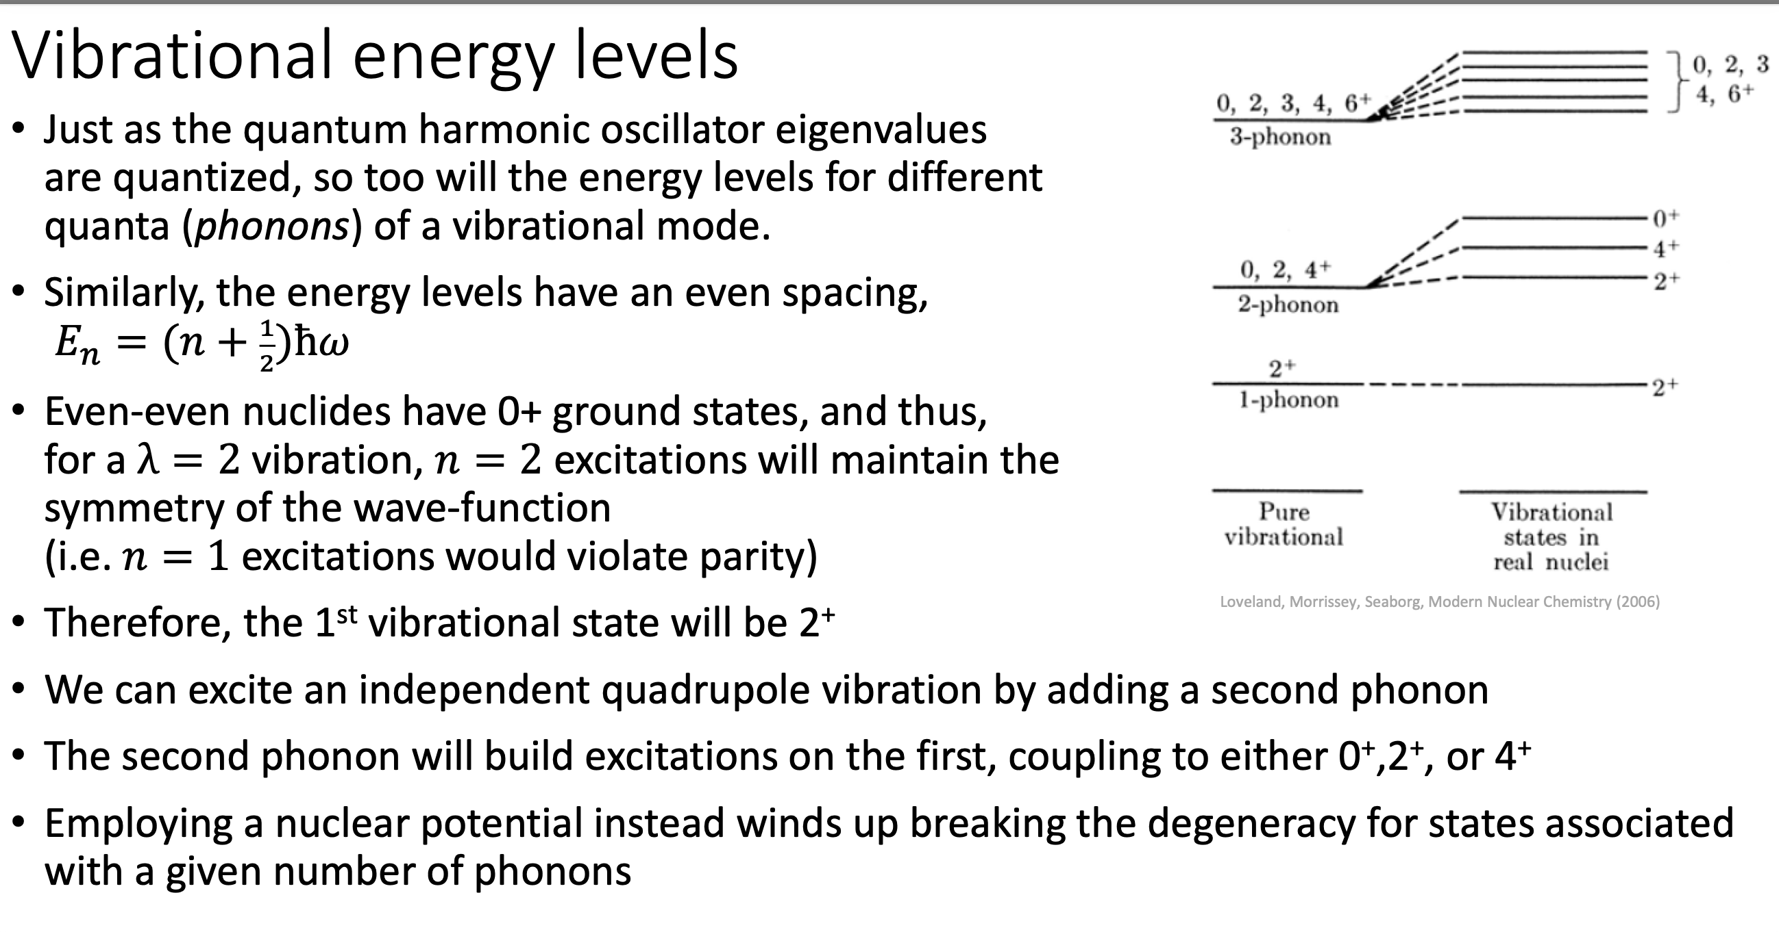
Project Motivation
Notes:
- while there isn’t a clear prescription for how to predict the absolute energies of vibration excitations, we can predict the relative values by taking the ratios of the second excited state to that of the first excited state E4/E2 which we can see here. The equation for energies of the vibrational states is also given, and it is therefore straightforward to understand how to find the relative relationship between the second and first excited states.

Slide 35
Collective Model: Vibrations
Notes:
- while there isn’t a clear prescription for how to predict the absolute energies of vibration excitations, we can predict the relative values by taking the ratios of the second excited state to that of the first excited state E4/E2 which we can see here. The equation for energies of the vibrational states is also given, and it is therefore straightforward to understand how to find the relative relationship between the second and first excited states.

Slide 36
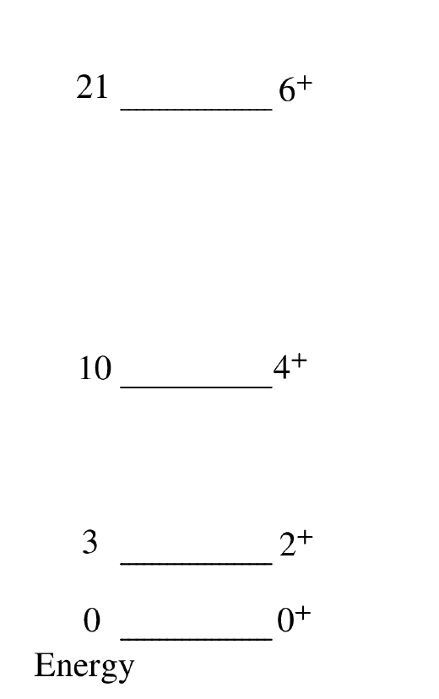
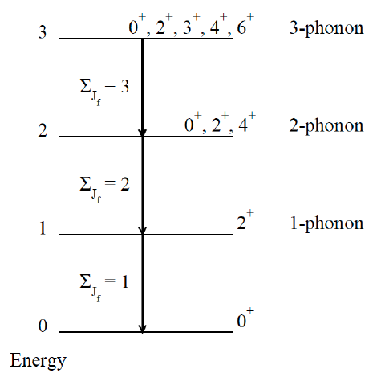
Project Motivation

Slide 37

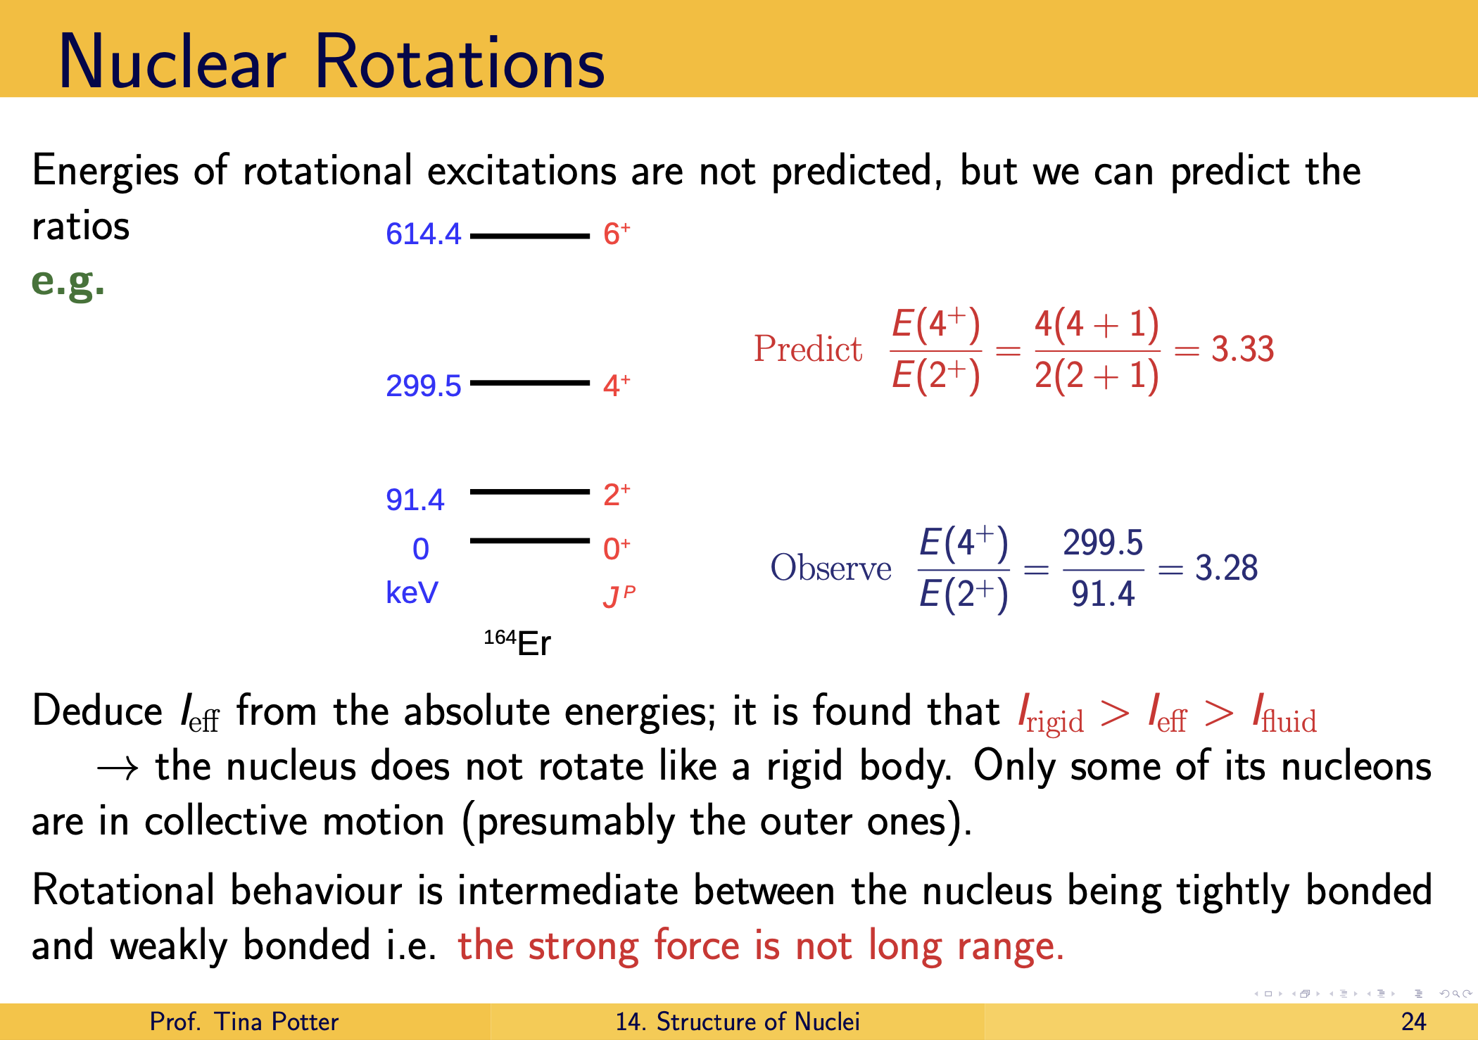


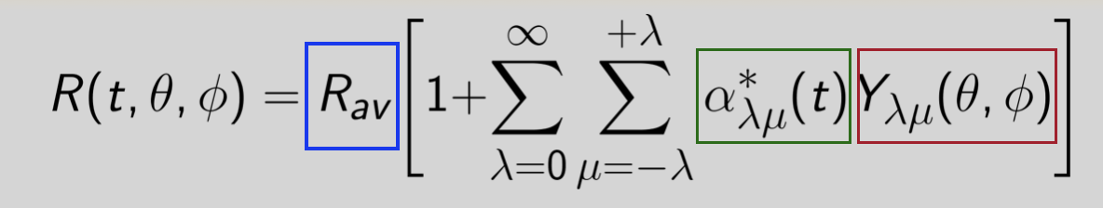
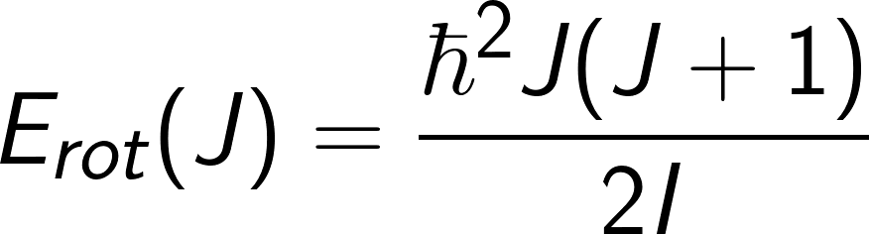
Collective Model: Rotations
Energy
Notes:
The second type of excitation, rotations, describes a rotation about an axis perpendicular to the symmetry axis, whereas rotations cannot occur about an axis of symmetry a nucleus possesses as it would leave the wavefunction unchanged and are not permitted in quantum mechanics. The level of deformation is quantified by a deformation parameter, β, which is related to the intrinsic quadrupole moment of the nucleus.
Similar to the vibrational model, the shape of rotational nuclei can be described by the
nuclear surface using the equation on slide 7, and has the form of a rotating ellipsoid ( with a λ=2 quadrupole deformation). The time-dependent amplitudes of the spherical harmonics, αλμ, in our equation can be rewritten in terms of two additional variables, β, the quadrupole deformation parameter, and γ, the degree of axial symmetry:
So now that we understand some ideas behind collective behaviour incorporated into the shell model picture to accommodate for excitations, and in particular the E4/E2 diagnostic tool that has been ubiquitously used to predict vibrational and rotational excitations in nuclei, we can take a look the experiment in this work, the 102Ru two neutron transfer reaction, as

Slide 38
Collective Model: Rotations
Notes:
The second type of excitation, rotations, about an axis perpendicular to the symmetry axis, whereas rotations cannot occur about an axis of symmetry a nucleus possesses as it would leave the wavefunction unchanged and are not permitted in quantum mechanics. The level of deformation is quantified by a deformation parameter, β, which is related to the intrinsic quadrupole moment of the nucleus.
Similar to the vibrational model, the shape of rotational nuclei can be described by the
nuclear surface using the equation on slide X, and has the form of a rotating ellipsoid ( with a λ=2 quadrupole deformation). The time-dependent amplitudes of the spherical harmonics, αλμ, in equation can be rewritten in terms of β, the quadrupole deformation parameter, and γ, the degree of axial symmetry:

Slide 39
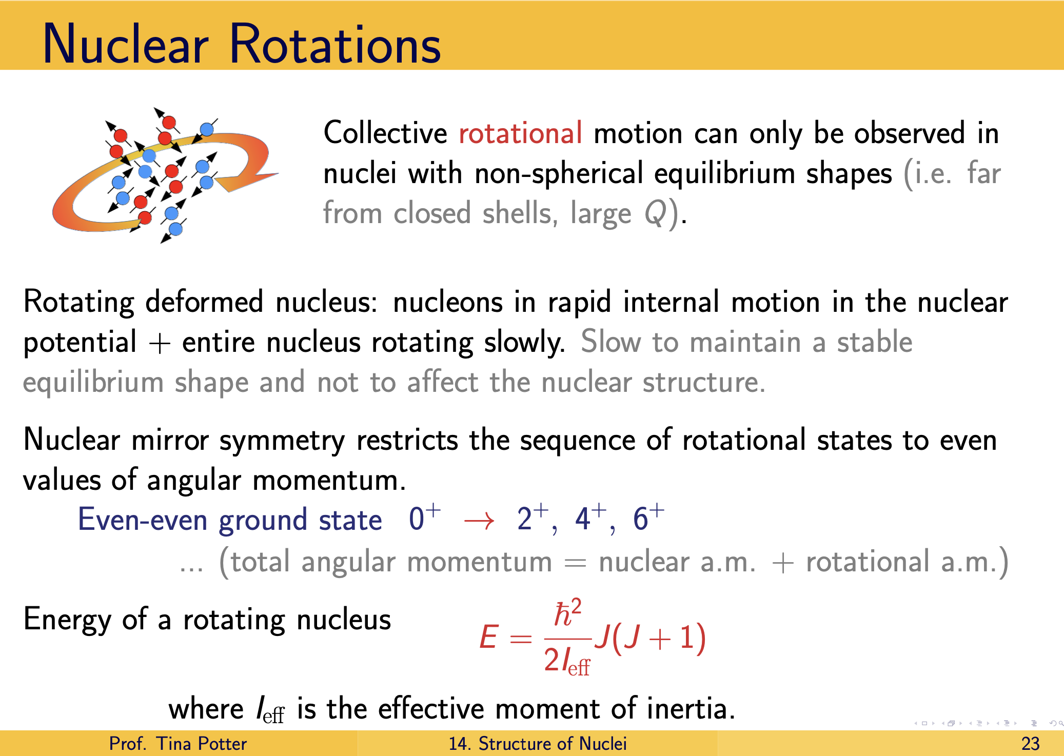
Collective Model: Rotations
Notes:
The second type of excitation, rotations, about an axis perpendicular to the symmetry axis, whereas rotations cannot occur about an axis of symmetry a nucleus possesses as it would leave the wavefunction unchanged and are not permitted in quantum mechanics. The level of deformation is quantified by a deformation parameter, β, which is related to the intrinsic quadrupole moment of the nucleus.
Similar to the vibrational model, the shape of rotational nuclei can be described by the
nuclear surface using the equation on slide X, and has the form of a rotating ellipsoid ( with a λ=2 quadrupole deformation). The time-dependent amplitudes of the spherical harmonics, αλμ, in equation can be rewritten in terms of β, the quadrupole deformation parameter, and γ, the degree of axial symmetry:

Slide 40
Project Motivation

Slide 41
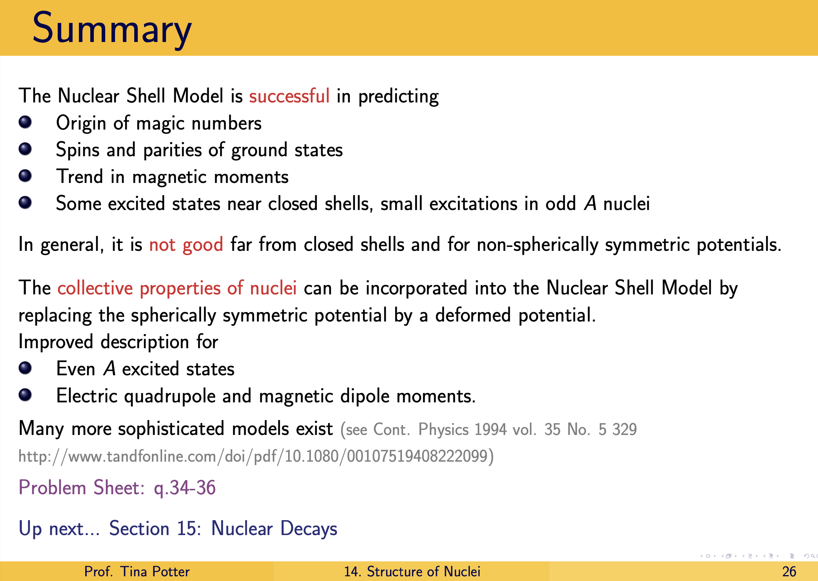
Project Motivation
Notes:
Perform the 102Ru(p,t) reaction to locate the natural parity states in 100Ru, and examine the relative strengths of the excited 0+ states.
Project Focus: Study of 100Ru via a two-neutron transfer reaction experiment performed using the Q3D magnetic spectrograph at the Maier-Leibnitz Laboratory, in Garching, Germany.

Slide 42
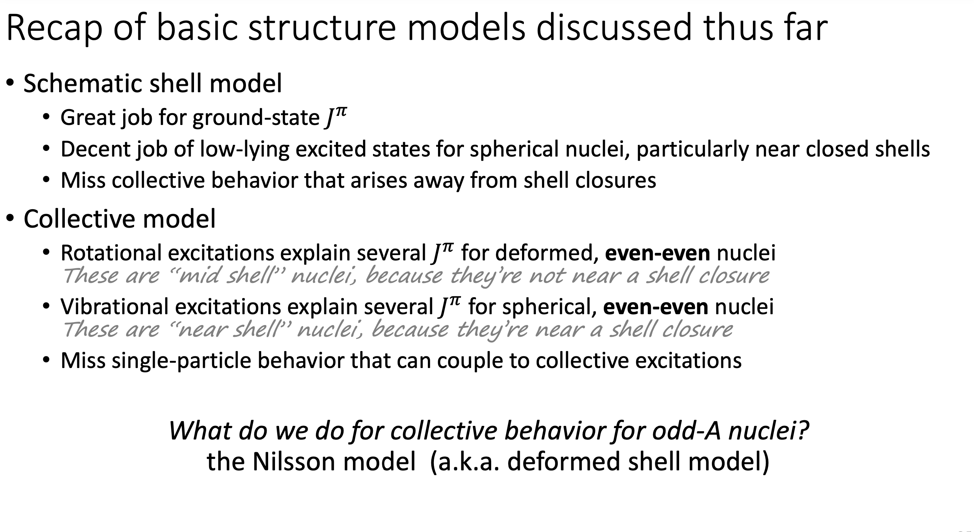
Project Motivation
Notes:
So now that we understand some ideas behind collective behaviour incorporated into the shell model picture to accommodate for excitations, we can take a look the experiment in this work, the 102Ru two neutron transfer reaction, as

Slide 43
Project Motivation
Notes:
So now that we understand some ideas behind collective behaviour incorporated into the shell model picture to accommodate for excitations, we can take a look the experiment in this work, the 102Ru two neutron transfer reaction, as

Slide 44
Project Motivation
Notes:
So now that we understand some ideas behind collective behaviour incorporated into the shell model picture to accommodate for excitations, we can take a look the experiment in this work, the 102Ru two neutron transfer reaction, as

Slide 45

Overview
Background
Topics of Discussion
Project Motivation
Experiment
Results & Discussion
Summary

Slide 46
Overview
Background
Topics of Discussion
Project Motivation
Experiment
Analysis
Results & Discussion
Summary
Notes:
These magic numbers can be explained in terms of the Shell Model of the nucleus, which considers each nucleon to be moving in some potential and classifies the energy levels in terms of quantum numbers \(n l j\), in the same way as the wavefunctions of individual electrons are classified in Atomic Physics.
Following the discoveries of the neutron by Chadwick in 1932 \cite{Chadwick1932} and fission by Meitner, Frisch, Hahn and Strassman in 1938 \cite{Meitner1939}, the discovery of $\beta$-delayed neutron emission was published by Roberts et al. \cite{Roberts1939, Roberts2_1939}.
Studying the neutron emitted following $\beta$-decay has a range of applications which includes characterizing the nuclear structure of short-lived neutron-rich nuclei and obtaining experimental inputs to be used for astrophysical r-process calculations and nuclear reactor modelling.
Fully understanding the r process is a challenge that involves detailed knowledge of nuclear masses, …
to be described in Section \ref{ch:BR}.
An efficiency curve was produced using calibration sources to correct fitted peak areas for Compton scattering effects. This was done using the $Radware$ programs $encal$ and $effit$ \cite{radware}, and the process is fully described in \cite{radich2015Thesis}.

Slide 47

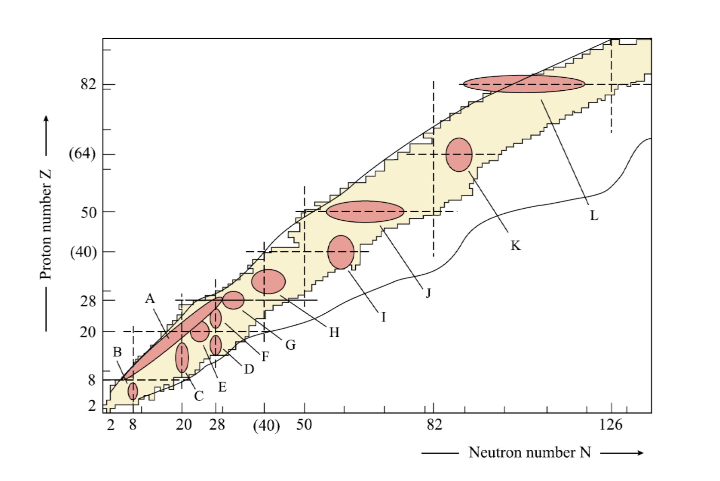

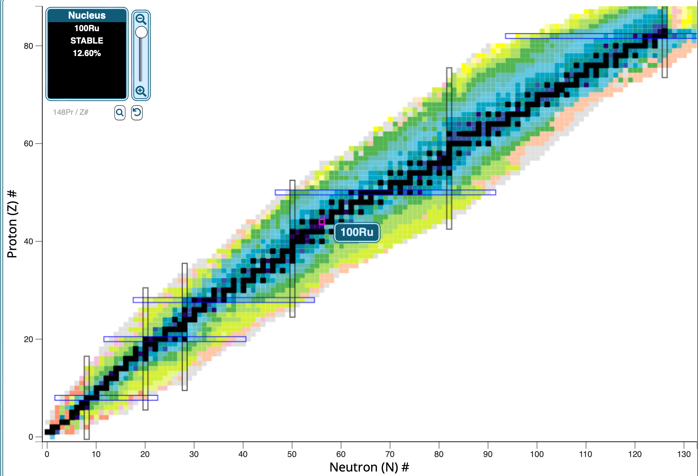
Project Motivation
Significance of Studying ¹⁰⁰Ru:
Notes:
So, as originally stated, in the context of nuclear structure, our general aim is to understand the puzzle that is the combinatorics of constituent protons and neutrons in the known nuclei, and to further evolve that understanding to adopt trends that are occurring outside of the parameters of our current framework, so we are probing for signs of
We introduced the shell model and the adaptations of collective vibrations and excitations accommodate for the gaps in the purely non-interacting picture of nuclei being treated solely as non-interacting particle systems. -Collective model can accommodate deformed behaviour (deformations) of nucleus by employing a non spherically symmetric potential : we get vibrators and rotators
As such, a probe for potential candidates for rotational nuclei and spherical vibrators (which we just outlined a few minutes ago) by using the expected ratios of the energy of the second excited state to the first excited state, E2/E1.
In this capacity, the even-even Ru isotopes, especially those with neutron numbers be- tween N=54 and N=60, have low-lying level schemes reminiscent of those expected for quadrupole harmonic vibrators, outlined in section, and In a survey conducted by Kern et al. [19] which used level excitation energies as indicators, a number of nuclei in the Z = 50 region, including Cd and Ru isotopes, were selected as strong candidates for spherical vibrational motion.
In more recently though, an alternative interpretation for the structure of the Cd isotopes has been offered with the suggestion that they instead possess multiple shape coexistence [20]. Shape coexistence (and shape mixing) occur as a result of the competition between the main actors in the dynamic features of nuclei; the spherical mean field, pairing correlations, and quadropole-quadropole interactions [14]. Shape coexistence manifests itself in various regions across the chart of nuclides [1],
With Z = 44 and N = 56, 100Ru lies near the middle of the Z = 40 − 50 shell, and ergo investigation into the excited states of this nucleus stands to offer an increased understanding of the evolution of collectivity in the Z = 40 − 50 region.

Slide 48

Project Motivation : Probing Pairing Content via Two-Nucleon Transfer Reactions
Pairing correlations are important for calculations of the nuclear matrix elements:
Do the correlations follow a normal BCS scheme or not?
Shape co-existence may disrupt the normal BCS distributions:
  Shape coexistence is known to occur approximately in the Z=40 N=60 region of the nuclear chart
Reactions that involve the transfer of two alike particles, such as the (p,t) two-neutron transfer reactions, specifically probe such pairing correlations:
We are probing the pairing correlations in ¹⁰⁰Ru via the ¹⁰²Ru(p,t)¹⁰⁰Ru reaction
To a high degree of accuracy, when both transferred nucleons are of the same type, they couple to total spin S = 0, so J = L:
As such, when the target S=0, the final states have J=L
Notes:
Practically all characteristics of low-energy physics, including the shape of nuclei and their transformations, are directly influenced by the pairing effects in nuclear systems. To this end, various approaches (that we’ve just spoken about in the background section) have been successfully developed to understand such pairing phenomena, and have provided an explanation of why the ground states of even-even nuclei have spin zero and the spin of an odd-mass nucleus is the same as the spin of the last unpaired nucleon
Now, a quick aside on pairing - in 1950s superconductivity in metals was understood through the lens of the “Cooper pair”, which, in this context, was characterized as two electrons of opposite momenta that attracted each other to form a bound state with zero momentum which behaved like a boson. This is the basic idea of the BCS theory of super-conductivity.
It turns out that, apart from some unique features for nuclear systems, the mechanism of pairing between nucleons in these systems is very much akin to that of electrons in superconductors. In both cases, we are dealing with systems of fermions which may be described by first approximation in terms of independent particle motion, a method that can be combined easily with the mean-field models such as the Shell Model to incorporate pairing correlations
Since shape coexistence and other unique collective behaviours manifest themselves via strong pairing correlations in the wave functions, experiments that probe these correlations are of utmost importance.
Reactions that involve the transfer of two alike particles, such as the (p,t) two-neutron transfer or (3He,n) two-proton transfer reactions, specifically probe such pairing correlations.

Slide 49

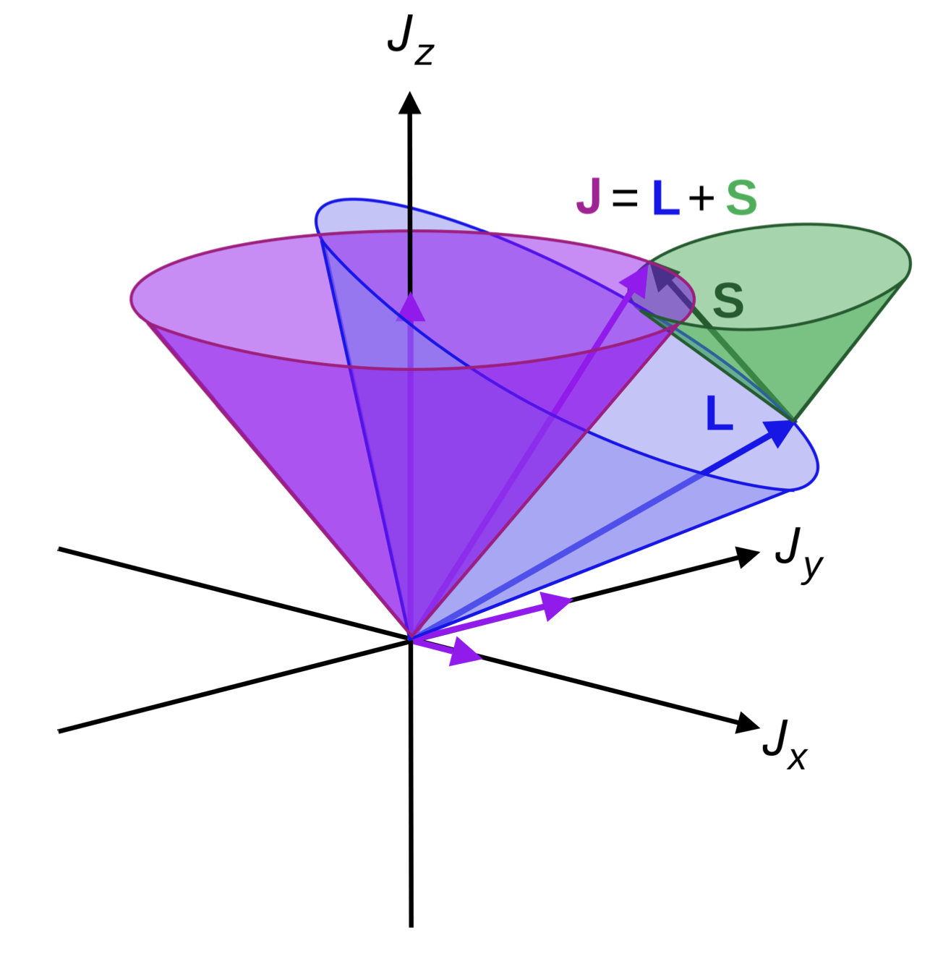
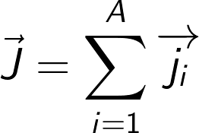

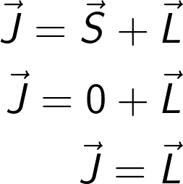

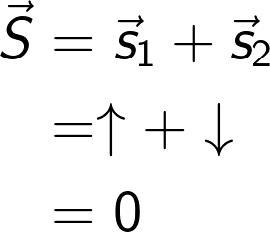
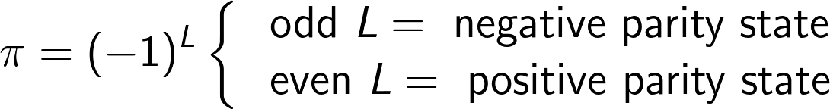
Project Motivation
Significance of Studying ¹⁰⁰Ru:
Notes:
The experiment under discussion here focuses on the study of 100Ru via the 102Ru(p, t) two-neutron transfer reaction whereby removing a pair of particles from the system enables the study of the neutron-pair properties of the states observed in the reaction. The experiment offers useful information on multiple fronts. Firstly, due to the anti-symmetric spin pairing (i.e. S = 0) exhibited by the transferred di-neutron pair in the (p, t) reaction, the reaction predominately populates natural spin states of the excited 100Ru daughter nucleus, allowing for unique assignments of the excited spin states and their parities to confidently be made. This is a unique feature that other reaction mechanisms can’t necessarily offer with the same level of confidence, and therefore stands to be particularly advantageous when used as a cross referencing yardstick for states observed via other experimental reaction mechanisms

Slide 50
Project Motivation : Probing Pairing Content via Two-Nucleon Transfer Reactions
Pairing correlations are important for calculations of the nuclear matrix elements:
Do the correlations follow a normal BCS scheme or not?
Shape co-existence may disrupt the normal BCS distributions:
  Shape coexistence is known to occur approximately in the Z=40 N=60 region of the nuclear chart
Reactions that involve the transfer of two alike particles, such as the (p,t) two-neutron transfer reactions, specifically probe such pairing correlations:
We are probing the pairing correlations in ¹⁰⁰Ru via the ¹⁰²Ru(p,t)¹⁰⁰Ru reaction
To a high degree of accuracy, when both transferred nucleons are of the same type, they couple to total spin S = 0, so J = L:
As such, when the target S=0, the final states have J=L
Notes:
Practically all characteristics of low-energy physics, including the shape of nuclei and their transformations, are directly influenced by the pairing effects in nuclear systems. To this end, various approaches (that we’ve just spoken about in the background section) have been successfully developed to understand such pairing phenomena, and have provided an explanation of why the ground states of even-even nuclei have spin zero and the spin of an odd-mass nucleus is the same as the spin of the last unpaired nucleon
Now, in 1950s superconductivity in metals was understood through the lens of the “Cooper pair”, which, in this context, was characterized as two electrons of opposite momenta that attracted each other to form a bound state with zero momentum which behaved like a boson [32,33]. This is the basic idea of the BCS theory of super-conductivity [33]. The characteristic of a metallic superconductor is primarily the large energy gap in the spectrum, corresponding to the energy required to break the aforementioned Cooper pair.
Apart from some unique features for nuclear systems, the mechanism of pairing between nucleons in these systems is very much akin to that of electrons in superconductors. The nuclear structure exhibits many similarities with the electron structure of metals. In both cases, we are dealing with systems of fermions which may be described by first approximation in terms of independent particle motion, a method that can be combined easily with the mean-field models such as the Shell Model to incorporate pairing correlations
Since shape coexistence manifests itself via strong correlations in the wave functions, experiments that probe these correlations are of utmost importance.
Among the most important are the pairing correlations, which can be described as the binding of two nucleons in Jπ = 0+ states, and the correlation effect can be expressed in terms of a pair field that is responsible for creating and annihilating two particles in time-reversed orbits.
Reactions that involve the transfer of two alike particles, such as the (p,t) two-neutron transfer or (3He,n) two-proton transfer reactions, specifically probe such pairing correlations.
In general, multiple pairs of particles with angular momenta that couple to J can contribute to the sum, depending on the availability of the orbitals near the Fermi surface. The cross-section angular distributions are sensitive to the L value, and while the magnitude of the cross section is sensitive to the j components, the shapes of the angular distributions generally are not.
Thus spectroscopic strengths for the transfer of a particular pair cannot be extracted from the experimental data, and often the ratios of cross sections are used to infer the nature of the final state. When available, two-nucleon amplitudes from shell-model calculations can be used to construct the spectroscopic amplitudes and combined with a reaction code to predict the cross sections.

Slide 51

Project Motivation : Probing Pairing Content via Two-Nucleon Transfer Reactions
Pairing correlations are important for calculations of the nuclear matrix elements:
Do the correlations follow a normal BCS scheme, or not?
Shape co-existence may disrupt the normal BCS distributions:
  Shape coexistence is known to occur approximately in the Z=40 N= 60 region of the nuclear chart
Reactions that involve the transfer of two alike particles, such as the (p,t) two-neutron transfer reactions, specifically probe such pairing correlations.
To a high degree of accuracy, when both transferred nucleons are of the same type, they couple to total spin S = 0, so J = L.
The coupled angular momentum J of the two nucleons, that have single-particle angular momenta j1 and j2, couples to the initial angular momentum Ji, resulting in the final angular momentum Jf .
Shape coexistence manifests itself via strong correlations in the wave functions, thus experiments that probe these correlations are of utmost importance.
Among the most important are the pairing correlations, which can be described as the binding of two nucleons in J^{π} = 0⁺ states.
Notes:
Since shape coexistence manifests itself via strong correlations in the wave functions, experiments that probe these correlations are of utmost importance.
Among the most important are the pairing correlations, which can be described as the binding of two nucleons in Jπ = 0+ states, and the correlation effect can be expressed in terms of a pair field that is responsible for creating and annihilating two particles in time-reversed orbits.
Reactions that involve the transfer of two alike particles, such as the (p,t) two-neutron transfer or (3He,n) two-proton transfer reactions, specifically probe such pairing correlations.
In general, multiple pairs of particles with angular momenta that couple to J can contribute to the sum, depending on the availability of the orbitals near the Fermi surface. The cross-section angular distributions are sensitive to the L value, and while the magnitude of the cross section is sensitive to the j components, the shapes of the angular distributions generally are not.
Thus spectroscopic strengths for the transfer of a particular pair cannot be extracted from the experimental data, and often the ratios of cross sections are used to infer the nature of the final state. When available, two-nucleon amplitudes from shell-model calculations can be used to construct the spectroscopic amplitudes and combined with a reaction code to predict the cross sections.

Slide 52
Project Motivation: Experimental Probes for Shape Coexistence
Shape coexistence can be investigated using a variety of experimental approaches:
Nuclear deformation can be obtained from the level energies
Alternatively from the energy systematics via electromagnetic transition strengths
Observation of low-lying 0⁺ states in even–even nuclei is usually interpreted as an indication of shape coexistence.
Additionally, if you see a strong enhancement in a 0+→ 0+ , this could point to multi-particle multi-hole excitations, and these are often the mechanism behind shape coexistence manifestation
Notes:
In the case that a nucleus has two states which have a different intrinsic deformation, are reasonably closely spaced, and remain distinct, the nucleus is said to possess shape coexistence.
One of the manifestations of shape coexistence would be the presence of excited states which aren’t usually expected, which can include excited 0+ states.
For several decades, two-neutron transfer reactions, such as (p t) and (t p) reactions have been the method of choice to study excited 0+ states. Two-neutron transfer reactions probe
the pairing interaction between nuclear wave functions, where if a nucleus contains strong pairing correlations, its 0+ → 0+ transition strength is greatly enhanced. One of the key findings was that in these reactions, the cross sections of the first excited L = 0 excitation (0+2 ) and ground states (0+1 ) were comparable in N = 88 − 90 nuclei, where a rapid onset of deformation emerges [10]. (Christina pg 15)
Shape coexistence can be investigated using a variety of experimental approaches:
The first indication of nuclear deformation can be obtained from the level energies
Alternatively from the energy systematics via electromagnetic transition strengths.
Shape coexistence can be studied via a variety of experimental probes. The first indication of nuclear deformation can be obtained from the level energies (The identification of shape coexistence often begins through the observation of states at excitation energies where they are not expected, or from trends observed in energy systematics. The former implies that we have a high degree of confidence in our knowledge of the structure of the ground state so as to predict the excitation spectrum), or alternatively from the electromagnetic transition strengths. In particular, observation of low-lying 0+ states in even–even nuclei is usually interpreted as a hint of shape coexistence. 4/5.. (look at 9/10 Two-state mixing model )

Slide 53
Project Motivation: Experimental Probes for Shape Coexistence
Shape coexistence can be investigated using a variety of experimental approaches:
Nuclear deformation can be obtained from the level energies
Alternatively from the energy systematics via electromagnetic transition strengths
For the first approach, identification begins through the observation of states at excitation energies where they are not expected, which requires that we have a high degree of confidence in our knowledge of the structure of the ground state in order to predict the excitation spectrum.
Observation of low-lying 0⁺ states in even–even nuclei is usually interpreted as an indication of shape coexistence.
Additionally, if you see a strong enhancement in a 0+→ 0+ , this could point to multi-particle multi-hole excitations, and these are often the mechanism behind shape coexistence manifestation
Notes:
In the case that a nucleus has two states which have a different intrinsic deformation, are reasonably closely spaced, and remain distinct, the nucleus is said to possess shape coexistence.
One of the manifestations of shape coexistence would be the presence of excited states which aren’t usually expected, which can include excited 0+ states.
For several decades, two-neutron transfer reactions, such as (p t) and (t p) reactions have been the method of choice to study excited 0+ states. Two-neutron transfer reactions probe
the pairing interaction between nuclear wave functions, where if a nucleus contains strong pairing correlations, its 0+ → 0+ transition strength is greatly enhanced. One of the key findings was that in these reactions, the cross sections of the first excited L = 0 excitation (0+2 ) and ground states (0+1 ) were comparable in N = 88 − 90 nuclei, where a rapid onset of deformation emerges [10]. (Christina pg 15)
Shape coexistence can be investigated using a variety of experimental approaches:
The first indication of nuclear deformation can be obtained from the level energies
Alternatively from the energy systematics via electromagnetic transition strengths.
Shape coexistence can be studied via a variety of experimental probes. The first indication of nuclear deformation can be obtained from the level energies (The identification of shape coexistence often begins through the observation of states at excitation energies where they are not expected, or from trends observed in energy systematics. The former implies that we have a high degree of confidence in our knowledge of the structure of the ground state so as to predict the excitation spectrum), or alternatively from the electromagnetic transition strengths. In particular, observation of low-lying 0+ states in even–even nuclei is usually interpreted as a hint of shape coexistence. 4/5.. (look at 9/10 Two-state mixing model )

Slide 54
Project Motivation: Experimental Probes of Shape Coexistence
Shape coexistence can be investigated using a variety of experimental approaches:
Nuclear deformation can be obtained from the level energies
Alternatively from the energy systematics via electromagnetic transition strengths.
For the first approach, identification begins through the observation of states at excitation energies where they are not expected which requires that we have a high degree of confidence in our knowledge of the structure of the ground state so as to predict the excitation spectrum.
For the second approach in particular, observation of low-lying 0⁺ states in even–even nuclei is usually interpreted as a hint of shape coexistence. 4/5.. (look at 9/10 Two-state mixing model )
Notes:
Shape coexistence can be investigated using a variety of experimental approaches:
The first indication of nuclear deformation can be obtained from the level energies
Alternatively from the energy systematics via electromagnetic transition strengths.
Shape coexistence can be studied via a variety of experimental probes. The first indication of nuclear deformation can be obtained from the level energies (The identification of shape coexistence often begins through the observation of states at excitation energies where they are not expected, or from trends observed in energy systematics. The former implies that we have a high degree of confidence in our knowledge of the structure of the ground state so as to predict the excitation spectrum), or alternatively from the electromagnetic transition strengths. In particular, observation of low-lying 0+ states in even–even nuclei is usually interpreted as a hint of shape coexistence. 4/5.. (look at 9/10 Two-state mixing model )

Slide 55
Project Motivation: Experimental Fingerprints of Shape Coexistence
Shape coexistence can be studied via a variety of experimental probes. The first indication of nuclear deformation can be obtained from the level energies (The identification of shape coexistence often begins through the observation of states at excitation energies where they are not expected, or from trends observed in energy systematics. The former implies that we have a high degree of confidence in our knowledge of the structure of the ground state so as to predict the excitation spectrum), or alternatively from the electromagnetic transition strengths. In particular, observation of low-lying 0+ states in even–even nuclei is usually interpreted as a hint of shape coexistence. 4/5.. (look at 9/10 Two-state mixing model )
Notes:
Shape coexistence can be studied via a variety of experimental probes. The first indication of nuclear deformation can be obtained from the level energies (The identification of shape coexistence often begins through the observation of states at excitation energies where they are not expected, or from trends observed in energy systematics. The former implies that we have a high degree of confidence in our knowledge of the structure of the ground state so as to predict the excitation spectrum), or alternatively from the electromagnetic transition strengths. In particular, observation of low-lying 0+ states in even–even nuclei is usually interpreted as a hint of shape coexistence. 4/5.. (look at 9/10 Two-state mixing model )

Slide 56
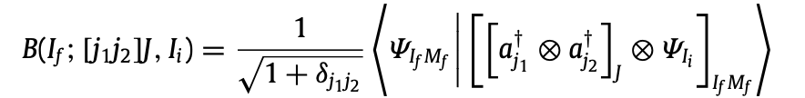

Project Motivation : Probing Pairing Content via Two-Nucleon Transfer Reactions
Shape coexistence manifests itself via strong correlations in the wave functions, thus experiments that probe these correlations are of utmost importance.
Among the most important are the pairing correlations, which can be described as the binding of two nucleons in J^{π} = 0⁺ states.
Reactions that involve the transfer of two alike particles, such as the (p,t) two-neutron transfer reactions, specifically probe such pairing correlations.
Two-nucleon transfer process spectroscopic amplitudes
Caption
The coupled angular momentum J of the two nucleons, that have single-particle angular momenta j1 and j2, couples to the initial angular momentum Ii resulting in the final angular momentum If .
To a high degree of accuracy, when both transferred nucleons are of the same type, they couple to total spin S = 0, so J = L.
Notes:
Since shape coexistence manifests itself via strong correlations in the wave functions, experiments that probe these correlations are of utmost importance.
Among the most important are the pairing correlations, which can be described as the binding of two nucleons in Jπ = 0+ states, and the correlation effect can be expressed in terms of a pair field that is responsible for creating and annihilating two particles in time-reversed orbits.
Reactions that involve the transfer of two alike particles, such as the (p,t) two-neutron transfer or (3He,n) two-proton transfer reactions, specifically probe such pairing correlations.
In general, multiple pairs of particles with angular momenta that couple to J can contribute to the sum, depending on the availability of the orbitals near the Fermi surface. The cross-section angular distributions are sensitive to the L value, and while the magnitude of the cross section is sensitive to the j components, the shapes of the angular distributions generally are not.
Thus spectroscopic strengths for the transfer of a particular pair cannot be extracted from the experimental data, and often the ratios of cross sections are used to infer the nature of the final state. When available, two-nucleon amplitudes from shell-model calculations can be used to construct the spectroscopic amplitudes and combined with a reaction code to predict the cross sections.

Slide 57
Project Motivation : Probing Pairing Content via Two-Nucleon Transfer Reactions
In general, multiple pairs of particles with angular momenta that couple to J can contribute to the sum, depending on the availability of the orbitals near the Fermi surface. The cross-section angular distributions are sensitive to the L value, and while the magnitude of the cross section is sensitive to the j components, the shapes of the angular distributions generally are not.
Thus spectroscopic strengths for the transfer of a particular pair cannot be extracted from the experimental data, and often the ratios of cross sections are used to infer the nature of the final state. When available, two-nucleon amplitudes from shell-model calculations can be used to construct the spectroscopic amplitudes and combined with a reaction code to predict the cross sections.
Notes:
Since shape coexistence manifests itself via strong correlations in the wave functions, experiments that probe these correlations are of utmost importance. Among the most important are the pairing correlations, which can be described as the binding of two nucleons in Jπ = 0+ states, and the correlation effect can be expressed in terms of a pair field that is responsible for creating and annihilating two particles in time-reversed orbits. Reactions that involve the transfer of two alike particles, such as the (p,t) two-neutron transfer or (3He,n) two-proton transfer reactions, specifically probe such pairing correlations.
We propose to perform the 102Ru(p,t) reaction to locate the natural parity states in 100Ru, and examine the relative strengths of the excited 0+ states.
WHY

Slide 58

Project Motivation: ¹⁰²Ru(p,t)¹⁰⁰Ru
The advantageous feature that this transfer reaction provides is the spin parities of the nuclear states for an even-even target.
We perform the ¹⁰²Ru(p,t) reaction, locate the natural spin parity states in ¹⁰⁰Ru, and examine the relative strengths of the excited 0+ states.
Using normal BCS pairing, the strength to excited 0+ states is expected to be a few percent. However, when we see strengths ~10 percent or greater, this is considered a significant enhancement in the transition strength, and therefore would reflect a very special characteristic of the excited state in question.
Notes:
Additionally, it has been the case for several decades that two-neutron transfer reactions, such as (p,t) and (t,p) reactions have been the method of choice to study excited 0+states [11]. Two-neutron transfer reactions reflect the pairing interaction between nuclear wave functions [8], where if a nucleus contains strong pairing correlations, its 0+ → 0+transition strength will be greatly enhanced.
These strong pairing correlations are often manifestations of pairing effects not typically characterized under a normal BCS pairing regime. As a result, these 0+ → 0+transition strengths can be used as a probe into such behaviour that falls outside of the scope of what would be expected from BCS pairing. Pairing correlations are a prime example of a diagnostic used to characterize behaviour of collective states within the context of the shell model, and how this feature evolves in different Z areas of the chart of nuclides
The cross sections of these low-lying excited 0+ states along with the 0+2 state population relative to the ground state strength can offer insight into special characteristics for these states, as the stronger the relative strength, the stronger the possibility that the 0+2 state is an example of shape coexistence.

Slide 59

Overview
Background
Topics of Discussion
Project Motivation
Experiment
Results & Discussion
Summary

Slide 60

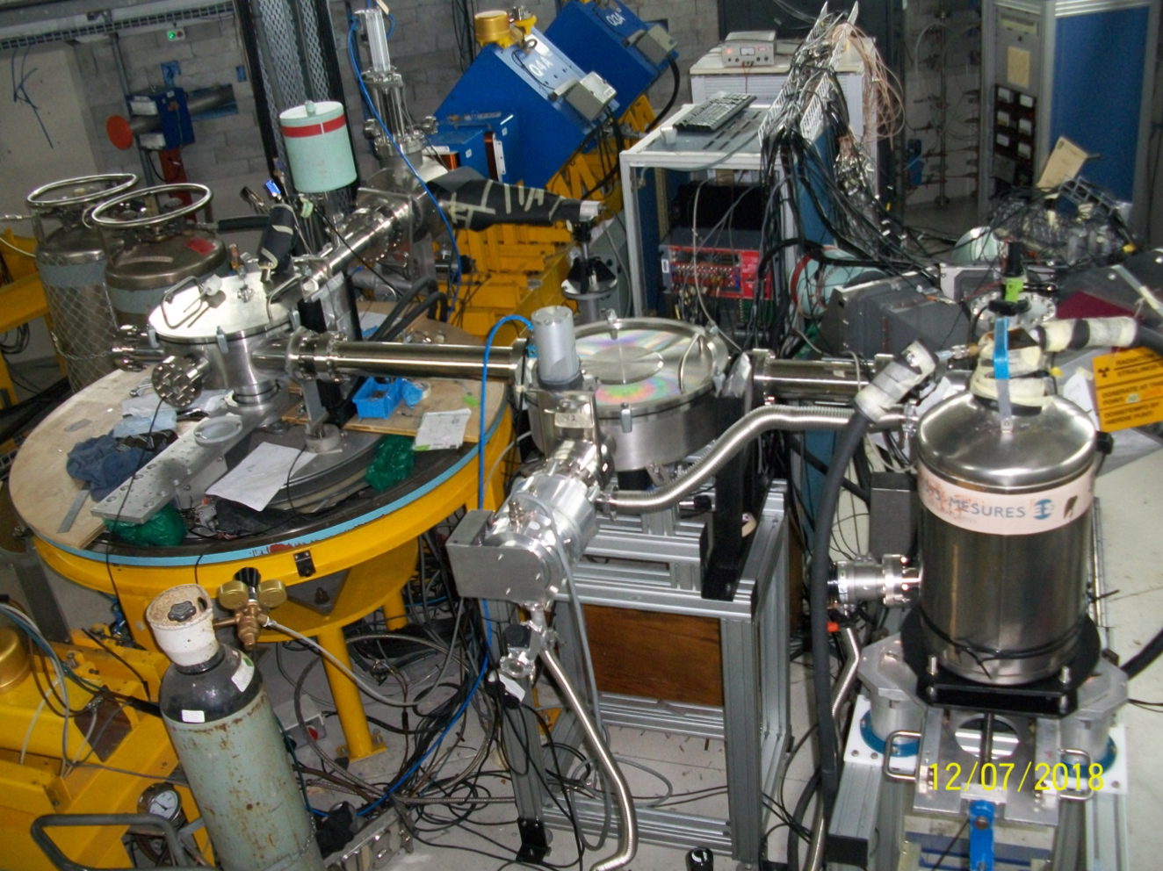
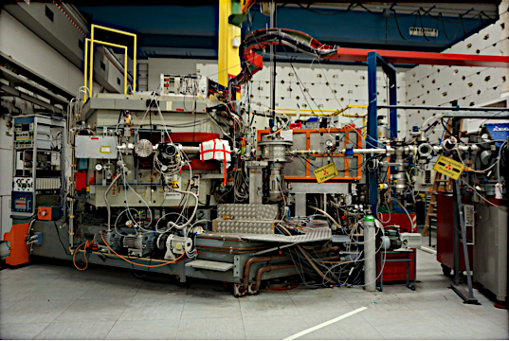
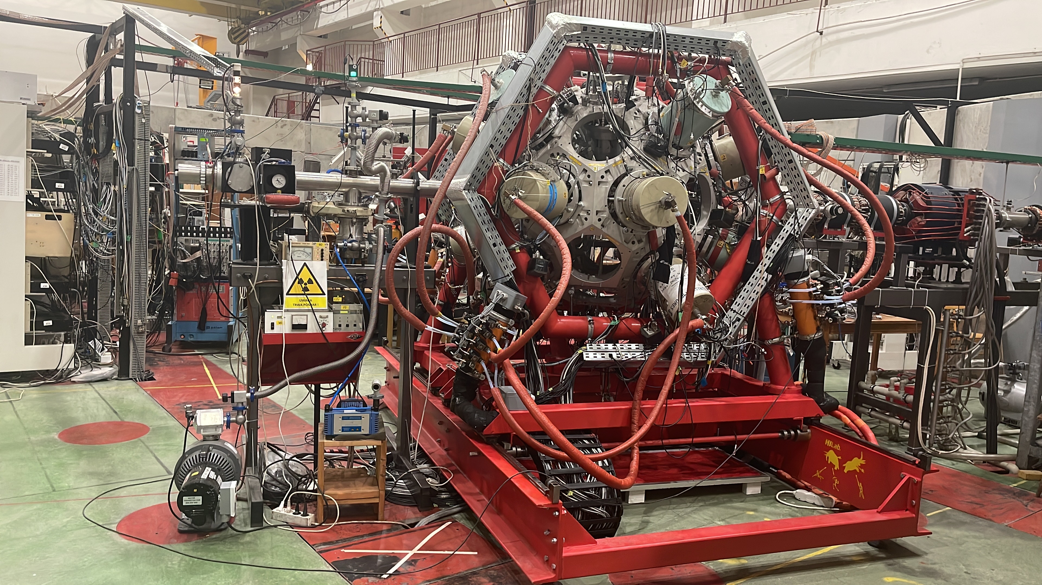
Experiment: ¹⁰²Ru(p,t)¹⁰⁰Ru
Purpose: Part of a multi-prong campaign aimed at investigating the structure of ¹⁰⁰Ru
Ithemba LABS: Beta Decay
MLL Q3D Magnetic Spectrograph :
Transfer Reaction
HIL: Coulomb Excitation
June 2018
August 2019
March 2022
Cape Town, South Africa
Garching, Germany
Warsaw, Poland
Notes:
So to be give the full picture, this particular two neutron transfer reaction was actually part of a multi pronged campaign to study 100Ru via various reaction channels, such as Beta Decay which was carried out at Ithemba LABs in South Africa in June of 2018, and a Coulomb excitation that was carried out in Poland just this past March, 2022.
The project Focus of this particular prong of the campaign was to study 100Ru via a two-neutron transfer reaction experiment, and this was performed performed using the Q3D magnetic spectrograph at the Maier-Leibnitz Laboratory, in Garching, Germany.
As a result of the level density in heavy nuclei being quite high, excellent detector energy
resolution is required to resolve discrete states in the residual nuclei. For this requirement,
the Quadrupole-3-Dipole (Q3D) magnetic spectrometer makes an exemplary choice, as it
provides excellent energy resolution as well as the possibility to detect particles at low angles required to create corresponding angular distributions. For L = 0 transfers in particular, such as the one investigated in this work, these angular distributions peak in cross section at 0◦, so the capability of the Q3D to probe low angles is a necessity.

Slide 61
Experiment: ¹⁰²Ru(p,t)¹⁰⁰Ru
Purpose: Part of a multi-prong campaign aimed at investigating the structure of ¹⁰⁰Ru
Ithemba LABS: Beta Decay
MLL Q3D Magnetic Spectrograph :
Transfer Reaction
HIL: Coulomb Excitation
June 2018
August 2019
March 2022
Cape Town, South Africa
Garching, Germany
Warsaw, Poland
Notes:
Aims of the campaign
Project Focus: Study of 100Ru via a two-neutron transfer reaction experiment performed using the Q3D magnetic spectrograph at the Maier-Leibnitz Laboratory, in Garching, Germany.
This is referred to as the elastic channel. Many non-elastic channels also exist, such as inelastic scattering, nucleon transfer reactions, breakup reactions and charge-exchange reactions. Each of these reaction channels is opened due to a different reaction mechanism (defined by the number of nucleons which are transferred, Q-values, excitation of a residual nucleus, etc.) and each channel can probe different components of the nuclear wave function.

Slide 62
Project Focus
Project Focus: Study of 100Ru via a two-neutron transfer reaction experiment performed using the Q3D magnetic spectrograph at the Maier-Leibnitz Laboratory, in Garching, Germany
Q3D Magnetic Spectrograph :
Transfer Reaction
Garching, Germany
Notes:
Why Ru?

Slide 63


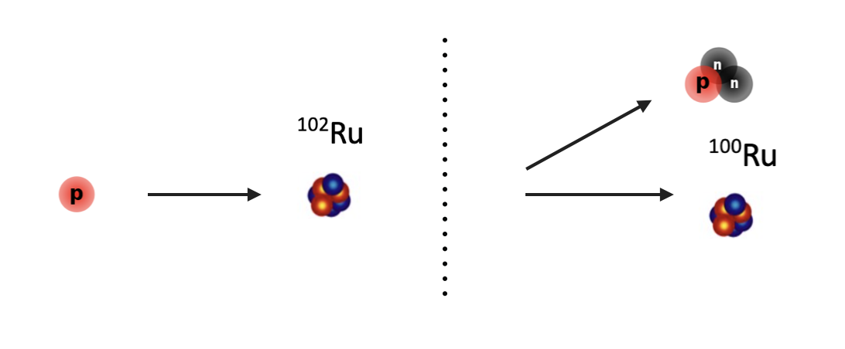
Experiment: ¹⁰²Ru(p,t)¹⁰⁰Ru
¹⁰²Ru(p,t)¹⁰⁰Ru : Study of ¹⁰⁰Ru via a two-neutron transfer reaction experiment performed using the Q3D magnetic spectrograph at the Maier-Leibnitz Laboratory, in Garching, Germany
Experimental Procedure employed a target of ¹⁰²Ru and bombard it with protons that effectively "pick-up" two neutrons from this target, resulting in the production of ¹⁰⁰Ru.
Q3D Magnetic Spectrograph :
Transfer Reaction
By removing a pair of particles from the system, one can study the neutron-pair properties of the states we observe in the reaction, leading to a better understanding of the structure of ¹⁰⁰Ru.
Garching, Germany
Notes:
So in general, how is a two neutron transfer reaction carried out?
Well we can look at the schematic on the right hand side as a reference, but essentially what was done was the bombardment of a 102Ru target using a proton beam , that in this case had energy of 22MeV, which effectively “picked up” a di-neutron pair from the 102Ru target, ultimately yielding an outgoing triton and the resulting 100Ru daughter nucleus.

Slide 64
¹⁰²Ru(p,t)¹⁰⁰Ru
Experimental Procedure:
Employed a target of 102Ru and bombard it with protons that effectively "pick-up" two neutrons from this target, resulting in the production of 100Ru.
By removing a pair of particles from the system, one can study the neutron-pair properties of the states we observe in the reaction, leading to a better understanding of the structure of 100Ru.

Slide 65
¹⁰²Ru(p,t)¹⁰⁰Ru
Experimental Procedure:
Employed a target of 102Ru and bombard it with protons that effectively "pick-up" two neutrons from this target, resulting in the production of 100Ru.
By removing a pair of particles from the system, one can study the neutron-pair properties of the states we observe in the reaction, leading to a better understanding of the structure of 100Ru.

Slide 66

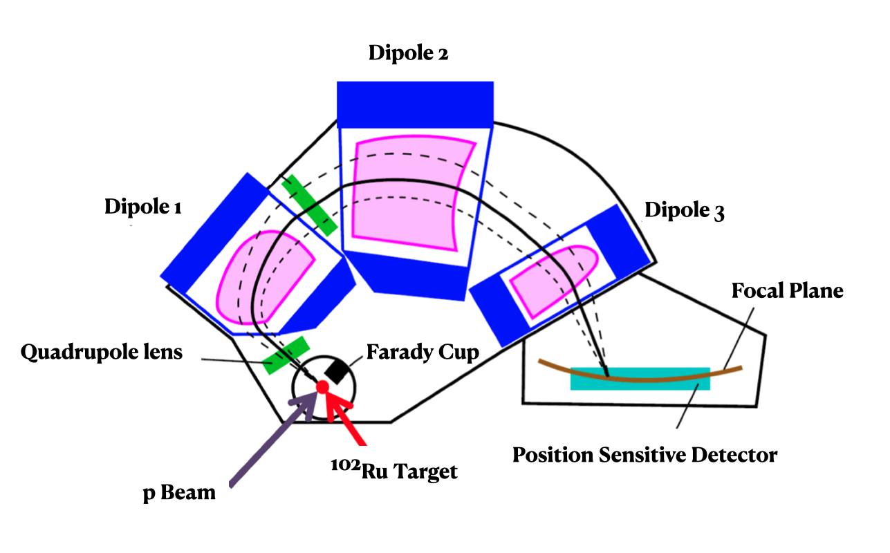
Quadrapole-3-Dipole Magnetic Spectrograph (Q3D)
Notes:
The detector that was used to perform this two neutron transfer of 102 Ru into 100 Ru was the Q3D, or Quadropole 3 Dipole magnetic spectograph. The (Q3D) is a compact, large-dispersion magnetic spectrograph which focuses reaction ejectiles onto a focal plane detector using magnetic field.
Because the Q3D fields are set for the kinematics of the desired nuclear reaction, all other reactions will be out of focus on the focal plane, so the wide impurity peaks from the reaction appear as to be out of focus when the accumulate on the detector.
The scattered ejectiles from the reaction enter the Q3D through an aperture which can be used to limit the beam intensity to the Q3D.
The scattered beam then passes through a quadrupole magnet, which focuses the scattered reaction ejectiles vertically. This quadrupole magnet is often called a “quadrupole lens” due to its similarity to an optical lens which uses glass to focus an object.
The three dipole magnets use a magnetic field to separate the reaction products by energy and bend them onto a focal plane detector. Each magnetic component of the Q3D are dependent on the reaction kinematics, and as a result, are unique to the reaction taking place. The Q3D interface calculates and sets the required magnetic fields for optimal resolution on the focal plane given the Q-value of the reaction and masses of the projectile and target.
The Q3D is mounted on a semi-circular iron track which allows the spectrograph to be rotated through 5-150° with respect to the beam axis.
For the reaction under investigation, data were collected at 9 angles ranging from 6-45◦.
where this rotation ability was used to create angular distributions, which is a key tool in observing the angular momentum transferred in a nuclear reaction.

Slide 67

Quadrapole-3-Dipole Magnetic Spectrograph (Q3D)
Notes:
So the detector that was used to perform this two neutron transfer of 102 Ru into 100 Ru was the Q3D, or Quadropole 3 Dipole magnetic spectograph. The (Q3D) is a compact, large-dispersion magnetic spectrograph which focuses reaction ejectiles onto a focal plane detector using magnetic field.
Because the Q3D fields are set for the kinematics of the desired nuclear reaction, all other reactions will be out of focus on the focal plane, so the wide impurity peaks from the reaction appear as to be out of focus when the accumulate on the detector. The coloured arrows show the direction in which the contaminant peaks are pushed out of the spectrum at high angles, and the dots represent the energies at which the peaks would appear from the reaction kinematics.
The scattered ejectiles enter the Q3D through an aperture which can be used to limit the beam intensity to the Q3D. The solid angle of this aperture is described in
The scattered beam then passes through a quadrupole magnet, which focuses the scattered reaction ejectiles vertically. The quadrupole magnet is often called a quadrupole lens due to its similarity to an optical lens which uses glass to focus an object [1]
The three dipole magnets use a magnetic field to separate the reaction products by energy and bend them onto a focal plane detector. Each magnetic component of the Q3D are dependent on the reaction kinematics, and as such, are unique to the reaction taking place. The Q3D interface calculates and sets the required magnetic fields for optimal resolution on the focal plane given the Q-value of the reaction and masses of the projectile and target.
The Q3D is mounted on a semi-circular iron track which allows the spectrograph to be rotated through 5-150° with respect to the beam axis.
This rotation can be used to create angular distributions, which are an important tool in studying angular momentum transferred in a nuclear reaction.

Slide 68
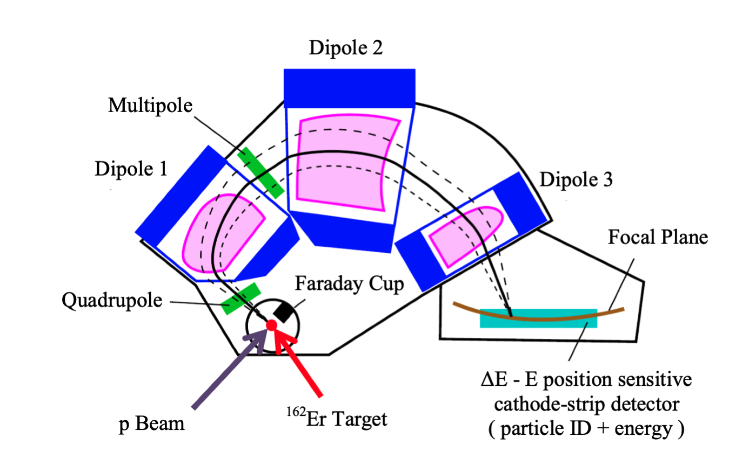
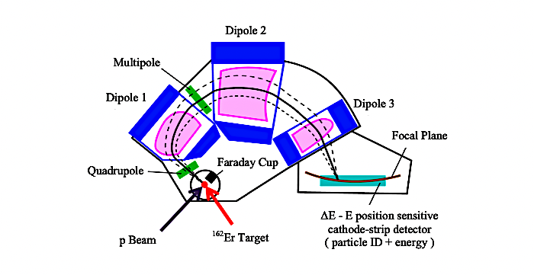
Quadrapole-3-Dipole Magnetic Spectrograph (Q3D)
Dipole 2
Dipole 1
Dipole 3
Focal Plane
Quadrupole lens
Farady Cup
102Ru Target
¹⁰²Ru Target
Position Sensitive Detector
p Beam

Slide 69
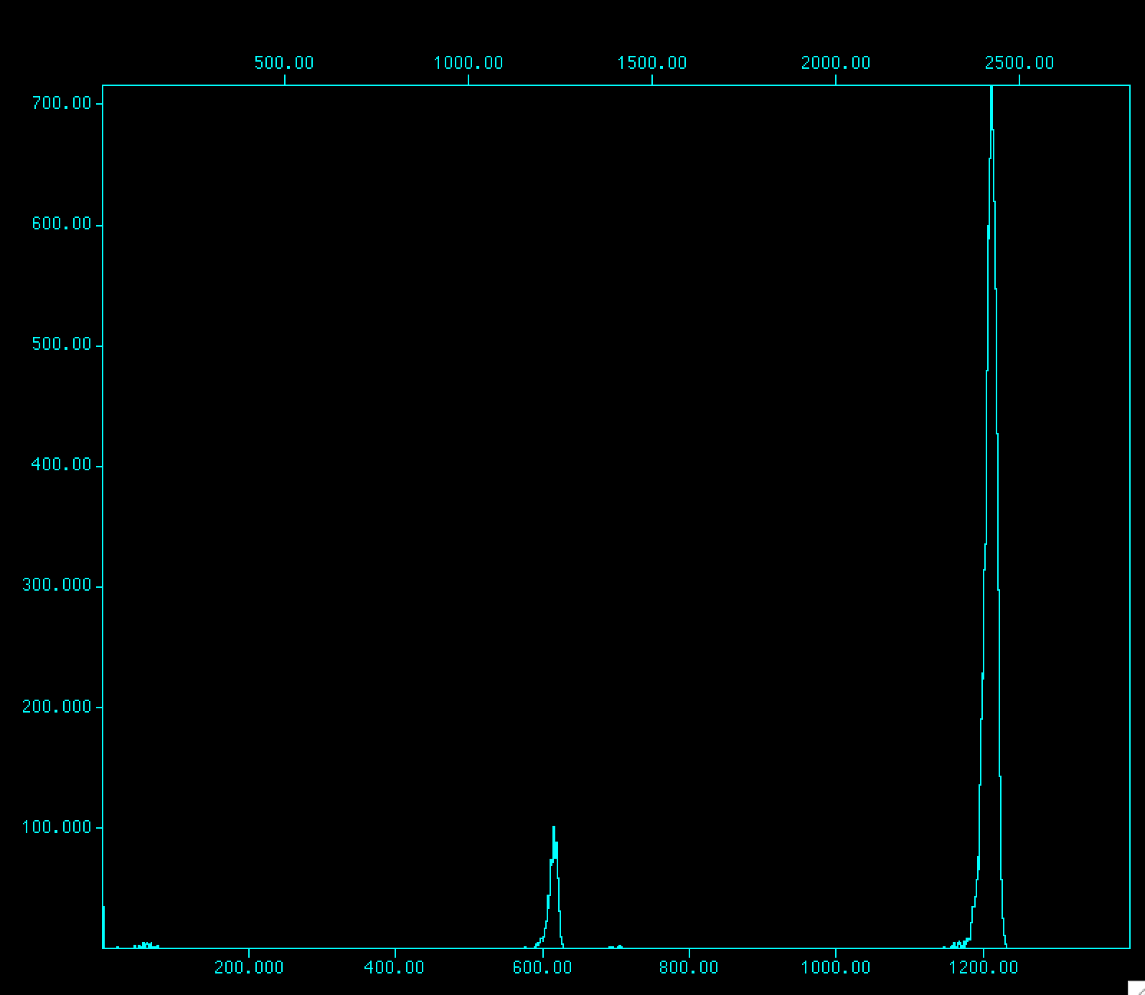
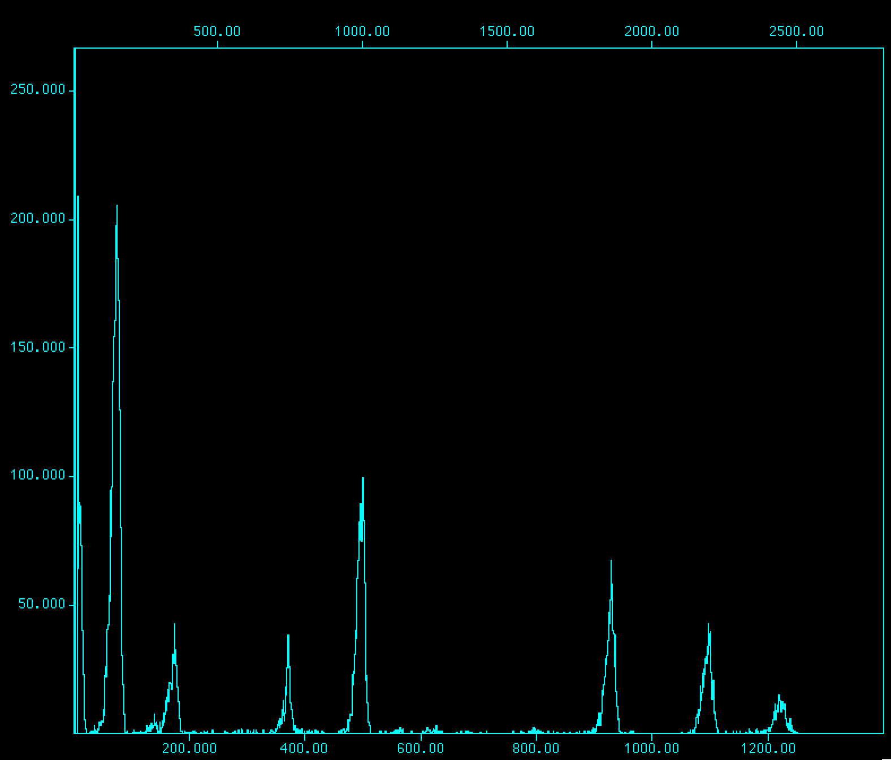
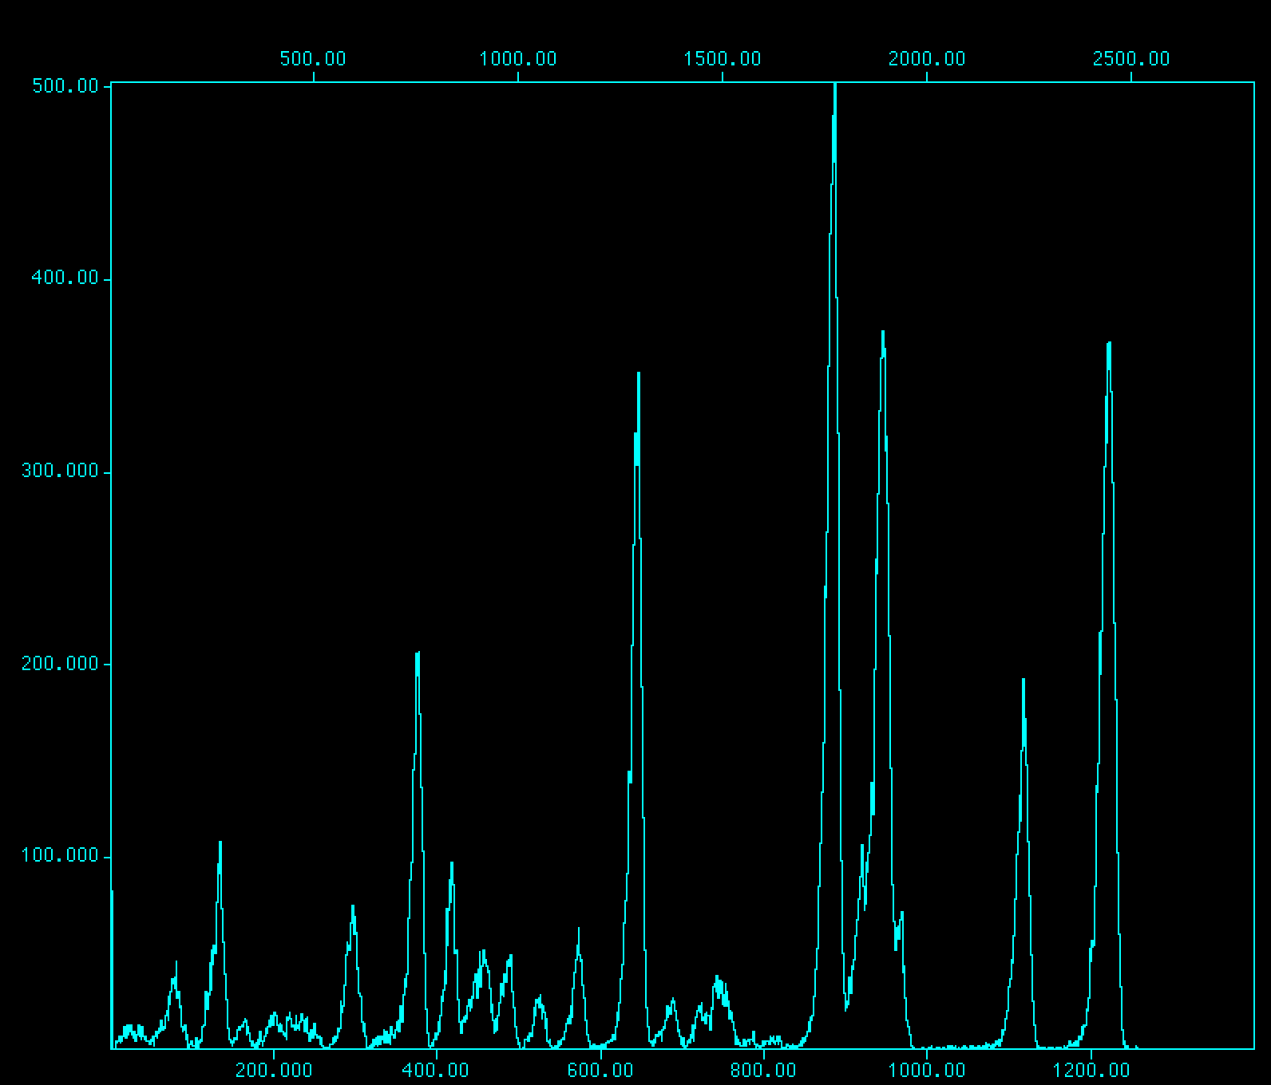

Spectral Analysis
Counts
Channel
102Ru_pt_450_25_run75_rebin2.spe
102Ru_pt_1550_25_run76_rebin2.spe
102Ru_pt_2550_25_run77_rebin2.spe
102Ru_pt_3400_25_run78_rebin2.spe
Focal plane covered a momentum range of ~ 1.15 MeV per momentum bite
Four momentum bites shown by increasing momenta for the 25 degree angle spectra
Notes:
9 angles were collected ranging from 6 degrees to 45 degrees

Slide 70







Spectral Analysis
102Ru_pt_450_06_run66_rebin2.spe
102Ru_pt_450_10_run62_rebin2.spe
102Ru_pt_450_15_run58_rebin2.spe
102Ru_pt_450_20_run50_rebin2.spe
102Ru_pt_450_25_run75_rebin2.spe
102Ru_pt_450_30_run79_rebin2.spe
102Ru_pt_450_35_run83_rebin2.spe
102Ru_pt_450_40_run87_rebin2.spe
Notes:
9 angles were collected ranging from 6 degrees to 45 degrees

Slide 71

Spectral Analysis
102Ru_pt_450_06_run66_rebin2.spe
102Ru_pt_450_10_run62_rebin2.spe
102Ru_pt_450_15_run58_rebin2.spe
102Ru_pt_450_20_run50_rebin2.spe
102Ru_pt_450_25_run75_rebin2.spe
102Ru_pt_450_30_run79_rebin2.spe
102Ru_pt_450_35_run83_rebin2.spe
102Ru_pt_450_45_run91_rebin2.spe
Notes:
9 angles were collected ranging from 6 degrees to 45 degrees

Slide 72
Spectral Analysis

Slide 73


Angular Distributions
Preliminary
Notes:
The curves are the result of FRESCO calculations for a di-neutron transfer.
angular distributions, which are an important tool in studying angular momentum transferred in a nuclear reaction.
Cross section as a function of the angles for which the data was collected for a specific momentum bite
The experimental differential cross section can be describing the probability of a transfer reaction scattering a particle into a specific direction

Slide 74

Overview
Background
Topics of Discussion
Project Motivation
Experiment
Analysis
Results & Discussion
Summary

Slide 75

Channel Number
Lower
Gate
Upper Gate
Peak Centroid
Number of Counts
Gaussian fit with left polynomial tail
Fit Residual

Slide 76



Spectra
Due to the finite acceptance of the focal plane (i.e. length of the detector), data are collected in finite “bites” differentiated with different magnetic field settings
¹⁰⁰Ru 450 KeV Excitation Energy Spectrum
¹⁰⁰Ru 1550 KeV Excitation Energy Spectrum
2166 KeV
1741 KeV
2051 KeV +2062KeV
1226 KeV
1362 KeV
1865 KeV
539 KeV
1130 KeV
Caption
Caption
Notes:
8-10 Kev FWHM
Due finite acceptance range of the spectrograph, must collect data in finite magnetic settings, here are the first two of those settings
The curves are the result of FRESCO calculations for a di-neutron transfer.
FRESCO is a tool that provides a schematic templacte for what to expect different L states to look like in order to provide a template to assign spins and parities to the observes states (from their angular distributions)
In general, multiple pairs of particles with angular momenta that couple to J can contribute to the sum, depending on the availability of the orbitals near the Fermi surface. The cross-section angular distributions are sensitive to the L value, and while the magnitude of the cross section is sensitive to the j components, the shapes of the angular distributions generally are not.
Thus spectroscopic strengths for the transfer of a particular pair cannot be extracted from the experimental data, and often the ratios of cross sections are used to infer the nature of the final state. When available, two-nucleon amplitudes from shell-model calculations can be used to construct the spectroscopic amplitudes and combined with a reaction code to predict the cross sections.
angular distributions, which are an important tool in studying angular momentum transferred in a nuclear reaction.
Cross section as a function of the angles for which the data was collected for a specific momentum bite
The experimental differential cross section can be describing the probability of a transfer reaction scattering a particle into a specific direction
“The cross sections of these low-lying excited 0+ states, with the 0+2 state population around 18% of the ground state strength, suggests a special character for this state …the possibility that the 0+2 state is an example of shape coexistence. Results of the relative population of the excited 0+ states in 160Er will be presented, “

Slide 77
Spectra
Due to the finite acceptance of the focal plane (i.e. length of the detector), data are collected in finite “bites” differentiated with different magnetic field settings
¹⁰⁰Ru 450 KeV Excitation Energy Spectrum
¹⁰⁰Ru 1550 KeV Excitation Energy Spectrum
2166 KeV
1741 KeV
2051 KeV +2062KeV
1226 KeV
1362 KeV
1865 KeV
539 KeV
1130 KeV
Caption
Caption
Notes:
8-10 Kev FWHM
Due finite acceptance range of the spectrograph, must collect data in finite magnetic settings, here are the first two of those settings
The curves are the result of FRESCO calculations for a di-neutron transfer.
FRESCO is a tool that provides a schematic templacte for what to expect different L states to look like in order to provide a template to assign spins and parities to the observes states (from their angular distributions)
In general, multiple pairs of particles with angular momenta that couple to J can contribute to the sum, depending on the availability of the orbitals near the Fermi surface. The cross-section angular distributions are sensitive to the L value, and while the magnitude of the cross section is sensitive to the j components, the shapes of the angular distributions generally are not.
Thus spectroscopic strengths for the transfer of a particular pair cannot be extracted from the experimental data, and often the ratios of cross sections are used to infer the nature of the final state. When available, two-nucleon amplitudes from shell-model calculations can be used to construct the spectroscopic amplitudes and combined with a reaction code to predict the cross sections.
angular distributions, which are an important tool in studying angular momentum transferred in a nuclear reaction.
Cross section as a function of the angles for which the data was collected for a specific momentum bite
The experimental differential cross section can be describing the probability of a transfer reaction scattering a particle into a specific direction
“The cross sections of these low-lying excited 0+ states, with the 0+2 state population around 18% of the ground state strength, suggests a special character for this state …the possibility that the 0+2 state is an example of shape coexistence. Results of the relative population of the excited 0+ states in 160Er will be presented, “

Slide 78
Spectra
Due to the finite acceptance of the focal plane (i.e. length of the detector), data are collected in finite “bites” differentiated with different magnetic field settings
¹⁰⁰Ru 450 KeV Excitation Energy Spectrum
¹⁰⁰Ru 1550 KeV Excitation Energy Spectrum
2166 KeV
1741 KeV
2051 KeV +2062KeV
1226 KeV
1362 KeV
1865 KeV
539 KeV
1130 KeV
Caption
Caption
Notes:
8-10 Kev FWHM
Due finite acceptance range of the spectrograph, must collect data in finite magnetic settings, here are the first two of those settings
The curves are the result of FRESCO calculations for a di-neutron transfer.
FRESCO is a tool that provides a schematic templacte for what to expect different L states to look like in order to provide a template to assign spins and parities to the observes states (from their angular distributions)
In general, multiple pairs of particles with angular momenta that couple to J can contribute to the sum, depending on the availability of the orbitals near the Fermi surface. The cross-section angular distributions are sensitive to the L value, and while the magnitude of the cross section is sensitive to the j components, the shapes of the angular distributions generally are not.
Thus spectroscopic strengths for the transfer of a particular pair cannot be extracted from the experimental data, and often the ratios of cross sections are used to infer the nature of the final state. When available, two-nucleon amplitudes from shell-model calculations can be used to construct the spectroscopic amplitudes and combined with a reaction code to predict the cross sections.
angular distributions, which are an important tool in studying angular momentum transferred in a nuclear reaction.
Cross section as a function of the angles for which the data was collected for a specific momentum bite
The experimental differential cross section can be describing the probability of a transfer reaction scattering a particle into a specific direction
“The cross sections of these low-lying excited 0+ states, with the 0+2 state population around 18% of the ground state strength, suggests a special character for this state …the possibility that the 0+2 state is an example of shape coexistence. Results of the relative population of the excited 0+ states in 160Er will be presented, “

Slide 79

Overview
Background
Topics of Discussion
Project Motivation
Experiment
Results & Discussion
Summary

Slide 80




Spectra
Due to the finite acceptance of the focal plane (i.e. length of the detector), data are collected in finite “bites” differentiated with different magnetic field settings
¹⁰⁰Ru 450 keV Excitation Energy Spectrum
¹⁰⁰Ru 1550 keV Excitation Energy Spectrum
¹⁰⁰Ru 2550 keV Excitation Energy Spectrum
Notes:
So, as we just mentioned the momentum “bites” via which the data was collected and analyzed, here are the composite distributions for the states observed in each one of the bite, ranging from the 450 keV bite, 1550 keV bite, and the 2550 keV bite.
We can see that the 2550 keV bite is much more densely populated than the 450 keV and 1550 keV which makes sense as we would be reaching higher excitation energy levels with that particular bite compared to the other two.
-talk about energy calibration to convert from position to energy

Slide 81
Spectra
100Ru 1550 KeV Excitation Energy Spectrum
Caption
Notes:
The curves are the result of FRESCO calculations for a di-neutron transfer.
FRESCO is a tool that provides a schematic templacte for what to expect different L states to look like in order to provide a template to assign spins and parities to the observes states (from their angular distributions)
In general, multiple pairs of particles with angular momenta that couple to J can contribute to the sum, depending on the availability of the orbitals near the Fermi surface. The cross-section angular distributions are sensitive to the L value, and while the magnitude of the cross section is sensitive to the j components, the shapes of the angular distributions generally are not.
Thus spectroscopic strengths for the transfer of a particular pair cannot be extracted from the experimental data, and often the ratios of cross sections are used to infer the nature of the final state. When available, two-nucleon amplitudes from shell-model calculations can be used to construct the spectroscopic amplitudes and combined with a reaction code to predict the cross sections.
angular distributions, which are an important tool in studying angular momentum transferred in a nuclear reaction.
Cross section as a function of the angles for which the data was collected for a specific momentum bite
The experimental differential cross section can be describing the probability of a transfer reaction scattering a particle into a specific direction
“The cross sections of these low-lying excited 0+ states, with the 0+2 state population around 18% of the ground state strength, suggests a special character for this state …the possibility that the 0+2 state is an example of shape coexistence. Results of the relative population of the excited 0+ states in 160Er will be presented, “

Slide 82








Angular Distributions Compared with FRESCO Calculation
Calculations were performed by assuming a direct di-neutron transfer of particles in the ji=g7/2 orbit; shapes are nearly independent of ji
The calculations are not expected to accurately re-produce the shape, but rather to act as a guide.
Notes:
Okay - so , the experimental differential cross section describes the probability of a transfer reaction scattering a particle into a specific direction, which can be used to construct these angular distributions that we kept mentioning for a reaction event by plotting the differential cross section as a function of scattering angle.
We can see here a few angular distribution plots which are themselves plotted superimposed onto FRESCO calculations for the 102Ru di-neutron transfer in this study.
FRESCO is a tool that provides a schematic template for what to expect different L states to look like in order to provide some intuition in assigning spins and parities to the experimentally observed states (from their angular distributions)
The angular distribution of particles reflects the angular momentum and parity that was
exchanged between the projectile and the target during the interaction. They probe the
total orbital angular momentum, L, which was transferred to the triton by the di-neutron
pair, and while the magnitude of the cross section has a strong dependence on the single-
particle angular momentum j, the shape of the angular distribution DOES NOT.
We have four example plots here, one with a 0+, one with a 2+ and one with a 4+ state, and then at the bottom right hand quadrant we see a 2- state, so an UN-NATURAL parity state.
They obviously are not all plotted here, but In total, forty-four energy levels were observed and angular momenta for thirty-eight of these states were assigned. Several previously unconfirmed spins have now confirmed, and a new (previously unobserved) level at 3036 keV was assigned. And if you’re interested in seeing those plots, you can look in the appendix of my thesis.

Slide 83
Angular Distributions Compared with FRESCO Calculation
Calculations were performed by assuming a direct di-neutron transfer of particles in the ji=g7/2 orbit; shapes are nearly independent of ji
The calculations are not expected to accurately re-produce the shape, but rather to act as a guide.
Optical Model Parameters:
Proton: RL Varner et al., physics report, 201 pg 57 (pub 1991)
Triton: FD Becchetti and GW Greenless, PhysRev 182 pg 1190 (pub 1969)
Notes:
The experimental differential cross section can be describing the probability of a transfer reaction scattering a particle into a specific direction, which can be used to construct angular distributions for a reaction event by plotting the differential cross section as a function of scattering angle.
We can see here a few examples plots which are themselves plotted superimposed onto FRESCO calculations for the 102Ru di-neutron transfer in this study.
FRESCO is a tool that provides a schematic template for what to expect different L states to look like in order to provide some intuition in assigning spins and parities to the observes states (from their angular distributions)
In general, multiple pairs of particles with angular momenta that couple to J can contribute to the sum, depending on the availability of the orbitals near the Fermi surface. The cross-section angular distributions are sensitive to the L value, and while the magnitude of the cross section is sensitive to the j components, the shapes of the angular distributions generally are not.
Thus spectroscopic strengths for the transfer of a particular pair cannot be extracted from the experimental data, and often the ratios of cross sections are used to infer the nature of the final state. When available, two-nucleon amplitudes from shell-model calculations can be used to construct the spectroscopic amplitudes and combined with a reaction code to predict the cross sections.
angular distributions, which are an important tool in studying angular momentum transferred in a nuclear reaction.
Cross section as a function of the angles for which the data was collected for a specific momentum bite
The experimental differential cross section can be describing the probability of a transfer reaction scattering a particle into a specific direction
“The cross sections of these low-lying excited 0+ states, with the 0+2 state population around 18% of the ground state strength, suggests a special character for this state …the possibility that the 0+2 state is an example of shape coexistence. Results of the relative population of the excited 0+ states in 160Er will be presented, “

Slide 84




Angular Distributions Compared with FRESCO Calculation
Notes:
The curves are the result of FRESCO calculations for a di-neutron transfer.
FRESCO is a tool that provides a schematic template for what to expect different L states to look like in order to provide a template to assign spins and parities to the observes states (from their angular distributions)
In general, multiple pairs of particles with angular momenta that couple to J can contribute to the sum, depending on the availability of the orbitals near the Fermi surface. The cross-section angular distributions are sensitive to the L value, and while the magnitude of the cross section is sensitive to the j components, the shapes of the angular distributions generally are not.
Thus spectroscopic strengths for the transfer of a particular pair cannot be extracted from the experimental data, and often the ratios of cross sections are used to infer the nature of the final state. When available, two-nucleon amplitudes from shell-model calculations can be used to construct the spectroscopic amplitudes and combined with a reaction code to predict the cross sections.
angular distributions, which are an important tool in studying angular momentum transferred in a nuclear reaction.
Cross section as a function of the angles for which the data was collected for a specific momentum bite
The experimental differential cross section can be describing the probability of a transfer reaction scattering a particle into a specific direction
“The cross sections of these low-lying excited 0+ states, with the 0+2 state population around 18% of the ground state strength, suggests a special character for this state …the possibility that the 0+2 state is an example of shape coexistence. Results of the relative population of the excited 0+ states in 160Er will be presented, “

Slide 85


Population of Excited 0+ States
Ratio of 0_2+ / 0_1+ = 0.63 %
Small enhancement for the population of 0_3+, but not unusually strong!
No evidence against a normal BCS distribution for the neutrons
Ratio of 0_3+ / 0_1+ = 3.0 %

Slide 86

Spin Assignments
Energy and Angular Momentum Assignments for observed energy levels in the first and second momentum bite of collected ¹⁰²Ru(p,t) data at a beam energy of 22MeV.
The literature values for energy and parities are from the Nuclear Data Sheets found on NNDC
Notes:
In total, five excited 0+states were assigned, one of which was unknown until the present
work.
It is interesting to note is that, out of the observed 0+states, the 0+3 state was the most strongly populated with respect to the ground state at 2.37%. This suggests that there were no significant enhancement in the transition strengths observed, and therefore there is nothing in this context that indicates a disruption to normal BCS pairing behaviour that would be expected of the transferred di-neutron pair in the reaction.

Slide 87






Population of Excited 0+ States
Notes:
In total, five excited 0+states were assigned, one of which was unknown until the present
work.
It is interesting to note is that, out of the observed 0+states, the 0+3 state was the most strongly populated with respect to the ground state at 2.37%. This suggests that there were no significant enhancement in the transition strengths observed, and therefore there is nothing in this context that indicates a disruption to normal BCS pairing behaviour that would be expected of the transferred di-neutron pair in the reaction.

Slide 88
Population of Excited 0+ States
Notes:
In total, five excited 0+states were assigned, one of which was unknown until the present
work.
It is interesting to note is that, out of the observed 0+states, the 0+3 state was the most strongly populated with respect to the ground state at 2.37%. This suggests that there were no significant enhancement in the transition strengths observed, and therefore there is nothing in this context that indicates a disruption to normal BCS pairing behaviour that would be expected of the transferred di-neutron pair in the reaction.

Slide 89
Population of Excited 0+ States
Notes:
As such, different states with the same transferred angular momentum will be probed in a similar way. Angular distributions are Q-value dependent but identifiable, and by extracting the cross sections at different angles of θ, an angular distribution can be created to assign orbital angular momenta to excited states. In particular, two-nucleon transfers such as the (p, t) eaction employed in this work yield distinctive L = 0 angular distributions. Due to this,
even excited states up to ∼ 3MeV can be unambiguously identified if they are L = 0 transfers provided that they are resolved from other nearby states.
However, at higher excitation energy and angular momenta, there tend to be significantly
more discrepancies between the DWBA calculation to the data. This phenomena is a natural consequence, as for higher angular momentum transfers, there is more likely to be coupled-channel effects which involve multi-step processes, where there is strong coupling between states. As such, only those angular momenta with L not = 0 angular distributions that can be assigned with a very high degree of certainty are reported. However, since the context of the work focuses on excited 0+states, states populated with L = 0 transfer are reported with a high degree of confidence
“The cross sections of these low-lying excited 0+ states, with the 0+2 state population around 18% of the ground state strength, suggests a special character for this state …the possibility that the 0+2 state is an example of shape coexistence. Results of the relative population of the excited 0+ states in 160Er will be presented, “

Slide 90
Population of Excited 0+ States
Ratio of 0_2+ / 0_1+ = 0.63 %
Small enhancement for the population of 0_3+, but not unusually strong!
No evidence against a normal BCS distribution for the neutrons
Ratio of 0_3+ / 0_1+ = 3.0 %
Notes:
As such, different states with the same transferred angular momentum will be probed in a similar way. Angular distributions are Q-value dependent but identifiable, and by extracting the cross sections at different angles of θ, an angular distribution can be created to assign orbital angular momenta to excited states. In particular, two-nucleon transfers such as the (p, t) eaction employed in this work yield distinctive L = 0 angular distributions. Due to this,
even excited states up to ∼ 3MeV can be unambiguously identified if they are L = 0 transfers provided that they are resolved from other nearby states.
However, at higher excitation energy and angular momenta, there tend to be significantly
more discrepancies between the DWBA calculation to the data. This phenomena is a natural consequence, as for higher angular momentum transfers, there is more likely to be coupled-channel effects which involve multi-step processes, where there is strong coupling between states. As such, only those angular momenta with L not = 0 angular distributions that can be assigned with a very high degree of certainty are reported. However, since the context of the work focuses on excited 0+states, states populated with L = 0 transfer are reported with a high degree of confidence
“The cross sections of these low-lying excited 0+ states, with the 0+2 state population around 18% of the ground state strength, suggests a special character for this state …the possibility that the 0+2 state is an example of shape coexistence. Results of the relative population of the excited 0+ states in 160Er will be presented, “

Slide 91

Population of Excited 0+ States
Ratio of 0_2+ / 0_1+ = 0.63 %
Small enhancement for the population of 0_3+, but not unusually strong!
No evidence against a normal BCS distribution for the neutrons
Ratio of 0_3+ / 0_1+ = 3.0 %
Notes:
The curves are the result of FRESCO calculations for a di-neutron transfer.
FRESCO is a tool that provides a schematic template for what to expect different L states to look like in order to provide a template to assign spins and parities to the observed states (from their angular distributions)
In general, multiple pairs of particles with angular momenta that couple to J can contribute to the sum, depending on the availability of the orbitals near the Fermi surface. The cross-section angular distributions are sensitive to the L value, and while the magnitude of the cross section is sensitive to the j components, the shapes of the angular distributions generally are not.
Thus spectroscopic strengths for the transfer of a particular pair cannot be extracted from the experimental data, and often the ratios of cross sections are used to infer the nature of the final state. When available, two-nucleon amplitudes from shell-model calculations can be used to construct the spectroscopic amplitudes and combined with a reaction code to predict the cross sections.
angular distributions, which are an important tool in studying angular momentum transferred in a nuclear reaction.
Cross section as a function of the angles for which the data was collected for a specific momentum bite
The experimental differential cross section can be describing the probability of a transfer reaction scattering a particle into a specific direction
“The cross sections of these low-lying excited 0+ states, with the 0+2 state population around 18% of the ground state strength, suggests a special character for this state …the possibility that the 0+2 state is an example of shape coexistence. Results of the relative population of the excited 0+ states in 160Er will be presented, “

Slide 92


Angular Distributions Compared with Simulation
Notes:
The curves are the result of FRESCO calculations for a di-neutron transfer.
FRESCO is a tool that provides a schematic templacte for what to expect different L states to look like in order to provide a template to assign spins and parities to the observes states (from their angular distributions)
angular distributions, which are an important tool in studying angular momentum transferred in a nuclear reaction.
Cross section as a function of the angles for which the data was collected for a specific momentum bite
The experimental differential cross section can be describing the probability of a transfer reaction scattering a particle into a specific direction
“The cross sections of these low-lying excited 0+ states, with the 0+2 state population around 18% of the ground state strength, suggests a special character for this state …the possibility that the 0+2 state is an example of shape coexistence. Results of the relative population of the excited 0+ states in 160Er will be presented, “

Slide 93

Angular Distributions
Preliminary

Slide 94

Angular Distributions
Preliminary
Notes:
Furthermore, the expression for the scattered flux should account for the solid angle coverage of the detector, which is measured in units of steradian (sr) ** pg 24/25 Christina

Slide 95


Angular Distributions
Preliminary
Notes:
Furthermore, the expression for the scattered flux should account for the solid angle coverage of the detector, which is measured in units of steradian (sr) ** pg 24/25 Christina

Slide 96

Angular Distributions
Preliminary
Notes:
Furthermore, the expression for the scattered flux should account for the solid angle coverage of the detector, which is measured in units of steradian (sr) ** pg 24/25 Christina

Slide 97

Angular Distributions
Preliminary

Slide 98

Angular Distributions
Preliminary

Slide 99
Summary
Motivation: To study the structure of 100 Ru via di-neutron transfer using Q3D Magnetic Spectrograph to perform ¹⁰²Ru(p,t)¹⁰⁰Ru.
Two-neutron transfer reactions probe the pairing correlations between nuclear wave functions; if the relative 0+→ 0+ transition strengths to excited states are greatly enhanced (i.e. greater than a few percent), it indicates disruption of normal BCS pairing distribution
Therefore by examining the relative strengths of the excited 0+ states, we can observe fingerprints of potential shape co-existence.
So far, nothing has been observed out of the typical range of relative strengths, but stay tuned!

Slide 100
Overview
Background
Topics of Discussion
Project Motivation
Experiment
Results & Discussion
Summary

Slide 101

Summary
Motivation: To study the structure of ¹⁰⁰Ru via di-neutron transfer using Q3D Magnetic Spectrograph to perform ¹⁰²Ru(p,t)¹⁰⁰Ru.
Unique assignments of the excited spin states and their parities (natural spin states)
Two-neutron transfer reactions probe the pairing correlations between nuclear wave functions; if the relative 0+→ 0+ transition strengths to excited states are greatly enhanced (i.e. greater than a few percent), it indicates disruption of normal BCS pairing distribution
Nothing has been observed out of the expected range of relative strengths to excited 0+ states
Total of forty-four energy levels were observed and angular momenta for thirty-eight of these states were assigned. Several previously unconfirmed spins were confirmed, and a new (previously unobserved) level at 3036 keV was assigned
Notes:
Project Focus: Study of 100Ru via a two-neutron transfer reaction experiment performed using the Q3D magnetic spectrograph at the Maier-Leibnitz Laboratory, in Garching, Germany.
Perform the 102Ru(p,t) reaction in order to locate the natural parity states in 100Ru, and examine the relative strengths of the excited 0+ states.

Slide 102
Summary
Motivation: To study the structure of ¹⁰⁰Ru via di-neutron transfer using Q3D Magnetic Spectrograph to perform ¹⁰²Ru(p,t)¹⁰⁰Ru.
Two-neutron transfer reactions probe the pairing correlations between nuclear wave functions; if the relative 0+→ 0+ transition strengths to excited states are greatly enhanced (i.e. greater than a few percent), it indicates disruption of normal BCS pairing distribution
Nothing has been observed out of the expected range of relative strengths to excited 0+ states
Additional 0+ states above 2.5 MeV have been observed and are very weakly populated
Notes:
Project Focus: Study of 100Ru via a two-neutron transfer reaction experiment performed using the Q3D magnetic spectrograph at the Maier-Leibnitz Laboratory, in Garching, Germany.
Perform the 102Ru(p,t) reaction in order to locate the natural parity states in 100Ru, and examine the relative strengths of the excited 0+ states.

Slide 103

Thank you!
Collaborators:
P.E.Garrett
C. Svensson
V.Bildstein
C. Burbadge
R. Coleman
B. Greaves
H. Bidaman
A. Radich
M. Rocchini
T. Zidar
T. Faestermann
H. -F. Wirth
R. Hertenberger
Caption

Slide 104



Quadrapole-3-Dipole Magnetic Spectrograph (Q3D)
Momentum Bites
Proton Beam Energy
Q-Value Reaction
Energy Range Accepted by Focal Plane Detector
22 MeV
+
Q = -7.53995
X
8%
Focal plane covered a momentum range of ~ 1.15 MeV per momentum bite
Four momentum bites of data were collected to cover and excitation energy range of ~4 MeV
Notes:
Momentum bites explanation:
Alright, so in terms of the data collection process, because of the finite range of momentum that the focal plane can handle, data must be collected for discrete energy ranges called “momentum bites”. The energy range accepted by the focal plane is approximately 8% of the ejectile energy. For example, if the proton beam energy is 22 MeV and Q=-7.53995 MeV for the 102Ru (p,t) reaction, the focal plane will cover a momentum range ∼ 1.15 MeV per momentum bite. Four momentum bites of data were taken to cover an excitation energy range up to approximately 4 MeV.

Slide 105
Collective Model: Rotations
Energy
Notes:
The second type of excitation, rotations, describes a rotation about an axis perpendicular to the symmetry axis, whereas rotations cannot occur about an axis of symmetry a nucleus possesses as it would leave the wavefunction unchanged and are not permitted in quantum mechanics. The level of deformation is quantified by a deformation parameter, β, which is related to the intrinsic quadrupole moment of the nucleus.
Similar to the vibrational model, the shape of rotational nuclei can be described by the
nuclear surface using the equation on slide 7, and has the form of a rotating ellipsoid ( with a λ=2 quadrupole deformation). The time-dependent amplitudes of the spherical harmonics, αλμ, in our equation can be rewritten in terms of two additional variables, β, the quadrupole deformation parameter, and γ, the degree of axial symmetry:
So now that we understand some ideas behind collective behaviour incorporated into the shell model picture to accommodate for excitations, and in particular the E4/E2 diagnostic tool that has been ubiquitously used to predict vibrational and rotational excitations in nuclei, we can take a look the experiment in this work, the 102Ru two neutron transfer reaction, as

Slide 106


Collective Model: Vibrations
Energy
Notes:
- while there isn’t a clear prescription for how to predict the absolute energies of vibration excitations, we can predict the relative values by taking the ratios of the second excited state to that of the first excited state E4/E2 which we can see here. The equation for energies of the vibrational states is also given, and it is therefore straightforward to understand how to find the relative relationship between the second and first excited states

Slide 107
Angular Distributions Compared with FRESCO Calculation
Calculations were performed by assuming a direct di-neutron transfer of particles in the ji=g7/2 orbit; shapes are nearly independent of ji
The calculations are not expected to accurately re-produce the shape, but rather to act as a guide.
Optical Model Parameters:
Proton: RL Varner et al., physics report, 201 pg 57 (pub 1991)
Triton: FD Becchetti and GW Greenless, PhysRev 182 pg 1190 (pub 1969)
Notes:
Okay - so , the experimental differential cross section describes the probability of a transfer reaction scattering a particle into a specific direction, which can be used to construct these angular distributions that we kept mentioning for a reaction event by plotting the differential cross section as a function of scattering angle.
We can see here a few angular distribution plots which are themselves plotted superimposed onto FRESCO calculations for the 102Ru di-neutron transfer in this study.
FRESCO is a tool that provides a schematic template for what to expect different L states to look like in order to provide some intuition in assigning spins and parities to the experimentally observed states (from their angular distributions)
The angular distribution of particles reflects the angular momentum and parity that was
exchanged between the projectile and the target during the interaction. They probe the
total orbital angular momentum, L, which was transferred to the triton by the di-neutron
pair, and while the magnitude of the cross section has a strong dependence on the single-
particle angular momentum j, the shape of the angular distribution DOES NOT.
We have four example plots here, one with a 0+, one with a 2+ and one with a 4+ state, and then at the bottom right hand quadrant we see a 2- state, so an UN-NATURAL parity state.
They obviously are not all plotted here, but In total, forty-four energy levels were observed and angular momenta for thirty-eight of these states were assigned. Several previously unconfirmed spins have now confirmed, and a new (previously unobserved) level at 3036 keV was assigned. And if you’re interested in seeing those plots, you can look in the appendix of my thesis.

Slide 108

Spectral Analysis
Counts
¹⁰⁰Ru
Channel
https://www.nndc.bnl.gov/nudat3/levelscheme/?nucleus=100Ru
102Ru_pt_450_25_run75_rebin2.spe

Slide 109


Project Motivation
Significance of Studying ¹⁰⁰Ru: Double beta decay of ¹⁰⁰Mo to excited states of ¹⁰⁰Ru. Potential importance due to the possibility of using ¹⁰⁰Mo for studies of the neutrino-less double-beta-decay process, that would shed light on the fundamental nature of neutrinos.
Figure: Investigation of double beta decay of ¹⁰⁰Mo to excited states of ¹⁰⁰Ru
May 2014, p.25-36, Nuclear Physics, Section A
Notes:
Perform the 102Ru(p,t) reaction to locate the natural parity states in 100Ru, and examine the relative strengths of the excited 0+ states.
Project Focus: Study of 100Ru via a two-neutron transfer reaction experiment performed using the Q3D magnetic spectrograph at the Maier-Leibnitz Laboratory, in Garching, Germany.

Slide 110

Quadrapole-3-Dipole Magnetic Spectrograph (Q3D)

Slide 111




