Slide 1

Core-collapse Supernova Constraint on the Origin of Sterile Neutrino Dark Matter via Neutrino Self-interaction
[2207.14300]
with M. Sen, W. Tangarife, D. Tuckler, Y. Zhang

Slide 2
Outline
Introduction
Supernova Environment
Result
Conclusion
Yu-Ming Chen, Carleton University

Slide 3
Introduction
What is dark matter?
Yu-Ming Chen, Carleton University

Slide 4
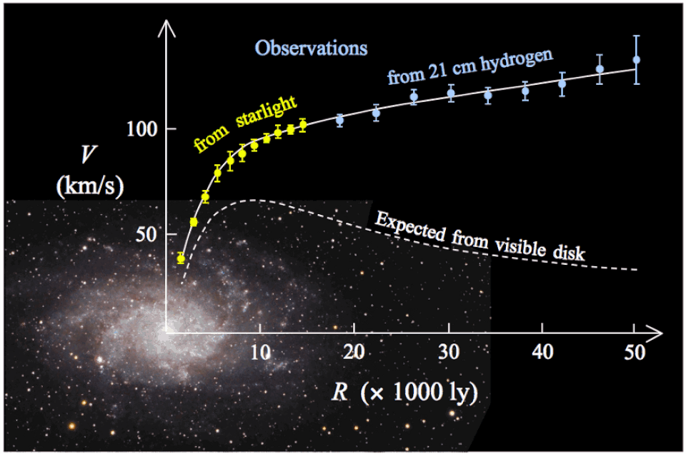
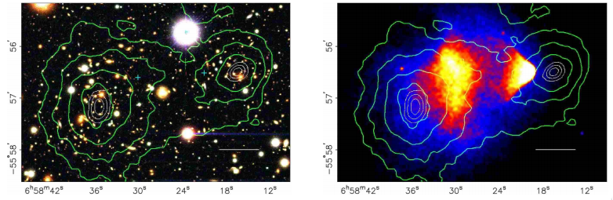
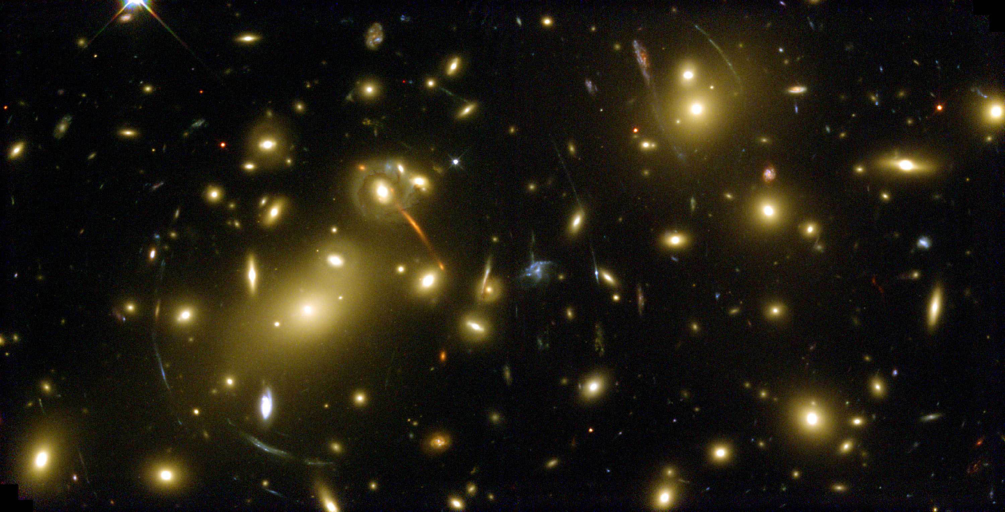
Introduction
What is dark matter?
Many evidences from observation
Yu-Ming Chen, Carleton University

Slide 5
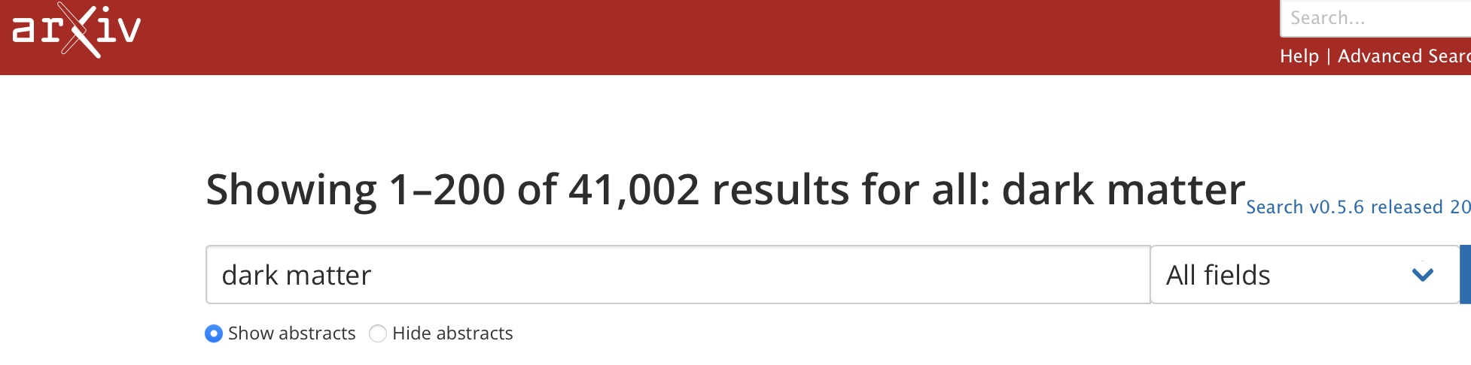
Introduction
What is dark matter?
Many evidences from observation
A LOT more theories
Yu-Ming Chen, Carleton University

Slide 6

Introduction
A simple extension of the standard model：Dodelson-Widrow Mechanism
Yu-Ming Chen, Carleton University

Slide 7



Introduction
A simple extension of the standard model：Dodelson-Widrow Mechanism
Add a SM gauge singlet fermion
$ν_{4}=ν_{s}\cos{θ}+ν_{a}\sin{θ}$
+
$$ν_{S}$$
STERILE NEUTRINO
Yu-Ming Chen, Carleton University

Slide 8
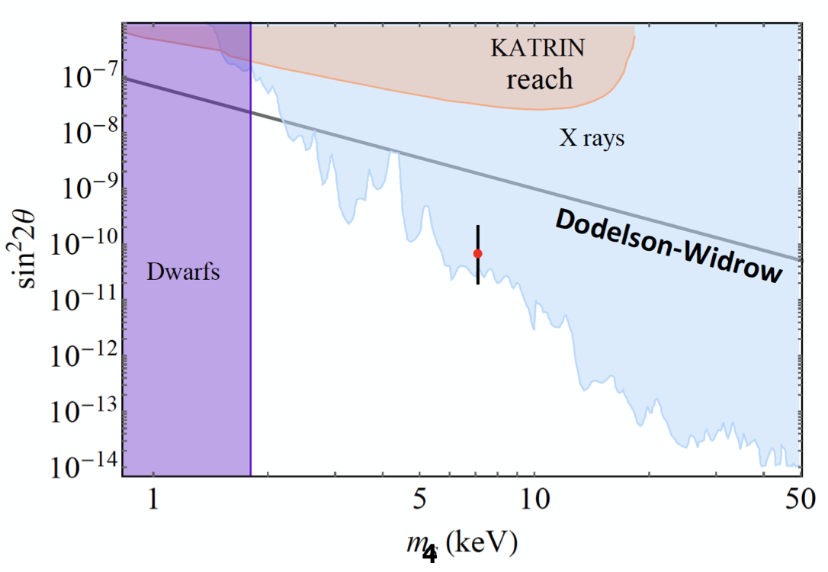
Introduction
A simple extension of the standard model：Dodelson-Widrow Mechanism
Add a SM gauge singlet fermion
$ν_{4}=ν_{s}\cos{θ}+ν_{a}\sin{θ}$
+
$$ν_{S}$$
STERILE NEUTRINO
m₄
Yu-Ming Chen, Carleton University

Slide 9

Introduction
Another ingredient: Neutrino Self-interaction
+
$$ν_{S}$$
STERILE NEUTRINO
Yu-Ming Chen, Carleton University

Slide 10
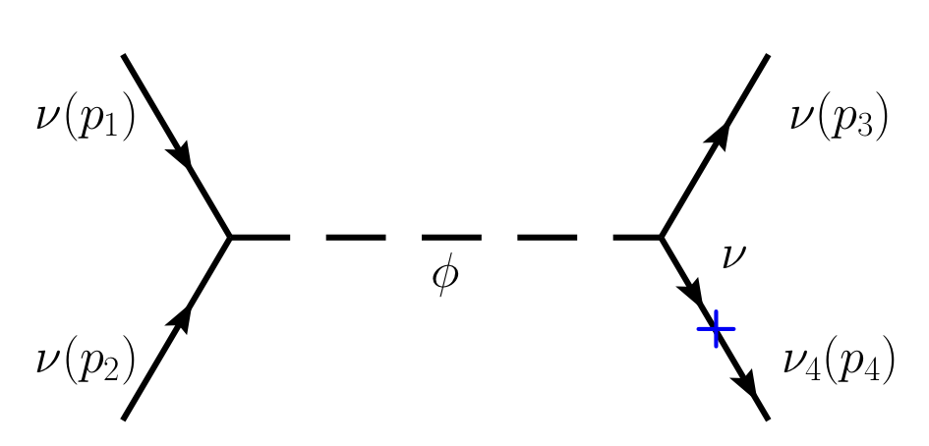



Introduction
Another ingredient: Neutrino Self-interaction
$ℒ_{int}=\frac{1}{2}λ_{αβ}ν_{α}ν_{β}φ+h.c.$
$$ν_{S}$$
STERILE NEUTRINO
+
$$φ$$
NEW SCALAR BOSON
Yu-Ming Chen, Carleton University

Slide 11
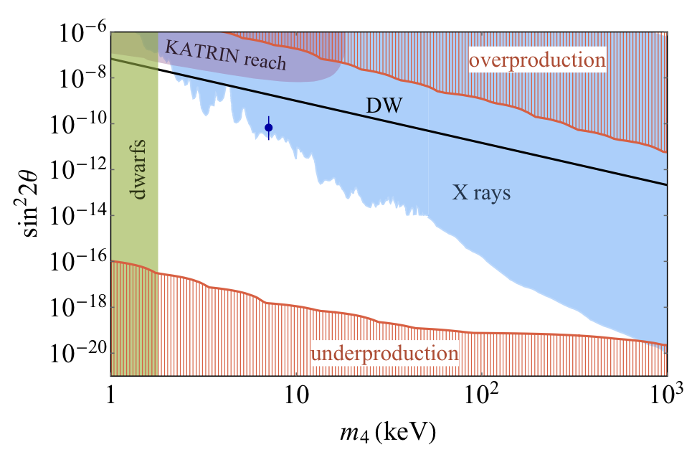
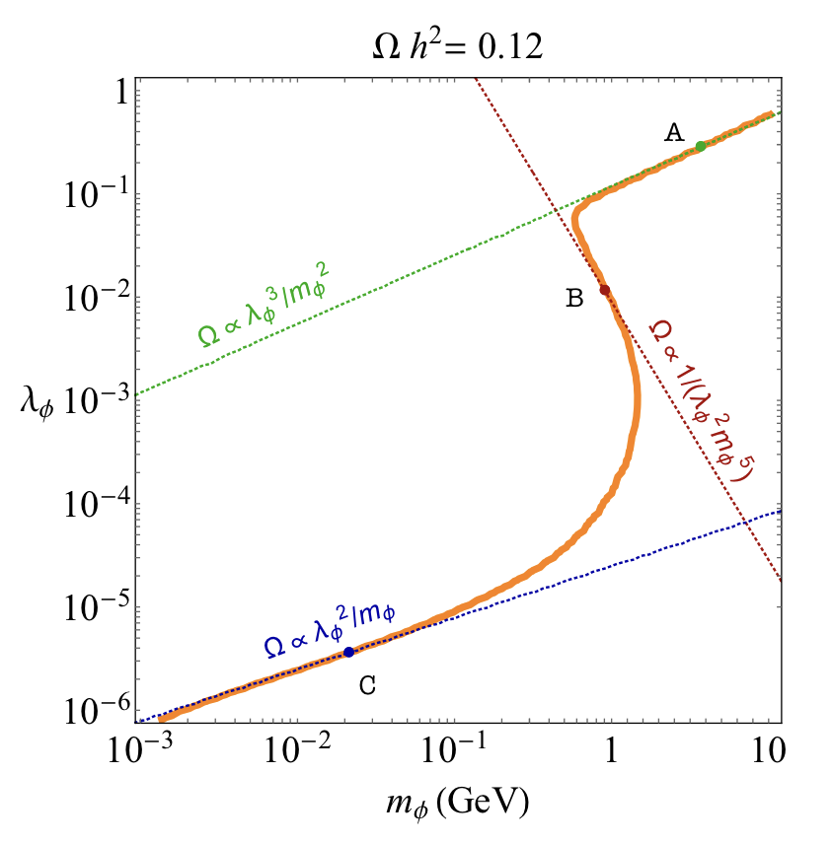
Introduction
Another ingredient: Neutrino Self-interaction
$ℒ_{int}=\frac{1}{2}λ_{αβ}ν_{α}ν_{β}φ+h.c.$
$$ν_{S}$$
STERILE NEUTRINO
+
$$φ$$
NEW SCALAR BOSON
ref: 1910.04901
Yu-Ming Chen, Carleton University

Slide 12
Supernova Environment
Supernovae are neutrino factories.
Core-collapse
Supernova
Yu-Ming Chen, Carleton University

Slide 13

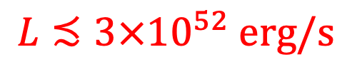
Supernova Environment
Supernovae are neutrino factories.
Core-collapse
Supernova
$$L≾3×{10}^{52} erg/s$$
Energy carried away by $ν_{4}$
Yu-Ming Chen, Carleton University

Slide 14
Supernova Environment
Supernovae are neutrino factories.
with some features:
Large matter-antimatter asymmetry
Core-collapse
Supernova
$$L≾3×{10}^{52} erg/s$$
Energy carried away by $ν_{4}$
Yu-Ming Chen, Carleton University

Slide 15
Supernova Environment
Supernovae are neutrino factories.
with some features:
Large matter-antimatter asymmetry
Chemical potential for electron neutrino
Core-collapse
Supernova
$$L≾3×{10}^{52} erg/s$$
Energy carried away by $ν_{4}$
Yu-Ming Chen, Carleton University

Slide 16
Supernova Environment
Supernovae are neutrino factories.
with some features:
Large matter-antimatter asymmetry
Chemical potential for electron neutrino
Reabsorption of neutrino
Core-collapse
Supernova
$$L≾3×{10}^{52} erg/s$$
Energy carried away by $ν_{4}$
Neutrino Sphere
Yu-Ming Chen, Carleton University

Slide 17
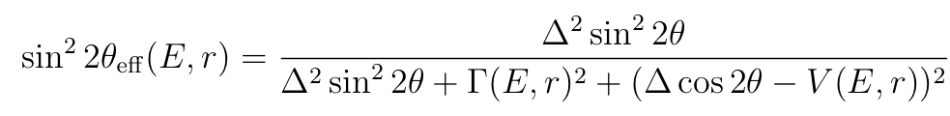
Supernova Environment
Mixing angle needs to be modified
Yu-Ming Chen, Carleton University

Slide 18


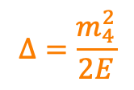
Supernova Environment
Mixing angle needs to be modified
$$Δ=\frac{m_{4}^{2}}{2E}$$
Yu-Ming Chen, Carleton University

Slide 19
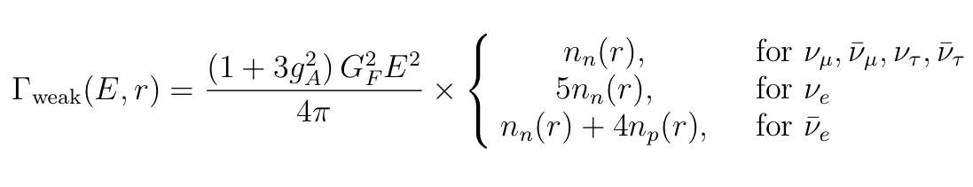
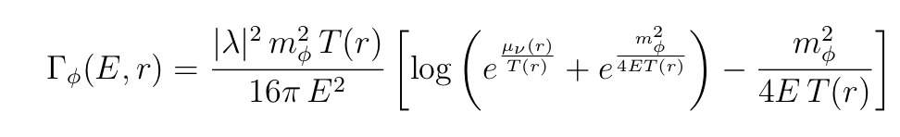



Supernova Environment
Mixing angle needs to be modified
$$Δ=\frac{m_{4}^{2}}{2E}$$
Interaction rate for active neutrino
$$Γ=Γ_{φ}+Γ_{weak}$$
Yu-Ming Chen, Carleton University

Slide 20
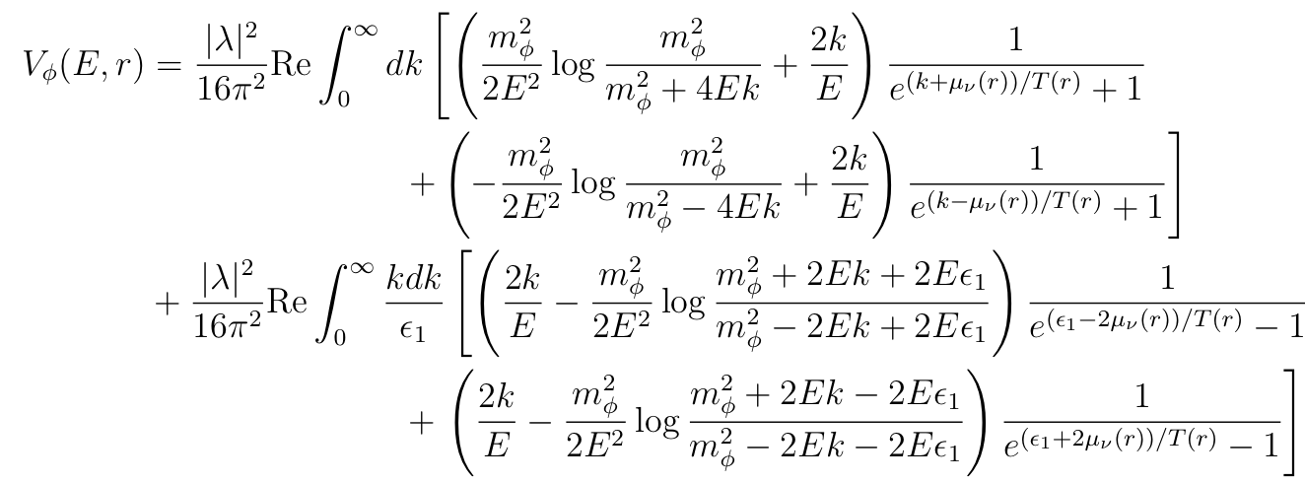

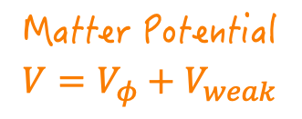
Supernova Environment
Mixing angle needs to be modified
$$Δ=\frac{m_{4}^{2}}{2E}$$
Matter Potential
$$V=V_{φ}+V_{weak}$$
Interaction rate for active neutrino
$$Γ=Γ_{φ}+Γ_{weak}$$
Yu-Ming Chen, Carleton University

Slide 21
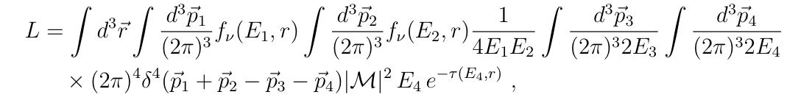
Supernova Environment
Recall our constraint
Yu-Ming Chen, Carleton University

Slide 22

Supernova Environment
Recall our constraint
Initial state integral
Yu-Ming Chen, Carleton University

Slide 23

Supernova Environment
Recall our constraint
Initial state integral
Final state integral
Yu-Ming Chen, Carleton University

Slide 24

Supernova Environment
Recall our constraint
Initial state integral
Final state integral
Neutrino reabsorption rate
Yu-Ming Chen, Carleton University

Slide 25
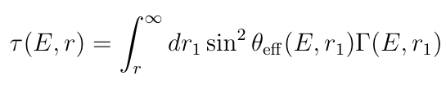
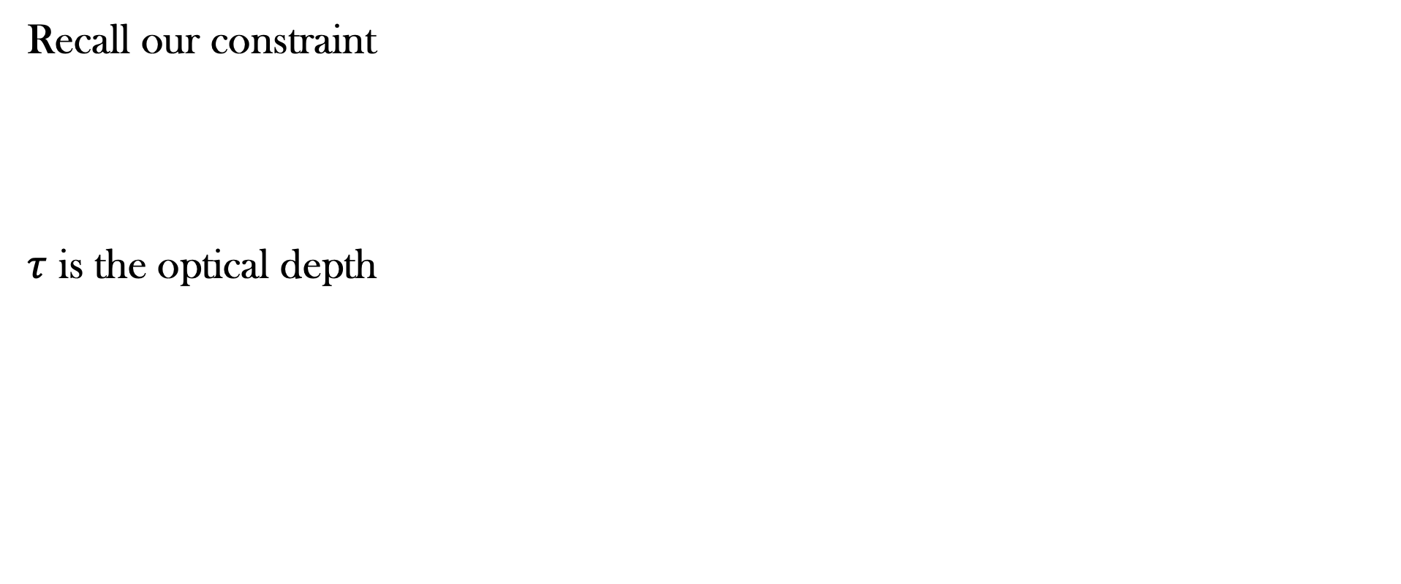
Supernova Environment
Recall our constraint
$τ$ is the optical depth
Initial state integral
Final state integral
Neutrino reabsorption rate
Yu-Ming Chen, Carleton University

Slide 26
Supernova Environment
Recall our constraint
$τ$ is the optical depth
Initial state integral
Final state integral
Neutrino reabsorption rate
Luminosity is NOT a Lorentz invariant!! ⟹
Calculate in SN rest frame
Yu-Ming Chen, Carleton University

Slide 27
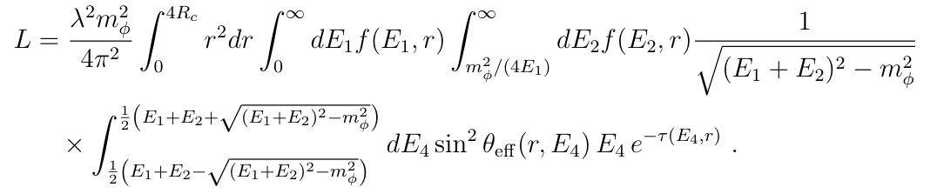
Supernova Environment
Recall our constraint
$τ$ is the optical depth
Initial state integral
Final state integral
Neutrino reabsorption rate
Luminosity is NOT a Lorentz invariant!! ⟹
Calculate in SN rest frame
Yu-Ming Chen, Carleton University

Slide 28
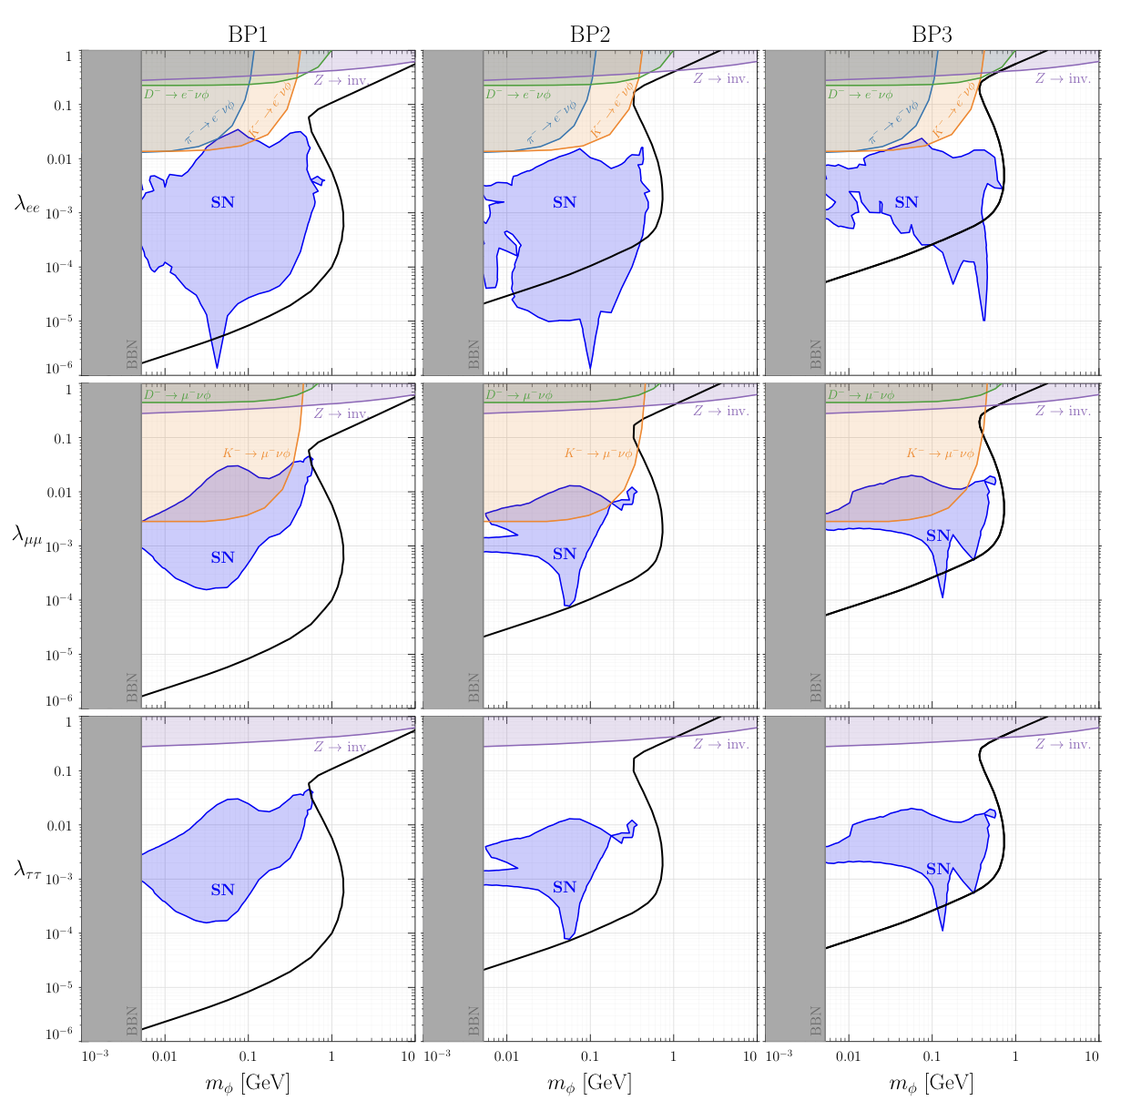



Result
$$λ_{ee}$$
$$λ_{μμ}$$
$$λ_{ττ}$$
Yu-Ming Chen, Carleton University

Slide 29
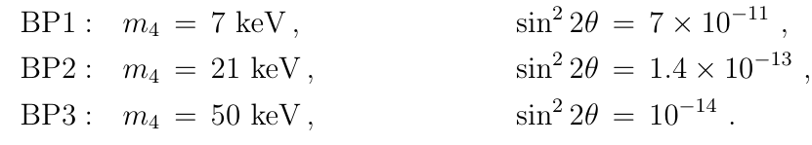



Result
3 Benchmark points：
$$λ_{ee}$$
$$λ_{μμ}$$
$$λ_{ττ}$$
Yu-Ming Chen, Carleton University

Slide 30
Result
3 Benchmark points：
$$λ_{ee}$$
w/
chemical
potential
$$λ_{μμ}$$
w/out
chemical
potential
$$λ_{ττ}$$
w/out
chemical
potential
Yu-Ming Chen, Carleton University

Slide 31
Result
3 Benchmark points：
$$λ_{ee}$$
w/
chemical
potential
More relevant constraint in electron case
Chemical potential enhances the constraint
$$λ_{μμ}$$
w/out
chemical
potential
$$λ_{ττ}$$
w/out
chemical
potential
Yu-Ming Chen, Carleton University

Slide 32
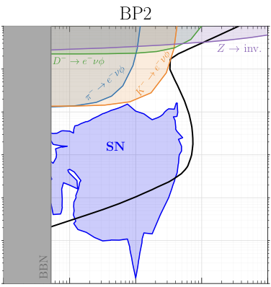
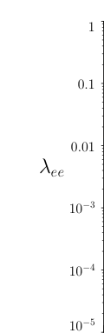
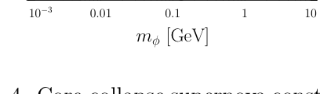
Result
Yu-Ming Chen, Carleton University

Slide 33

Result
Correct relic curve for 𝜈₄
Yu-Ming Chen, Carleton University

Slide 34


Result
Correct relic curve for 𝜈₄
Heavy 𝜙 is Boltzmann suppressed
Yu-Ming Chen, Carleton University

Slide 35
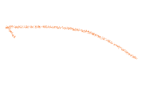
Result
Quantum Zeno effect
Correct relic curve for 𝜈₄
Heavy 𝜙 is Boltzmann suppressed
Yu-Ming Chen, Carleton University

Slide 36

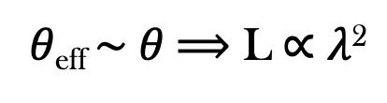
Result
Quantum Zeno effect
Correct relic curve for 𝜈₄
Heavy 𝜙 is Boltzmann suppressed
𝜃_{eff} $\sim$𝜃 ⟹ L ∝ 𝜆²
Yu-Ming Chen, Carleton University

Slide 37


Result
Quantum Zeno effect
Correct relic curve for 𝜈₄
Constraints are strongest when 𝜆～10⁻³
^{(see next page)}
Heavy 𝜙 is Boltzmann suppressed
𝜃_{eff} $\sim$𝜃 ⟹ L ∝ 𝜆²
Yu-Ming Chen, Carleton University

Slide 38



Result
Every plot has a tail around 𝜆=10⁻³
$$λ_{ee}$$
$$λ_{μμ}$$
$$λ_{ττ}$$
Yu-Ming Chen, Carleton University

Slide 39
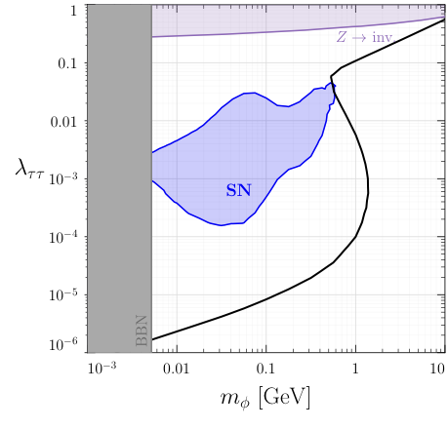
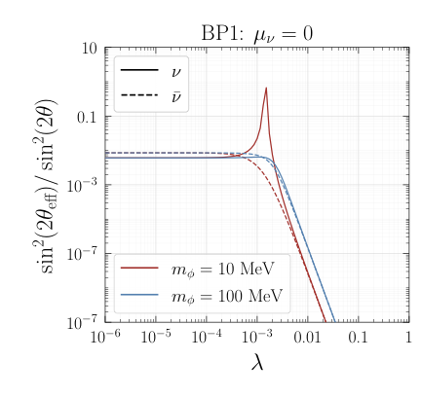
Result
Fixed parameter: T～30 MeV
r～10 km
Yu-Ming Chen, Carleton University

Slide 40


Result
For large 𝜆, self-interaction >> weak interaction , 𝜃_{eff} is suppressed
Fixed parameter: T～30 MeV
r～10 km
Yu-Ming Chen, Carleton University

Slide 41


Result
For large 𝜆, self-interaction >> weak interaction , 𝜃_{eff} is suppressed
For small 𝜆, weak interaction >> self-interaction, L ∝ 𝜆²
Fixed parameter: T～30 MeV
r～10 km
Yu-Ming Chen, Carleton University

Slide 42
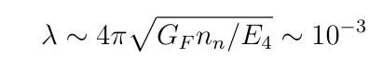
Result
For large 𝜆, self-interaction >> weak interaction , 𝜃_{eff} is suppressed
Strongest constraint when V_{weak} ～V_{𝜙} ⟹
For small 𝜆, weak interaction >> self-interaction, L ∝ 𝜆²
Fixed parameter: T～30 MeV
r～10 km
Yu-Ming Chen, Carleton University

Slide 43
Conclusion
Sterile neutrino DM can be produced efficiently in a core-collapse SN
SN cooling argument can be a viable constraint on the sterile neutrino DM
Constraint is more significant in electron neutrino case where we include the chemical potential
Production of sterile neutrino DM is through collisional effect, the resonance transition is negligible.
Yu-Ming Chen, Carleton University

Slide 44
Thank You!

Slide 45
Comment on Resonant Transition
Relevant parameter: spatial width of the resonance region 𝛥_{Res}
free streaming length 𝜆_{𝜈}

Slide 46
Comment on Resonant Transition
Relevant parameter: spatial width of the resonance region 𝛥_{Res}
free streaming length 𝜆_{𝜈}
Condition of resonance: 𝛥_{Res} << 𝜆_{𝜈}

Slide 47
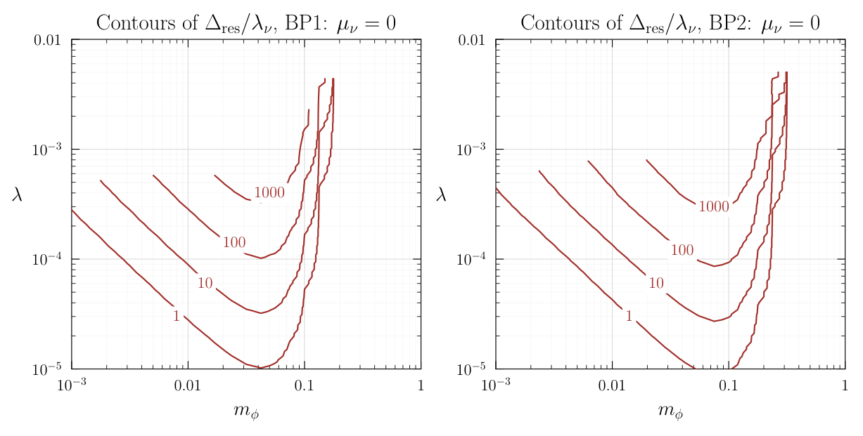
Comment on Resonant Transition
Relevant parameter: spatial width of the resonance region 𝛥_{Res}
free streaming length 𝜆_{𝜈}
Condition of resonance: 𝛥_{Res} << 𝜆_{𝜈}
Resonant transition is not important in the region of parameter space of interest

