Slide 1
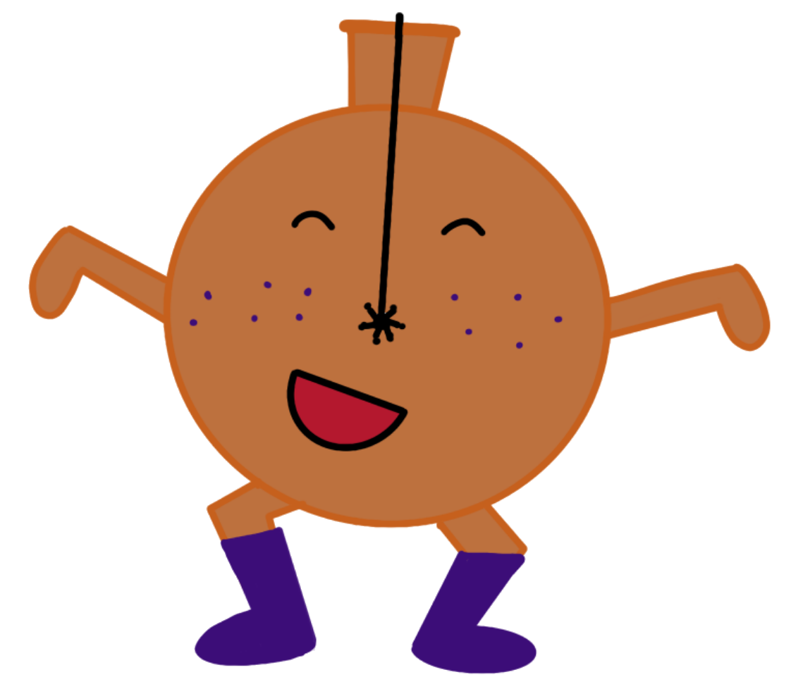
New results from the NEWS-G dark matter experiment
Jean-Marie Coquillat
Winter Nuclear & Particle Physics Conference
February 17th, 2023

Slide 2
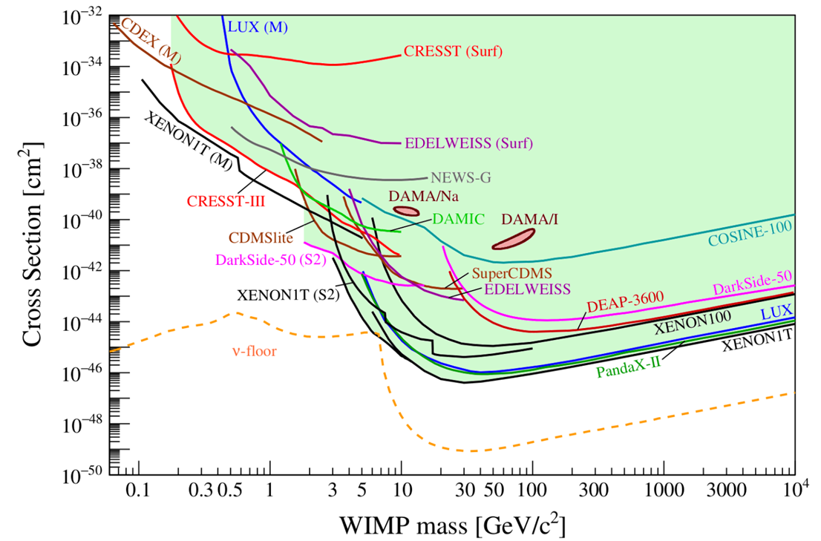
Low mass WIMP search motivation
Given the absence of canonical WIMPs, there is motivation to look at the parameter space left at lower masses (~0.1-1 GeV) for WIMP-like dark matter candidates.
arXiv:2104.07634 [hep-ex]

Slide 3
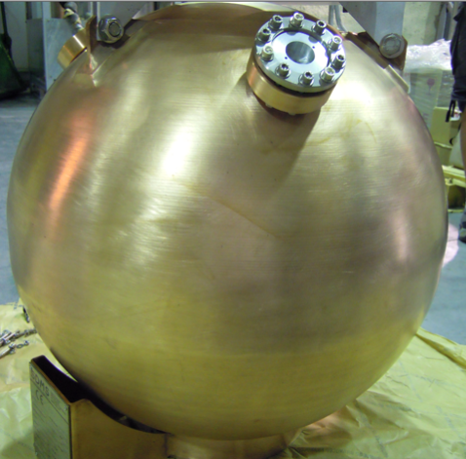
NEWS-G and SPCs
The SEDINE detector
The NEWS-G experiment uses spherical proportional counters (SPC) to search for low mass dark matter.
SPCs are metallic spheres filled with gas, with a central anode producing a radial electric field.
The last dark matter limits are from the SEDINE detector (60 cm diameter) at the Laboratoire Souterrain de Modane (LSM) in 2017.
The latest detector, S140, is a 140 cm of diameter copper sphere currently at SNOLAB, after a short commissioning at the LSM in 2019.
doi: 10.1016/j.astropartphys.2017.10.009

Slide 4
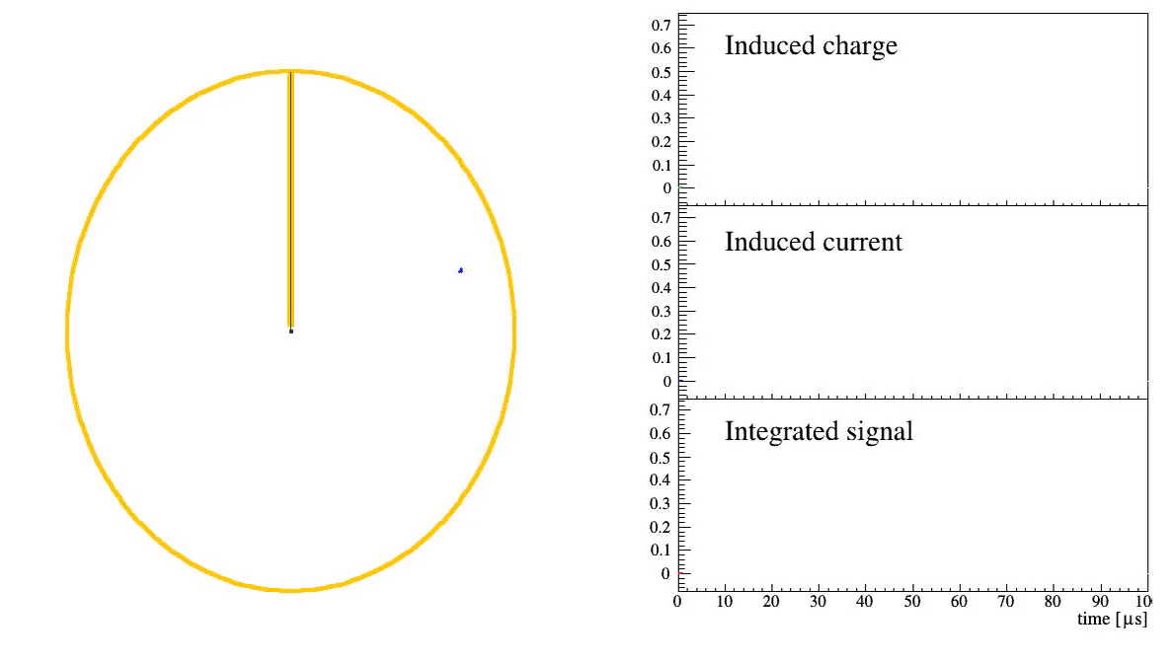
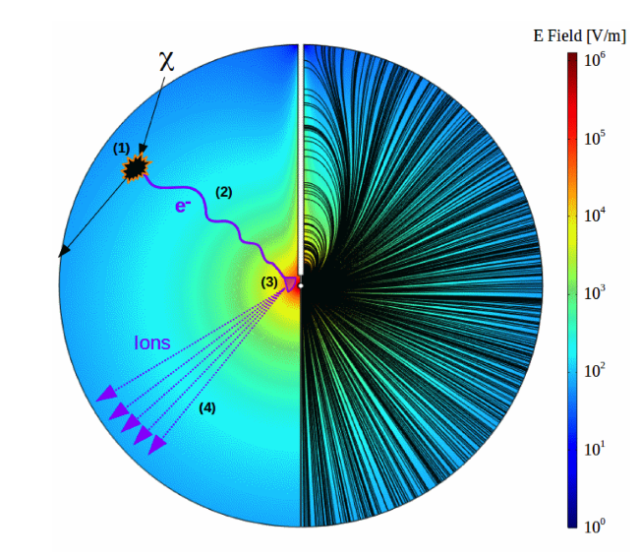
How an SPC works:
Atomic recoil causes ionization of the gas.
Primary electrons drift towards the central anode.
Townsend avalanche near the anode amplifies the signal.
Drifting secondary ions induce a current on the anode.
doi: 10.1016/j.nima.2019.162390
Animation by P. Gros

Slide 5
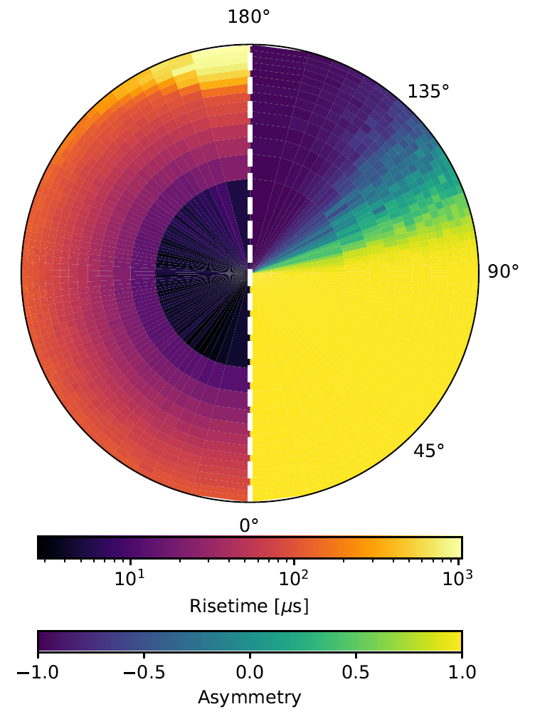
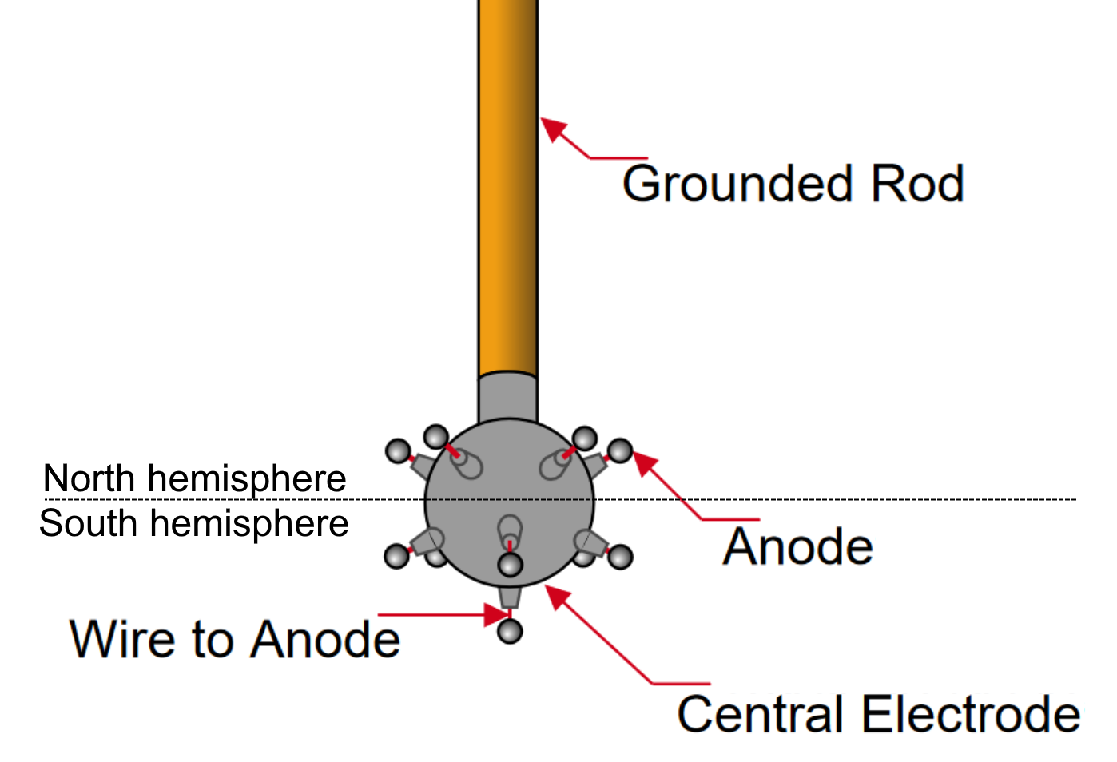
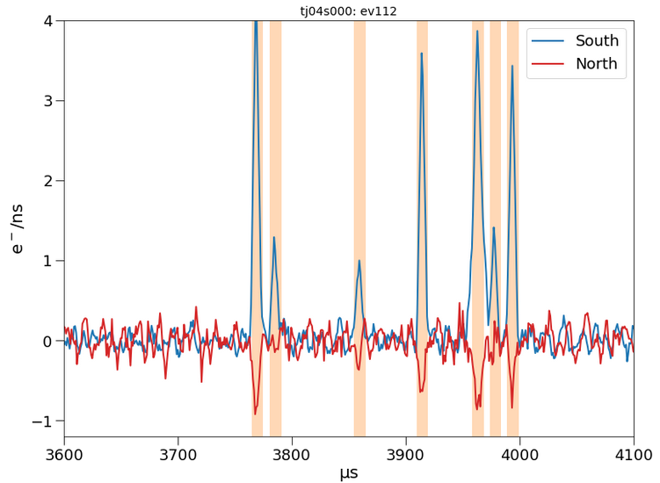
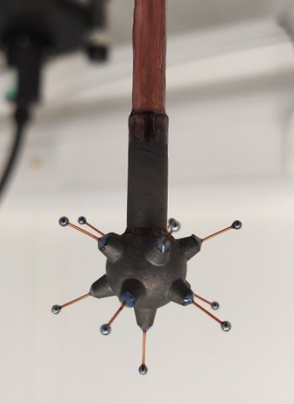
Sensor (achinos)
NEWS-G now uses a multi-anode sensor that can achieve high gain while keeping a strong electric field at a high radius.
The sensor is divided in two channels connecting the anodes of each hemisphere.
A signal on one channel induces a negative signal on the other one (Shockley-Ramo effect).
About 2/3 of the volume leads to the south anodes, due to the effect of the rod on the electric field.
arXiv:2301.05183
doi:10.1088/1742-6596/2156/1/012059

Slide 6
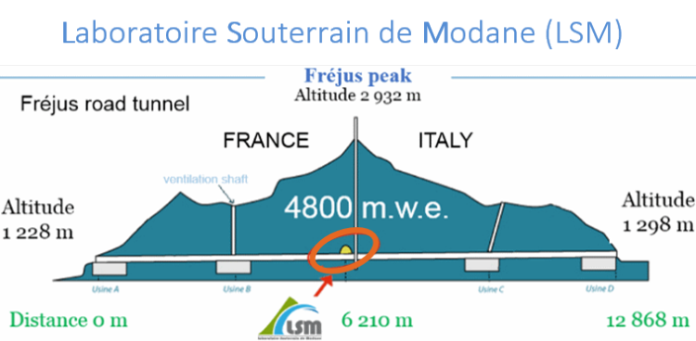
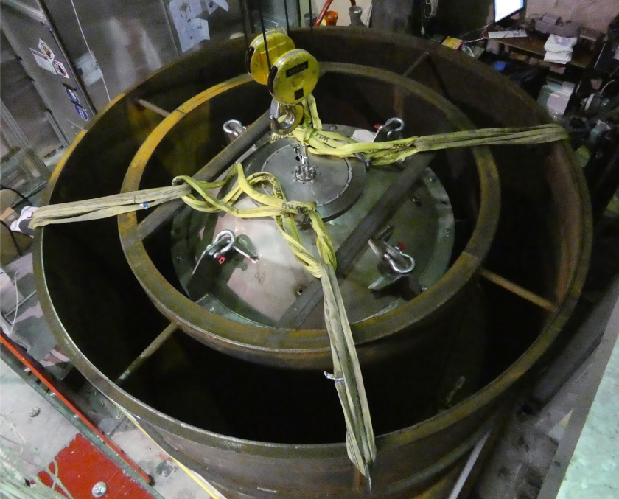

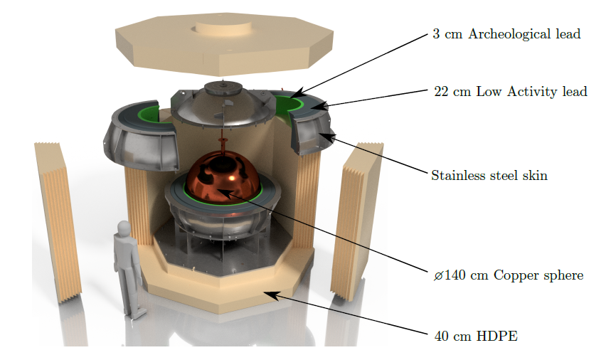

Shielding and data taking with S140
The sphere is made of C10100 copper, with the inner 0.5 mm being electroformed ultra-pure copper.
Lead, archeological lead and polyethylene (PE) make the shielding, although water was used at the LSM since the PE shield was unfinished.
10 days of physics data taken in 135 mbar of CH₄ at the LSM before the detector was shipped to SNOLAB.

Slide 7
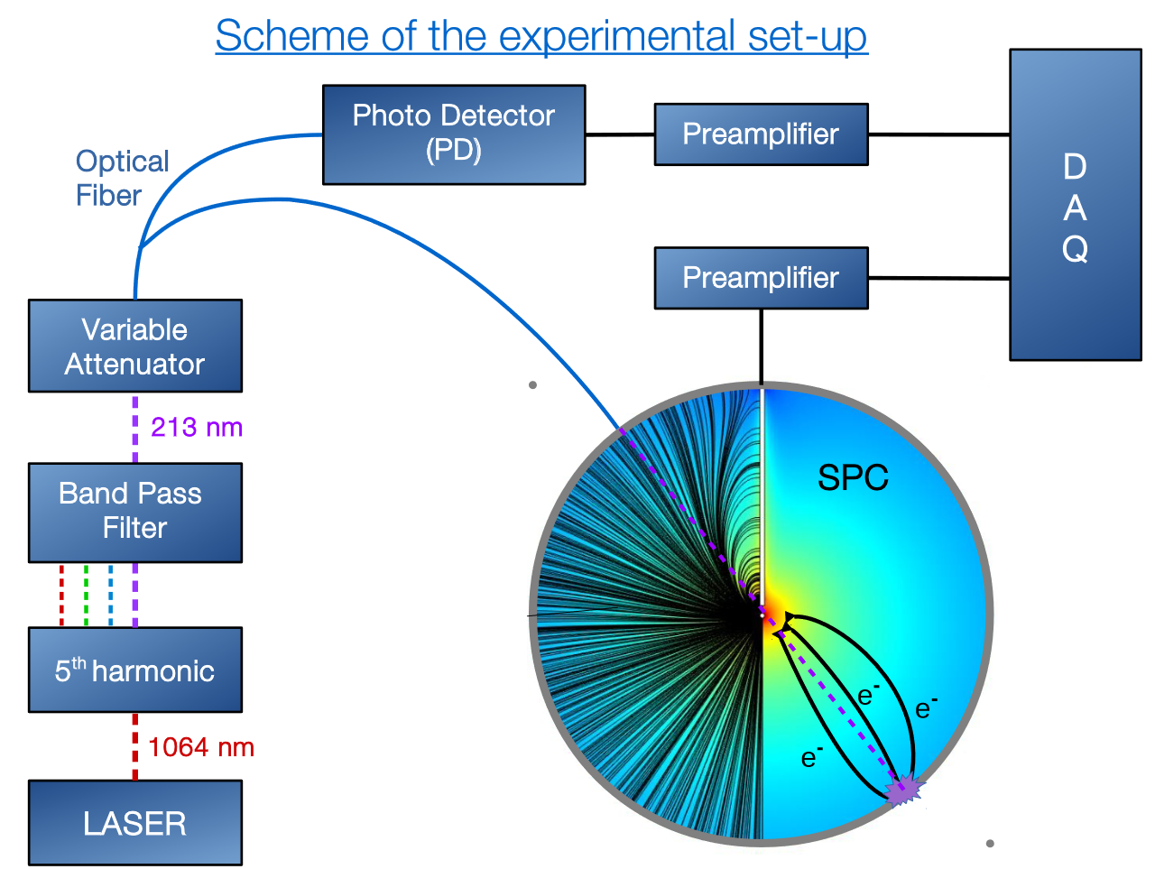
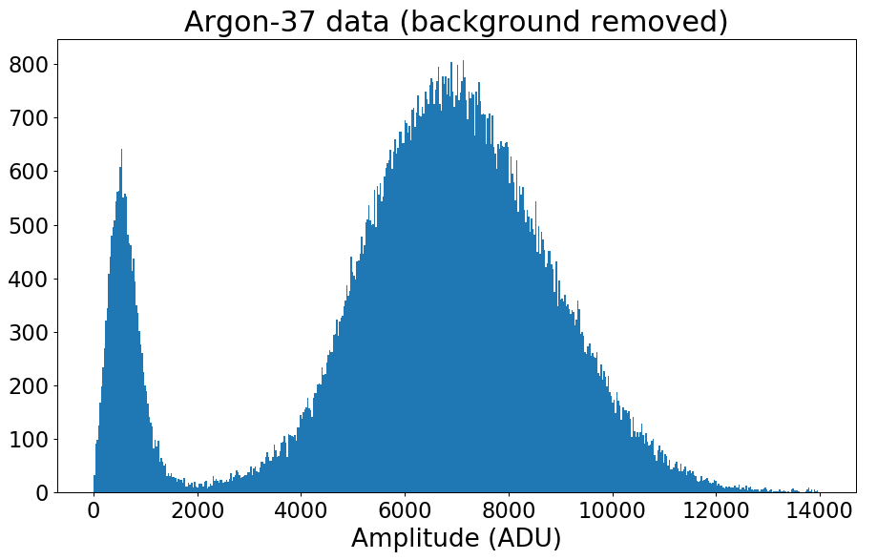
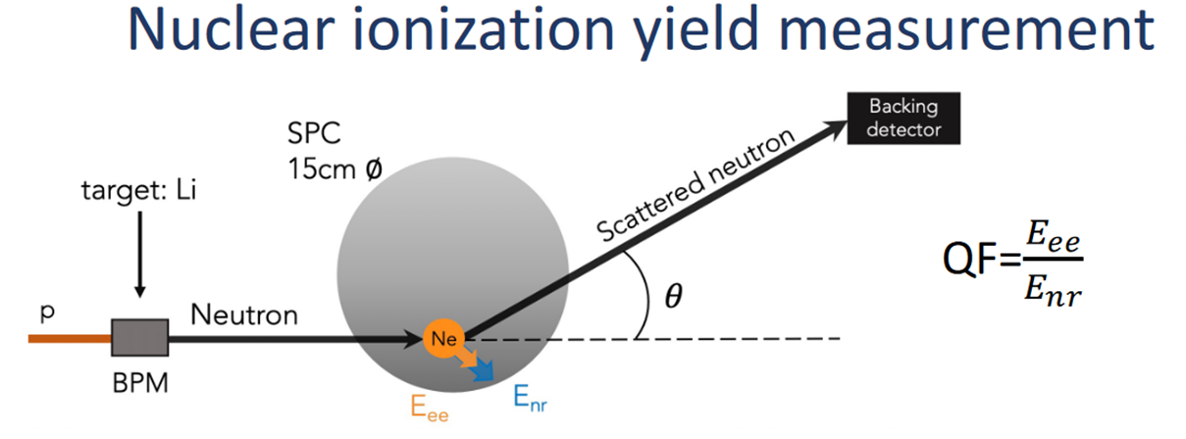
Calibration
A UV laser is directed at the inner copper surface of the sphere and releases electrons though the photoelectric effect. The UV light also goes to a photodetector so the laser events can be tagged.
Some argon-37 is released inside the sphere, and the gas diffuses in the whole volume. This isotope is radioactive and has two peaks that enable energy calibration.
The quenching factor was measured at COMIMAC.
W-value measured at Queen’s University.
270 eV peak
2.8 keV peak

Slide 8
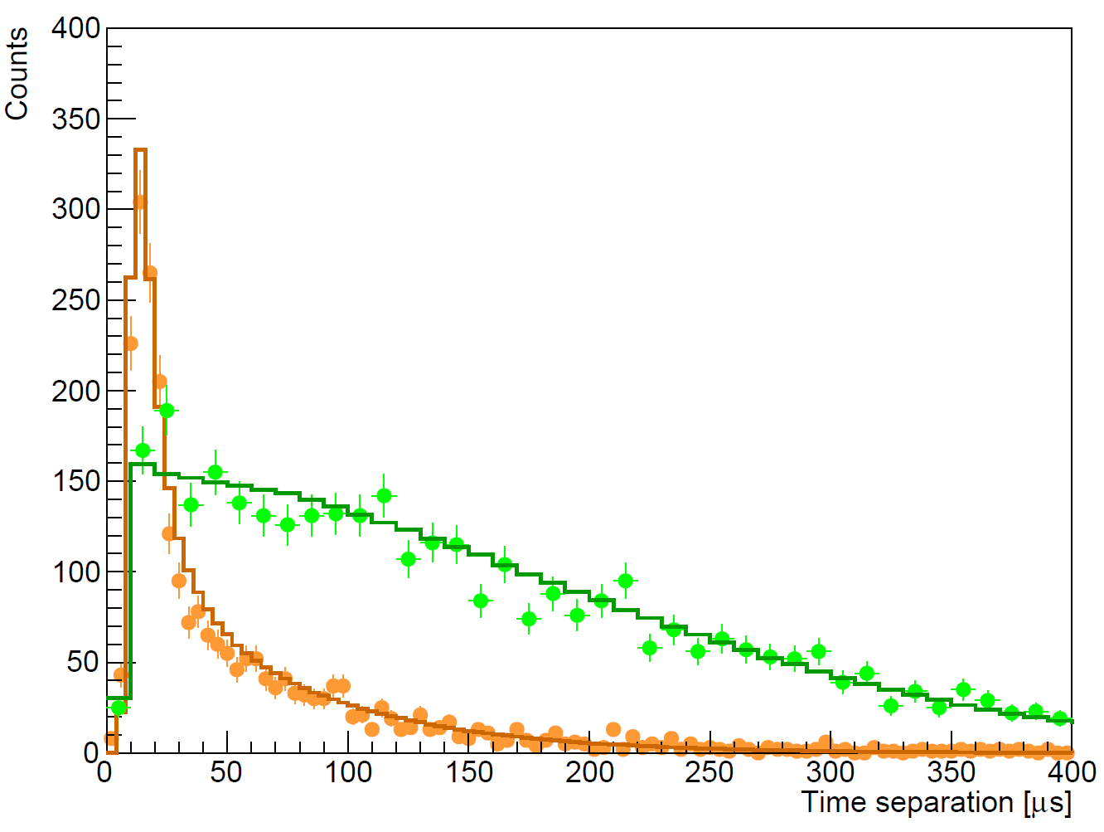
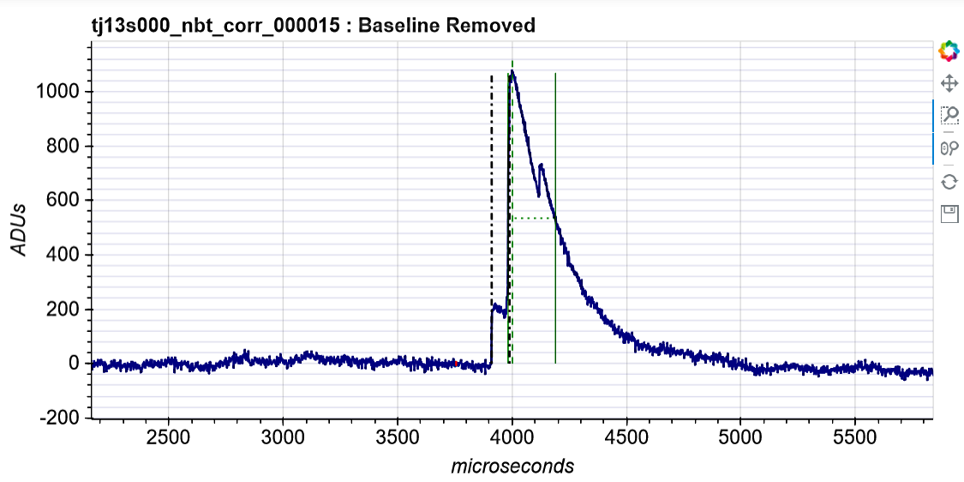
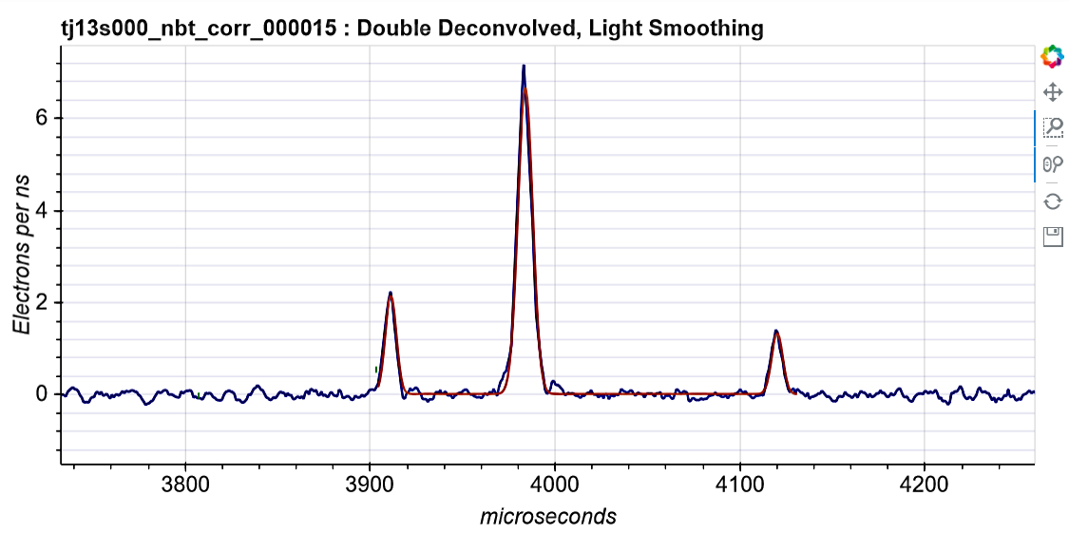
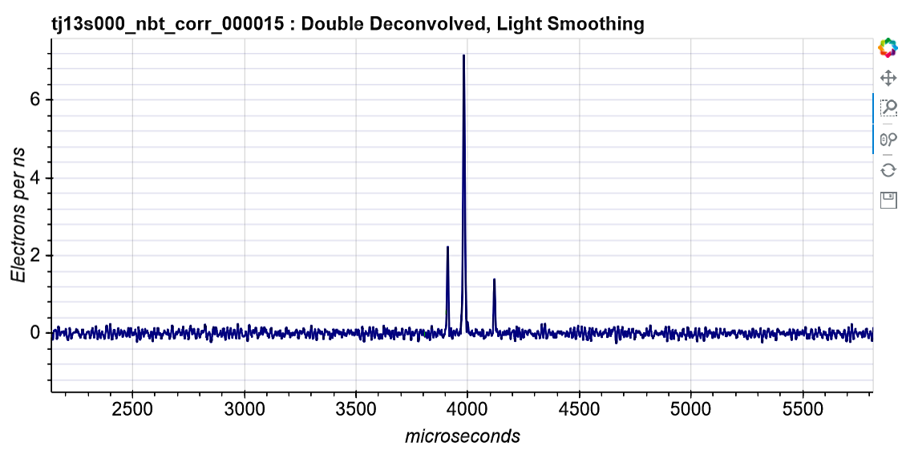
Peak counting and time separation
scipost_202210_00005v1
The exponential decay of the preamplifier and the ion response are deconvolved from the raw signal.
It is possible to count individual primary electrons.
Surface events experience more diffusion than volume events, which causes the time separation between the first and last peak to be larger.
VOLUME (³⁷Ar)
SURFACE (laser)
DOUBLE-DECONVOLUTION

Slide 9
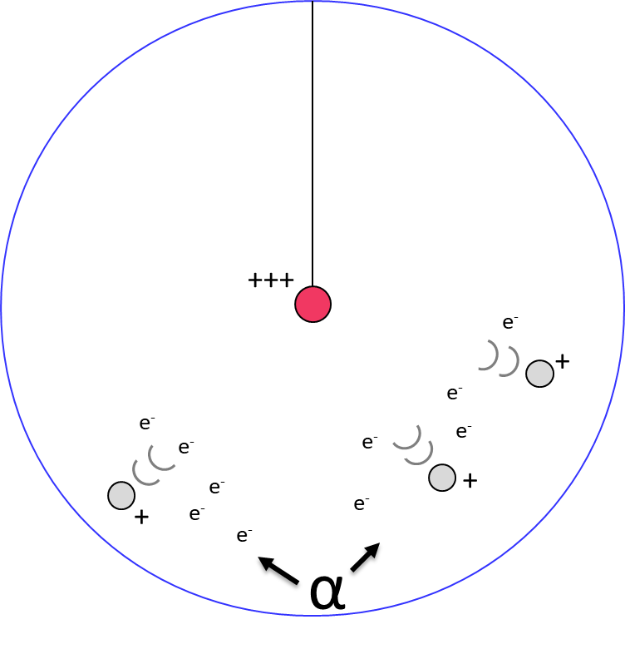
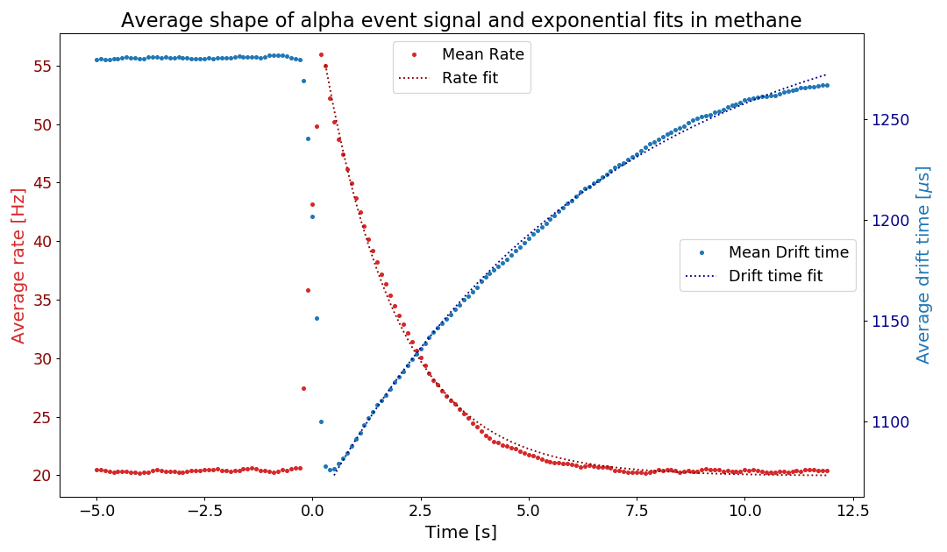
Alpha contamination
There is ~25 mHz of alphas from ²¹⁰Po contamination in the copper surface.
Alphas ionize a lot of gas and create a space charge that disturbs the electric field, and changes the electron drift time.
For some still unknown reason, a high rate of low energy events keep happening for around 5s after each alpha.
We remove most of the low-energy background due to alphas with a 5s cut after each one, keeping 85-90% of the total time.
DRIFT TIME
Methane
135 mbar
1630 V
RATE

Slide 10
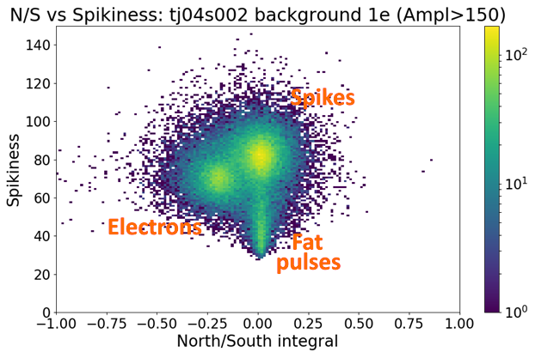
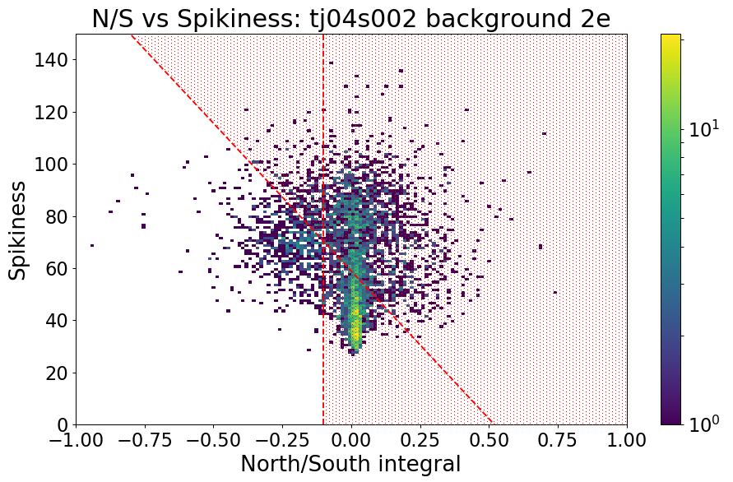
Pulse shape discrimination
There are spurious pulses caused by electronic discharges in the data.
Those can be discriminated from physical events with two different methods:
  Spurious pulses are either measurably spikier or wider than physical events.
  Spurious pulses do not cause a negative induced pulse on the opposite channel.
Around 95% of the spurious pulses are removed with cuts usings theses discriminants, while still keeping 77% of the physical events.
Wide

Slide 11
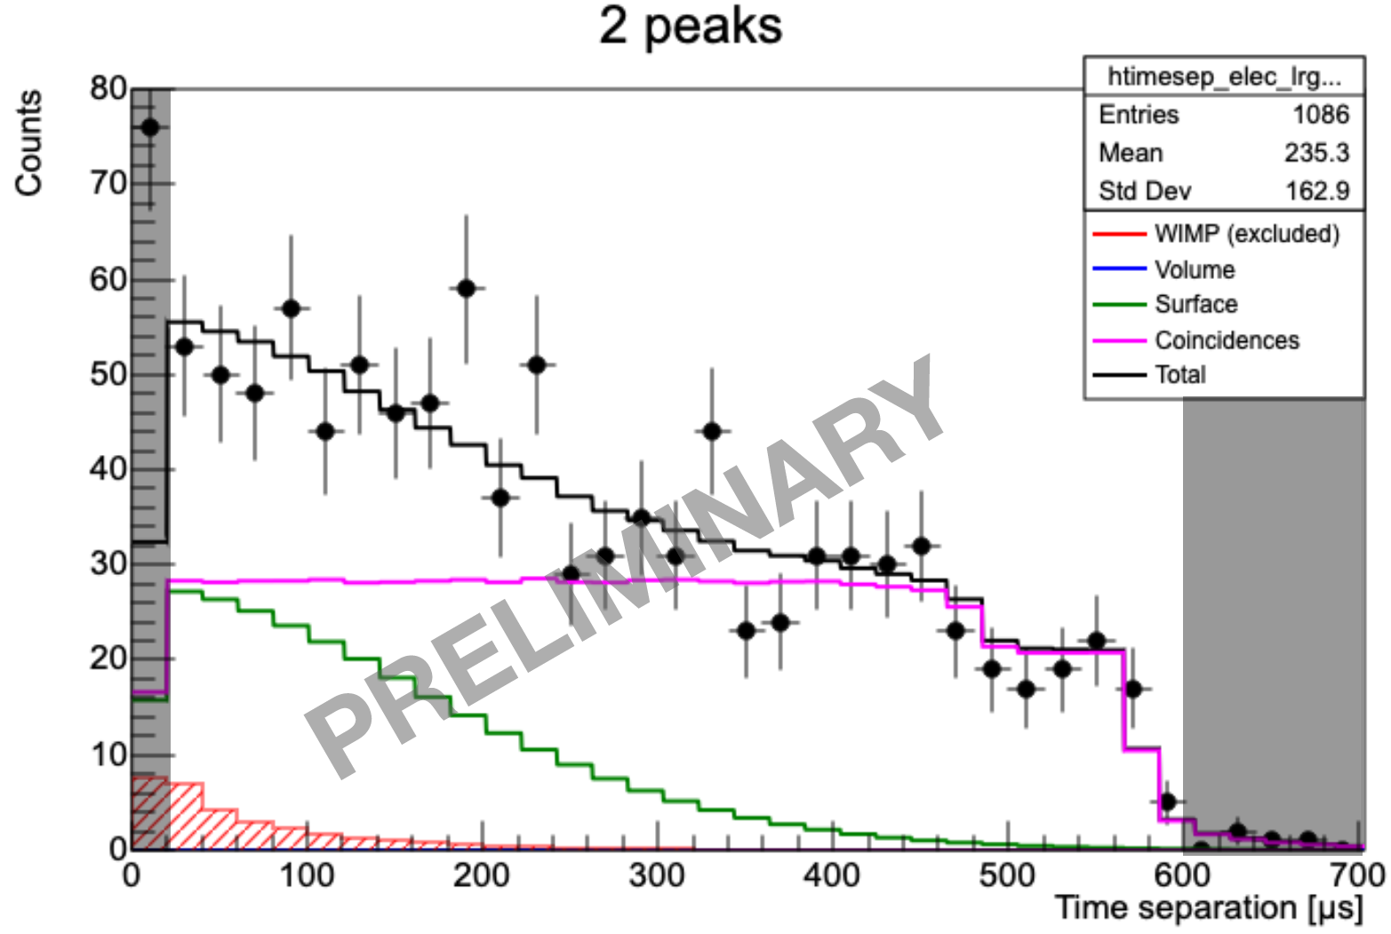
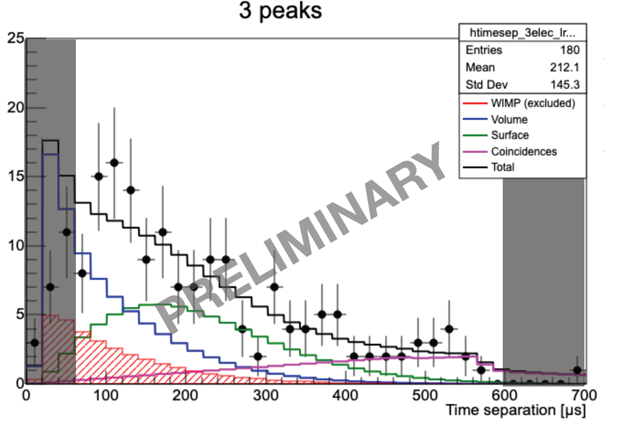
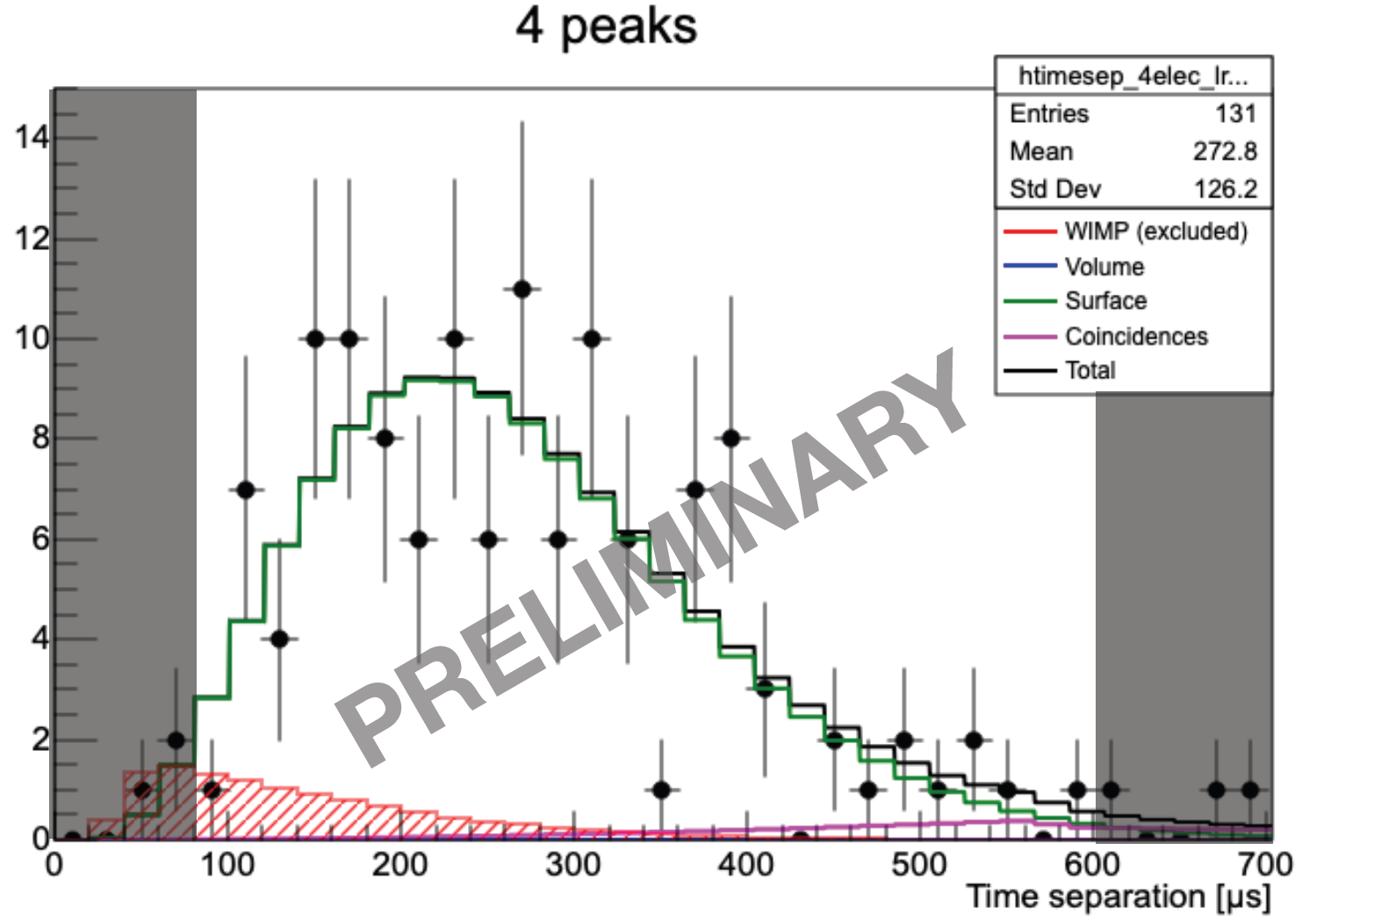
Physics data fits
30% of the full data was set aside as a test data before the rest is unblinded.
Profile likelihood fits of the test data were made for 2-3-4 peak data
Fits with contributions from volume background, surface background, coincidences and WIMP signal.
No significant WIMP signal was detected.
scipost_202210_00005v1

Slide 12
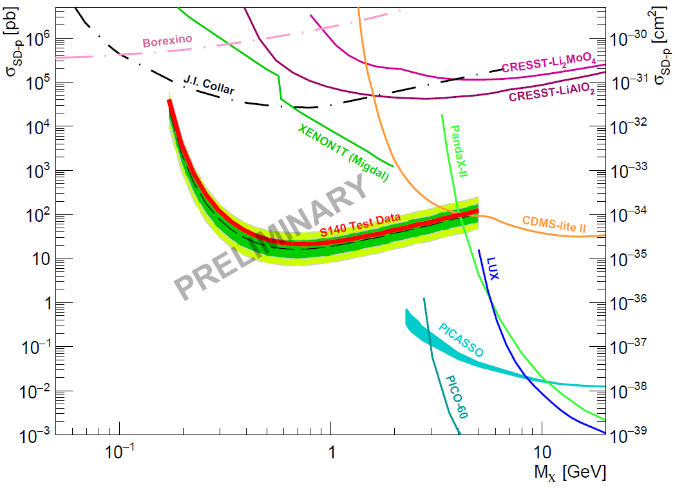
Preliminary limits
WIMP exclusions limits with ~0.12 kg·days of data
Strongest constraints for the proton spin-dependent interaction in the 0.2 - 1.5 GeV range.
Final blind data results to come in a few weeks.
scipost_202210_00005v1

Slide 13
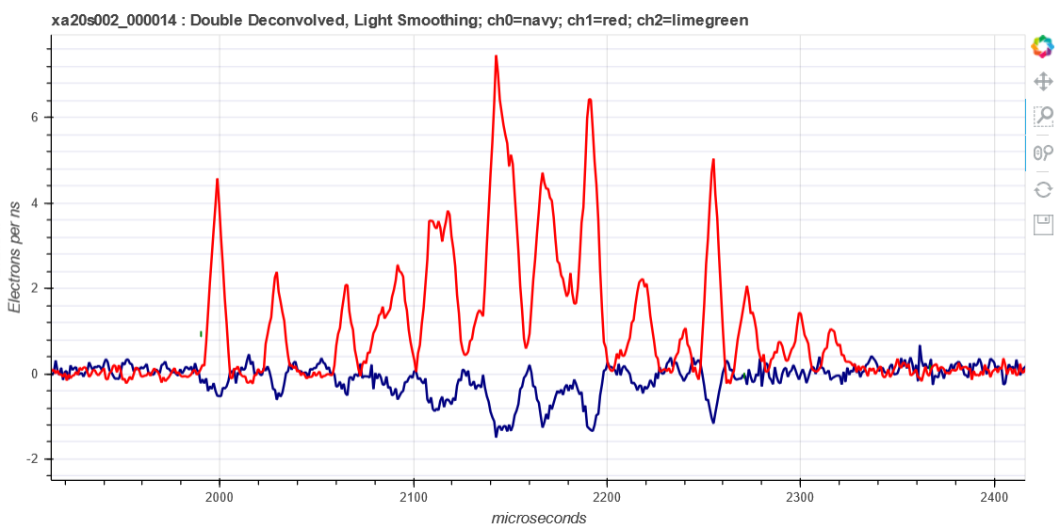
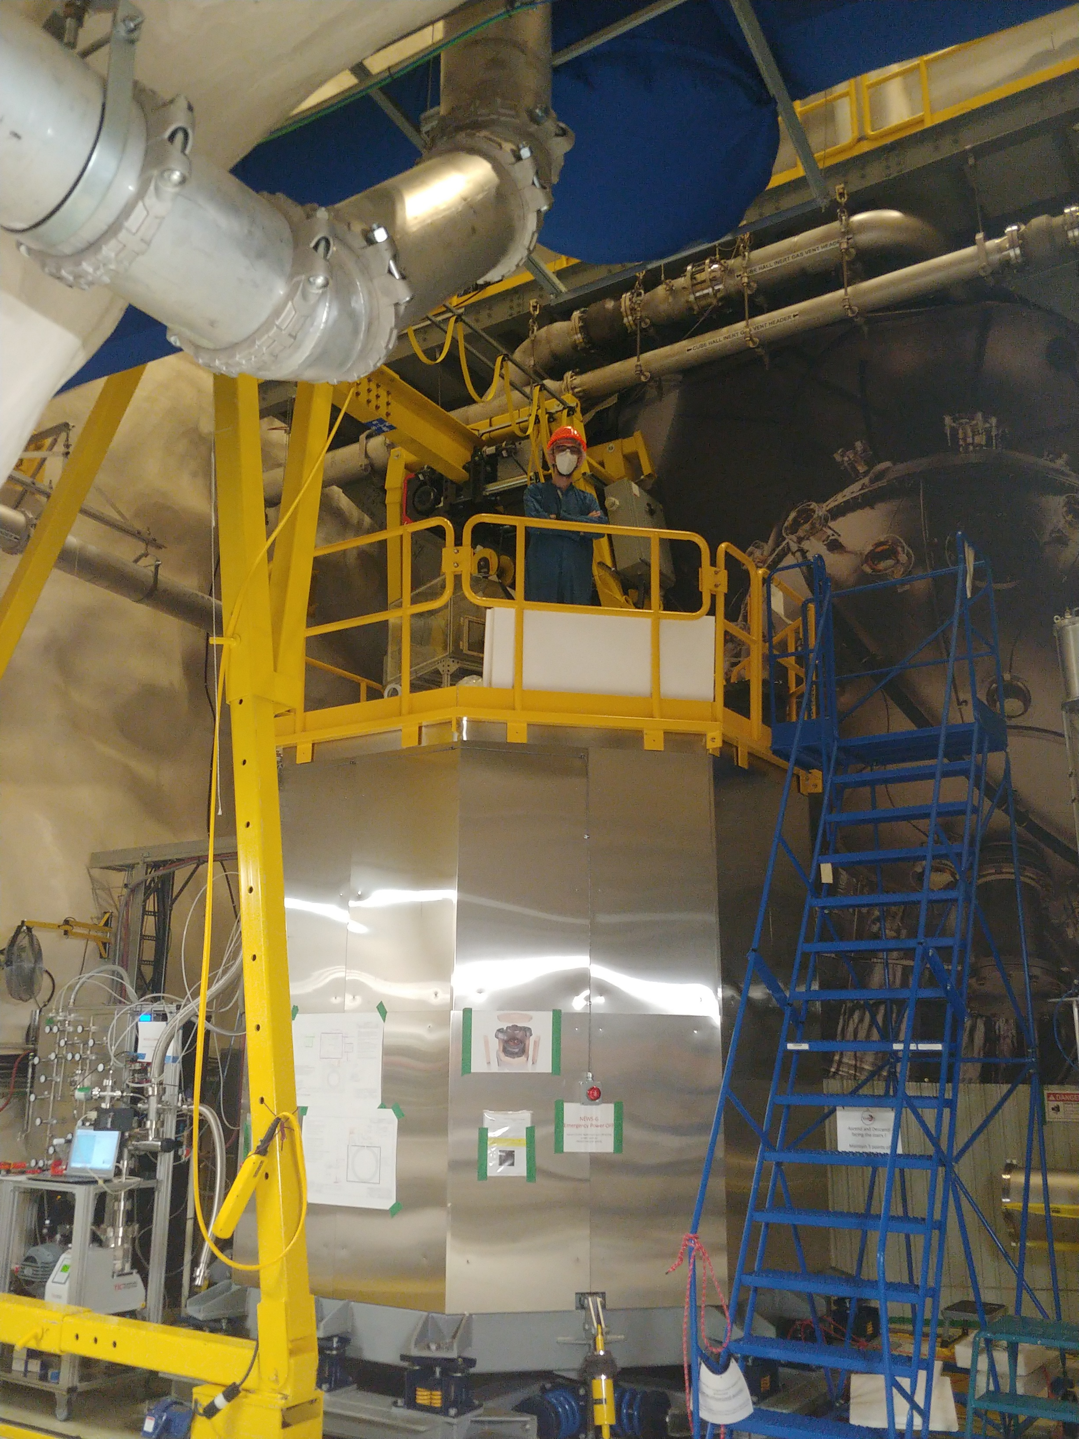
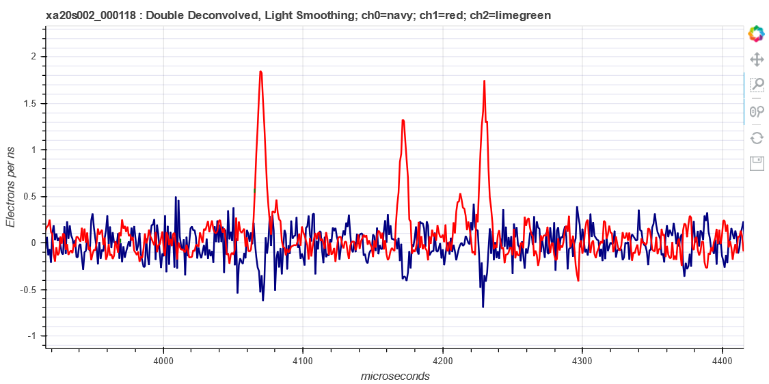
News from SNOLAB
³⁷Ar
Currently taking physics data
Still countable electrons
Improvements from LSM:
Trigger on three channels (North, South, PD)
Reduced noise
No spurious pulses
Neon+2%CH₄, CH₄, He+CH₄ etc.
laser

Slide 14
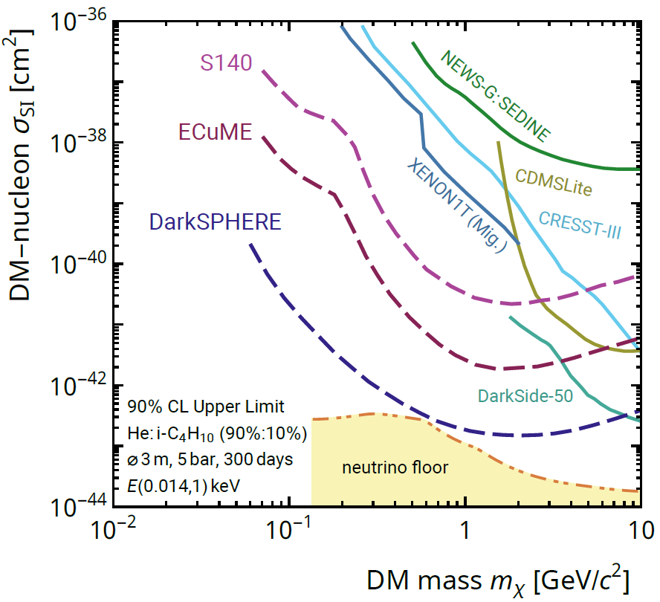
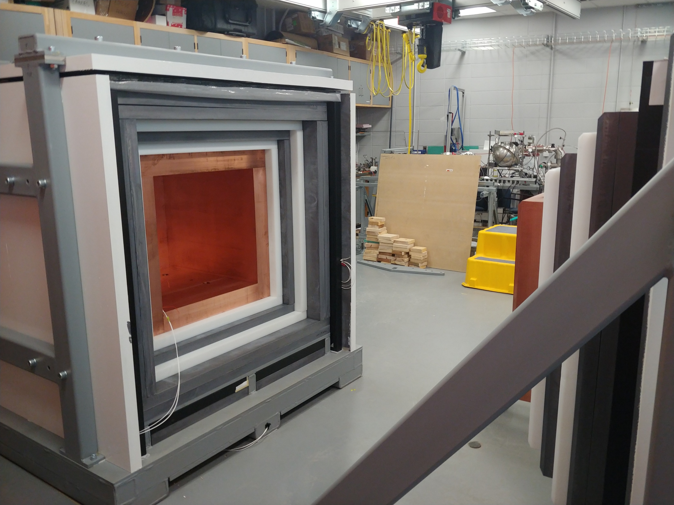
Future projects
ECuME (& miniECuME):
  Fully underground electroformed copper sphere in SNOLAB.
  (tests ongoing at PNNL)
DarkSPHERE:
  Fully electroformed 3m of diameter sphere for Boulby (UK) in a water shield.
  (under consideration)
G3:
  Shield at Queen’s University intended for CEνNS detection at nuclear reactors.
  (shield completed, starting testing)
arXiv:2301.05183

Slide 15
Conclusion
NEWS-G and SPCs well suited for low mass dark matter search.
LSM data able to set new SD-p WIMP constraints with CH₄.
Currently taking physics data at SNOLAB with many improvements.
Promising future projects in the works.

Slide 16
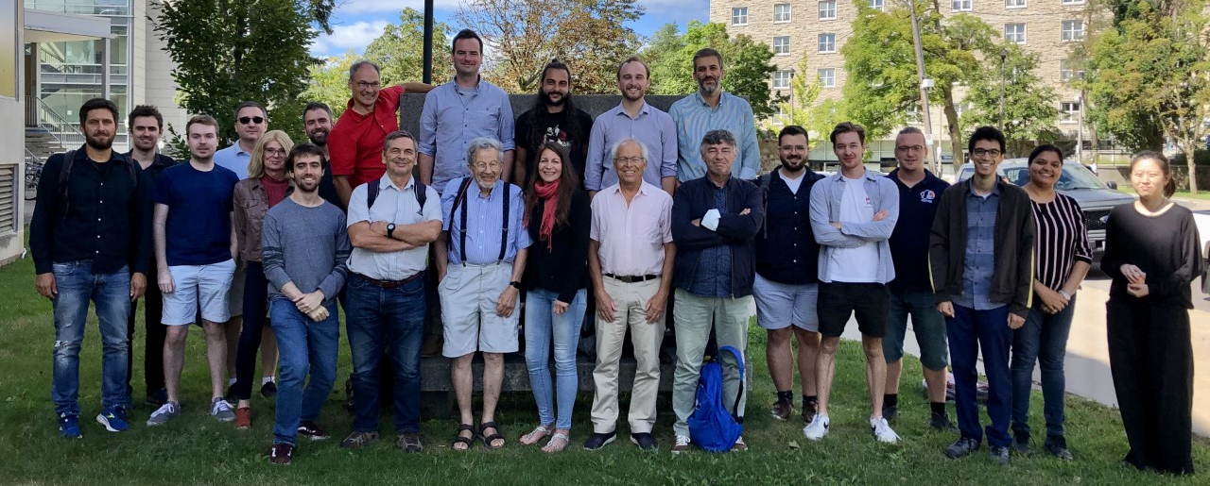
Thank you!

Slide 17
Extra slides

Slide 18
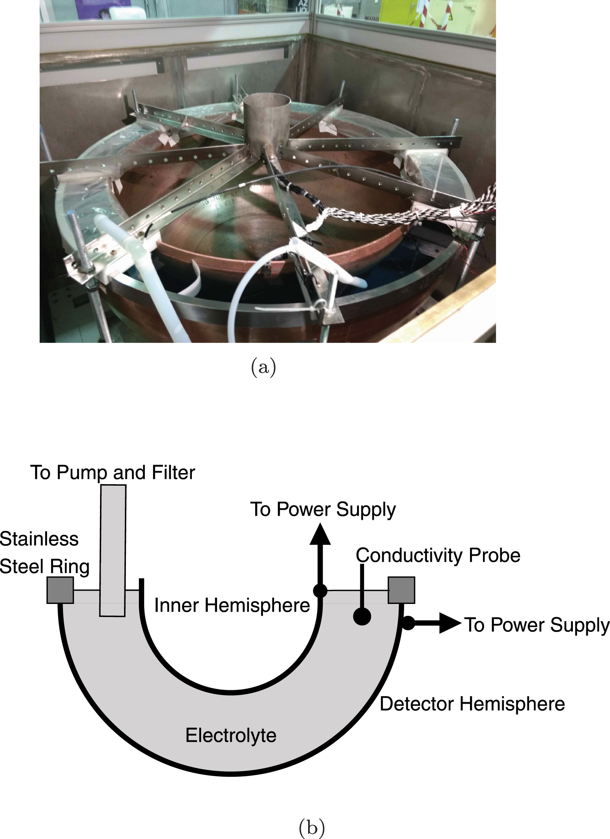
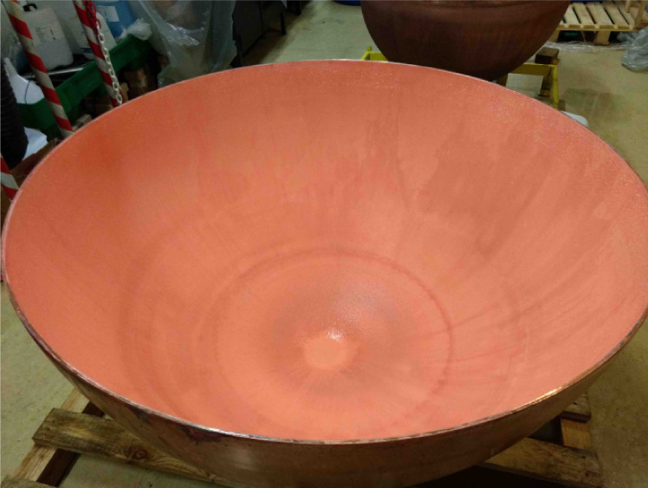
Making the sphere, electroforming, etching

Slide 19
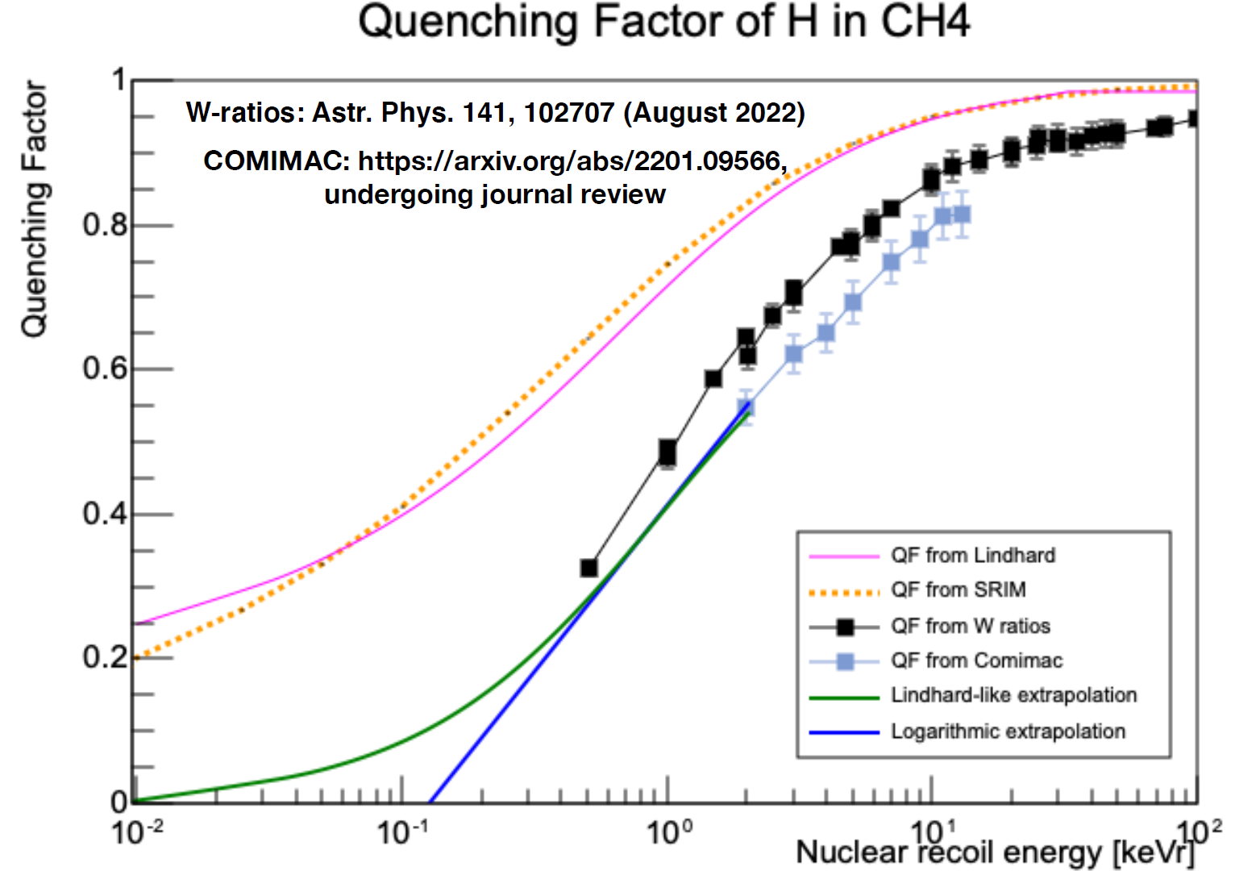
Quenching factor

Slide 20
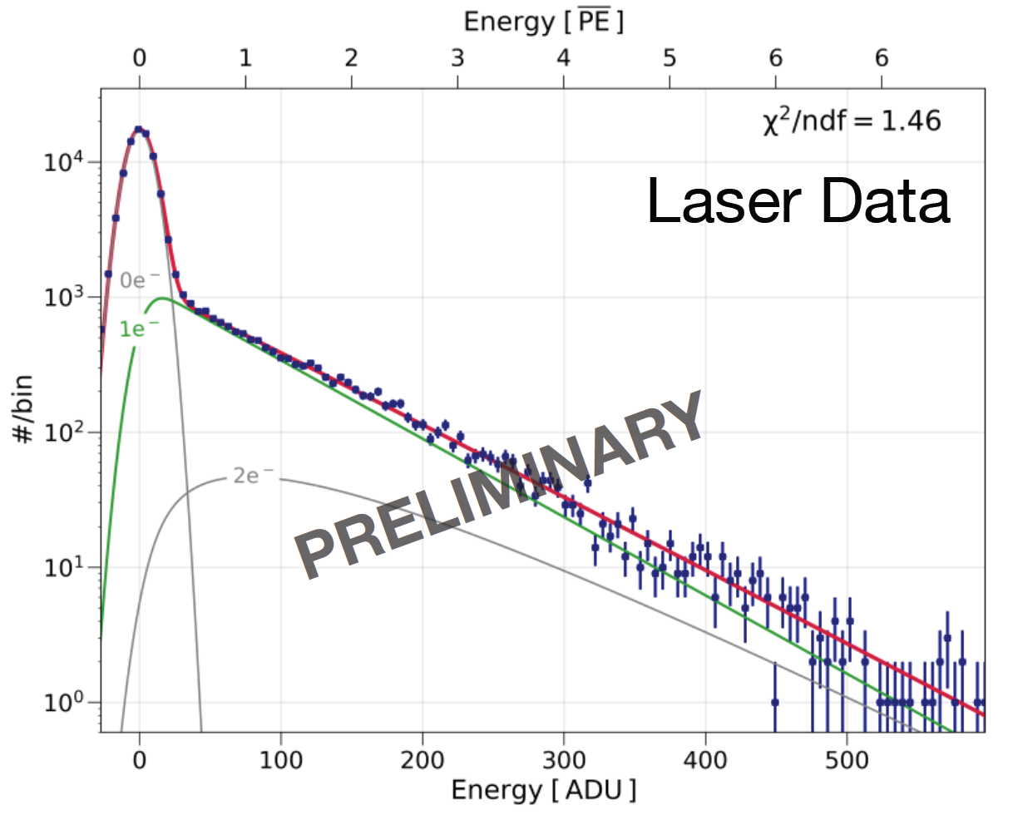
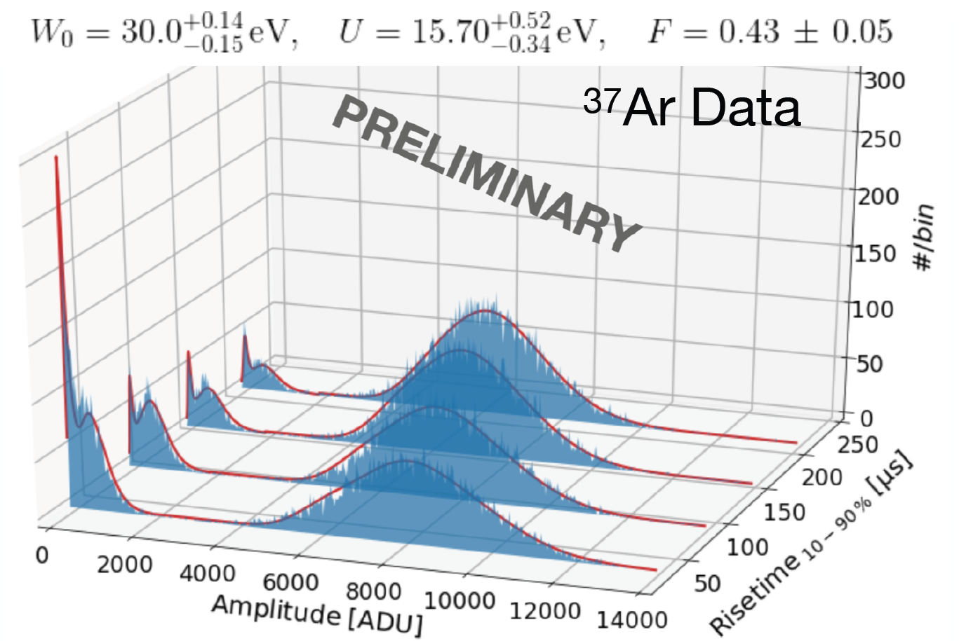
Gas mixture and calibration (laser and ³⁷Ar)
doi:10.1088/1742-6596/2156/1/012059

Slide 21
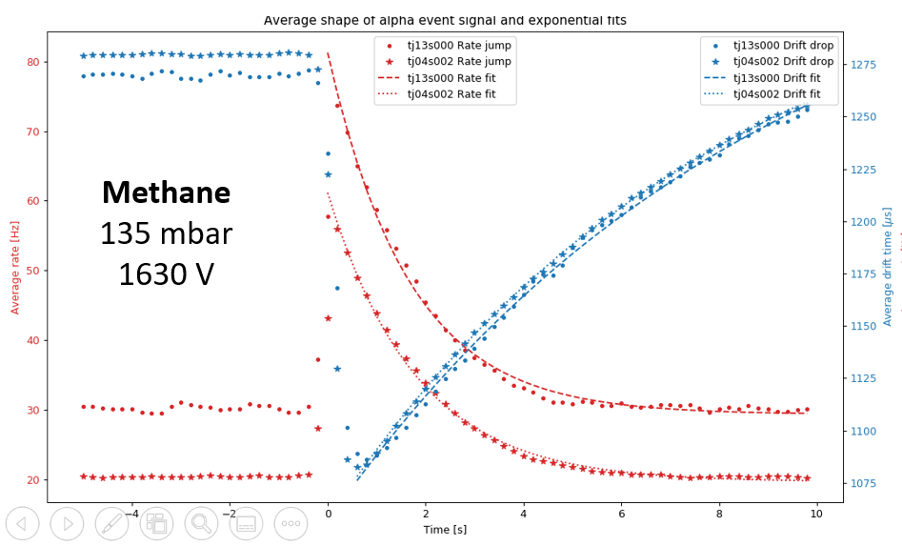
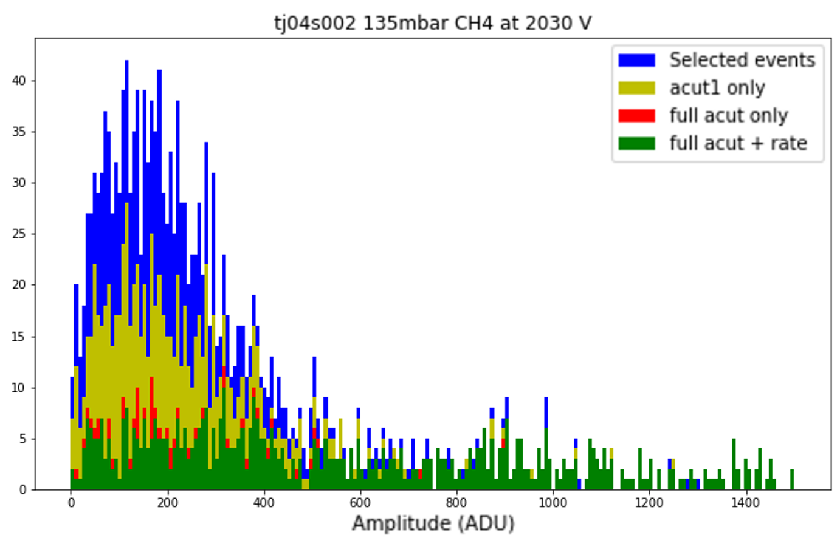
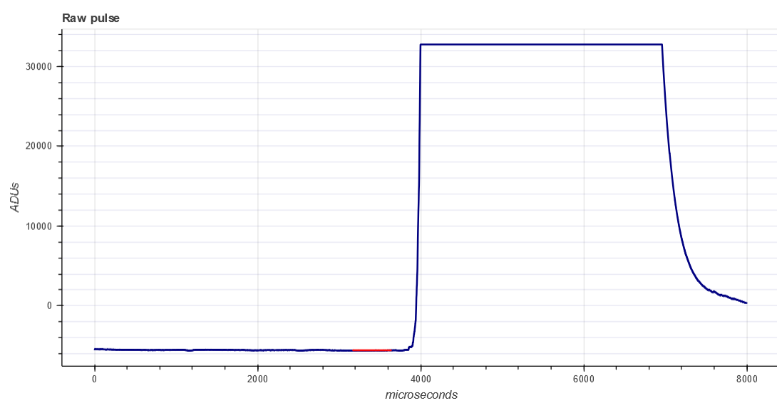
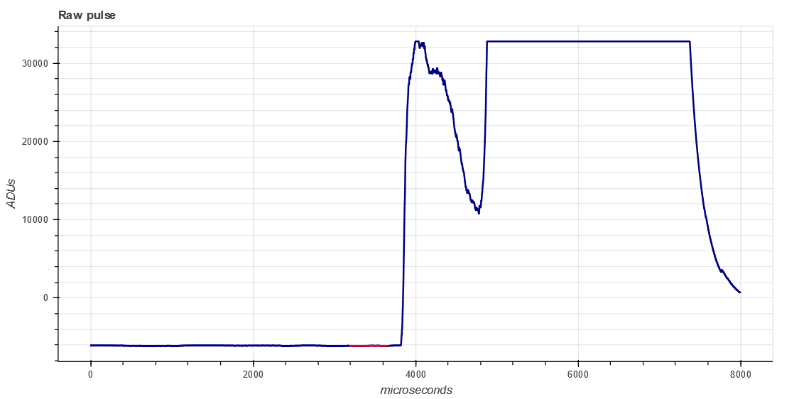
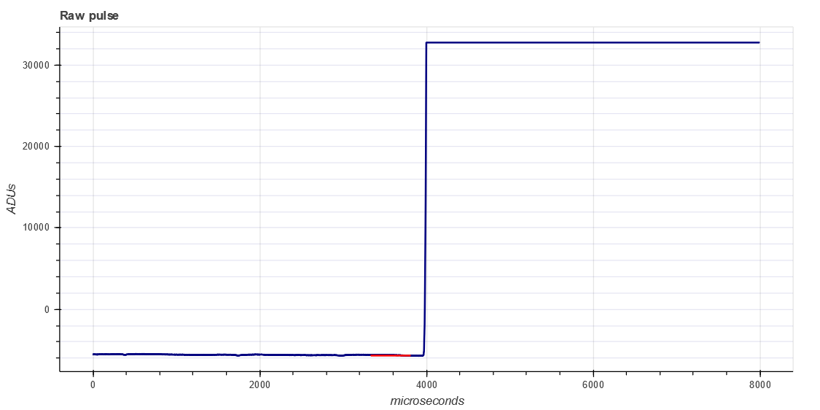
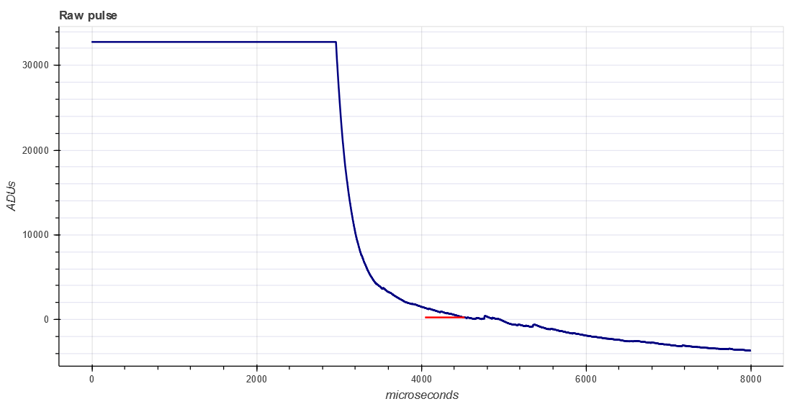
Alpha background
There is ²¹⁰Po contamination in the copper surface, which causes alphas that ionize a lot of gas. All the ions create a space charge that disturbs the electric field, and changes the electron drift time. For some still unknown reason, a high rate of low energy events keep happening for around 5s after each alpha.
Electron drift time
Total rate of events
The saturated alpha signals can be broken up and difficult to detect, but using the drift time, rate of events and decreasing baselines, we can identify alphas and remove most of the low-energy background due to them with a 5s cut after each alpha, keeping 85-90% of the total time.
21

Slide 22
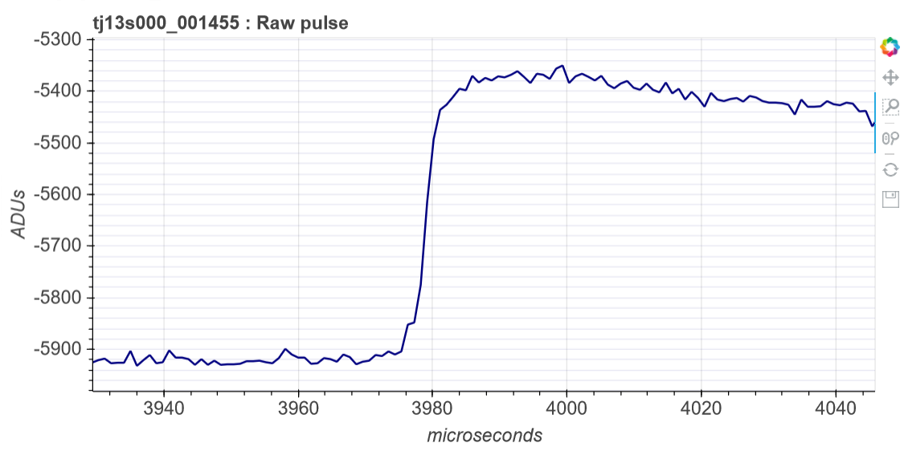
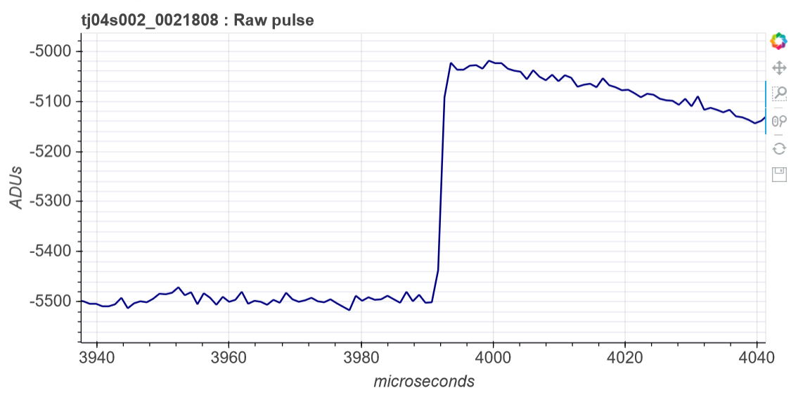
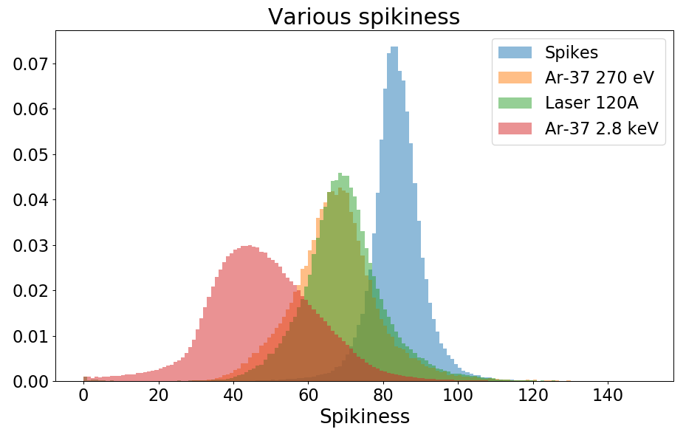
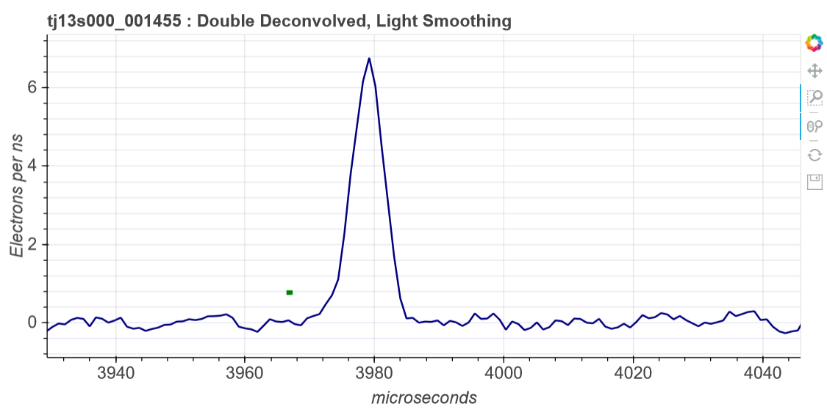
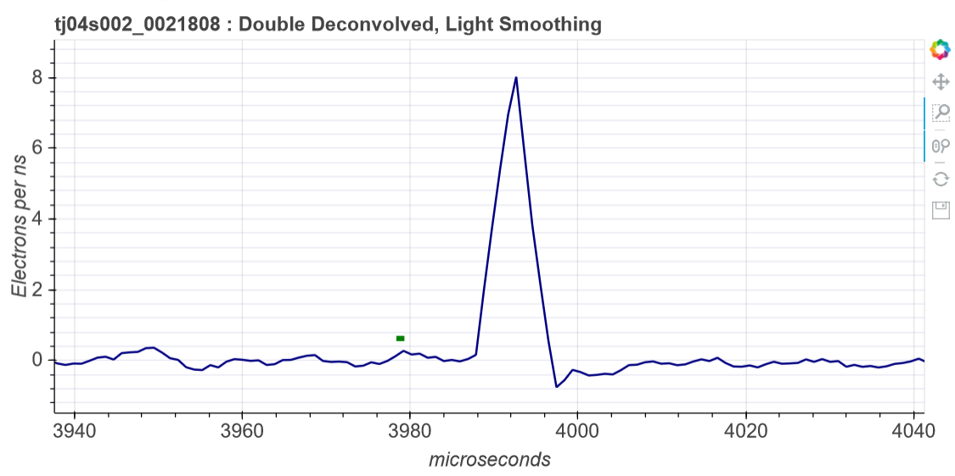
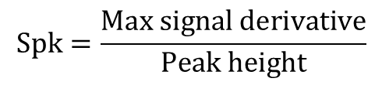
Spikiness
1st comparison method
Spikiness
$$Spk=\frac{Max signal derivative}{Peak height}$$
Probable
electron event
Probable spike event
22

Slide 23




North/South integral ratio
2nd comparison method
N/S ratio
$$N/S=\frac{North DD2 integral}{South DD2 integral}$$
Probable
electron event
Probable spike event
23

Slide 24







Linear Fisher discriminant
Optimal comparison:
Combining both methods
Separation $J\left(ω\right)=\frac{(μ_{1}−μ_{2})²}{N_{1}{\left(σ_{1}\right)}^{2}+N_{2}(σ_{2})²}$
New axis $τ_{i}=ω^{t}x_{i}^{t}$
ω=[−0.678619815,−76.8674863]
Spk NS
24

Slide 25


Fits to the physics data
Wide
The separation between electron and spike events is weaker at lower energies.
Wide pulses are another dominant background of unknown origin in the data.
A cut on N/S removes fat pulses (dominant in 2-peak data) and a Fisher discrim. cut removes spikes.
25

