Slide 1
Study of W Boson Production in Association with Two Jets using Boosted Decision Trees on Data Collected by the ATLAS Detector.
Matthew Smith
Supervisor:
Alain Bellerive

Slide 2
Overview
Introduce the LHC and ATLAS
Physics Background and Motivation
Methodology
Concluding Remarks
Notes:
As an overview:
first i’ll briefly motivating the topic,
Then i will describe the methodology, including explaining how Boosted Decision Trees work, and then explaining the type of boosting im using.
Then i will show you some data that i applied my method too, and the results.
Finally we will end off with a brief conclusion

Slide 3
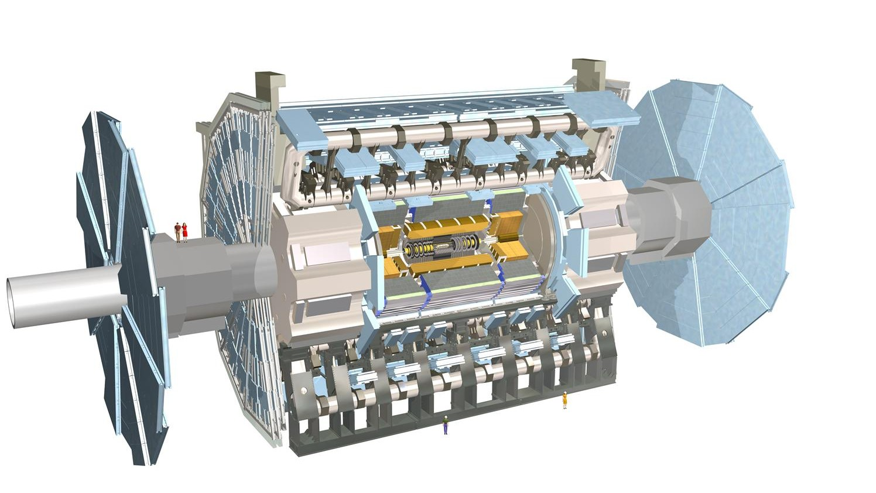
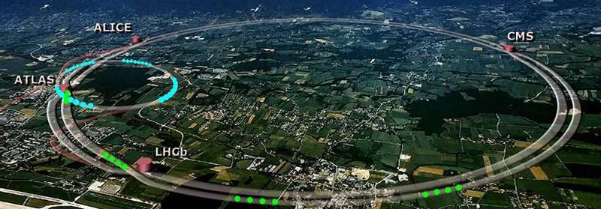
The LHC and ATLAS
The LHC is largest particle accelerator ever built
Bunches of protons are collided together at the largest energies ever achieved
ATLAS is the largest detector at the LHC
25m tall and 46m long
Helped discover the Higgs boson in 2012
ATLAS completed a data collection period that ran from 2015 – 2018. This dataset will be used in this analysis
Average height of a person
~26.6 km
circumference
Notes:
ATLAS is the largest detector at the LHC, spanning 25 m tall and 46 m long.
It was integral in the 2012 nobel prize winning discovery of the higgs boson
Atlas completed a full high luminosity data collection period for which it ran for 3 years at a peak C.O.M Enegy of 13 TeV. This is the data that will be used in this analysis

Slide 4
The Standard Model
Leptons
Bosons
Quarks
Force carrying particles
Mediators
Proton
neutrons
$$ν_{e}, ν_{μ}, ν_{τ}$$
$$e , μ , τ$$
Photons
$$u, c, t$$
$$d, s, b$$
$$γ$$
Higgs
$$H$$
Gluons
g
Weak Bosons
$$W^{±}, Z$$
Notes:
Quarks and leptons make up the stable matter in universe
Quarks for hadrons like protons and neutrons, and leptons combined with hadrons to make atoms
Bosons are the force carrying particles, the mediators for interactions between the leptons and quarks.
Without bosons, particles could not interacti with eachother and the universe could not exist

Slide 5
Purpose
To perform a total fiducial cross section measurement of the Electroweak W + Jets interaction within the ATLAS detector
Notes:
The point of a cross section measurement is to find out how often an event occurs.

Slide 6
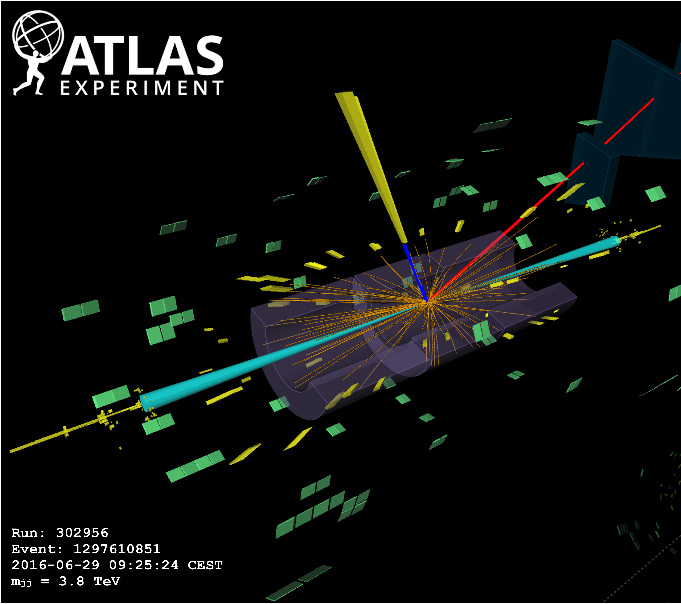
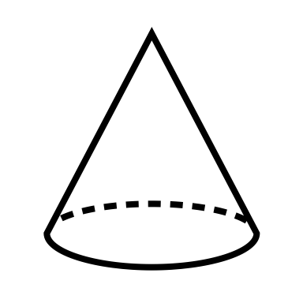
Physics Process of Interest
“Electroweak W + Jets”
Motivation
Constrain the Anomalous triple gauge couplings
Electroweak production of a W boson + particle Jets
Initial State
Final State
“Jet”
of
particles
$$μ^{±}$$
$$𝓮^{±}$$
$$q_{i}$$
$$q_{f}$$
$$Z/γ^{∗}$$
Anomalous triple
gauge couplings
$$g_{WWγ}$$
$$g_{WWZ}$$
$$ℯ^{±} or μ^{±}$$
Jet of particles
$$W^{±}$$
$$W^{±}$$
$$ν_{ℯ }or ν_{μ }$$
$$q_{i}$$
$$q_{f}$$
“Jet”
of
particles
M. Aaboud et al. (ATLAS Collaboration)
Phys. Rev. Lett. 123, 161801 DOI:
https://doi.org/10.1103/PhysRevLett.123.161801
Notes:
This is the process of interest
This interaction is a fundamental interaction in nature
- tells us how the bosons interact with each other and therefore tells us how the universe interacts with itself.
This vertex is proportional to something called the anomalous triple gauge couplings.
-coupling factors have become very popular among theorist for exploring beyond the standard model of particle physics and predict things that have not yet been modeled.
So how does this interaction actually look inside of her detector. What the detector will see is the final state of our interaction.
- You see that this proton after having interacted will go off to produce a jet or a stream of particles through a process called hadronization.
- W boson will decay leptonicaly to an electron or a muon and neutrinos.
Here I’ve got a reconstructed event with in the atlas detector. this event is very similar to our event although not quite exactly the same.
you can see the interaction point where most interactinos, other protons in the bunch, have just rickoched into the detectror.
- However, our interaction has produced two jets of particles, highlighted in this turquoise colour.
-While out event has wiher one electron or one muon, I have displaed both here so you can see its signature in the detector
Just because we have observed this final state that matches that of our signal do does not mean that we have observed our process of interest

Slide 7
Physics Process of Interest
“Electroweak W + Jets”
Largest Background
“Strong W + Jets”
Electroweak production of a W boson + particle Jets
Strong production of a W boson + particle Jets
Initial State
Final State
Initial State
Final State
“Jet”
of
particles
“Jet”
of
particles
$$q_{i}$$
$$q_{f}$$
$$q_{i}$$
$$q_{f}$$
$$Z/γ^{∗}$$
$$ℯ^{±} or μ^{±}$$
$$ℯ^{±} or μ^{±}$$
$$g$$
$$W^{±}$$
$$W^{±}$$
$$ν_{ℯ }or ν_{μ }$$
$$W^{±}$$
$$ν_{ℯ }or ν_{μ }$$
$$q_{f}$$
$$q_{i}$$
$$q_{f}$$
$$q_{i}$$
“Jet”
of
particles
“Jet”
of
particles
+ Other Backgrounds
Notes:
However just because we have observed this final state does not mean that we have observed our process of interest.
One of our largest backgrounds present in the analysis also shares this same final state as our process however has a different interaction Vertex.
This is where the machine learning is going to come in to play this interaction although it has the same final state will have different characteristics these leptons will have higher momentum then those from our process of interest
by looking at these physical characteristics of our events we can differentiate between signal and background.
There are of course other backgrounds present in our analysis, however these other backgrounds may not share the same final state as our process of interest.
We can therefore limiting the space of events that we are looking at in order to minimize the contributions of these backgrounds to our measurement volume so that we have a purer signal Region

Slide 8
Defining a “fiducial” volume
Space of all interactions at all energies
Only events producing one lepton
Signal rich
Background suppressing
Optimized for significance = $\frac{S}{\sqrt{S+B}}$
Well defined for theorists
Fiducial volume
*Detailed list of restrictions available in backup slides
Notes:
Remove events or “selection criteria” instead of cut
careful to not restrict our Fiducial volume too much because this can result in not enough signal to be measured.
Itt is going to be well defined for theorist. This makes it much easier for thierists to utilize our measurement in their theories which might themselves have heavy restrictions to their phase space.

Slide 9
Methodology

Slide 10
A Machine Learning Classification Tool:
Boosted Decision Trees (BDT)
Subsequent trees are trained on the previous tree’s Incorrectly classified data
Background
Signal
$M_{jj}<700 GeV$
Pass
Fail
Pass
Fail
Pass
Fail
Pass
Fail
Pass
Fail
Pass
Fail
Pass
Fail
Leading Jet $p_{t}>120 GeV$
Total # of Jets $≥2$
Pass
Fail
Pass
Fail
Notes:
We give a tree an event that we know is signal (or background), and the tree will attempt to make a series of binary split decisions on various observables with the goal of separating signal and background. What we hope to avoid are leaves ( or end containers) that contain a mix of signal and background.
Boosting is simply the process of training many trees instead of just one, where each subsequent tree is trained on the previous tree’s Incorrectly classified data.

Slide 11
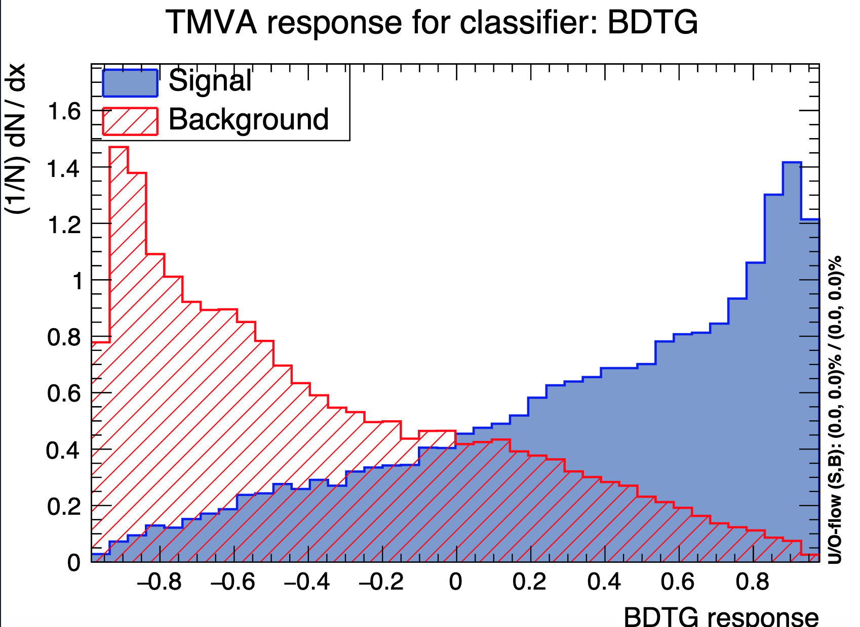
A Machine Learning Classification Tool:
Boosted Decision Trees (BDT)
Subsequent trees are trained on the previous tree’s Incorrectly classified data
Background
Signal
$M_{jj}<700 GeV$
Pass
Fail
Pass
Fail
Pass
Fail
Pass
Fail
Pass
Fail
Pass
Fail
Pass
Fail
Leading Jet $p_{t}>120 GeV$
Total # of Jets $≥2$
Pass
Fail
Pass
Fail
BDT Output Distribution
ATLAS work in progress
Normalized to equal areas
“Background like” events score closer to -1
“Signal like” events score closer to 1
(TMVA Implementation)
TMVA: A. Hoecker, P. Speckmayer, J. Stelzer, J. Therhaag, E. von Toerne, and H. Voss, TMVA - Toolkit for Multivariate Data Analysis, PoS ACAT 040 (2007), arXiv:physics/0703039
Score
Notes:
We give a tree an event that we know is signal (or background), and the tree will attempt to make a series of binary split decisions on various observables with the goal of separating signal and background. What we hope to avoid are leaves ( or end containers) that contain a mix of signal and background.
Boosting is simply the process of training many trees instead of just one, where each subsequent tree is trained on the previous tree’s Incorrectly classified data.
Ultimately, we combine the results of all trees into one overall improved descriminator. The result isan output distribution that hopefully looks similar to the one here.

Slide 12
Analysis Strategy: Basic Anatomy
Train BDTs and classify Monte Carlo & Data
Using binned extended likelihood fit, extract the number of electroweak and strong W + Jets events
Background
ATLAS work in progress
Signal
Data
2
Normalized to equal areas
1
fit
8
2
4
1
7.5
5
4.5
2
3
3
-1
+1
-1
+1
Score
Score
Score
$$N_{B, Pred.}=6$$
$N_{s, Pred.}=10$
$$×2$$
$$×1.5$$
$$N_{B, Fit}=12$$
$$N_{s, Fit}=15$$
Convert
$$N_{s,Fit} \& N_{B,Fit}$$
$σ_{EW W+Jets }$& $σ_{Strong W+Jets }$
Convert this fitted number of observed events to a cross section measurement
Notes:
This boosted decision tree output distribution is how we will recover our number of signal events.
High score bins are expected to have large significance sue to the lack of background
use a binned extended likelihood fit to extract the of electric and strong W plus jets events. By making the assumption that the shape of the signal and background distributions will be consistent between our Montecarlo and data, we scale our distribution up or down by constant scale factors shared between all bins.
The fit will prioritize the use of the high significance bins at the far right of our distribution.
Finally our fit will return scale parameters which we will need to convert into our cross-section measurement.

Slide 13
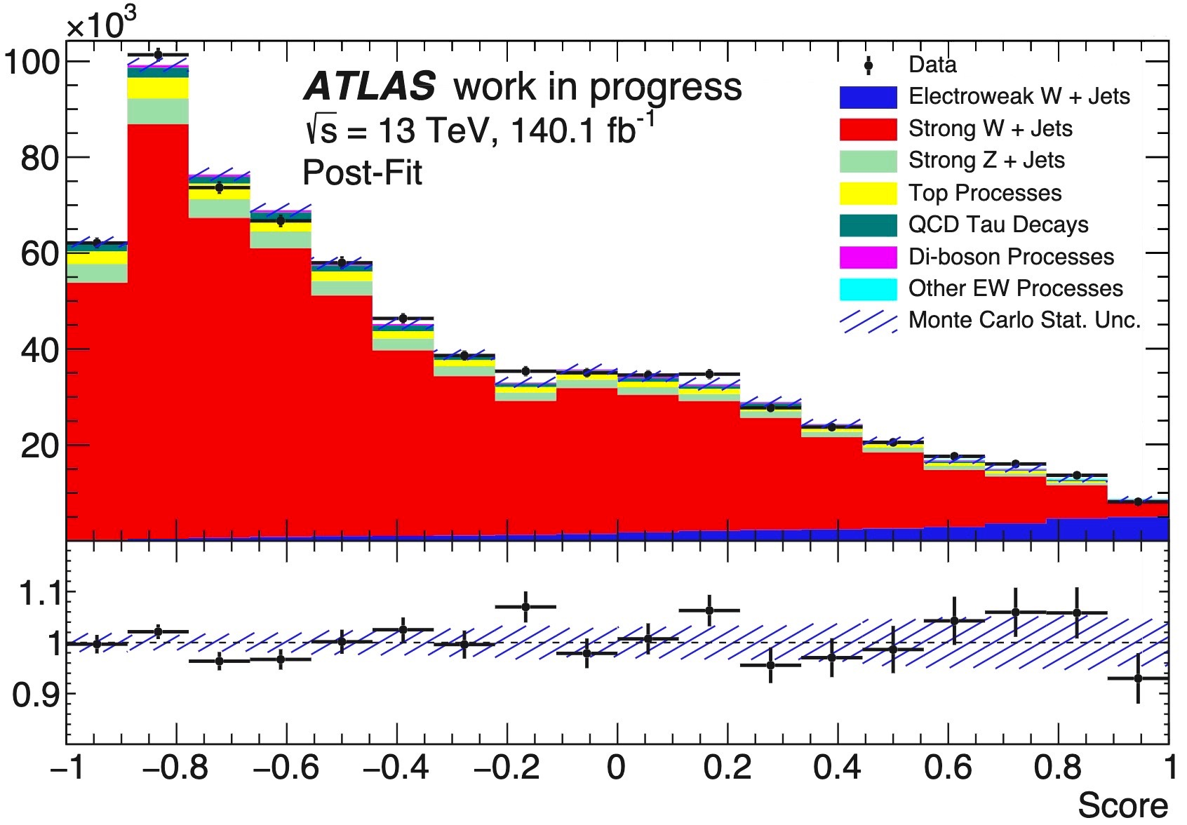
Transforming Fitted Parameters to a Fiducial Cross Section Measurement
Example fit between two Monte Carlo samples (No systematic uncertainty)
$σ_{Cross Section }= {∑_{j}^{n}N}_{Bin,j} ÷ \text{Total}\text{ \# }\text{of} \text{events} \text{in} \text{Run}\text{ 2}$ $×$ Unfolding factor
I
II
III
Convert fitted values to a total # of events
$$\frac{N_{Fit Tot}}{N_{Tot Run 2}}=σ_{Cross Sections}$$
Apply corrective factor to “deconvolute” detector effects, and infer “truth” values
Notes:
Run 2 integrated luminosity was 140.1 +- 1.2 fb^-1
Describe plot.
-post fit plot
-MC Stats only
- Strong background in red, signal in blue
Run two ran for three years and this is just the way that we can remove that three-year time component dependence from our measurement.
After the addition of Statistical uncertainty, we are expecting an around 10% uncertainty
A measurement of a similar process recently found a 37.14 ± 9% (stat.) ± 16% (syst.)
Atlas style -> Log Y axis
cross section , sigma
Total amount of data collected ( size of dataset ) instead of luminosity
“ correct for detector effects
Make data points bigger with bold lines, log scale y axis ( text a lot bigger )
sigma -> lamda , or epsilon

Slide 14
Uncertainty: Fit, Re-Fit Method
The systematic uncertainty is the difference from nominal
$$ε_{±}= N_{nom }−N_{sys± }$$
ATLAS work in progress
ATLAS work in progress
Normalized to equal areas
Normalized to equal areas
Final error for all systematics
$$ε_{tot}^{2}=\sum_{i}^{n}{ε_{i}^{2}}+\sum_{i}^{n}{\sum_{j(j≠i)}^{n}{ρ_{ij}ε_{i}ε_{j}}}$$
Score
Score
Fit Nominal MC to Data
$$N_{s,nom } \& N_{B,nom}$$
Fit MC Varied by $±1σ$ to Data
$$N_{s,sys± } \& N_{B,sys±}$$
Correlation Coefficient
Notes:
Because of miss modeling we change our MC by +- 1 sigma variation due to a source of uncertainty
Vary Monte Carlo by $±1σ$ variation due to a source of uncertainty. Allows us to recover a systematically varied fitted number of events.

Slide 15
Summary
This research will produce a total fiducial cross section measurement of the electroweak production of a W boson + Jets.
Goal to study a fundamental interaction in nature between three guage bosons.
Constrain the anomalous triple gauge couplings for use in beyond the SM physics.
Boosted decision trees will be employed as multivariate discriminators.
A binned extended likelihood fit will be applied to the BDT output
Plan to unblind our dataset soon, so that the method can be applied to real data

Slide 16
Backup Slides

Slide 17
Various Definitions
Centrality
Coordinate System
$$Centrality=\left|\frac{y_{i} −\frac{y_{j1}+y_{j2}}{2}}{y_{j1}−y_{j2}}\right|$$
Sub-Leading jet
Transverse axis
A “Central jet” is any jet who’s Centrality < 0.4
A “Gap Jet” is any jet who’s Centrality < 0.5
Leading jet
$$φ$$
$$−z$$
$$−y$$
$$y$$
$$+z$$
Beam axis
$$W^{±}$$
Dijet Invariant Mass
$$ν_{ℓ}$$
$$ℓ^{±}$$
2019. Dijet Invariant Mass with ALICE at the LHC. [Poster] Quark Matter 2019, Nov 4th, Wuhan, China

Slide 18
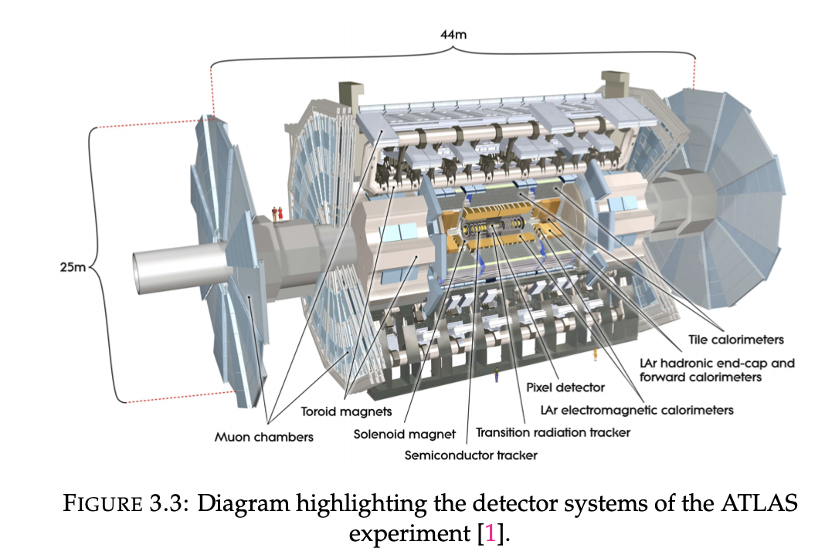
S. Weber, “Measurements of Z Boson Production in Association with Two Jets using the ATLAS Run-II Dataset,” PhD thesis, Carleton University, (2021).

Slide 19
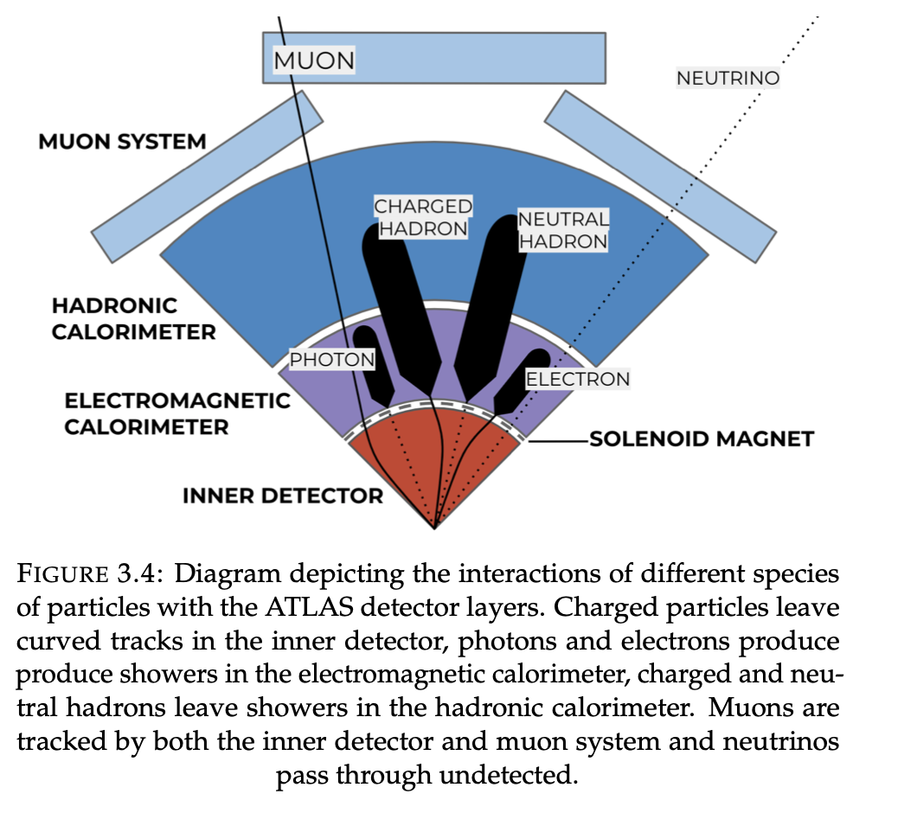
S. Weber, “Measurements of Z Boson Production in Association with Two Jets using the ATLAS Run-II Dataset,” PhD thesis, Carleton University, (2021).

Slide 20
Chosen Input Observables and Hyper-Parameters
Chosen observables for use in training
Leading Jet $p_{t}$
Leading Jet $y$
Sub-Leading Jet $p_{t}$
Sub-Leading Jet $y$
Lepton $η$
Lepton Centrality
Dijet Invariant Mass ${(M}_{jj})$
Jet azimuthal angle difference ($Δφ_{jj}$)
# of Central Jets
# of Gap Gets
Chosen Hyperparameter
Number of Trees | 800
Minimum node Size | 5%
Maximum tree Depth | 3
Learning rate | 0.1
# grid points used for variables | 50
Fraction of Events used per tree | 0.5
Monte Carlo Train / Test Split | 50%
Chosen variables for use in Training
Leading Jet $p_{t}$
Leading Jet $y$
Sub-Leading Jet $p_{t}$
Sub-Leading Jet $y$
Lepton $\left|η\right|$
Lepton Centrality
Dijet Invariant Mass ${(M}_{jj})$
Jet azimuthal angle difference ($Δφ_{jj}$)
# of Central Jets
# of Gap Gets
Number of Trees : 800
Minimum node Size : 5%
Maximum tree Depth : 3
Learning rate : 0.1
# grid points used for variables : 50
Fraction of Events used per tree=0.5
Notes:
I do gradient boosting using Cross entropy loss fuction
They were chosen based of a “hyperparameter tuning” type selection process that optimized the separation of the BDT output as a function of the selected input variables

Slide 21
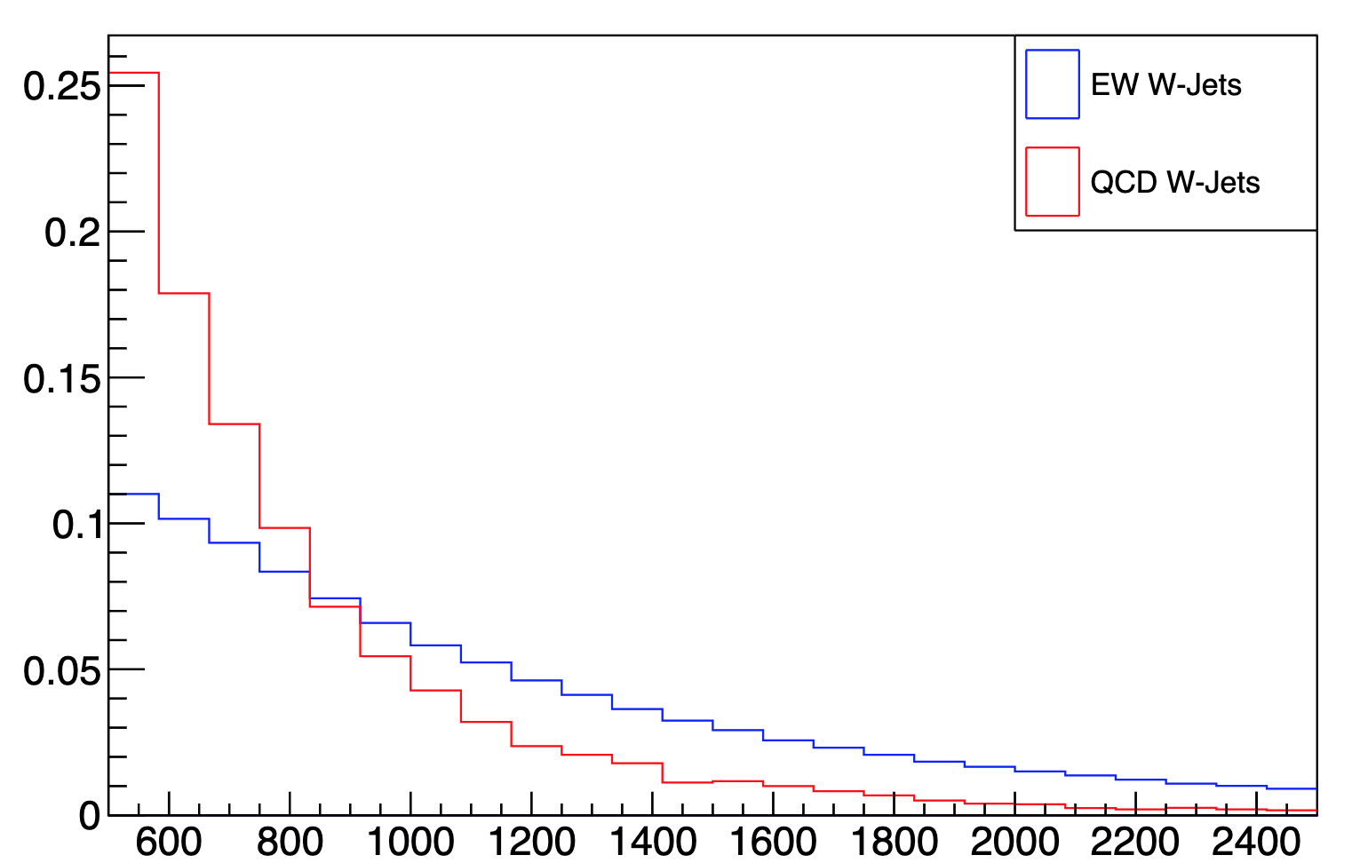
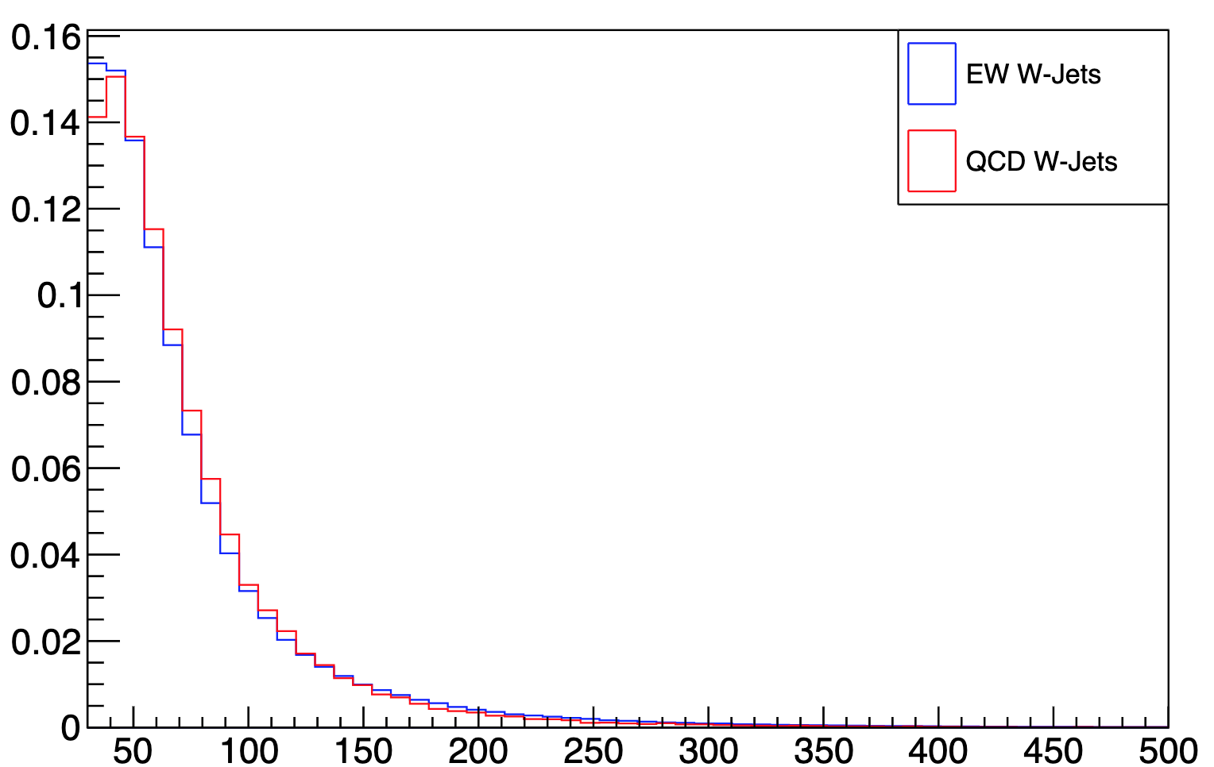
What observables should be given to the BDT?
Some observables have better separation power than others
Example:
Dijet invariant mass will have greater separation power than missing transverse energy
Dijet Invariant Mass $M_{jj}$
Missing Transverse Energy ${(E}_{t})$
EW W + Jets
Strong W + Jets
EW W + Jets
Strong W + Jets
ATLAS work in progress
ATLAS work in progress
$$M_{jj} GeV$$
$$E_{t} GeV$$
Should we use or exclude $E_{t}$ when training our BDT ?
Is their hidden information that we will lose in variable correlations ?
Notes:
So you’re just the first point we now need to think about what do we actually want to show there are many observables that we could give but perhaps some are better to give to the British country than others what do I owe some observables have better separation power than others. for example digestion very mass on the left you can see that the PDFs for the electric weak signal blue and the strong background which is in red can be distinguished as the blue

Slide 22
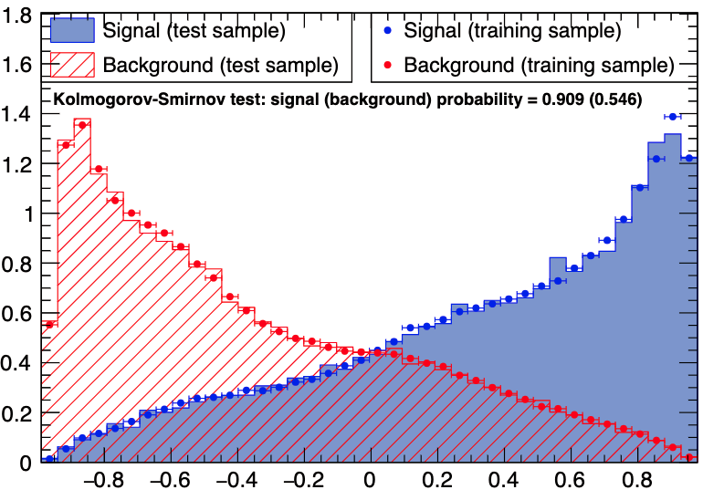
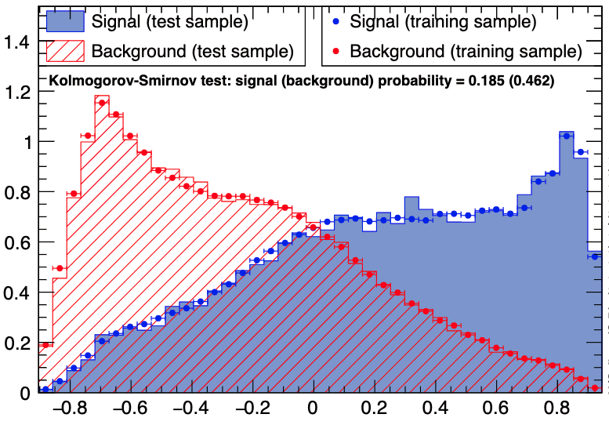
Input Observable Selection
A Trained BDT’s Output distribution can be used to evaluate the separation power of the input variables when used in combination
ATLAS work in progress
ATLAS work in progress
Normalized to equal areas
Normalized to equal areas
Defined in Section 3.1.10, P.25 of the TMVA guide: https://root.cern.ch/download/doc/tmva/TMVAUsersGuide.pdf
Score
Score
$\left\langle S^{2}\right\rangle$ Classifier Separation: 0.317608
$\left\langle S^{2}\right\rangle$ Classifier Separation: 0.186807
Feed BDT only select observables.
Train BDT to classify signal & background.
Use separation of BDT output distribution to measure of the separation power of the inputs.
Optimize separation

Slide 23
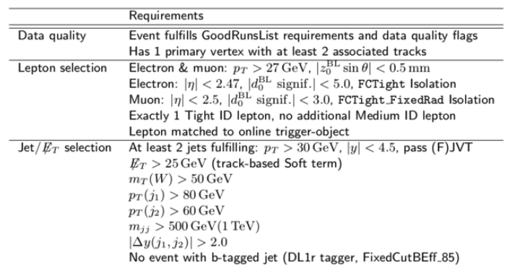
Full list of Jet Selection Criteria
Lepton Requirements
Lepton $p_{t}>27 GeV$
Electron $\left|η\right|<2.47$
Muon $\left|η\right|<2.5$
Jet Requirements
Leading Jet $p_{t}>80 GeV$
Sub-Leading Jet $p_{t}>60 GeV$
Dijet Invariant Mass $M_{jj}>500 GeV$
Jet Rapidity Difference $\left|Δy_{jj}\right|<2.0$
Missing Transverse Energy ${(E}_{t})>30 GeV$
Transverse W Mass $M_{T}(W)>50 GeV$
Rapidity
Pseudo-Rapidity
Notes:
Because the event we are looking at is a very rare decay, we have to restrict the space of events that we are looking into in order to gain a signal region where we have low contamination from background sources
So what do you mean by that well if we have the gray circle which is the space of all interactions of all energies that happens within the atlas detector then we’re going to have to define that small gray circular region that is a signal rich and backgrounds of pressed region. We do this by defining the cuts on the far right I will not be going through all of those but it would be noted that all of these cuts for me to either optimize significance because the signal or to suppress a specific background that might be causing issues down the line.
Missing ET restricts a background we call “multijet” which is a region where many fake leptons are present, and is poorly modeled by out MC.

Slide 24
Full list of Jet Selection Criteria

Slide 25
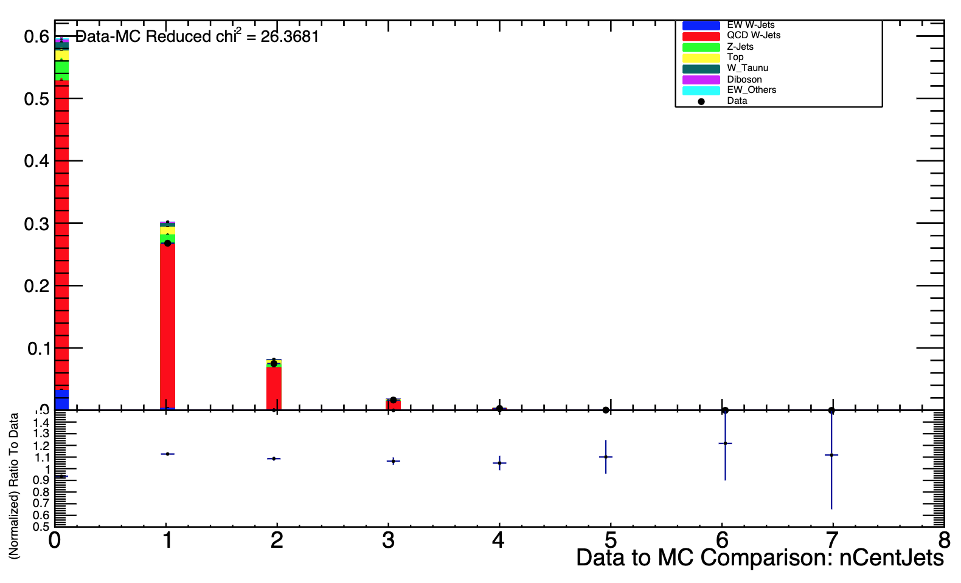
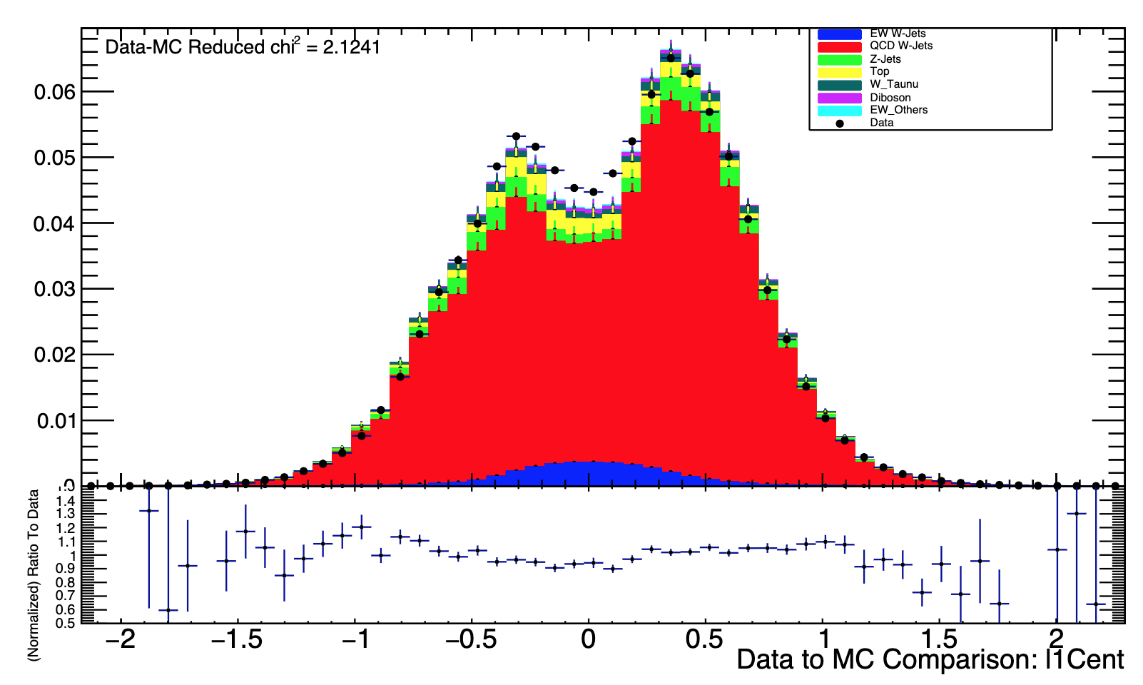
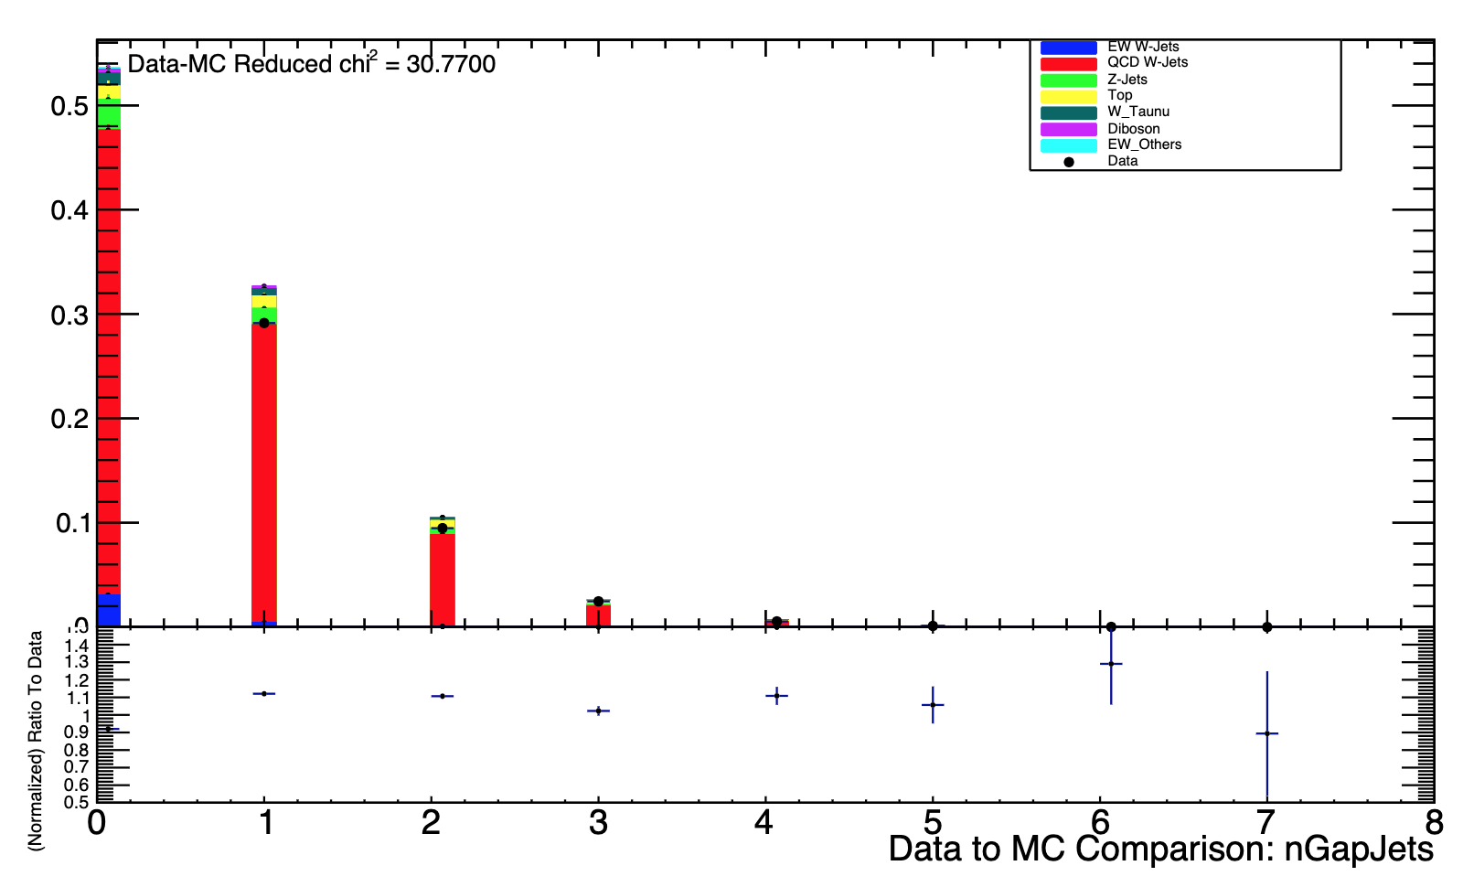
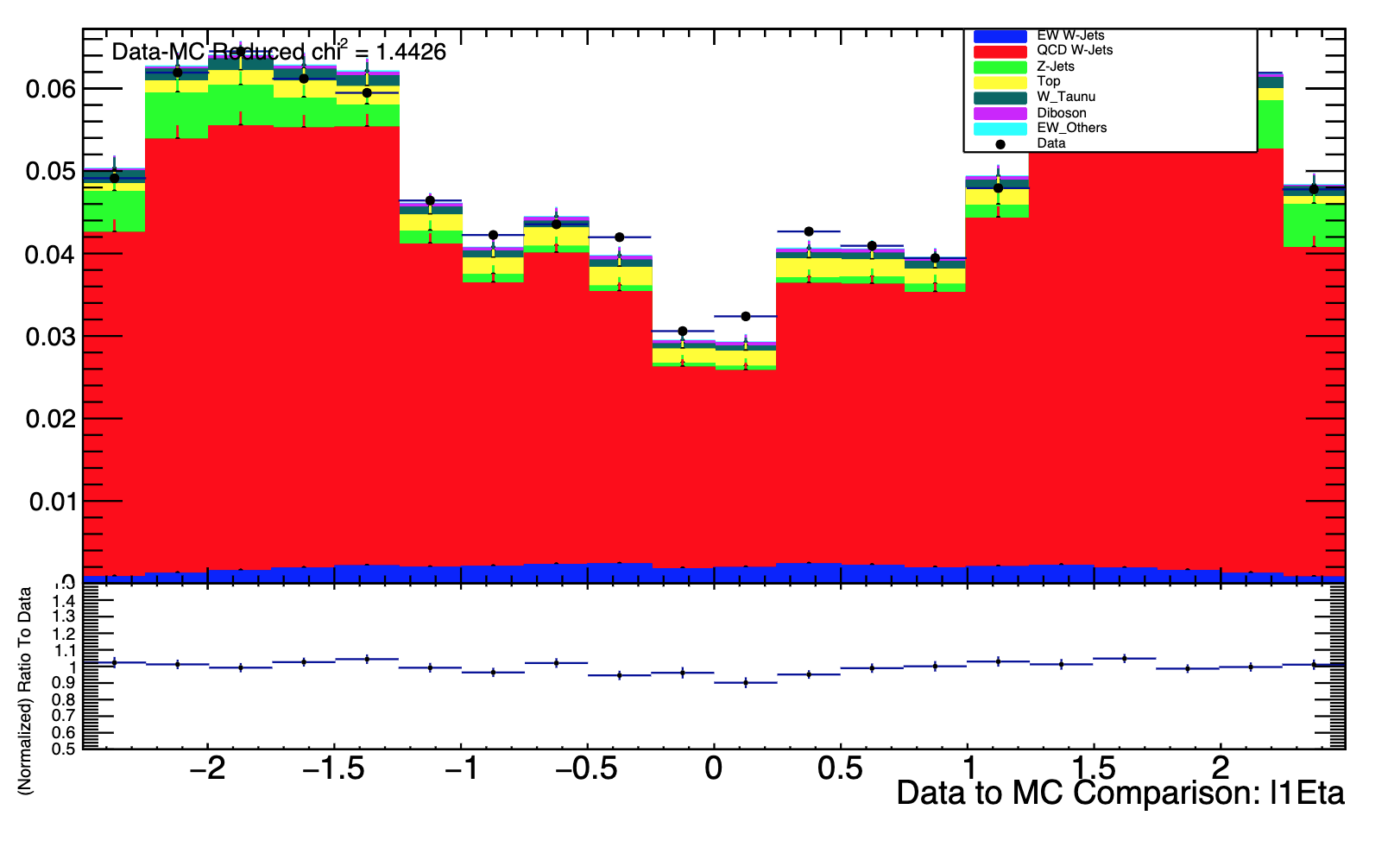
Data to Monte Carlo Comparisons
ATLAS work in progress
ATLAS work in progress
Number of Central Jets
$±$Lepton Centrality
ATLAS work in progress
ATLAS work in progress
Number of Gap Jets
Lepton η

Slide 26
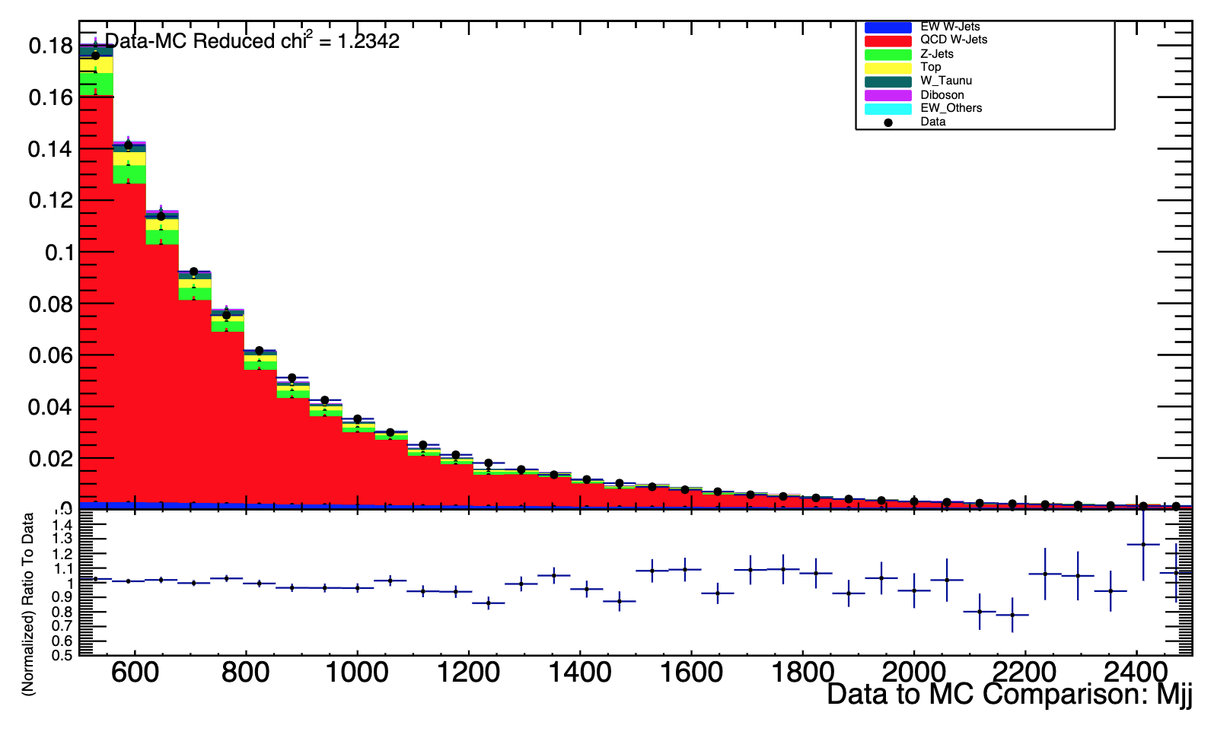
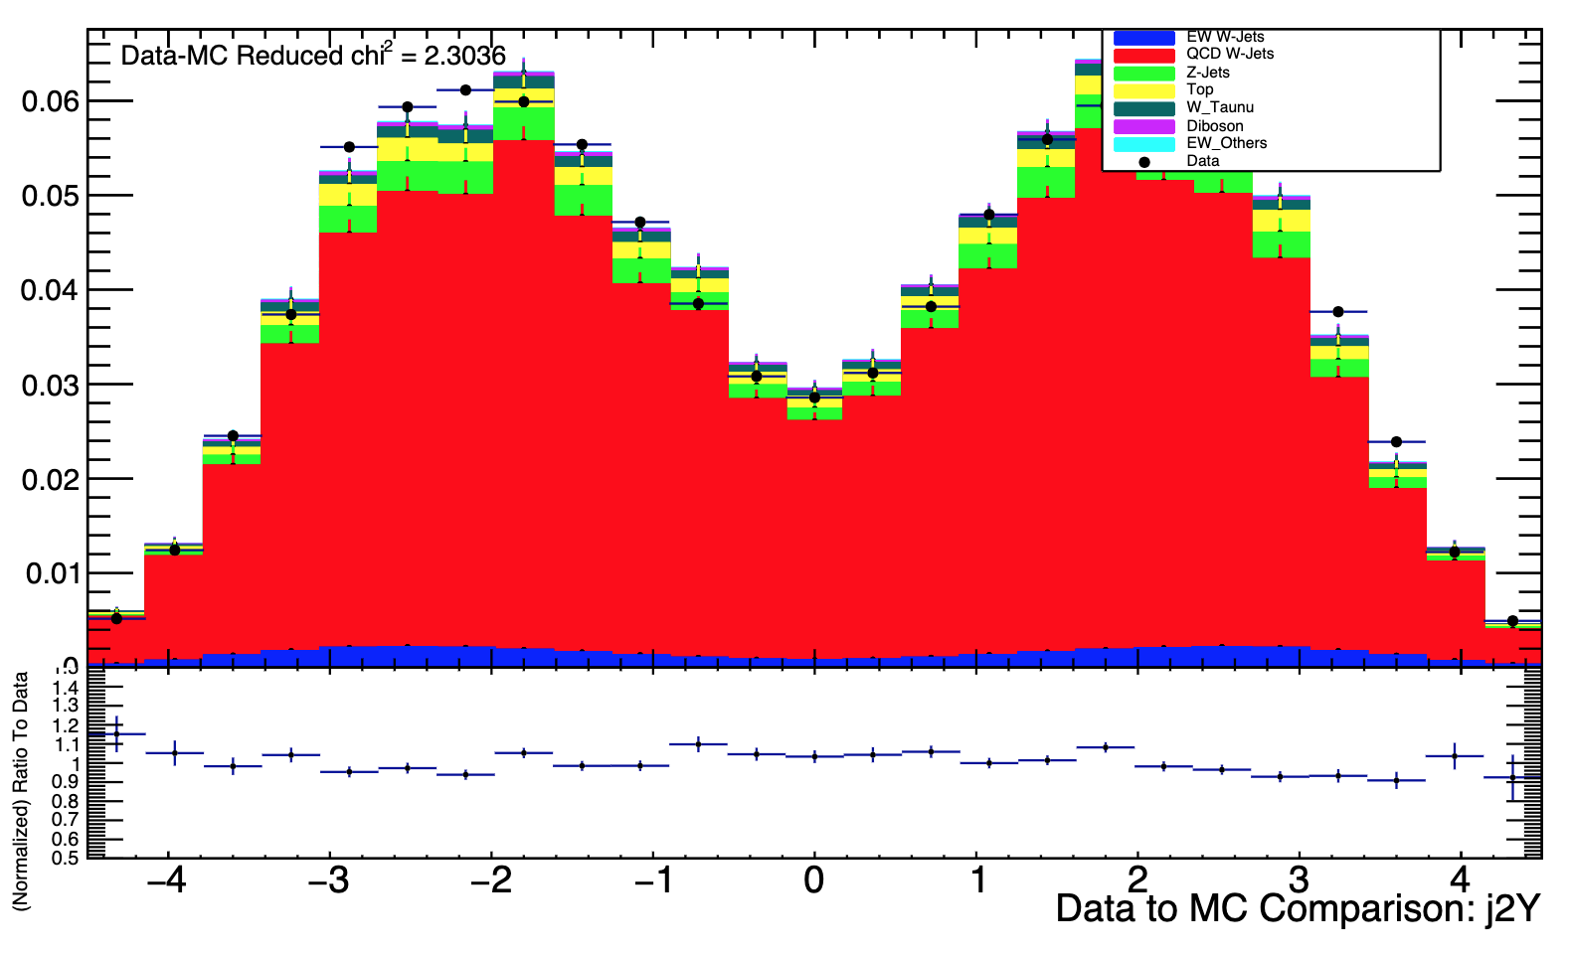
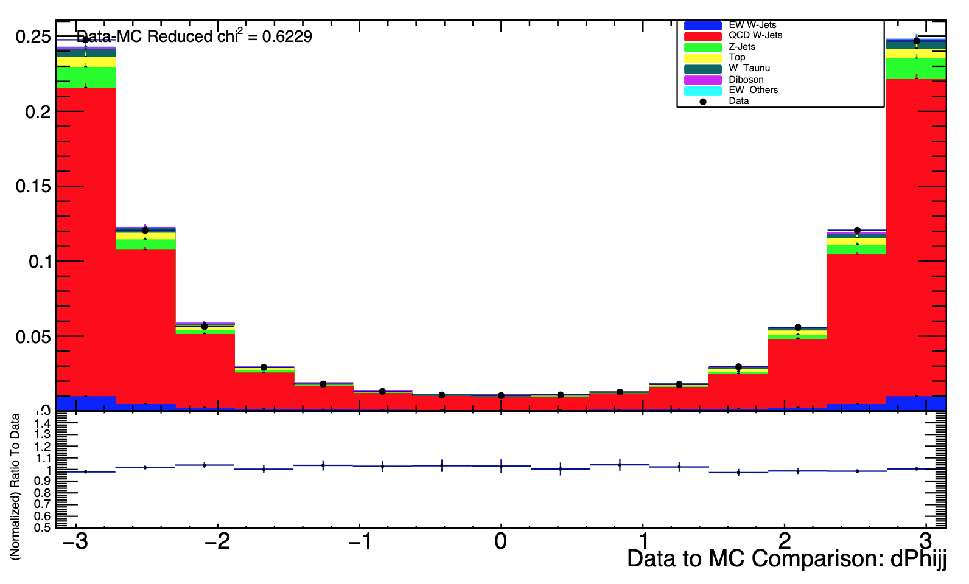
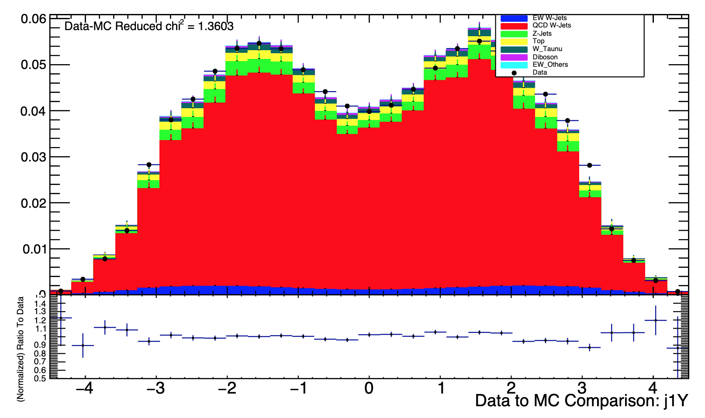
Data to Monte Carlo Comparisons
ATLAS work in progress
ATLAS work in progress
Dijet Invariant Mass
Sub-Leading Jet y
ATLAS work in progress
ATLAS work in progress
$$Δφ_{jj}$$
Leading Jet y

Slide 27
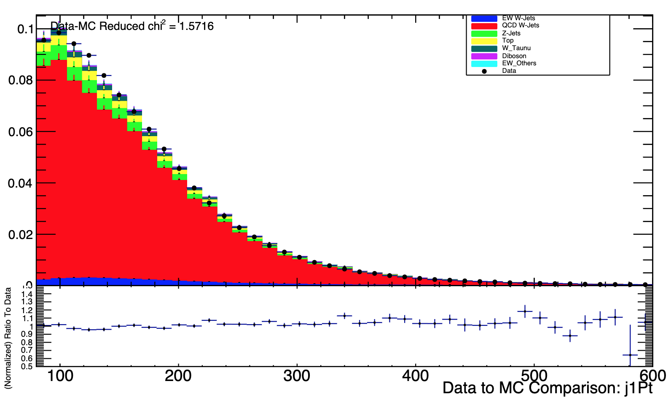
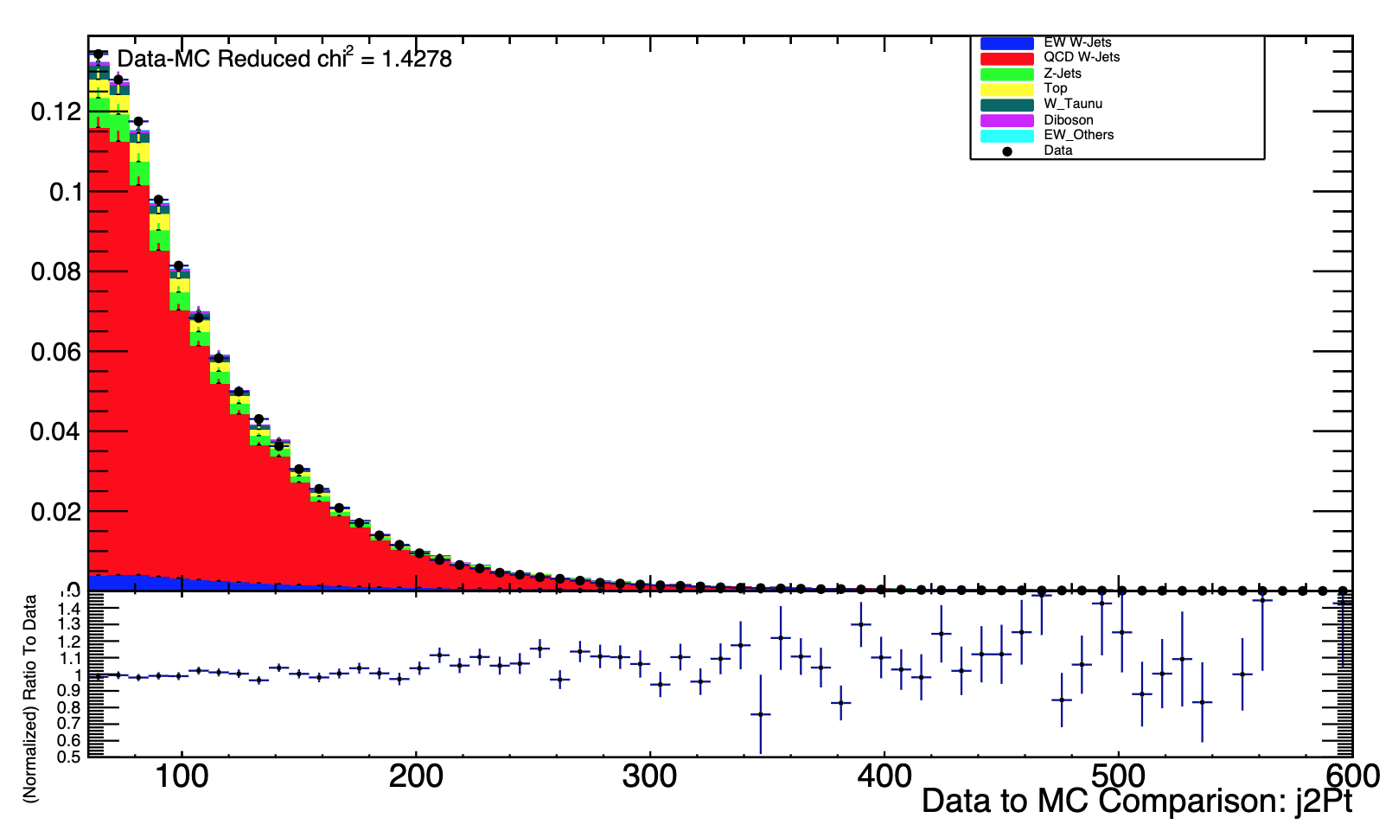
Data to Monte Carlo Comparisons
ATLAS work in progress
ATLAS work in progress
Leading Jet $p_{t}$
Sub-Leading Jet $p_{t}$

Slide 28
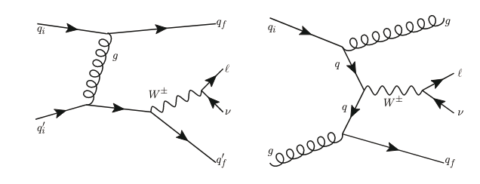
Other Backgrounds
Strong / Electroweak production of a Z boson + Jets
Weak W + Jets tau decay channels
Strong W+ Jets tau decay channel for
Di-boson
Top quark processes
MultiJet
Strong W+Jets first order diagrams

Slide 29
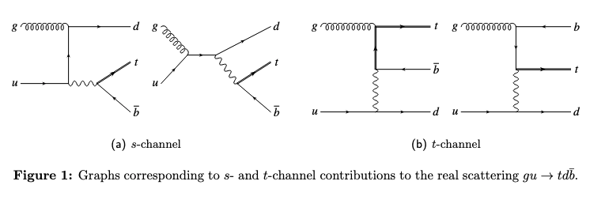
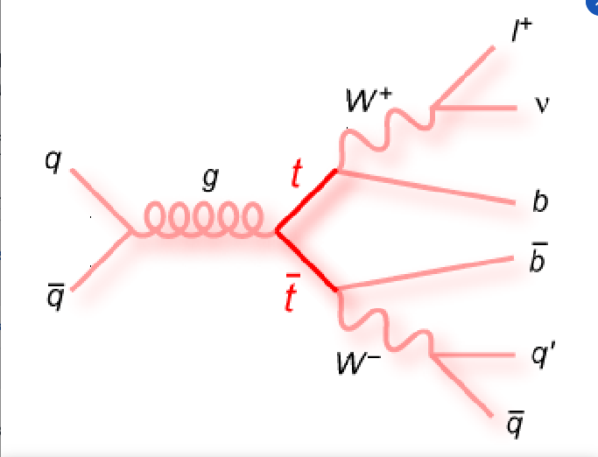
Other backgrounds – “Top”
1) $ug →td\overline{b}$https://doi.org/10.48550/arXiv.0907.4076
3) $q\overline{q} →t\overline{t}$
2) b$g →W^{−}t$ https://doi.org/10.48550/arXiv.1009.2450
Other backgrounds – “Diboson”
Top quarks shown as double lines

Slide 30
Other signals ( to first order) – EW W+ Jets
While Both the Multiperipheral and the Bremsstrahlung diagrams share the same final state as our target, both processed have previously been well measured (Citations below)
In addition, our signal phase space significantly reduces the contributions of these two interactions to the overall cross section. (Cut to M_jj
“VBF”
ATLAS Collaboration, Measurement of the WW cross section in √s = 7 TeV pp collisions with1583 the ATLAS detector and limits on anomalous gauge couplings, Phys. Lett. B712 (2012) 289,1584 arXiv: 1203.6232 [hep-ex].1585
ATLAS Collaboration, Measurement of the WW + W Z cross section and limits on anomalous1586 triple gauge couplings using final states with one lepton, missing transverse momentum, and two1587 jets with the ATLAS detector at √s = 7 TeV, JHEP 01 (2015) 049, arXiv: 1410.7238 [hep-ex].
“Multiperipheral”
“Bremsstrahlung”
Notes:
MultiJet - a purely QCD event that doesn’t make any leptons but the 3rd jet looks like a signal and the electron ionizes more, the muon does not ionize as much and it loses les energy so it can be identified more

Slide 31
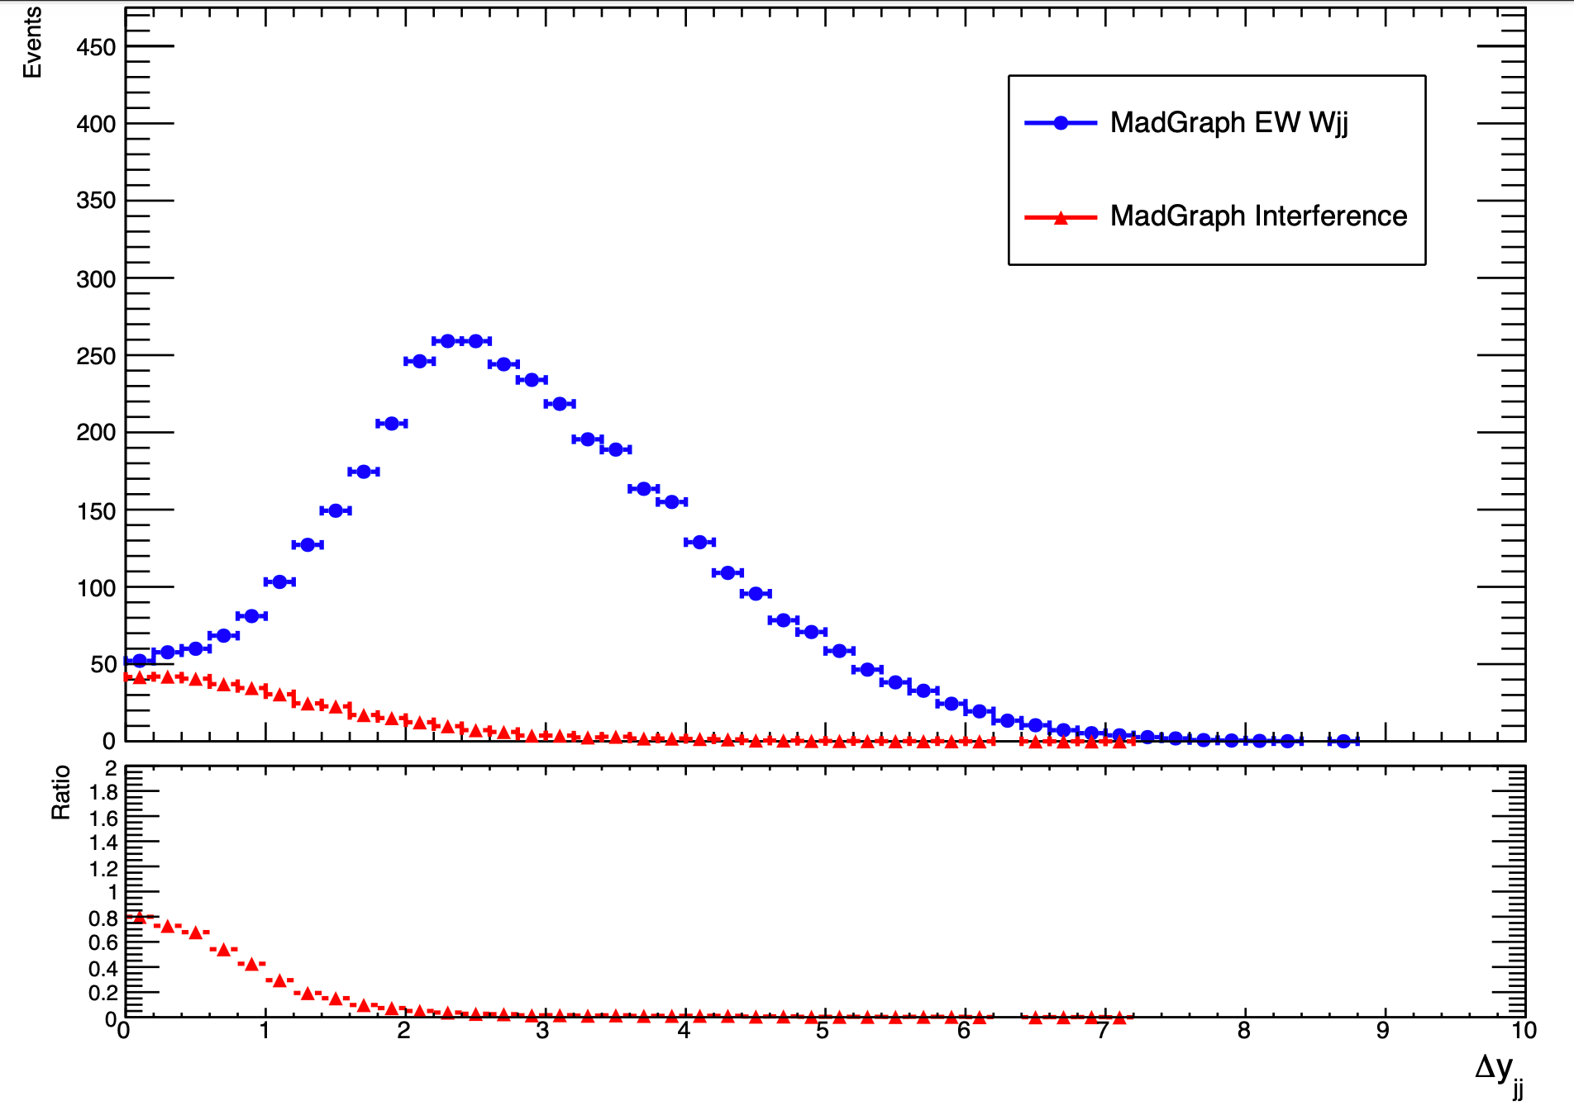
Interference term on matrix element
$M_{jj}>250 GeV$
ATLAS work in progress
Because the final stated of the EW and Strong processes are the same, they are
$$σ∝ M^{2}∝{\left|M_{EW}+M_{Strong}\right|}^{2}$$
$$σ ∝ M_{EW}^{2}+M_{Strong}^{2}+2M_{EW}M_{Strong}$$
“interference”
In red
For $Δy_{jj}>2$ interference, the interference term is greatly reduced
This is improved for $M_{jj}>500 GeV$

Slide 32
General idea - Optimizing the Loss
Converge to minima by following the direction of the steepest descent - the negative gradient!
Do this iteratively using an update rule:
Start
Regularizer
loss
Convergence to local extrema
Binary Cross Entropy Loss Function
Multidimensional Reweighting using Machine Learning
Notes:
To ensure that as we continue to update out prediction, we are heading in the direction of the minimum of L, we use the idea of gradient descent.
The general concept is that we converge to a minimum of the loss function by following the path of steepest descent, ie the negative gradient. This negative gradient term is often accompanied by a regularization term, which usually limits the step size of the descent, so that you don't overshoot the minimum and get something that oscillates back and forth.
Recall that boosting is the process of adding a bunch of trees together, so if we're clever on how we add the trees together, then we can apply this gradient optimization idea to our model so that the loss function converges to a minimum, and thus out model is well trained.
The real update rule is a little different, and i’m just going to flash this here because of time constraints. Note that i also didn’t talk about how to build the trees, only how to minimize loss. This is a different topic which can be discussed if needed.
L_{J+1} = L_j - \frac{\partial L_j}{\partial \hat{r}_{ij}} * \gamma

Slide 33
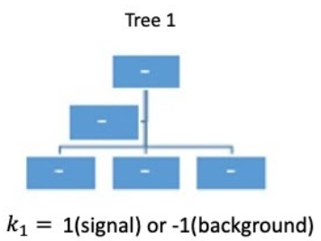
Gradient Boosting - Train on the Residuals
Tree 1
Tree 2
output:
$$F_{j}\left(\vec{x_{i}}, y_{i}\right)=Tree_{j}$$

Slide 34
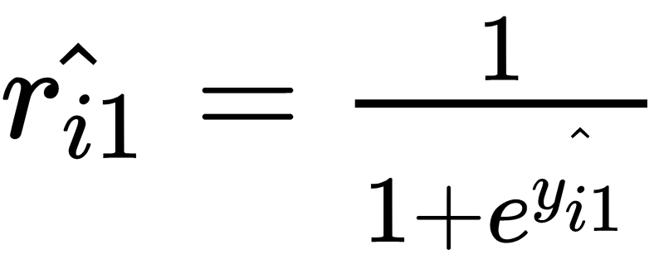
the outputs (TMVA implementation)
So that:
or
Then
Later Rescaled to [-1,1]
Multidimensional Reweighting using Machine Learning
Notes:
\frac{\partial(L_1)}{\partial(\hat{y_{i1})}} = \sum_{i=0}^N\hat{r_{i1}}- y_i
\hat{y_{i1}} \epsilon (-\infty, \infty)
\hat{y_{i1}} = log(\frac{\hat{r_{i1}}}{1 - \hat{r_{i1}} })
\hat{r_{i1}} = \frac{1}{1 + e^{\hat{y_{i1}} }}

Slide 35
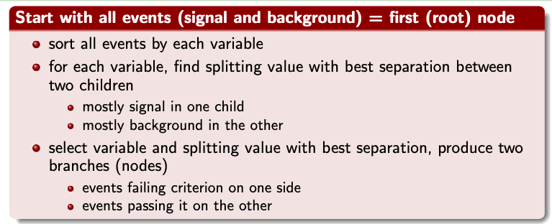
Building Trees
Optimal split minimizes the Gini Index of the daughter nodes:
n being the number of events in a given node
Coadou, Y. C. (2016, February 9). Boosted decision trees [Slides]. Semanticscholar.Org. https://pdfs.semanticscholar.org/8acd/5a260276d96d6ca54c0199618c64704b663e.pdf
Multidimensional Reweighting using Machine Learning
Notes:
\sum_{i=1}^n (Weight_i)P(1-P)

