Slide 1
Magnetic Fields During Gravitational Experiments with Antihydrogen
Adam Powell
WNPPC
18th February 2023

Slide 2
Why study antihydrogen?
Hydrogen has been studied extensively through history, comparing to antihydrogen can test fundamental symmetries
Neutral so allows a test Weak-Equivalence-Principle in free fall experiments -> ALPHAg

Slide 3
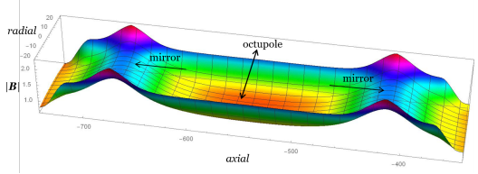
Antihydrogen Laser Physics Apparatus (ALPHA)
Quick recap on talks from
Chukman, Pooja, and Gareth

Slide 4
Cartoon schematic to guide us
DOWN
UP

Slide 5
Assuming gravity acts the same on matter and antimatter
$$φ=μ_{B}B − mgh$$
$$∆φ=−mg∆h$$
$$∆B \sim 4 × {10}^{−4} T$$

Slide 6
Assuming gravity acts the same on matter and antimatter
$$φ=μ_{B}B − mgh$$
$$∆φ=−mg∆h$$
$$∆B \sim 4 × {10}^{−4} T$$

Slide 7
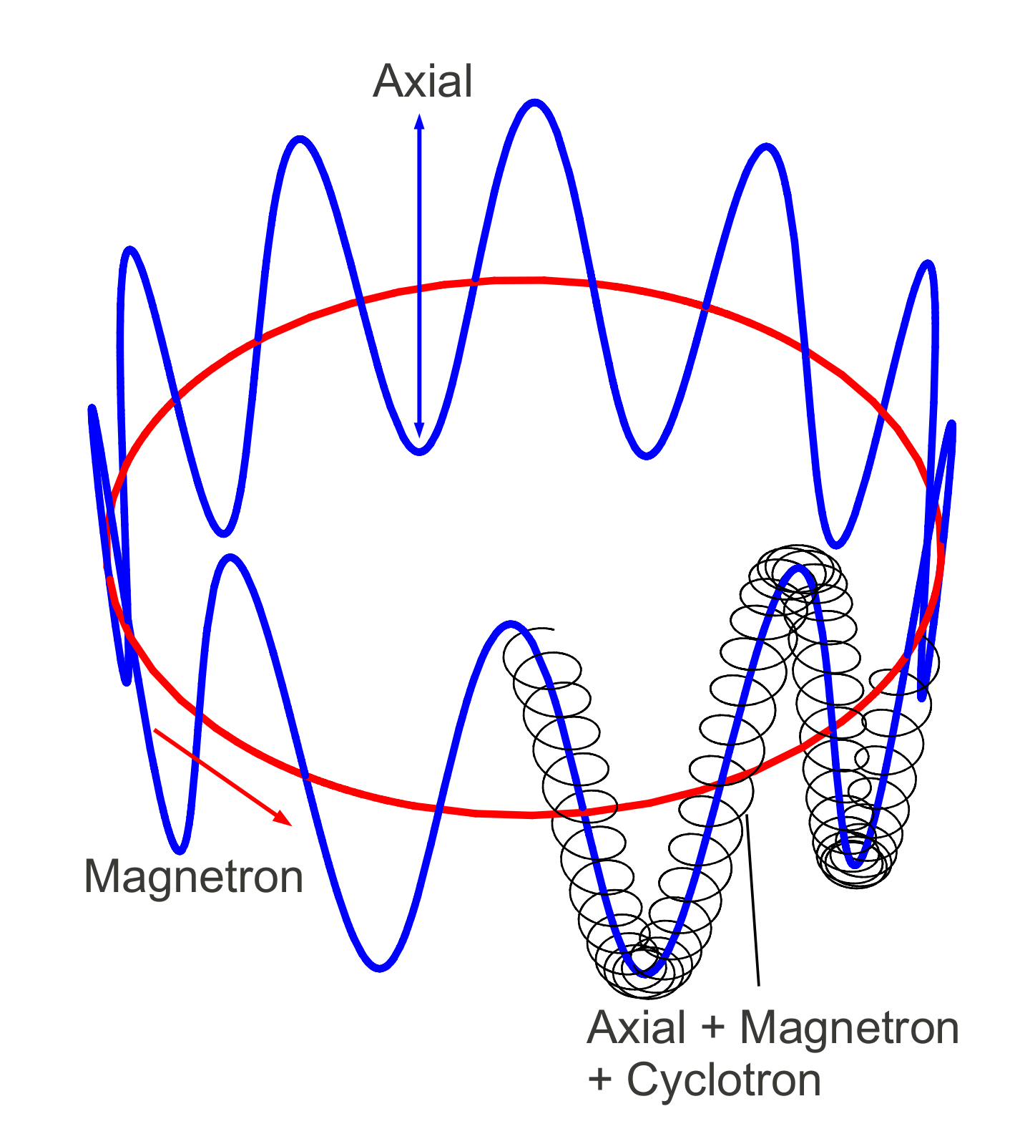
Using cyclotron frequency for magnetometry
$$f_{c}= \frac{q B}{2 π m}$$
$f_{c}$for electrons at $1 T \sim 28$GHz
But…the cyclotron motion isn’t all
that happens in a Penning trap
Axial frequency $\sim$ 10 - 50 MHz
Magnetron frequency $\sim$ 100 - 300 kHz
Image credit: T.Friesen

Slide 8
What is Electron cyclotron resonance magnetometry?

Slide 9
Get an electron plasma
e-

Slide 10
Remove a small “scoop” of electrons
e-

Slide 11
And another
e-

Slide 12
Move to target location
e-

Slide 13
Irradiate with a microwave pulse
e-

Slide 14
Measure temperature of electron “scoops”
e-
Electron Cyclotron Resonance (ECR) Magnetometry with a Plasma Reservoir
E. D. Hunter, A. Christensen, J. Fajans , T. Friesen, E. Kur, and J. S. Wurtele (2019)

Slide 15
An example of ECR spectra
Narrow central peak = $f_{c}$
Precision related to peak width
Broad, asymmetric sidebands from electrons axial frequency

Slide 16
How do you understand the magnetic environment?
What is the background field?
How does the field respond to applied current for each magnet?
Where is the maxima of each magnet?
Are there any uncontrolled fields?
Key point: We are always interested in the differences bottom/top

Slide 17
Field mapping the background magnet
${10}^{−4}$ T = 1 Gauss = 2.8 MHz
17
17
17

Slide 18
Calibrating magnetic field to current applied
${10}^{−4}$ T = 1 Gauss = 2.8 MHz

Slide 19
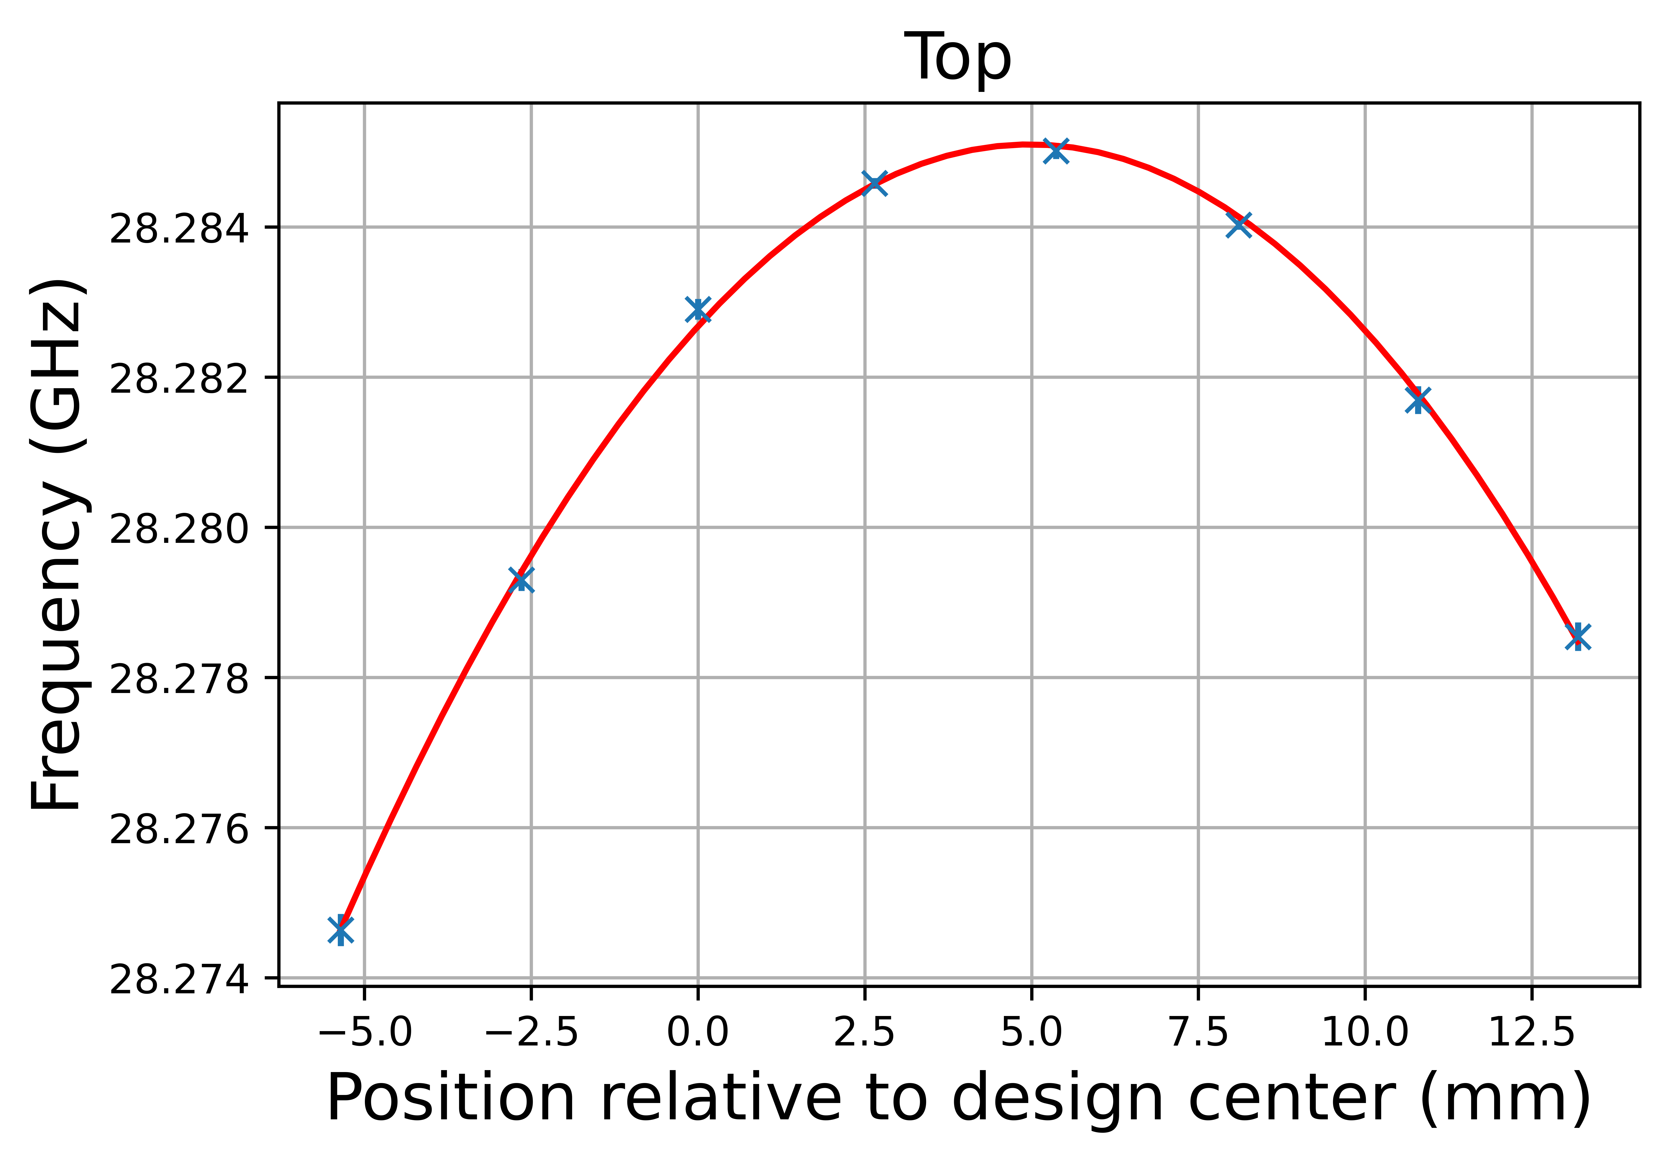
Mapping out the on axis maxima of a solenoid
${10}^{−4}$ T = 1 Gauss = 2.8 MHz

Slide 20
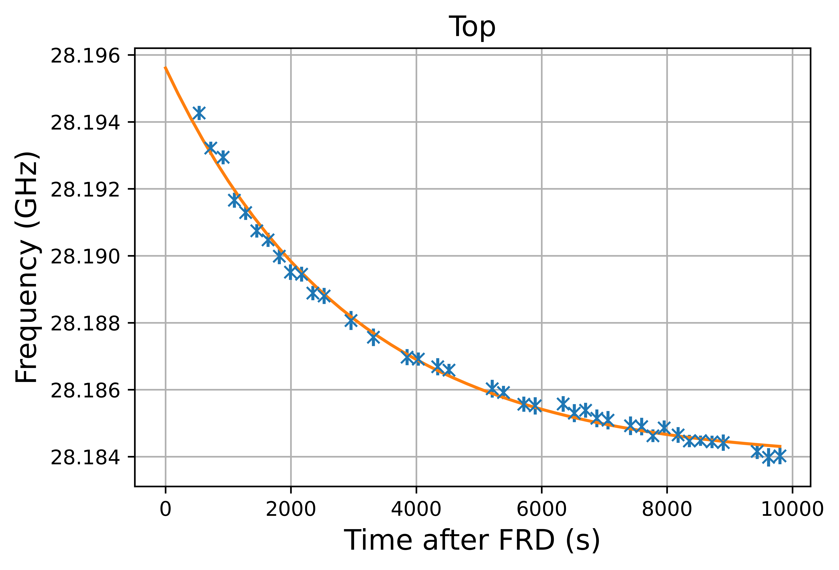
Measure decaying induced fields
${10}^{−4}$ T = 1 Gauss = 2.8 MHz
20
20

Slide 21
Summary
Antihydrogen properties are a powerful test of fundamental theories
ALPHA requires precise magnetic field measurement
In situ magnetometry technique has been developed in ALPHA to reach required precision
We have show precision measurements in:
High fields
High field gradients
Mapping along an axis
Changing fields over time
We are in a great position for an ALPHAg measurement!

Slide 22
Thank you to:

Slide 23
Significant improvements to ECR capabilities
Measure in multiple locations simultaneously
Resolution better than ${10}^{−4}$ T (even in high field gradients of a few ${10}^{−4}$ T/mm)
Stable plasmas for repeatable measurements over months
On axis field mapping with resolution < 1mm
Available range: 0.5 – 1.78 T (14 – 50 GHz)
Low frequency end not tested

