Slide 1
Developing The Detector Array For Energy Measurements Of Neutrons (DAEMON)
60th Winter Nuclear and Particle Physics Conference (WNPPC 2023)
Zarin Ahmed (she/her)
University of Guelph
Notes:
So, Zarin, why build a neutron detector?
The use of radioactive materials has witnessed a substantial growth over time due to the advances in nuclear physics and its applications. Applications ranging from medical (diagnosis and treatment), archaeological (dating and tomography), commercial (sterilizing goods), in fact, and many more. And accordingly, the need to identify and quantify different isotopes as quickly and efficiently as possible can prove to be extremely beneficial to the protection of human lives.

Slide 2
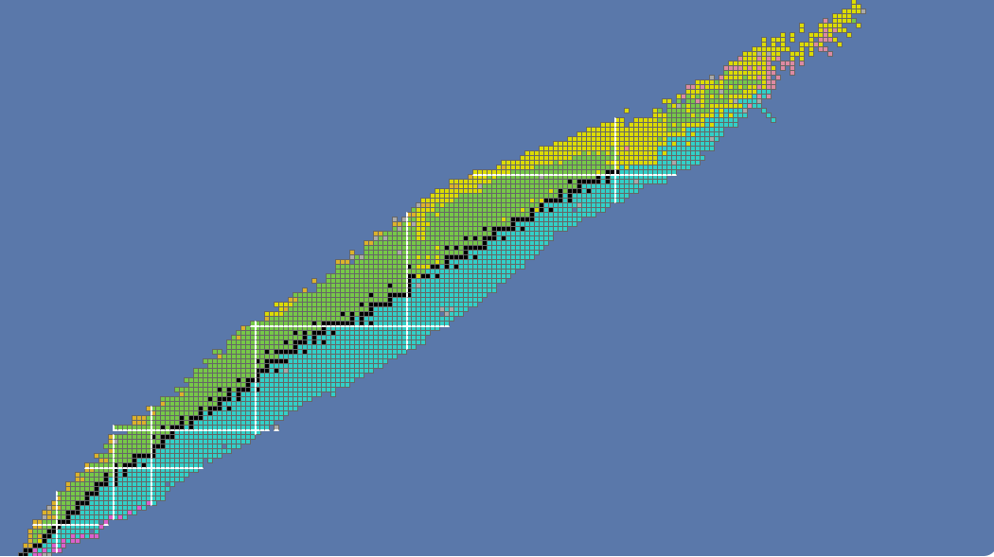
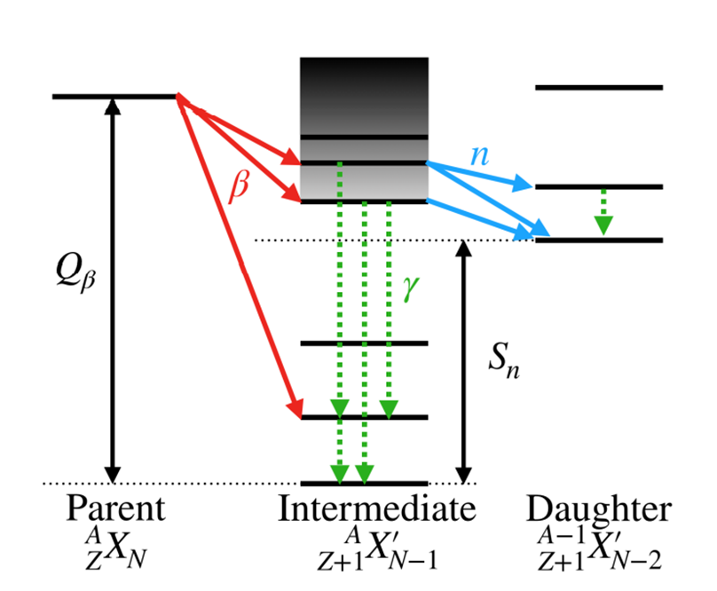
Beta-delayed neutron emission, 𝛽$n$
Can occur directly following β-decay ($n →p+e^{−}+\overline{ν}$) if $Q_{β}> S_{n}$
Detection of emitted neutrons can give valuable information
Neutron emission probabilities
Highly excited states
Neutron energies
Notes:
More to the neutron-rich side
Min energy to separate one neutron decreases
-Bn can follow directly after B-decay if Sn of daughter is below the Q value
-A state populated greater than the Sn in daughter/ parent can de-excite thru gamma or by emitting neutron
-States above Sn in the intermediate nucleus are the particle unbound states that undergo delayed neutron emission
-Depending on the energy of the state, one, two or more neutrons can be emitted.

Slide 3
Why study 𝛽$n$ emission?
Shaping abundance curve for astrophysical r-process
Controlling fission in nuclear reactors
Nuclear structure
Siegel, D. M. (2022). r-Process nucleosynthesis in gravitational-wave and other explosive astrophysical events. Nature Reviews Physics, 4(5), 306-318.
Notes:
R-process -> accounts for half the abundance of elements heavier than iron and follows a path along the n-rich region
Remains an open question to not just nuclear theorists & experimentalists but gravity studies, etc.
Competition between neutron-capture and photo-disintegration
Final abundances determined by combination of beta and beta-n emission
_ discrepancies between observation and theoretical results
Requires experimental inputs to constraint models

Slide 4
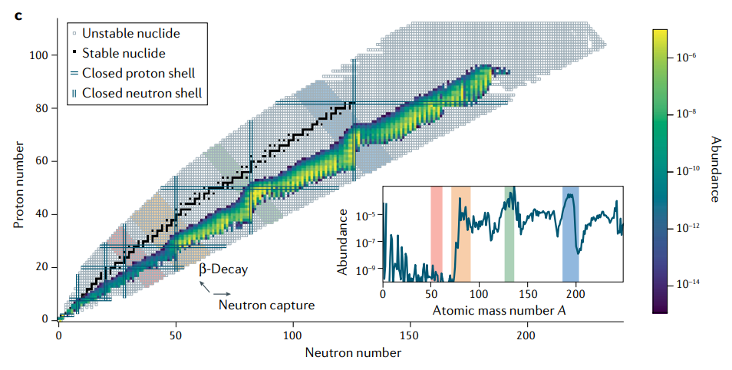
Why study 𝛽$n$ emission?
Shaping abundance curve for astrophysical r-process
Controlling fission in nuclear reactors
Nuclear structure
Siegel, D. M. (2022). r-Process nucleosynthesis in gravitational-wave and other explosive astrophysical events. Nature Reviews Physics, 4(5), 306-318.
Notes:
R-process -> accounts for half the abundance of elements heavier than iron and follows a path along the n-rich region
Remains an open question to not just nuclear theorists & experimentalists but gravity studies, etc.
Competition between neutron-capture and photo-disintegration
Final abundances determined by combination of beta and beta-n emission
_ discrepancies between observation and theoretical results
Requires experimental inputs to constraint models

Slide 5
Time-Of-Flight (TOF) Technique
Measure neutron energies following 𝛽$n$ emission
$E_{n}=\frac{1}{2}mv^{2}=\frac{1}{2}m\frac{d^{2}}{{TOF}^{2}}$
$d,$ known flight path
$TOF=t_{2}−t_{1},$time difference between two detectors
Energy resolution dependent on flight d and $TOF$
Neutron detection
Stop signal
$$t_{2}$$
$$d$$
$$\frac{δE_{n}}{E_{n}}=2\sqrt{{\left(\frac{δt}{TOF}\right)}^{2}+{\left(\frac{δd}{d}\right)}^{2}}$$
$$n$$
$$e^{−}$$
$δd,$ detector thickness $δt,$time resolution of electronics | thin detectors Fast components
Reduced by
Start signal
β detection
$$t_{1}$$
Notes:
Measurement of fast neutrons are typically performed by measuring the their time of flight.
Neutron kinetic energy very simply measured using their time of flight.
Such measurements, however pose significant challenges, (balance between detection efficiency (thick detectors) and energy resolution (thin detectors)
Uncertainty of time-of flight is determined by the timing resolution of the detector components, as well as associated signal processing and DAQ

Slide 6
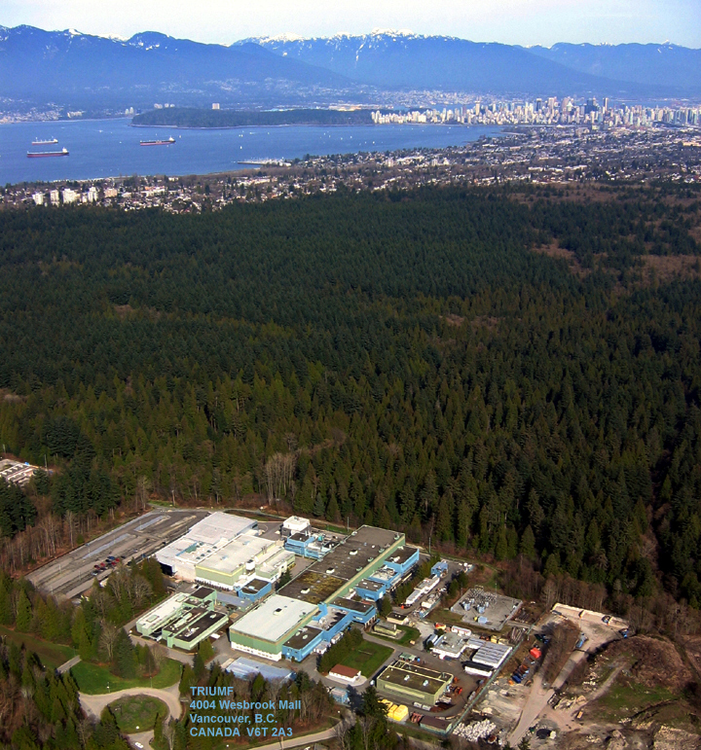
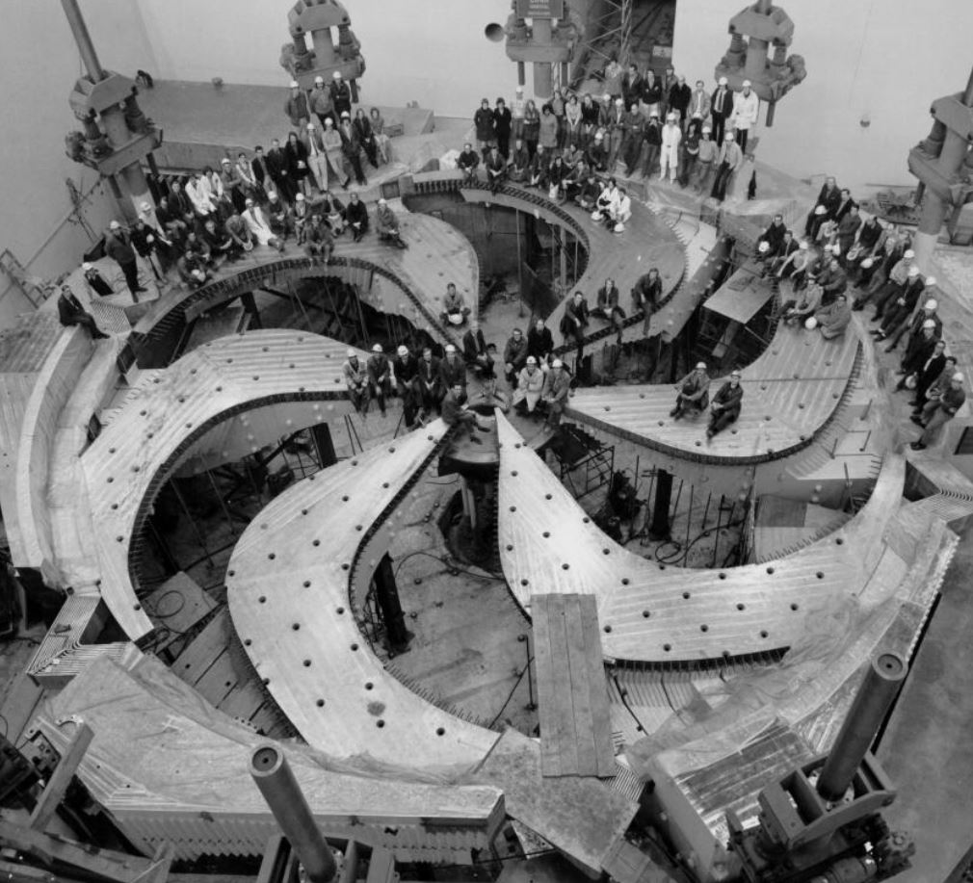
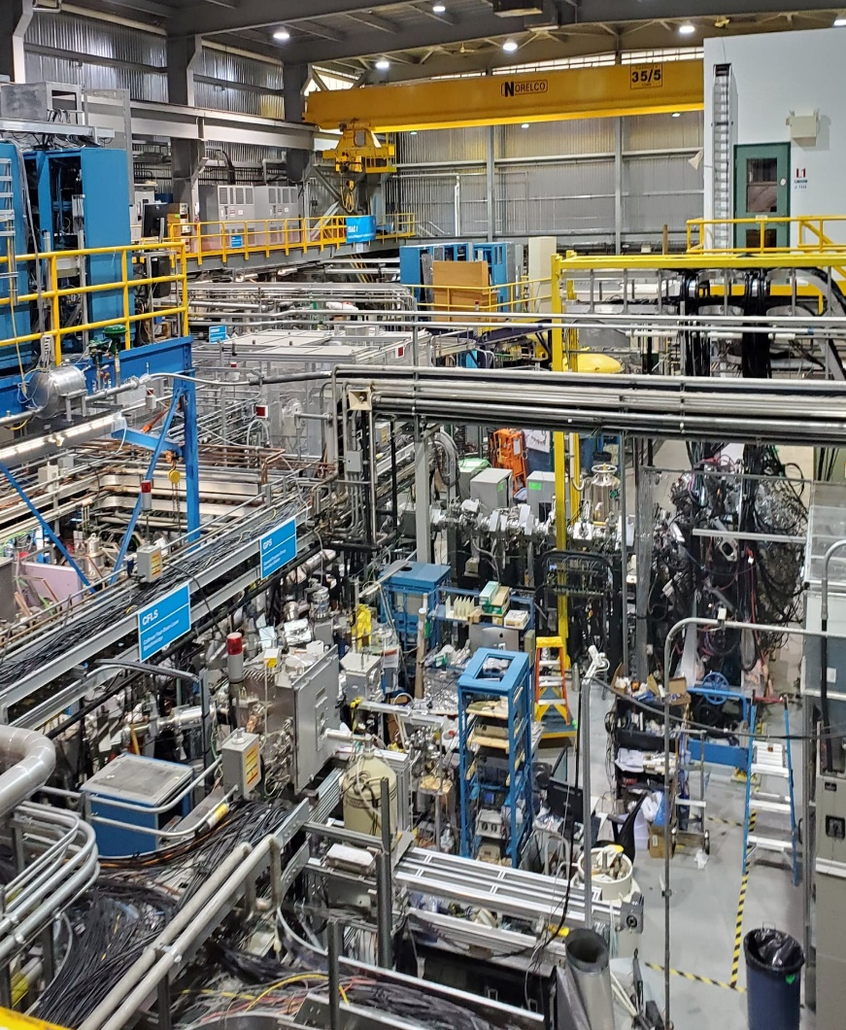
Isotope Separator and Accelerator (ISAC) facility
Decay Station
Vancouver, BC
Notes:
Proposed DAEMON to be used in conjunction with the GRIFFIN Decy station at Our favourite facility TRIUMF to enable high-resolution measurement of the neutrons following beta-decay.

Slide 7
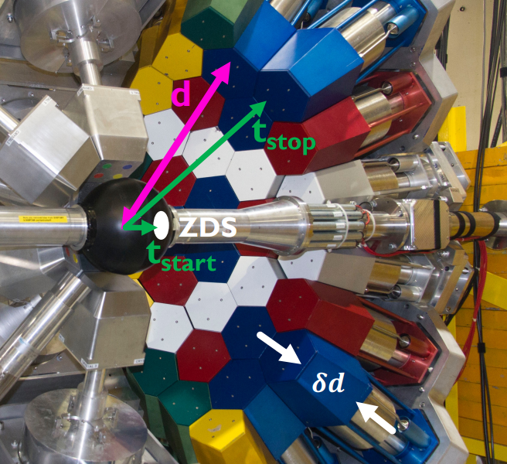
GRIFFIN Decay Station:
High efficiency γ-ray spectrometer
Ancillary detectors:
Zero Degree Scintillator (ZDS)
Deuterated Scintillator Array for Neutron Tagging (DESCANT)
High detection efficiency of neutrons
Poor resolution for measuring neutron energies (15cm scintillator depth)
$$\frac{δE_{n}}{E_{n}}=2\sqrt{{\left(\frac{δt}{TOF}\right)}^{2}+{\left(\frac{δd}{d}\right)}^{2}}$$
Notes:
High-efficiency γ-ray spectrometer for beta-decay experiments.
Which houses a range of ancillary detectors that give GRIFFIN versatile & powerful capabilities well catered to any unique decay experiments.
Madeilines poster –DESCANT
What DESCANT can’t do and therefore Zarin has a job

Slide 8
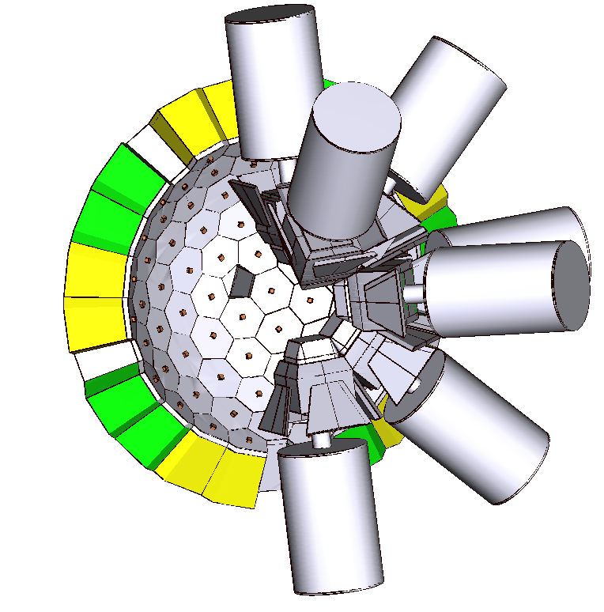
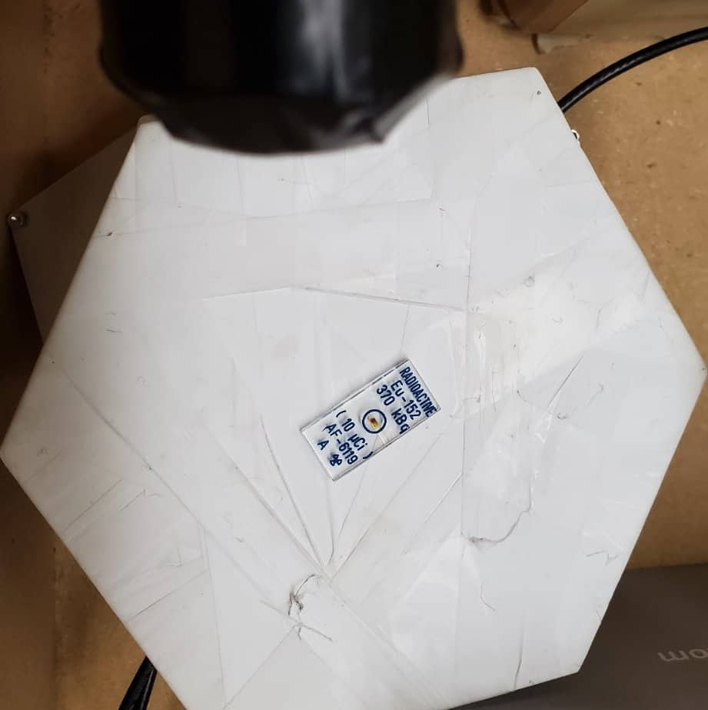
Building a powerful all-in-one capability for broad investigation of neutron-rich species
DAEMON - Detector Array for Energy Measurement of Neutrons
Improved energy resolution ($δd \sim 15cm vs δd \sim 1.5cm$)
Notes:
Initial configuration will be made to fit within DESCANT neutron detectors –semi-spherical approx. 25% solid angle
We are constantly improving GRIFFIN decay stations capabilities – see Druval’s Poster next door beta-proton emissions, etc
For 1MeV neutron, we predicted an energy resolution of about 4% whereas DESCANT TOF has one of 19% because of detector thickness

Slide 9
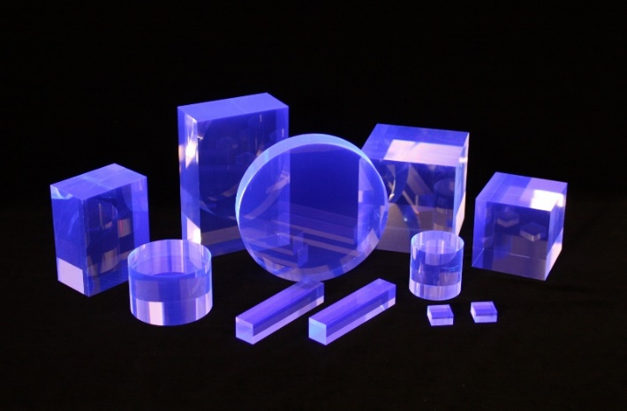
DAEMON Components
PLASTIC SCINTILLATOR
Well-suited for fast-timing measurements
Large light attenuation length (380 cm)
Eljen EJ-200 plastic scintillator
$$1cm×1cm×1cm$$
$$1cm×1cm×6cm$$
$$1. 5cm thick hexagon$$
Notes:
Low Z material for high probability of neutron depositing its full energy
Light output proportional to incident radiation
High Scintillation efficiency and light output
High speed response
Good attenuation length
Can be machined to larger shapes

Slide 10
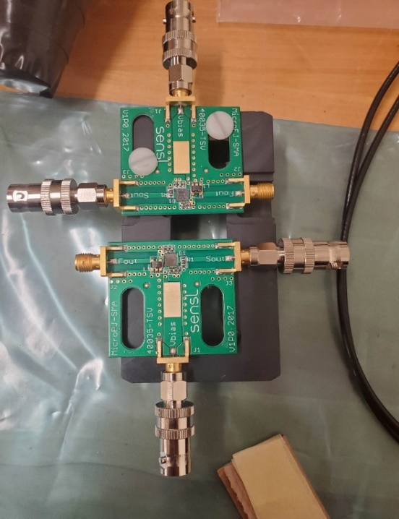
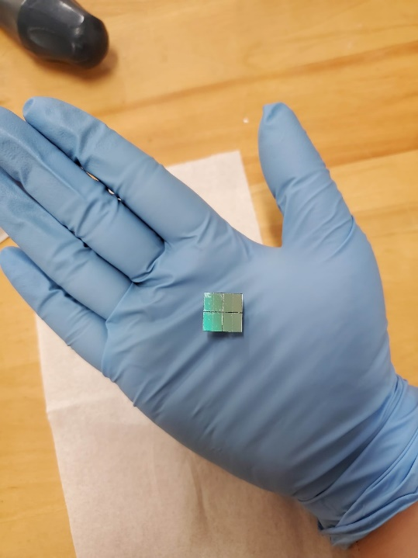
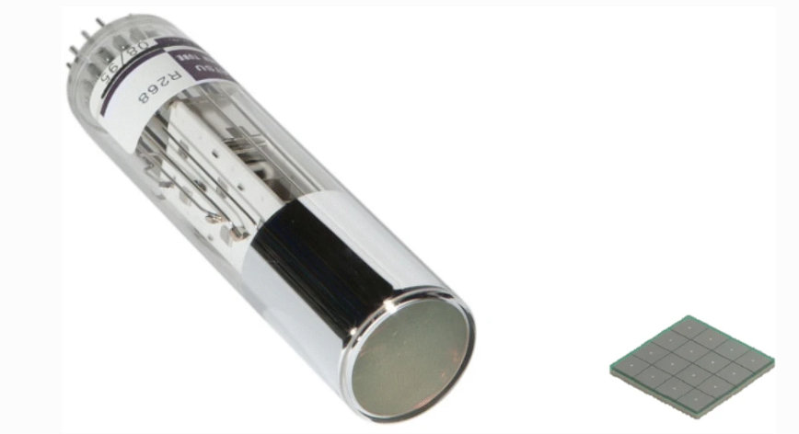
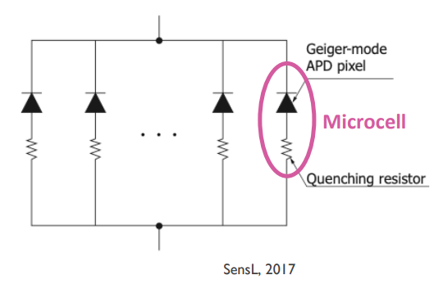
DAEMON Components
Silicon Photomultipliers (SiPM)
Alternative to a photomultiplier tube (PMT)
Robust, cheaper, less bulky, require relatively small bias voltage (25-50V) compared to PMT that requires 1-2 kV
$$4mm×4mm$$
2x2 array of $6mm×6mm$
SCINTILLATION LIGHT COLLECTION
Collected light converted to electrical signal and amplified for processing
Dense array of single photon avalanche diodes (SPAD)
Each microcell operates independently and in Geiger Mode
Photocurrents from all microcells are summed → instantaneous photon flux
Notes:
Identify & acquire potential detector components & investigate timing response for suitability as a TOF neutron detector.
PMTs are considered the standard method of light collection. In radiation, we use them widely to convert weak scintillation light into usable signal pulses. However, PMT require a large bias voltage, can be bulky and are expensive on a per-channel basis.
Geiger mode – large reverse bias is applied such that the silicon breaks down and becomes conductive. Large bias creates electric field. Accelerated charge carriers possess kinetic energy to create secondary carriers (impact ionization) ->Cascade/avalanche of current from the incident photon.
Quenching resister lowering the voltage seen by diode below breakdown voltage. ->rechared & reactivated. (photo triggered switch)

Slide 11
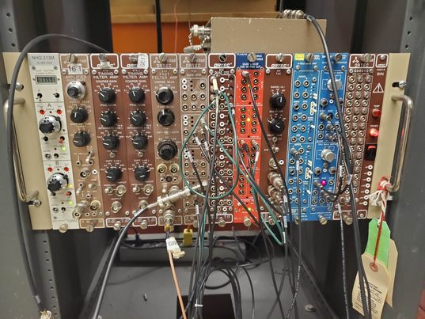
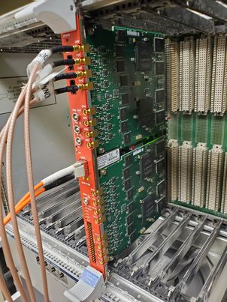
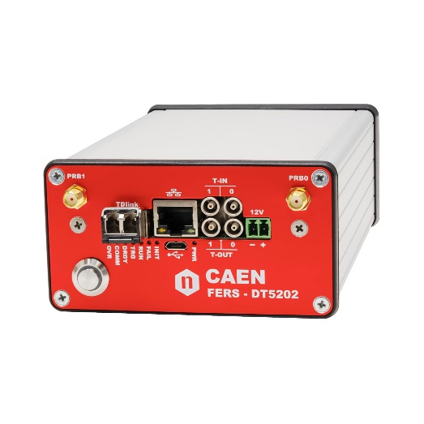
Data Acquisition System (DAQ)
Analog DAQ → To understand SiPM signals
Digital DAQ → Customizable parameters
Generation 1 : CAEN VX1730 digitizer
→ Customizable threshold, pulse polarity, has dynamic range and waveform collection option and event selections
→ Each comes with 16 readout channels
Generation 2: Application-specific integrated circuit (ASIC)
→ Currently under investigation
→ Each comes with 64 readout channels
Notes:
-on small scale with analog signal readout to establish understanding of detector response.
-Digital DAQ allowed for simultaneous time and energy measurements and it allows many customizable parmeters – thresholds, pulse polarity, dynamic range, waveform collection.
Customizable event selection – where we can apply event conditions on energy or time to decrease noise
- And development of various techniques to reduce the noise associated with SiPM readout

Slide 12
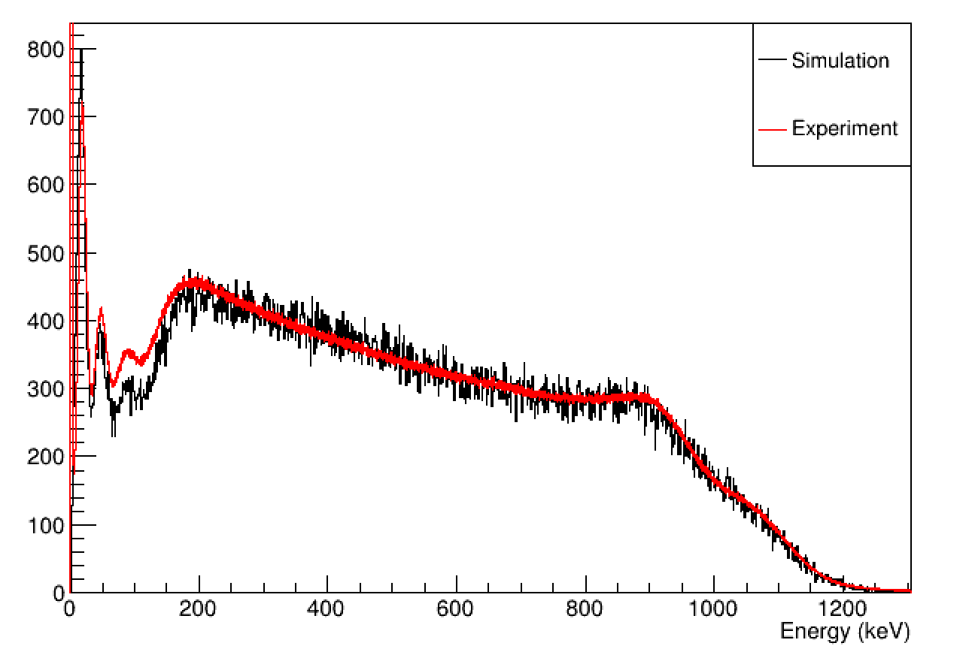
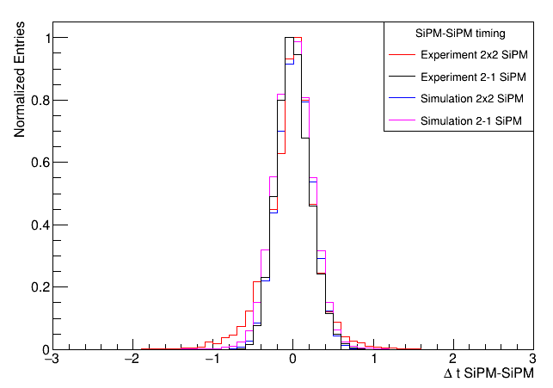
Experimental Comparison
Simulation [Bidaman, H., PhD dissertation in progress] versus experimental data
Ensure Compton edges align
Anomalies in comparison
If simulation for a single unit proves successful, we can confidently make simulations of the whole array
Notes:
Discrepancy between experiment & simulation -> Electronics
Experimental input to constrain simulations

Slide 13
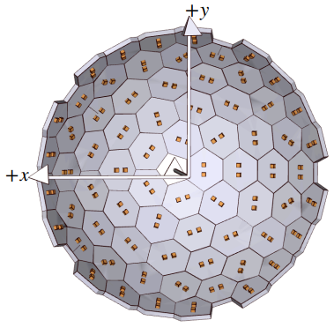
CONCLUSION & NEXT STEPS
CONCLUSION & NEXT STEPS
First work with SiPM’s as scintillation light collectors by UofG NPG (initial timing resolution measurement as low as 339(4) ps for small scale scintillator-SiPM setup) [Radich, A.J., PhD Dissertation]
Intensive complementary investigation of experimental and simulations
On-going & future multi-pixel SiPM and ASIC data acquisition system
No neutrons were hurt in this work (Unfortunately). Tests with monoenergetic neutron beam
Introducing powerful capability at TRIUMF-ISAC enabling high-resolution energy measurement of neutrons via TOF, while simultaneously, with DESCANT providing a high efficiency device to tagging on the neutrons (& unsurpassed γ-ray detection efficiency with GRIFFIN)
First work with SiPM’s as scintillation light collectors by UofG NPG (initial timing resolution measurement as low as 339(4) ps for small scale scintillator-SiPM setup) [Radich, A.J., PhD Dissertation]
Intensive complementary investigation of experiment and simulations
Multi-pixel SiPM and ASIC DAQ
No neutrons were hurt in this work (Unfortunately). Tests with monoenergetic neutron beam
Approved NSERC funding
Notes:
Encouraging results, quite impressive
Used w/ GRIFFIN, DAEMON will establish a frontier of Bn studies currently non-existent at the facility.
Therefore, initiating a road to stronger international collaborations.
From shaping the abundance curve of Astro r-process, and controlling neutron induced fission in nuclear reactors, the building of a neutron detector will address a broad arena of physics.

Slide 14
THANK YOU
University of Guelph
Paul Garrett
Vinzenz Bildstein
Allison Radich
Konstantin Mastakov
Harris Bidaman
TRIUMF
Iris Dillmann
Adam Garnsworthy

Slide 15
BACK-UP SLIDES

Slide 16
Reactor Physics
Requires extensive knowledge of decay properties of fission nuclei, which are particularly neutron-rich.
Improved accuracy of delayed neutron yields
Energy resolution of neutron spectra
Additional neutron induced fission can occur from some neutron-rich fission products undergoing 𝛽$n$emission.
Current experimental libraries lack delayed neutron data which are needed for determining decay heat emitted by fission products via 𝛽 or γ-rays (half-lives, 𝛽$n$ abundances & neutron emission probabilities)
Experimental work at RIB facilities is anticipated to provide data on neutron-rich isotopes that can improve reactor calculations leading to improved design, safety & sustainability.
Notes:
Some neutron-rich fission products may undergo beta-delayed neutron emission

Slide 17
$β$-decay strength function & neutron-rich nuclei
$$T_{1/2}^{−1}= \sum_{E_{i}≥Q_{β}}^{E_{i}≤Q_{β}}{S_{β}\left(E_{i}\right)}×f(Z,Q_{β}−E_{i})$$
Gamow-Teller (GT) transitions dominate $β$ strength distribution $S_{β}(E_{i})$ for neutron-rich nuclei
$B(GT)$ within $Q_{β}$ value has direct influence of $β$ decay half-life
Theoretical models have high success in $B(GT)$ calculations in limited areas
Neutron spectroscopy will allow deriving $B(GT)$ for neutron-unbound states
Evidence of single-particle states influencing $B(GT)$ (M. Madurga et al. 2016)
Notes:
Large-scale shell model calculations have successfully reproduced the GT response in the p, sd, and pf shell nuclei, but have been of limited success elsewhere.
At higher masses->valence space for nucleons can be quite large.
Larger the space ->complicated/longer calculations become, eventually impossible.
Theoretical predictions of many of these nuclei become unreliable.
Need exp data to continue to truncate the valence space and verify predictions.
Results show sensitivity of the influence of single-particle states on B(GT) above Sn

Slide 18
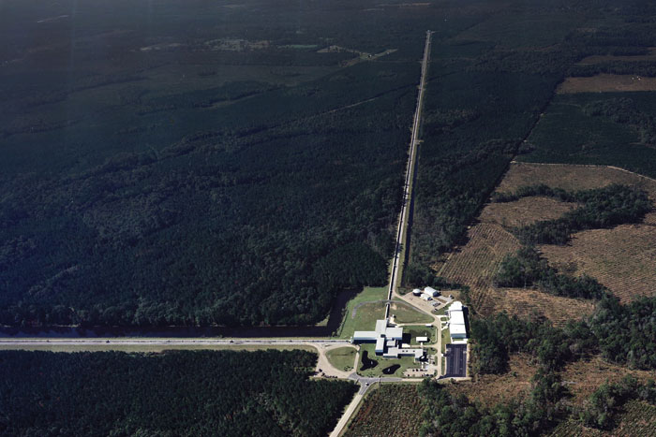
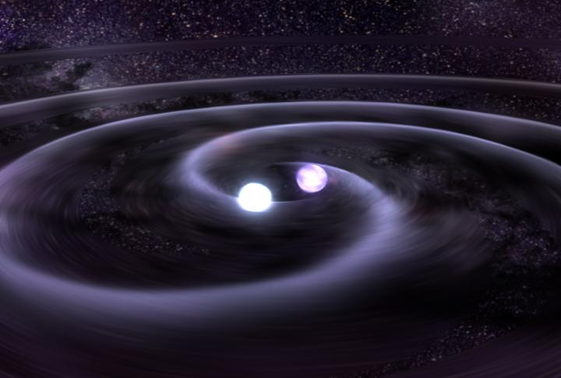
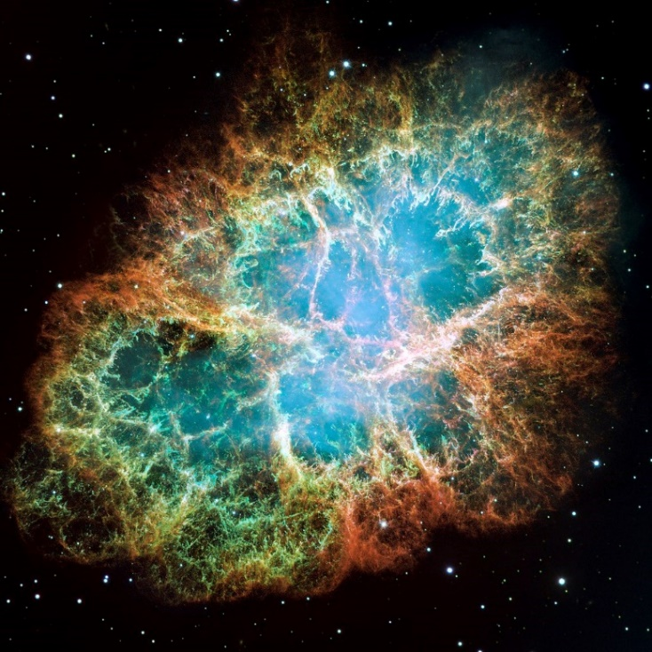
GW170817 – observation of first neutron star merger (2015)
2017 Nobel Prize in Physics
GMS: Neutron Star Merge (nasa.gov)
Credit: LIGO
HubbleSite: NASA, ESA, J. Hester and A. Loll (ASU)
Notes:
R-process thought to account for approx. one half the abundance of elements heavier than iron
Sites home to r-process neutron star supernova
Fully understanding the r-process is a challenmergers, core-collapse ge
Need knowledge of nuclear mass, neutron capture rates, Bn emission probabilitities etc
Sites home to r-process neutron star mergers, core-collapse supernova
Models reproducing solar abundances lack sig amount of data or neutron rich nuclei
NIKAS, STYLIANOS & Kankainen, Anu & Beliuskina, Olga & Nesterenko, Dmitrii. (2022). Impact of nuclear mass measurements in the vicinity of 132Sn on the r-process nucleosynthesis. HNPS Advances in Nuclear Physics. 28. 86-92. 10.12681/hnps.3605.

Slide 19
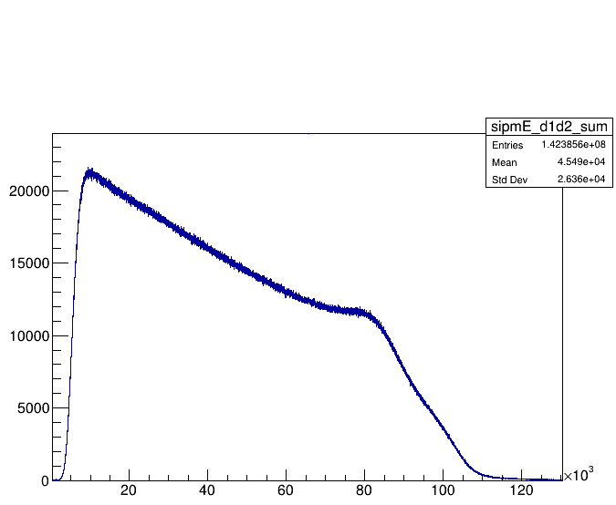
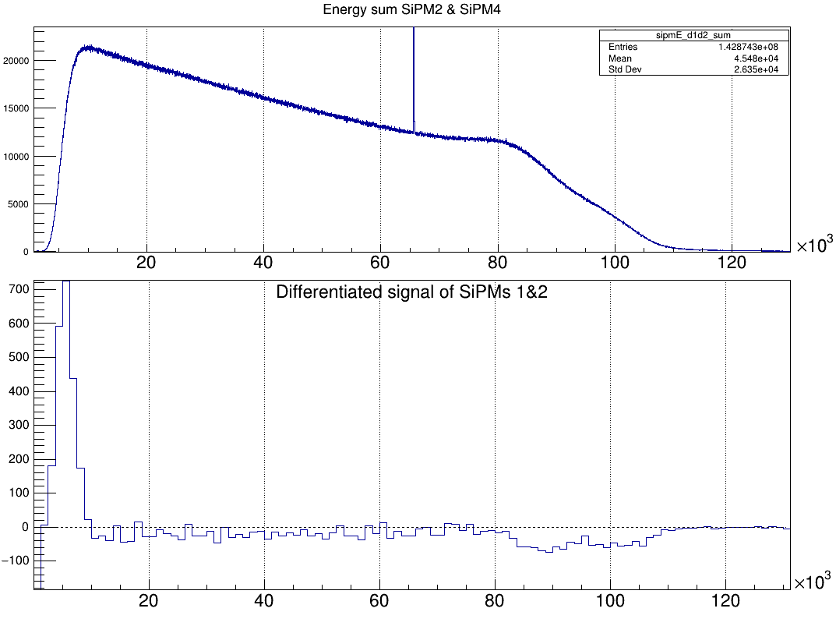
DAEMON Experimental Testing
Single SiPM with analog and digital DAQ (Radich, A.J., Phd Dissertation)
2x2 SiPM array
ZDS-SiPM Coincidence Timing Resolution
SiPM Energy Measures – γ sources
Energy calibration with γ sources
Low energy threshold measurement
Summing at software & hardware level

Slide 20
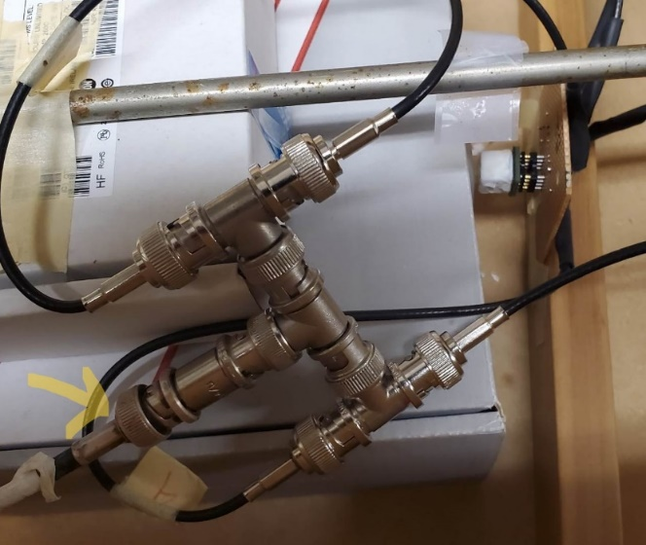
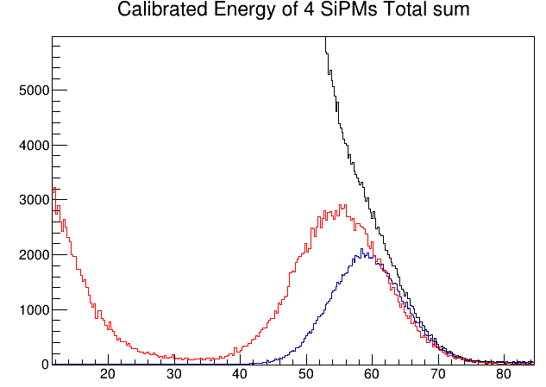
Threshold Tests
“Poor man’s summing” at hardware level
Reduced noise/event rate allowed to go low threshold settings
Reduces cost of electronic channels by a factor of 4
Impedance mismatch – need to test on industrial summing boards

Slide 21
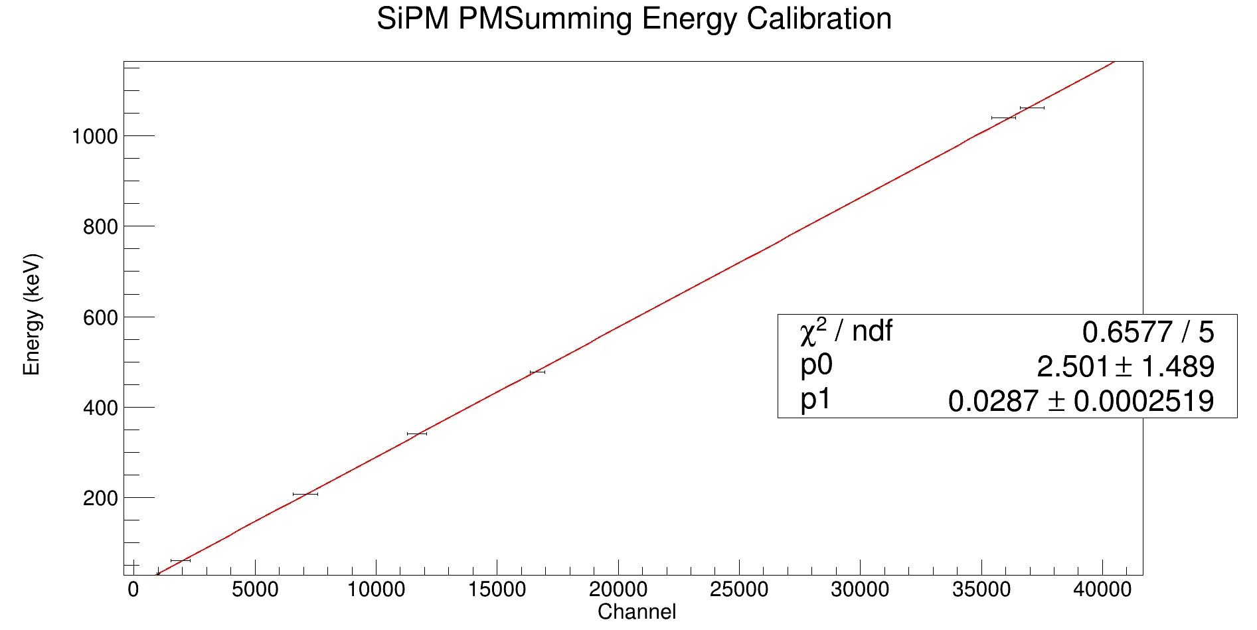
“Poor-man’s summing” Calibration

Slide 22
$$4mm×4mm$$
2x2 array of $6mm×6mm$
Gain | $$\sim 1×{10}^{6}$$ | $$>1×{10}^{6}$$
“Efficiency” | ~25% QE | ~25-50% PDE
Bias voltage | 1 – 2 kV | 25 - 50 V
Rise time | 0.7 ns | 0.09 – 0.11 ns
Notes:
Delta T is the uncertainty in the time-of-flight, T, of the neutron and delta L is the uncertainty in the neutron flight-path length.
Therefore, the energy resolution is directly related to the timing resolution of the detection system and the precision in the measurement of the path length. The latter is mainly due to the uncertainty in the determination of the interaction point within the detector.

Slide 23
Detector Array for Energy Measurements of Neutrons (DAEMON)
EJ200 plastic scintillators (various geometries under test)
Has a proven fast time response
Can be machined into complex shapes
+
SiPMs –Silicon Photomultipliers (various arrays under testing)
Compact, inexpensive, requires low bias voltage
$$4mm×4mm$$
2x2 array of $6mm×6mm$
Zero Degree Scintillator (ZDS)
1 mm plastic scintillator (BC422Q)
+
photomultiplier assembly (Hamamatsu H6533)
$$1cm×1cm×1cm$$
$$1cm×1cm×6cm$$
$$1. 5cm thick hexagon$$
Notes:
Delta T is the uncertainty in the time-of-flight, T, of the neutron and delta L is the uncertainty in the neutron flight-path length.
Therefore, the energy resolution is directly related to the timing resolution of the detection system and the precision in the measurement of the path length. The latter is mainly due to the uncertainty in the determination of the interaction point within the detector.

Slide 24
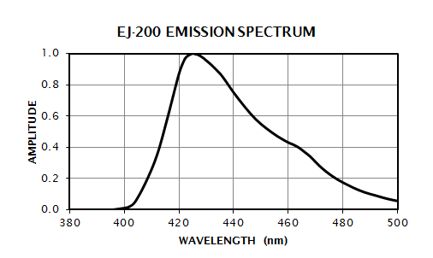
Eljen EJ-200 plastic scintillator
Scintillation emission wavelengths in the violet-indigo visible region
Well-suited for fast-timing measurements
Sensitive to X-rays, γ rays, charged particles and fast neutrons
Can be machined to different shapes and sizes
Large light attenuation length (380 cm)
For critical operating requirements such as high sensitivity and signal uniformity
Notes:
SiPM – sensitive to 420nm range as well. Visible photons , multipled in our SiPM , converted to voltage, signal converted to energy

Slide 25
Rapid Neutron-Capture Process
Notes:
By NASA, ESA, J. Hester and A. Loll (Arizona State University) – HubbleSite
NIKAS, STYLIANOS & Kankainen, Anu & Beliuskina, Olga & Nesterenko, Dmitrii. (2022). Impact of nuclear mass measurements in the vicinity of 132Sn on the r-process nucleosynthesis. HNPS Advances in Nuclear Physics. 28. 86-92. 10.12681/hnps.3605.

Slide 26
Data Acquisition System (DAQ)
Analog DAQ → To understand SiPM signals
Digital DAQ → Customizable parameters
Option 1 : CAEN VX1730 digitizer
→ Customizable threshold, pulse polarity, has dynamic range and waveform collection option
→ Each comes with 16 readout channels
Option 2: Application-specific integrated circuit (ASIC)
→ Currently under investigation
→ Each comes with 64 readout channels

