Slide 1
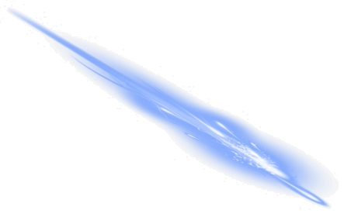

Laser Calibration Studies Using the ALPHA-g Detector
Pooja Woosaree
WNPPC 2023
18.02.2023

Slide 2
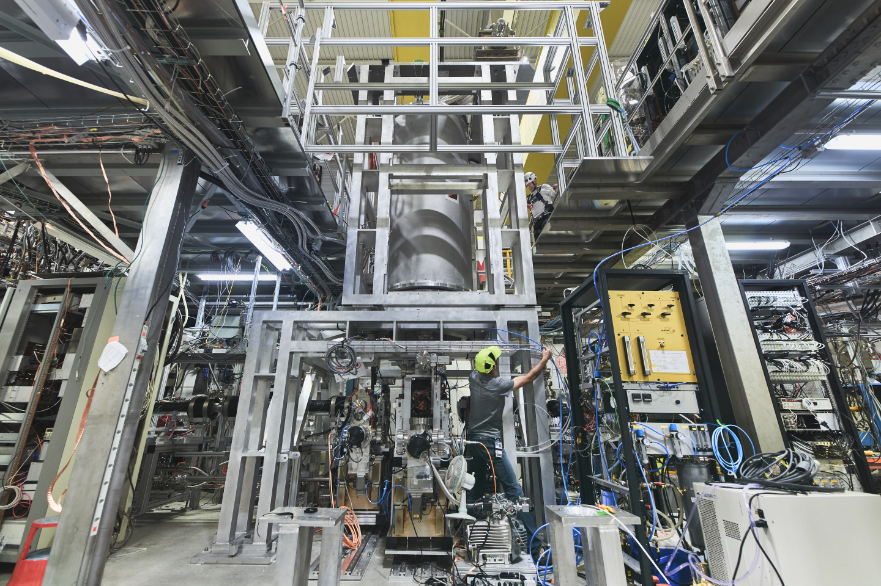
Outline
Weak Equivalence Principle
The ALPHA-g Apparatus
    radial Time Projection Chamber
Laser Calibration
    System
    Results
    Outlook
<number>

Slide 3
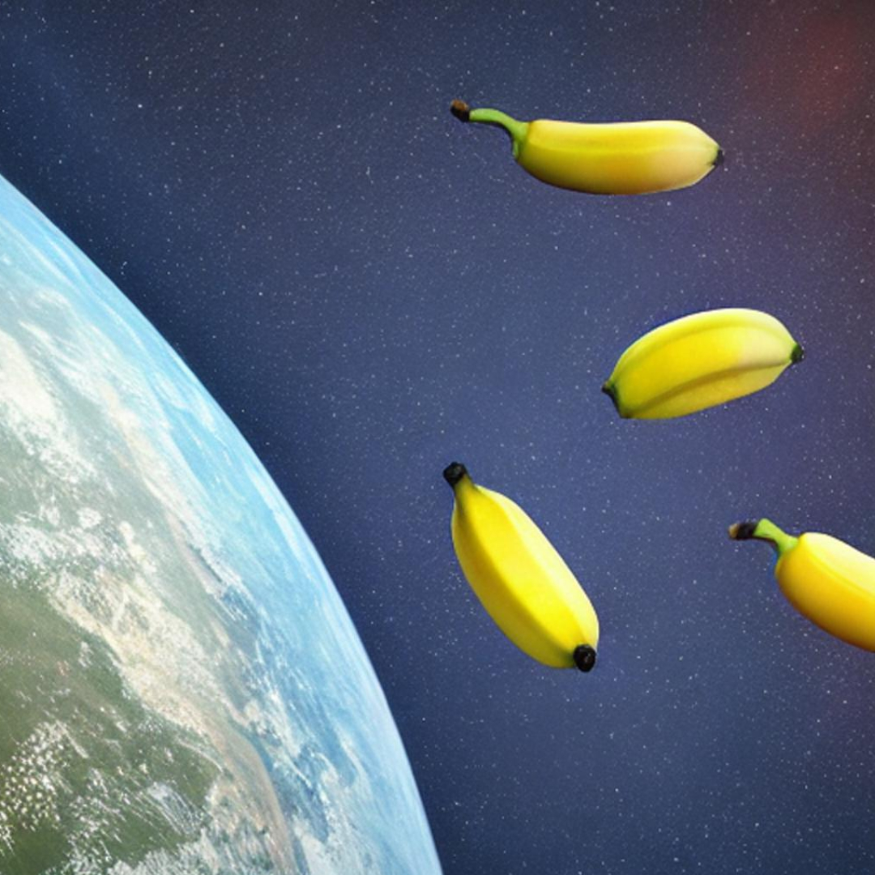
Einstein’s Weak Equivalence Principle
The acceleration due to gravity that a body experiences is independent of its structure or composition
<number>

Slide 4
Let’s skip the part where I explain how we make antihydrogen…
<number>

Slide 5
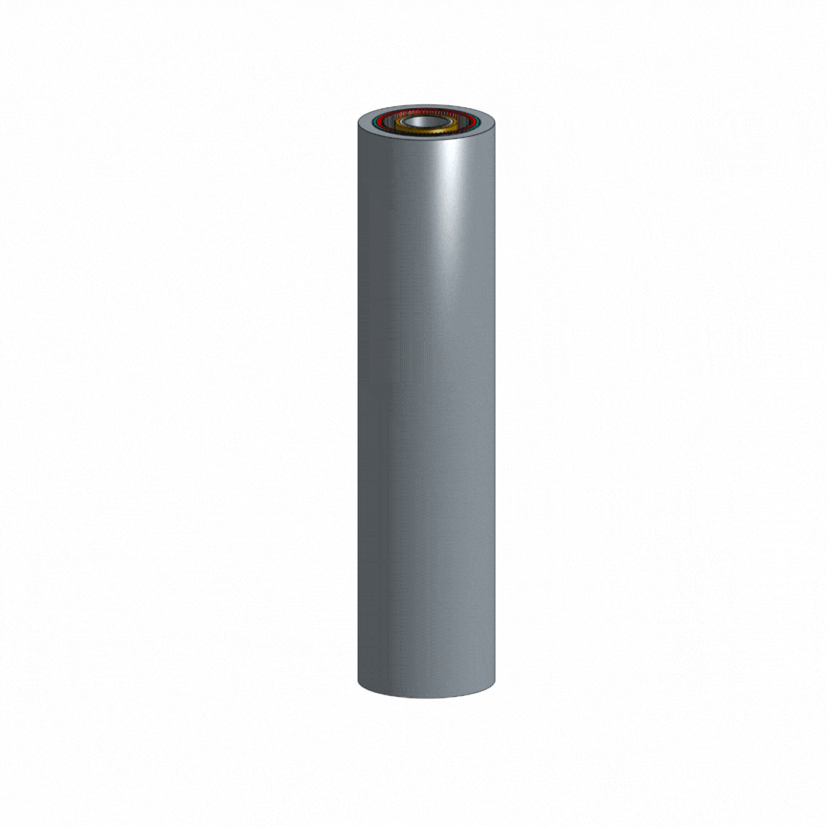
**Images are not to scale. Parts of the apparatus have been greatly exaggerated for clarity.
<number>

Slide 6
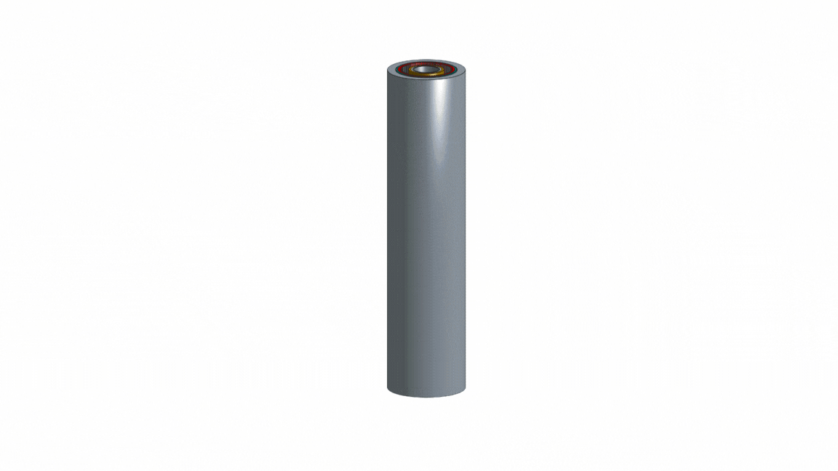
**Images are not to scale. Parts of the apparatus have been greatly exaggerated for clarity.
<number>

Slide 7
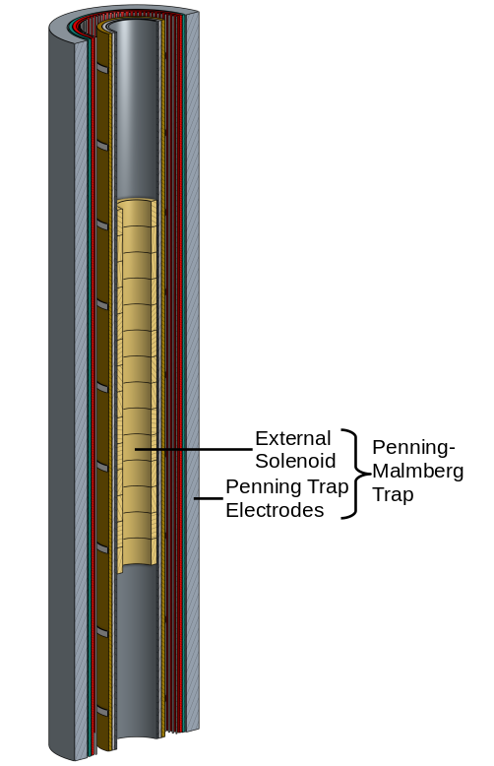
“Magnetic Fields During Gravitational Experiments with Antihydrogen”
Adam Powell at 9:45AM
**Images are not to scale. Parts of the apparatus have been greatly exaggerated for clarity.
<number>

Slide 8
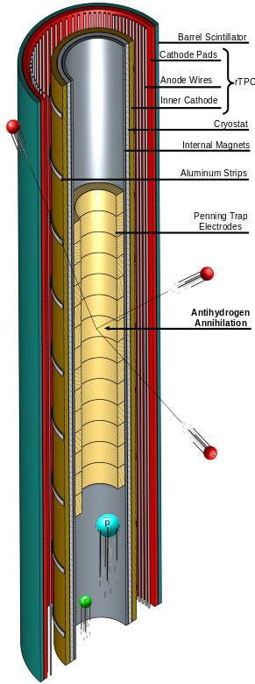
“Anti-hydrogen Detection and Background Rejection for ALPHA-g”
Gareth Smith at 9:30AM
**Images are not to scale. Parts of the apparatus have been greatly exaggerated for clarity.
<number>

Slide 9
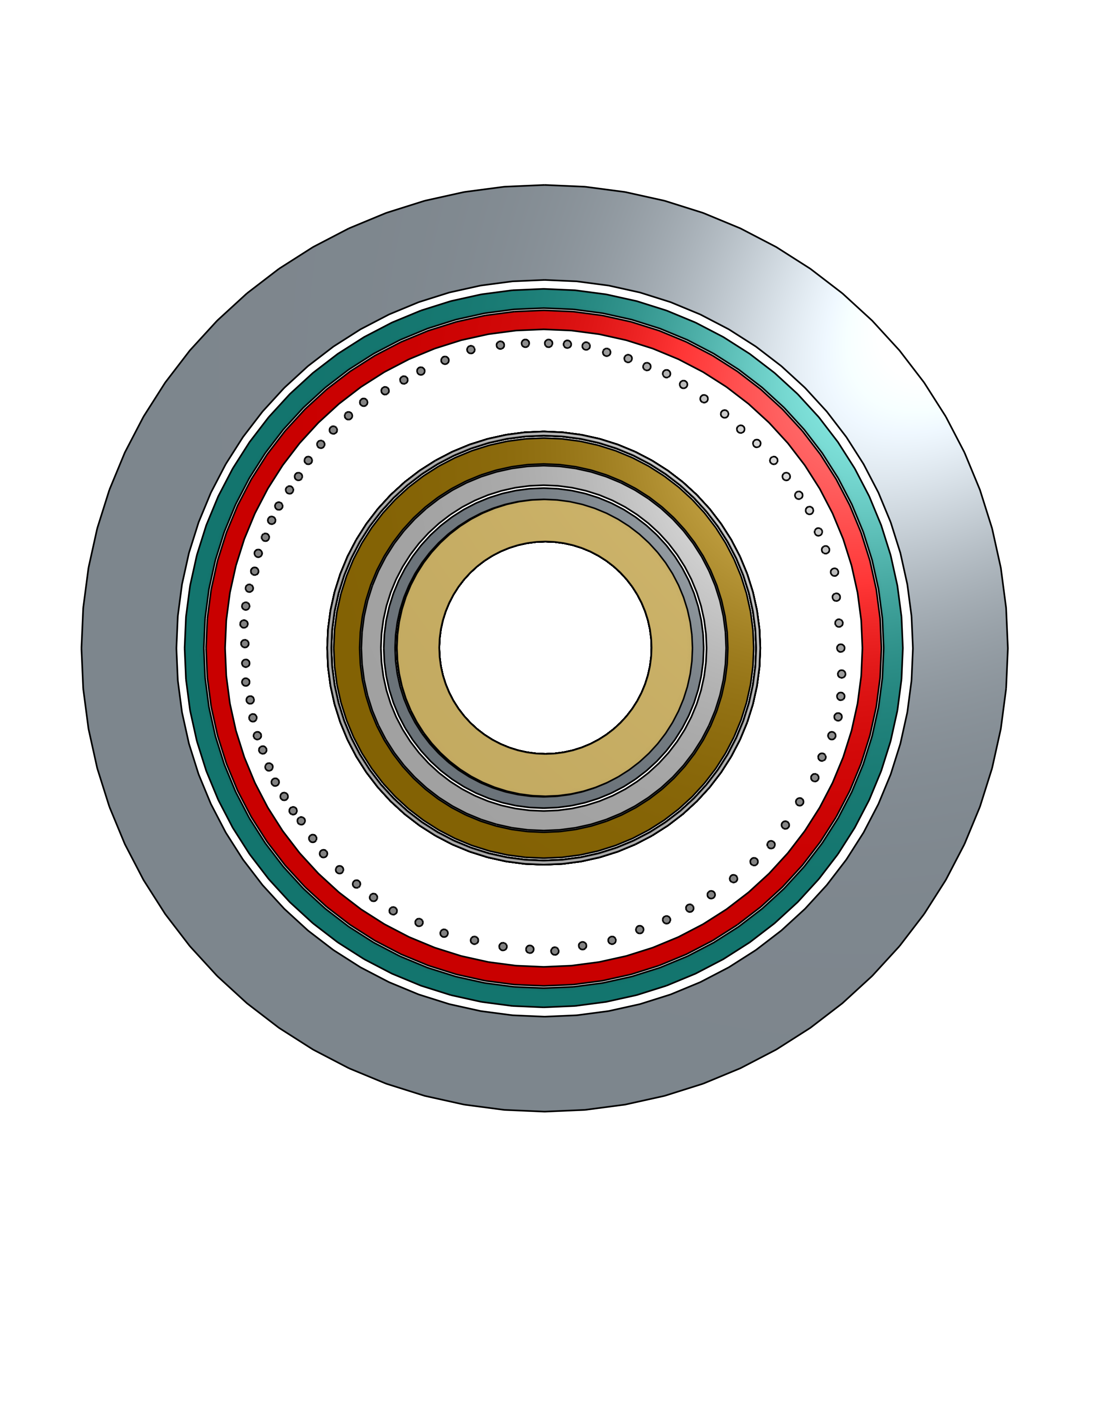
The radial Time Projection Chamber
**Bottom view of ALPHA-g apparatus, not to scale
Pion track
Antihydrogen annihilation
Pion track
Pion track
<number>

Slide 10
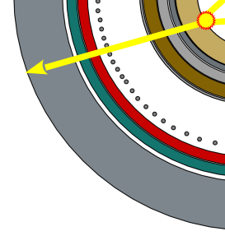
The radial Time Projection Chamber
**Bottom view of ALPHA-g apparatus, not to scale
pion track
Electron tracks
Electron drift time is necessary to reconstruct the pion track
Anode wires
Cathode pads
<number>

Slide 11
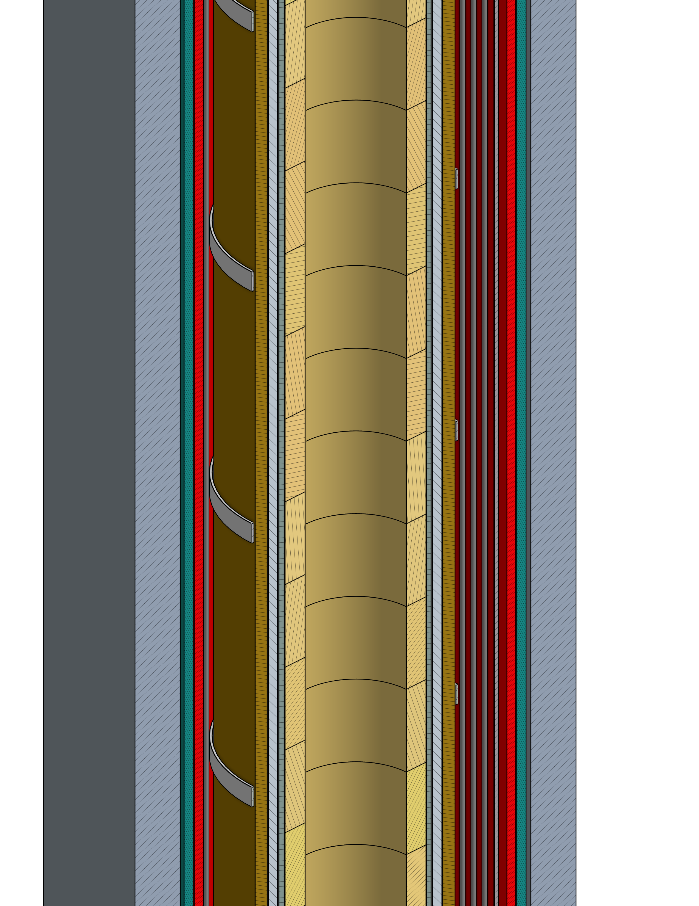
The radial Time Projection Chamber
Timing and position information are critical to the gravity measurement
Antihydrogen annihilation
**side cross section of ALPHA-g apparatus, not to scale
pion track
Electron tracks
Cathode pads – z information and timing information
Anode wires – timing information
<number>

Slide 12
Laser Calibration
Purpose
To understand the detector response in tracking particles in a non-uniform magnetic field
Key observable: drift time
Factors that affect particle drift:
  Pressure
  Temperature
  Gas mixture
  Magnetic field
<number>

Slide 13
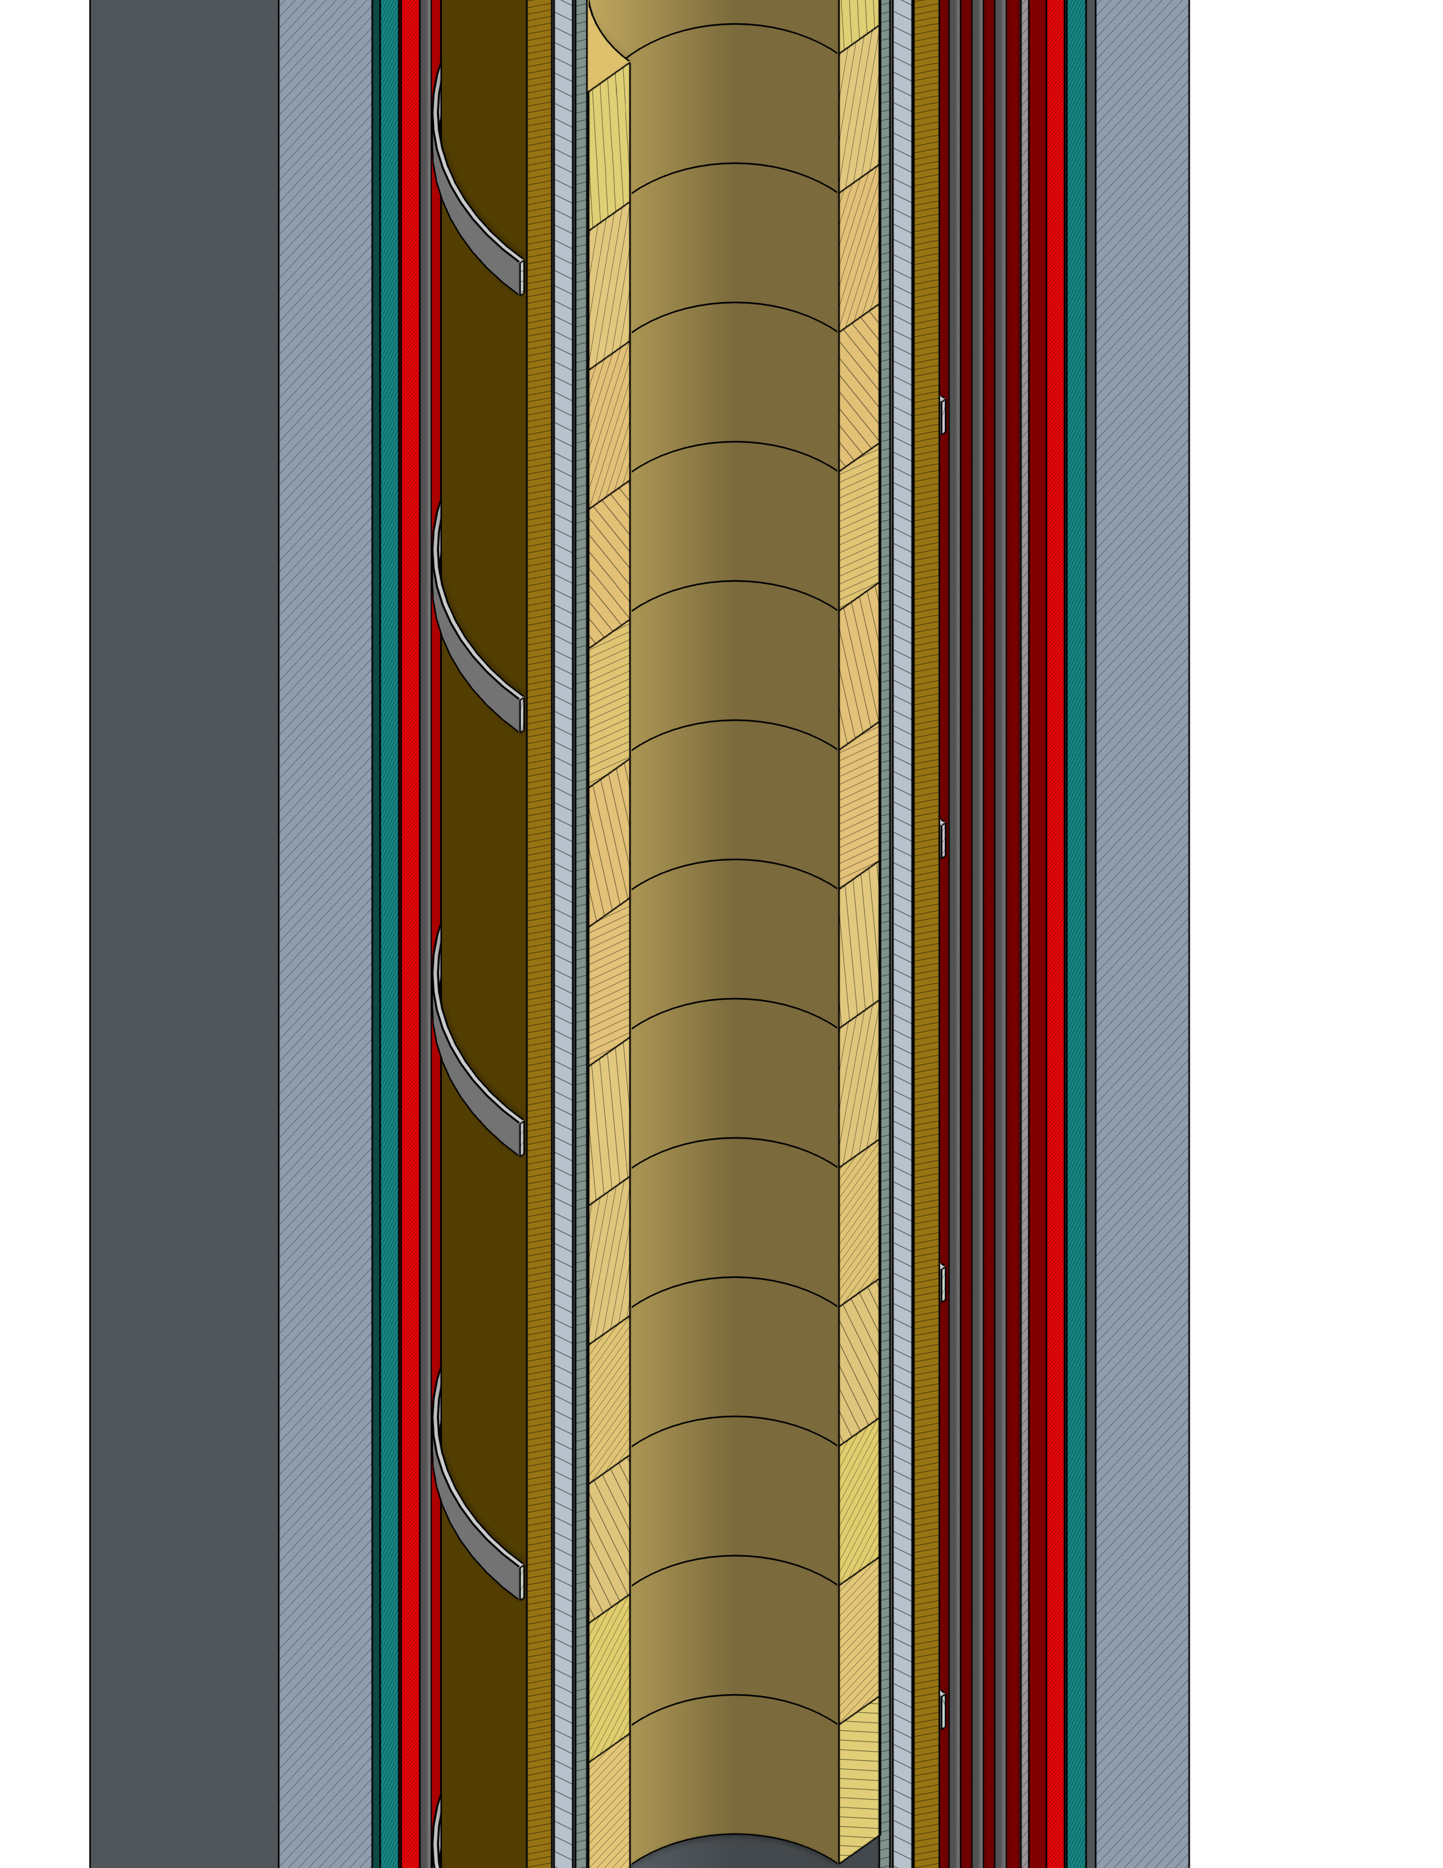
Laser Calibration
Technique
Laser type: Nd:YAG
Laser pulsed beam: 50 Hz
Wavelength: 266 nm
Energy operated: < 0.1mJ
Al strip width: 6 mm
**Images are not to scale. Parts of the apparatus have been greatly exaggerated for clarity.
<number>

Slide 14
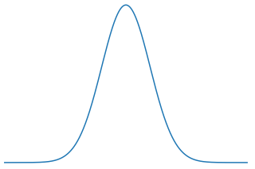
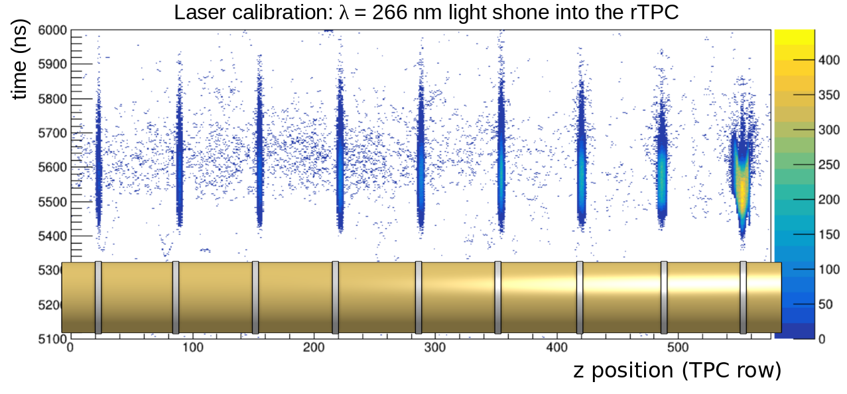
Laser Calibration
Proof of Concept
<number>
**Images are not to scale.

Slide 15
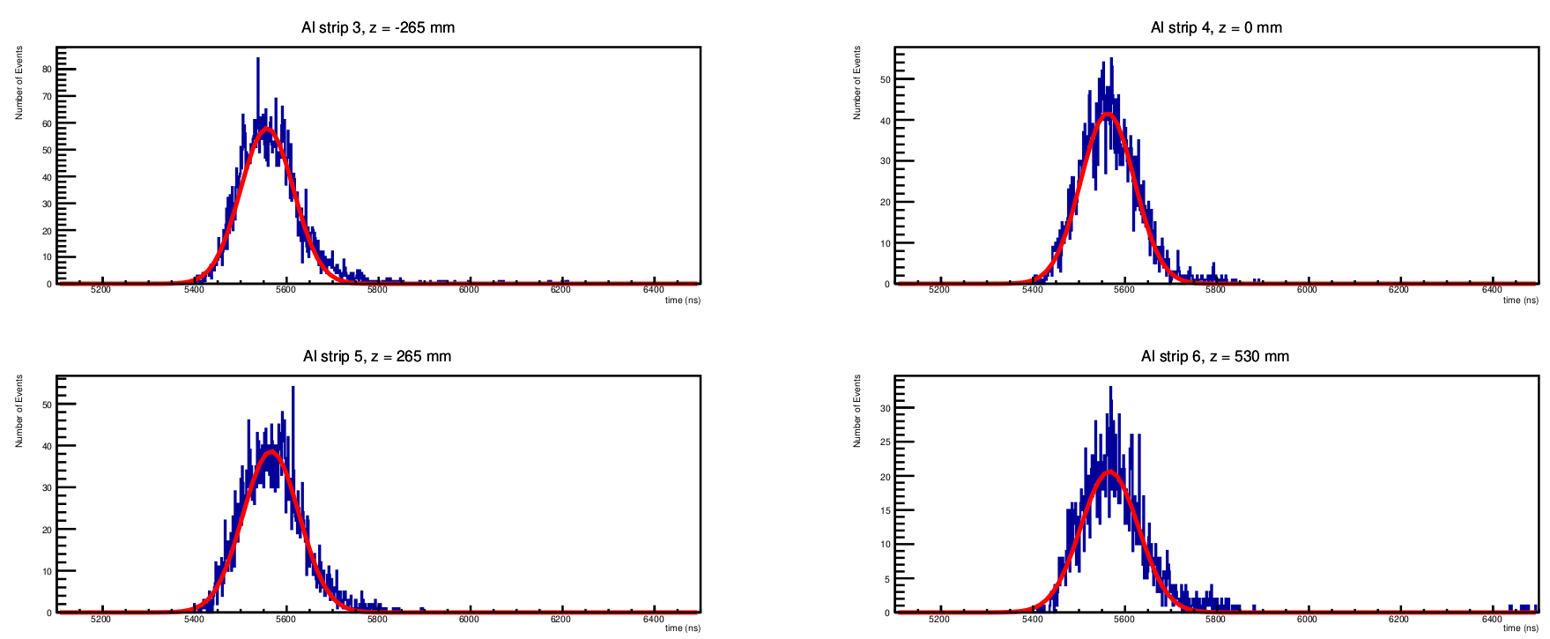
Laser Calibration
Proof of Concept
Number of Events
Time [ns]
<number>

Slide 16
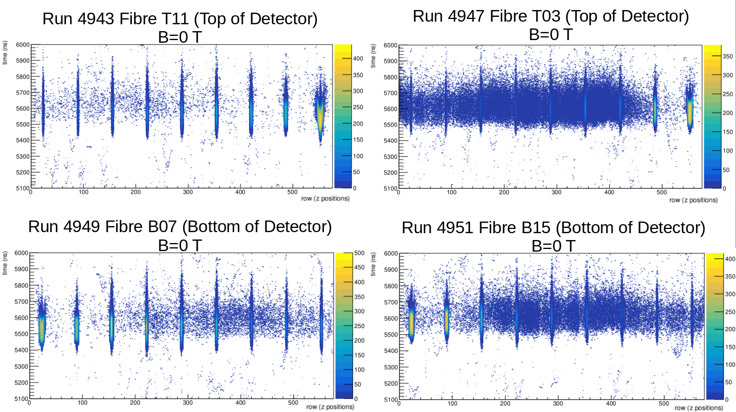
<number>

Slide 17
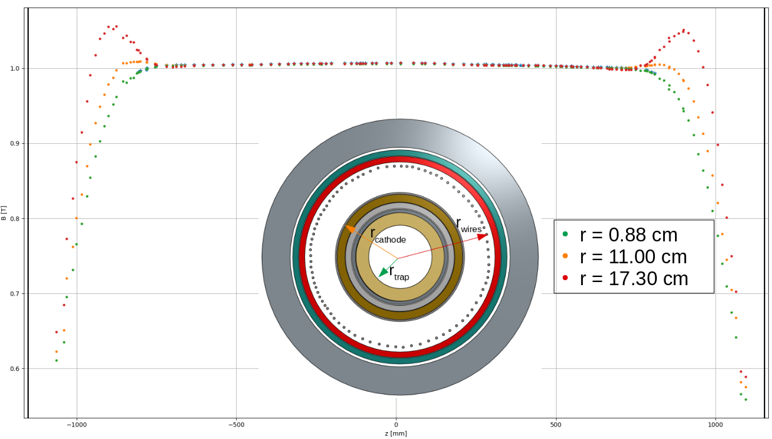
Magnetic field B [T]
Z position [mm]
<number>

Slide 18
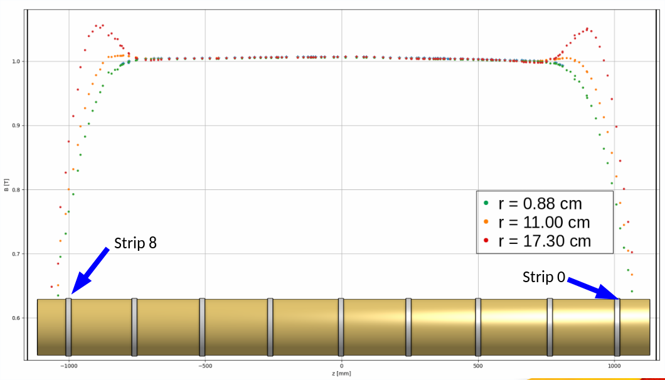
Magnetic field B [T]
Z position [mm]
<number>

Slide 19
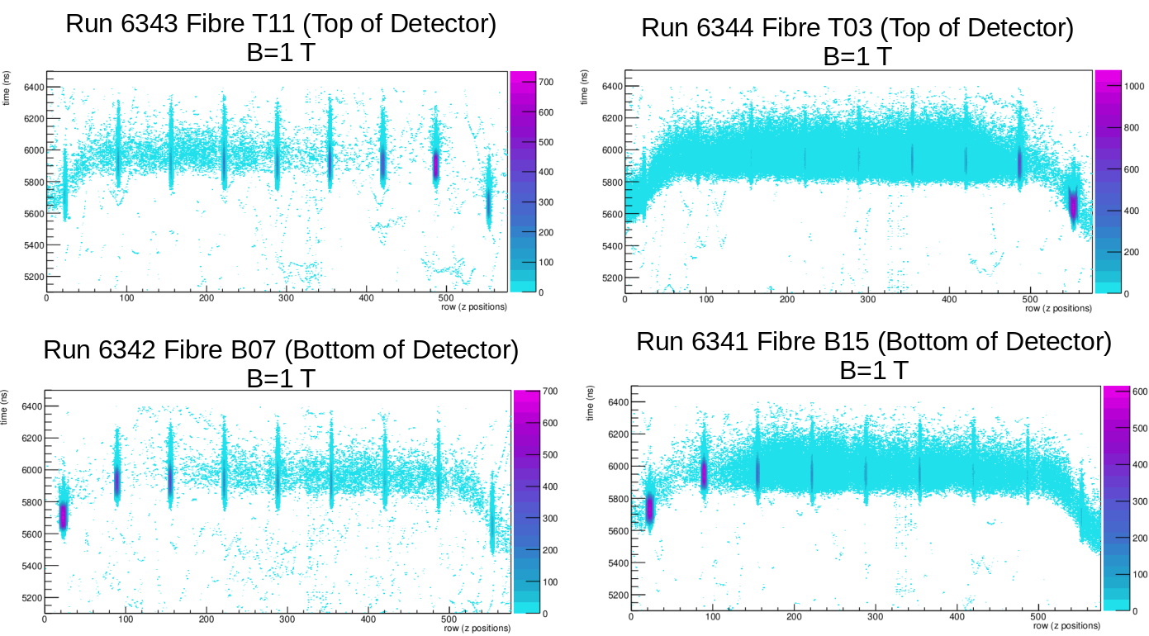
<number>

Slide 20
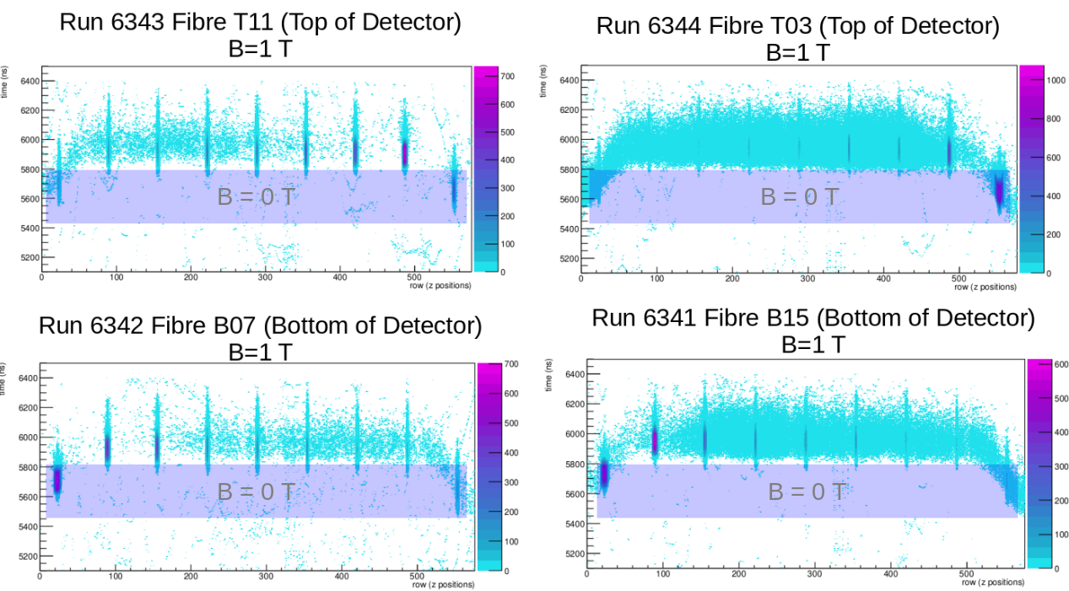
<number>

Slide 21
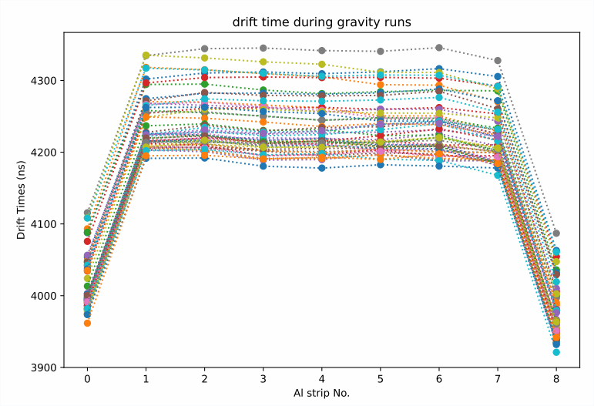
Laser Data Drift Times
drift time max change
Drift time runs during data-taking period
Upper limit on drift time was found to be 165.9 ns (or 4.2% difference)
During the time period of November 2 and December 15, 2022
Each colour is a different day – a different run
<number>

Slide 22
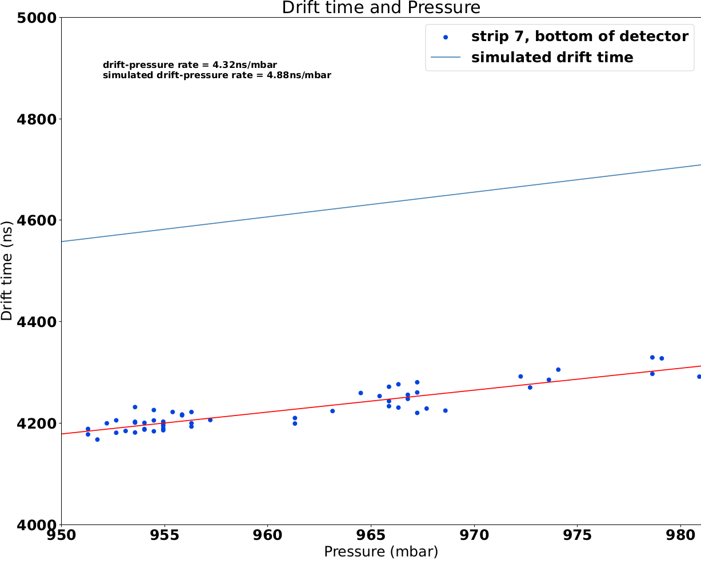
Laser Data
drift time vs pressure
Nice linear correlation with pressure
Over the same period, the pressure difference was 31.9 mbar
<number>

Slide 23
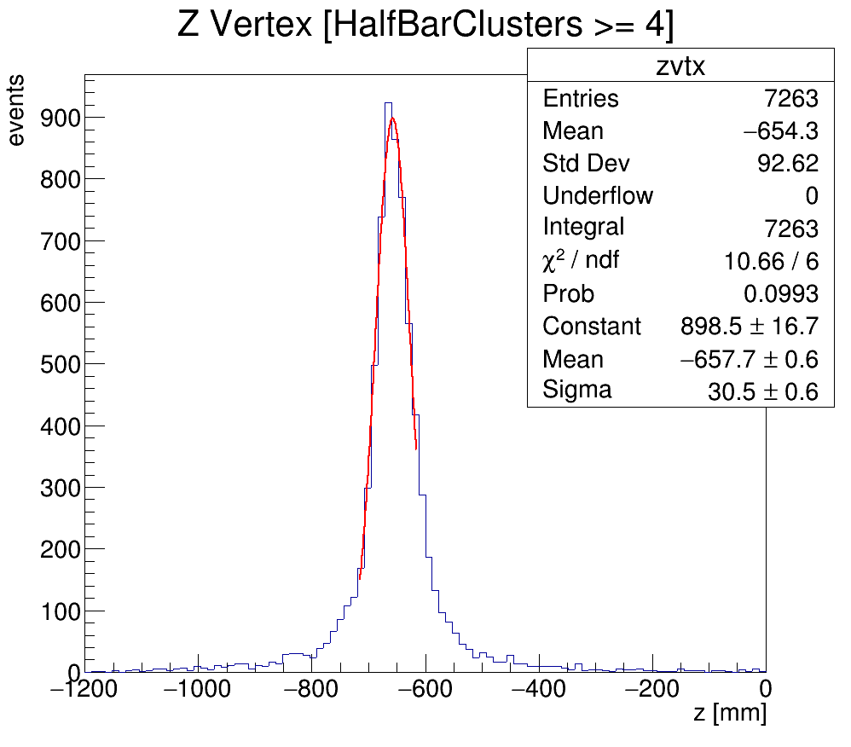

Laser Data
drift time and z position
Controlled antiproton for annihilation calibrations
Adjust z position reconstructions to account for max drift of 4.2%
Drift time adjustment | z (mm) | z error (mm) | Sigma z (mm) | Sigma error (mm)
0% | -658.214 | 0.563535 | 31.1112 | 0.6065
4.2% | -657.672 | 0.556122 | 30.4971 | 0.5830
Δz < 1 mm
<number>

Slide 24
Conclusion
ALPHA-g has successfully commissioned the detector to move forward with the experiment
Laser calibration is crucial to determining key drift information in the rTPC
Future laser calibration work includes analysis to determine observables such as the Lorentz angle to futher improve reconstructions
<number>

Slide 25
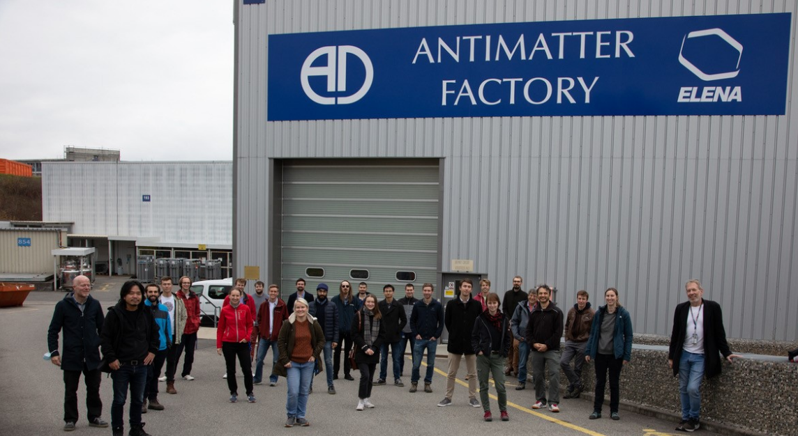





Thank you!
<number>

Slide 26
rTPC gas mixture
70% Argon, 30% CO2
<number>

Slide 27
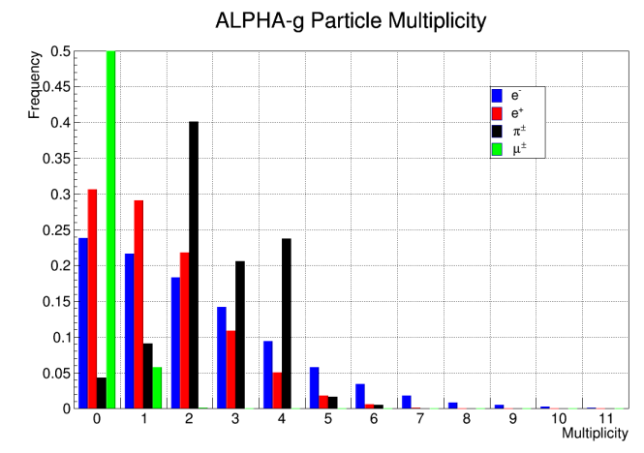
Particle Multiplicity
<number>

Slide 28
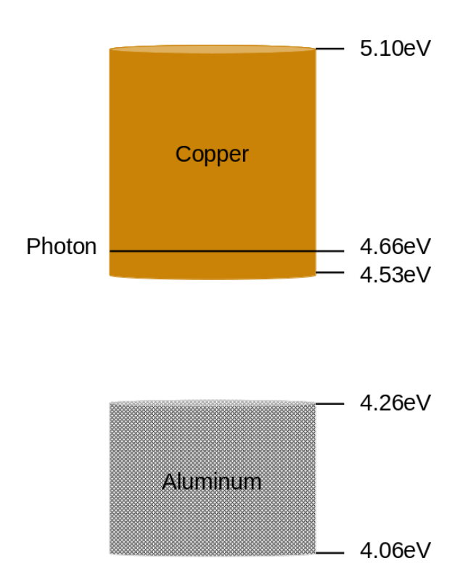
Work Functions
<number>

