Slide 1










Welcome!
1

Slide 2
Welcome to WNPPC 2023
60th Anniversary!
Tim Friesen (he/him/his)
on behalf of the organizing committee
Banff, Alberta
timothy.friesen@ucalgary.ca
February 17, 2023

Slide 3
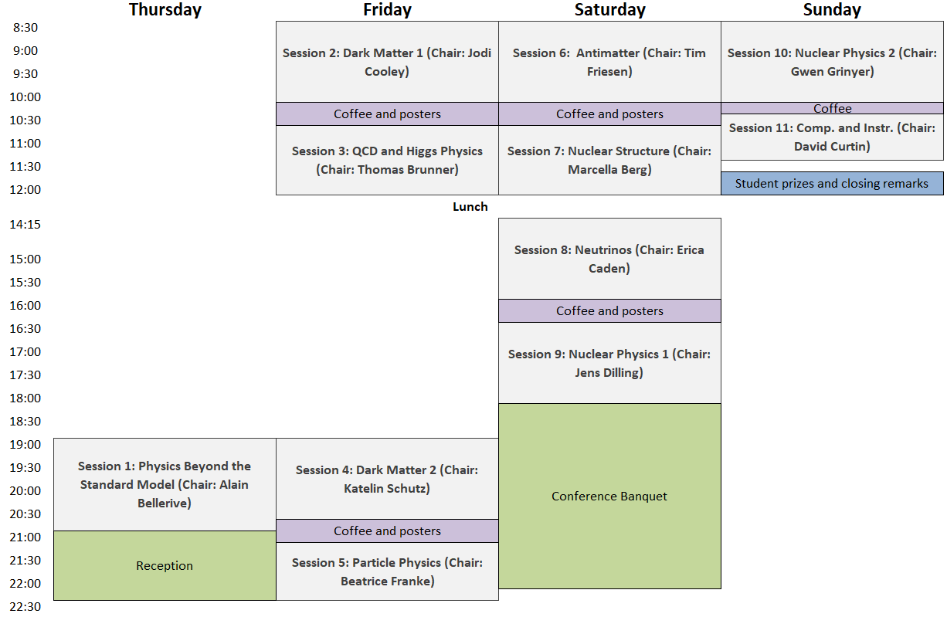
Schedule at a glance

Slide 4
Conference photo
Saturday morning coffee break
Looking for good camera. Contact Tim or Jana if you have one we can use.

Slide 5
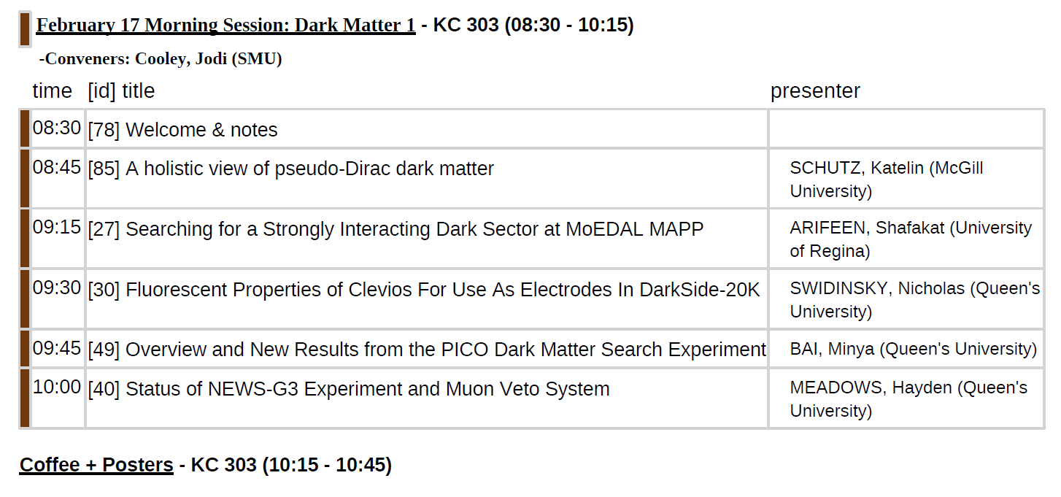
Friday Morning sessions

Slide 6
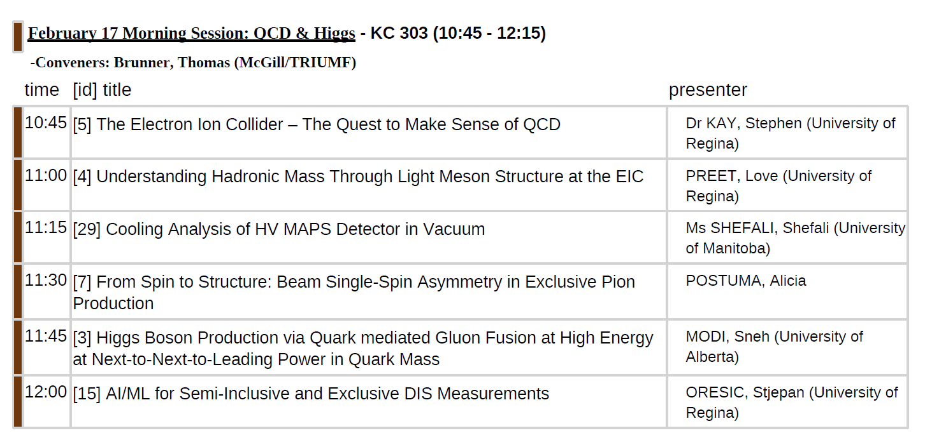
Friday Morning sessions

Slide 7
Talk logistics
Upload your slides to Indico (https://meetings.triumf.ca/event/346/) prior to the session
Talks will be downloaded onto conference laptop
Microphone for questions

