Slide 1
ALPHA-g
The antihydrogen gravity experiment
WNPPC 2023
Chukman So / TRIUMF
Notes:
Name
Postdoc
Tell you a story about…

Slide 2
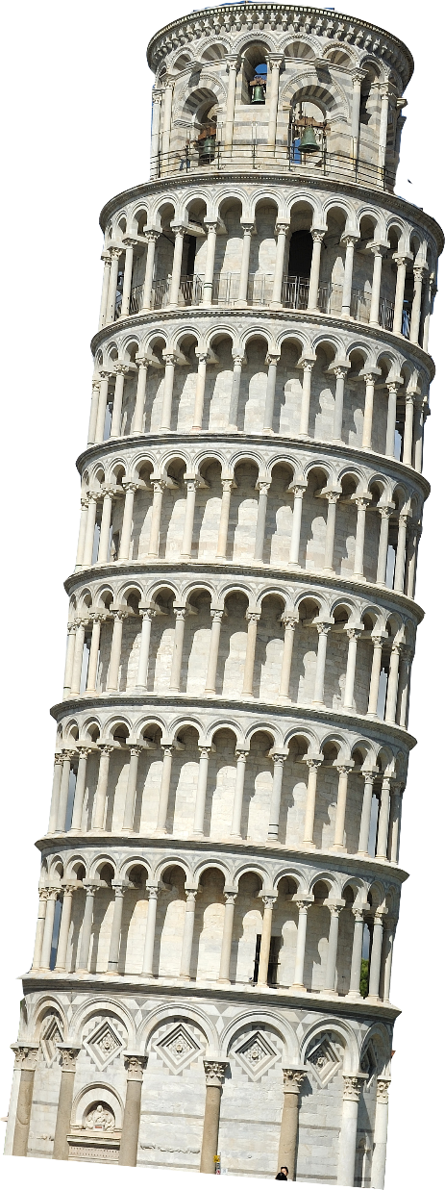
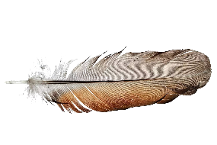
Antimatter gravity
Fundamental symmetries
Trapped antihydrogen
  Slow
  Neutral
  Long-lived
  Well-measured matter counterpart
ALPHA at Cern’s AD
  First trapping in 2010 - Nature 468, 673 (2010)
  1S-2S - Nature 557, 71–75 (2018)
  1S-2P - Nature 561, 211-215 (2018)
  Hyperfine - Nature 548, 66–69 (2017)
  Lamb shift - Nature 578, 375–380 (2020)
  Charge neutrality - Nature Communications 5, 3955 (2014)
Next: gravity
  More exotic than a feather!
Notes:
Long history of experiments investigating the symmetry…
Important because we need to explain how our visible universe…
It is also important to expand our understanding of…
Think of the classic physics lab demo

Slide 3
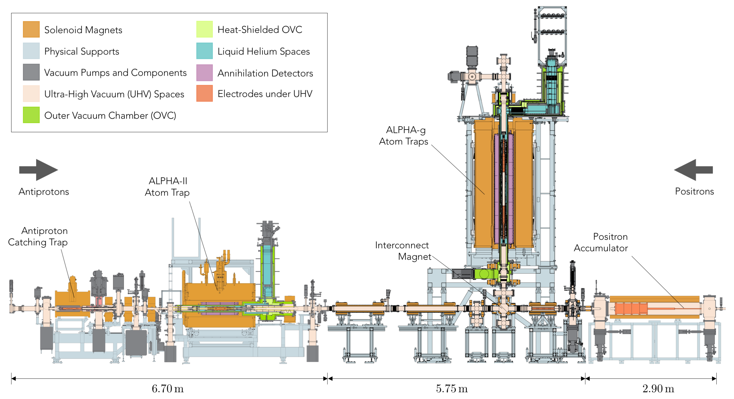
The ALPHA-g experiment

Slide 4
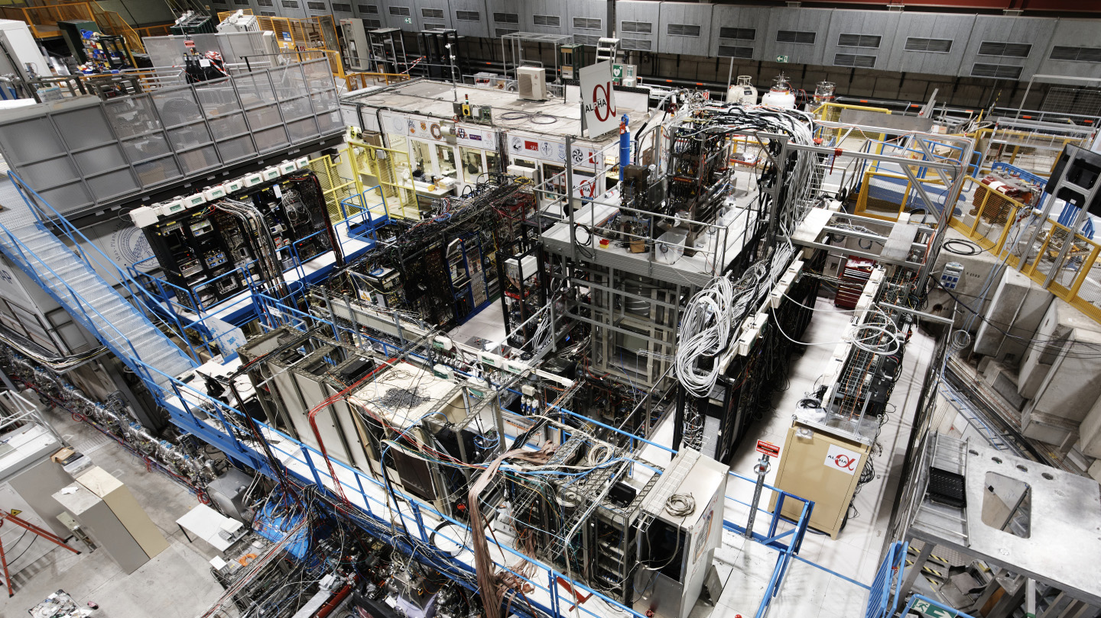

Slide 5
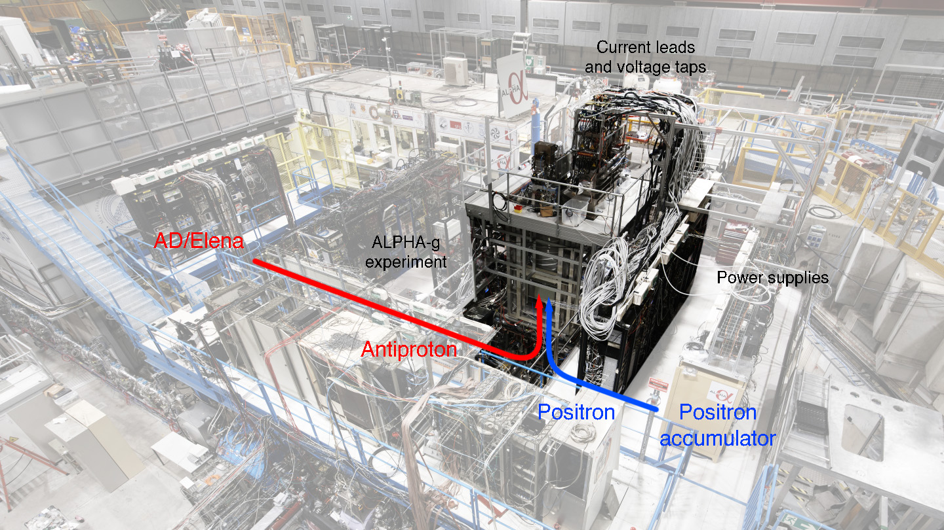

Slide 6
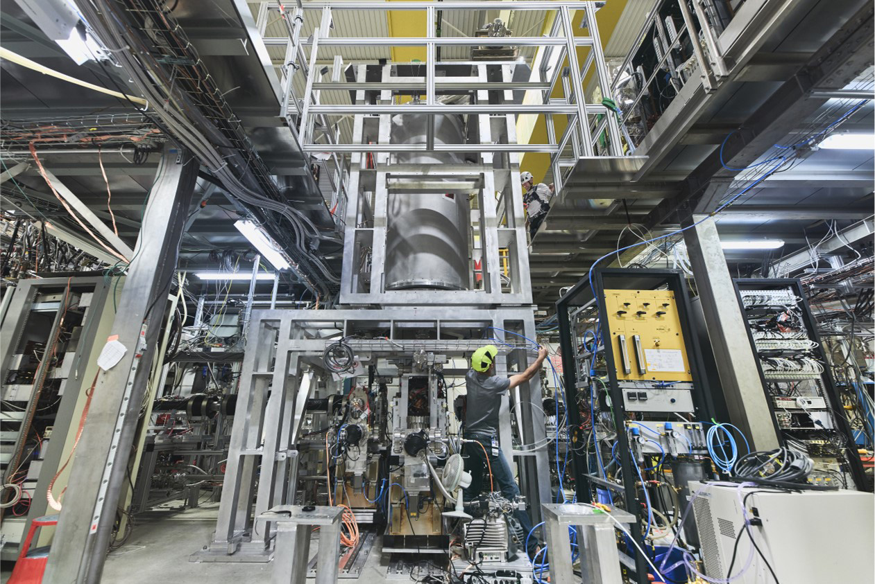

Slide 7
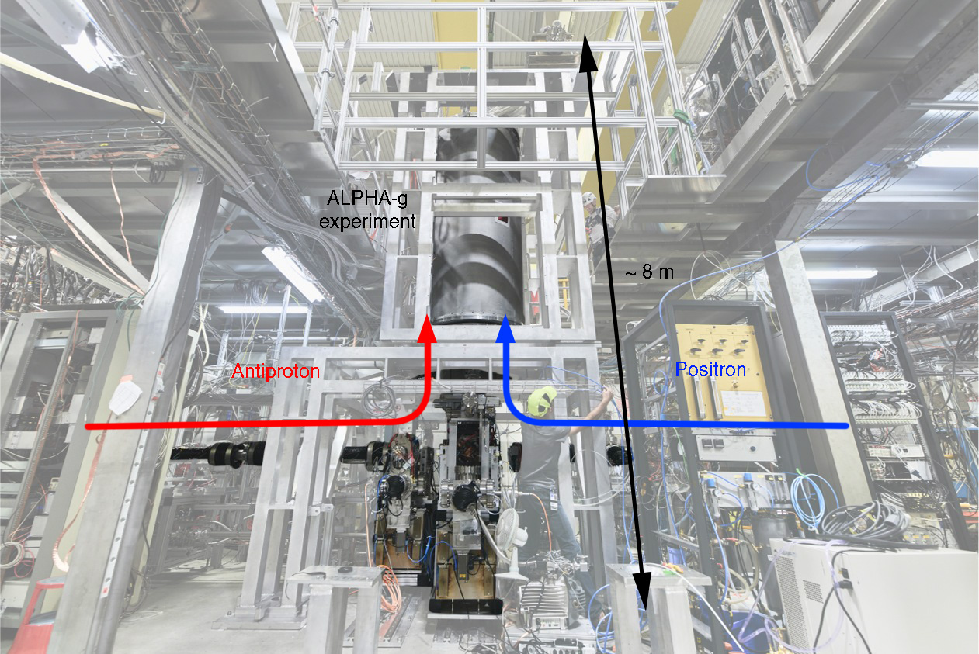

Slide 8
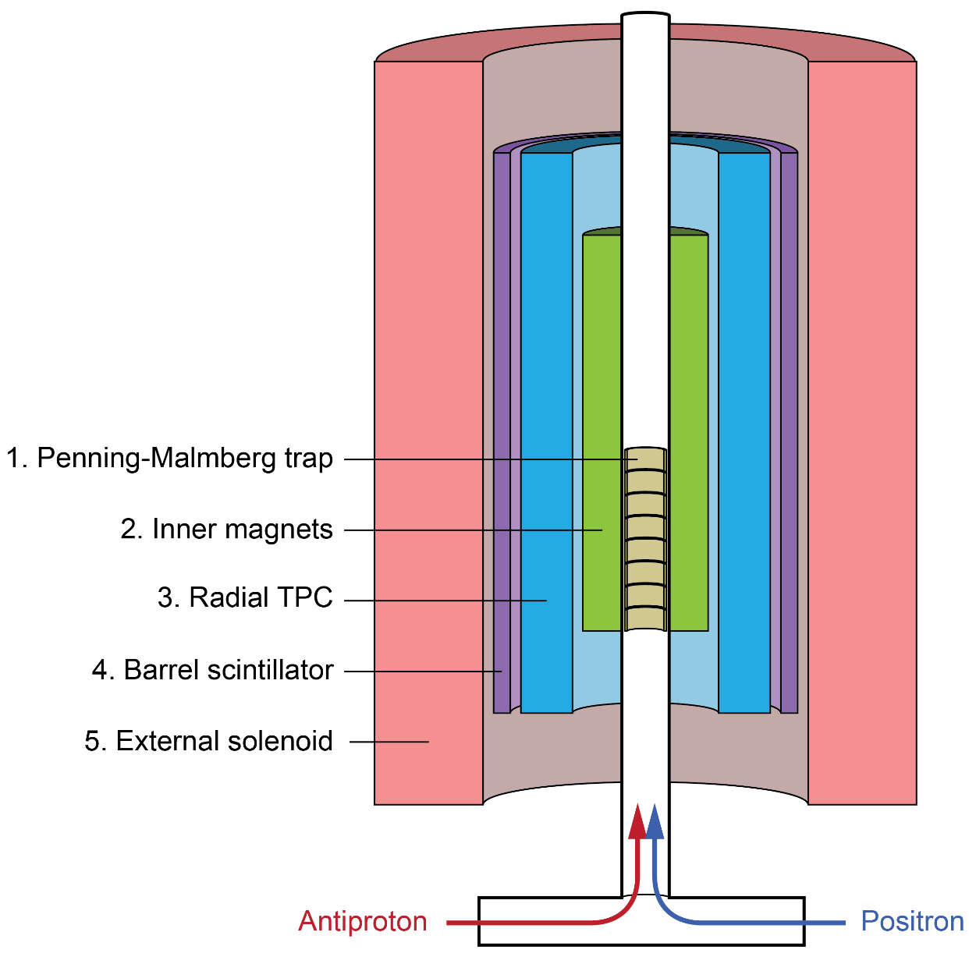
The ALPHA-g experiment
[1+5] Penning trap
  Catching and cooling plasmas
  Mixing to create antihydrogen
[2] Magnetic trap
  Trapping anti-atoms
  Releasing for physics measurement
[3] Radial time projection chamber
  Identify and locate annihilations
[4] Barrel scintillator
  Cosmic muon veto

Slide 9
The ALPHA-g experiment
[1+5] Penning trap
  Catching and cooling plasmas
  Mixing to create antihydrogen
[2] Magnetic trap
  Trapping anti-atoms
  Releasing for physics measurement
[3] Radial time projection chamber
  Identify and locate annihilations
[4] Barrel scintillator
  Cosmic muon veto
This talk
Adam Powell, 9:45 – 10:00 am
Pooja Woosaree, 9:15 – 9:30 am
Gareth Smith, 9:30 – 9:45 am

Slide 10
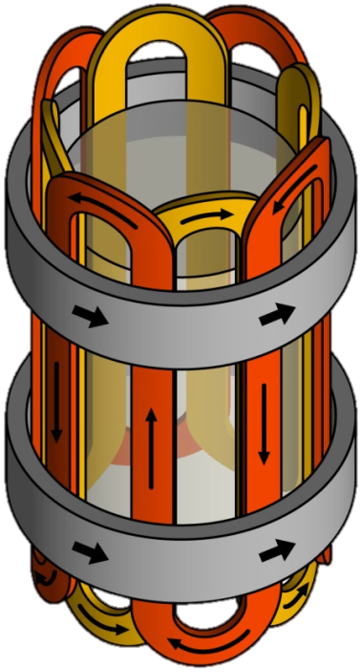
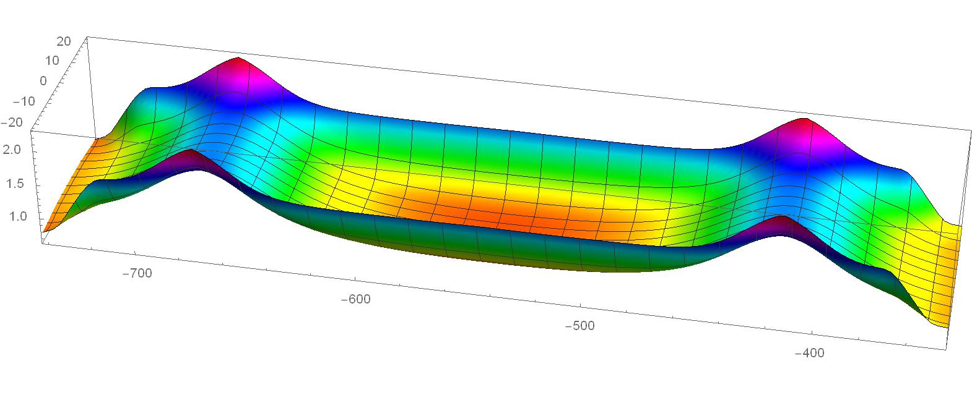
Magnetic minimum trap
Anti-atoms attracted to minimum in |B|
Radial confinement: octupole
Vertical confinement: mirror coils
g
horizontal
octupole
mirror
mirror
|B|
vertical

Slide 11
Gravity measurement
Mirror coils slowly turned off
Observe antiatom escape, up or down
g
horizontal
octupole
mirror
mirror
|B|
vertical

Slide 12
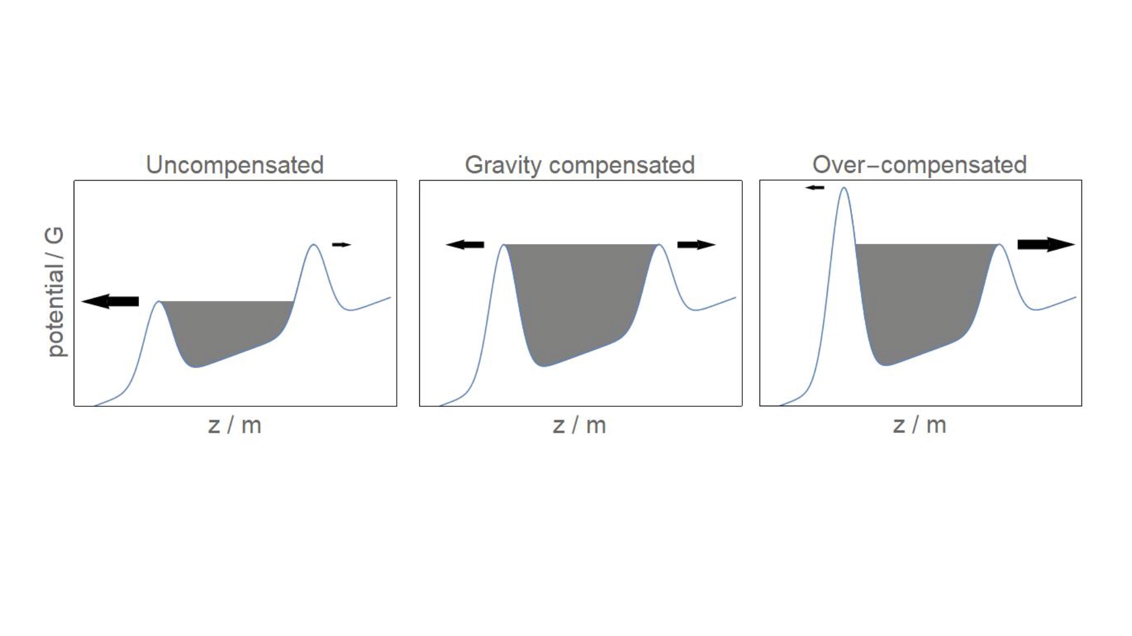
Gravity measurement

Slide 13
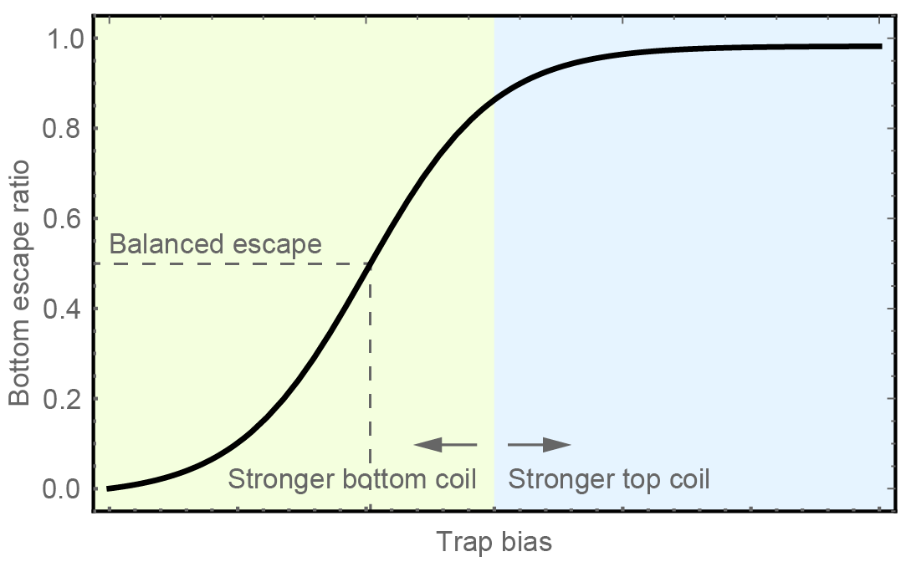
Gravity measurement
Uncompensated trap favours “down”
Balanced escape require stronger bottom coil
Determine gravity by horizontal offset of the curve

Slide 14
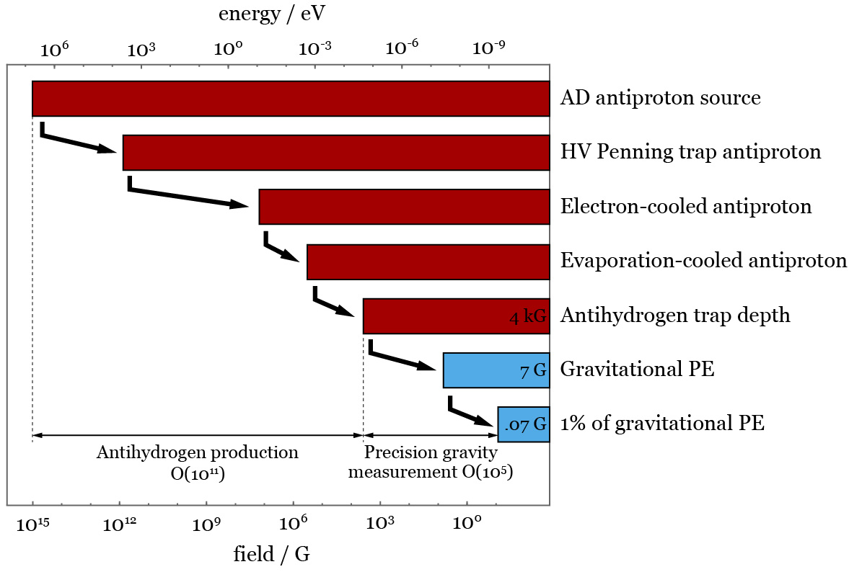
Challenges
Trapping antihydrogen
  O(10¹¹) decrease in energy
  Method developed and refined in ALPHA and ALPHA-2
Precise field control
  O(10⁻⁵) control in trap field

Slide 15
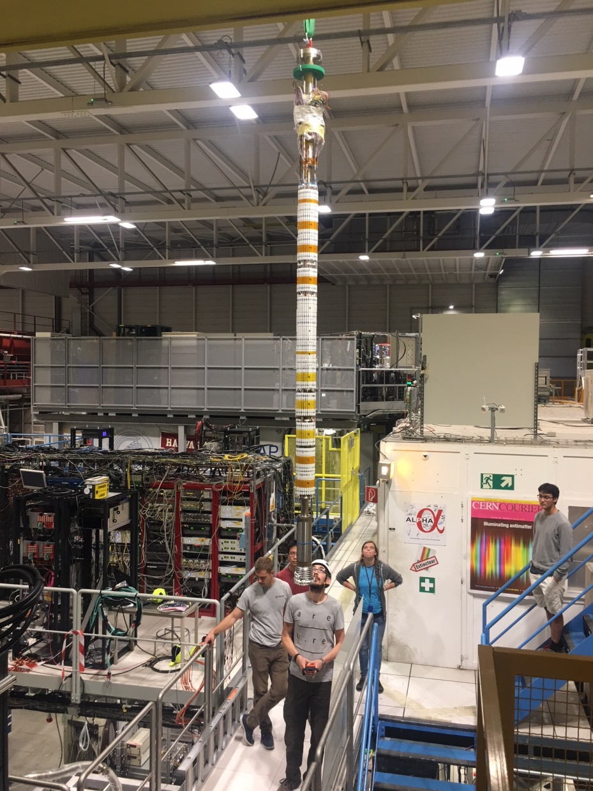
Inner
magnets
3 m
Chris

Slide 16
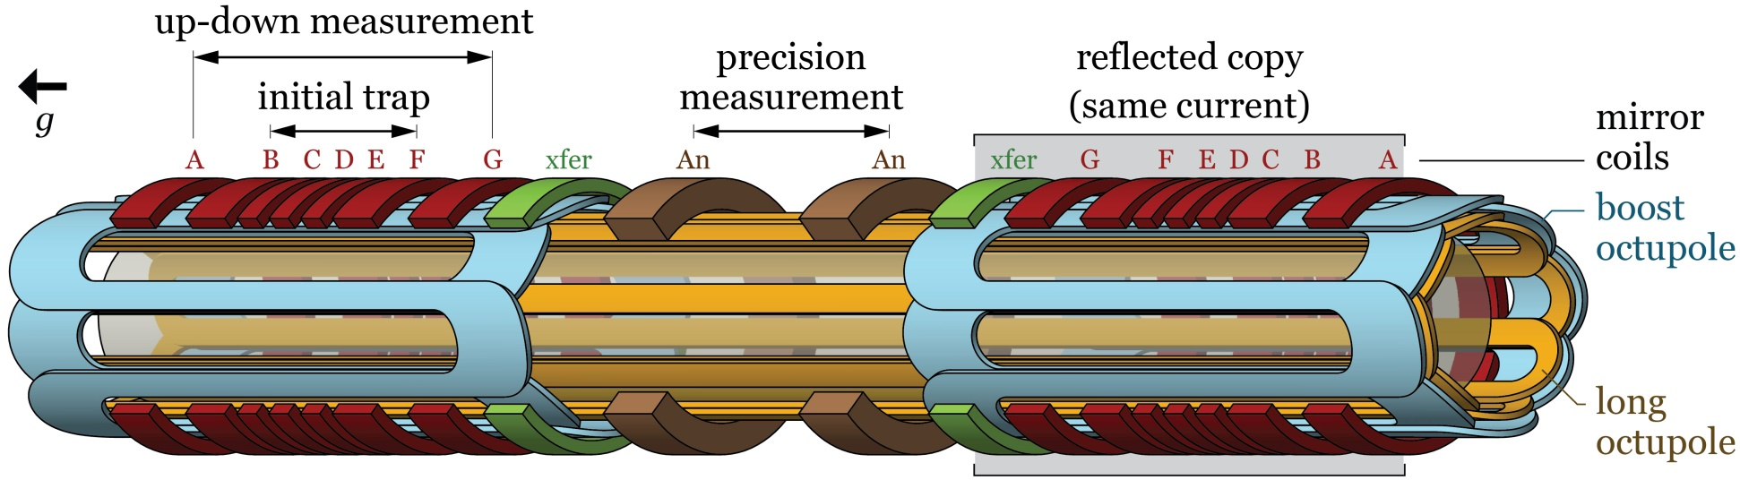
Inner magnet geometry
Centre: Precision measurement
Bottom: Stronger trap
Top: reflected copy
Why the complicated trap?

Slide 17
1. Persistent field
Induced field in superconductor
  Current loops induced in response to field changes
  Analogous to eddy current in normal conductors
  History-dependent, no direct control
Mitigation:
  Weak magnets, minimal NbTi around precision region
  Thin, numerous NbTi filaments in magnet wire
  Symmetrise magnetic history
  Neighbouring strong trap for initial trapping

Slide 18
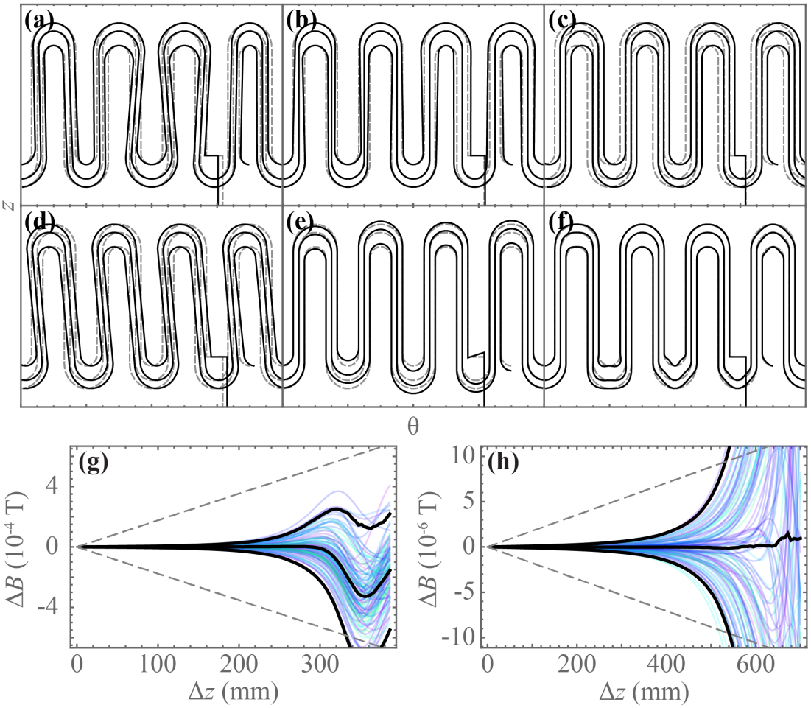
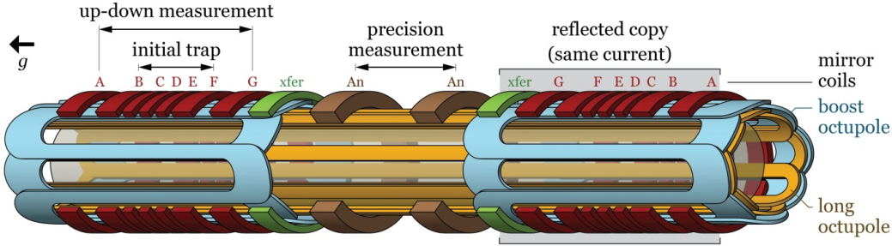
2. Wire placement
Octupole winding
  Wire-laying precisely controlled, but nothing is perfect
  Field error most severe near end turns
  Measurement regions avoid these regions
  Long + boost octupole minimises number of end turns near the precision region

Slide 19
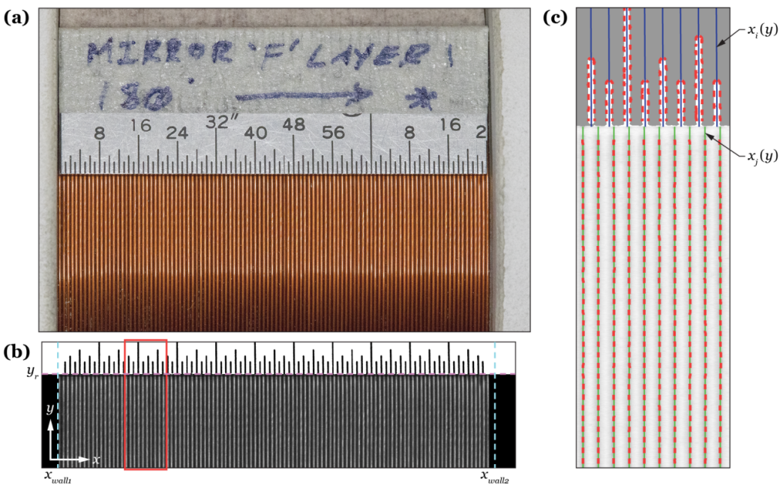
2. Wire placement
Coil winding
  Each layer is macro-photographed and analysed to locate turns

Slide 20
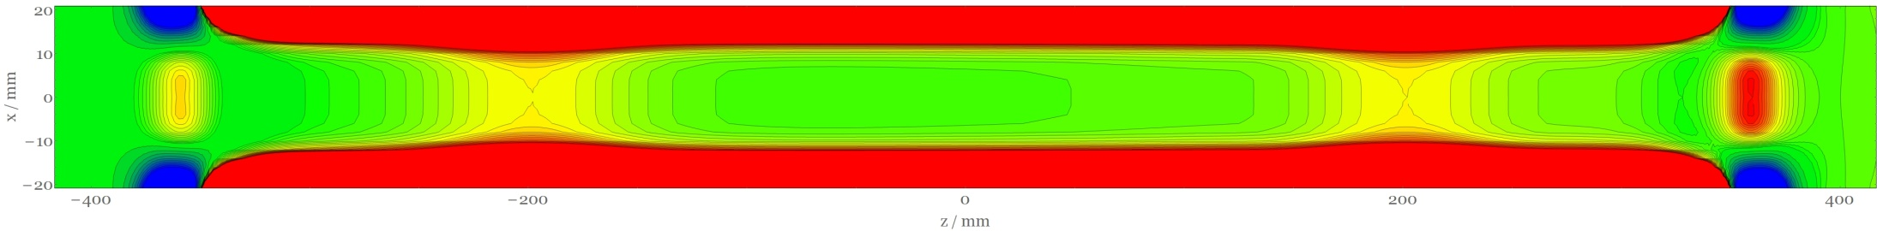

3. Separated DoF
bottom coil
top coil
Energetic escape requires hitting pin hole with all energy allocated to z
Slow (x,y) and z energies mixing
Anti-atoms mostly escape off-axis, at much later time
Must tailor on- and off-axis fields

Slide 21
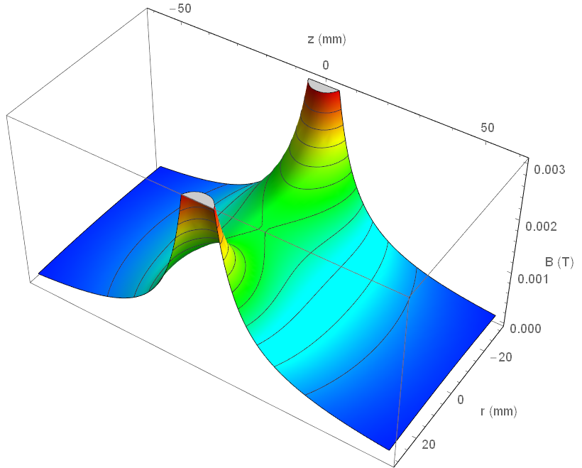
3. Separated DoF
A coil’s field is saddle-shaped

Slide 22
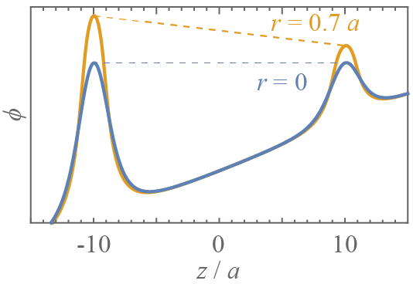
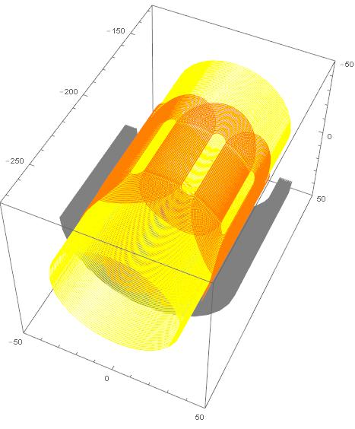
3. Separated DoF
Two coils at different currents cannot form equal barriers for all r
  Radial saddle point scaling
  Octupole field quadrature
Correctors
  A longer coil – dynamically alter effective coil length, i.e. saddle point aspect ratio
  A short octupole – alter local octupole field strength
Can achieve < 0.1 Gauss match for all radii
gravity gradient
Corrector coil
Corrector octupole
Main mirror coil

Slide 23
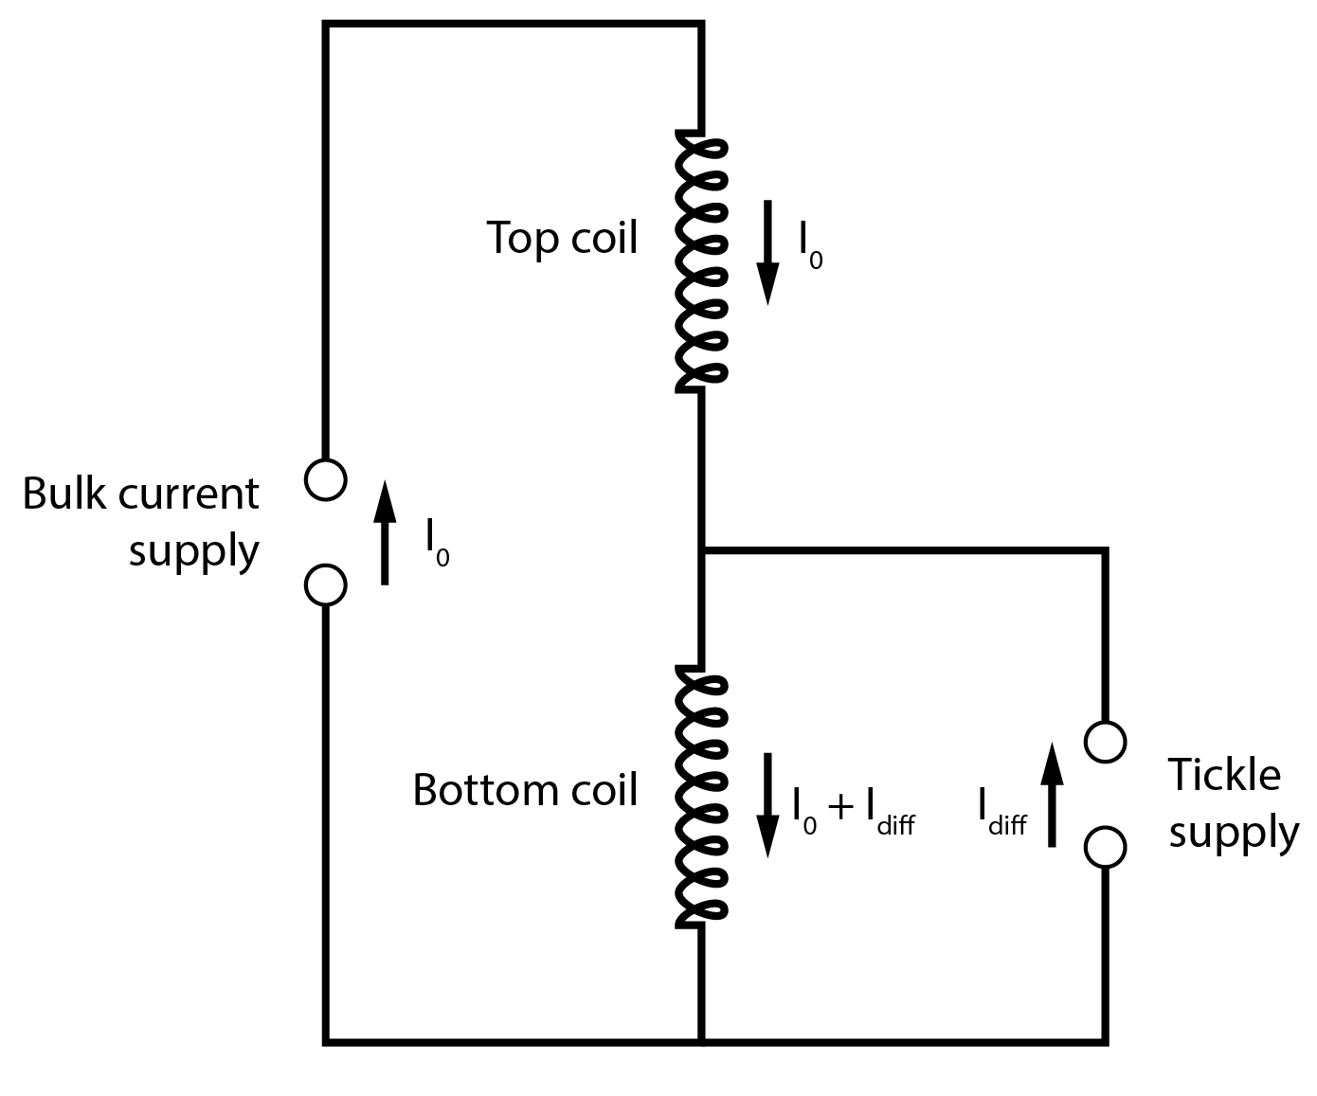
4. Current supply
Extremely fine current control on barrier coils
  Common mode: 70 A to ~0 A, no specific precision requirement
  Difference: ~ 0.1 A, precise to ~1 mA
Two completely separate PS: 10 ppm
One bulk current supply and one “tickle” supply: 10000 ppm
Two currents measured by DCCT and fed back to power supplies PID control

Slide 24
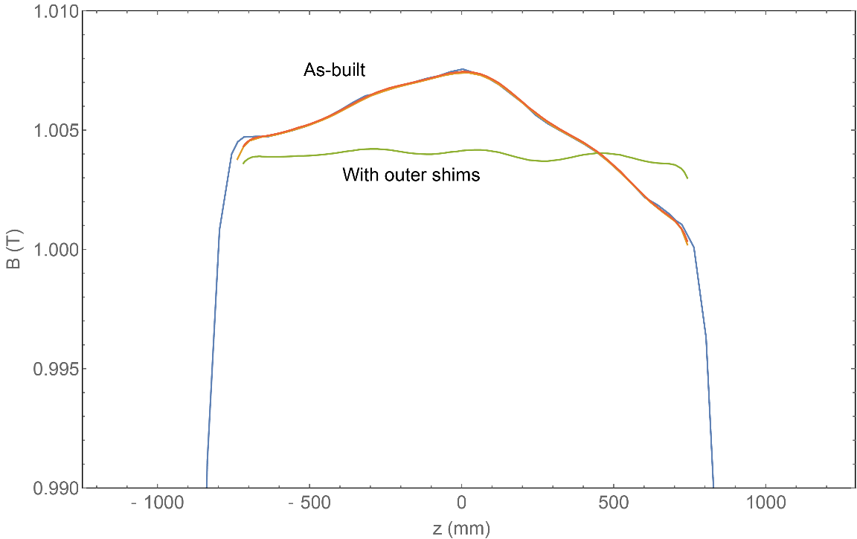
5. Background solenoid uniformity
Affects gravity measurement due to field gradient
As-built
  ~20 G non-uniformity
With outer shims
  ~4 G non-uniformity
  Compensate by adjusting mirror coil currents
Possible future inner shims
  ~0.02 G non-uniformity
  Reduced coil adjustment

Slide 25
Performing a first measurement

Slide 26
An “up-down” measurement
Using only the bottom set of magnets
Pro
  Deeper trap, more statistics
  Fewer magnet elements needed
Con
  Less accurate field – more persistence effect, no correctors
  Cannot use the long octupole
Aiming to resolve the direction of gravity on antihydrogen

Slide 27
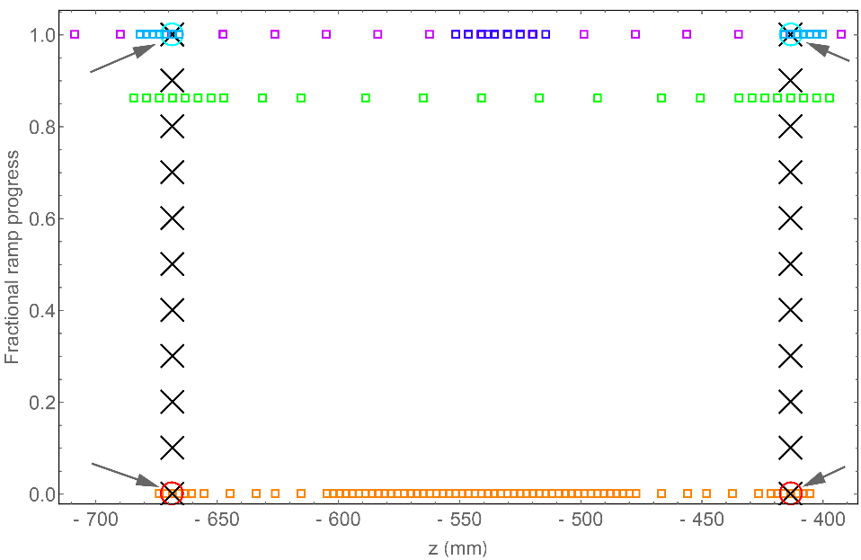
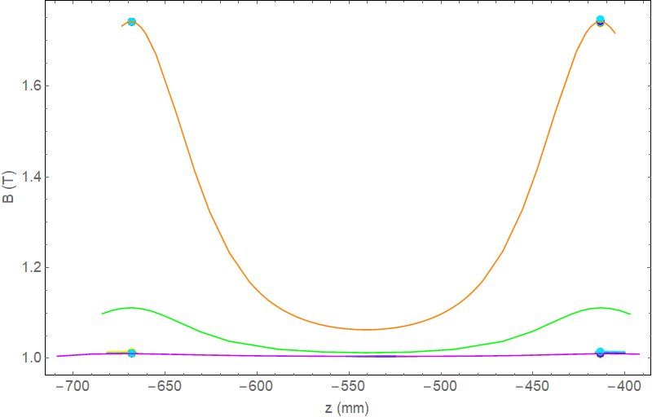
Magnetometry
Persistence effect is inevitable
Measure field and adjust current, to maintain trap bias throughout release ramp
ECR
  Measures cyclotron frequency in Penning trap
  Slow measurement process
Magnetron counting
  Measures the phase of ExB drift of Penning trap plasmas
  Fast measurement
  Less accurate than ECR
Able to control relative trap bias to ~0.1 Gauss
See [Adam Powell, 9:45 – 10:00 am]

Slide 28
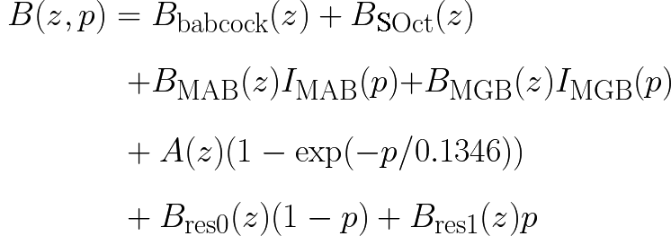
Field model
Magnetometry results are integrated into a 3D field model
O(1 Gauss) precision, much better around the saddle points
Particle pusher uses field to evolve anti-atoms through the entire experimental sequence
  Obtain the expected escape bias as a function of gravitational acceleration
  Field model is critical as antiatoms escape off-axis
Wire model field, from currents we provide
Exponentially saturating component
from magnetron results
Field we
don’t control
Residual to account for ECR

Slide 29
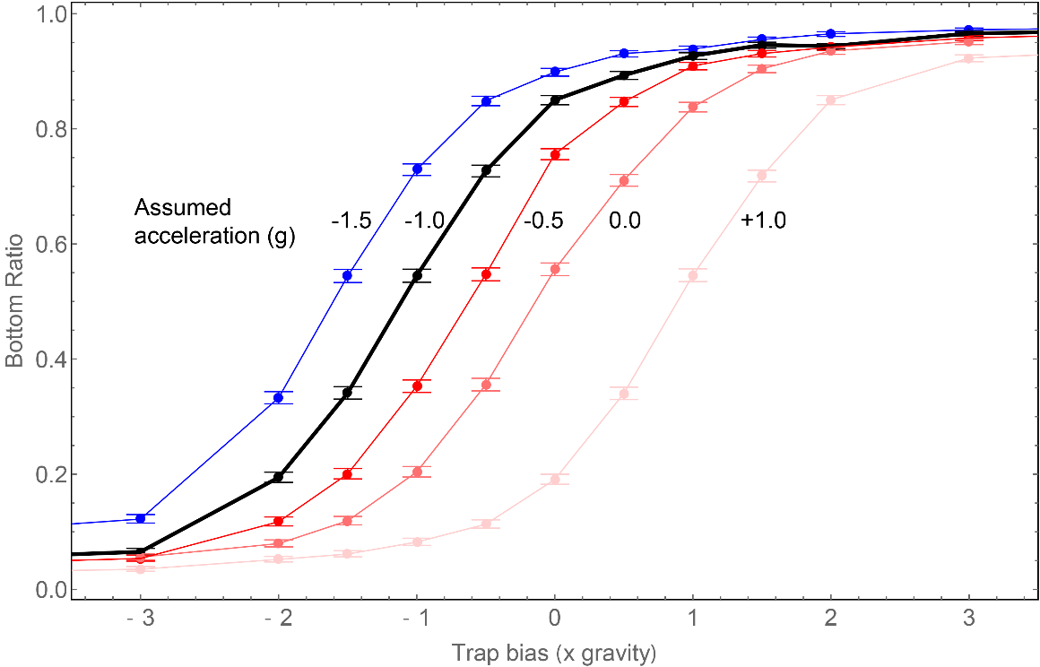
Experiment progress
In 2022: performed experimental release at 13 trap biases
Results being analysed and compared to simulation

Slide 30
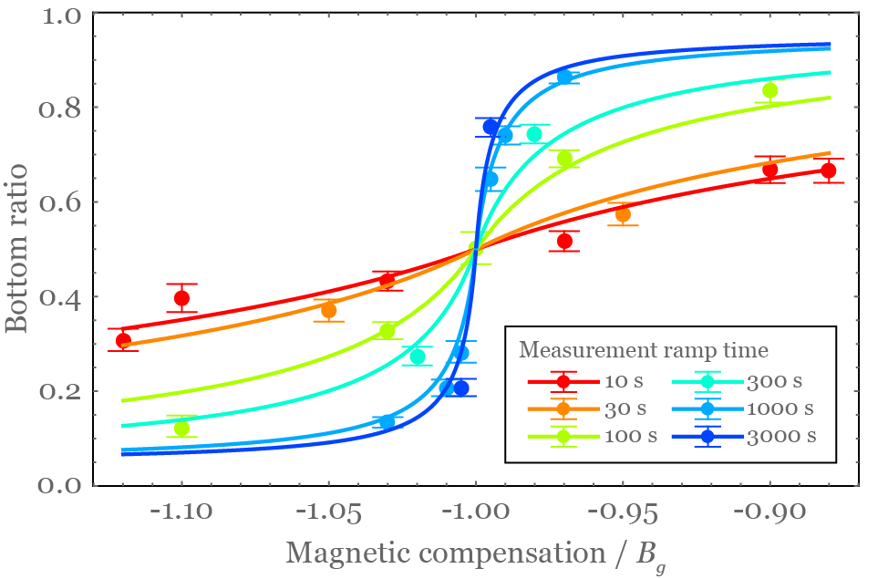
Future precision
Using the proper precision region
Steepness of escape balance curve closely affects sensitivity
Long ramp = more chance anti-atoms can escape on-time, higher sensitivity
Down side:
  Long window = more cosmics
  Depends on our ability to reject cosmics
Other factors like current noise and anti-atom temperature

Slide 31
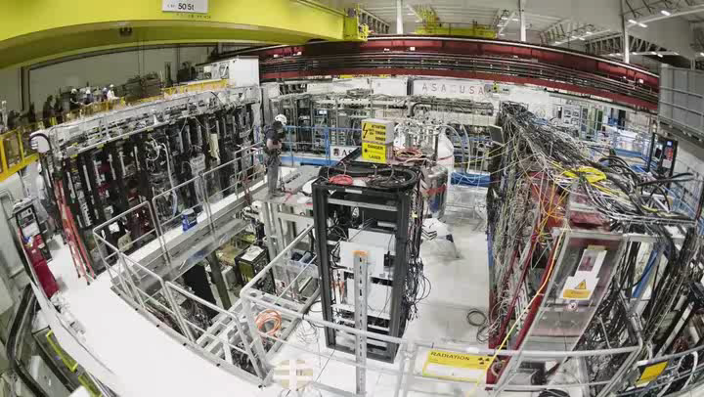
The big picture
ALPHA-g design and construction: a decade-long effort
  Magnet
  Detector
  Current control
  Beamline
  Cryostat
  Vacuum system
  Penning trap
  Sequencer
  Laser and optics
  Microwave
  Diagnostic stations
First physics in 2022
Moving towards precision!

