Slide 1
An Analytic Approach to Light Dark Matter Propagation
Christopher Cappiello
GUINEAPIG 2023, Montreal
July 13, 2023

Slide 2
An Intro to Dark Matter Attenuation

Slide 3
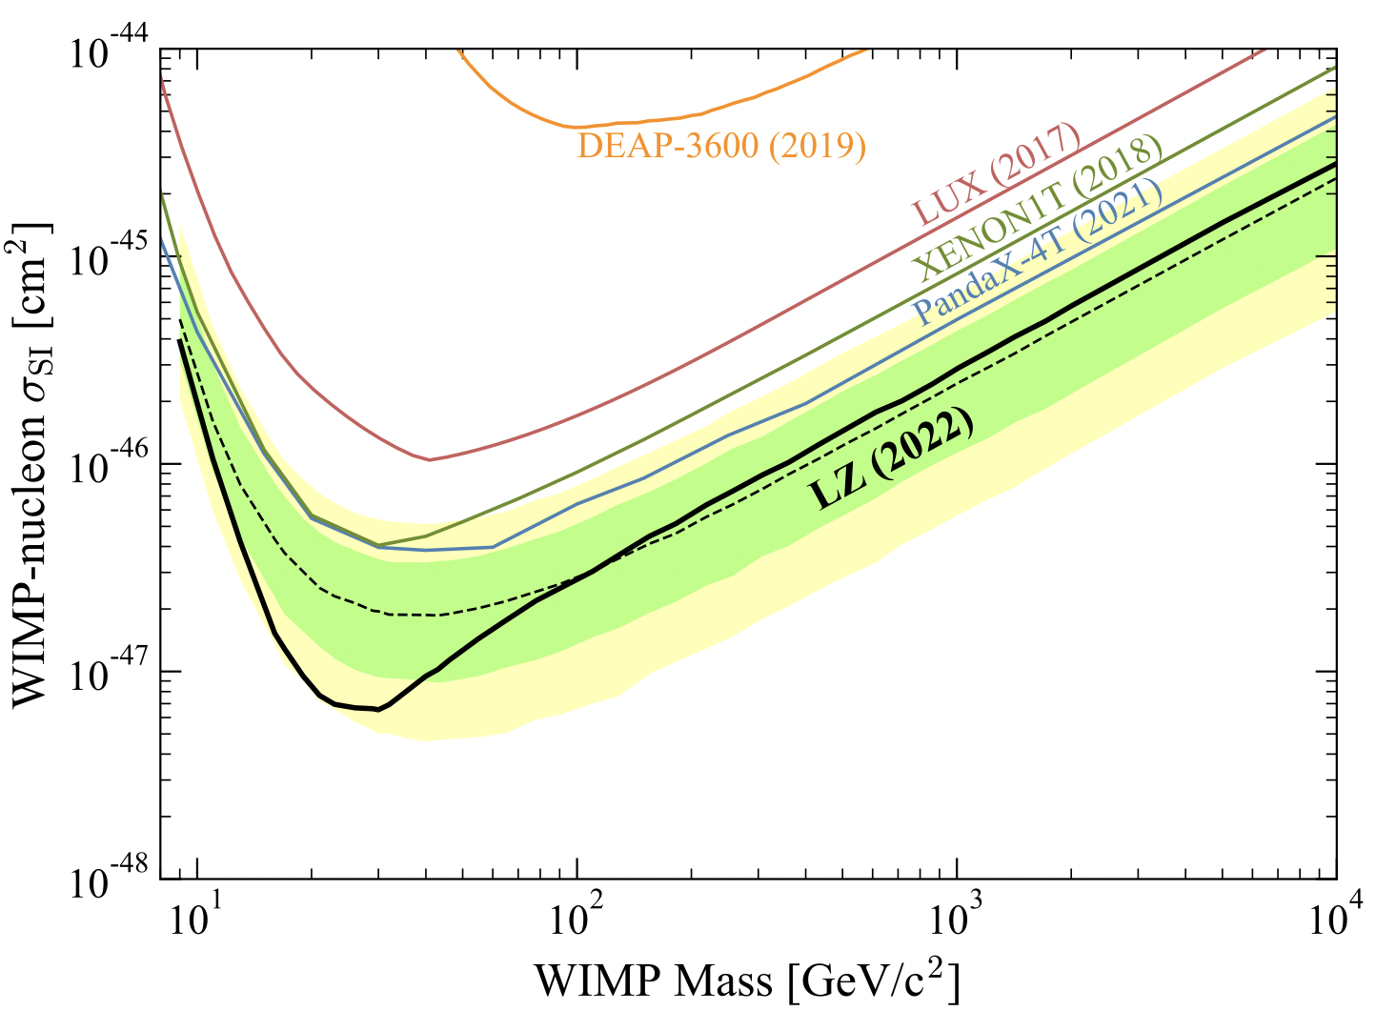
Direct Detection Limits
arXiv:2207.03764

Slide 4
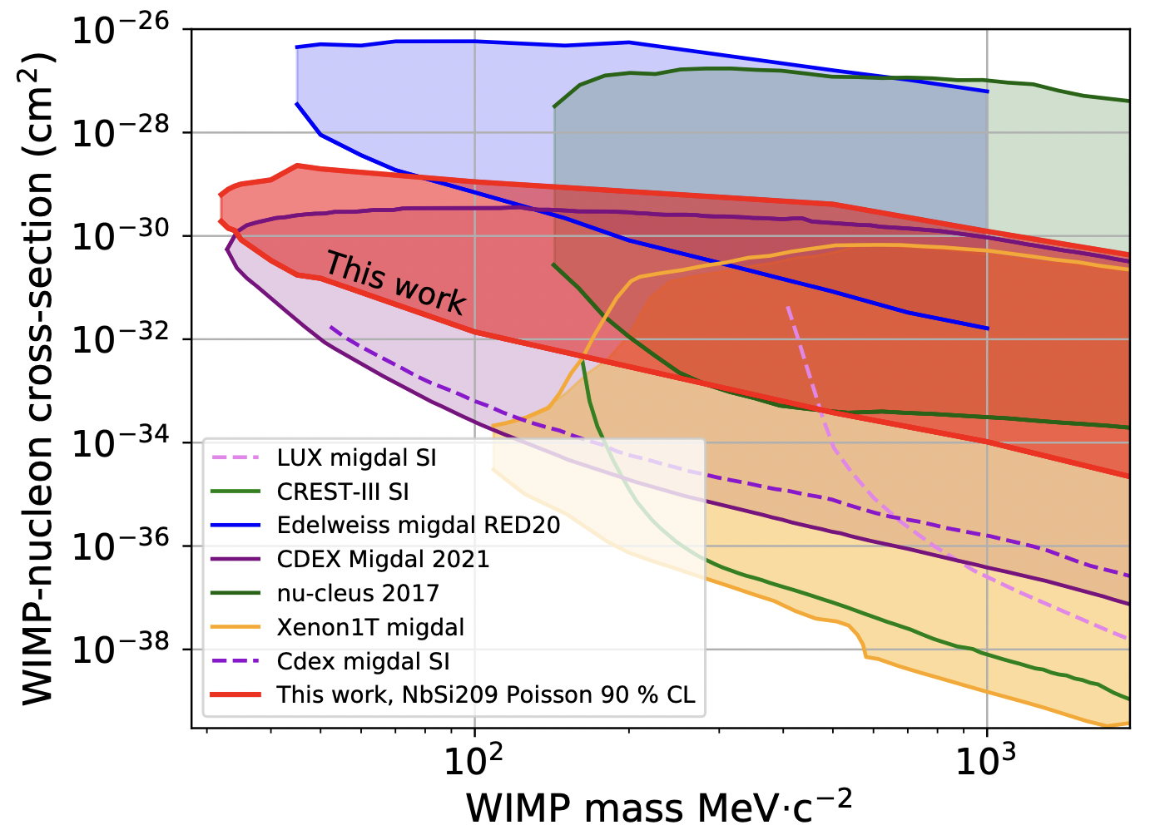
Direct Detection Limits
arXiv:2207.03764
arXiv:2203.03993 (Edelweiss)

Slide 5
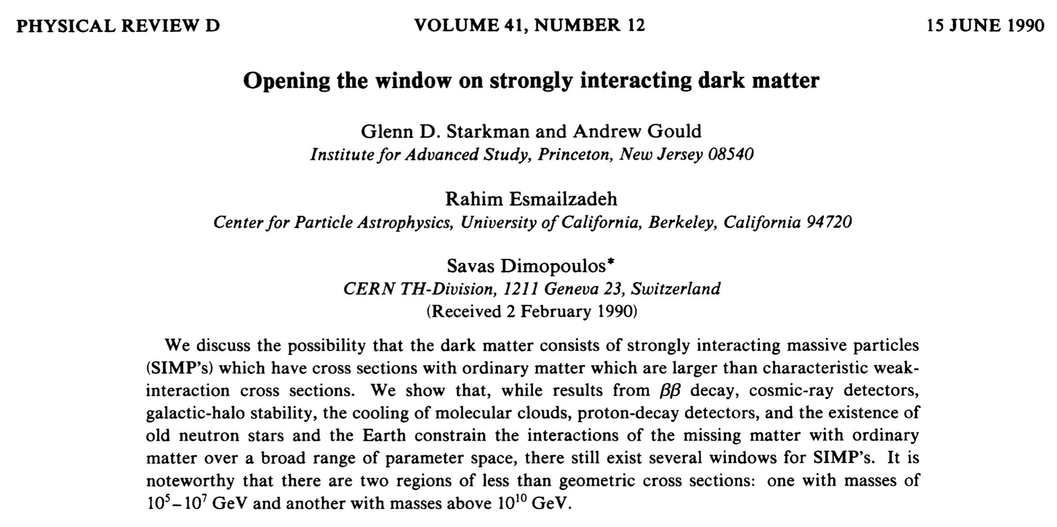
Attenuation: Straight Line Approximation
arXiv:2203.03993

Slide 6
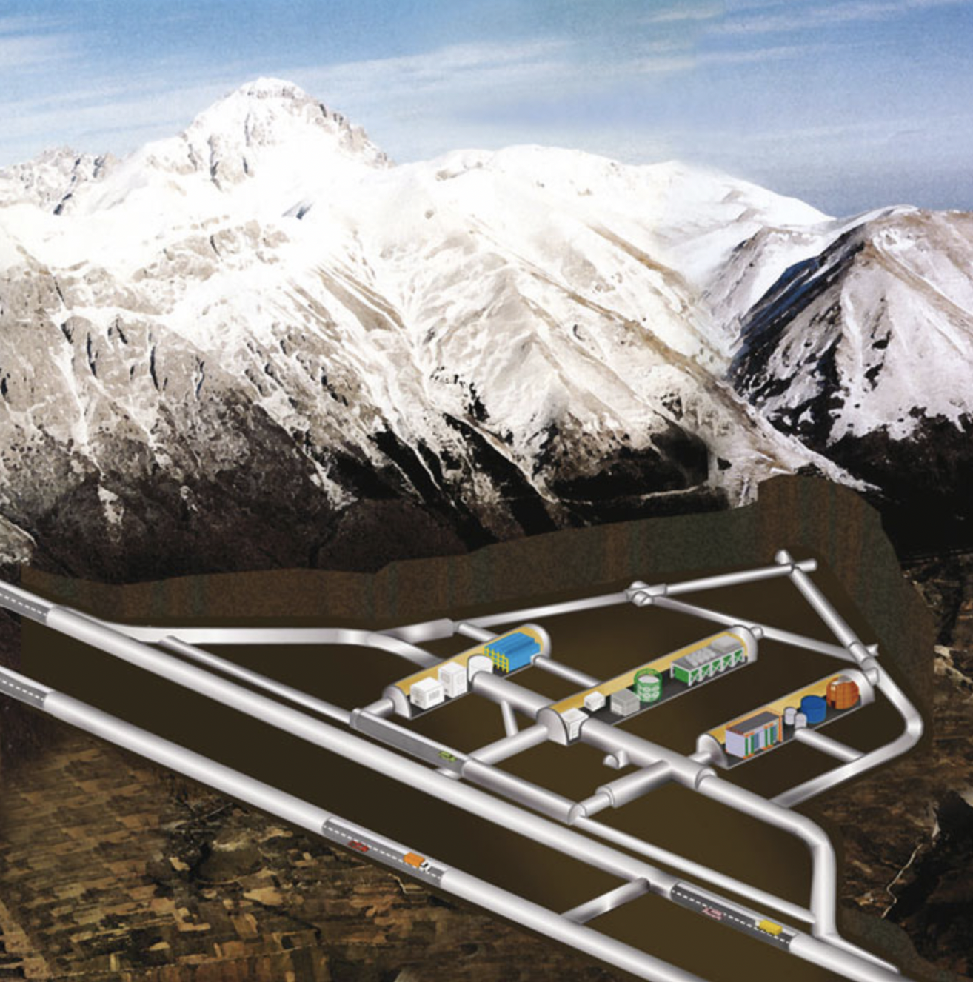
Attenuation: Straight Line Approximation
Assume that dark matter follows a straight (ballistic) trajectory, every particle losing the average possible amount of energy:
n_{i} : number density of nuclei in overburden
<E_{R}>_{i} : average recoil energy
σ_{i} : DM-nucleus cross section
Left: Schematic of LNGS
-Credit: https://www.appec.org

Slide 7
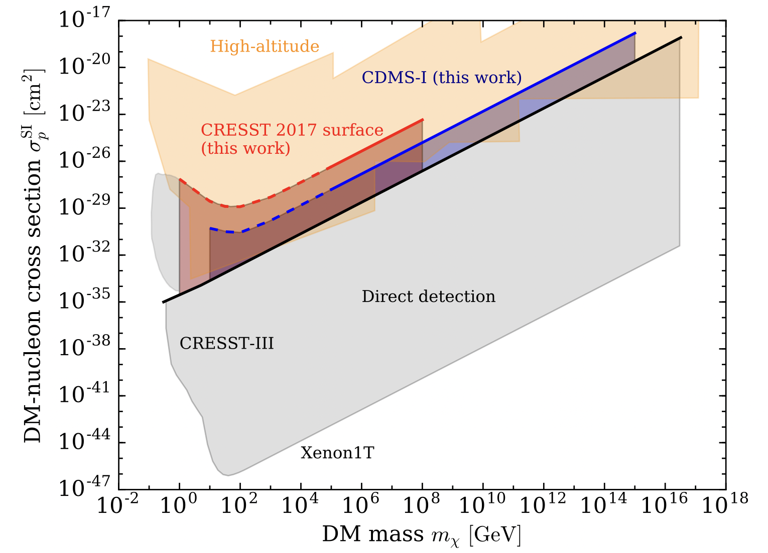
Attenuation: Straight Line Approximation
arXiv:1712.04901

Slide 8
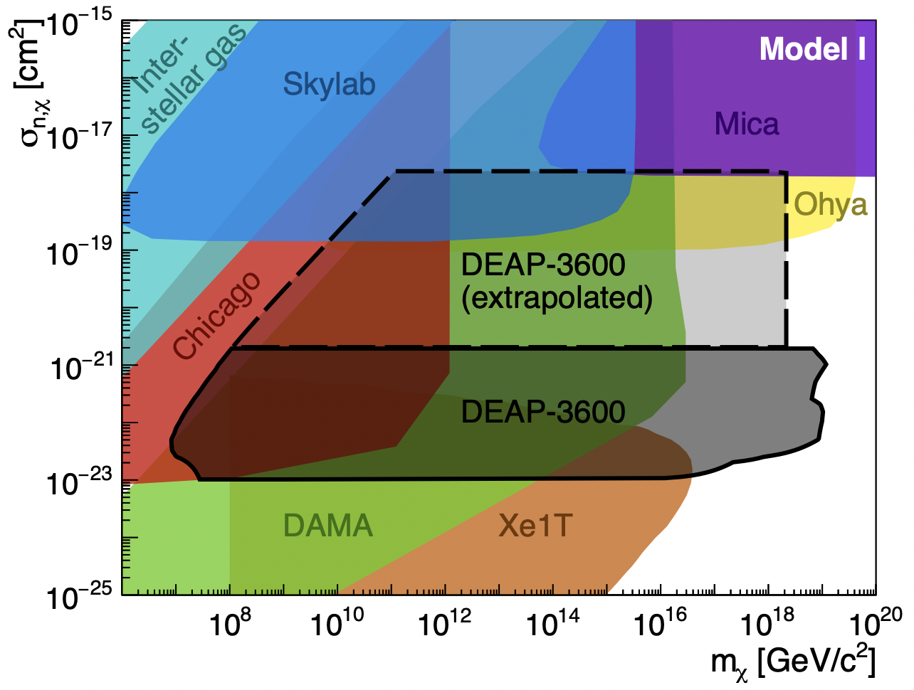
Attenuation: Straight Line Approximation
arXiv:1712.04901
arXiv:2108.09405

Slide 9
Attenuation: Straight Line Approximation
arXiv:2203.03993 (EDELWEISS)

Slide 10
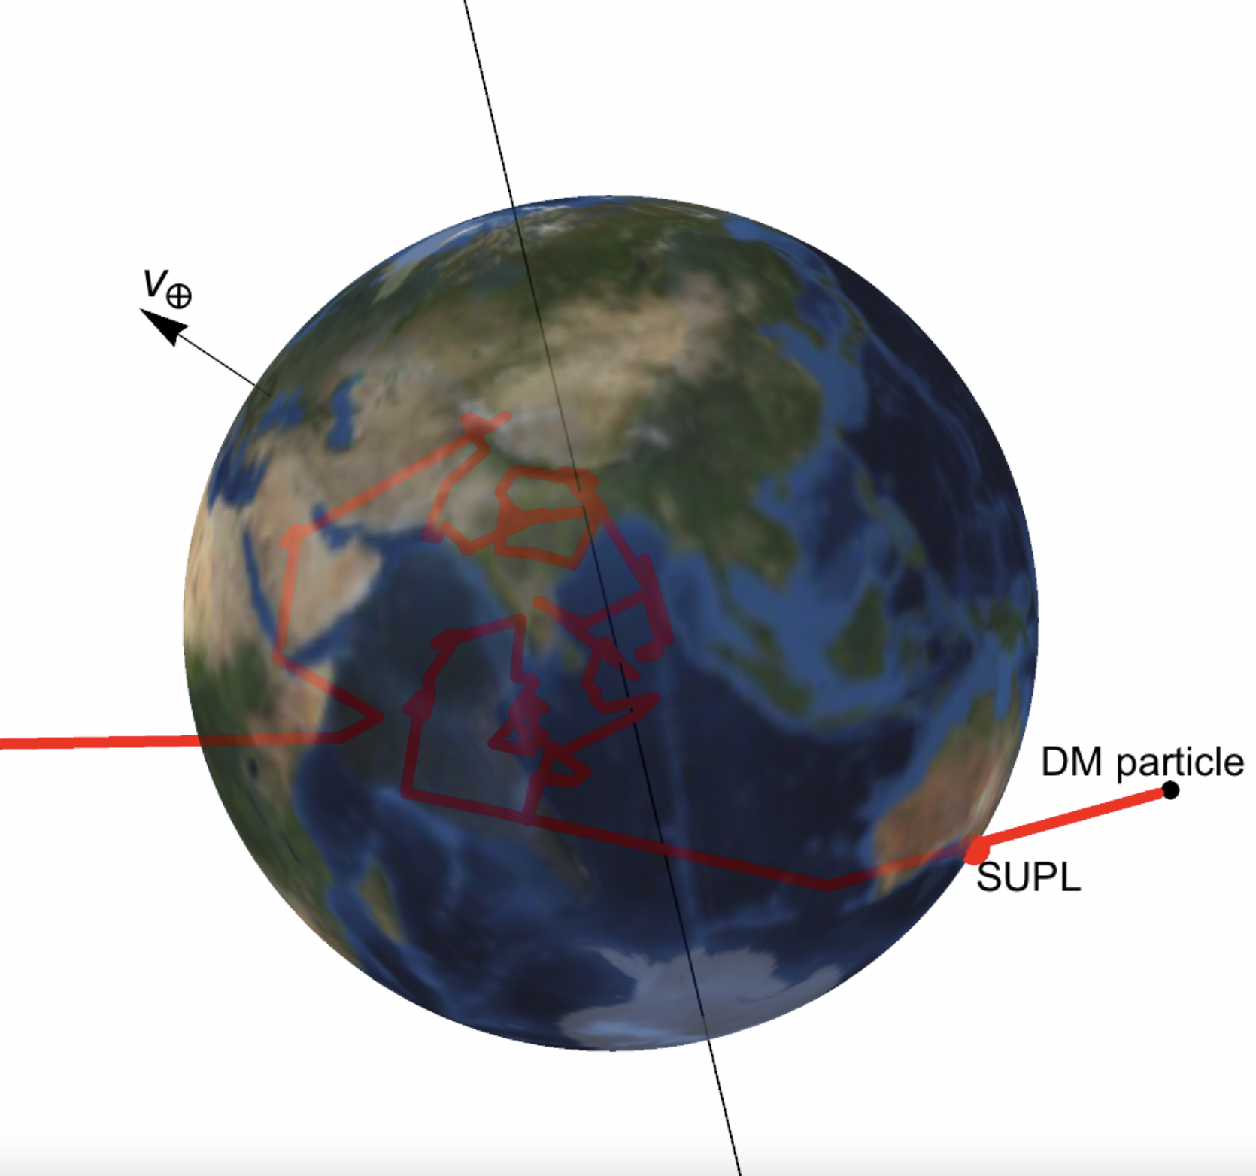
Attenuation: Monte Carlo Simulations
Alternative approach: numerically simulate millions of dark matter particles scattering in Earth
Initialize a particle above the Earth with initial velocity v
Choose distance particle travels without scattering from exponential path length distribution
Choose target + scattering angle, update velocity
Stop if particle is detected, loses too much energy, or leaves Earth
timonemken.com/code, arXiv:1706.02249

Slide 11
Attenuation: Monte Carlo Simulations
Examples:
DaMaSCUS: Dark Matter Simulation Code for Underground Scatterings, Timon Emken
DMATIS: Dark Matter Attenuation Importance Sampling, M. Shafi Mahdawi
DarkProp (for cosmic ray boosted dark matter), Chen Xia
See also:
CVC and Beacom: PRD 100, 103011 (2019)
PROSPECT Collaboration, CVC: PRD 104, 012009 (2021)
timonemken.com/code, arXiv:1706.02249

Slide 12
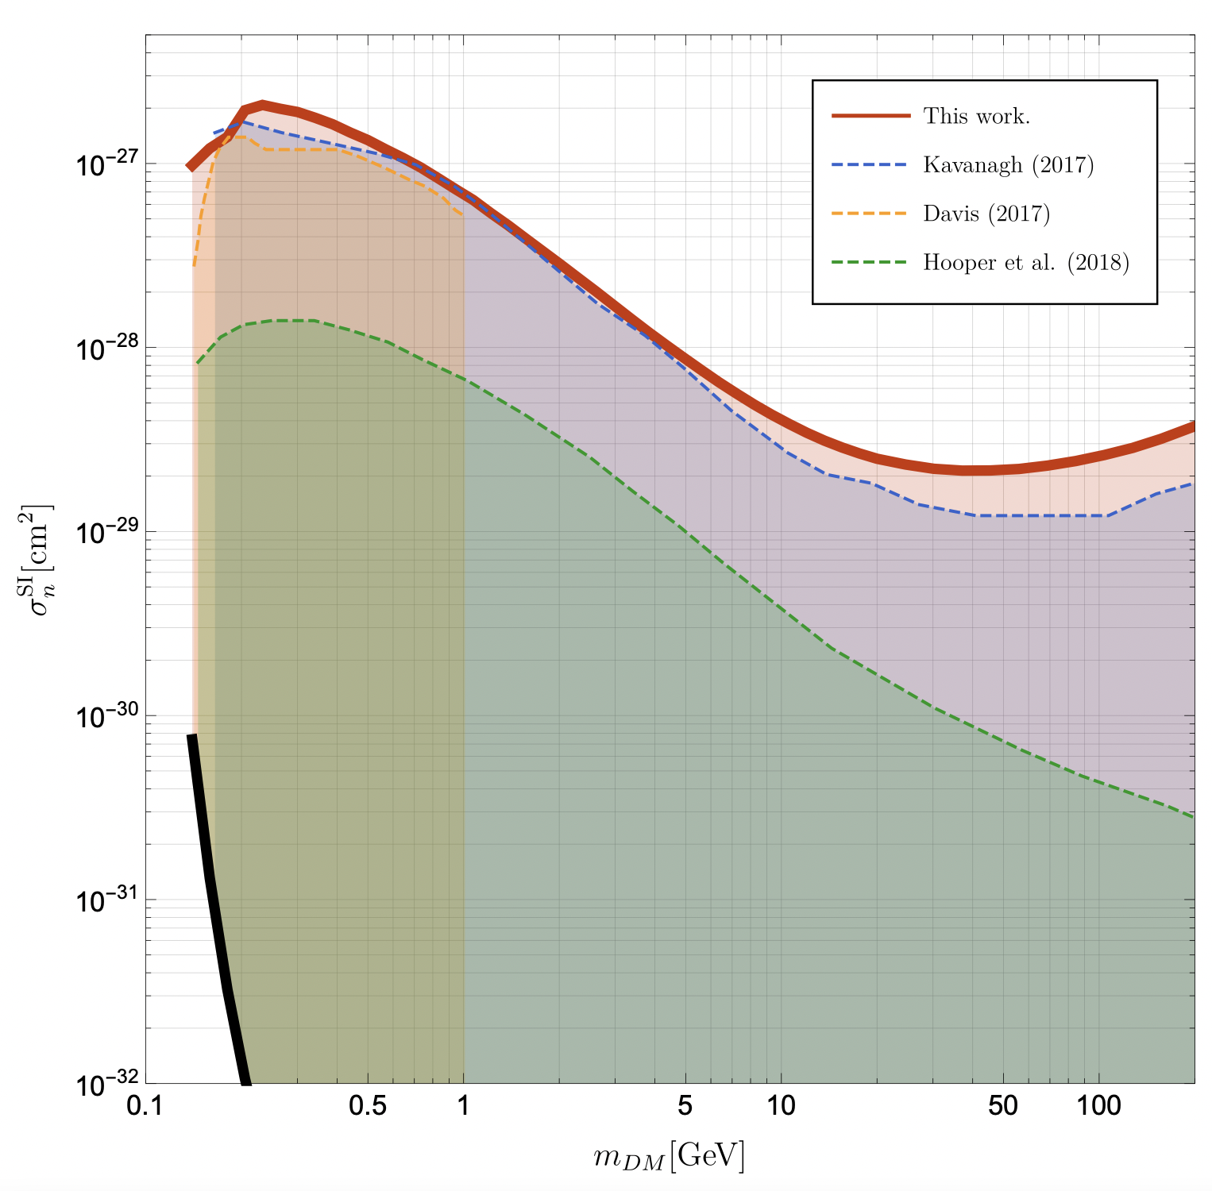
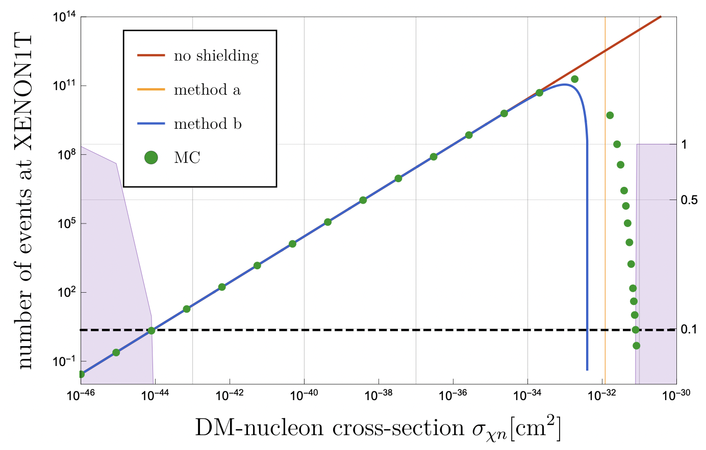
Straight Line vs. Monte Carlo
MC: Monte Carlo code
Method B: Straight Line Approximation
arXiv:1802.04764

Slide 13
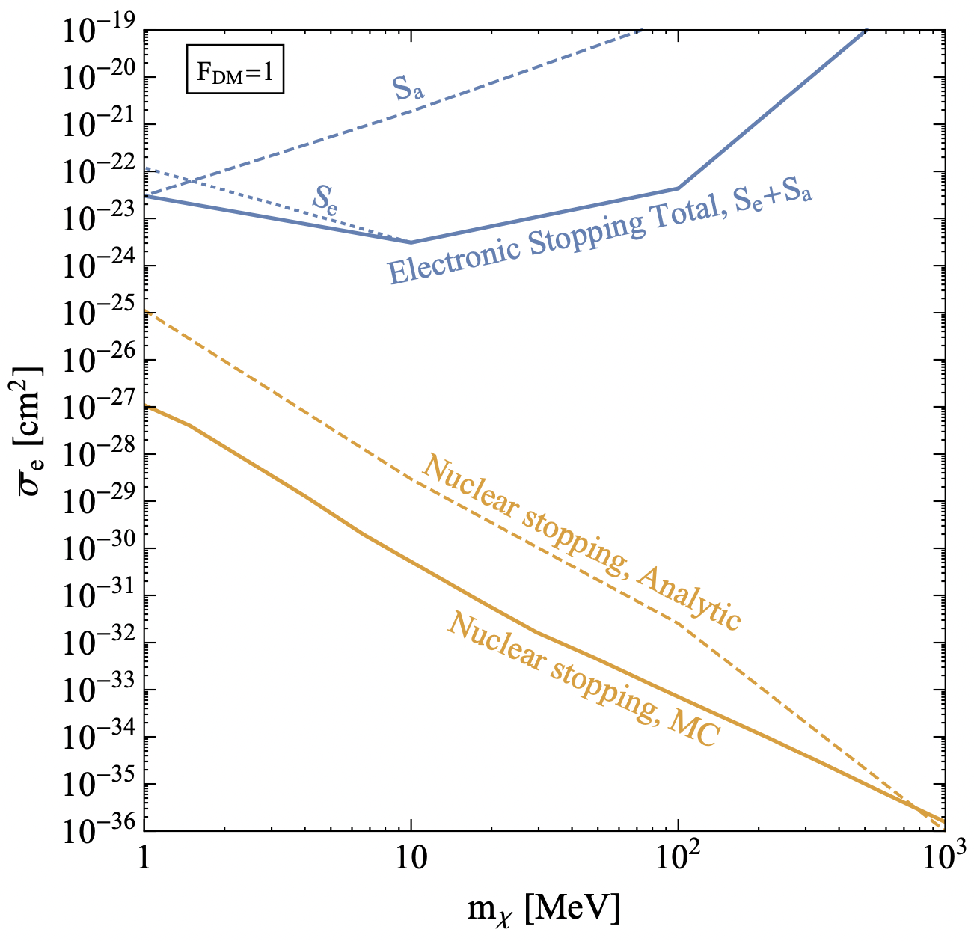
Straight Line vs. Monte Carlo
arXiv:1802.04764
arXiv:1905.06348

Slide 14
A New Analytic Approximation
Based on CVC, PRL 130, 221001 (2023)

Slide 15
Probability of Not Scattering
We want an alternative to both Monte Carlo and straight-line approaches
Hooper & Mcdermott (Green):
Compute fraction of dark matter reaching CRESST surface detector without scattering
arXiv:1802.04764

Slide 16
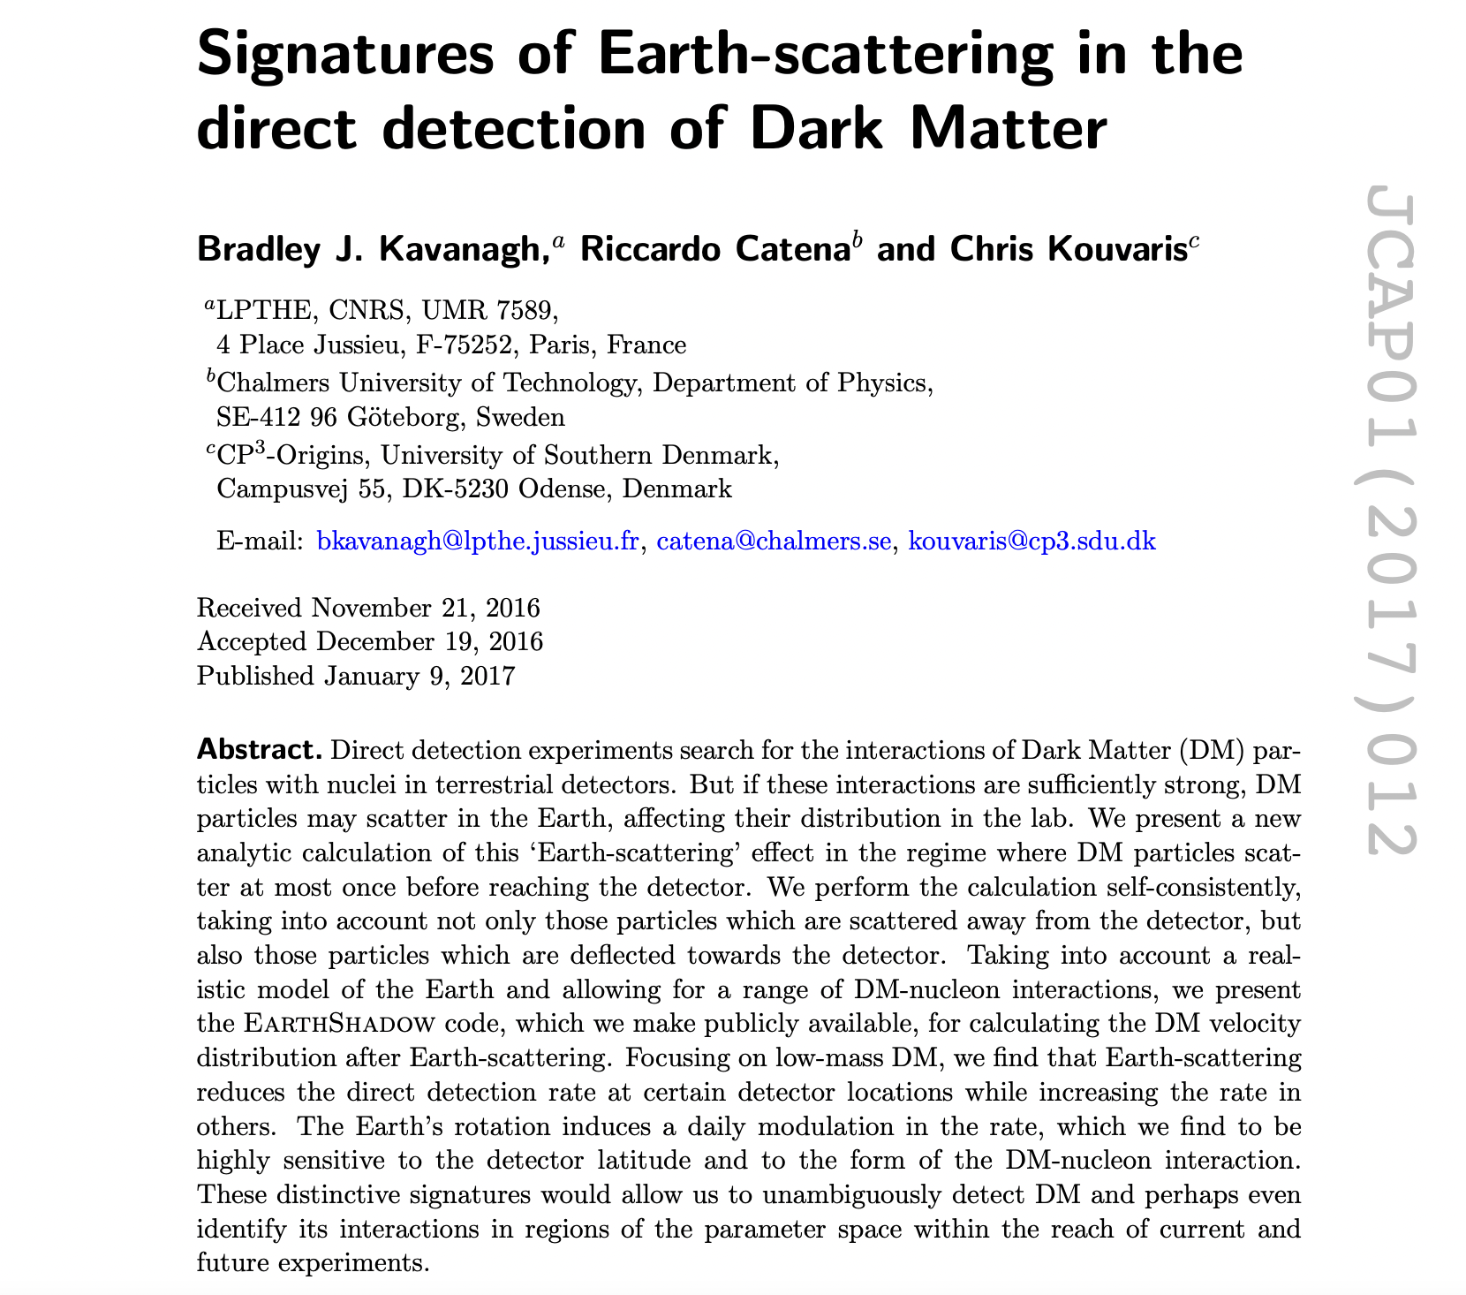
What about scattering?

Slide 17
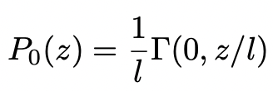
What about scattering?

Slide 18
What about scattering?
Assume isotropic scattering (heavy mediator)

Slide 19
What about scattering?

Slide 20
What about scattering?

Slide 21
What about scattering?
This process is iterative!
Can compute probabilities through n scatterings

Slide 22
Energy Loss

Slide 23
Energy Loss

Slide 24
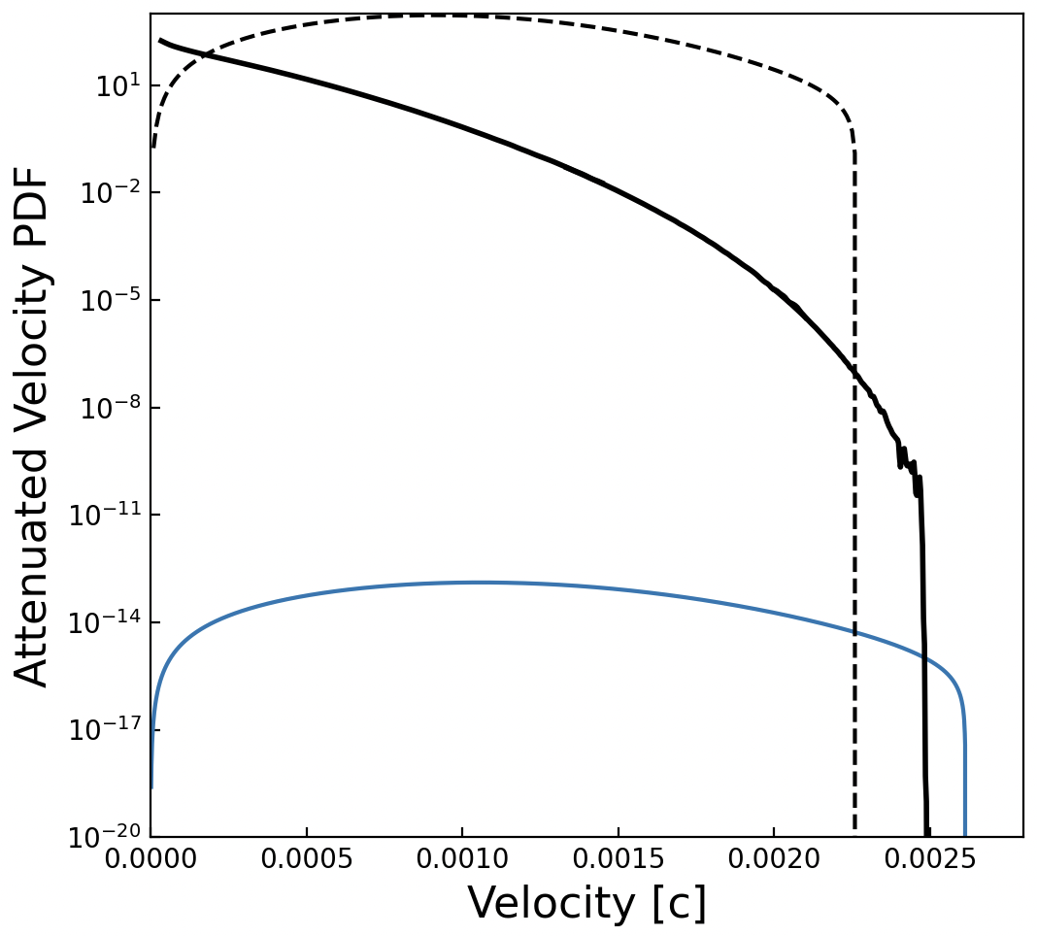
Velocity Distribution
M_{X} = 100 MeV
σ_{XN} = 5*10⁻³⁰ cm²
Depth = 1400 m

Slide 25
Probability of Not Scattering
We want an alternative to both Monte Carlo and straight-line approaches
Hooper & Mcdermott (Green):
Compute fraction of dark matter reaching CRESST surface detector without scattering
arXiv:1802.04764

Slide 26
Velocity Distribution
M_{X} = 100 MeV
σ_{XN} = 5*10⁻³⁰ cm²
Depth = 1400 m

Slide 27
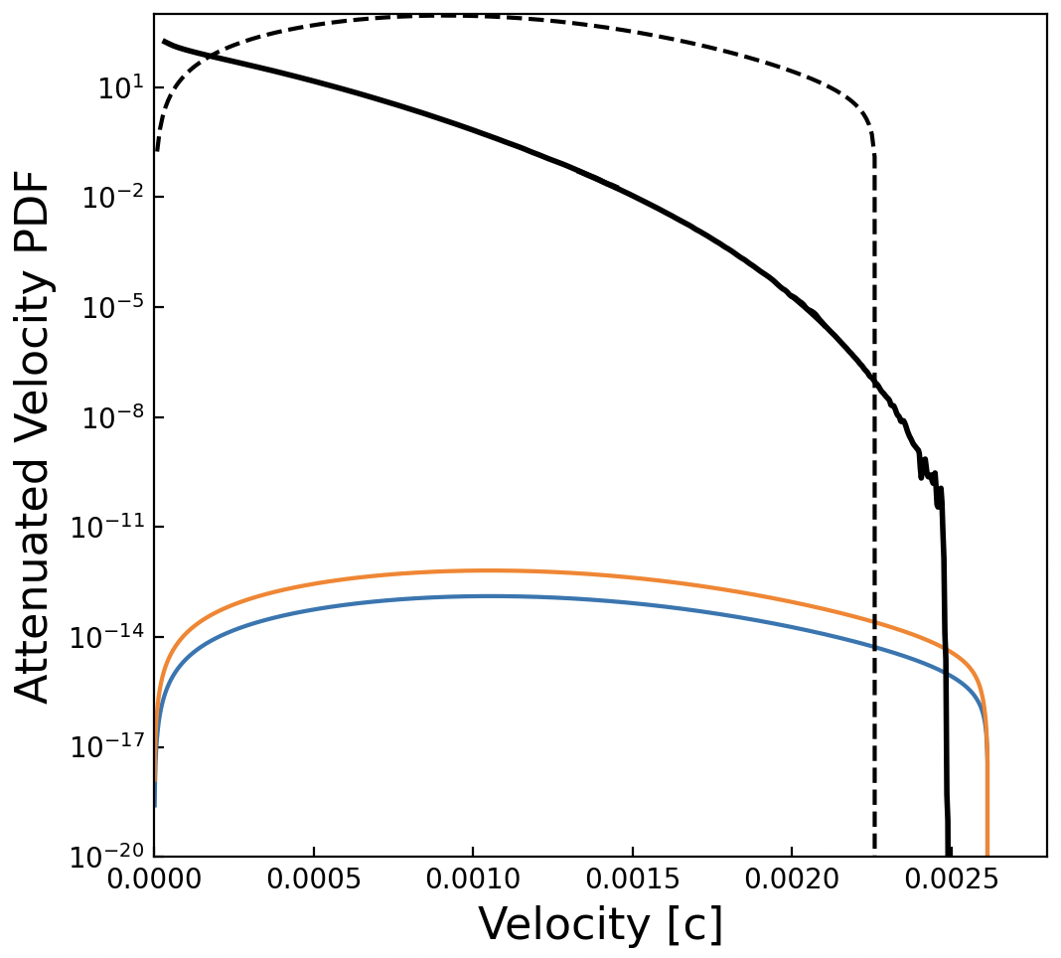
Velocity Distribution
M_{X} = 100 MeV
σ_{XN} = 5*10⁻³⁰ cm²
Depth = 1400 m

Slide 28
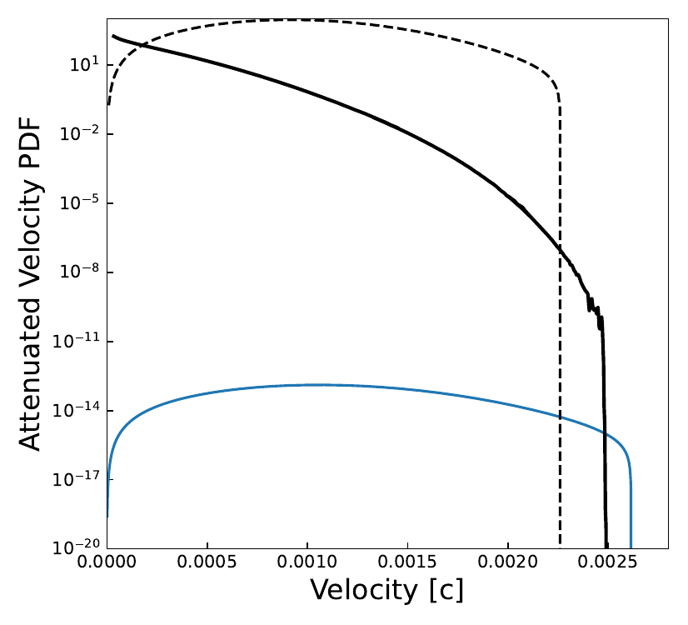
Velocity Distribution
M_{X} = 100 MeV
σ_{XN} = 5*10⁻³⁰ cm²
Depth = 1400 m

Slide 29
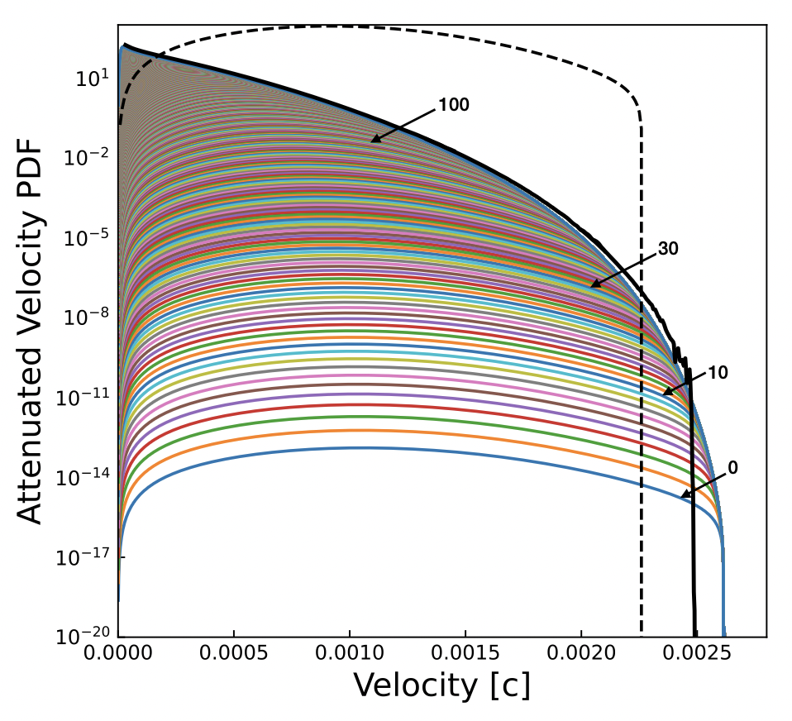
Velocity Distribution
M_{X} = 100 MeV
σ_{XN} = 5*10⁻³⁰ cm²
Depth = 1400 m

Slide 30
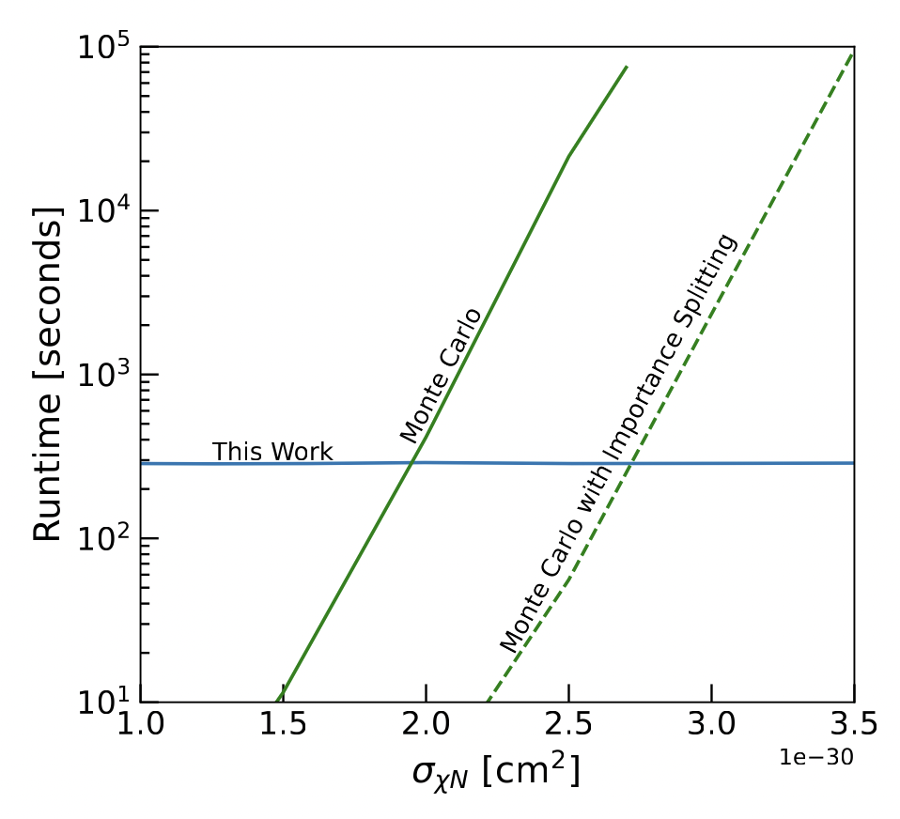
Runtime Comparison
M_{X} = 200 MeV
Depth = 1400 m

Slide 31
Attenuation: Straight Line Approximation
arXiv:2203.03993 (EDELWEISS)

Slide 32
Runtime Comparison
M_{X} = 200 MeV
Depth = 1400 m

Slide 33
Thank you!
Many thanks to Timon Emken for details on the DaMaSCUS Monte Carlo code
Thank you to Ivan Esteban for suggestions on speeding up integration
Code publicly available: https://github.com/ccapp413/DMpropPublic

Slide 34
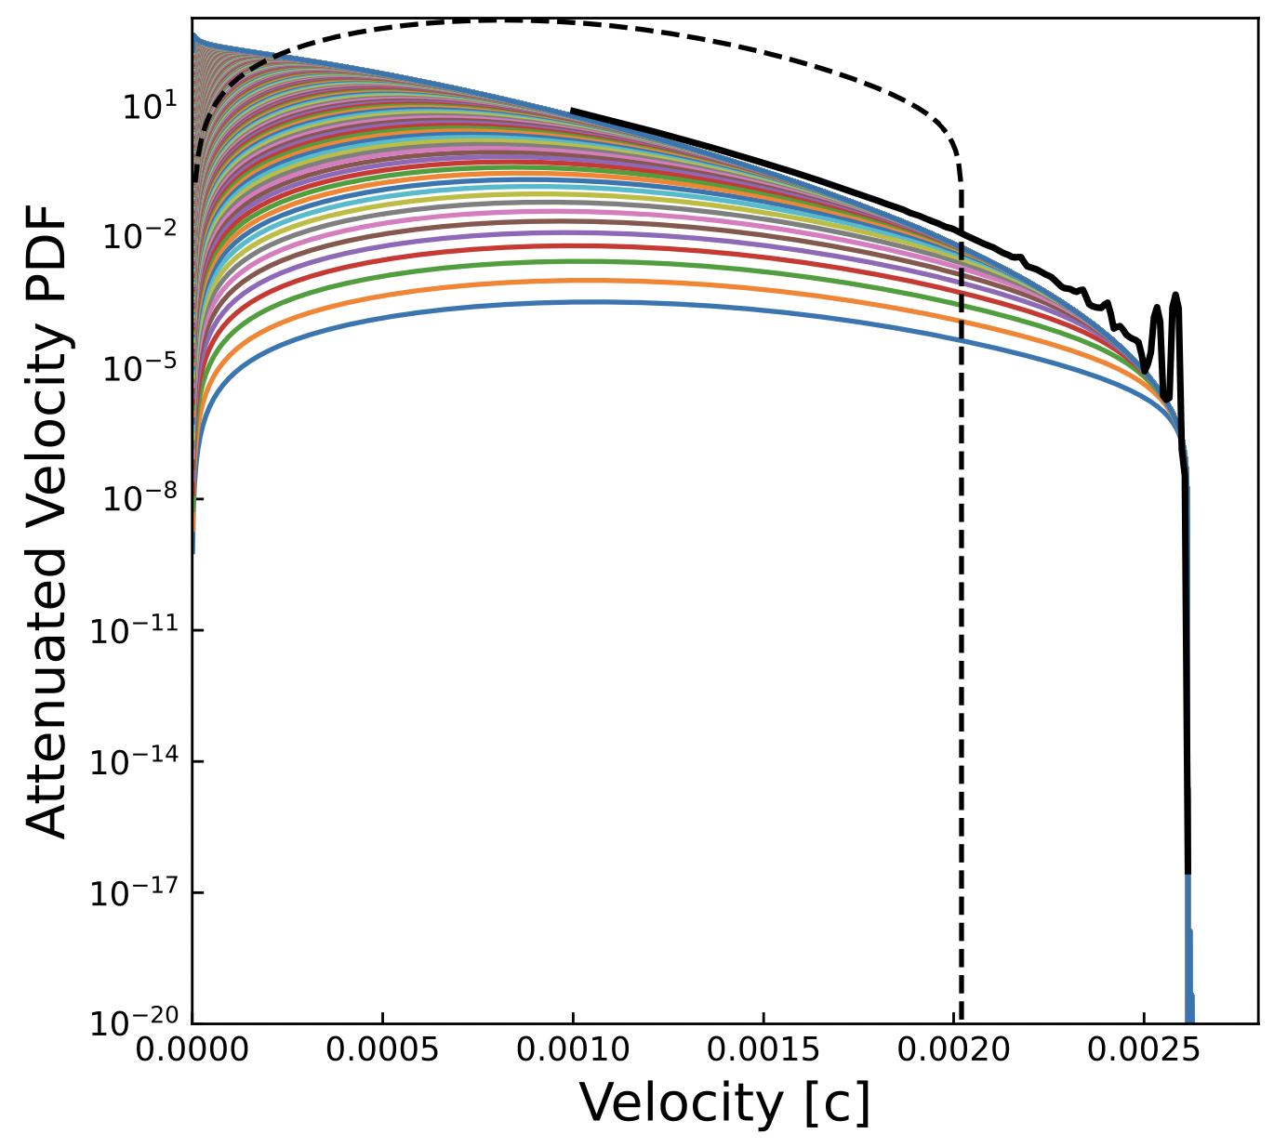
Backup: 500 MeV, 10⁻³⁰ cm²

