Slide 1
(Towards) Emulators for the In-Medium Similarity Renormalization Group
J. Davison (presenter), J. Crawford, S. K. Bogner, H. Hergert
This work is supported in part by the U.S. Department of Energy, Office of Science, Office of Nuclear Physics under Awards No. DE-SC0017887, DE-SC0023516, as well as DE-SC0018083, DE-SC0023175 (SciDAC NUCLEI Collaboration). Computing resources were provided by the Institute for Cyber-Enabled Research at Michigan State University.

Slide 2
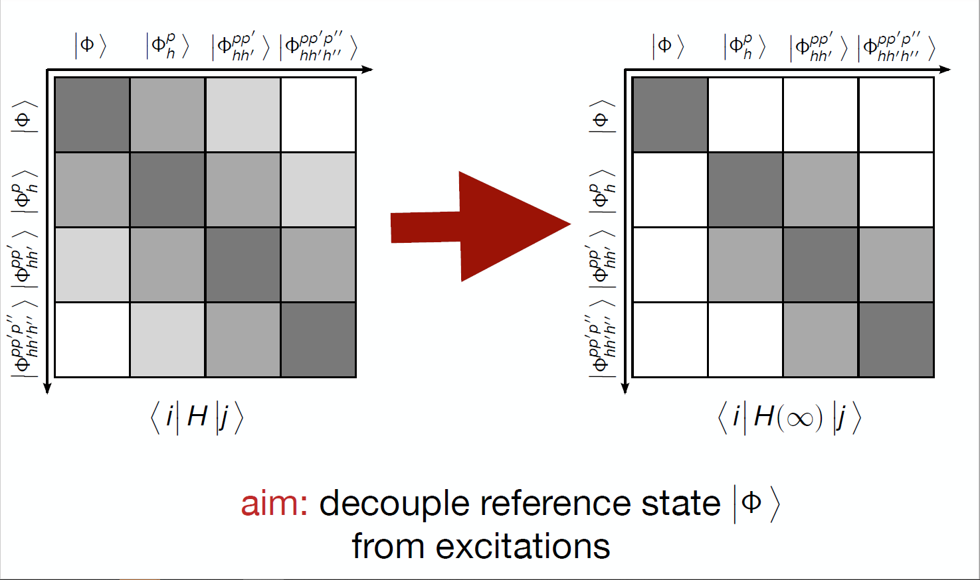
What is the IMSRG?
The In-Medium Similarity Renormalization Group (IMSRG) is an ab-initio method for computing the properties of nuclei.
The IMSRG is constructed in the normal-ordered operator basis of the many-body Hamiltonian; the IMSRG flow decouples a target reference state from excitations in the many-body basis via a continuous, unitary transformation [2] which effectively block-diagonalizes the Hamiltonian.
$$U\left(s\right)H\left(0\right)U^{∗}(s)$$
[2] Hergert et al. 2016
Notes:
The IMSRG flow decouples a target reference state from excitations in the many-body operator basis via a continuous, unitary transformation which effectively block diagonalizes the Hamiltonian. Excitations are iteratively suppressed according to a particular partitioning scheme that separates diagonal elements from off-diagonal elements.

Slide 3
What is the IMSRG?
We do not know the character of this transformation a priori. Instead, we solve for the transformation implicitly by integrating the nonlinear first-order ODE called the IMSRG flow equation, which reads [2]
$$\frac{d}{ds}H\left(s\right)= \left[η\left(s\right), H(s)\right].$$
The anti-Hermitian “generator” $η(s)$ takes a particular form which produces the desired decoupling behavior over the integration scale s.
Computational effort to solve the IMSRG scales $O\left(N^{6}\right)$ (at 2B truncations) where N is the system size. For typical nuclei calculations, N might range from ${10}^{6}$ to ${10}^{9}$ (or more). Data-driven emulators can help us reduce the number of $O(N^{6})$ iterations required for a converged result.
[2] Hergert et al. 2016
Notes:
We don’t know the transformation beforehand. Instead, we solve for the transformation via the IMSRG flow equation, which is integrated over the scale parameter s. The IMSRG is a dynamical problem in s. Computational effort to solve the IMSRG at 2B truncations is N^6, but we can use data-driven emulators to reduce the number of N^6 iterations required for a converged result. A data-driven emulator is a machine that we feed measurements of the evolving system, and then ask it to predict the rest of the dynamic range.

Slide 4
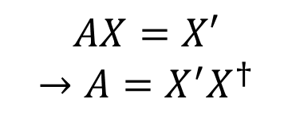
Dynamic Mode Decomposition
The DMD operator linearizes the first order ODE:
$$\frac{dx}{dt}=f\left(x\right)≈𝒜x$$
$$X$$
$$X′$$
A
$$AX=X′$$
$$→A=X^{′}X^{†}$$
$$x_{1}… x_{k}… x_{N−1}$$
$$x_{2}… x_{k+1}… x_{N}$$
State vector prediction
DMD eigenvectors
DMD eigenvalues
Initial condition
$$λ_{1}^{k}$$
$$b_{1}$$
$$…$$
$$x\left(t\right)=Φe^{Ωt}b$$
$$=$$
$$…$$
$$λ_{j}^{k}$$
$$b_{j}$$
$$x_{k}$$
$$φ_{1}… φ_{j}… φ_{r}$$
$$b=Φ^{†}x_{0}$$
$$…$$
$$…$$
$$λ_{r}^{k}$$
$$b_{r}$$
[4] Schmid 2010
Notes:
The Dynamic Mode Decomposition is a linearization method which decomposes the nonlinear dynamical system into a linear operator characterized by a discrete number of dynamical modes. First introduced by Schmid in 2010 for fluid dynamics. The DMD operator is, formally, the best-fit operator that propagates the system one step forward. The practicality of the DMD is that we can expand the solution vector in the DMD eigenbasis, thereby reconstructing the dynamics WITHOUT measuring the full dynamical range.

Slide 5
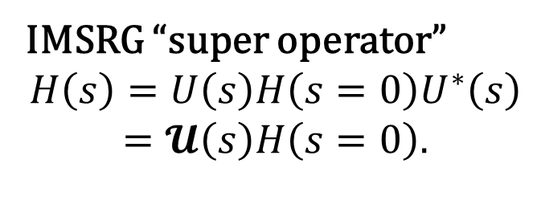
Emulating the IMSRG Flow
IMSRG “super operator”
$$H\left(s\right)=U\left(s\right)H\left(s=0\right)U^{∗}\left(s\right)$$
$$=𝓤\left(s\right)H\left(s=0\right).$$
DMD expansion
$$H\left(s\right)=\left\{Φe^{Ωs}Φ^{†}\right\}H(0)$$
The DMD “forecast” remains highly correlated with the IMSRG flow over the full dynamical range.
$${\left\|H_{DMD}−H_{IMSRG}\right\|}_{F}/{\left\|H_{IMSRG}\right\|}_{F}$$
Notes:
We use the DMD as a kind of unitary “super operator” that acts on the Hamiltonian to produce the IMSRG flow. The behavior of the DMD operator is determined by measurements of the IMSRG flowing Hamiltonian. The left panel shows that the accuracy of the DMD forecasted IMSRG flow is controlled by the number of observations used to build the operator. The right panel shows that the DMD reconstructed flow stays highly correlated with the IMSRG flow throughout the dynamical range. The DMD can reproduce the full flowing Hamiltonian.

Slide 6
Interpolating DMD for Parametric IMSRG
Goal:
Input: LECs from chiral EFT
Trained DMD interpolation engine
Output: Fully constructed IMSRG flow
Notes:
Eventually, we want to use DMD to build a machine that will provide an IMSRG prediction from an input set of LECs from chiral EFT. One strategy we have attempted is to train an interpolator to predict relevant DMD operators, in a large training space of LEC realizations.

Slide 7
Interpolating DMD for Parametric IMSRG
Left panel: 50 training points. Right panel: 300 training points. Toy model with 2 coupling constants.
Chiral EFT 2B interaction with 300 training points varying 24 LECs.
IMSRG compute time: 1 year
Interpolation engine compute time: 9 hours
PRELIMINARY
Notes:
The interpolation works well using a toy model with two coupling constants, but notice how the validation error surface is rough, even when more than quadrupling the number of training points. This roughness extends to a validation set of realistic IMSRG predictions. We need new interpolation strategies, or parametric DMD strategies, to smooth out the error; however, we note that one example of the usefulness of such a interpolator is that global sensitivity analysis of IMSRG to LEC input becomes possible.

Slide 8
Future Work
Expand DMD to nonlinear feature space via LANDO algorithm, to reduce forecast error further for hard interactions (hopefully)[3]
Adjust interpolation strategy to optimize memory usage and smooth error variability (high dimensional manifold interpolation strategies?)
Apply learned transformation of Hamiltonian to other observables, e.g. radius
Apply DMD to Magnus formulation of the IMSRG

Slide 9
References
B. O. Koopman, Hamiltonian systems and transformation in hilbert space, Proceedings of the National Academy of Sciences 17, 315 (1931), https://www.pnas.org/doi/pdf/10.1073/pnas.17.5.315.
H. Hergert, S. Bogner, T. Morris, A. Schwenk, and K. Tsukiyama, The in-medium similarity renormalization group: A novel ab initio method for nuclei, Physics Reports 621, 165–222 (2016).
P. J. Baddoo, B. Herrmann, B. J. McKeon, and S. L. Brunton, Kernel learning for robust dynamic mode decomposition: linear and nonlinear disambiguation optimization, Proceedings of the Royal Society A: Mathematical, Physical and Engineering Sciences 478, 10.1098/rspa.2021.0830 (2022).
P. J. SCHMID, Dynamic mode decomposition of numerical and experimental data, Journal of Fluid Mechanics 656, 5–28 (2010).
Q. A. Huhn, M. E. Tano, J. C. Ragusa, and Y. Choi, Parametric dynamic mode decomposition for reduced order modeling (2022).

