Slide 1
Implicit Particle-in-Cell Development for Bounded Plasmas
Nicolas Savard^{1,2}, G. Fubiani³, R. Baartman¹, M. Dehnel²
¹TRIUMF, ²D-PACE, ³CNRS

Slide 2
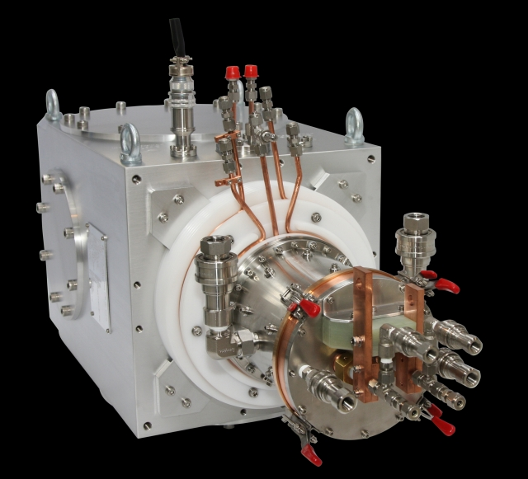
Ion Source Modeling
Ion sources development experimentally focused
Particle-in-Cell has large computational cost at high electron densities - > Impractical!
Implicit Particle-in-Cell scheme claims more than 1000x speedup in high density cases
Can we get speedup that would make implicit practical for engineering?

Slide 3
Particle-in-Cell Method: Explicit
Simple implementation
Need resolution on order of debye length and plasma frequency: Δx < λ_{De}, Δt < 1/ω_{p}
Disobeying above requirements leads to numerical instabilities!
Makes high plasma density (~ 10¹⁸ m⁻³) simulations for ion sources impractical
Interpolation of particle charge on grid
Solve for particle motion
Δt
Solve for fields on grid
Interpolation of fields on particles
Explicit example:
$$v^{k+1}= v^{k}+ \frac{∆t q}{m}E^{k}$$

Slide 4
Particle-in-Cell Method: Implicit
Solve E^{k+1} given v^{k+1}, x^{k+1} for particles
Fields dependent on future particle phase space and vice versa: non-linear!
Implicit scheme is unconditionally stable and energy conserving
Allows Δx > λ_{De}, Δt > 1/ω_{p} which can offset additional computation
Claims of large speedups!
t^{k+1} = t^{k} + Δt
Convergence?
Yes
Solved!
No
Solve v^{k+1}, x^{k+1} for particles given E^{k+1}
Implicit Example:
$$v^{k+1}= v^{k}+ \frac{∆t q}{m}\frac{E^{k}+ E^{k+1}}{2}$$

Slide 5
This Work
1D energy-and-charge conserving scheme (Chen 2011)
Uses discrete curvilinear mapping to rectangular grid (Chacon 2013)
Programming kept as similar as possible with explicit scheme
Run + average results over 22 us
Field Eq:
Picard Iteration:
Convergence:

Slide 6
Benchmark Model: Emmert et.al. 1980
1D Ion kinetic equation
Ion source term flux-Maxwellian
Boltzmann electrons
Neumann/symmetric boundary
Metal plate
φ
wall
Symmetry Boundary
φ_{wall}
x = 0
x = L

Slide 7
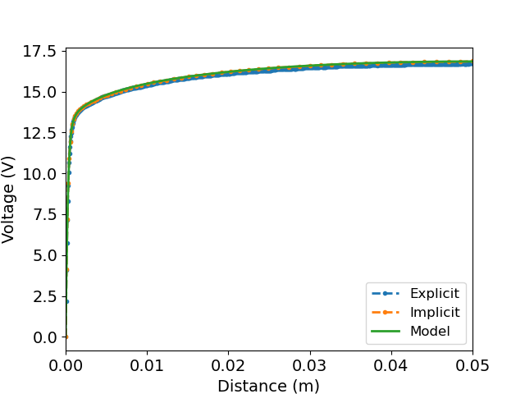
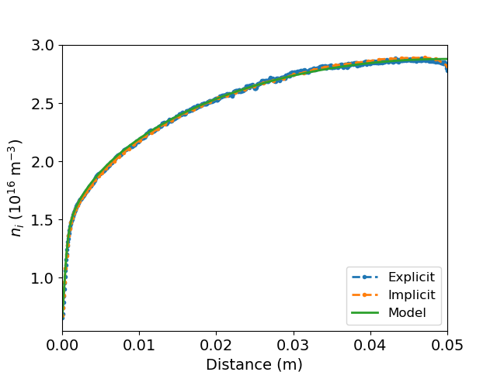
Benchmark Match
T_{e} = 5 eV, T_{i} = 1 eV, <n_{e}> = 2.5 x 10¹⁶ m⁻³, L = 0.05 m
Explicit: Δx = 0.5 λ_{De} (952 nodes), Δt = 0.2/ω_{p}
Implicit: 64 nodes, last cell Δx = λ_{De}, Δt = 2/ω_{p}
Run + averaged over 22 us

Slide 8
Implicit vs Explicit Timing
Equivalent but large PPC for low # nodes with implicit -> Speedup!
Not fair as using more particles than necessary in explicit
If field solver dominates particle mover, then implicit will be faster for larger L/ λ_{De}
Using conjugate gradient solver leads unfair
multi-grid methods can lead to roughly linear scaling with # nodes
Use Thomas algorithm as best-case O(n) solver
Explicit example
∆x_{exp}
3 PPC
∆x_{imp}
Implicit example

Slide 9
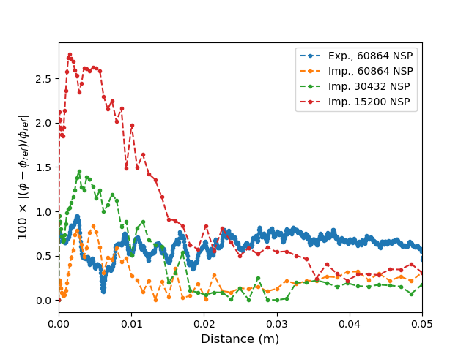
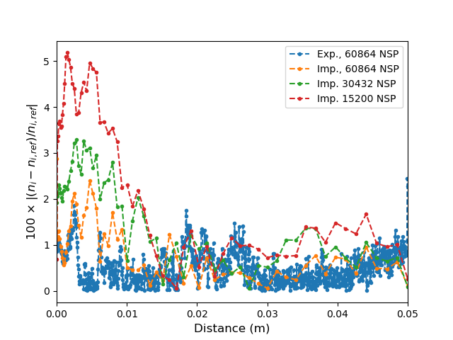
Changing Number-Simulation-Particles (NSP)
Δx = 0.15 λ_{De}, Δt = 0.05/ω_{p} explicit PIC used as reference for absolute value residual
Other explicit (blue) at Δx = 0.5 λ_{De}, Δt = 0.2/ω_{p}
Implicit needs less particles for accuracy in bulk, but sheath suffers

Slide 10
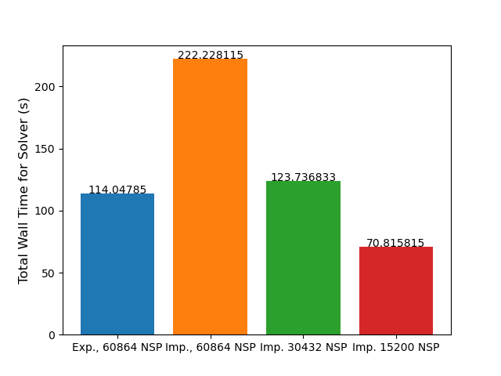
Timing for varied NSP
Extra iterations costly for same amount of NSP
Can reduce particles for speedup, but explicit can also be reduced
But… limit to how much particles can be reduced, eventually field dominated
For engineering purposes, 10% accuracy is ok!

Slide 11
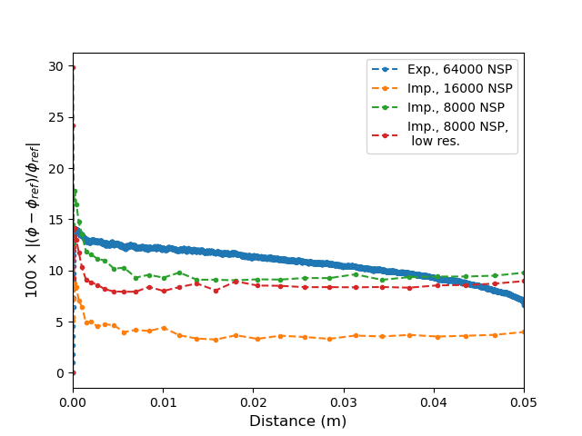
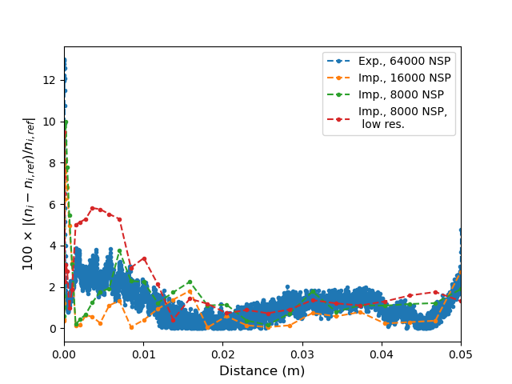
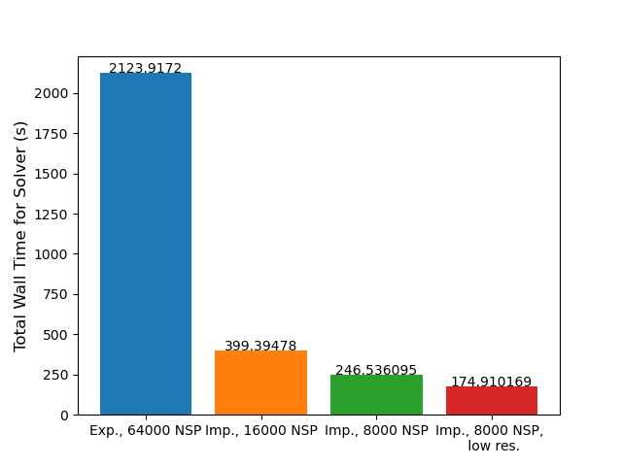
Low-macroparticle Resolution 10¹⁸ m⁻³
128 PPC, Δx = 0.5 λ_{De}, Δt = 0.2/ω_{p} explicit PIC used as reference for residual
Use 32 nodes for implicit, cell at wall has Δx = λ_{De}
8.6x faster for similar accuracy, goes up with density as expected!
12x faster when relaxing convergence criterion

Slide 12
Future Work
2D bounded plasma: does # macro-particles in volume needed scale with dimensions? How does particle pusher scale with density using multigrid in higher dimensions for fixed # CPUs? Picard iterations necessary for particles lead to slowdown?
Linear interpolation: slower particle mover, but lower macroparticle # needed?
Pre-conditioned Jacobian-Free Newton-Krylov?
1D self-consistent discharge: implicit numerical stability offer greater advantage over explicit?

Slide 13
^{References}
G. Emmert et.al., “Electric sheath and presheath in a collisionless, finite ion temperature plasma”, Phys. of Fluids 1980
R. Procassini et.al., “A fully kinetic, self consistent particle simulation model of the collisionless plasma-sheath region”, Phys. of Fluids, 1989
G. Chen et.al., “An energy-and-charge-conserving, implicit, electrostatic particle-in-cell algorithm”, J. Comp. Phys., 2011
L. Chacon et.al., “A charge-and-energy-conserving implicit, electrostatic particle-in-cell algorithm on mapped computational meshes”, J. Comp. Phys., 2013
S. Mattei et.al., “A fully-implicit Particle-in-Cell Monte Carlo Collision code for the simulation of inductively coupled plasmas”, J. Comp. Phys., 2017
D. Eremin et.al., “An energy-and-charge-conserving electrostatic implicit particle-in-cell algorithm for simulations of collisional bounded plasmas”, J. Comp. Phys., 2022
G. Chen et.al., “An implicit, conservative and asymptotic-preserving electrostatic particle-in-cell algorithm for arbitrarily magnetized plasmas in uniform magnetic fields”, J. Comp. Phys., 2023

