Slide 1
HVE Ion sources for medium and high energy accelerator systems
Arun Annaluru
on behalf of the HVE Physics Department
21-09-2023

Slide 2
Outline
About HVE
HVE product range- what do we develop?
Standard ion sources for accelerators
Recent 2.45GHz microwave ion source development at HVE
Summary / Outlook

Slide 3
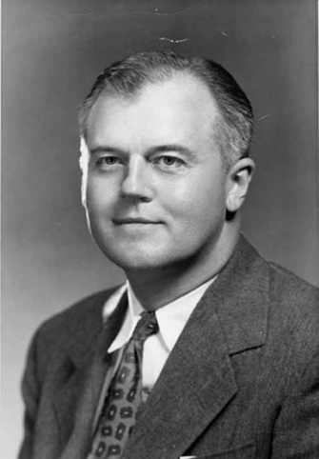
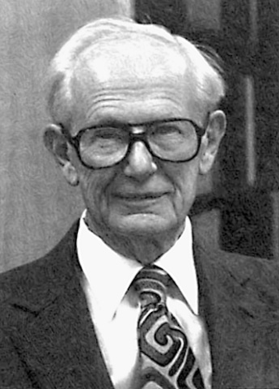
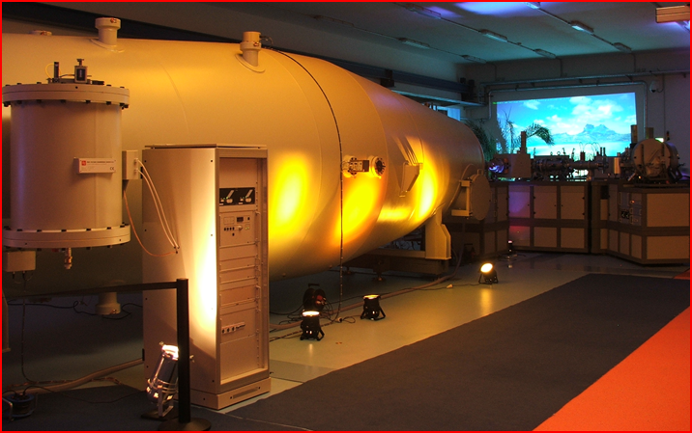

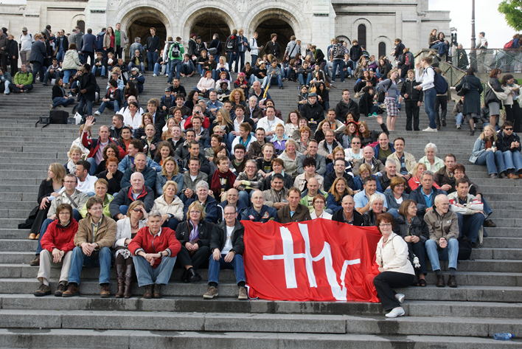
High Voltage Engineering Europa
Founders of High Voltage Engineering Corp.
1959
Established as a subsidiary of High Voltage Engineering Corp., USA
1977
High Voltage Engineering Europe became independent - started manufacturing its own products.
What do we do?
Develop and manufacture customized particle accelerator systems for science and industry.

Slide 4
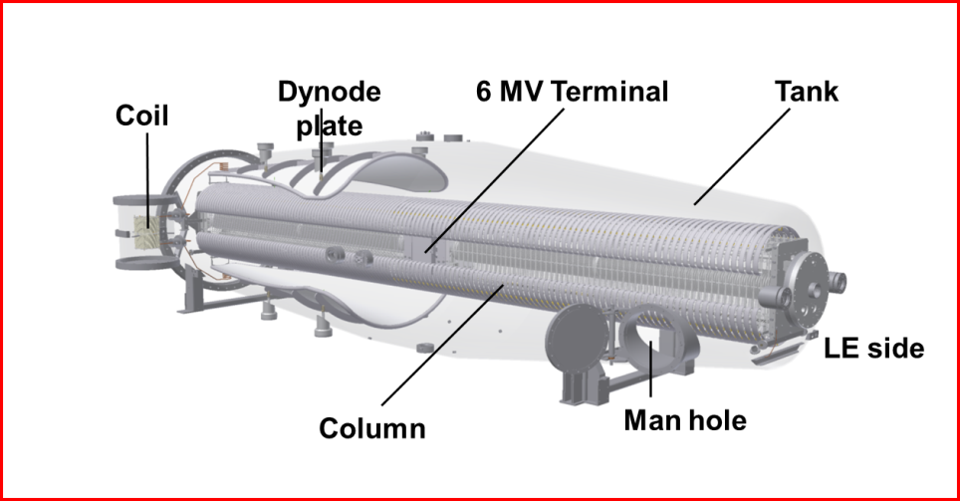
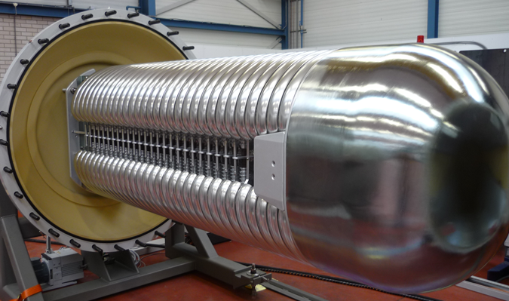
HVE product range
Tandem particle accelerators 1 – 6 MV
Tandetrons™
Single-ended particle accelerators 1 – 6 MV
Singletrons™
Typical applications:
Accelerator Mass Spectrometry (AMS)
Ion implantation
Rutherford Backscattering Spectrometry (RBS)
Particle Induced X-ray Emission (PIXE)
8 MV system design is ready
Typical applications:
Ion Beam Analysis (IBA)
Micro & nano beam applications
Ion beam modification of materials
Ion beam mixing
Electron beam processing

Slide 5
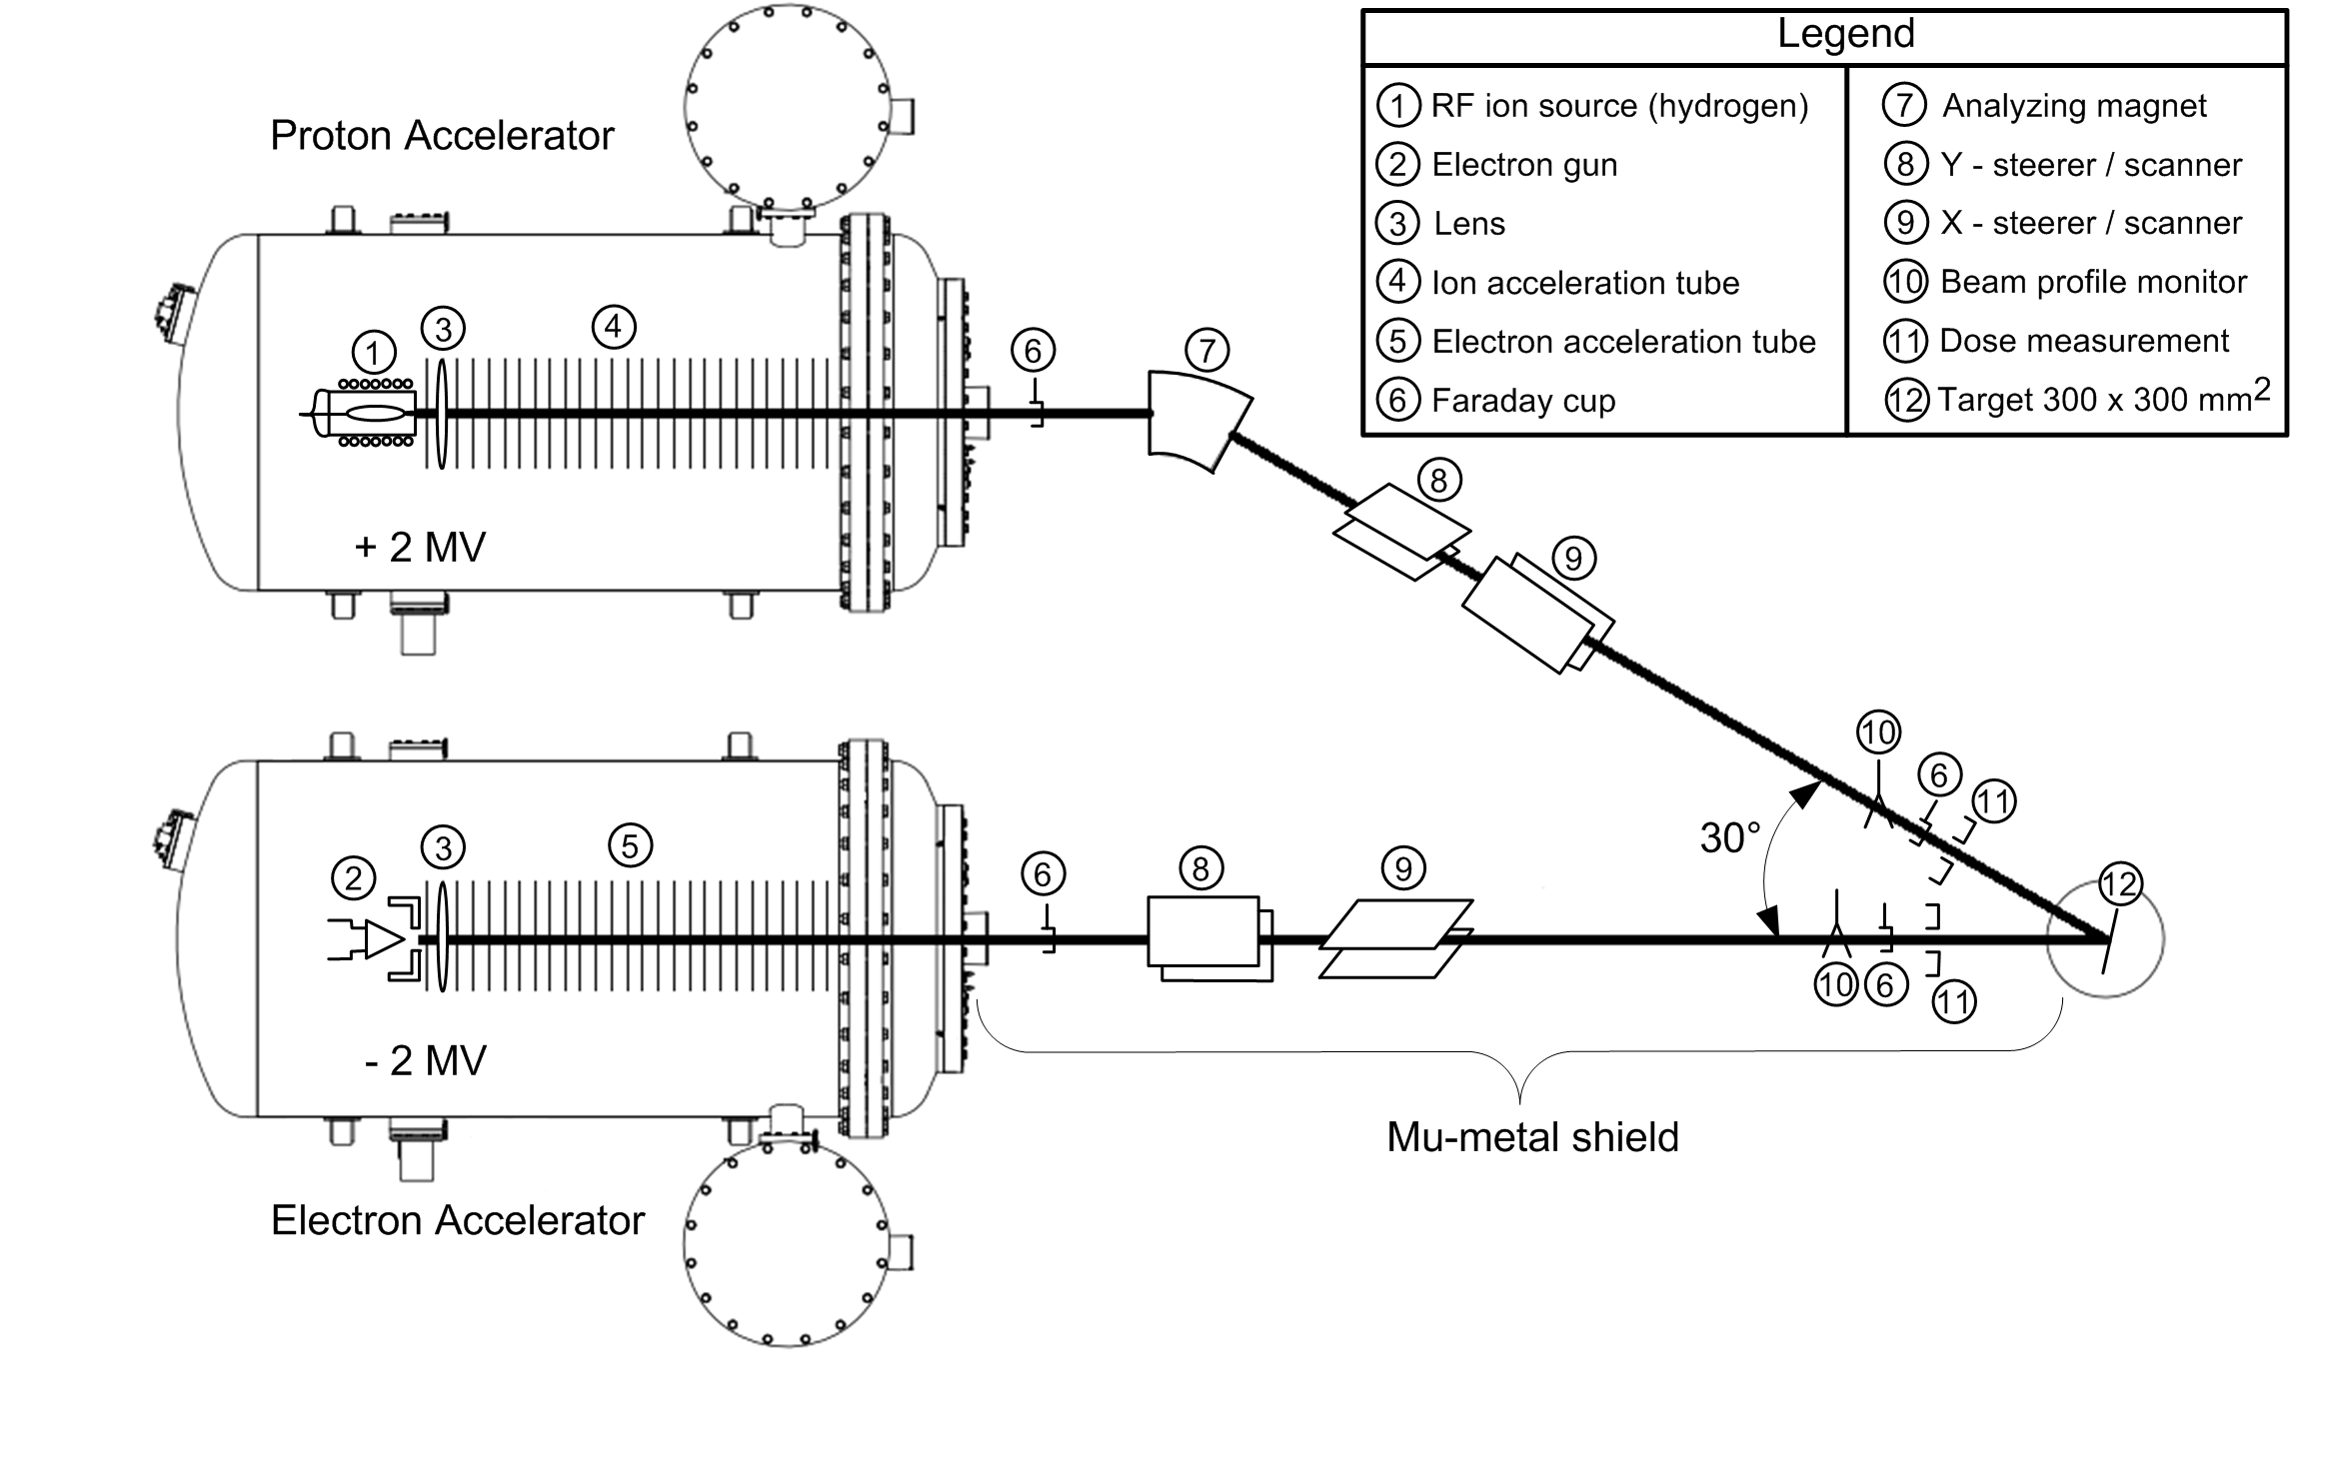
Typical SingletronTM accelerator system overview
+ 2 MV
System operational at
Lanzhou Institute of Physics, China
6.8 m (22.3 ft.)
- 2 MV
Singletron TV range: 100 kV to 6 MV
10.8 m (35.4 ft.)

Slide 6
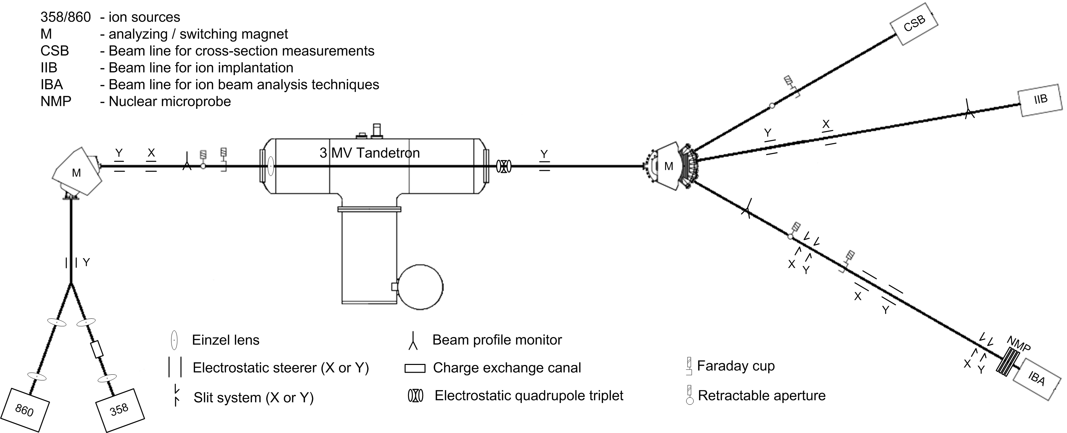
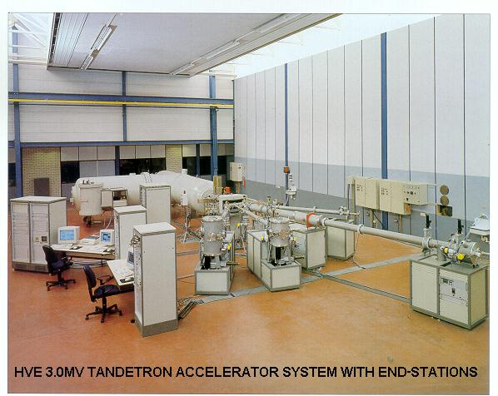
Typical TandetronTM accelerator system overview
System operational at
Institute of Physics and power eng., Obninsk, Russia
TV range 100 kV to 6 MV (Next upgrade: 8 MV system)
System footprint: 6.8 × 18.7 m²

Slide 7
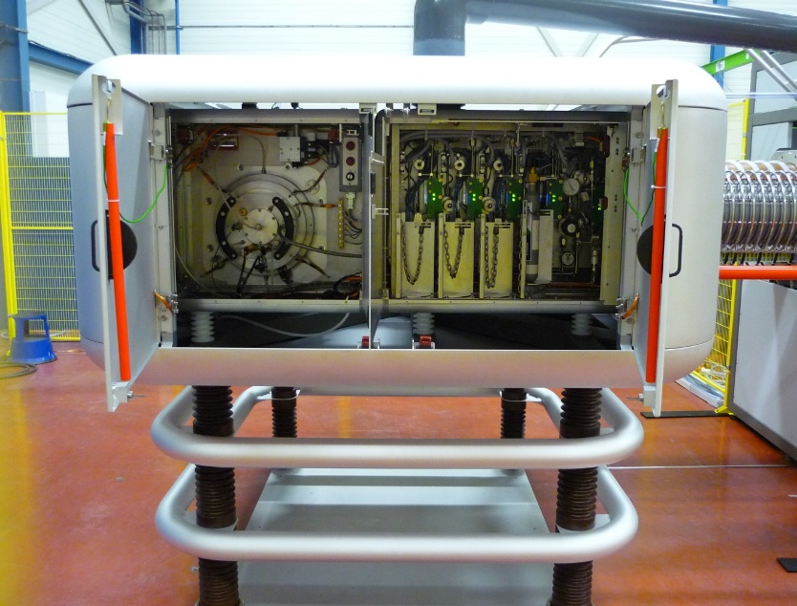
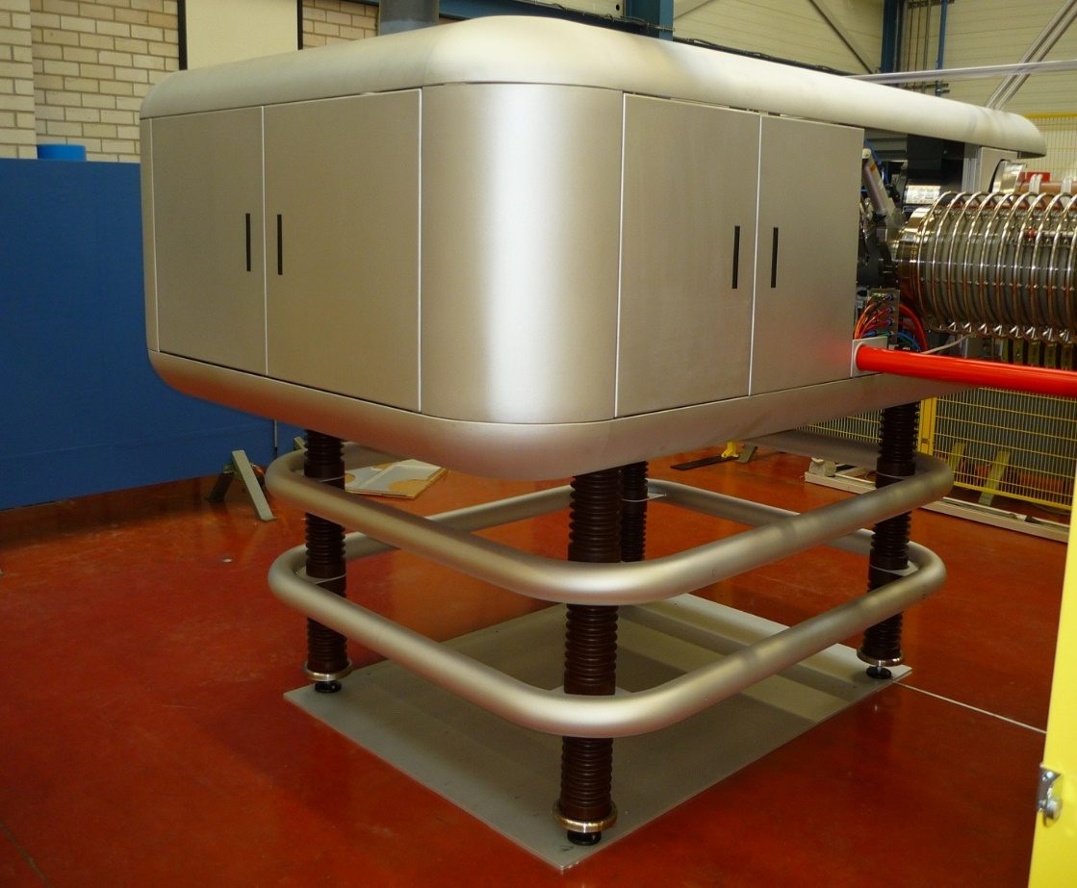
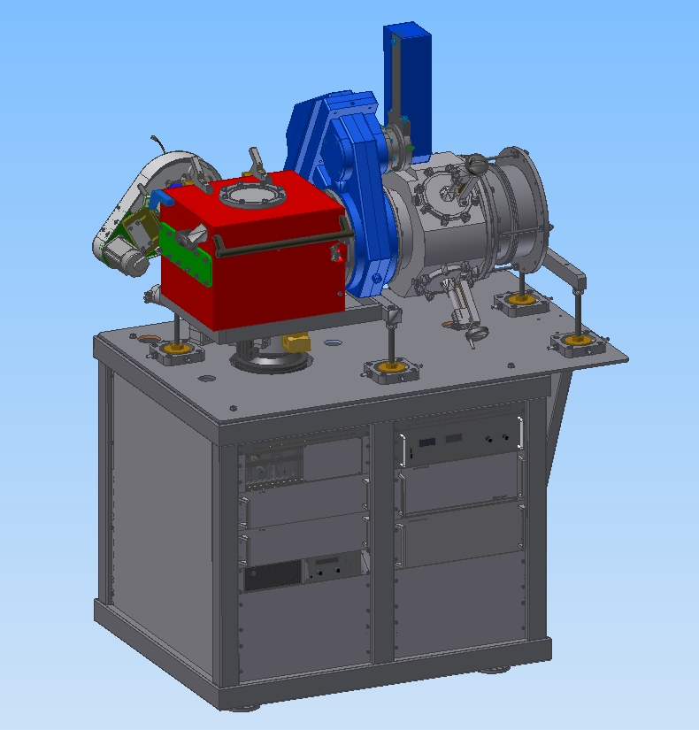
More products from HVE
Air-insulated particle accelerator systems – 100kV to 500kV
  Compact HV terminal
  state of the art gas feed system – supporting BF₃, AsH_{3,} etc.
  Analysing magnet with M/ΔM > 300
Ion sources
  Positive ion extraction
  Negative ion extraction
Beam diagnostics
  Beam profile monitors
  Retractable Faraday cups
Beam handling
  Electrostatic quadrupole triplet lens
  Beam sweep systems
  Charge exchange canals
  Switching magnets
Implant chamber
Beam
System operational at
Rossendorf, Germany
4- corner Faraday cup assembly

Slide 8
HVE Ion sources
Ion sources integrated into Tandetron systems:
  AMS Hybrid Ion Source (Model SO-110 )
    Bernas ion source (Model SO-140)
      Multicusp Ion Source for H⁻ & D⁻ (Model SO-120 )
        Multicusp Ion Source for He⁻ (Model SO-130)
          Dual polarity 2.45GHz ECR ion source (Model SO-160)
Ion sources integrated into Singletrons systems:
  Duoplasmatron Ion Source (Model 358)
    10 GHz ECR ion source (Model SO-150)
      2.45GHz ECR ion source (Model SO-170)
        RF Ion Source (Model SO-173)
          Sputter Penning Ion Source (Model SO-90 )

Slide 9
Standard ion sources used in HVE accelerator systems

Slide 10
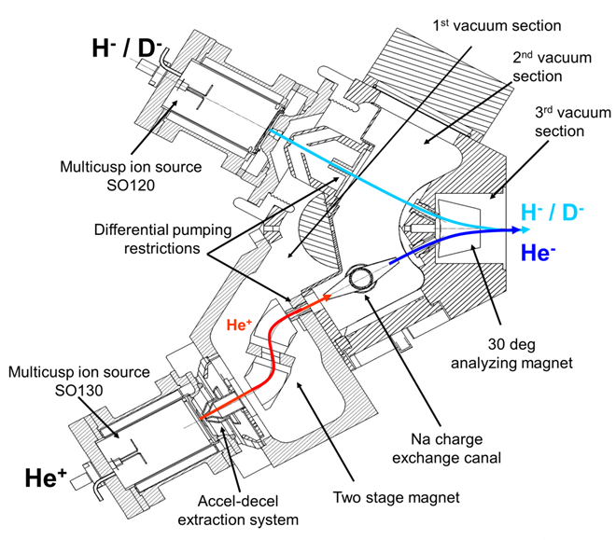
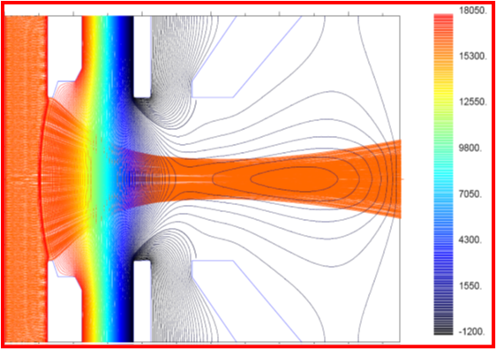
Model SO120 & SO130 - Dual Multicusp Injector
Injector characteristics:
Differential pumping section
SO-120 Multicusp source for H⁻ and D⁻ :
Injection energy: 30 kV
H- current: up to 3 mA
SO 130 + Na CEC output for He⁻ :
Brightness = 20 – 40 A×m⁻²×rad⁻²×eV⁻¹ (80 %)
Injection energy : 20 keV
He+ current: 15 mA (typical)
He- current: 75 eµA (Measured 1m away from CEC)
Brightness = 100 – 200 A×m⁻²×rad⁻²×eV⁻¹ (80 %)
N₂ injection for SCC in the source block
Injector:
Footprint = 1.8 m x 1.4 m
Filament lifetime > 500 hours (typical)
Filament replacement time < 20 minutes
Second-order corrected ion optics
Accel-Decel extraction geometry:
Optimized for 20 keV He⁺ current of 15 mA
Beam size at the waist ~1mm
Beam half angle divergence of 20 mrad
doi:10.1063/1.3259235

Slide 11
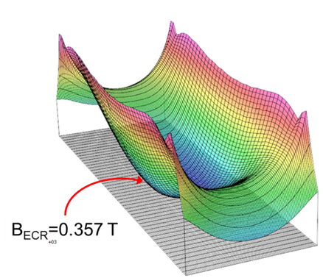
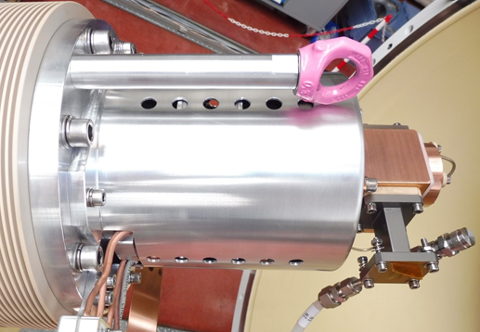
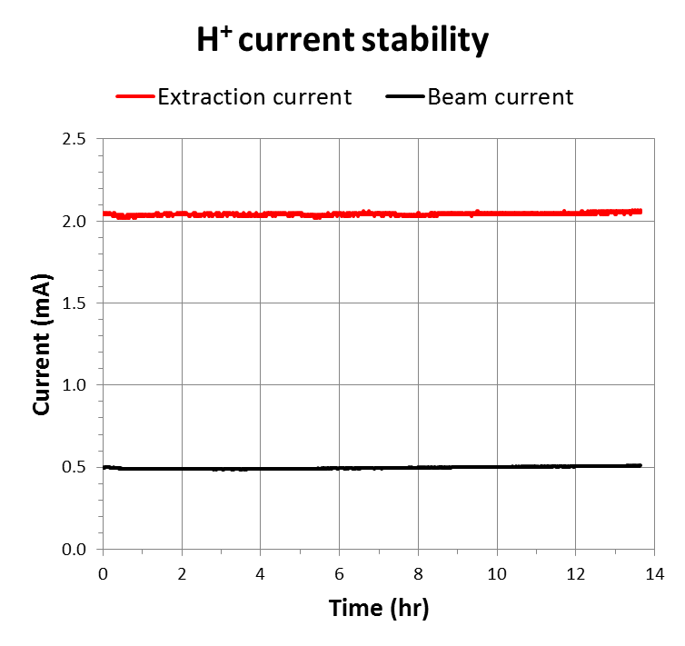
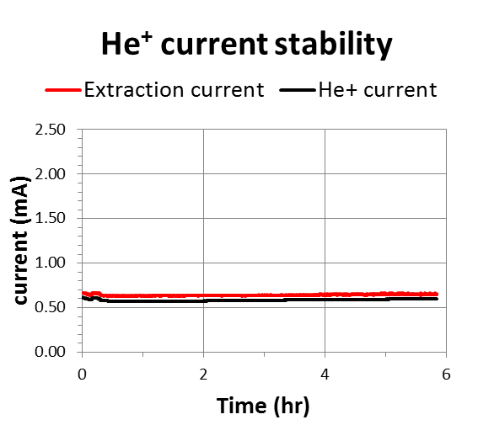
Model SO150 - 10GHz ECR ion source
Permanent magnet ion source
Compact design, 17 kg
Syltherm cooled
Low gas consumption and easy operation
Emittance 12 mm mrad MeV^{1/2} for 1.5 mA of H⁺
Beam current stability = 0.4% / hr
Beam current stability = 1.4% / hr

Slide 12
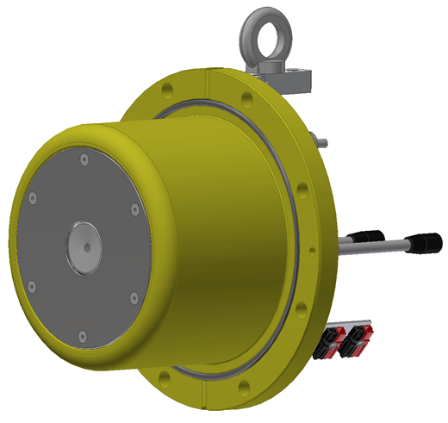
Model SO160 - 2.45GHz dual polarity microwave ion source
Goal:
  Integrate a compact light ion source into singletrons
  Alternative for multicusp dual injector system in tandem accelerators
  Cesium free operation
Challenges:
  Na Charge exchange canal (NaCEC) to produce He⁻
  Optimal extraction system to transport H⁻ and He⁺ through CEC
  Optimum filter magnetic field to extract He⁺ and H⁻
  Differential pumping section to restrict He⁻ losses after CEC
  Low maintenance and user-friendly operation
Required specs:
  Support positive and negative ion extraction that is switchable without intervention
  > 20 µA of He⁻ @30 keV
  > 250 µA of H⁻ @ 30 keV

Slide 13
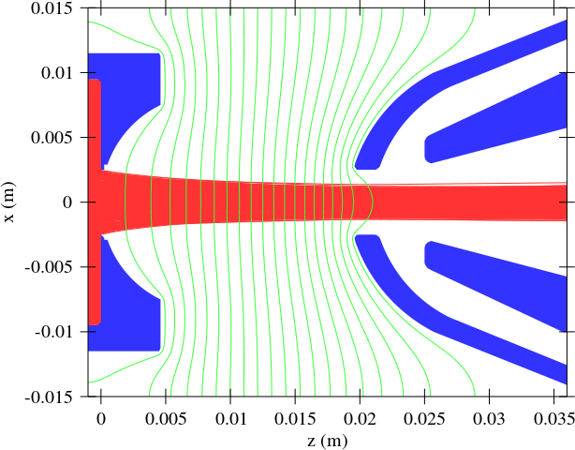
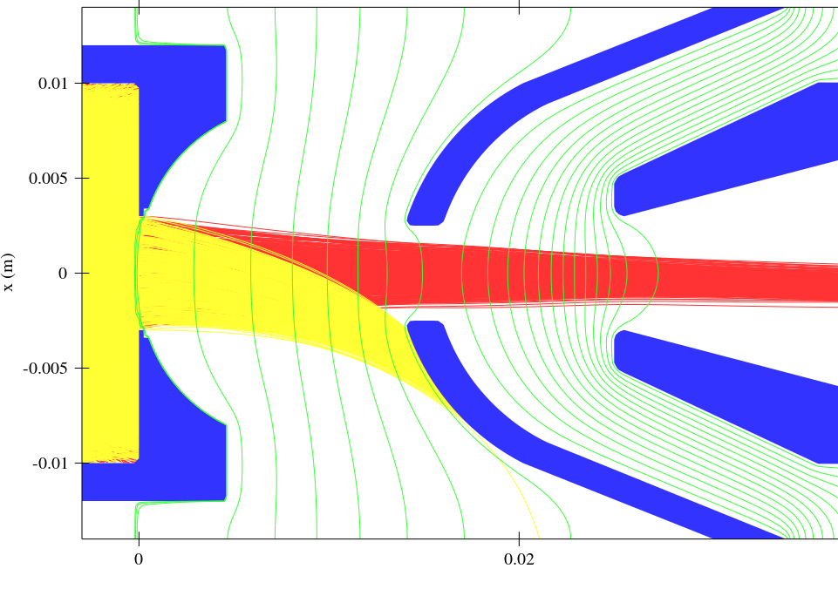
SO160 Extraction geometry design
Introduced movable puller/1st electrode in X, Y, and Z direction
Shaping of extraction electrodes to achieve maximum transmission through NaCEC
1st electrode
1st electrode
source
source
source
source
source
Ground
Ground
Ground
Ground
Two-stage acceleration for H⁻ beam up to 1mA
Accel-decel extraction for He⁺ beam up to 8 mA
Source HV: -30 kV
1st electrode HV: 5 kV (on source potential)
Co extracted Electrons dumped on 1st electrode
Source HV: 30 kV
1st electrode HV: -5 kV

Slide 14
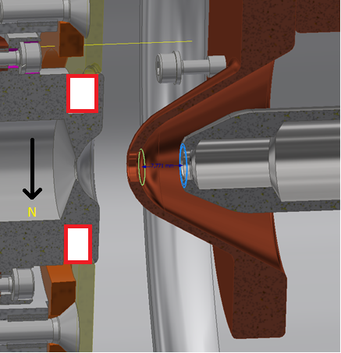
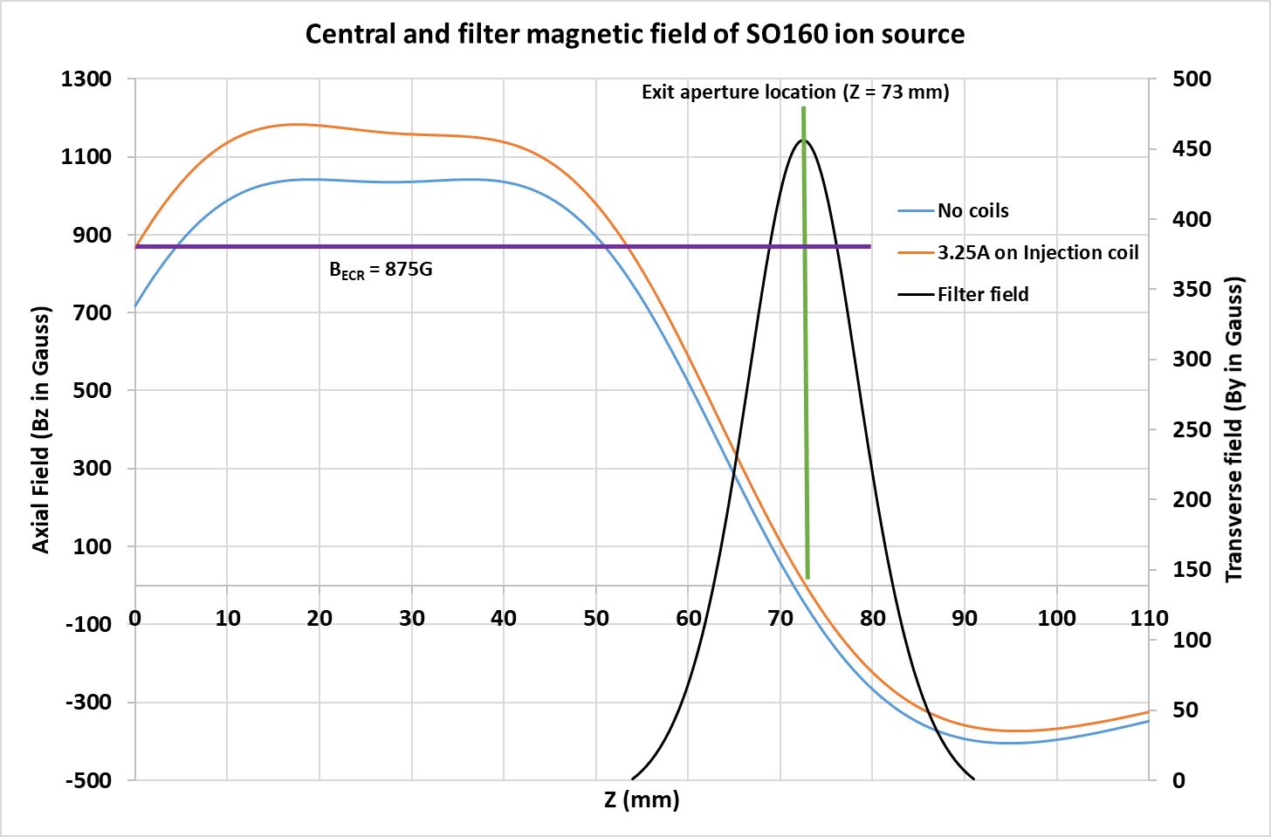
SO160 magnetic field configuration
Plasma chamber diameter: 37 mm
RF coupling: Tapered WR284 waveguide coupled to the source dielectric window and Quartz
Stainless steel liner to enhance the H⁻ production
Stacks of permanent magnets arranged around the plasma chamber to create the axial magnetic field
Optimized collar structure and filter magnet location for production of H⁻ and extraction of He⁺
A pair of filter/deflection magnets is placed on the source exit aperture.
Z = 0mm represents the Quartz disk facing towards the plasma chamber

Slide 15
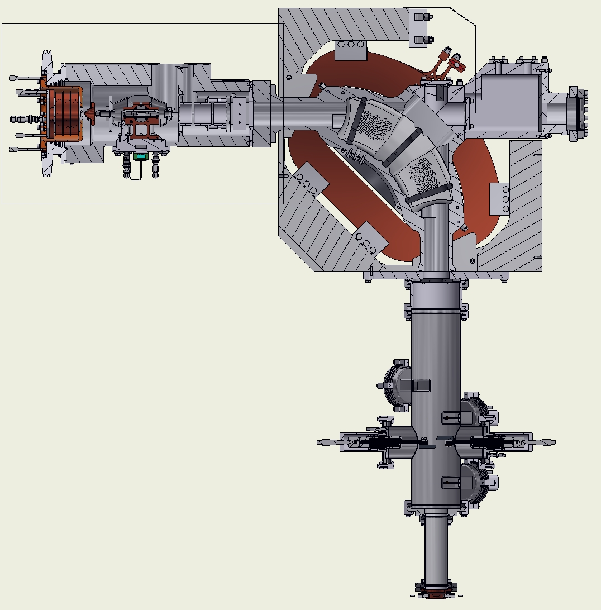
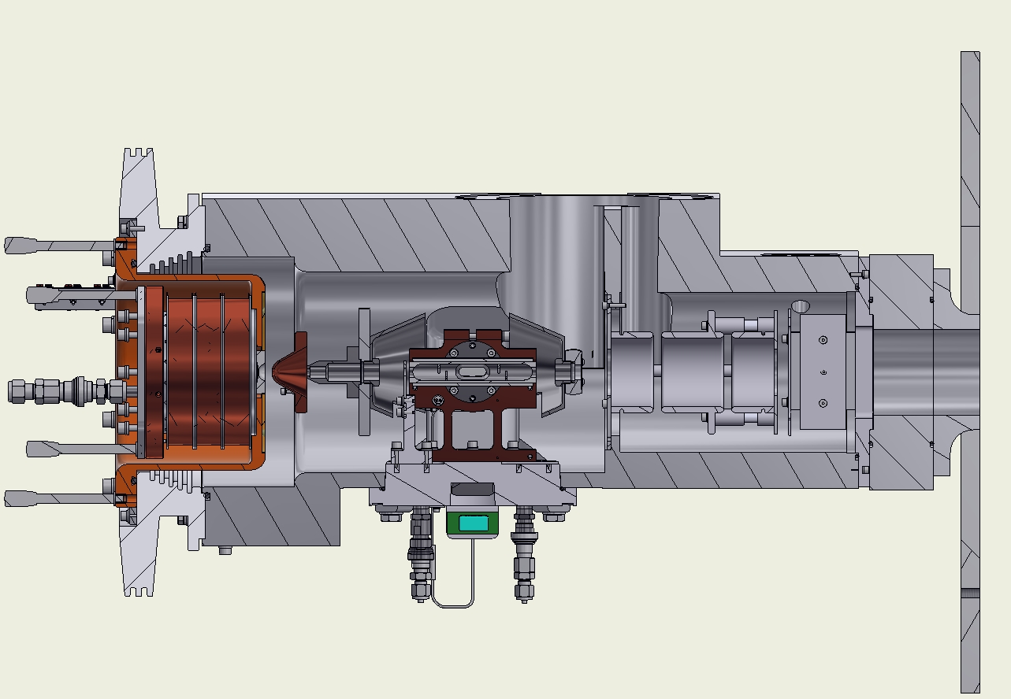
SO160 test bench
SO160 injector block
SO160 injector block
SO160
Extraction
Beam profile monitors
Faraday cup
Einzel lens
NaCEC
90° magnet
Beamline for diagnostics

Slide 16
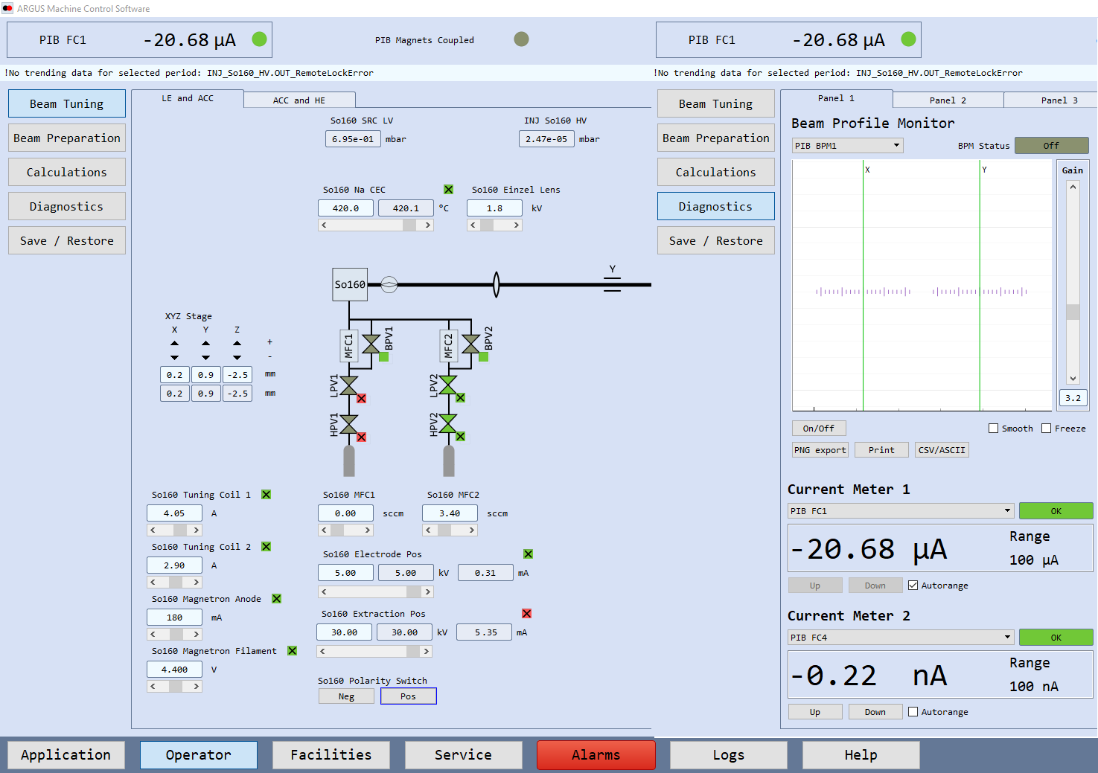

He⁻ production from NaCEC
A.S. Schlachter, AIP Conf. Proc. 111 (1984), 300-332
$$Charge exchange efficency=\frac{{He}^{−}}{{He}^{+}}$$

Slide 17
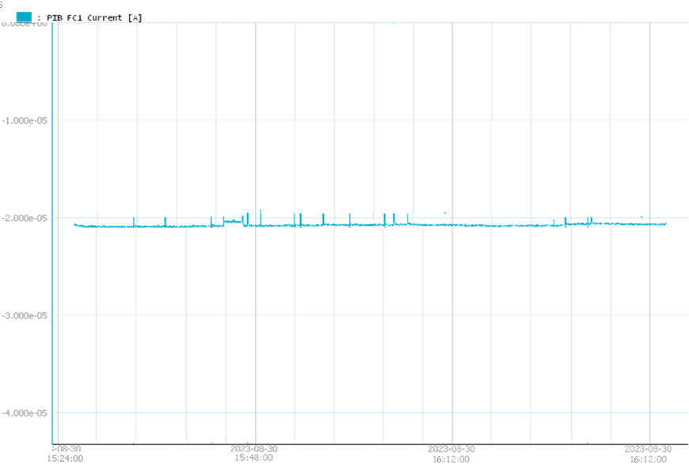
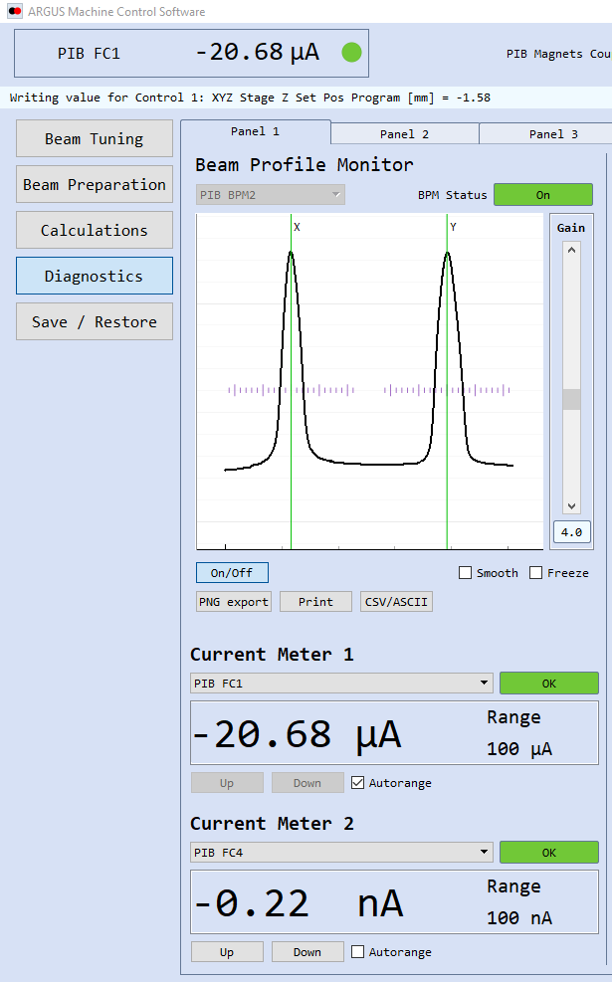
He⁻ stability test for 1 hour
Beam current stability = 0.3% / hr

Slide 18
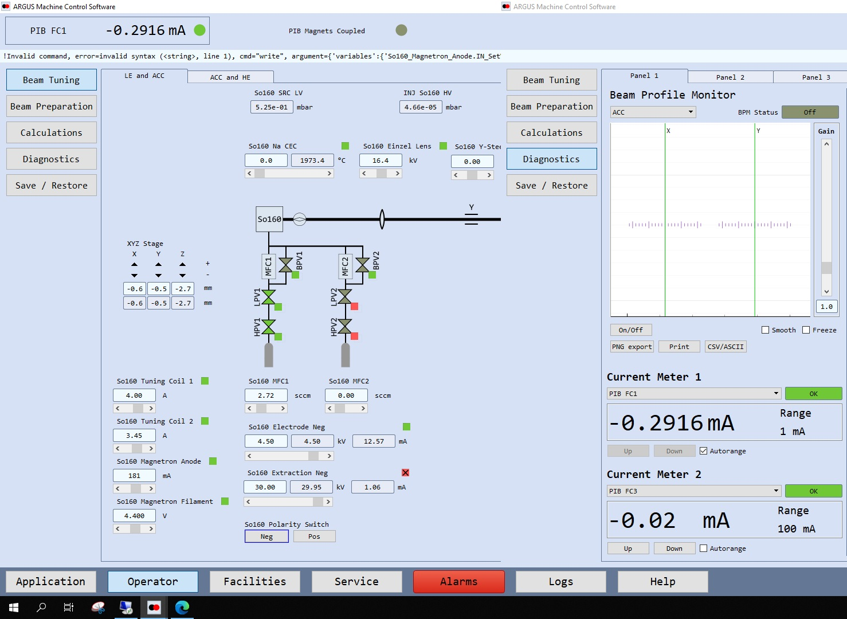
H⁻ extraction from SO160

Slide 19
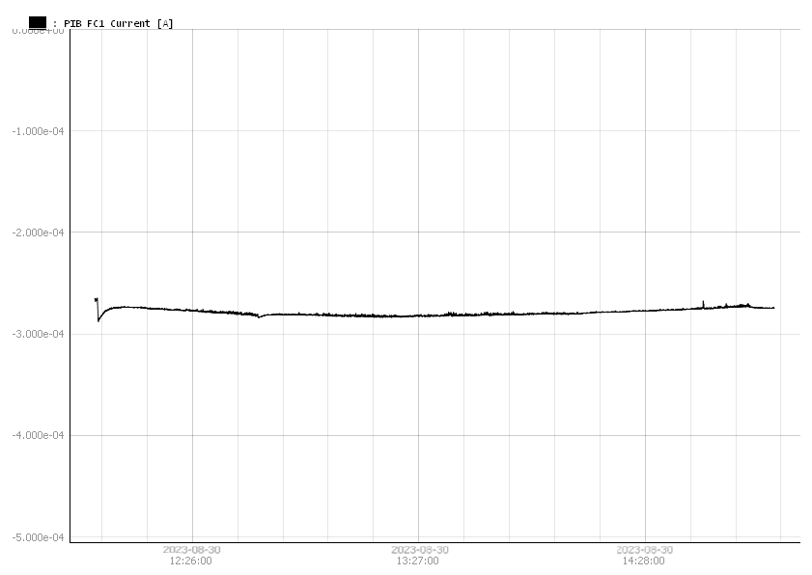
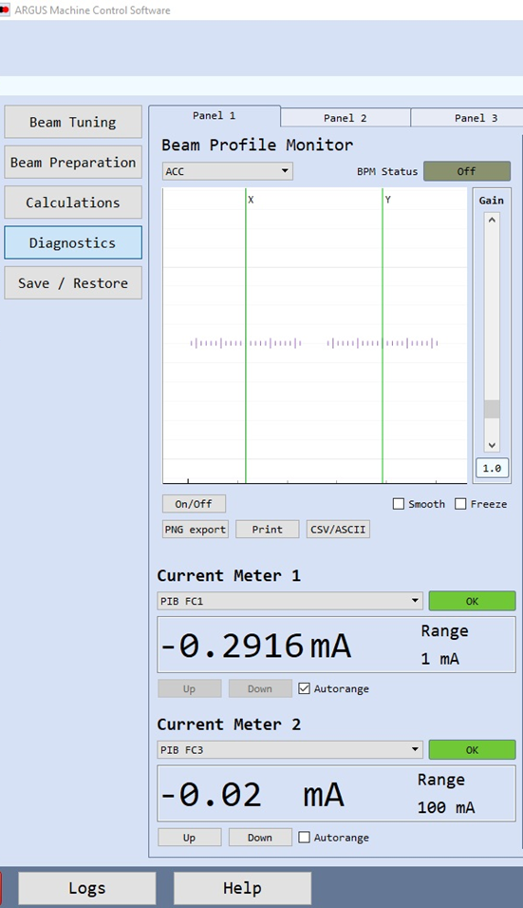
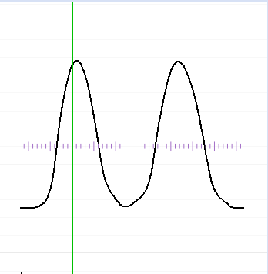
H⁻ stability test for 3 hours
Beam current stability = 0.7% / hr

Slide 20
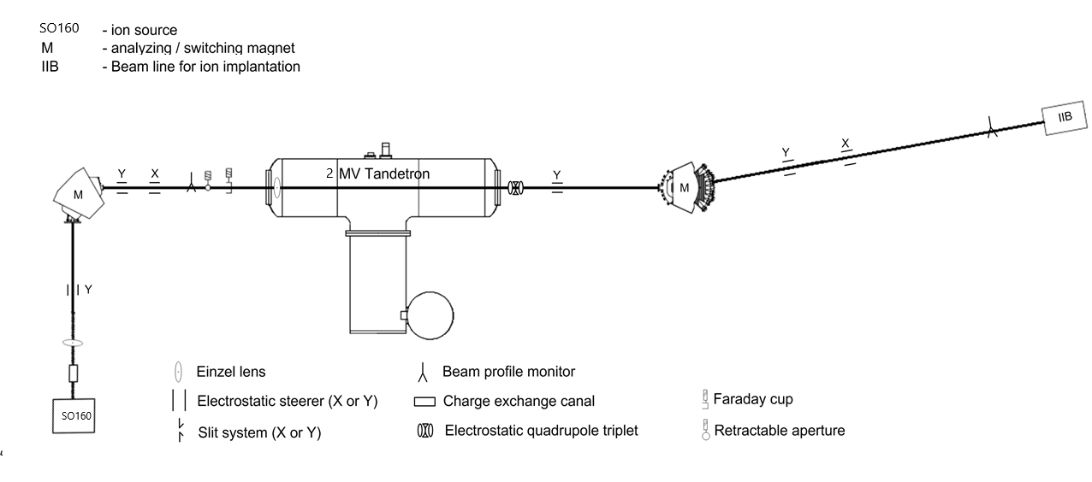
Integration of SO160 in 2MV Tandetron system
System installed and commissioned in
Harbin, China

Slide 21
Summary / Outlook
HVE can deliver tailored accelerator systems with terminal voltages up to 8 MV to meet stringent requirements
Tandetrons Can deliver 12 MeV of H⁺, 18 MeV of He⁺ and > 50 MeV of heavy ions
HVE has a wide range of compact ion sources suitable for applications in science and industry
  Can be integrated easily into accelerator systems
  Easy operation and low maintenance
New ion source available at HVE, Model SO160, for direct positive and negative ion extraction
  Change the extraction polarities, thanks to HV relays, using a single knob provided in the user interface
  No human interference or hardware change
  Full computer control
H⁻ and He⁻ beam currents up to 300 µA and > 20 µA at 30keV
SO160 will be tested for C⁻, NH⁻ and other species
Future SO160 model aims for > 1-3 mA of H⁻ and > 50 µA of He⁻, replacing dual multicusp injector system for Tandetrons

Slide 22
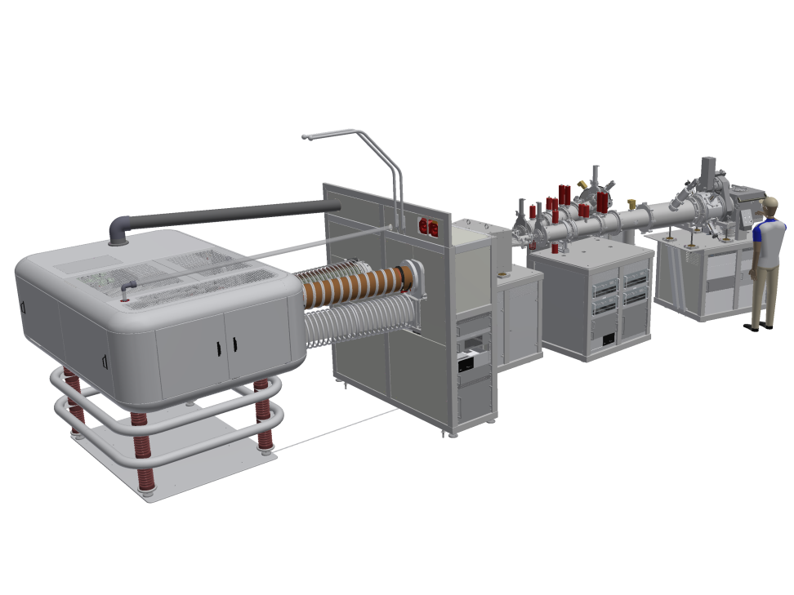
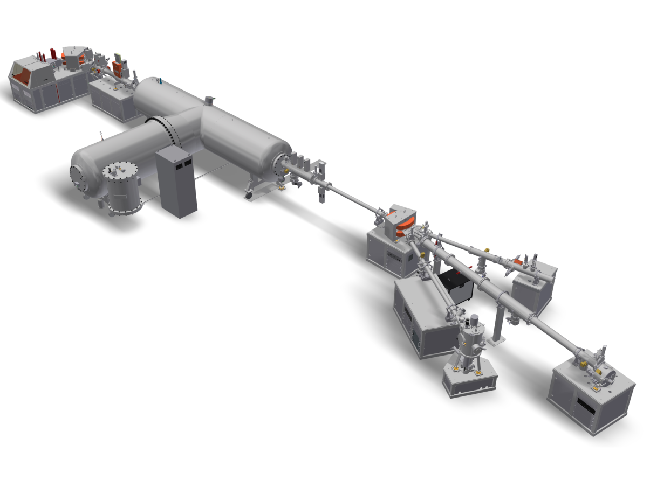
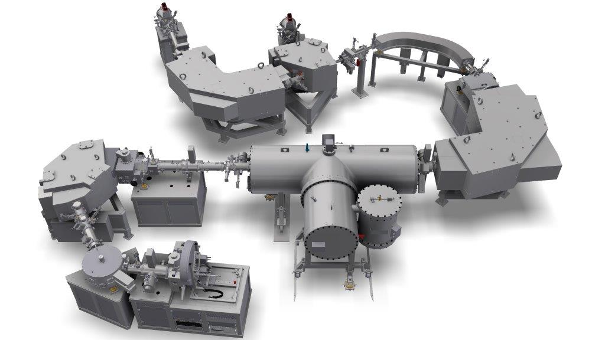



Thank you for your attention
Questions?
Questions?
We are hiring- Scan QR for open positions

Slide 23
BACKUP SLIDES

Slide 24
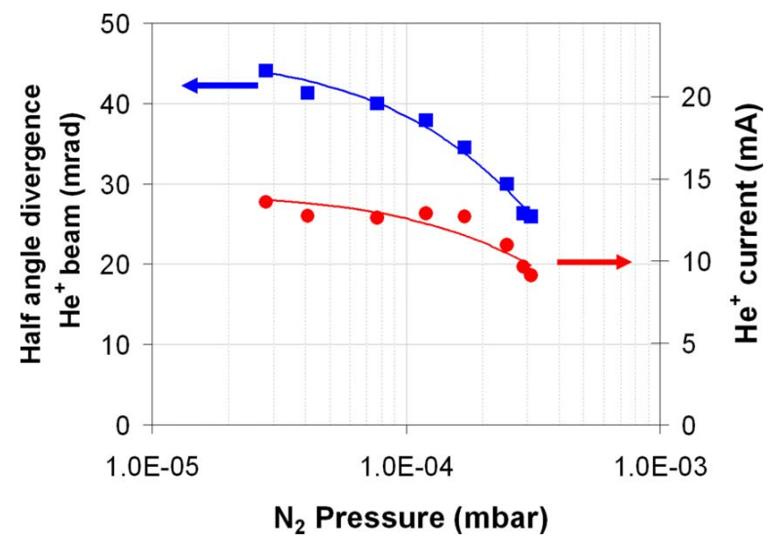
N₂ pressure Vs He+ beam current and half angle divergence
doi:10.1063/1.3259235

Slide 25
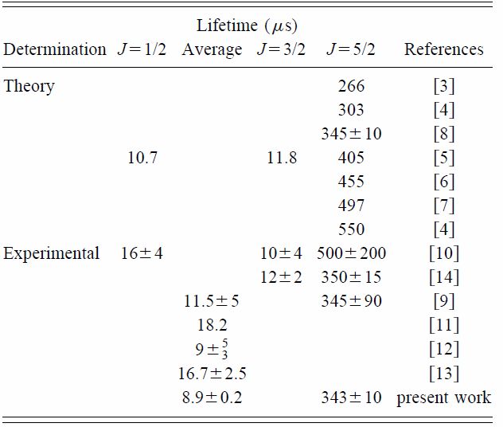
He⁻ lifetime
He⁻ : 1s2s2p ⁴P
3 fine structure components:
⁴P_{5/2} : spin-spin coupling (50%)
⁴P_{3/2} : spin-orbit coupling (37.5%)
⁴P_{1/2} : spin-orbit coupling (12.5%)
A. Wolf, I. Ben-Itzhak et al. Phys. Rev. A, 59, 267, (1999)

Slide 26
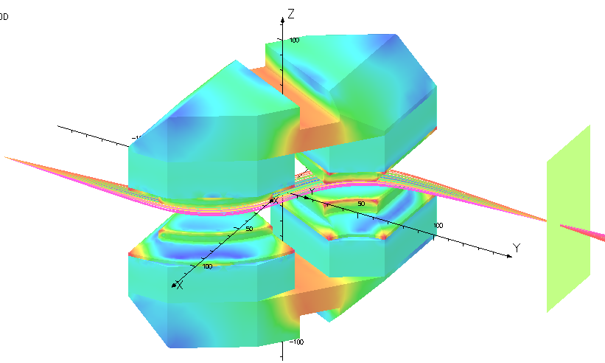
S-magnet design
Object
Image
2nd order corrected ion optics, double focusing ion optics

Slide 27
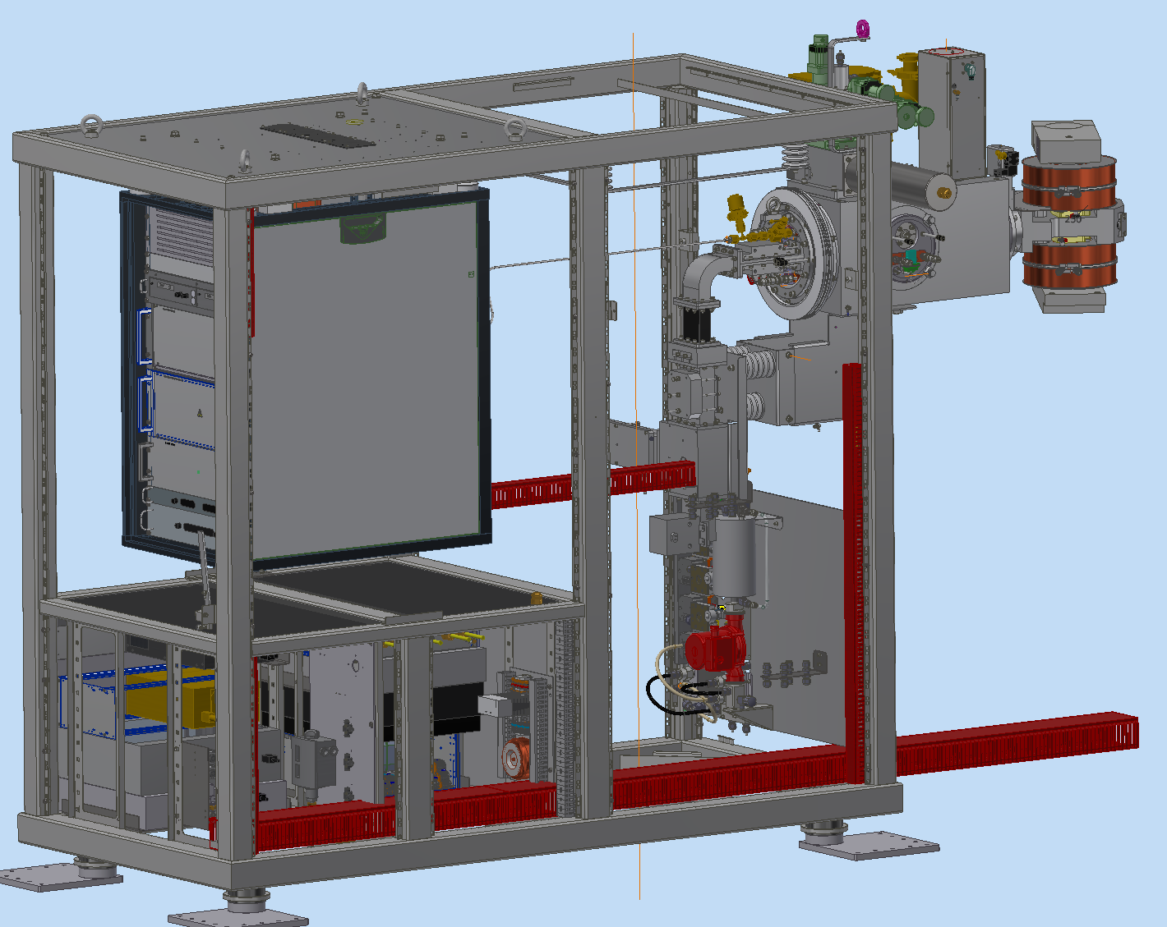
Injector deck

Slide 28
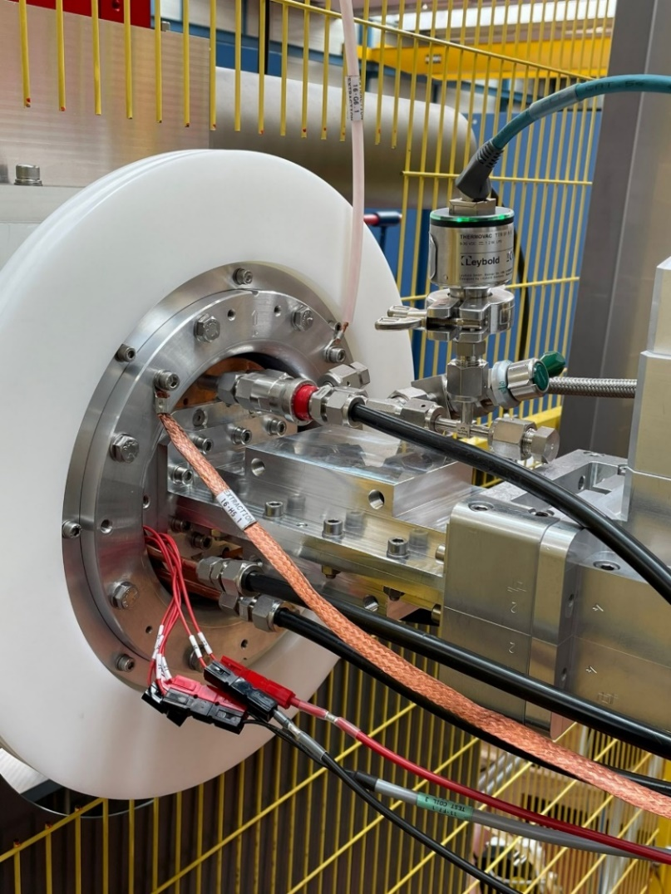
System characteristics
Ion source:
Dimensions: 230 mm x 130 mm.
Source service time: < 20 mins.
He+ performance with filter magnets in plasma chamber:
He⁺ current: 6 mA (from 2.5 mm PE aperture with 200W of RF power).
Extraction voltage: up to 30 kV.
H⁻ performance:
H- current: 0.3 mA (from 4 mm aperture).
Extraction voltage: 30 kV.
H⁺ performance:
H+ current: 5 mA (from 2.5 mm aperture with 150 W of RF power).
Proton fraction: ~90%.
Extraction voltage: 20-30 kV.

