Slide 2
ICIS 2025
St Catherines
College
Oxford
7th - 13th September 2025
Notes:
The abstract pattern can be removed or repositioned if required. Be careful to ‘Send to Back’ so that it does not obscure any important information.

Slide 3
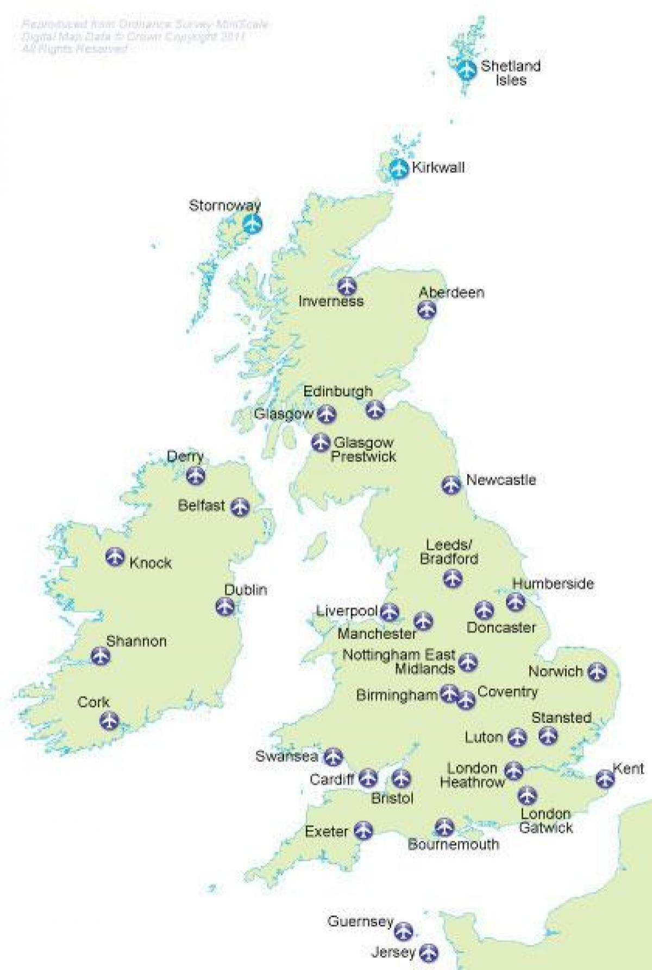
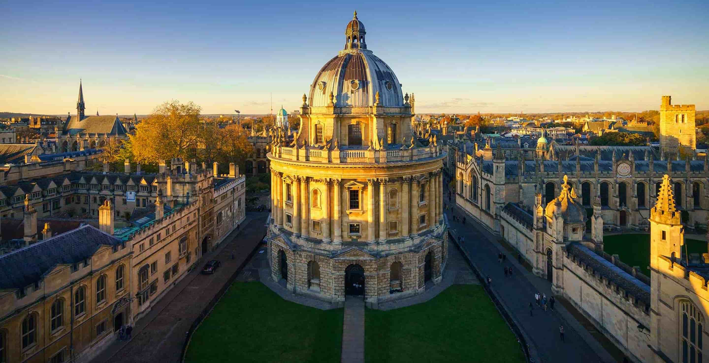
Oxford-
Historic city with good transport links to Heathrow and Birmingham airports
1 hour train to London and Eurostar
Oxford

Slide 4
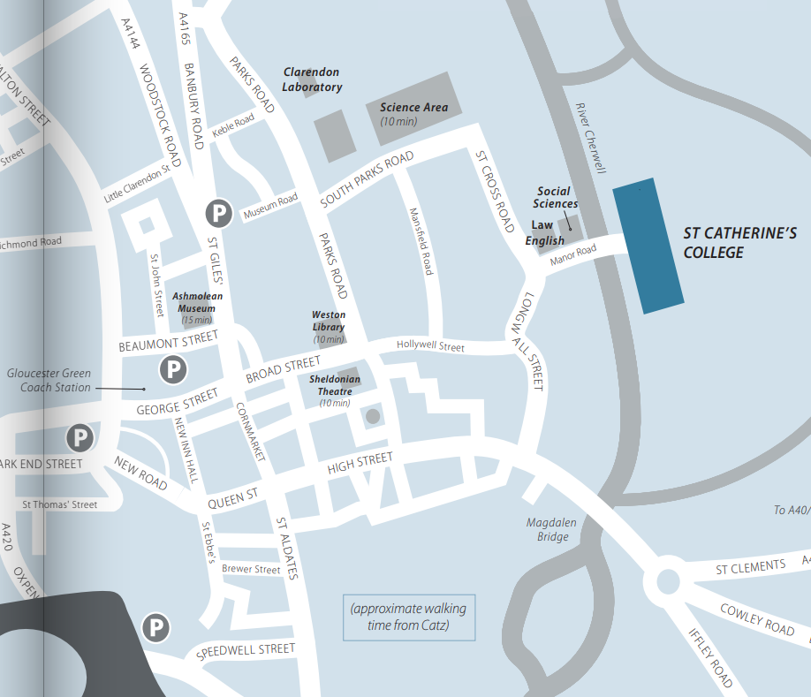
St Catherines College
10-15 minute walk into city center
1 mile to train station

Slide 5
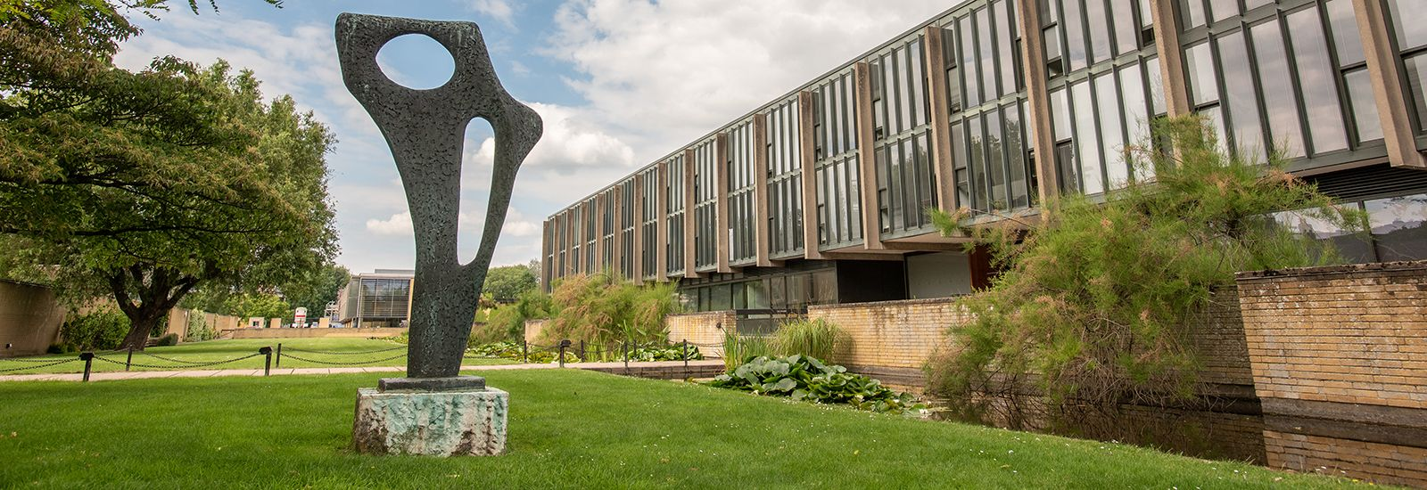
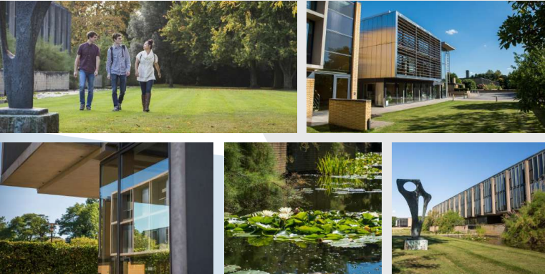
St Catherines College
1960s
Grade 1 Listed Modernist Architecture

Slide 6
250 seats

Slide 7
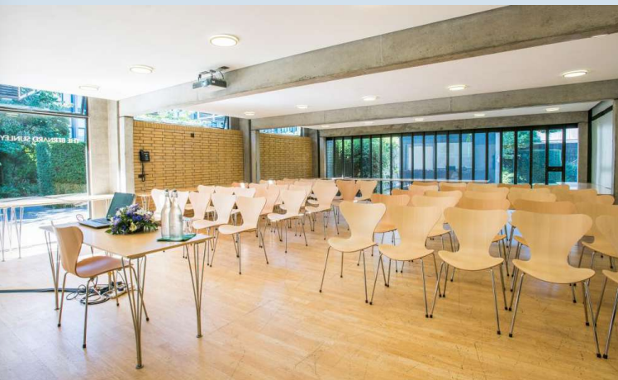
Posters,
Industrial Exhibit
and
Coffee breaks in
next door room

Slide 8
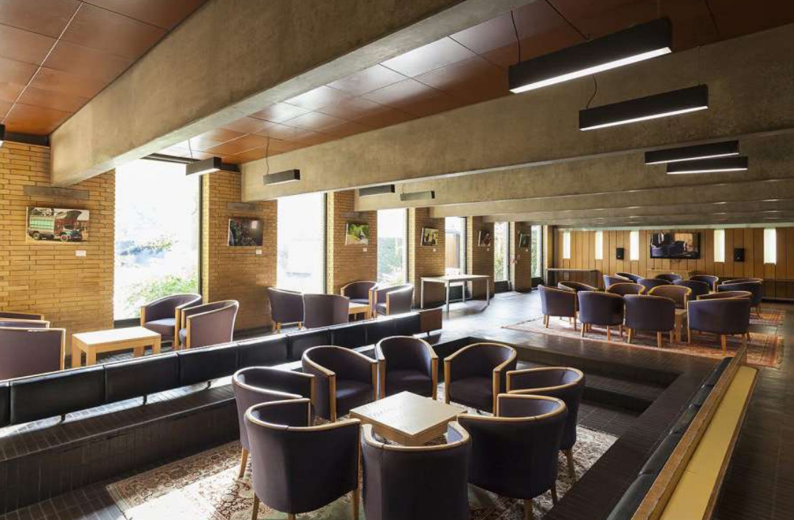
Lounge and Bar

Slide 9
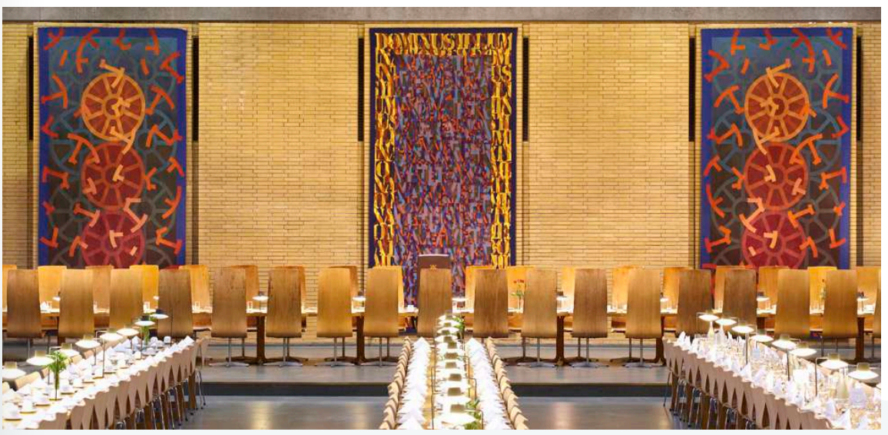
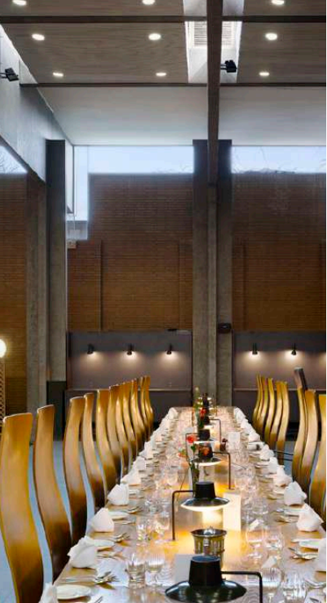
Dining Hall

Slide 10
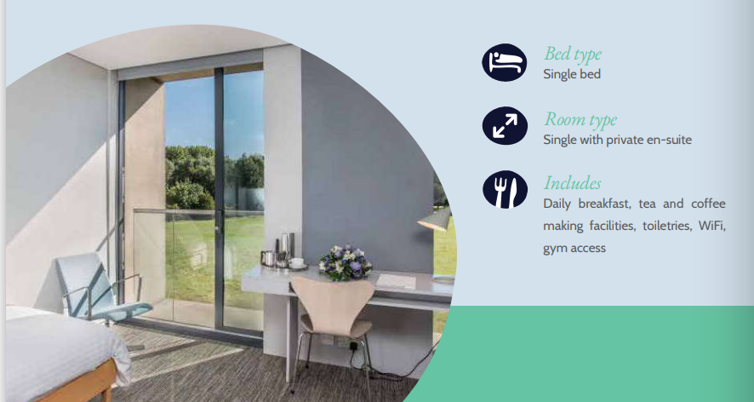
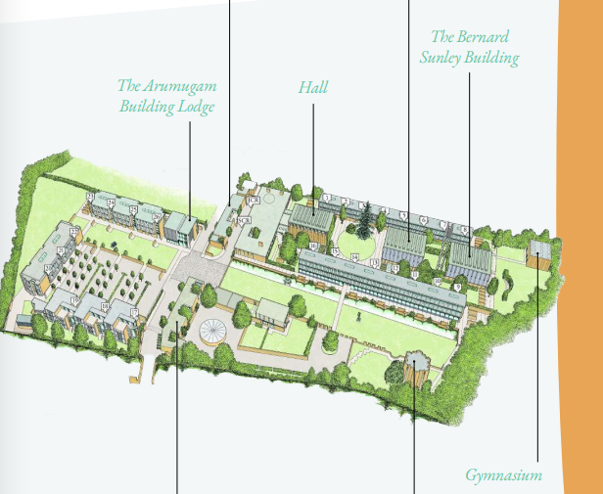
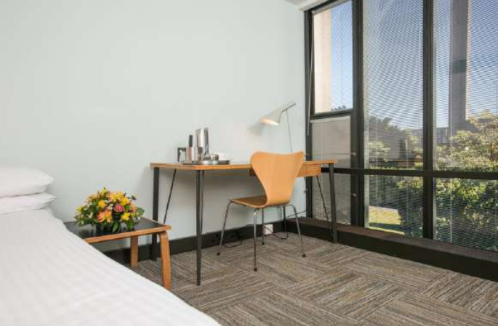
Accommodation
£125 per night (2025 rates)
250 rooms available

Slide 11
Social and Excursion Ideas
- Punting + pub
- BMW Mini factory tour (close-up assembly line robots)
- Gin and beer (TOAD distillery + Tap brewery tour)
- Bletchley Park guided tour (1 hour bus drive)
- Blenheim Palace
- Silverstone museum + F1 simulator experience (1 hour bus drive)

Slide 12
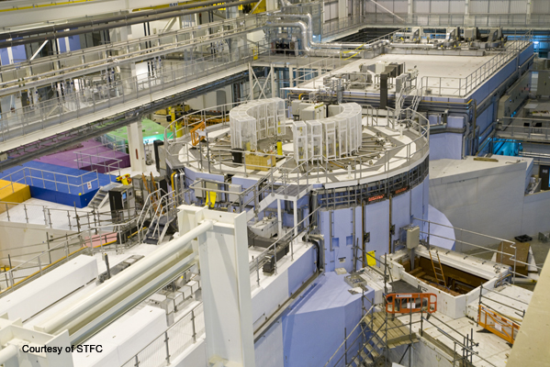
Laboratory Tours
ISIS Spallation neutron source
Penning surface plasma sources
(1X and 2X)
RF external coil volume source
Test stands (FETS, VESPA, ISDR, Pre-Injector)
Also possible: Culham JET/Fusion tours
ISIS Spallation Neutron Source
Pre-injector Test Stand: A New Pre-injector for ISIS

Slide 13
We look forward to welcoming you to
ICIS 2025
St Catherines College
Oxford, UK
7th - 13th September 2025

Slide 14
Notes:
The abstract pattern can be removed or repositioned if required. Be careful to ‘Send to Back’ so that it does not obscure any important information.

Slide 15
Science and Technology Facilities Council
@STFC_matters
Science and Technology Facilities Council
Notes:
The abstract pattern can be removed or repositioned if required. Be careful to ‘Send to Back’ so that it does not obscure any important information.

