Slide 1


Photo-assisted negative ion production in cesium sputter ion source
Akbar Hossain
Doctoral Researcher
University of Jyväskylä, Finland
20th International Conference on Ion Sources – ICIS’23
Sep 17 - Sep 22 2023, Victoria, BC Canada
Co-authors: Olli Tarvainen, Mikael Reponen, Risto Kronholm, Jaakko Julin, Ville Toivanen, Taneli Kalvas, Mikko Kivekäs and Mikko Laitinen

Slide 2
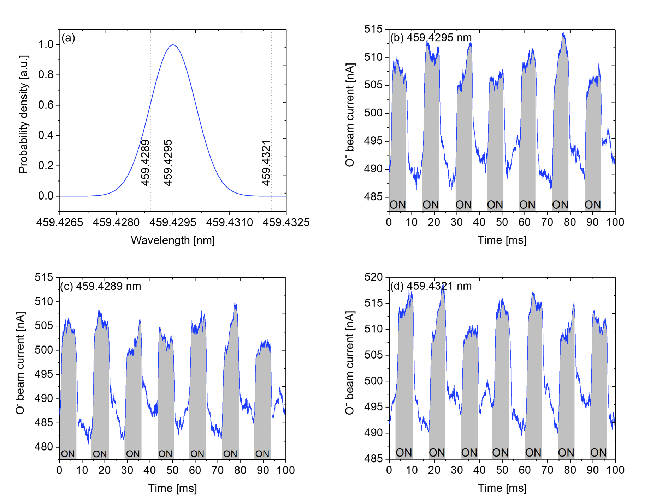
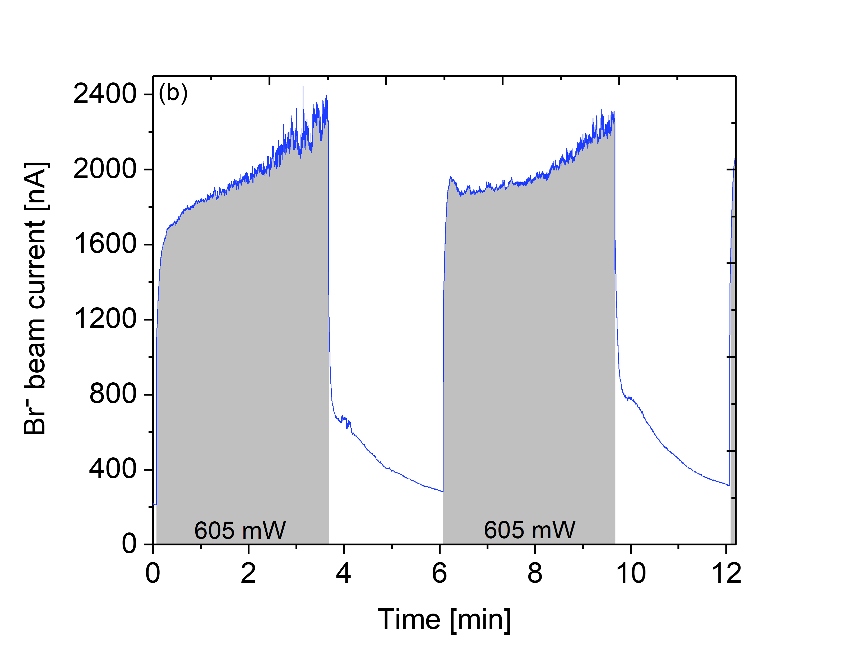
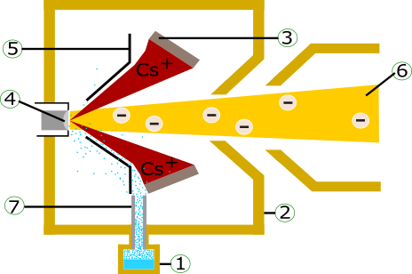
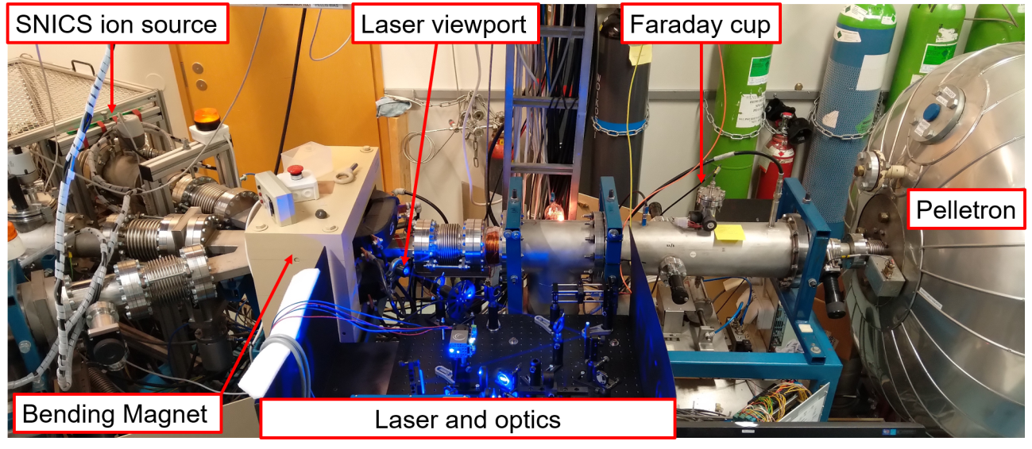
Outline: SNICS ion source and Lasers
Motivation and background
Previous results: Evidence of non-resonant nature
Our proposed mechanism
New experimental results
Conclusion
900 %

Slide 3
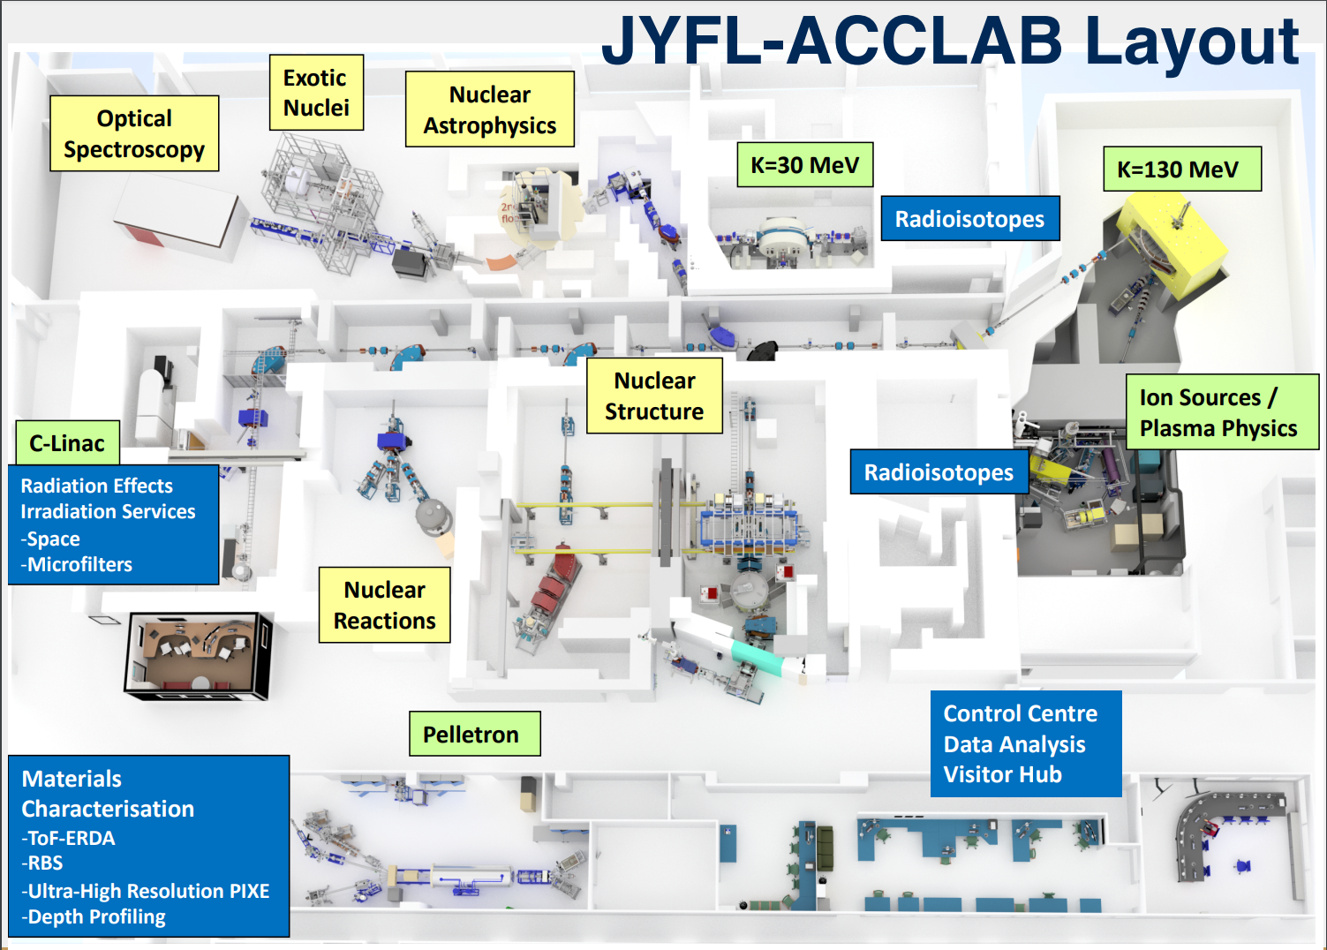
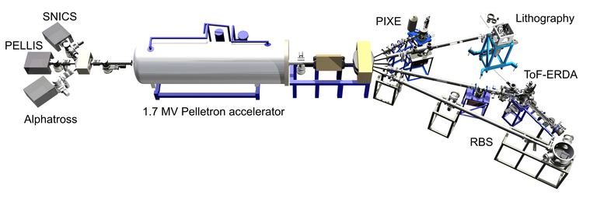
Accelerator Laboratory - University of Jyväskylä
Large scale nuclear physics-based infrastructure
Versatile support from ion source, laser, IBA experts available
Experiments done at Pelletron lab:
Using NEC made 40 cathode MC-SNICS source, where
Laser input has been through the viewport at the magnet
Viewport

Slide 4
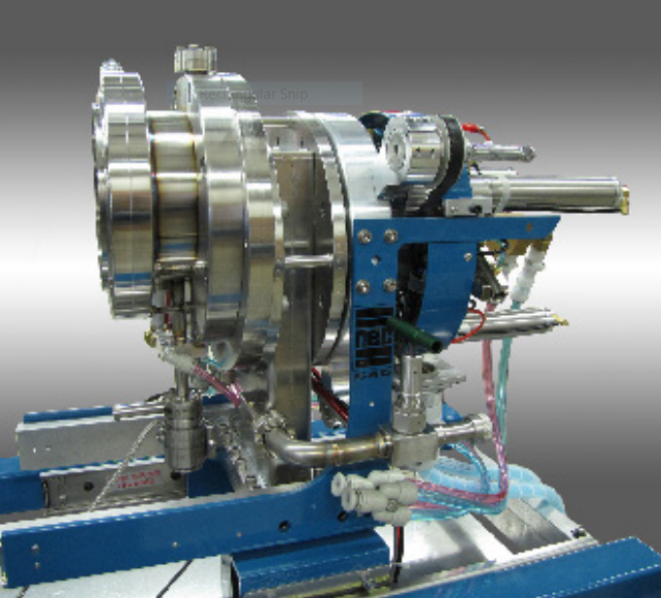
SNICS ion source
Schematic drawing of the SNICS ion source:
Caesium oven and transfer line, (up to the ionizer in reality)
Ionisation chamber
Ionizer
Cathode,
Focusing electrode (immersion lens) and
Extraction channel and electrodes.
Cs transfer tube
SNICS:
- Beams from H to U
- AMS (C14, etc) usage and IBA
- Molecule beams available
- Gaseous targets also possible (CO2)
- Beam currents up to ~400 uA (Carbon)

Slide 5
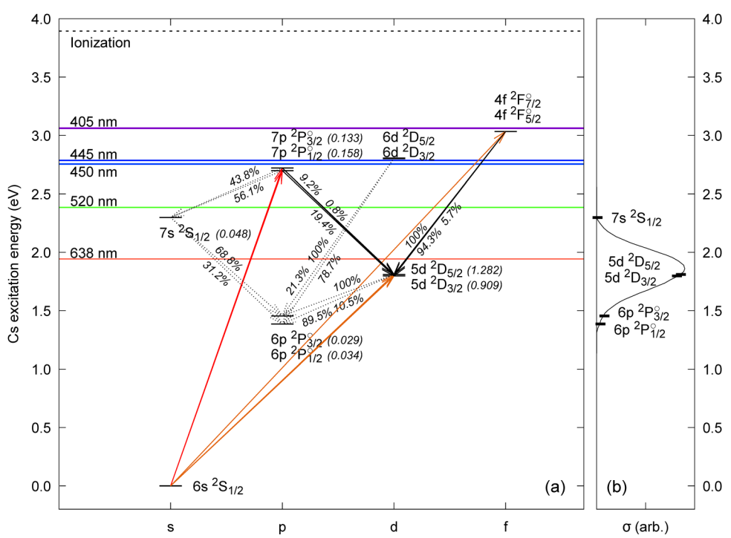
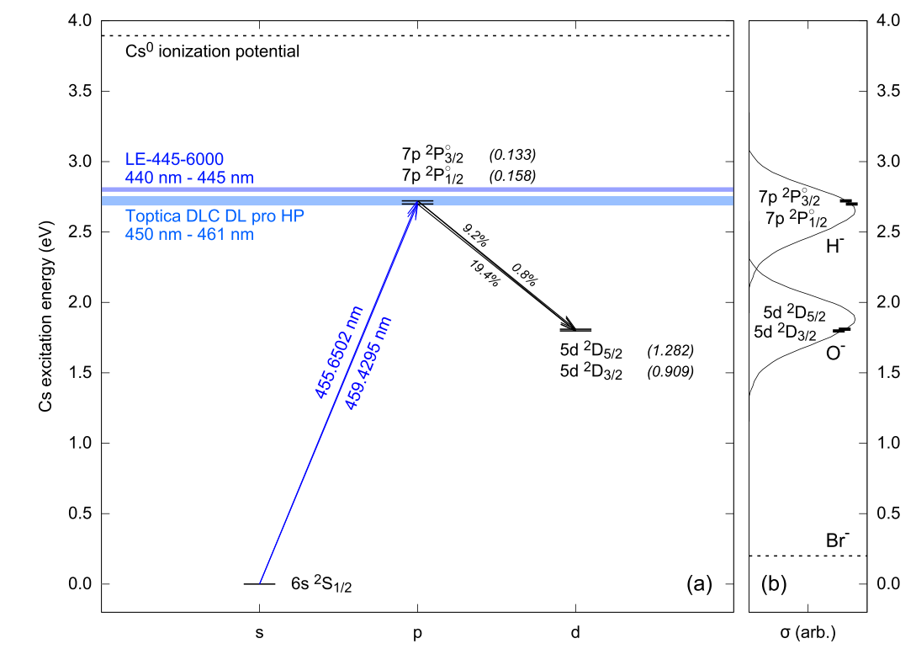
Motivation and background
Vogel: The negative ion current can be enhanced by exposing the cathode to a laser beam resonantly exciting neutral cesium atoms to 7p electronic states (ion pair production) (2018) [1]
  [1] J. S. Vogel, “Lasis: The laser assisted sputter ion source,” NIMB 438, 89–95 (2019).

Slide 6
Evidence of non-resonant nature?
Motivation and background
7p1/2
Beam intensity change was similar amount for broad range of wavelengths (>10) scanned over the expected resonance frequencies of the neutral Cs.
->> not a resonance effect
(at least for these states - OR the 7p3/2 states which was also tested)
Wavelength selection for the excitation of the 7p1/2 electronic state of neutral Cs: (a) shows the expected maximum Doppler broadening of the absorption line and the laser wavelengths used for probing the putative ion pair production.
The prompt effect of the laser exposure on the O− beam current with different wavelengths: (b) in-vacuum resonance at 459.4295 nm, (c) 459.4289 nm within the maximum Doppler broadening, and (d) 459.4321 nm outside the maximum Doppler broadening.

Slide 7
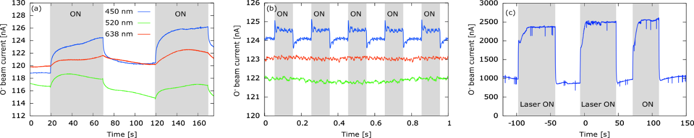
Motivation and background
JYFL-ACCLAB and the UK Science and Technology Facilities Council, STFC:
Negative ions can be provoked by any laser (2020) [2]
JYFL-ACCLAB and STFC: Beam current enhancement does not depend on the resonant ion pair production, extracted beam current can be enhanced by a factor >2 (2022) [3]
Two different phenomena recognized: Long-term “heating” effect and short-term prompt effect
The effect of (a) 50 s and (b) 100 ms laser pulses at 450 nm / 1.6 W, 520 nm / 1.0 W and 638 nm / 0.7 W wavelengths / powers on the O⁻ beam current. The best recorded example of the (c) 445 nm, 6 W laser on the O⁻ beam current. [2]
  [2] O. Tarvainen, R. Kronholm, M. Laitinen, M. Reponen, J. Julin, V. Toivanen, M. Napari, M. Marttinen, D. Faircloth, H. Koivisto, and T. Sajavaara,
  “Experimental evidence on photo-assisted O⁻ ion production from Al2O3 cathode in cesium sputter negative ion source,” Journal of Applied Physics 128, 094903 (2020).
  [3] A. Hossain, O. Tarvainen, M. Reponen, R. Kronholm, J. Julin, T. Kalvas, V. Toivanen, M. Kivekäs and M. Laitinen
  Photo-enhanced O-, H- and Br- ion production in caesium sputter negative ion source-no evidence for resonant ion pair production, J. Phys. D: Appl. Phys. (2022).

Slide 8
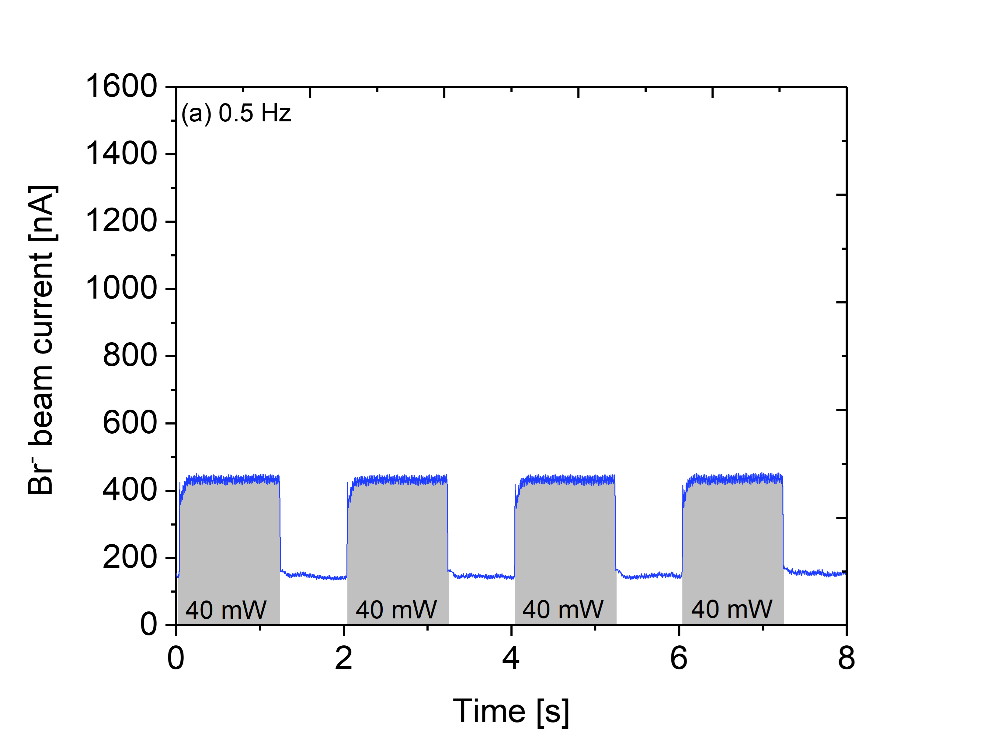
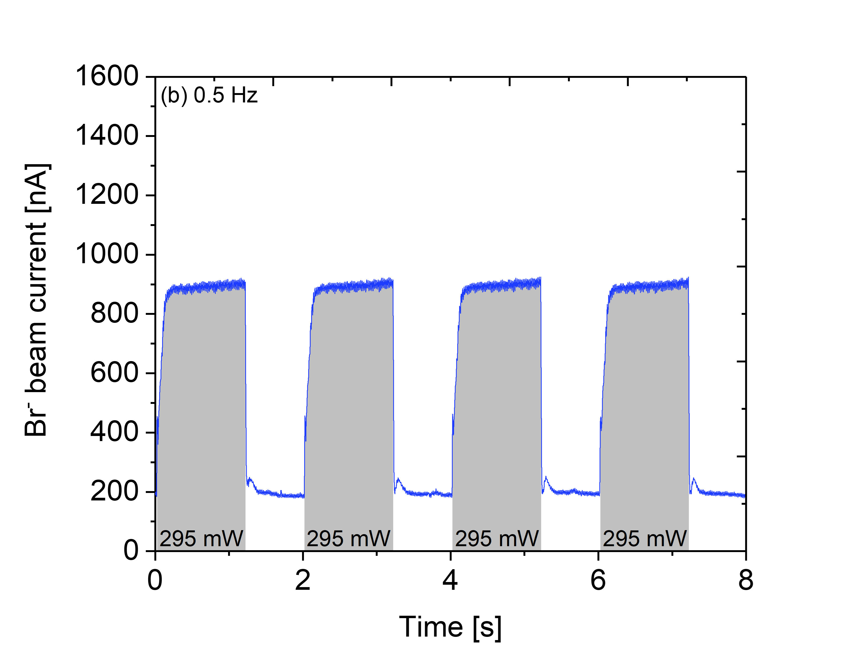
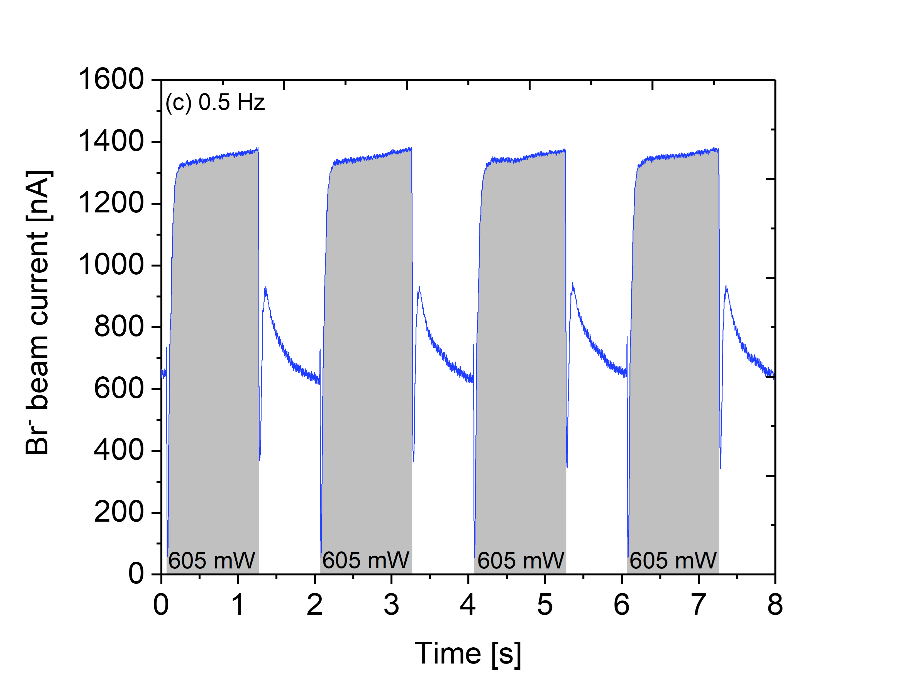
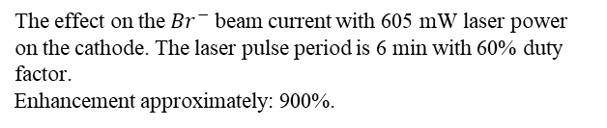
Motivation and background
Experiments with Cl⁻, Br⁻ and I⁻: All have similar Cs-matrix material + usage in Ion Beam Analysis (IBA) [4]
Beam current enhancement depends on the: Applied laser power, Wavelength, Pulse length, and the ion source conditions [4]
The extracted beam current can be enhanced by a factor up to 9 or more [4]
Recent Experiment: Different cathode holder materials (Al, Ti, Ni, C or Cu), and
ﬁrst attempts to sustain a stable beam current
(d)
900 %
The effect on the ${Br}^{−}$ beam current with 605 mW laser power on the cathode. The laser pulse period is 6 min with 60% duty factor.
Enhancement approximately: 900%.
200 nA as base beam current before and after for all measurements.
The effect on the ${Br}^{−}$ beam current with (a) 40 mW, (b) 295 mW and (c) 605 mW laser output power at nominal 445 nm wavelength incident on the cathode. The laser pulse period is 2 s with 60% duty factor. Enhancement: (a) 110%, (b) 350% and (c) 550%.
[4] A. Hossain, O. Tarvainen, M. Reponen, R. Kronholm, J. Julin, T. Kalvas, V. Toivanen, M. Kivekäs and M. Laitinen, Photo-enhanced Cl-, Br- and I- production in caesium sputter ion source, JINST (2023).

Slide 9
Our Proposed
Mechanism
Notes:
.

Slide 10
Proposed Mechanism
Photoelectron emission
Beam current enhancement/
Stable beam current
Laser
SNICS
Cs coverage
Photoelectrons ionise Cs in front of the cathode, which increases the sputtering rate. If sputtering rate increase, then negative ion yield also increase.
Cs coverage affects the work function of the cathode surface and thus affect the negative ion yield.
900 %

Slide 11
Experimental
Results
Notes:
.

Slide 12
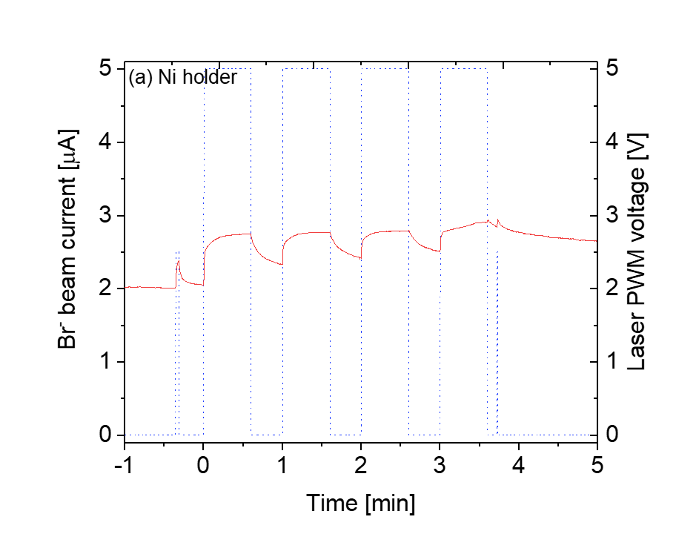
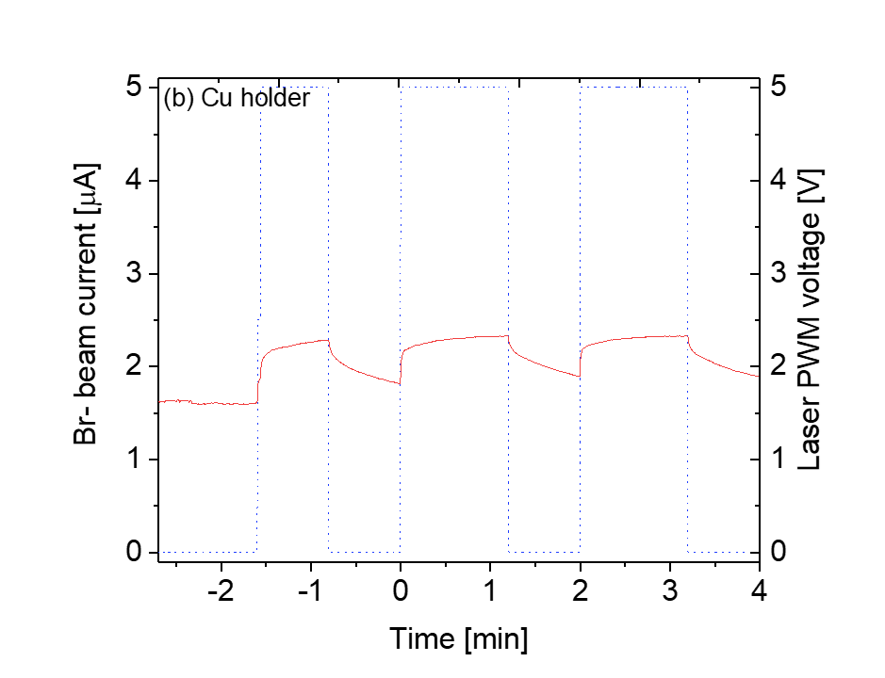
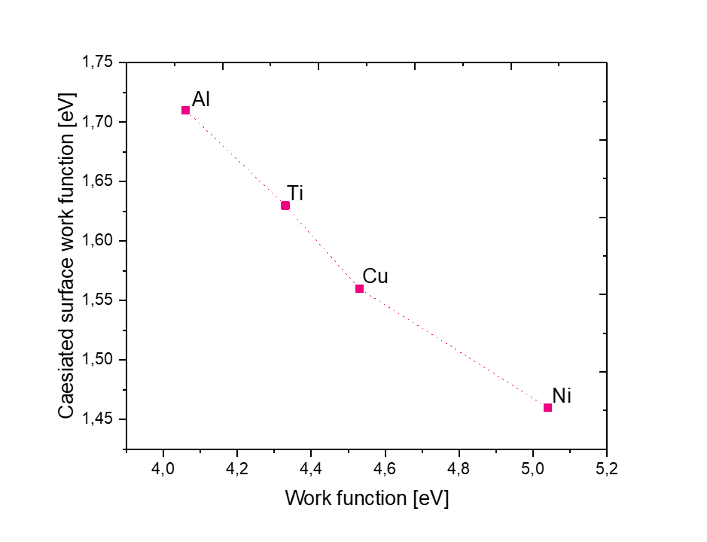
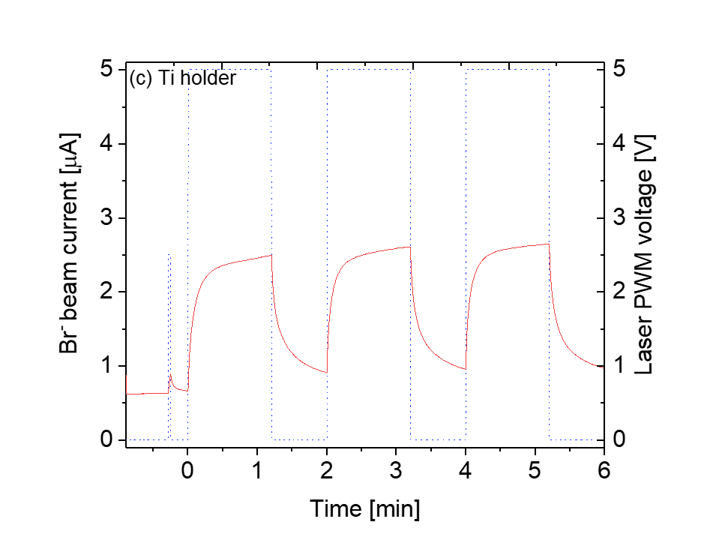
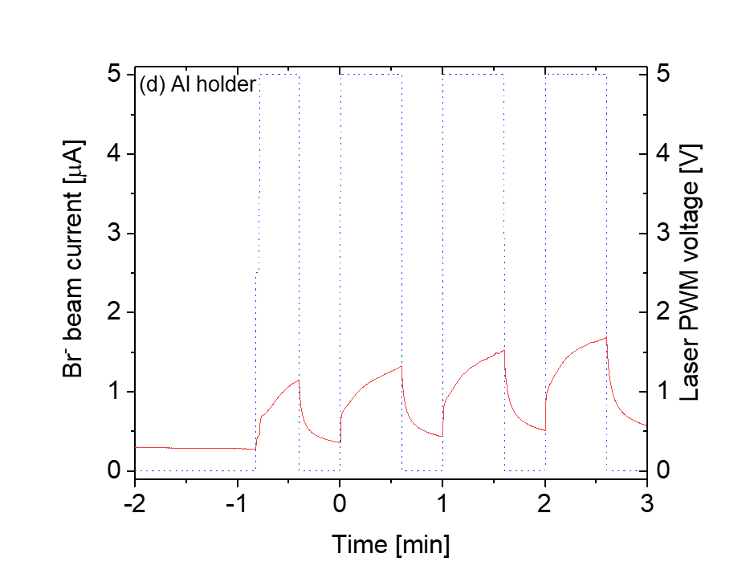
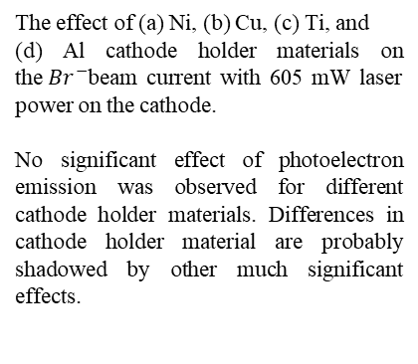
Different cathode holder experiment
The effect of (a) Ni, (b) Cu, (c) Ti, and
(d) Al cathode holder materials on the${ Br}^{−}$beam current with 605 mW laser power on the cathode.
No significant effect of photoelectron emission was observed for different cathode holder materials. Differences in cathode holder material are probably shadowed by other much significant effects.

Slide 13
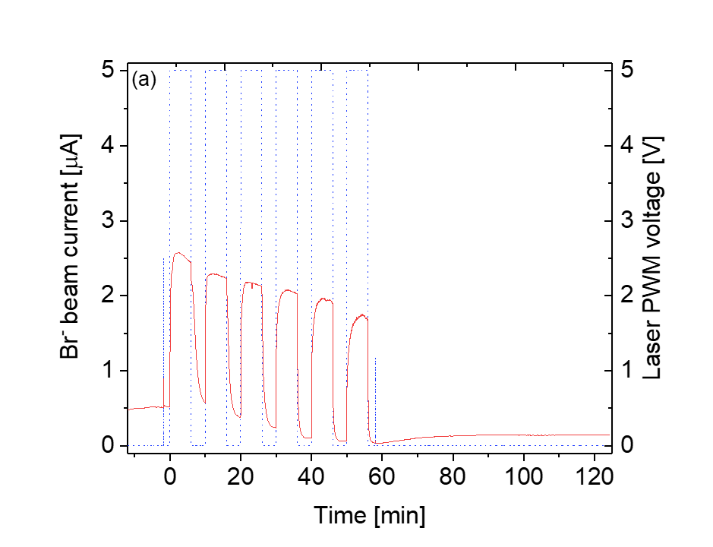
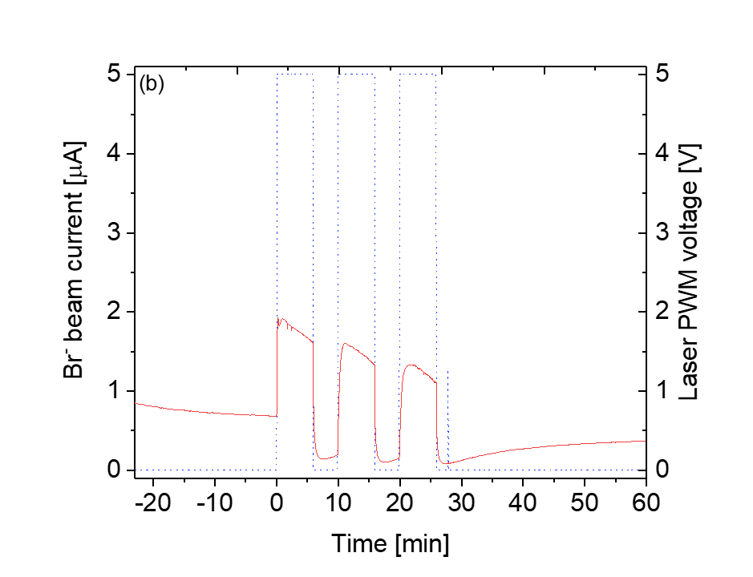
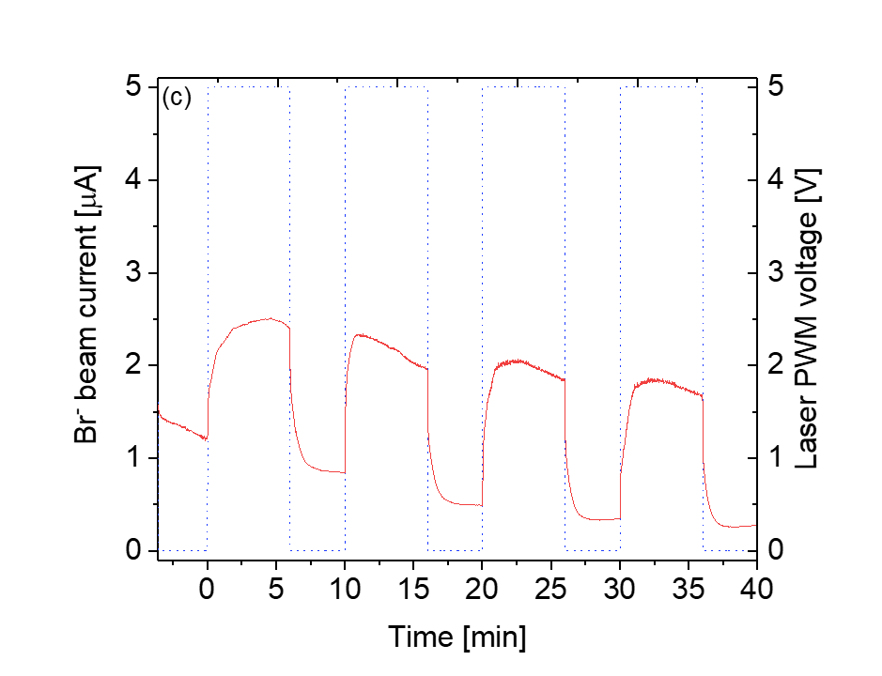
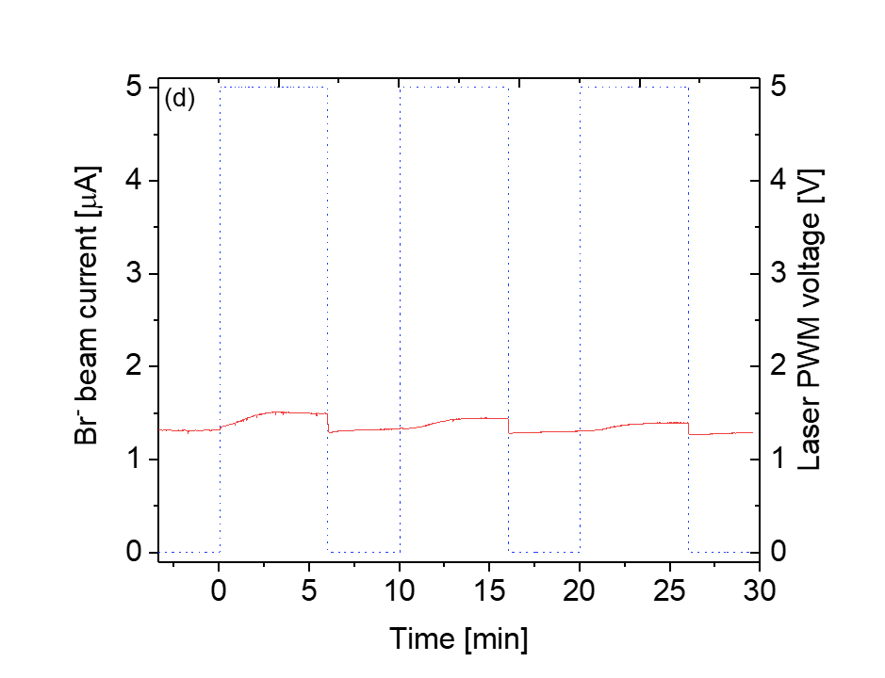
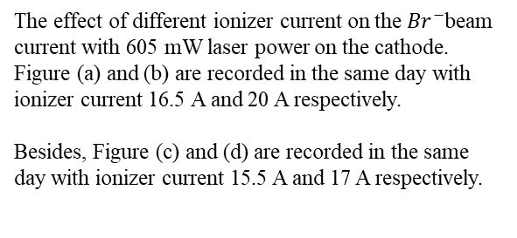
Different Ionizer Temperature Effect
Low IonizerTemperature
High IonizerTemperature
The effect of different ionizer current on the${ Br}^{−}$beam current with 605 mW laser power on the cathode.
Figure (a) and (b) are recorded in the same day with ionizer current 16.5 A and 20 A respectively.
Besides, Figure (c) and (d) are recorded in the same day with ionizer current 15.5 A and 17 A respectively.
Large effect
Small effect

Slide 14
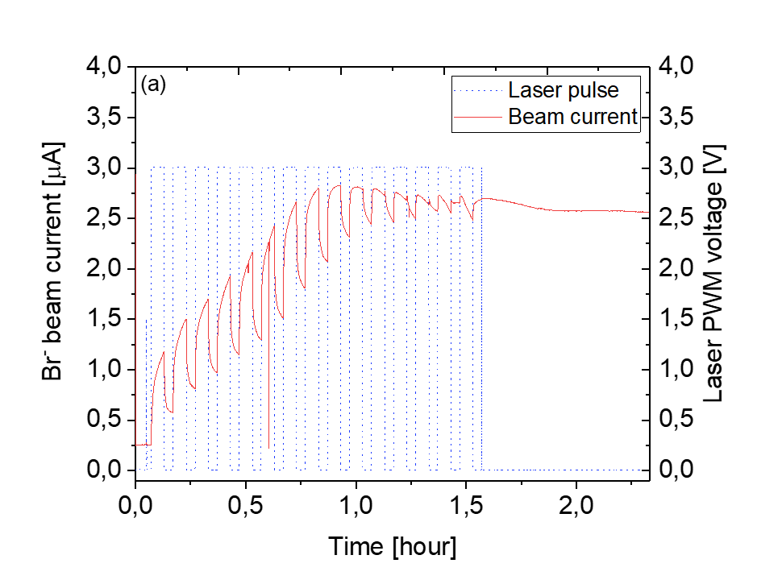
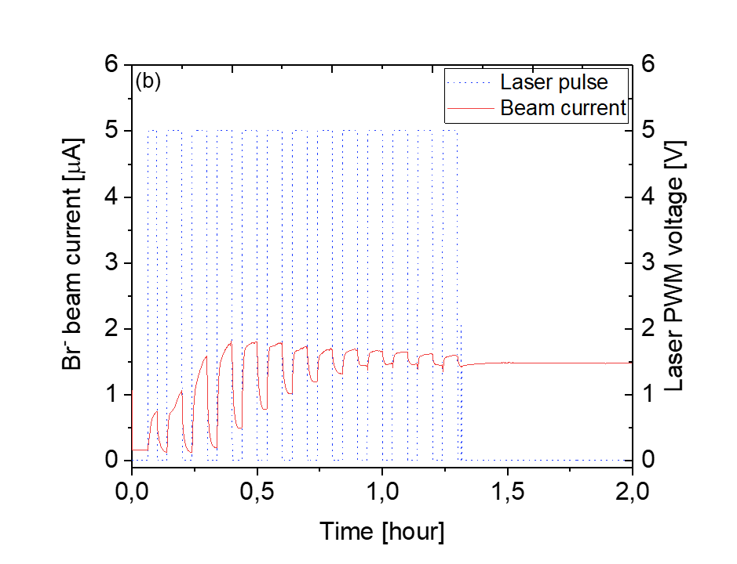
Priming Effect
The effect on the${ Br}^{−}$beam current with (a) 295 mW, and (b) 605 mW laser power on the surface. In this case (a) Ti, and (b) Cu cathode holder, Ionizer current 17 A, and Cs oven temperature ${145}^{0}c$ was used.

Slide 15
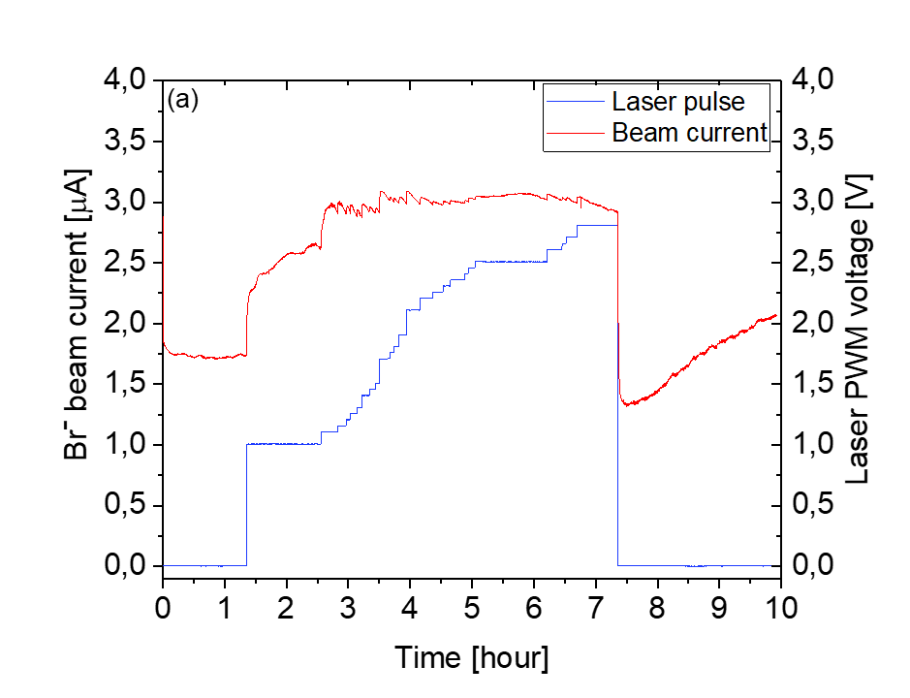
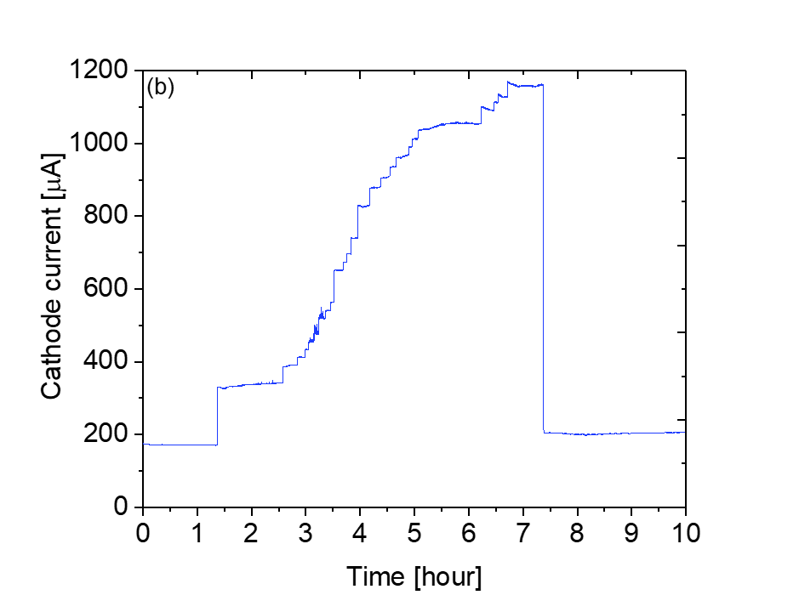
Feedback System for Stable Beam Current
Beam current
Cathode current
The effect on the (a)${ Br}^{−}$beam current with different laser power on the cathode and corresponding (b) cathode current. In this case Ti cathode holder, Ionizer current 17.5 A and Cs oven temperature ${165}^{0}c$ was used.

Slide 16
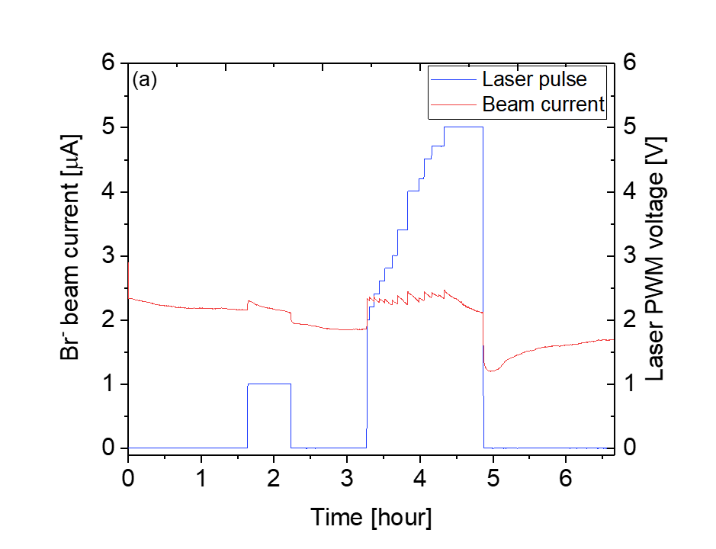
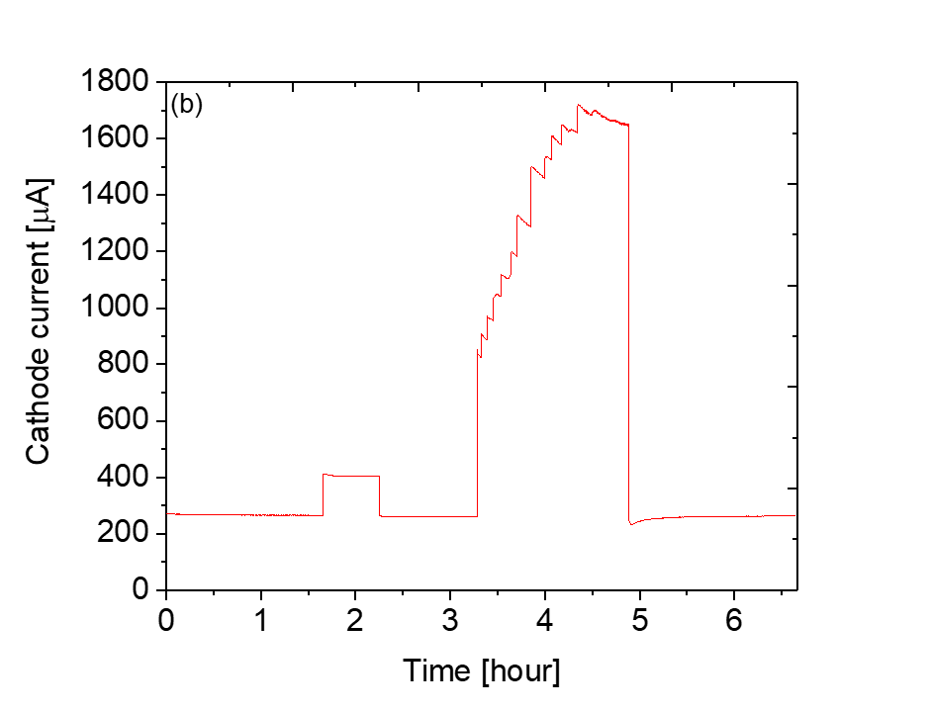
Feedback System for Stable Beam Current
Beam current
Cathode current
The effect on the (a)${ Br}^{−}$beam current with different laser power on the cathode and corresponding (b) cathode current. In this case Ni cathode holder, Ionizer current 18 A and Cs oven temperature ${170}^{0}c$ was used.

Slide 17
Conclusions
Different cathode holder materials does not have a significant impact on photoelectron emission
Laser allows reaching higher beam currents at low ionizer temperatures compared to running the source without the laser but at higher ionizer temperature.
We observed the "priming effect.
We suggest a qualitative explanation for the observed effect
    Photoelectron emission
    Cs coverage on the cathode surface
Stable beam current at the elevated level, achieved through active control of the laser power.

Slide 18
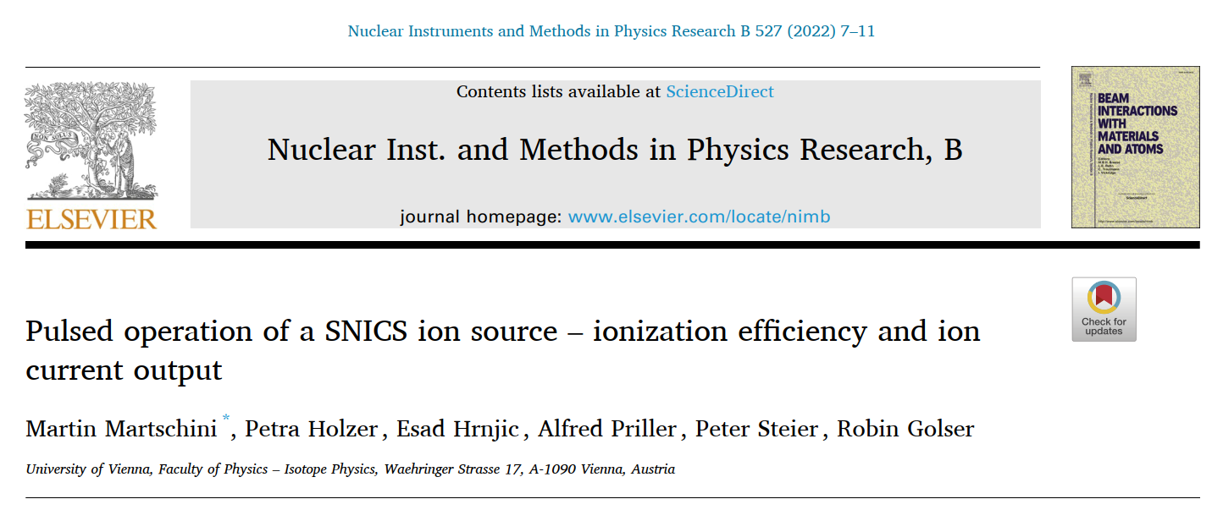
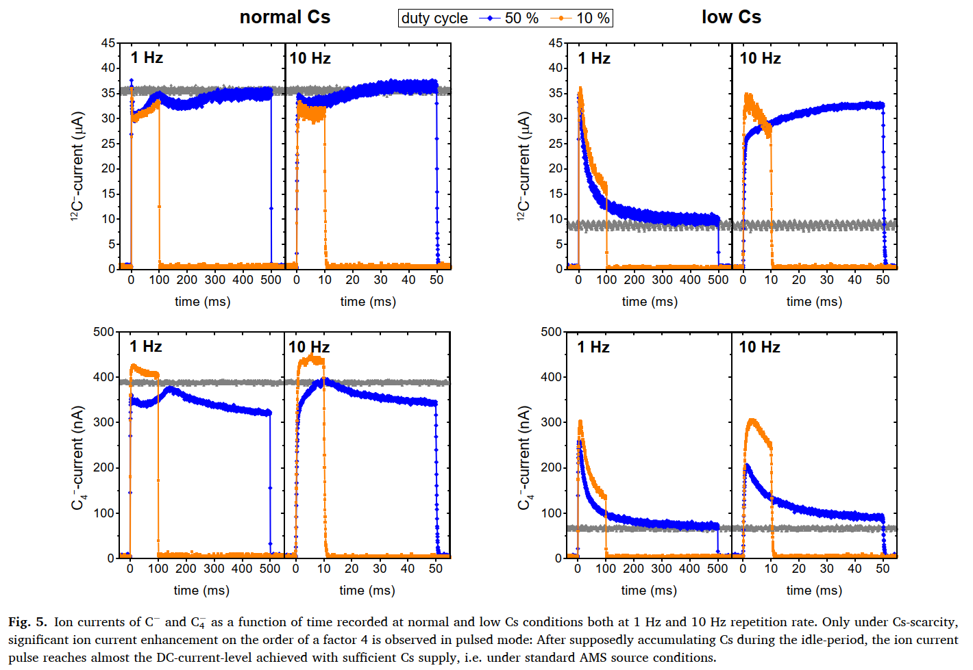
Future plan
Cathode voltage pulsing with/without the laser
“High performance” tests at Helsinki AMS lab
Where does the effect relate, does if have a molecule effect?
(LiO vs Li2O)
Ionizer effect tested independently to Cs condition (by the oven)
Continuation of the measurement through multiple materials and target, measuring the cathode temperature as well.
… a lot of possiblities
Patent pending…
Vienna, VERA: No gain for total beam current for SNICS with ordinary pulsing
-> how about with the laser..
Martin Martschini, Petra Holzer, Esad Hrnjic, Alfred Priller, Peter Steier, Robin Golser, Pulsed operation of a SNICS ion source – ionization efficiency and ion current output, Nuclear Instruments and Methods in Physics Research Section B: Beam Interactions with Materials and Atoms,Volume 527, 2022, Pages 7-11

Slide 19
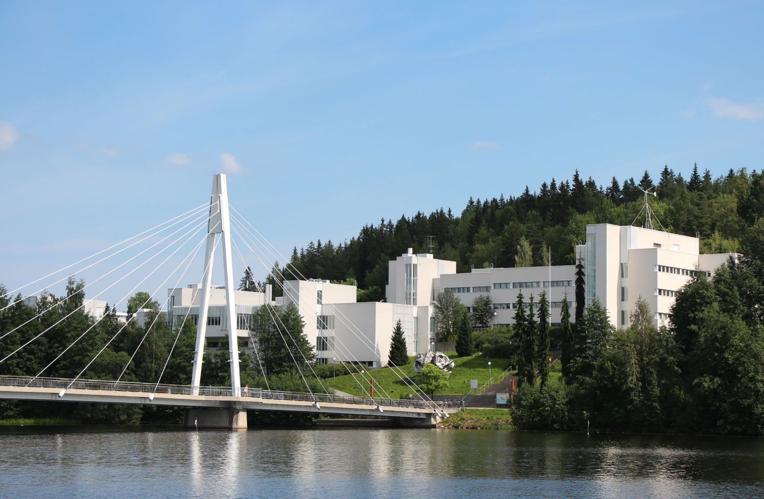
Thank you for your attentation

Slide 20
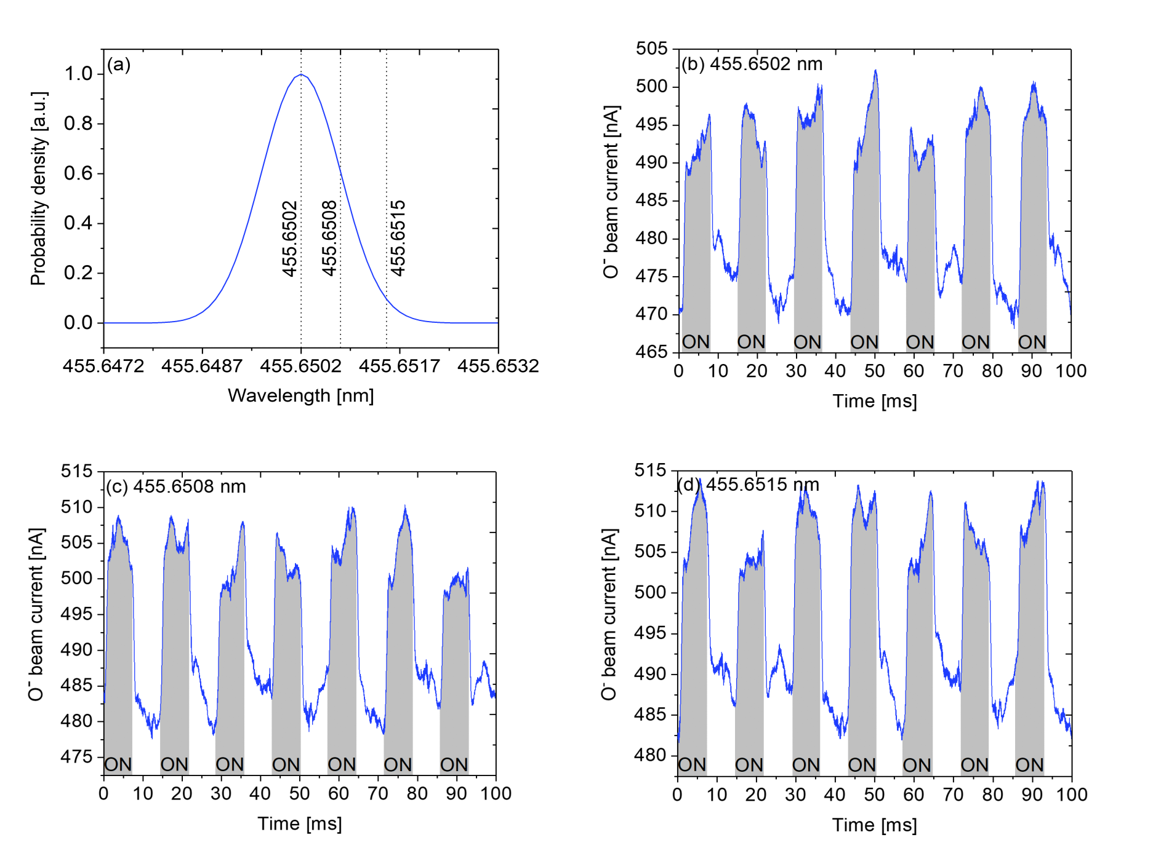
Evidence of non-resonant nature?
7p3/2
Beam intensity change was similar amount for broad range of wavelengths (>10) scanned over the expected resonance frequencies of the neutral Cs.
->> not a resonance effect
(at least for these states)
Wavelength selection for the excitation of the 7p3/2 electronic state of neutral Cs: (a) shows the expected maximum Doppler broadening of the absorption line and the laser wavelengths used for probing the putative ion pair production.
The prompt effect of the laser exposure on the O− beam current with different wavelengths: (b) in-vacuum resonance at 455.6502 nm, (c)
455.6508 nm within the maximum Doppler broadening, and (d) 455.6515 nm outside the maximum Doppler broadening.
Notes:
.

Slide 21
Different cathode holder experiment
Work Function
Caesiated surface work function
Al: 4.06-4.26 eV
Al: ~1.71 eV
Ti: ~1.63 eV
Cu: ~1.56 eV
Ni: ~1.46 eV
Ti: 4.33 eV
Cu: 4.53-5.1 eV
Ni: 5.04-5.35 eV

Slide 22
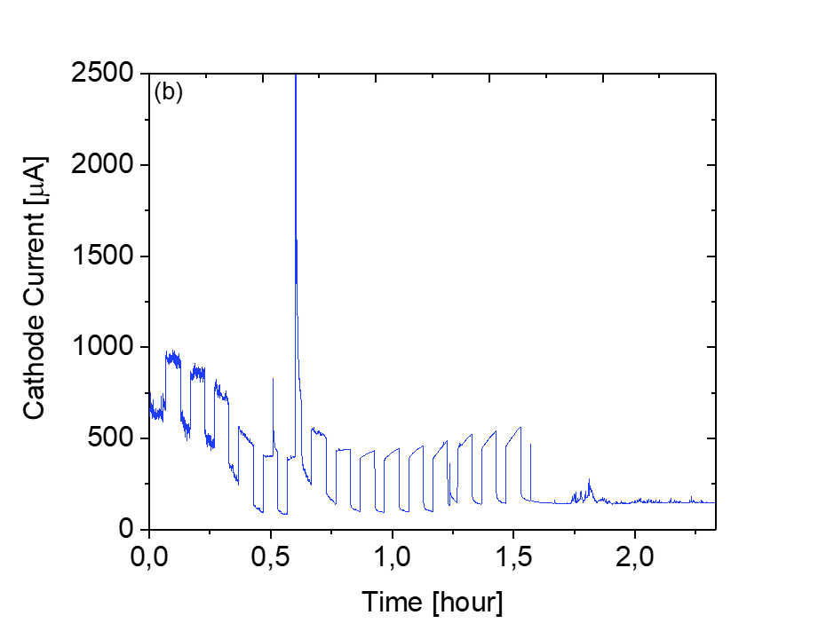
Priming Effect
The effect on the (a)${ Br}^{−}$beam current with 295 mW laser power on the cathode and corresponding (b) cathode current. In this case Ti cathode holder, Ionizer current 17 A and Cs oven temperature ${145}^{0}c$ was used.

Slide 23

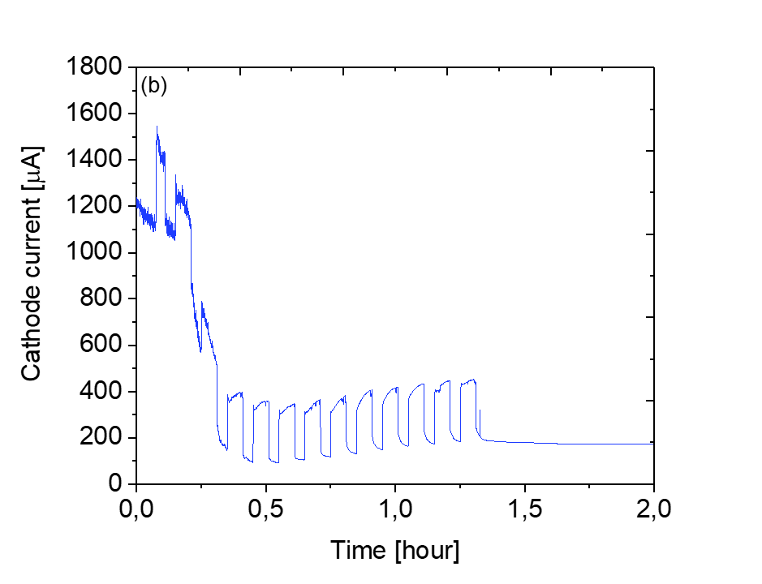
Priming Effect
The effect on the (a)${ Br}^{−}$beam current with 605 mW laser power on the cathode and corresponding (b) cathode current. In this case Cu cathode holder, Ionizer current 17 A and Cs oven temperature ${145}^{0}c$ was used.

Slide 24
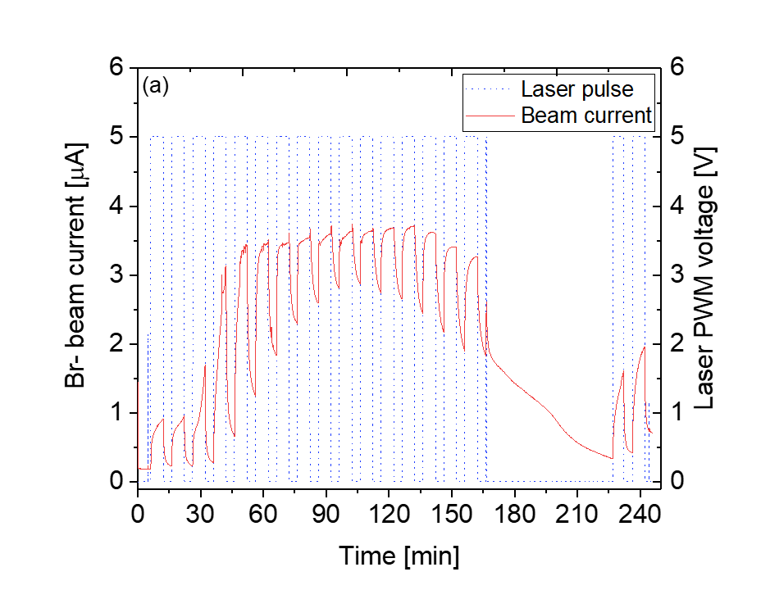
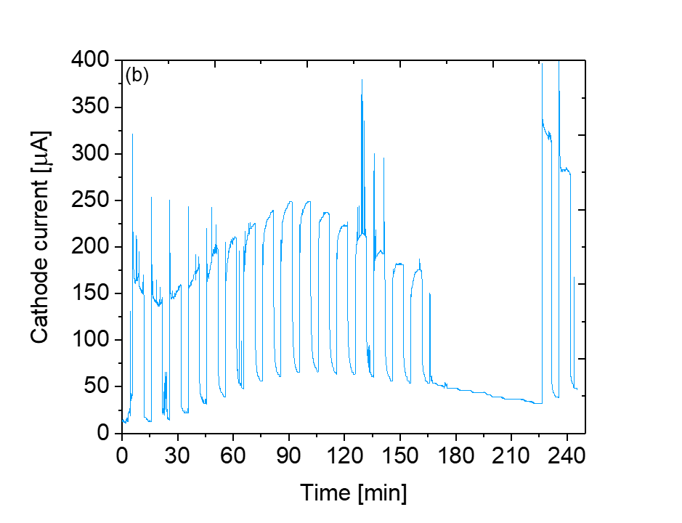
Priming Effect
The effect on the (a)${ Br}^{−}$beam current with 605 mW laser power on the cathode and corresponding (b) cathode current. In this case Ni cathode holder, Ionizer current 16.5 A and Cs oven temperature ${145}^{0}c$ was used.

Slide 25
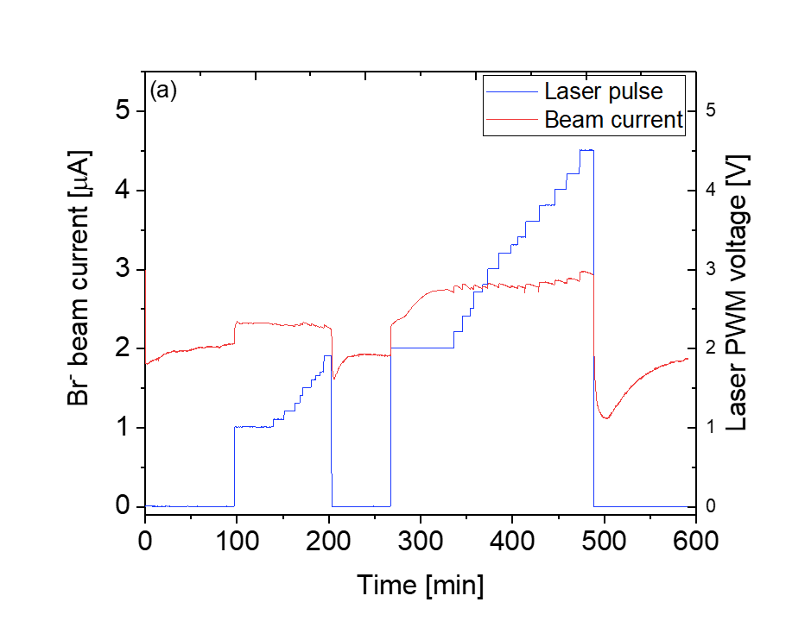
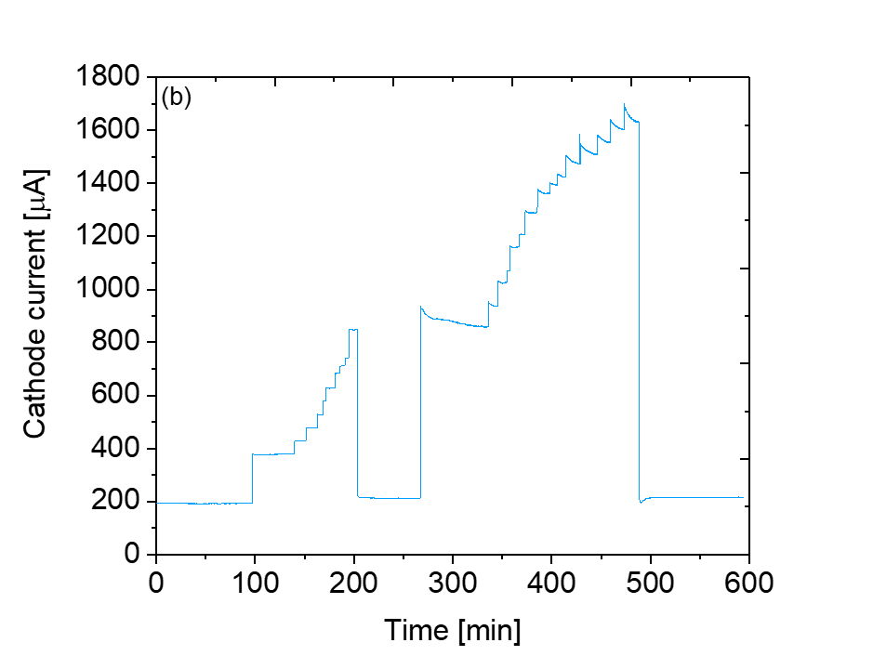
Stable Beam Current
The effect on the (a)${ Br}^{−}$beam current with different laser power on the cathode and corresponding (b) cathode current. In this case Ti cathode holder, Ionizer current 17.5 A and Cs oven temperature ${165}^{0}c$ was used.

Slide 26
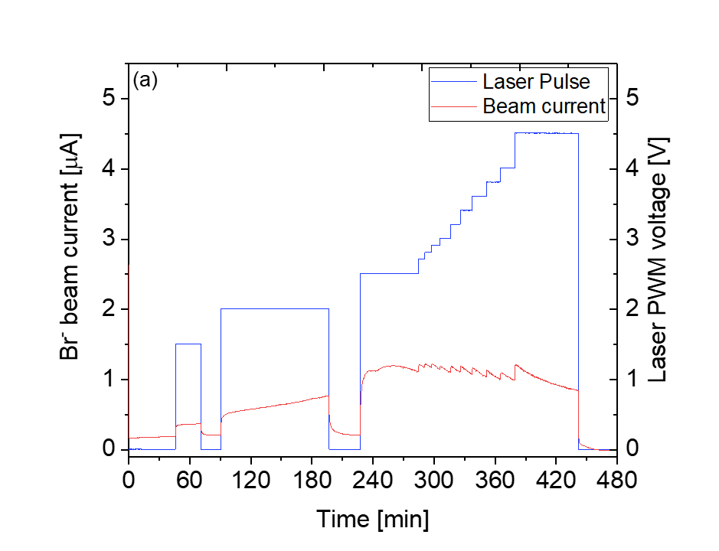
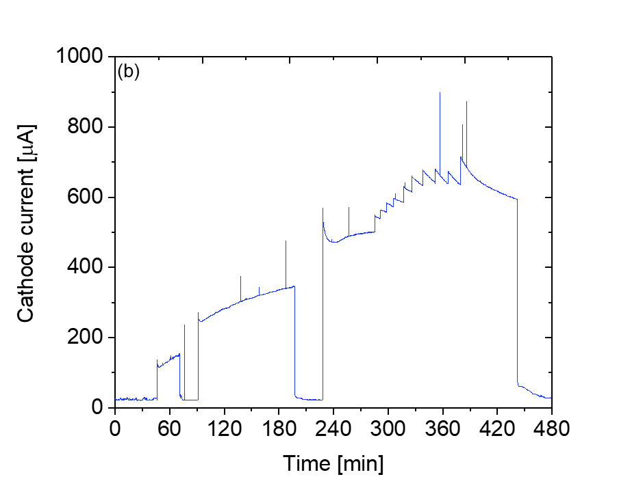
Stable Beam Current
The effect on the (a)${ Br}^{−}$beam current with different laser power on the cathode and corresponding (b) cathode current. In this case Ti cathode holder, Ionizer current 17.5 A and Cs oven temperature ${150}^{0}c$ was used.

Slide 27
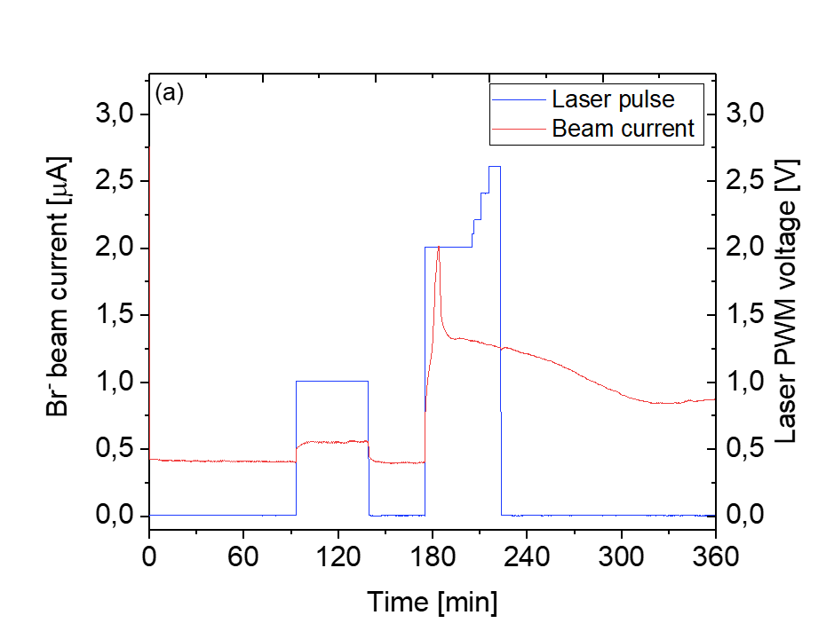
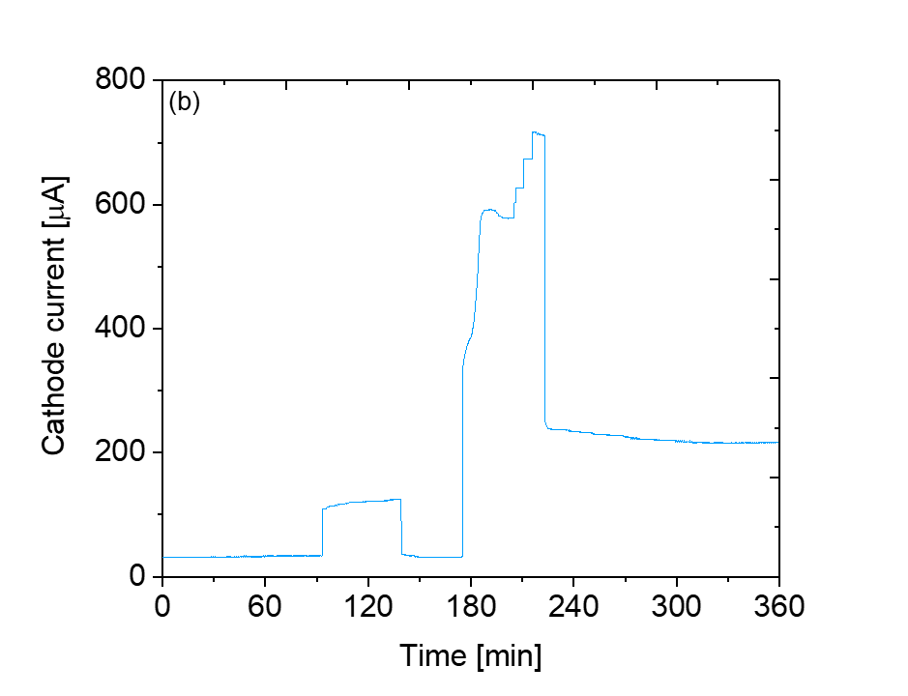
Stable Beam Current
The effect on the (a)${ Br}^{−}$beam current with different laser power on the cathode and corresponding (b) cathode current. In this case Ni cathode holder, Ionizer current 17.5 A and Cs oven temperature ${165}^{0}c$ was used.

Slide 28
Different cathode holder experiment

Slide 29
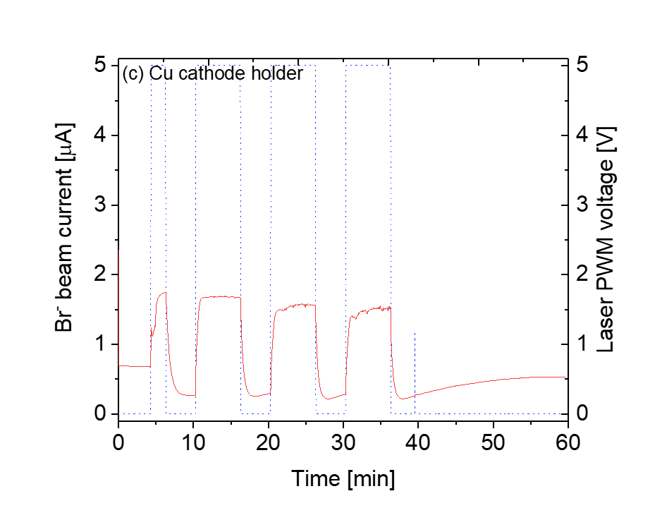
Different cathode holder experiment

