Slide 1
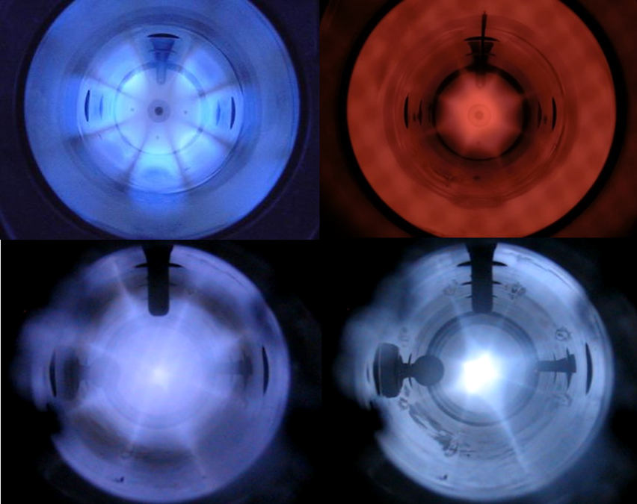
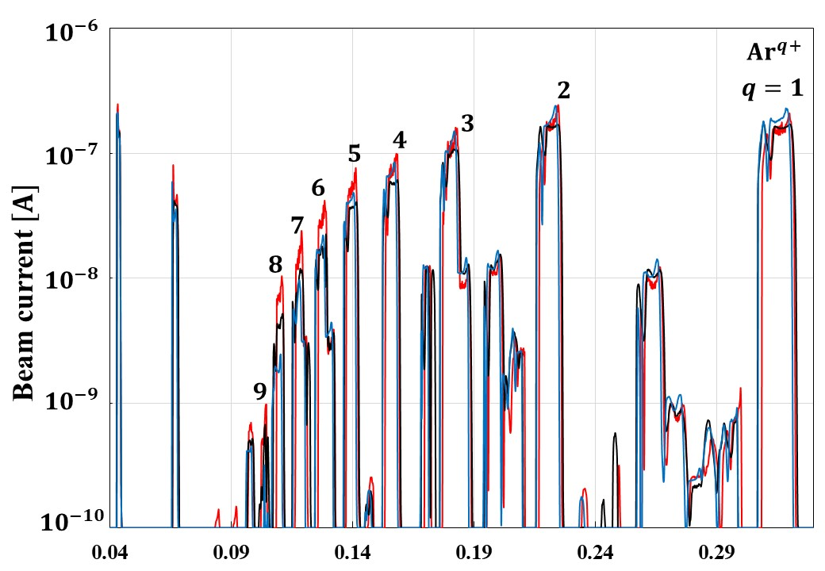
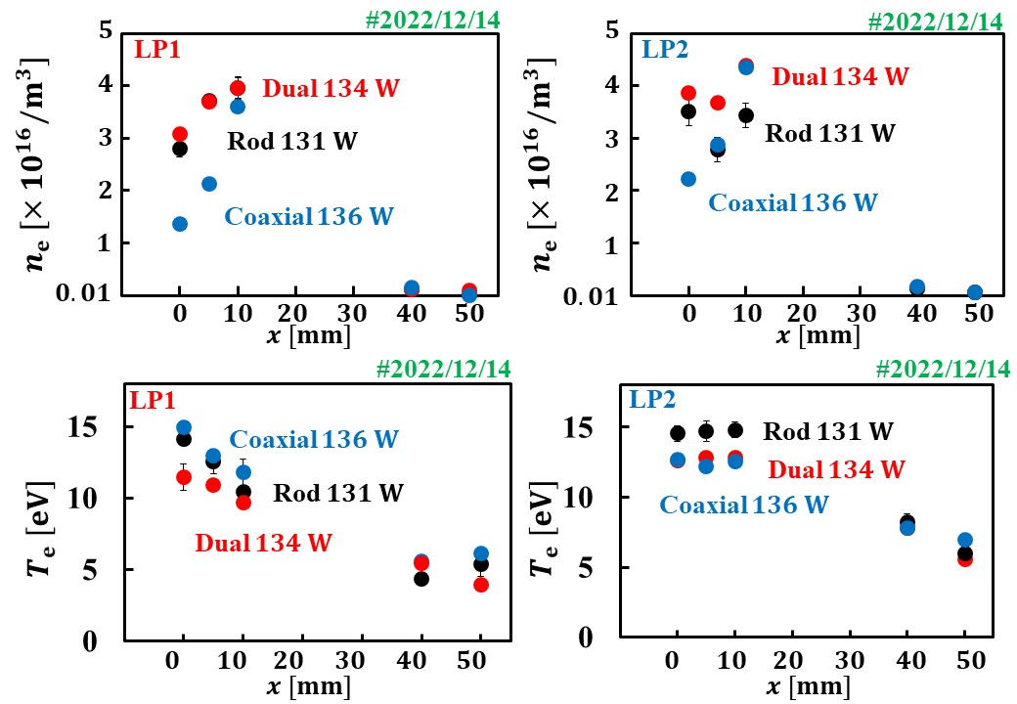
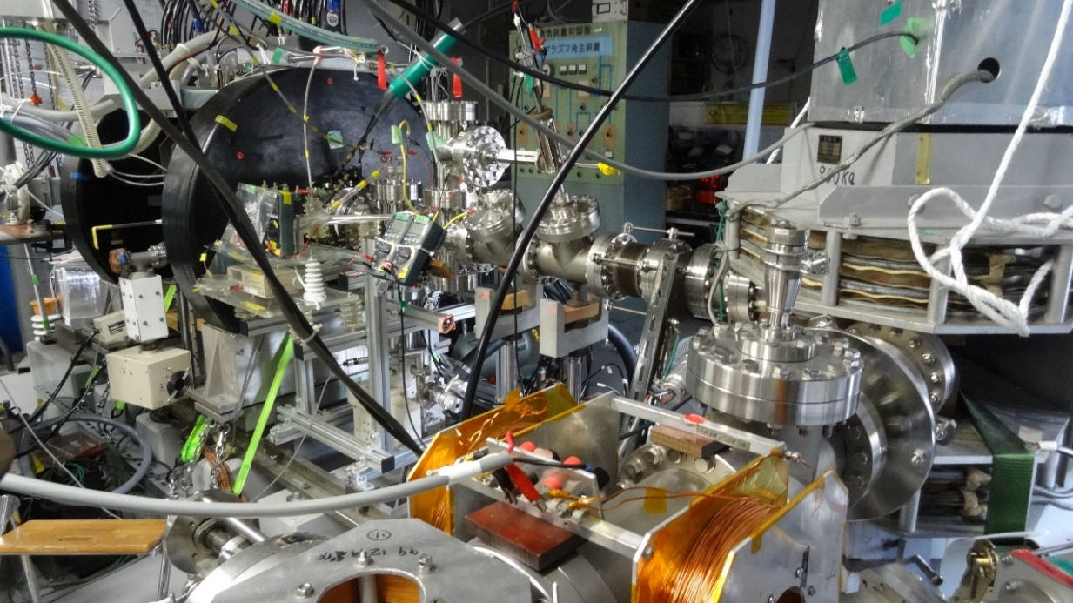
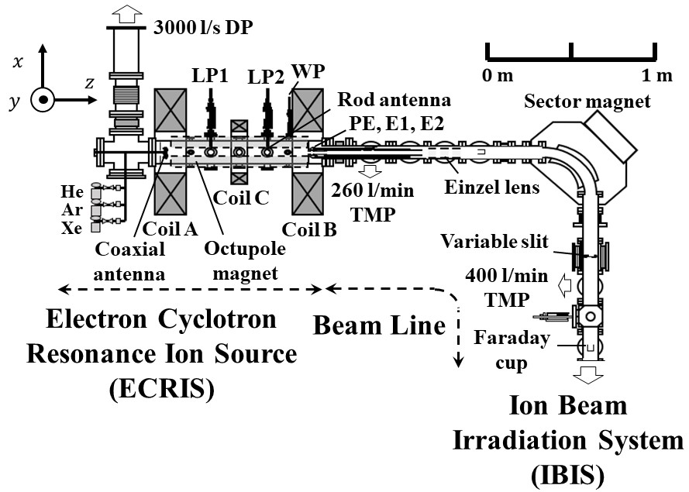
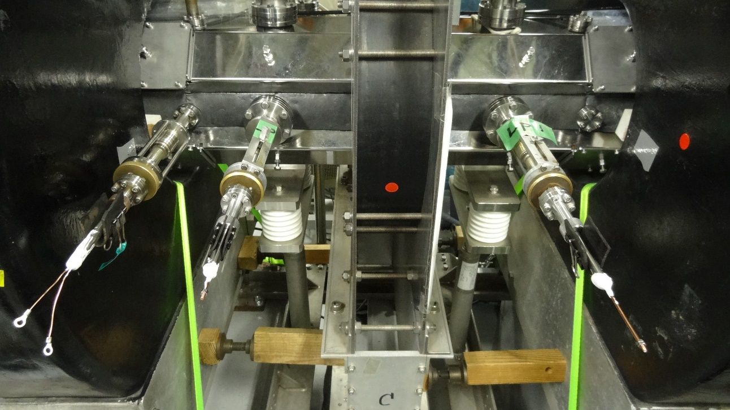
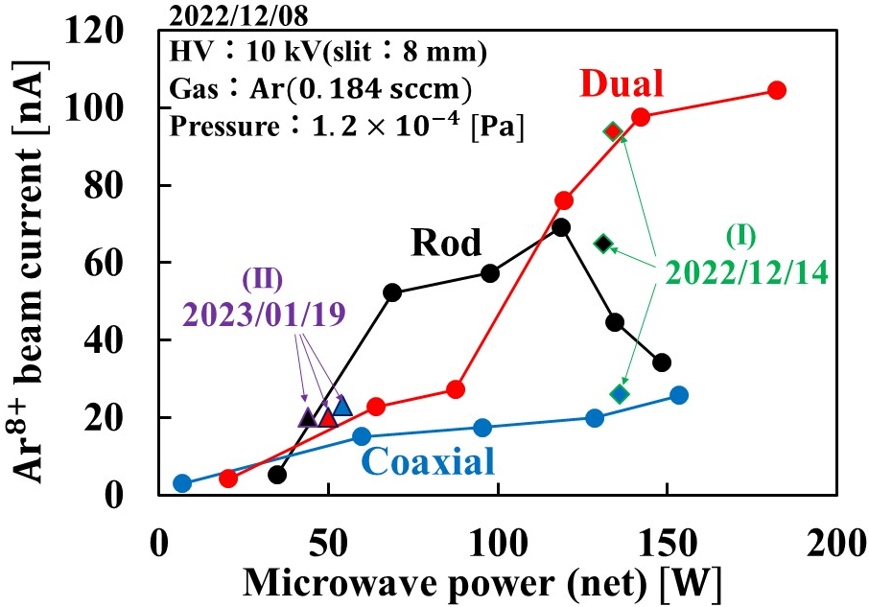
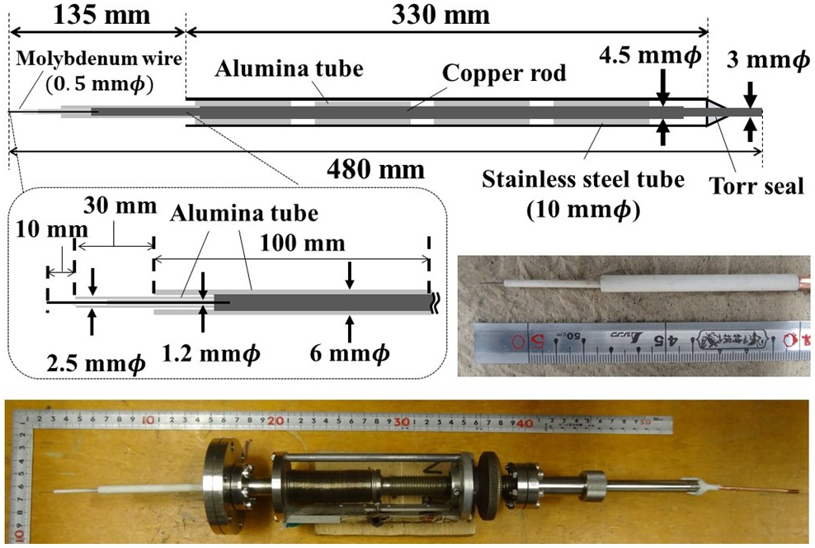
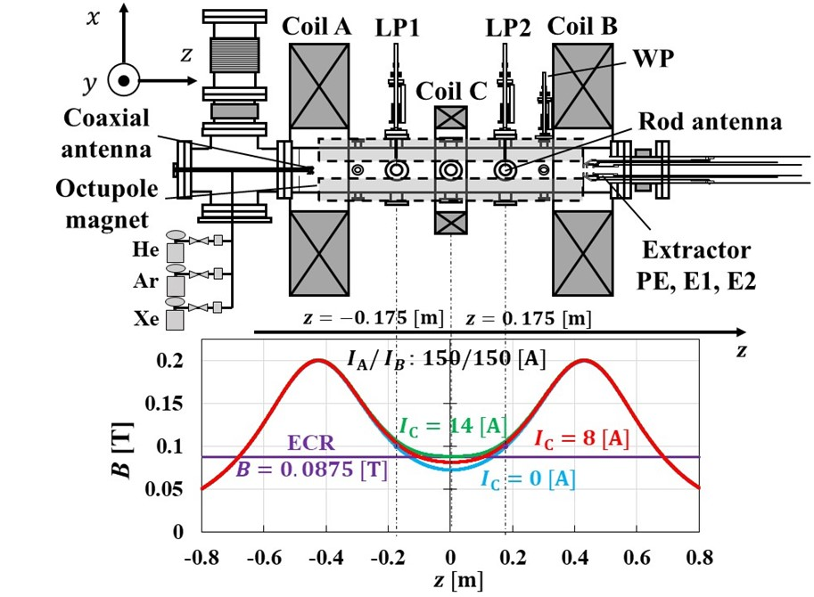
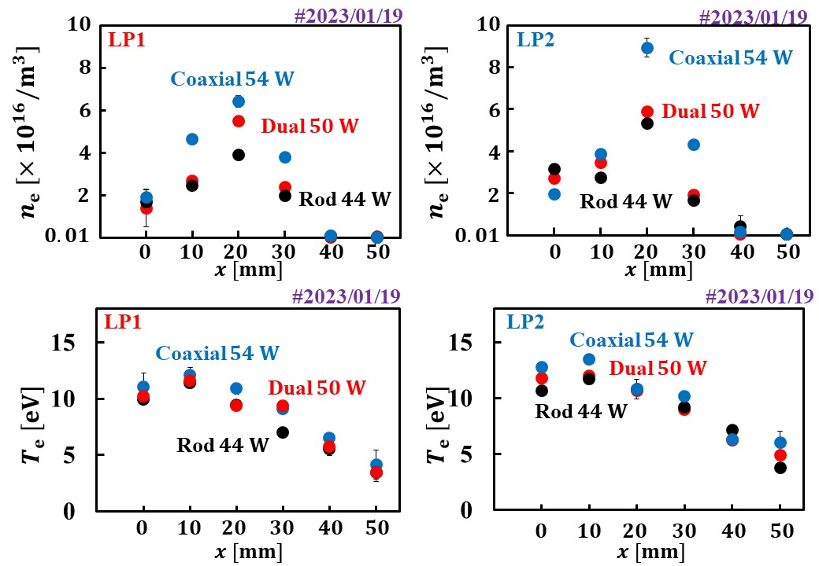
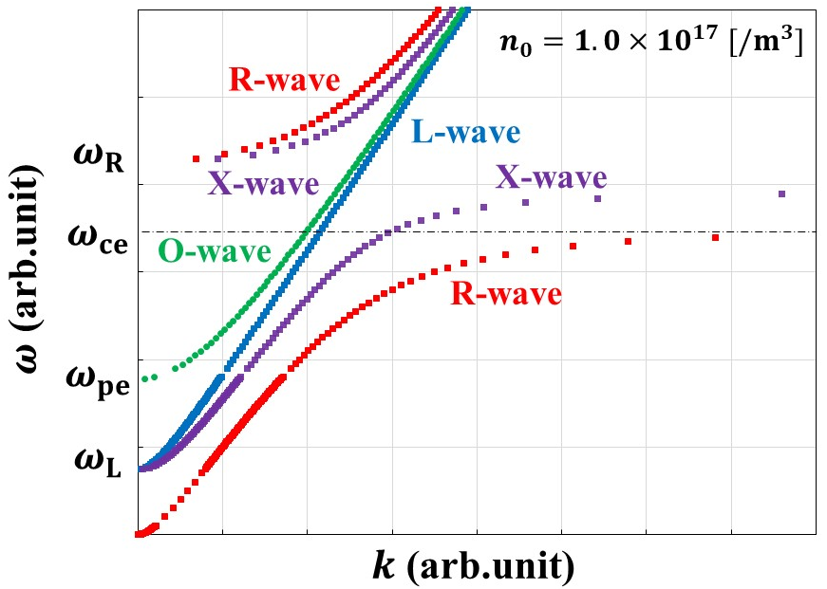
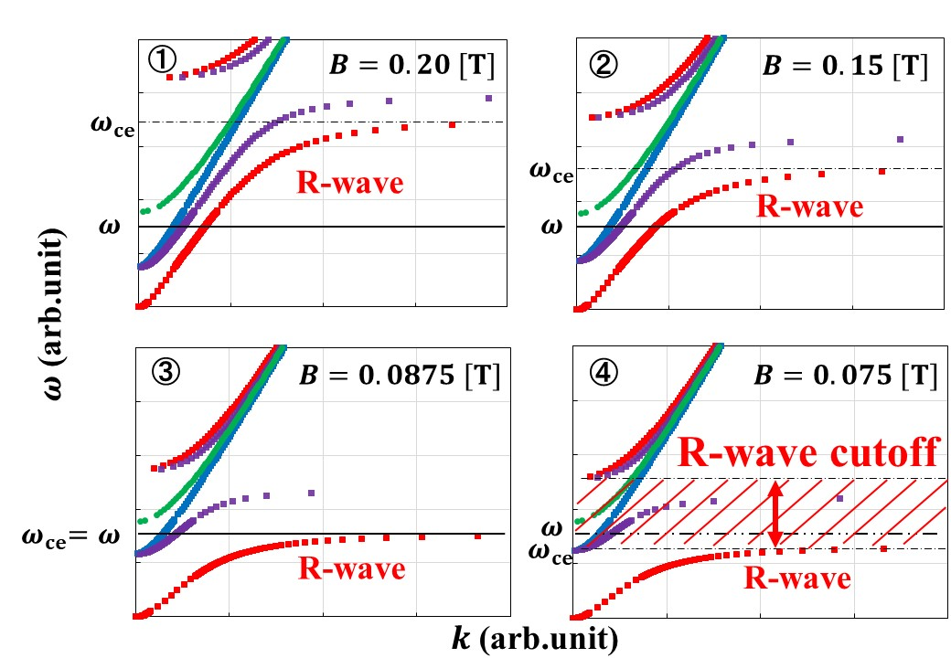
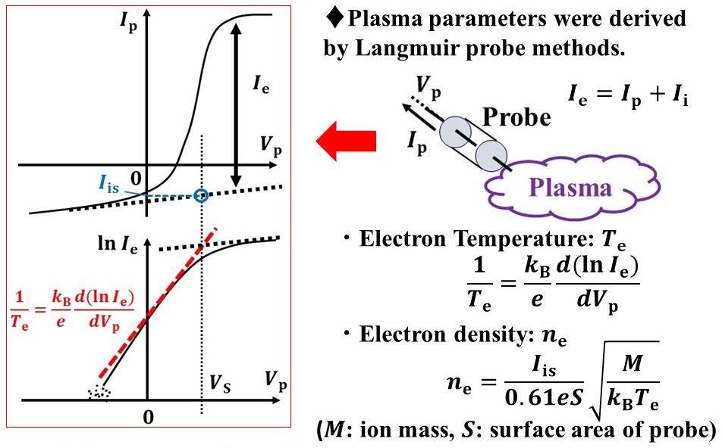
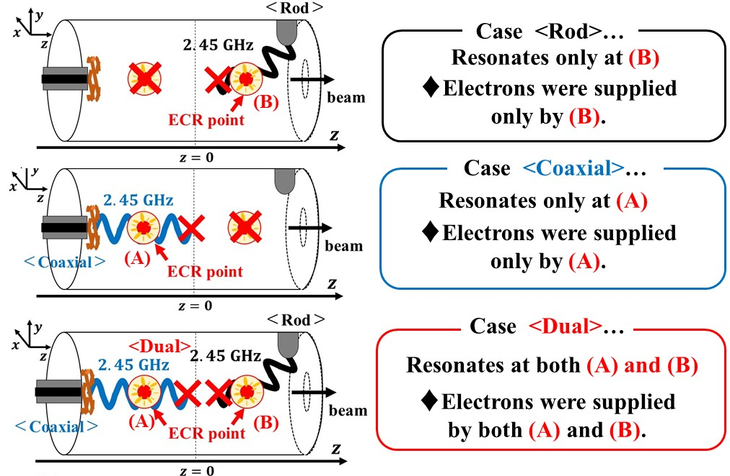
Various Parameter Measurements in Dual-ECR Heating
on Electron Cyclotron Resonance Ion Source
Kouki Iwahara, Takumu Maenaka, Yushi Fujimura, and Yushi Kato
Division of Electrical, Electronic and Inforcommunication Engineering, Graduate School of Engineering,
Osaka Univ.
2-1 Yamadaoka, Suita-shi, Osaka 565-0871, Japan
Corresponding author: iwahara@nf.eie.eng.osaka-u.ac.jp
§1. Introduction
§4. Experimental Results
Background
2022/12/14
HV：10 kV(slit：8 mm) Gas：$Ar(0.184 sccm)$
Pressure：$1.2×10^{−4} [Pa]$ $I_{A}/I_{B}/I_{C}$：$150/150/13,9,13 [A]$
$Dual:123/39 [W]+171/121 [W] (net 134 W)$
$$Rod:253/122 [W] (net 131 W)$$
$Coaxial:353/217 [W] (net 136 W)$
■ We succeeded in generating multi-charged
Ar ions effectively by Dual-ECR heating.
■ Dual-ECR heating means
we introduced microwaves
from both the upstream side (Coaxial)
and the downstream side (Rod).
(I)
Objectives
■ We obtained the relationship between net microwave powers and the beam currents of multi-charged Ar ions
by Rod, Coaxial, and Dual-ECR methods.
■ We measured the beam currents and plasma parameters
such as electron density ($n_{e}$) and electron temperature ($T_{e}$),
and we obtained their spatial distributions by each method.
$$B [T]$$
§2. Experimental Apparatus
Figure 6: The charge state distribution (CSD) of each method.
LP2
LP1
Figure 7: The distribution of plasma parameters at high microwave powers.
Experimental
procedure
1. Main gas:Ar
2. Applying currents to Coil A, B, and C
3. Introducing microwaves from antennas (Coaxial, Rod)
4. Extraction voltage 10 kV and ions are measured by Faraday cup
＜Coaxial＞
Figure 1: Experimental apparatus (Osaka Univ.).
Figure 3: The design and photographs of
Langmuir probe 1, 2 (LP1, LP2).
Figure 8: The dependency of ${Ar}^{8+}$ beam currents on microwave powers.
We found:
♦Rod: ${Ar}^{8+}$ increased around 120 W and decreased after that.
outer
inner
♦Coaxial: ${Ar}^{8+}$ increased but the value was lowest.
19 mm
8 mm
Self-resonant circuit
＜Rod＞
(II)
♦Dual: ${Ar}^{8+}$ increased and didn’t go lower.
taper
$$a=2×0.1λ=24 [mm]$$
$$b=0.1λ=12 [mm]$$
$$\left(λ=\frac{c}{f}=\frac{3.0×10^{8}}{2.45×10^{9}}≈0.12 \left[m\right]\right)$$
Microwave for 2.45 GHz
$$B=\frac{mω_{c}}{q}≈0.0875 [T]$$
Figure 2: The ECRIS and the distribution of the magnetic field.
§3. Theoretical Background
§5. Discussion
§3.1 $ω$-$k$ diagram and cutoff (only electron)
Q. Why was $n_{e}$ at Dual-ECR heating highest?
R-wave：$k^{2}={\left(\frac{ω}{c}\right)}^{2}\left\{1−\frac{ω_{pe}^{2}}{ω\left(ω−ω_{ce}\right)}\right\}$
L-wave：$k^{2}={\left(\frac{ω}{c}\right)}^{2}\left\{1−\frac{ω_{pe}^{2}}{ω\left(ω+ω_{ce}\right)}\right\}$
X-wave：$k^{2}={\left(\frac{ω}{c}\right)}^{2}\frac{\left\{1−\frac{ω_{pe}^{2}}{ω\left(ω−ω_{ce}\right)}\right\}\left\{1−\frac{ω_{pe}^{2}}{ω\left(ω+ω_{ce}\right)}\right\}}{1−\frac{ω_{pe}^{2}}{ω^{2}−ω_{ce}^{2}}}$
O-wave：$k^{2}={\left(\frac{ω}{c}\right)}^{2}\left(1−\frac{ω_{pe}^{2}}{ω^{2}}\right)$
$$\left(ω_{ce}=\frac{eB}{m},ω_{pe}=\sqrt{\frac{n_{0}e^{2}}{ε_{0}m}}\right)$$
-We thought R-wave cutoff was one of the primary factor.
Figure 9: The distribution of plasma parameters at low microwave powers.
The magnetic field $B$ values by $z$-coordinate.
R-wave can’t pass towards the opposite side of ECR point.
(Figure 11)
(Case <Coaxial>)
Figure 4: $ω$-$k$ diagram.
♦In the electromagnetic waves, there exist right-hand polarization wave
(R-wave) and left-hand polarization wave (L-wave) and two cutoffs ($ω_{R},ω_{L}$).
$$ω_{R}=\frac{ω_{ce}+\sqrt{ω_{ce}^{2}+4ω_{pe}^{2}}}{2},ω_{L}=\frac{−ω_{ce}+\sqrt{ω_{ce}^{2}+4ω_{pe}^{2}}}{2}$$
Figure 10: The distribution of magnetic field and ECR points.
§3.2 Plasma parameters derivation
Figure 11: The $ω$-$k$ diagrams and R-wave cutoff$(n_{0}=1.0×10^{17} [/m^{3}])$.
§6. Conclusion
■ $Ar^{8+}$ beam currents of Rod, Coaxial, and Dual:
♦${Ar}^{8+}$ beam currents at Dual-ECR heating was highest
in three ways of introducing microwaves.
♦There was an instability at Rod and the values were low at Coaxial.
We can generate multi-charged $Ar$ ions stably by Dual-ECR heating.
■ Plasma parameters of Rod, Coaxial, and Dual:
$n_{e}$: highest at Dual-ECR heating
$T_{e}$: higher at the microwave introducing side
♦$n_{e}$ at Dual-ECR heating was highest in three ways.
■ From Discussion…
Figure 5: Langmuir probe methods.
It is reasonable that $n_{e}$ at Dual-ECR heating
was highest in three ways.

