Slide 1
Upgrade and Improvement of the TRIUMF ECRIS Charge State Booster
ICIS’23
Joseph Adegun
Notes:
Hello everyone,
I would also like to take this opportunity to extend my sincere appreciation to the international advisory committee members for selecting me to give this invited talk..
My name is Joseph Adegun.

Slide 2
Outline
Brief introduction of the TRIUMF ECRIS CSB and transport optics
Optimization of the optics
Simulation of the extraction system
Implementation of two-frequency heating technique (TFHT)
Results of TFHT
Summary and Outlook
Joseph Adegun

Slide 3
Why charge breeding is required at TRIUMF ISAC Facility
$$E≤60 keV$$
Charge breeding required for isotopes with $A>30 u$
$$2.0 keV/u$$
$$A/Q≤6$$
Notes:
Depending on the mass and energy requirements of the experiment, the selected isotope is post-accelerated using a series of linear accelerators (LINAC) to achieve higher energy levels.
RFQ – 2.0 keV/u to 150 keV/u (dE = 148 keV/u)
DTL – 150 keV to 1.50 MeV/u (dE = 150 MeV/u)
SRF – 1.50 MeV/u to 16.0 MeV/u (dE = 15 MeV/u) – Higher accelerating field gradients compared with RFQ and DTL
Stripping using foils is less efficient for high masses after the RFQ
RFQ acceptance = 140 $mm−mrad$
Other reason for charge state breeding
Compact accelerator facility and cost-efficient – E = QeV
Beam formation from extracted molecules from the target station: Oxygen beam formation from the ${CO}_{2}^{+}$ injected into the CSB

Slide 4
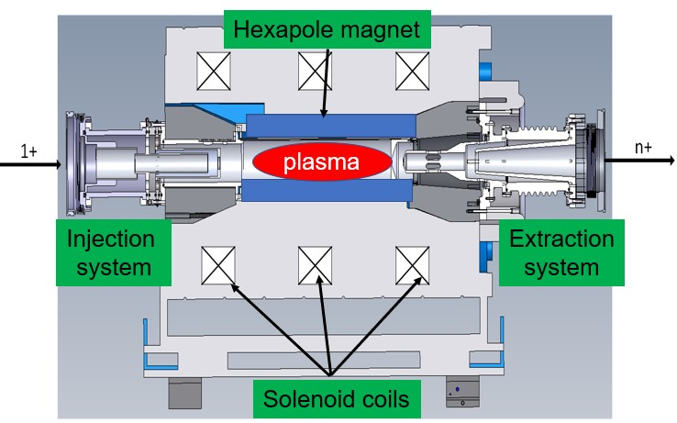
TRIUMF ECRIS Charge State Booster
ECR ion source: EM waves + Magnetic fields
Designed by PANTECHNIK for single frequency heating operation
Plasma confinement is by magnetic mirror effect: Solenoid and Hexapole fields
Three – electrode injection and extraction systems
Two cryopumps installed to achieve background pressure $\sim {10}^{−8} Torr$ (lowest gas pressure for ECRIS charge breeder operation worldwide)
Because of the limited space around the CSB to install conventional Emittance meter, we use quadrupole scan technique to measure emittance
With the single-frequency heating of the charge state booster, the global efficiency for Cs charge states between 20+ and 28+ is 35.4 %
$$1+$$
$$Q+$$
Resonance heating for electrons
$$f_{rf}=f_{cyc}=\frac{eB_{ecr}}{2πm_{e}}$$
Notes:
ECRIS uses electromagnetic waves and magnetic fields to produce and confine plasma of energetic electrons and relatively cold ions.
Plasma confinement is achieved from the magnetic fields created by 3 solenoid coils and hexapole permanent magnet
higher frequency (>2.5 GHz) means higher plasma density means higher charge state and current
TWTA: 13.75 – 14.5 GHz, rf power up to 600 W
Injection and Extraction electrodes are Aluminum materials
A system of charged particles can only be called plasma if
Debye length is far less than the length of the container of the plasma
Number of particles in the Debye sphere is far greater than 1
Plasma frequency is greater than collision frequency with neutral atoms
Electron-impact ionization – Inelastic Collision

Slide 5
Axial Magnetic Field Distribution of the CSB
The magnetic field of the CSB was modelled and mapped to have up-to-date information about the CSB and correct field for injection and extraction simulations.
Magnetic Fields | Values [T]
$$B_{inj}$$ | $$\sim 1.0$$
$$B_{min}$$ | $$\sim 0.3$$
$$B_{ext}$$ | $$\sim 0.7$$
$$B_{r}(r=32 mm)$$ | $$\sim 0.7$$
$$B_{ecr}(f_{rf}=14.5 GHz)$$ | $$\sim 0.5$$
Notes:
On this slide, I would like to briefly summarize the axial magnetic field distribution of the CSB
Plasma chamber length is around 320 mm
Extraction system length is around 378 mm
The whole length of the CSB from injection soft iron to the extraction soft iron is 640 mm
Axial field drops from 0.7 T to 19 mT within the first 50 mm on the extraction region
Number of turns in the wire = 128
Iron yoke – ARMCO
Permanent magnet material – Neodymium
Hexapole field distribution is quadratic with distances from the center.
Magnetic flux flow from positive (north) to negative (south) poles
Function of sextupole or hexapole is to correct for the chromatic aberration due to dispersion created in a dipole

Slide 6
Improvement of an ECRIS Charge State Booster
The performance of the ECRIS CSB strongly depends on:
Injection optics and injection system - distinguish an ECRIS charge state booster from an ordinary ECR ion source – crucial
Optimization enhances efficient injection of singly charged ions (prevents beam loss)
Plasma parameters (rf power, frequency and B-field): plasma density, electron energy and ion confinement time
Optimized parameters enhances intensity and charge state
Extraction system and extraction optics
Optimization prevents unnecessarily emittance growth
It is important to optimize all the above simultaneously to improve the efficiency and beam quality of a charge state booster

Slide 7
Schematic of the injection and extraction optics of the TRIUMF CSB
Injection Optics
Cesium surface test ion source to facilitate tuning of plasma and optics
CTIS and CSB are approximately biased to the same Voltage
Optics designed by R. Baartman, TRIUMF, (2007)
Extraction optics
CSB
Combination of the dipole and benders act as a Nier-type spectrometer
Notes:
Achromatic system - Nier-type spectrometer – the energy dispersion of the magnetic dipole is compensated by the energy dispersion of the electrostatic benders.
Achromatic system helps to filter out impurities extracted from the CSB.
Chromatic aberration is a phenomenon in which particles of different energies have slightly different trajectories when passing through a magnetic field.
Electrostatic benders are preferred over sextupole for chromatic aberrations correction because it is suitable for a wider energy range, making them more versatile than sextupole magnets.
Bending angle of the magnetic dipole is 90 degrees with bending radius of 36 cm
Bending angle of the benders is 45 degrees with bending radius of 25 cm
Mass resolution scales with size. The limited space allows a resolution of 200 which also depends on the ECRIS emittance.
Mass dispersions are different for the two bends. The do not cancel.
Magnetic solenoids are not used in low-energy beamlines because of high power requirements

Slide 8
Optimization of the CSB Injection optics in TRANSOPTR
TRANSOPTR is a beam envelope code. It is maintained by the TRIUMF’s beam physics group.
It was used to simulate the optics of the CSB to optimize the envelope of injected and extracted beam from the CSB.
Beam envelope of ¹³³Cs⁺
$$B_{inj}≠0,E_{inj}≠0$$
$$B_{inj}=E_{inj}=0$$
$$B_{inj}≠0,E_{inj}≠0$$
This is the first-time investigating and optimizing the injection optics by including the magnetic and electric fields has been done
Envelope optimized with B and E-fields ON
Optics described in Slide 7
Notes:
On this slide I would like to summarize the work that I did to further optimize the transport optics of the CSB.
When the optics of the CSB were designed, the electric and magnetic fields of the CSB were not considered.
So, I imported these fields into TRANSOPTR, I defined minimization goals for each optics, and finally determined the settings of the optics for efficient beam transport.
For the injection optics, the goal is to achieve a parallel beam with a size much smaller than the aperture radius of the injection system in the presence of the electric and magnetic fields at the injection region, and that was achieved.
For the extraction optics, the goal is to achieve zero dispersion and converging beam at the point labelled FC16A with the beam starting the magnetic field of the CSB, and that was also achieved.
Axial field of the CSB drops from 0.7 T to 19 mT within the first 50 mm on the extraction region
TRANSOPTR integrate the equation of motion using Runge Kunta method.
The optimization methods in TRANSOPTR is downhill simplex and Simulated annealing
Given the beam initial parameters, objective functions can be defined, and quad settings are minimized to satisfy the objectives.
The CSB is not operated in space charge regime – The total current from the CSB required before significant intensity of charged bred ions can be detected is about 50 uA
It’s known that two parallel currents attract each other.

Slide 9
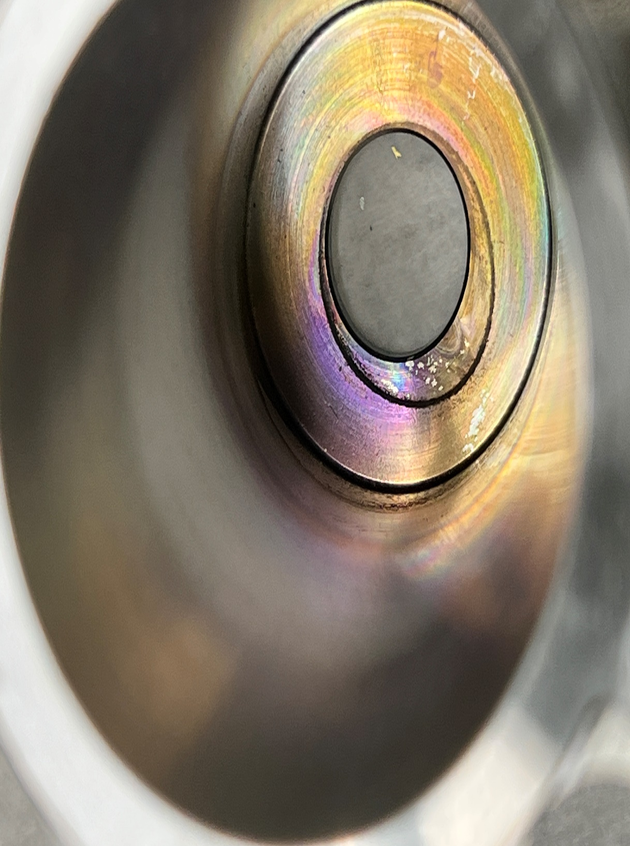
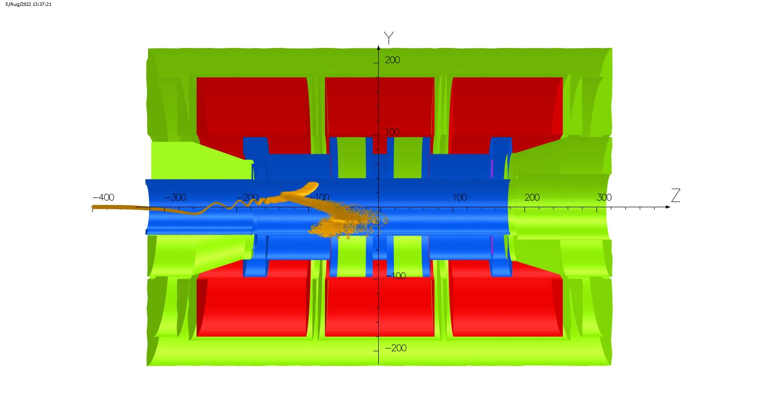
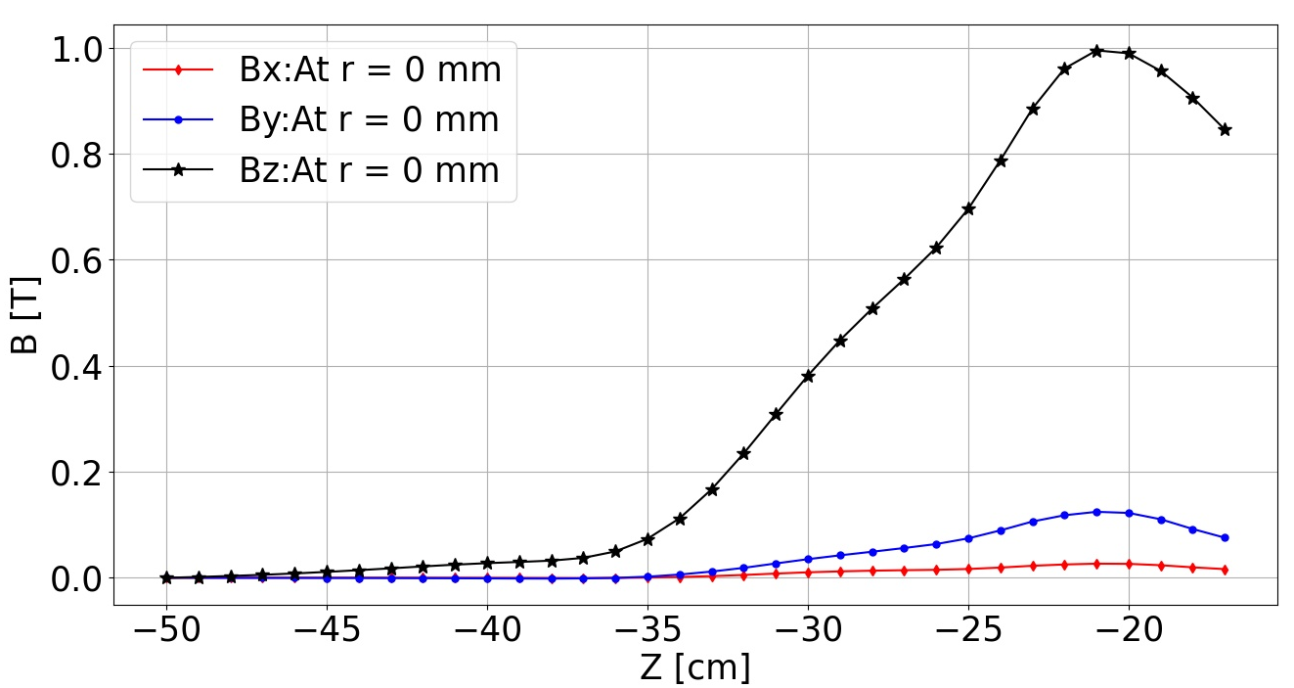
Asymmetry Magnetic Field in the Injection Region of the CSB
Asymmetry in the B-field in the injection region
Footprint of lost injected ions
There is a gap in the injection soft iron of the CSB. The presence of the gap creates an asymmetric magnetic field in the injection region that affects efficient injection of ions into the CSB.
20 mm
$B_{y}=10\%$ of $B_{z}$ at the injection region
Reducing the size of the gap in the soft iron is necessary to enhance the injection of singly charged ions.
Notes:
The magnetic field induces a circular motion with a Larmor radius greater that the injection aperture radius
Causing the ions to be lost to the injection electrode
At Larmor radius of 10 mm and B-field of 1 T, The Cs+ ions at that injection hole have a transverse velocity of $7.2×{10}^{3}$ m/s.
Since the Larmor radius is larger than 10 mm as shown here, then the beam has larger angle as they enter the extraction system.
At the location of IE2, assuming the beam parameters in both directions are equal x = 3 mm and x’ = 0.87 rad, that corresponds to a transverse velocity of about $1×{10}^{5} m/s$
Diameter of the IE1 is 28 mm, diameter of IE2 is 20 mm

Slide 10
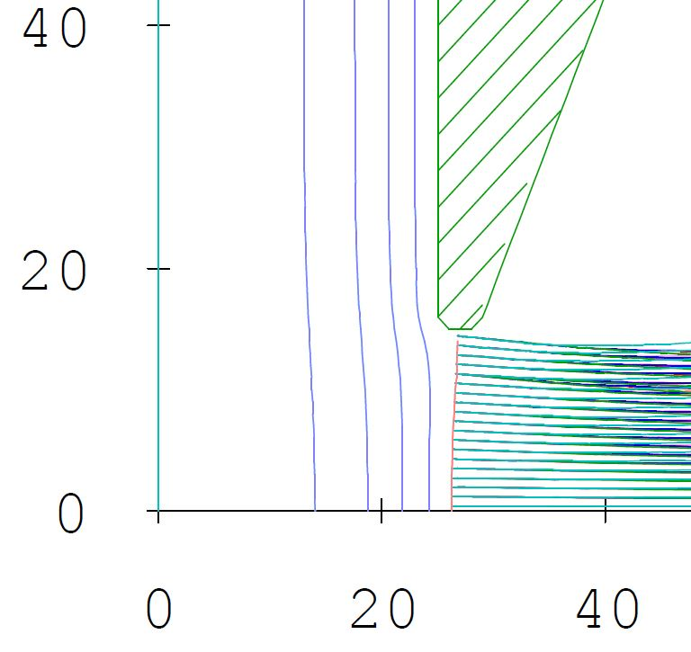
Simulation of the Extraction System in IGUN
Magnetic Field
Simulated most intense residual ions (H,C,N O), support gas, He and Cs24+
Beam
Plasma
Electrode
Puller
Electrode
Beam rotation, $θ^{′}→$ Magnetic field
Divergence, $r^{′}→$ Electric field
Ground
Electrode
Notes:
The electric field for beam formation is created between the plasma electrode and the puller electrode
The electric field affects the beam divergence of the extracted ions depending on the shape of plasma meniscus
The case where the plasma meniscus is flat, the divergence is optimum, emittance is smallest
In reality, the gap is not fixed during CSB operation, the length of the gap varies depending on the magnitude of the extraction field and the ion density
For ion extraction from the ECR plasma, optimized extraction field is achieved only when the plasma density balances the space charge density.
I systematically optimized the CSB extraction system to identify the optimized extraction field.
Shape of the plasma boundary depends on Extraction E-field
Convex – ion beam forms with large angle
Planar – ion beam forms with optimum angle
Concave – ion beam forms with over focused angle
On this slide, I would like to talk about the optimization process of the CSB extraction system in IGUN. The extraction system consists of the
The whole extraction system is installed in the strong magnetic field of the CSB
If the extraction field is low, the shape of the plasma boundary is Convex meniscus producing large Emittance (extraction gap smaller than the designed)
If the extraction field is moderate, plasma boundary aligns with the extraction aperture, and the shape of the plasma boundary is Planar meniscus – lowest emittance (designed gap)
If the extraction field is high, the shape of the plasma boundary is Concave meniscus producing also large emittance (Extraction gap longer than the designed)
Magnetic field has been identified to be the main cause of large emittance in ECR ion sources because of the beam rotation induced by the field in the extraction region.
It also causes different focal points for the ion masses and charge states in the extracted beam
The parameters that influence the beam emittance are categorized as:
Ion temperature
Extraction gap
Extraction aperture
Magnetic field
Pierce geometry minimize aberrations in the extraction system.
Ui is the ion directed energy – initial energy of the plasma

Slide 11
Total Emittance of the CSB: Measurement vs IGUN Simulation
10 kV Bias Voltage
 | Optimized Emittance [mm-mrad] | Extraction field [kV/m]
Simulation | 139.8 | 128.0
Measurement | 101.6 | 112.0
Total current collimated
Collimated ions are not needed
Simulation approximates the CSB beam
Notes:
Acceptance of the quad is not measured because each mass in the beam has different focal length because of the magnetic field.
This is the plot of the results of the IGUN simulation compared with total emittance of the CSB.
The extraction field was varied between 80 and 140 kv/m. Emittance from IGUN simulation is plotted in red and the measured emittance of the CSB using the QST is plotted in black.
The trend of the plots indicates that as the extraction field is varied, the total emittance of the CSB is changed as shown in the plot.
The disagreement between the measurement and IGUN simulation is because the total extracted current from the CSB was collimated by the quadrupole in front of the CSB extraction system, removing a fraction of the low-mass ions that significantly contribute to the large emittance of the CSB included in the IGUN simulation.
So, only a fraction of the total current was present at the location where the total emittance was measured.
From the measurement, the Lowest emittance of 101.6 mm-mrad was found at 112 Kv/m
The beam rotation due to the decreasing magnetic field of the ECRIS becomes the dominating contribution to the ion beam emittance when $B∗r≥0.5\sqrt{kT}\sqrt{A/Q}$
CSB Bias to 10 kV
100 % beam Emittance = 5$ε_{1rms}$ Waterbag distribution
86 % beam Emittance = 4$ε_{1rms}$
When you add up all currents you should see Child-Langmuir. If it deviates then there are losses in the extraction system, which we cannot detect.

Slide 12
Comparison between the Emittances of Cs charge states, residual ions and magnetic emittance
$$ε_{mag}=0.16\frac{B_{0}r^{2}}{A/Q}$$
$$B_{0}=0.7 T$$
The plots show that for a beam with different masses as the case in ECR plasma:
Normalized emittance strongly depends on mass of the ions.
Lighter ions cool the heavier ions, so that heavier ions are extracted closer to the axis, a phenomenon called gas mixing effect which is a similar ion-ion cooling effect like in an EBIS.
Magnetic emittance allows estimation of the maximum radius ions of a certain mass are extracted from the plasma
H, C, N, O: between 1.0 mm and 2.5 mm
Cs charge states: between 0.5 mm and 1.0 mm
Notes:
4He+ and 16O4+ has the same A/Q – Measured emittance on that A/Q is 100 % going to be for He depending on the width of the slit.
* Geometrical Emittance is both mass and charge state dependence while normalized emittance is only mass dependence
I also measured the Normalized Emittance of Cs charge states between 16 and 27 and residual ions from H,C,N and O. I also compared the measurements with the Magnetic Emittance calculation for plasma aperture radius between 0.5 mm and 2.5 mm to estimate the radius where the ions are extracted from the plasma.
It was observed that Hydrogen, the lightest of the ions, has the highest normalized emittance and Cs, the heaviest ions, has the lowest normalized emittance.
From the magnetic emittance calculation, I estimated that the residual ions were extracted from the radius between 1 mm and 2.5 mm while Cs charge states were extracted between 0.5 mm and 1.5 mm .
The cooling of the highly-charged heavy ions by the low-charged light ions is responsible for the spatial emittance distribution.
ion-ion cooling effect in which low-charged lighter ions are repelled to the plasma edge, and highly-charged heavier ions are attracted to the plasma center, and the magnetic field from the ion extraction are responsible for the spatial emittance distribution.

Slide 13
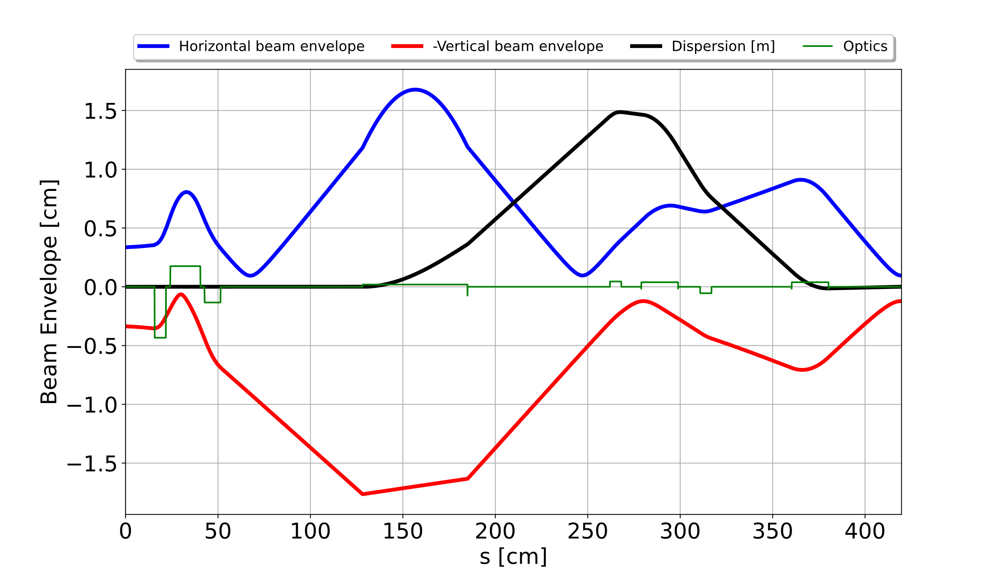
Beam Envelope from the CSB Nier-type Spectrometer transport optics
Beam envelope of ¹³³Cs²⁴⁺
The extraction optics were optimized such that the dispersion of the dipole was compensated by the dispersion of the electrostatic benders by varying the voltage of the quads most especially the triplets
Optics described in Slide 7
Notes:
The extraction optics were optimized such that the dispersion of the dipole was compensated by the dispersion of the electrostatic benders by varying the voltage of the quads most especially the triplets
Rick Baartman did an amazing job in designing the extraction optics. The optics were designed such that dispersion is cancelled out by tuning only the triplet.
The CSB extraction optics is very tricky because the total current extracted from the CSB consist of ions from different masses
Accurate simulation of the extraction system of the CSB is require to determine the initial beam parameters to optimize the optics

Slide 14
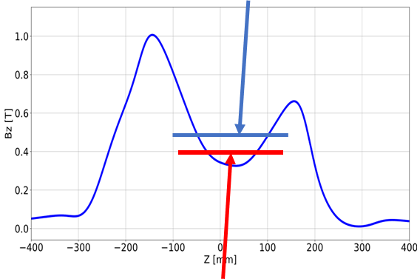
Implementation of two-frequency heating technique (TFHT)
$$f_{rf1}≠f_{rf2}$$
$$f_{rf1}=\frac{|e|B_{1}}{2πm_{e}}$$
As known TFHT is when two distinct frequencies are launched in ECR plasma
It provides additional resonance zone for electrons heating, increasing the electrons energy and density thus providing better confinement for the ions
Conventionally, two separate waveguides are use but implemented it using the existing waveguide. The CSB was not designed to accommodate two waveguides
$$f_{rf2}=\frac{|e|B_{2}}{2πm_{e}}$$

Slide 15
RF Upgrade: Two-frequency heating technique Set up
First approach
(Reflected power damaged TWTA)
Implemented setup
8 – 18 GHz
400 W
Minor improvement (currently underway) still required to further protect the TWTAs – RF isolators will be connected between the amplifiers and the combiner
Setup based on R. Racz et al, 2018.
J. Adegun et al, ICIS21
Notes:
On this slide, I would like to summarize the Two-frequency heating Technique and how I implemented it on the TRIUMF CSB
Electron heating occurs in the ECRIS plasma when the frequency of the applied electromagnetic waves equals the cyclotron frequency of the plasma electrons due to magnetic field distribution of the ECR ion source.
If a single frequency is coupled to the plasma, only one resonance surface is created for electron heating.
However, another frequency can be coupled to the plasma to create another resonance surface that can either be inside or outside the first resonance zone to further heat the plasma electrons-this technique is called the Two-frequency heating technique.
Conventionally, the technique is implemented using two separate wave guides, but TRIUMF CSB was not designed to accommodate…
Main components of the TFHT are
Two-frequency heating creates additional resonance zones for electron heating
Reason for implementing TFHT
-it is known to stabilize plasma
-Increase the intensity of HCIs
-Pushes the charge state distribution to higher charge states

Slide 16
Results I: SFHT vs. TFHT
SFHT: - 14.500 GHz [350 W]
TFHT:- 14.063 GHz [300 W] + 14.354 GHz [46 W]
With the optimization of the optics and the implementation of the two-frequency heating technique:
Maximum efficiency increased from 8.5 % at SFHT for Cs²³⁺ to 9.1 % at TFHT for Cs²⁶⁺
Maximum charge that can be produced shifted from 28+ to 32+
Global efficiency shifted from 35.4 % to 41.1 %
As shown, TFH of the plasma increases the electron energy, plasma density and ion confinement time, leading to the production of higher charge states.
Notes:
Cs+ - 10 nA, 4RMS Emittance = 8.78 mm-mrad
The shifting of the peak of the Cesium charge state distribution to higher charge states as shown on this plot is a result of the TFH of the plasma.
The TFH of the plasma increases the electron energy, plasma density and ion confinement time, leading to the production of higher charge states.
The CSB efficiency is compared for different heating modes and plasma configuration
About 79 % increase in the global efficiency
Global Efficiency interpolating the missing CS
SFHT1 – 46 %: C22+ = 7.8 % and Cs25+ = 4.9 %
SFH2 – 39 %: Cs25+ = 3.4 %
SFHT3 – 25 %: Cs25+ = 1.3 %
TFHT – 50 %: Cs25+ = 8.6 %
Higher charge states contribute more to the global efficiency
Electron energy, plasma density and ion confinement time increased with the two-frequency heating of the plasma resulting in the production of higher charge states

Slide 17
Results II: SFHT vs TFHT
Experimental Setup:
²³⁸U⁺ isotope injected into the CSB from the target station
Results:
Maximum U charge state shifted from (SFHT): 36+ to (TFHT): 39+
Global efficiency shifted from 12.2 % to 37.6 %
Under both regimes, the peak of the efficiency distribution is maximum at 28+ for both SFHT and TFHT but efficiency of 28+ under TFHT is more than a factor of 2 larger than SFHT.
Notes:
238U$+ = \sim 2.6 nA,$ 4RMS emittance = 21 mm-mrad
Plasma and transport optimization U²⁶⁺
Optimized parameters are: $1200 A/264 A/793 A$
Helium gas valve voltage: $6.7 V$
TFHT – Freqs: $14.5 GHz+ 14 GHz$ and Power: 300 W + 46 W
SFHT – Freq: 14.5 GHz and power: = 350W
Although the charge state with maximum efficiency remains the same but was more than 2 orders of magnitude higher than the SFH regime

Slide 18
Summary and Outlook
Two-frequency heating technique was implemented on the TRIUMF CSB using single waveguide installed. – Significant efforts are currently underway to enhance the protection of the TWTAs to minimize the risk of damage.
The injection and extraction optics of the CSB were systematically optimized in TRANSOPTR code. The magnetic field configuration was modelled in OPERA and measured to provide the correct field for the optic simulations.
Beam formation and extraction were systematically performed in IGUN to optimize the extraction system of the CSB.
The wide gap in the injection soft iron of the CSB produces an asymmetric magnetic field in the injection region, resulting in the loss of singly charged ions during injection. A plan is underway to fix the problem.
Through the systematic improvements implemented in the charge state booster, the global efficiency between 20+ and 32+ increased to 41.1% under TFHT operation from 35.4 % under SFHT operation.

Slide 19
Thank you for your attention
JOSEPH ADEGUN

Slide 20
Backup Slides

Slide 21
ISAC facility
Isotope Separator and Accelerator (ISAC) Facility
To the mass
separator
ISOL method for production of exotic isotopes at TRIUMF.
Proton beam at 480 MeV from TRIUMF primary beam accelerator – Cyclotron.
Two target stations in the TRIUMF ISAC facility
The isotopes are ionized and accelerated up $60 keV$
Post-accelerated isotopes are then used in nuclear physics or nuclear astrophysics experiments.
Proton beam
TRIUMF
Cyclotron
Notes:
As known, TRIUMF employs the ISOL method for production of exotic isotopes.
Cyclotron is the primary accelerator with proton as the driver beam.
One of the target materials is irradiated at a time.
These isotopes are produced at the isotope separator and accelerator facility of TRIUMF via ISOL method – This method involves
Cyclotron is used for acceleration of H-minus beam to final energy of 520 MeV. Proton is then extracted to irradiate on of the target stations in the ISAC facility for production of isotopes.
The isotopes are allowed to diffuse into an ion source where singly charge ions are created.
The singly charge ions are extracted
Products of the reaction (nuclides) diffuse into an ion source such as Forced Electron Beam Induced Arc Discharge for ionization
Stripping at 520 MeV results on loss of efficiency
ISOL method is prefer over in-flight fragmentation because ISOL offers higher purity, higher intensity, and almost any isotope can be produced.
Cyclotron – Accelerated by sector focussing
Example of target materials are Si, Ti, Nb, Zr, Ta, U
Particle is considered relativistic if it is moving at roughly 85 % of the speed of light.
TRIUMF injects bunches into cyclotron at the RF frequency of 23 MHz.
The H-minus in TRIUMF cyclotron is about 77 % of the speed of light.
Accelerating negative hydrogen ions simplifies extracting the beam from the machine
FEBIAD is useful for isotopes with higher ionization energies (>8eV) such as noble gases
Acceleration in the cyclotron is by 5th harmonic rf at 23.06 MHz. Energy gained per turn is 380 keV.
Other ion sources that are used at TRIUMF are Ion guide laser ion source, surface ion source and Resonant Laser ionization.

Slide 22
Phase Space Ellipse of Cs CSD and Residual Ions

Slide 23
Effect of Phase Shift
Power
combiner
Port1- TWTA1
Port4 –
Dummy
load
Port3 – to the CSB
Port2 – TWTA2
TFHT – No phase shift between the waves
TFHT – 180° phase shift between the waves
SFHT
Notes:
The power combiner was modelled in ANSYS – HFSS to investigate its behavior
RF isolator will be installed between the amplifiers and the power combiner to protect the amplifiers and allows operation of the CSB using single-frequency.

Slide 24
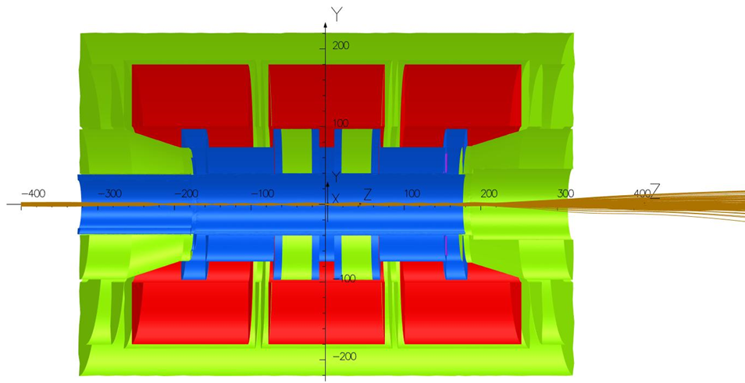
Symmetry in the B-field in the injection region

Slide 25
Plot of the current loss to the Quads and Total extracted current vs Extraction field

Slide 26
Past Improvements of the CSB
F. Ames et al, 2012
Activities:
Aluminum coating of the chamber wall
Exchange of the injection and extraction electrodes with aluminum material
Results:
Suppression of sputtered ions
Enhancement of charge bred ions
Enhancement of beam intensity because of the production of secondary electrons
Notes:
Constituents of Stainless steel
Iron (A = 56, Q = 11+, 10+, 9+, 8+) – 5.09, 5.6, 6.22, 7
Chromium (A = 52, Q =10+, 9+, 8+) – A/Q = 5.2, 5.78, 6.5

Slide 27
Br Vs. Z

Slide 28
Introduction: Charge Breeding at the ISAC Facility
Isotope post-acceleration - Linear Accelerators (LINACs)
The first section of the LINACs was designed to accept isotopes at the initial energy of $2.0 keV/u$.
Thus, charge boosting is required for $A>30 u$ before post-acceleration
ISAC charge breeding is based on an Electron Cyclotron Resonance Ion Source (ECRIS).
$$E≤60 keV$$
$$2.0 keV/u$$
A/Q $≤30$
RFQ
$$A/Q≤6$$
A/Q $≤6.0$
DTL
A/Q $≤6.0$
SRF
Notes:
Depending on the mass and energy requirements of the experiment, the selected isotope is post-accelerated using a series of linear accelerators (LINAC) to achieve higher energy levels.
RFQ – 2.0 keV/u to 150 keV/u (dE = 148 keV/u)
DTL – 150 keV to 1.50 MeV/u (dE = 150 MeV/u)
SRF – 1.50 MeV/u to 16.0 MeV/u (dE = 15 MeV/u) – Higher accelerating field gradients compared with RFQ and DTL
Stripping using foils is less efficient for high masses after the RFQ
RFQ acceptance = 140 $mm−mrad$
Other reason for charge state breeding
Compact accelerator facility and cost-efficient – E = QeV
Beam formation from extracted molecules from the target station: Oxygen beam formation from the ${CO}_{2}^{+}$ injected into the CSB

Slide 29
The Single-Frequency heating setup
Travelling wave tube amplifier
13.75 – 14.5 GHz, rf power up to 600 W
Notes:
The setup consist of BNC signal generator, CPI TWTA, WR62 Waveguide (12.4 – 18 GHz)

Slide 30
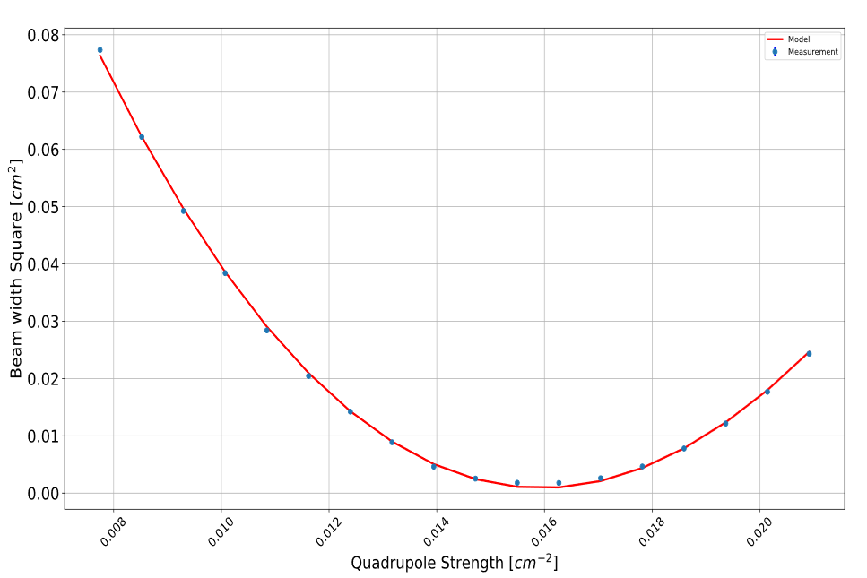
Quadrupole Scan Technique
Limited space to install conventional Emittance meter
QST is more flexible in terms of using the installed quadrupole optics – there is no need to install any device.
Point where emittance is determined
Python code was developed to automatically scan the quad and process the mathematics involves in the Emittance measurement
Notes:
I would like to summarize the alternative method that was developed for the emittance measurement of the CSB
The method is called the QST.
The technique involves scanning through a range of the strengths of a quadrupole and measuring the corresponding beam distribution on a profile monitor at a given drift length.
By plotting the standard deviation of the distribution against the quadrupole strength, a parabolic curve is produced.
The beam matrix is extracted and use to determine the beam emittance.
Conventional Emittance meters are not installed because of limited spaces around the CSB
Space charge effect is proportional to the beam intensity being transported, and it produces a defocusing outward electric field that spreads beam radially.
Space charge effect is canceled out at high velocity due to the magnetic effect.
In beam transport, space charge can be compensated for by collision with neutral atoms.
$f_{e}$ is the charge neutralization factor – the charge has opposite sign to the beam
Elements of the sigma matrix are the moments of the particle distribution being measured.
The moments provide information about the shape, size, and orientation of the distribution.
If matrix M is simplectic (determinant = 1), the volume of the phase space is constant during transport)
With the Two-Extraction system, electrons that are generated within the beam channel are accelerated towards the plasma and may change the CSD in the emission region.
Thin lens:- the length of the quad is small compared to its focal length ($l≪f$) or ($f≫l$)
Two-Extraction System with an Einzel lens - Not as flexible as TRIUMF Three-Extraction System.

Slide 31
Quadrupole Scan Technique (QST) for Beam Emittance Measurement
QST involves scanning through a range of the strength $k$ of a quad and measuring the spread of the beam distribution $x_{s}$ at a given drift length on a profile monitor - Plot of $x^{2}$vs $k^{2}$ gives a parabolic curve.
Fitting the beam transfer matrix to the parabolic curve yields the sigma matrix at the entrance of the quadrupole, given as
Beam matrix $σ=\left[\begin{matrix}σ11 & σ12 \\ σ21 & σ22\end{matrix}\right]=\left[\begin{matrix}\left\langle x^{2}\right\rangle & \left\langle xx′\right\rangle \\ \left\langle xx′\right\rangle & \left\langle {x′}^{2}\right\rangle \end{matrix}\right]$
Point where emittance and the Twiss parameters are determined.
Beam matrix
$$x_{s}^{2}={[MσM^{T}]}_{11}$$
$$ε=\sqrt{\left|σ\right|}$$
$$x_{m}=\sqrt{σ11}=\sqrt{βε}$$
$${x′}_{m}=\sqrt{σ22}=\sqrt{γε}$$
$$βγ−α^{2}=1$$
$x_{s}$ = standard deviation of the beam distribution at the profile monitor
M = product of the beam transfer matrix
$σ=$ unknown beam matrix at the entrance of the quad
Notes:
Space charge effect is proportional to the beam intensity being transported, and it produces a defocusing outward electric field that spreads beam radially.
Space charge effect is canceled out at high velocity due to the magnetic effect.
In beam transport, space charge can be compensated for by collision with neutral atoms.
$f_{e}$ is the charge neutralization factor – the charge has opposite sign to the beam
Elements of the sigma matrix are the moments of the particle distribution being measured.
The moments provide information about the shape, size, and orientation of the distribution.
If matrix M is simplectic (determinant = 1), the volume of the phase space is constant during transport)
With the Two-Extraction system, electrons that are generated within the beam channel are accelerated towards the plasma and may change the CSD in the emission region.
Thin lens:- the length of the quad is small compared to its focal length ($l≪f$) or ($f≫l$)
Two-Extraction System with an Einzel lens - Not as flexible as TRIUMF Three-Extraction System.

Slide 32
Total Emittance – SFHT vs TFHT
Ions are attracted to the plasma center due to negative potential dip
Notes:
Overall lowest emittance is achieved under the TFHT.
With the TFH of the plasma, the thermal motion of electrons is directed towards the center, leading to the formation of a negative potential dip. This negative potential induces the electrostatic attraction of ions to the plasma center, and they are extracted at a small radius resulting in low emittance.
Emittance was compared with IGUN simulation
Extraction voltage was varied between $2.0 kV$and $3.5 kV$
Extraction voltage at which minimum emittance is achieved varies because of the changes in the plasma density

Slide 33
Plasma Potential Measurement: DeltaV Variation
Microscopically, plasma is not neutral
Loss of low-energy electrons creates positively charged plasma called plasma potential $Vp$,
Plasma potential affects injection of singly charge ions and affects the efficiency of the HCIs from the CSB
$$DeltaV= {CTIS}_{bias}−{CSB}_{bias}$$
Plasma potential seems to be order of $17 V$
Notes:
At the plasma edge, some electrons have sufficient energy to escape the magnetic confinement leaving the plasma positively charged.
The potential that the plasma acquire in this process is called the plasma potential, and it affects both the injection and extraction of ions from the charge state booster.
I measured the plasma potential by varying deltaV which is the difference between the bias voltage of the test ion source and bias voltage of the CSB between 0 and 30 V
The CTIS bias voltage (DeltaV) can be increased up $500 V$ above the CSB bias voltage to compensate for the plasma potential
$$DeltaV= {CTIS}_{bias}−{CSB}_{bias}$$
Low-energy electrons are found mainly at the plasma edge – Highly collisional and not perfectly confined
The CTIS bias voltage can be increased up $500 V$ above the CSB voltage to compensate for the plasma potential.
Plasma potential is as a result of non-neutrality at the edge of the plasma due to the loss of low energy and highly collisional electrons.
Plasma potential depends solely on electron temperature $V_{p}=\frac{2.84T_{e}}{e}$ - It is only valid at the plasma edge, assuming neutrality at the plasma center.

Slide 34
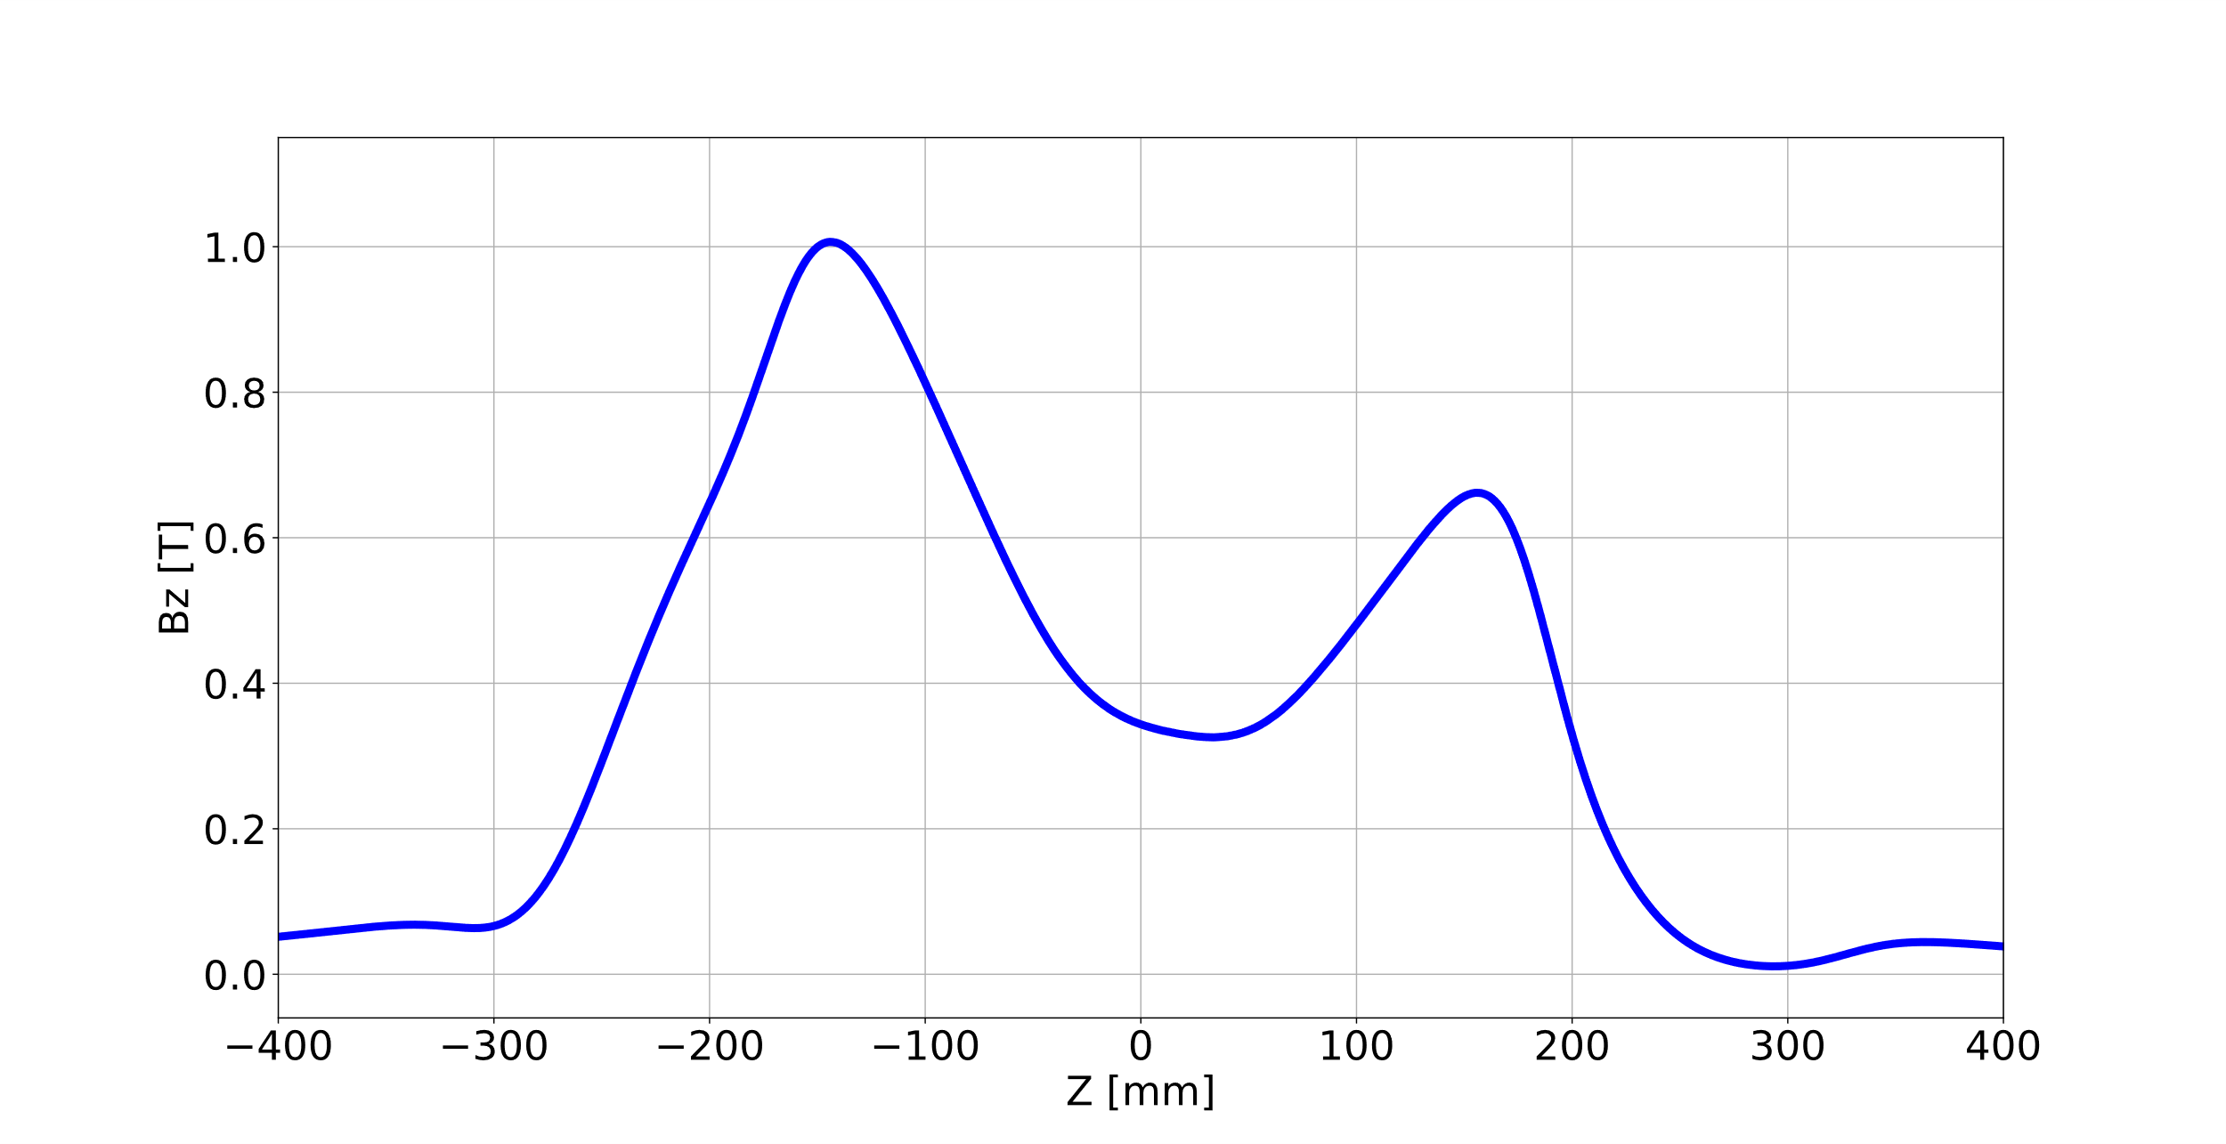
Implementation of the Two-Frequency Heating Technique (TFHT)
$$f_{rf1}=\frac{|e|B_{1}}{2πm_{e}}$$
Wave guide termination
Old: 14 – 14.5 GHz
New: 12.75 – 14.5 GHz
$$f_{rf1}$$
$$f_{rf2}$$
$$f_{rf2}=\frac{|e|B_{2}}{2πm_{e}}$$
$$f_{rf1}≠f_{rf2}$$
TFHT creates additional resonance surface for electron heating

Slide 35
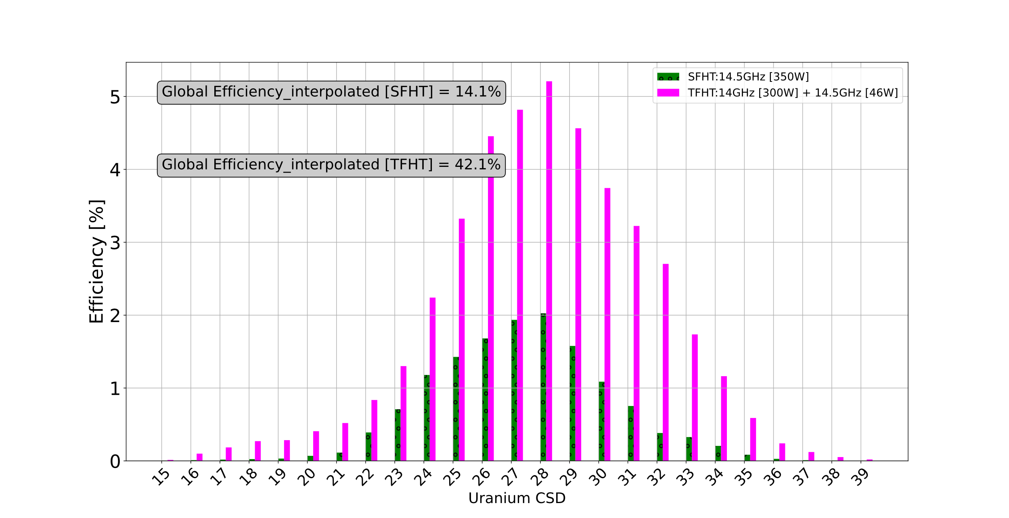
Efficiency: Actual vs interpolation

Slide 36
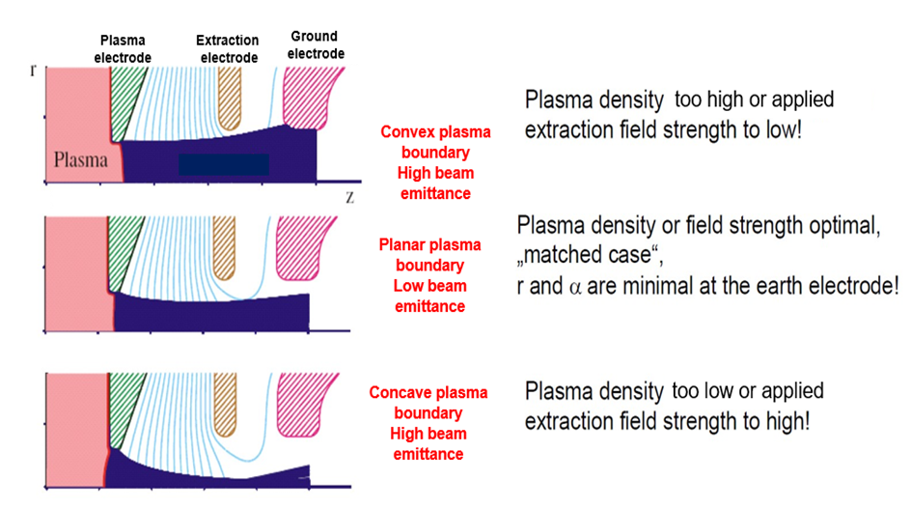
Optimization of the Extraction System: IGUN Simulation
Puller
electrode
Magnetic Field
Beam
Plasma
Electrode
Ground
Electrode
Puller
Electrode
Notes:
On this slide, I would like to talk about the optimization process of the CSB extraction system in IGUN. Since the extraction system is located in the strong magnetic field of the CSB, it is important to include the field in the simulation. The extraction system consists of the
The aperture where ions are extracted from the plasma is located on the plasma electrode and the electric field for beam formation is created between the plasma electrode and the puller electrode, this region is called the extraction gap
In reality, the gap is not fixed during CSB operation, the length of the gap varies depending on the extraction field and ion density
If the extraction field is low, the shape of the plasma boundary is Convex meniscus producing large Emittance (extraction gap smaller than the designed)
If the extraction field is moderate, plasma boundary aligns with the extraction aperture, and the shape of the plasma boundary is Planar meniscus – lowest emittance (designed gap)
If the extraction field is high, the shape of the plasma boundary is Concave meniscus producing also large emittance (Extraction gap longer than the designed)
I performed systematic investigation to determined the matched extraction field
Magnetic field has been identified to be the main cause of large emittance in ECR ion sources because of the beam rotation induced by the field in the extraction region.
It also causes different focal points for the ion masses and charge states in the extracted beam
The parameters that influence the beam emittance are categorized as:
Ion temperature
Extraction gap
Extraction aperture
Magnetic field
Pierce geometry minimize aberrations in the extraction system.
Ui is the ion directed energy – initial energy of the plasma

Slide 37
Characterization of the Charge Bred beam: Emittance and the Twiss Parameters
Emittance describes the area occupied by a beam of particles in phase space ($x,x^{′}$) at a given location along the beam transport. According to Liouville’s theorem, a beam of particles under linear forces is conserved.
If the area under the phase space ellipse is known, which is the same as the beam emittance, then the Twiss parameters can be determined.
Statistically, the area of the phase space can be evaluated – This produces RMS Emittance:
$$ε_{RMS}=\sqrt{\left\langle x^{2}\right\rangle \left\langle {x′}^{2}\right\rangle −{\left\langle xx′\right\rangle }^{2}}$$
RMS Twiss Parameters: $α=\frac{−\left\langle xx′\right\rangle }{ε}, β=\frac{\left\langle x^{2}\right\rangle }{ε}, γ=\frac{\left\langle {x′}^{2}\right\rangle }{ε}$
$$ε_{rms}=γx^{2}+2αxx^{′}+β{x′}^{2}$$
$x$ = transverse beam size and $x′$ = beam divergence
Along the beamline, the emittance is constant, but the Twiss parameters vary. So, using the Twiss parameters transformation, the shape and the orientation of the ellipse can be determined at any other points along the beamline
Notes:
In addition to current, Emittance and the Twiss parameters were also used to characterized the charge-bred beam.
The Twiss parameters make the description of the beam transport effective
RMS Emittance is obtained by taking the square root of the second central moment of the beam distribution.
1 sigma of the distribution corresponds to the 68 % of the particles
2 sigma corresponds to about 95 % of the particles
Normalized Emittance remains constant with beam acceleration, but geometrical emittance shrink because longitudinal momentum increases.
$$ε_{n}=βγε$$
The second moment, also known as the variance, is a statistical measure of the spread or dispersion of a distribution of values.
It is calculated by taking the average of the squared differences of each value from the mean of the distribution.
The KV distribution is a Gaussian-like distribution. The waterbag distribution is a flat-top distribution.
Beta function depends on the beam focusing. The physical dimension of the beam transport is called acceptance
Beam Intensity (current) is another figure of merit to characterized a beam, it is related to emittance by the brightness, $B=\frac{Current}{Emittance}$

Slide 38
Efficiency of the CSB under SFHT
Experimental Setup
Cs⁺ injected current $\sim 10 nA$
Plasma and optics optimized for Cs²⁴⁺
Optimized parameters :
Freq. = 14.5 GHz, TWTA power = 350 W
$1050 A$ /$762 A$/200 A
Helium support gas valve = 6.0 V
Results:
Maximum Cs charge state is 27+ with an efficiency of 1.4 %
Peak is at 23+ with an efficiency of 8.5 %
Global efficiency is 54%
${Efficiency}_{Q}= \frac{I_{Q+}}{Q∗I_{+}}×100$
$Global Efficiency=\sum_{Q=1}{{Efficiency}_{Q}}$
Notes:
Global Efficiency interpolating the missing CS is about 74 %
The current of the magnetic dipole was scan and the mass spectrum with and without Cs were collected.

Slide 39
Overall Optimization of the CSB under Single frequency heating Regime
Optimization of the CSB involves
Injection beamline
Injection system
Extraction system
Extraction beamline
Increase in global efficiency for charge states between 12+ and 27+ increased to 44.2 % after optimization
Charge state with maximum efficiency shifted from 21+ to 23+.
Notes:
With interpolation
Global Efficiency after optimization = 62.3 % [ Cs¹⁹⁺ = 5 % Cs²²⁺ = 8.1 % Cs²⁵⁺ = 5.1 % ]
Global Efficiency before optimization = 41.2 % [ Cs¹⁹⁺ = 4.4 % Cs²⁵⁺ = 1.6 % ]

Slide 40
TFHT Bench test
Spectrum of two frequencies through the TWTA: 13.65 GHz + 14.5 GHz

Slide 41
Efficiency of the CSB under TFHT Regime
Experimental Setup:
Cs⁺ injected current $\sim 8 nA$
Plasma and transport optimization for Cs²⁸⁺
Optimized parameters :
$1200 A/$ $263A /801 A$
W$ith frequency tuning:f1=14.0631 GHz$ and $f2=14.3536 GHz$
TWTA power1 = $300 W$, TWTA power2 = $46 W$
Helium gas valve voltage $=6.5 V$
Results:
Maximum charge state is 32+ with an efficiency of 0.02 %
Peak was at 26+ with an efficiency of 9.1 %
Global Efficiency was 43 %
Notes:
Global Efficiency interpolating the missing CS is about 53 %

Slide 42
Overall Improvement of the Performance of the CSB
Optimization of the injection and extraction optics – Prevents beam loss and increase efficiency
Optimization of the extraction system – improves beam quality and increase efficiency
Optimization of the plasma – increases efficiency

Slide 43
RPM Profile

Slide 44
QST: Parabolic curve and Phase Space

Slide 45
Cs Charge States Geometrical Emittance SFHT

Slide 46
Normalized Emittance of Cs Charge States and Residual ions

Slide 47
The phase space of the ion beam simulated in IGUN

Slide 48
Effect of Minimum Magnetic Field on Total Emittance

Slide 49
Emittance Vs Bmin: Phase Space

Slide 50
A typical Mass Spectrum of the TRIUMF ECRIS CSB between A/q = 1 and 10.0
Only one A/q (A/q < 6.0) will be selected and post-accelerated.
This region of interest is largely dominated by residual ions.
Notes:
There are over 80 peaks between A/q = 1 and 60 of the mass spectrum extracted from the TRIUMF CSB

Slide 51
Aluminum Coating of the Plasma Chamber
Notes:
Chemical components of Stainless Steel are iron, chromium, nickel, molybdenum, carbon, nitrogen, copper, silicon, and sulfur

Slide 52
Electric Field and Electric Potential Distribution of the ECRIS
With the CSB Bias to 10 kV, typical injection electrode voltage values are
IE1 ~ 7.1 kV
IE2 ~ 9.2 kV
And typical puller electrode voltage is
- EE ~ 7.5 kV

Slide 53
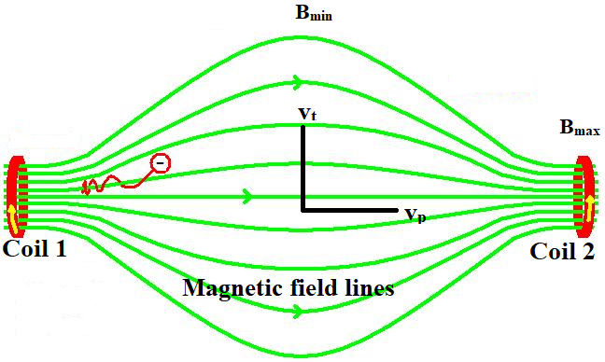
Magnetic mirror effect
The electrons performing the ionization are selectively heated in a small resonance surface in the center of the plasma by the applied electromagnetic wave of a defined frequency $f_{rf}$ where $f_{rf}=f_{ecr}=\frac{eB_{ecr}}{2πm_{e}}$ while the electrons are confined through conservation of magnetic moment:
$$μ_{m}=\frac{mv^{2}\sin^{2}θ}{2B_{min}}=\frac{mv^{2}}{2B_{max}}$$
Where,
$$v=v_{t}+v_{p}$$
$$v_{t}=v\sin{θ}$$
$θ$ is the angle between the particle’s velocity components and magnetic field.
Confinement relies on the magnetic mirror effect.
$θ=90°$ - particle is confined at the $B_{max}$
$θ>\sin^{−1}{\sqrt{{B_{min}}/{B_{max}}}}$ - particle is trapped between $B_{min}$ and $B_{max}$
$θ<\sin^{−1}{\sqrt{{B_{min}}/{B_{max}}}}$ - particle is lost

Slide 54
Beam Envelope

Slide 55
Charge exchange with residual gas
The cross section for charge exchange from initial charge state Q to final charge state Q-1 is given by
$$σ_{Q→Q−1}=1.43×{10}^{−12}Q^{1.17}{U^{−2.76}}_{0→1}\left({cm}^{2}\right)$$
U= first ionization energy of the neutral atom in eV
The lower the neutral pressure in the plasma the higher the charge state that can be achieved - The density of the neutral atoms must be far lower than the plasma density to keep the charge exchange recombination rate low.
$$n_{e}≫n_{0}$$
In TRIUMF ECRIS CSB at Vacuum pressure of $5×{10}^{−8} Torr$, room temperature 293 K, and microwave frequency of 14.46 GHz. Using $P=nkT and f_{rf}≥\frac{1}{2π}\sqrt{\frac{n_{e}e^{2}}{ε_{0}m_{e}}} (f_{rf}≥f_{p})$
Plasma density, $n_{e}=2.60×{10}^{12}{cm}^{−3}$and Density of neutral atom, $n_{0}=1.65×{10}^{9}{cm}^{−3}$
Notes:
Microwave with frequency greater than the plasma frequency can only propagate the plasma.

Slide 57
Notes:
Summary - Electrons are heated mainly by absorption of the microwave power at the resonance surface

Slide 58
Notes:
Summary - Ions are not heated by electrons

Slide 59
Notes:
Cold electrons are responsible for ionization of low charge state ions. They are not well confined. Cold electrons are the majority in the ECRIS. They are responsible for plasma potential.
Warm electrons are not many, they are responsible for ionization of highly charged ions
Hot electrons are well confined. They are responsible for the electrostatic potential in the bulk plasma. They contribute very little to ionization
Hot electrons confines the ions electrostatically while ionization is performed by cold and warm electrons

Slide 60
Notes:
Ion-ion collision frequency is greater than ion cyclotron frequency. Ions are not magnetically confined because their gyromotion is affected by collisions

Slide 61
Concept of Charge Breeding
Injection of a 1+ beam into an Ion sources and extraction of n+ beam after a certain confinement time.
Production of high charge state ions by electron impact ionization – Single collision and Multi- step ionization
Ionization Cross-section ${(cm}^{2})$: Lotz’s semi-empirical formula.
$$σ_{n→n+1}=4.5×{10}^{−14}\sum_{n}{\frac{\ln{({E_{k}}/{E_{bn})}}}{E_{k}E_{bn}}}$$
$E_{k}$= Electron beam energy, $E_{bn}$= electron binding energy in the $n_{th}$ shell
Notes:
Charge breeding is a process where high charge state ions are produced by electron impact ionization. RIB can reach higher charge by either a single collision, where many electrons are removed from the ion and by multistep ionization, where only one electron is removed per collision and high charge states are produced in successive different collisions.
Other atomic process going on in the plasma in addition to electron impact ionization include radiative recombination with electrons and charge exchange recombination with neutral atoms and other ions

Slide 62
Emittance Ellipse

Slide 65
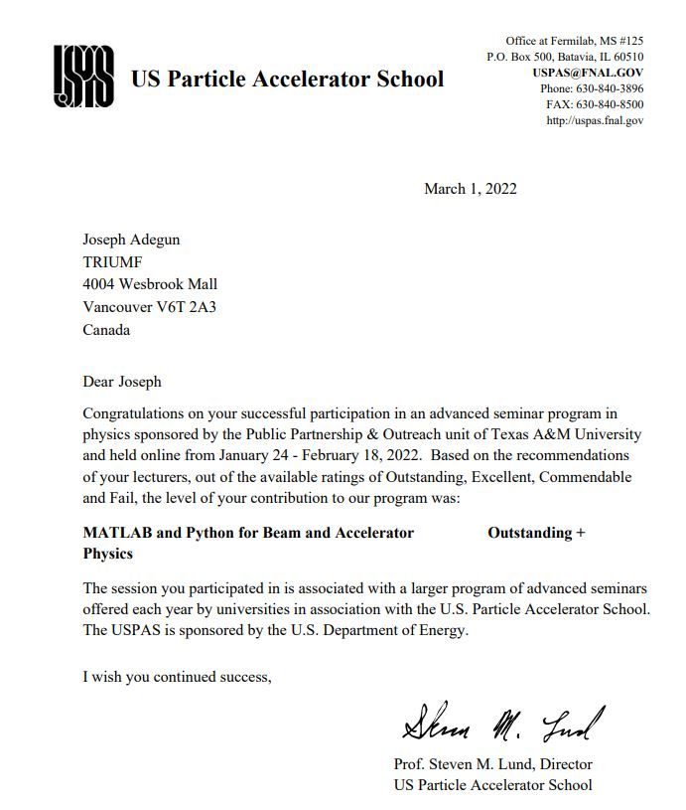
USPAS:MATLAB and Python for Beam and Accelerator Physics
Final Rating
US Particle Accelerator School (USPAS) lasted for two weeks (February 7 – 18, 2022)
I received the Sekazi K. Mtingwa Scholarship to Attend the program.
6 hours of lecture, followed by additional 6 hours of group assignments, lab work and homework everyday.
Involved Individual project and project defense.
Learned how to use Python to design and optimize beamlines

Slide 66
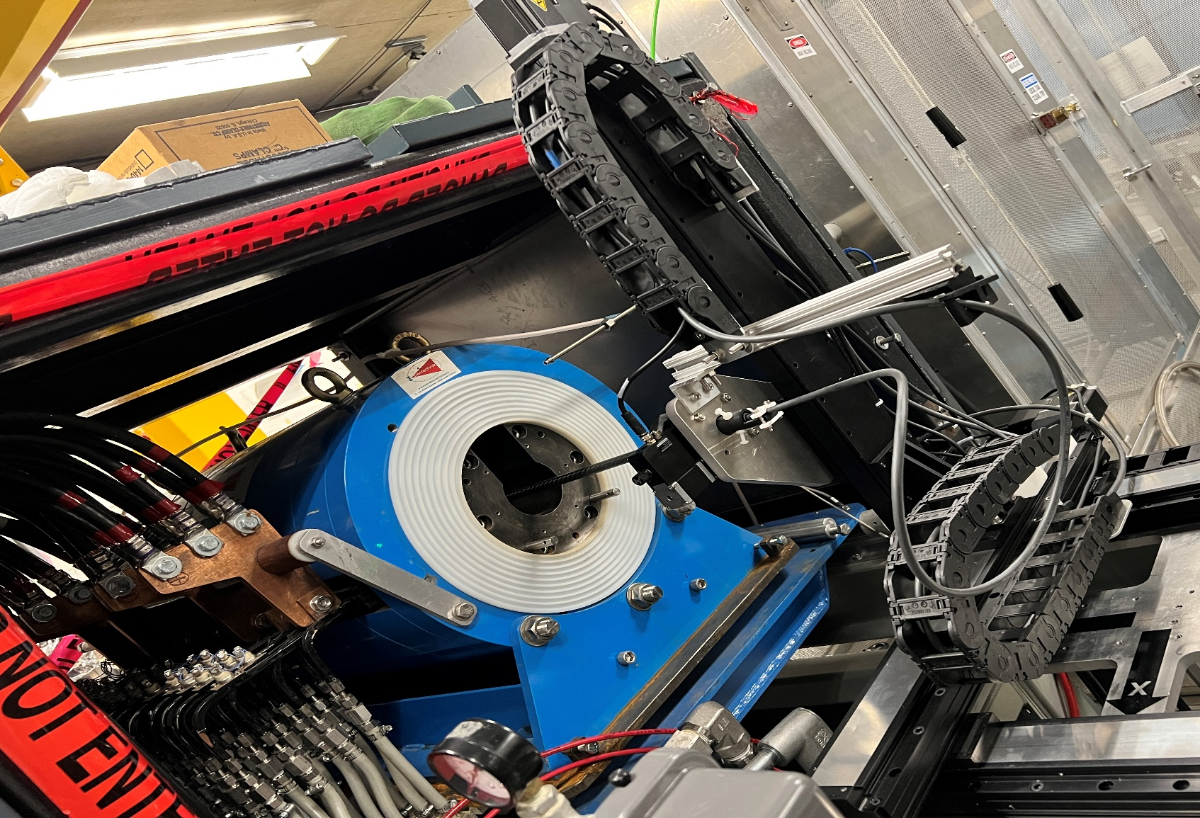
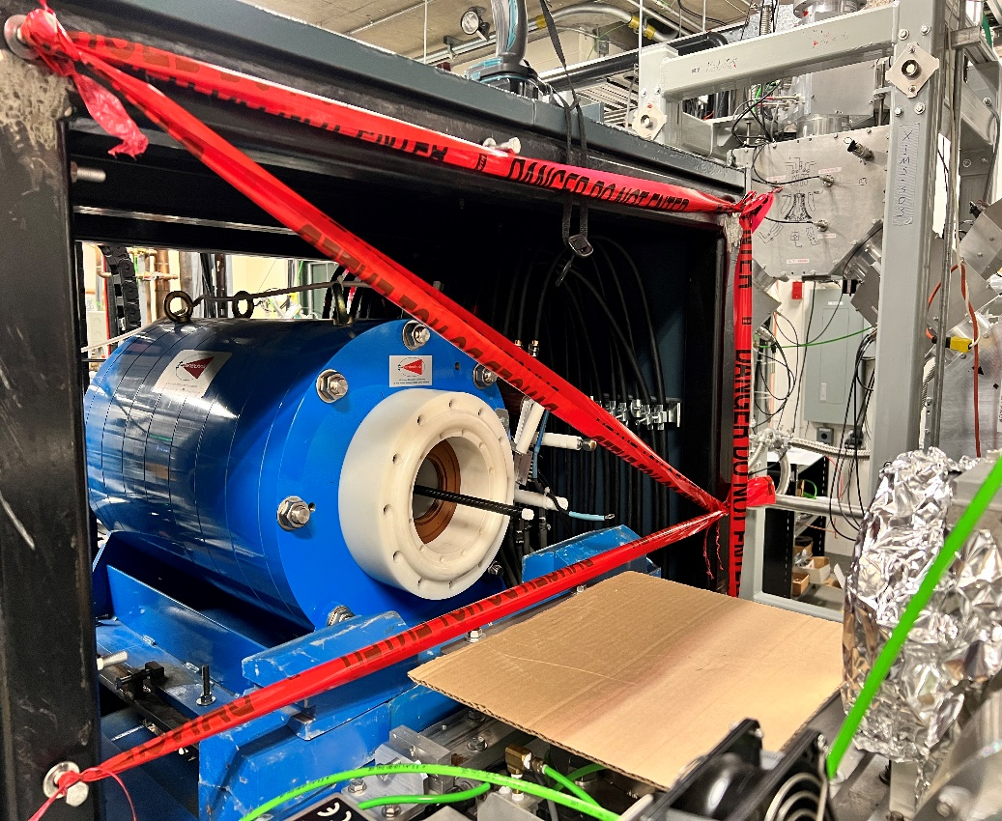
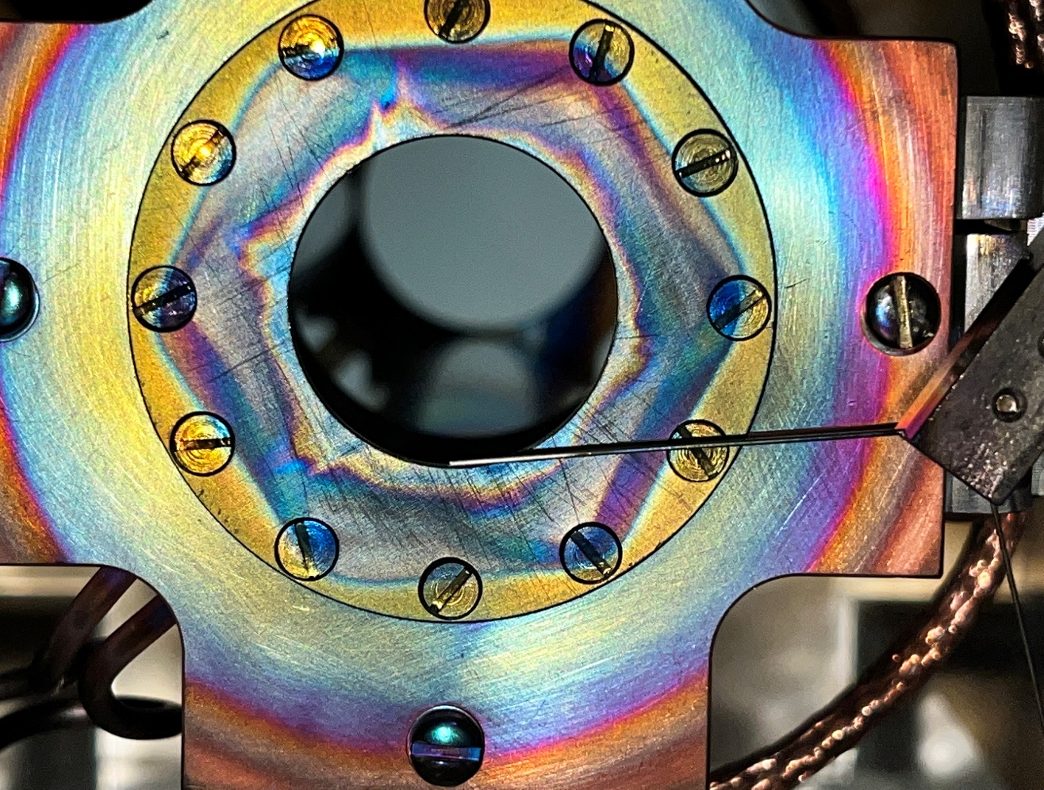
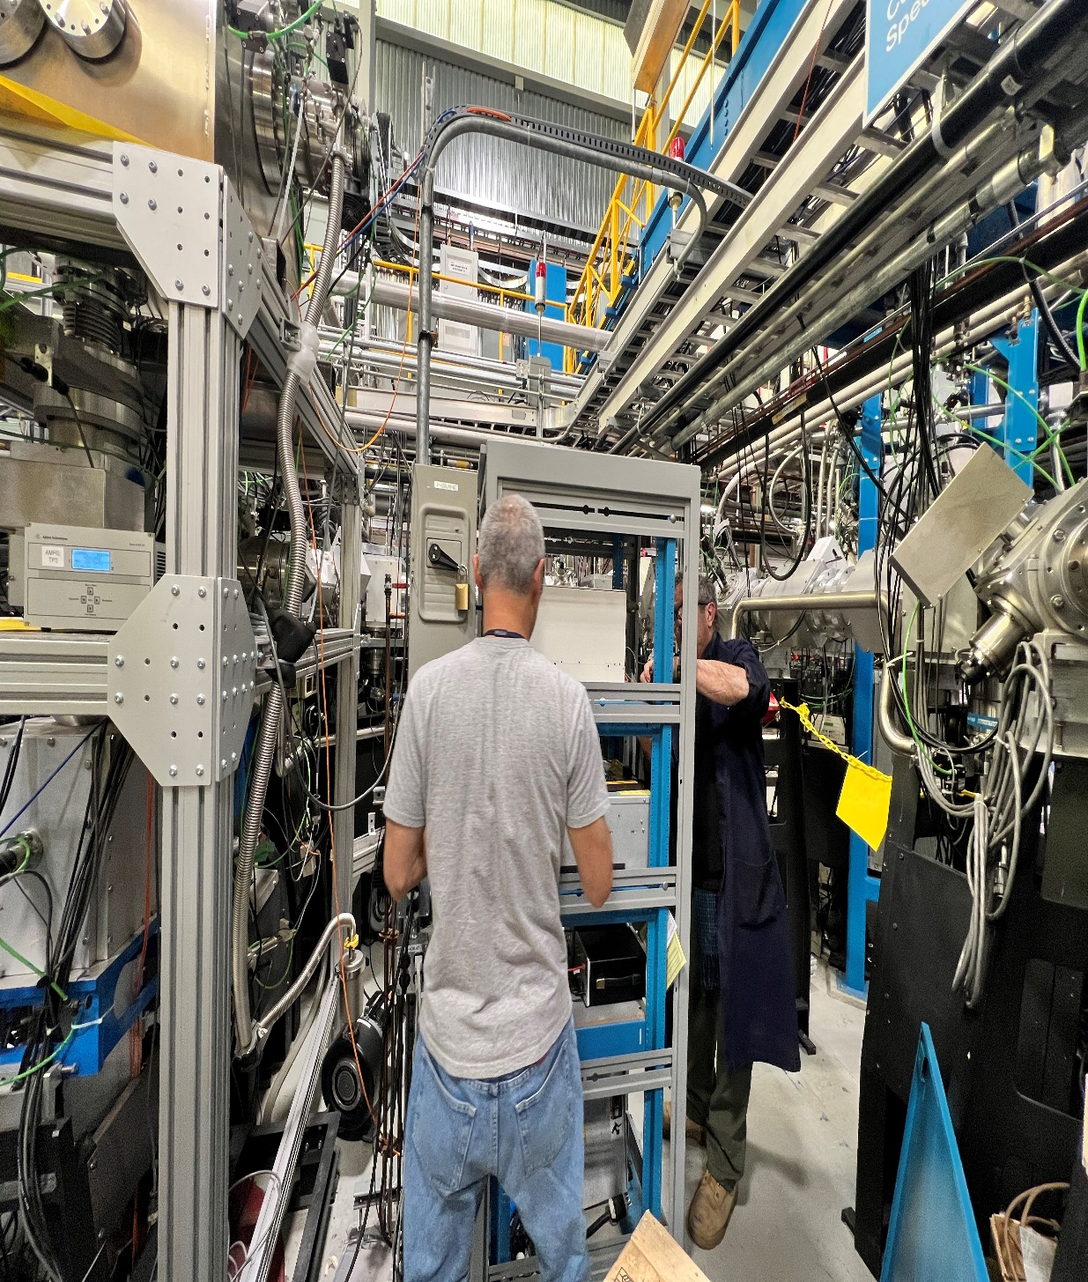
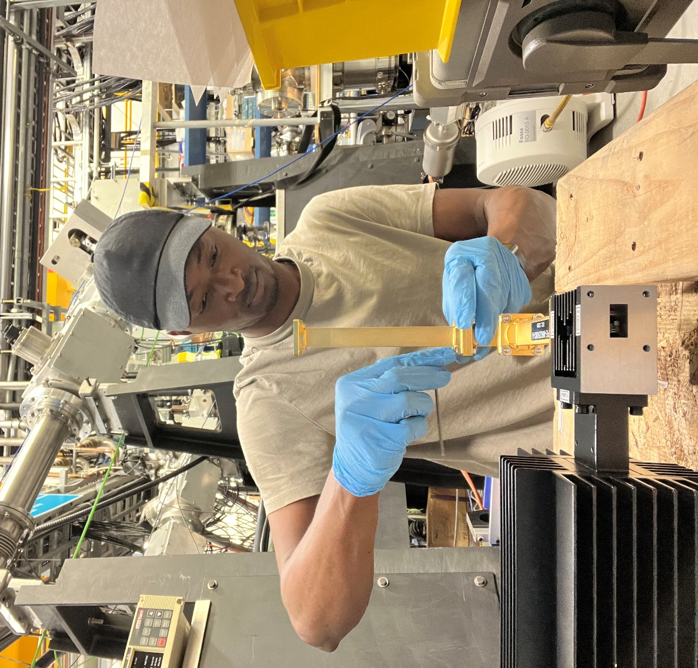
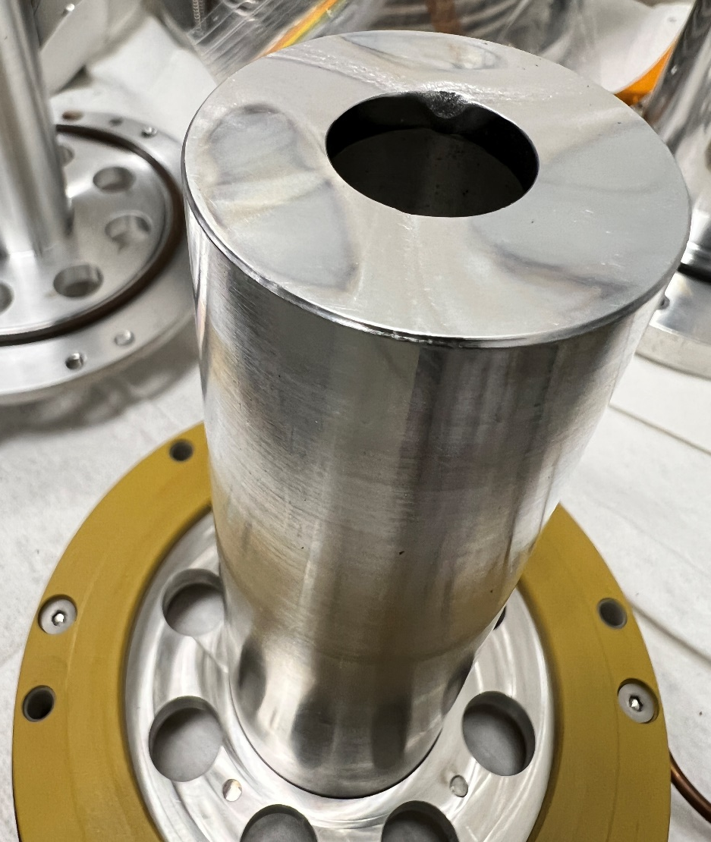
Magnetic field mapping
Magnetic field mapping
Hexapole signature and skimmer collimating the CSB beam
TFHT Setup
Thank
you
Merci
TFHT Setup
Marco
Chipping of the injection tube by the plasma
Brian
Notes:
The coulomb barrier is the energy barrier due to electrostatic interaction that two nuclei need to overcome in order to undergo nuclear reaction. Th is energy barrier is given by the electric potential energy:
$$U_{coul}=k\frac{q1q2}{r}$$

Slide 67
Acknowledgement
Funding for the project was provided by the Natural Sciences and Engineering Research Council of Canada (NSERC) in collaboration with TRIUMF and the University of Victoria.
Special appreciation to Brian Minato and Marco Lovera for helping with the remodification of the CSB RF rack.
Finally, I would like to thank Rick Baartman for engaging in a meaningful discussion with me about the transport optics of the CSB.
Joseph Adegun

