Slide 1
A review of state-of-the-art ion source plasma diagnostics
Olli Tarvainen¹ and Ursel Fantz²
¹UK Science and Technology Facilities Council
²Max-Planck-Institut für Plasmaphysik
International Conference on Ion Sources
September 17th – 22nd, 2023, Victoria, BC, Canada

Slide 2
Outline
Introduction – why this should be a 25 hour talk
The importance of choosing the right diagnostics technique
Examples of ion source plasma diagnostics methods and what they can tell us
Notes:
Had to be selective and leave out a lot
Focusing on how to choose the right technique
Plenty of examples and what they can tell us

Slide 3
Introduction

Slide 4
Ion source
diagnostics
Material to be ionised
+ additives (buffer gas, Cs,…)
Energy
Ion beam
A
B
What happens between A and B?
… and how to make more B(eam)?
Notes:
This is an ion source. It takes in material to be ionised and energy and outputs an ion beam. The purpose of diagnostics is to reveal how this happens and how to make more beam.

Slide 5
A review of state-of-the-art ion source plasma diagnostics
Caveat #1
Caveat #2
Caveat #3
This talk is largely based on a recent Special Topic of Review of Scientific Instruments
Plasma
Ion
beam
Plasma generator
Extraction
The most important diagnostic of an ion source is the beam.
Not discussed in this presentation
(just one exception)
Not all ion sources are plasma ion sources
Cs sputter ion sources, laser ion sources, surface properties etc. not discussed in this presentation
We have included certain examples of ion source plasma diagnostics not covered in the special topic
BUT
Some techniques are not introduced here
AND
We apologise for those left out
Notes:
Some caveats: read them out loud.

Slide 6
A massive thank you to the authors of
and everyone else helping to prepare this talk
Notes:
Want to take this opportunity to thank

Slide 7
The web of plasma ion source classification
Pulsed
Electron impact ionisation
Negative
High charge state
Electron cyclotron resonance
Cusp-field
Stable isotope
High-current
CW
Single charge
Electron beam
Volume ionisation
Microwave
Light ion
Single aperture
Heavy ion
Positive
Large area
Gasdynamic
Penning discharge
Filament-driven
Charge breeder
Inductive RF
Surface ionisation
Minimum-B
Multi-aperture
Caesiated
Radioactive isotope
Each plasma ion source requires different diagnostics
Notes:
There are plenty of different types of ion sources, sometimes difficult to classify. The bottom line is that each of them requires a bespoke set of diagnostics.

Slide 8
Ion source plasma diagnostics
What to measure?
How to measure?
Plasma density
Ion density
Electron density
Positive ion density
Negative ion density
Neutral particle density
Electron energy distribution
(temperature)
Ion energy distribution
Ion species distribution
Plasma potential
Ionisation rate
Electron loss rate
Charge exchange rate
….
Langmuir probe
Directional ion velocity probe
Retarding field analyser
Optical emission spectroscopy
X-ray and bremsstrahlung spectroscopy
Absorption spectroscopy
Microwave interferometry
Microwave polarimetry
Electron spectroscopy
Diamagnetic loop
RF probe
Pulsed material injection
Laser-photodetachment
Microwave emission
Cavity ring down
…
Plasma properties and reaction rates
Diagnostics techniques
Notes:
So, the first question that needs to be asked is what to measure – typically plasma properties or reaction rates
Then the question becomes how to do that – which means selecting the diagnostic techniques

Slide 9
Choose the right technique!
Notes:
Some examples of the importance of choosing the right technique… I’m going to do this through comparison

Slide 10
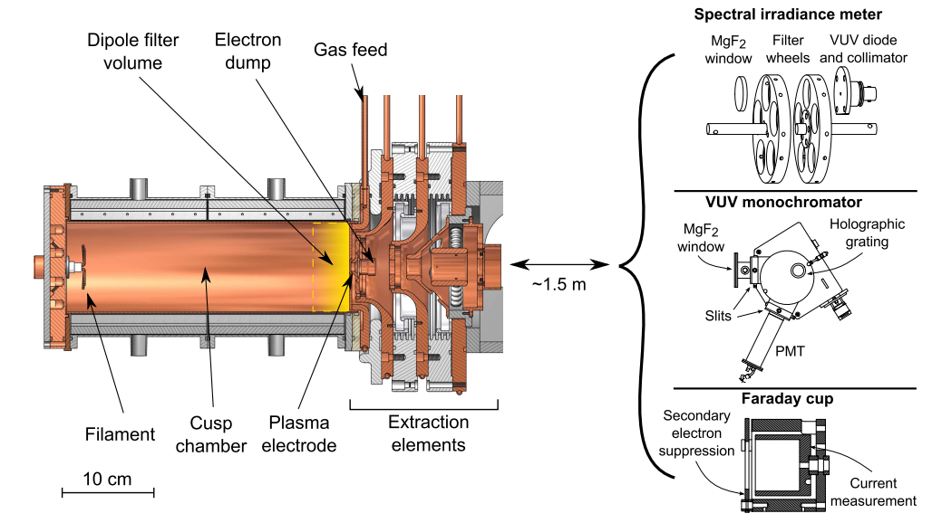
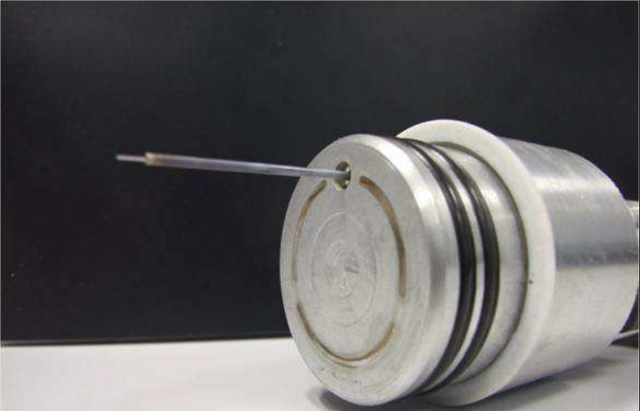
Invasive vs. non-invasive
Langmuir probe
Optical emission spectroscopy (OES)
Figure credit: Ana Megia
Figure credit: Jani Komppula
Perturbative: can affect the plasma properties
Light ion sources, singly charged ions
Large volume ion sources
High charge state ion sources
Small volume ion sources
“Parasitic”: no effect on the plasma properties
All types of plasma ion sources
Data analysis can be arduous
Uncertainties can be large
Absolute (vs. relative) measurements difficult
Notes:
The first one is invasive versus non-invasive. The classic example of invasive (some may call it perturbative) is the Langmuir probe. This works in… but is a poor choice for…
Another classic example – this time non-invasive is optical emission spectroscopy – measurement of the plasma light emission. This technique is pretty much universal but …

Slide 11
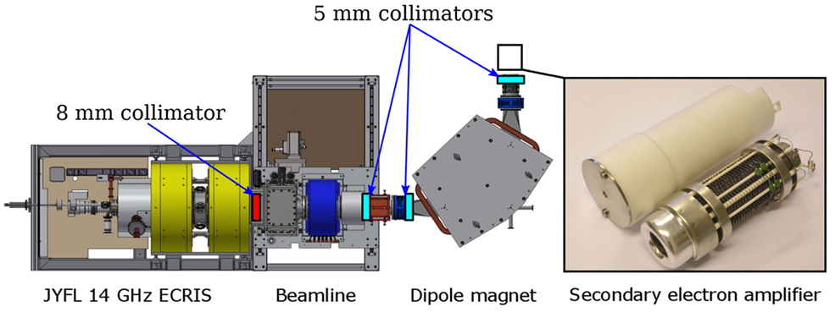
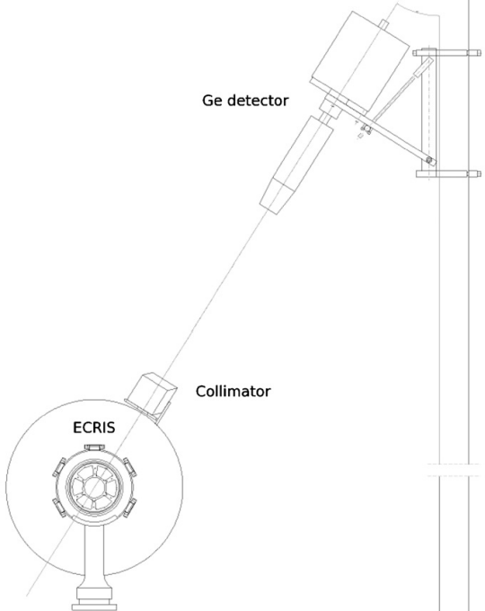
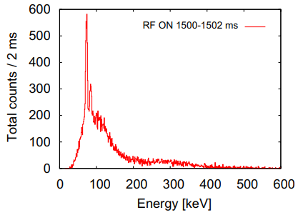
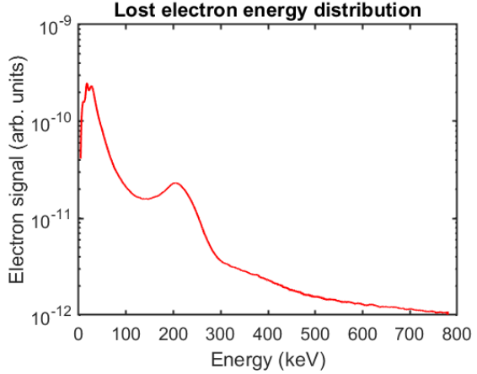
Direct vs. indirect
(escaping) Electron spectroscopy
Wall bremsstrahlung spectroscopy
Figure credit: Ivan Izotov
Figure credit: Tommi Ropponen
Measures the (escaping) Electron Energy Distribution
Prohibits ion source operation
Measures the bremsstrahlung photons (spectrum) emitted by the electron – thick target (wall) interaction, not electron energies
Allows ion source operation
Deconvolution of the (escaping) Electron Energy Distribution is very challenging
Notes:
A comparison of direct versus indirect methods. In this case electron spectroscopy of the electrons escaping from an ECR ion source by using the beamline bending magnet to probe the electron energy distribution.
The same thing can be probed with wall bremsstrahlung measurements, which is indirect method but allows ion source operation. Not easy to convert the measured spectrum to EED though.

Slide 12
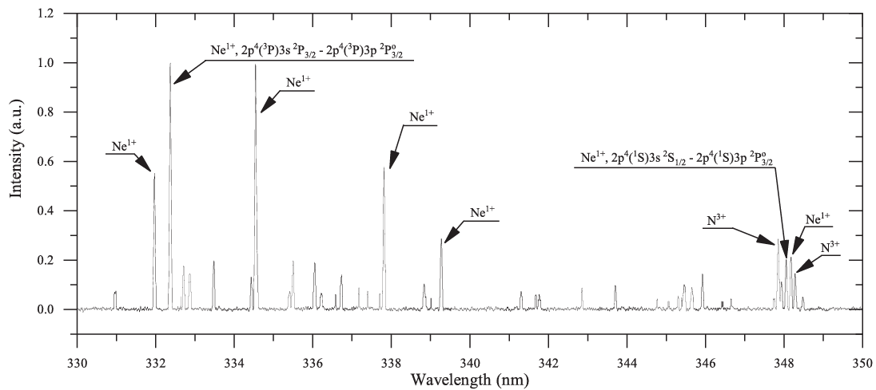
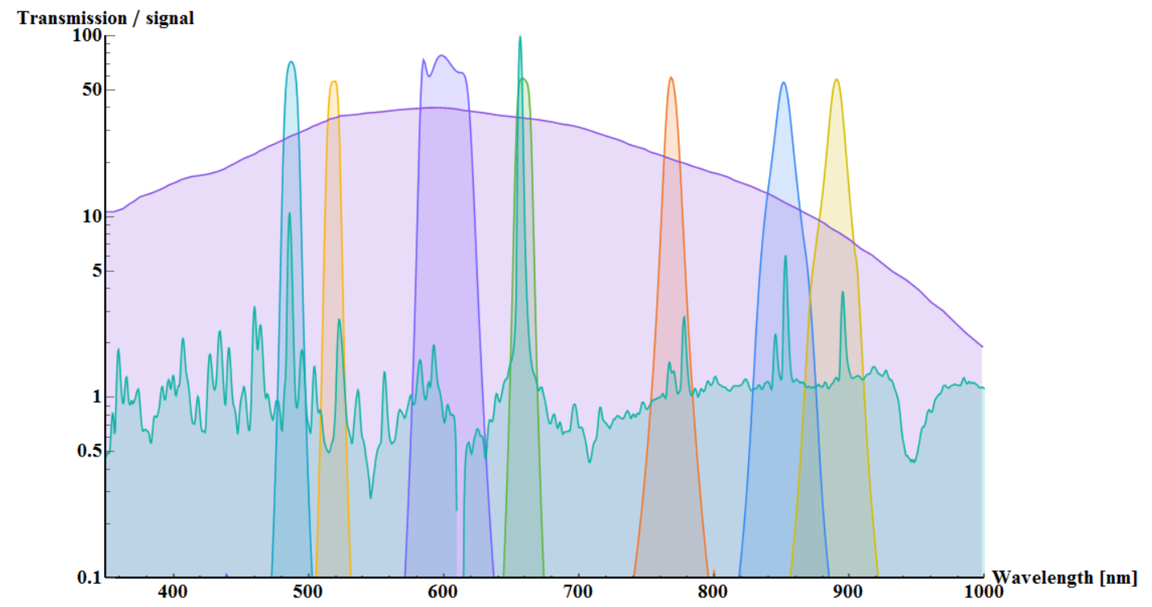
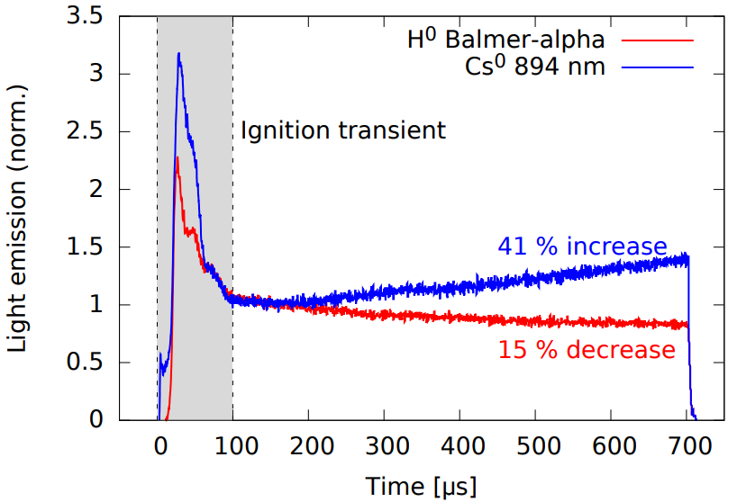
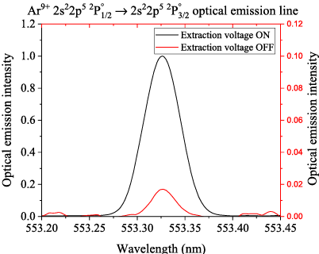
Time-averaged vs. time-resolved
Balmer-α
JYFL 14 GHz A-ECR (CW)
Figure credit: Risto Kronholm
Cs⁰
Diode
response
Spectrum
Cold electron average energy from emission line ratio
(known cross sections and assumed EED)
ISIS Penning ion source
Optical filters and diode detector (SiPM) allow measuring several emission lines of a pulsed discharge simultaneously
The effect of ion source high voltage on high charge state ion (Ar⁹⁺) emission.
Always do diagnostics at ion source relevant conditions
Notes:
In ion sources producing continuous beams time-averaged diagnostic methods such as optical emission are most often sufficient. One can probe for example the effect of various control parameters on the electron energies. This example here shows how the intensity of a high charge state ion optical emission is affected by switching off the extraction voltage. I wanted to highlight this to stress the importance of always doing diagnostics at relevant conditions.
For pulsed ion sources the diagnostics should be time-resolved. Here is an example from the ISIS penning ion source where we know how the emission spectrum looks like and can then use bandpass filters to monitor several emission lines of hydrogen and caesium within the discharge pulse.

Slide 13
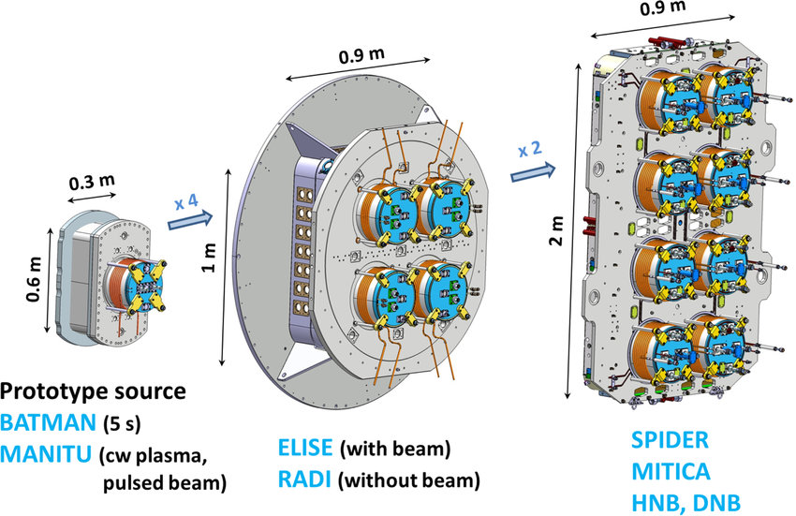
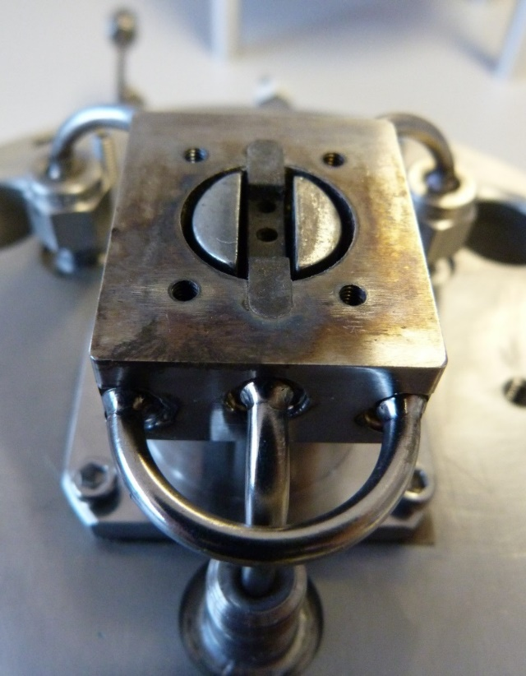
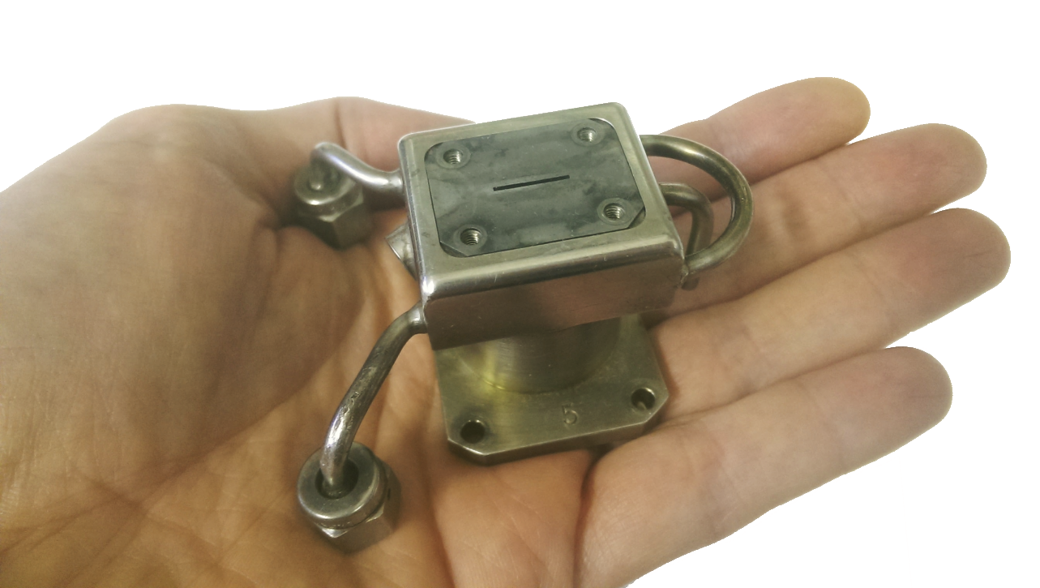
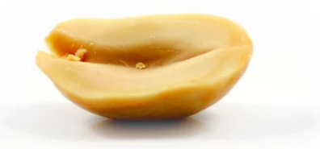
Choice vs. no choice
The ITER neutral beam injection ion source and its prototypes
The ISIS Penning ion source
10 mm
5 mm
Futon mattress
Half a peanut
vs.
The selection of available diagnostics depends on the size of the ion source and its plasma
Notes:
Sometimes you have the luxury to implement several diagnostics techniques into a single ion source, for example the large area ITER neutral beam injection negative ion source…
… whereas sometimes your ion source is so small that you can just measure the light emitted through the extraction aperture (this is the ISIS penning source).
Just to give you an idea of the difference: asked chatGPT to name objects with the same size and these are the answers.
Bottom line is …. (read)

Slide 14
Ion source plasma diagnostics examples
Notes:
Presenting techniques and highlighting some (subjectively) interesting results achieved with them

Slide 15
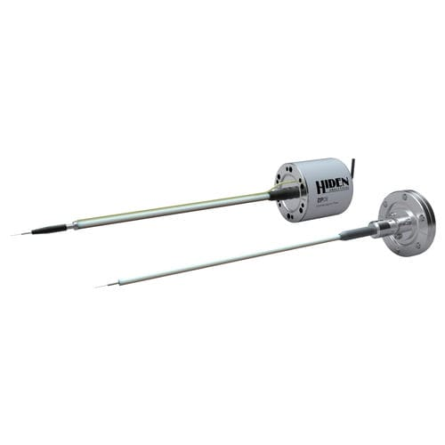
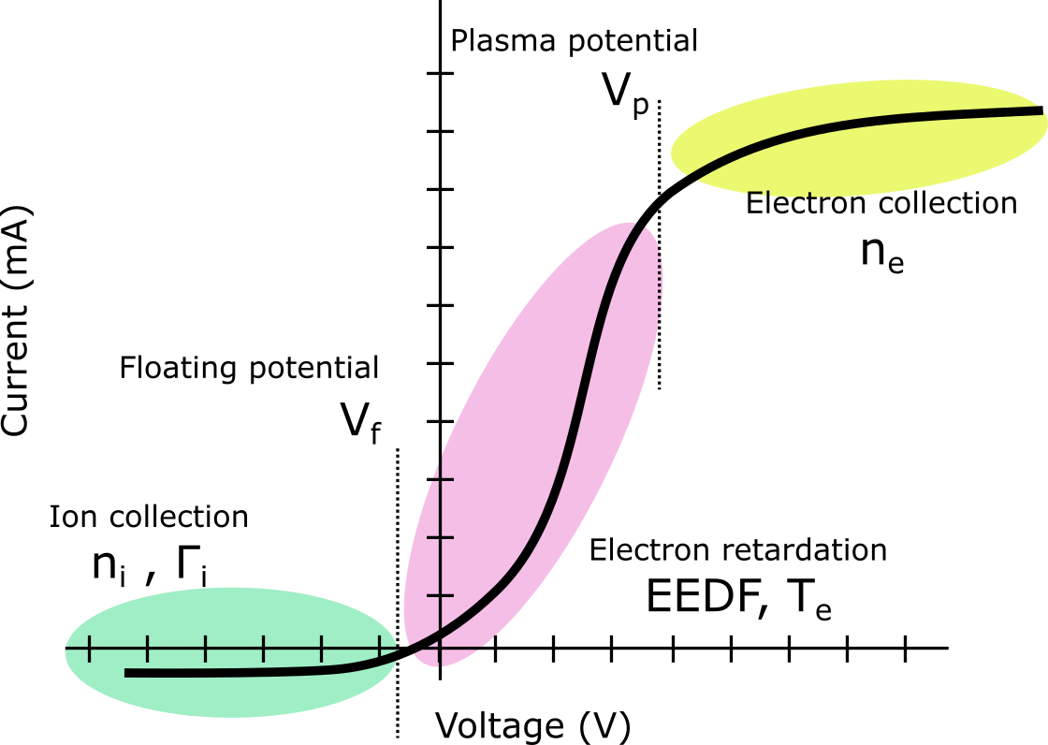
Langmuir probe
Isolated conductor (wire, planar) introduced to the plasma
Collects ions end electrons by sweeping the probe tip voltage
From the I-V curve it is possible to determine:
Floating Potential, Vf
Plasma Potential, Vp
Electron Temperature, Te
Electron (and ion) density, ne
Note: 4-quadrant power supply, RF compensation, magnetic field, plasma composition, negative ions,…
Figure credit: Mari Napari, King’s college London
Notes:
Langmuir probe is one of the most commonly used in light ion sources (and plasma generators).
Read the text and note the difficulties.

Slide 16
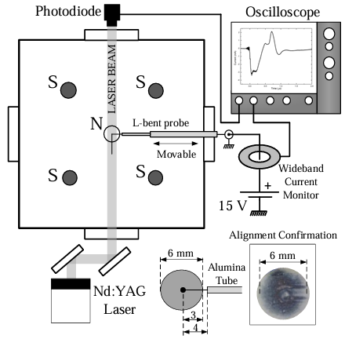
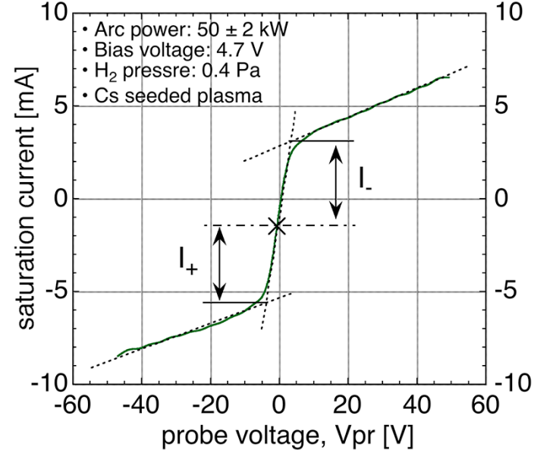
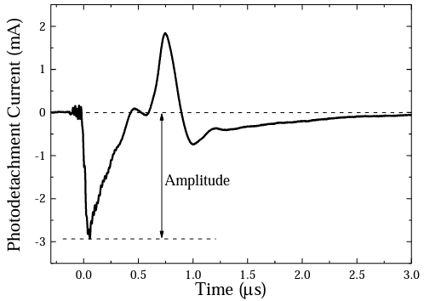
Langmuir probe – negative (H⁻) ions
Symmetric Langmuir probe IV-curve of an electronegative (ion-ion) plasma in the filter field of a negative ion source
Laser photodetachment: 1064 nm laser stripping H⁻ ions
High laser power to detach all H⁻ ions
H⁻ ion density from the probe signal (spatially resolved)
Figure credit: Spyridon Aleiferis
Notes:
Couple of examples of using Langmuir probes in negative ion sources.
Have been used to confirm the existence of ion-ion electronegative plasma near the extraction (symmetric IV-curve, electrons replaced by neg. ions)
Langmuir probe used in laser photodetachement measurements to directly measure the density by stripping H- with a laser pulse and then collecting the excess charge and working out the density.

Slide 17
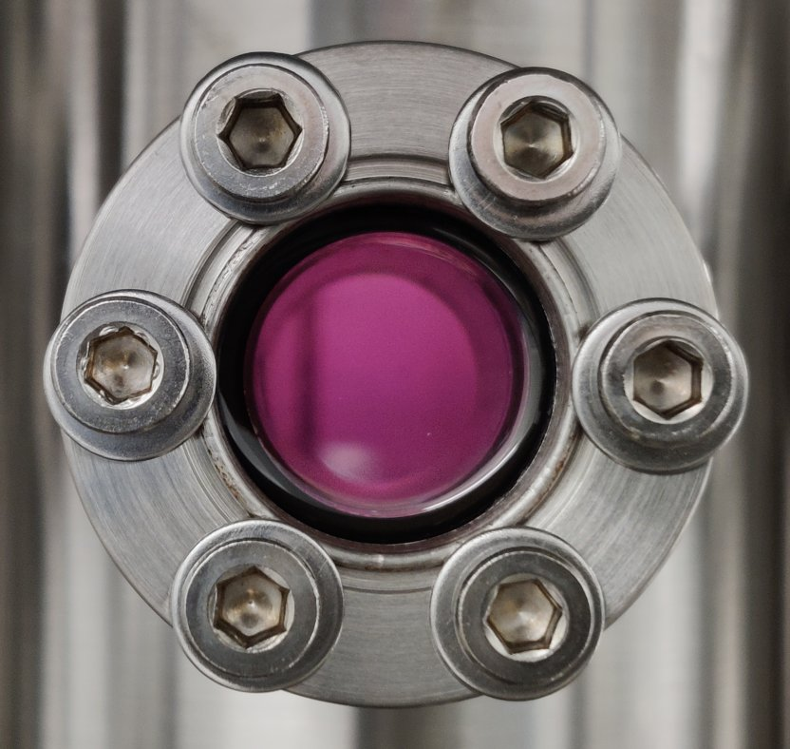
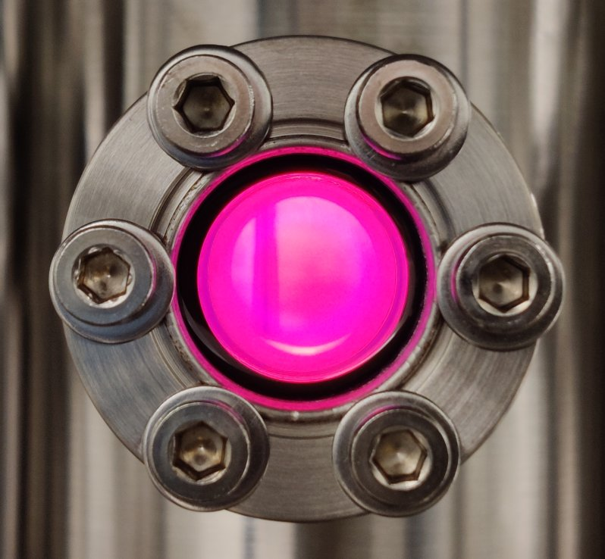
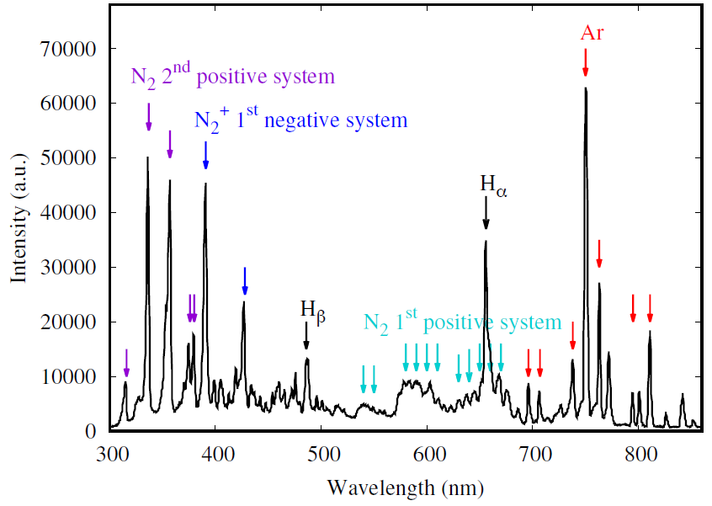
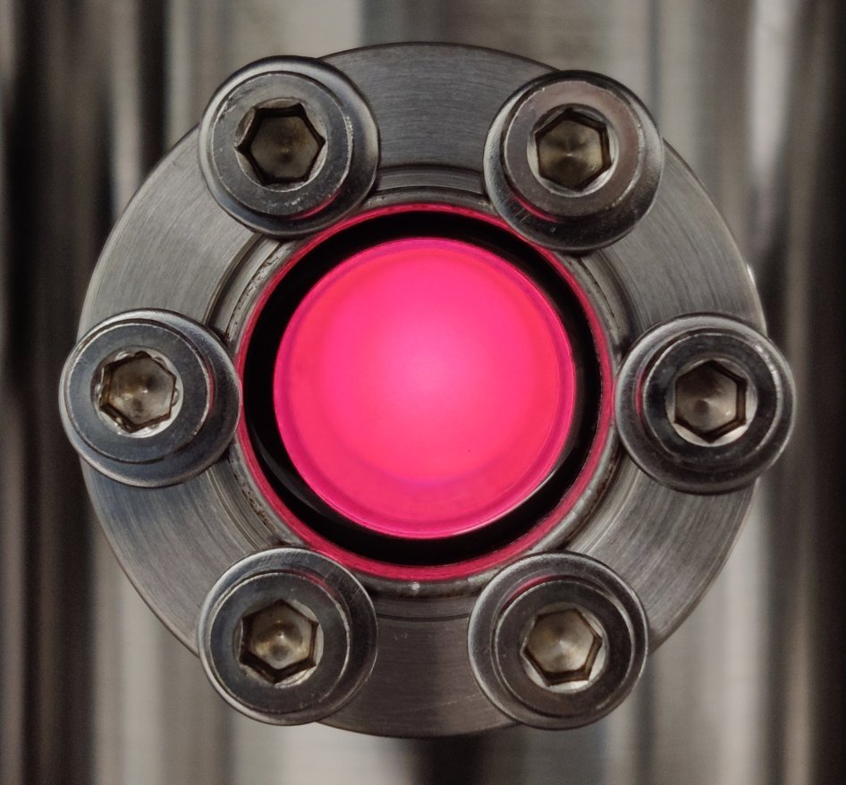
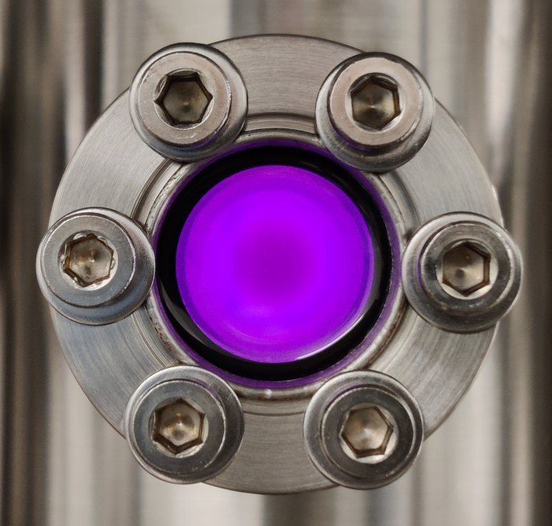
Optical Emission Spectroscopy (OES)
From the emission spectrum and power:
Plasma species (elements, ion charge states)
Electron temperature (average energy) – line ratios
Neutral and ion temperatures – Doppler broadening
Excitation rates – absolute light emission
Figure credit: Mari Napari, King’s college London
Notes:
Optical emission spectroscopy can be used to measure… (read)

Slide 18
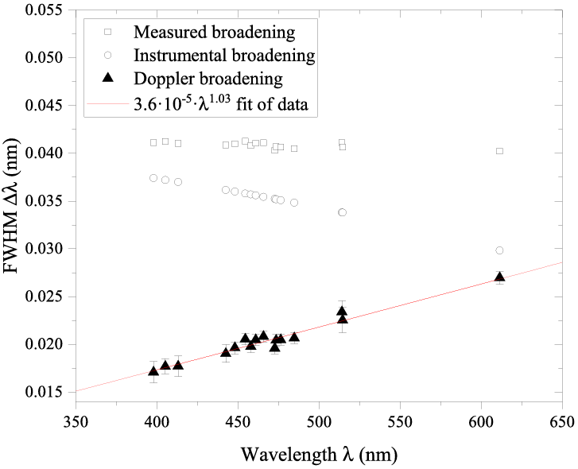
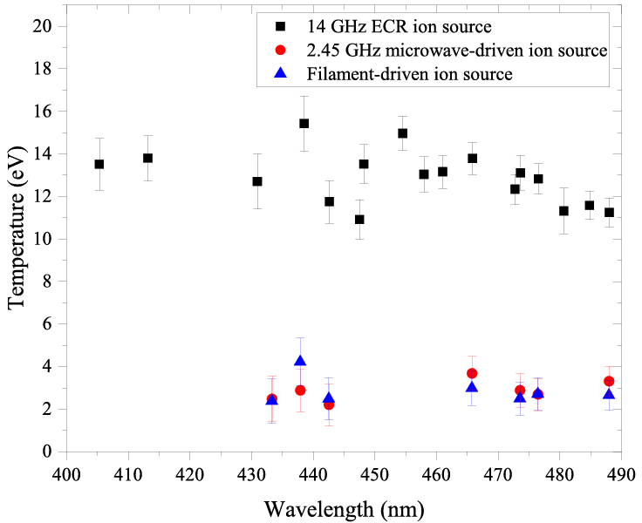
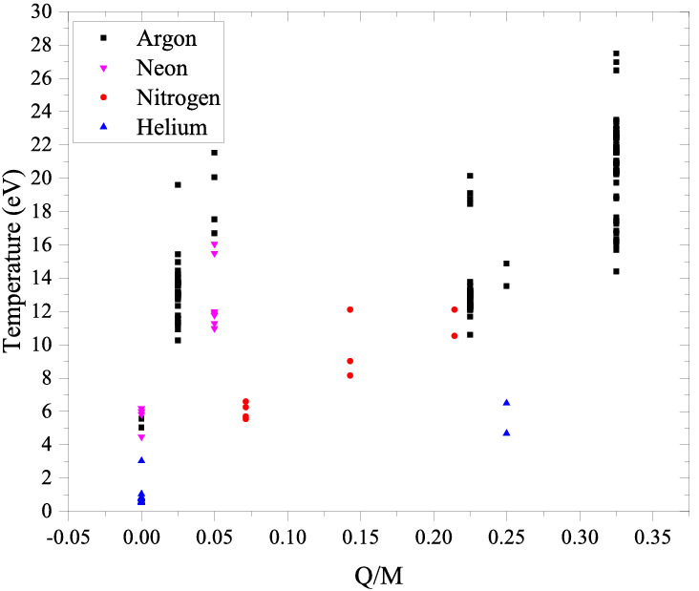
OES – Ion temperature from Doppler broadening
Doppler broadening due to ion temperature
Pressure broadening (collisions)
Instrumental broadening
(Fastie-Ebert monochromator)
Ar⁹⁺
Higher than expected
ion temperature
in ECR ion sources
(10 eV vs. 1 eV)
Ar¹³⁺
Notes:
Here is an example from high charge state ECR ion sources where the ion temperatures were measured with a high-resolution spectrometer. The line width in this case is affected by…
The result is that the ion temperatures seem to be an order of magnitude higher than was thought, which has some implications (happy to discuss more). We saw a talk by Oskari Timonen where this technique is developed further to enable time-resolved measurments. Looking forward to seeing more results.

Slide 19
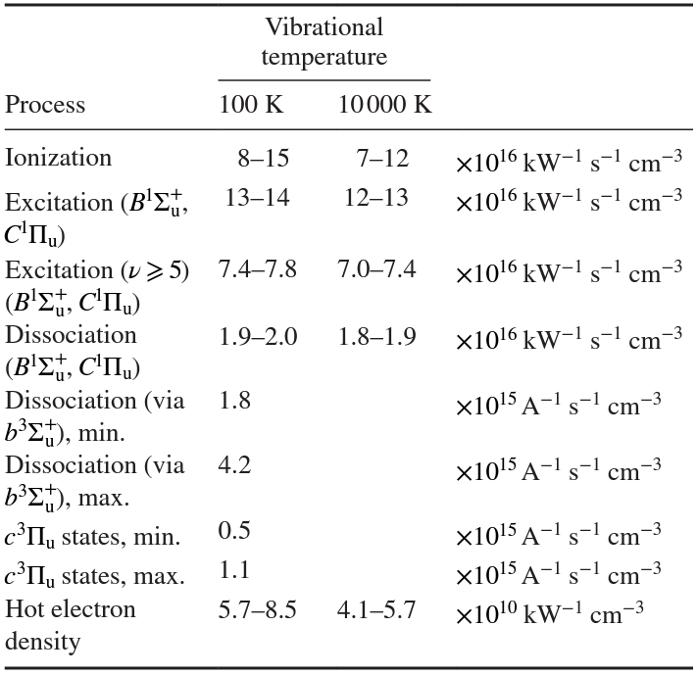
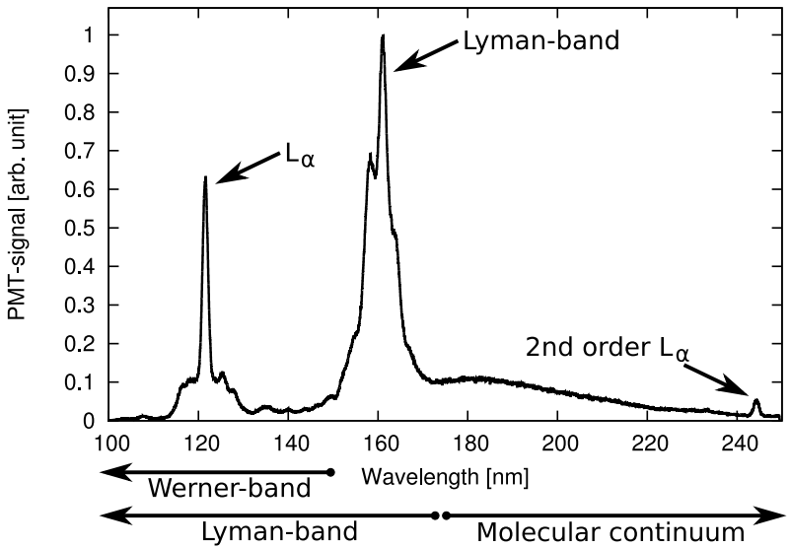
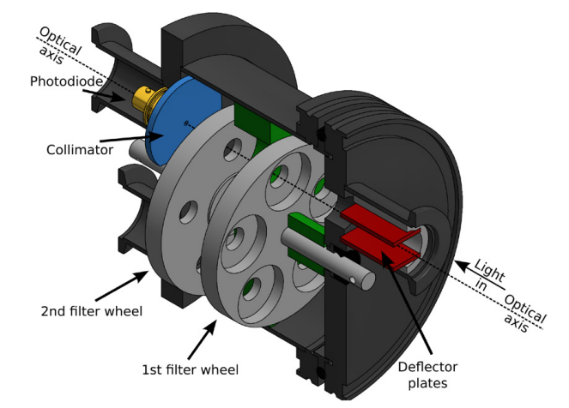
OES – VUV emission of hydrogen plasmas
Vibrational excitation rates (via B and C states),
dissociation rate, absolute VUV power, metastables,
comparison between hydrogen and deuterium,…
Figure credit: Jani Komppula
Notes:
Here is an example of using a VUV-spectrometer to measure to measure the emission of hydrogen plasmas and then using a bandpass-filtered spectral irradiance meter selecting a range of wavelengths into an absolutely calibrated diode to work out different reaction rates in the plasma

Slide 20
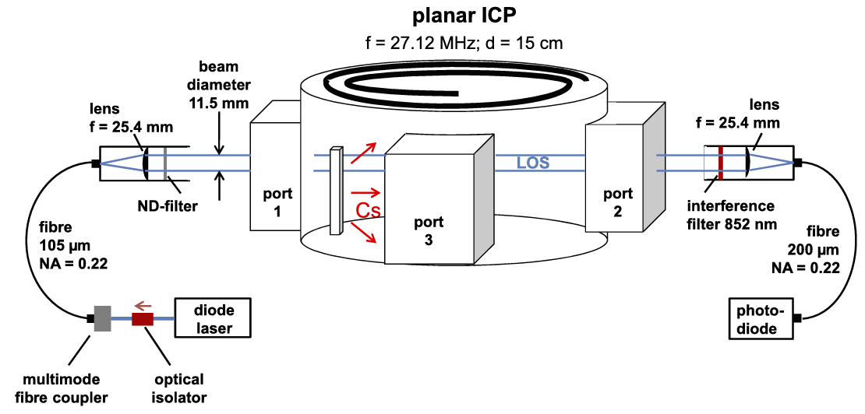
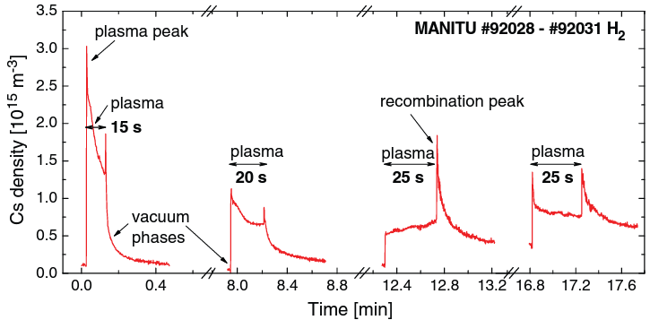
Laser absorption spectroscopy
The technique is based on the attenuation of (laser) light signal by absorption in the plasma volume
Average density of e.g. neutral Caesium atoms along the laser path length
Caesium dynamics of long pulse ion sources
852.1 nm
Notes:
Here is an example of absorption spectroscopy. Instead of measuring what the plasma emits, one can direct a probe light signal into the plasma and measure how much it is attenuated. This technique can be used for example to measure the caesium density in negative hydrogen ion sources.

Slide 21
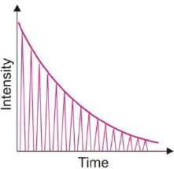
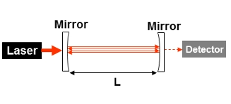
Laser absorption spectroscopy – cavity ring down
The sensitivity of single-pass absorption spectroscopy is often not good enough
Cavity ring down spectroscopy is based on reflecting a laser pulse with semi-transparent mirrors and measuring the decay time of the signal with an empty ‘cavity’ and with the absorbing ‘medium’, e.g. H⁻ ions
$$τ_{0}=\frac{nL/c}{1−R}$$
$$τ=\frac{nL/c}{\left(1−R\right)+σnL}$$
Notes:
Read out loud

Slide 22
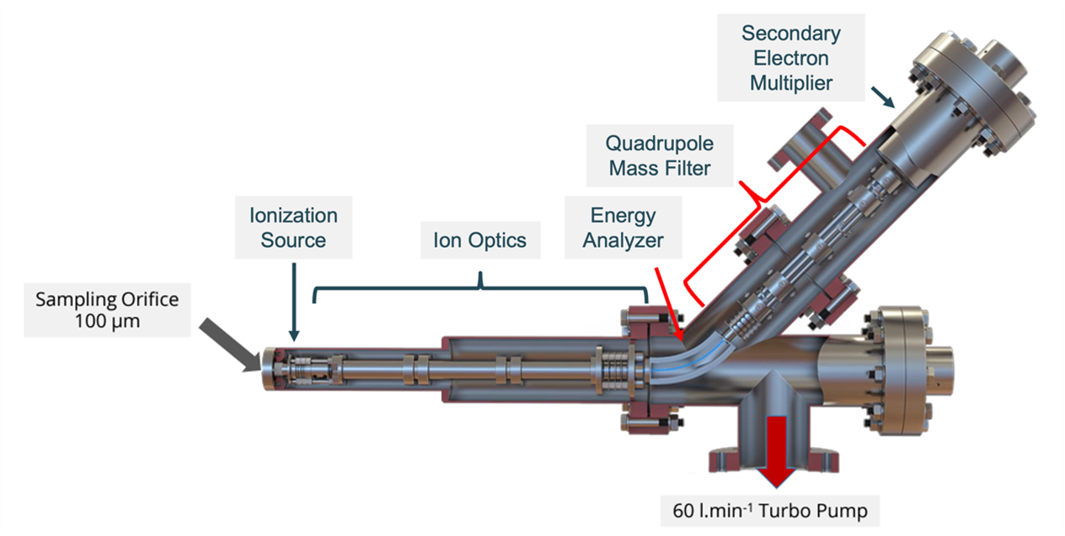
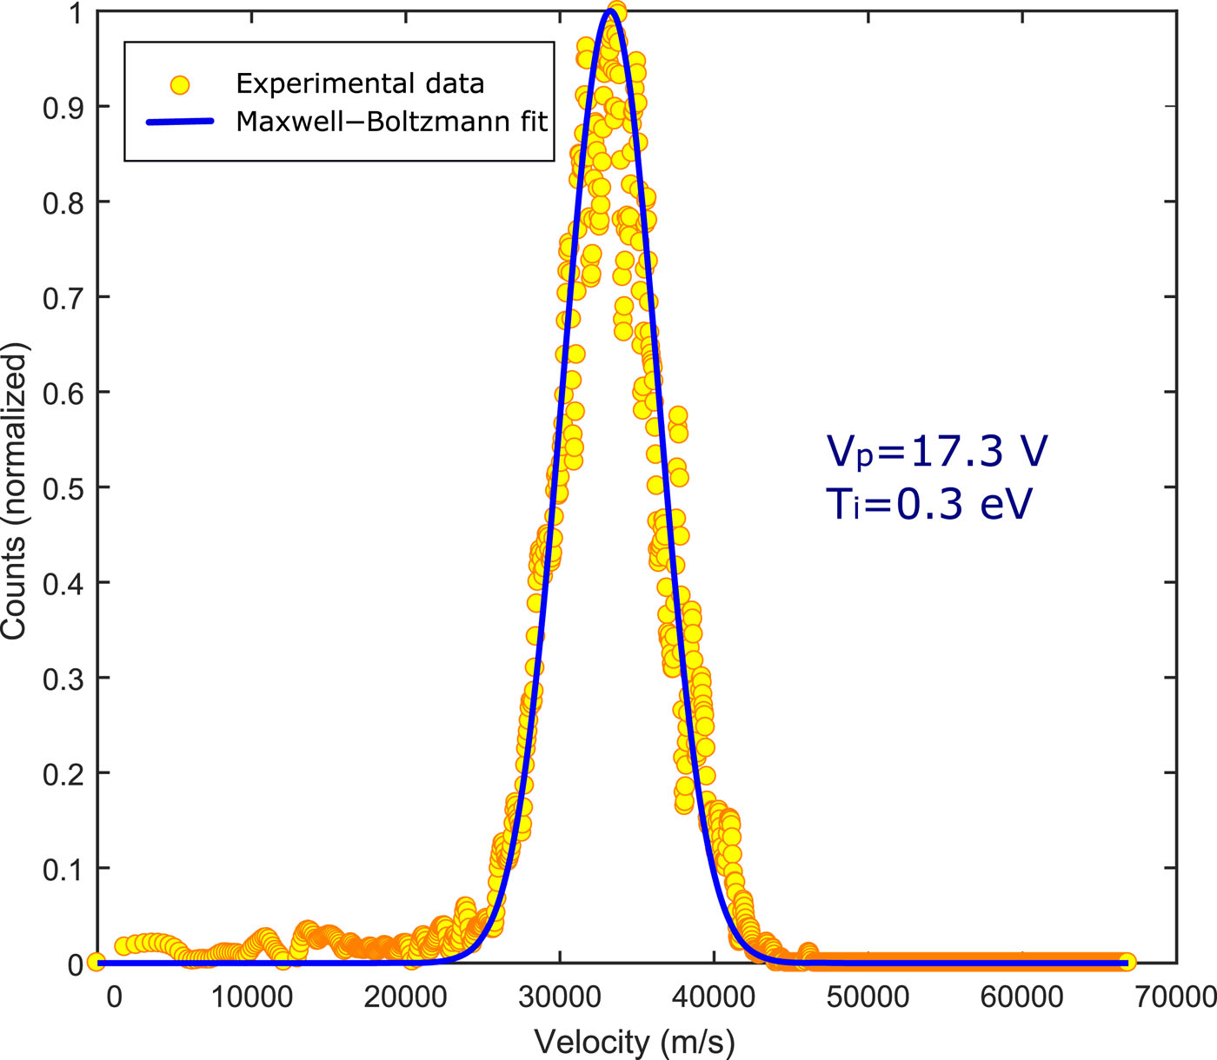
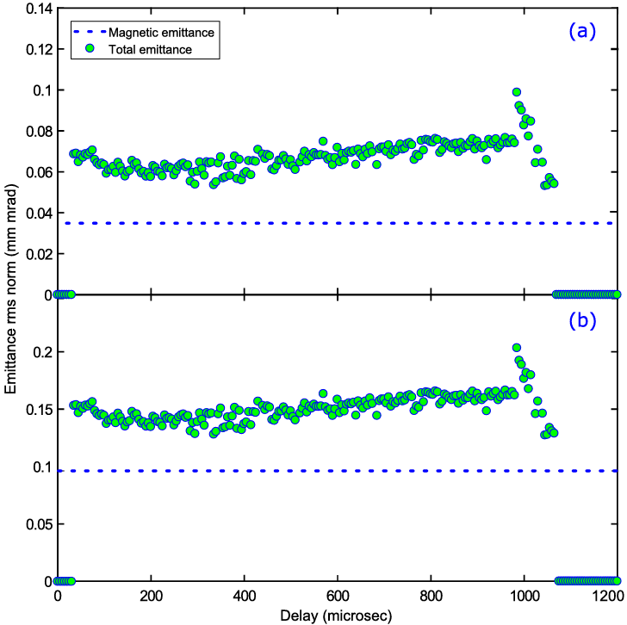
Energy-resolved mass spectrometry – H⁺ microwave source
Electrostatic quadrupole plasma (EQP) analyzer
Combination of an energy analyser and quadrupole mass spectrometer
Detection of neutral, positive, and negative ion species
Ions pass an electrostatic analyzer, selects ions with certain energy by electrostatic deflection
Ions with selected energy move to QMS that filters ions with specific m/q ratio
These ions measured with a secondary electron multiplier / microchannel plate detector.
Information on the ion species (m/q) and their energy (plasma potential V_{p}, IEDF, T_{i})
V_{p} 17.3 V
T_{i} 0.3 eV
φ 6 mm
φ 10 mm
Megia-Macias et al. Rev Sci Instrum 92 (2021)113301
Notes:
Electrostatic quadrupole analyser to measure the plasma species and their energies.
Here’s an example of a microwave proton source. Knowing the ion energy (temperature) helps to quantify the contributions of magnetic and total emittances. Can be time-resolved.

Slide 23
ECR plasmas with high charge state ions
Invasive methods perturb the plasma
OES often limited to neutrals and low charge state ions (‘cold’ electron population)
Balance equation
We would like to know the electron density, average electron energy and ion confinement time
*Cross sections are assumed to be known
How to measure these?
Notes:
ECR ion sources with high charge state ion require specialised diagnostics. That’s because….
If we look at the ion balance equation, which tells what processes affect the density of a high charge state ions, we can see that the relevant parameters are… (that is if we can trust the cross sections)… and the question becomes how to measure these.

Slide 24
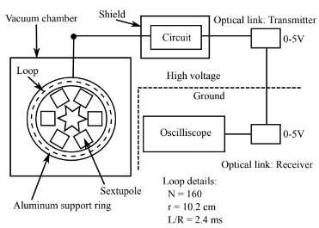
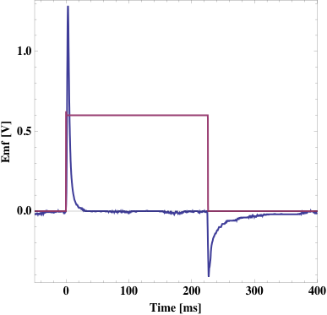
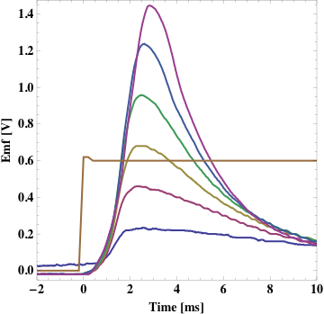
Plasma diamagnetism
The the diamagnetic effect of the plasma electrons induces a voltage on a pick-up loop
The voltage is proportional to: $\frac{d(n_{e}\left\langle E_{e}\right\rangle }{dt}$
305 W
305 W
Microwave on
The integral of the signal is proportional to the plasma energy density
Microwave off
62 W
Figure credit: Jonathan Noland
Notes:
One technique is to measure the plasma diamagnetism with tha pick-up loop. The voltage induced in the loop is proportional to the rate of change in the plasma energy content.
So, this is a pulsed technique where the integral of the signal yields the energy content in relative terms, not absolute.

Slide 25
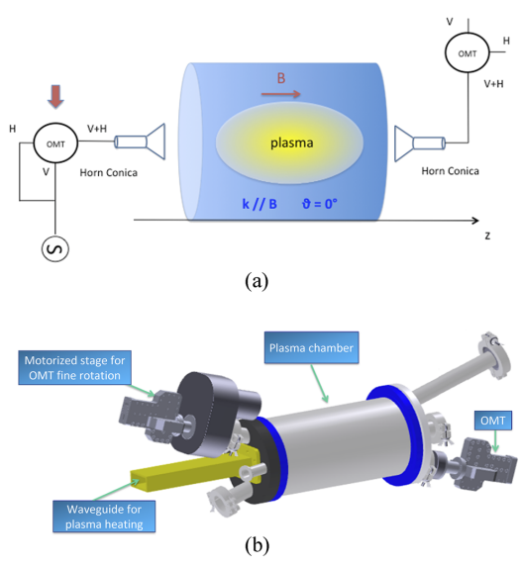
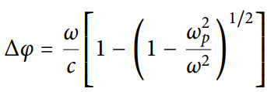
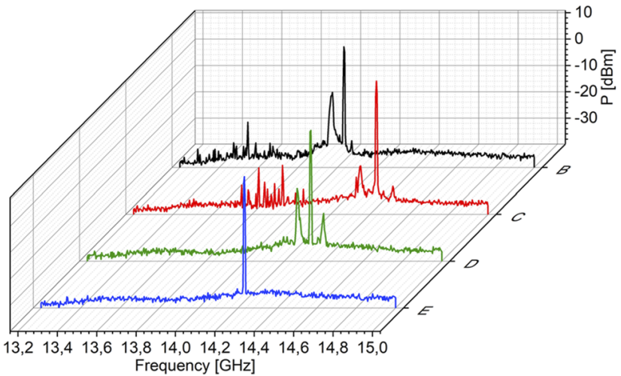
Microwave techniques
Interferometry
Polarimetry
Plasma immersed RF probe
Two-pin probe for measuring the plasma (self-)emission
n_{e} from the phase shift, which depends on the plasma frequency
Unstable plasma
n_{e} from the Faraday rotation of the polarisation angle
Stable plasma
Notes:
The electron density can be measured using microwave techniques. Interferometry is based on measuring the phase shift of a probe microwave signal … and polarimetry on measuring the change of its polarisation angle. These techniques require a signal source and a receiver, which is very difficult to arrange in high frequency sources at least.
Another microwave technique is an RF probe measuring the plasma self-emission, which can be used for quantifying the stability of the plasma.

Slide 26
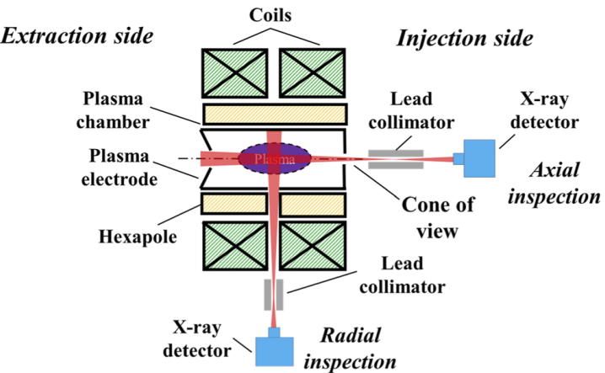
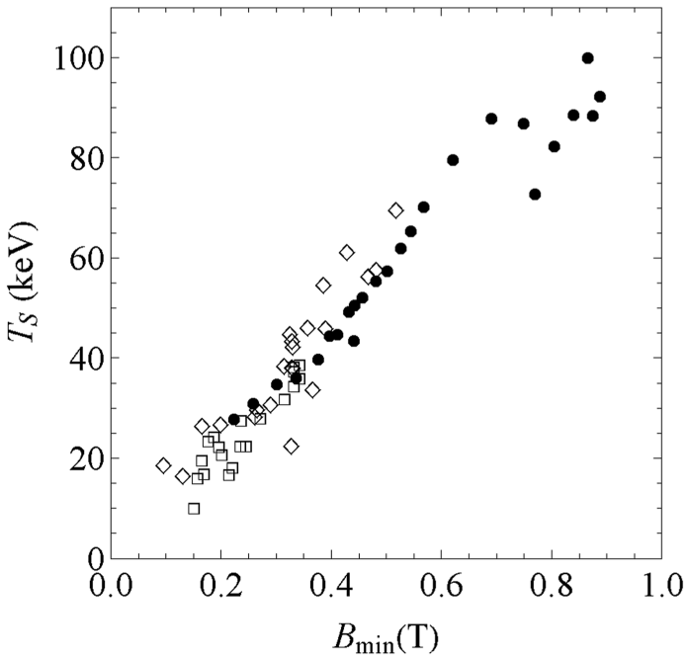
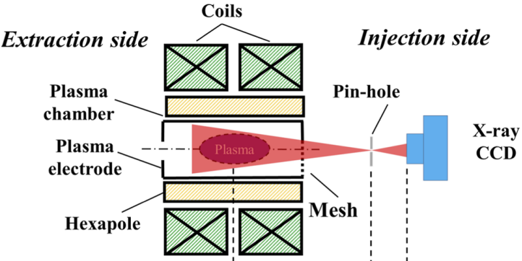
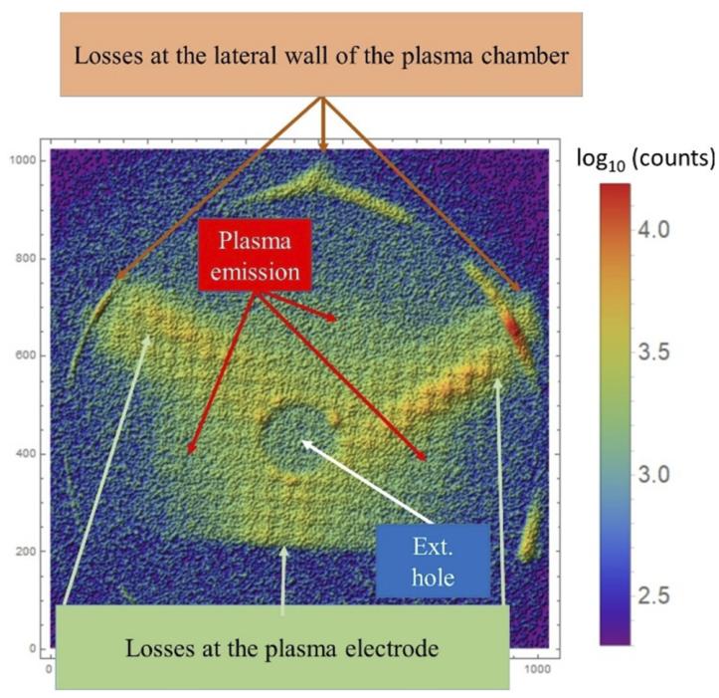
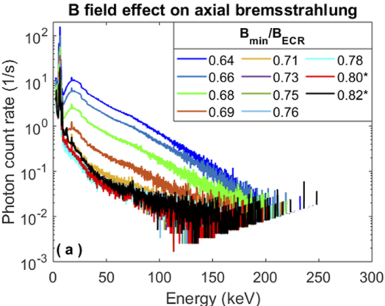
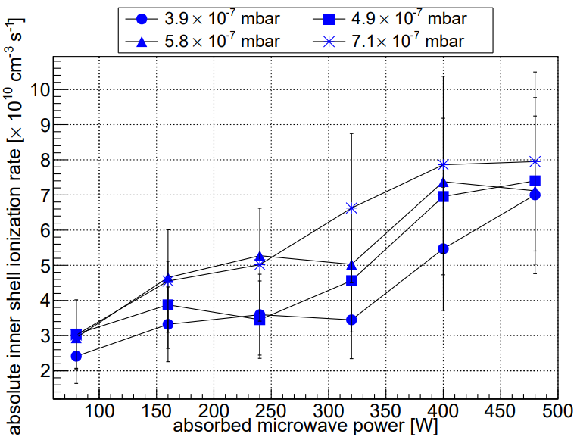
X-ray diagnostics
Volumetric measurement
X-ray plasma imaging
Bremsstrahlung T_{s}
T_{s} not T_{e}!
Pile-ups
Characteristic x-rays:
inner shell ionisation rate
Notes:
Examples of x-ray diagnostics. I won’t spend too mich time on this as there is another talk dedicated to the topic.
Just want to highlight that measuring x-rays does not give direct information on electrons and great care is required to interpret the results, also during the measurments because it is easy to artificially inflate the high energy part of the spectrum through pile-up events if the count rate is too high.
Spatial information on X-ray emission can be acquired by using a pinhole and CCD camera.

Slide 27
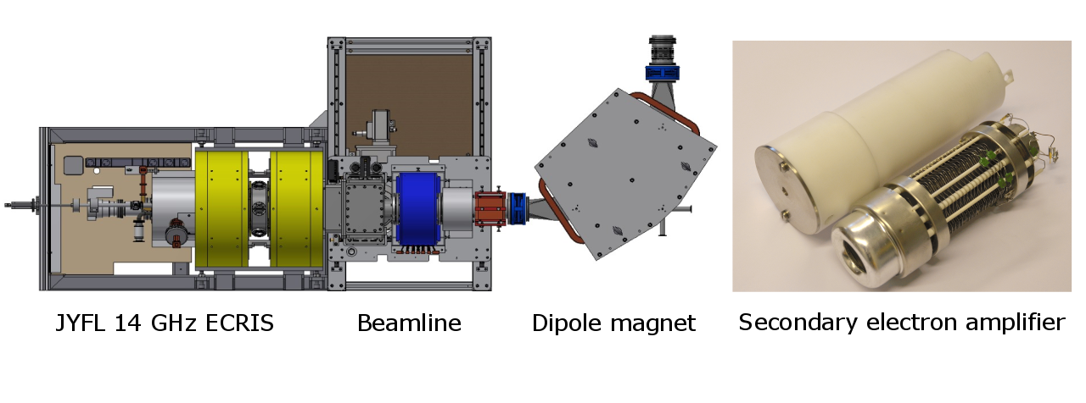
(escaping) Electron spectroscopy
Figure credit: Ivan Izotov
Sweep of the dipole magnet field → EED
CW or pulsed mode measurements
Important to know the transport efficiency vs. electron energy
“Source” of kinetic instabilities
Escaping EED ≠ confined EED
Notes:
The energies of the escaping electrons can be measured by using the beamline dipole magnet as a spectrometer in cw or pulsed mode. In this case it is important to know the transport efficiency.
What this technique has revealed is for example the dependence of the escaping EED on magnetic field parameters and a high energy component being the source of kinetic instabilities.
Want to emphasise that the escaping EED is not the same as the confined EED.

Slide 28
1+ beam probe – charge breeder ECRIS
K¹⁰⁺
n_{e} 10¹¹ -10¹² cm⁻³
⟨ E_{e} ⟩ 0.4 – 1.1 keV
Confinement time 15 ms
(ionisation time,
charge exchange time)
+ fitting to experimental data
Uncertainties defined by cross section data
Figure credit: Miha Luntinen
Notes:
The plasma parameters can be probed with 1+ beam injection. This is especially useful in charge breeder ion sources, where the 1+ beam is required anyways. This technique is based on injecting a pulse of the 1+ ions and then measuring the transient N+ beam currents. These transients can then be reproduced by fitting parameters and converted into a range of possible Ee ne –values and ion confinement times.
This method has quite large uncertainties defined by the cross section data.

Slide 29
It is important to combine different diagnostics techniques

Slide 30
Case #1 – ECR ion source kinetic plasma instabilities
Microwave emission
X-rays and escaping electrons
Beam current
Unstable
Stable
2-frequency heating stabilises the ECRIS plasma
Other products are available
Notes:
First example is the detection of kinetic instabilities in ECRIS plasmas. Here we see that the combination of microwave techniques measuring the microwave emission spectrum and detection of electrons either through xrays or escaping electron EED can be really helpful in understanding what causes the instabilities. This can then be combined with the measurement of the beam current to look at methods to stabilise the plasma – two frequency heating in this case. This is with single frequency, this with two at the same total power.

Slide 31
Case #2 – Large area negative ion source for NBI at NIFS
mm-IF: Millimetre-wave Interferometer
Hα / Cs LAS: Laser Absorption Spectroscopy
DLP: Directional Langmuir Probe
DPP: Directional Photodetachment probe
CRD: Cavity Ring Down spectroscopy
OES: Optical emission spectroscopy
Hα CCD: CCD spatial imaging (filtered)
SWP: Surface wave probe
(electron density from the plasma dielectric constant)
Notes:
Another example is the large are negative ion source for NBI at NIFS where they have used this range of diagnostics to form a comprehensive picture of what is going on in the plasma.

Slide 32
Summary
Vast choice of diagnostics methods
Choosing the correct technique depends on what you want to measure and what kind of ion source you want to probe
Make sure the diagnostic is not perturbing the plasma
Use as many diagnostics techniques as possible
Diagnostics allows quantifying ions source performance, monitoring them in long-term use and guiding their R&D.
THANK YOU!
A
B
What happens between A and B?

Slide 33
1+ beam capture – charge breeder ECRIS
Collisional or electrostatic capture of the 1+ beam?
(strong m₁₊ and T_{i}-dependence or no m₁₊ and T_{i}-dependence)
In practice the capture is optimised by adjusting the potential difference ΔV between the charge breeder and the 1+ ion source
In-beam Retarding Field Analyser to measure the plasma potential (from the IV-curve)
Double grid V_{source} + V_{adjustable}
Beam
Experiment with multi-species injection:
No mass dependence
Favours the electrostatic stopping model,
i.e. no Ti-dependence expected
A

