Slide 1

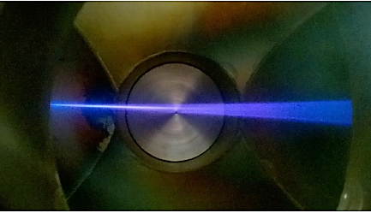
Intense proton beam production with Compact Ion Sources
-
ALISES ion sources family developed at CEA Saclay
Olivier TUSKE
Université Paris-Saclay – CEA – Irfu
ICIS 2023 September 18, Victoria, BC, CANADA

Slide 2
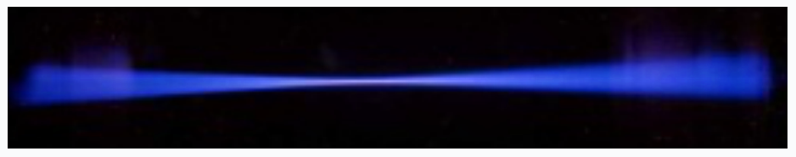
OUTLINE
ECR Ion Sources for light ions production
Intense Beam Problematic
ALISES Ion Source family
Conclusion

Slide 3
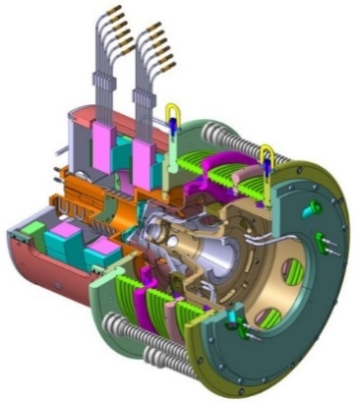
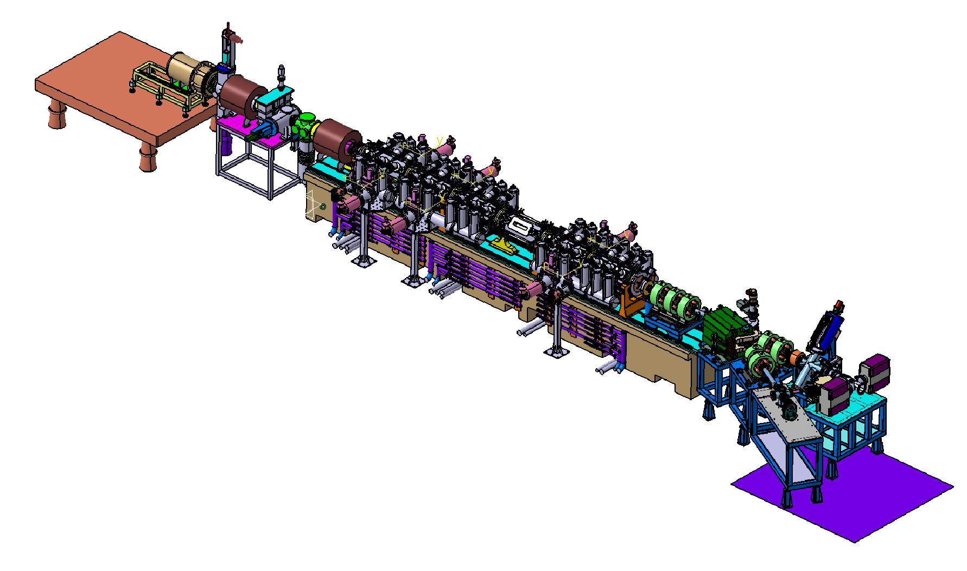



« Typical » LINAC ENVIRONNEMENT
IPHI Accelerator 100 mA Proton @3 MeV
LEBT with diagnostics
Low Energy Beam Transport line
Transport
and
Beam characterization
SILHI source
∅9mm
H⁺ 100 mA
@95 keV
Ion Production
and
Electrostatic Acceleration
IPHI : Injecteur Proton Haute Intensité (Saclay, France)
SPIRAL2 : Système de Production d’Ions RAdioactifs en Ligne de 2eme génération (Caen, France)
FAIR : Facility for Anti-proton and Ion Research at GSI (Darmstadt, Germany)
IFMIF : International Fusion Materials Irradiation Facility (ITER Broader Approach, Rokkasho, Japan)

Slide 4
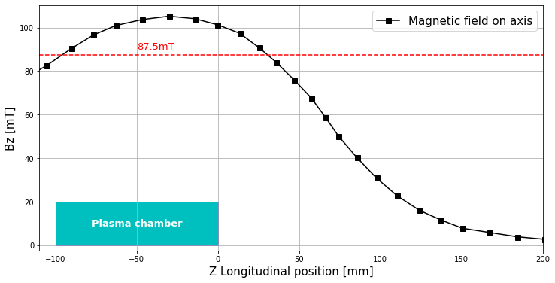
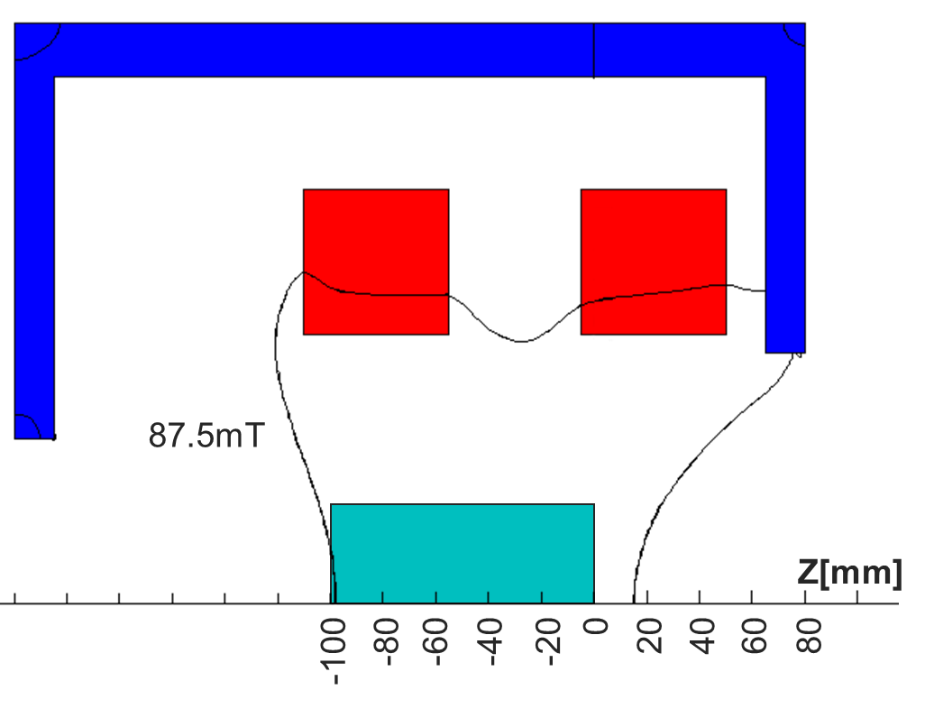
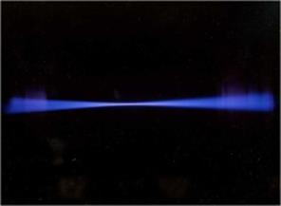
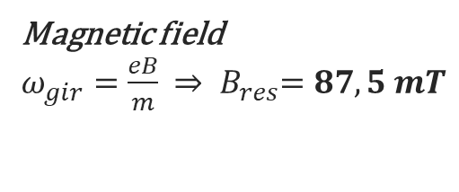
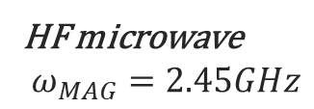
Intense Light Ion ECR Source
ECR Heating Process
(Electron Cyclotron Resonance)
HF microwave
$$ω_{MAG}=2.45GHz$$
Magnetic field
$ω_{gir}=\frac{eB}{m}$ ${⇒ B}_{res}=87,5 mT$
Ground
Magnetron
generator
2,45 GHz
Current : Faraday Cup - ACCT / DCCT
D⁺ D₂⁺ D₃⁺
H₂ / D₂
_{injection}
H⁺ H₂⁺ H₃⁺
Size, angle, position and proportion:
EMU; Wires Profiler/Camera; Wien filter
High Voltage 95 kV
65 kV
-3 kV
Plasma
Pentode extraction system
Diagnostics
Ion Source
LEBT
Ion Production
and
Electrostatic Acceleration
Transport
and
Beam characterization

Slide 5
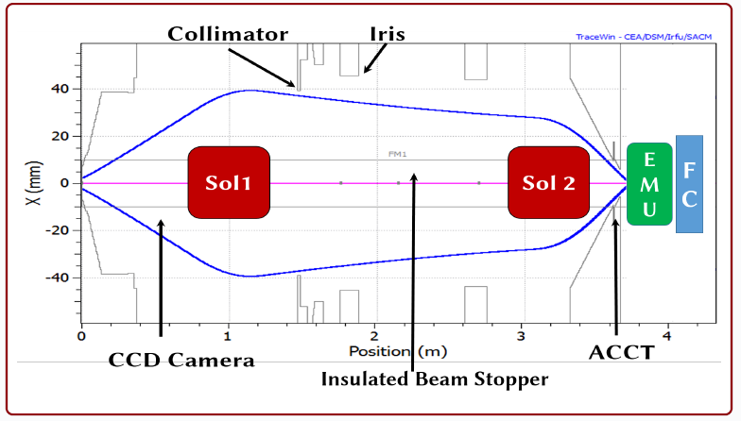
Intense Beam Problematic at Low Energy
Need for a « good / stable » Ion Source
Intensity, energy and emittance value
Reproducibility over time
Reliability (high MTBF)
Easy maintenance (low MTTR)
PROBLEMATIC: Emittance growth along LEBT
if Space Charge Compensation is perturbed by
  ► Electric field aberrations
  ► Magnetic & Fringe field
  ► Strong focalization while beam transport
Context : Injection into RFQ
Pair of SOLENOIDS to control size and angle of beam
Simple solutions:
► Space charge compensation must be effective as soon as possible
► Solenoid length reduction
► Transport beam smoothly
RFQ
“ The shorter, the better”
Notes:
What do we call a good or stable ion source ?
The source must fulfill the project requested value for extracted current, energy and emittance.
Naturally those measurements must be reproducible in time
The ion source must be reliable, so that meantime between failure must be the highest
And must have easy maintenance with the shortest the mean time to repair
Our context is to inject the beam into the RFQ so we must control the size and angle of the beam: this is done with a pair of solenoid in the LEBT
The intense beam interacts with the residual gas in the LEBT, it ionize the gas and free electrons are produced. Those electrons remain trapped by the transverse potential of the beam and so reduce the space charge of the beam. We called the process the Space charge compensation
There will be emittance growth in the LEBT if this space charge compensation process is perturbed
This perturbation is effectif if electric field is applied, but even with magnetic field, where the electron motion is diverted
Strong focalization and a cross over introduce an huge electric field that destroy this compensation
So the simple solution to reduce as much as possible this emittance growth is to leave the SCC to be effective as soon as possible
Reduce the Solenoid length
And transport the beam smoothly
In other word : the shorter LEBT, the better

Slide 6
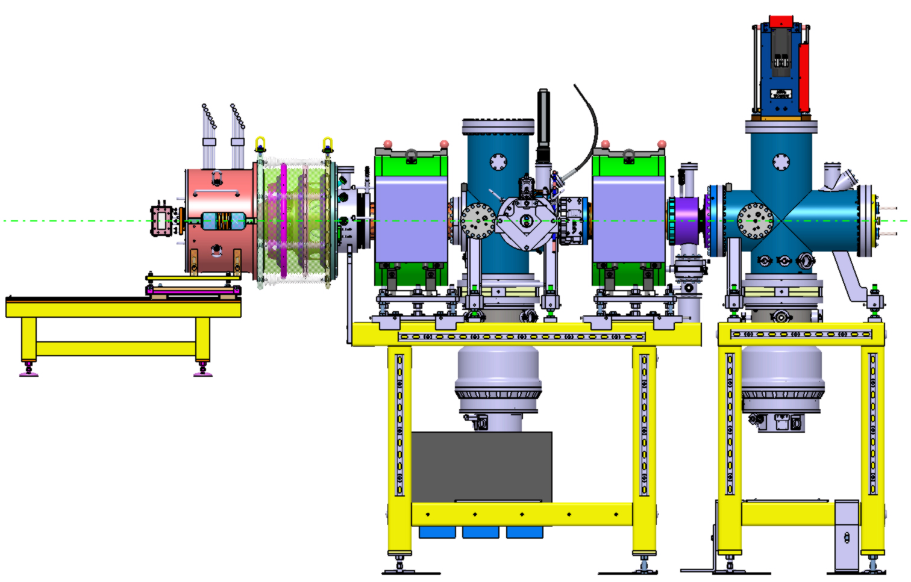
Emittance growth along LEBT
Extraction Hole
Z₀
RFQ entrance
SOLENOID
IFMIF source
D⁺ 160 mA
@95 keV
HV platform
High voltage

Slide 7
ALISES :
Advanced Light Ion Source Extraction System
► An easily maintenable Ion Source
Less people required
Less stress
Reduced maintenance time (MTTR)
Need
► A smaller & cheaper Ion Source
By modifing internal plasma chamber dimensions
Plasma chamber length / internal diameter
Microwave Injection
Interest
► A compact extraction system
to reduce the LEBT length and to reduce Emittance growth along LEBT
Request

Slide 8
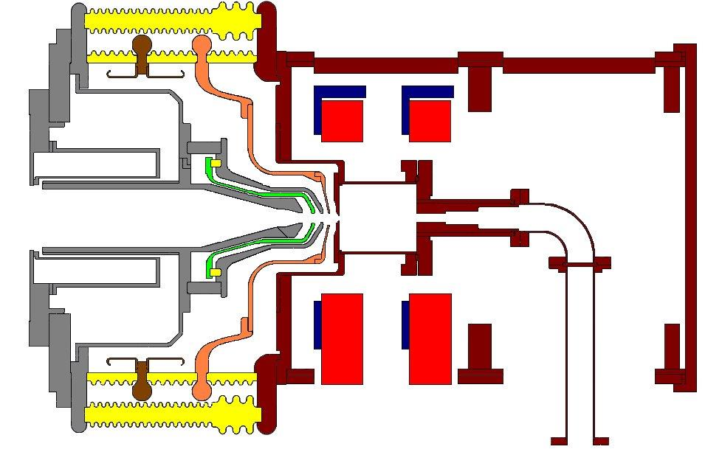
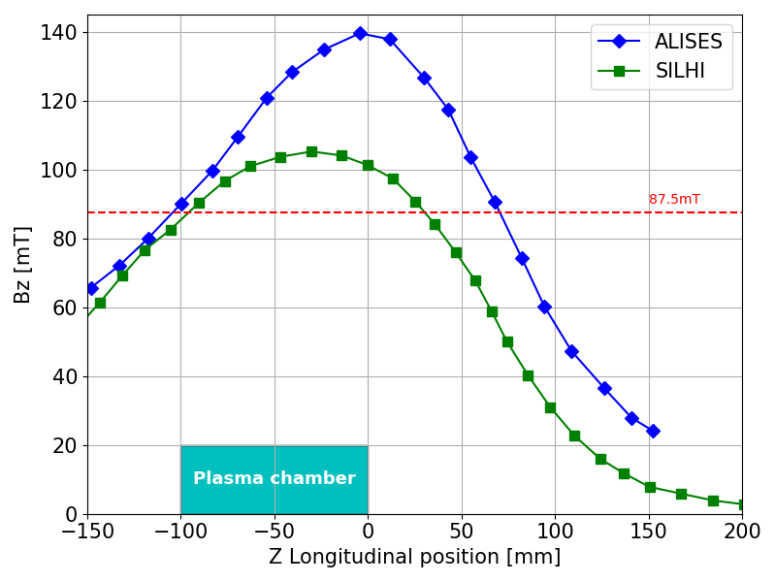
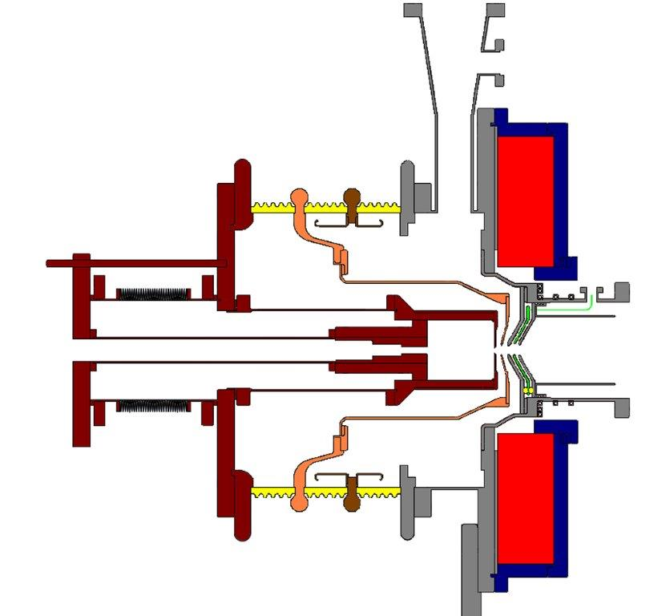
Proof of Concept - Idea n°1
A compact extraction system
The ALISES concept : Reversed structure
► Put the insulating structure before beam extraction
► ECR resonance obtained with fringe field of a solenoid at ground potential at the beginning of LEBT
► Extraction system is simplified, except for the puller
SILHI
Z₀
20 cm
Reduction
ALISES v1
Z₀

Slide 9
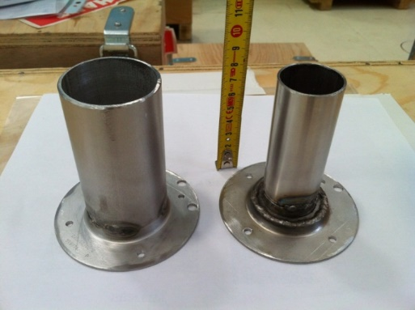
Proof of Concept - Idea n°2
A smaller & cheaper Ion Source
Injection side can be shifted to modify plasma chamber length
RF Injection study
Installation of a tube to modify the internal diameter of plasma chamber
Adjustable gaps

Slide 10
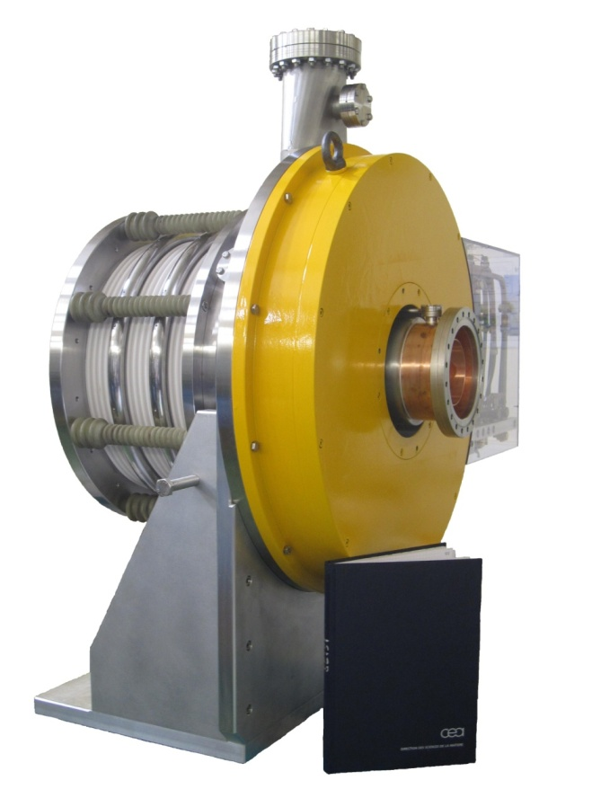
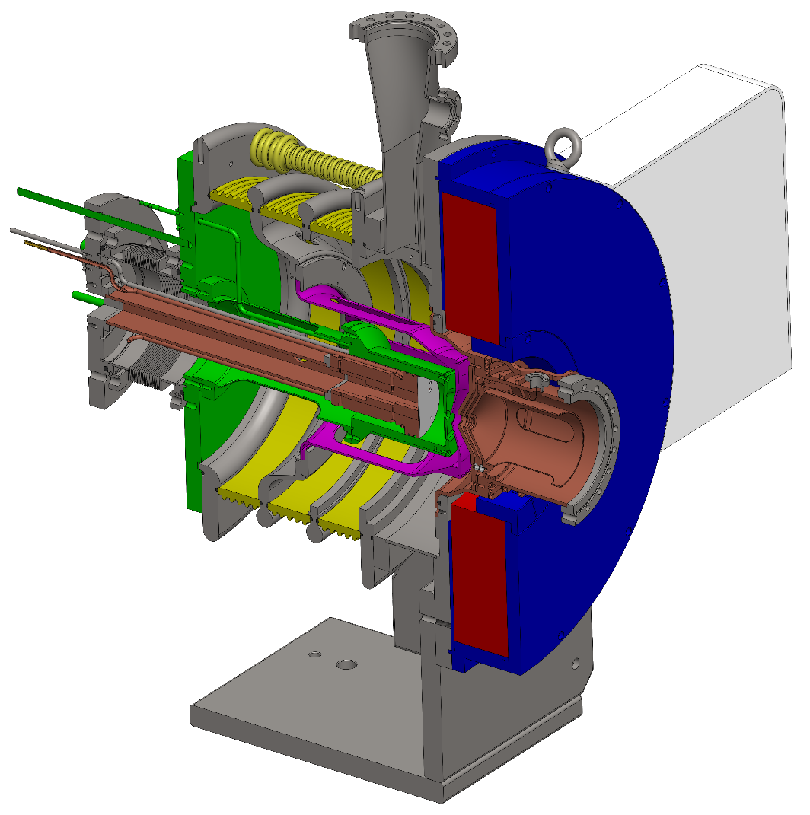
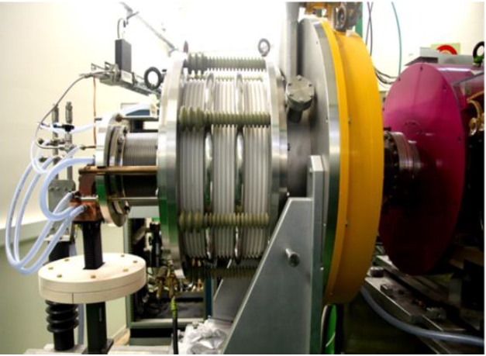
ALISES v1: built with SILHI’ spare parts
Patent FR 2969371 -2010
ALISES
is not really small
Commissioning started
on BETSI in 2012
Notes:
On BETSI, we had only a 50kV high voltage power supply and for a start we were really confident that is will be high enough.
So at first we tested the ECR process, without high voltage: as the magnetron was turned on the pink color of the plasma was visible : proving that Hydrogen was ionized with 500 watt of µwave and a reasonable Hydrogen flux.
As the high voltage and the magnetic field was set simultaneously on, the power supply voltage dropped down with a maximum current flow. This behavior was systematic and occurs even without sparks. We suggested that it could be a Penning discharge occurring inside the accelerating column.

Slide 11
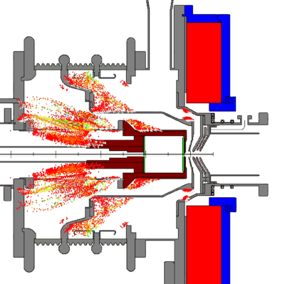
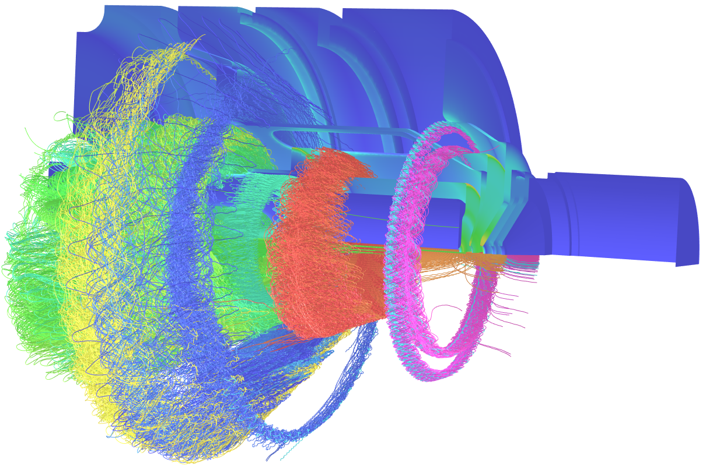


PENNING DISCHARGES 1/3
ExB = shutdown of High Voltage Power Supplies
Areas where B and E field are not collinear :
► Electrons are accelerated and trapped
► Hit on biased electrodes leading to the shutdown of source HV PS
PHD Thesis : S. Nyckees
OPERA Code simulation

Slide 12
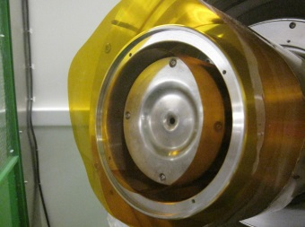
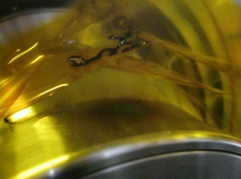

PENNING DISCHARGES 2/3
Simulations Validation with Experiment
Experimental measurements
Simulation validation

Slide 13
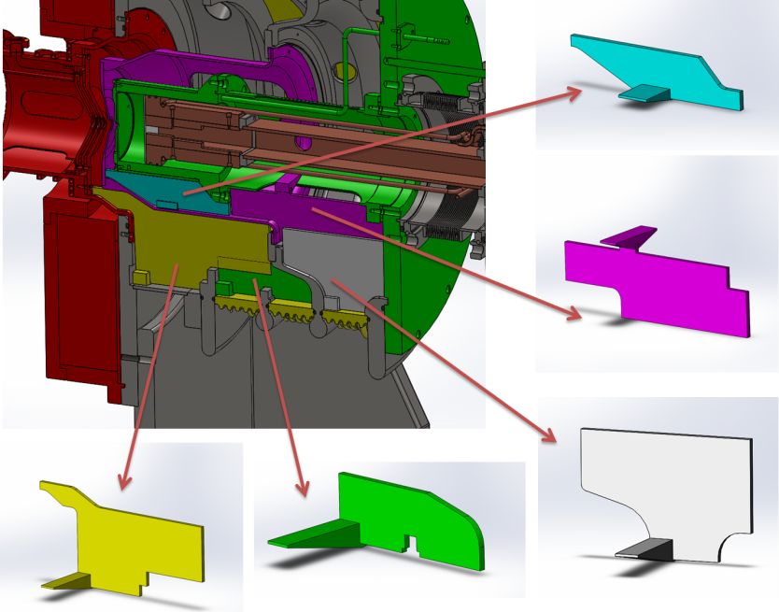
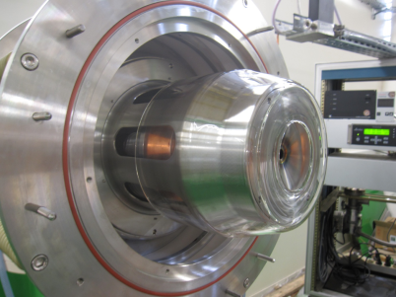
PENNING DISCHARGES 3/3
How to get rid of them !
Fill up the empty spaces under vacuum
► With 5 ceramic parts in the insulating structure
► With glass tube around electrode gaps
Biased up to 23 kV
► 2 months of tests
► Plasma chamber parameters modifications

Slide 14
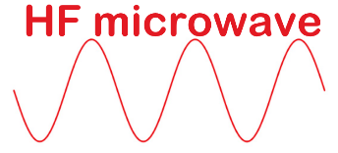
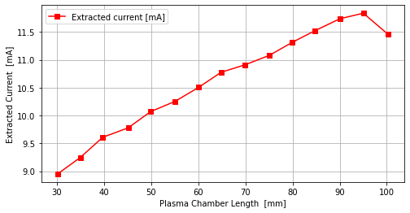
Plasma chamber length
“Reductio ad Absurdum”
Pressure = 10⁻³mbar
H⁺
neutralized
lost
No particles
extracted
Infinite length
Tiny volume : few H₂ molecules for H⁺ creation
Few or no
particles extracted
First measurements:
@17 kV in pulsed mode
Maximum extracted current for L = 95 mm
There must be an optimum somewhere between infinite and short plasma chamber length !
Notes:
I need your help ti imagine an very long plasma chamber…

Slide 15
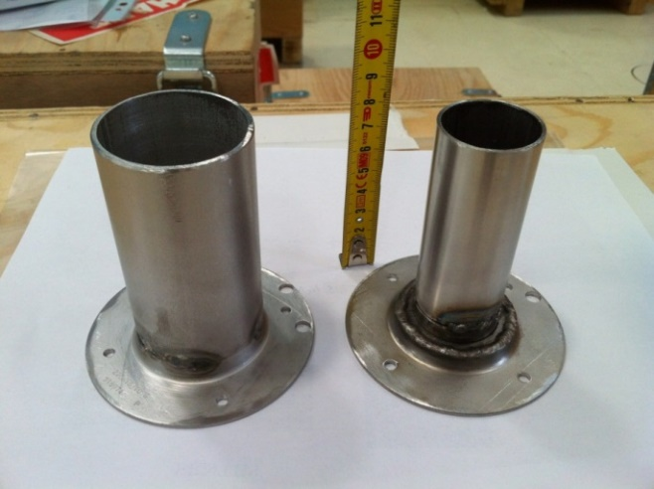
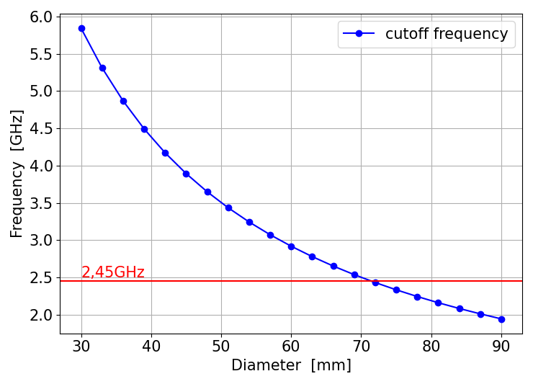
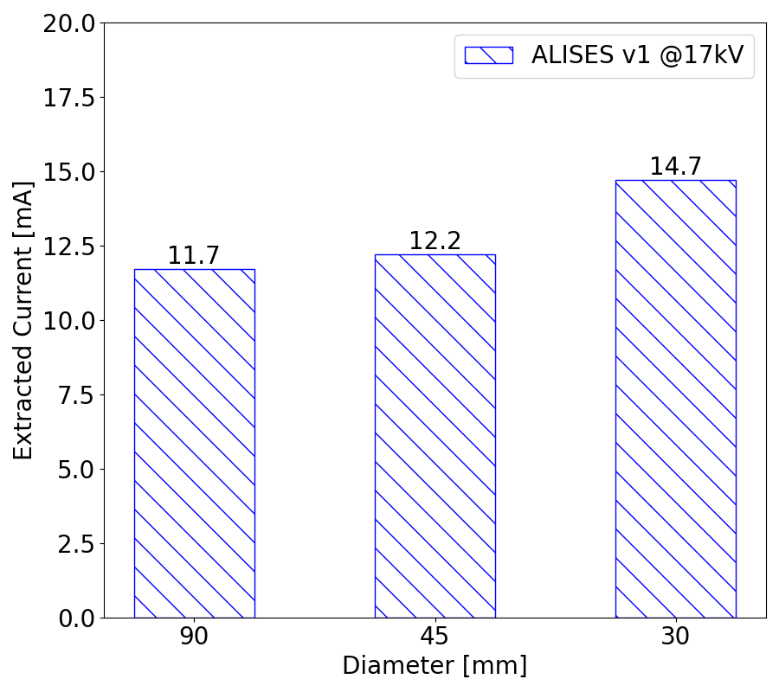
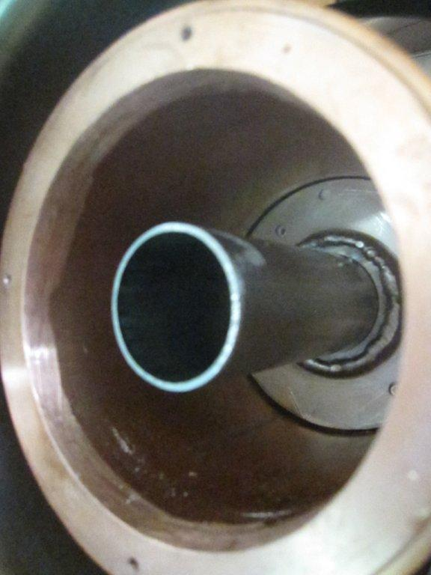

Plasma Chamber Diameter
Ion Source operating only in Pulsed mode
Plasma Chamber ∅ 95 mm
$$f_{c,vn}=\frac{c}{2π}\frac{p_{vn}^{′}}{a}$$
45 mm and 30 mm
Magnetron @2.45 GHz
► TE10 mode rectangular
► TE11 mode in cylindrical
Plasma chamber :
► ∅_{plasma}> 71 mm
Plasma ignition as long as resonant zone is near cavity entrance
EVANESCENT WAVE ?

Slide 16
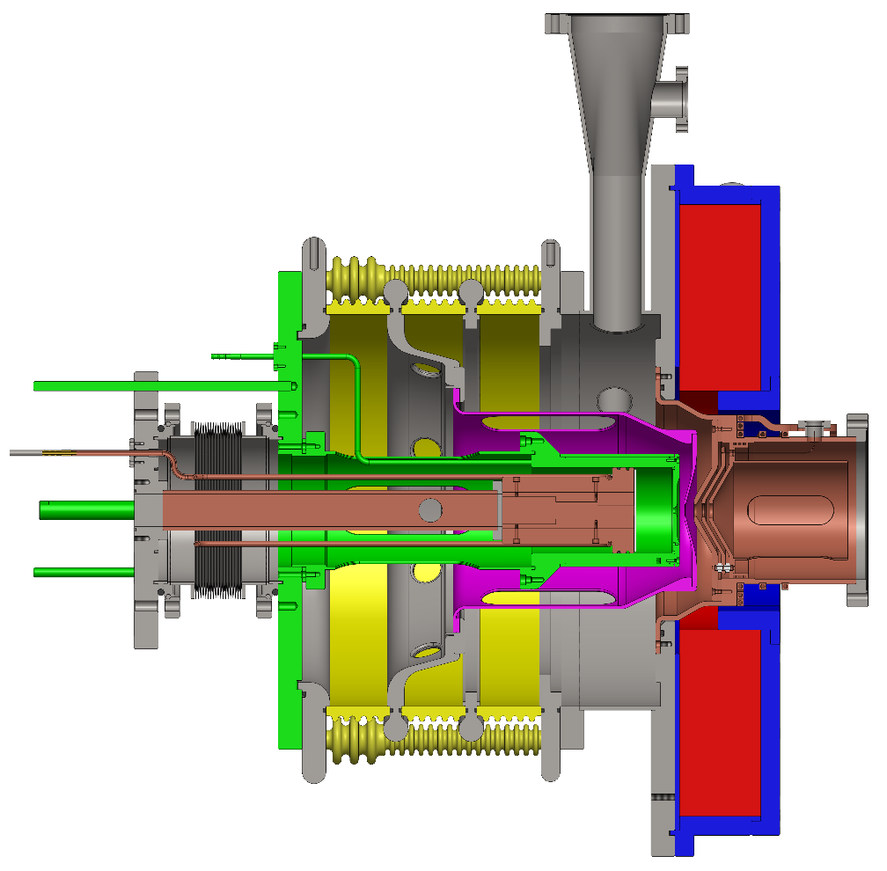
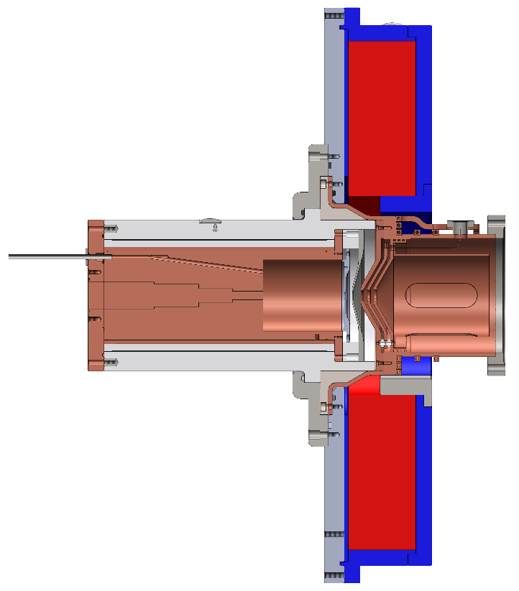
Towards ALISES v2
ALISES v1
ALISES v2
ALISES family roadmap :
LEBT Reduction
Compactness
Easy Maintenance
SILHI performances
From three to only one smaller insulating structure
Insulator in contact with plasma chamber and wave guide (source body)
Keep the ALISES 1 coil

Slide 17
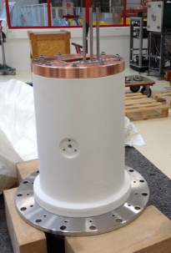
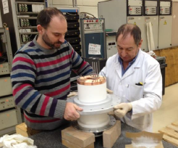
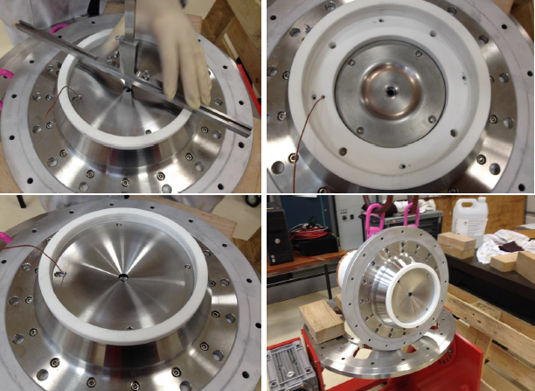
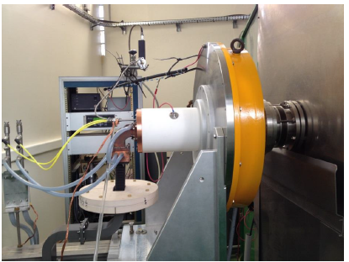
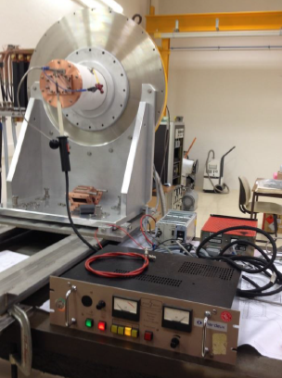
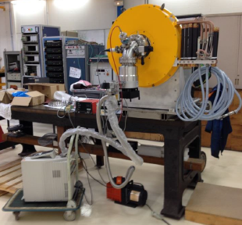
ALISES v2 : Assembly and tests in 2015
Assembly
Alignment & cabling
Installed on BETSI
HV tests
Leak Tests

Slide 18
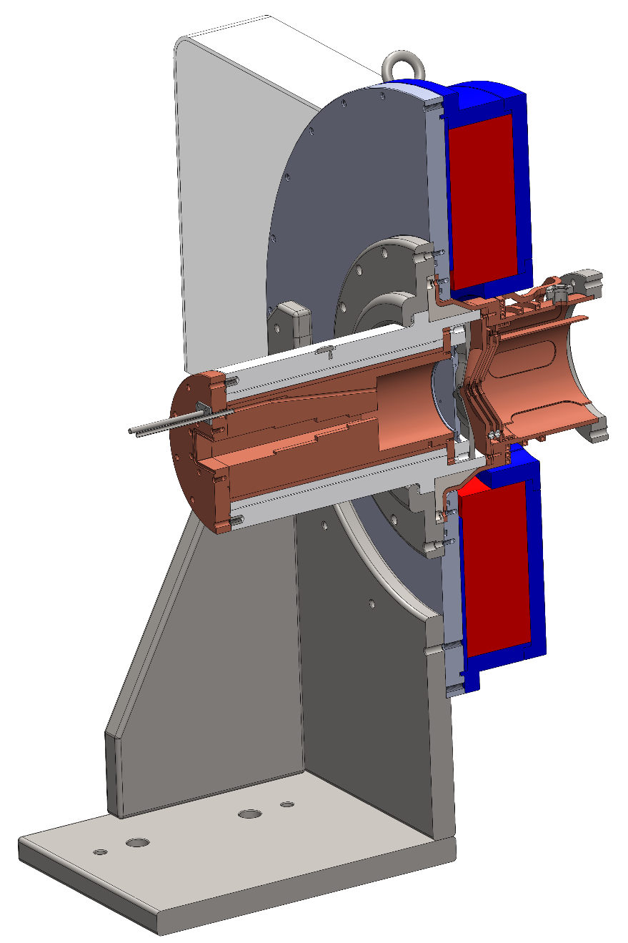
ALISES v2 : First beam in 2015
Standard plasma chamber length : 100 mm
Standard plasma chamber diameter : ∅ 90 mm
Extraction aperture : ∅ 6 mm
Electrical insulator in ceramic : ∅ 200 mm
Usual settings for the 87.5 mT at plasma chamber entrance
► I_{coils} = 181 A
Patent FR 1556871 -2015
No sparks & no Penning discharges !!
Pulsed beam 50% duty cycle @1Hz
Total extracted current = 18mA @35kV

Slide 19
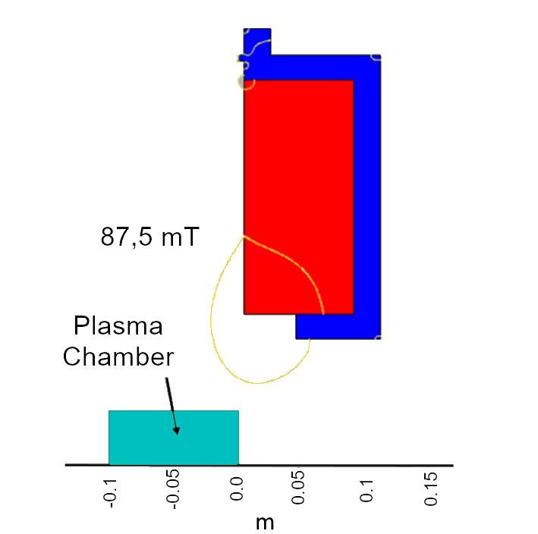
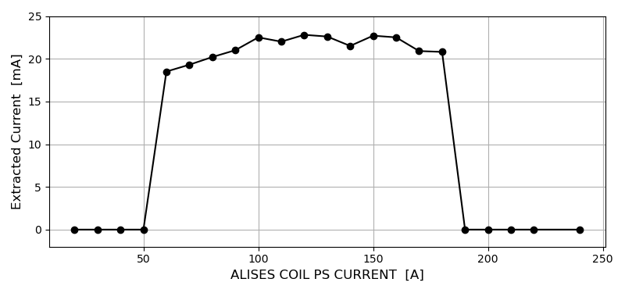
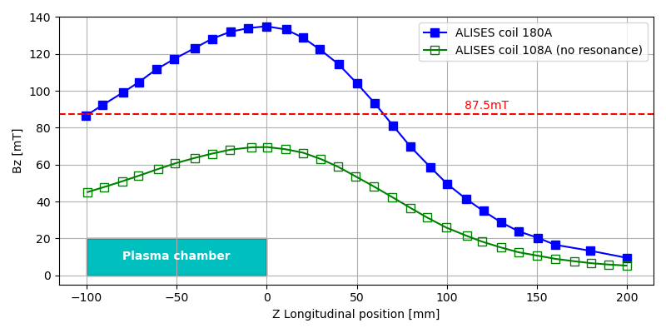
ALISES v2 : while optimization, unexpected…
I_{ALISES COIL}= 108 A
181A
108A
BEST RESULT:
PHF = 980 W, H₂ gaz injection = 1.65 sccm
35 mA @ 50 kV, Puller = 22 kV, CW mode
Is It still an ECR Heating?

Slide 20
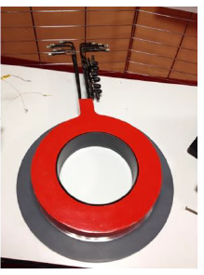
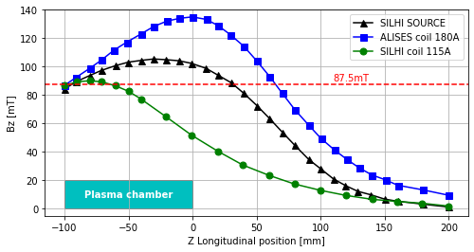
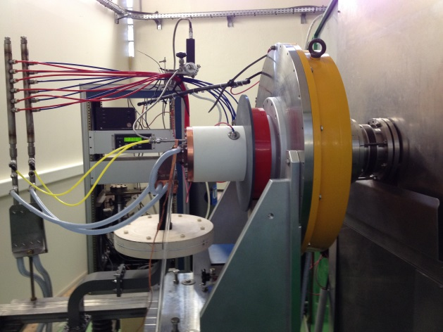
ALISES v2
Investigation On Magnetic Field Profile
SILHI-type coil
Magnetic configuration optimization
3 possible working modes :
► Initial ALISES source coil only : I_{coil} = 181 A
► SILHI-type coil only : I_{coil} = 115 A
► Tuning with both SILHI-type and ALISES source coils

Slide 21
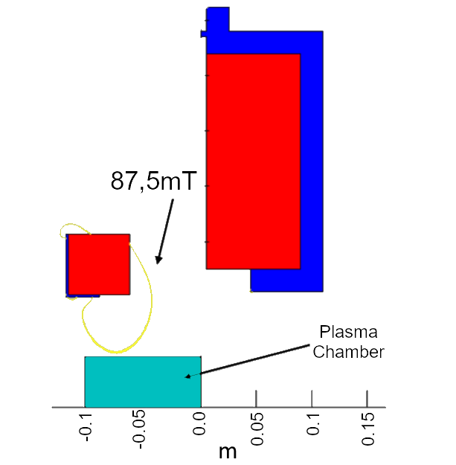
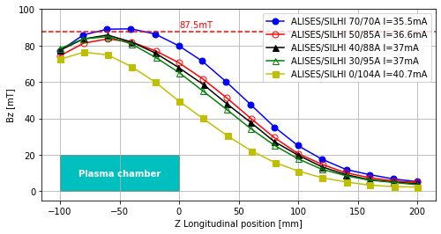
Using SILHI type + ALISES type Coils
Pulsed Mode
I_{SILHI COIL}= 104 A
BEST RESULT : P_{HF} = 700 W, @50 kV
Pulsed H₂ gas injection = 1.95 sccm I_{ext} = 40.7 mA
CW mode H₂ gas injection = 2.10 sccm I_{ext} = 48.5 mA
LEBT BEAM DUMP in CW ► I_{beam dump} = 26 mA

Slide 22
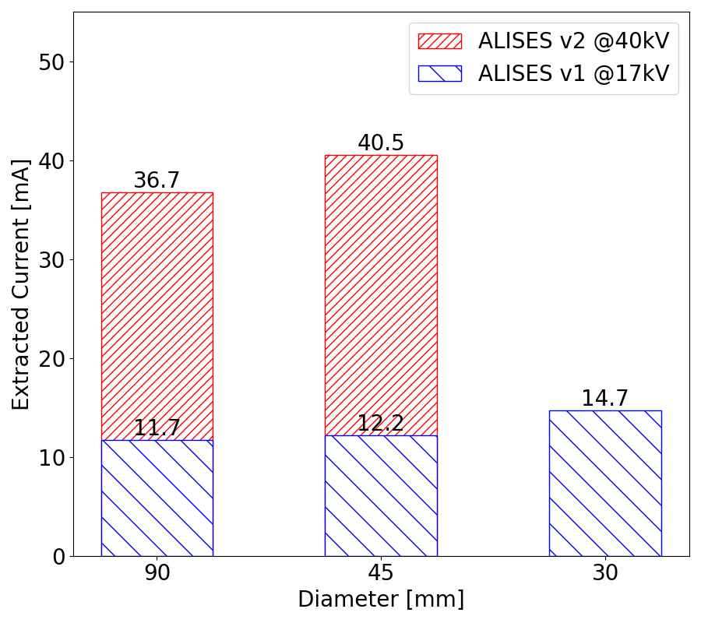
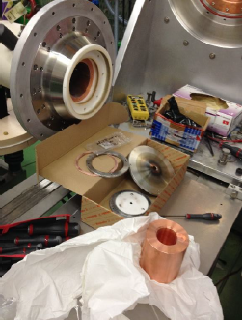


ALISES v2
Plasma Chamber Radial Reduction
Plasma chamber reduction still works!

Slide 23


ALISES v2 for other Projects
4D Emittance-meter R&D
Irradiation tests of scintillators
SPIRAL2 Project
Thermal stress of new beam stop prototype for S³ spectrometer experiment
FAIR Project
EMU Debugging
Emittance measurements with a new Allison scanner for FAIR proton linac injector
Hydrogen beam 35 mA @40 kV extracted from ALISES, 17 mA H⁺ at the end of BETSI LEBT on beam stop prototype for S³

Slide 24

Towards ALISES v3
ALISES v2
ALISES v3
ALISES family roadmap :
LEBT Reduction
Compactness
Easy Maintenance
SILHI performances
Extraction system simplified
Plasma chamber diameter reduced
Insulator diameter reduced
One Silhi-type Coil

Slide 25




ALISES v3
P.25
TROPICS
Compact Ion Source :
► Internal diameter : Ø45 mm
► Aperture hole : Ø6 mm
► Electrical insulator in Ceramic : Ø175 mm
► No platform, the ion source is plugged directly onto the beam line
Tested on the TROPICS test bench in sept-2019
(Test, Research and Optimization for Production of Ions with Compact Sources)
---
Installed on BETSI in 2020
BETSI

Slide 26

ALISES v3, Long runs for stability in 2022
Source in pulsed mode, current on beam dump :
► 140 hours (6 days) ~25 mA @ 37 kV
► 85 hours (3,5 days) ~21 mA @ 40 kV

Slide 27


ALISES v3, Emittance measurements campaign in 2022
P.27
Constant settings :
► Gas : 1,3 sccm
► Frequency : 10 Hz – 10 ms
► HF Power : 600 W

Slide 28

ALISES v3, toward 100 kV
Initial design adapted for 50 kV :
GAP #1 Plasma ► Puller 20 kV
GAP #2 Puller ► Ground 30 kV
Bias voltage increased slowly to 95 kV :
GAP #1 Plasma ► Puller 30 kV
GAP #2 Puller ► Ground 65 kV
Initial Design
But for higher extraction voltage, ceramic length between electrode under vacuum were not adapted at all.
➔ “carbonized” path inside the ceramic in GAP #2
Ceramic Second Design (2022) :
was made to increase the path length on ceramic surface between electrodes
Second Design
BEST RESULT in early 2023 : P_{HF} = 800 W
Pulsed 40% – 41 mA @ 70 kV
CW – 50 mA @ 76 kV
Poster session : DUBOIS Augustin, n°71

Slide 29
ALISES family objectives
P.29
ALISES v3
Next Compact Design
► Gas injection system simplified
► Different materials for
plasma chamber & ceramics
► Plasma chamber diameter at 80 mm
ALISES family roadmap :
LEBT Reduction
Compactness
Easy Maintenance
SILHI performances

Slide 30


SUMMARY
ALISES SOURCES at SACLAY
P.30
95 kV CW mode
Ø9 – 130 mA
Ø6 – 60 mA
Ø6
Pulsed – 21 mA@ 23 kV
Ø6
Pulsed – 40.7 mA @ 50 kV
CW – 48.5 mA @ 50 kV
Ø6
Pulsed – 41 mA @ 70 kV
CW – 50 mA @ 76 kV
1995
v1-2012
v2-2015
v3-2018
First plasma Nov. 2018 on TROPICS
Installation 2020 on BETSI
ALISES v1
► LEBT reduction
► Penning discharges
► Plasma Chamber size reduction tests
ALISES v2 et v2 mod
► Electrical insulator in single ceramic
► Plasma Chamber size reduction validation
► Some unexplained results
ALISES v3
► Compact source
► Long runs and Beam qualification with EMU up to 65 kV
►Second design of insulator to reach 100 kV
We are really close to SILHI performances
Work in Progress!

Slide 31
Thank you for your attention
Olivier TUSKE – olivier.tuske@cea.fr
Université Paris-Saclay – CEA – Irfu

