Slide 1
Using machine learning algorithms for ECR tuning and physics studies
Damon Todd
Yubin Hu, Alex Kireef, Wenhan Sun, Marco Salathe,
Janilee Benitez, Heather Crawford, Victor Watson, Larry Phair
Lawrence Berkeley National Laboratory
September 22, 2023

Slide 2
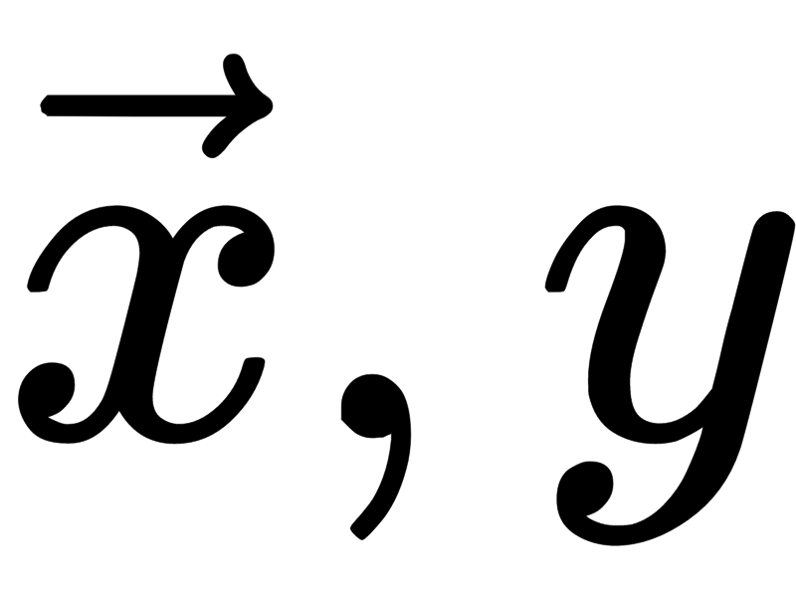
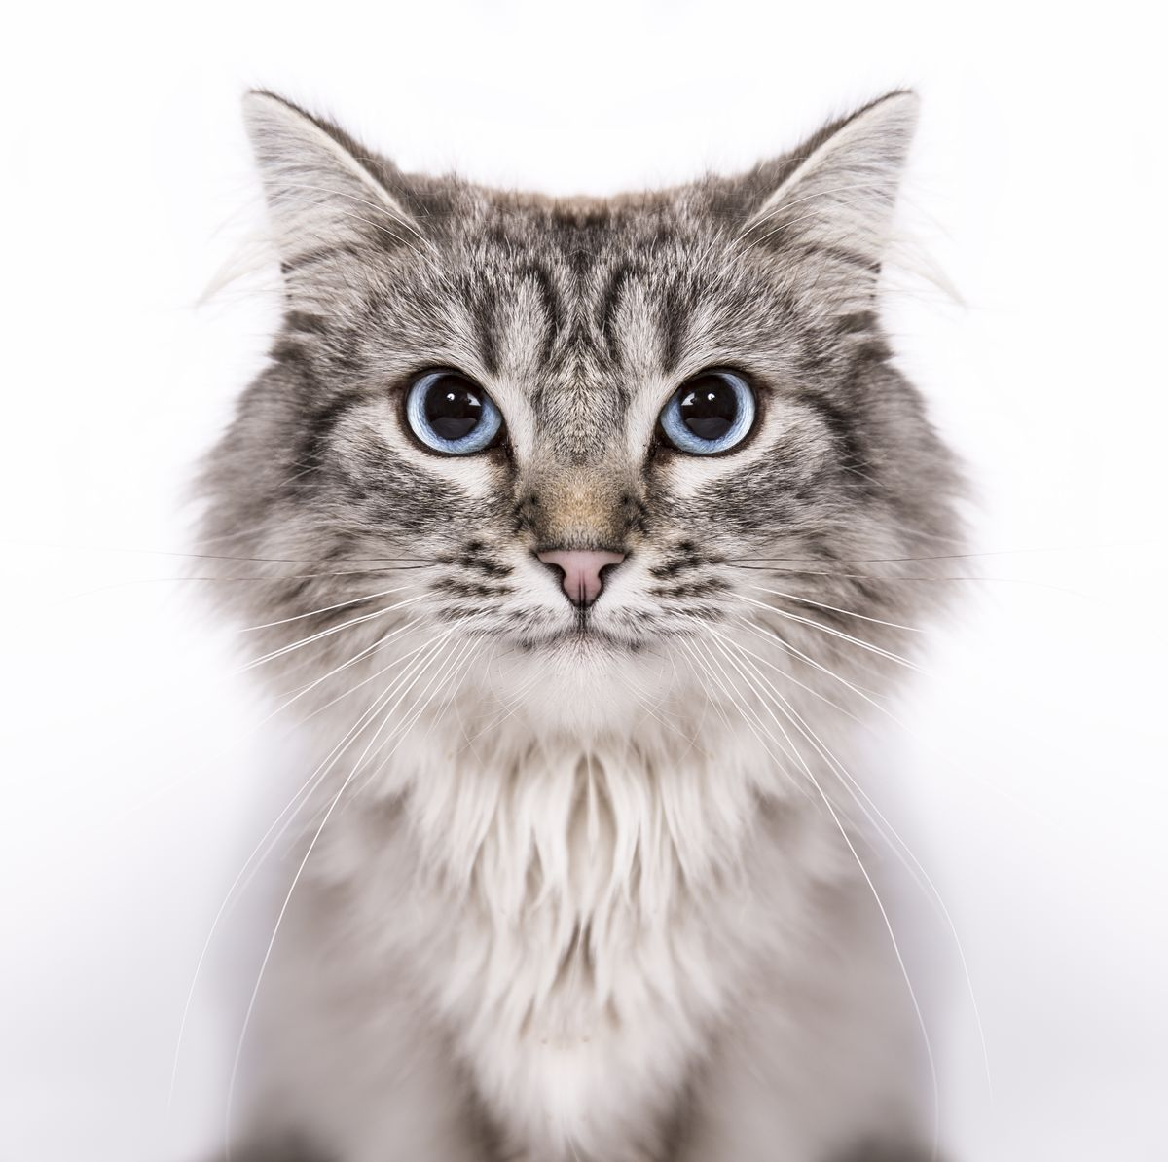
What we mean by machine learning (here, at least)
A data point: feature vector and a label (e.g. x=jpg, y=”cat”)
cat
cow
Data set: collection of feature vectors and labels
cow
cat
Goal:
Have computer learn from the data set so it can predict the label for a new vector
???

Slide 3
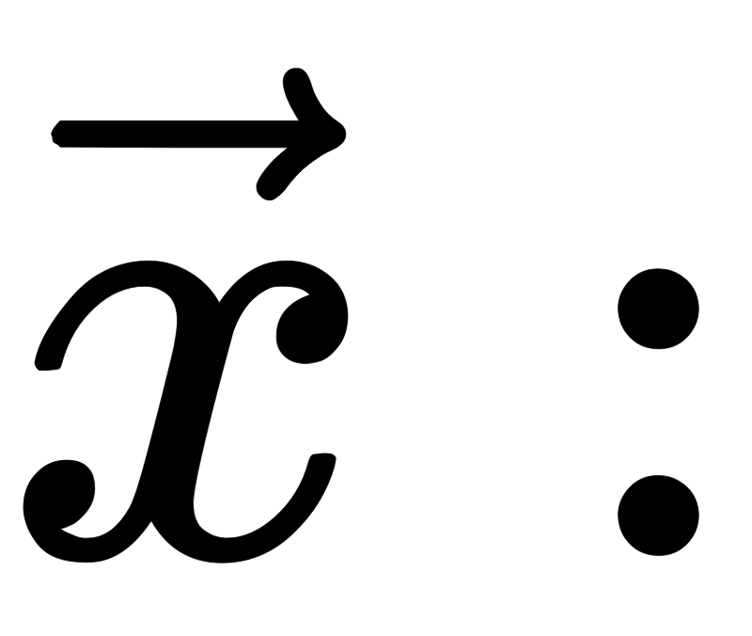
Using machine learning with electron cyclotron resonance (ECR) ion sources
Possible elements:
Set parameters (magnetic fields, biased disk voltage, RF power, etc.
Measured quantities (biased disk current, x-ray flux, drain current, etc.)
A measured parameter (e.g., ion species current, emittance, etc.)
Machine learning:
Measure many vector/label pairs then predict a continuous variable label
Possible goals:
Maximize beam current
Minimize emittance
Maintain stability
Understand source physics???

Slide 4
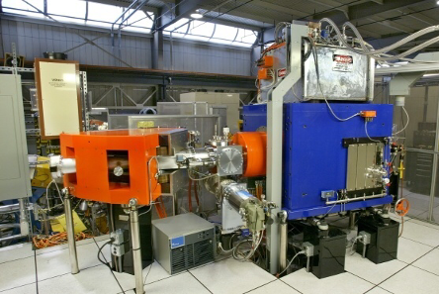
Our test bed: VENUS
VENUS:
World’s first fully-superconducting ECR ion source designed for 28 GHz operation
Injector for LBNL’s 88” Cyclotron
Prototype ECR for FRIB
RF: 28+18 GHz (up to 10+2 kW)
Maximum axial fields: 4 T
VENUS
LBNL
Example beams:
> 4.7 mA O⁶⁺, > 20 mA He⁺ from source
> 2 pμA, 5 MeV/u ⁴⁸Ca¹¹⁺ from Cyclotron for superheavy element research
¹⁹⁷Au⁶¹⁺ extracted from cyclotron

Slide 5
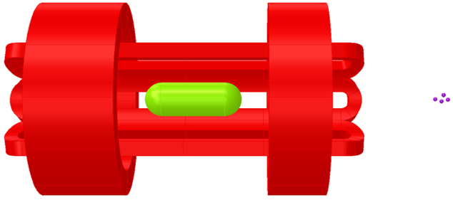
VENUS primary control and diagnostic parameters
material:
gases, ovens, sputtering
ion beam
plasma
RF:
18 and 28 GHz
sextupole
biased disk
(not shown)
injection coil
middle coil (not shown)
extraction coil
Diagnostics:
Faraday cup/analyzing magnet
Emittance scanner
Drain, bias currents
Cryostat x-ray load
Etc.

Slide 6
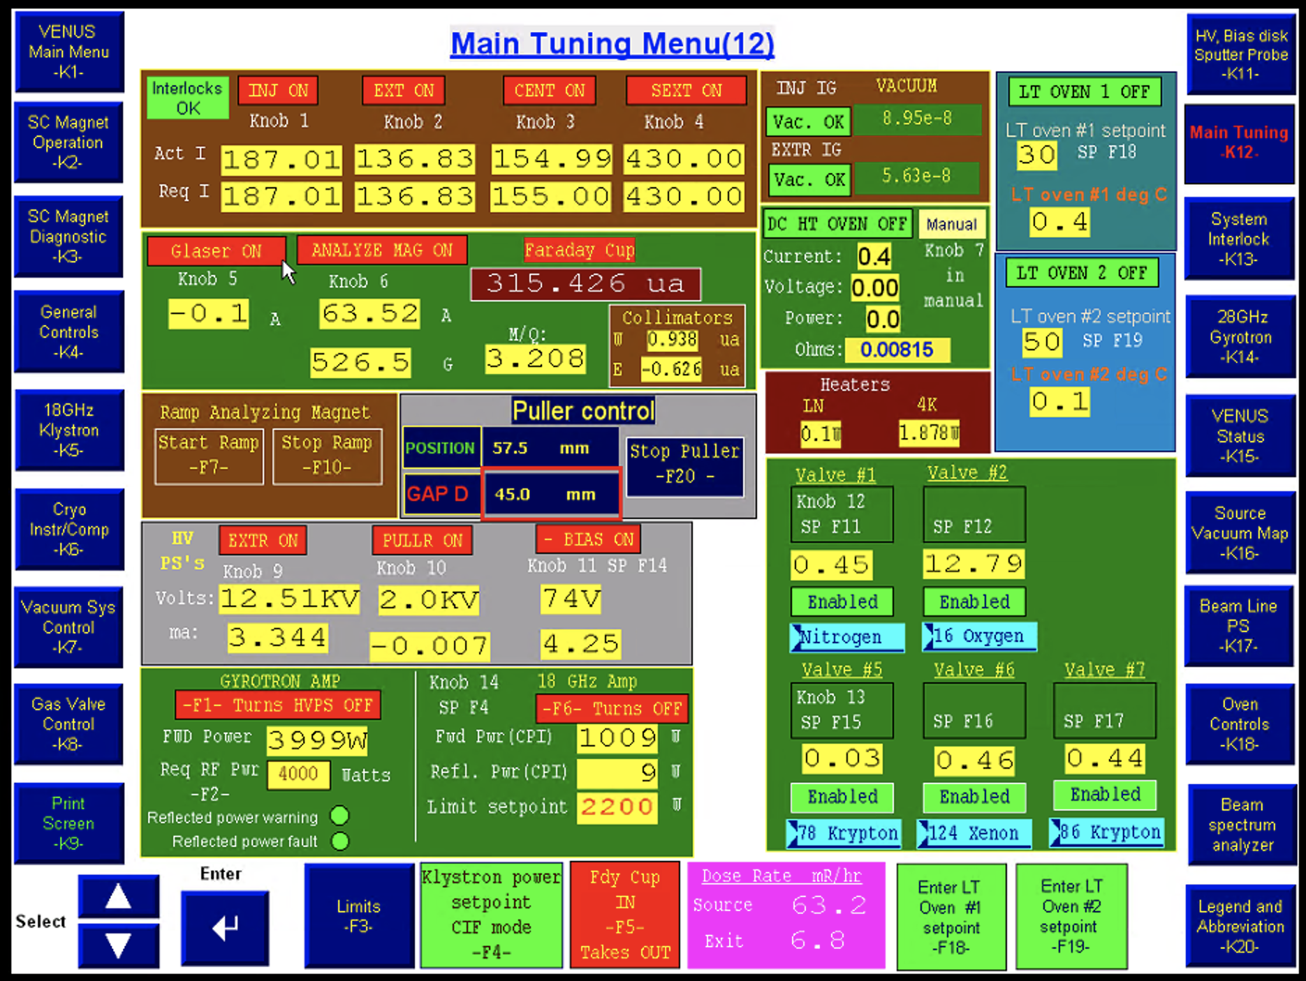
VENUS operation and data collection
Controls
Operator
Diagnostics
Panelview + PLC
(Programmable Logic Controller)
VENUS
Advantage: Exploit 2 decades of safely logic in PLC
Disadvantage: Slow ~3 Hz communication
Computer control through PLC:

Slide 7
What we have done
Collected over 1.5 years of all VENUS control and primary diagnostic data
Performed thousands of hours of computer-only control and optimization of VENUS without human interaction
This work is supported by the U.S. Department of Energy, Office of Science, Nuclear Physics program under Award Number DE-FOA-0002490.

Slide 8
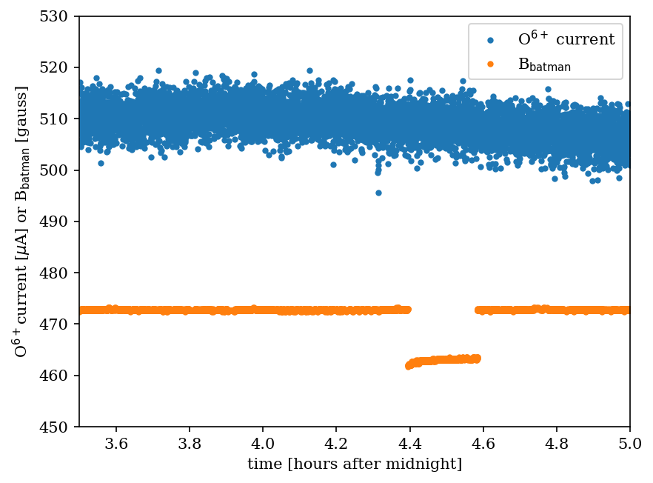
VENUS logging
Analyzing dipole field measurement dropped every ~13.5 hours for ~6 minutes with no beam effect
Incorrect calculated M/Q seen occasionally by cyclotron operators, but not discussed
Solution:
Incorrect ground for liquid nitrogen (LN) system affects hall probe during LN fills
Note:
This isn’t machine learning, but we are currently using the monitoring of VENUS for neural network training

Slide 9
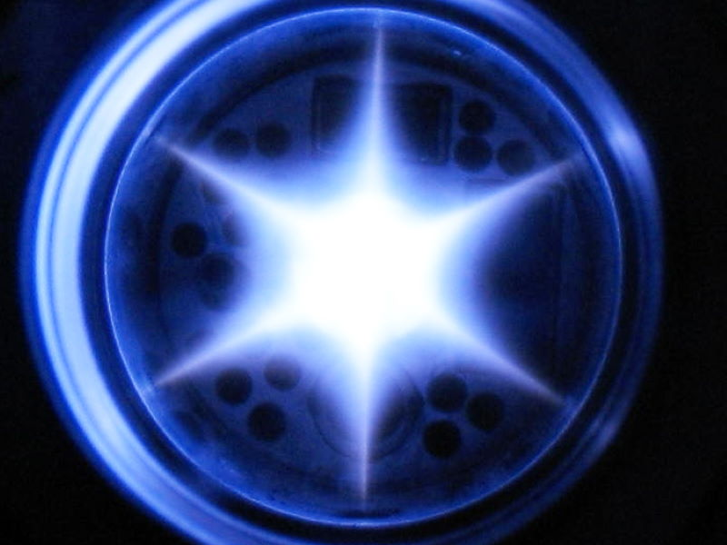
Computer-driven operation: baking
Blessing/curse of ECRIS: ion beams produced from any materials reaching plasma that don’t destroy the plasma
Adsorbed particles later desorbed:
Residues from previous work or handling of inner surfaces
Water, salts, etc. on all surfaces after atmosphere exposure
Prior beam materials (e.g., metals)
Plasma chamber desorption can be sped up using plasma as heating element
Acknowledgement...

Slide 10
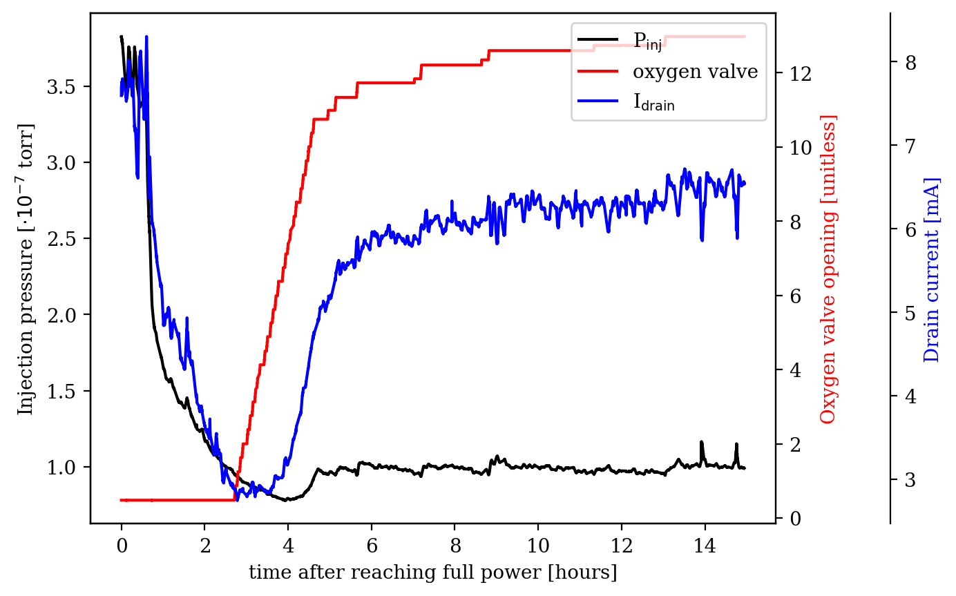
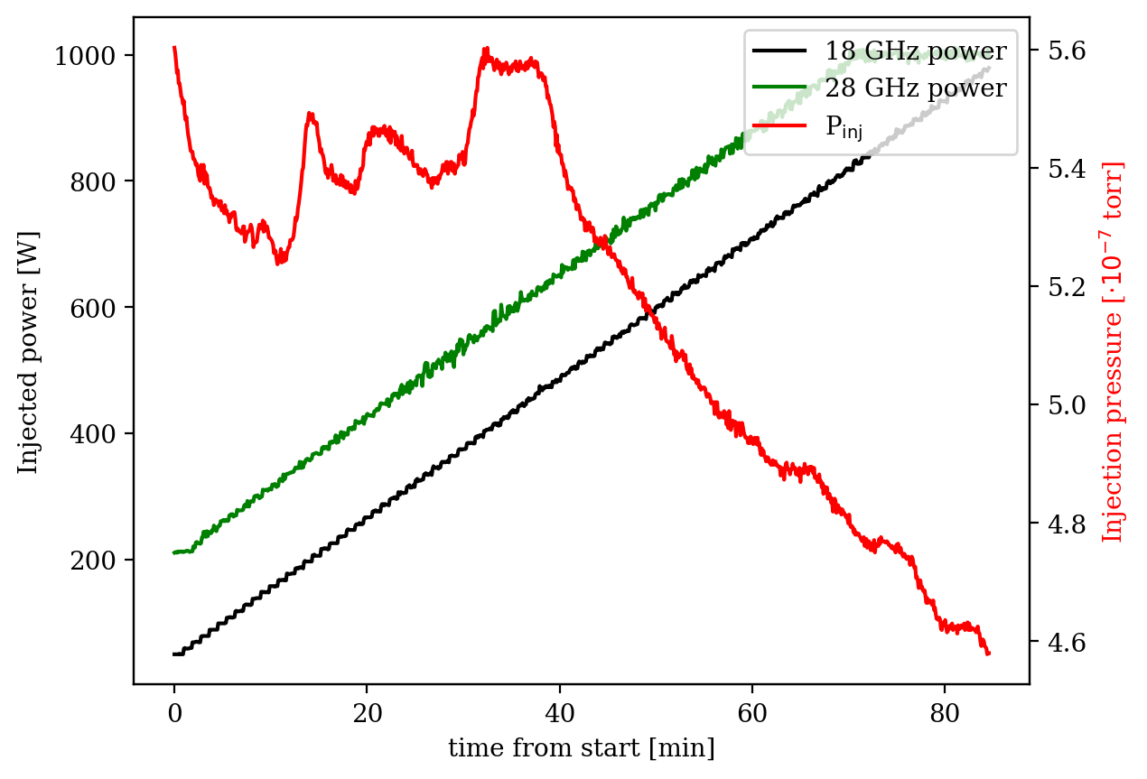
Computer-driven baking
Two-step process:
Source to full RF power
Monitor pressure, currents, etc. and raise safely
Time significantly reduced as the computer is persistent
“Slosh” plasma around to bake plasma chamber
Change confining fields and add gas when desorption rate drops
Every 6th change return to “base” fields and perform charge state distribution to monitor evolution

Slide 11
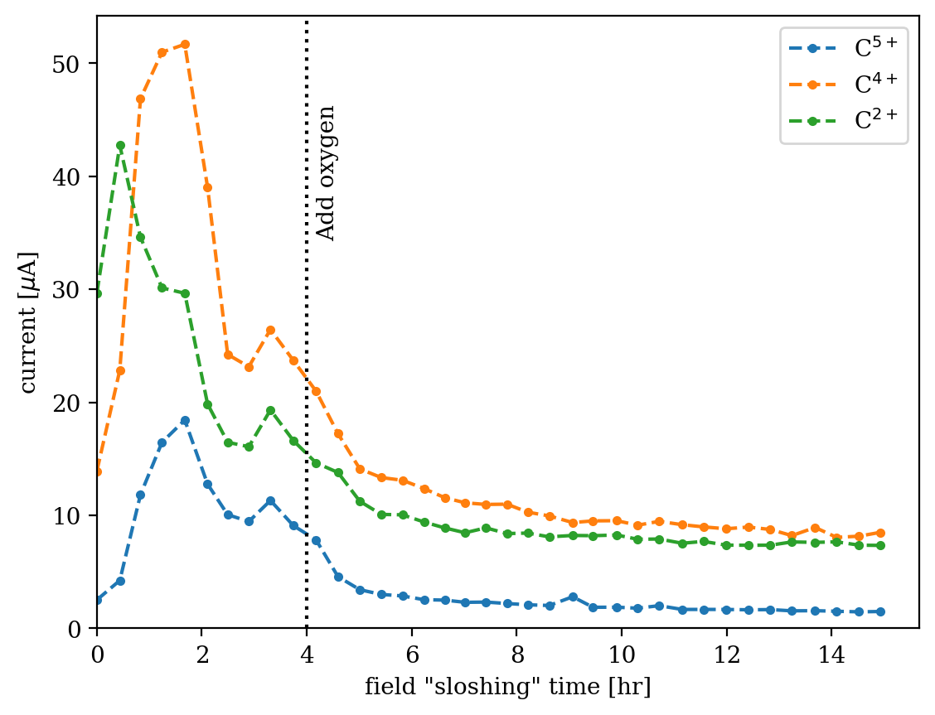
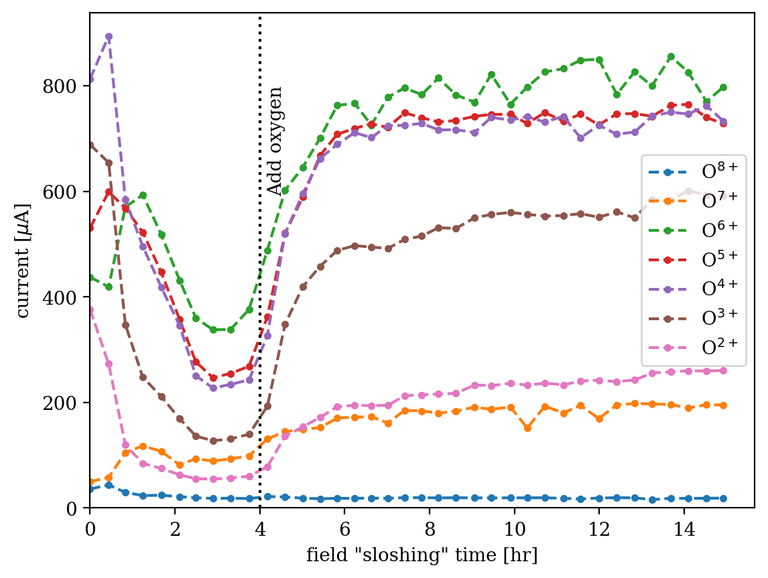
Charge state distributions (CSDs) give feedback on progress
Carbon
Oxygen
Last ~6 bakes have been fully automatic
Not machine learning, but data will be used to produce more efficient baking technique (ML!)

Slide 12
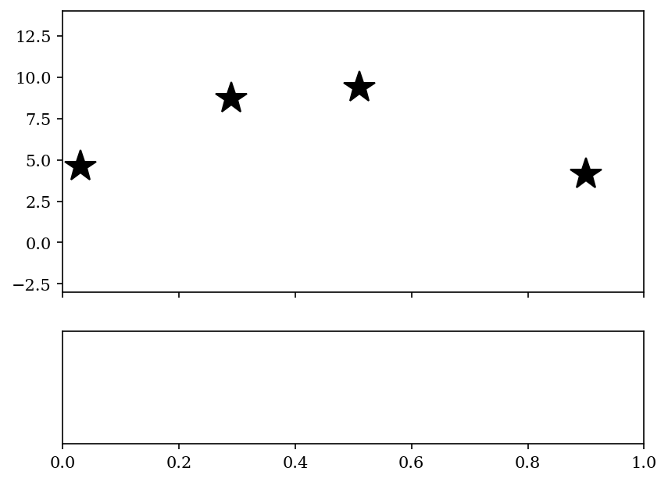
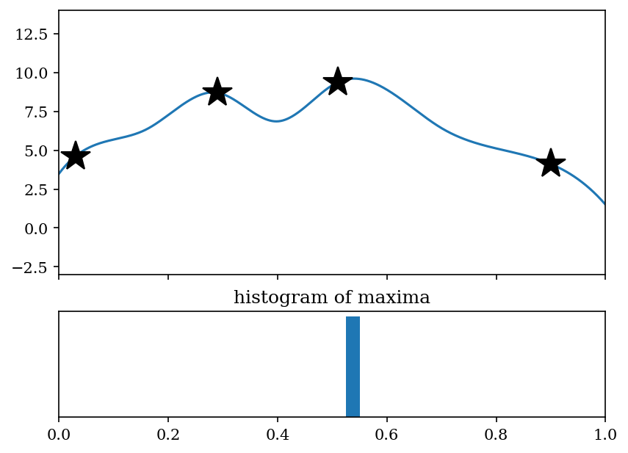
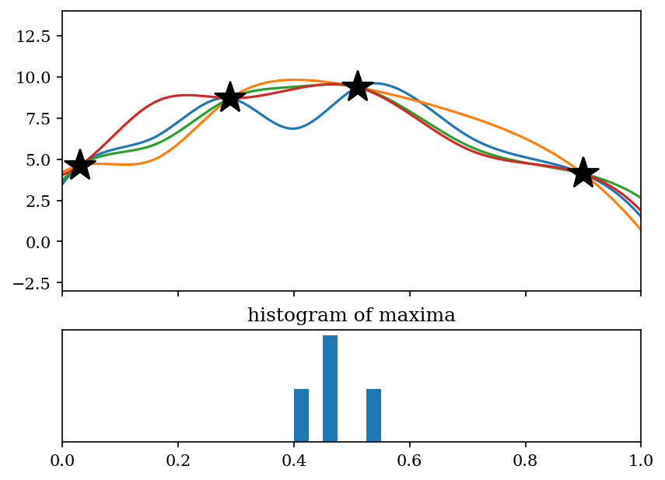
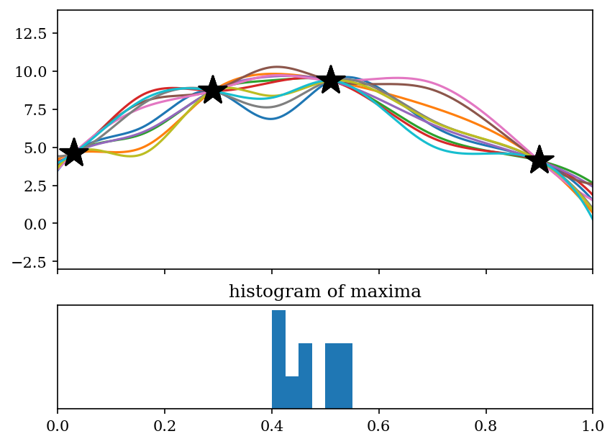
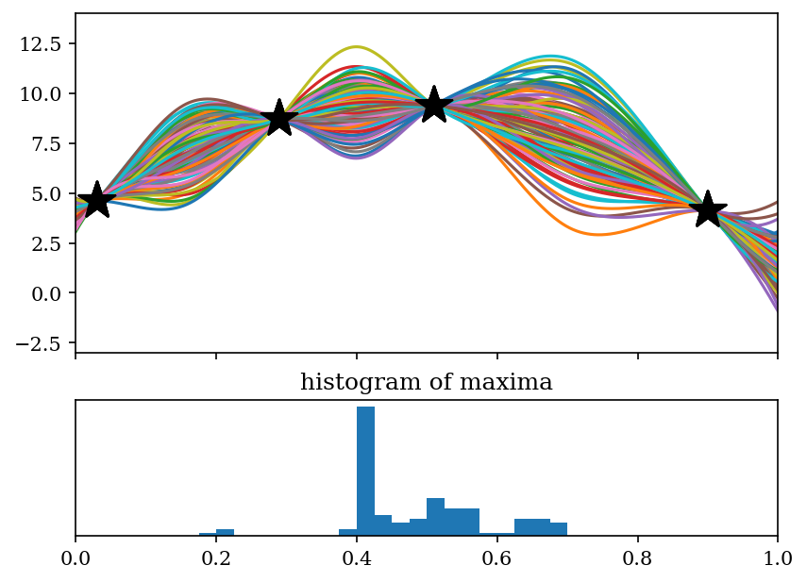
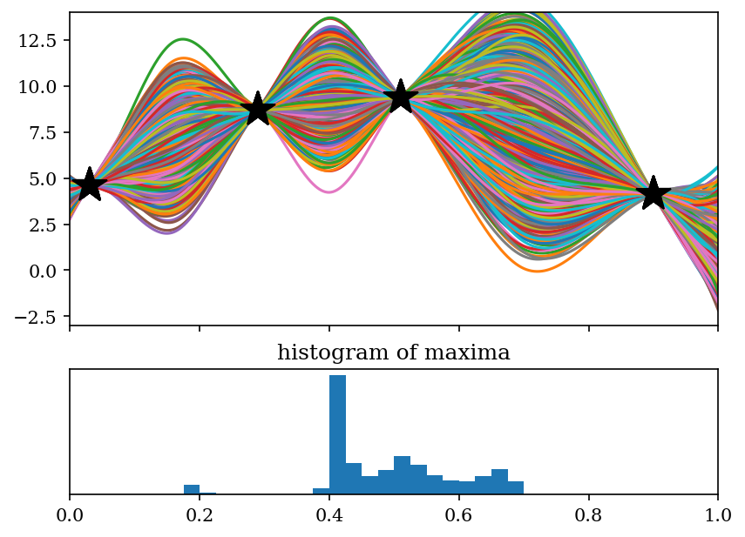
Problem: find extremum of an unknown function when measurements are expensive
Ten curves
One hundred curves
Four curves
Lots of curves
Find maximum of unknown function:
Measurements are expensive (time, $, etc.)
Four points have been measured
Where to search next?
Method:
Fit curve between points
Find maximum
Repeat

Slide 13
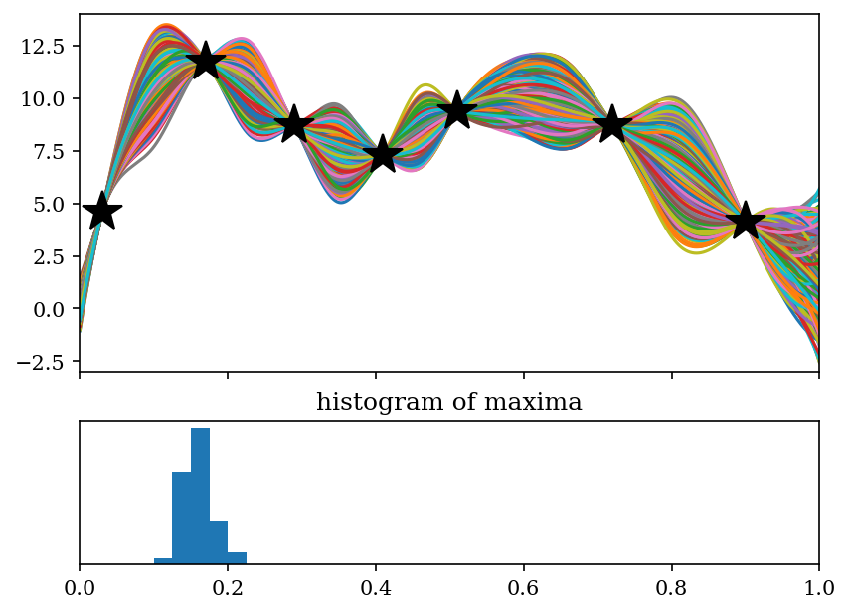
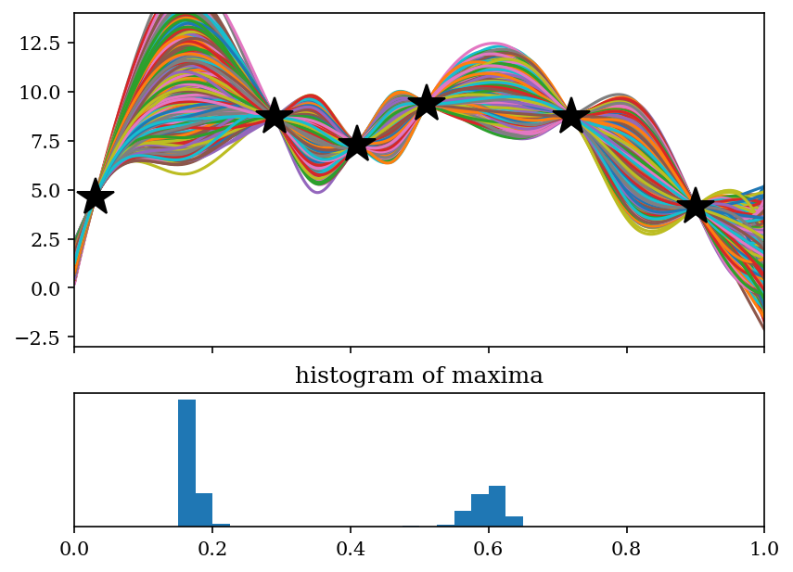
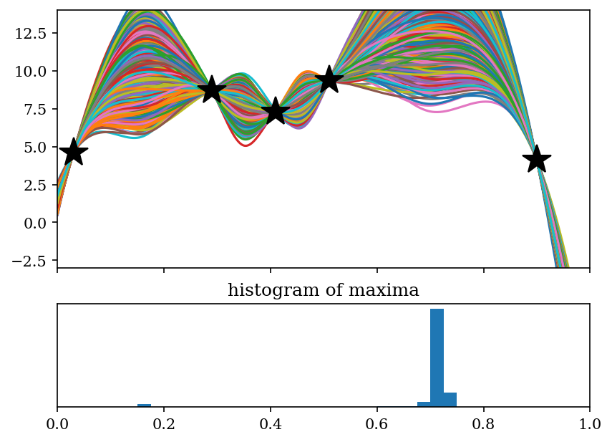
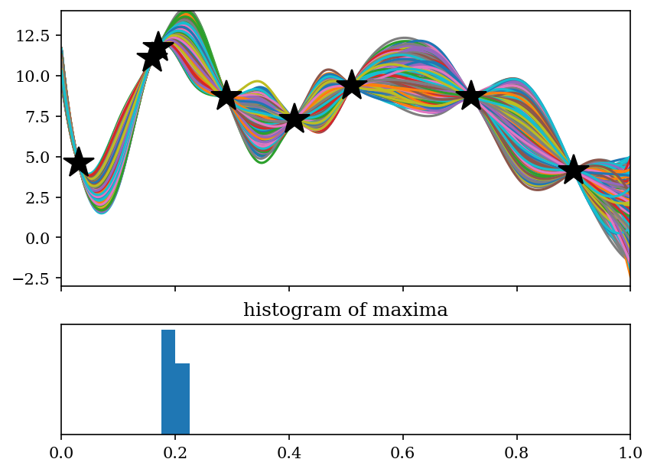
Bayesian optimization basically follows a path like this
Notes:
Next search point has highest probability of improvement though other points may have curves with higher extrema
Path to maximum isn’t always smooth

Slide 14
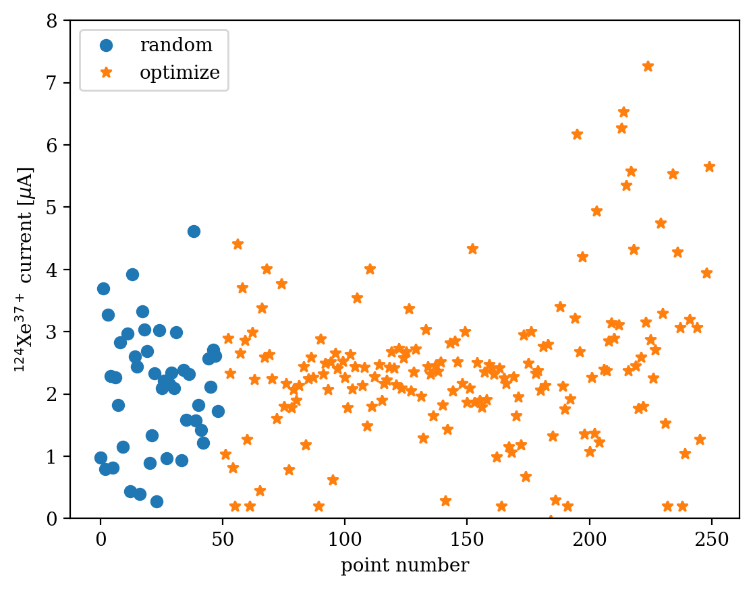
Full Bayesian Optimization of ¹²⁴Xe³⁷⁺
Records:
VENUS: ~40 μA
SECRAL II: ~50 μA
(fields and power much more conservative than LBL records)
Parameter | Min | Max
Bias voltage [V] | 40 | 105
Oxygen valve | 11.6 | 12.5
Xenon valve | 8.0 | 13.0
Inj coil [A] | 185.6 | 186.0
Ext coil [A] | 136.6 | 136.8
Mid coil [A] | 152.0 | 152.3
Sext coil [A] | 430.3 | 430.5
18 GHz [kW] | 1.4 | 1.8
28 GHz [kW] | 5.2 | 6.0
This is machine learning!
(~5 min/point)

Slide 15
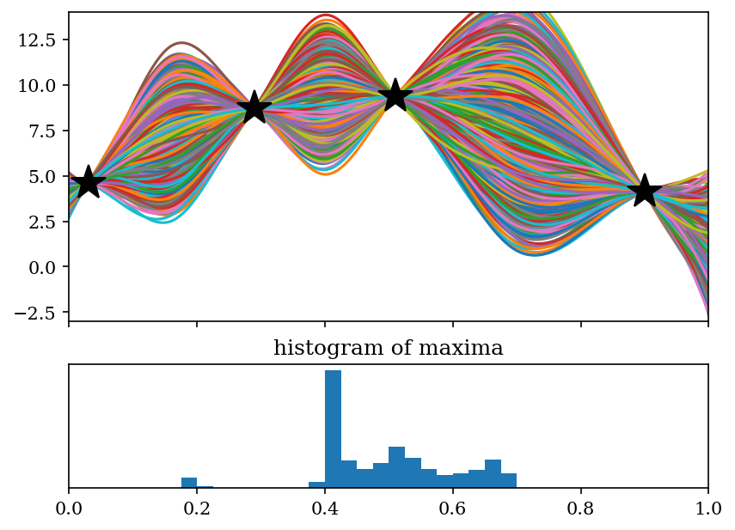
Augmenting search based on cost
Say cost of search increases with x
We could create a “cost function” where we only search a large x point if the likelihood of improvement is over some threshold
For superconducting sources:
Coils: Δt_{change} ➞ minutes
Bias: Δt_{change} ➞ seconds
We have employed cost functions to judiciously use coil changes

Slide 16
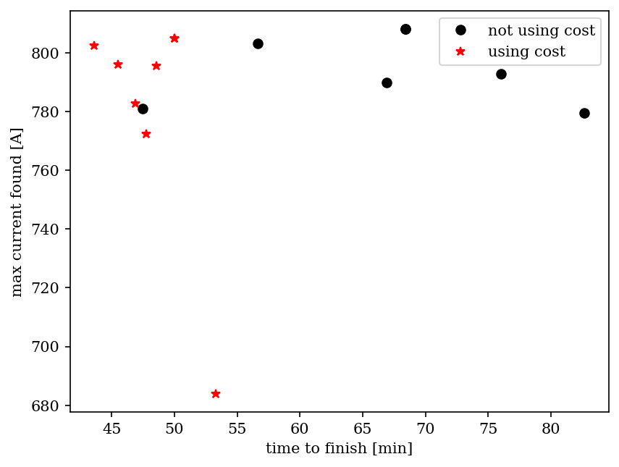
Using cost function in VENUS optimizations
Proof of principle:
Three parameter optimization of O⁷⁺ (biased disk, middle solenoid, and oxygen valve) can be tens of minutes faster using cost function
Peak current found can be lower as it is a less-thorough search
We will continue to explore this optimization technique
O⁷⁺
Full optimization time

Slide 17
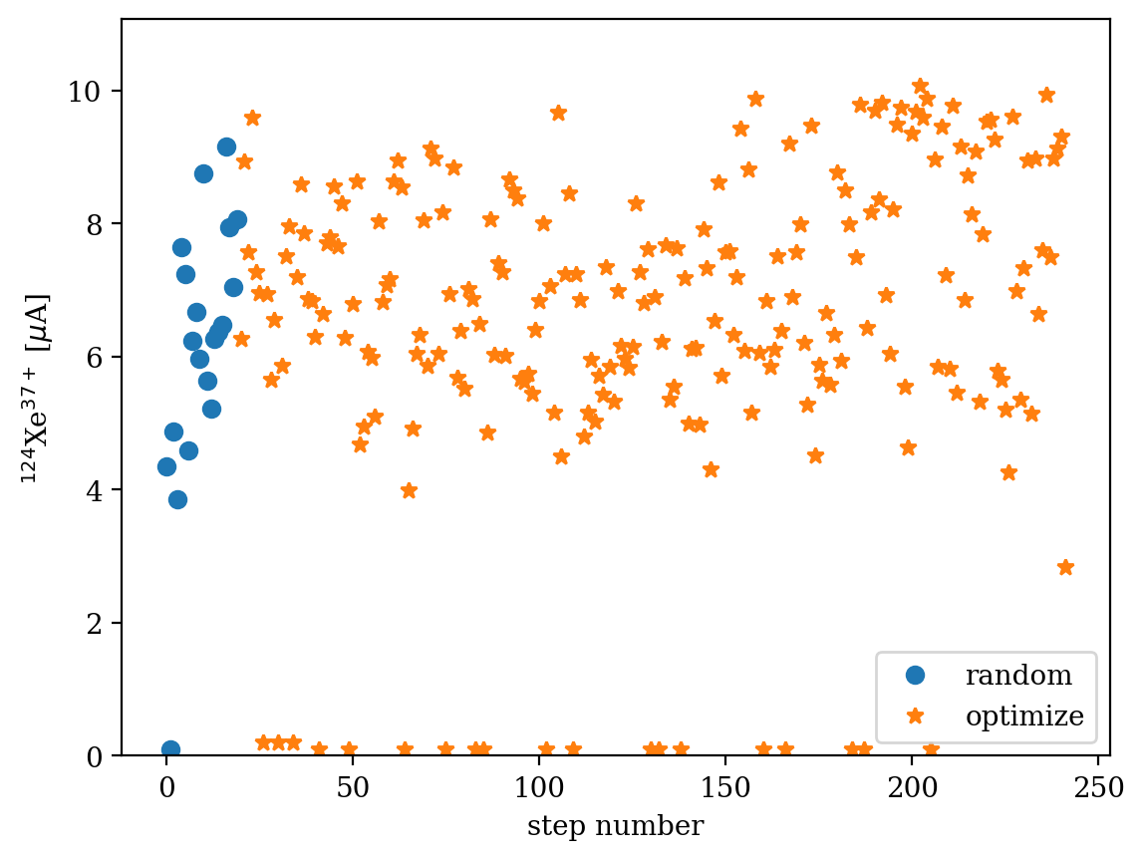
Optimizing a little more like a human
Parameter | Min | Max
Bias voltage [V] | 25 | 65
Oxygen valve | 11.5 | 12.0
Xenon valve | 9.0 | 12.0
18 GHz [kW] | 1.20 | 1.80
Many human records are achieved by using a cost-function-like approach:
Coils are slow, so find a pretty good solution and work from there
Note:
When instabilities or too low pressures encountered, low current is recorded

Slide 18
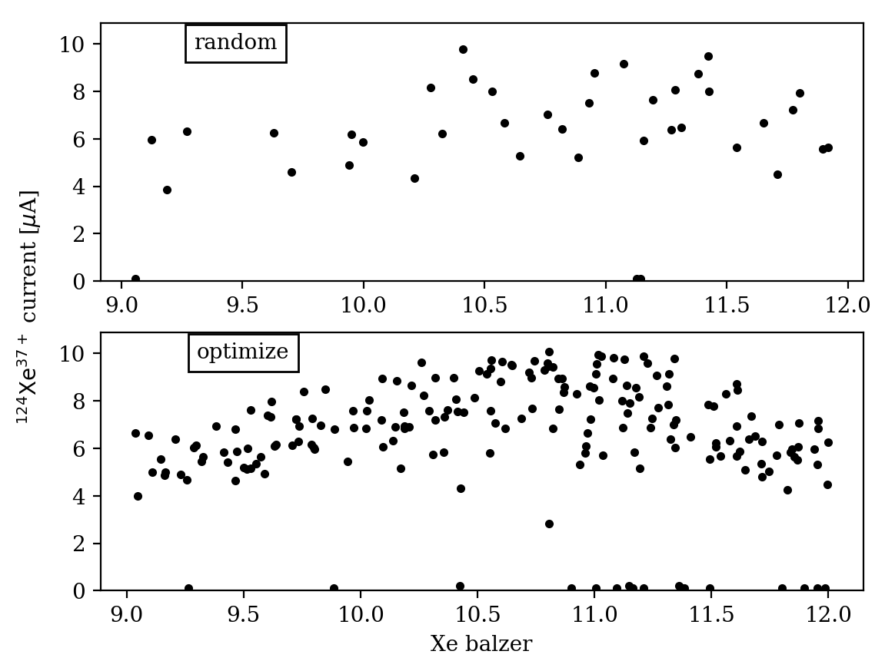
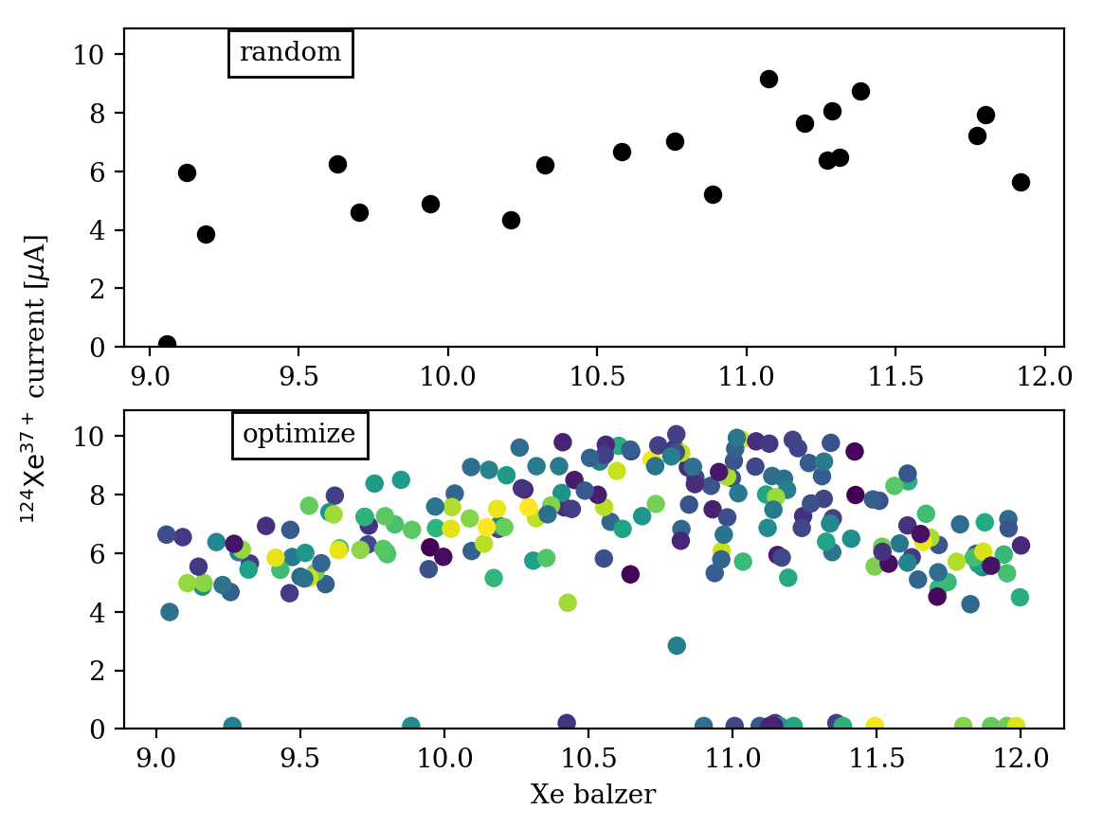
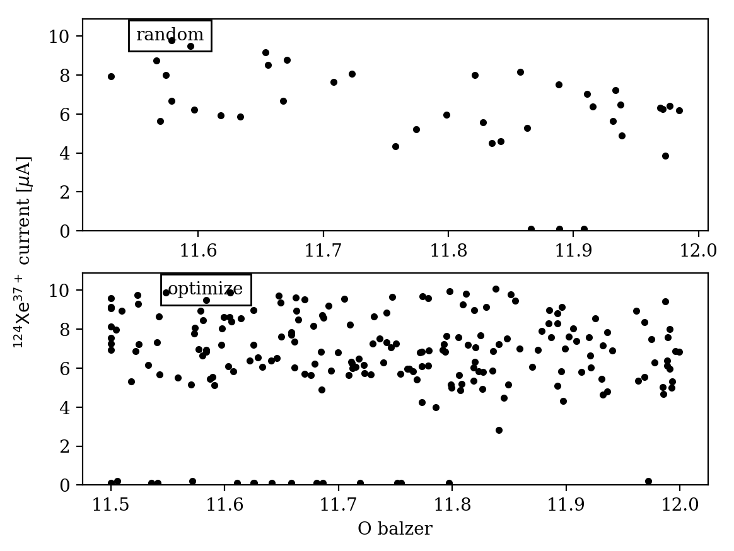
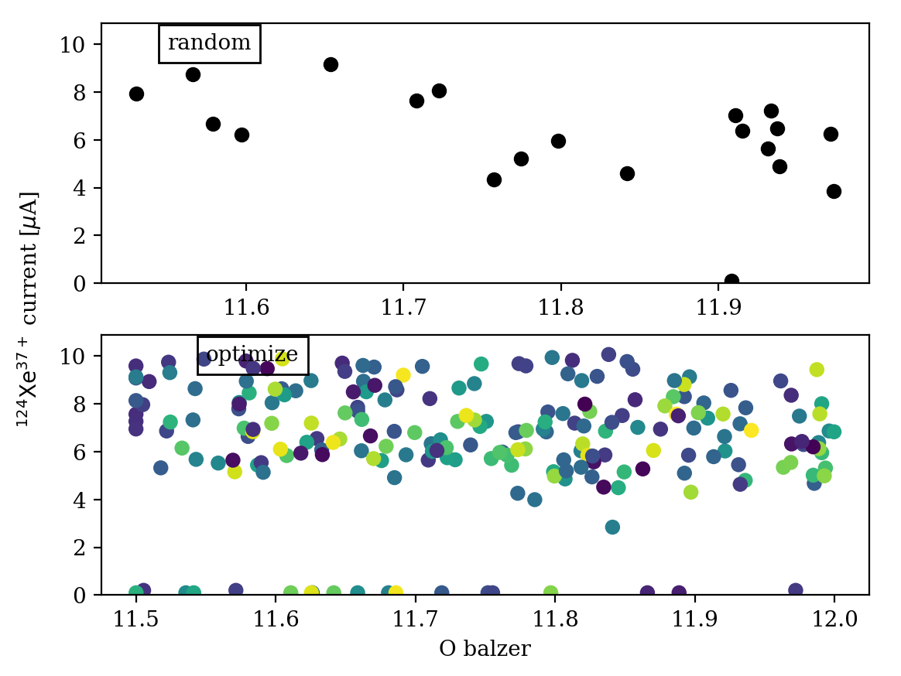
Are there trends we can see?
time [hours]
Code not being as smart as a person would be
Can change this by adjusting fitting functions

Slide 19
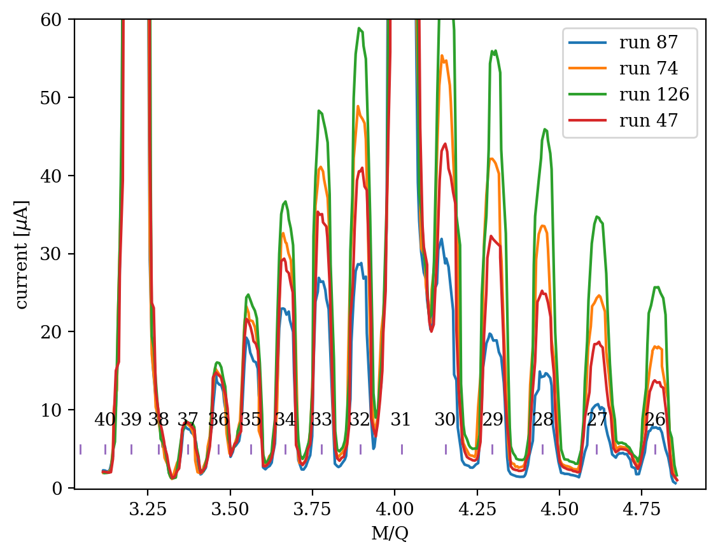
Exploiting patience of computer
~5 minutes between optimization as computer performed charge state distribution (CSD) measurement at each step (~1-2 minutes)
Most human optimizations are missing CSD information
These four runs had almost identical ¹²⁴Xe³⁷⁺ currents but their CSDs were dramatically different
This information will be fed into neural network efforts for general plasma understanding

Slide 20
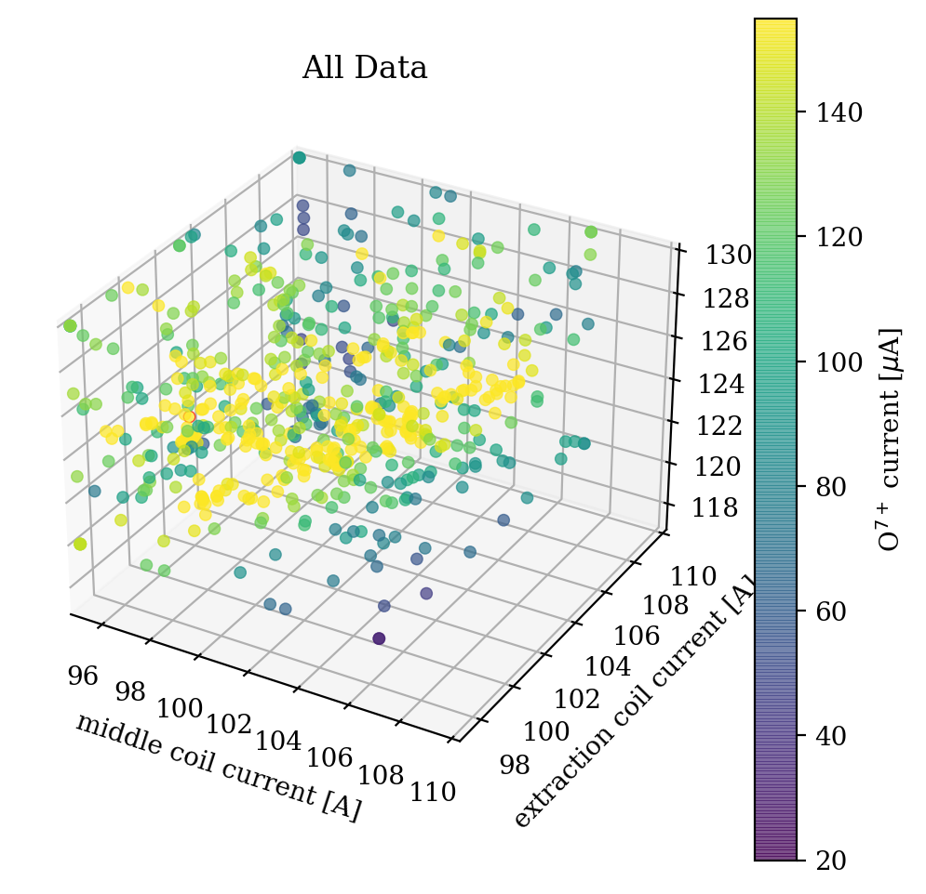
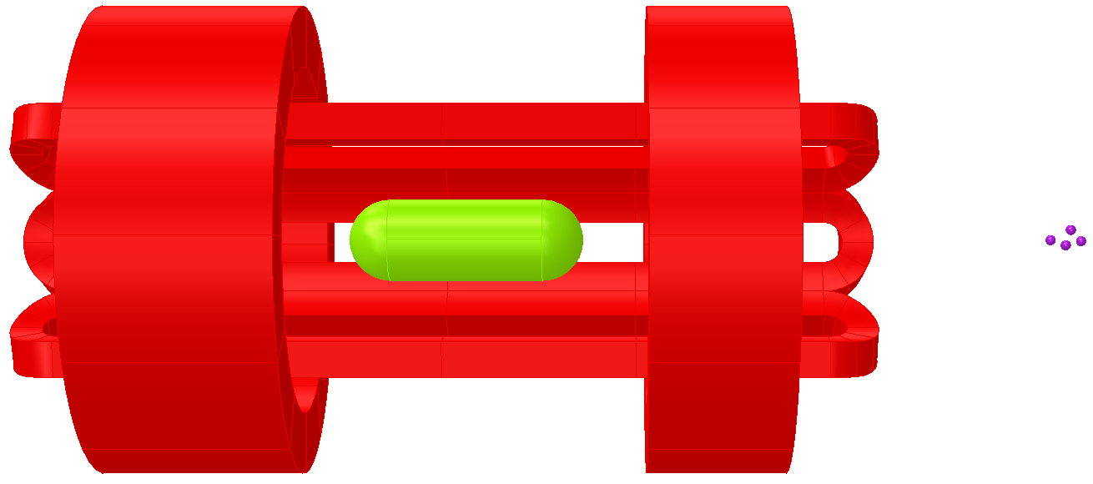
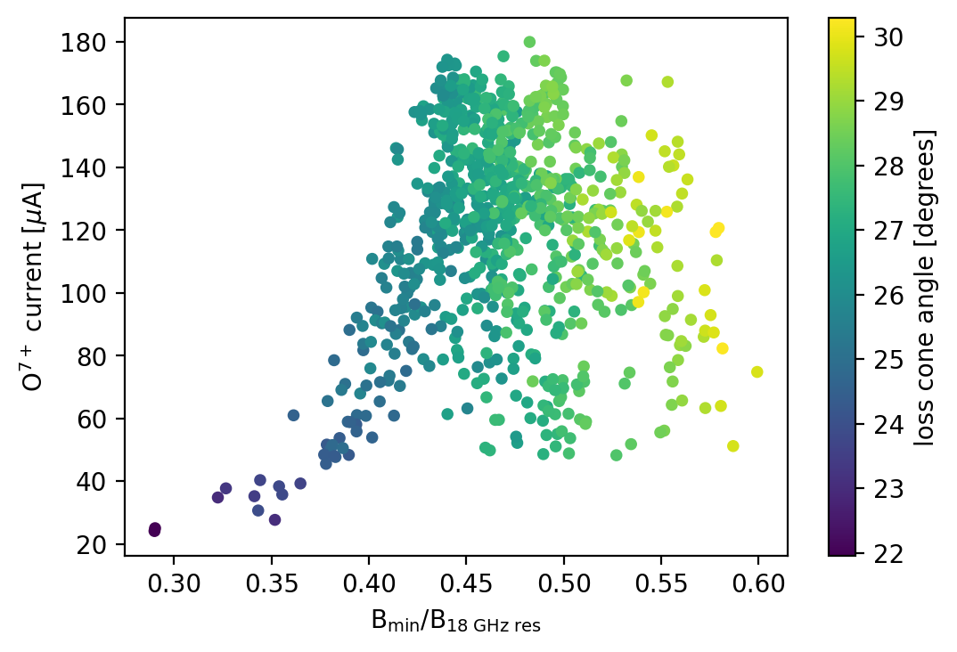
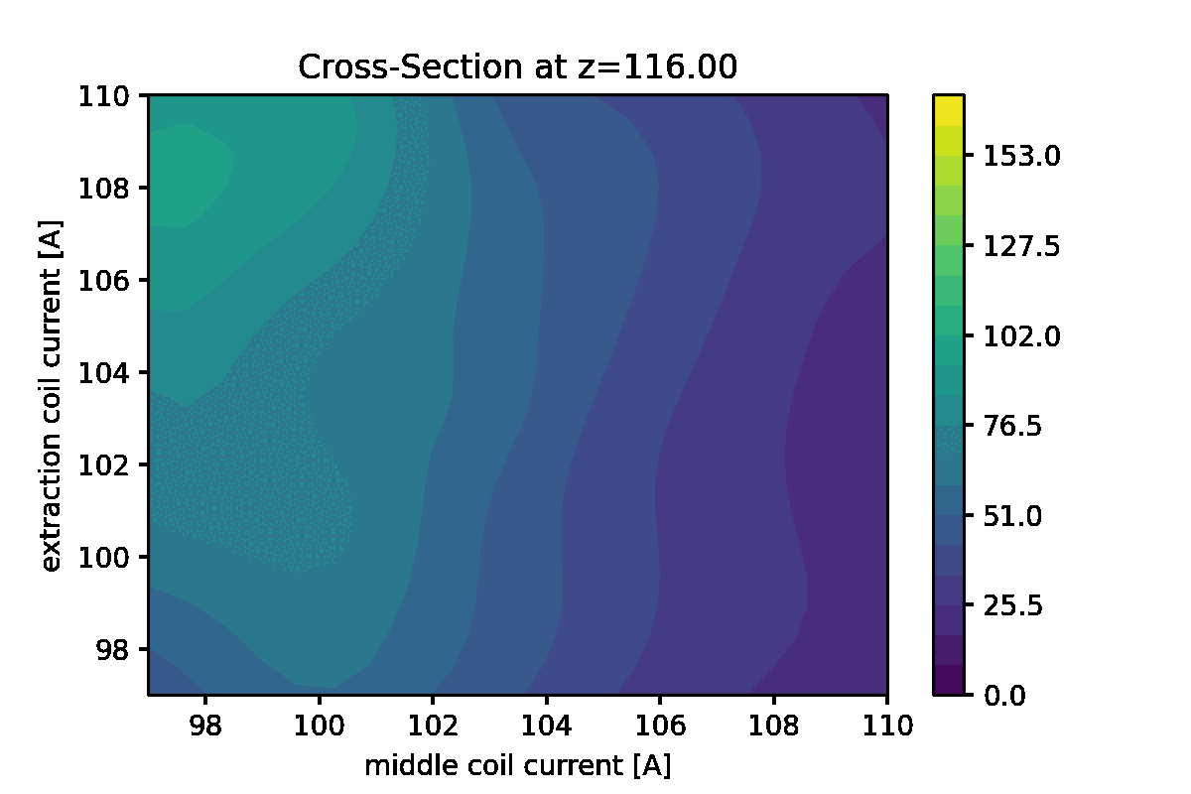
Lots of data
inj. coil [A]
Inj. coil [A]
plasma
beam
injection coil
middle coil (not shown)
extraction coil
Explore solenoid coil operation space using only 18 GHz
Difficult to discern any pattern or trend

Slide 21
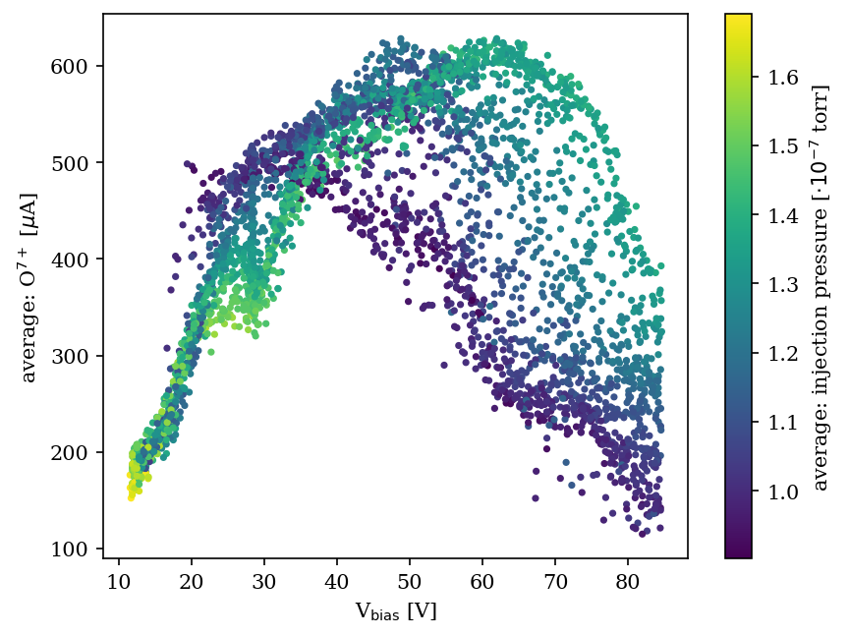
Lots and lots of data: explore bias voltage and pressure influence
Two parameter space exploration:
Biased disk voltage
Oxygen gas flow
3695 configurations, averaged over 30 measurements each

Slide 22
Summary and looking forward
We have thousands of hours of full-computer-control of VENUS for baking and beam optimization (limited by VENUS availability)
Our careful attempts at ¹²⁴Xe³⁷⁺ optimization are about 20% of record beams. Will push harder when backup chamber is complete
Team has begun on neural network to understand what leads to long-term instability
Next steps:
Speed up data taking, CSDs, etc.
Optimize optimization to transition away from exploring with time
Use neural network to improve understanding and control long-term instabilities, improve baking, etc.
Thank you!!

Slide 23
Backup slides

Slide 24
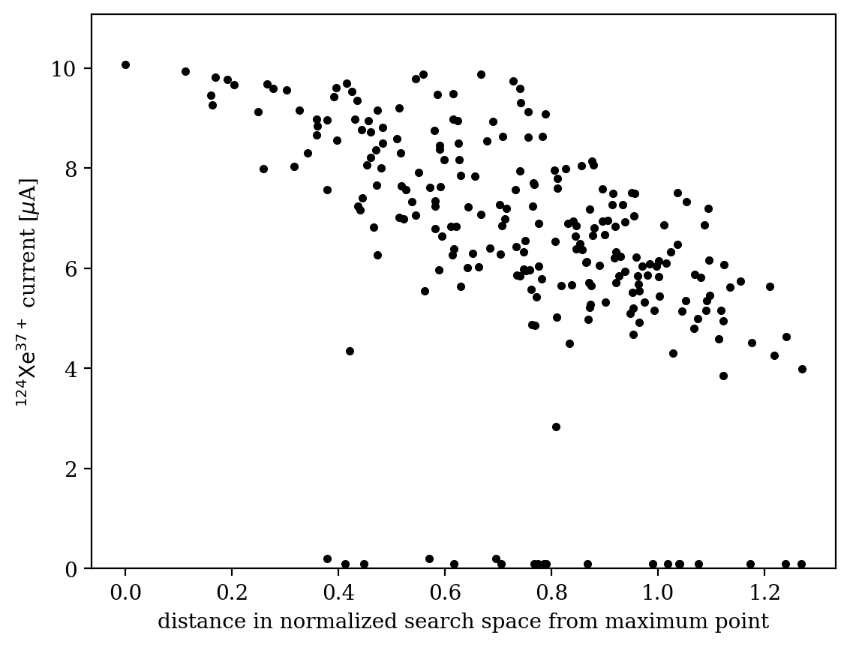
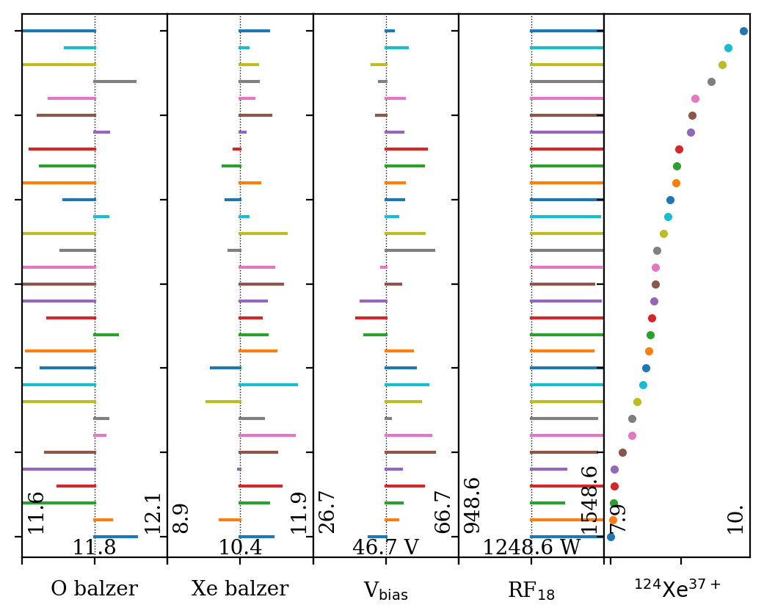
Relations of maxima

Slide 25
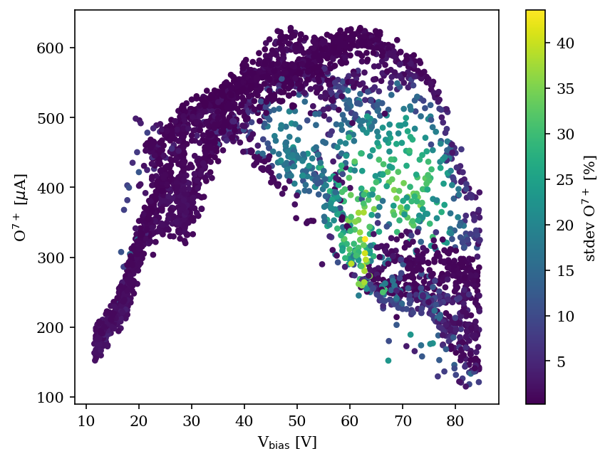
Visualization of unstable operation region
Two parameter space exploration:
Biased disk voltage
Oxygen gas flow
3695 configurations

