Slide 1
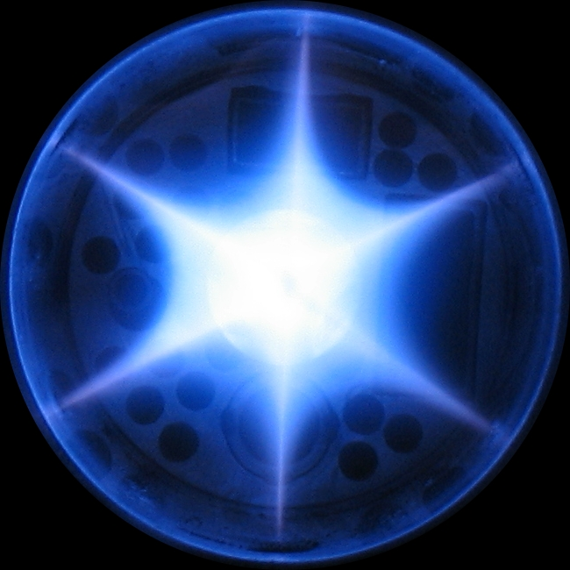

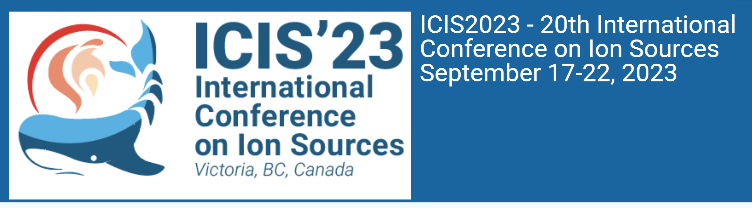
X-ray Diagnostics of ECR
Ion Sources
Richard Racz
Institute for Nuclear Research (Atomki)
Debrecen, Hungary

Slide 2
Outlook
What is diagnostics?
Why the diagnostics is needed?
Type of diagnostics?
How the X-ray photons are generated?
Detection of X-ray photons
Soft X-ray diagnostics
Hard X-ray diagnostics
Soft X-ray imaging
Richard Racz, X-ray Diagnostics of ECR Ion Sources, 22.09.2023, ICIS’23

Slide 3
What is diagnostics?
Diagnostics: tests/methods are used to obtain a diagnosis
Diagnosis: recognising a condition, or disease from the signs and symptoms
Signs and symptoms are revealing unnormal operation
So the role of the diagnostics:
To obtain signs and symptoms to control
Richard Racz, X-ray Diagnostics of ECR Ion Sources, 22.09.2023, ICIS’23

Slide 4
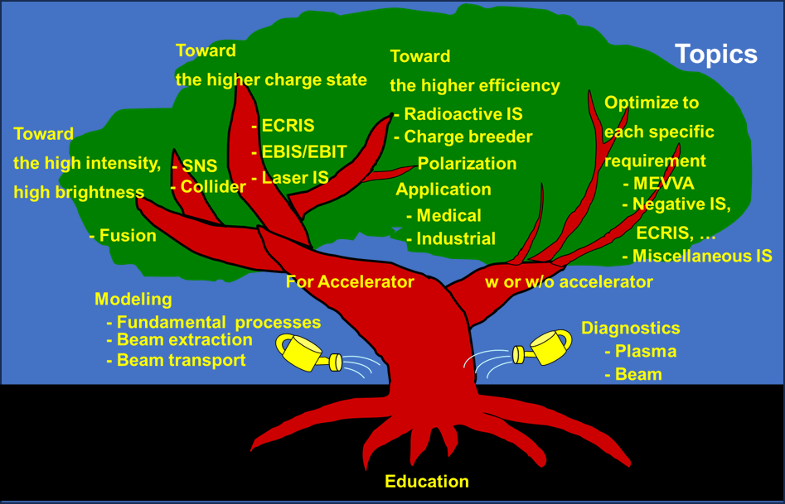
Why is it needed?
The aim: to collect the fruits
For fruits we need healthy tree crowns
For healthy crowns we need regular lifecycle
We should know the indicators of the regular or more efficient lifecycle
To obtain indicators we need diagnostics methods
Once we have indicator we can further improve the crops
ICIS 2015, New York, USA, Dr. Atsushi Kitagawa:
Voltaire:
“we must cultivate our garden.”
Richard Racz, X-ray Diagnostics of ECR Ion Sources, 22.09.2023, ICIS’23

Slide 5
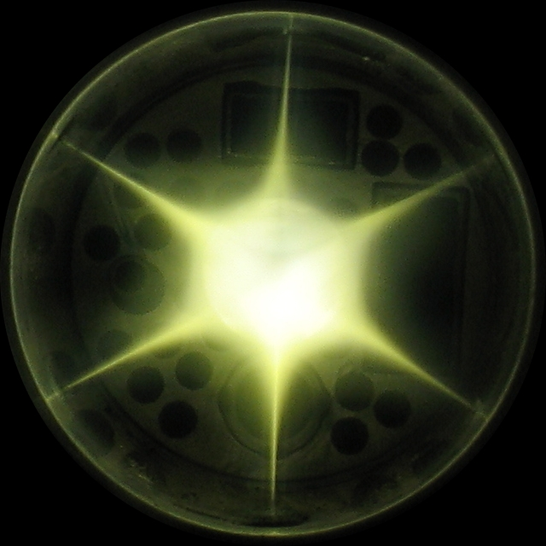


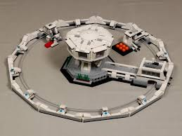
ECR diagnostics
The plasma
The heart of the ECR Ion Source
The beam parameters (brightness, emittance, etc.) directly linked to the plasma conditions
Richard Racz, X-ray Diagnostics of ECR Ion Sources, 22.09.2023, ICIS’23

Slide 6
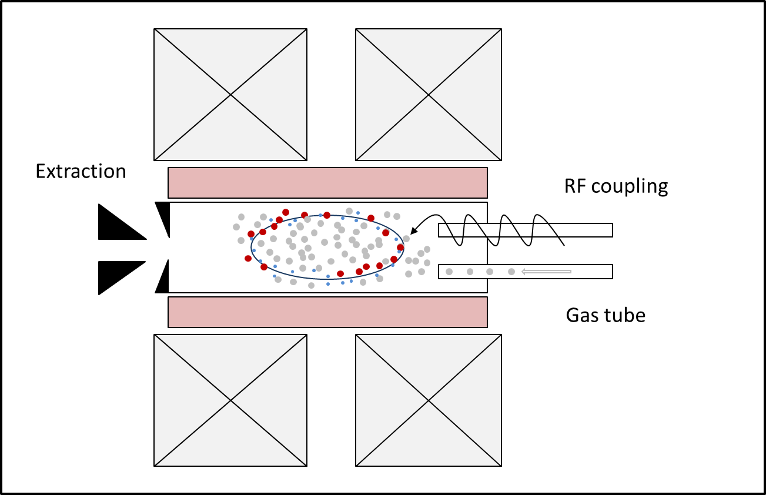
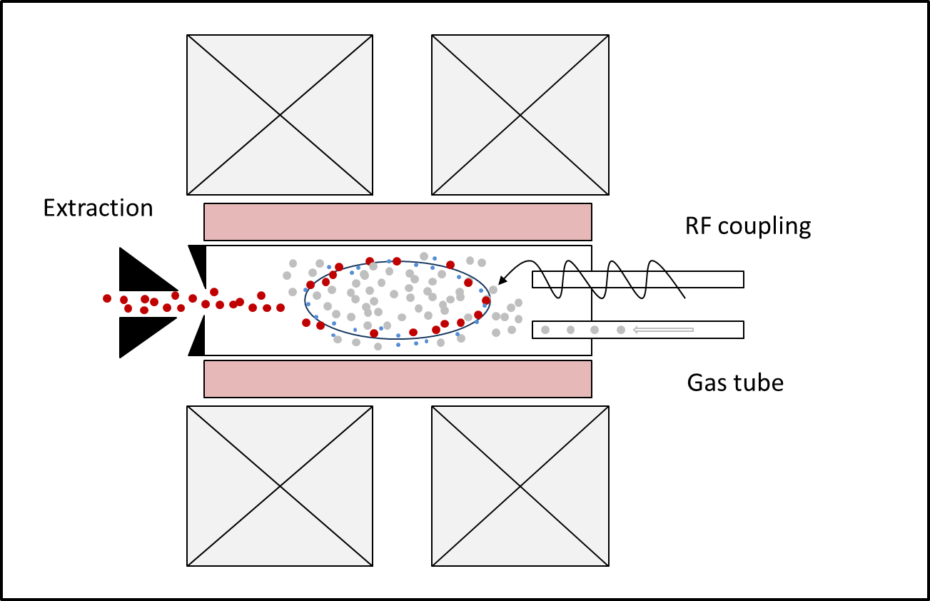
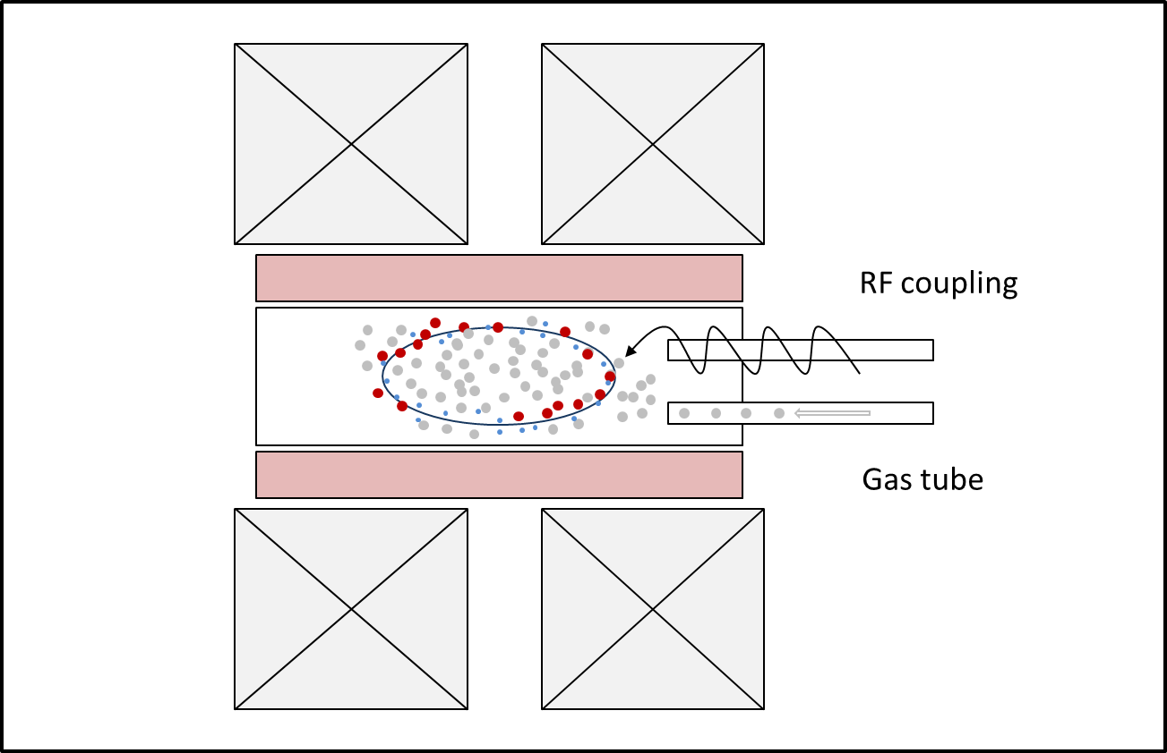
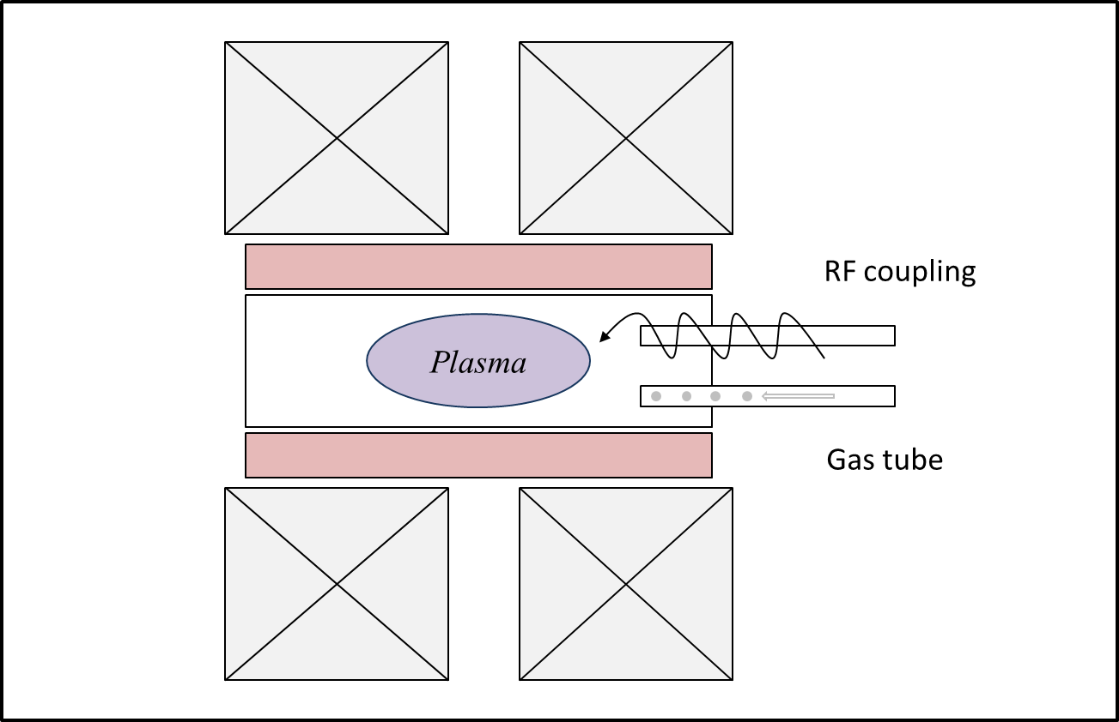
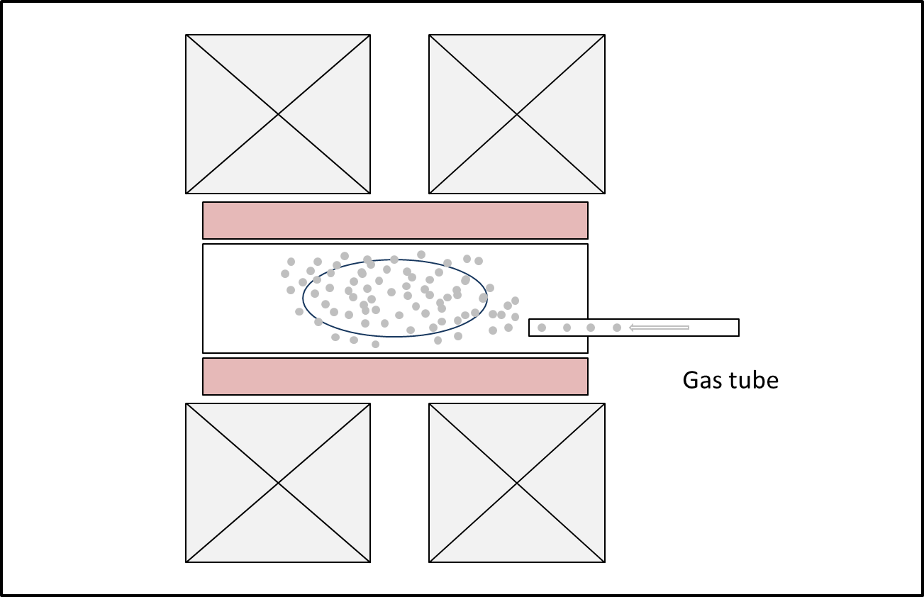
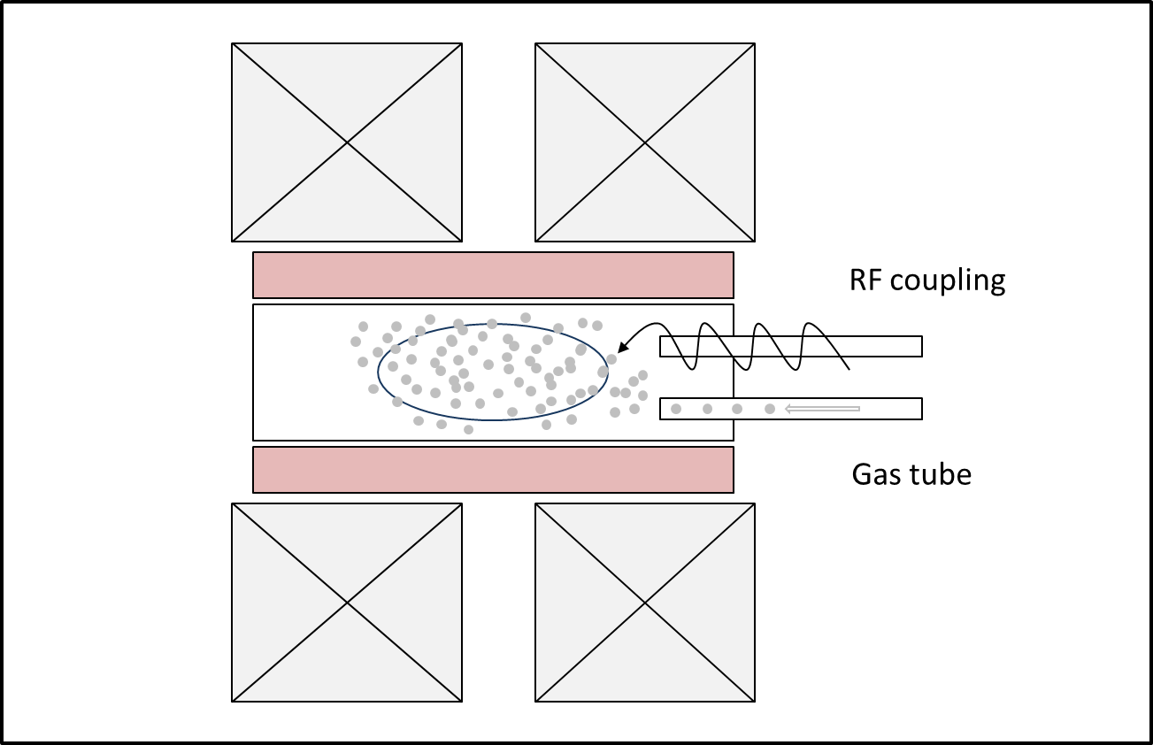
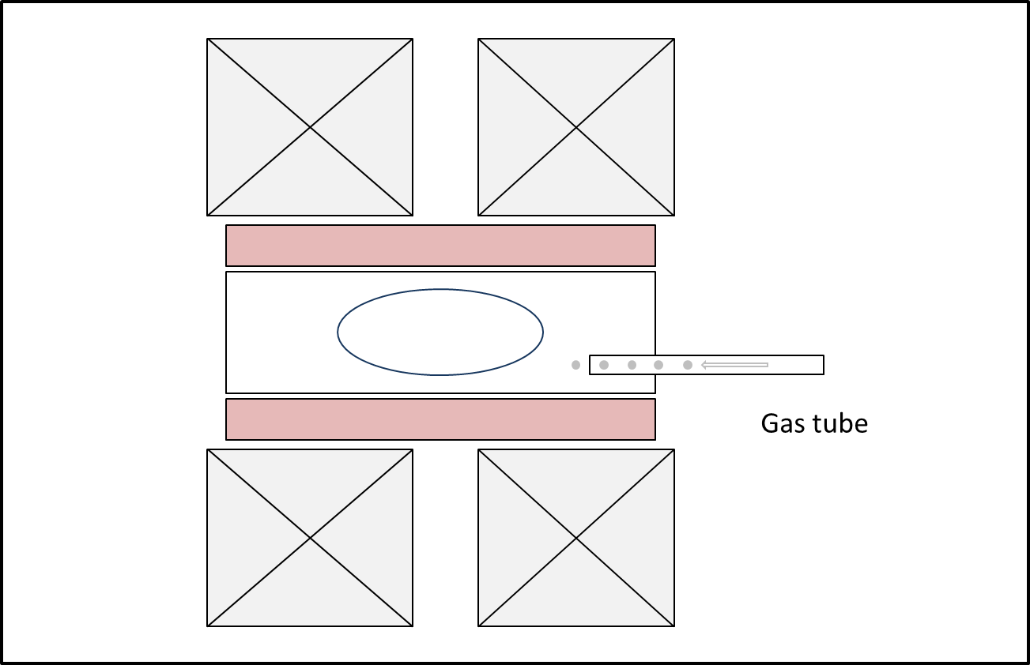
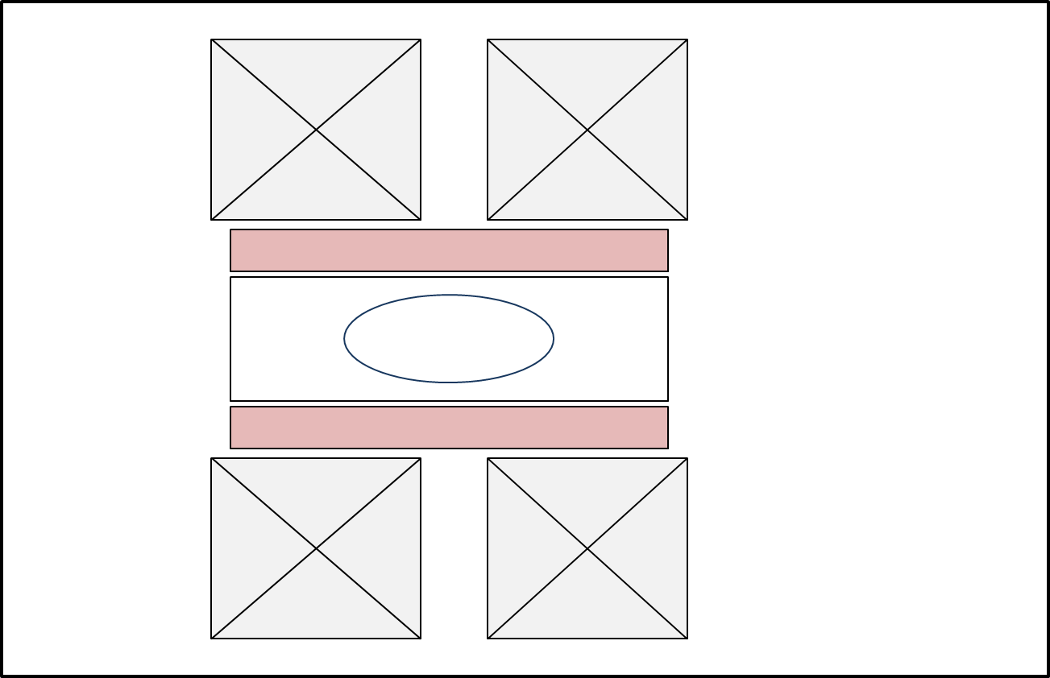
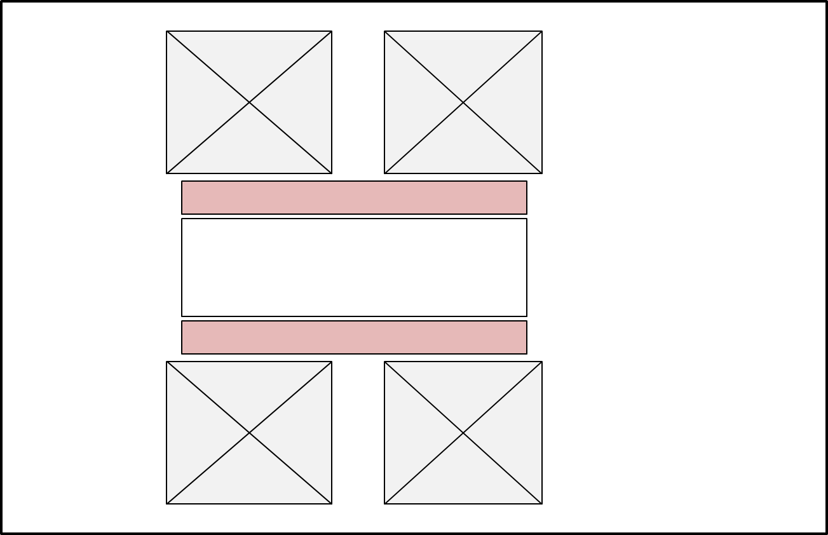
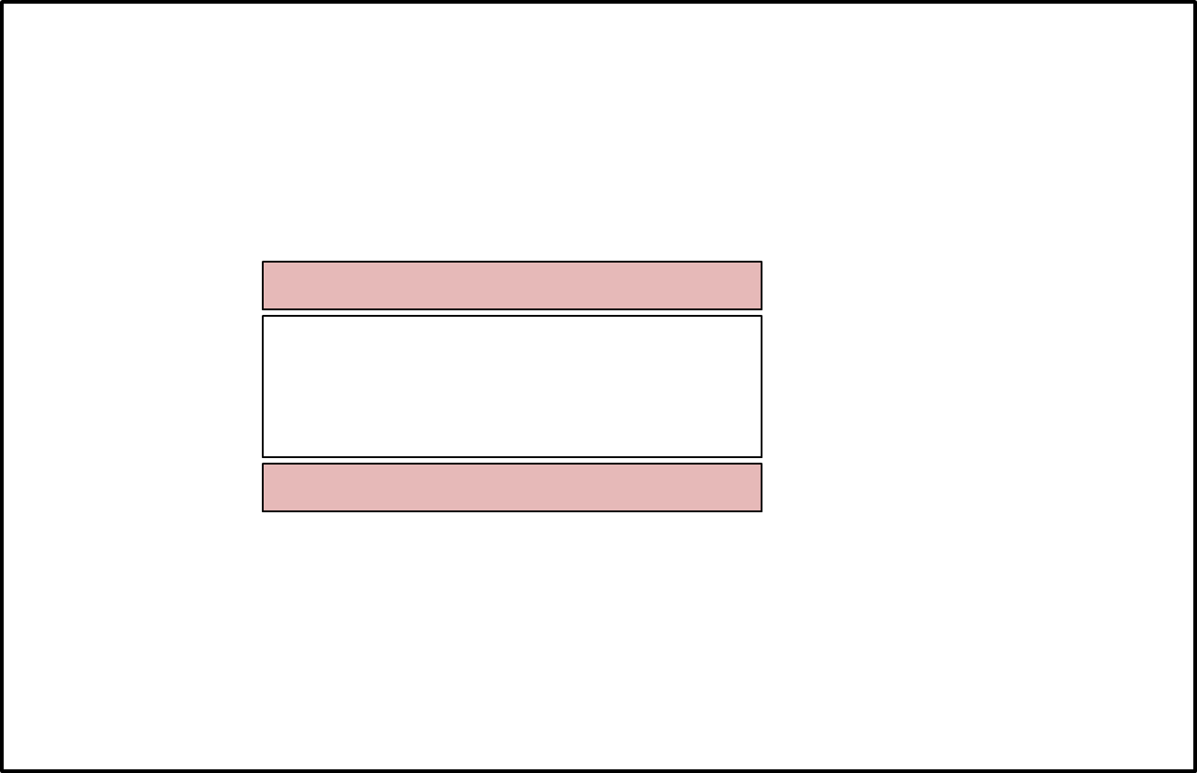



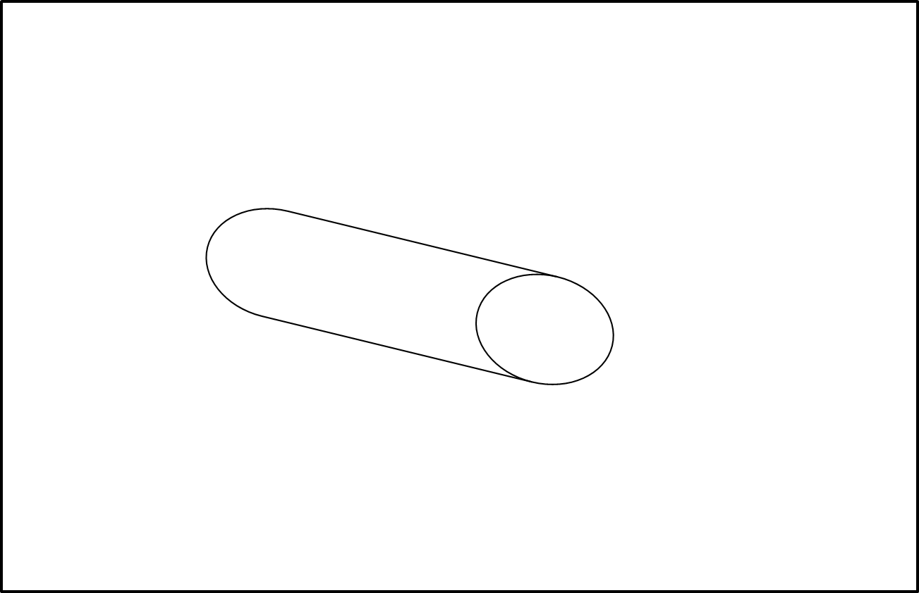
How to obtain information about the plasma
Difficulties to have an access to the plasma
Richard Racz, X-ray Diagnostics of ECR Ion Sources, 22.09.2023, ICIS’23

Slide 7
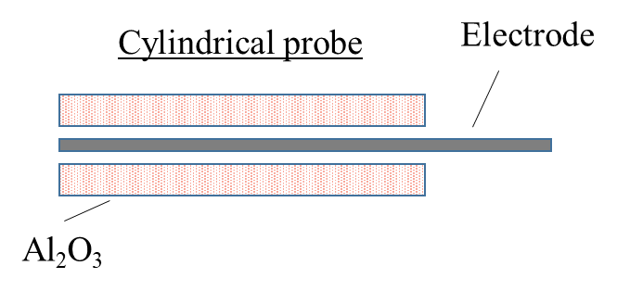
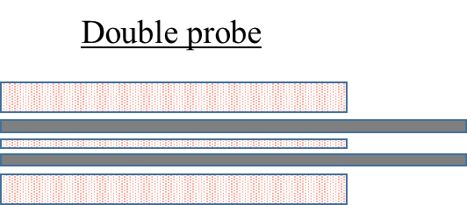
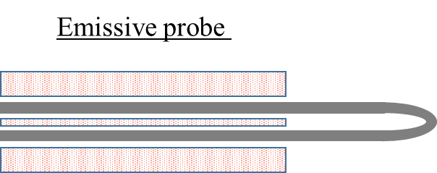
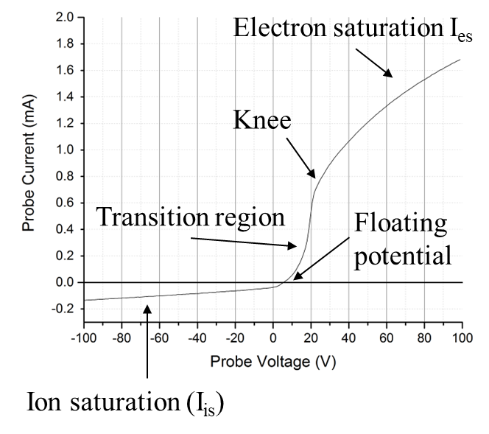
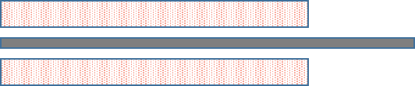
Type of diagnostics
Langmuir-probes
Local
Intrusive method
Plasma parameters can be derived
Interpretation of the measured curves are difficult
Many type of probes: cylindrical, emissive, probe
Mainly used in semiconductor technique (rf plasmas)
Richard Racz, X-ray Diagnostics of ECR Ion Sources, 22.09.2023, ICIS’23

Slide 8
Type of diagnostics
Global
Plasma emits EMW
The energy of the photons are corresponding to the different plasma processes
Visible light
Electrons with this energy are effective for the ionization!
high energy plasma electrons gyro-motion
mainly plasma chamber wall and hot electron interaction
atom-atom interaction
Or
ion, atom – low energy (cold) electron
warm electron to atom and ion
molecular motion
1 mm
100 µm
10 µm
10 nm
1 nm
1 Å
0.1 Å
0.01 Å
Infrared
UV
X-ray
1 µm
100 nm
mid
far
soft
hard
RF
far
near
near
10⁻³eV
10⁻²eV
10⁻¹eV
1 eV
10 eV
100 eV
10³ eV
10⁴ eV
10⁵ eV
10⁶ eV
Richard Racz, X-ray Diagnostics of ECR Ion Sources, 22.09.2023, ICIS’23

Slide 9
Processes that prone to X-ray emission
Electron impact:
A^{n+} + e⁻ → A^{*(n+1)} +2e⁻
A^{*(n+1)+} → A^{(n+1)+} + hv
Charge exchange:
A^{n+} + B → A^{*(n+1)} + B⁺
A^{*(n+1)+} → A^{(n+1)+} + hv
The emitted photon has characteristic energy. Those emissions are isotropic.
Recombination:
A^{n+} + e⁻ → A^{*(n-1)} + hv
Continuous spectra from zero to energy of impacting electrons.
Anisotropic.
Bremsstrahlung:
Electrons are decelerated by the Coulomb interaction →
Richard Racz, X-ray Diagnostics of ECR Ion Sources, 22.09.2023, ICIS’23

Slide 10
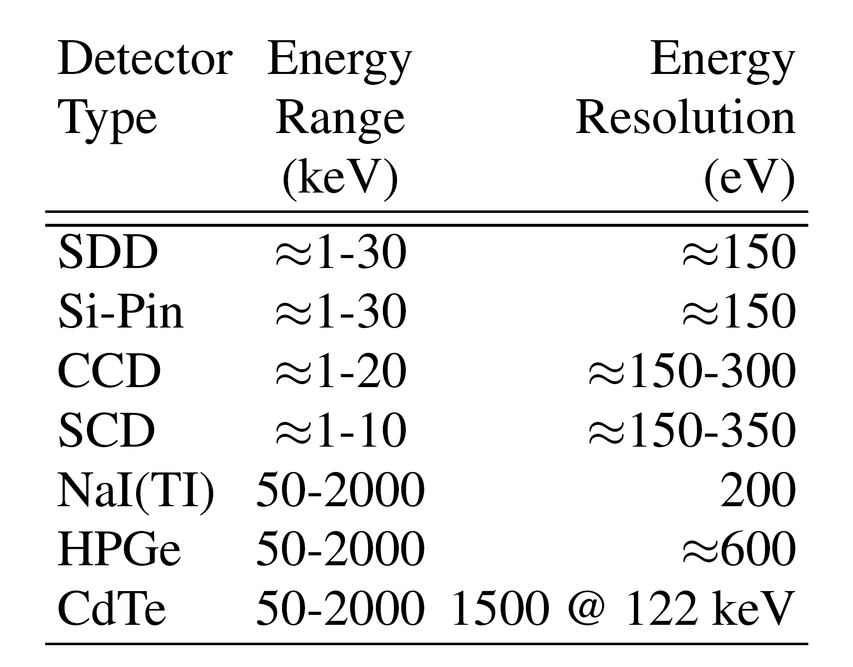
Detectors
The incoming photons generate charges
Number of the charges is proportional with the photon energy
Different detectors for different energy domains
Richard Racz, X-ray Diagnostics of ECR Ion Sources, 22.09.2023, ICIS’23

Slide 11
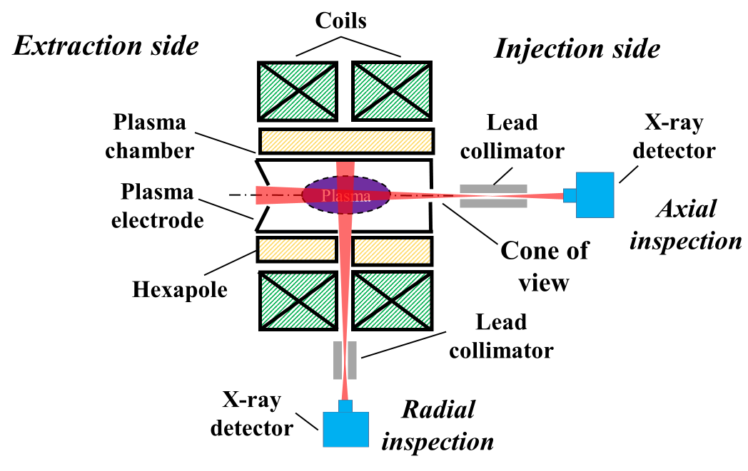
Possible detector arrangement
Collimation by high Z materials
Lead collimation
X-ray
detector
AM
FC
Richard Racz, X-ray Diagnostics of ECR Ion Sources, 22.09.2023, ICIS’23

Slide 12
Methods and its applications
Soft X-ray detection and interpretation of the obtained data
Results obtained by this techniques
K-alpha diagnostics
Results, obtained by this techniques
Hard X-ray detection and interpretation of the obtained data
Results obtained by this techniques
Soft X-ray imaging
Results obtained by this techniques

Slide 13
Typical spectra in soft X-ray ranges (SDD)
Argon K-beta
Using the Kramer’s formula and assuming Maxwellian distribution of the warm electron domain:
In log plot, the inverse slope of the fitted BS gives the spectral temperature
Intersection of the fitted BS with the vertical axis gives a value proportional with the electron density
Plasma Bremsstrahlung
e.g. in Gumberidze et al. Rev. Sci. Instrum. 81, 033303 2010
Richard Racz, X-ray Diagnostics of ECR Ion Sources, 22.09.2023, ICIS’23

Slide 14
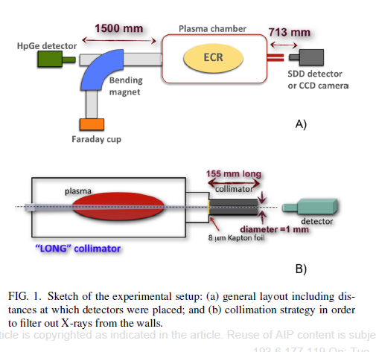

An example: frequency tuning
Strong collimation to measure just the plasma emissions
Mascali et al, REVIEW OF SCIENTIFIC INSTRUMENTS 87, 02A510 (2016)
Richard Racz, X-ray Diagnostics of ECR Ion Sources, 22.09.2023, ICIS’23

Slide 15
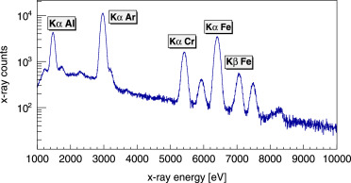
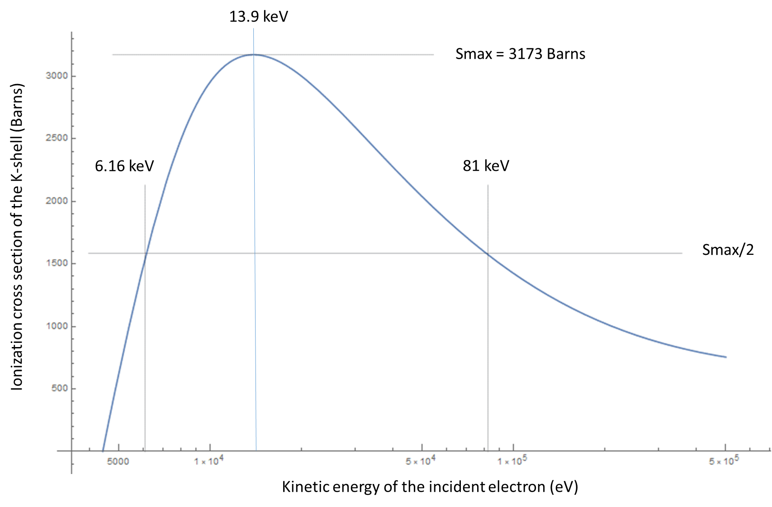
K-alpha diagnostics, inner shell ionization rate
The K-alpha emission rate from plasma can be used to determine the absolute inner shell ionization.
Why to measure?:
Easy to simulate and easy to measure: code validation
Estimation of EEDF:
R. Friedlin et al Rev. Sci. Instrum. 67, 1261–1263 (1996)
Richard Racz, X-ray Diagnostics of ECR Ion Sources, 22.09.2023, ICIS’23
C Hombourger: J. Phys. B: At. Mol. Opt. Phys. 31 (1998) 3693–3702.

Slide 16
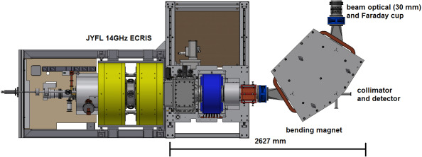
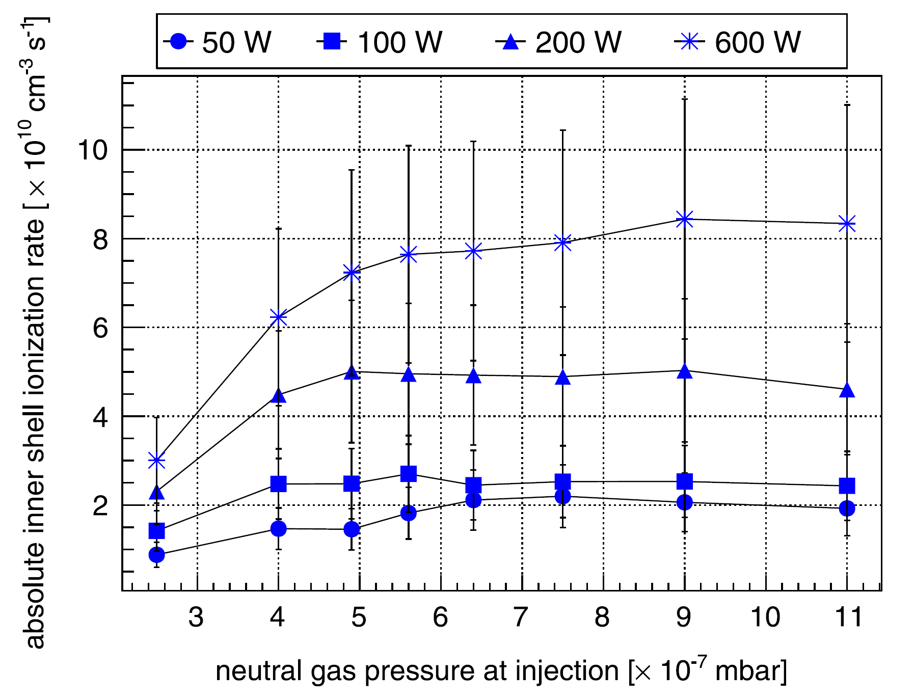
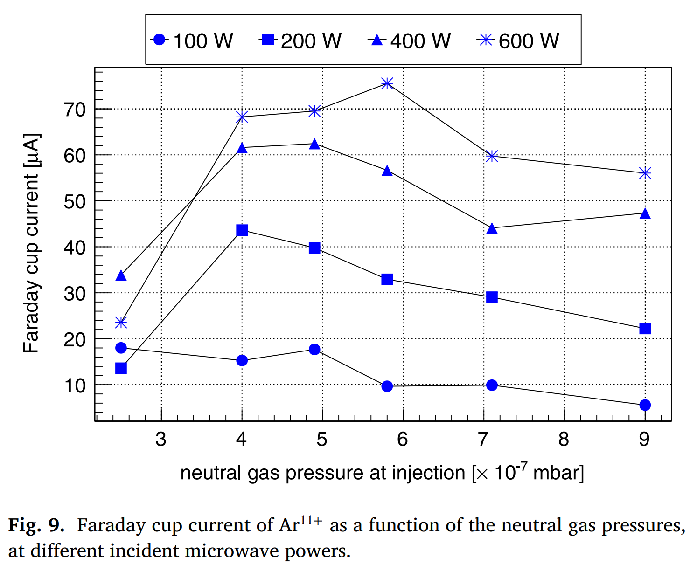
As an example:response to tuning parameter
M. Sakildien et al. Nuclear Inst. and Methods in Physics Research, A 900 (2018) 40–52
Richard Racz, X-ray Diagnostics of ECR Ion Sources, 22.09.2023, ICIS’23

Slide 17
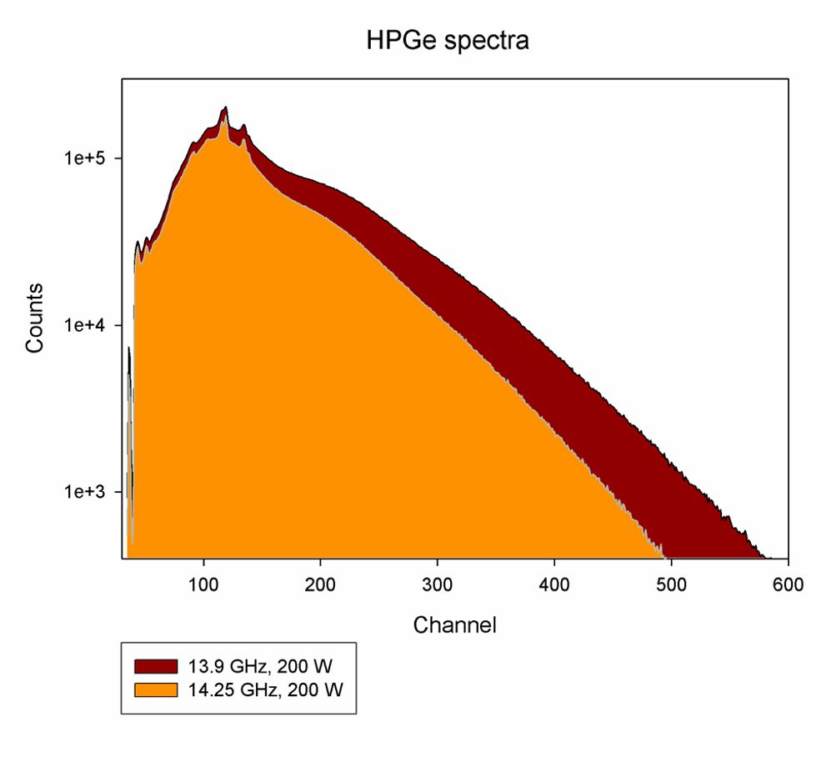
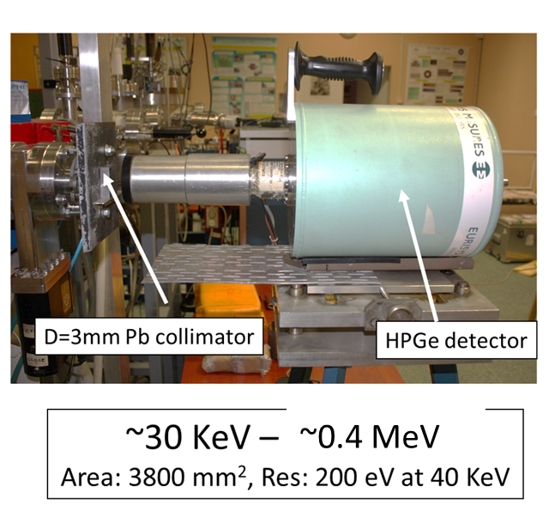
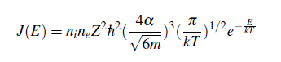
Typical hard X-ray spectra
Again the Kramer’s formula:
To obtain spectral temperature
!
Up to 1 MeV
Richard Racz, X-ray Diagnostics of ECR Ion Sources, 22.09.2023, ICIS’23

Slide 18
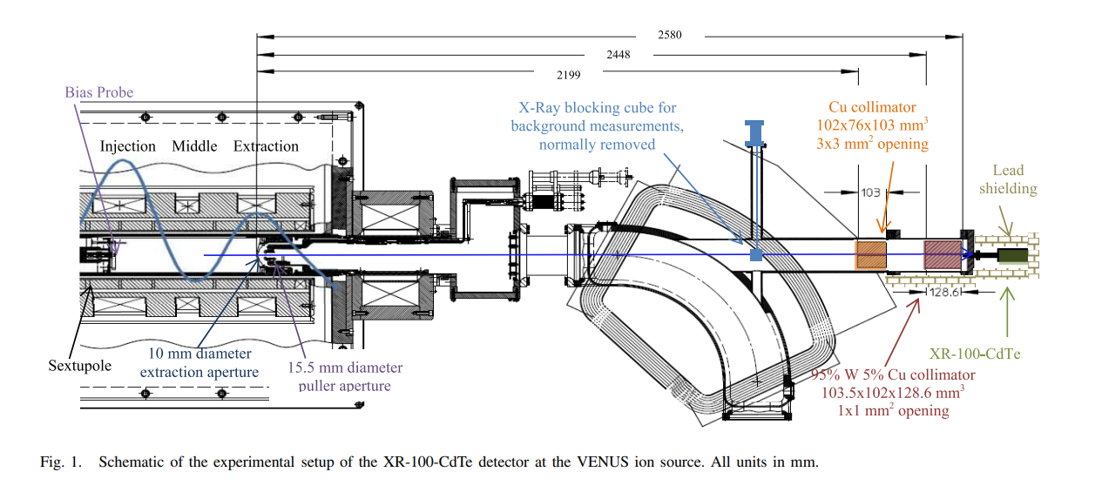
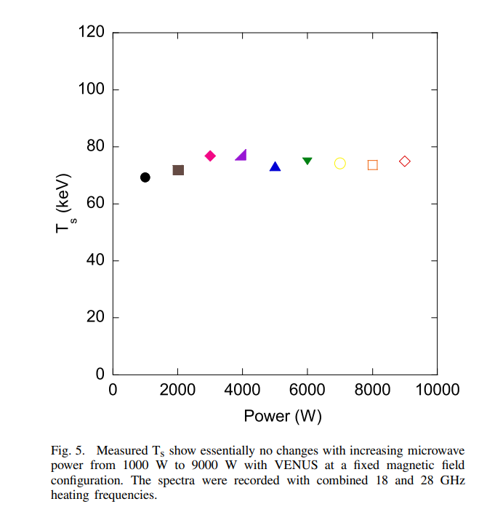
Some example / power dependence
VENUS
J. Benitez et al IEEE Transactions on Plasma Science 45, 1746 (2017).
Richard Racz, X-ray Diagnostics of ECR Ion Sources, 22.09.2023, ICIS’23

Slide 19
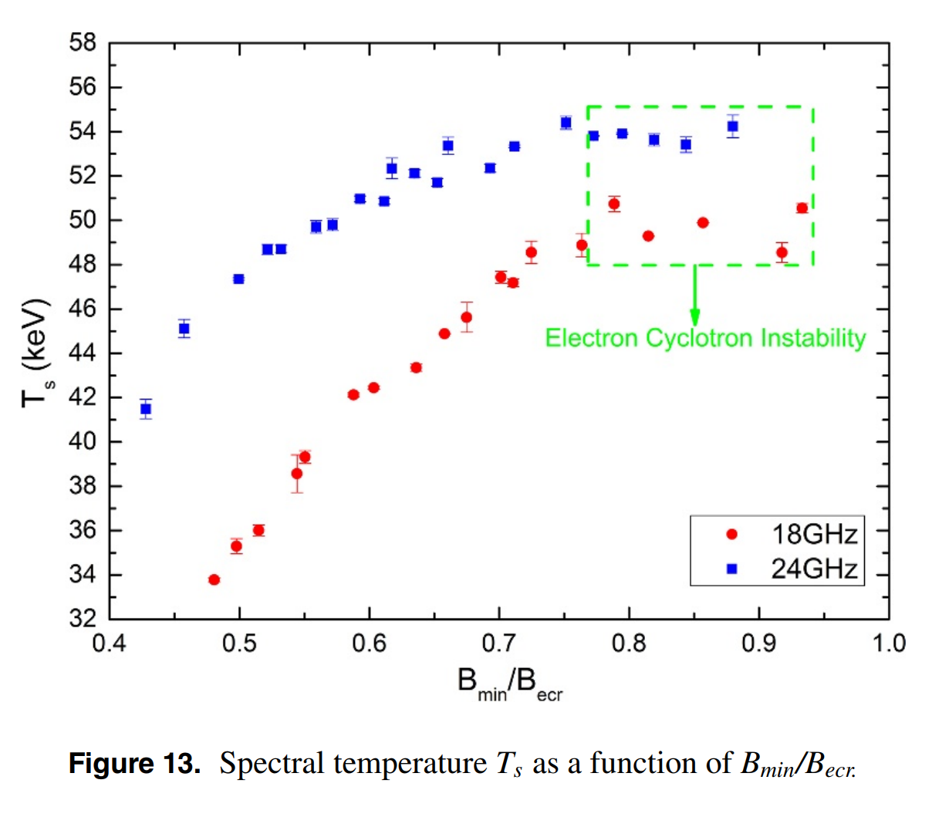
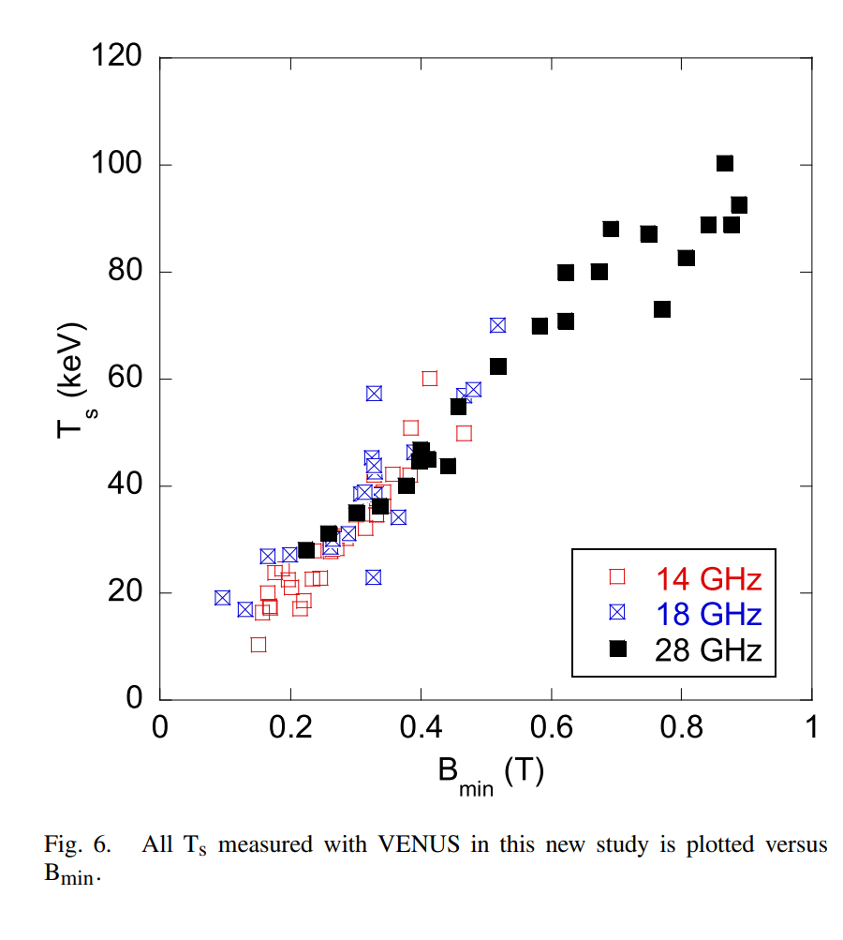
Some example: B_{min} / B_{ECR} dependence
VENUS
SECRAL
J. Benitez et al IEEE Transactions on Plasma Science 45, 1746 (2017).
J B Li et al, Plasma Phys. Control. Fusion 62 (2020) 095015
Richard Racz, X-ray Diagnostics of ECR Ion Sources, 22.09.2023, ICIS’23

Slide 20
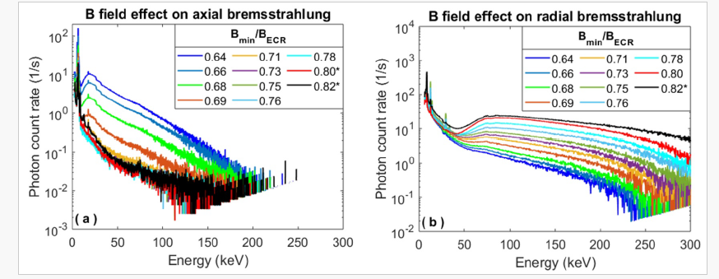
Some example: anisotropy
14 GHz AECR at Jyvaskyla University
B. S. Bhaskar et al, Plasma Physics and Controlled Fusion 63, 095010 (2021).
Richard Racz, X-ray Diagnostics of ECR Ion Sources, 22.09.2023, ICIS’23

Slide 21
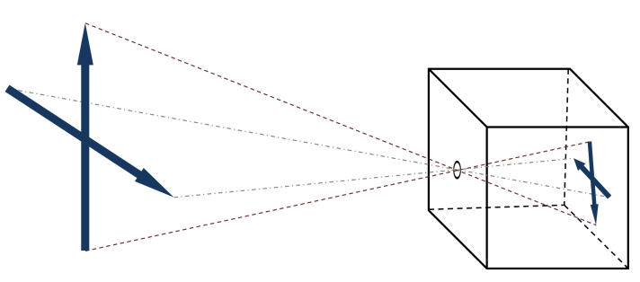
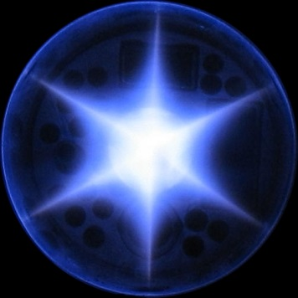
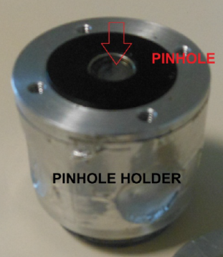
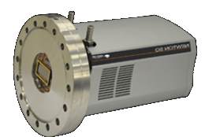
X-ray imaging in soft X-ray region
Object
Pinhole
Image
For visible light imaging used from the 11th century
The ’simplest’ method for imaging
No lens
Infinite depth of field
Perspective view
The best way for X-ray imaging
X-ray
Plasma
~ 100 um pinhole
X-ray CCD
Richard Racz, X-ray Diagnostics of ECR Ion Sources, 22.09.2023, ICIS’23

Slide 22
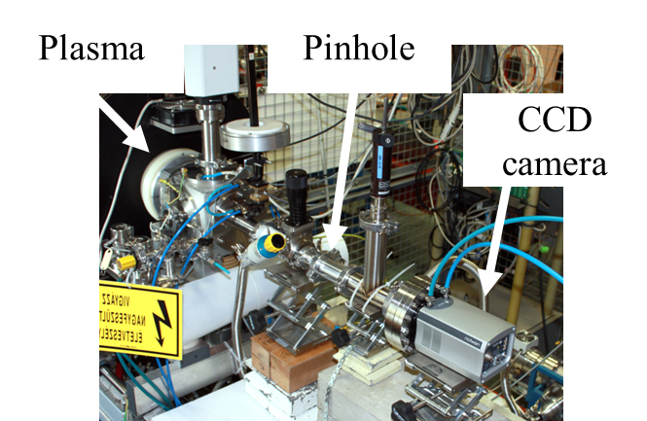
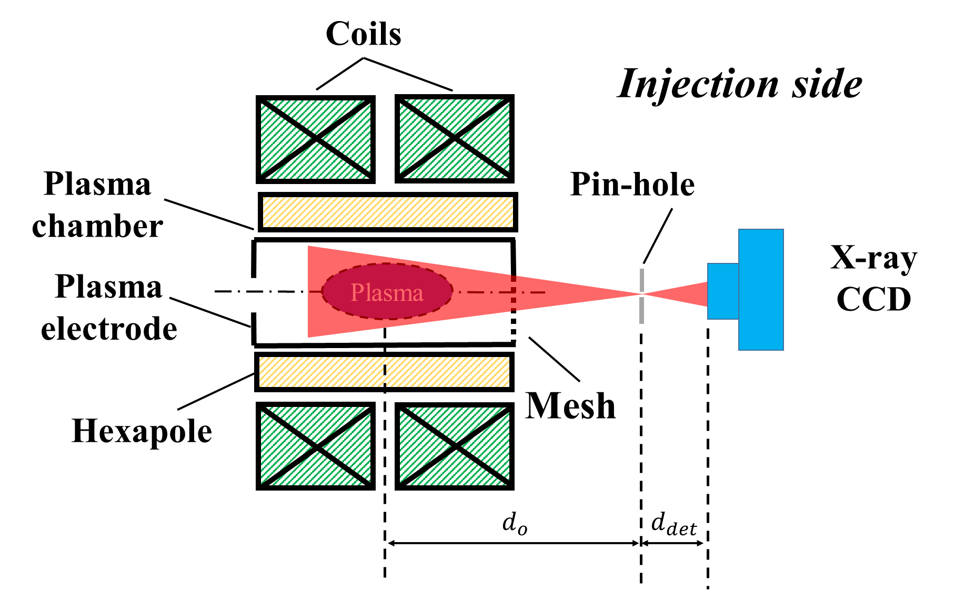
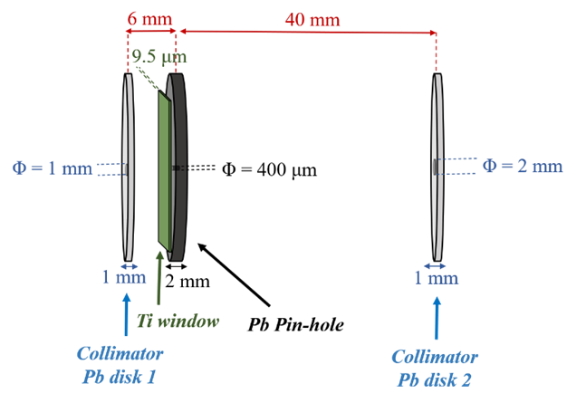
X-ray imaging
w
W ~ several 100 um
Since d_{det}*λ<<w → no diffraction effect
Resolution is in the range of w if d_{o} << d_{det}
S. Biri JINST 16 (2021) P03003
Richard Racz, X-ray Diagnostics of ECR Ion Sources, 22.09.2023, ICIS’23

Slide 23
X-ray imaging (spectrally integrated)
Long exposure time: several 10 s, to avoid the blooming of the CCD
One frame for one image
Individual pixels can be loaded by many X-ray photons → no spectral information
Spectrally integrated but spatially resolved structural information
Acquisition
0 | 0 | 0 | 1 | 0 | 0 | 0 | 0
1 | 0 | 0 | 0 | 0 | 1 | 0 | 0
0 | 1 | 0 | 1 | 0 | 1 | 0 | 0
0 | 1 | 0 | 1 | 0 | 0 | 0 | 0
0 | 0 | 1 | 1 | 0 | 0 | 0 | 0
1 | 0 | 1 | 0 | 0 | 0 | 0 | 0
0 | 0 | 0 | 0 | 1 | 0 | 1 | 0
0 | 1 | 0 | 0 | 0 | 0 | 0 | 0
0 | 0 | 0 | 2 | 0 | 0 | 0 | 0
2 | 0 | 0 | 0 | 0 | 2 | 0 | 0
0 | 2 | 0 | 2 | 0 | 2 | 0 | 0
0 | 2 | 0 | 2 | 0 | 0 | 0 | 0
0 | 0 | 2 | 2 | 0 | 0 | 0 | 0
2 | 0 | 2 | 0 | 0 | 0 | 0 | 0
0 | 0 | 0 | 0 | 2 | 0 | 2 | 0
0 | 2 | 0 | 0 | 0 | 0 | 0 | 0
0 | 0 | 0 | 3 | 0 | 0 | 0 | 0
3 | 0 | 0 | 0 | 0 | 3 | 0 | 0
0 | 3 | 0 | 3 | 0 | 3 | 0 | 0
0 | 3 | 0 | 3 | 0 | 0 | 0 | 0
0 | 0 | 3 | 3 | 0 | 0 | 0 | 0
3 | 0 | 3 | 0 | 0 | 0 | 0 | 0
0 | 0 | 0 | 0 | 3 | 0 | 3 | 0
0 | 3 | 0 | 0 | 0 | 0 | 0 | 0
0 | 0 | 0 | 4 | 0 | 0 | 0 | 0
4 | 0 | 0 | 0 | 0 | 4 | 0 | 0
0 | 4 | 0 | 4 | 0 | 4 | 0 | 0
0 | 4 | 0 | 4 | 0 | 0 | 0 | 0
0 | 0 | 4 | 4 | 0 | 0 | 0 | 0
4 | 0 | 4 | 0 | 0 | 0 | 0 | 0
0 | 0 | 0 | 0 | 4 | 0 | 4 | 0
0 | 4 | 0 | 0 | 0 | 0 | 0 | 0
0 | 0 | 0 | 5 | 0 | 0 | 0 | 0
5 | 0 | 0 | 0 | 0 | 5 | 0 | 0
0 | 5 | 0 | 5 | 0 | 5 | 0 | 0
0 | 5 | 0 | 5 | 0 | 0 | 0 | 0
0 | 0 | 5 | 5 | 0 | 0 | 0 | 0
5 | 0 | 5 | 0 | 0 | 0 | 0 | 0
0 | 0 | 0 | 0 | 5 | 0 | 5 | 0
0 | 5 | 0 | 0 | 0 | 0 | 0 | 0
0 | 0 | 0 | 6 | 0 | 0 | 0 | 0
6 | 0 | 0 | 0 | 0 | 6 | 0 | 0
0 | 6 | 0 | 6 | 0 | 6 | 0 | 0
0 | 6 | 0 | 6 | 0 | 0 | 0 | 0
0 | 0 | 6 | 6 | 0 | 0 | 0 | 0
6 | 0 | 6 | 0 | 0 | 0 | 0 | 0
0 | 0 | 0 | 0 | 6 | 0 | 6 | 0
0 | 6 | 0 | 0 | 0 | 0 | 0 | 0
0 | 0 | 0 | 7 | 0 | 0 | 0 | 0
7 | 0 | 0 | 0 | 0 | 7 | 0 | 0
0 | 7 | 0 | 7 | 0 |  | 0 | 0
0 | 7 | 0 | 7 | 0 | 0 | 0 | 0
0 | 0 | 7 | 7 | 0 | 0 | 0 | 0
7 | 0 | 7 | 0 | 0 | 0 | 0 | 0
0 | 0 | 0 | 0 | 7 | 0 | 7 | 0
0 | 7 | 0 | 0 | 0 | 0 | 0 | 0
0 | 0 | 0 | 8 | 0 | 0 | 0 | 0
8 | 0 | 0 | 0 | 0 | 8 | 0 | 0
0 | 8 | 0 | 8 | 0 | 0 | 0 | 0
0 | 8 | 0 | 8 | 0 | 0 | 0 | 0
0 | 0 | 8 | 8 | 0 | 0 | 0 | 0
8 | 0 | 8 | 0 | 0 | 0 | 0 | 0
0 | 0 | 0 | 0 | 8 | 0 | 8 | 0
0 | 8 | 0 | 0 | 0 | 0 | 0 | 0
0 | 0 | 0 | 9 | 0 | 0 | 0 | 0
9 | 0 | 0 | 0 | 0 | 9 | 0 | 0
0 | 9 | 0 | 9 | 0 | 9 | 0 | 0
0 | 9 | 0 | 9 | 0 | 0 | 0 | 0
0 | 0 | 9 | 9 | 0 | 0 | 0 | 0
9 | 0 | 9 | 0 | 0 | 0 | 0 | 0
0 | 0 | 0 | 0 | 9 | 0 | 9 | 0
0 | 9 | 0 | 0 | 0 | 0 | 0 | 0
0 | 0 | 0 | 10 | 0 | 0 | 0 | 0
10 | 0 | 0 | 0 | 0 | 9 | 0 | 0
0 | 10 | 0 | 10 | 0 | 10 | 0 | 0
0 | 10 | 0 | 10 | 0 | 0 | 0 | 0
0 | 0 | 10 | 10 | 0 | 0 | 0 | 0
10 | 0 | 10 | 0 | 0 | 0 | 0 | 0
0 | 0 | 0 | 0 | 10 | 0 | 10 | 0
0 | 10 | 0 | 0 | 0 | 0 | 0 | 0
0 | 0 | 0 | 11 | 0 | 0 | 0 | 0
11 | 0 | 0 | 0 | 0 | 11 | 0 | 0
0 | 11 | 0 | 11 | 0 | 11 | 0 | 0
0 | 11 | 0 | 11 | 0 | 0 | 0 | 0
0 | 0 | 11 | 11 | 0 | 0 | 0 | 0
11 | 0 | 11 | 0 | 0 | 0 | 0 | 0
0 | 0 | 0 | 0 | 11 | 0 | 11 | 0
0 | 11 | 0 | 0 | 0 | 0 | 0 | 0
0 | 0 | 0 | 17 | 0 | 0 | 0 | 0
42 | 0 | 0 | 0 | 0 | 73 | 0 | 0
0 | 50 | 0 | 40 | 0 | 30 | 0 | 0
0 | 72 | 0 | 11 | 0 | 0 | 0 | 0
0 | 0 | 56 | 47 | 0 | 0 | 0 | 0
17 | 0 | 60 | 0 | 0 | 0 | 0 | 0
0 | 0 | 0 | 0 | 43 | 0 | 72 | 0
0 | 50 | 0 | 0 | 0 | 0 | 0 | 0
Richard Racz, X-ray Diagnostics of ECR Ion Sources, 22.09.2023, ICIS’23

Slide 24
X-ray imaging (photon counting mode)
0 | 0 | 0 | 1 | 0 | 0 | 0 | 0
0 | 0 | 0 | 0 | 0 | 1 | 0 | 0
0 | 1 | 0 | 0 | 0 | 1 | 0 | 0
0 | 1 | 0 | 1 | 0 | 0 | 0 | 0
0 | 0 | 1 | 1 | 0 | 0 | 0 | 0
0 | 0 | 1 | 0 | 0 | 0 | 0 | 0
0 | 0 | 0 | 0 | 1 | 0 | 1 | 0
0 | 0 | 0 | 0 | 0 | 0 | 0 | 0
0 | 0 | 0 | 17 | 0 | 0 | 0 | 0
1 | 0 | 0 | 0 | 0 | 25 | 0 | 0
0 | 47 | 0 | 25 | 0 | 1 | 0 | 0
0 | 9 | 0 | 1 | 0 | 0 | 0 | 0
0 | 0 | 30 | 20 | 0 | 0 | 0 | 0
1 | 0 | 1 | 0 | 0 | 0 | 0 | 0
0 | 0 | 0 | 0 | 1 | 0 | 1 | 0
0 | 1 | 0 | 0 | 0 | 0 | 0 | 0
0 | 0 | 0 | 1 | 0 | 0 | 0 | 0
0 | 0 | 0 | 0 | 0 | 1 | 0 | 0
0 | 1 | 0 | 0 | 0 | 1 | 0 | 0
0 | 1 | 0 | 1 | 0 | 0 | 0 | 0
0 | 0 | 1 | 1 | 0 | 0 | 0 | 0
0 | 0 | 1 | 0 | 0 | 0 | 0 | 0
0 | 0 | 0 | 0 | 1 | 0 | 1 | 0
0 | 0 | 0 | 0 | 0 | 0 | 0 | 0
0 | 0 | 0 | 1 | 0 | 0 | 0 | 0
0 | 0 | 0 | 0 | 0 | 1 | 0 | 0
0 | 1 | 0 | 0 | 0 | 1 | 0 | 0
0 | 1 | 0 | 1 | 0 | 0 | 0 | 0
0 | 0 | 1 | 1 | 0 | 0 | 0 | 0
0 | 0 | 1 | 0 | 0 | 0 | 0 | 0
0 | 0 | 0 | 0 | 1 | 0 | 1 | 0
0 | 0 | 0 | 0 | 0 | 0 | 0 | 0
0 | 0 | 0 | 1 | 0 | 0 | 0 | 0
0 | 0 | 0 | 0 | 0 | 1 | 0 | 0
0 | 1 | 0 | 0 | 0 | 1 | 0 | 0
0 | 1 | 0 | 1 | 0 | 0 | 0 | 0
0 | 0 | 1 | 1 | 0 | 0 | 0 | 0
0 | 0 | 1 | 0 | 0 | 0 | 0 | 0
0 | 0 | 0 | 0 | 1 | 0 | 1 | 0
0 | 0 | 0 | 0 | 0 | 0 | 0 | 0
0 | 0 | 0 | 1 | 0 | 0 | 0 | 0
0 | 0 | 0 | 0 | 0 | 1 | 0 | 0
0 | 1 | 0 | 0 | 0 | 1 | 0 | 0
0 | 1 | 0 | 1 | 0 | 0 | 0 | 0
0 | 0 | 1 | 1 | 0 | 0 | 0 | 0
0 | 0 | 1 | 0 | 0 | 0 | 0 | 0
0 | 0 | 0 | 0 | 1 | 0 | 1 | 0
0 | 0 | 0 | 0 | 0 | 0 | 0 | 0
0 | 0 | 0 | 1 | 0 | 0 | 0 | 0
0 | 0 | 0 | 0 | 0 | 1 | 0 | 0
0 | 1 | 0 | 0 | 0 | 1 | 0 | 0
0 | 1 | 0 | 1 | 0 | 0 | 0 | 0
0 | 0 | 1 | 1 | 0 | 0 | 0 | 0
0 | 0 | 1 | 0 | 0 | 0 | 0 | 0
0 | 0 | 0 | 0 | 1 | 0 | 1 | 0
0 | 0 | 0 | 0 | 0 | 0 | 0 | 0
0 | 0 | 0 | 1 | 0 | 0 | 0 | 0
0 | 0 | 0 | 0 | 0 | 1 | 0 | 0
0 | 1 | 0 | 0 | 0 | 1 | 0 | 0
0 | 1 | 0 | 1 | 0 | 0 | 0 | 0
0 | 0 | 1 | 1 | 0 | 0 | 0 | 0
0 | 0 | 1 | 0 | 0 | 0 | 0 | 0
0 | 0 | 0 | 0 | 1 | 0 | 1 | 0
0 | 0 | 0 | 0 | 0 | 0 | 0 | 0
0 | 0 | 0 | 1 | 0 | 0 | 0 | 0
0 | 0 | 0 | 0 | 0 | 1 | 0 | 0
0 | 1 | 0 | 0 | 0 | 1 | 0 | 0
0 | 1 | 0 | 1 | 0 | 0 | 0 | 0
0 | 0 | 1 | 1 | 0 | 0 | 0 | 0
0 | 0 | 1 | 0 | 0 | 0 | 0 | 0
0 | 0 | 0 | 0 | 1 | 0 | 1 | 0
0 | 0 | 0 | 0 | 0 | 0 | 0 | 0
0 | 0 | 0 | 1 | 0 | 0 | 0 | 0
0 | 0 | 0 | 0 | 0 | 1 | 0 | 0
0 | 1 | 0 | 0 | 0 | 1 | 0 | 0
0 | 1 | 0 | 1 | 0 | 0 | 0 | 0
0 | 0 | 1 | 1 | 0 | 0 | 0 | 0
0 | 0 | 1 | 0 | 0 | 0 | 0 | 0
0 | 0 | 0 | 0 | 1 | 0 | 1 | 0
0 | 0 | 0 | 0 | 0 | 0 | 0 | 0
0 | 0 | 0 | 1 | 0 | 0 | 0 | 0
0 | 0 | 0 | 0 | 0 | 1 | 0 | 0
0 | 1 | 0 | 0 | 0 | 1 | 0 | 0
0 | 1 | 0 | 1 | 0 | 0 | 0 | 0
0 | 0 | 1 | 1 | 0 | 0 | 0 | 0
0 | 0 | 1 | 0 | 0 | 0 | 0 | 0
0 | 0 | 0 | 0 | 1 | 0 | 1 | 0
0 | 0 | 0 | 0 | 0 | 0 | 0 | 0
0 | 0 | 0 | 1 | 0 | 0 | 0 | 0
0 | 0 | 0 | 0 | 0 | 1 | 0 | 0
0 | 1 | 0 | 0 | 0 | 1 | 0 | 0
0 | 1 | 0 | 1 | 0 | 0 | 0 | 0
0 | 0 | 1 | 1 | 0 | 0 | 0 | 0
0 | 0 | 1 | 0 | 0 | 0 | 0 | 0
0 | 0 | 0 | 0 | 1 | 0 | 1 | 0
0 | 0 | 0 | 0 | 0 | 0 | 0 | 0
0 | 0 | 0 | 1 | 0 | 0 | 0 | 0
0 | 0 | 0 | 0 | 0 | 1 | 0 | 0
0 | 1 | 0 | 0 | 0 | 1 | 0 | 0
0 | 1 | 0 | 1 | 0 | 0 | 0 | 0
0 | 0 | 1 | 1 | 0 | 0 | 0 | 0
0 | 0 | 1 | 0 | 0 | 0 | 0 | 0
0 | 0 | 0 | 0 | 1 | 0 | 1 | 0
0 | 0 | 0 | 0 | 0 | 0 | 0 | 0
0 | 0 | 0 | 1 | 0 | 0 | 0 | 0
0 | 0 | 0 | 0 | 0 | 1 | 0 | 0
0 | 1 | 0 | 0 | 0 | 1 | 0 | 0
0 | 1 | 0 | 1 | 0 | 0 | 0 | 0
0 | 0 | 1 | 1 | 0 | 0 | 0 | 0
0 | 0 | 1 | 0 | 0 | 0 | 0 | 0
0 | 0 | 0 | 0 | 1 | 0 | 1 | 0
0 | 0 | 0 | 0 | 0 | 0 | 0 | 0
0 | 0 | 0 | 1 | 0 | 0 | 0 | 0
0 | 0 | 0 | 0 | 0 | 1 | 0 | 0
0 | 1 | 0 | 0 | 0 | 1 | 0 | 0
0 | 1 | 0 | 1 | 0 | 0 | 0 | 0
0 | 0 | 1 | 1 | 0 | 0 | 0 | 0
0 | 0 | 1 | 0 | 0 | 0 | 0 | 0
0 | 0 | 0 | 0 | 1 | 0 | 1 | 0
0 | 0 | 0 | 0 | 0 | 0 | 0 | 0
0 | 0 | 0 | 1 | 0 | 0 | 0 | 0
0 | 0 | 0 | 0 | 0 | 1 | 0 | 0
0 | 1 | 0 | 0 | 0 | 1 | 0 | 0
0 | 1 | 0 | 1 | 0 | 0 | 0 | 0
0 | 0 | 1 | 1 | 0 | 0 | 0 | 0
0 | 0 | 1 | 0 | 0 | 0 | 0 | 0
0 | 0 | 0 | 0 | 1 | 0 | 1 | 0
0 | 0 | 0 | 0 | 0 | 0 | 0 | 0
0 | 0 | 0 | 1 | 0 | 0 | 0 | 0
0 | 0 | 0 | 0 | 0 | 1 | 0 | 0
0 | 1 | 0 | 0 | 0 | 1 | 0 | 0
0 | 1 | 0 | 1 | 0 | 0 | 0 | 0
0 | 0 | 1 | 1 | 0 | 0 | 0 | 0
0 | 0 | 1 | 0 | 0 | 0 | 0 | 0
0 | 0 | 0 | 0 | 1 | 0 | 1 | 0
0 | 0 | 0 | 0 | 0 | 0 | 0 | 0
0 | 0 | 0 | 1 | 0 | 0 | 0 | 0
0 | 0 | 0 | 0 | 0 | 1 | 0 | 0
0 | 1 | 0 | 0 | 0 | 1 | 0 | 0
0 | 1 | 0 | 1 | 0 | 0 | 0 | 0
0 | 0 | 1 | 1 | 0 | 0 | 0 | 0
0 | 0 | 1 | 0 | 0 | 0 | 0 | 0
0 | 0 | 0 | 0 | 1 | 0 | 1 | 0
0 | 0 | 0 | 0 | 0 | 0 | 0 | 0
0 | 0 | 0 | 1 | 0 | 0 | 0 | 0
0 | 0 | 0 | 0 | 0 | 1 | 0 | 0
0 | 1 | 0 | 0 | 0 | 1 | 0 | 0
0 | 1 | 0 | 1 | 0 | 0 | 0 | 0
0 | 0 | 1 | 1 | 0 | 0 | 0 | 0
0 | 0 | 1 | 0 | 0 | 0 | 0 | 0
0 | 0 | 0 | 0 | 1 | 0 | 1 | 0
0 | 0 | 0 | 0 | 0 | 0 | 0 | 0
Short exposure time (ms)
Thousands of frames for one image
Individual pixels as a single photon detector
Spectrally and spatially resolved information
Richard Racz, X-ray Diagnostics of ECR Ion Sources, 22.09.2023, ICIS’23

Slide 25

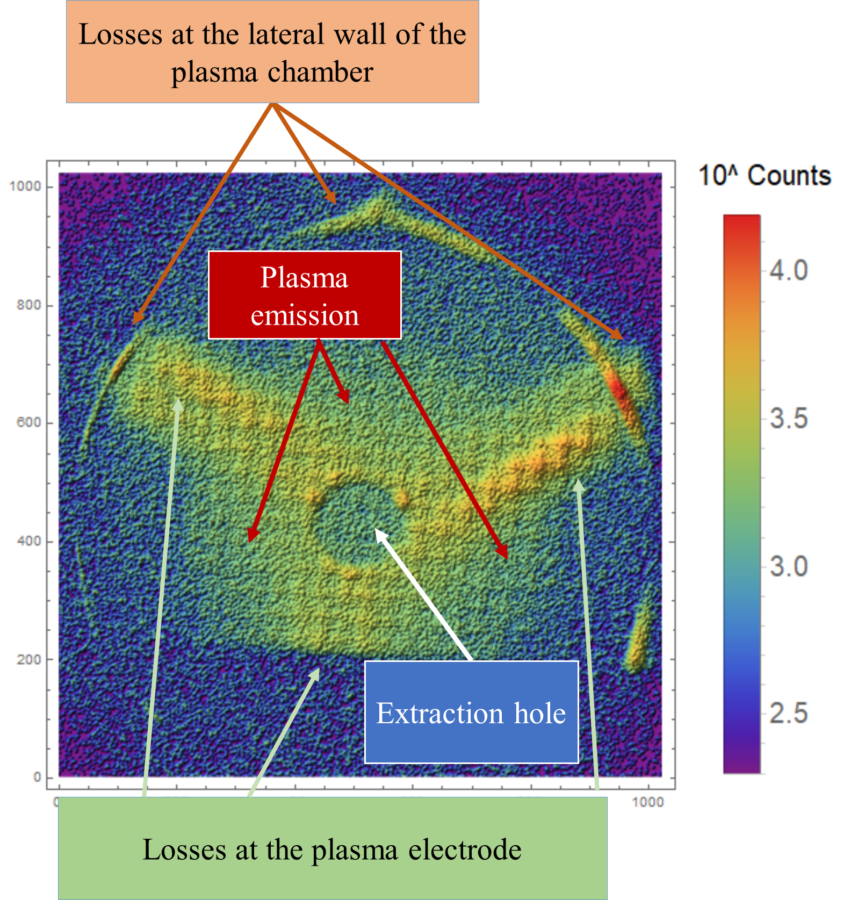
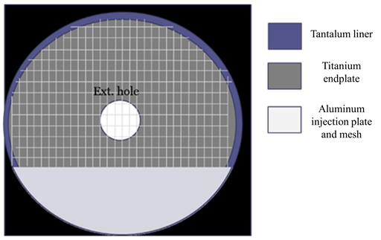
Spectrally integrated images
Argon plasma
Injection plate
We can measure the energy content
Counts ~ Sum [ni * Ei]
Richard Racz, X-ray Diagnostics of ECR Ion Sources, 22.09.2023, ICIS’23
D. Mascali et al 2022 Plasma Phys. Control. Fusion 64 035020

Slide 26
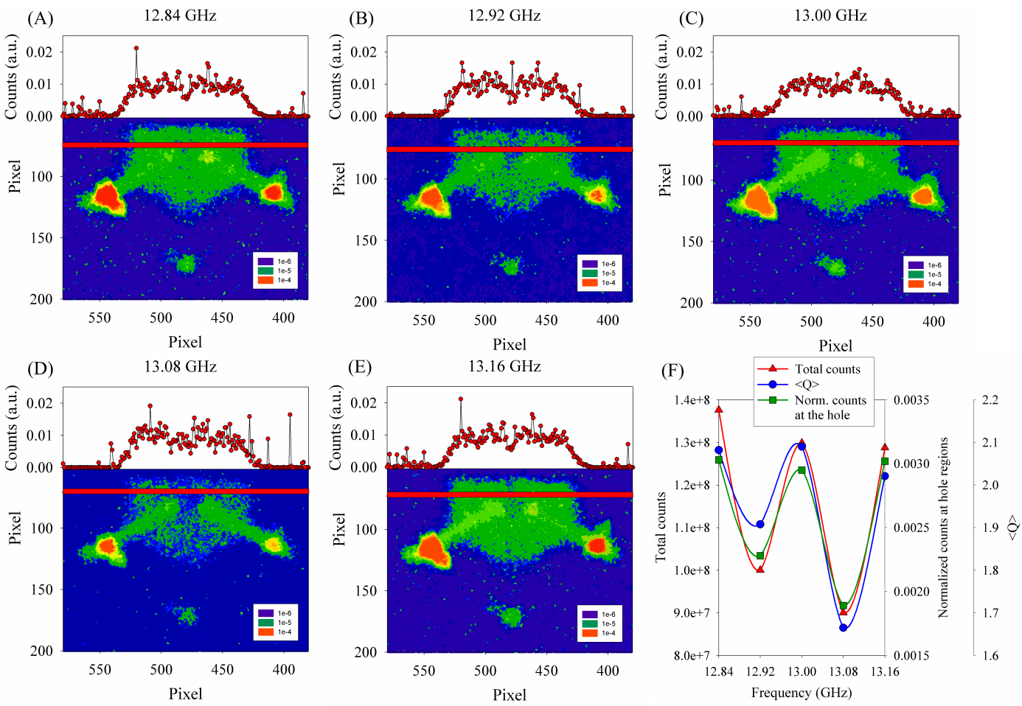
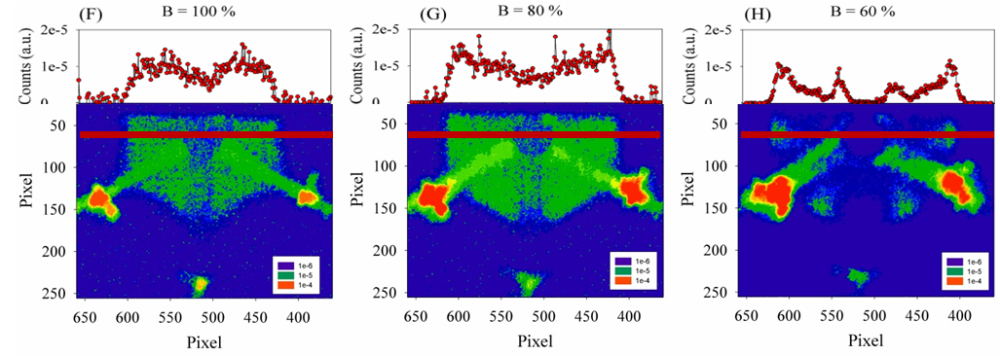
Some example
Frequency tuning
Axial B-field tuning
Plasma images in the near axis region becomes emptier at each reduction step (horizontal profiles)
Plasma is expanding and is shifting toward the plasma chamber wall
This shift can be explained by the radial expand of the resonant surface
Strong effect of the rf frequency on the plasma images especially in the near axis region
The total counts measured at the near axis regions
R. Racz et alPlasma Sources Sci. Technol. 26 (2017) 075011 (14pp)
Richard Racz, X-ray Diagnostics of ECR Ion Sources, 22.09.2023, ICIS’23

Slide 27
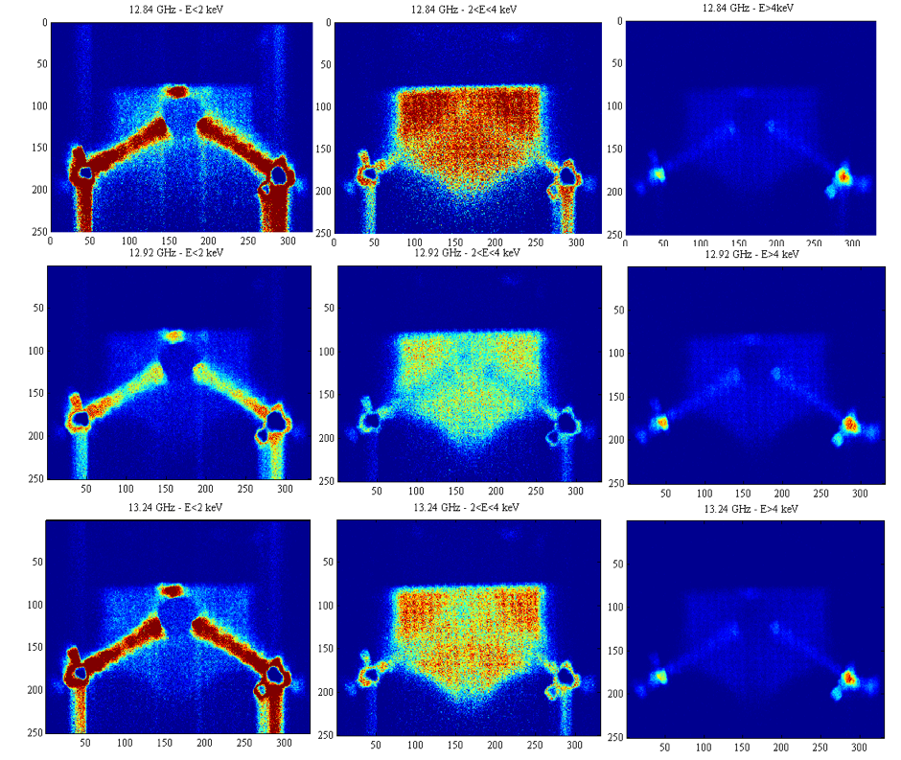
Photon counted images
R. Racz et al Plasma Sources Sci. Technol. 26 (2017) 075011 (14pp)
D. Mascali et al Rev. Sci. Instrum. 87, 02A510 (2016)
Selecting only the pixels of the frames which are loaded by the photons having energy correspond to:
‚Low’ energy E < 2 keV
Argon K-alpha line 2 keV < E < 4 keV
‚High’ energy E > 4 keV
Low power
Low energy electrons lose mainly axially
Spatial distribution of the argon plasma; dense in magnetic gap position
High energy electrons lose mainly radially
Richard Racz, X-ray Diagnostics of ECR Ion Sources, 22.09.2023, ICIS’23

Slide 28
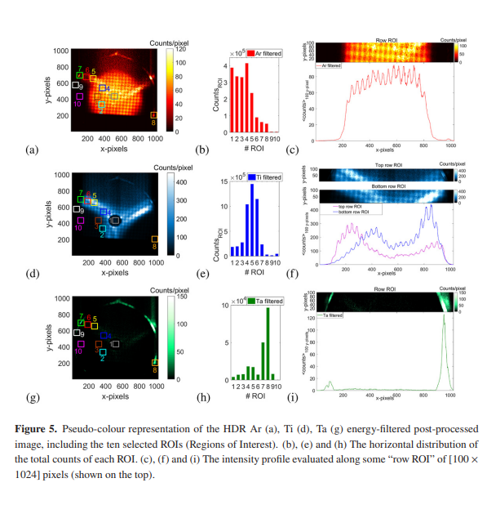

Photon counting at high power operation
E. Naselli et al 2022 JINST 17 C01009
E. Naselli et al Condens. Matter 2022, 7, 5
High power
Read out noise: shutter and /or algorithm
HDR X-ray photography
E. Naselli’s talk yesterday
Important component of PANDORA diagnostics
Calculation of density distribution
Richard Racz, X-ray Diagnostics of ECR Ion Sources, 22.09.2023, ICIS’23
B. Mishra et al PHYSICS OF PLASMAS 28 : 10 Paper: 102509 (2021)

Slide 29

Thank You for Your attention
For more information and references:

