Slide 1
Use TRIUMF produced radionuclides for radiopharmaceutical development
Hua Yang
Research Scientist, Life Sciences Division, TRIUMF
Adjunct Professor, Department of Chemistry, Simon Fraser University

Slide 2
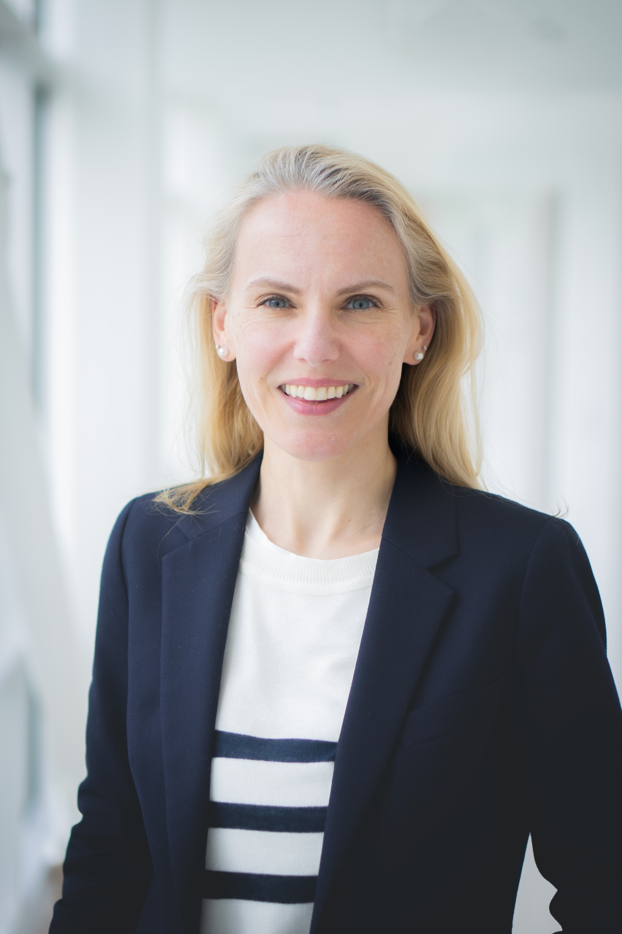
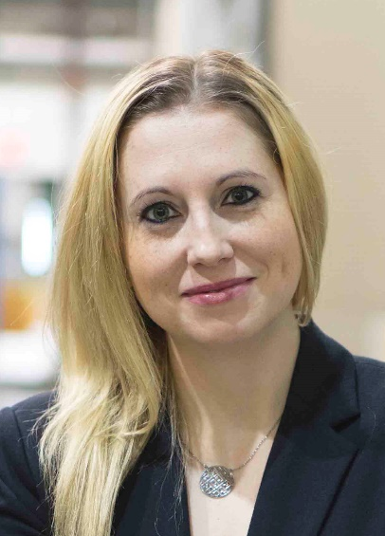
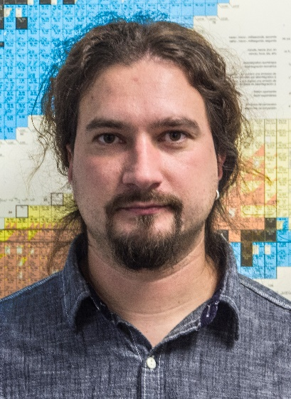
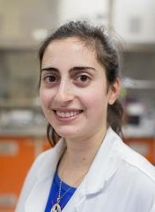
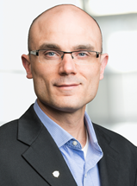
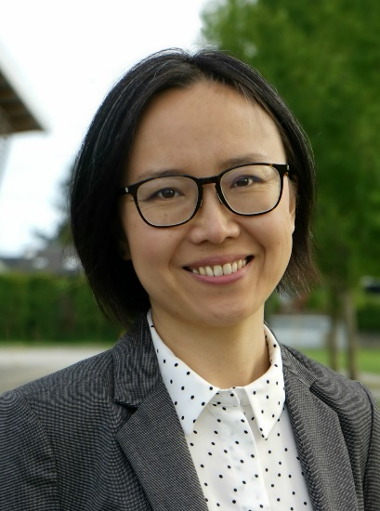
Life Sciences Division
Applied Ion Beams
Nuclear Chemistry
Applied Isotopes
Cornelia
Hoehr
Monika
Stachura
Valery
Radchenko
Paul
Schaffer
Hua
Yang
Caterina
Ramogida

Slide 3
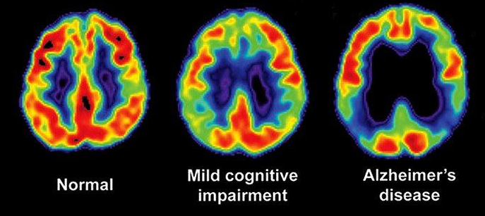
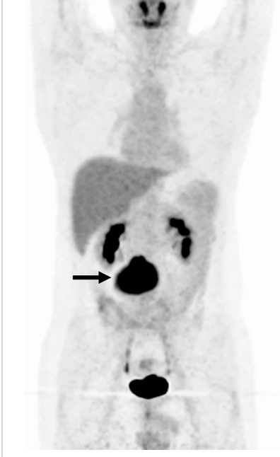
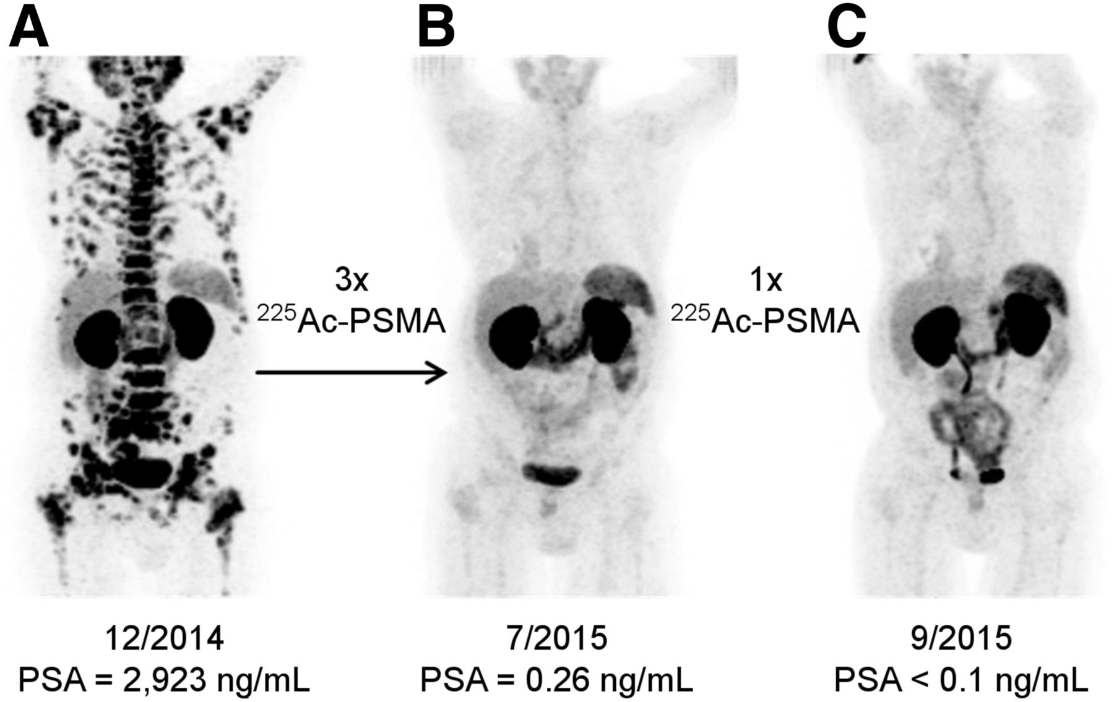
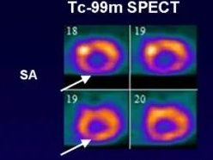
Nuclear Medicine
Theranostics
β: ⁹⁰Y, ¹⁷⁷Lu, ¹³¹I, ¹⁶¹Tb
α: ²²⁵Ac, ²²³Ra, ²¹³Bi, ²²⁷Th
MAE: ¹¹¹In, ¹⁹⁷Hg, ¹⁶⁵Er
PET (e⁺): ¹⁸F, ⁸⁹Zr,⁶⁸Ga
SPECT (γ):^{99m}Tc, ¹²³I
Imaging
Radioisotopes
Therapy
Brain
Heart
Whole body
Dicardiology.com
Everydayhealth.com
J. Nucl. Med. 2016

Slide 4
Nuclear Medicine
Theranostics
β: ⁹⁰Y, ¹⁷⁷Lu, ¹³¹I
α: ²²⁵Ac, ²²³Ra, ²¹³Bi
Auger e⁻: ¹¹¹In
PET (e⁺): ¹⁸F, ⁸⁹Zr,⁶⁸Ga
SPECT (γ):^{99m}Tc, ¹²³I
Imaging
Radioisotopes
Therapy
Our goals:
Production of unconventional radionuclides
New chemistry to incorporate radionuclides
Novel radiopharmaceuticals for better cancer imaging or therapy
Dicardiology.com
Everydayhealth.com

Slide 5
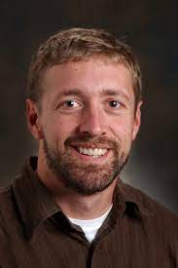
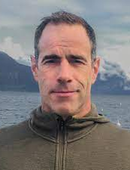
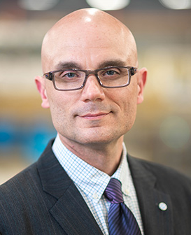
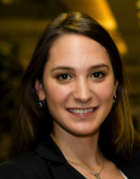
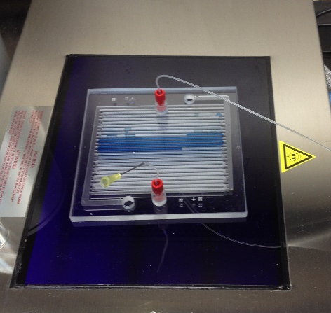
Photocatalyzed fluorination – new method to make ¹⁸F amino acids
SFU: Robert Britton, Matthew Nodwell, Zheliang Yuan
TRIUMF: Paul Schaffer, Milena Čolović, Gokce Engudar, Hua Yang
BC Cancer: Francois Benard, Florian Kuchenbauer, Helen Merkens
Britton
Nodwell
Schaffer
Čolović
1-step fluorination from unmodified amino acid precursors
Microfluidic chip

Slide 6
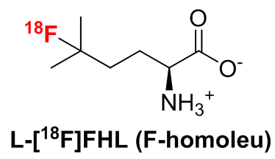
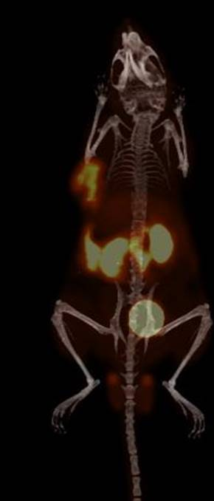
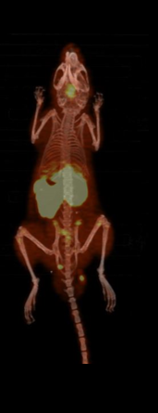
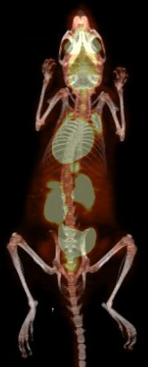
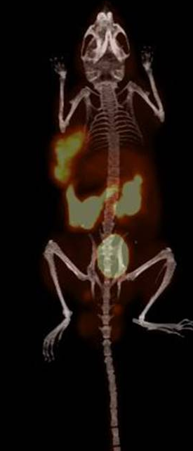
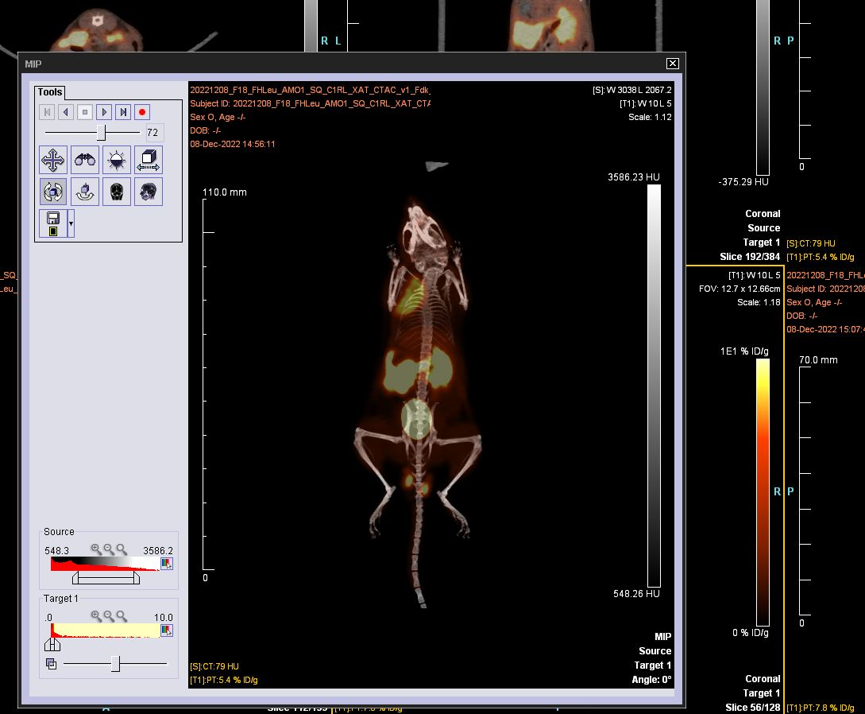
Imaging multiple myeloma with L-5-[¹⁸F]FHL
10 % ID/g
0 %ID/g
NCI H929
L363
[¹⁸F]FHL uptake via LAT1 transporter
Metastases evident on PET/CT scans with [¹⁸F]FHL and [¹⁸F]FDG, Many more metastases could be identified with [¹⁸F]FHL PET
Higher basal uptake of [¹⁸F]FDG overall
Liver metastasis evident on [¹⁸F]FDG scan which would have likely been missed on the [¹⁸F]FHL scan
[¹⁸F]FHL [¹⁸F]FDG
Local multiple myeloma
Metastatic multiple myeloma
Radiochemical process allows synthesis of large number of radiotracers
High impact, award winning publications, multiple grants
Pending clinical translation

Slide 7
Imaging multiple myeloma with L-5-[¹⁸F]FHL
10 % ID/g
0 %ID/g
NCI H929
L363
[¹⁸F]FHL uptake via LAT1 transporter
Metastases evident on PET/CT scans with [¹⁸F]FHL and [¹⁸F]FDG, Many more metastases could be identified with [¹⁸F]FHL PET
Higher basal uptake of [¹⁸F]FDG overall
Liver metastasis evident on [¹⁸F]FDG scan which would have likely been missed on the [¹⁸F]FHL scan
[¹⁸F]FHL [¹⁸F]FDG
Local multiple myeloma
Metastatic multiple myeloma
Radiochemical process allows synthesis of large number of radiotracers
High impact, award winning publications, multiple grants
Pending clinical translation

Slide 8
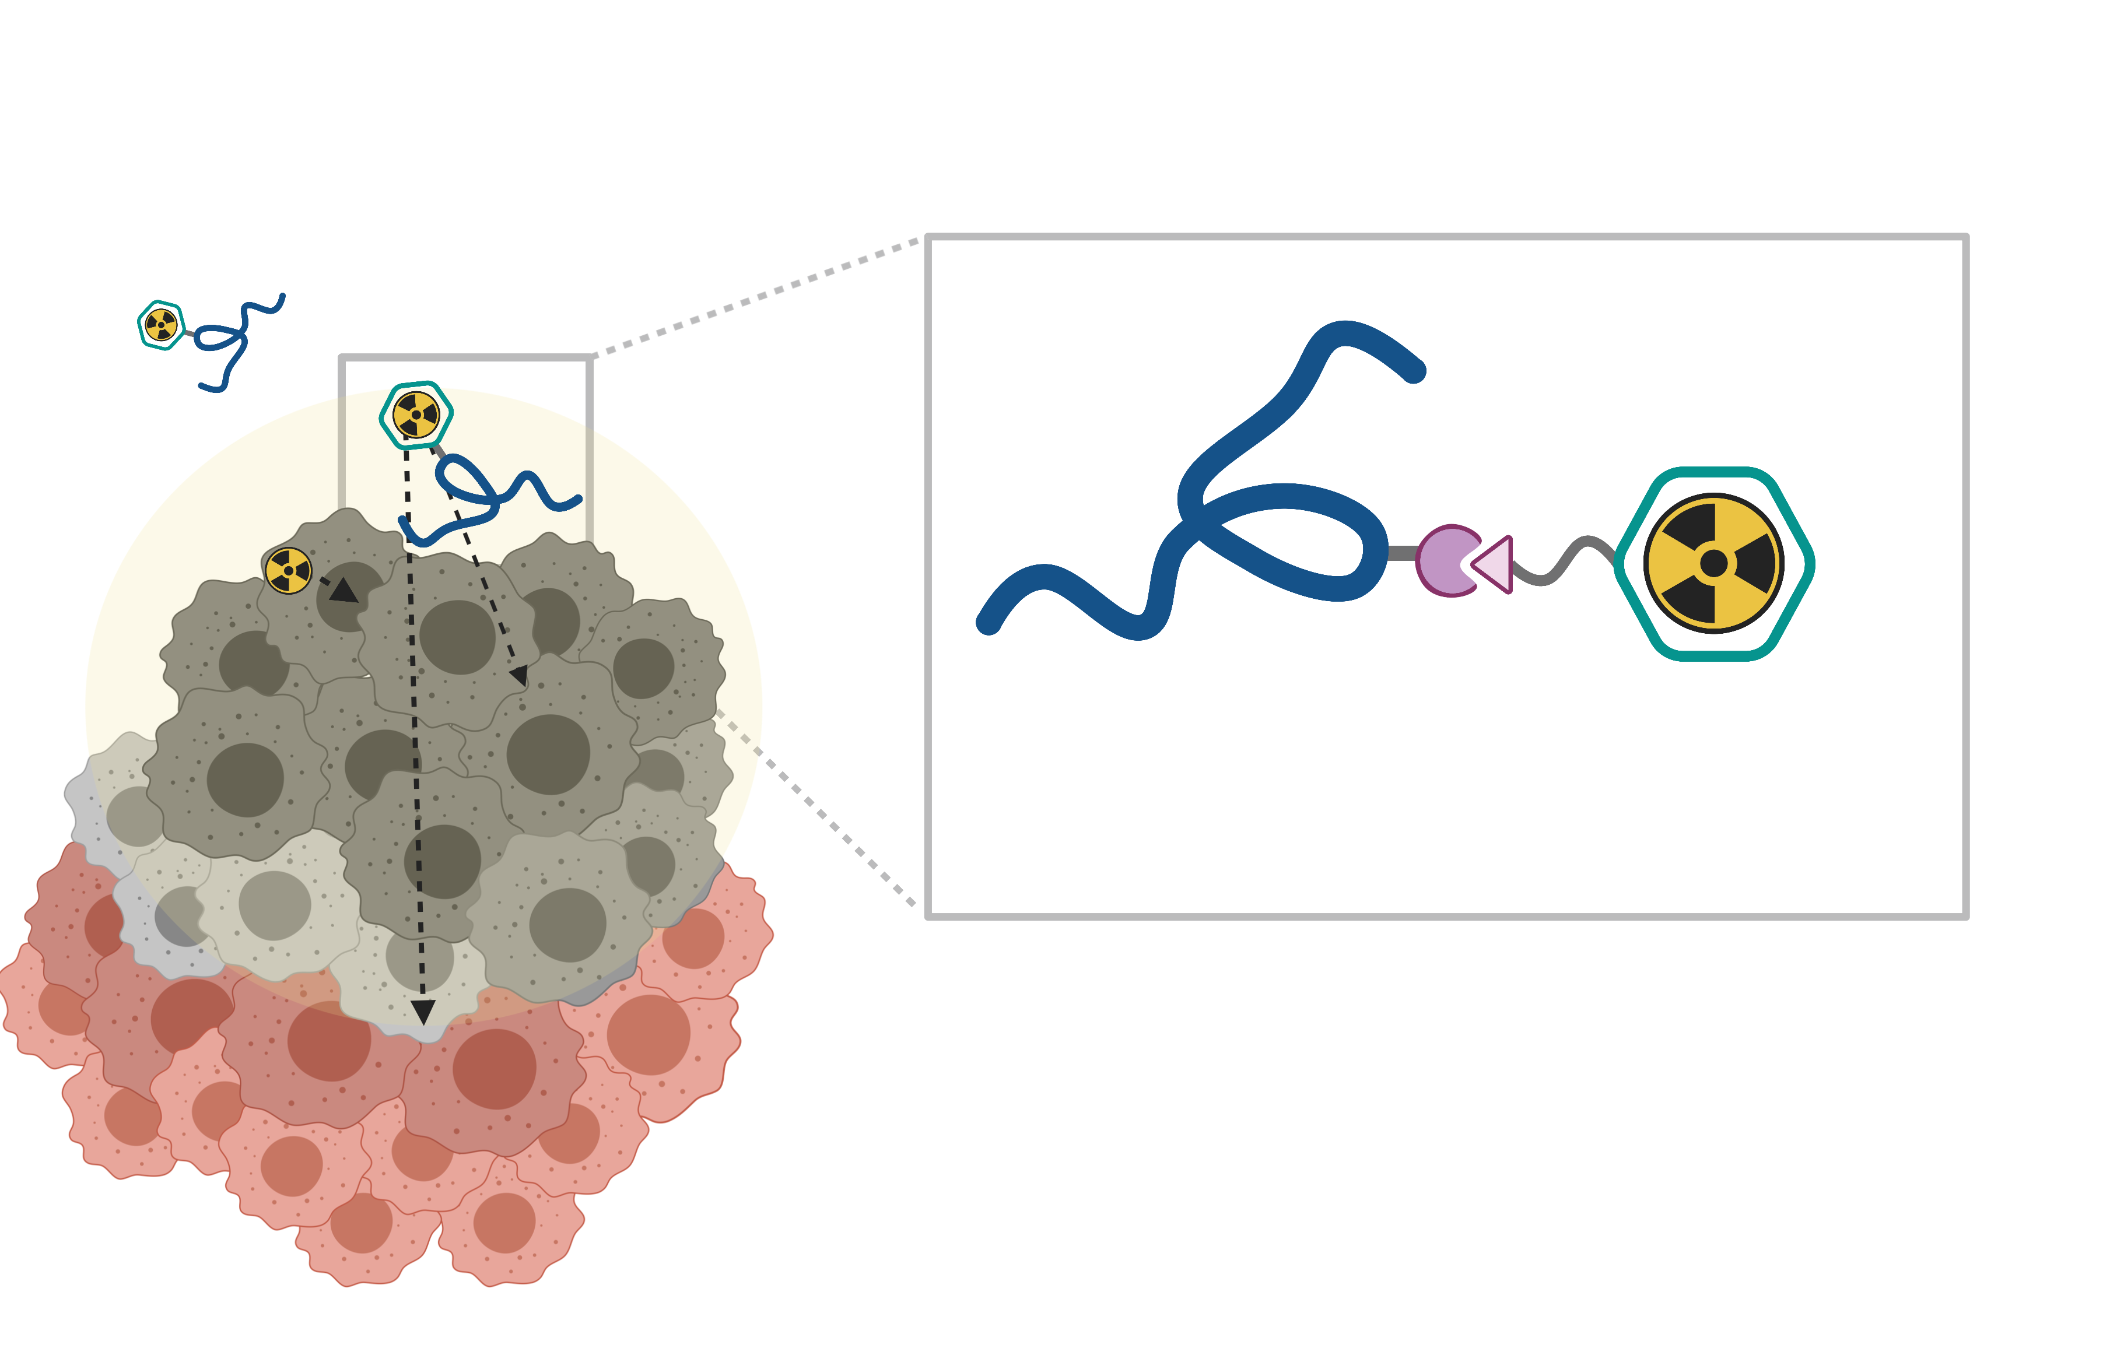
New chemistry for Targeted Radionuclide Therapy (TRT)
Tumour-targeting vector
(peptide, mAb, small molecules)
Expression level
Off-target uptake
Stability
Pharmacokinetics
Bifunctional chelator
and linker
Labeling efficiency
Labeling conditions
Stability
Impact on uptake
Radionuclide
Decay characteristics
Tissue penetration
Availability
Therapeutic radiation dose is selectively delivered to malignant tissue using tumor-targeting vector

Slide 9
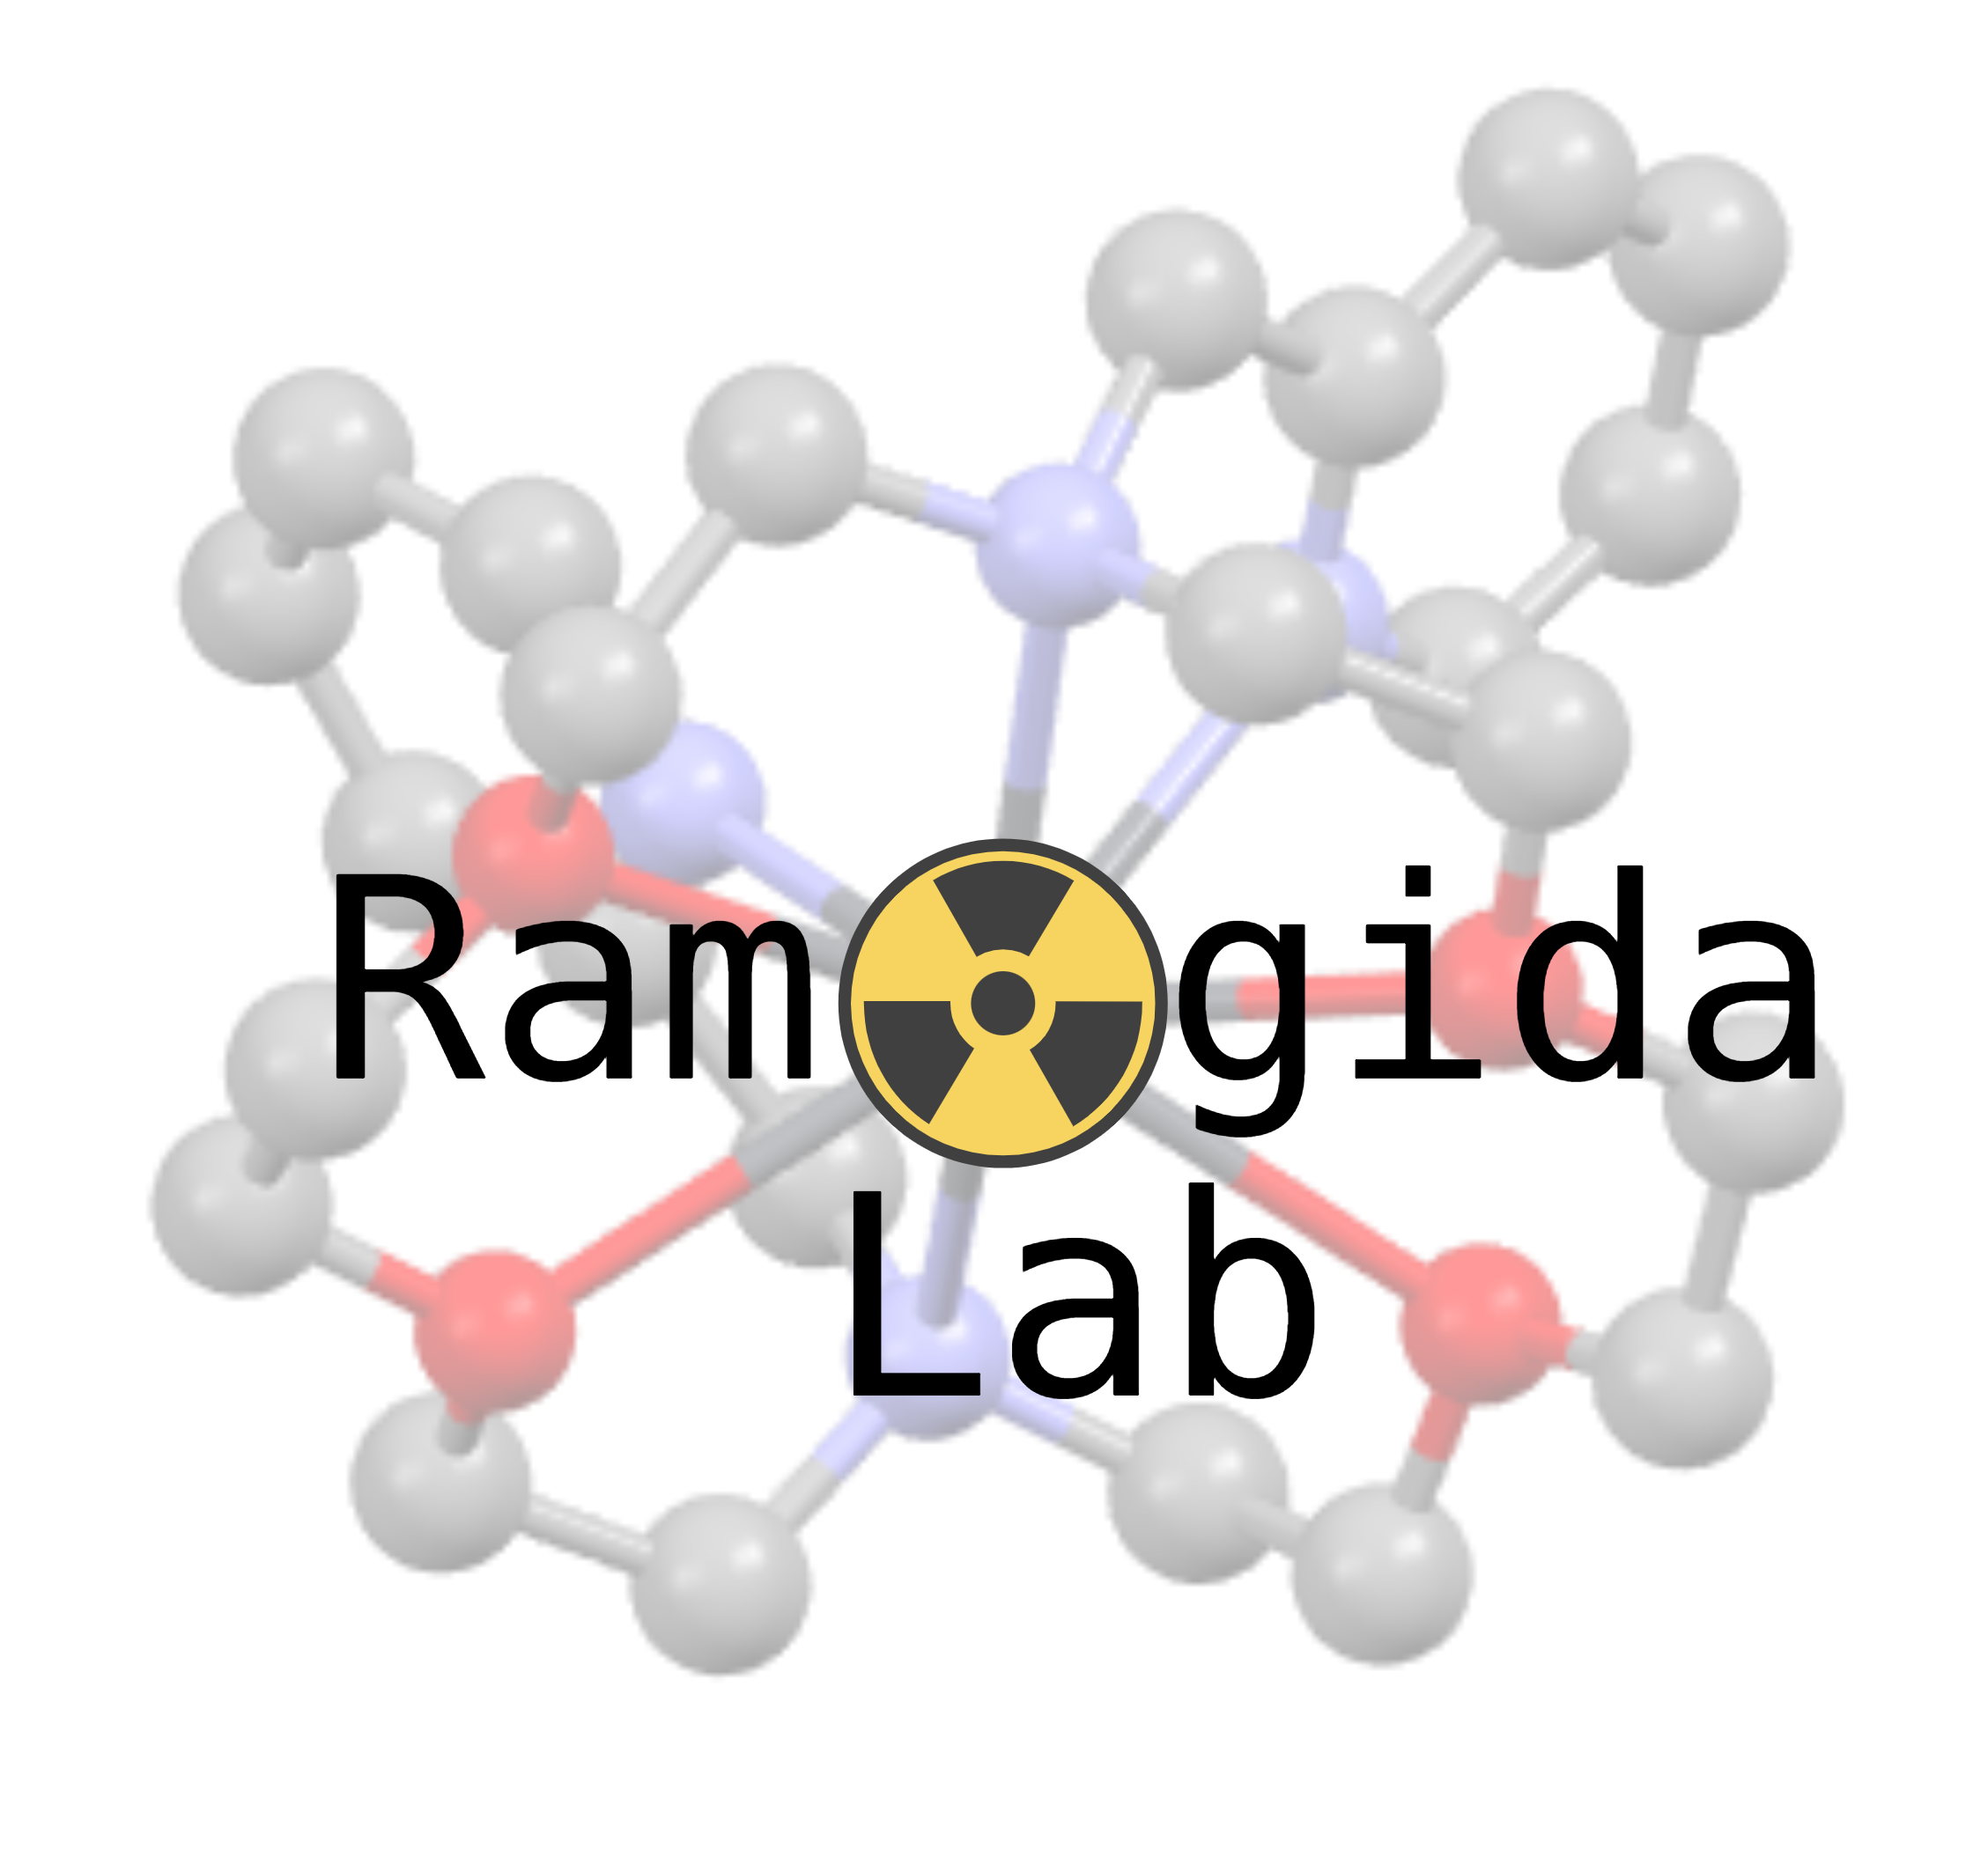
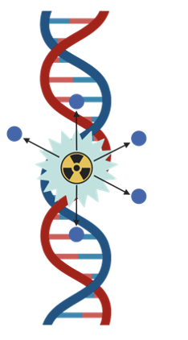
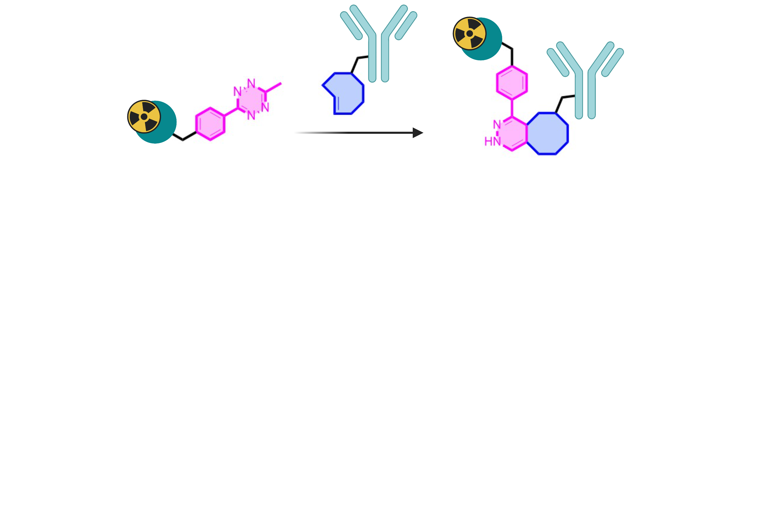
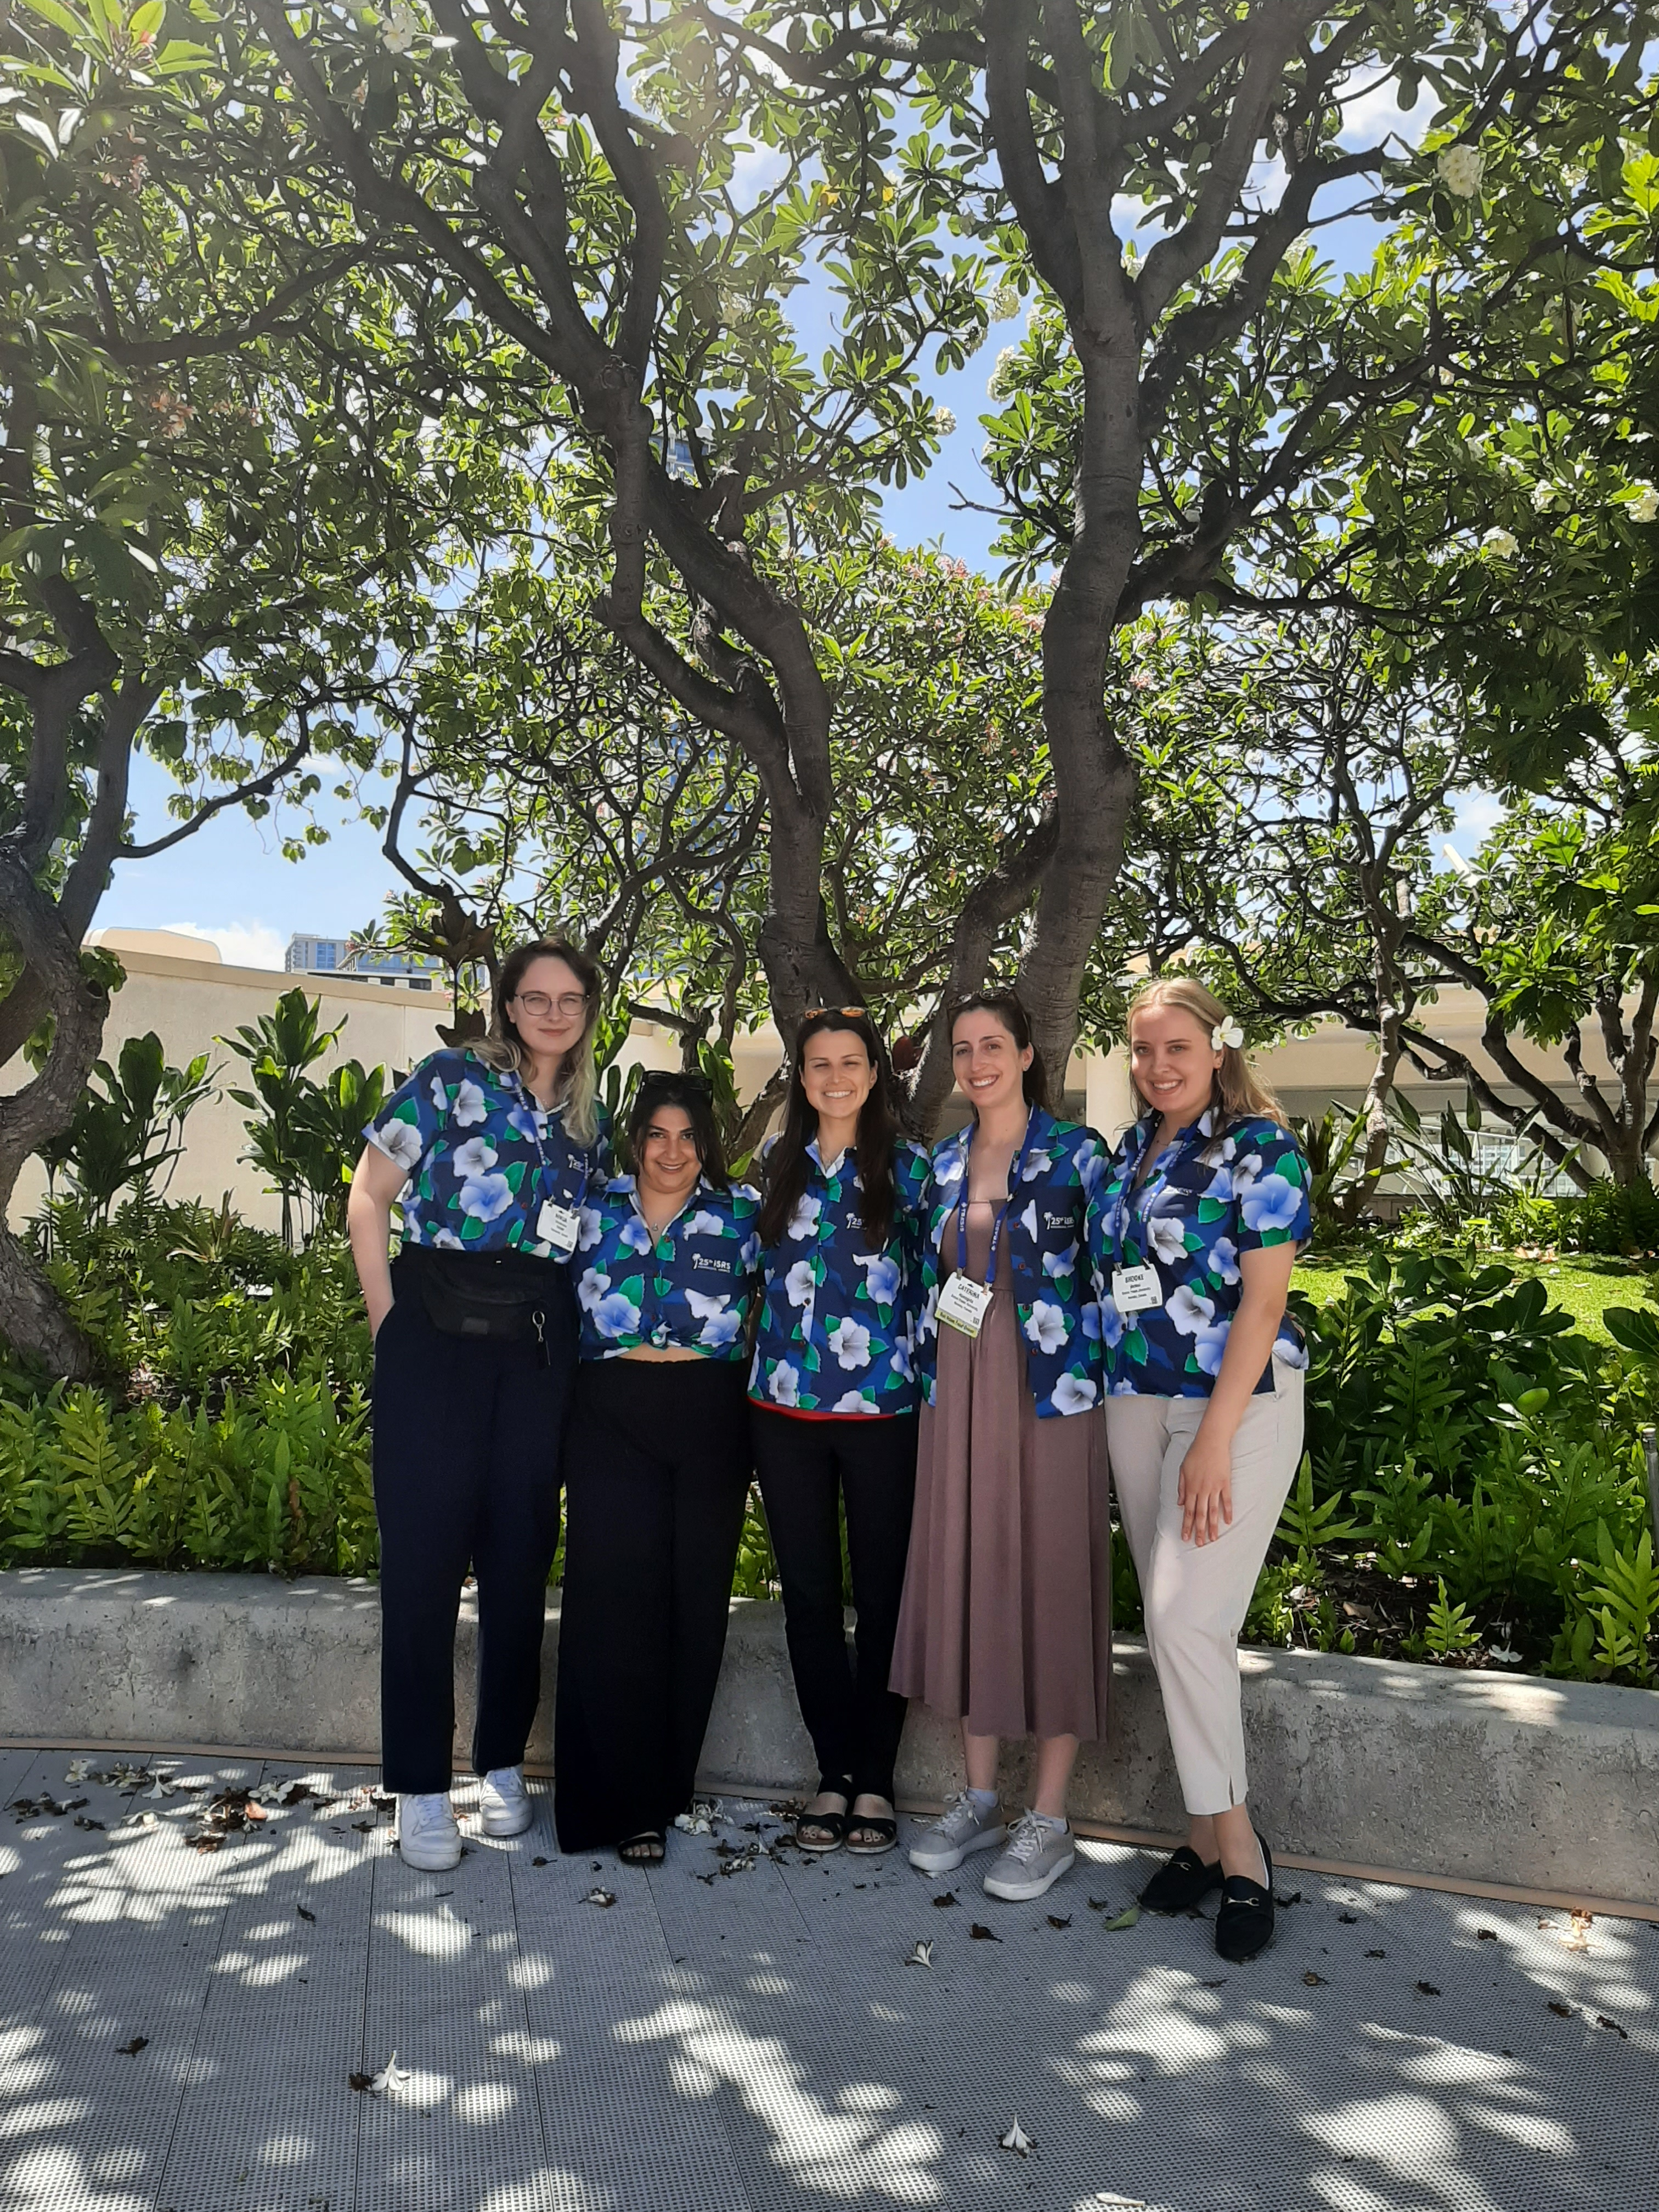
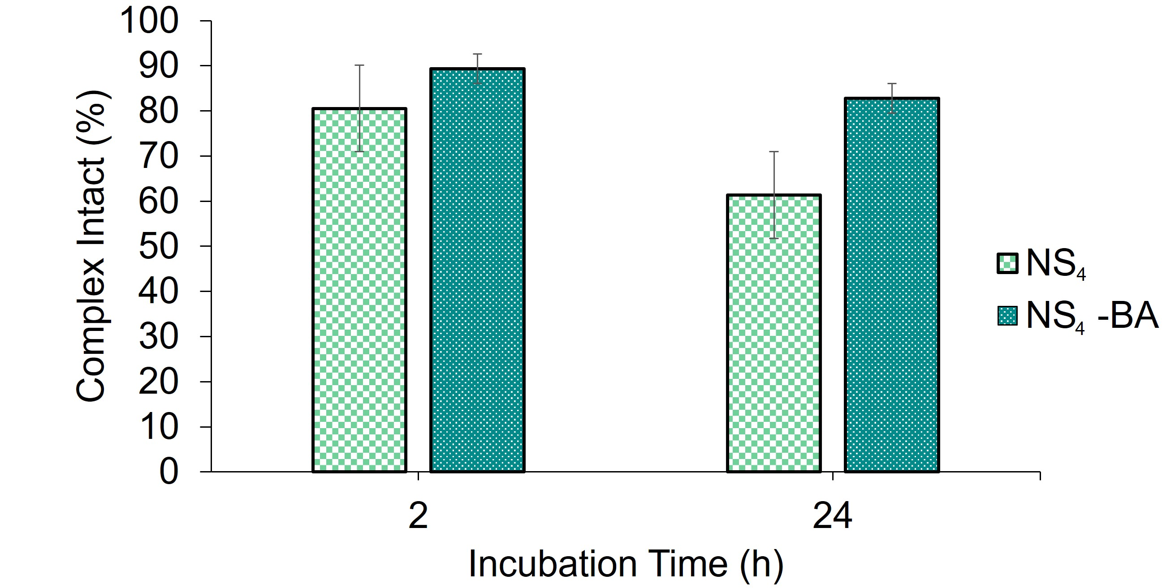
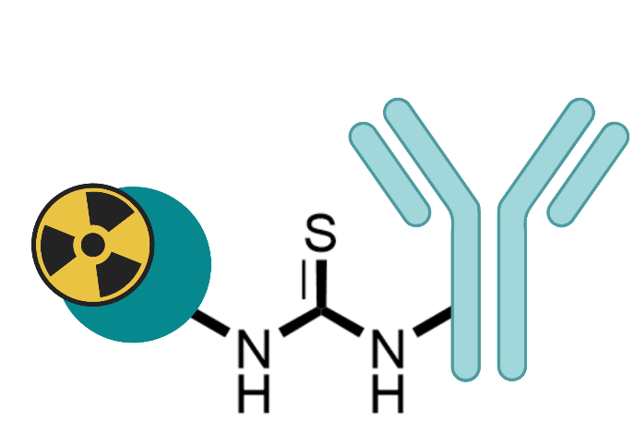


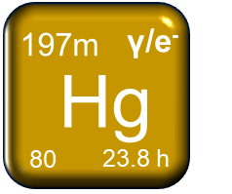
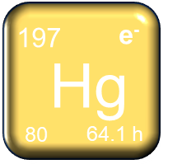
Capturing the Exotic Meitner-Auger Emitter ^{197m/g}Hg with Sulfur-rich Macrocycles
^{197m/g}Hg radiolabeling (37°C)
Preparation of immunoconjugates currently underway for targeted in vitro/in vivo studies
Parmissa Randhawa
PhD Candidate
DFT of [Hg(NS₄-BA)]²⁺
(lowest energy configuration)
Therapy + SPECT imaging
Therapy
Reilly
Lab
Radiometal-complex stability in human serum
Randhawa, P., et al. Chem. – A Eur. J. 2023, 29, e202203815.
https://doi.org/10.1002/chem.202203815
Notes:
We are also heavily involved with L136 and the chelation of Hg-197(m). You would’ve seen Parmissa’s Hg-chelation work on development of selective chelators for radiomercury. Her first generation ligands were recently published in Chem A Eur J. These NS4 macrocycle derivatives are able to incorporate Hg-197m,g under biologically relevant conditions (37degC) and form stable complexes in vitro. She has since prepared bifunctional analogues of her most promising scaffolds for conjugation to trastuzumab for proof-of-principle in vivo studies.

Slide 10
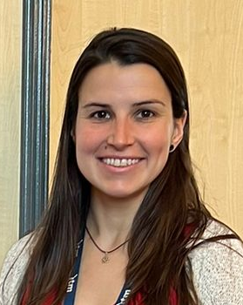
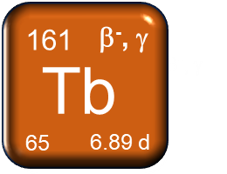
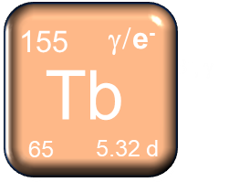
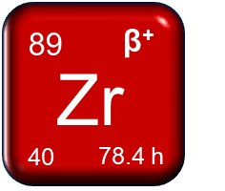
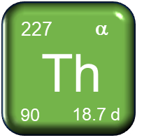
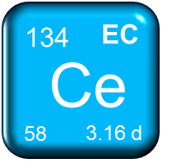
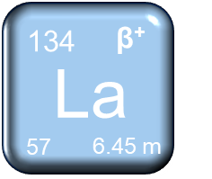
High dentate HOPO chelator for radioactinides/lanthanides
⁸⁹Zr/¹⁶¹Tb/²²⁷Th/¹³⁴Ce-HOPO-O₈-Tz immunoconjugates for (pre-)targeting
Carbo-Bague, I., Inorg. Chem. 2023, asap. https://pubs.acs.org/doi/10.1021/acs.inorgchem.2c03671
Imma Carbo-Bague
PhD Candidate
Notes:
Imma published her work on the decadentate 1,2-HOPO ligand with isotopes of Ac, La, Tb, and Th, and after careful assessment, both the 8- and her novel 10-coordinate structure showed promise for both Tb and Th isotopes. She has since prepared bifunctional analogues with Tz and is starting to study their in vivo behaviour when conjugated to trastuzumab. She is conducting studies with the Zr-89 and Tb-161 labeled conjugated.
She also initiated a collaboration with UCSF who are performing preclinical in vivo work with her BFC using their YS5 antibody and labeled with Ce-134 and Th-227.

Slide 11
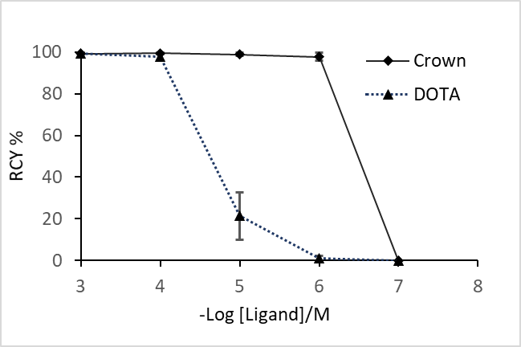
New chelators for therapeutical isotopes: crown
Crown: a new generation chelate for therapeutic isotopes: Ac³⁺, Bi³⁺, Lu³⁺, Tb³⁺
Labeling: quantitative, fast, ambient temperature, physiological pH
TRIUMF proprietary chelator
Crown
²²⁵Ac labeling yield with various buffer and pH
²²⁵Ac labeling at various ligand concentration
Crown: r.t.; DOTA: 85ºC, 15 min
²²⁵Ac labeling yield over time
Labels ²²⁵Ac 100 x more efficient than DOTA
Yang, et. al. Chem. Eur. J. 2020, 26, 11435
Wharton, et. al, Molecules, 2023, 28, 3155
Hua Yang
Notes:
Crown labels Ac at room temperature at low concentrations. In this Figure, you can see it

Slide 12
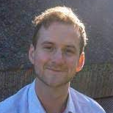
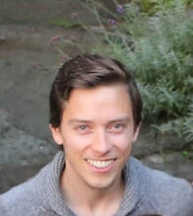
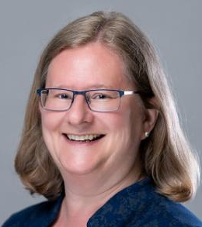
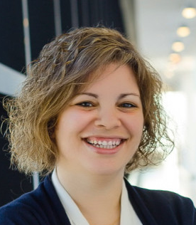
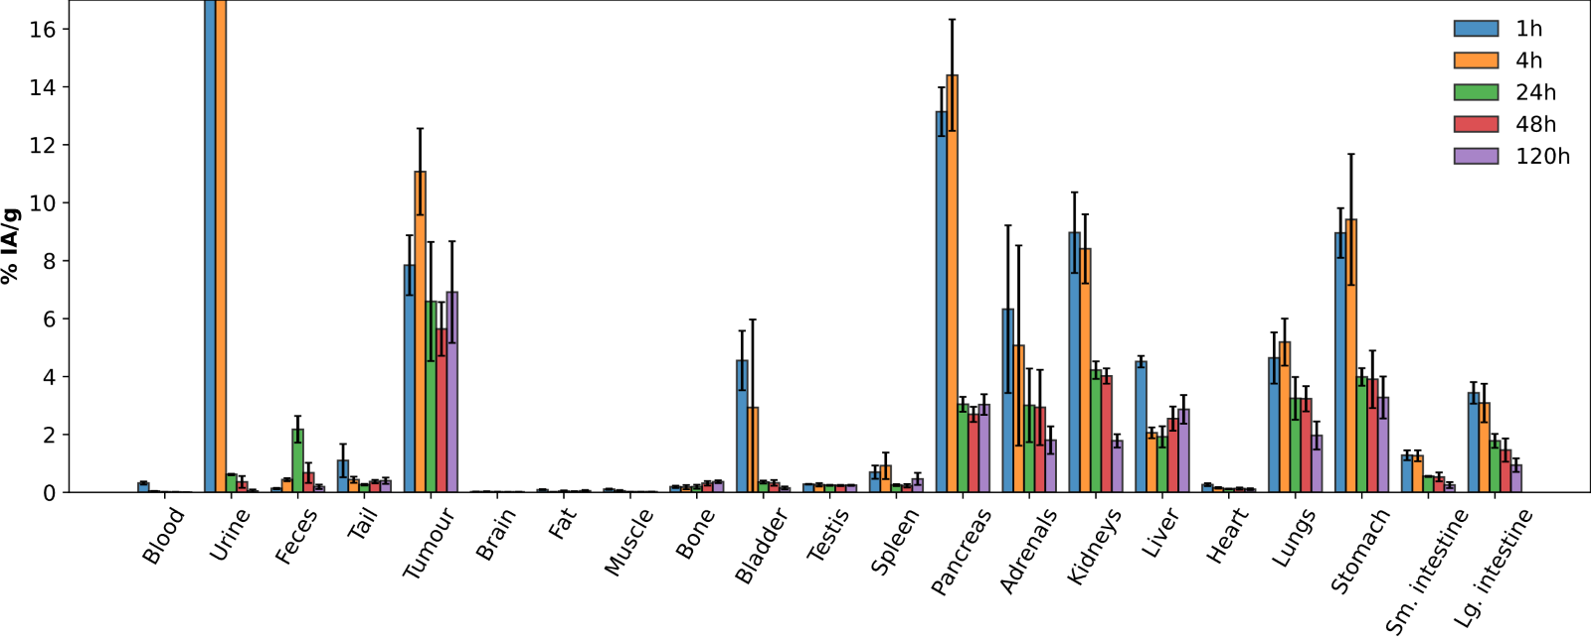
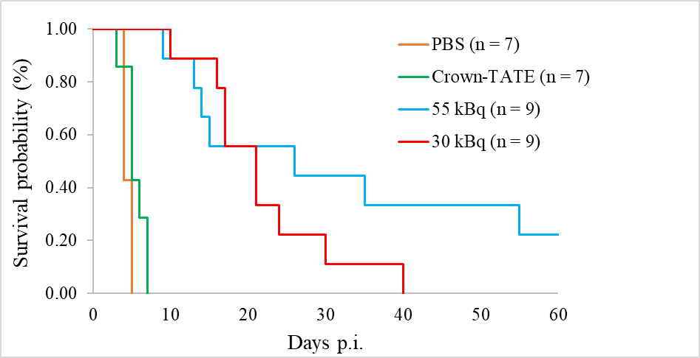
[²²⁵Ac]Ac-crown-TATE animal studies
Ingham
Wharton
Merkens
(BCC)
Rodriguez-Rodriguez (UBC)
Biodistribution of [²²⁵Ac]Ac-crown-TATE in AR42J tumour mice shows high tumor retention (%ID/g > 5) over 5 days (n=4)
TRIUMF in-house developed radiopharmaceutical
First animal study using our Th spallation produced ²²⁵Ac

Slide 13
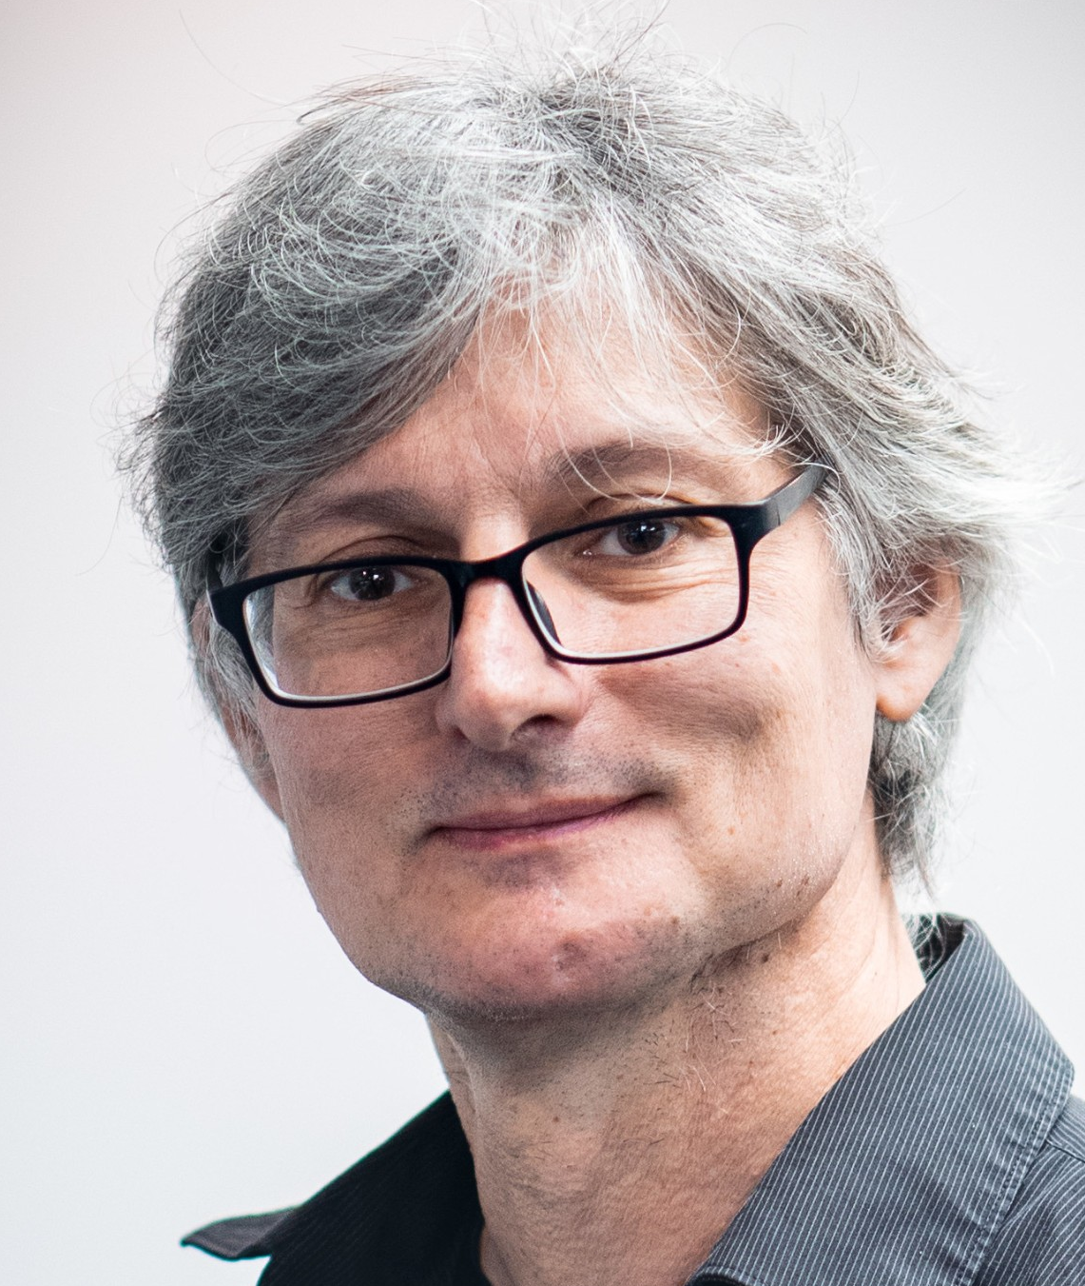
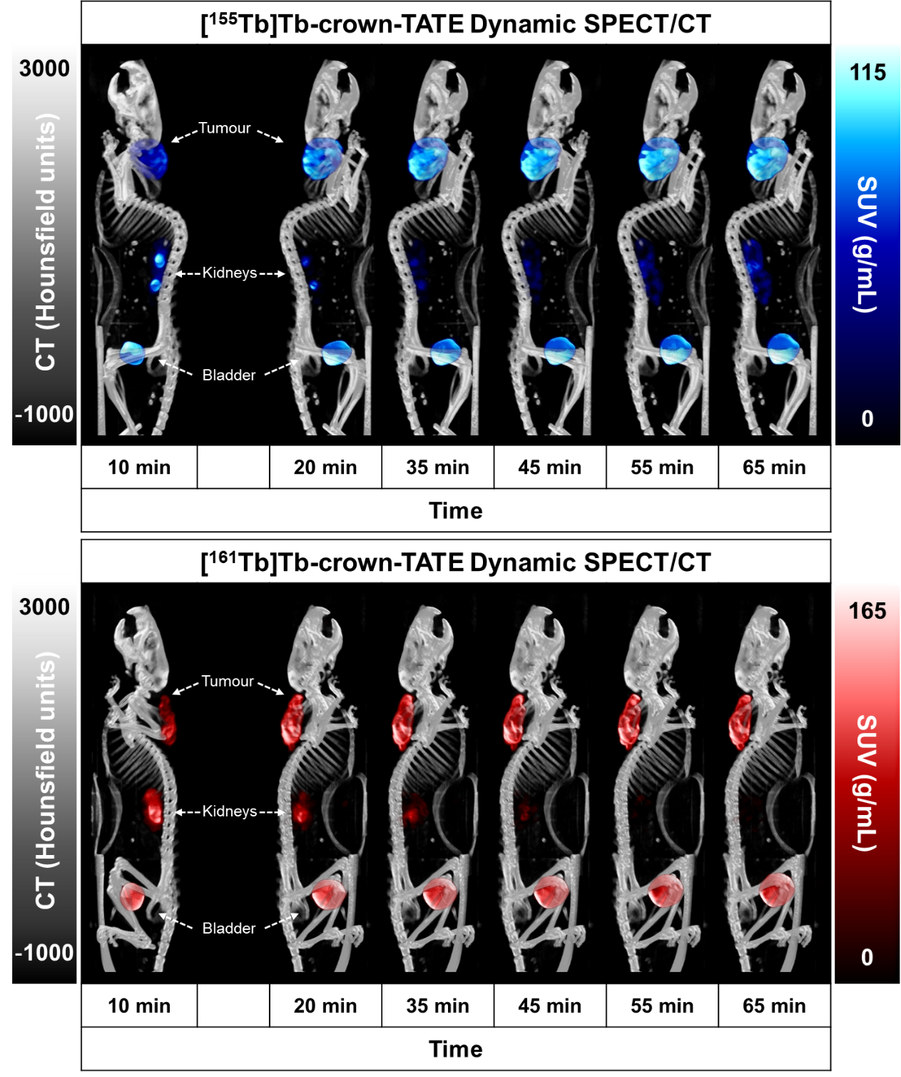
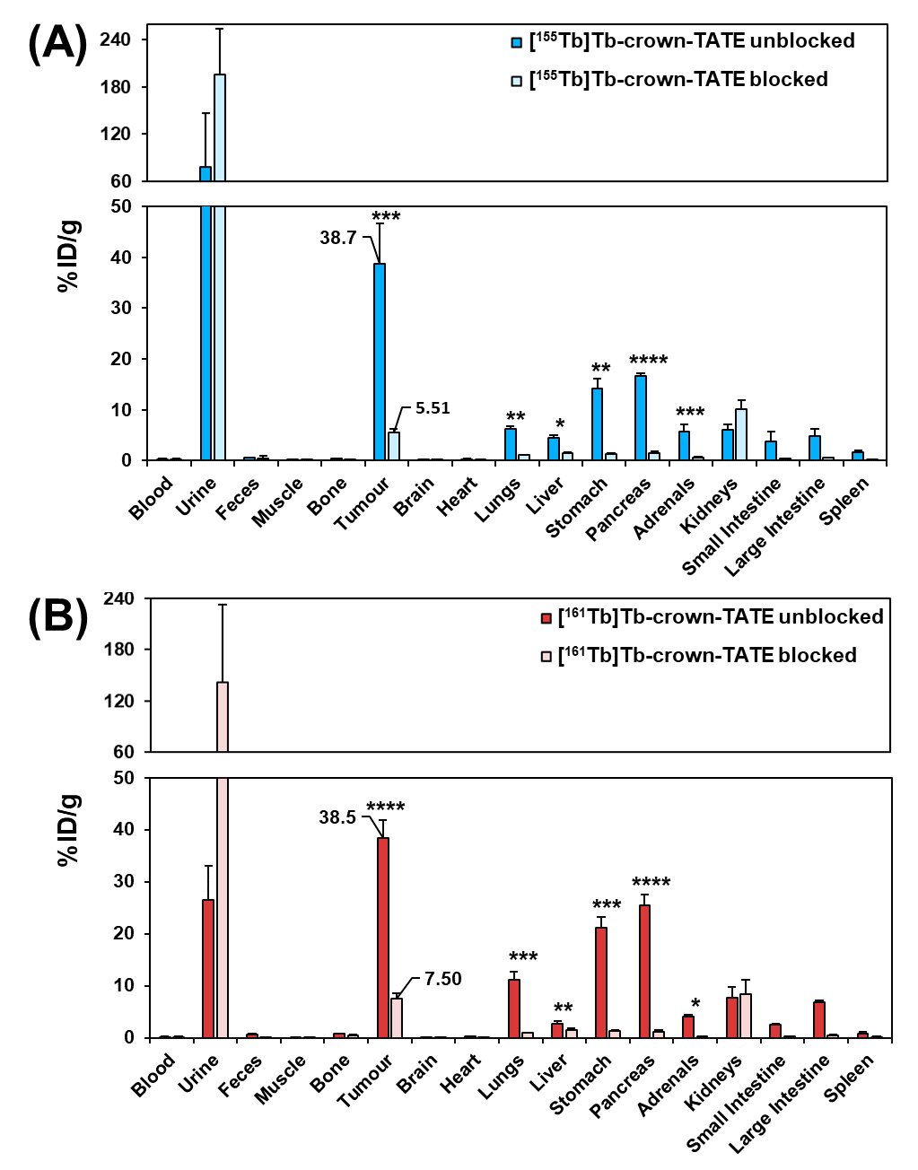
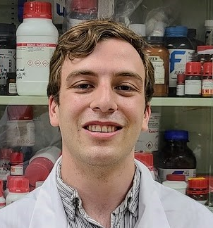
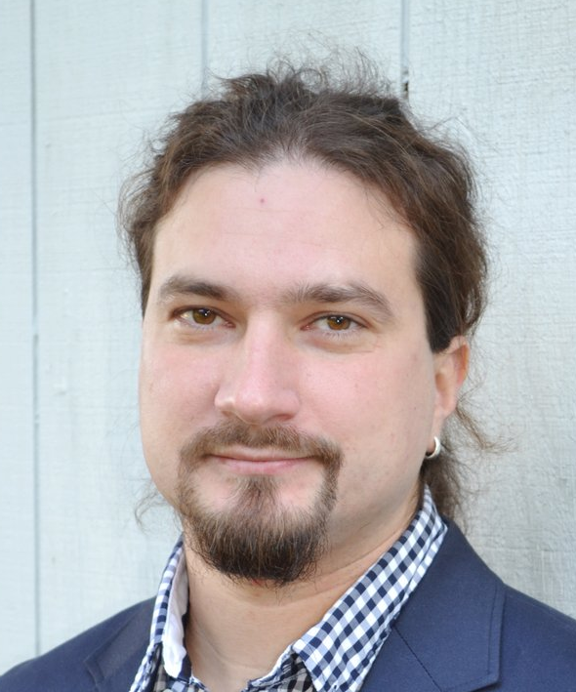
[^{161/155}Tb]Tb-crown-TATE: in vivo SPECT imaging and biodistribution
Wharton
Kunz
S. McNeil
Radchenko
ISAC produced ¹⁵⁵Tb
SCK CEN gifted ¹⁶¹Tb
¹⁵⁵Tb/¹⁶¹Tb theranostic pair
¹⁵⁵Tb serves as imaging partners for ²²⁵Ac for patient screening and dosimetry
Biodistribution at 2h in AR42J tumour mice with and without blocking reagent
SPECT imaging in AR42J tumour mice

Slide 14
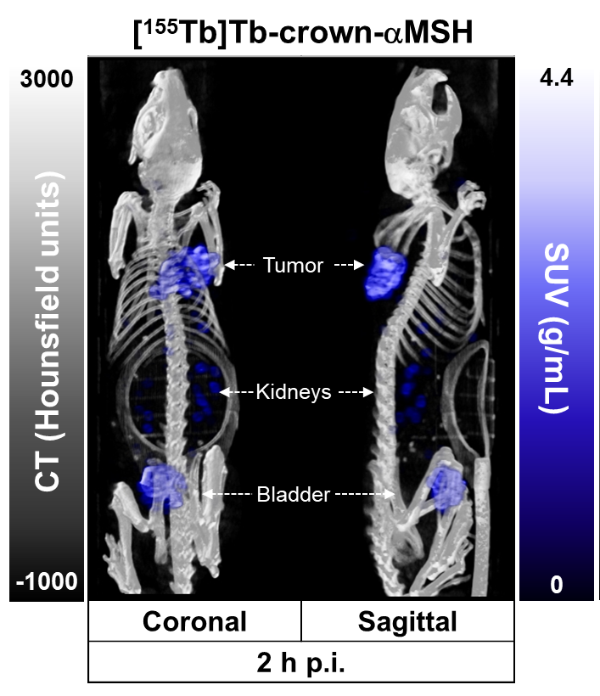


Radiopharmaceutical development
¹⁵⁵Tb from ISAC mass separator
Wharton
Zhang (BCC)
Rodriguez-Rodriguez (UBC)
BioD in B16F10 (melanoma tumor bearing mice) at 2-hour post injection
Late-stage melanoma: low long-term survival, no curable option
MSH derivatives targeting MC1R are highly promising for therapy and imaging
Because of low receptor density, highly effective chelator required to get enough radioactive payload on target
²²⁵Ac-crown-aMSH showed high tumor accumulation and low uptake in healthy organs and tissues (low toxicity)
Imaging partner with ¹⁵⁵Tb for patient screening, dosimetry and monitoring
Kunz

Slide 15

Therapy study with [²²⁵Ac]Ac-crown-αMSH2
Human melanoma model
Significantly improve the survival of the tumour bearing mice
Much better treatment efficacy compared to ¹⁷⁷Lu
Clinical translation hopeful

Slide 16
Summary:
Production of unconventional radionuclides: alpha-emitters and MAE emitters
  ²²⁵Ac, ²¹³Bi, ²²⁷Th, ^{212/203}Pb, ^{197/m}Hg, ¹¹⁹Sb, ^{13x}La, ¹⁶⁵Er etc.
New chemistry to incorporate unconventional radionuclides:
  new fluorination method
  new and better chelators for ^{197/m}Hg, ²²⁵Ac, ^{155/161}Tb, and ²²⁷Th
Novel radiopharmaceuticals for improved cancer imaging or therapy
  Targeting multiple myeloma, breast cancers, neuroendocrine tumours, and melanoma
Future directions:
Wed 5 Year Plan session: Paul Schaffer & Caterina Ramogida

Slide 17
Acknowledgement
TRIUMF
(²²⁵Ac prod.)
Stuart McDiarmid
Chelsey Currie
Julius Balatoni
Geoff Hodgson
Qing Miao
Cornelia Hoehr
Andrew Robertson
Ellard Portman
Paul Schaffer
TRIUMF (Research)
Paul Schaffer
Luke Wharton
Aidan Ingham
Gokce Engudar
Helena Koniar
Milena Čolović
Brooke McNeil
Cornelia Hoehr
Feng Gao
TRIUMF
(support)
RPG
Machine shop
ATG
Research Service
Finance
HR
SFU
Zheliang Yuan
Matthew Nodwell
Robert Britton
Caterina Ramogida
Imma Carbo Bague
Parmissa Randhawa
Shaohuang Chen
Valery Radchenko
Peter Kuntz
UBC
Cristina Rodriguez-Rodriguez
Sathiya Sekar
Maryam Osooly
Chris Orvig
BC Cancer
Chengcheng Zhang
Helen Merkens
François Bénard
Florian Kuchenbauer
SCK CEN
Michiel van de Voorde
Maarten Ooms
$$: TRIUMF, NSERC, NETRF, CIHR, NFRF
Hua Yang
Email: hyang@triumf.ca

Slide 18




Thank you
Merci
www.triumf.ca
Follow us @TRIUMFLab

