Slide 1
ALPHA-g & HAICU Antimatter science at TRIUMF
Science Week 2023
Chukman So
Notes:
Name
Applied physicist
Belong to ALPHA, international collaboration with a major TRIUMF and Canadian contribution
I want to tell you a bit about our work, which is the study of antimatter

Slide 2
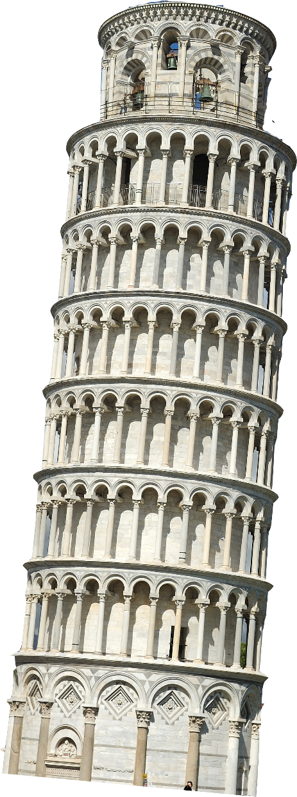
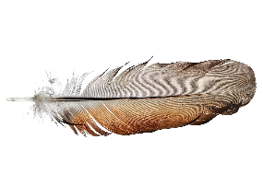
Antimatter science
Fundamental symmetries
ALPHA at Cern’s AD
First trapping in 2010 - Nature 468, 673 (2010)
1S-2S - Nature 557, 71–75 (2018)
1S-2P - Nature 561, 211-215 (2018)
Hyperfine - Nature 548, 66–69 (2017)
Lamb shift - Nature 578, 375–380 (2020)
Charge neutrality - Nature Communications 5, 3955 (2014)
Next: gravity
More exotic than a feather!
Notes:
By comparing antimatter and its normal matter counterpart, we can better understand how the universe come to be dominated by…
Also one way to investigate fundamental CPT symmetry, and to explore physics beyond…
ALPHA specialises in antihydrogen, the antimatter version of hydrogen, which is…
We have had great success…
Next experiment is an analogue of the classic classroom experiment…
Probe the nature of gravity as well as particle physics

Slide 3
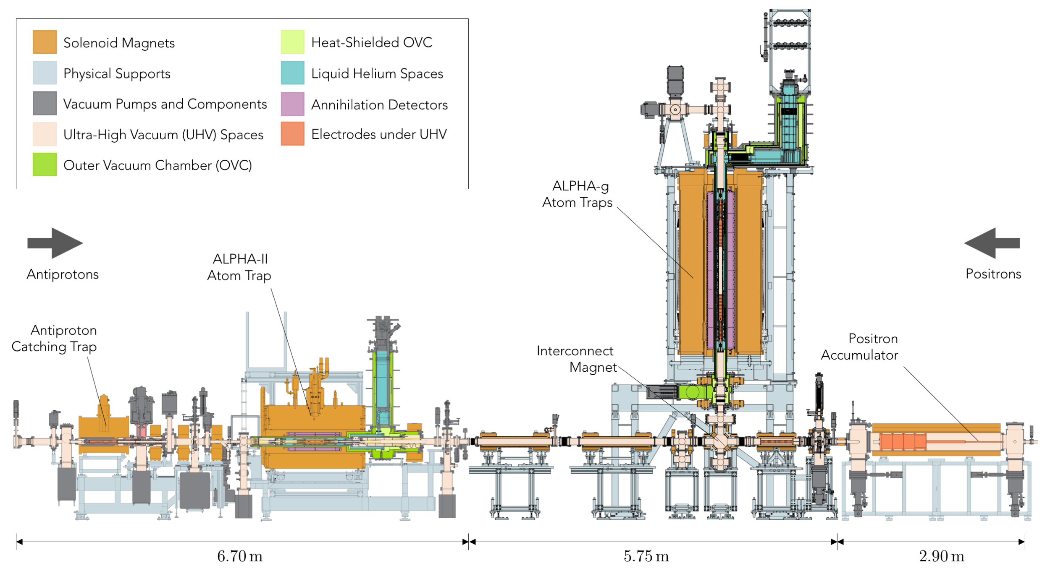
The ALPHA-g experiment

Slide 4
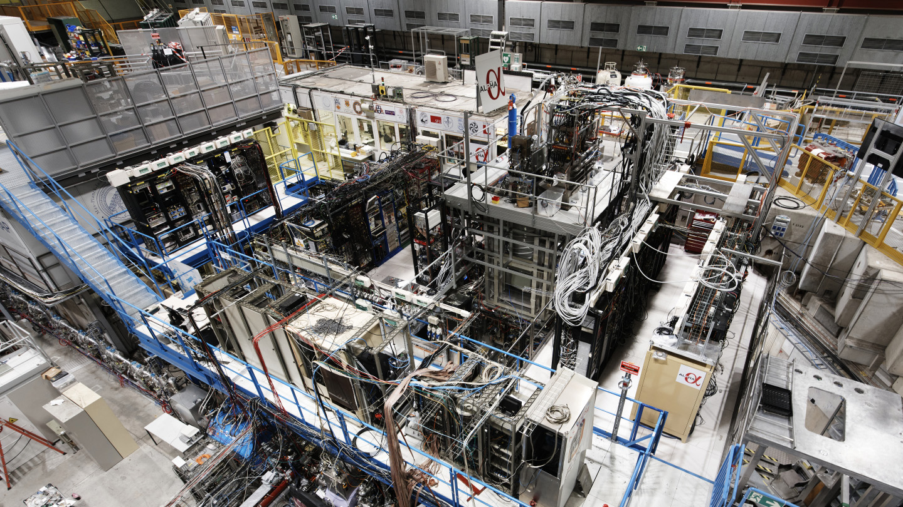

Slide 5
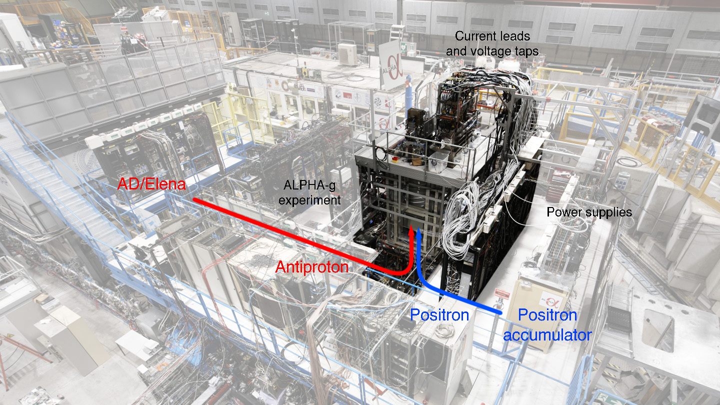

Slide 6
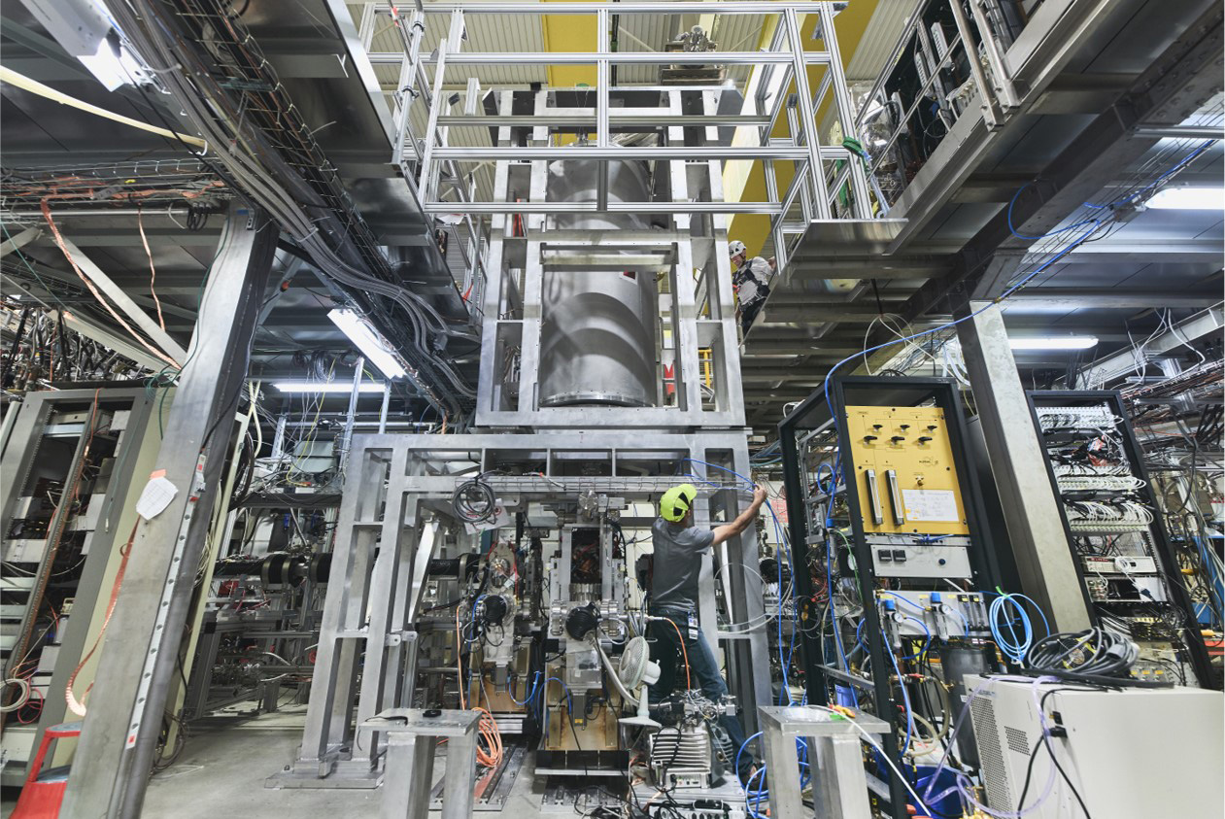

Slide 7
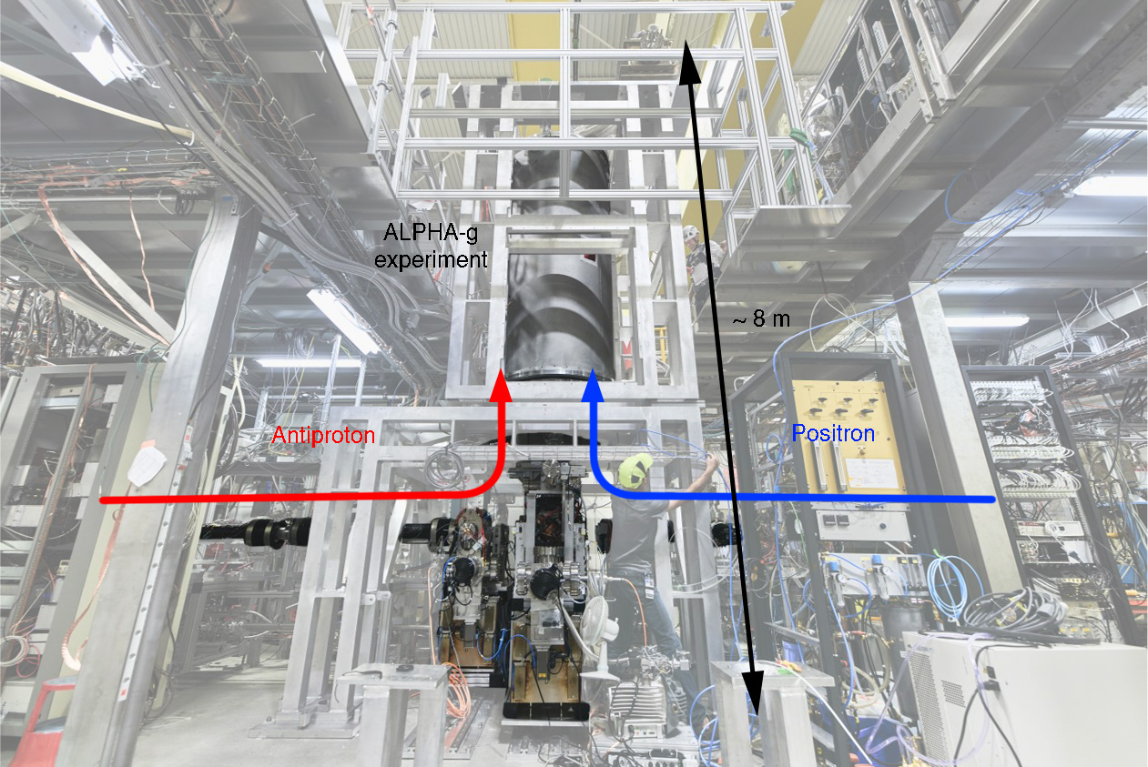

Slide 8
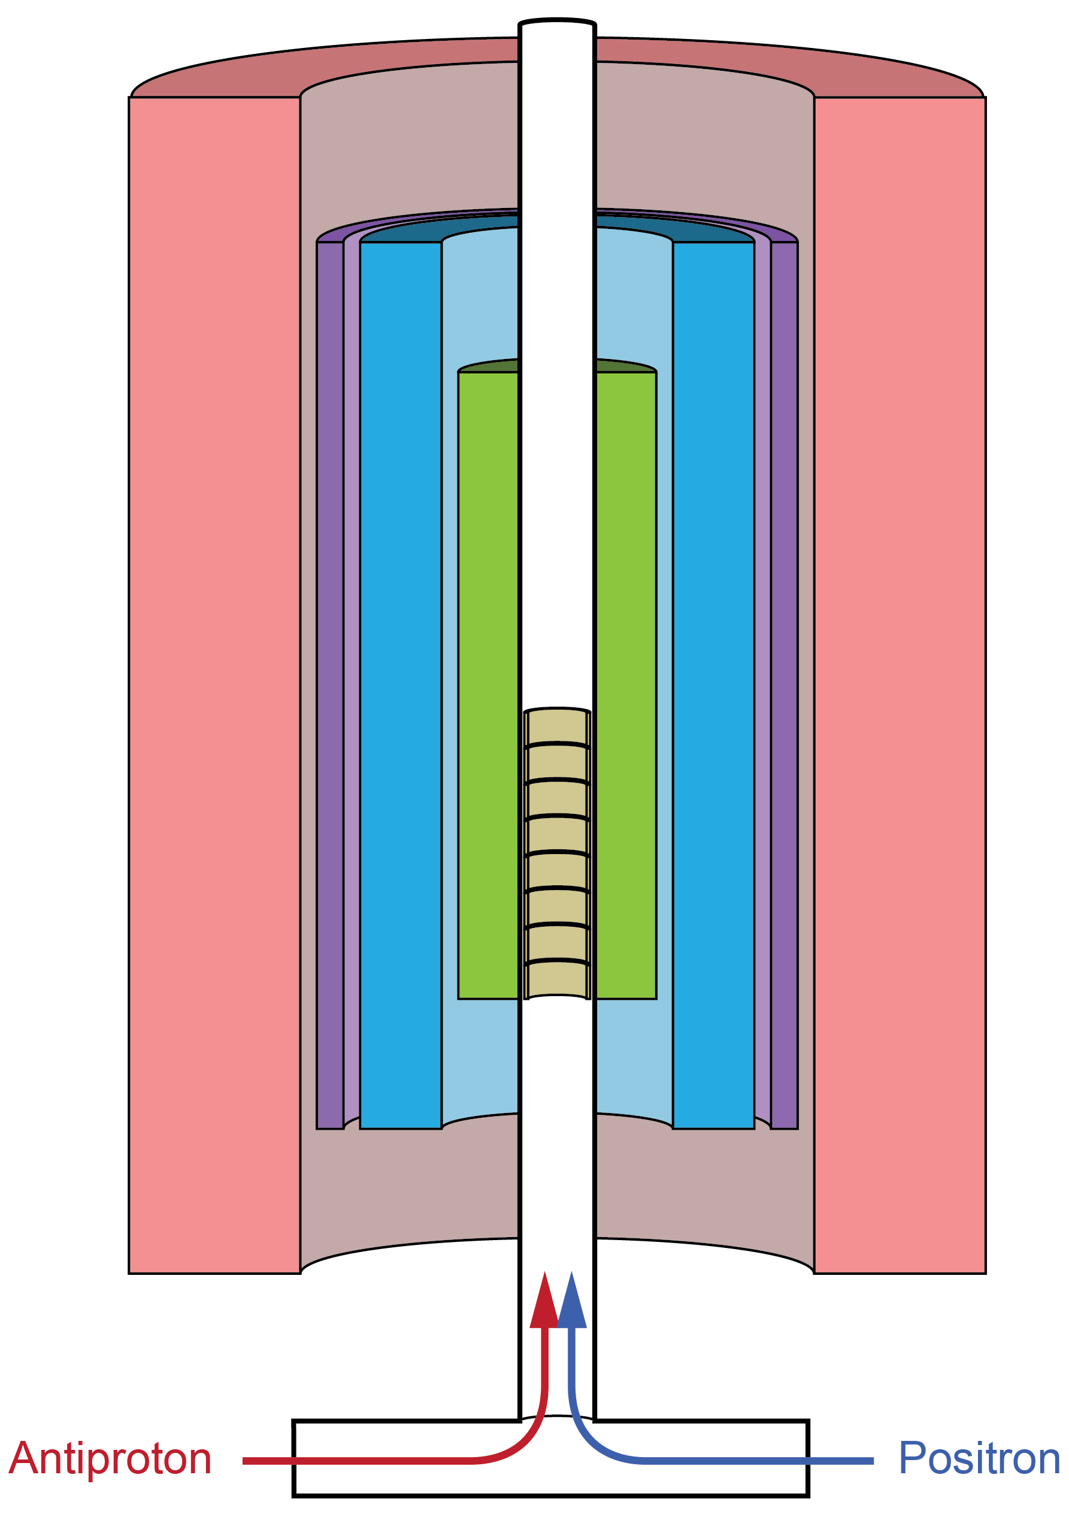
The ALPHA-g experiment
Penning trap
Catching and cooling plasmas
Mixing to create antihydrogen
Magnetic trap
Trapping anti-atoms
Release for gravity
Detector
Determine the behaviour of antihydrogen
Rejecting anything else

Slide 9
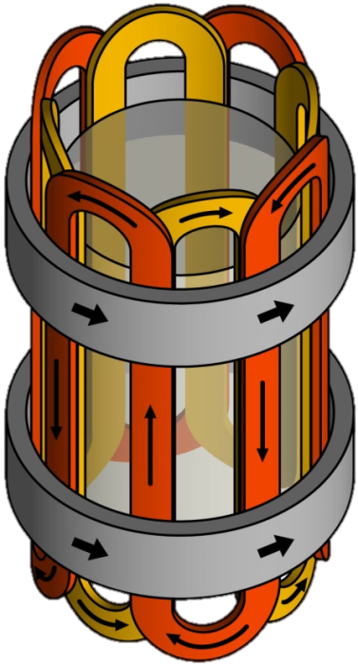
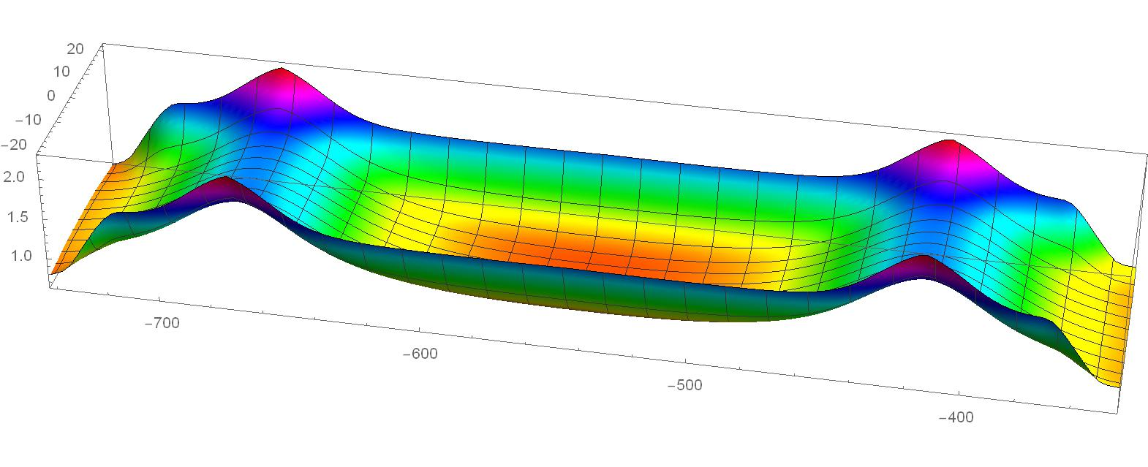
Magnetic minimum trap
Anti-atoms attracted to minimum in |B|
Radial confinement: octupole
Vertical confinement: mirror coils
g
horizontal
octupole
mirror
mirror
|B|
vertical

Slide 10
Gravity measurement
Mirror coils slowly turned off
Observe antiatom escape, up or down
g
horizontal
octupole
mirror
mirror
|B|
vertical

Slide 11
Gravity measurement

Slide 12
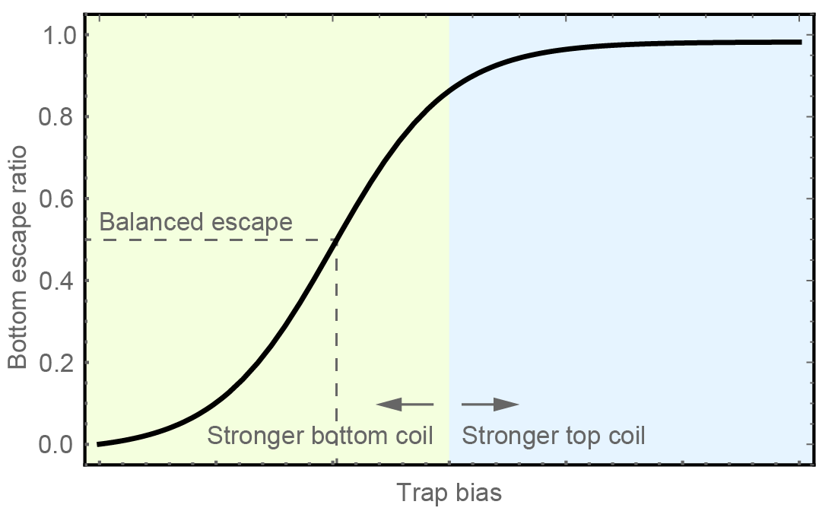
Gravity measurement
Uncompensated trap favours “down”
Balanced escape require stronger bottom coil
Determine gravity by horizontal offset of the curve

Slide 13
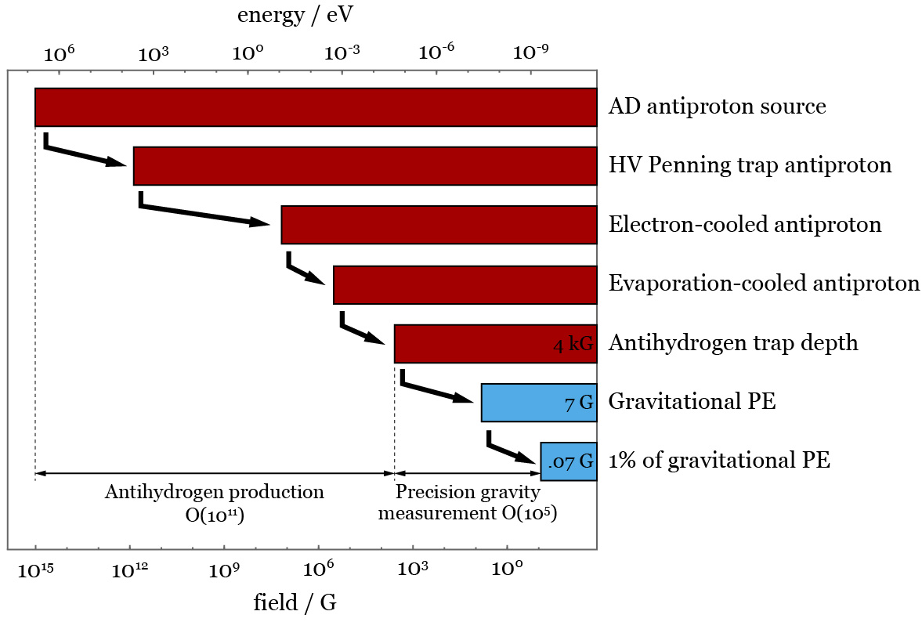
Challenges
Trapping antihydrogen
O(10¹¹) decrease in energy
Method developed and refined in ALPHA and ALPHA-2
Precise field control
O(10⁻⁵) control in trap field

Slide 14
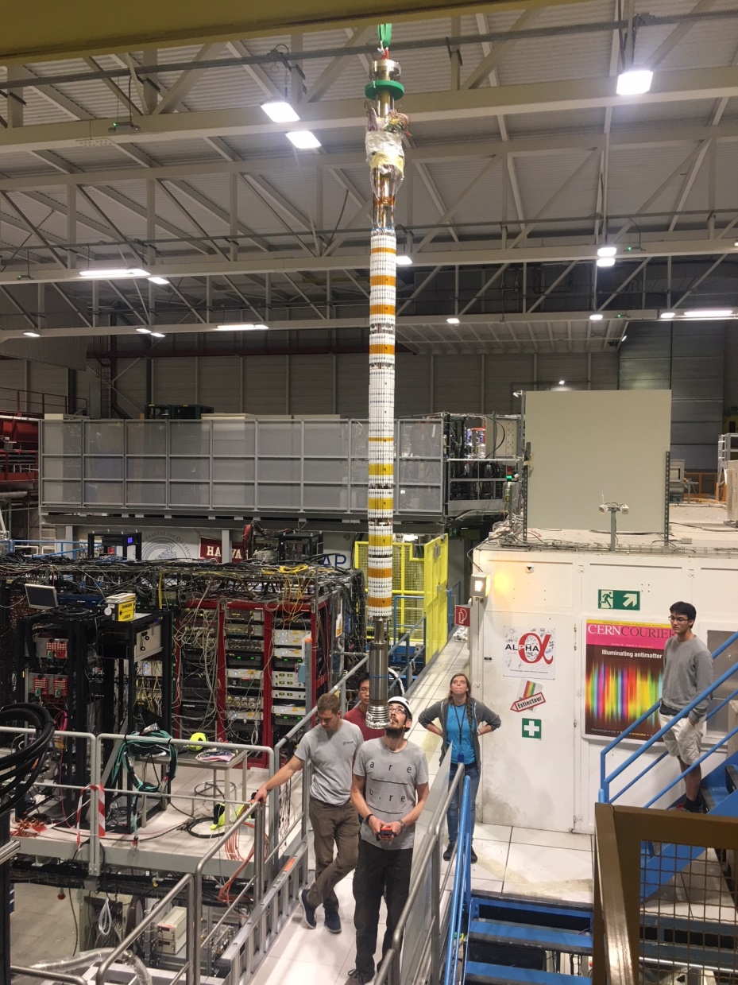
Inner
magnets
3 m

Slide 15
Inner magnet geometry
Centre: Precision measurement
Bottom: Stronger trap
Top: reflected copy
Why the complicated trap?

Slide 16
1. Persistent field
Induced field in superconductor
Current loops induced in response to field changes
History-dependent
Mitigation:
Weak magnets
Thin, numerous NbTi filaments
Symmetrise magnetic history
Neighbouring strong trap for initial trapping

Slide 17
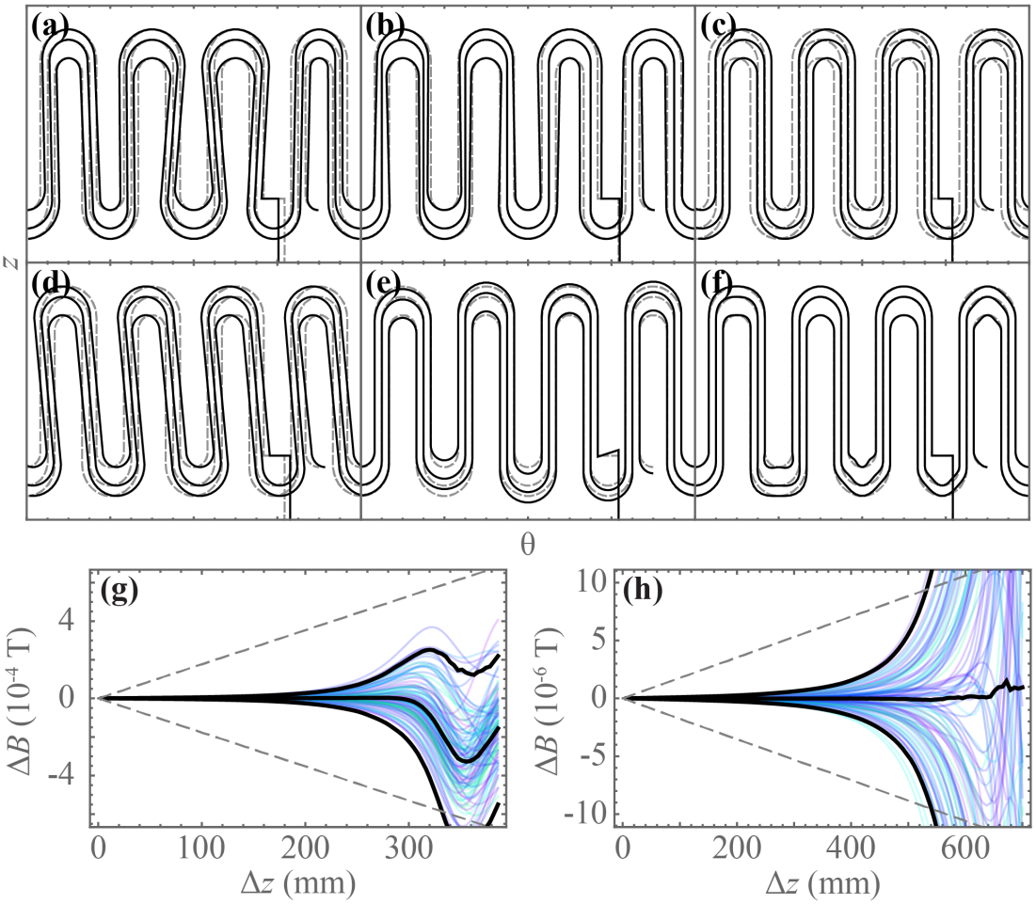
2. Wire placement
Octupole winding
Wire-laying precisely controlled, but nothing is perfect
Field error most severe near end turns
Measurement regions avoid these regions
Long + short octupole minimises number of end turns near the precision region

Slide 18
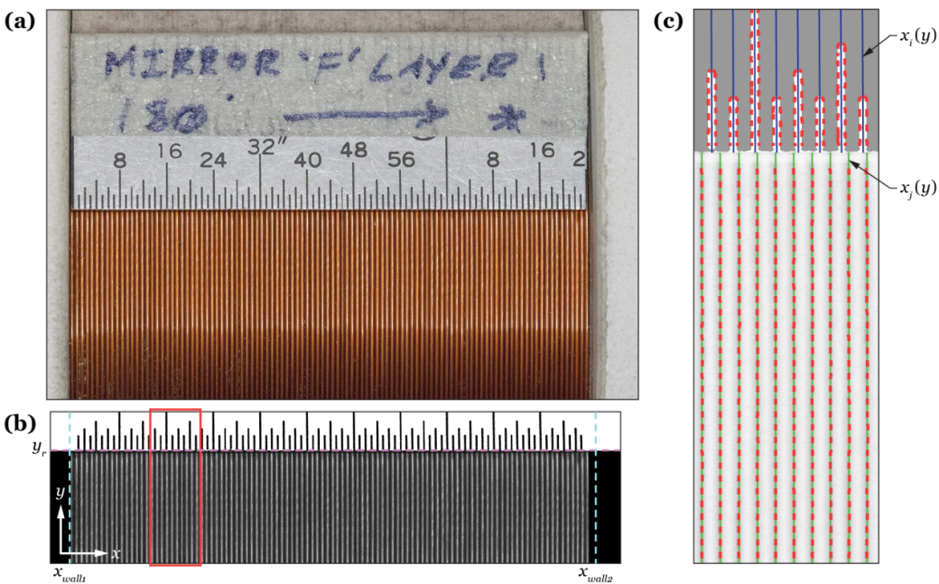
2. Wire placement
Coil winding
Each layer is macro-photographed and analysed to locate turns

Slide 19
3. Separated DoF
bottom coil
top coil
Energetic escape requires hitting pin hole with all energy allocated to z
Slow (x,y) and z energies mixing
Anti-atoms mostly escape off-axis, at much later time
Must tailor on- and off-axis fields

Slide 20
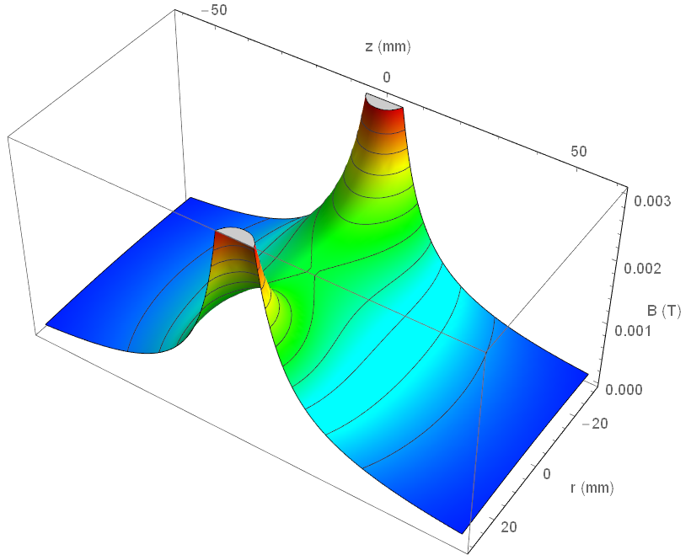
3. Separated DoF
A coil’s field is saddle-shaped

Slide 21
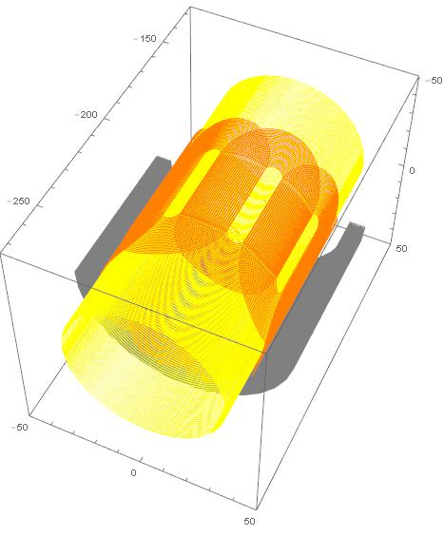
3. Separated DoF
Two coils at different currents cannot form equal barriers for all r
Even messier picture with octupole contribution
Correctors implemented to improve trap bias uniformity across r
gravity gradient
Corrector coil
Corrector octupole
Main mirror coil

Slide 22
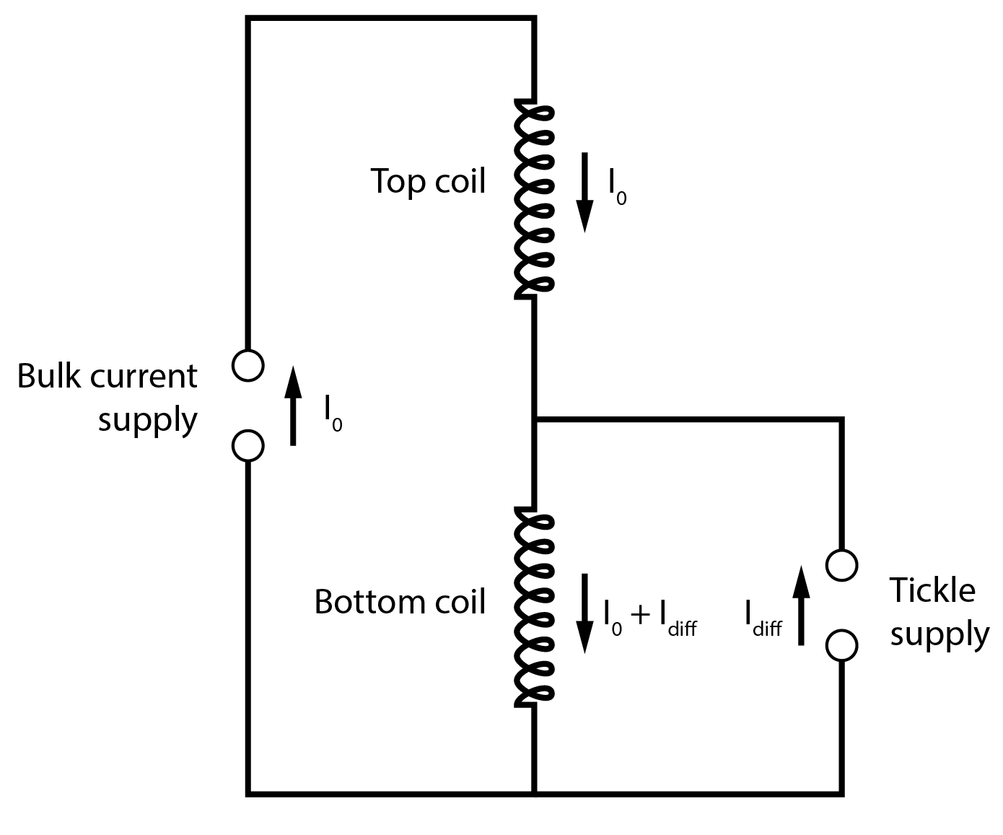
4. Current supply
Extremely fine current control on barrier coils
Common mode: 70 A to ~0 A, no specific precision requirement
Difference: ~ 0.1 A, precise to ~1 mA
Two completely separate PS: 10 ppm
One bulk current supply and one “tickle” supply: 10000 ppm
Two currents measured by DCCT and fed back to power supplies PID control

Slide 23
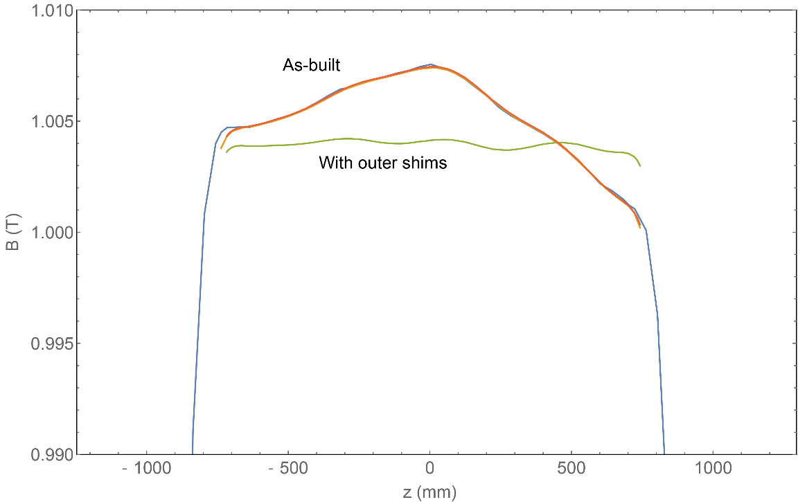
5. Background solenoid uniformity
Affects gravity measurement due to field gradient
As-built
~20 G non-uniformity
With outer shims
~4 G non-uniformity
Compensate by adjusting mirror coil currents
Possible future inner shims
~0.02 G non-uniformity
Reduced coil adjustment

Slide 24
Performing a first measurement

Slide 25
An “up-down” measurement
Using only the bottom set of magnets
Pro
Deeper trap, more statistics
Fewer magnet elements needed
Con
Less accurate field – more persistence effect, no correctors
Cannot use the long octupole
Aiming to resolve the direction of gravity on antihydrogen

Slide 26
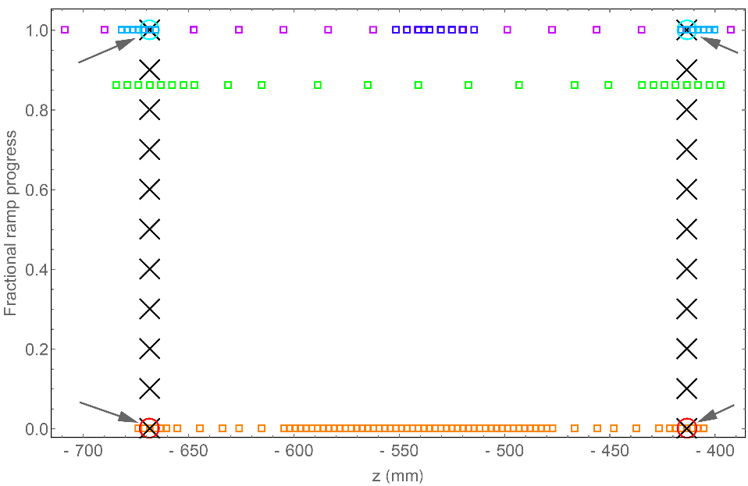
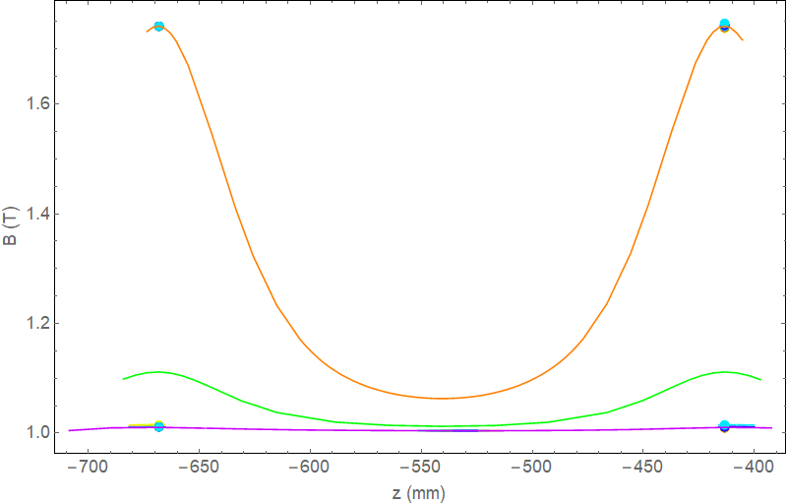
Magnetometry
Persistence effect is inevitable
Measure field and adjust current, to maintain trap bias throughout release ramp
ECR
Measures cyclotron frequency in Penning trap
Slow measurement process
Magnetron counting
Measures the phase of ExB drift of Penning trap plasmas
Fast measurement
Less accurate than ECR
Able to control relative trap bias to ~0.1 Gauss

Slide 27
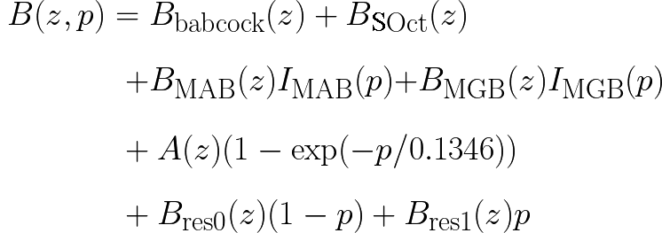
Field model
Magnetometry results are integrated into a 3D field model
O(1 Gauss) precision, much better around the saddle points
Particle pusher uses field to evolve anti-atoms through the entire experimental sequence
Obtain the expected escape bias as a function of gravitational acceleration
Field model is critical as antiatoms escape off-axis
Wire model field, from currents we provide
Exponentially saturating component
from magnetron results
Field we
don’t control
Residual to account for ECR

Slide 28
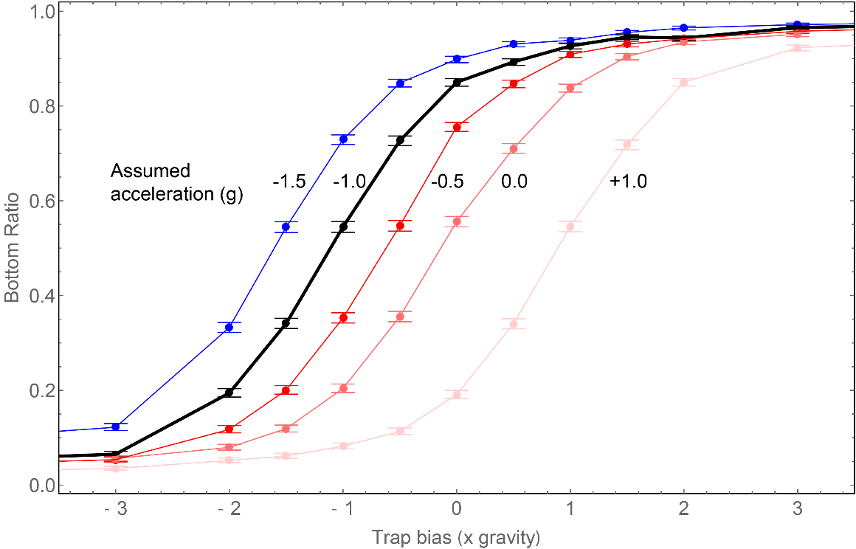
Experiment progress
In 2022: performed experimental release at 13 trap biases
Results being analysed and compared to simulation

Slide 29
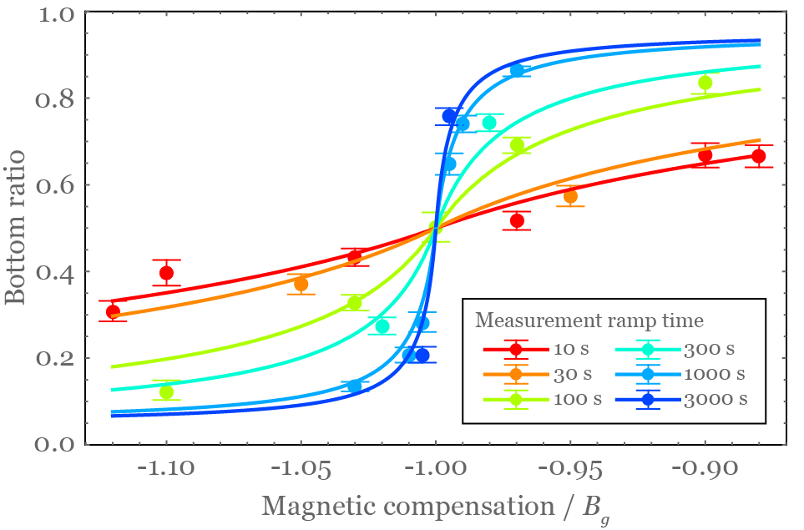
Future precision
Using the proper precision region
Steepness of escape balance curve closely affects sensitivity
Long ramp = more chance anti-atoms can escape on-time, higher sensitivity
Down side:
Long window = more cosmics
Depends on our ability to reject cosmics
Other factors like current noise and anti-atom temperature

Slide 30
HAICU

Slide 31
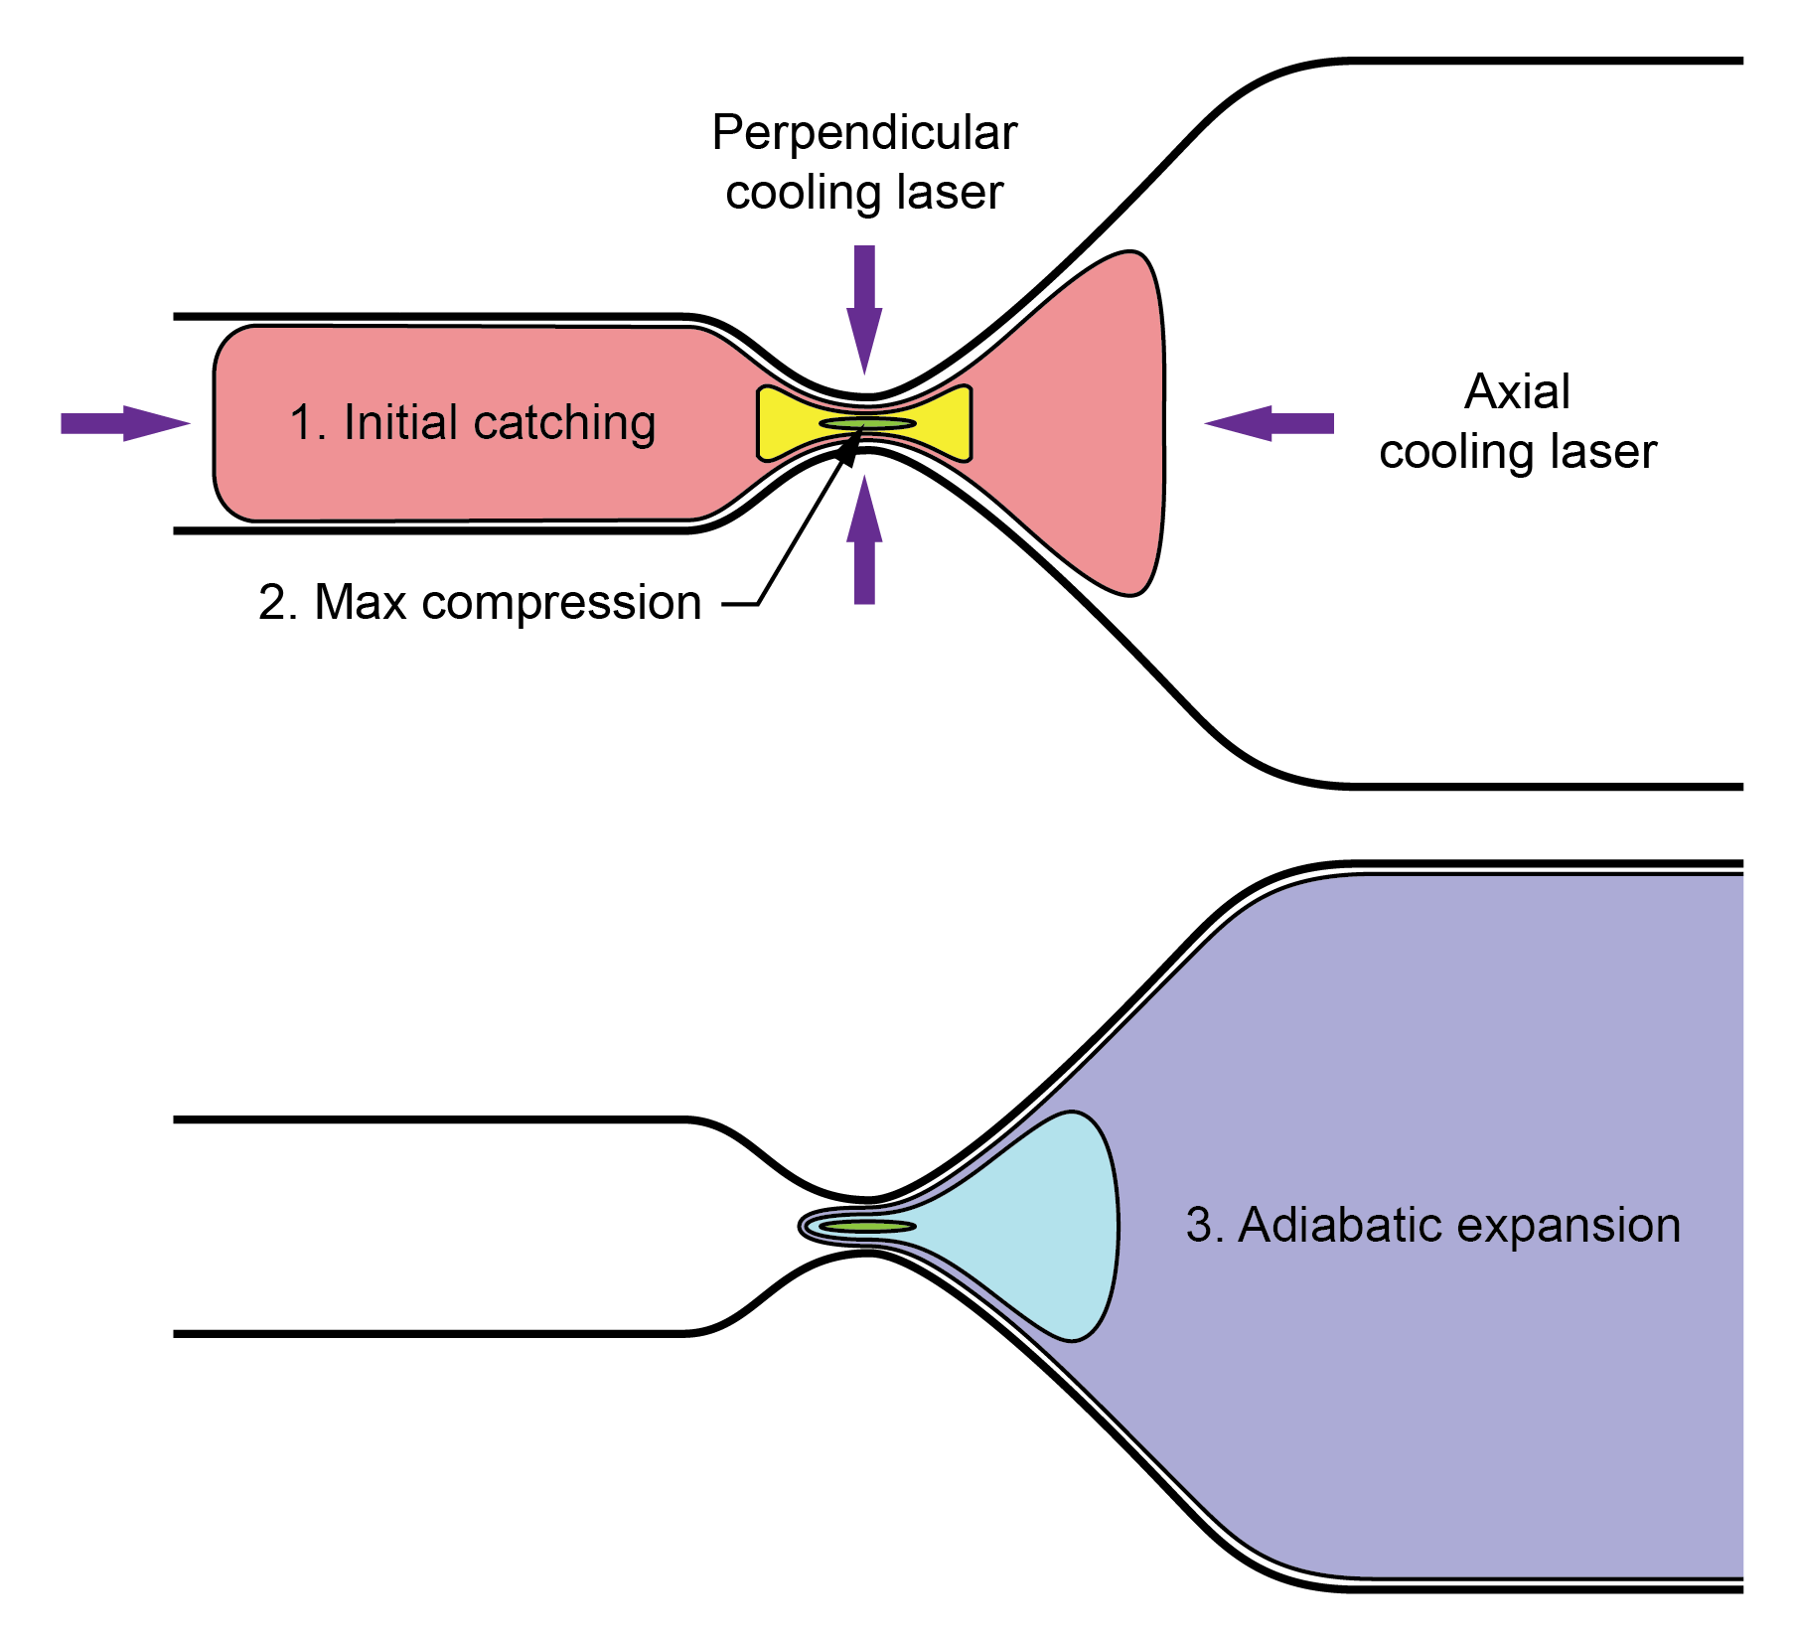
Interferometer
Raman interferometer:
Weighing atoms without field
Coherent interrogation during free-fall
10⁻² vs 10⁻¹⁴ precision
Requires extremely slow atoms
Beyond Doppler laser cooling with magnetic compression
Special magnetic trap with a “neck”
Bitter magnet trap
Bitter magnet trap with a neck
Superconducting trap with a much stronger neck

Slide 32
Bitter magnet development
Water-cooled, normally conducting
350 A, 5 kW test coil
Test of fabrication and assembly technique

Slide 33
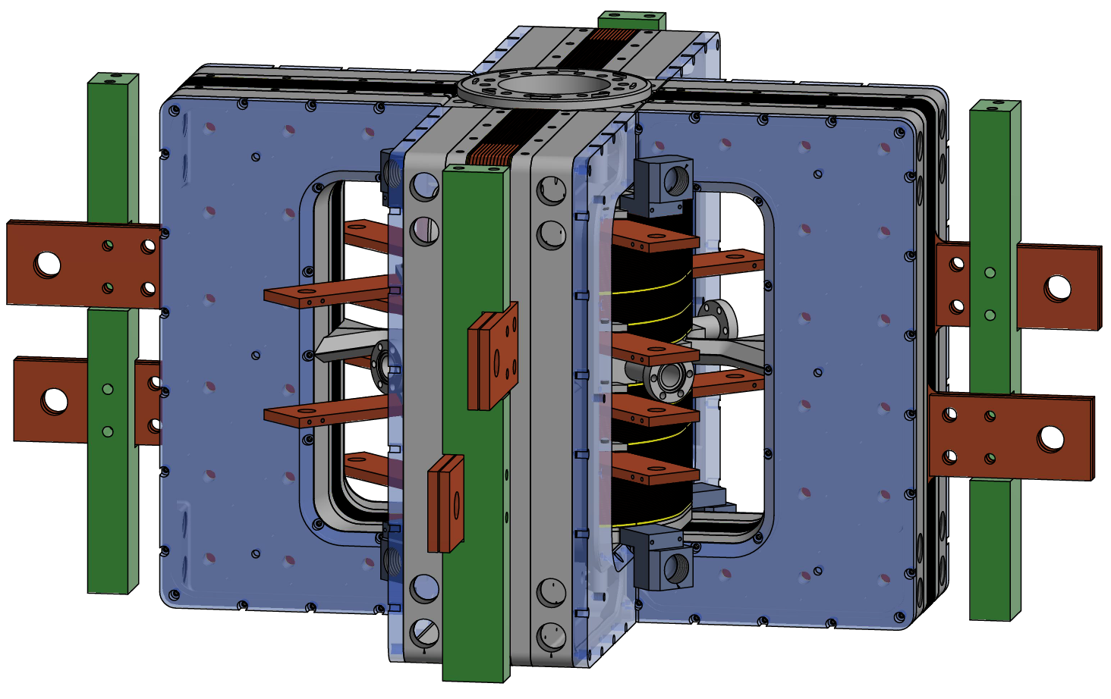
Magnetic trap prototype
High power density winding
1800 A, 80 kW quadrupole
350 A, 10 kW mirror coils
0.2 T trap depth on a 0.3 T background
10 L/s cooling water
Axial and perpendicular optical access for laser cooling
In final design stage
Experiment located in meson hall extension
Uses hydrogen atom as proxy
Aiming for commissioning by end of 2023

Slide 34
The big picture
ALPHA-g design and construction: a decade-long effort
Magnet
Detector
Current control
Beamline
Cryostat
Vacuum system
Penning trap
Sequencer
Laser and optics
Microwave
Diagnostic stations
First physics in 2022
Moving towards 1% precision
Planning for an interferometer

