Slide 1


Five Year Plan
2025 – 2030
Accelerator Science
Oliver Kester
Director, Accelerator Division
TRIUMF Science week
August 2, 2023

Slide 2
Outline
  TRIUMF Accelerator Division – 5YP
  The TRIUMF accelerator complex
    Keeping the TRIUMF accelerator complex on high performance in the next 5YP
    Gain in efficiency
  Increase of research capacity - ARIEL
    ARIEL completion
    The path towards ARIEL design performance
  Accelerator science at TRIUMF
  three pillars of excellence:
    Beam physics, secondary particle production and SRF/RF
    Present and future involvement in domestic and international accelerator projects

Slide 3
ACC division mission statement
The TRUMF accelerator division safely operates the TRIUMF accelerator complex with high performance and availability. We develop and implement new accelerator facilities and related technologies to support world class science nationally and internationally.
We lead accelerator physics research in Canada and foster TRIUMF’s position at the forefront of accelerator science. We advance our core competencies and transfer our knowledge to industry for the benefit of society.
We leverage infrastructure and expertise to provide world class training of HQP in accelerator physics and engineering.

Slide 4
TRIUMF Accelerator Development and Research
  Areas of activities:
  Operation, refurbishment and upgrade of the TRIUMF accelerator complex
  Capacity increase via design and construction of new accelerator systems (ARIEL, CANREB, THz radiation)
  Domestic and international accelerator projects
  Accelerator research and development (focused on TRIUMF)
  based on three pillars of excellence in
  beam physics
  secondary particle production
  SRF/RF technologies and research

Slide 5
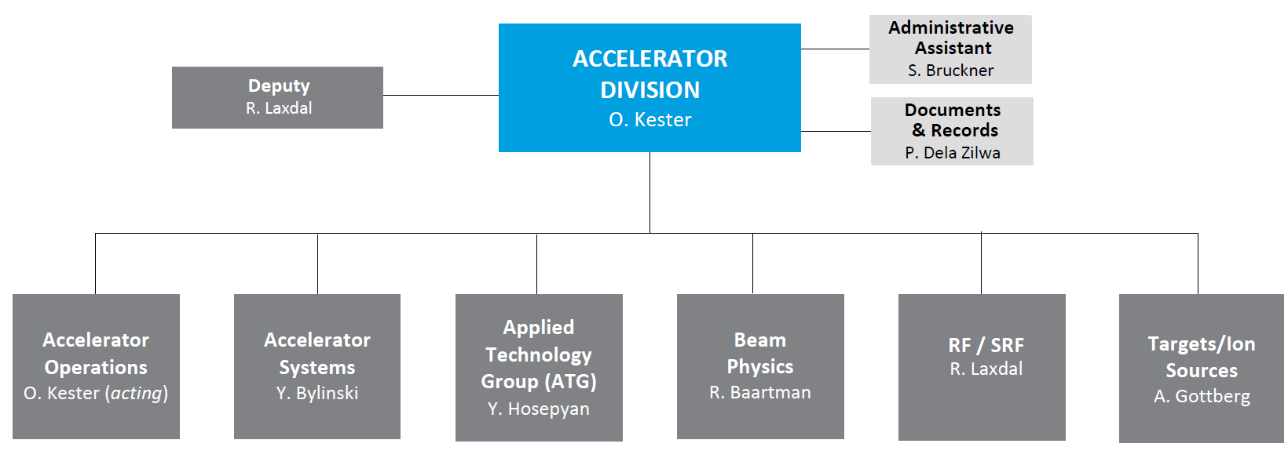
Who are we: Structure of the ACC Division
145 staff members (including post doctoral fellows)
34 staff members in ATG
15+2 graduate students (2 among staff)
Accelerator
Operations
J. Aoki
Operation of the accelerator facilities including TR13 and TR24. Simultaneous delivery of multiple beams.
Beam line systems (electrostatic and magnetic), Vacuum systems, cryogenic systems, power converter technologies, high and low intensity beam diagnostics.
Operation and maintenance of TR30s, Solid Target Facility (STF) and Isotope Production Facility (IPF).
Accelerator commissioning & machine development. Simulation code development & beam tuning applications. High-power accelerators & colliders
Low level and power RF, Superconducting RF, cavity development and cryomodules.
Target technology for high power ISOL systems. Target ion sources. Nuclear spin polarization and muon production, material radiation damage and Remote handling.

Slide 6
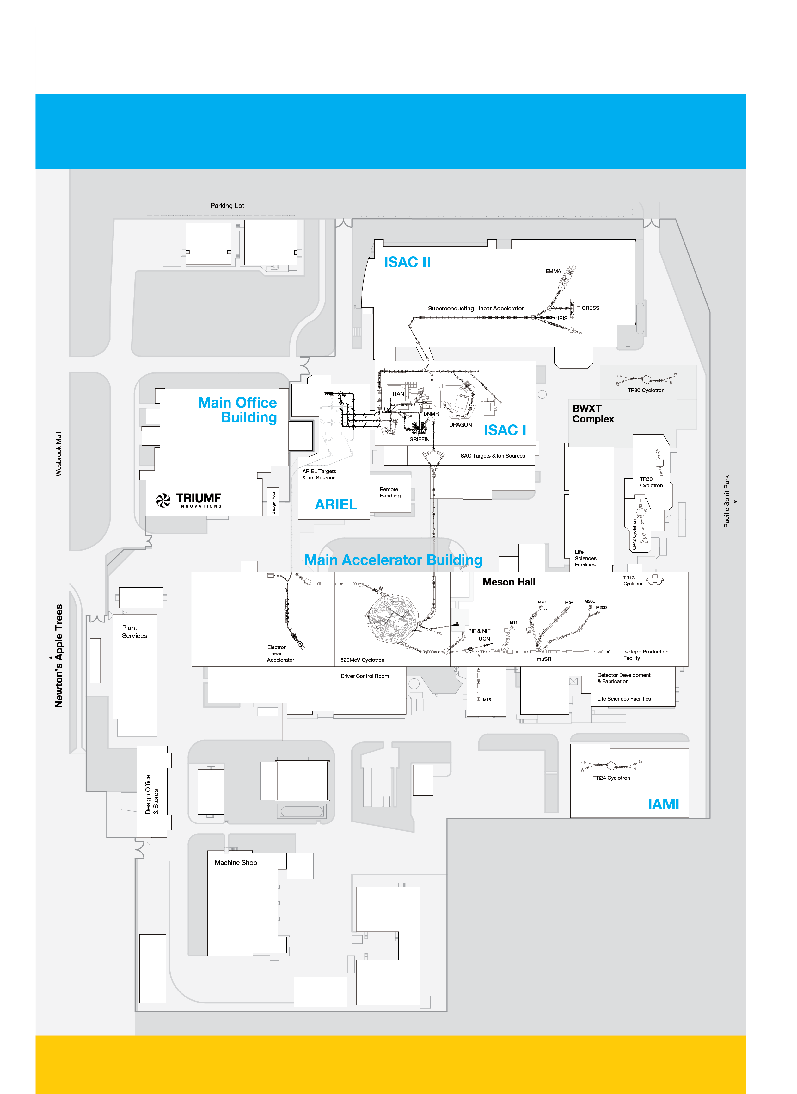
TRIUMF accelerator complex
A diversity of accelerators from:
  High-power to rare-isotope beams
  Cyclotrons & Linacs
  Normal conducting to superconducting structures
Supporting:
  Flexible RIB delivery for science
  Medical isotope research & prod.
  Neutron & muon science
  Accelerator science R&D
ARIEL = new infrastructure on all fronts: driver, targets & RIB

Slide 7

Division planning process for 5YP 2025-2030
Divisional planning started in spring 2022 with retreats of
the Accelerator Division lead team.
The retreats did focus on the mission, core competencies,
SWOT analysis → major activities and initiatives in the
next 5YP derived from an updated project and issue
matrix and the divisional risk registry.
In a next step priorities for projects and activities were
derived as well as MRO volume and staffing for the ARIEL
operation era.
Development of the final activity list within the operational
and sustainability model with focus on
  Alignment with
    TRIUMF 20-Year Vision
    TRIUMF present Goals & Objectives
  Delivering and operating ARIEL
1) Make groundbreaking discoveries across TRIUMF’s multidisciplinary research portfolio.
2) Reinforce TRIUMF as a globally leading particle accelerator centre.
3) Become a hub for interdisciplinary education and training
4) Inspire Canadians
to discover and
innovate
5) Translate knowledge
and discovery into
innovation
6) Increase national
and international
collaboration

Slide 8
Operational Model, sustainability concept
Operational model Accelerator Division:
Core operation (Running and maintaining the accelerators, break fixes)
Keep capability and do capacity development (can have an opportunity component)
Divisional MRO activities (refurbishment projects, SAS activities)
Divisional MRO projects and LDRD-type projects managed by PMOG/QRPP
Science delivery
Sustainability model (categories of expenses):
Core/baseline operation
  MRO costs and work forces – Staff and machine operation costs (including labs)
Keep capabilities and capacity development (Capacity for research)
  Refurbishment (520 MeV cyclotron, RIB program and ACC infrastructure),
  ACC operation with new beams / beam parameter
  ARIEL-II completion and towards ARIEL and e-linac design performance
Science delivery (Research and innovation)
  Grant driven projects like HL-LHC, EIC contributions, PC-CANS, e-linac and THz capabilities, DarkLight
  Accelerator R&D, WFO, commercial projects

Slide 9
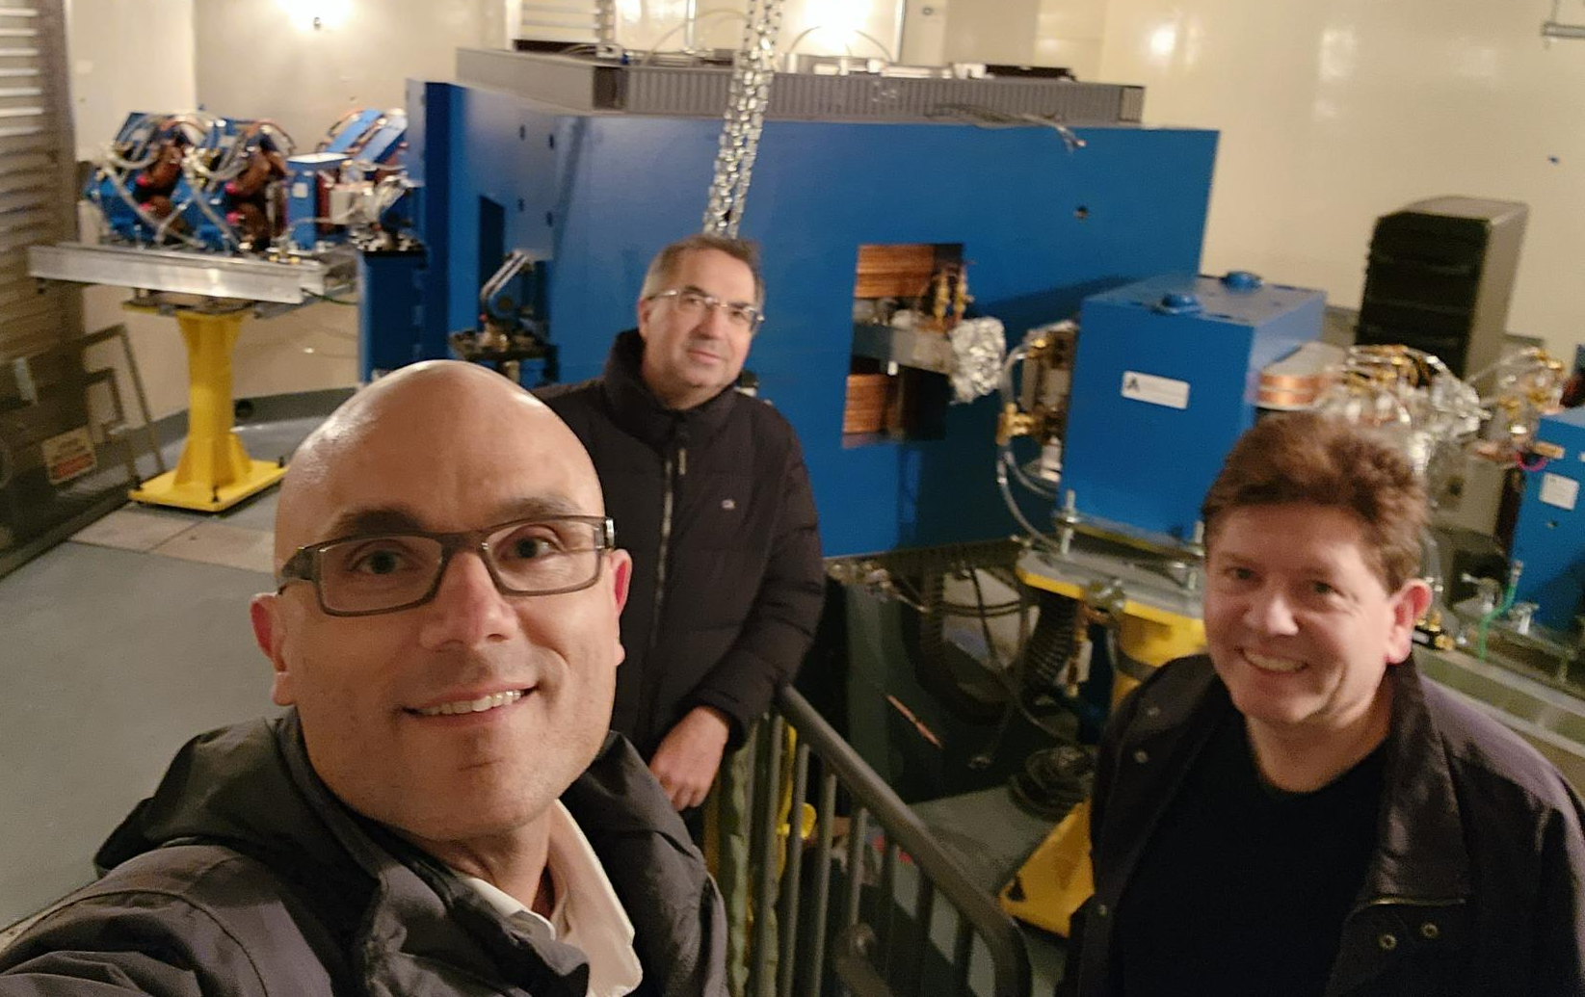
NRC Evaluation of TRIUMF in parallel with the 5YP planning process
Peer Review (November 29 – December 3, 2022)
  Science divisions participated in plenary talks, parallel sessions, poster session, tour
Some comments about ACC Division:
The PRC found the TRIUMF accelerator division is internationally outstanding and has achieved major global scientific contributions.
The major new ARIEL accelerator has demonstrated operation at its commissioning goal of 10 kW beam power, the limit of the beam dump in the e-hall, which is noted by the PRC as a significant accomplishment that demonstrates the outstanding capability of the
accelerator group and TRIUMF.
The ARIEL project achieved a recent milestone with
the extraction of a beam from the 520 MeV H- cyclotron
into the new beamline (4N).
Researchers are contributing knowledge and
technology to CERN’s Large Hadron Collider (LHC)
and are positioned to collaborate on future projects
such as the Electron Ion Collider (EIC).
After the PRC

Slide 10
The TRIUMF accelerator complex – refurbishment and gain in efficiency

Slide 11
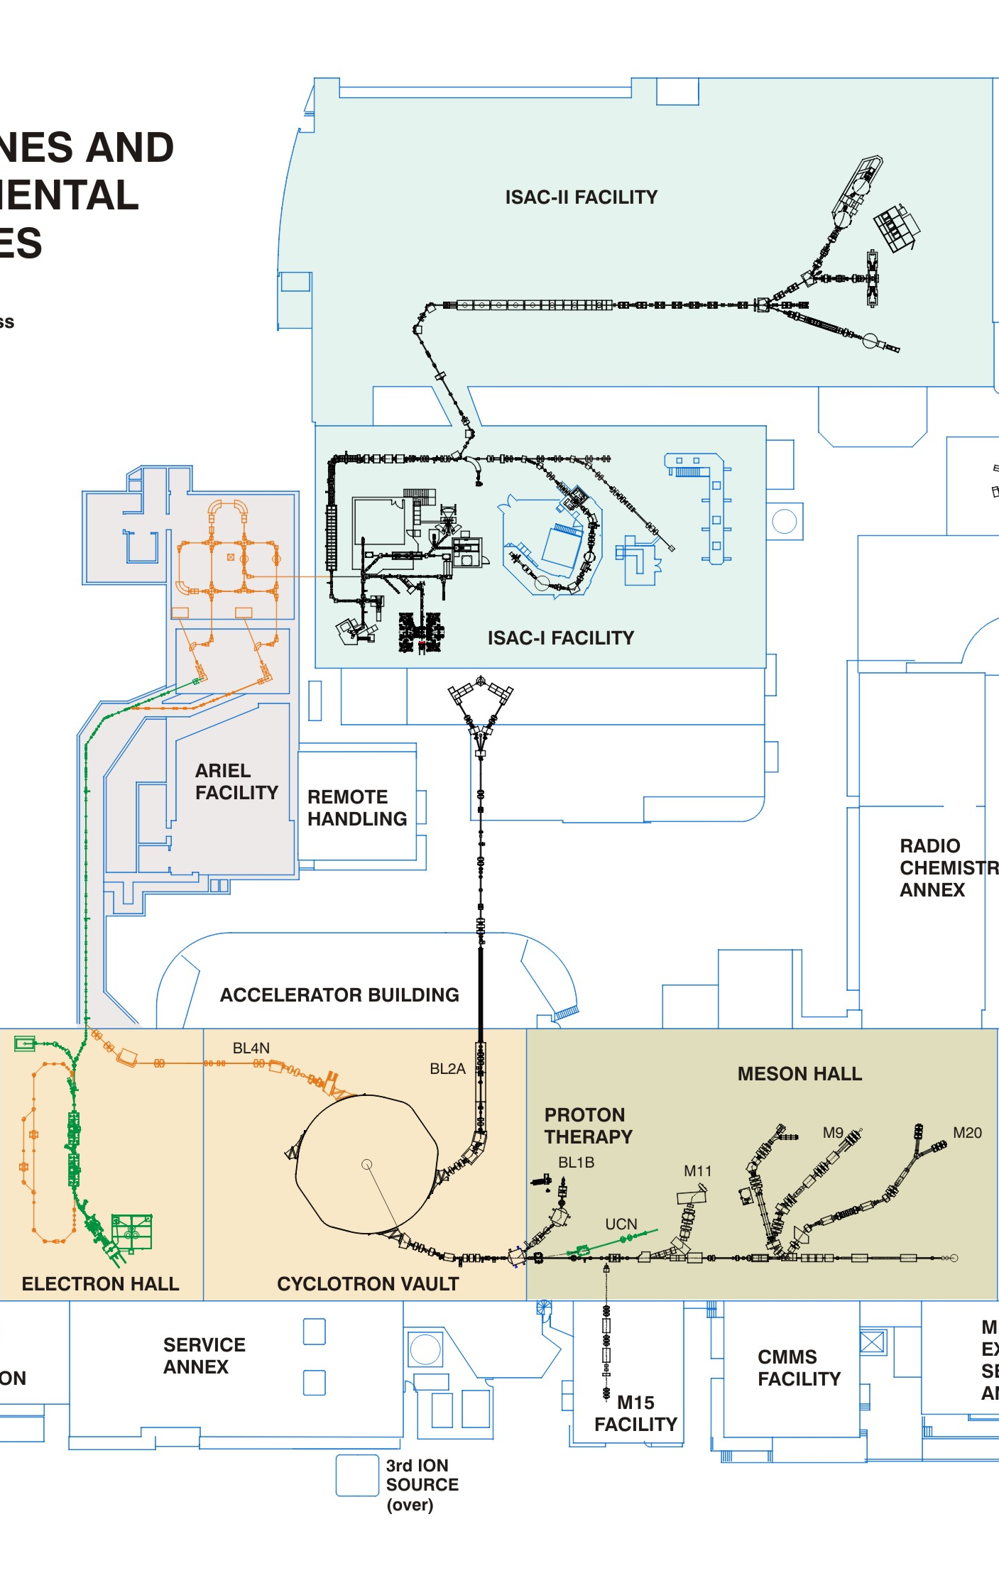
Refurbishment in the next FYP
Chief goals of the continuing refurbishment program:
  Risk mitigation against extended down-time as guided by the Division Risk Registry
  Improving efficiency of operation → prerequisite for the ARIEL operation era – reduced maintenance requirements, model assisted tuning, power-smart, unification of site equipment, amalgamation of control rooms
Cyclotron: RF system, remote handling, vacuum, BL1A upgrade, BL2A upgrade, Control system
TRIUMF Control Center (TCC)
ISAC: RF system, target hall infrastructure, laser
ion source (LIS), Remote Handling, beam delivery

Slide 12
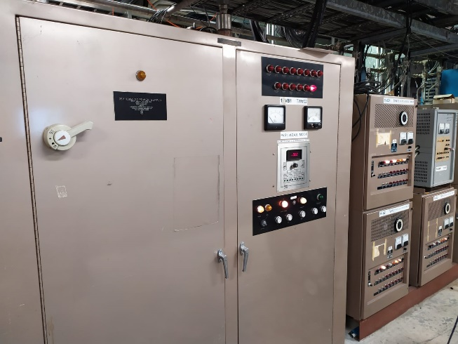
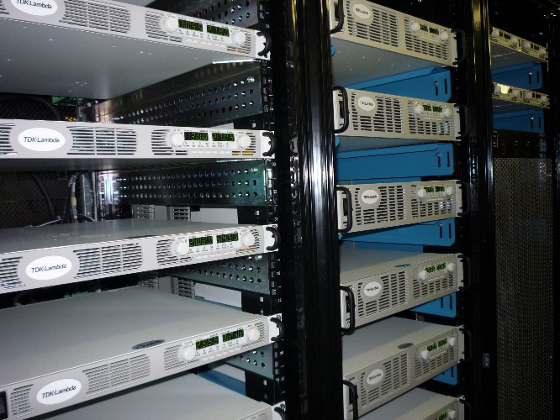
Refurbishment of BL1A
The BL1A refurbishment project is a collection of activities to restore reliable beam operation and enhance functionality of BL1A.
The refurbishment project did start with a revision of the beam optics give the boundary conditions of the targets T1 and T2 and their position, UCN and IPF.
The project will address: Vacuum system, controls, diagnostics and collimators, additional steerer, T2 monument, replacement of the quadrupole triplet with a double doublet and phase 2 of the replacements of magnet power supplies (→ BC Hydro incentive).
Replacement of old magnets does need remote handling capabilities → upgrade of
the remote handling capabilities in the Meson Hall.
Irradiation facility
Material science
BL1U
IPF
T1
BL1A
T2
Quadrupole triplet

Slide 13
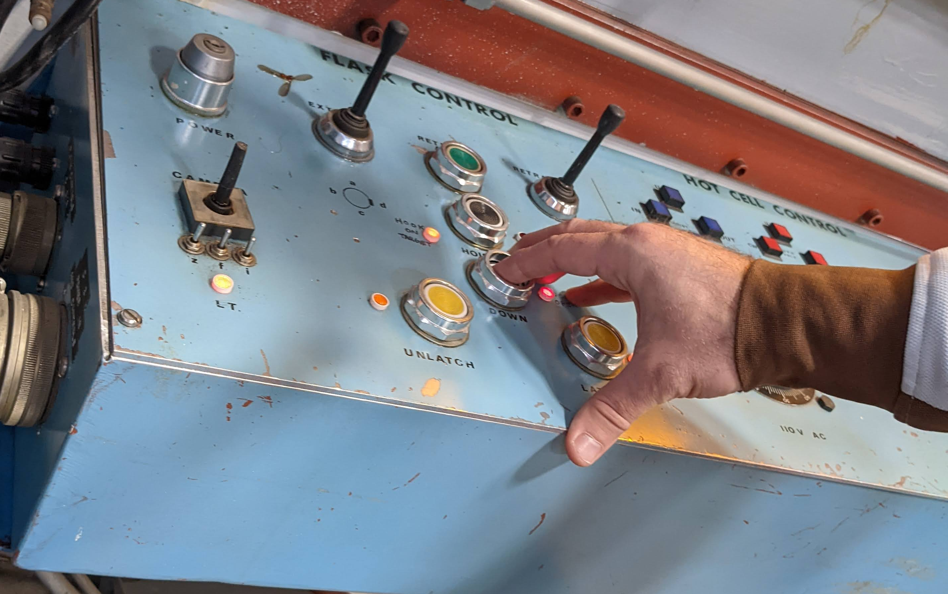
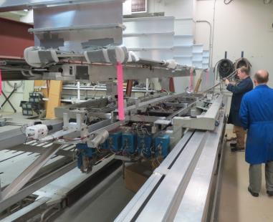
Remote handling (RH) activities
TRIUMF is internationally recognized for its leading role in RH, hot cell design and operation and development of systems for operation in
kGy – PGy dose fields.
  Mechatronics and robotics development for cyclotron and primary beam transport lines
  Training programs on prototypes and hot cells,
  new tools
  International collaborations (T2K, CERN, SCK,
  VECC, RISP, etc.)
  Refurbishment / exchange of aged and obsolete RH equipment and electronics:
  Cyclotron RH controls,
  Meson hall RH
  infrastructure
  shielding flasks,
  hot cells etc.).
  Exchange of obsolete remote handling controls and the consolidation of controls hardware into one central area in ISAC
  RH waste management program
  target handling for shipment, separation and sorting of waste material
RH robotics development

Slide 14
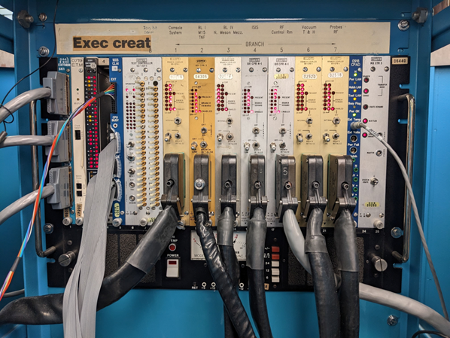
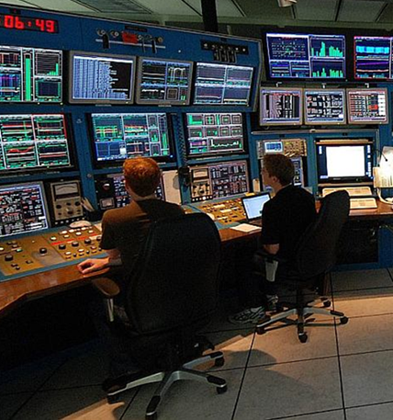
CCS upgrade and the TCC
Cyclotron Control System (CCS) upgrade
Scope: Replace legacy CCS CAMAC executive crates with in-house built hardware running EPICS.
Motivation: Address a top-level risk – failure of the executive crate could cause months of downtime due to the scarcity of replacement parts – and allow for the removal of controls hardware from the site of the future TRIUMF Control Centre.
Strategy: Develop and test the new system in parallel leaving legacy equipment largely undisturbed until the new control system has been commissioned.
CCS executive crate
TRIUMF Control Centre (TCC)
Scope: Consolidate Driver and RIB accelerator operation within a single space.
Motivation: Gain operational efficiencies in terms of staffing and enable Accelerator Operations to better manage the paradigm shift as ARIEL transitions from commissioning to production.
This transition will result in a significant increase of RIB output to experiments, supported by two driver accelerators and three target stations.
Driver Control Room

Slide 15
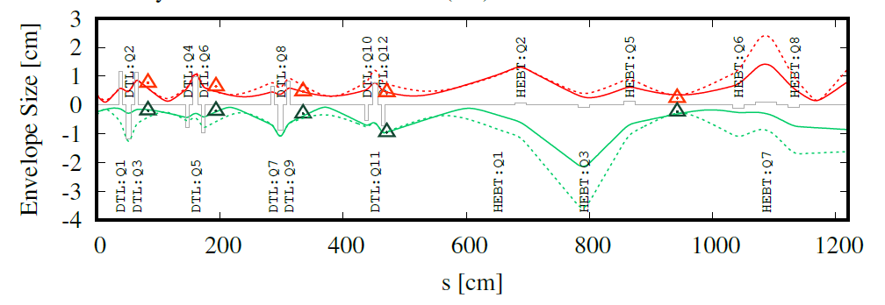
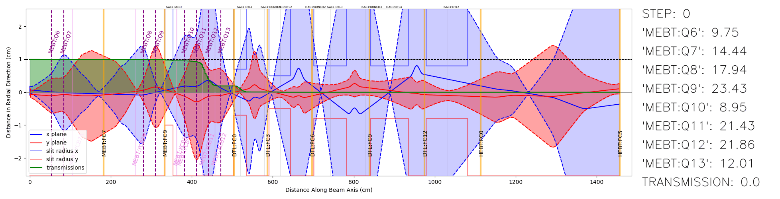
Advanced beam tuning – gain in operation efficiency and quality
Web-based framework and python interface to
communicate with the accelerator control system
has been developed for
High-level applications (HLA).
Emerged from HLA → Model Coupled Accelerator
Tuning (MCAT). (Presentation of Hui Wen Koay)
All of TRIUMF’s accelerators and beamlines will be integrated in model-based tuning. Significant reduction of beam delivery time and gain of beam quality.
Using machine learning
tools (Bayesian
optimization) for reduction
of beam tuning time.
(presentation of
Wojtek Fedorko)
Computing infrastructure and beam instrumentation (low intensity diagnostic) are key.

Slide 16
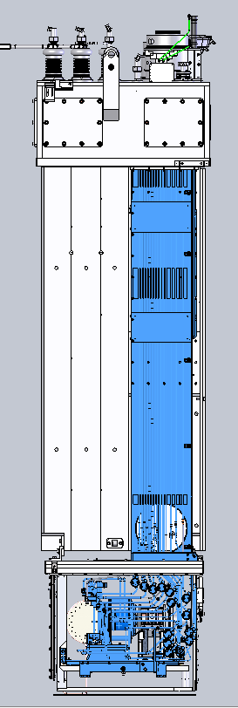
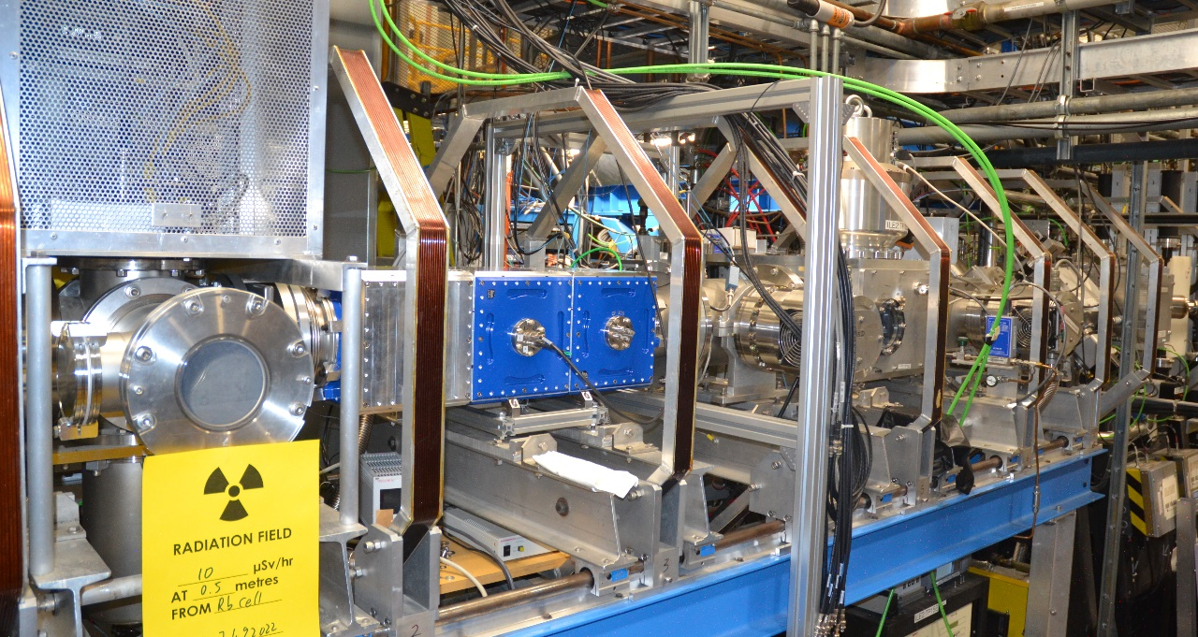
ISAC in the next 5YP
Full roll-out of regular target module refurbishment program (all major components except shielding). TM3 was the test case for a module refurbishment.
Target production and conditioning systems renewal → lab infrastructure
Electrical and mechanical systems
refurbishment and procurement of critical
spares.
Laser Ion Source system of TRILIS needs
refurbishment. It’s the most demanded
Target Ion Source at TRIUMF.
Also, beam development becomes
increasingly difficult (2 elements/y).
Allow for more complex setups and
ALIS (ARIEL) & TRILIS (ISAC)
parallel operation!
Continued infrastructure refurbishment
for spin-polarized beams at ISAC.
ISAC-I Linac RF system refurbishment
Replacing 25 years old tube amplifiers
with solid state amplifiers (SSA).

Slide 17
Capacity increase:
The advanced rare isotope laboratory – ARIEL

Slide 18
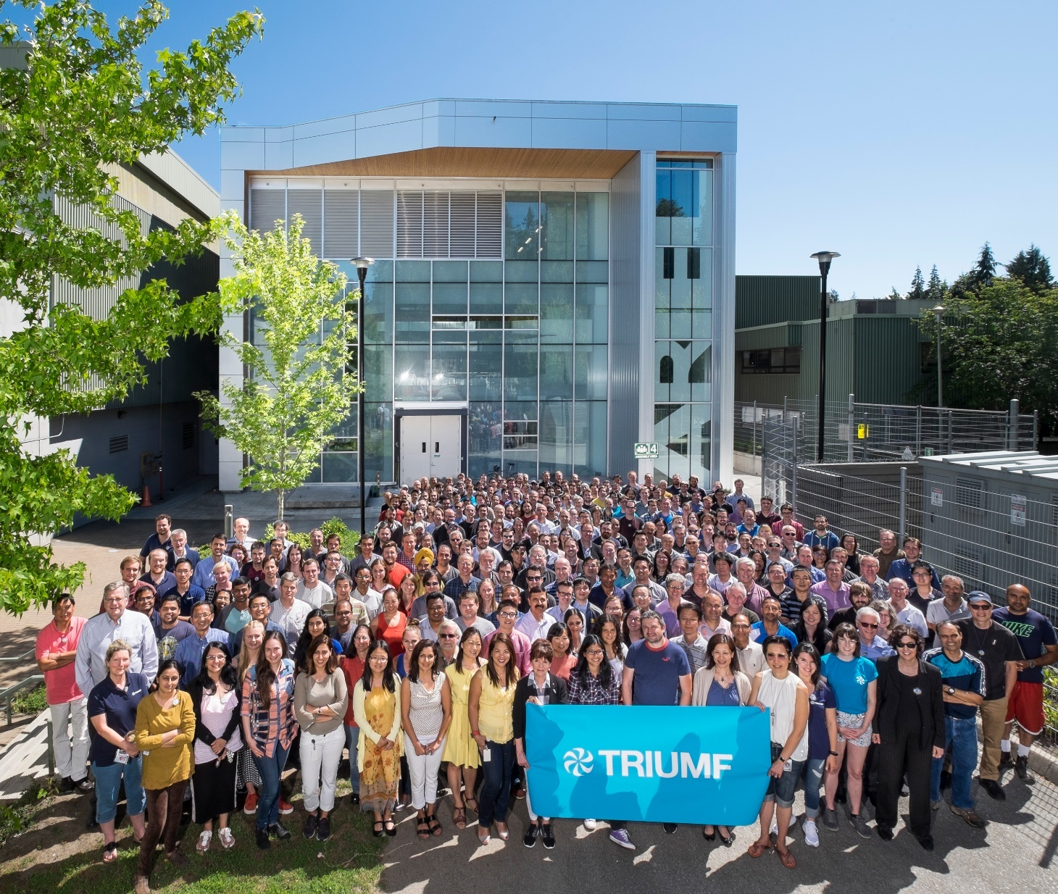
ARIEL: ISAC×3
ARIEL is the world’s most powerful isotope separation online complex.
It will triple ISAC's present rare isotope capabilities by adding
  a 50kW proton target station
  a 100kW electron target station
  Unique beam preparation and transport system (CANadian Rare isotope facility with Electron Beam ion source - CANREB)
ARIEL is the only rare isotope facility that will provide three RIB beams simultaneously to experiments.

Slide 19
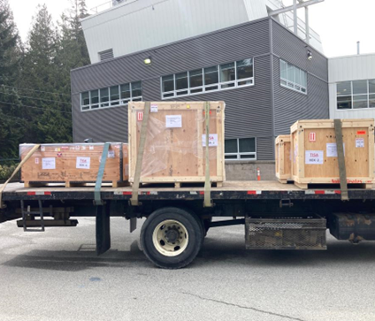
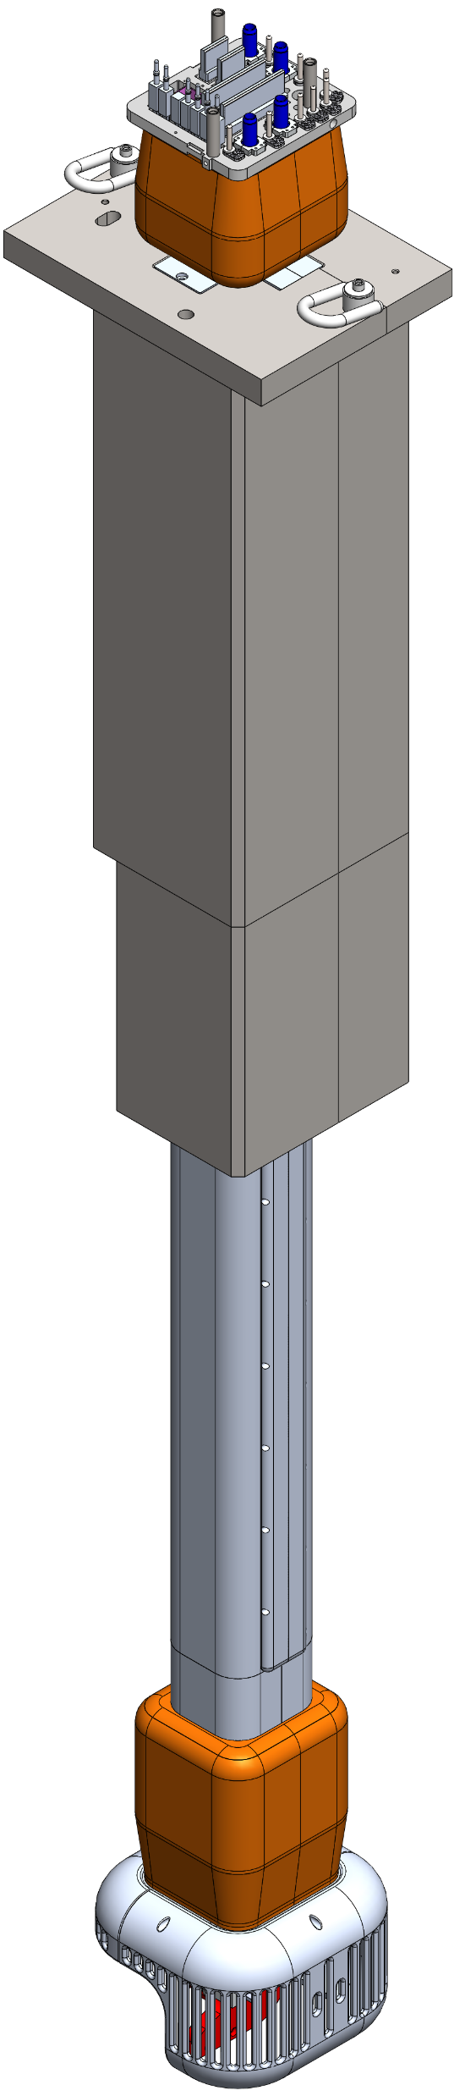
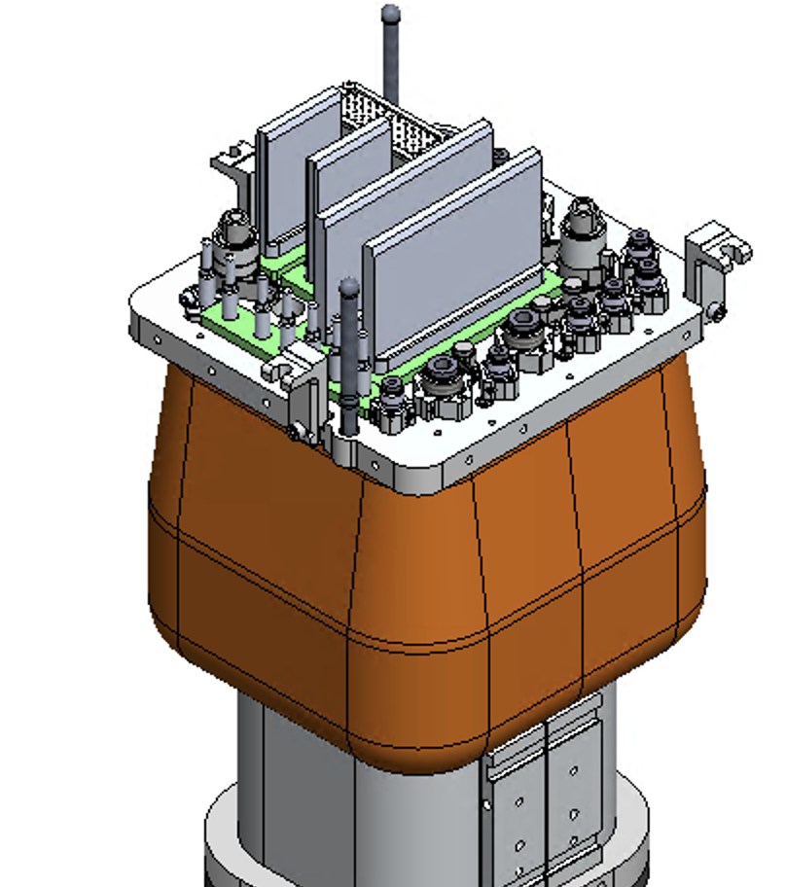
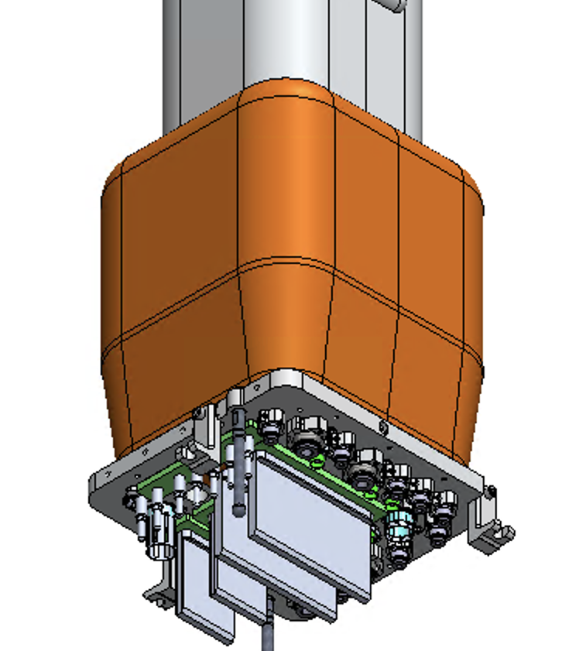
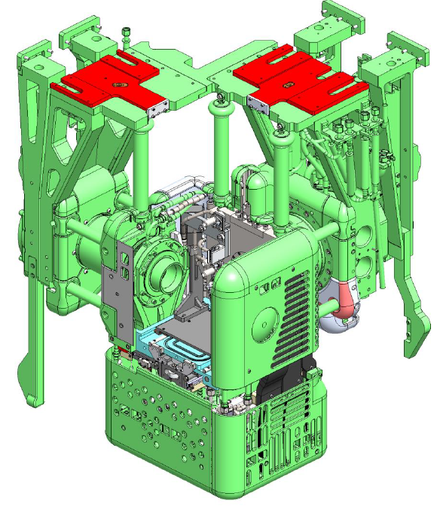
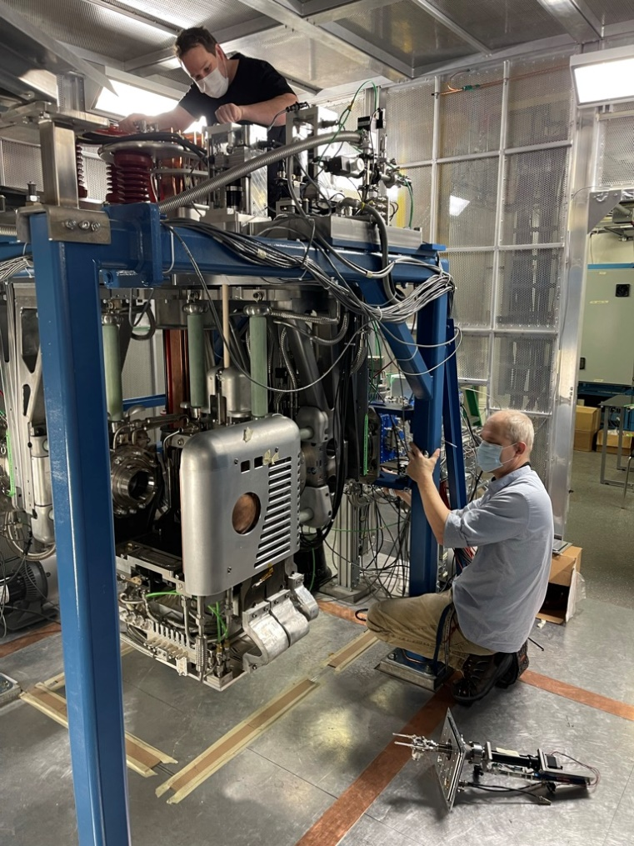
ARIEL status:
Target Station
AETE (ARIEL Target Station East) targetry protype testing complete, technical risks retired.
VECC collaboration: AETE Target/Ion Source Front End Prototype shipped
Target Module front end & High Voltage Feedthroug (HVFT):
Design & drawings nearing completion and parts being completed by machine shop and HVFT ordered.

Slide 20
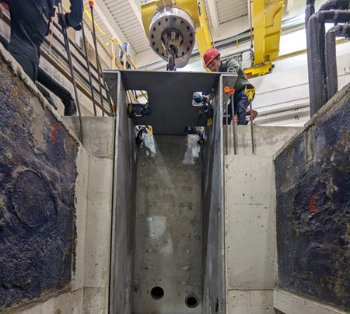
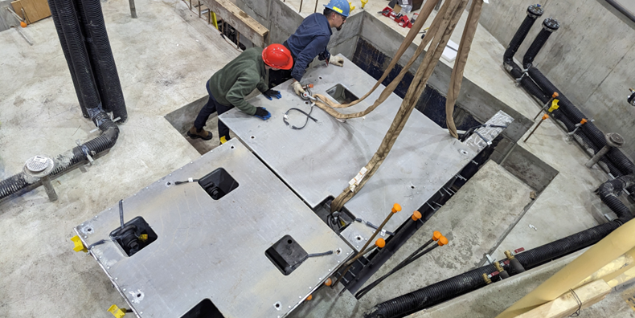
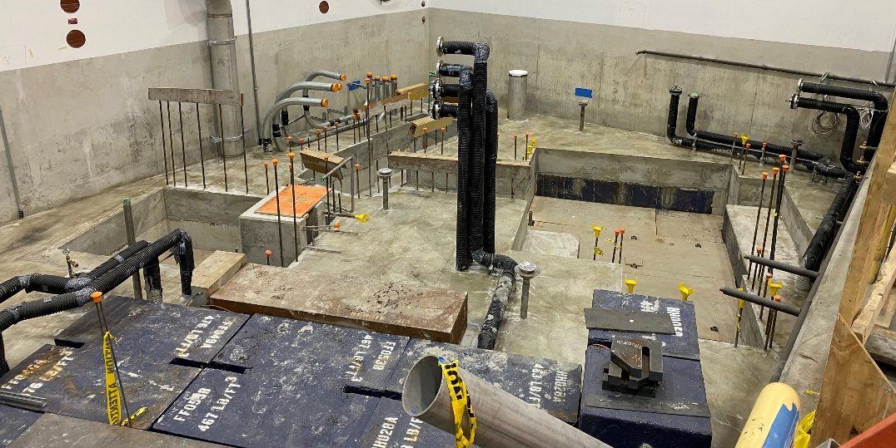
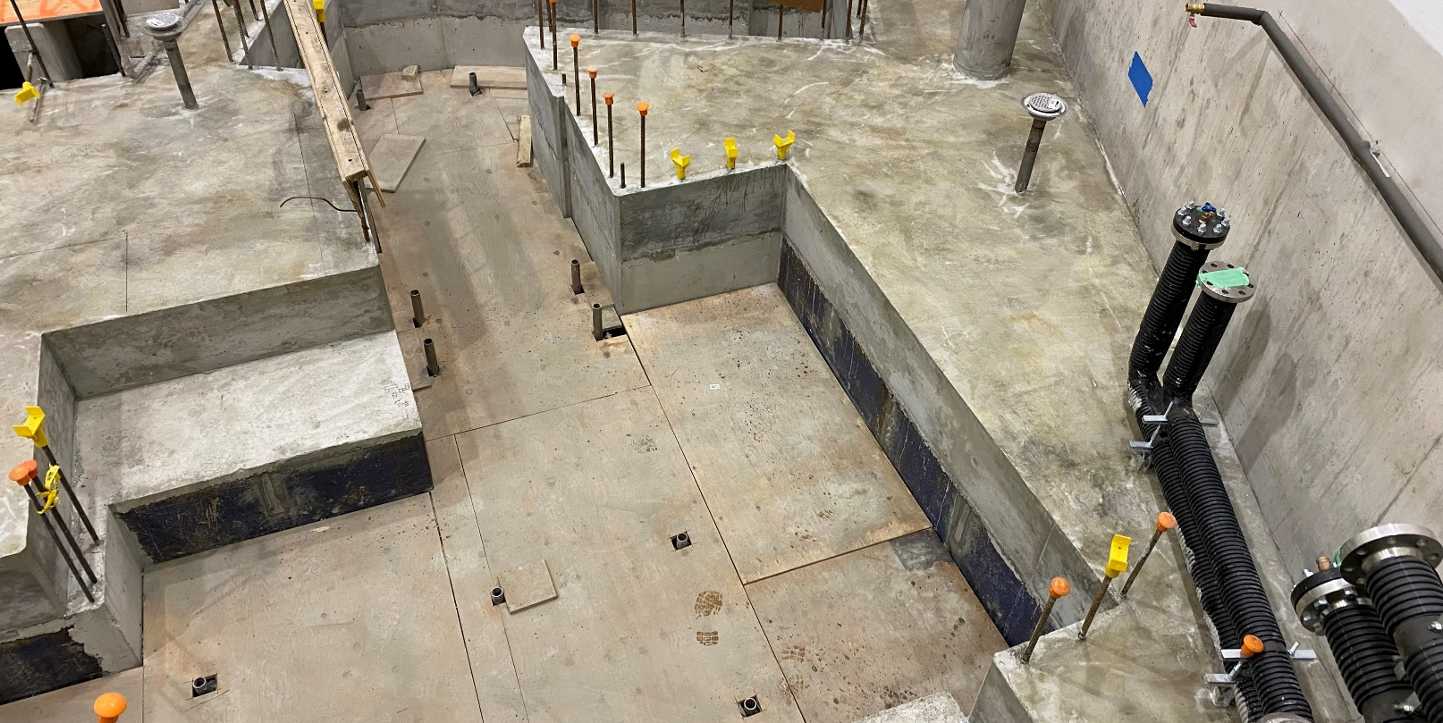
Target Hall Infrastructure
Shielding construction of Level 2 successfully completed on time.
Structural Supports for heavy ARIEL modules received and installation completed.

Slide 21
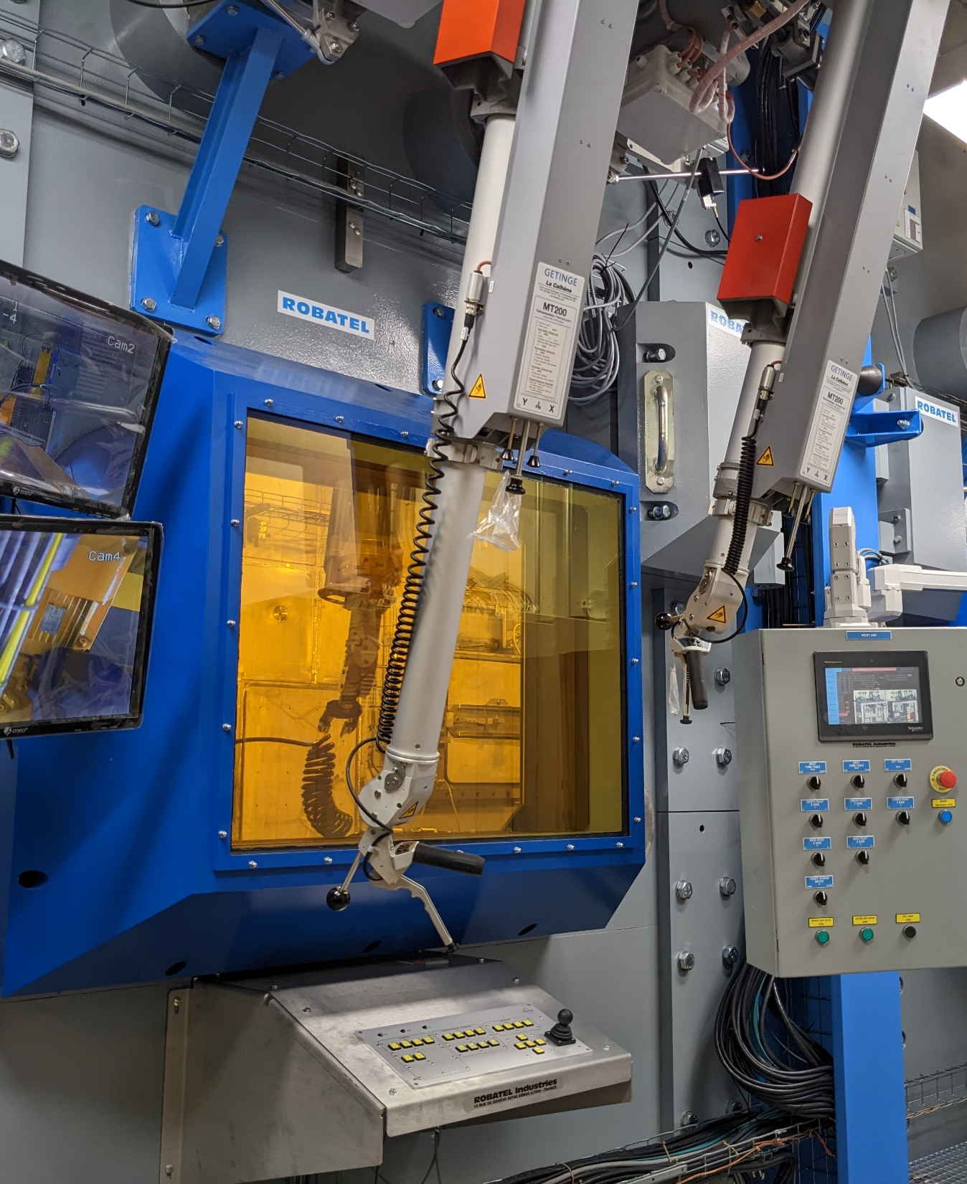
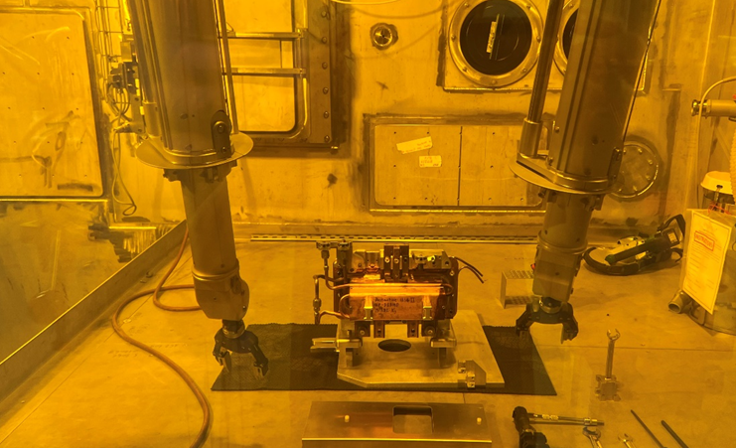
ARIEL status:
Hot cell
Largest single capital investment for the project.
Hot cell installation completed!

Slide 22
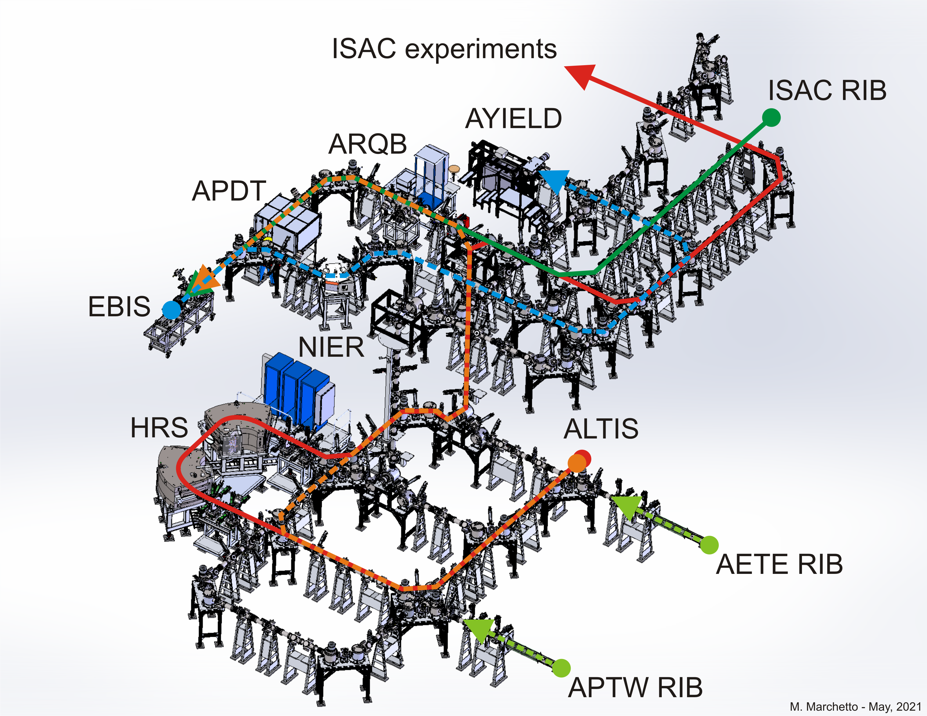
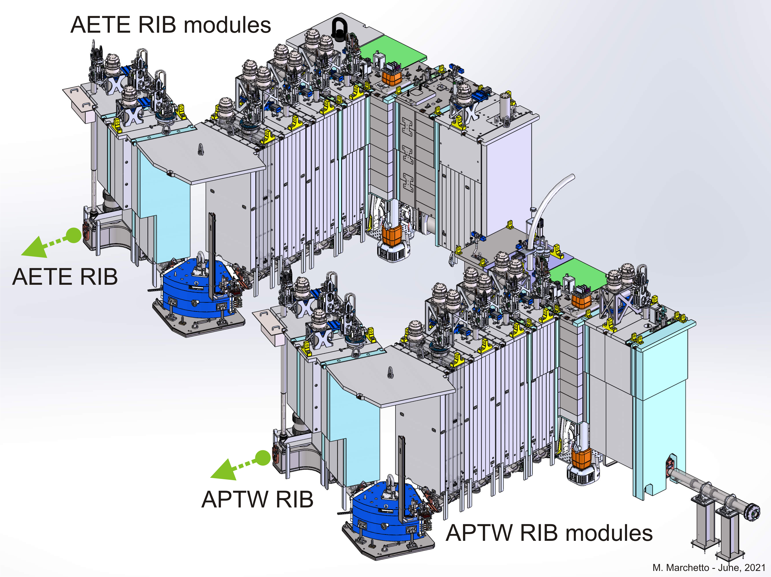
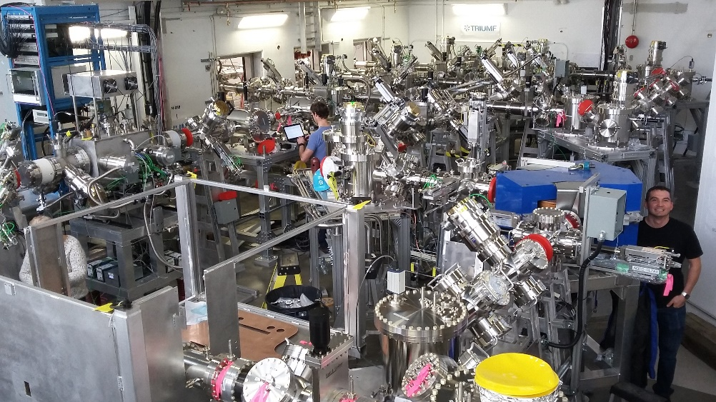
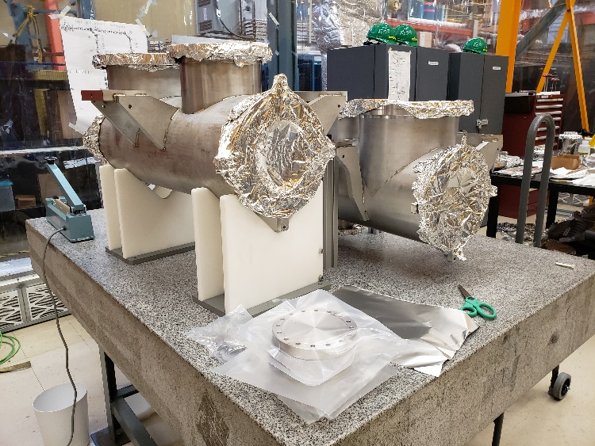
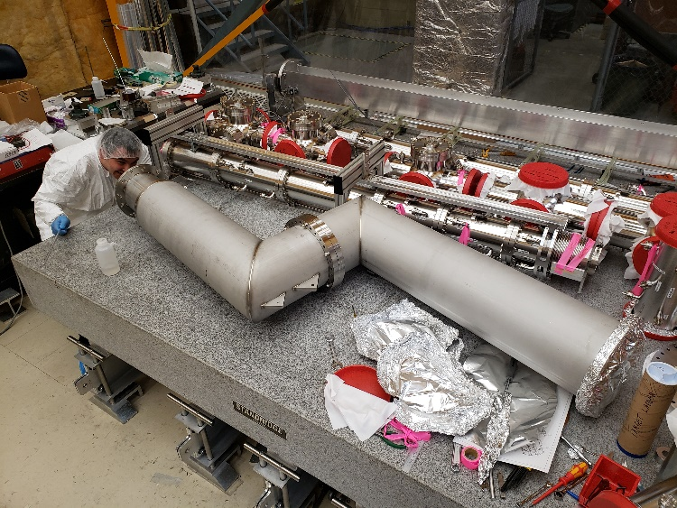
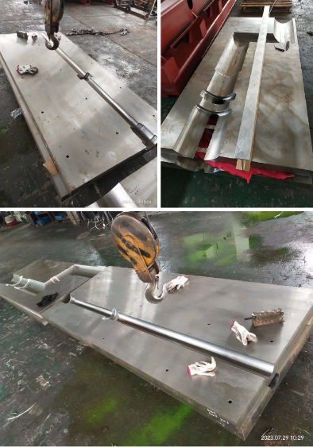
ARIEL status: RIB (transport) modules
RIB transport system outside the target hall (200 m of electrostatic beamline)
>95% installed and commissioned
RIB module vacuum chambers fabricated for VECC
First RIB module vacuum dog-leg fabricated and assembled.
RIB module steel shielding fabrication in progress!
Front-end outside the target hall
Front-end inside the target hall
RIB transport system
G level
RIB module vacuum chambers
RIB modele2 dog-leg
RIB module shields

Slide 23
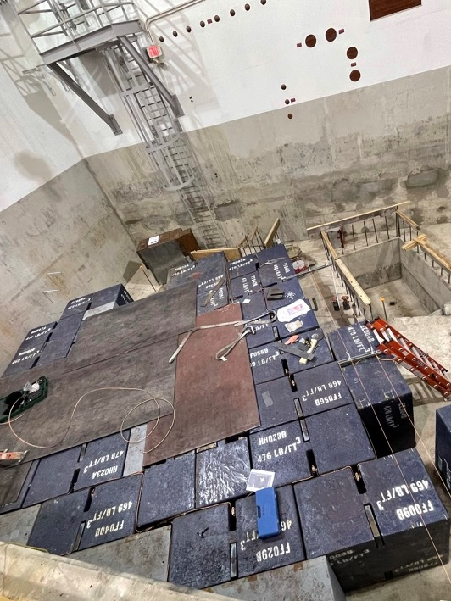
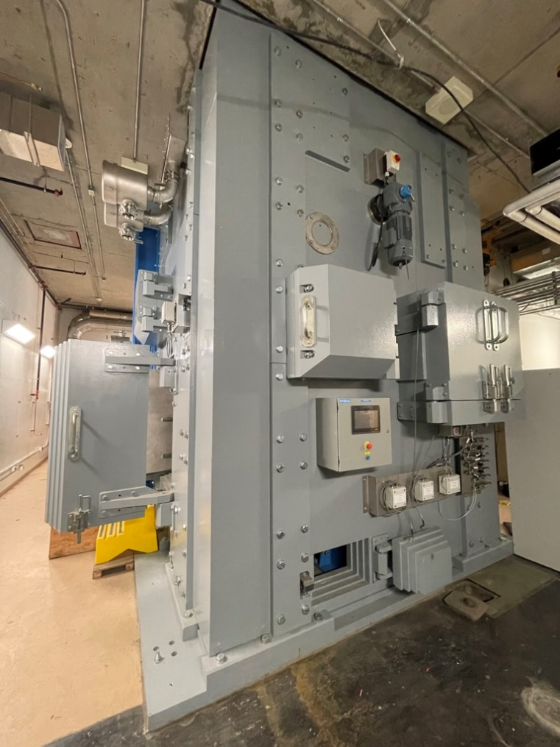
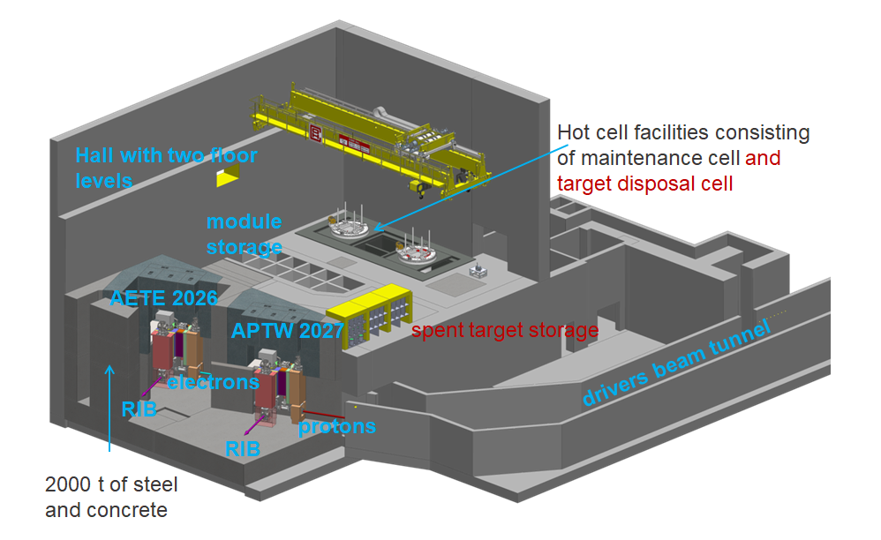
ARIEL completion and transition into Operation
Electron target station completion and online in 2026
Proton target station and BL4N completion in 2027
(support from SCK CEN, Belgium)
Required for the ramp up in operation to take full advantage of ARIEL over the next 5YP:
  Target production laboratories
  Target decay storage vault
  Offline target acceptance stand – TISA completion
  Resonant laser ion source for proton target station
  APTW proton beam raster system
Design goal 9000 hours beam time and 3 simultaneous RIBs. Only possible within the funding request of $450 M.
Target hall shielding
TISA

Slide 24
ARIEL operation – ramp up of beam delivery
Commissioning of the electron line in the ARIEL tunnel followed by a gradual power ramp up to the electron target.
Commissioning of BL4N followed by a gradual Cyclotron extracted current ramp up to 400 μA, with stable beam current in 3 high-energy beamlines.
Roll out of the ARIEL-era operational model:
TRIUMF will become a facility much more complex to operate.
Success will require: TCC, Model-Based Tuning and integrated multi-facility maintenance.
After the commissioning phase, the reliable delivery of high-power electron and proton beams to ARIEL requires regular machine development and targeted technology development programs.

Slide 25
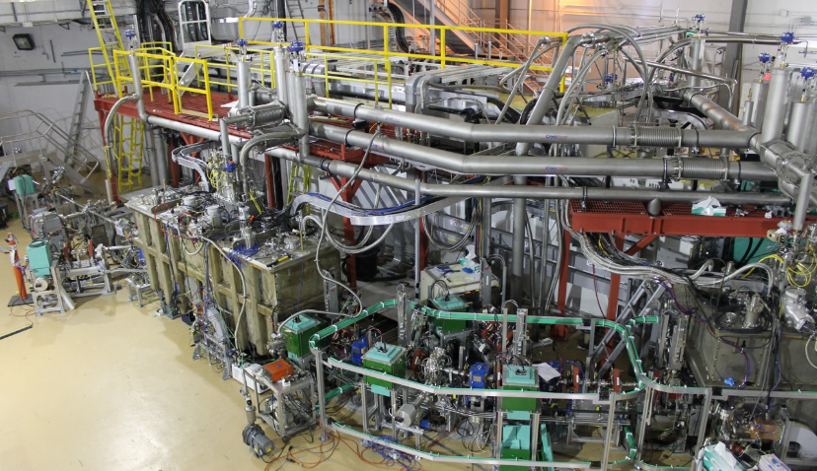
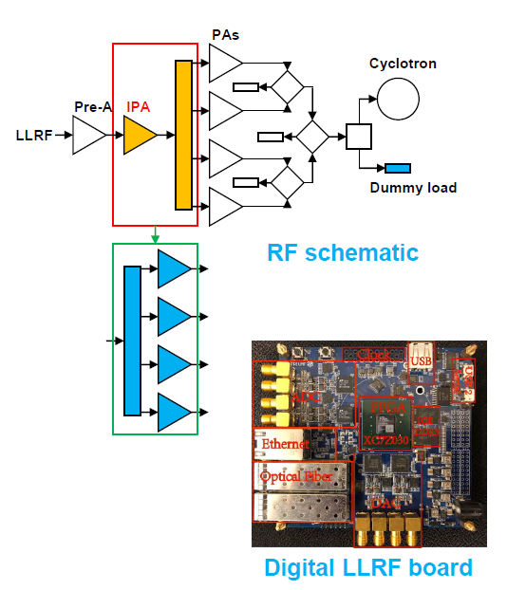
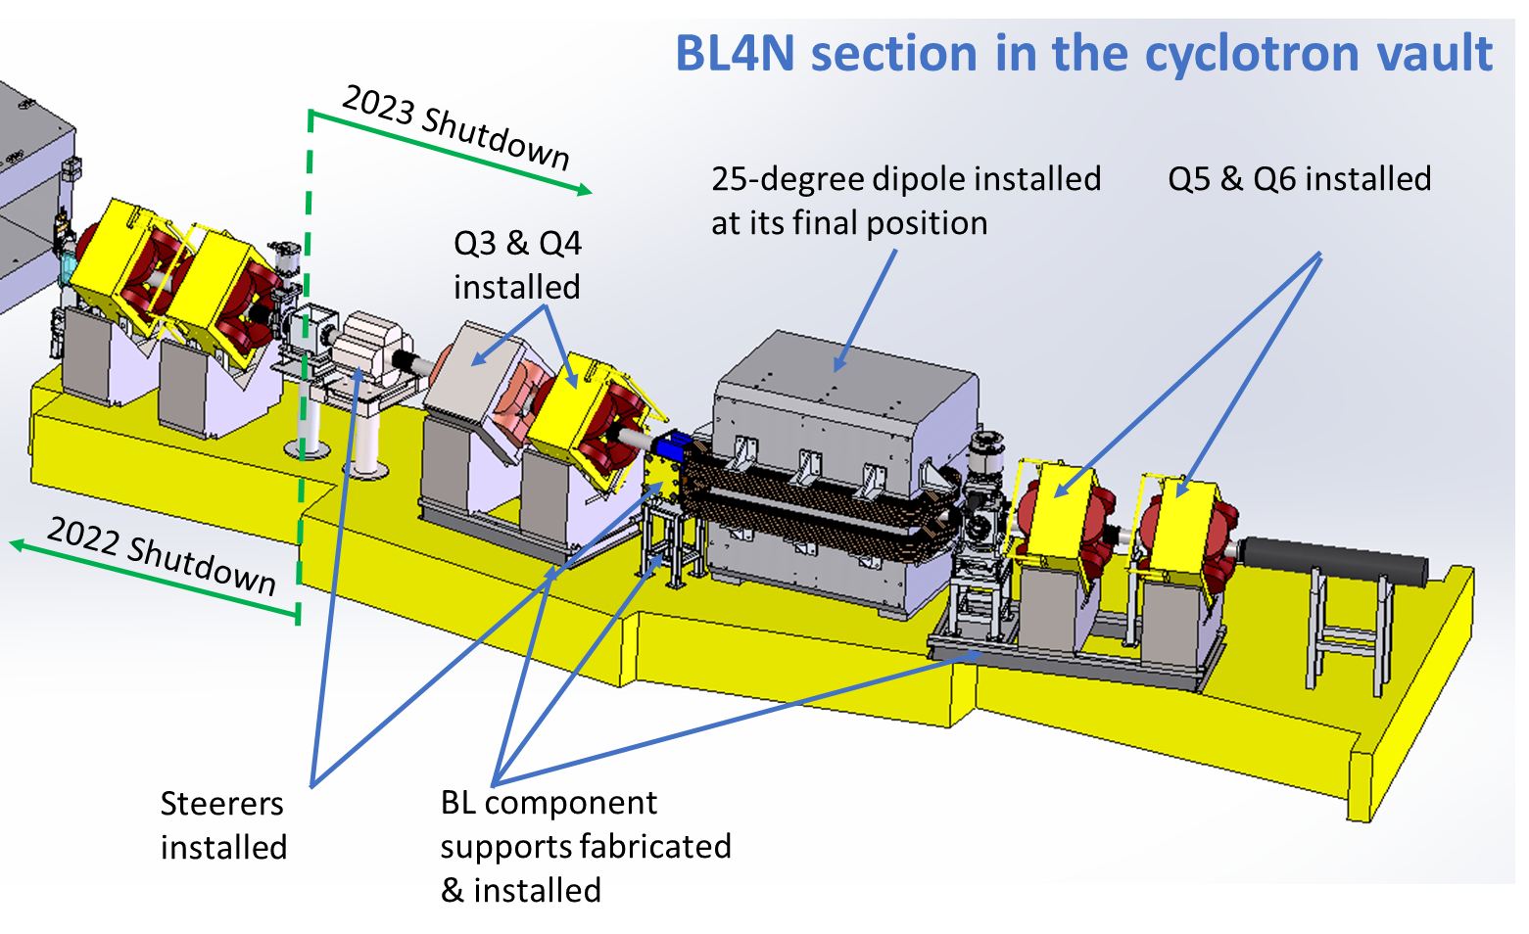
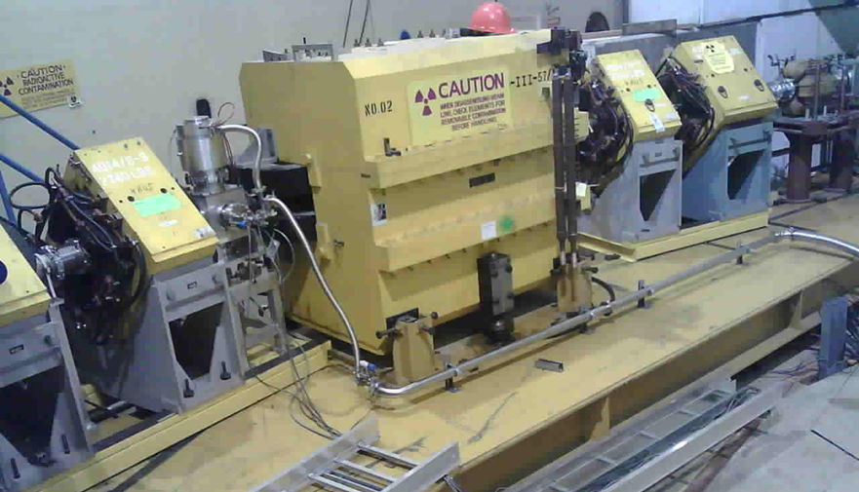
Driver accelerators for ARIEL
E-linac towards high reliability and 100 kW beam power
  R&D on particulate contamination, Plasma cleaning
  Develop software tools to support beam ramp-up and high-power operation
  Intense THz and IR radiation – realize photo-gun and optics
  Support science (DarkLight, FLASH, etc.)
Towards reduced cyclotron maintenance time (lid-up only every second year)
Continue cyclotron refurbishment RF system (SSA and digital LLRF) for high current operation!
Primary proton beam line - BL4N
All beamline components for the vault
section installed.

Slide 26
Staffing towards the ARIEL operation era
Basis for the staffing decision towards the ARIEL operation era is the Operational model for ARIEL (Document-129655).
→ Factory model, where the three RIB target areas are each scheduled in three-week cycles with each cycle starting on a subsequent week.
The operational model analysis includes an estimation of the extra effort required to commission, operate, develop and maintain a significantly expanded facility, over and above the present effort.
From this analysis we identified additional hires, taking the gain of efficiency into account!
(TCC, advances beam tuning, IT tools, refurbished equipment)

Slide 27
Accelerator science at TRIUMF:
Three pillars of excellence.

Slide 28
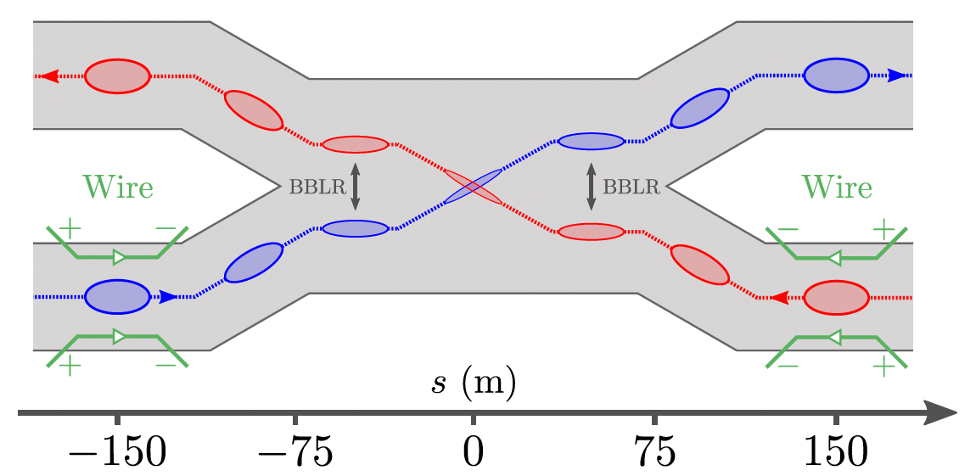
Beam Physics
Beam Physics will focus internally on cyclotrons and linacs and externally on ring accelerators / colliders:
Beam physics studies of the ARIEL e-linac for THz radiation and DarkLight. Recirculation ring and Energy Recovery Linac operation mode.
Rastering of 100 kW e-beam on the ARIEL electron convertor target.
Commissioning protons (BL4N), simultaneous electron&proton operation.
Increasing the beam current in the cyclotron (500 μA capability, 400 μA daily operation) and overcome issues of high current beam extraction into three beam lines.
RIBs from ARIEL → towards regular ARIEL HRS operation at a resolution oft 20,000.
Internal accelerator facility tuning development, model based
beam tuning and Machine Learning applications.
Dust in accelerators – new hot topic in the accelerator community.
→ UFO analysis in LHC and dust migration in SC linacs.
UFOs lead to sudden loss spikes or even beam dumps!
Investigating the charging mechanism of dust and migration in
the system.
Important collaborations with CERN LHC:
Beam-Beam Long Range and compensation methods
(presentation of Hui Wen Koay)
Test of Wire Compensators for LHC Run 3 around IP1 and IP5

Slide 29
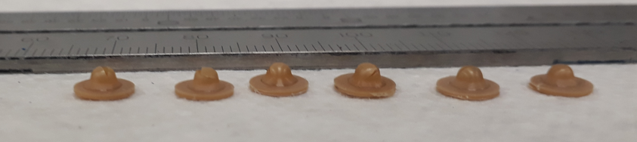
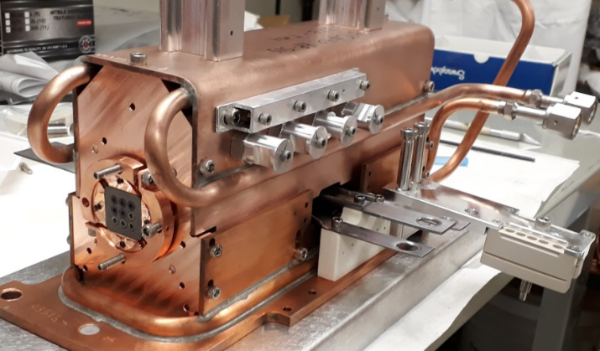
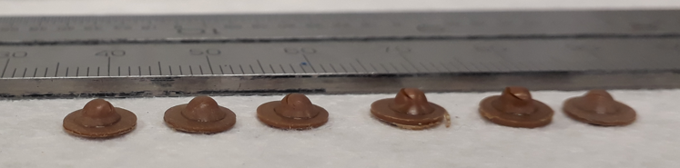
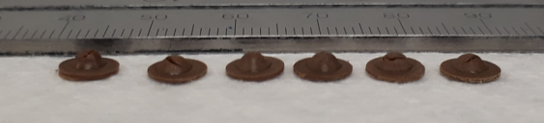
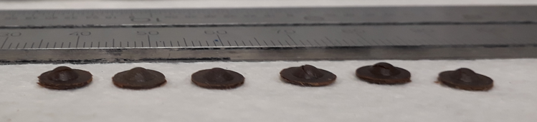
Targets and Ion Sources Research Examples
Research focus:
Target materials for intense radioisotope release
Ionization schemes and laser ionization efficiency
Material irradiation damage for accelerator and nuclear applications
Applications of accelerators and high-power targets for neutron and medical isotopes production
Converter targets
(example Proton-to-neutron )
Irradiation damage studies – example: PEEK
Tensile and fracture properties
1 MGy
R&D on high power electron convertor target for ARIEL
4 MGy
17 MGy
24 MGy

Slide 30
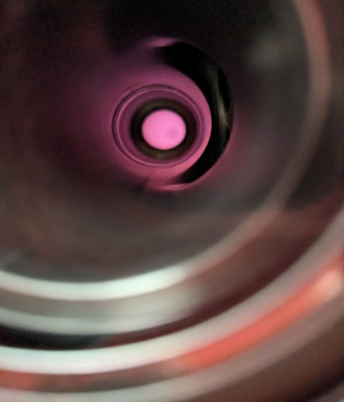
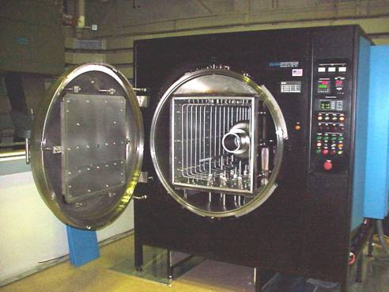
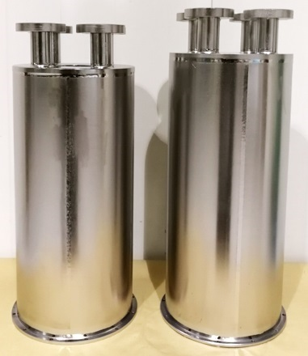
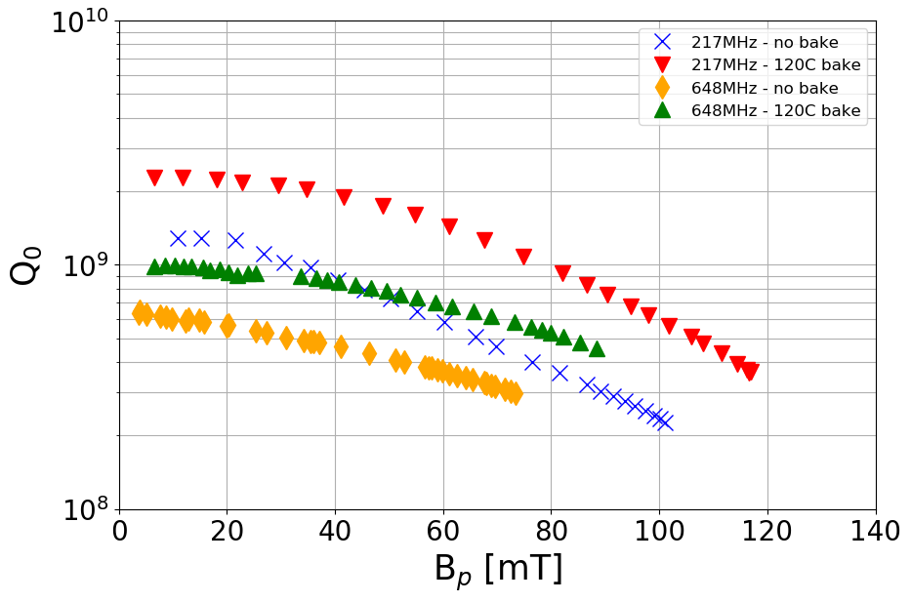


RF/SRF research activities
To support on-site accelerators, student focused R&D and
external collaborations (like HL-LHC crab cavity cryomodules, presentation of Philipp Kolb)
Linac developments
  E-Linac – plasma cleaning for in-situ processing, model and mitigate particulate migration
  ISAC-II – implement heat treatments to improve gradient and Q
SRF R&D
  Exploit coaxial cavities to develop new insight into optimized design, fabrication and processing (furnace baking, electro-polish, Temperature-maps)
  Exploit beta-SRF to develop new SRF processes and materials and understand fundamental limits
Plasma cleaning
Furnace degassing
Heat treated
Baseline
ISAC-II cavity performance
Helmholtz coil

Slide 31



Electron Ion Collider (EIC) at BNL
The EIC is the next discovery machine to be built in North America at Brookhaven National Laboratory.
TRIUMF is working with EIC-Canada to seek Canadian funding to support in-kind contributions.
TRIUMF’s SRF group has started work on the design of the 394 MHz crab cavity – similar size to HL-LHC 400 MHz crab cavity with significant challenges in managing the higher order modes (HOM) excited by the high circulating beam current.
TRIUMF to contribute to the design of kicker systems in collaboration with CLS and BNL.
394 MHz RF Dipole Cavity

Slide 32

THz radiation project
beam dump
Transport
to ARIEL
TRIUMF, as part of a pan-Canadian collaboration (including TRIUMF and CLS), will receive CFI funding to develop a THz light source within the ARIEL e-linac hall.
Addition of a new photo-gun to produce short, high brightness, low emittance, beam bunches, and a bunch compression chicane.
A partial recirculation arc and septum will be used to install the chicane off the main linac beamline.
Additional funds are being sought to complete the recirculation ring for either Energy Recovery or Energy doubling for Darklight for instance.
septum
THz chicane
1.3 GHz SRF Cavities
650 MHz eGun
Photo-gun

Slide 33
Summary of Accelerator topics in the next 5YP
Driver accelerators:
  Cyclotron refurbishment and upgrades
  e-linac towards full performance and for new experiments
  beam lines (BL1A), BL4N completion for ARIEL
TCC – TRIUMF Control Center (combines Driver and RIB control rooms) and Cyclotron Control System upgrade
RIB facilities:
  ISAC target hall consolidation, target module refurbishment, labs, ISAC-I Linac
  Target ion sources – Laser ion sources and polarizer and Remote Handling
  ARIEL completion and ramp up of operation
Research and education:
  HLA, model coupled beam tuning, machine learning and high power beams – e-linac, HL-LHC, EIC
  Cyclotron technology (injection, high beam intensity operation → beam loss reduction)
  SRF research - plasma conditioning, heat treatments, particulate migration, cavity development, SRF materials and fundamental limits
  High power targetry and material R&D, Laser Ion Sources R&D
Domestic and international projects:
  THz radiation, DarkLight, FLASH and PC-CANS
  CERN HL-LHC, EIC

Slide 34
Thank you

Slide 35
Additional slides

Slide 36
Core Competencies of the accelerator Division
Operation of a sophisticated accelerator facilities with simultaneous delivery of multiple beams
Particle sources: H⁻-sources, Heavy ion sources, charge state breeder (ECR and EBIS), electron guns
Beam physics: Simulation codes, beam tuning applications, physics of space charge dominated ion and electron beams, collider beam physics
Beam transport systems: Electrostatic and magnetic beam line systems, high resolution mass separators
Target technology and ISOL systems: High power RIB targets, target ion sources (SIS, FEBIAD, LIS), in-target beam purification technologies (IG-LIS, cold transfer line, proton-to-neutron converter), nuclear spin polarization, muon production targets, high-power targetry, material radiation damage
Remote handling: Hot cell technology, robotics, irradiated target and radioisotope handling, manipulation of activated and contaminated parts, cyclotron services, radioactive waste management
Accelerators: Linacs (heavy ions and electrons) normal and superconducting, cyclotrons (H-), synchrotrons, FFA, accelerator design
Accelerator systems: RF (low level and power RF, SRF, cavity development), cryomodules, vacuum (including UHV), cryogenic systems, power converter technologies, high and low intensity beam diagnostics (ions and electrons), machine protection
Accelerator Application: Medical isotope production, irradiation (material, therapy, electronics,…)
Education: Seminars, lectures, lab research projects and thesis research

Slide 37

Risk registry
The Accelerator Division Risk Registry summarizes potential
risk for the operation of systems of the TRIUMF accelerator complex.
The risk registry addresses the primary beam accelerators the 520 MeV cyclotron and the ARIEL e-linac and the according beam lines. It also refers to the RIB delivery systems, Target-Ion sources and the RIB preparation and acceleration facilities.
It also comprises a list of issues (risks that have been materialized) and need to be addressed. One example is the mitigation of the shortage of LHe.

Slide 38
TRIUMF accelerator complex
ISAC-II
High energy
ARIEL
Primary beam driver:
Cyclotron, 500 MeV, H⁻
Produces rare isotopes, neutrons and muons!
Isotope Separator and Accelerator facility - ISAC
Isotope Separator Online (ISOL) facility
ISAC-I: Normal conducting-linac, 0.15-1.5 MeV/u
ISAC-II: Superconducting-linac, 5-15 MeV/u
Advanced Rare Isotope Laboratory - ARIEL
Superconducting electron linac
30 MeV, 10 mA, cw
4 Cyclotrons for medical isotope production
(with a TR24 to be commissioned in the Institute for advanced Medical Isotope – IAMI)
ISAC-I
Low and
medium
energy
Cyclotrons
for medical
Isotope
production
500 MeV
Cyclotron

Slide 39



Medical Isotope Production Facilities
Applied Technology Group (ATG) incorporated in the Accelerator Division since 2018
Applied Technology Group (ATG) works closely with BWXT. Prior relation to NORIDION for ~30 years.
ATG provides irradiation services to BWXT
34 people: engineers, technicians,
applied science staff
2 dedicated cyclotrons: TR30-1, TR30-2
Plus STF (100MeV) and IPF (400+MeV),
→ beam from the 520MeV cyclotron
TR30-1
TR30-2
Accelerator Division together with Life Sciences: Operates TR-13 and upcoming IAMI TR-24 cyclotron

Slide 40
ARIEL - TRIUMF’s flagship project
(see ARIEL sessions on Thursday)
Simultaneous RIB production from 3 targets
  50 kW existing ISAC proton target
  50kW new ARIEL proton target
  100kW new ARIEL electron target
ARIEL will triple ISAC's present rare isotope capabilities.
Multi-user capability with more and new isotopes for
  Nuclear Structure and Dynamics
  Nuclear Astrophysics
  Fundamental Symmetries
  Materials Science
  Life Sciences
Unique beam preparation and transport system (CANadian Rare isotope facility with Electron Beam ion source - CANREB)
  High resolution separator
  Beam preparation with RFQ and EBIS
TRIUMF campus

Slide 41







HRS development status
Example of internal collaboration between Engineering Physics and Beam Physics groups
Design parameters: 20,000 resolving power for 3 μm transmitted emittance
Development runs with 10,000 and 16,000 resolving power tunes:
  Multipole corrector can successfully correct for any aberration
  Emittance growth due only to widening of transverse position (not angle) due to a 60 Hz beam energy jitter
Recently, 60 Hz beam jitter successfully compensated for 10,000 resolving power tune
uncorrected
corrected

Slide 42


ISAC: Model Coupled Accelerator Tuning (MCAT) to Autofocus Beam
( PhD thesis of Olivier Shelbaya)
MCAT: A control-room high level application (HLA) that computes start-to-end LINAC using sequential optimization. Can compute ISAC-DTL and HEBT line tune in real time!
Notes:
Objective is efficiency, 9000 hours , but we don’t want to triple the human power. We don’t want to depend on the skills, but we have a rational process
This plot is an end-to-end model, that is online-real time that integrate all kind of elements

Slide 43

Example domestic: PC-CANS
TRIUMF is collaborating with the University of Windsor and the Canadian neutron scattering community towards an accelerator-based neutron facility
Collaboration has conceptualized a stageable prototype CANS facility, PC-CANS, based on linac technology.
PC-CANS will allow competitive rates for neutron science, while
simultaneously producing F18 for PET and neutrons for a dedicated
BNCT research and development facility.
The PC-CANS prototype will be the
first CANS in Canada and the first
for BNCT in North America.
The project will augment and solidify
TRIUMF core competence in linac and target systems
and the proton accelerator technology is well aligned with applications

Slide 44



20-Year Vision
Five themes make up the foundation of the 20-Year Vision document. The Accelerator Division vision links to all themes:

Slide 45
Our 20-year Vision for TRIUMF Accelerator Science and Facilities
Isotope Valley
With ISAC+ARIEL+IAMI we will greatly expend our capabilities, and establish TRIUMF as a leading global center for isotope research.
Isotopes for physical science
Isotopes for life science
Isotopes to cure Canadians
Canadian Hub
We are Canada’s centre of excellence in accelerator-related science and technology.
We centralize knowledge, and diffuse it through training, counsel, and collaborations.
With our always evolving expertise we remain a leader in Canada’s transformation to a knowledge based economy.
Big Science — Big Tech
International collaborations are key to contribute to the most significant discoveries, attract talents, and maintain cutting-edge expertise.
We support international projects by leveraging our core knowledge and engaging Canadian industry.
We build on our strengths to serve science and invent life-changing technologies.
https://beamphys.triumf.ca/~tplanche/20-year-vision-acc.pdf

