Slide 1
TRIUMF’s Role in a Canada-Wide Effort to Transform Cancer Therapy with Rare Isotopes
Science Week – 5YP session
Caterina Ramogida
Assistant Professor
Chemistry | Simon Fraser University
Life Sciences | TRIUMF
Notes:
Today with my time, I intend to give you a look into what we (TRIUMF) plan to accomplish in the framework of our recently funded NFRF-Transformation Program “Called Rare Isotopes to Transform Cancer Therapy”

Slide 2
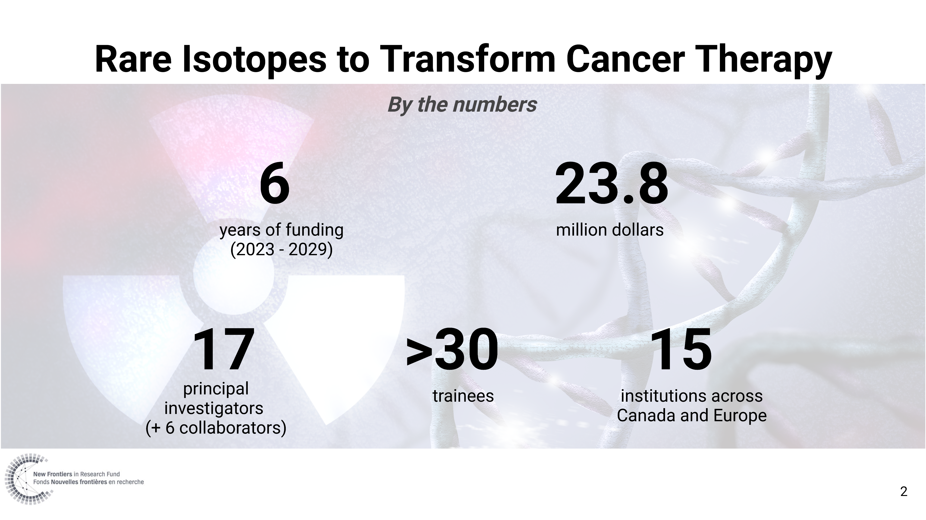
Notes:
Before we get into the details, here are some overview figures from the program:
Funded by the new frontiers in research fund – transformation stream
Our program has funding for 6 years and is expected to run until 2029
This is a nearly $24million dollar effort
Which includes 17 PI, + 6 collaborators,
Under these PIs we have approx. 30 trainees at all levels currently working under the program initiative – with more new recruits and hires coming onboard over the course of the 6 years
Our team members are from 15 different institutions across Canada and Europe

Slide 3
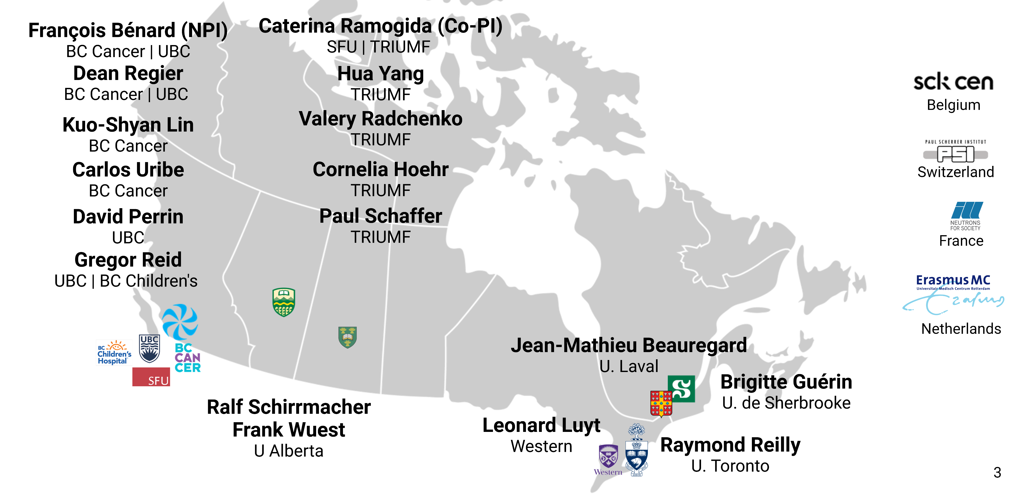
Our NFRF-T Team
Notes:
We are a multidisciplinary team involving a diverse group of researchers at all career stages. The applicants are listed here. The project is lead by FB from BC Cancer as NPI, myself and Co-PI joint between SFU and TRIUMF. And at the core of the program is the TRIUMF team – who will play a pivotal role in enabling medical isotope production and chelation – which I will highlight in a few minutes.

Slide 4
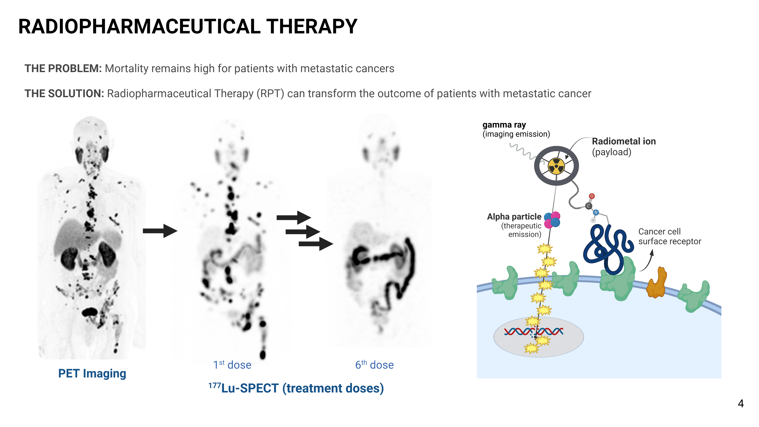
Radiopharmaceutical Therapy
PET Imaging
1st dose
6th dose
¹⁷⁷Lu-SPECT (treatment doses)
Notes:
Our research focuses on the development of novel radiopharmaceuticals for use in cancer therapy. Radiopharmaceutical therapy is rapidly emerging as a potent, effective and well tolerated approach to treat patients with advanced metastatic cancer, a leading cause of death and productivity loss in Canada. The principles of radiopharmaceutical therapy are simple, relying on radioactive drugs that bind tightly to proteins that are selectively expressed at the surface of cancer cells. Using a diagnostic radioisotope, patients who are likely to benefit from treatment are identified by an imaging test. Those with high accumulation of the radiotracer are treated by a therapeutic radioisotope that can kill those same cancerous cells. This image shows the exceptional response of a participant in BC Cancer’s ongoing national randomized clinical trial comparing RPT with chemotherapy in prostate cancer.
You see the diagnostic image in the first stage before treatment and subsequent disappearance of the tumours after treatment is the therapeutic lutetium-177 drug.

Slide 5
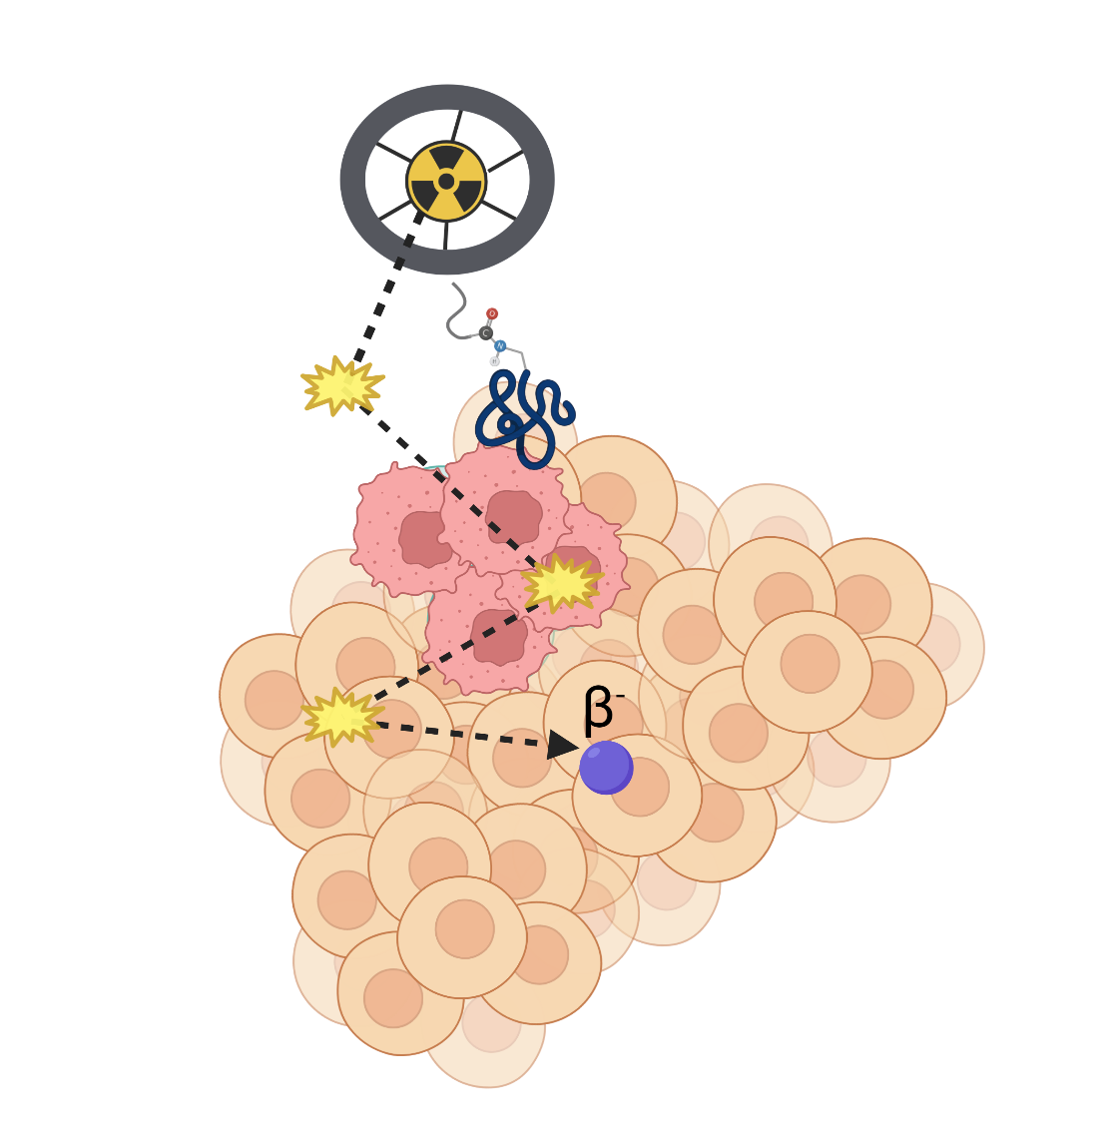



Radiopharmaceutical Therapy & Theranostics
Nuclear Imaging
Single-photon emission computed tomography (SPECT) – γ (gamma) ray
Positron emission tomography (PET) – β⁺ (positron)
Therapy
Beta (β⁻)
Alpha (α)
Meitner-Auger electron (MAE)
LET 0.2 keV/μm
LET 50 – 230 keV/μm
LET 4 – 26 keV/μm
vs.
vs.
50 – 1000 cells
< 10 cells
< 1 cells
Range in tissue
Notes:
Different types of radioactive emissions can be employed for RPT and imaging – with the combination of these two techniques known as ‘Theranostics’.
In imaging modalities, SPECT and PET, gamma and positron emission isotopes are employed, respectively.
While for therapeutic purposes, we can exploit isotopes that emit beta, alpha, or MAE given these particles high LET values, and propensity to cause ionizations and thus cell damage in close proximity to the isotope.
Each particle type can travel varying distances within tissue, with Beta particles traversing the longest distance (upwards of 1000 cells), followed by alpha particles that travel less than 10, and MAEs can travel less than 1 cell diameter – leading to the most precise delivery of cytotoxic radiation possible – assuming we can deliver the isotope precisely to the diseased cells.

Slide 6
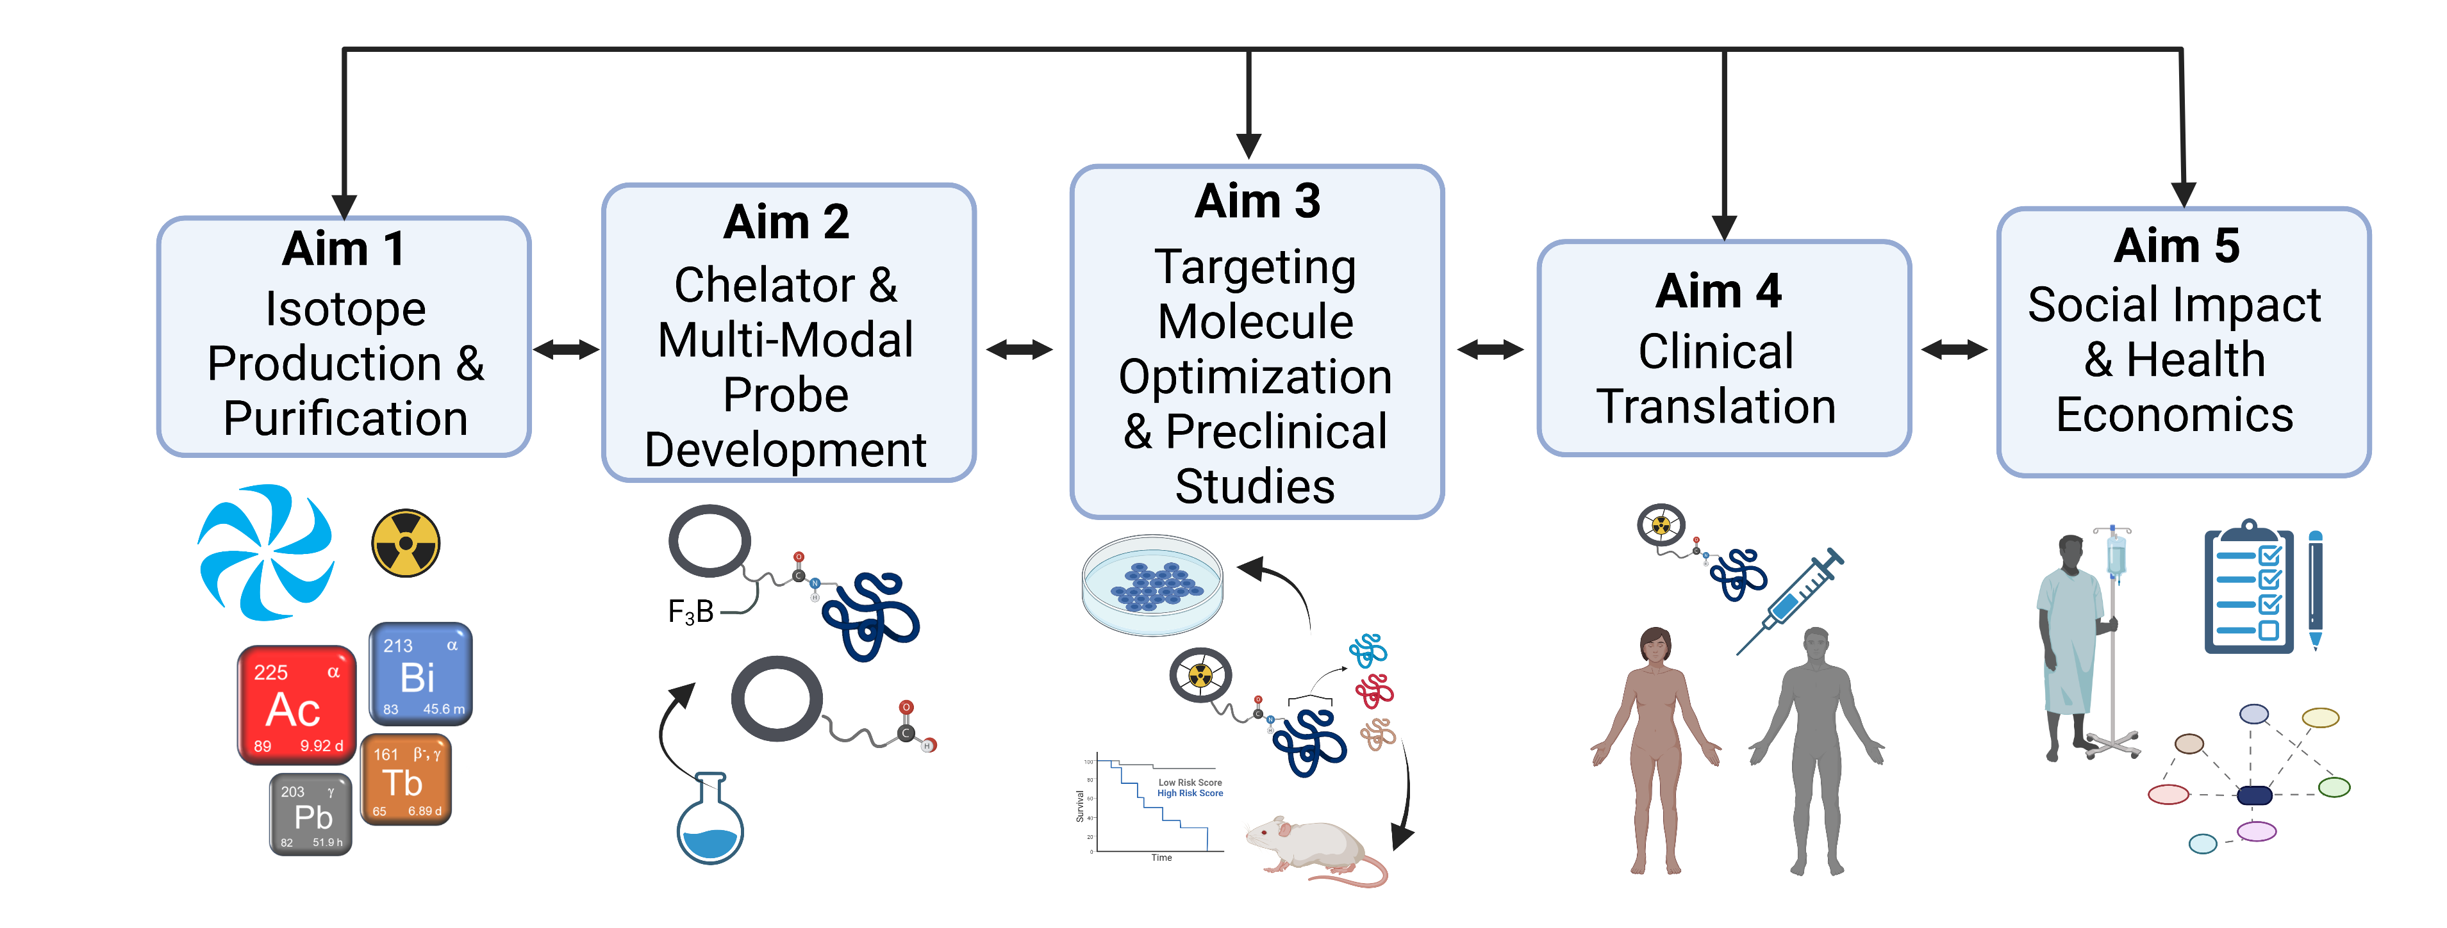












Our Approach
Notes:
With these concepts of RPT and theranostics in mind, Our NFRF program covers all the key areas necessary to transform radiopharmaceutical therapy and theranostics in Canada.
In Aim 1 – We will capitalize on the world’s largest cyclotron at TRIUMF, radioisotope production infrastructure in BC, Alberta, Ontario and Quebec and at international collaborator facilities to produce and isolate pre-clinical and clinical amounts of a library of medically relevant isotopes that span the gamut of imaging, and therapy applications and that we believe have the best potential to make an impact in the clinic.
In Aim 2 - We build on world class research in radiometal chelator design and radiopharmaceutical development to design tailored chelating ligands (or molecular cages) that have optimal properties for each of the isotopes produced in Aim 1.
In Aim 3 - Based on our strong expertise, we will develop the next generation of radioligands with the ultimate goal of enhancing treatment effectiveness for different types of cancer by optimizing the targeting vector binding to cancer cells.
Our initial focus will involve clinical translation of a PSMA ligand for prostate cancer that has proven potential but other vectors targeting Melanoma, breast, ovarian and colorectal cancers to name a few will be studied extensively.
In Aim 4 – we will conduct investigator initiated clinical trials – our plan is to conduct trials on 3 compounds over the grant’s lifetime, with the prostate cancer ligand being the first.
Aim 5 – is integrated into the translational pathway and will use regulatory science and economics to understand the social and population impacts of radiopharmaceuticals. Key decision points highlighted by the arrows in this figure are informed by these Social Impact and Health Economics analyses, to select which novel radio-isotopes to prioritize, guide the design of clinical trials and facilitate adoption by patients and health care funders.
So where does TRIUMF fit into approach? TRIUMF’s key role is in enabling medical isotope production (Aim 1) and chelation (Aim 2) – necessary components that will feed into clinical trials and translation.
What does this mean for TRIUMF? Where do we fit in? and what resources do we need to succeed?
With my remaining time, I’ll dive a little deeper into what we plan to do and how we will accomplish it.

Slide 7
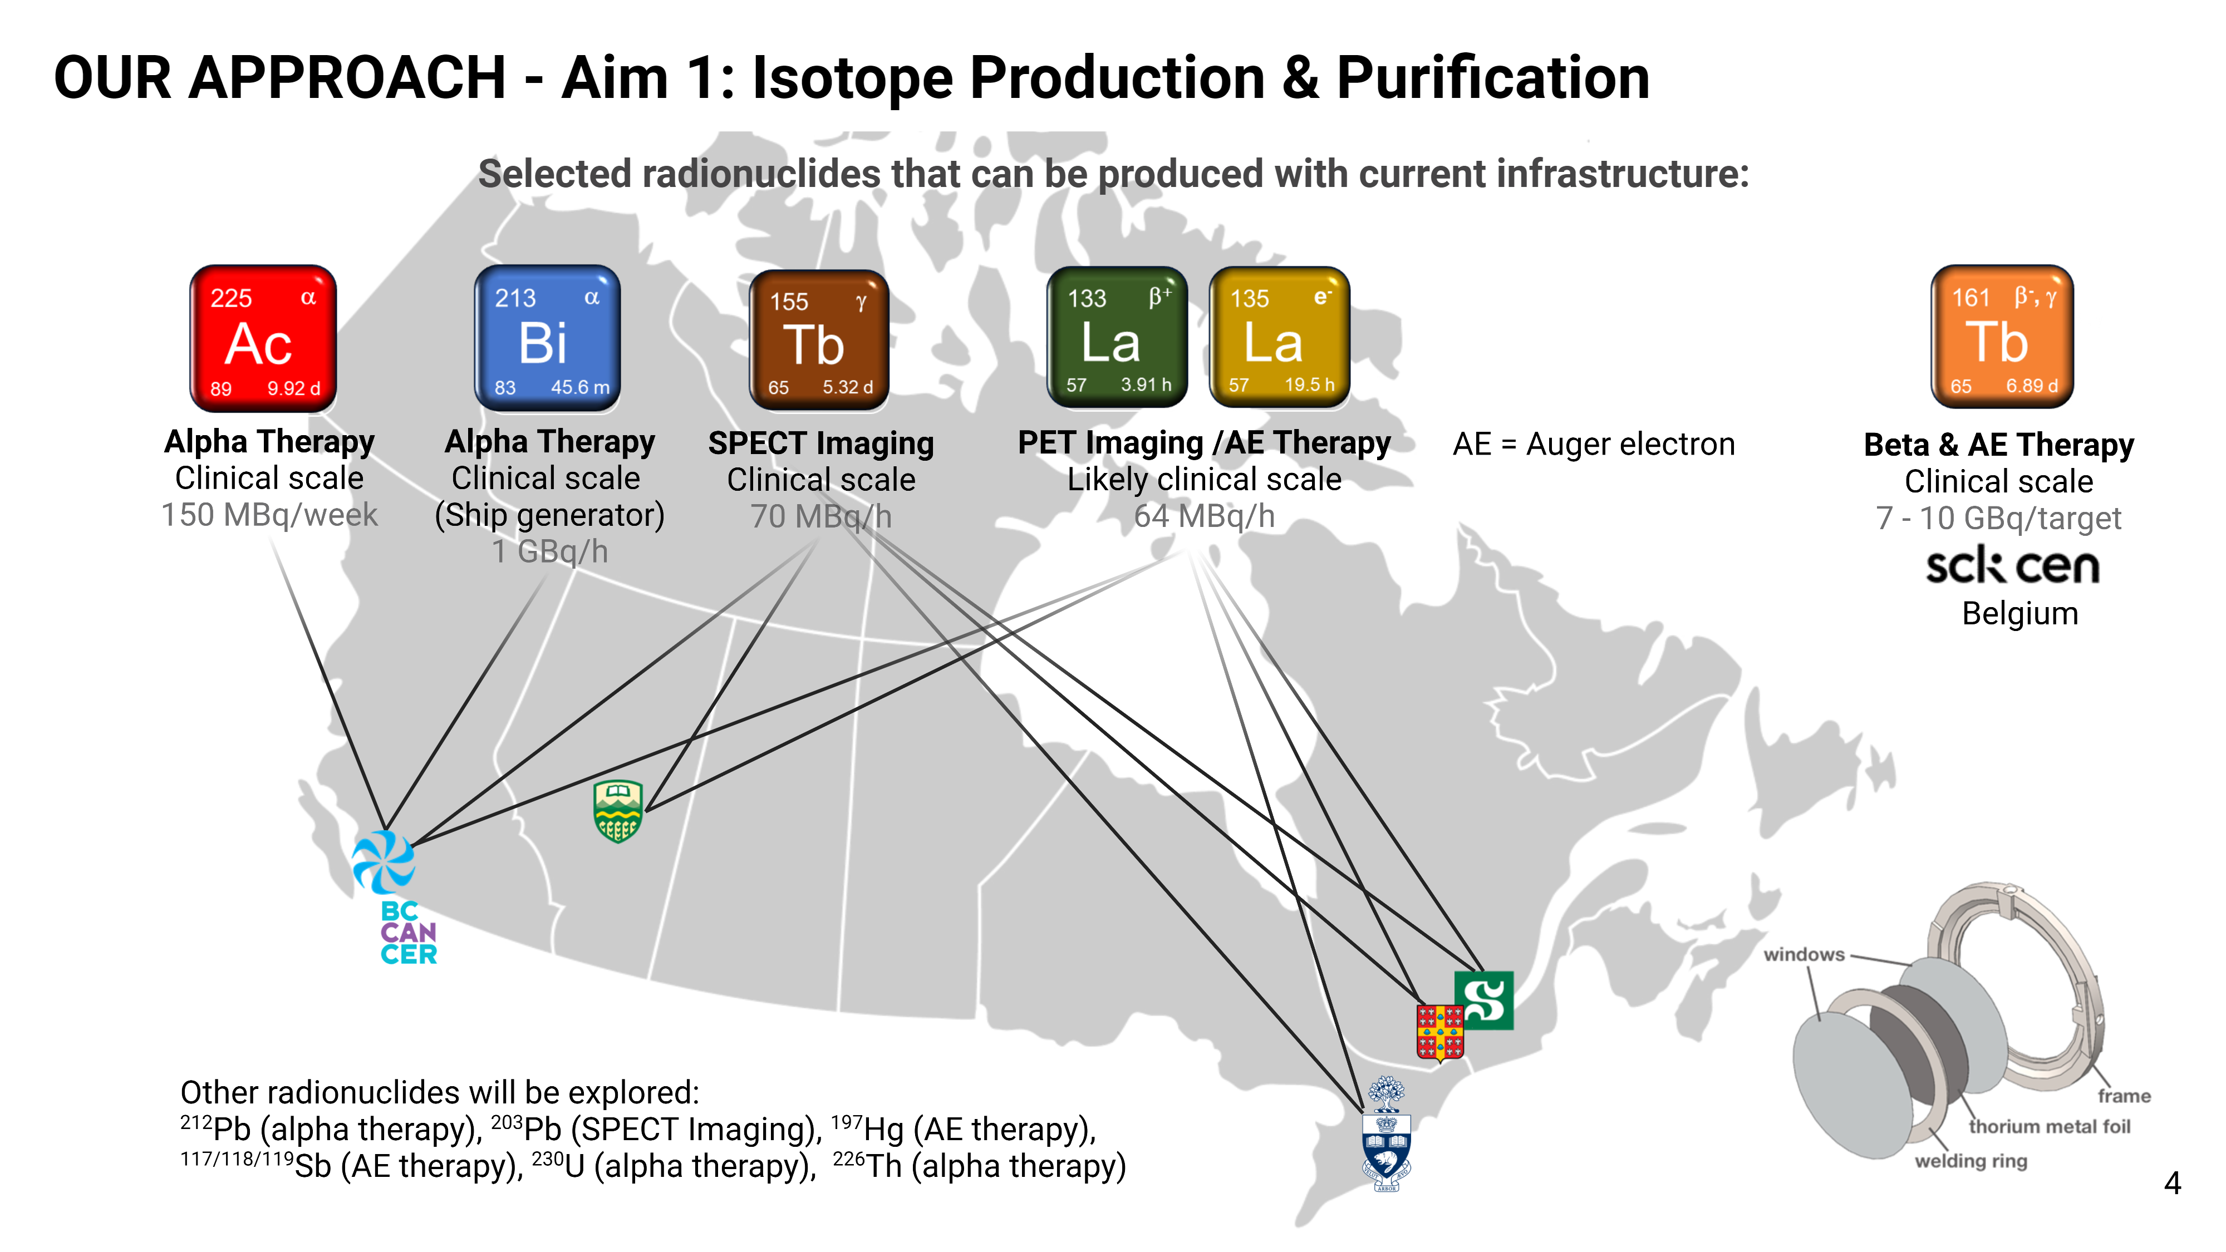
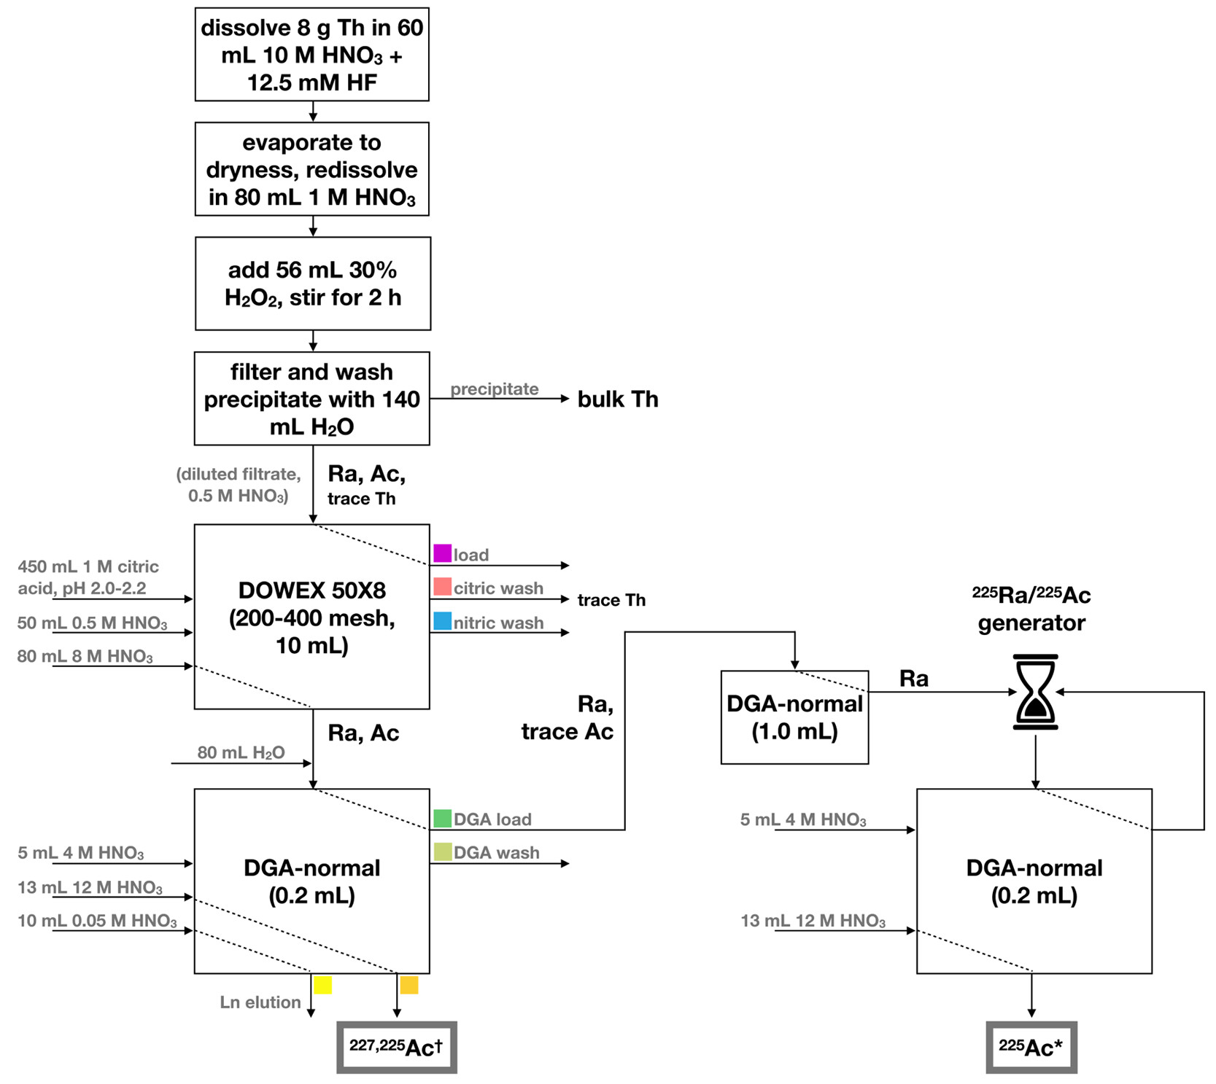
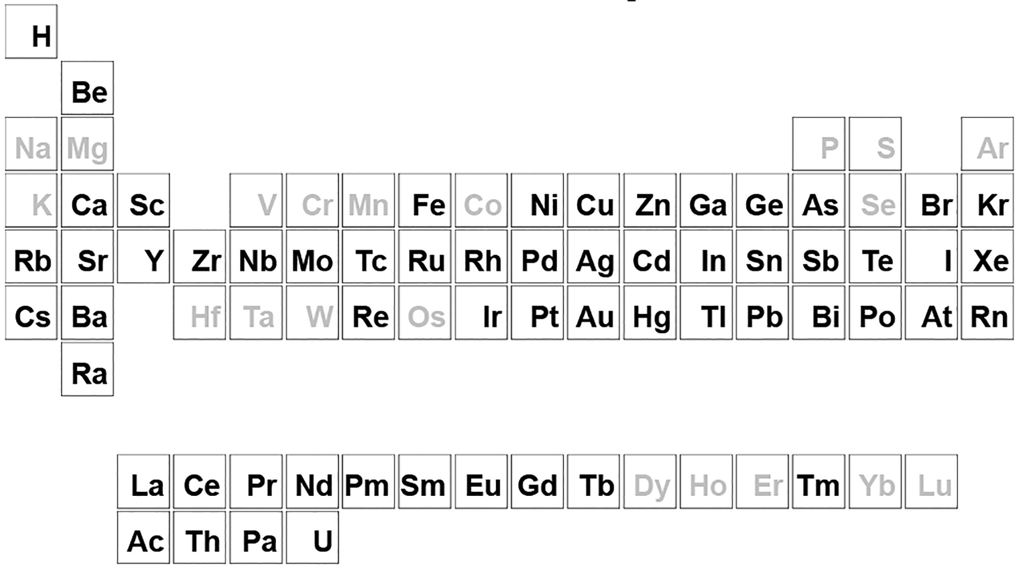
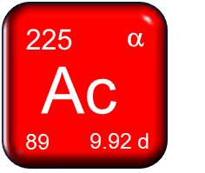
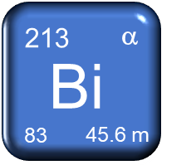
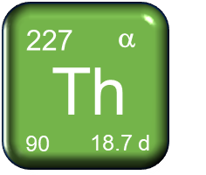
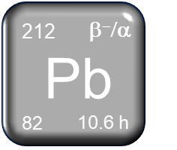
Aim 1 – Medical Isotope Production @TRIUMF
500 MeV
Thorium spallation on BL1A
²³²Th + p → x
²²⁸Th → ²¹²Pb
Alpha therapy
Clinical scale
150 MBq/week
Alpha therapy
Clinical scale
(Generator)
3 GBq/3 hr
Alpha therapy
Clinical scale
(Generator)
3 MBq/week
Alpha therapy
Pre-clinical
(Generator)
50 MBq/week
^{225,227}Ac → ²¹³Bi
²²⁷Ac → ²²⁷Th
²²⁵Ac
Robertson et al. Inorg. Chem. 2020, 59, 12156.
Notes:
In particular –
Using our 500 MeV cyclotron, and Th spallation products on BL1A, we will exploit our previously established purification scheme to isolate several promising alpha emitting isotopes:
This scheme which was developed for the production of Ac-225 – an alpha emitter that has proven clinical potential to eradicate late stage cancers. With current infrastructure, TRIUMF can produce ~20 patient doses every week. Supported by industrial partners and infrastructure upgrades, we are working on increasing the capacity.
Using the first-pass Ac-225 material which is spiked with the long-lived Ac-227, we can make Bi-213 generators at clinical scale. Bi-213 emits a single alpha particle during its decay which has been used for treating melanoma, lymphoma and neuroendocrine tumours.
Alternatively, we can wait for the Ac-225 to decay, leaving Ac-227 (with a half-life of 21.7 y) that can be used as a generator for Th-227 – another potent alpha emitter that has 5 alpha particles in its decay chain.
We can recycle the Th material isolated early on in this process, which includes Th-228 that was co-produced during irradiation. Th-228 can be used as a generator for The beta and alpha emitter Pb-212.
With one target we can extract several potent and promising therapeutic isotopes.

Slide 8
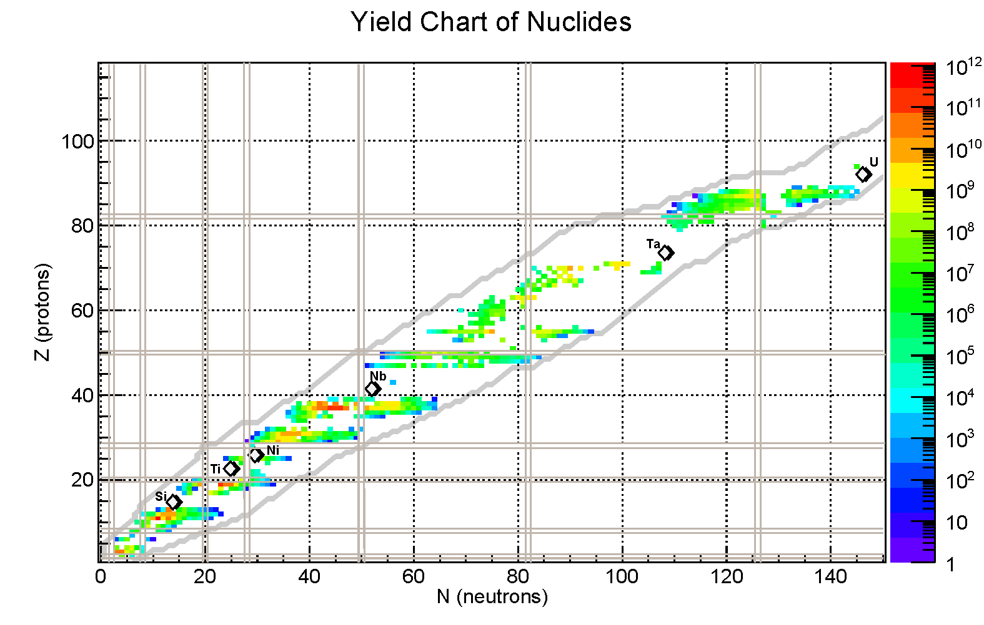
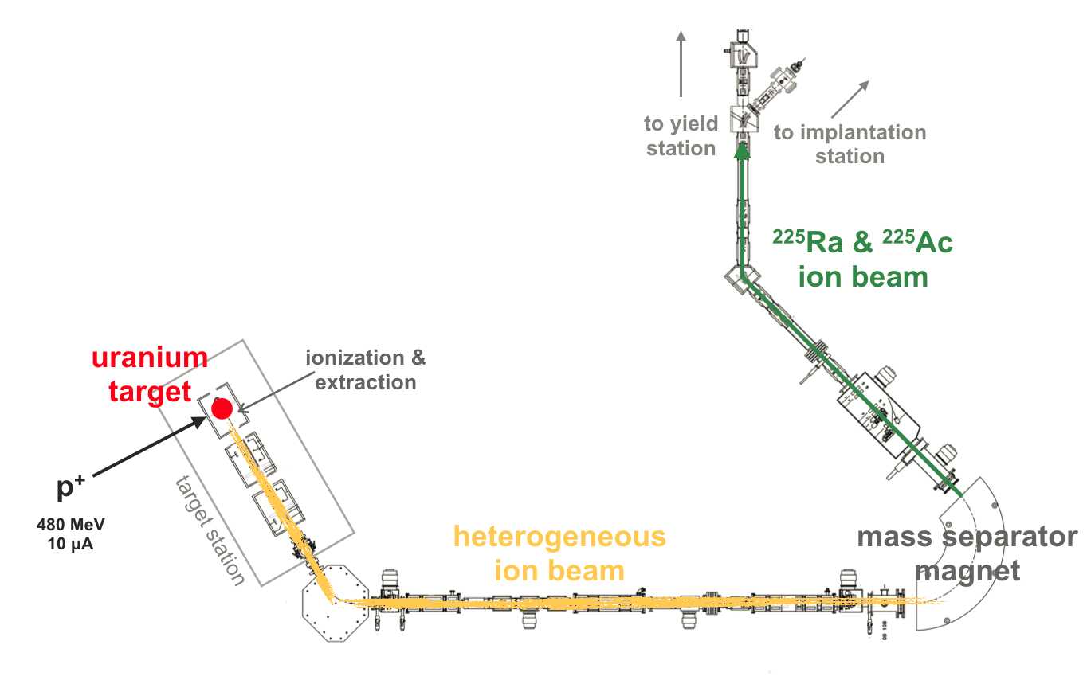
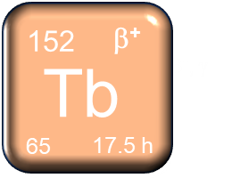
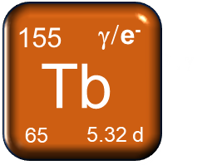
Aim 1 – Medical Isotope Production @TRIUMF
ISAC ISOL (500 MeV)
PET imaging
Likely clinical scale
101 MBq/h
Previously isolated:
SPECT imaging
Pre-clinical scale
5.5 MBq/h
Notes:
Tb-162 yield = 2.56e9 ions/s
Tb-155 yield – 1.02e9 ions/s
We will also exploit ISAC’s ISOL facility to collect Tb-152 – a PET emitter that can be used for dosimetry as a chemically matched pair theranostic pair with other Tb isotopes such as therapeutic isotope Tb-161 (made by our collaborators at the SCK CEN reactor in Belgium).

Slide 9
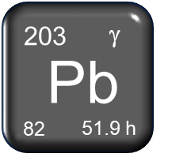
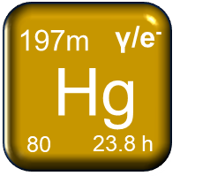
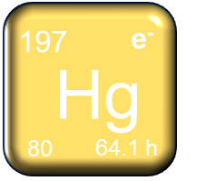
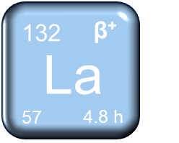
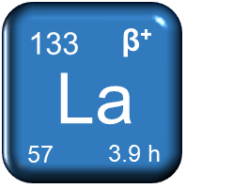
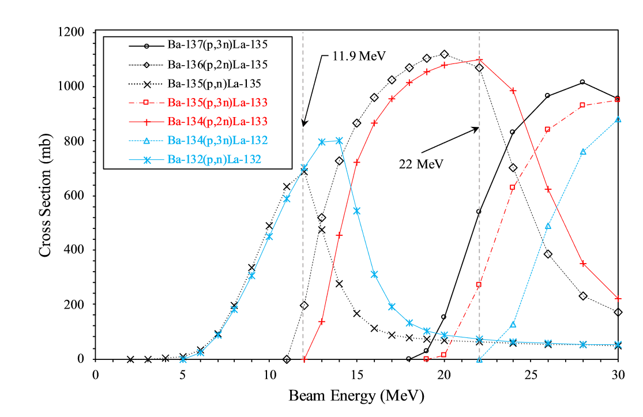
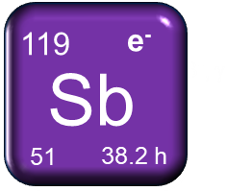
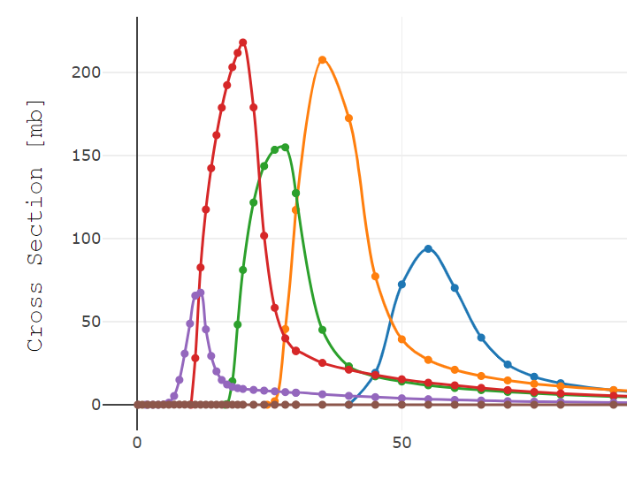
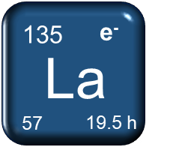
Aim 1 – Medical Isotope Production @TRIUMF
13 MeV, 24 MeV
¹⁹⁷Au(p,n)^{197m,g}Hg
²⁰⁵Tl(p,3n)²⁰³Pb
SPECT Imaging
(Pre-)clinical scale
500 MBq/target
SPECT / MAE therapy
Likely clinical scale
2.7 GBq/target
²⁰³Tl(p,n)²⁰³Pb
Azzam (2007)
Saleh (2010)
^{13x}Ba(p,xn)^{133/135}La
¹⁵⁶Gd(p,2n)¹⁵⁵Tb
¹¹⁹Sn(p,n)¹¹⁹Sb
^{13x}Ba(p,n)^{132/135}La
SPECT imaging
Clinical scale
70 MBq/h
MAE therapy
(Pre-)clinical scale
1.2 GBq/target
¹⁵⁵Gd(p,n)¹⁵⁵Tb
PET / MAE therapy
(Pre-)clinical scale
700 MBq/target
Wuest (2020)
Thisgaard (2009)
Notes:
With our smaller medical cyclotrons – the 13 MeV and the up and coming 24 MeV at IAMI, we can produce a variety of gamma emitting or MAE emitting isotopes for SPECT imaging or MEA therapy.
We will produce Pb-203 – a SPECT isotope – and chemically matched pair for therapeutic Pb-212 (produced via BL1A). On the TR13 we can make preclinical amounts, and if we transition to the TR24, we can increase our production 24-fold to make clinical quantities
We can and currently produce isomers Hg-197m and g, that form a chemically matched theranostic pair for SPECT and MAE therapy
We can and currently produce isotopes of La, depending on the proton energy – we can make the 132,135La pair for PET and MAE therapy using the TR13, or 133,135La pair using the TR24
We can make clinical quantities of Sb-119 via the Sn(p,n) reaction on the TR13 – Sb-119 has been identified as a MAE emitter with the most ideal decay properties for this use. We can also make other imageable isotopes of Sb using other Sn-isotopes.
And finally, we will look into producing Tb-155 as an additional Tb-isotope for SPECT imaging and dosimetry
From Wuest’s paper on La – saturation yields of 161 MBq/uA La-133; 561 MBq/uA La-135

Slide 10
R&D
TRIUMF’s GOALS – Aim 1
Clinical production
Y1
Y2
Y3
Y4
Y5
Y6
Y1 – 2:
  Optimize and scale-up ²²⁵Ac/²¹³Bi production.
  Optimize and scale-up ²²⁸Th/²¹²Pb generator.
  Develop waste management plan for sustainable production.
Y3 – 4:
  Deliver ²²⁵Ac and ²¹²Pb to centers to enable research in Aims 2 – 3 and clinical trials in Aim 4.
  Develop production for ¹⁵⁵Tb, ^{132/135}La via TR13.
  Develop production for ¹⁵²Tb via ISOL.
Notes:
This is on first glance, quite the laundry list of isotopes. But each has been carefully chosen based on its proven potential as a powerful therapeutic and/or imageable medical isotope, and can theoretically be produced in pre-clinical or clinical quantities.
Overall, what will this look like over the 6 year lifetime of the grant? We have organized our efforts to prioritise the most ‘clinically relevant’ isotopes with the most chance for clinical translation, and be used in downstream clinical trials as part of Aim 4. Followed by the second and third ‘generation of isotopes’ that are nonetheless promising but are less explored and may need more development before hitting primetime.
Our first priority will be to optimize and scale up production of Ac-225, Bi-213, and Pb-212 all harvested from Th spallation on BL1A; TRIUMF (as well as co-investigators at Ualberta) will produce Pb-203. We will also develop a waste management plan for sustainable production
In Y3 – 4, we will be resonisble for delivering Ac-225, Bi-213, and Pb-212 to other centres which will enable research Aims 2-3, and most importantly drive our clinical trials - in particular on Ac-225 TAT tracers.
We will also develop the production of Tb-155 and further optimize La-132 production on the TR13, and collect Tb-152 via ISOL.

Slide 11
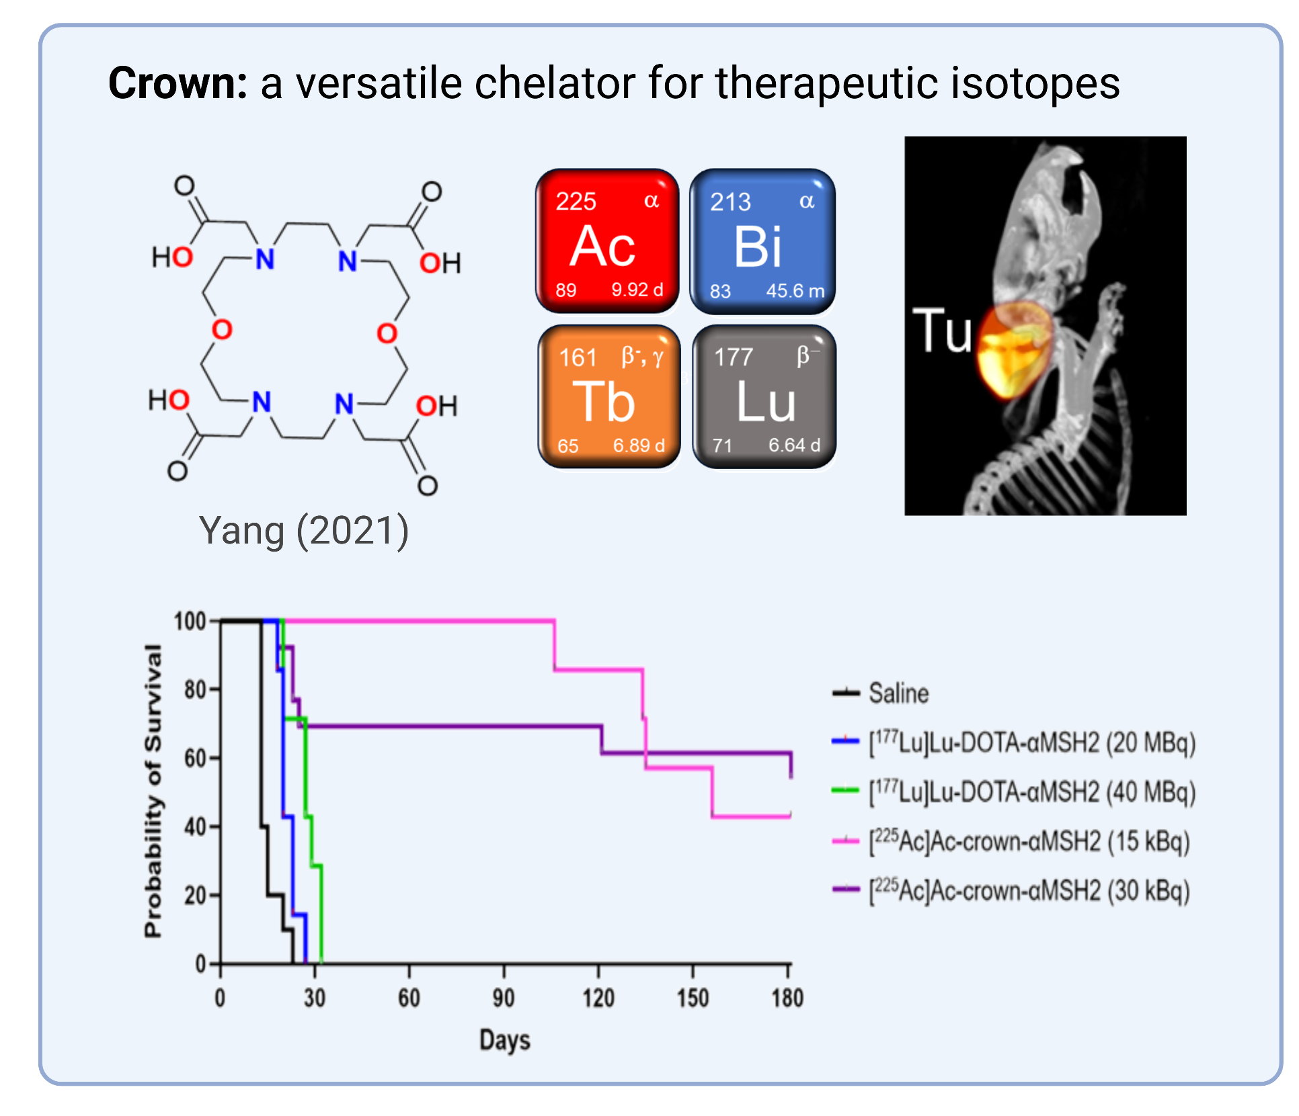
Aim 2: Chelator & Multi-Modal Probe Development
Design novel tailored chelators to enable stable attachment of radioactive atoms to targeted delivery molecules
Bifunctional Chelator
Notes:
In addition to our pivitol work in Aim 1 on isotope production, TRIUMF will also contribute to Aim 2. Where we will work on the chemistry to incorporate the radioactive atoms to biomolecules via these so-called bifunctional chelators.
Our co-applicant Hua Yang has co-developed a chelator named crown. It can coordinate Ac 100 times more efficient than current standard. The synthesis of these chelators and their bifunctional analgues will be scaled up and made available to co-investigators who will employ crown and any next generation chelators into their radiopharmaceutical design and testing in Aim 3.

Slide 12
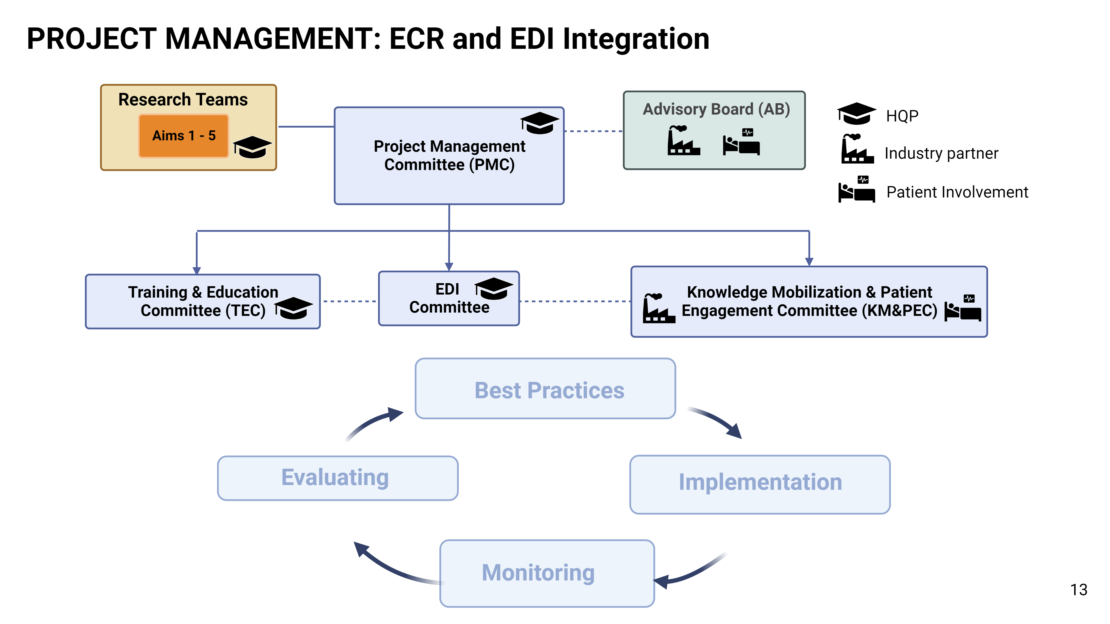


Project Management
Ramogida (Co-director, Y1-6)
Radchenko (Lead, Y1-2)
Yang (Lead, Y1-2)
Hoehr (Member)
Schaffer (Member)
Annual symposium & workshop
Commitment to EDI
Canadian nuclear medicine
network
Notes:
Cohesive integration of such a large team of diverse co-applicants from across multiple institutions and fields is no small feat. Thus we have developed a robust Project Governance Structure, which is overseen my an independent advisory board. Our Training and Education Committee will support the HQP and formalize mentorship and initiate new training opportunities, our EDI committee will put in place measures to follow our initial best practices and be point of contact for raising any issues. Our Knowledge Mobilisation and Patient Engagement Committee will incorporate industry partners and patient members and make clinical trial decisions and assess new projects.
TRIUMF personnel (highlighted in blue) hold key positions within each of these committees.
The Program will also host an annual symposium and workshop put on by the TEC, we will also track and evaluate our commitments to EDI and reevaluate yearly to make sure we are making an positive impact, and this program will create a network of Canadian scientists and physicians working on RPT and nuclear medicine.

Slide 13
What will the effort bring to TRIUMF?
Est. $4.8mil over 6 years (in direct and indirect costs)
Additional support for HQP training ($40-60K/yr) and EDI initiatives ($50K/yr)
Secure TRIUMF as a World-leader in medical isotope production
Potential for future revenue from knowledge translation of isotope production
Notes:
Moreover, what specifically will this NFRF-T program bring to TRIUMF?
About 4.8 mil over the 6-yrs is earmarked for TRIUMF research efforts and will flow through TRIUMF directly
Additional support for HQP training and EDI initiatives
Secure TRIUMF as a world leader in medical isotope production
And potential future revenue from KT and isotope production other IP.

Slide 14
What do we need to succeed?
What we have
What we still need
Personnel
  isotope production team (lead by Qing Maio)
Lab Space
  Existing space and infrastructure in MHESA basement (shielded fume hoods, hot cells)
Beam Time
  BL1A (²³²Th irradiations for ²²⁵Ac, ²¹³Bi, ²¹²Pb, ²²⁷Th)
  TR13 (¹⁵⁵Tb, ^{197(m)}Hg, ¹¹⁹Sb)
  TR24 (²⁰³Pb, ^{133/135}La)
  ISOL (¹⁵²Tb)
Admin Support
More Lab Space
  Additional ‘hot’ lab space (shielded fume hoods and hot cells)
  Additional ‘cold’ lab space (chemical fume hoods)
Office Space
  HQP desk space
Admin Support
  LCH amendment

Slide 15






Impact and Rewards
Health System Impacts
Advancing Science Knowledge
Increasing Canada’s International Standing
Training and Education of HQP
Addressing Significant Unmet Patient Need
Notes:
In Summary, we hope the impact from this NFRFT initiation will be profound and far reaching.
Health System Impacts – we will impact the Health Care System by increasing the supply of rare isotopes which will enable affordable and equitable access for patients
Advancing Science Knowledge – we will advance knowledge in several fields which will lead to new discoveries even beyond our Transformation project.
Increasing Canada’s International Reputation – We will increase Canada’s Standing. By building on a strong legacy in medical isotope production we will position Canada as a leading technology exporter, rather than importer.
Training and Education of HQP – We will train the next generation of HQP. Our trainees will be well positioned to fuel a growing ecosystem of Canadian start-ups and companies.
Addressing Significant Unmet Patient Need – Finally, we will address a significant unmet patient need. These radiopharmaceutical therapies will become useful treatments for patients with advanced metastatic cancers. With our novel interdisciplinary approach, we aim to revolutionize the care, quality of life, and outcomes of these patients who would otherwise have no other option available.

Slide 16


Thank you
MERCI

Slide 18

Notes:
In Aim 1 - Supported by the unique infrastructures we have on this team, including 10 medical cyclotrons across Canada, we can produce a list of promising but under explored medical radionuclides. A few examples include: Ac225 has shown remarkable results treating prostate cancer patients who have exhausted any other options. With current infrastructure, TRIUMF can produce ~20 patient doses every week. Supported by industrial partners and infrastructure upgrades, we are working on increasing the capacity. We can produce 213Bi at large quantity, which has been used for treating melanoma, lymphoma and neuroendocrine tumours. Tb155 is a spect imaging radionuclide that can be used for dosimetry. It can be produced at multiple centers.

Slide 19
Aim 1 – Medical Isotope Production @TRIUMF
13 MeV, 24 MeV
¹⁹⁷Au(p,n)^{197m,g}Hg
²⁰¹Tl(p,3n)²⁰³Pb
SPECT
(Pre-)clinical scale
150 MBq/week
SPECT / MAE therapy
Clinical scale
150 MBq/week
²⁰³Tl(p,n)²⁰³Pb
Azzam (2007)
Saleh (2010)
^{13x}Ba(p,xn)^{133/135}La
¹¹⁹Sn(p,n)¹¹⁹Sb
PET / MAE therapy
(Pre-)clinical scale
64 MBq/h
^{13x}Ba(p,n)^{132/135}La
MAE therapy
(Pre-)clinical scale
150 MBq/week
Wuest (2020)
Thisgaard (2009)
Notes:
Add Tb-155?

Slide 20
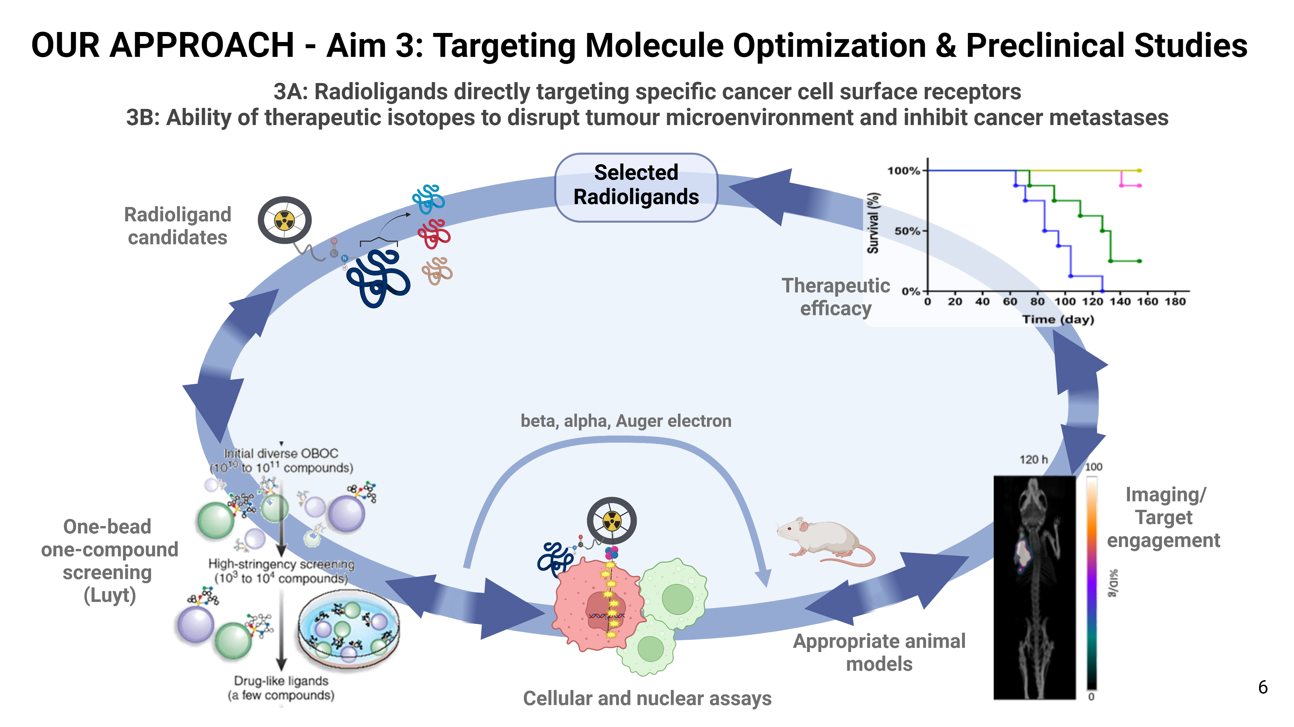
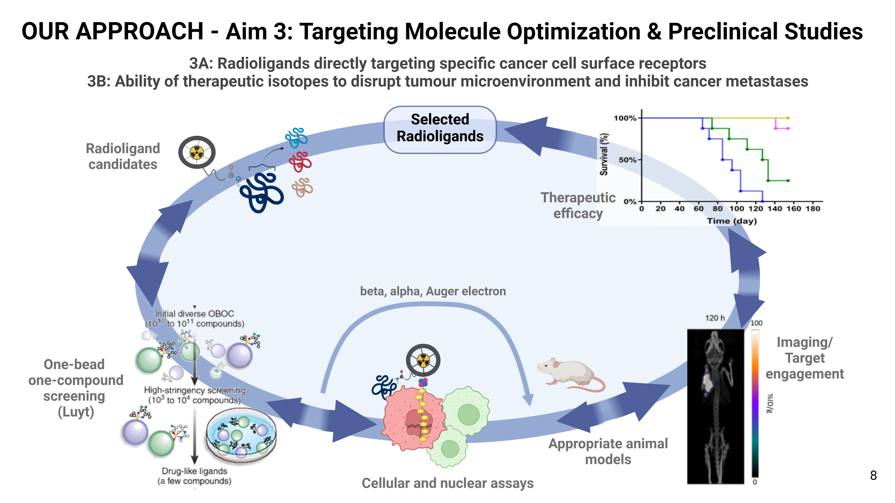
Notes:
In AIM 3, we will develop radioligands that directly target cancer cell surface receptors and we will study the ability of therapeutic isotopes to disrupt the tumour microenvironment and block cancer metastases.
This will be done in a reiterative process to optimize binding affinity, selectivity, stability, pharmacokinetics and therapeutic efficacy of our radioligands.

Slide 21
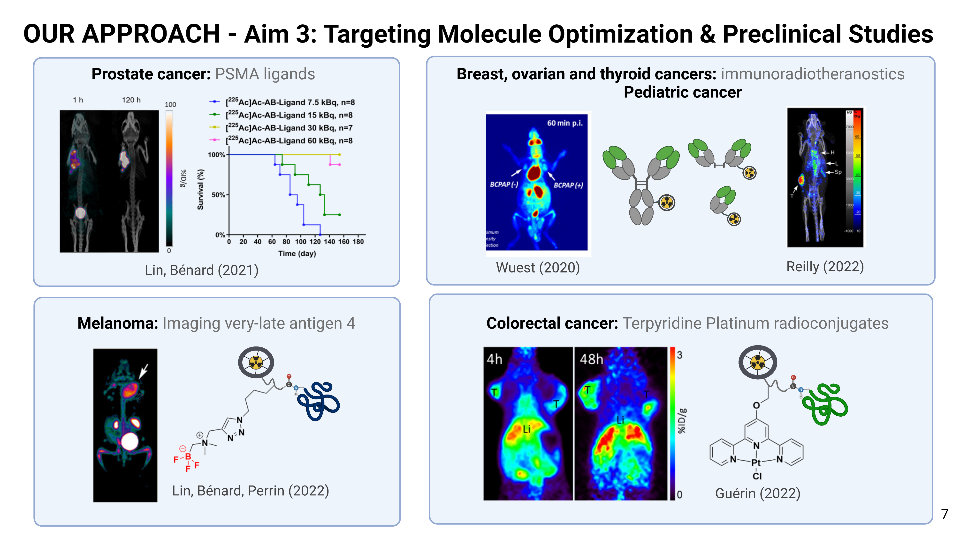

Notes:
Based on our strong expertise, we will develop the next generation of radioligands with the ultimate goal of enhancing treatment effectiveness for different types of cancer.
Our initial focus will involve clinical translation of a PSMA ligand for prostate cancer that has proven potential but other vectors targeting Melanoma, breast, ovarian and colorectal cancers to name a few will be studied extensively.

Slide 22
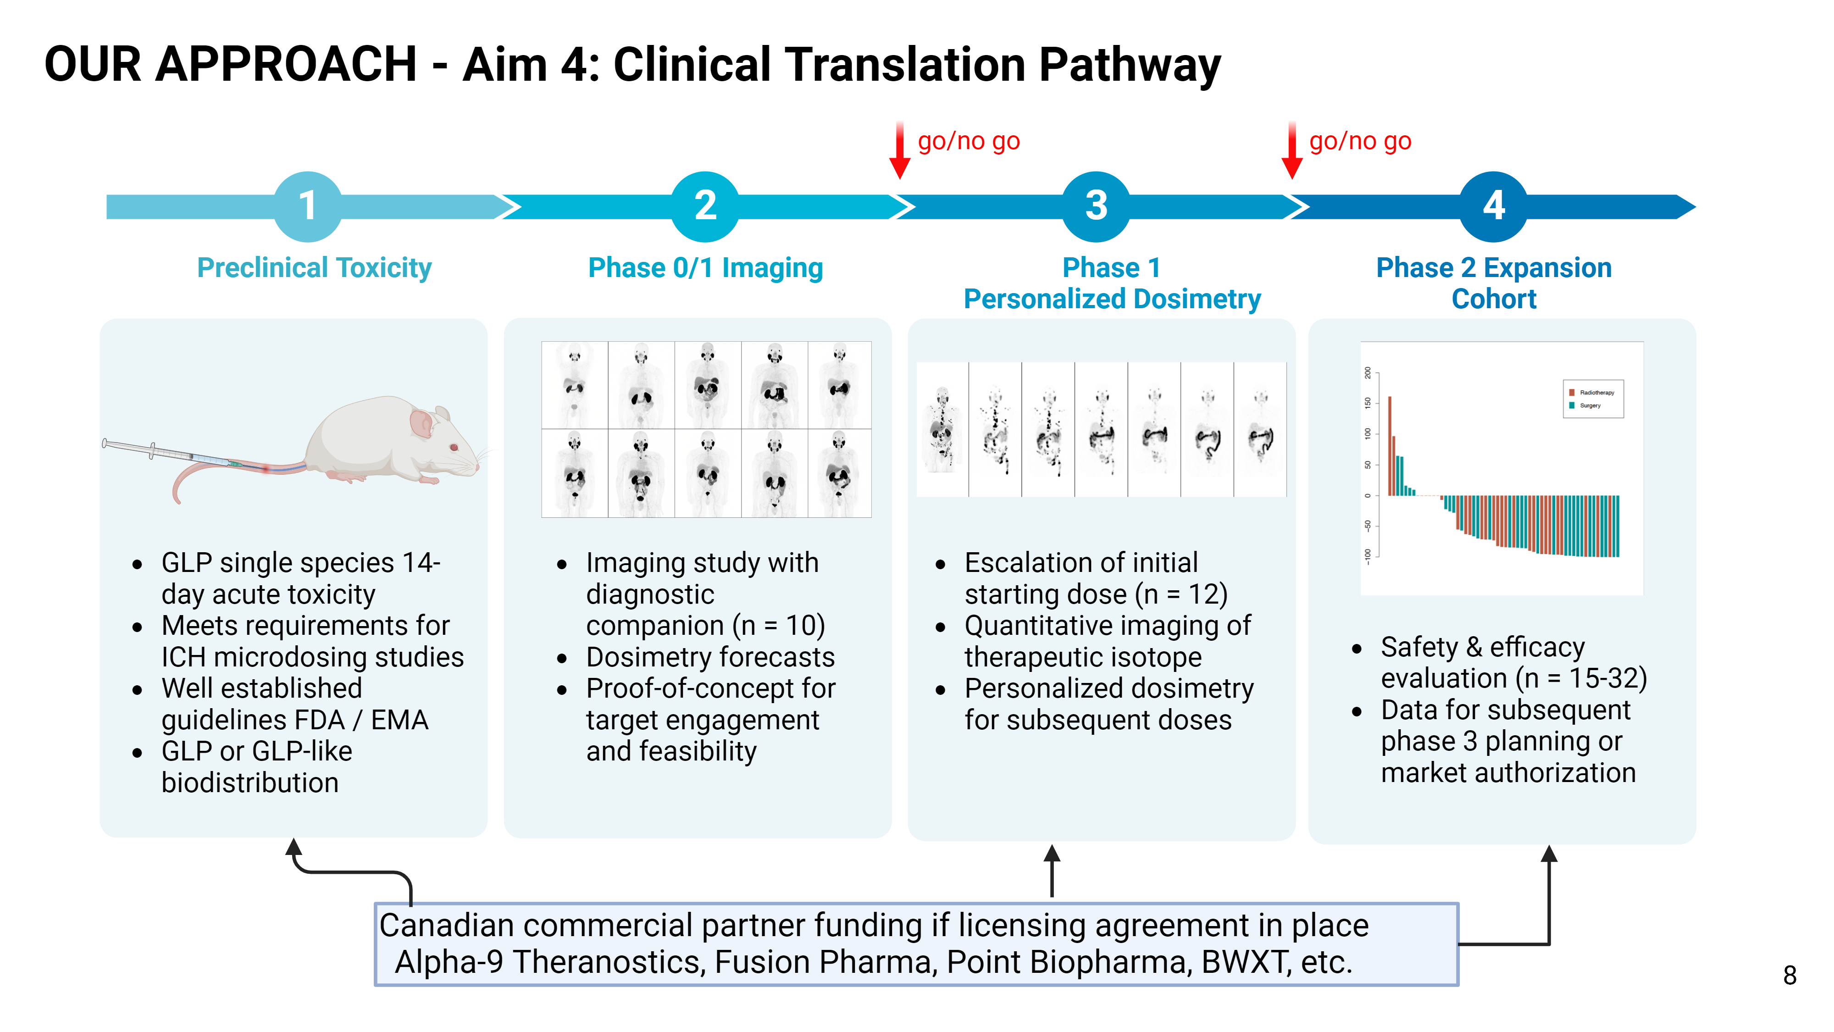
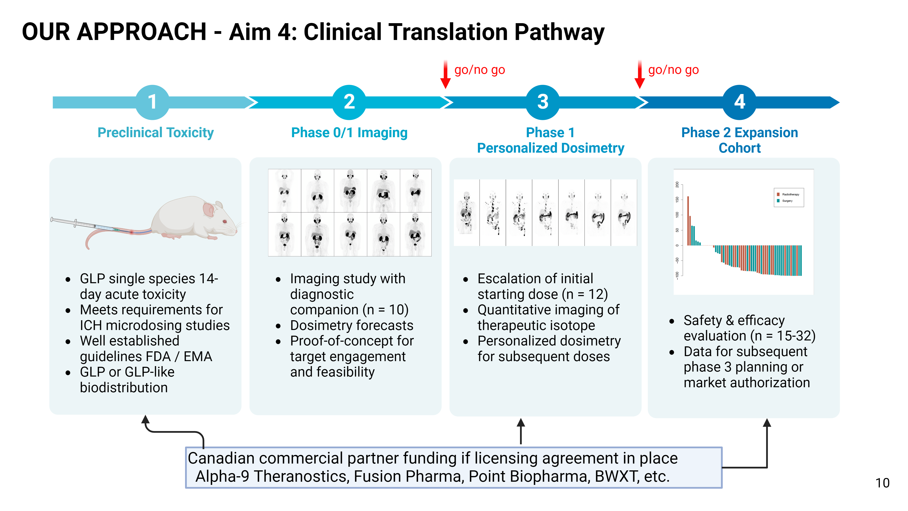
Notes:
For clinical translation, the pathway is illustrated here. We advance an imaging version of the radiopharmaceutical for proof-of-concept and to demonstrate target engagement. This is followed by an initial dosimetry and dose escalation study. We use personalized dosimetry to ensure participant safety while providing quantitative data for research on improved dosimetry methods.
We plan to partner with Canadian radiopharmaceutical companies when opportunities arise and licensing agreements are in place, which may increase funding capacity for clinical trials.

Slide 23
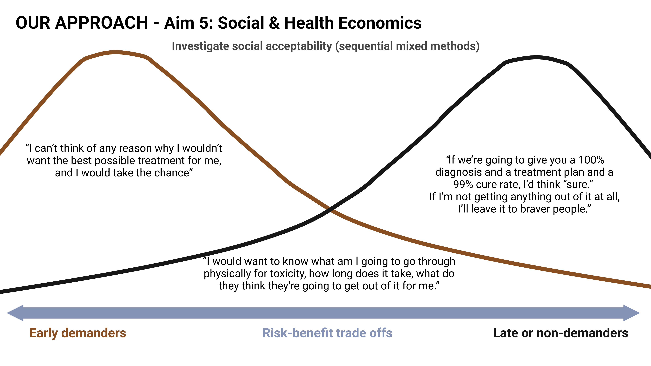


Notes:
Aim 5 is integrated in the translational pathway and will use regulatory science and economics to understand the social and population impacts of radiopharmaceuticals.
For social acceptability, we want to understand what patients want from their healthcare and to what extent those outcomes matter, which includes trade-offs between toxicity and length of life in light of uncertainty.

Slide 24
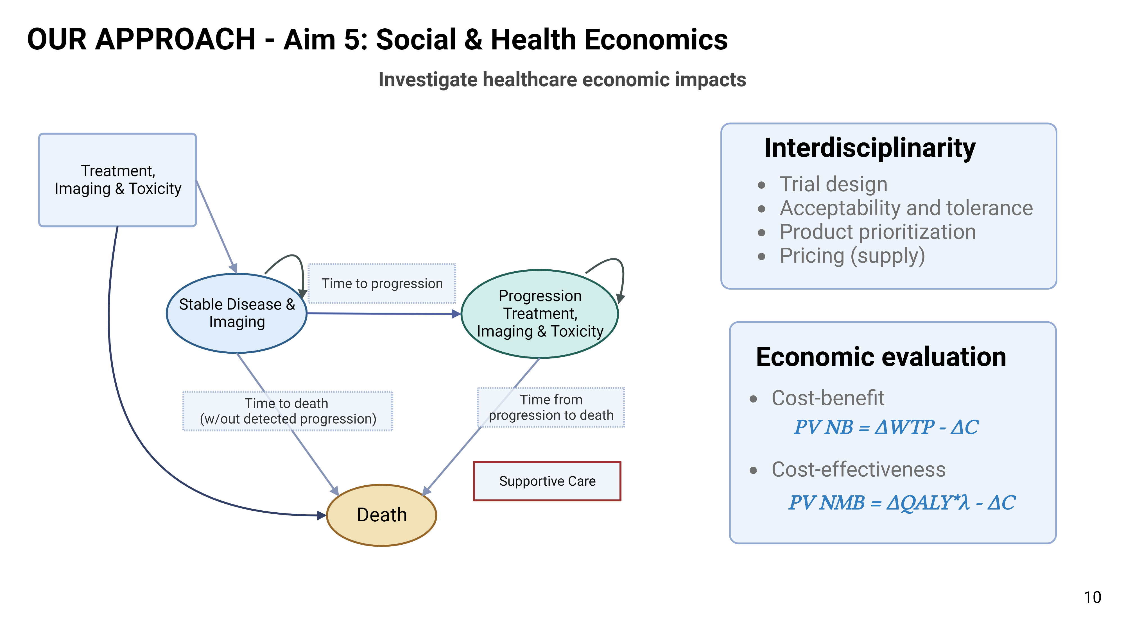

Notes:
We will also assess the economic impact of implementing radiopharmaceutical therapies. And look at cost effectiveness analysis. This work can inform prioritization and allocation of resources within the healthcare system. It can also take into account the unintended risks to, for example, the environment.
The integration of social and health economics into the design of our program truly makes this a interdisciplinary approach. These analyses can inform clinical trial design through, for example, endpoints that are patient centric. Other knowledge gained can articulate risk-benefit trade-offs, which can be used in regulatory decisions. And our economic models can help understand health product prioritization and pricing.

Slide 25



NFRF-T: Management Plan
Research Teams
Project Management Committee (PMC)
Research Lead (Bénard Y1-2; Ramogida 3-4)
Training Lead (Radchenko Y1-2)
EDI Lead (Yang Y1)
Knowledge Mobilization & Patient Engagement Lead (Regier and Beauregard Y1-2)
Member (1 HQP – vacant)
Advisory Board (AB)
4 prominent scholars or industry leaders
1 patient
Rodney Hicks (PreMIT)
Richard Wahl (WashU)
Lisa Bodei (MSKCC)
Christian Lafougere (Tuebingen)
Burnd Pichler (Tuebingen)
Julie Sutcliffe (UC Davis)
Christian Behrenbruch (Telix Pharm)
Sergio Calvo (Jubilant)
Jonathan Cirtain (BWXT)
Christina Muller (PSI)
Suzy Lapi (UAB)
Aim 1: Isotopes
(Lead: Schaffer)
Aim 2: Chelators & Probes
(Lead: Ramogida)
Aim 3: Vectors & Preclinical
(Lead: Lin)
Executive
Co-Directors
(FB, CR, (Y1-6))
(BG Y1-3, vacant Y4-6)
Aim 4: Clinical
(Lead: Beauregard)
Aim 5: Health Econ
(Lead: Regier)
HQP
Training & Education Committee (TEC)
Training Lead
Members (Reilly, Uribe)
Members (4 HQP)
EDI
Committee
EDI Lead
Co-leads (Hoehr, Schirrmacher)
Members (4 HQP)
Knowledge Mobilization and Patient Engagement Committee (KMC & PEC)
KM&PMC Leads
Members Knowledge Mobilization (Perrin, Schaffer)
Members Patient Engagement (Wuest, Luyt )
Members (2 industry partners, 1-2 patients)
Industry partner
Patient involvement
Notes:
Hihglight integration of EDI and ECR support

Slide 26
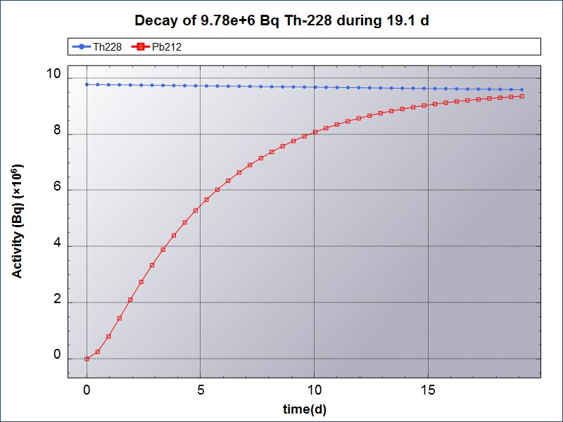

Slide 27
β⁻, γ
161
161
155
γ/e⁻
Tb
β⁻, γ
197m
γ/e⁻
197
e⁻
161
Tb
β⁻, γ
161
161
β⁻
Hg
Hg
α
177
225
213
α
161
161
65
6.89 d
Lu
Ac
161
Bi
65
5.32 d
80
23.8 h
80
64.1 h
89
9.92 d
71
6.64 d
83
45.6 m
β⁺
152
161
Tb
β⁻, γ
β⁻/α
227
α
119
e⁻
212
17.5 h
161
161
65
Sb
β⁻, γ
161
Th
Pb
82
10.6 h
90
18.7 d
223
α
51
38.2 h
161
Ra
88
11.4 d
203
γ
134
EC
134
β⁺
161
161
161
Pb
Ce
La
132
β⁺
135
e⁻
161
161
β⁺
La
La
51.9 h
3.16 d
57
6.45 m
89
82
58
161
Zr
57
4.8 h
57
19.5 h
132
β⁺
135
e⁻
133
β⁺
40
78.4 h
161
161
La
La
161
La
57
4.8 h
57
19.5 h
57
3.9 h

