Slide 1
Recent results from the mass spectrometer EMMA at TRIUMF
Louis Wagner
Postdoc for DRAGON and EMMA at TRIUMF
2023 TRIUMF Science Week Jul. 31st, 2023
Vancouver, B.C. Canada
Notes:
6 minutes radiative capture
12 minutes for recoil separators
12 minutes for science highlights

Slide 2

TRIUMF

Slide 3
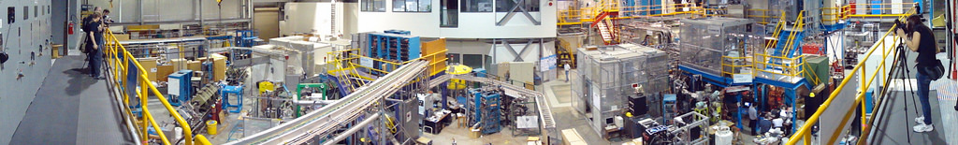
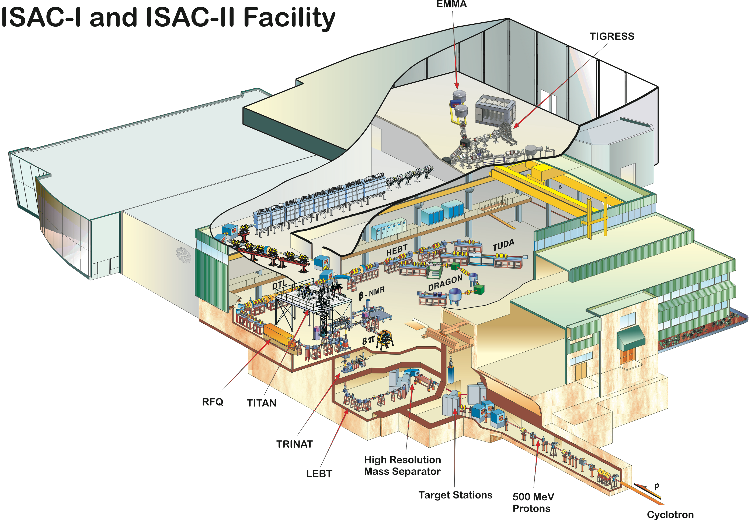
TRIUMF ISAC Facility
The Isotope Separator and
Accelerator (ISAC) facility at TRIUMF provides a wide variety of intense beams of exotic nuclei produced using the ISOL method
Beams reaccelerated through 35 MHz RFQ with A/q<30
105 MHz variable energy DTL (3 ≤ A/q ≤ 6)
Energies between 0.15 MeV/u & 1.8 MeV/u
Low-energy regime well suited for reaction studies for novae & X-ray bursts
ISAC-II SC-LINAC max. beam energies 6.5 – 16.5 MeV/u suited for transfer reactions on heavy ions
EMMA

Slide 4
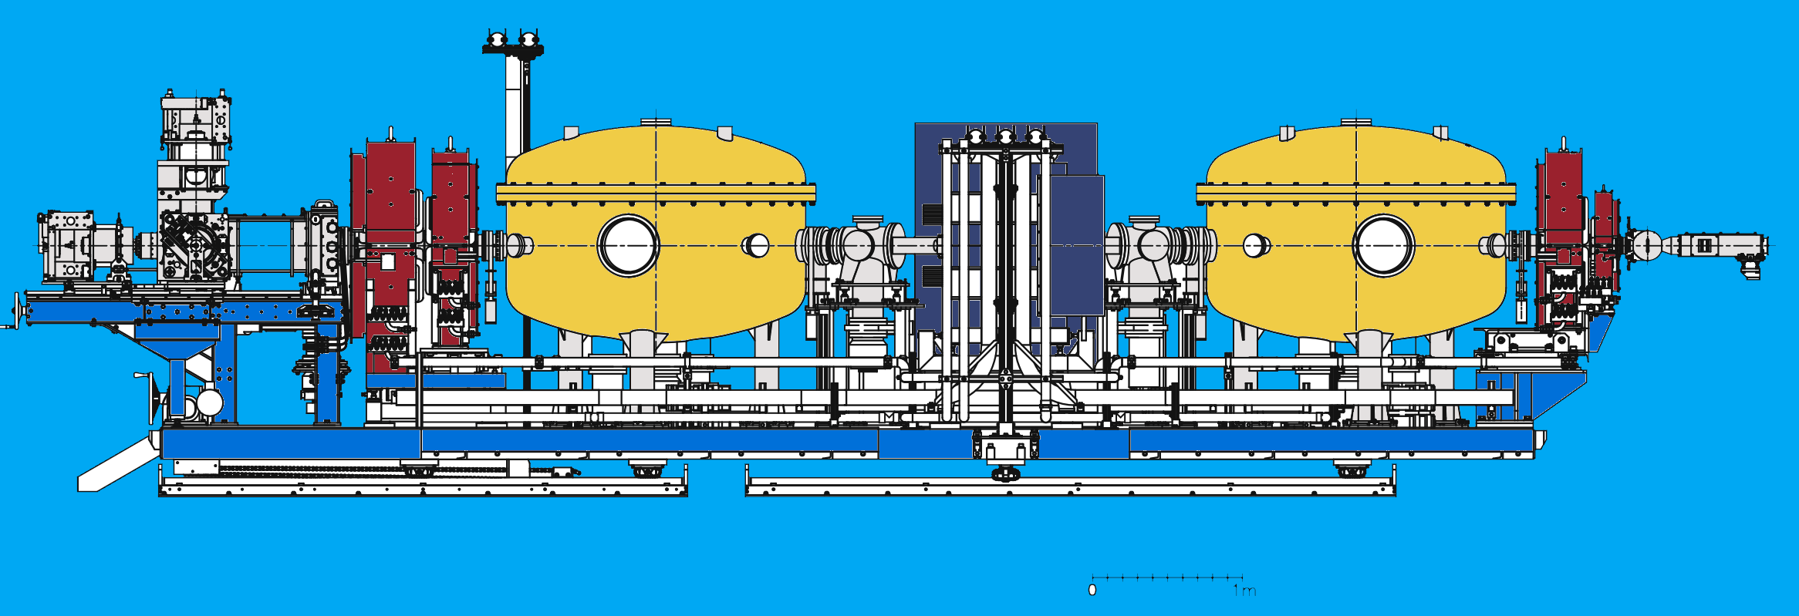
Recoil Mass Spectrometer EMMA

Slide 5
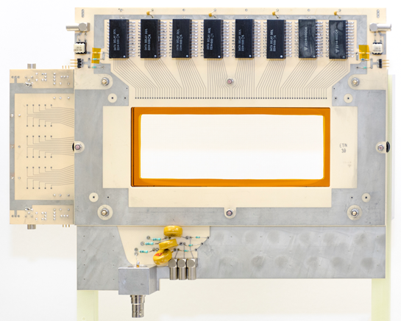
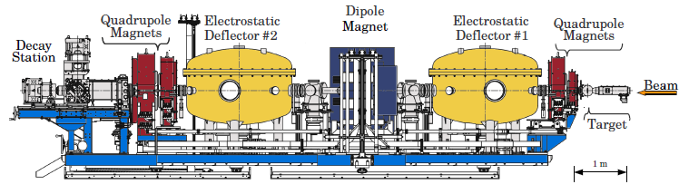
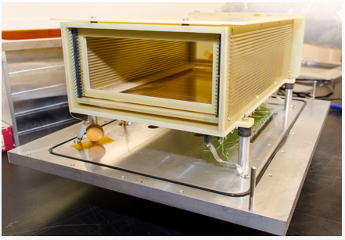
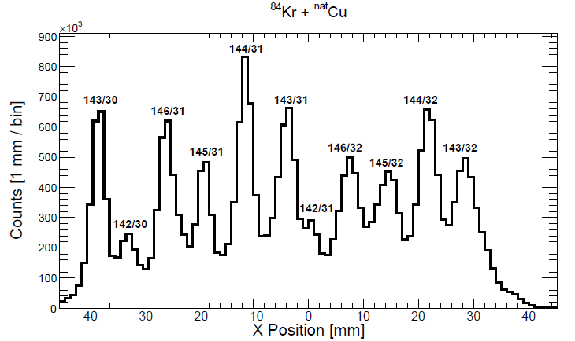
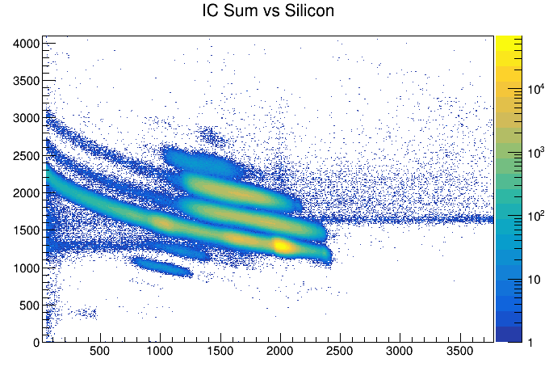
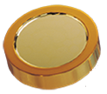
The Electro-Magnetic Mass Analyzer (EMMA)
PGAC
Angular Acceptance: ± 3.6° | Energy Acceptance: ±15% | m/q acceptance = ±3.3% | Rigidity limit: ~7q MeV
Ion Chamber
PGAC spectrum from Fusion Evap test run:
IC PID plot from ¹⁷O experiment:
Ion-implanted Silicon
[1] B. Davids, M. Williams, et al., NIMA 930, 191-195 (2019).
.

Slide 6
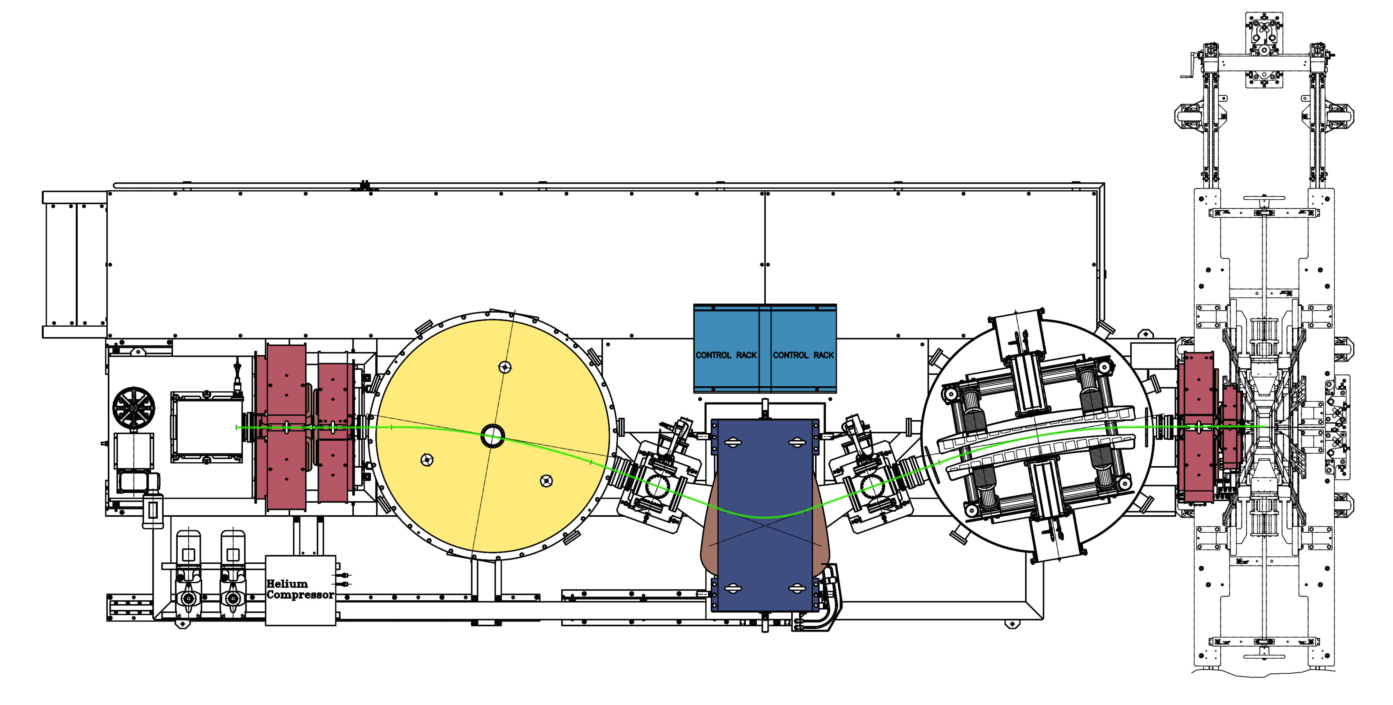
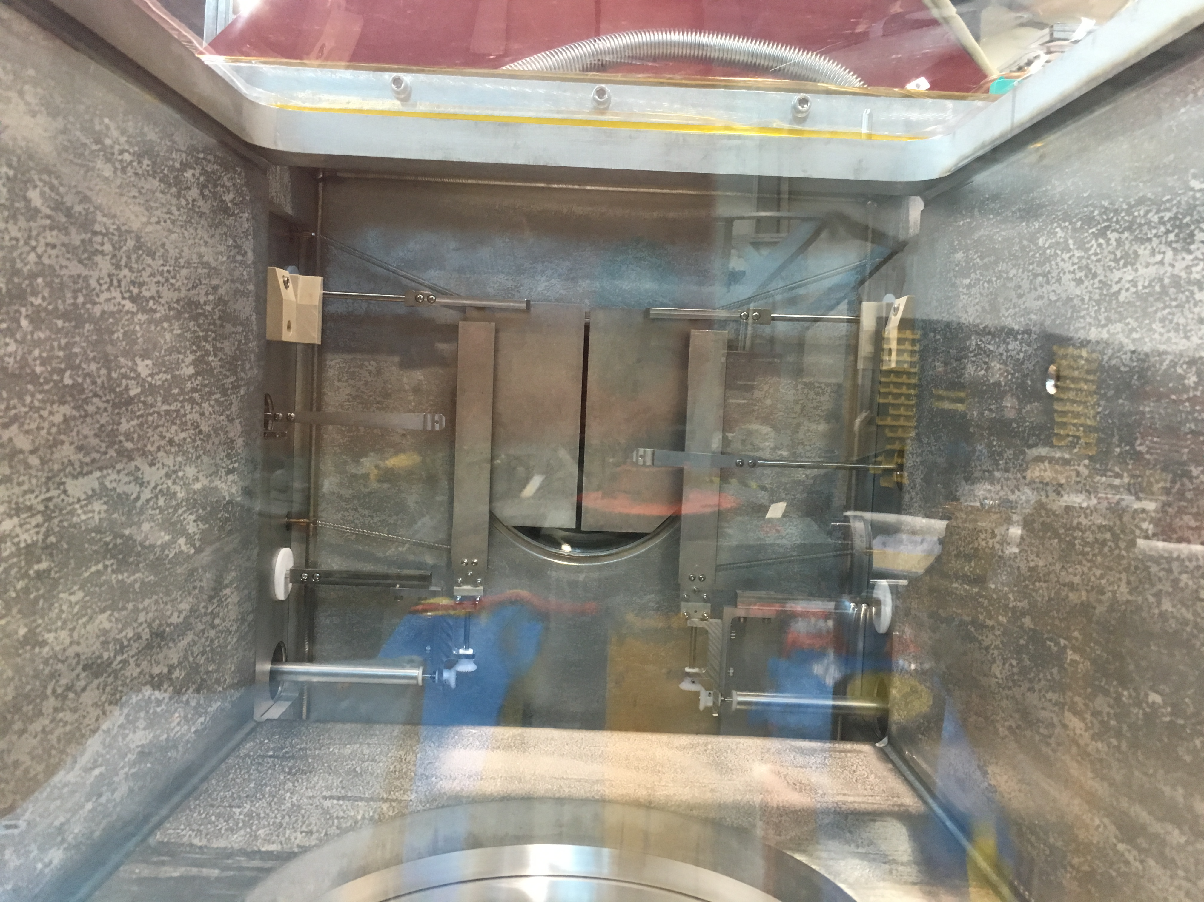
Beam suppression in EMMA
Need to use EMMA’s slit systems to improve beam suppression.
Suppression factor of slits alone was measured ~5 x10⁴ with no cuts on the data
Together with gate on Time-of-Flight total suppression up to ~10¹⁰ can be achieved
Suppression Slits
Focal plane slits
Magnetic Dipole

Slide 7
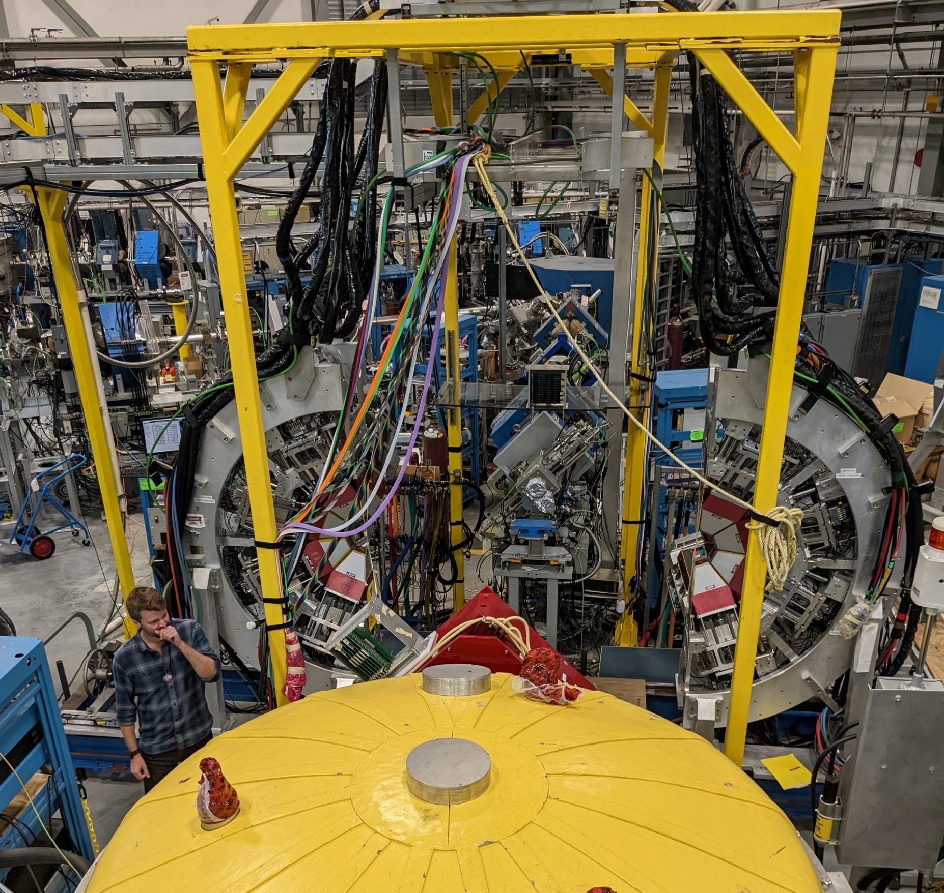
TIGRESS γ-detection array
12 Clover detectors with 8 centered at 90° and 4 at 135°
segmented outer contacts for improved Doppler correction for spectroscopy after in-beam reactions
4 crystals in a common cryostat
BGO Compton suppressor shields, reconfigurable in situ

Slide 8
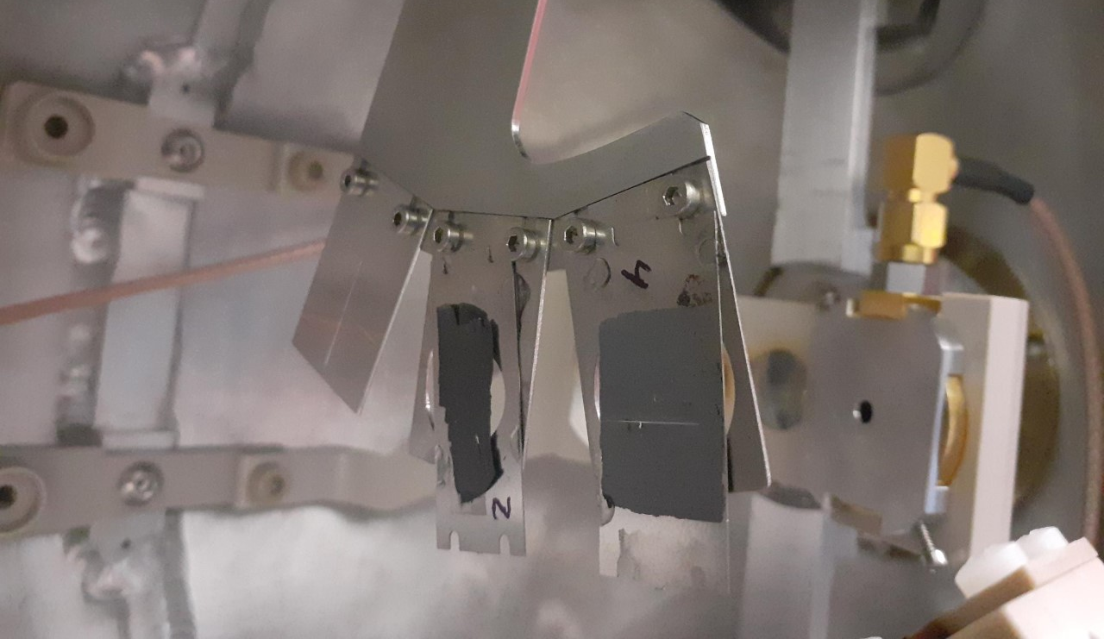
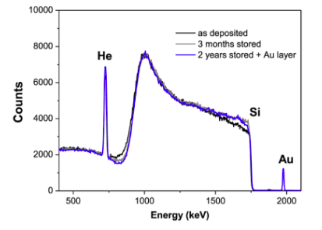
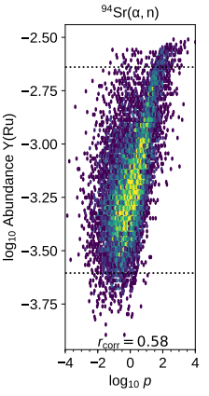
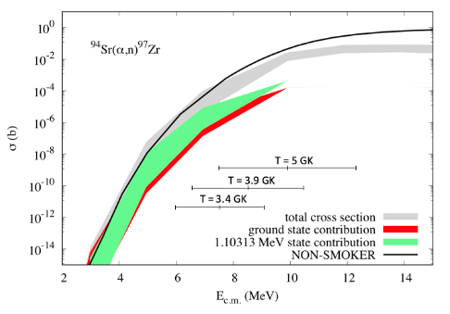
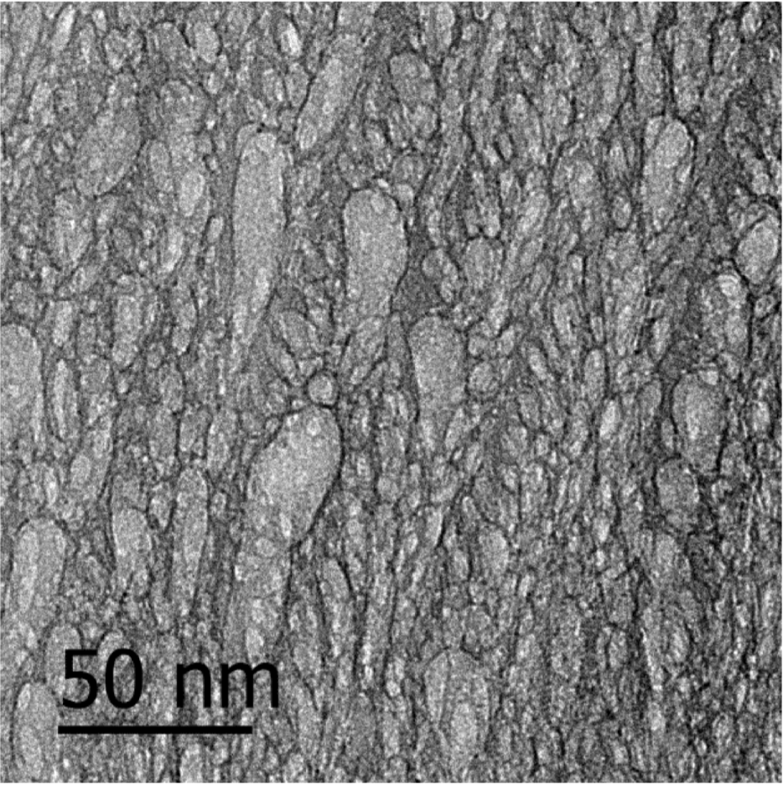
Studying the weak r-process with EMMA+TIGRESS
(α,n) reactions on isotopes of Kr, Rb and Sr are identified as particularly important for determining weak r-process abundance signatures.
Currently there is a lack of (α,n) cross-section data in this mass region, so all predictions rely on statistical model calculations, which carry large uncertainties (> x10).
How to make a target from an inert gas?
Typical options include gas targets and implanted foils
Advances in materials science provides new options: Magnetron-sputtered silicon thin-films formed in a helium plasma environment.
Helium
Nano-pockets
High He density
Homogeneous distribution.
Content stable in storage and in beam.
Compact with no expensive infrastructure.
[1] J. Bliss et al., Phys. Rev. C 101, 055807 (2020).
[2] V. Godinho et al., ACS Omega 1,1229– 1238 (2016)
Slide from Matthew Williams

Slide 9
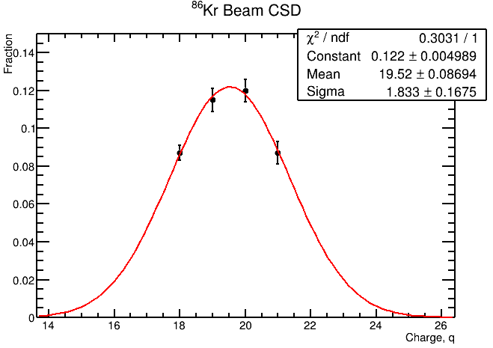
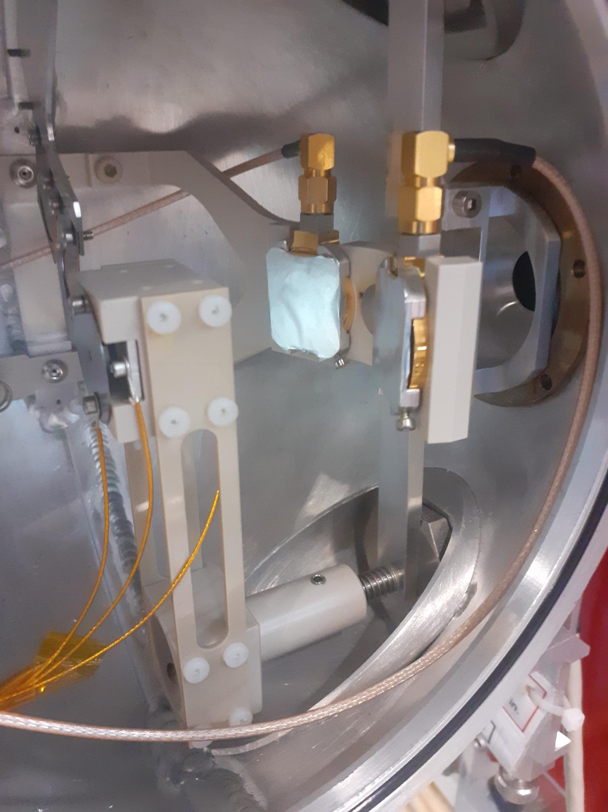
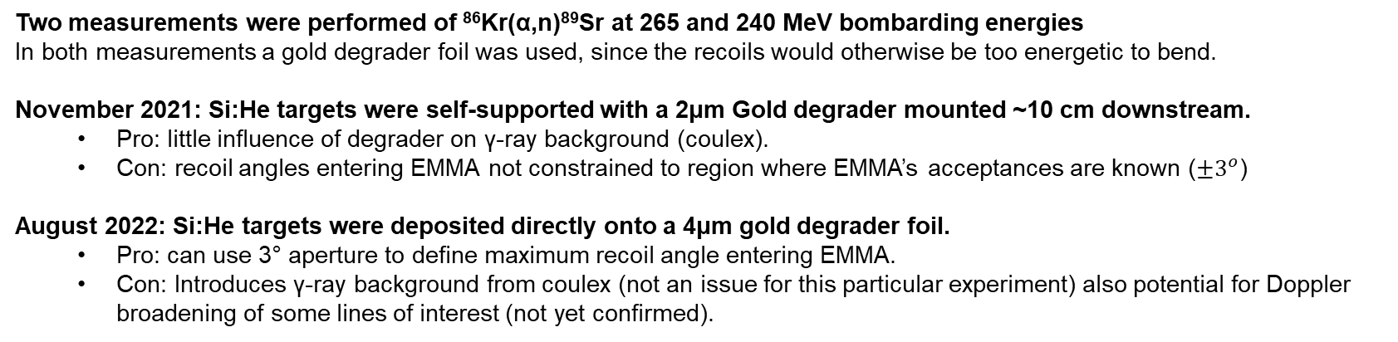
Measurement of ⁸⁶Kr(α,n)⁸⁹Sr
Two measurements were performed of ⁸⁶Kr(α,n)⁸⁹Sr at 265 and 240 MeV bombarding energies
In both measurements a gold degrader foil was used, since the recoils would otherwise be too energetic to bend.
November 2021: Si:He targets were self-supported with a 2μm Gold degrader mounted ~10 cm downstream.
  Pro: little influence of degrader on γ-ray background (coulex).
  Con: recoil angles entering EMMA not constrained to region where EMMA’s acceptances are known ($±3^{o}$)
August 2022: Si:He targets were deposited directly onto a 4μm gold degrader foil.
  Pro: can use 3° aperture to define maximum recoil angle entering EMMA.
  Con: Introduces γ-ray background from coulex (not an issue for this particular experiment) also potential for Doppler broadening of some lines of interest (not yet confirmed).
Beam normalisation & target content measured via 2 SSB detectors
Transmission through EMMA was measured for different energy tunes and charge states to find optimum settings. Compare attenuated beam rate on scintillator vs focal plane.
Slide from Matthew Williams

Slide 10
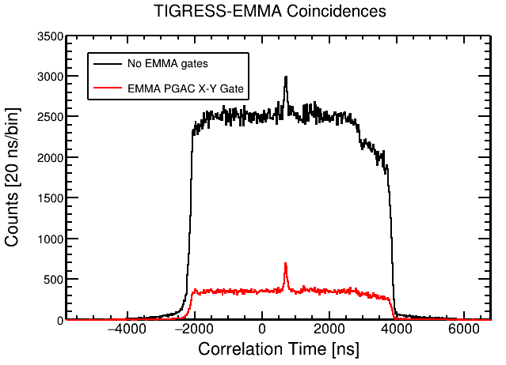
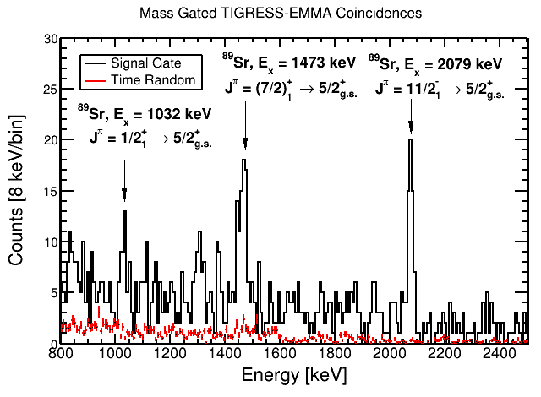
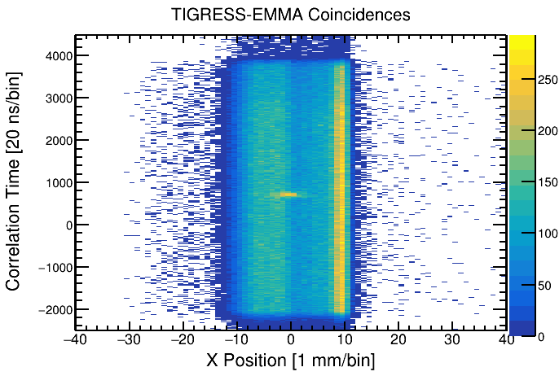
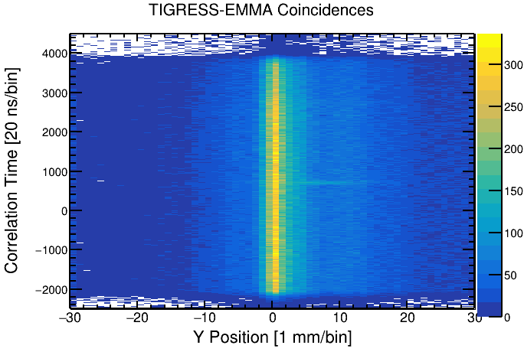
Stable beam test measurement: ⁸⁶Kr(α,n)⁸⁹Sr
EMMA was tuned to A=89 (q=19+) 89.7 MeV recoils
See clear peak in the timing signal between EMMA and TIGRESS events.
The timing peak is also correlated with a well-focused A=89 (q=19+) peak seen in the focal plane X-position (dispersive direction).
Able to pick-out clear ⁸⁹Sr γ-rays in coincidence with EMMA events gated on the PGAC spectrum. Can now use these γ-ray yields to constrain statistical model calculations.
Measurements were successful with stable beam & targets clearly performed well!
Slide from Matthew Williams

Slide 11
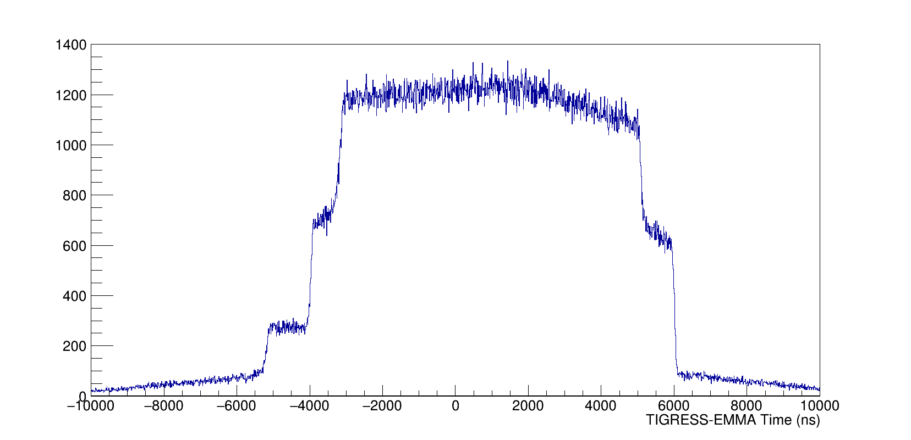
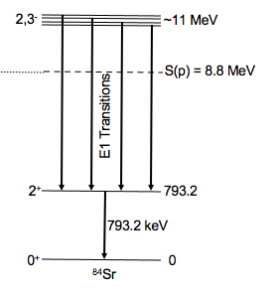
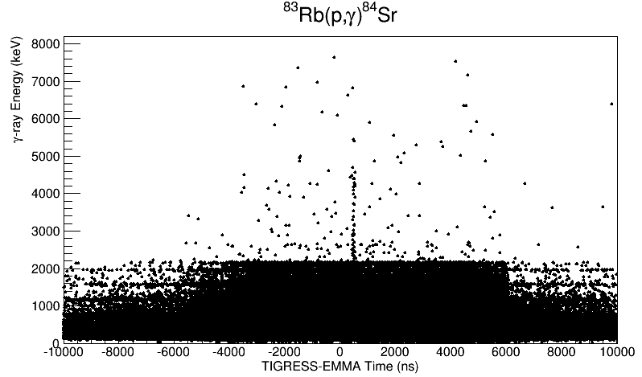
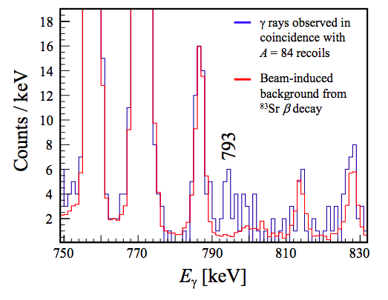

Measurement of ⁸³Rb$(p,γ)$⁸⁴Sr
Large background from ⁸³Sr contamination in the beam, which scatters onto EMMA’s entrance aperture → obscures the timing peak!
Plotting γ-ray energy vs the correlation time reveals signal of high energy γ-rays at the expected correlation time.
Gating around the correlation peak reveals the transition from the first 2⁺ to ground state transition in ⁸⁴Sr. (16 events above background)
G. Lotay, S. Gillespie, M. Williams, et al., Phys. Rev. Lett. 127, 112701
Slide from Matthew Williams
11

Slide 12
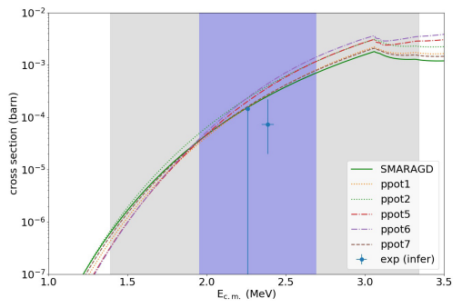
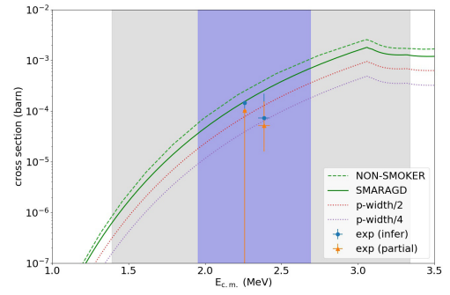
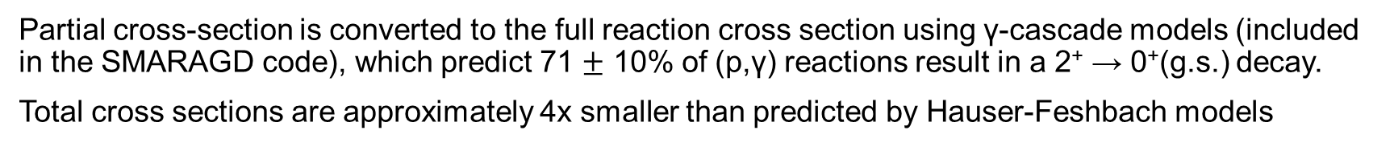
First measurement of a p-process reaction with a radioactive beam
Partial cross-section is converted to the full reaction cross section using γ-cascade models (included in the SMARAGD code), which predict 71 $±$ 10% of (p,γ) reactions result in a 2⁺ → 0⁺(g.s.) decay.
Total cross sections are approximately 4x smaller than predicted by Hauser-Feshbach models
G. Lotay, S. Gillespie, M. Williams, et al., Phys. Rev. Lett. 127, 112701 (2021).
M. Williams, et al., Phys. Rev. C 107, 035803 (2023).
Statistical modeling by T. Rauscher
Slide from Matthew Williams

Slide 13
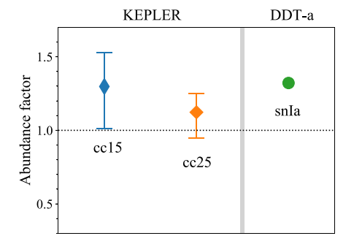

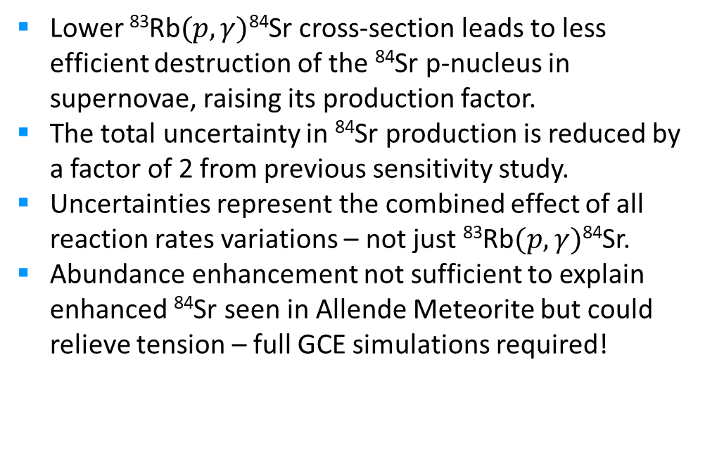

Astrophysical impact of ⁸³Rb$(p,γ)$⁸⁴Sr measurement
Investigated for both Type II and Type Ia supernovae explosions
Lower ⁸³Rb$(p,γ)$⁸⁴Sr cross-section leads to less efficient destruction of the ⁸⁴Sr p-nucleus in supernovae, raising its production factor.
The total uncertainty in ⁸⁴Sr production is reduced by a factor of 2 from previous sensitivity study.
Uncertainties represent the combined effect of all reaction rates variations – not just ⁸³Rb$(p,γ)$⁸⁴Sr.
Abundance enhancement not sufficient to explain enhanced ⁸⁴Sr seen in Allende Meteorite but could relieve tension – full GCE simulations required!
15 $M_{⊙}$ CCSNe = +30 %
25 $M_{⊙}$ CCSNe = +12 %
Type 1a SNe = +32 %
Astrophysical modeling by N. Nishimura
M. Williams, et al., Phys. Rev. C 107, 035803 (2023).
Slide from Matthew Williams

Slide 14
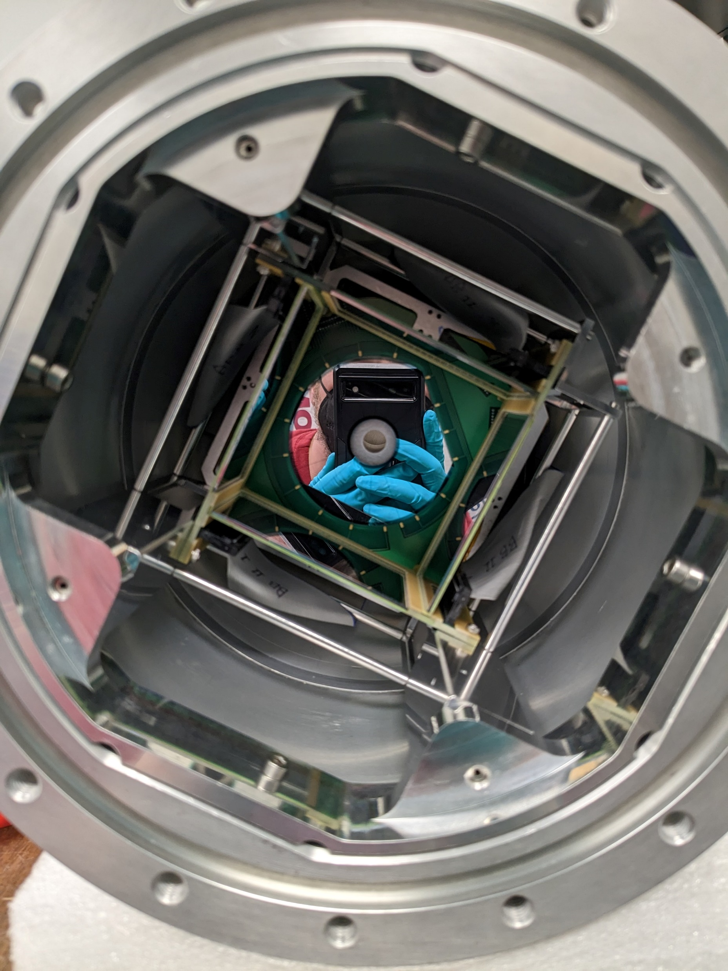
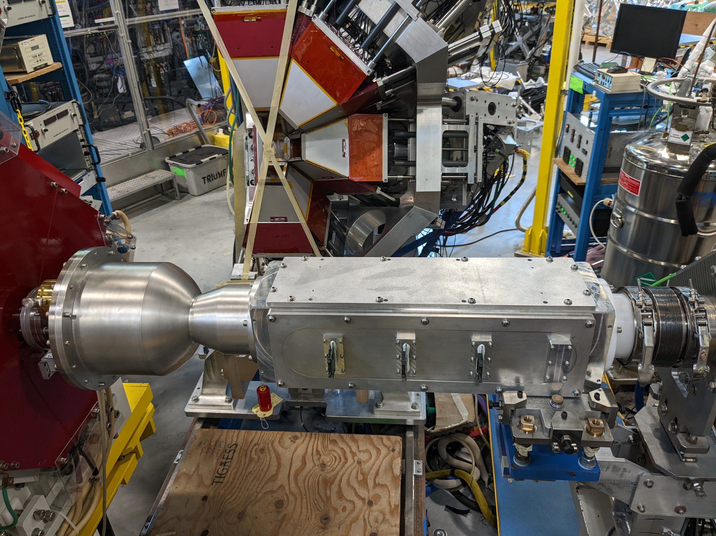
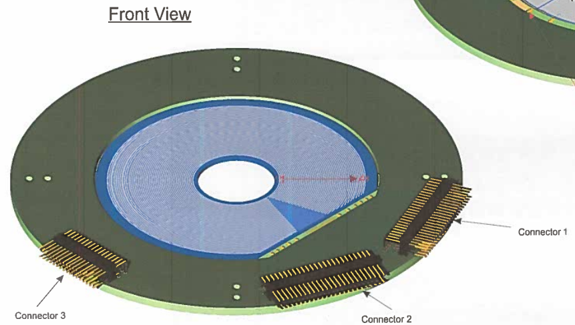
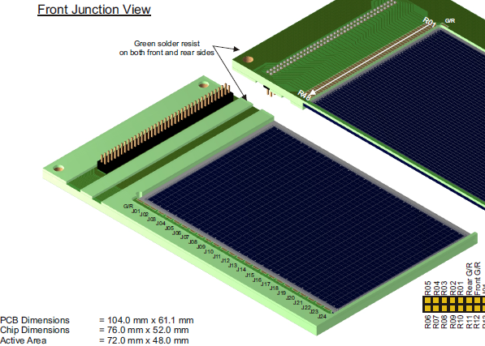
New target chamber SHARC-II for EMMA & TIGRESS
Upgrade of SHARC target chamber to connect it to EMMA
Designed by C. Diget et al., J. Instrum. 6, P02005 (2011)
6 DSSSD detectors to cover angular range of:
10° − 28° ∼ 100° − 140° 146° − 172°
Louis Wagner

Slide 15
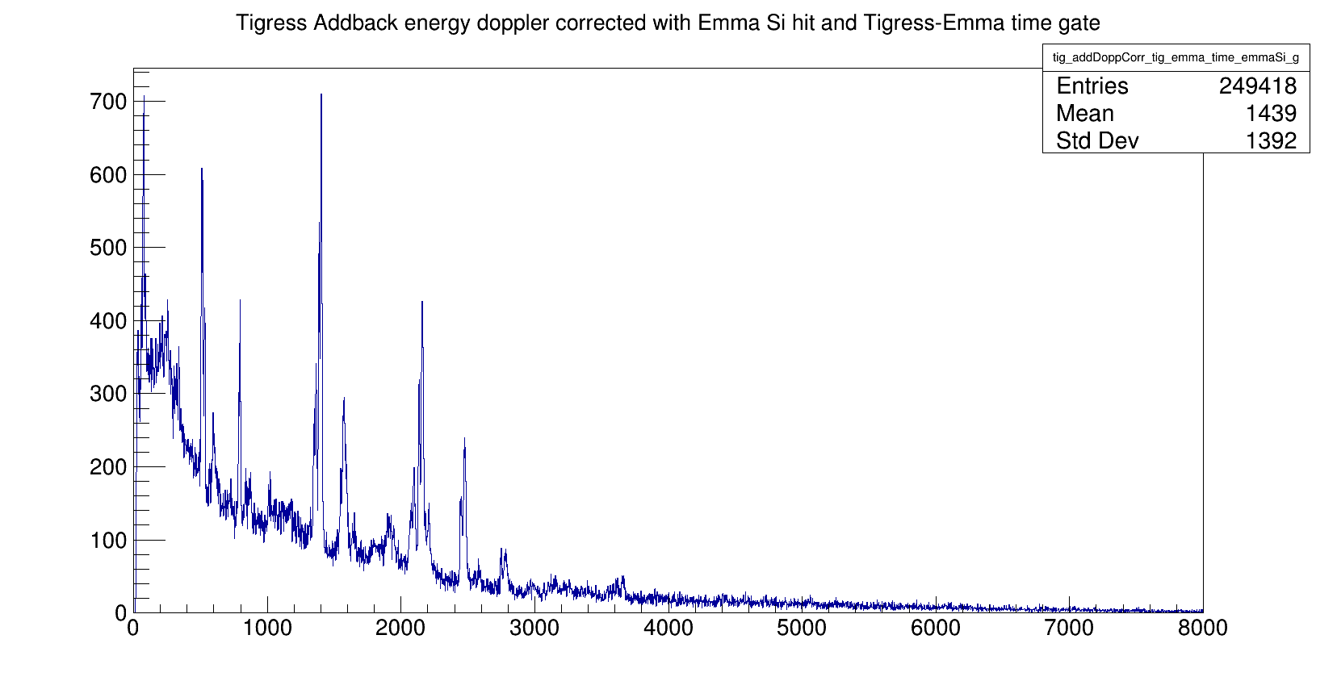
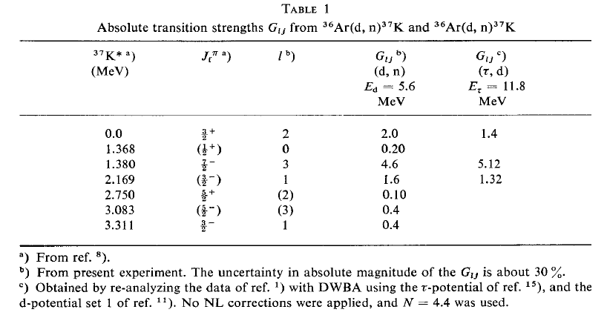
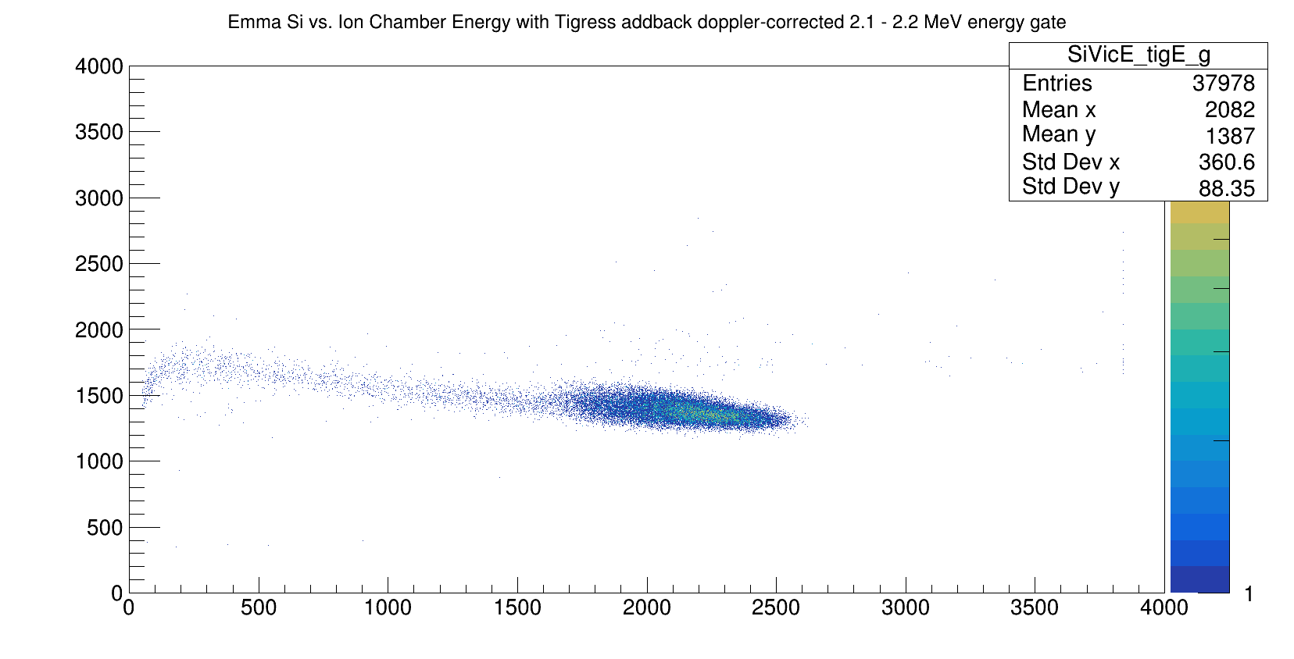
Test of new target chamber SHARC-II with EMMA & TIGRESS
Tested with ³⁶Ar 7+ beam impinging on 3 MeV/u on CD₂ target 300µg/cm²
Simultaneous measurement of ³⁶Ar(d,p)³⁷Ar and ³⁶Ar(d,n)³⁷K
Different gate conditions reveal (d,p) and (d,n) reactions
M. HAGEN, U. JANETZKI and K.-H. MAIER Nuclear Physics A152 (1970) 404--418
Louis Wagner

Slide 16
SUMMARY / OUTLOOK
Transfer reactions critical for many astrophysical processes/sites but very challenging to measure
Recoil mass spectrometer very specific device to solve issue (primarily for RIB)
Techniques well developed for all conditions: low cross section, beam contaminants
Recoil Separation needed to making pioneering measurements, i.e. first direct measurements of p-process reaction with radioactive beam
Can contribute to precision measurements of stable reactions as well, complementary to normal kinematics
Upcoming EMMA experiment in August:
⁸⁶Kr(α,n)⁸⁹Sr and ⁹⁴Sr(α,n)⁹⁷Zr (Part III) for weak r-process
SHARC-II chamber allows transfer reaction measurement with full information on reaction products (light particle, gamma & recoil)
Decay station for studying recoil decay will be assembled over the next year

Slide 17




Thank you
Merci
My thanks to Barry Davids (TRIUMF) & Matthew Williams (Uni of Surry) for slides and to all my collaborators at EMMA & TIGRESS!
www.triumf.ca
Follow us @TRIUMFLab

Slide 18
Backup
Slides

Slide 19


Inverse Kinematics
Recoil Separator Goes Here!
θ_{γ}
θ’₃
Maximum possible recoil angle when E_{γ} is maximized for E_{γ} = Q+E_{c.m.}
AND emission perpendicular to beam axis (θ_{γ}=π/2)

Slide 20
The Challenge
In inverse kinematics we have:
– Beam that did not interact
– Recoil with, in average, the same momentum as the beam
– Recoil with an momentum/energy distribution
– Recoil with an angular opening that is larger than that of the beam
– Beam and recoil with various charge states
Difficult to detect the recoils right after the target
Recoil separators are devices which separate nuclear reaction products (recoils) leaving a target from the unreacted beam particles.

Slide 21
Inverse Kinematics
Necessity due to not being able to make short-lived radioactive targets
Detect recoiling product nucleus: forward focused, 100% efficiency
Becomes problem of separating rare reaction products from abundant beam
  zero-degree electromagnetic separator
Additional advantages:
  Target either H₂ or He: usually gaseous → windowless (jet,extended), purified etc…
  Still detect gamma rays (tag)
  Particle ID on reaction products
T₃*’ = T₁’ – E
http://skisickness.com/2020/02/kinematics/

Slide 22
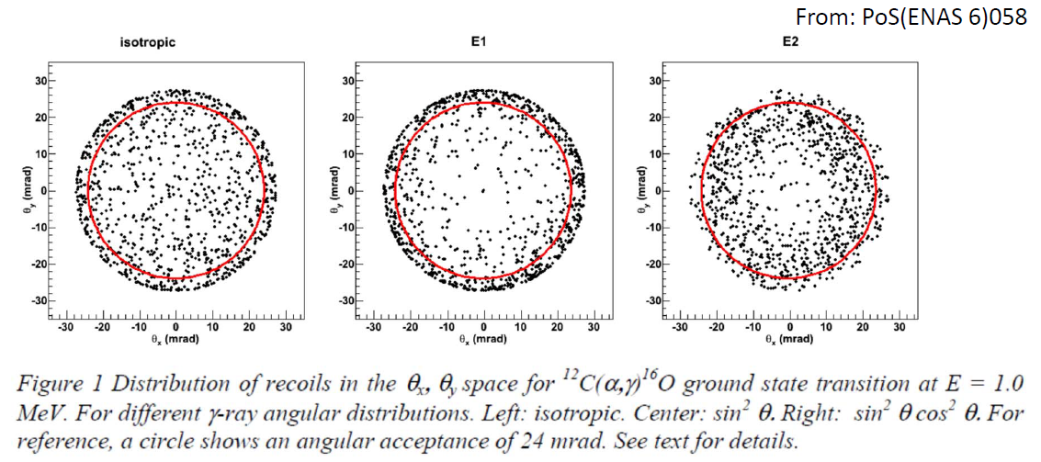
Angular distribution of recoils
For absolute cross section, full transmission of the selected charge state is needed
Example from FMA to study ¹³C(p,γ)¹⁴N and ¹⁸O(p,γ)¹⁹F and ¹⁸F(p,γ)¹⁹Ne but limited in transmission

