Slide 1

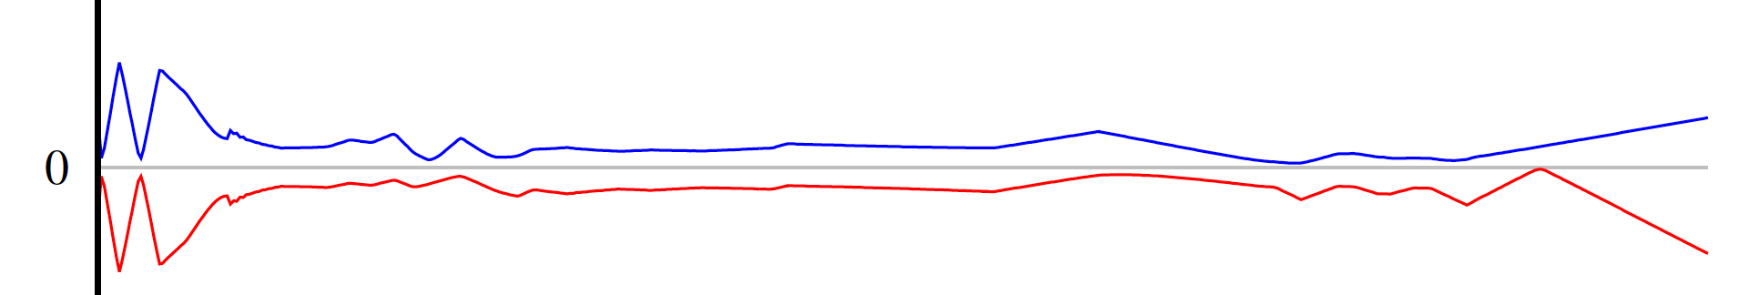
BEAM PHYSICS
Hui Wen Koay
Accelerator Division

Slide 2
Outline
Supports the commissions and upgrades of beamlines
  Cyclotron & BL4N
  ARIEL e-LINAC
  CANREB-HRS
  ISAC
Engaged in new research and international collaboration
  Cyclotron research
  CERN-LHC

Slide 3
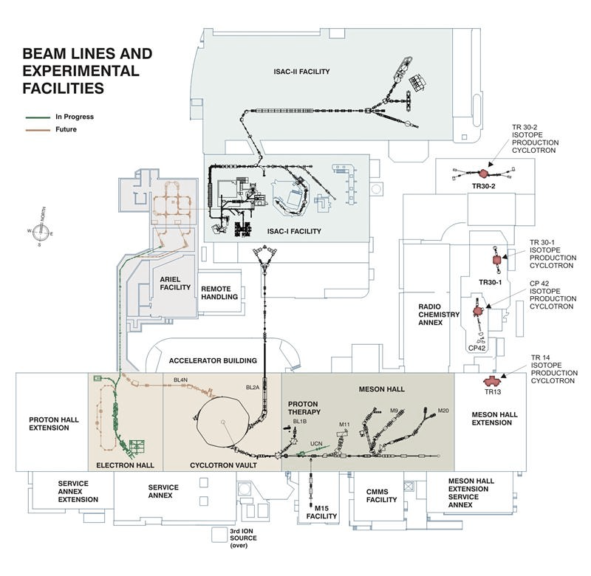
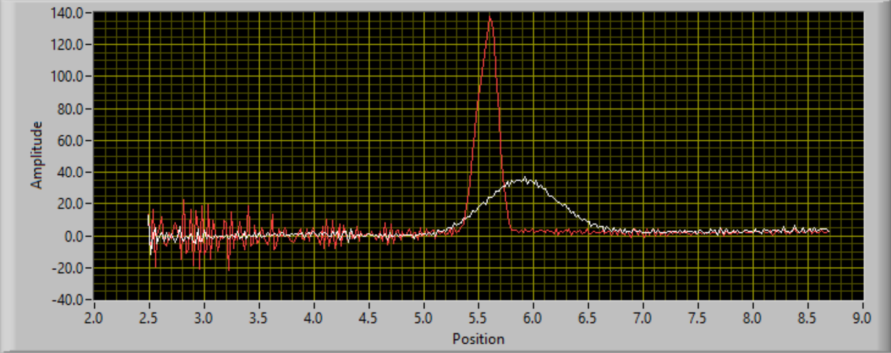
Cyclotron : First extraction at new beamline (BL4N)
New milestone:
First 460 MeV proton beam sent from the cyclotron to BL4N front end on 27th September 2022
New in-house designed and built wire-scanner successfully measured the extracted beam profiles
BL4N front end beam optics validated
ARIEL
460 MeV
BL4N
E-LINAC
CYCLOTRON
Beam profile measured with the new profile monitor at BL4N front end. Red line shows the radial profile, while white line shows the axial profile
Y. Rao, TRI-BN-23-07
Notes:
Include captions for the figures, improve the plots for the beam profile
Maybe replace the left figure

Slide 4
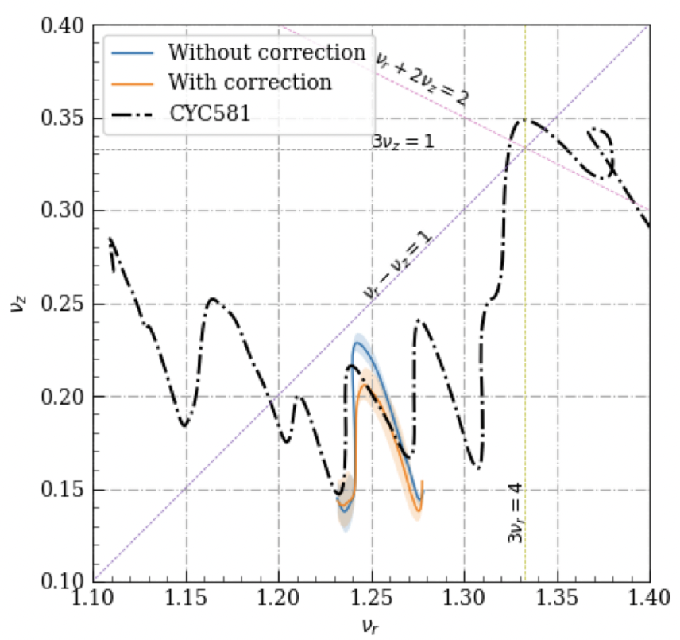
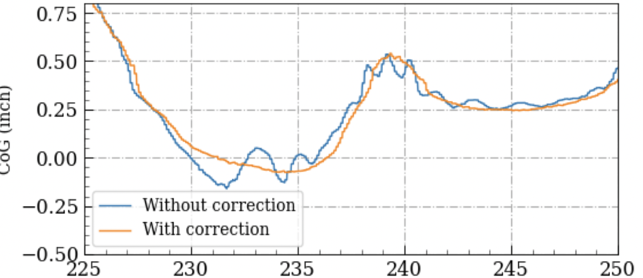
Cyclotron : First tune correction for coupling resonance
Aim to reduce activation from beam loss → potentially increase the limit of beam current/operational hours to support ARIEL
Tune diagram
Centroid motion
Distance (inch)
Example of correction by Trim Coils
Radius (inch)
Beam loss is reduced by about 16%!
Y.N. Rao and L. Zhang 2023 JINST 18 P03020
Notes:
(1) Compensation of 3 main resonance crossings by Harmonic Coils (HC) – powering the top/bottom coils in opposite currents to generate Br at the median plane.
(2) The one you point out with the arrow, we actually move the beam tune away so it does not cross resonance.
Explain the experimental/theoretical difference/resonance lines explanation, maybe acceleration moving the line away
you have to motivate this development, something about beam loss, activation, need for more circulating beam for BL4N... Also explain what is measurement-derived data, and what is not.

Slide 5
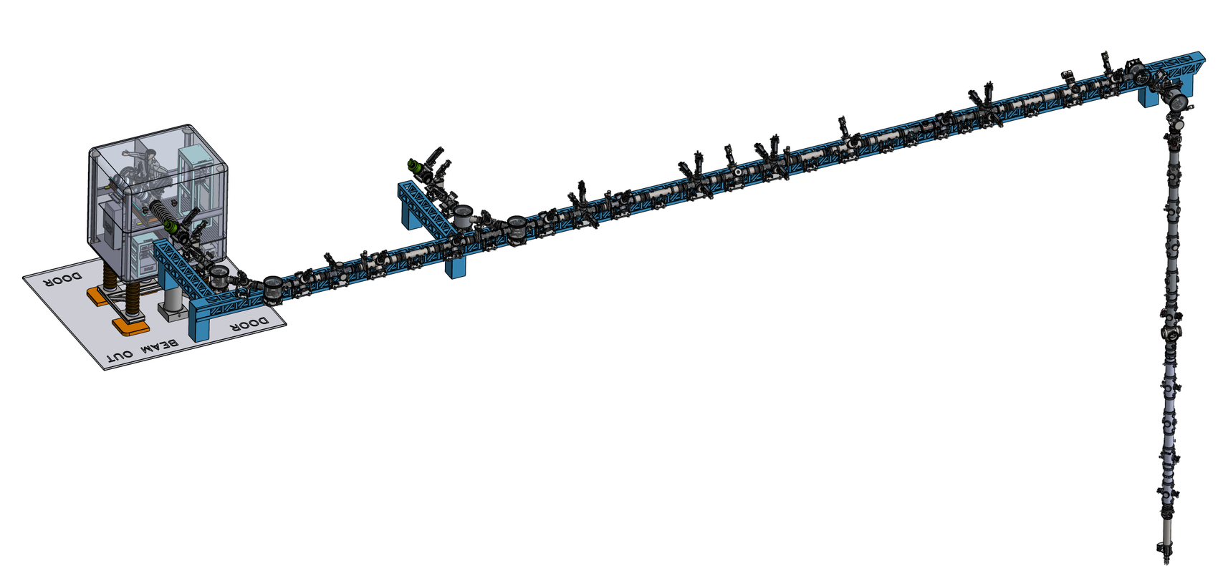
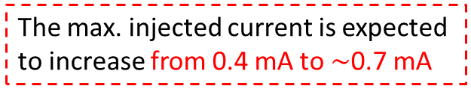
Cyclotron: Injection beam upgrade program
Upgraded the vertical injection beamline
Replace the current double-gap buncher to a multi-harmonic buncher + rebuncher
Currently the design is completed [1]
The longitudinal phase space portrait measured at the final view screen of the injection beamline using the new fast simulation (HYPER3D) developed by Paul to include the non-linear terms [2]
The max. injected current is expected to increase from 0.4 mA to $\sim$0.7 mA
[1] Design of a multi-harmonic buncher for TRIUMF 500 MeV cyclotron (2023) S. Saminathan et. Al, IPAC’23
[2] Jung, Paul et.al.(2022). Hybrid macroparticle algorithm for modeling space charge. Physical Review Accelerators and Beams, 25(8), 084602.
Notes:
To be able to support ARIEL
We have the design, one of the part that requires particular study is the space charge
Benchmark that to Paul’s work (combine 10/11)
Faster- better. For online tuning

Slide 6
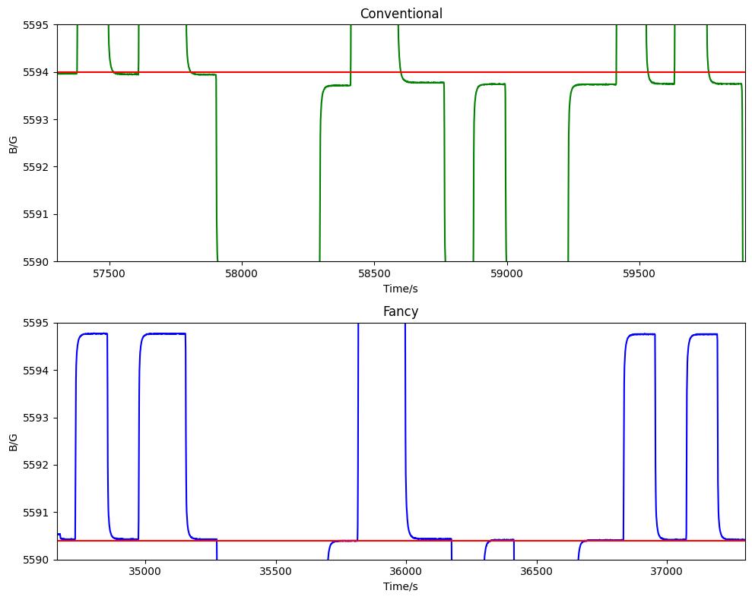
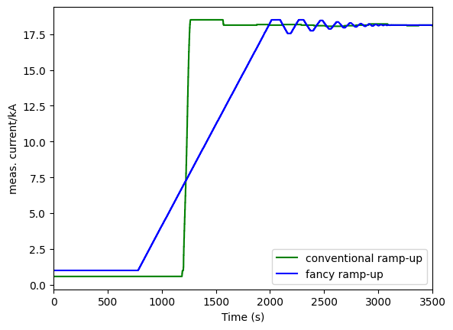



Cyclotron: Improving the reproducibility of the main-magnet
$Δ$B $\sim$ 250 mG
$Δ$B $\sim$ 40 mG
TRI-BN-23-12
Notes:
Increase current, reduce loss, improve efficiency,kA on the left
Link the mG error to the isochonism
For cyclotron we need the magnetic field to mG, else no beam is coming out (unlike synchrotron)
Like degaussing the magnet at the setpoint, the right is the experimental data using the nmr probe

Slide 7
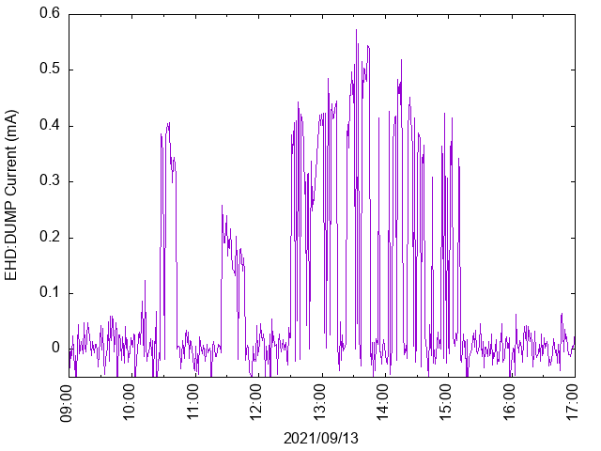
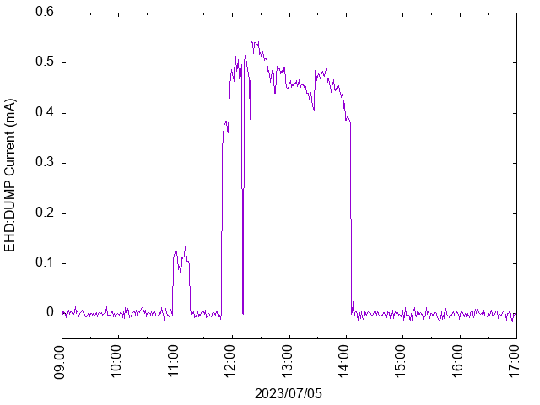
E-linac: Commissioning Timeline
Dec. 2019
Feb. 2020
Dec. 2020
Sep. 2021
Jul. 2018
First 3-cavities acceleration to 25 MeV
1 kW 7 MeV
31 MeV at low beam power
1 kW 26 MeV
First 10 kW 30 MeV
2021
2023
The current at the EHD:DUMP on a typical beam delivery day
Notes:
First acceleration of three cavities, plot the positive graph, express the challenges (10 kW is a very high power, be careful with the tune etc….), can self-destruct

Slide 8
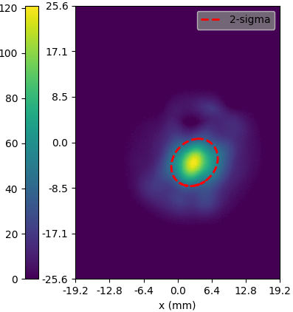
E-linac: Contribution to Handover to Gate-4B
Periodically update the models to improve the estimation of the real beamline
Enhance the operating efficiency by a fully/semi-automated diagnostic (work by co-op students)
Handover to Operations (Gate-4B)
CFI funded project: Terahertz
Other scientific research: Darklight
Example of the comparison of the theoretical values with the actual enveloped measured in control room

Slide 9
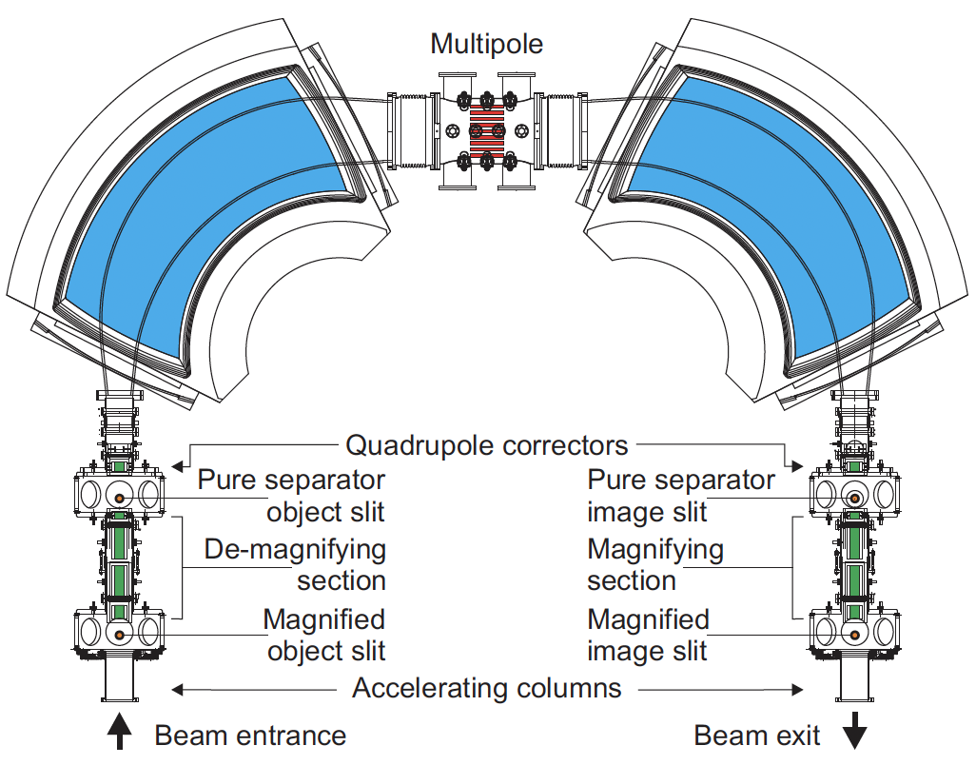
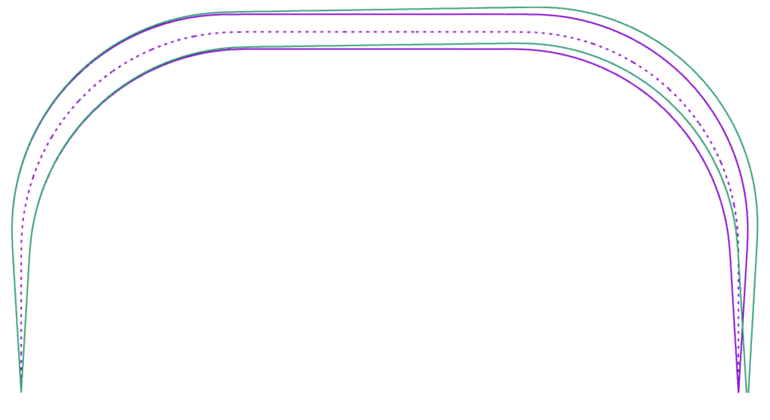
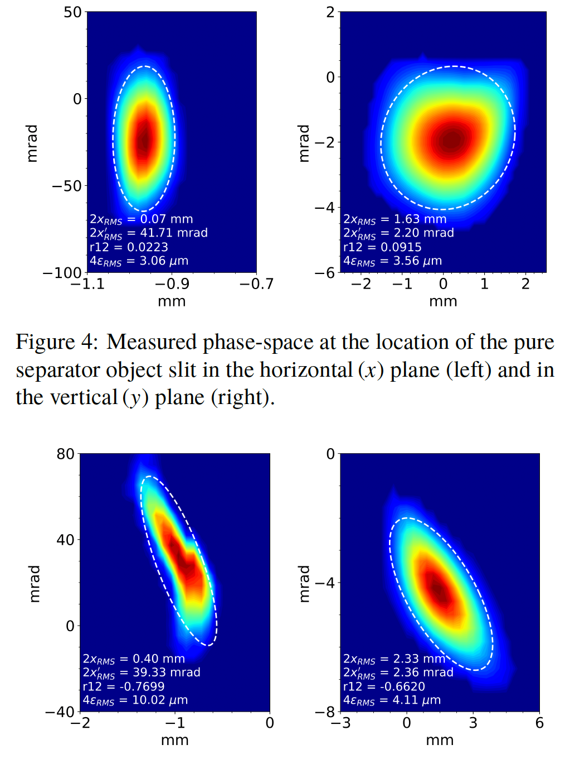
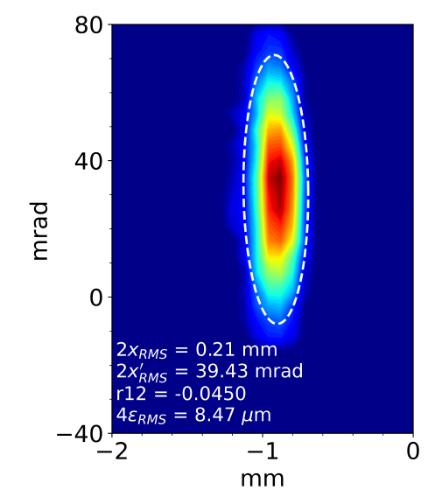
CANREB-HRS: Commission of HRS with the new multipole as a corrector
Goal of HRS: To achieve a tuneable resolving power, up to the designed 20,000 for a transmitted emittance of 3 𝜇m with an energy spread of less than 0.5 eV for a beam energy up to 60 keV
Before multipole correction
After multipole correction
Non-linear aberration
M. Marchetto et. al. (2023) Progress on the TRIUMF high resolution mass separator beam commissioning. IPAC’23
resolving power = 16000
Notes:
When the resolution is high, need to include multipole to take care of the high-order aberration, first in the world to achieve 20000 resolving power at 3 um emittance (without losing all of the beam)~50% transmission

Slide 10
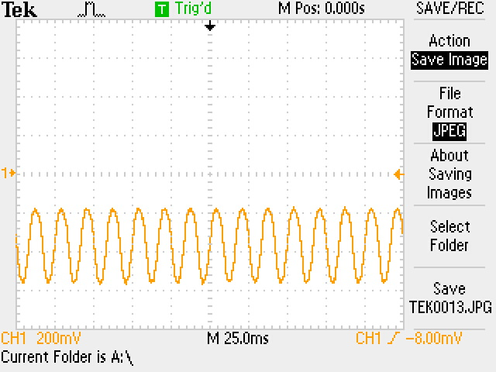
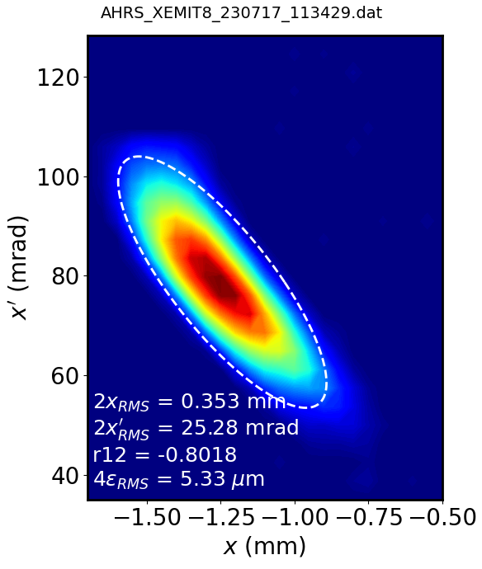
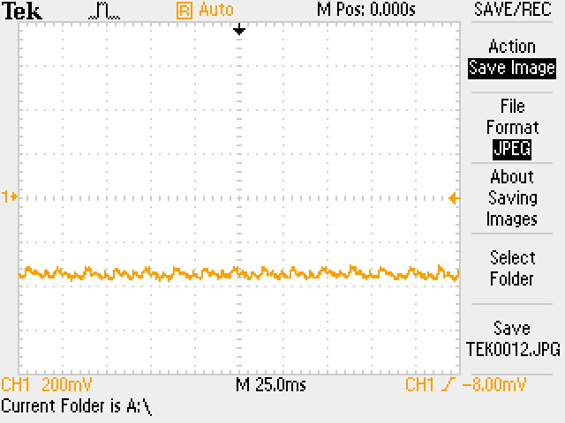
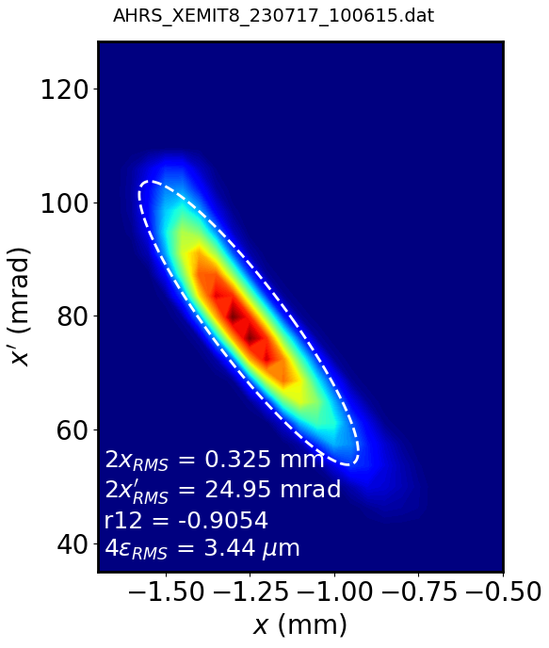
CANREB-HRS: Commission of HRS with the new multipole as a corrector
However, undesired X-emittance growth is observed. A 60 Hz voltage modulation is observed in the transported beam.
Mitigation by another power supply of 1.7 Vpp at exactly the same frequency.
Before voltage compensation
After voltage compensation
Example of voltage compensation with a stable beam (multipole turned off)
Courtesy of S. Saminathan
Notes:
Active noise cancellation

Slide 11
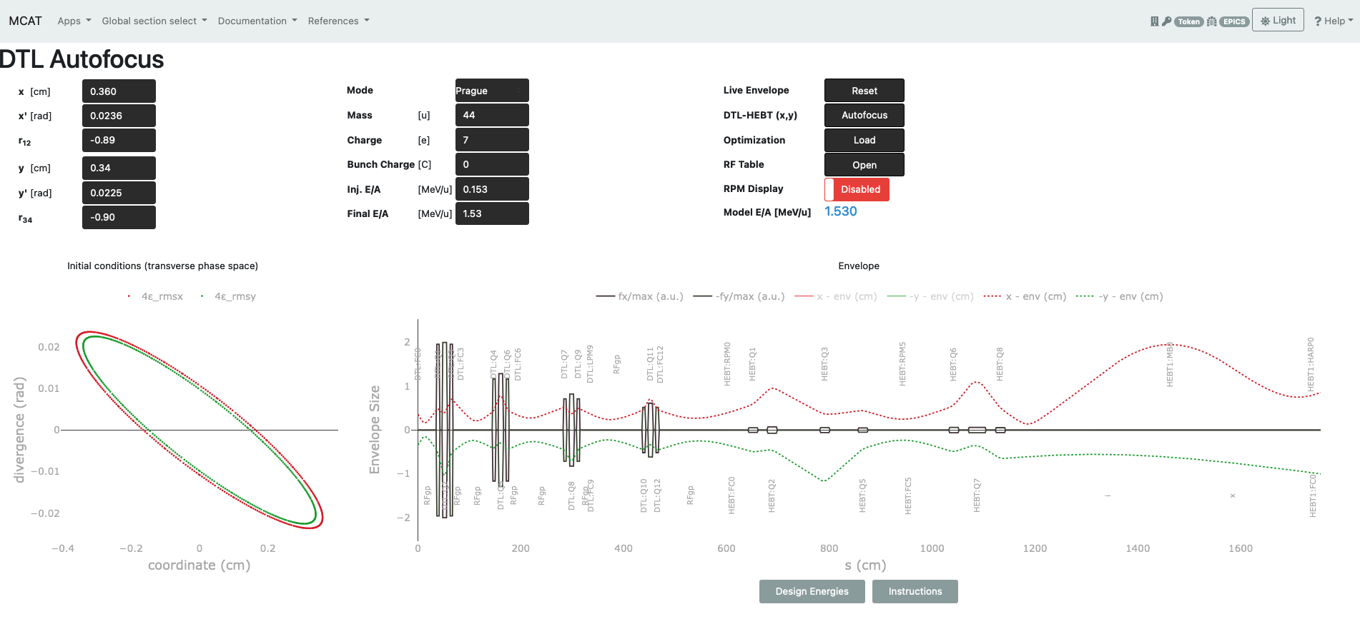
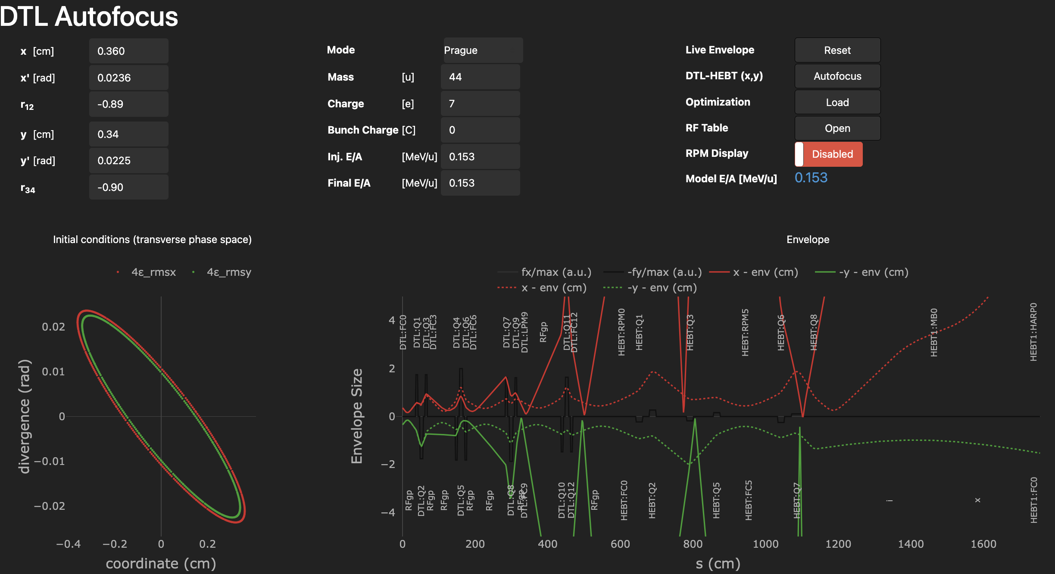
ISAC: Model Coupled Accelerator Tuning (MCAT) to Autofocus Beam
( PhD thesis of Olivier Shelbaya)
MCAT: A control-room high level application (HLA) that computes start-to-end LINAC using sequential optimization. Can compute ISAC-DTL and HEBT line tune in real time!
Notes:
Objective is efficiency, 9000 hours , but we don’t want to triple the human power. We don’t want to depend on the skills, but we have a rational process
This plot is an end-to-end model, that is online-real time that integrate all kind of elements

Slide 12
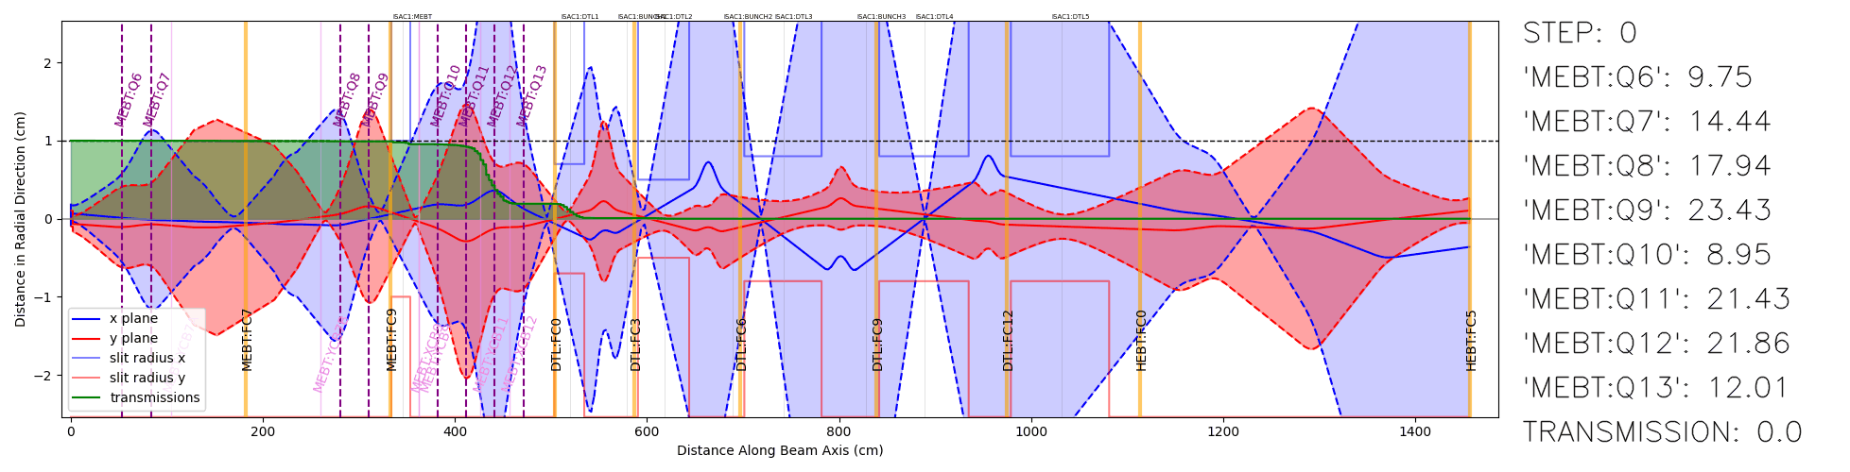
ISAC: Bayesian Optimization (BO) in Beam Tuning (MEBT-HEBT)
BO was tested in actual beam tuning for OLIS and MEBT-HEBT section of ISAC.
Max transmission from MEBT:FC9 to HEBT: FC5 up to 99.9% in about 6 mins compared to hours of tuning by an operator!
→ refer to Wojtek’s talk on Tuesday and poster session by Defne on Wednesday
Courtesy of D. Tanyer and D. Wang

Slide 13
Outline
Supports the commissions and upgrades of beamlines
  Cyclotron & BL4N
  ARIEL e-LINAC
  CANREB-HRS
  ISAC
Engaged in new research and international collaboration
  Cyclotron research
  CERN-LHC

Slide 14
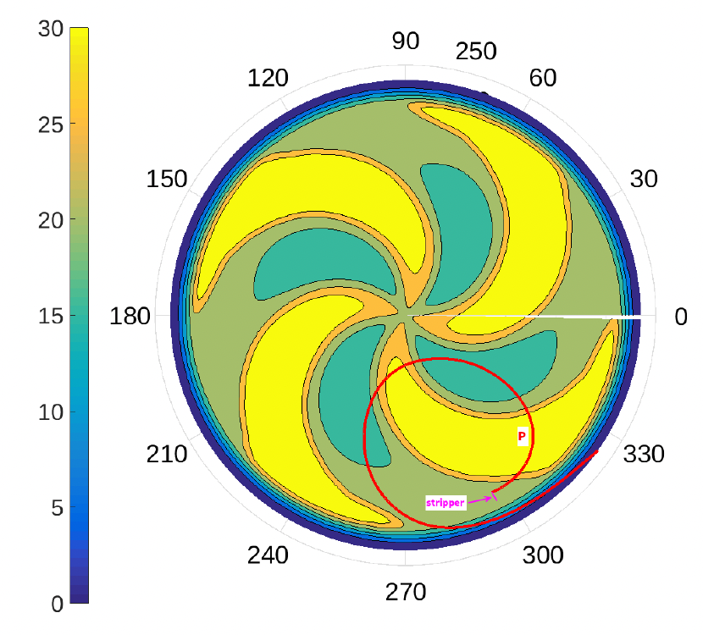
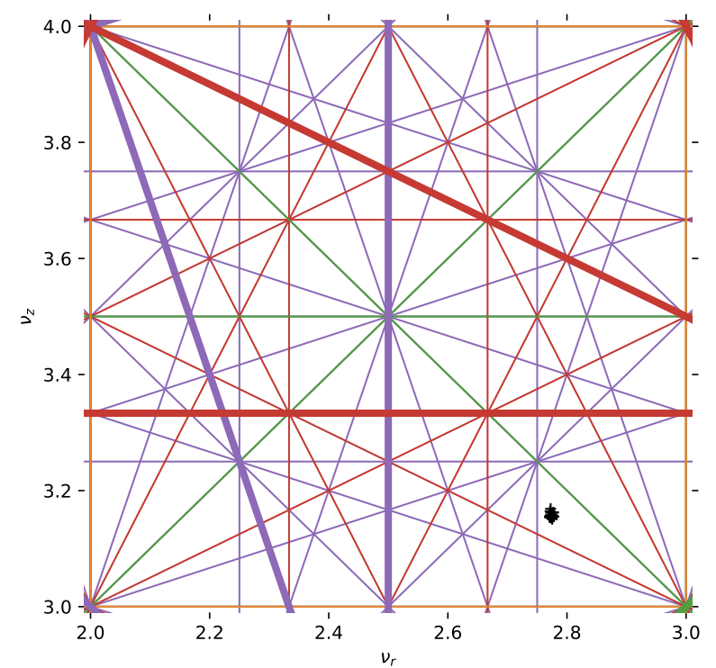
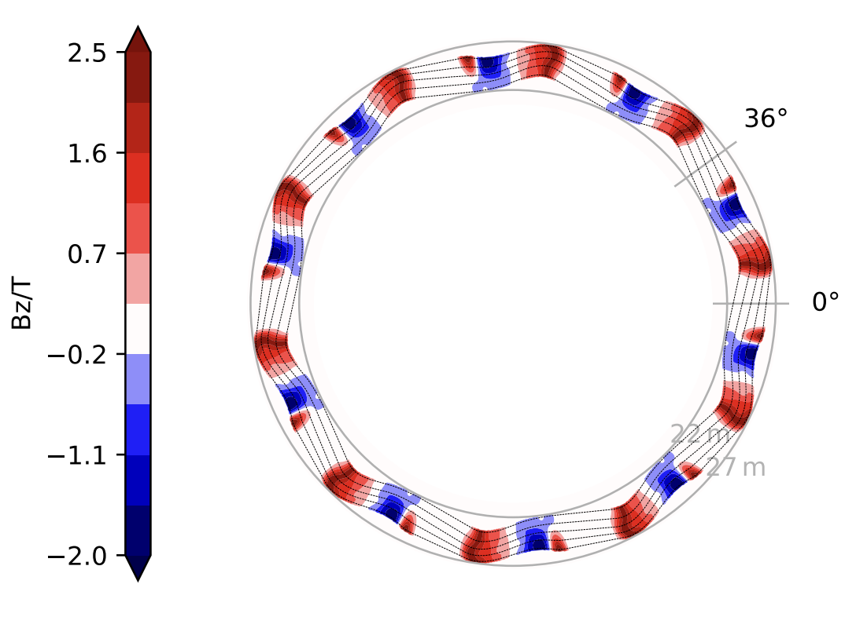
Ongoing new research of cyclotron
Invented constant-tune cyclotron to reduce the number of resonance crossings for high-energy acceleration [1]
Proposal of a high-intensity 150 MeV H³⁺ cyclotron for radio-isotope production [2]
[1] T. Planche 2023 JINST 18 P03019
[2] Y.-N. Rao et al 2023 JINST 18 P03023
Notes:
“One of the” main cyclotron facilities in the world

Slide 15
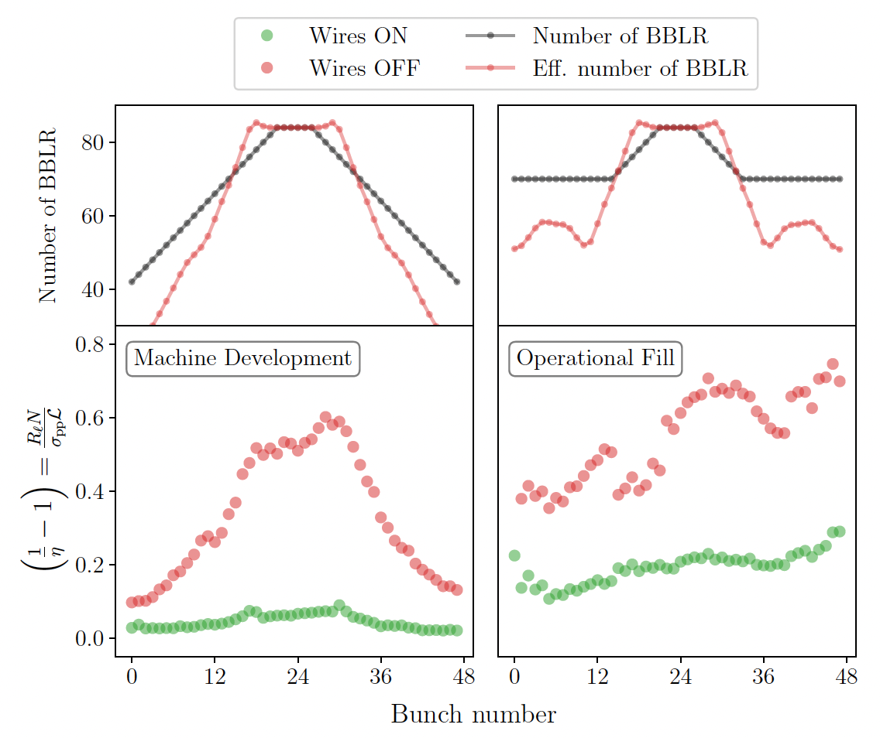
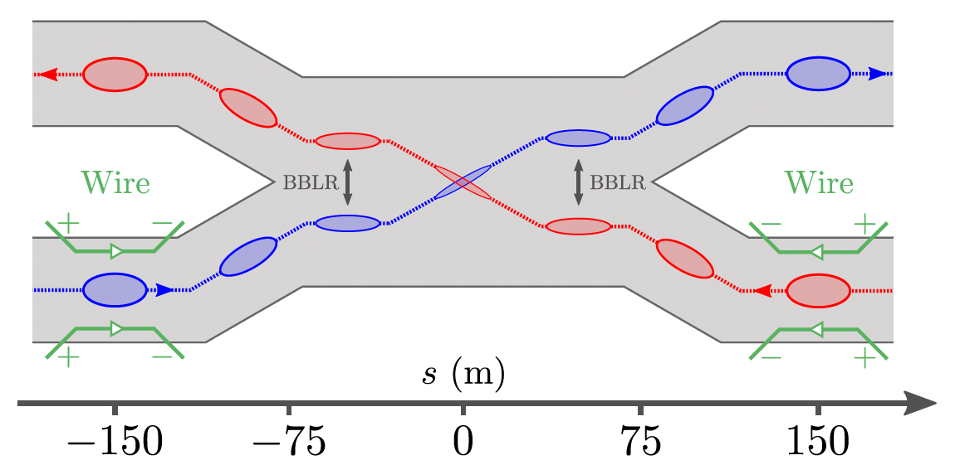
Collaborations with CERN LHC: Beam-Beam Long Range
Example of Beam-beam Wire Compensators for LHC Run 3 around IP1 and IP5
Bunch-by-bunch normalized losses for the machine development study and the operational fill. The red and green dots show the average losses 5 min before and 5 min after powering-on the compensator wires
P. Belanger, Beam-beam long-range wire compensators in LHC Run 3, in Proc. IPAC'23, Venezia
Notes:
Lower values on the right is better (link to Philipp crb cavity)
-limit the luminousity in the LHC

Slide 16
Summary
Assist the commissioning and upgrades of new beamlines/facilities
Rationalise the tuning process by utilizing the simulation that includes all the focusing elements and accelerating cavities to improve the operating efficiency
Exciting multidisciplinary projects/collaborations underway to consistently seek mutual development for the scientific community
Notes:
Change the word revolution to some milder expression

Slide 17

Thank you for you attention!

