Slide 1
Accelerator Physics and ARIEL
Tobias Junginger
Assistant Professor UVic
in a joint appointment with TRIUMF

Slide 2
TRIUMF/UVic Accelerator Research
UVic is the lead University of the ARIEL project – PI D. Karlen
Through ARIEL we received NSERC funding for student support which allowed us to grow the accelerator research and education program
  Currently 14 UVic graduate students in accelerator physics based at TRIUMF (11), UVic (2), D-Pace (1)
  One graduate lecture course taught by the adjunct faculty each year at TRIUMF and broadcasted nationwide
  Undergraduate lecture course, graduate + undergraduate projects offered at UVic
  Special topics classes offered on demand (Ion sources, synchrotrons, SRF)
RESEARCH FOCUS at TRIUMF
Beam physics and instrumentation (R. Baartman, T. Planche, O. Kester)
Superconducting RF (R. Laxdal)
Ion Sources and Targets for secondary particle production (A. Gottberg, T. Day Goodacre, O. Kester)
Projects at UVic
Cryocooler based fundamental SRF studies
Surface and Materiel Science Studies at the Electron Microscopy Facility (A. Blackburn)
Application of SRF technology to quantum computing (R. de Sousa)
Beam Dynamics studies for SuperKEKB (M. Roney)
Today my focus will be on graduate students projects which are directly relevant to ARIEL and science opportunities available through ARIEL

Slide 3
Content
Availability and reliability of ARIEL e-linac
  Plasma cleaning
  Dust migration and mitigation
Development of high power ISOL targets
Future science opportunities enabled through ARIEL
  TRISR - Storage Ring
  Material Science with betaNMR for SRF research

Slide 4
Content
Availability and reliability of ARIEL e-linac
  Plasma cleaning
  Dust migration and mitigation
Development of high power ISOL targets
Future science opportunities enabled through ARIEL
  TRISR - Storage Ring
  Material Science with betaNMR for SRF research

Slide 5
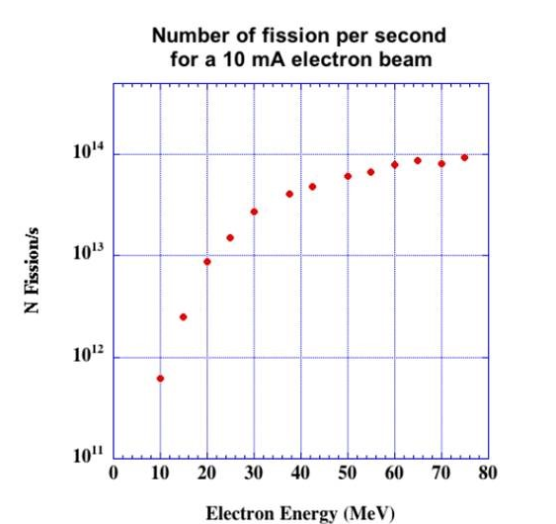
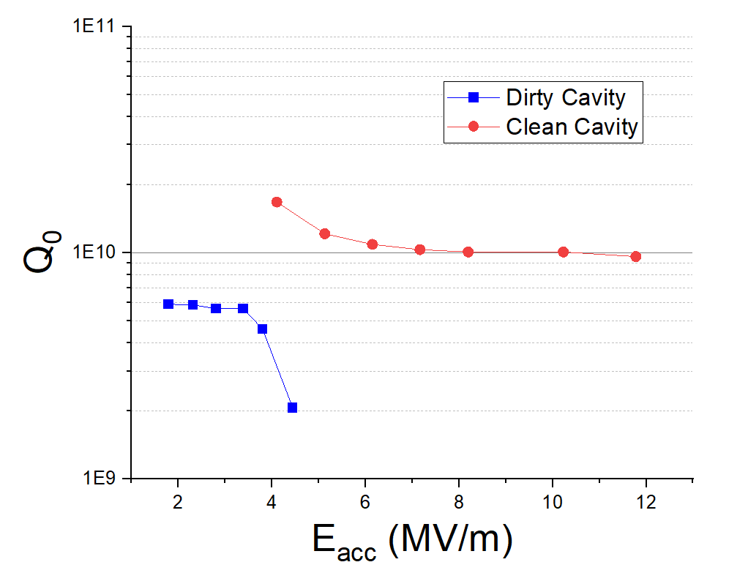
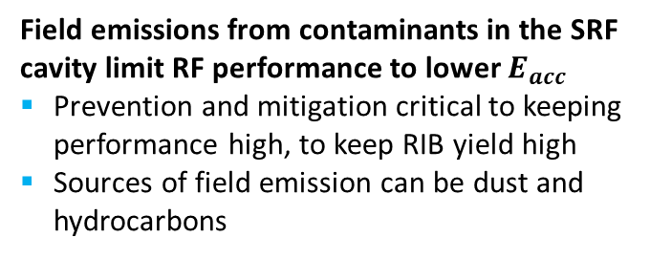


eLINAC: Reliable 30MeV Operation
Stable 30MeV operation is critical for RIB production:
RIB yield is strongly dependent on beam energy
We’re operating at 30MeV – at the lower end of the yield curve
Field emissions from contaminants in the SRF cavity limit RF performance to lower $E_{acc}$
Prevention and mitigation critical to keeping performance high, to keep RIB yield high
Sources of field emission can be dust and hydrocarbons
Clean cavity reaches $E_{acc}>10 MV/m$
Field Emission limits performance to $E_{acc}≈ 4MV/m$
As presented by Philipp on Monday

Slide 6
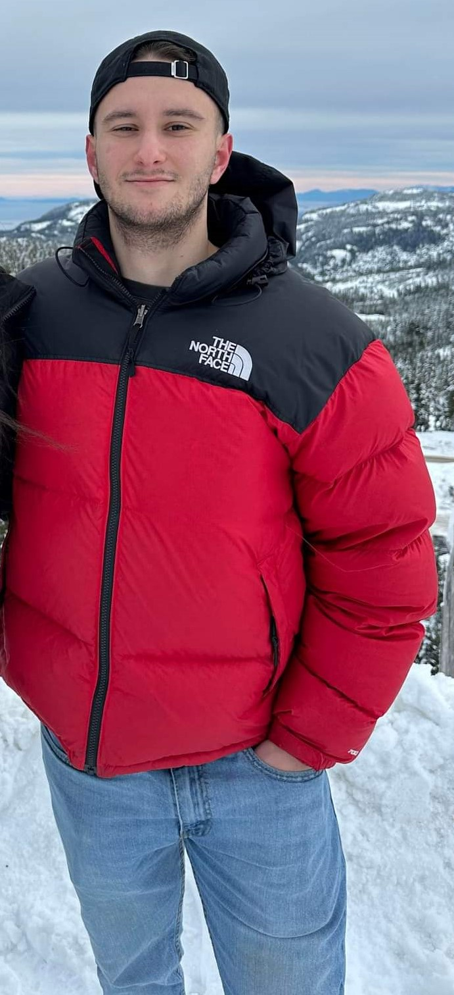
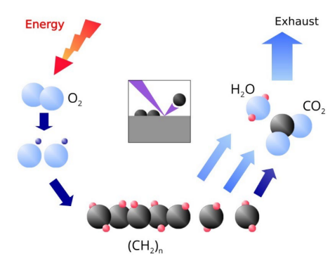
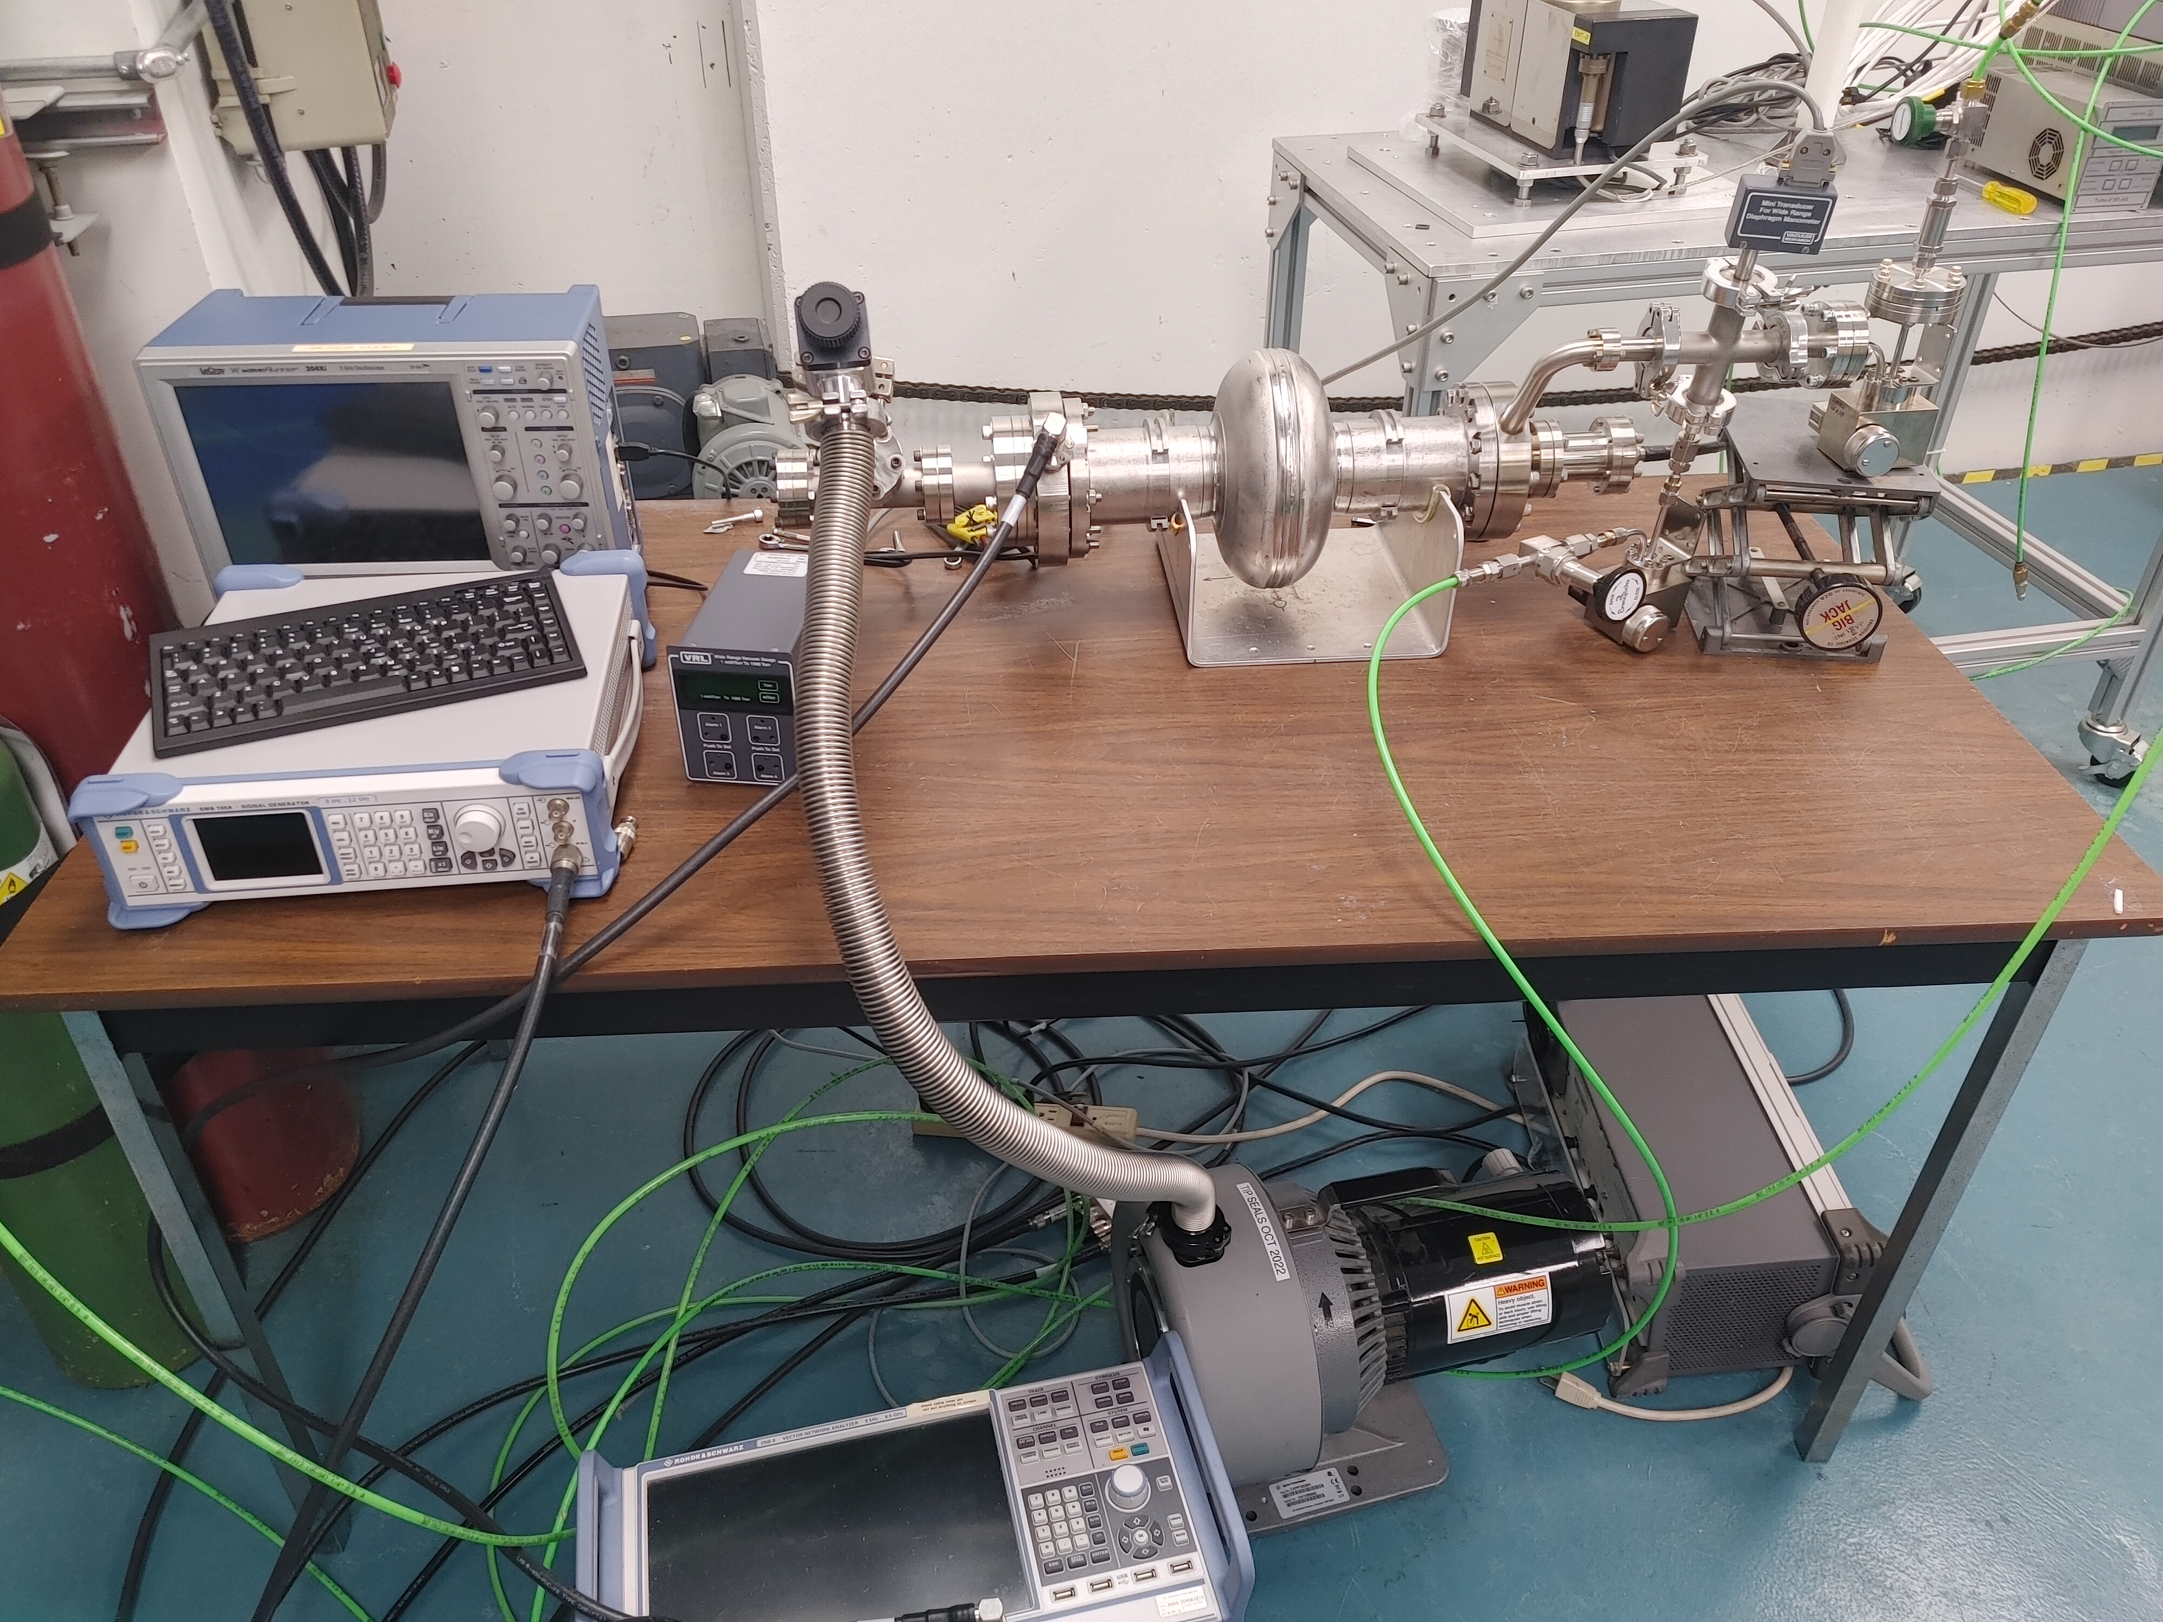
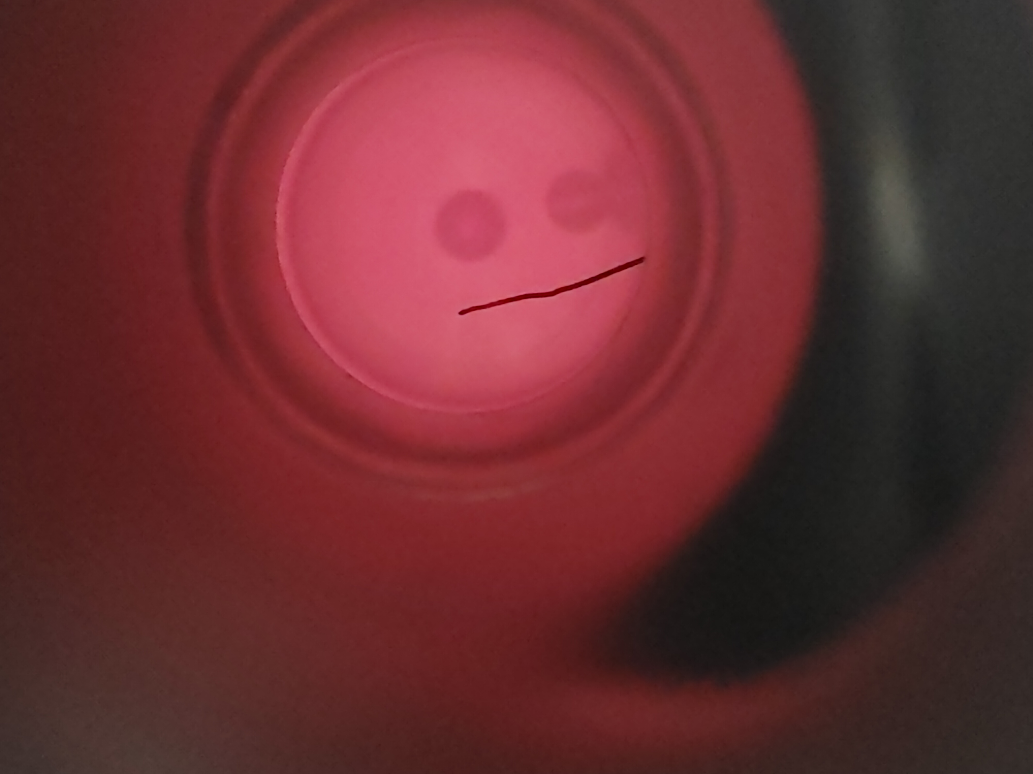
Plasma Cleaning
Adsorbate gasses in the form of hydrocarbons are one facilitator of field emission within Superconducting RadioFrequency (SRF) cavities.
Currently, cavity cleaning procedures are done ex-situ and are time-exhaustive (2-3 months).
Plasma cleaning allows for an in-situ cleaning of surface hydrocarbons using an ArO plasma mixture, which reduces cleaning time to ~1 week.
Once plasma cleaning has been optimized on uninstalled cavities, the technique will be rolled out onto ARIEL's e-linac.
MSc. D. Hedji
P.I. R.E. Laxdal
Plasma Cleaning Apparatus
ArO Plasma

Slide 7
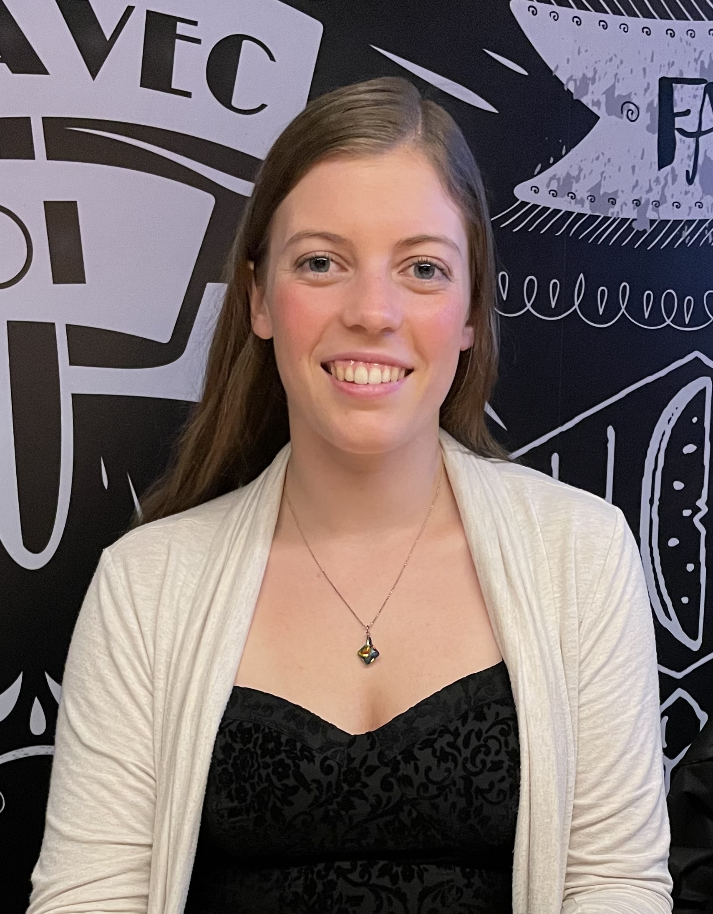
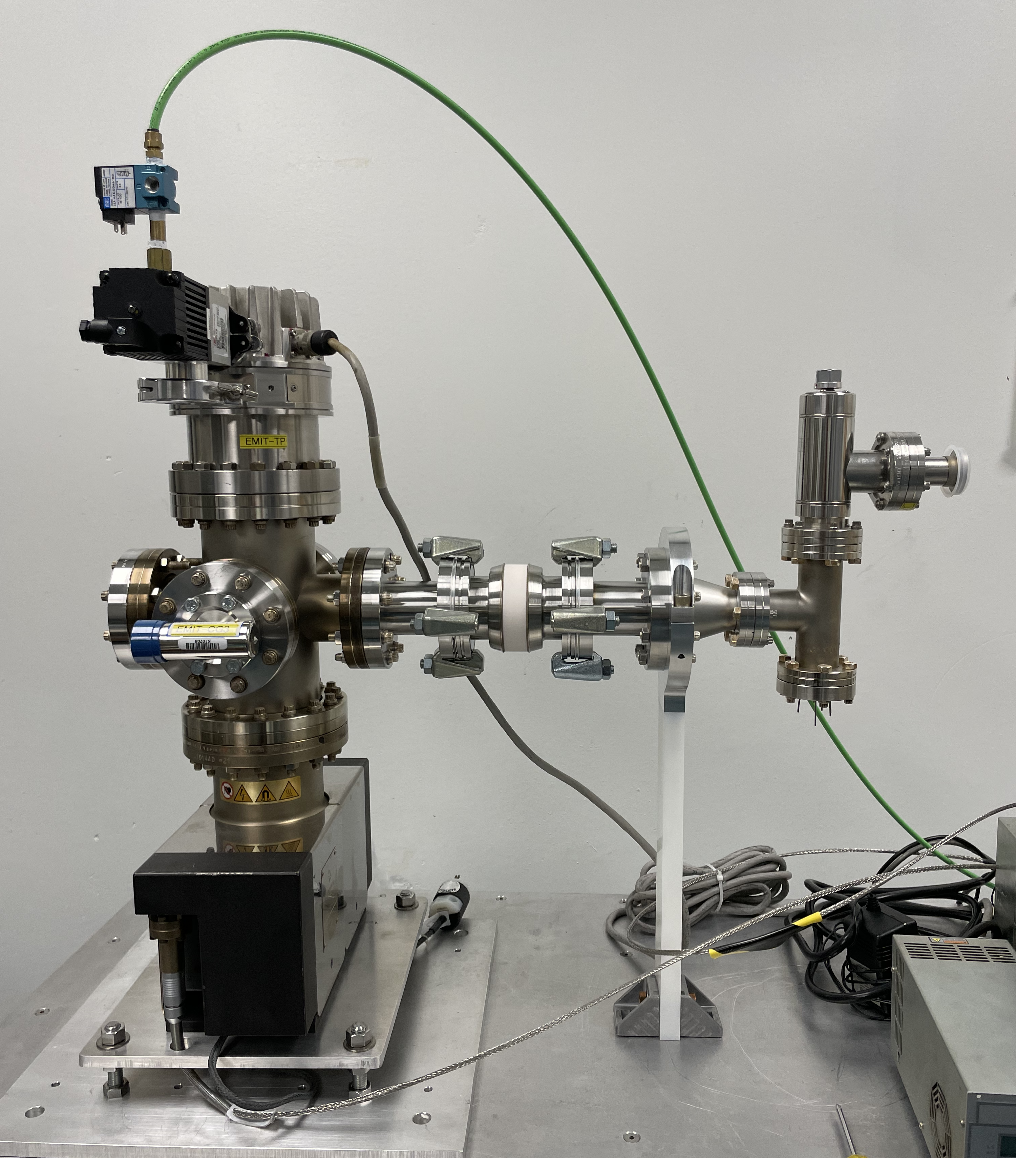
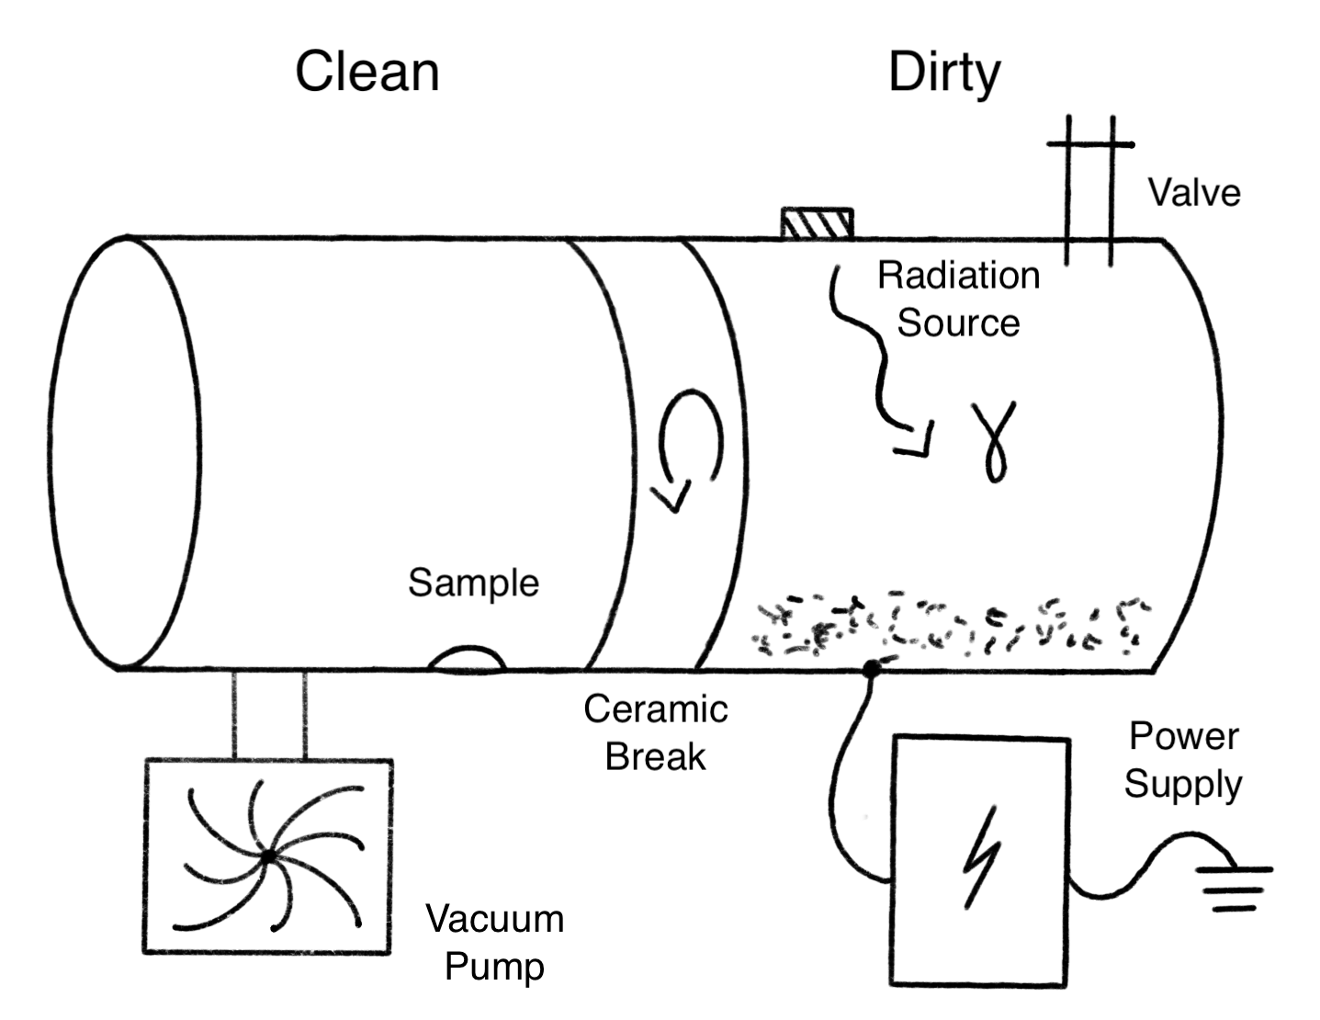
Dust migration
Most common cause of beam loss in e-linac is currently field emission.
Emitters are μm to sub μm sized contaminants → dust
Previous studies indicate that dust migrates and is charged:
  A potential barrier could therefore suppress dust migration and tackle field emission problem at its source.
Status: Proof of principle experiment has been designed and assembled. Awaiting final components. Detailed experimental plan in development.
PhD A. Mahon
PI T. Planche

Slide 8
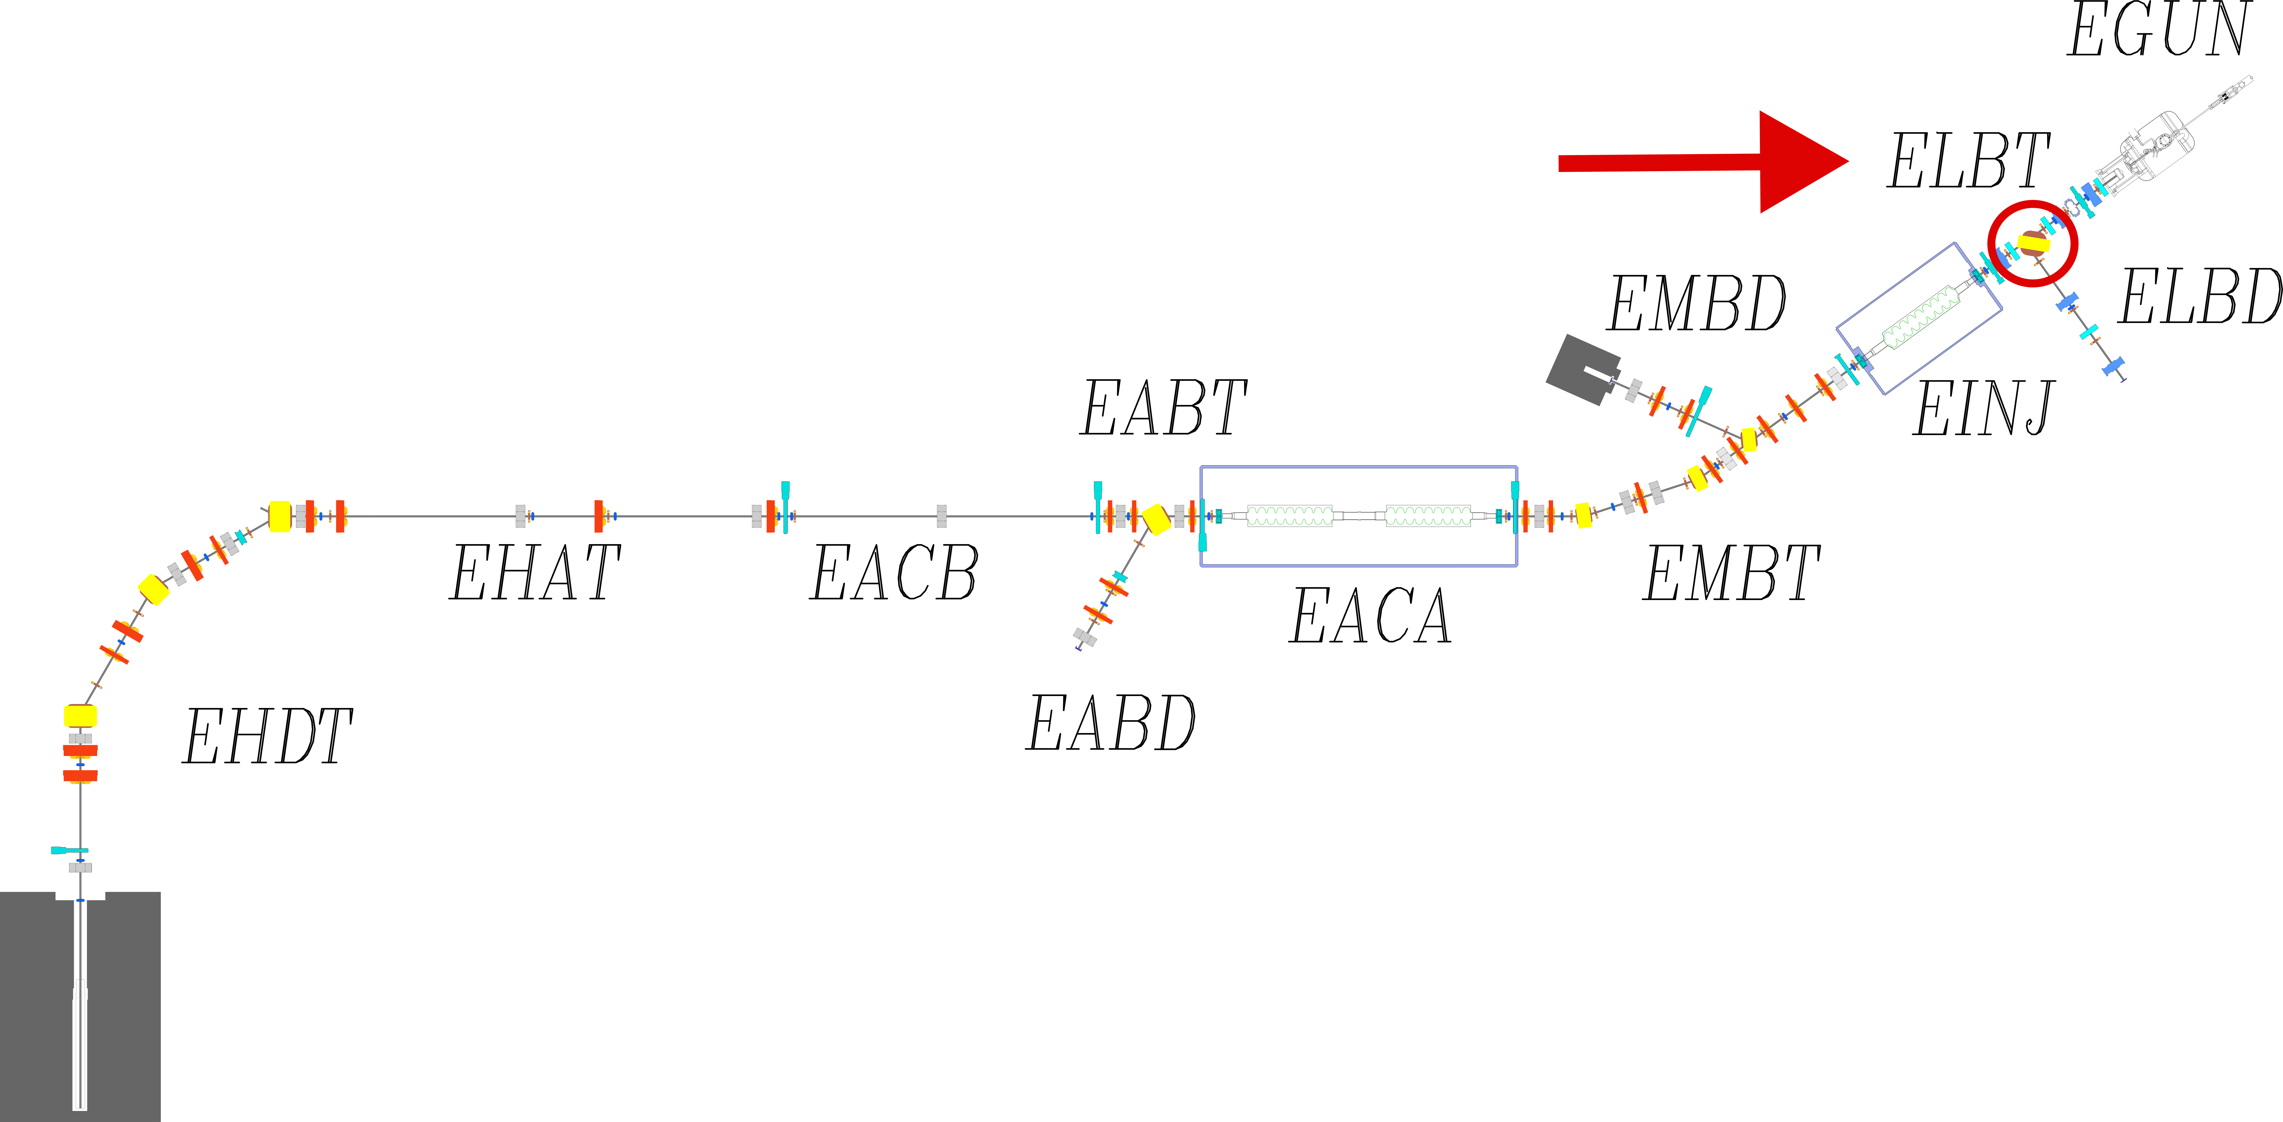
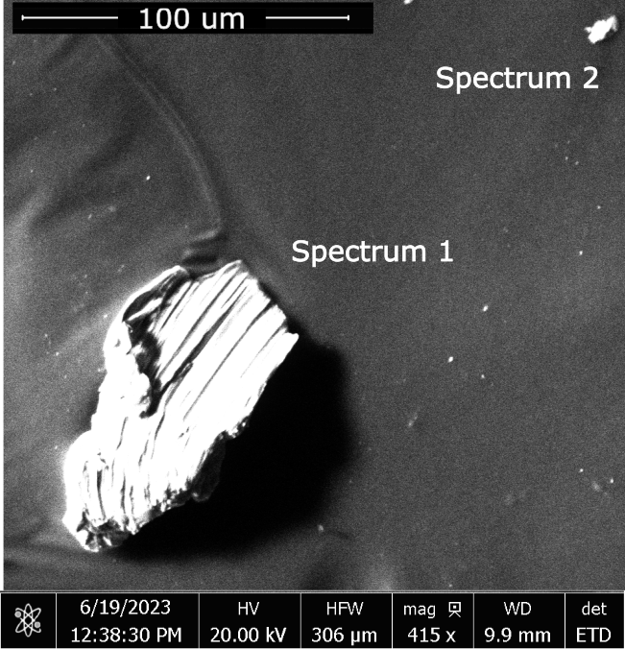
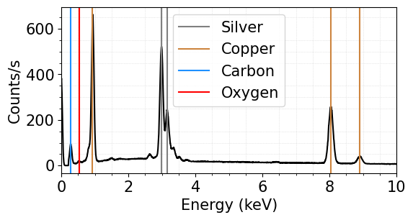
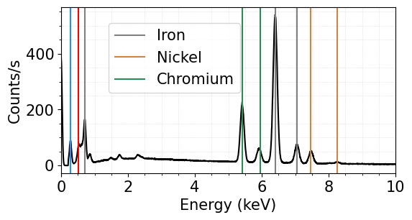
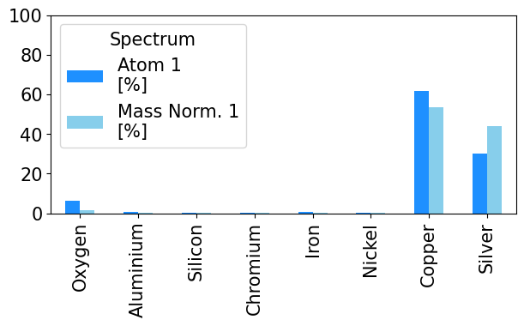
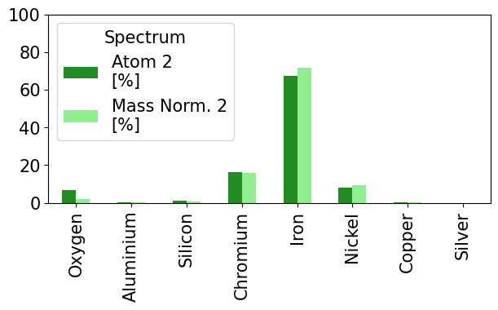
Dust migration
Dust samples were collected from the low energy section (ELBT) of the e-linac early 2023.
Preliminary results for collected dust grains were analyzed and characterized via SEM.
Sizes range from a few micrometers to a few hundreds of micrometers.
Elemental composition determined via EDX:
  Copper, Silver, Chromium, Iron, Nickel, Oxygen, Silicon, Calcium, Sodium, etc.
  Conclusions on origin of dust contamination still pending.
Example sample
Spectrum 1:
Spectrum 2:

Slide 9
Content
Availability and reliability of ARIEL e-linac
  Plasma cleaning
  Dust migration and mitigation
Development of high power ISOL targets
Future science opportunities enabled through ARIEL
  TRISR - Storage Ring
  Material Science with betaNMR for SRF research

Slide 10
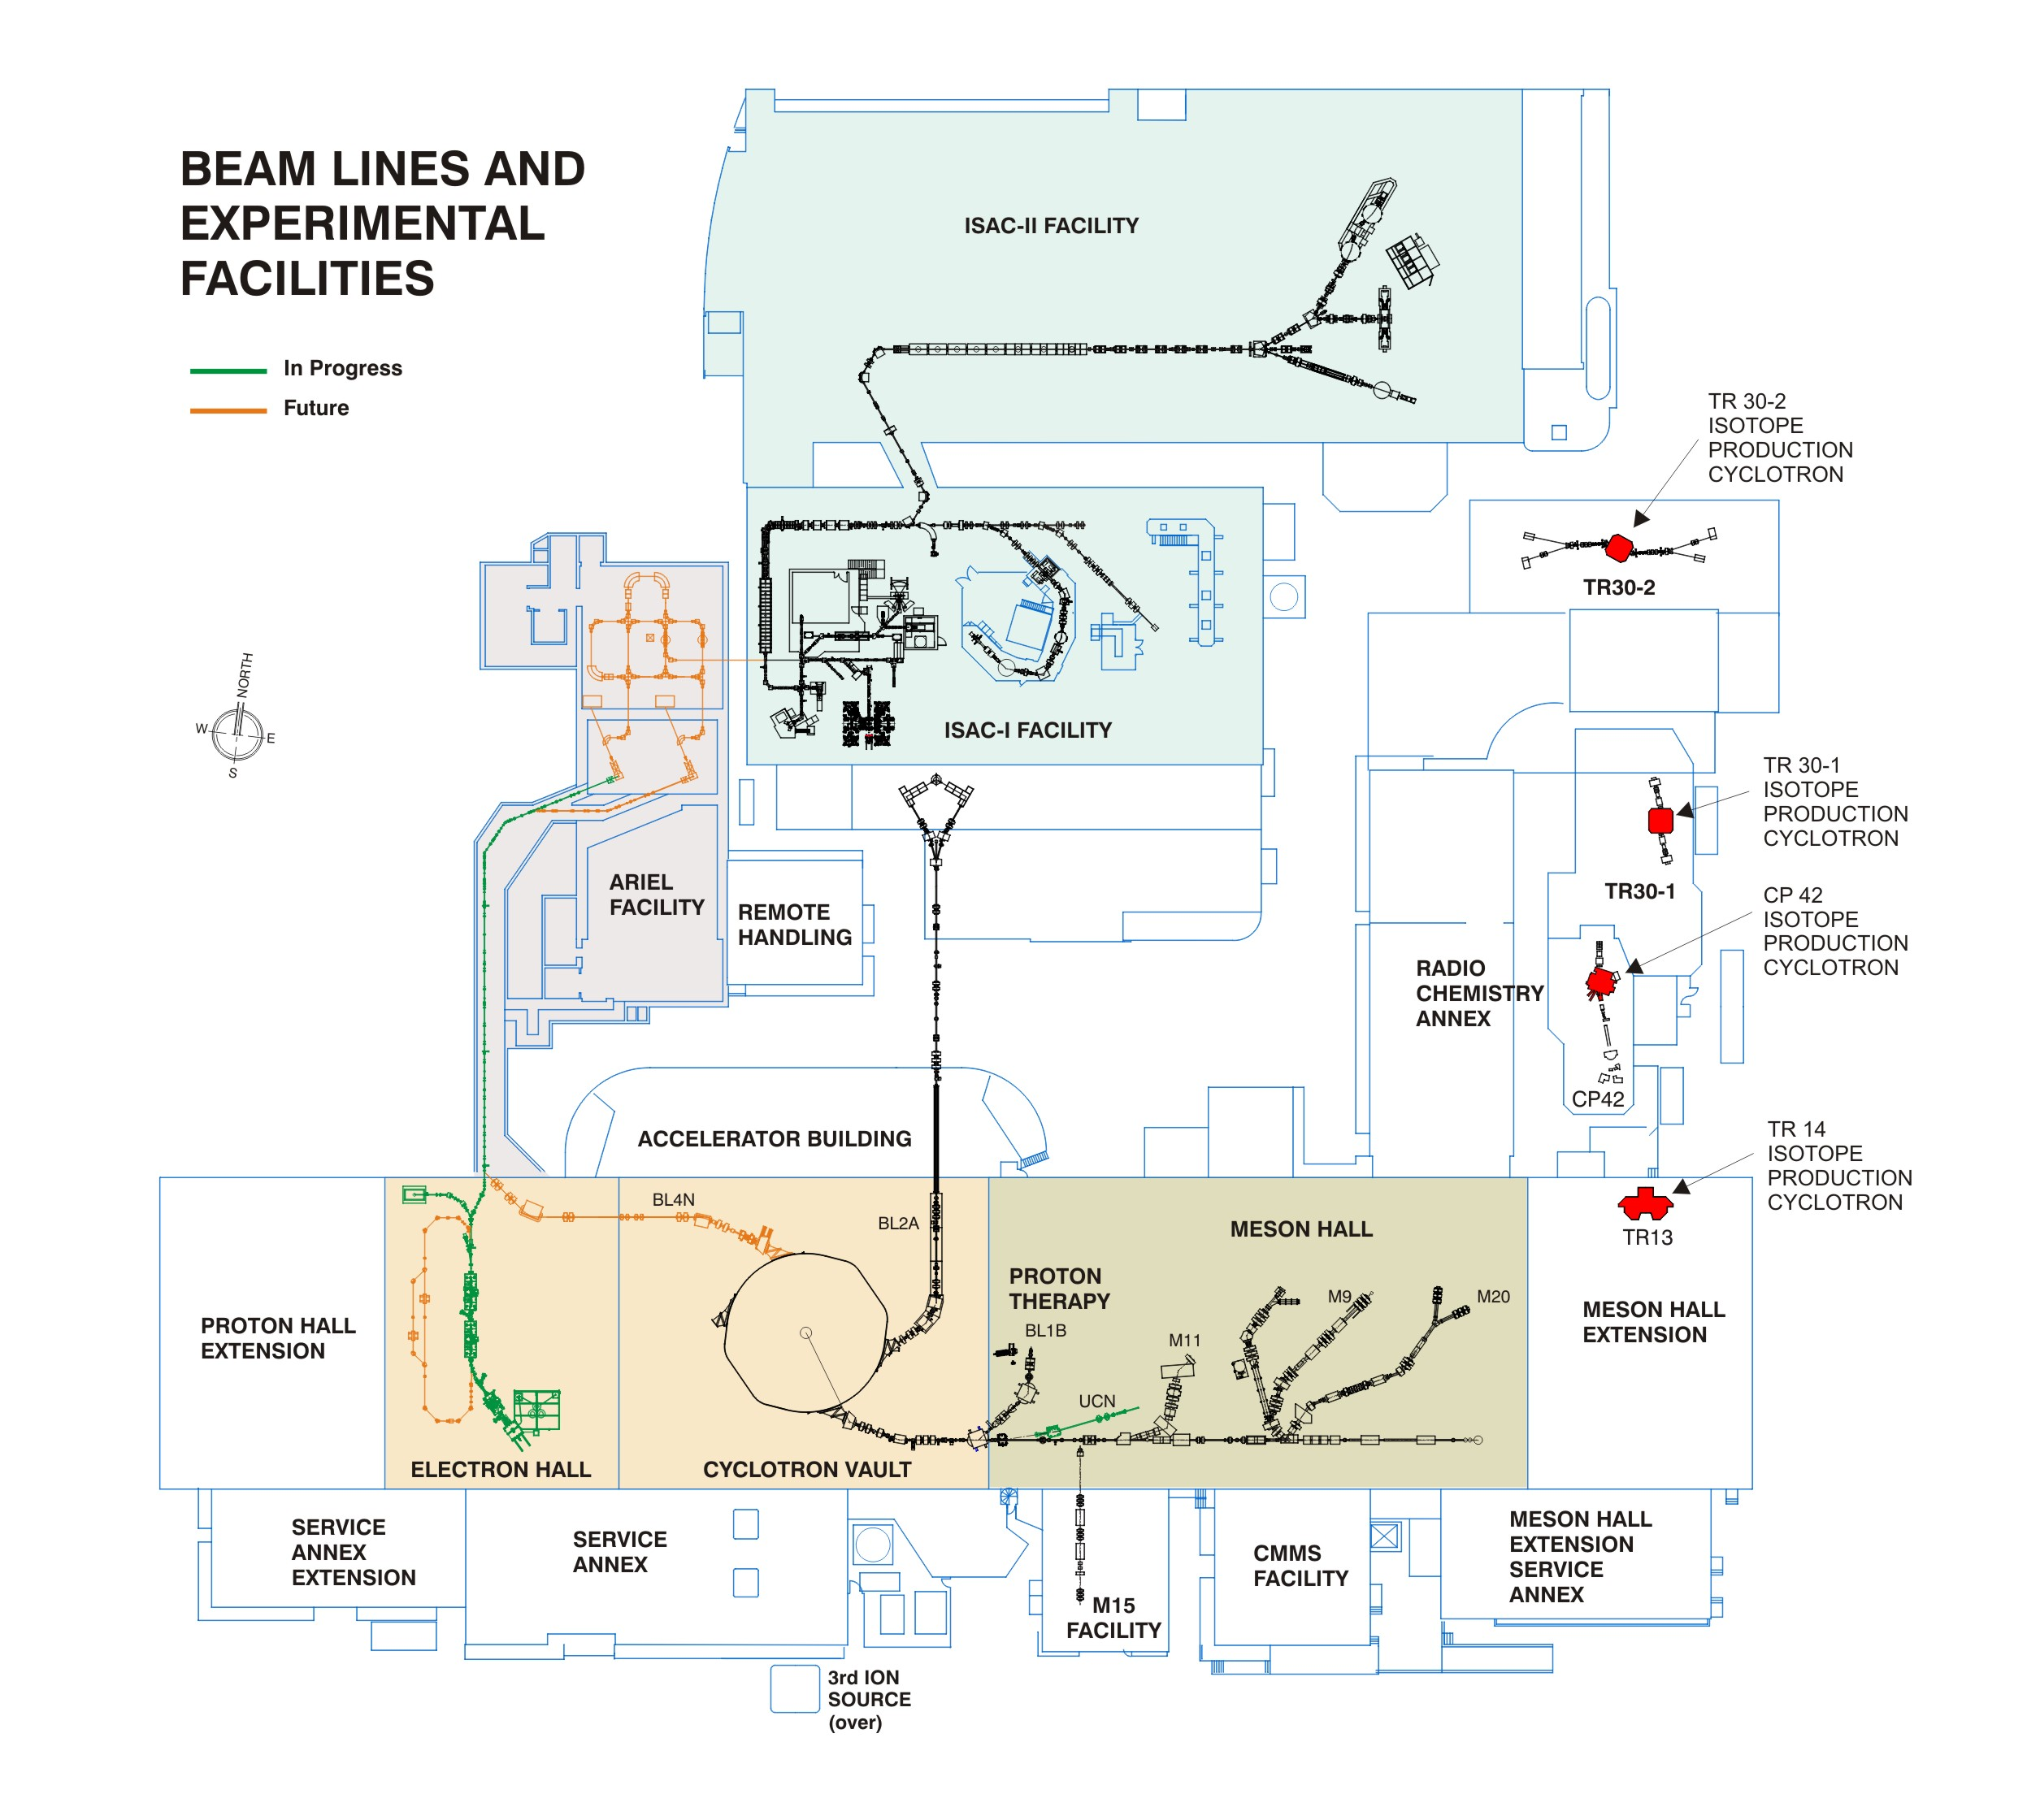
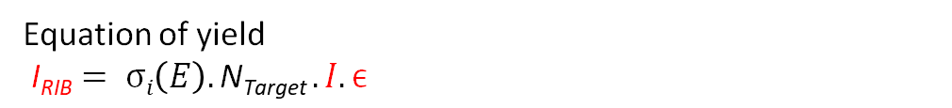
Development of high power ISOL targets
At ARIEL two high power drivers will be available for RIB production
  Proton beam (50 kW)
  Electron beam (35 MeV x 2800 μA = 100 kW
Maximizing output requires the development of Isol targets which can handle high power and to optimize the overall efficiency ε which can be as low as 10⁻⁶
To meet these requirements, we need a target material with
very high melting point
low vapor pressure
high effective thermal conductivity
Extremely efficient target container to dissipate very high beam power
Equation of yield
$\text{I}\text{RIB}= σi\left(E\right).\text{N}\text{Target} .I.ϵ$

Slide 11
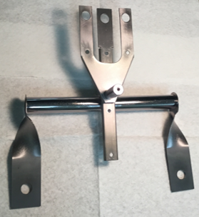
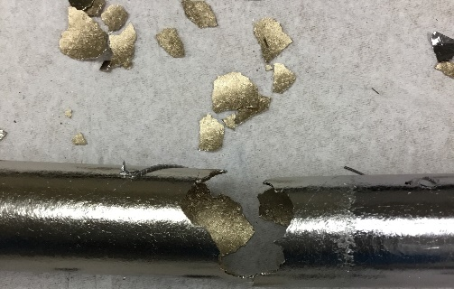
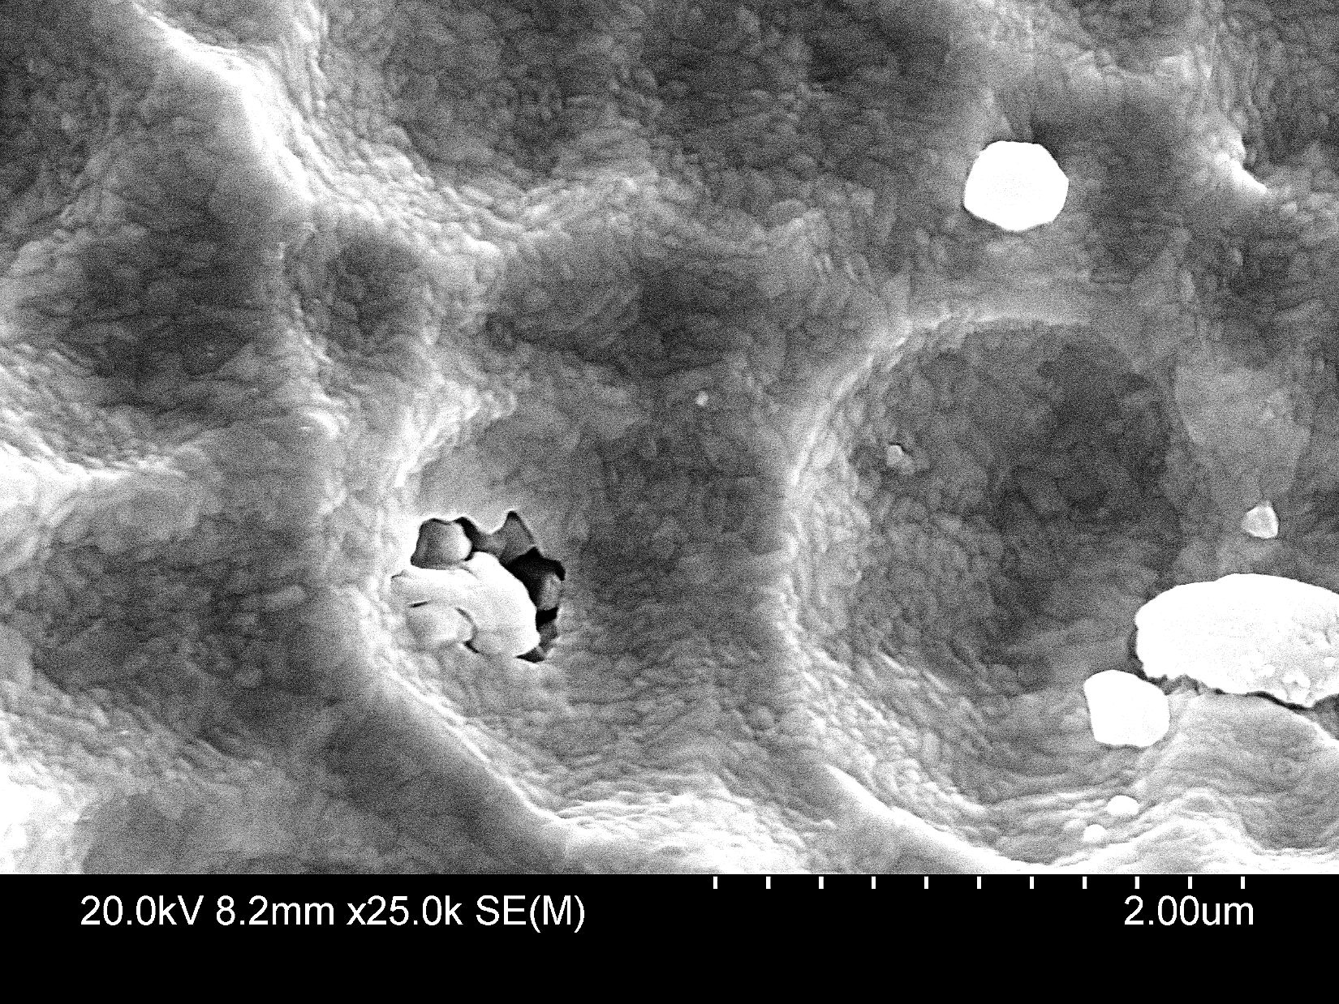
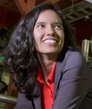
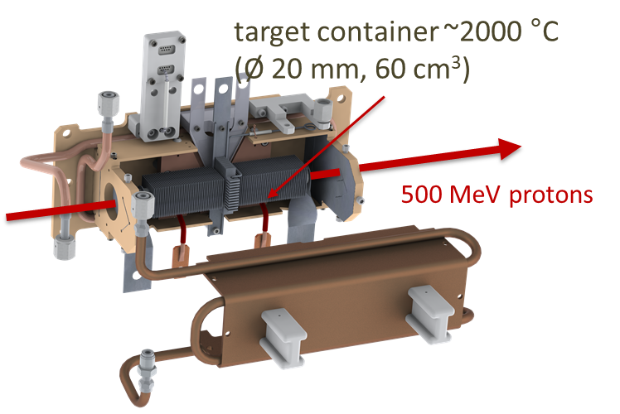
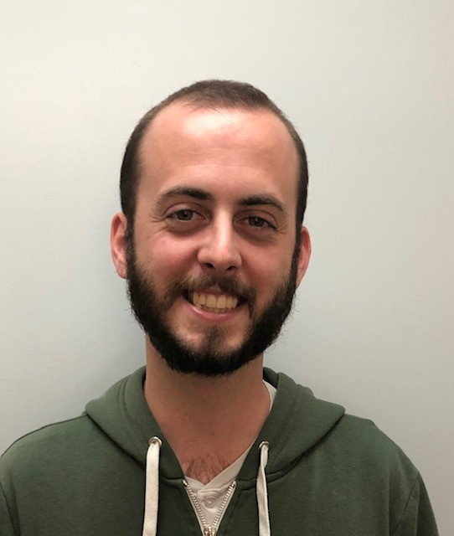
Target Material and Target ion sources
Several UVic students have made significant contributions to TIS developments for ARIEL
Tantalum oven attacked by carbon from target material
Marla Cervantes
Novel Target Materials for Increased Radioisotope Intensities
Ph.D. Project Marla Cervantes
SEM image with a rhenium coating as carbon diffusion barrier.
Fundamental studies on Ion Sources for High-Intensity Radioactive Beams
Ph.D. Project Fernando Maldonado
(graduated in 2022)​
Material damage dissipation for accelerator components in high radiation fields
Ph.D. Project
Ferran Boix Pamies​
PI A. Gottberg
Notes:
whole surface is covered with small grains of rhenium
Bright areas are big grains of rhenium
-----------------------------------------------------------
The process to coat the internal surface of the tantalum tube was to Joule heating a rhenium wire that passed through the axial centre of the tantalum tube; the evaporated rhenium deposited on the colder tantalum tube.
Besides washing the tube, no other treatment was done to prepare the tantalum surface, so larger grains deposited on imperfections.
The coating was covering well the centre of the tube, but it faded towards the ends of the tube.
For future coatings I would let the system hot for a longer time to apply a thicker coating. Also, I would analyze the samples as the experiment progress instead of analysing them all at the end.

Slide 12

Development of high power ISOL targets
Goal: Development of high-power target container to ramp up the existing beam power handling capacity at TRIUMF by a factor of 5
Finite Element Simulation of target system under proton beam and resistive heating
Heat generation in target material by proton current is obtained from FLUKA simulation and fed as an input into ANSYS.
PhD S. Ghosh
PI A. Gottberg
Target material = TiC
Supplied current = 400 A
Proton beam current = 50 μA
Temperature contour plot of target material
Temperature contour plot of half-section of high-power target container

Slide 13

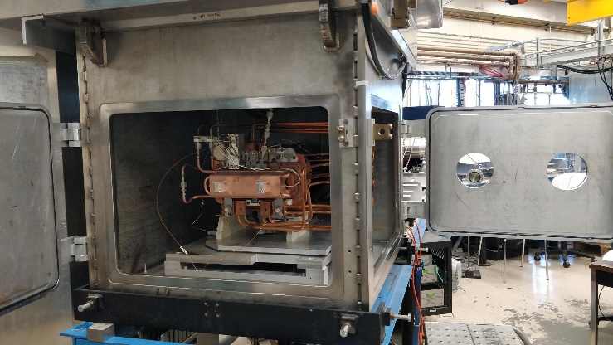
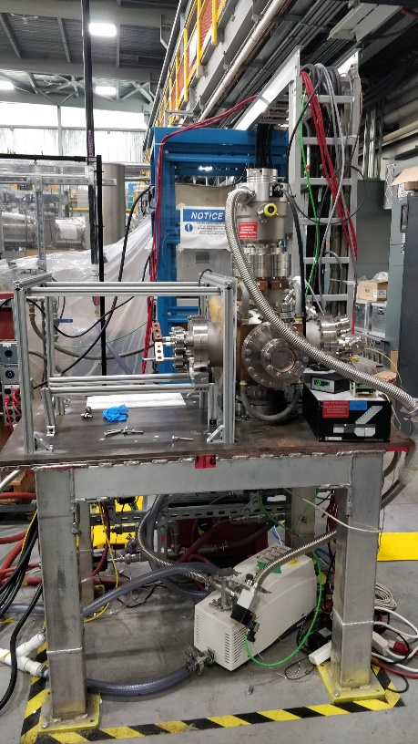
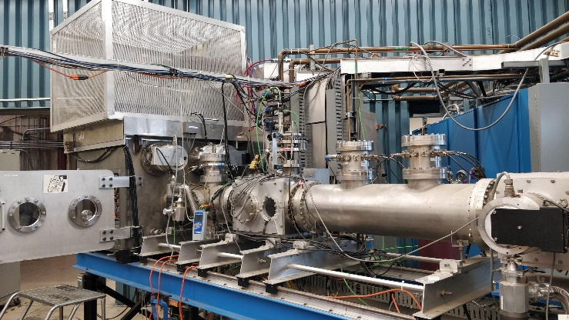
Study of high-power target material properties
Chamber for heating investigations (CHI)
Experimental set-up to investigate thermal properties (thermal conductivity, etc.) of existing and future R&D ISOL target materials
ISAC Offline Test Stand
Will be used for investigating heat transfer through bulk material housed inside actual target container (thermal conductivity, contact resistance, etc.)
Design of an electron bombardment heating setup on the test stand is in progress to simulate online proton heating.

Slide 14
Content
Availability and reliability of ARIEL e-linac
  Plasma cleaning
  Dust migration and mitigation
Development of high power ISOL targets
Future science opportunities enabled through ARIEL
  TRISR - Storage Ring
  Material Science with betaNMR for SRF research

Slide 15
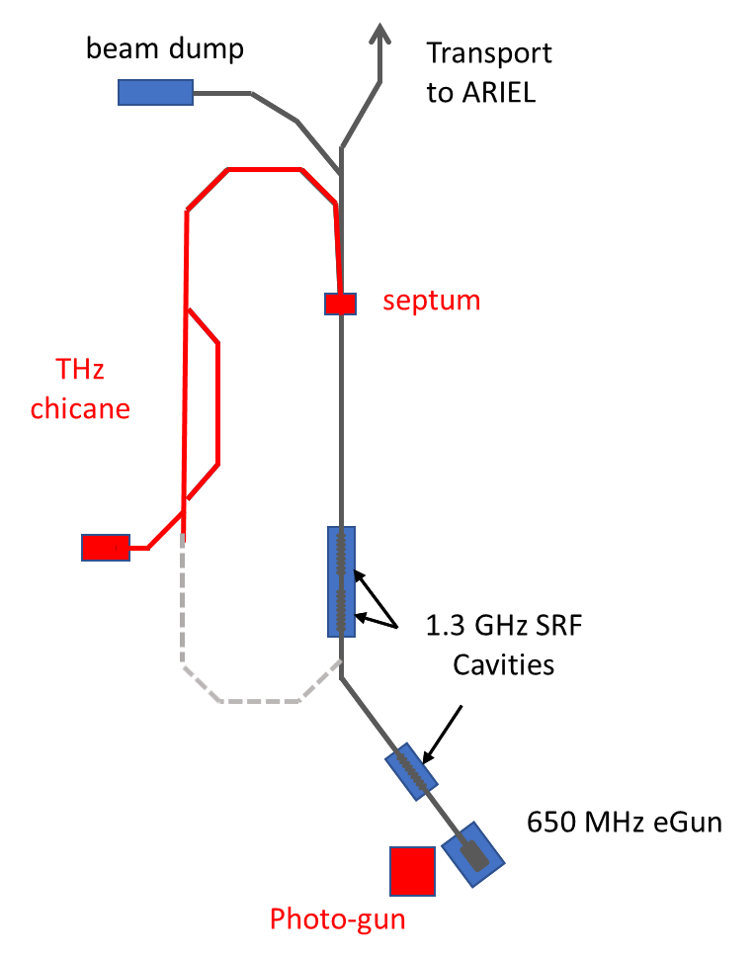
Future science opportunities enabled through ARIEL
The ARIEL e-linac enables unique science opportunities
  FLASH-MRT - Reducing side effects in radiotherapy by a combination of two novel treatment techniques, the ultra-fast (FLASH) radiotherapy with spatially fractionated microbeam therapy (MRT) – First beam delivered to experiment in February 2022
  DarkLight project - Electron scattering experiment to search for particles beyond the standard model – Target chamber installed December 2021
  CFI funded project: Terahertz radiation project
ARIEL will triple TRIUMF’s RIB output which provides more beam to current and future experiments such as
  TRISR - Storage Ring
  Material Science with betaNMR for SRF research
THz radiation project

Slide 16
Future science opportunities enabled through ARIEL
The ARIEL e-linac enables unique science opportunities
  FLASH-MRT - Reducing side effects in radiotherapy by a combination of two novel treatment techniques, the ultra-fast (FLASH) radiotherapy with spatially fractionated microbeam therapy (MRT) – First beam delivered to experiment in February 2022
  DarkLight project - Electron scattering experiment to search for particles beyond the standard model – Target chamber installed December 2021
  CFI funded project: Terahertz radiation project
ARIEL will triple TRIUMF’s RIB output which provides more beam to current and future experiments such as
  TRISR - Storage Ring
  Material Science with betaNMR for SRF research
THz radiation project

Slide 17
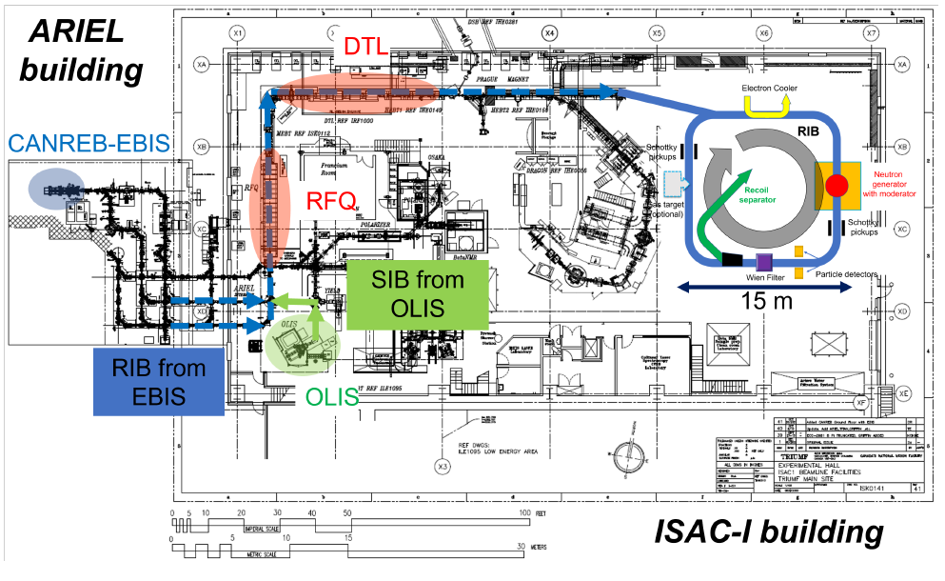
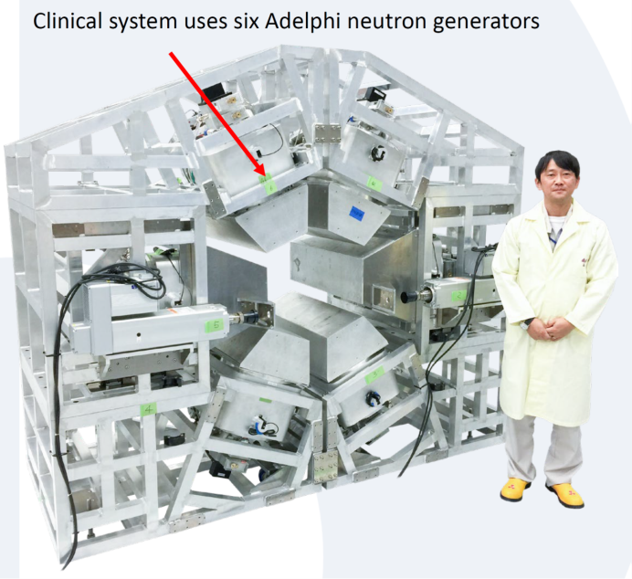
The TRIUMF Storage Ring (TRISR) Project
Motivation: Direct measurement of neutron capture cross sections of short-lived
radionuclides down to seconds of half-lives.
Requirement: ISOL Facility + Storage Ring + Free Neutron “Target”
Several proposal exist – no facility world-wide
Others have considered using a reactor (safety issues) or a spallation source (costly) as targets. We consider using a commercial neutron generator as target.
Timeline: Feasibility studies towards TDR in 2026 – First experiments in 2031
PI I. Dillmann
TRIUMF+UVic Adjunct Prof
Example of an existing system (for
Boron Neutron Capture Therapy) in Japan

Slide 18
The TRIUMF Storage Ring (TRISR) Project
Mini-Workshop at TRIUMF (July 18-21) with European colleagues and a presentation from neutron generator company Adelphi Technologies Inc.
  Potential design: “star-like” design with 4-6 neutron generators (DT/DD) around moderator and beamline
  Mobile setup:
  Step 1 (2025-2030): Installation and first measurements planned at GSI Darmstadt (CRYRING)
  Step 2 (>2030): Then move to TRIUMF once TRISR is constructed
Funding applications this year
  ERC Synergy Grant (up to 14 MEuro)
  NSERC project discovery grant
First TRISR paper has been published and two papers on extraction of circulating beam via Wien filter into recoil separator and neutron target design are in progress

Slide 19
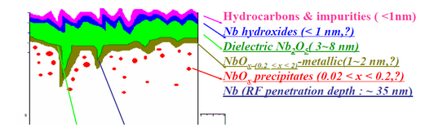
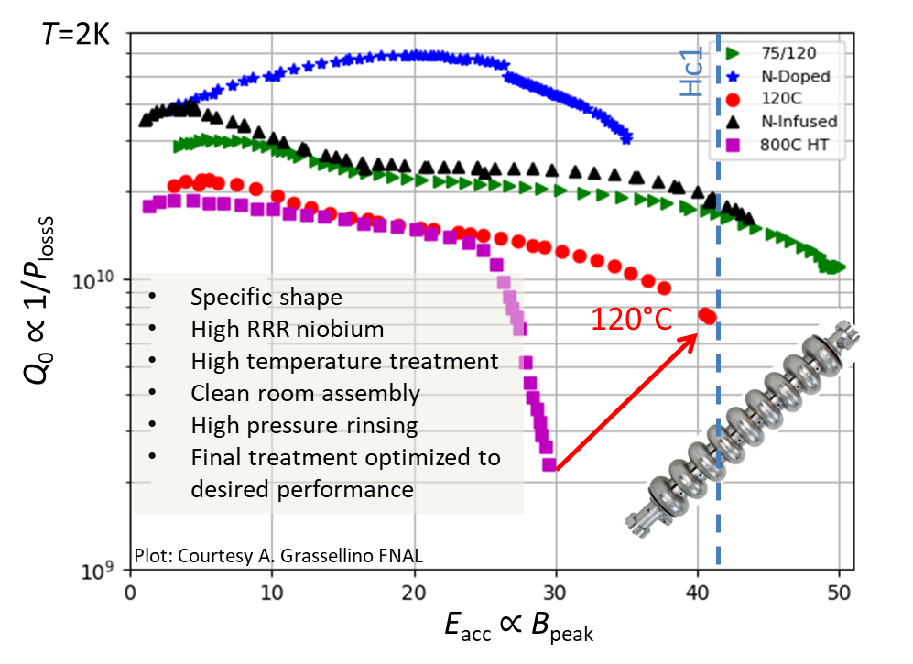
Motivation for fundamental SRF research
SRF is highly efficient but complex technology
Supercurrents only flow within a few tens of nanometres
  Performance is very sensitive to near surface material properties which can be engineered by heat treatments in vacuum or low pressure gas atmosphere
Current material of choice niobium is reaching fundamental limitations → Further improvements require new materials potentially as multilayers
Ultimate limitation H_{sh}

Slide 20
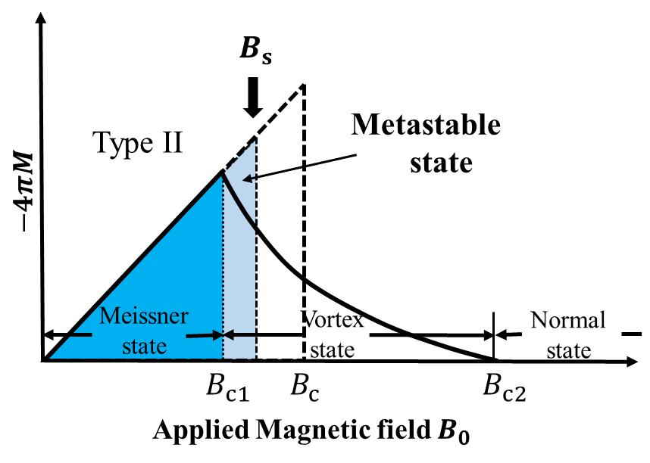
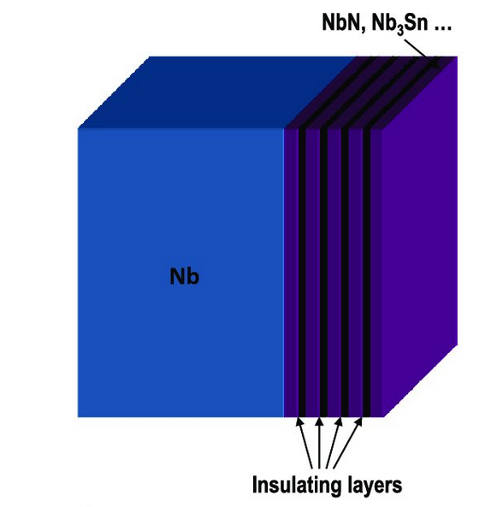
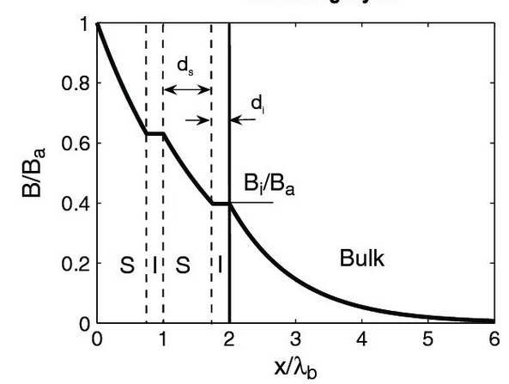
Hetero Structures for higher accelerating gradients
Superconducting radiofrequency (SRF) cavities need to be operated in the Meissner state to avoid strong dissipation from vortices.
  Nanometer thin multilayerd structures can potentially reach fields beyond Nb limitations.
  The current in each layer is influenced by all other layers →The exact current distribution in all layers needs to be known to predict the maximum E_{acc}
For a defect free superconductor the maximum attainable field is set by the superheating field, which directly depends on the RF current.

Slide 21
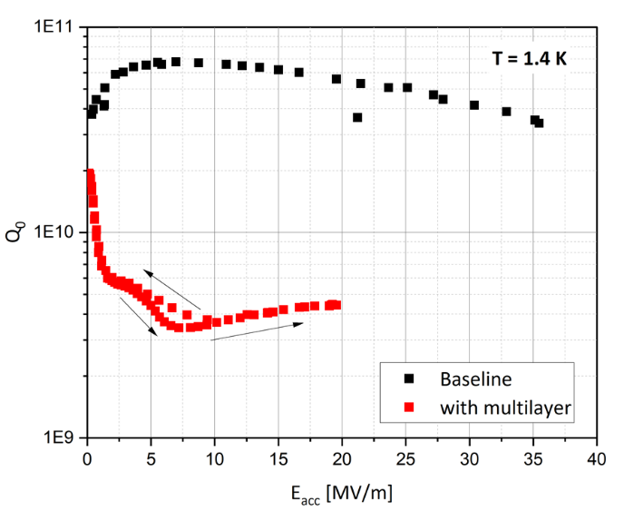
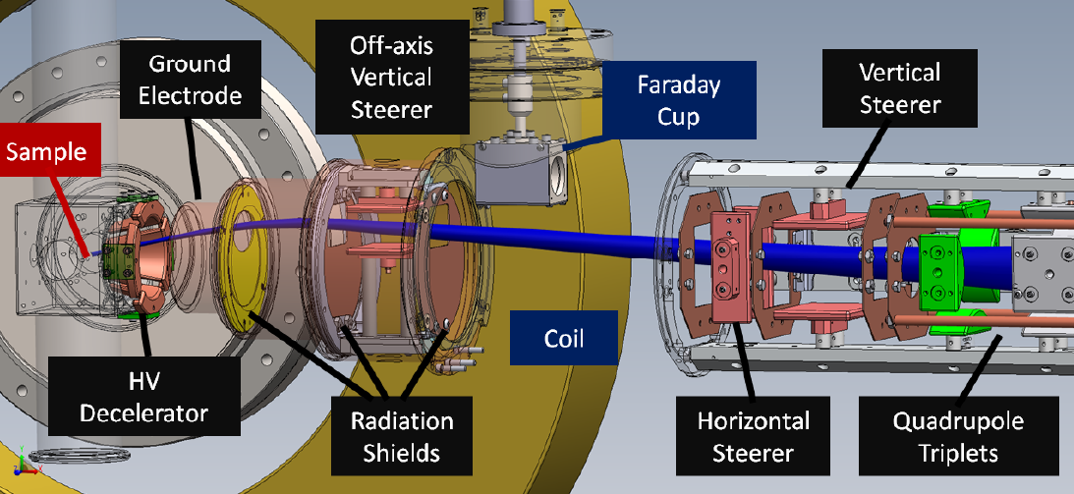
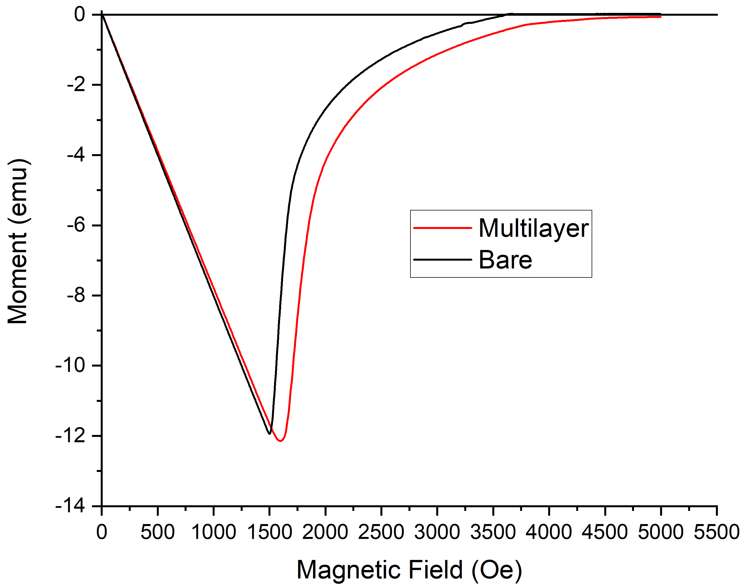
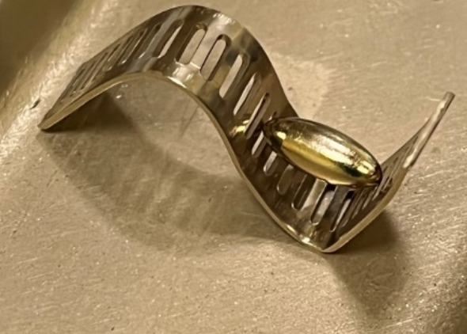
β-NMR + SRF @ TRIUMF
R. Laxdal, R. McFadden, PhD E. Thoeng (UBC), PhD Md Assaduzzaman
RF performance of heterostructures generally lags behind Nb cavities
  Early flux penetration into overlayer?
With β-SRF we are able to detect penetration of magnetic flux with nanometer depth resolution at relevant fields for accelerator application
A niobium ellipsoid has been coated using atomic layer deposition with 8nm of AlN and 46nm of NbTiN and will be tested in September
ARIEL will enable more beta-NMR beam time
Early flux penetration (at defects) into the NbTiN layer?
Courtesy T. Proslier, Y. Kalboussi
NbTiN/ALN/Nb coating shows weakened performance compared to uncoated cavity
Courtesy T. Proslier, Y. Kalboussi
β-SRF: High parallel field extension of the β-NMR facility
NbTiN/AlN coating increased field of first vortex penetration

Slide 22

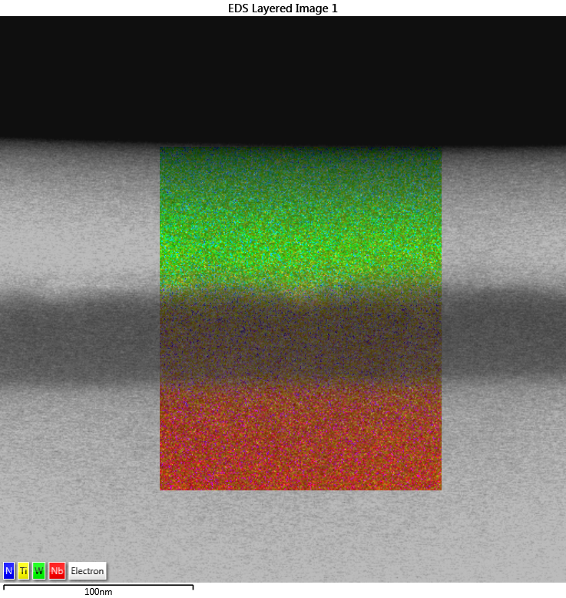
Measurement of the vortex penetration field
β-NMR studies will be coupled with measurements of superconducting bulk and material properties at UVic
Vibrating sample magnetometry can be used to measure the bulk vortex penetration field
  Instruments are commercially available but the SRF parameter range (relatively low field at low temperature) favor a dedicated design which can be realized at a fraction of the cost
  Status: Design finalized, construction started (MSc Lucas Wallace)
TEM/EDX map of a NbTiN on Nb sample
BSc Will Stokes

Slide 23
Summary
Through ARIEL TRIUMF extended its expertise in
  Beam physics and instrumentation
  Superconducting RF
  Ion Sources and Targets for secondary particle production
Field emission mitigation in the e-linac and high power targets are key for high yield RIB delivery in the ARIEL area
ARIEL will enable more beam time for current and future experiments such as β-NMR and TRISR

