Slide 1
γ-ray spectroscopy for nuclear structure; β-decay studies in the ARIEL era
Paul Garrett
University of Guelph

Slide 2
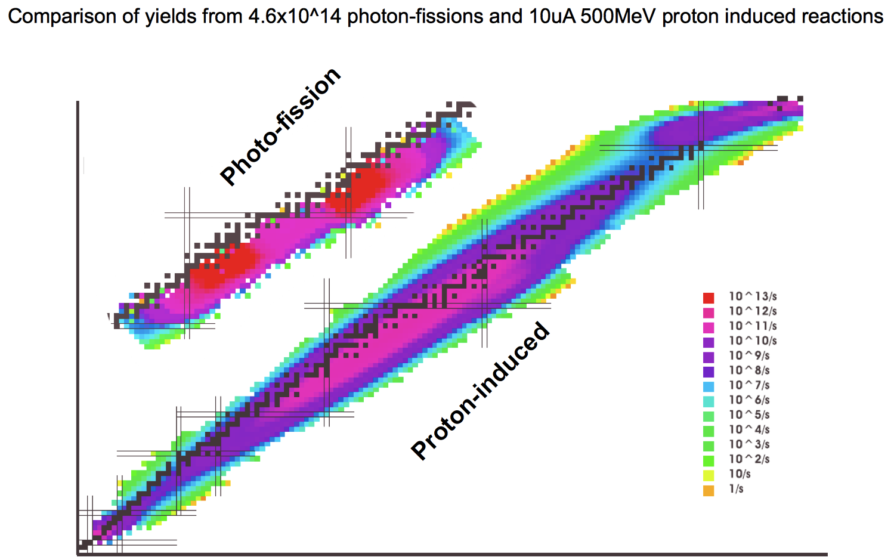
What will ARIEL do for us?
Excellent yields near the fission peaks
Multi-user capability that enables experiments of longer duration
Both points are important to our future programme
N=82
N=50
Z=50
Z=28

Slide 3
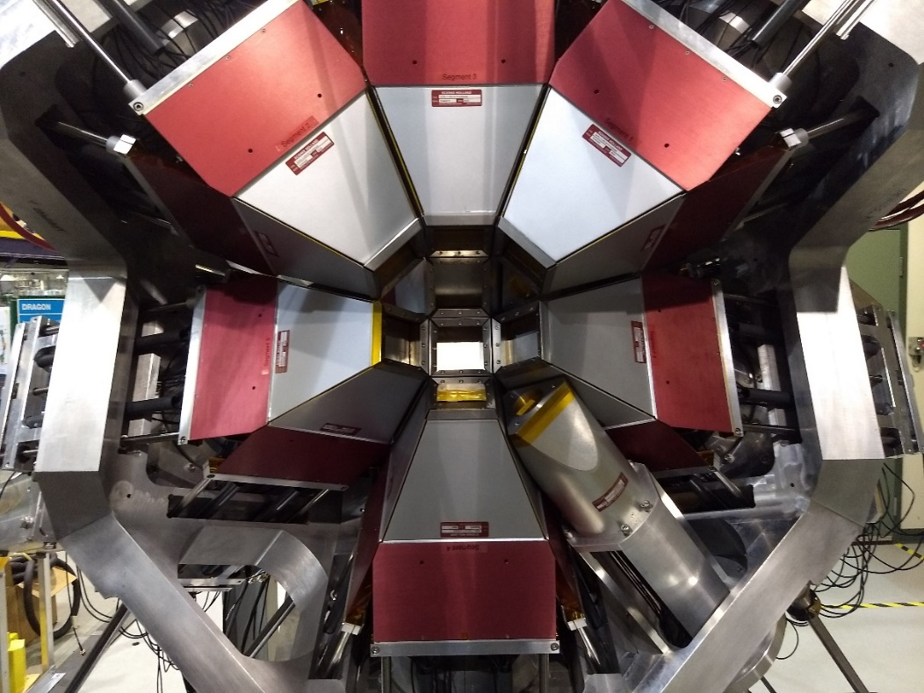
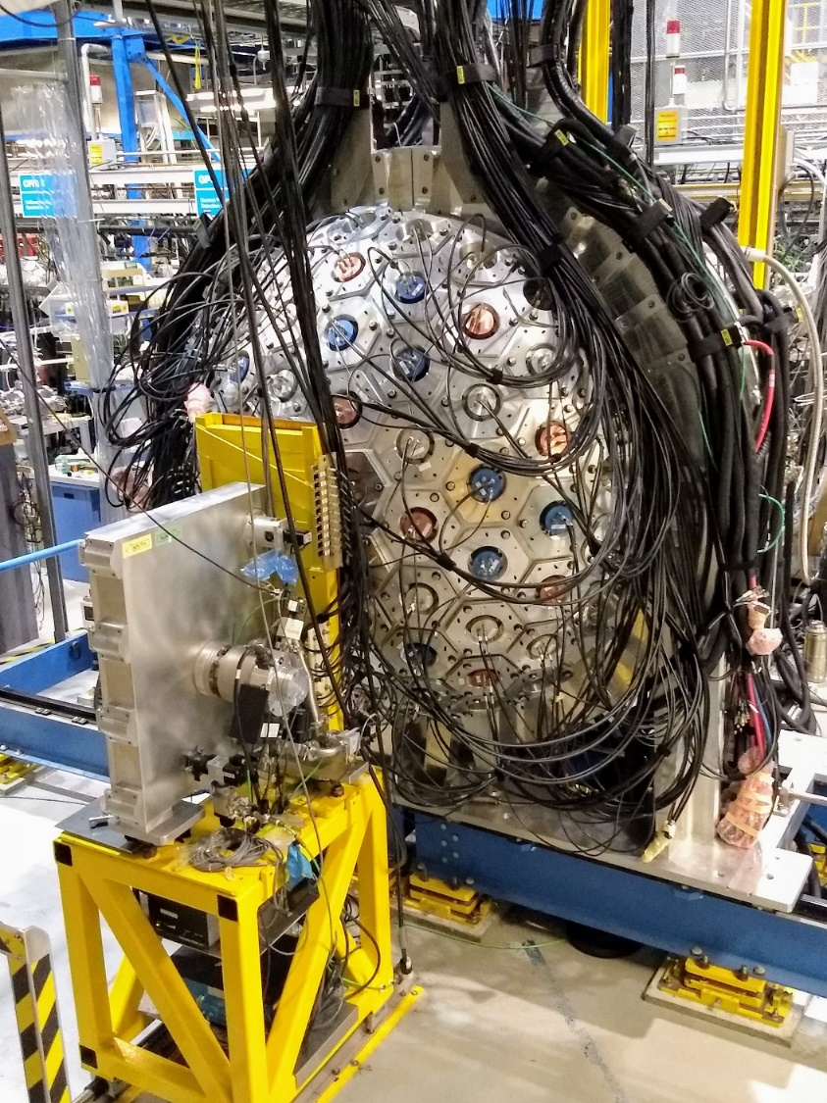
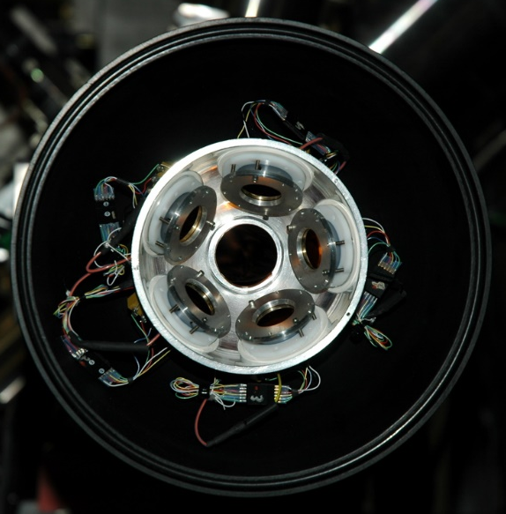
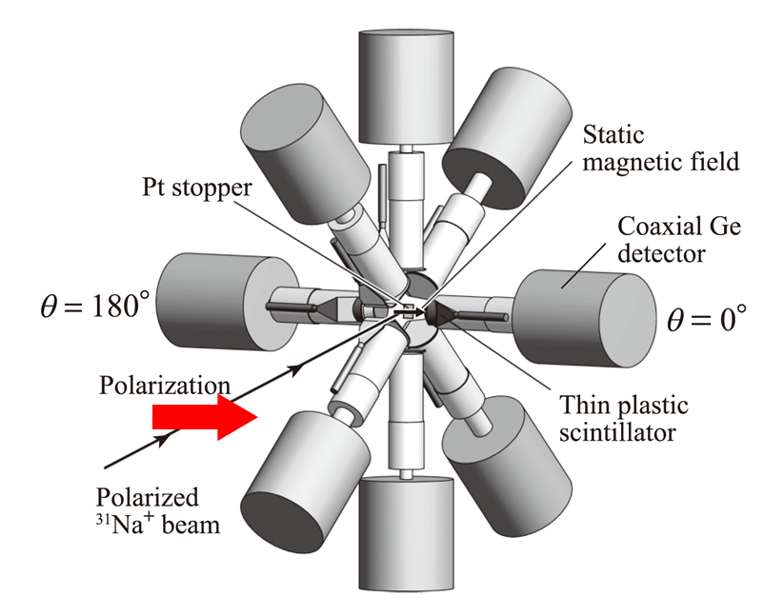
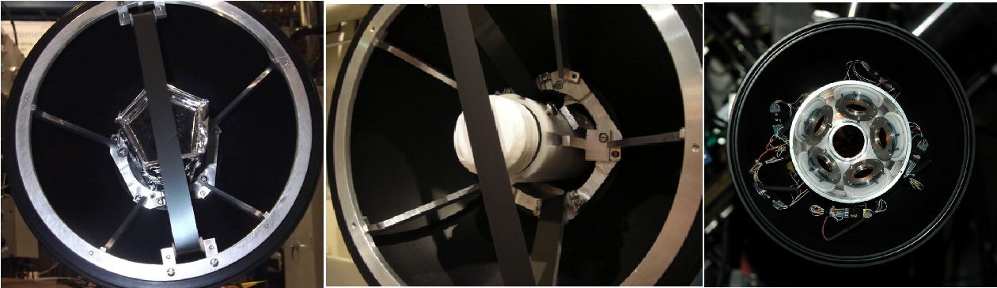
Our workhorse – the GRIFFIN spectrometer
Otsaka setup for β-γ angular correlations with spin-polarized beams also produces important results and extend capabilities

Slide 4
Nuclear structure studies with γ-ray spectroscopy following β-decay
Three general themes
  Studies related to fundamental symmetries, e.g. superallowed Fermi β decay, characterized by high-precision measurements
    Structure information on the daughters gathered in the process
  Studies related to nuclei far from stability, characterized by weak beams and low rates
    Can be compensated somewhat by GRIFFIN’s capabilities or long durations
  Studies related to nuclei on or near stability, characterized by intense beams and high rates
    ARIEL can extend the intense-beam envelope into the photofission yield peak region
My view:
  Let other facilities pursue the extremes – we should focus on where we have the superior beam+detection efficiency+duration advantage
  Push the level of statistics – low-statistics experiments lead to high-speculation physics; we should aim for definitive experiments

Slide 5
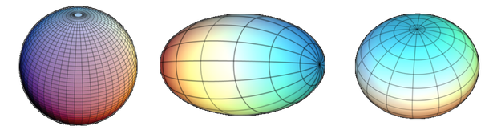
Focus on shape coexistence – why are they interesting?
What do we mean by shape coexistence?
  presence of states in the same nucleus within a narrow energy range of two (or more) states that have well defined and distinct properties that can be interpreted in terms of different intrinsic shapes
The shapes we observe, e.g., spherical, prolate, oblate, triaxial
  emerge as a consequence of the nucleon-nucleon interaction manifest in a many-body system
The presence of competing shapes due to effects of correlations, especially pairing and quadrupole-quadrupole correlations amongst nucleons, overcoming cost of energy promoting particles into different orbits – even across major shell gaps
Studies of shape coexistence enables us to study effects of correlation energies on deformation (or vice versa) within a system having the same number of protons and neutrons

Slide 6
Multiparticle-multihole states and shape coexistence
Deformation is driven by the quadrupole-quadrupole interaction between protons and neutrons – the more valence particles of both types, the greater the deformation (up to a point)
There can be a substantial gain in energy due to correlations between the particles such that the energy cost for promoting particle across shells can be offset
The most common mechanism to generate states with different shapes involves the creation of multiparticle-multihole states
Heyde and Wood, RMP 83, 1467 (2011)

Slide 7
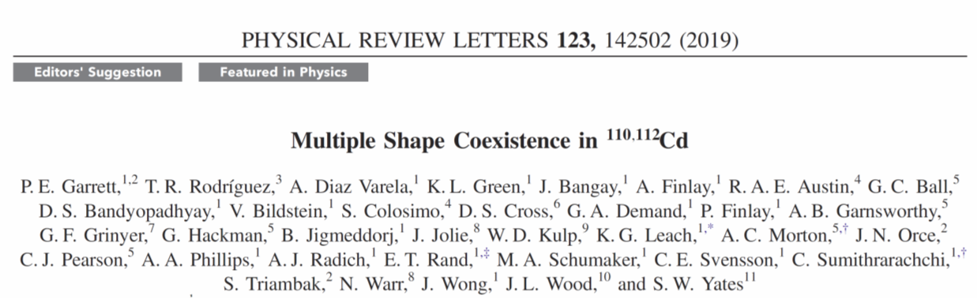
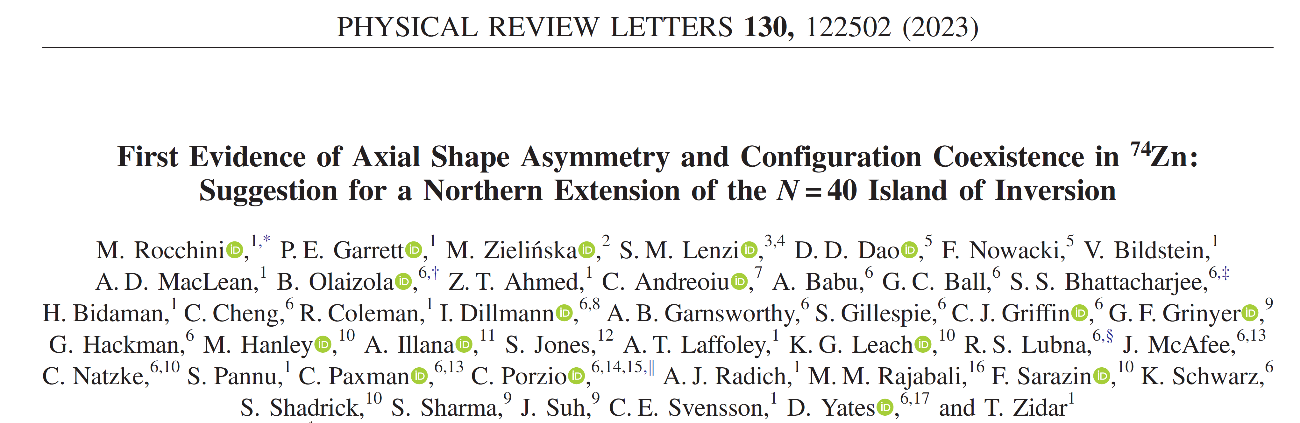
We have a strong programme in shape coexistence studies with β decay

Slide 8
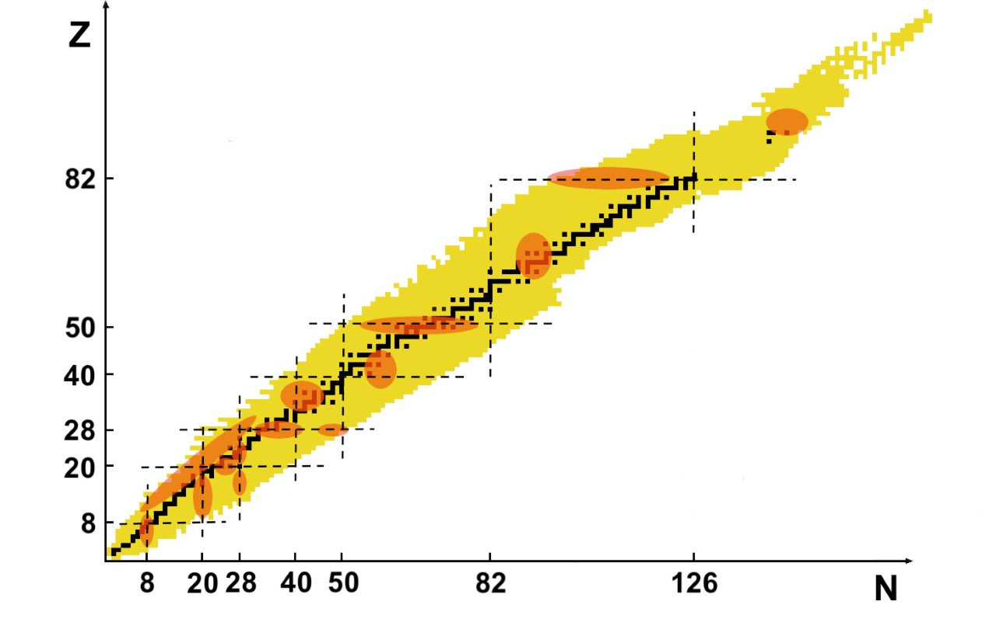
Shape coexistence in the nuclear landscape
Regions of shape coexistence are now known to be located throughout the nuclear chart, although still mainly concentrated in the vicinity of closed shell or subshells
  There has been much activity recently, including areas suggested to possess multiple shape coexistence – C, Si/Mg, Ni, Sr/Zr, Cd, Pb/Hg
Highlight some examples from these regions
Regions with nuclei having some experimental evidence for possessing multiple shapes at low spin

Slide 9
What are the experimental signatures of shape coexistence?
Level energies
  Appearance of “unexpected” levels at low energies, e.g., low-lying 0⁺ states
  Appearance of rotational bands, especially in a spherical nucleus
  Inferred moments of inertia
Transition rates – vastly different B(E2) values within bands
Transfer reaction cross sections – large enhancements of cross sections, especially to excited 0⁺ states
Quadrupole moments – measure of charge distribution revealing deformation
Charge radii – directly measuring size of nuclear state
Sets of EM transition matrix elements to form “invariant” quantities
E0 transition strengths – enhancements to E0 transition rates require mixing of states with different deformations
From γ-γ coincidence measurements with Ge detectors
From lifetime measurements with LaBr₃ detectors
From measurements of conversion electrons using Si(Li) detectors

Slide 10
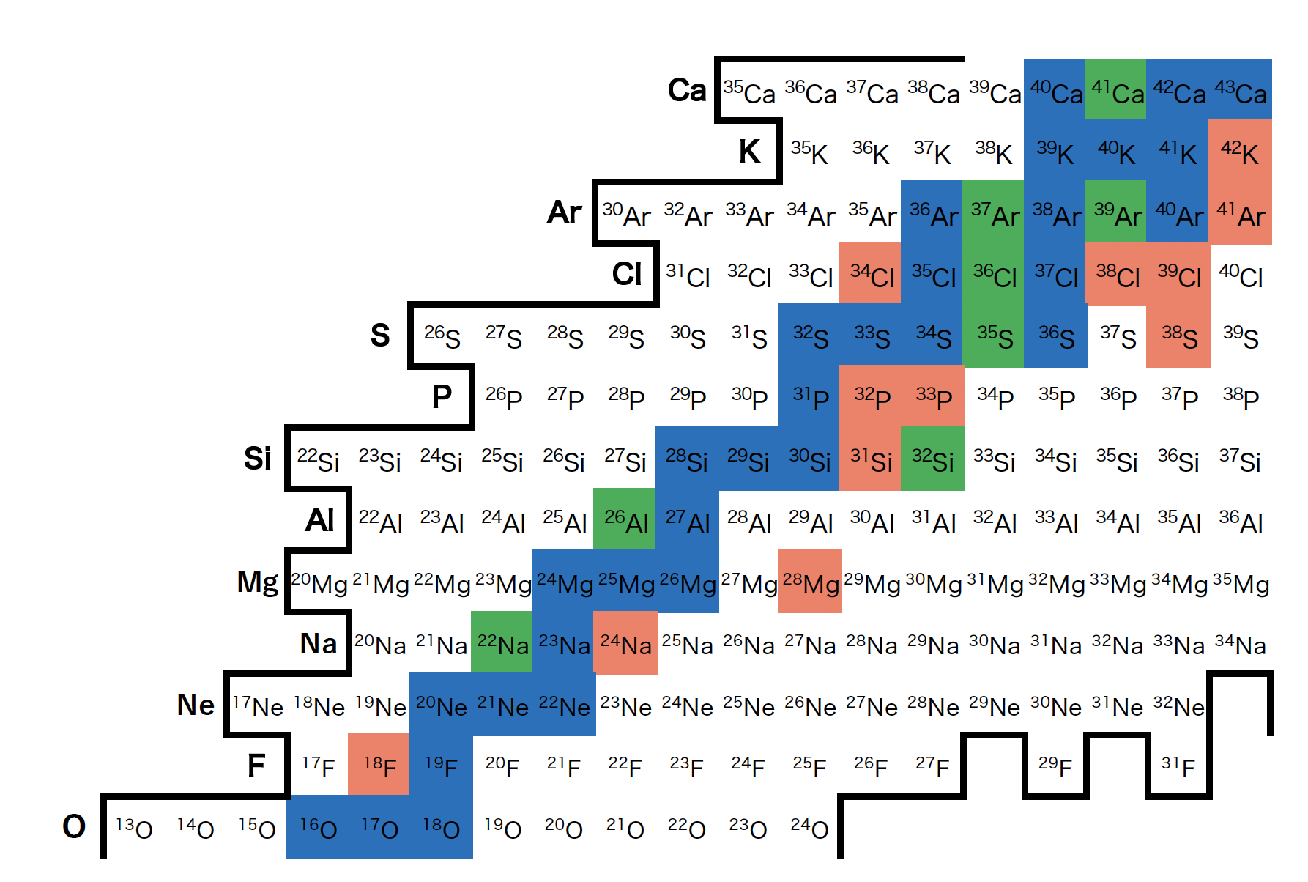
The N=20 “island of inversion”
Expected spherical shape for the ground states, but instead they are deformed
N = 20
₂₀Ca
₁₂Mg
island of inversion
E(2⁺) (MeV)
₁
Proton number (Z)
₁₀Ne
Neutron Number (N)
Neutron number (N)
N = 20
magic number
fp shell
dominant in
neutron-rich N~20
region
E. Caurier et al., Phys. Rev. C 90, 014302 (2014).
sd shell
“island of inversion”
0p0h
(0-paticle-0-hole)
2p2h (+4p-4h+…)

Slide 11
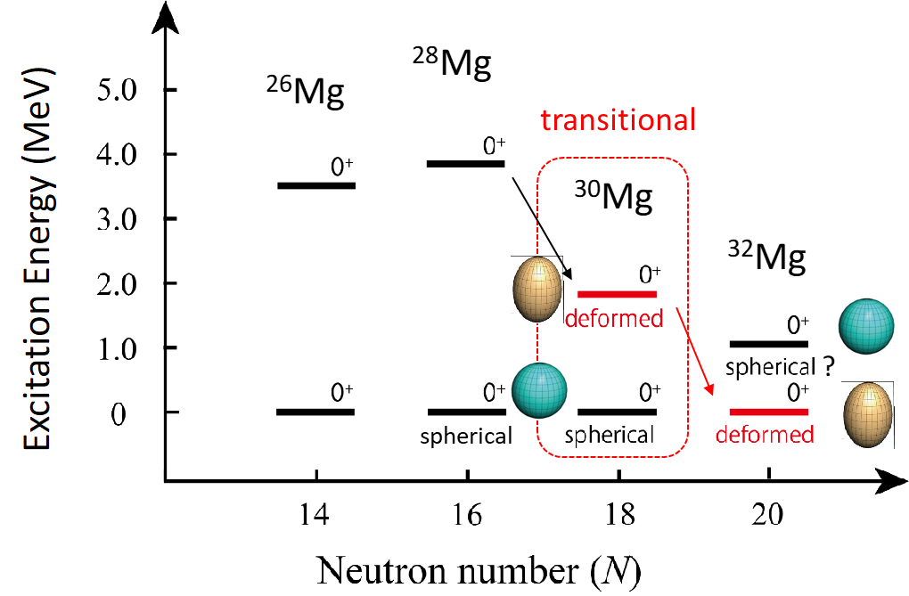
The N=20 island of inversion region
Recent 3-level mixing calculations suggested that the ³⁰Mg ground state was a mixture of the normal-ordered 0p-0h and intruder 2p-2h configurations, with the 0₂⁺ a mixture of the 2p-2h and 4p-4h configurations, and the existence of an unknown 0₃⁺ state that has the dominant 0p-0h configuration
0₂⁺ state in ³²Mg believed to have t_{1/2} in range of 10 – 38 ns
Can reach 10¹⁰ decays of ³⁰Na in ~ 10 days, 10⁸ decays of ³²Na in ~ 3 weeks

Slide 12
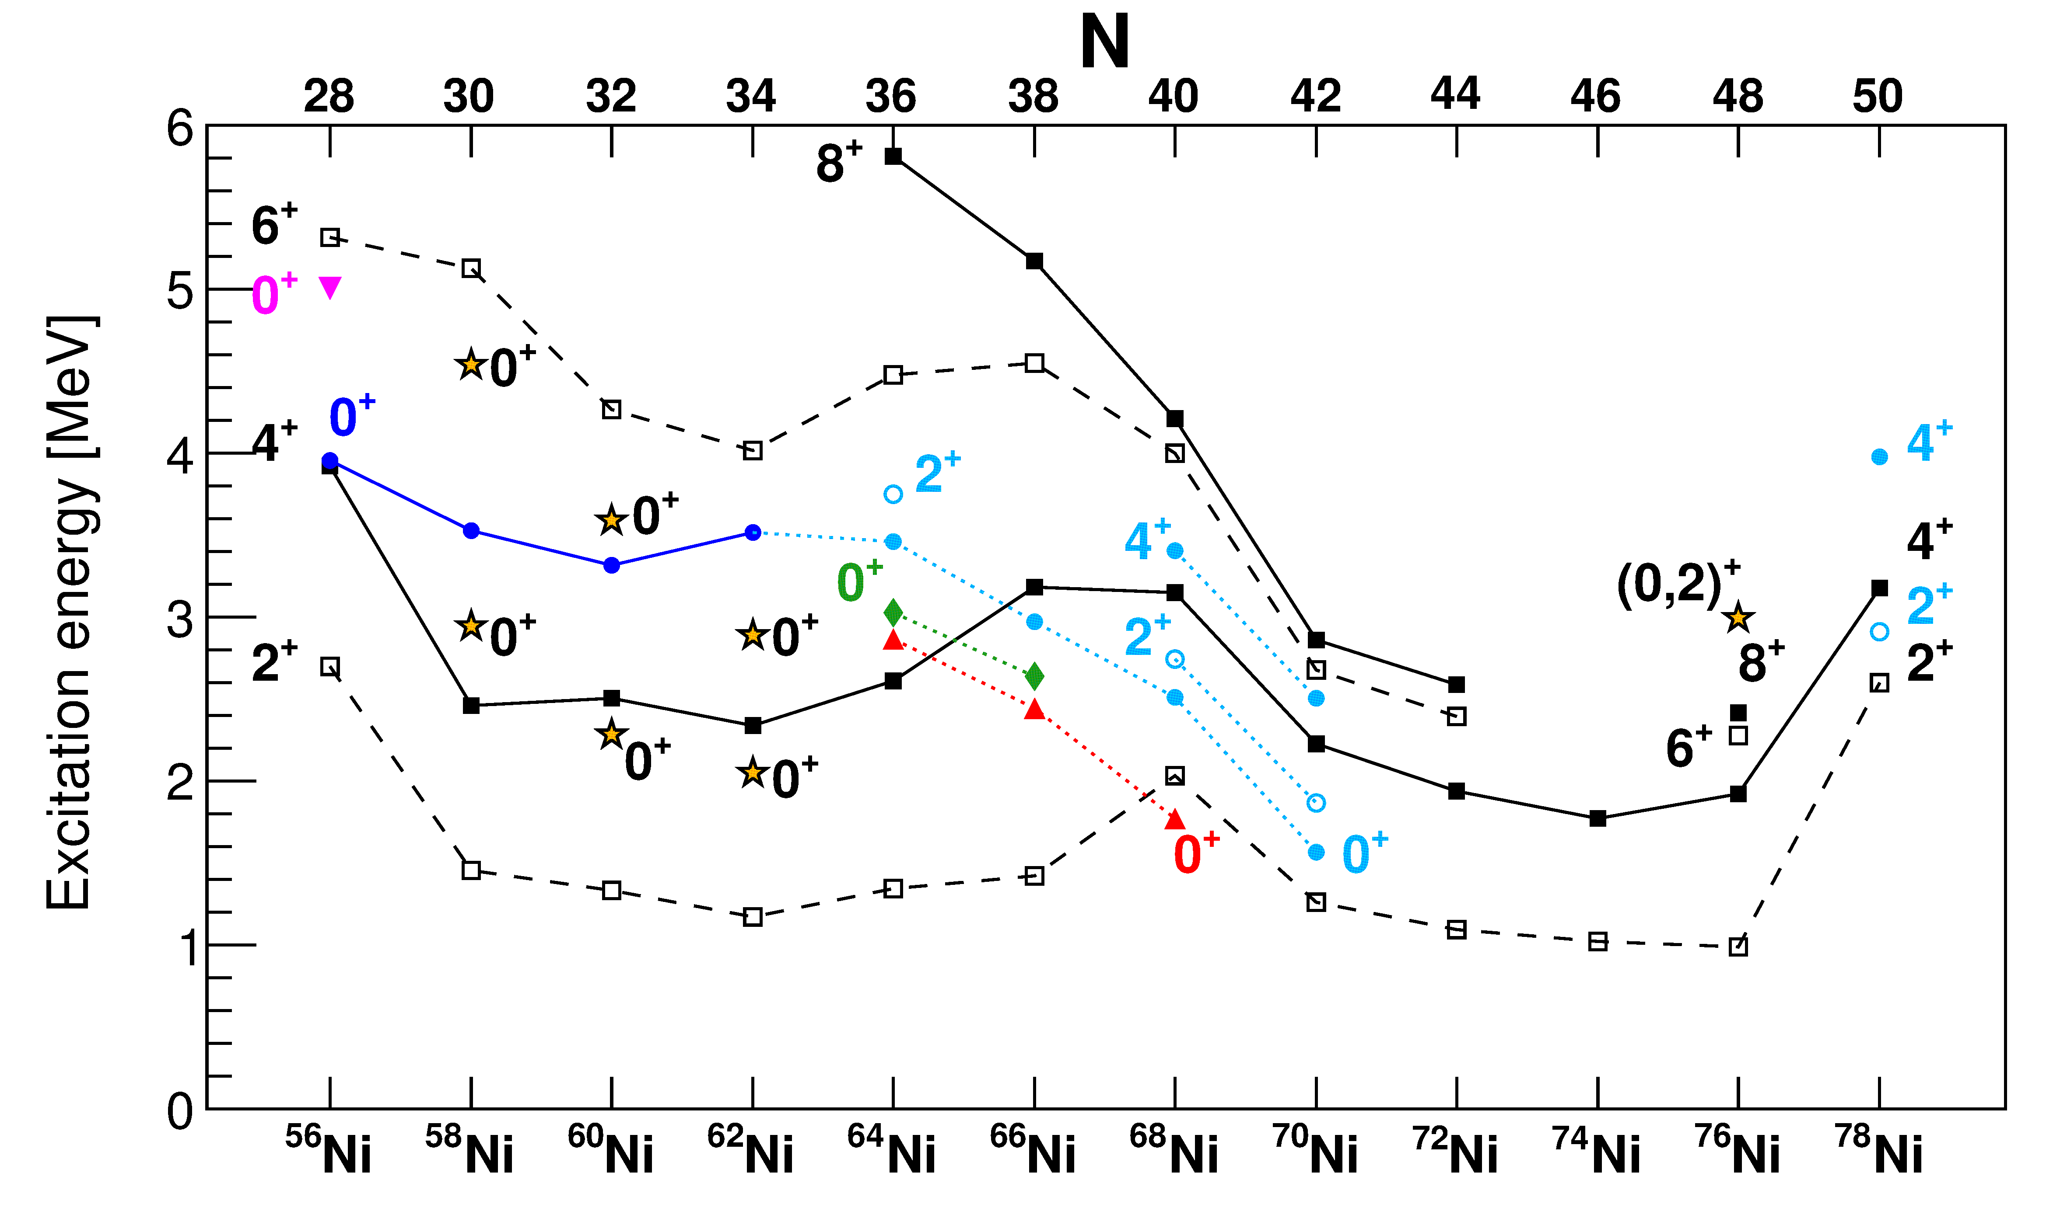
The Ni isotopes
Variety of highly deformed structures observed in vicinity of ⁵⁶Ni by Lund group (e.g., ⁵⁶Ni by D. Rudolf et al., PRL 82, 3763 (1999))
4p-4h
π2p-2h
?
spherical
“ν2p-2h” oblate
“π2p-2h” prolate
Calculated character
Garrett, Zielinska, and Clement, PPNP 124, 123931 (2022)

Slide 13
Suggestions for multiple shapes in ⁶⁴⁻⁶⁸Ni through comparisons with MCSM
Suggested shapes need to be confirmed through additional measurements
S. Leoni et al., PRL 118, 162502 (2017)
N. Mărginean et al., PRL 125, 102502 (2020)

Slide 14
Trouble in paradise for E0s – the mysterious case of the Ni isotopes
Transitions labelled with 10³ρ²(E0)
E0 data from L. Evitts et al., PRC 99, 024306 (2019)
4p-4h SD band
(⁶Li,d) transfer strength % of gs
(³He,n) transfer strength % of gs
Deformed structure?
No obvious mechanism for generation of enhanced ρ²(E0)
Q_{s} (eb)
Garrett, Zielinska, and Clement, PPNP 124, 123931 (2022)

Slide 15
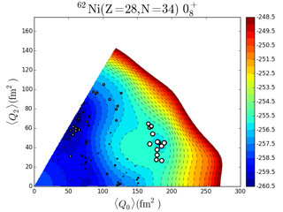
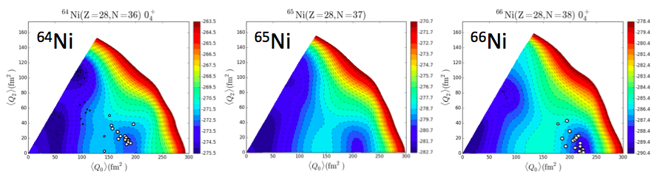
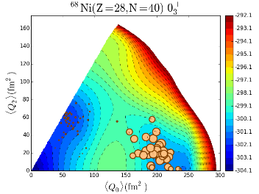
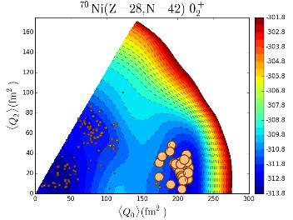
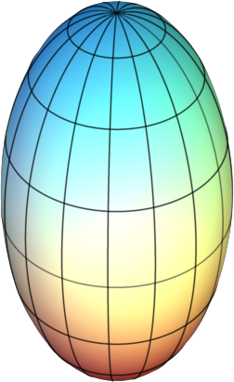
Example – conflicting interpretations in ⁶⁸Ni
Key transition 2₁⁺ → 0₂⁺ ~ 9 W.u. establishes a deformed structure, but was a very weak transition observed in one experiment only
An alternative interpretation involves a seniority-2 structure, with the ground state and 0₂⁺ state involving a mixture of (g_{9/2})²+(p_{1/2})² neutrons
To study Ni isotopes, ideally extract Co beams (successfully done at ISOLDE); a Co laser scheme for use with TRILIS is ready
Rates will still be low to reach ⁶⁸Ni – prime example of extended beam time making use of multi-user capability
prolate
prolate
prolate
prolate
prolate

Slide 16
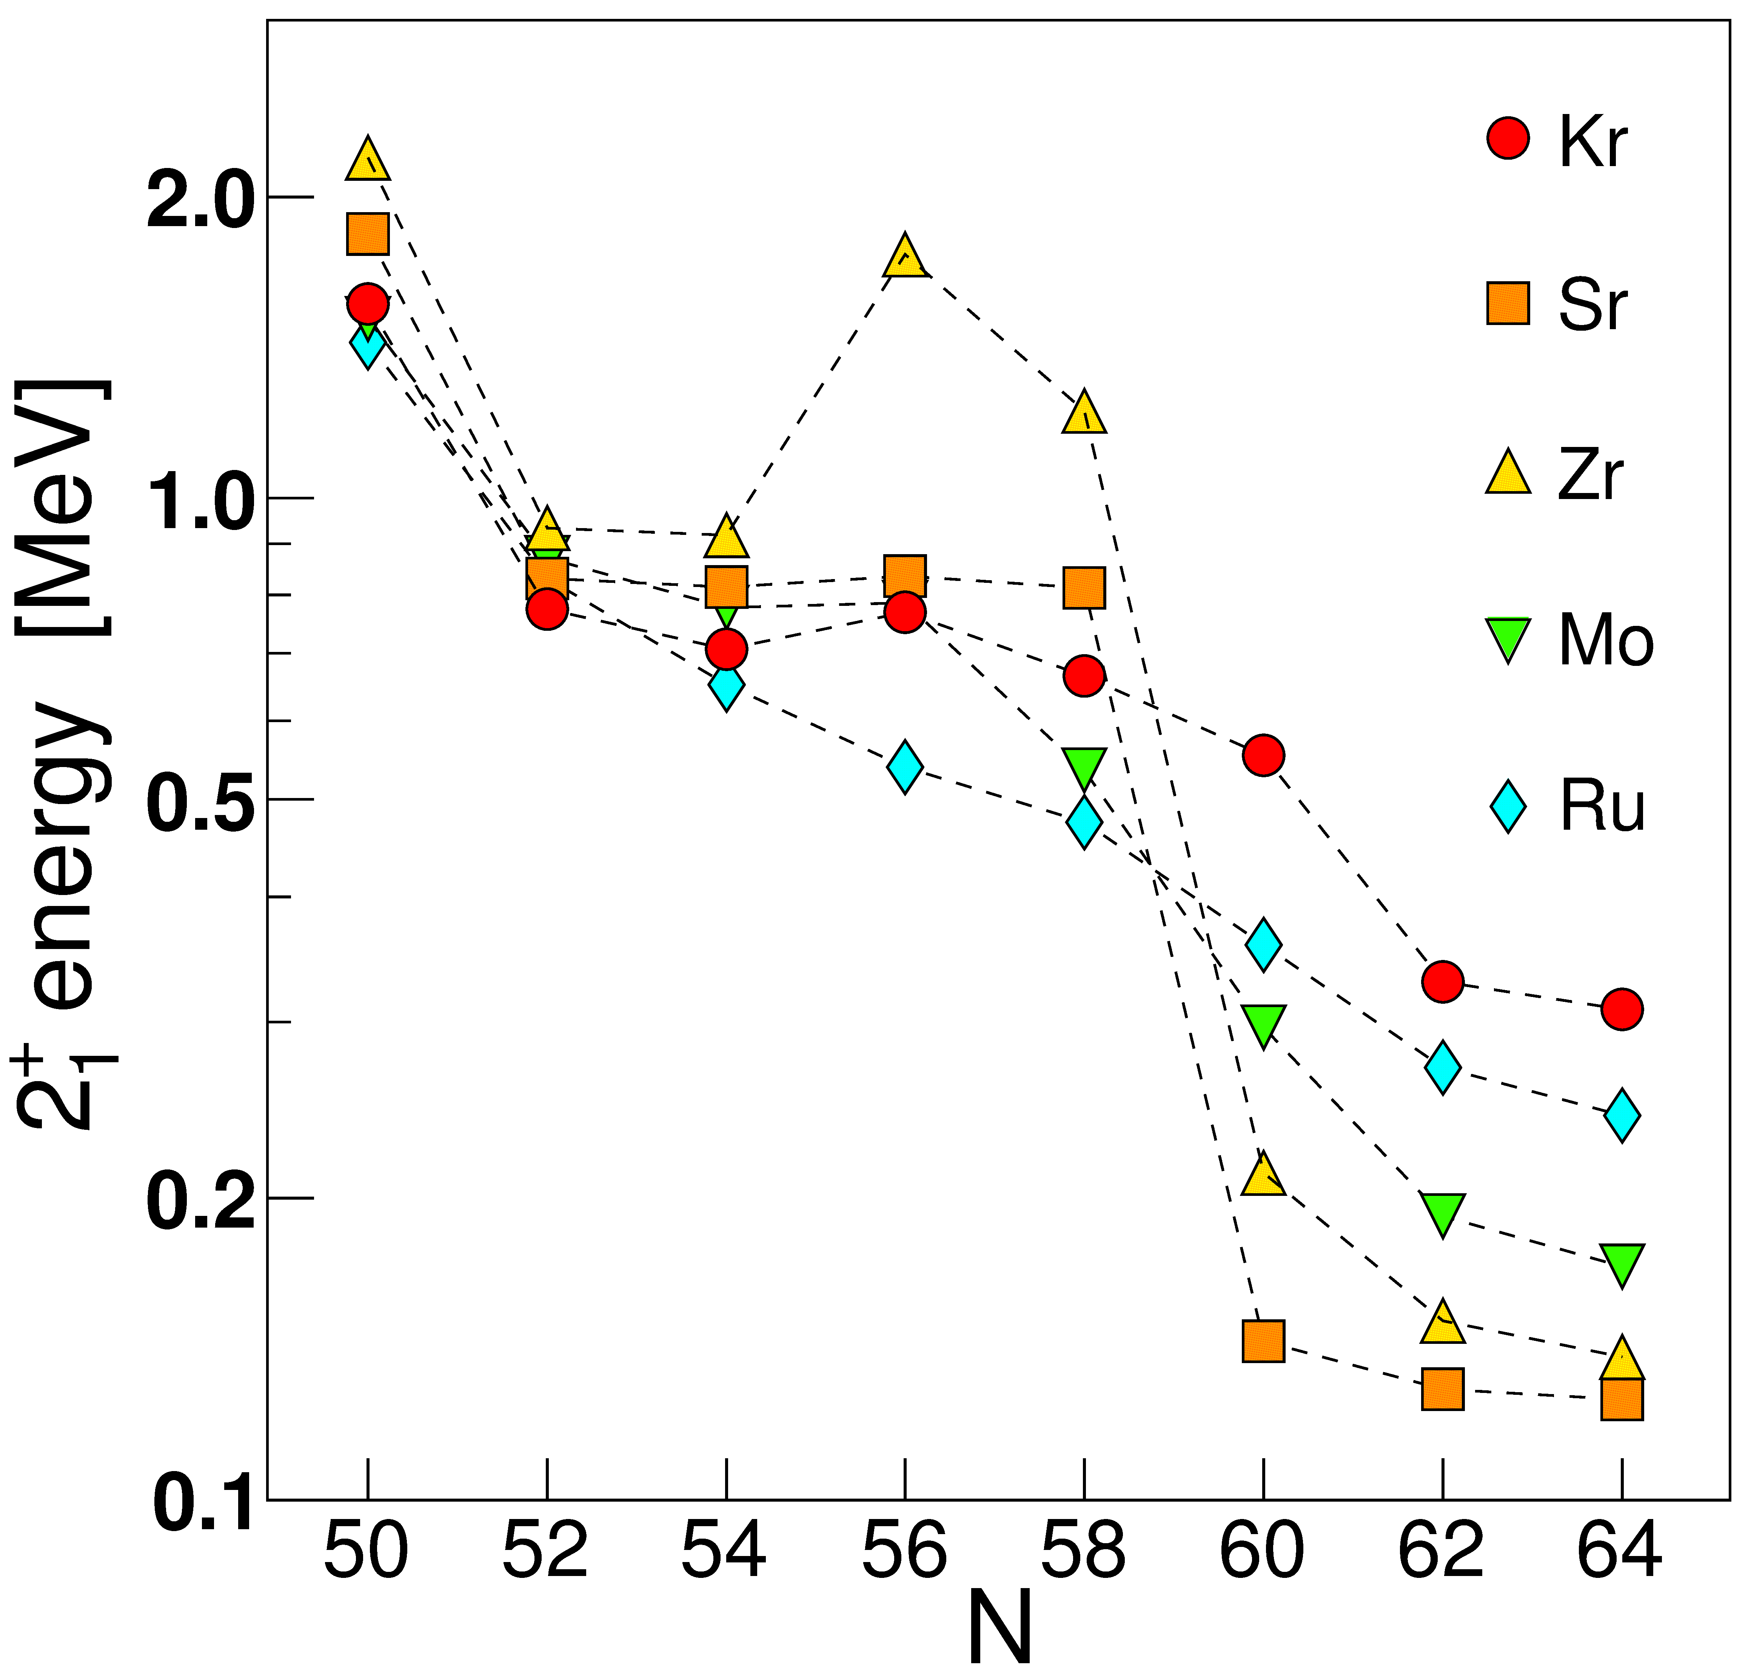
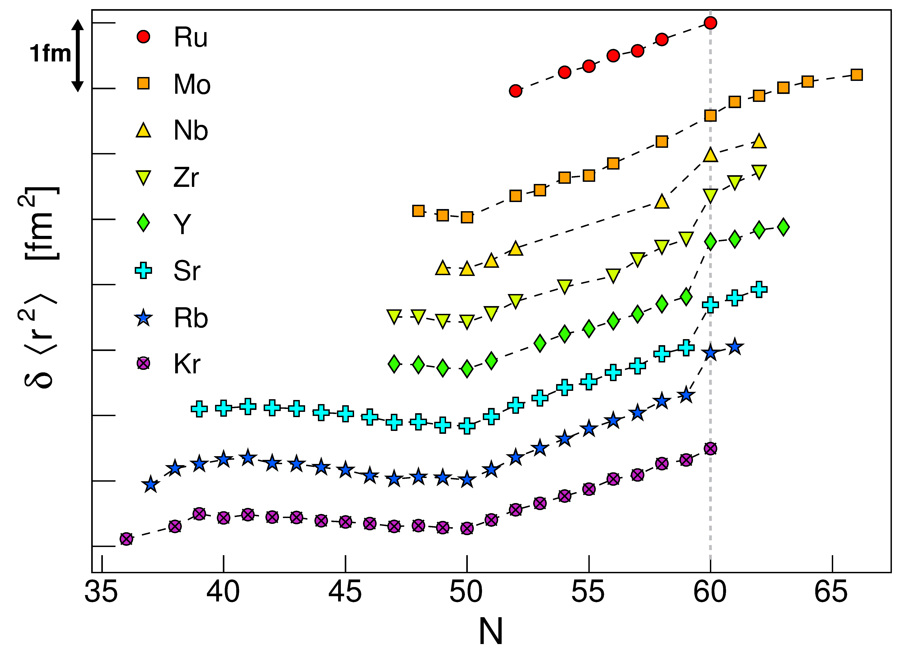
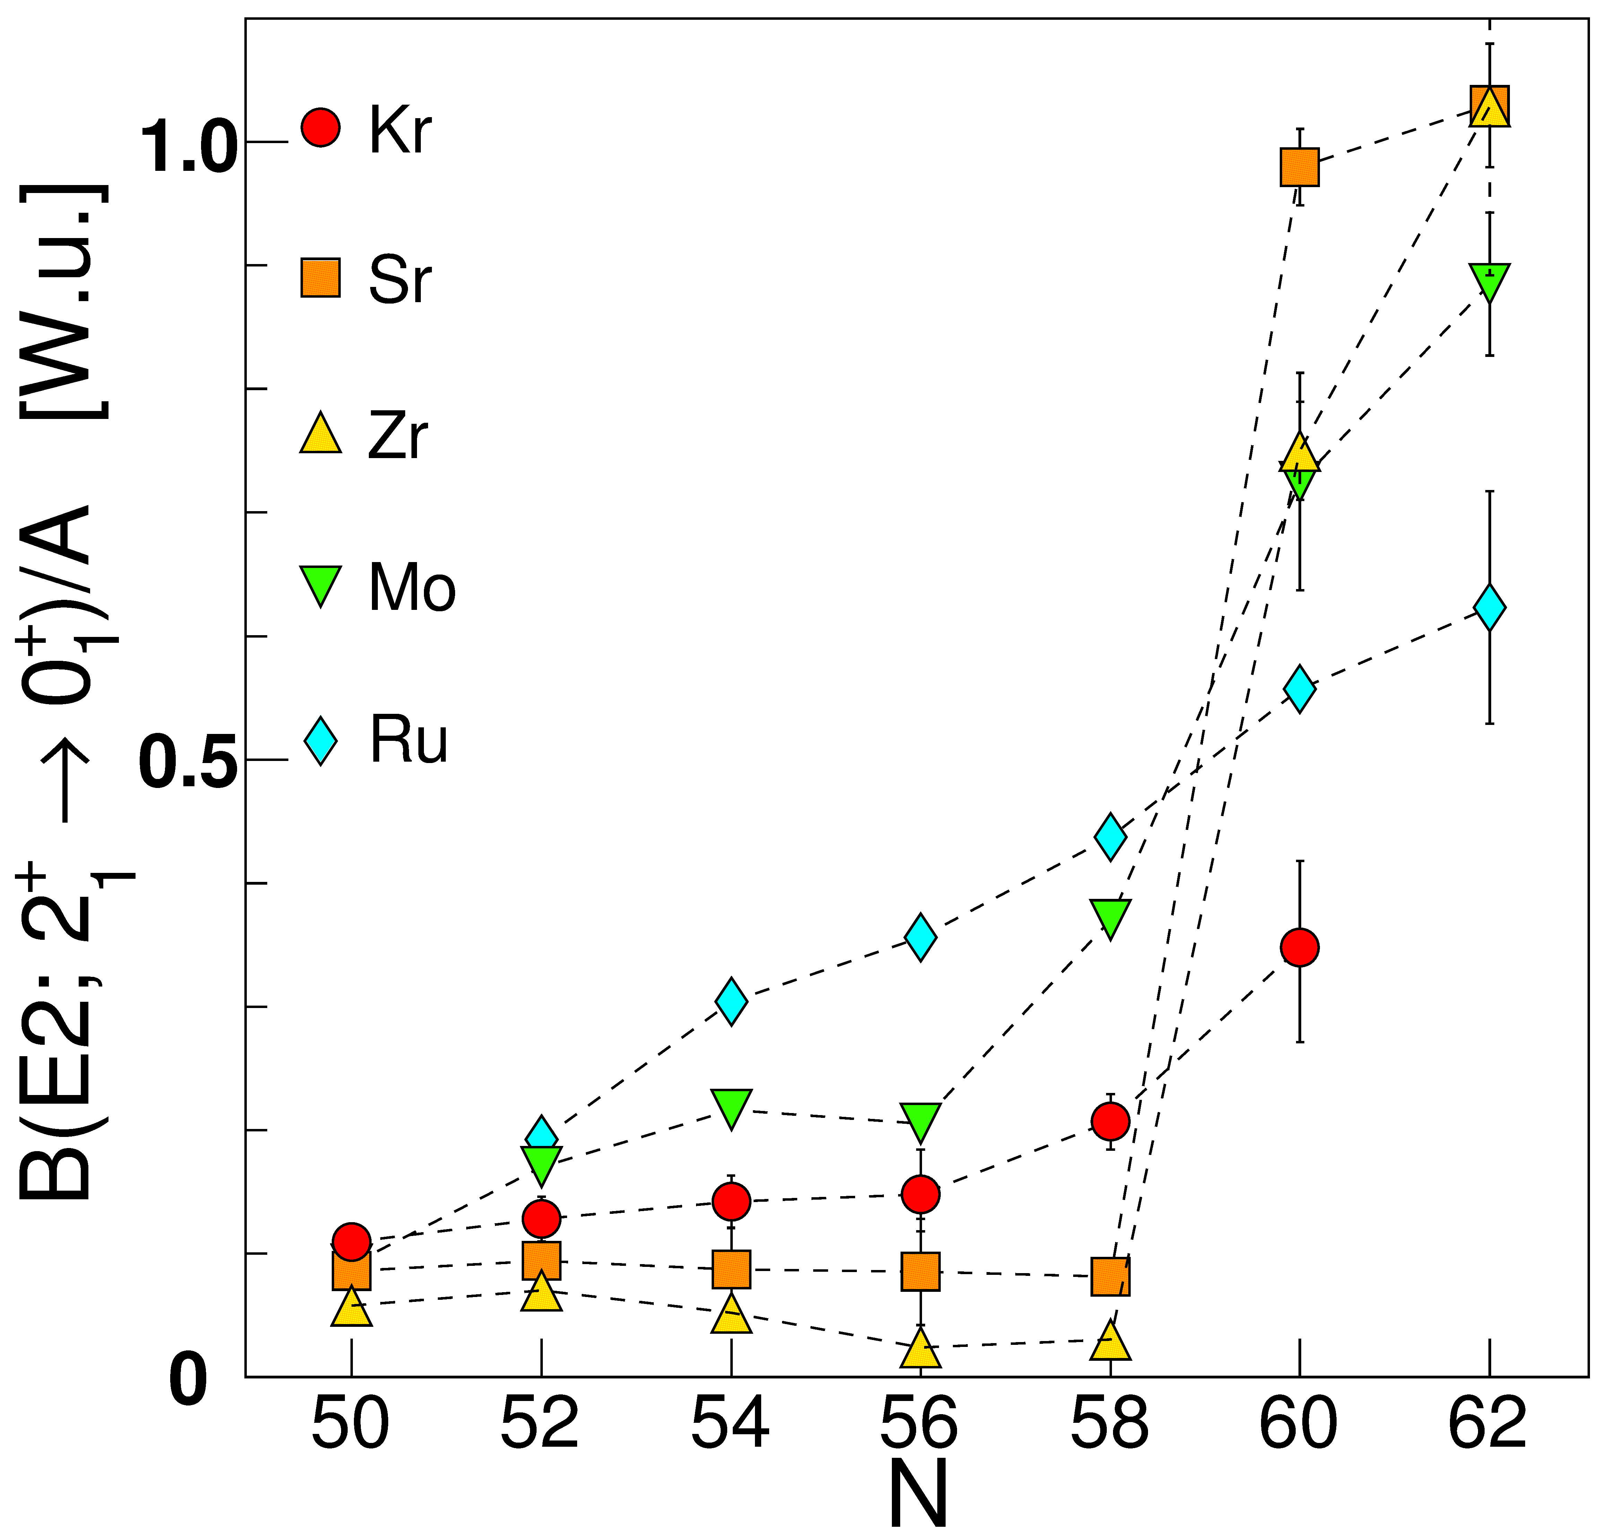
Zr isotopes undergo the most rapid change of ground state structure across the nuclear chart
There have been numerous experimental investigations, but firm evidence for shape coexistence has been lacking, and only recently B(E2)s determined for deformed states
Measured isotope shifts

Slide 17
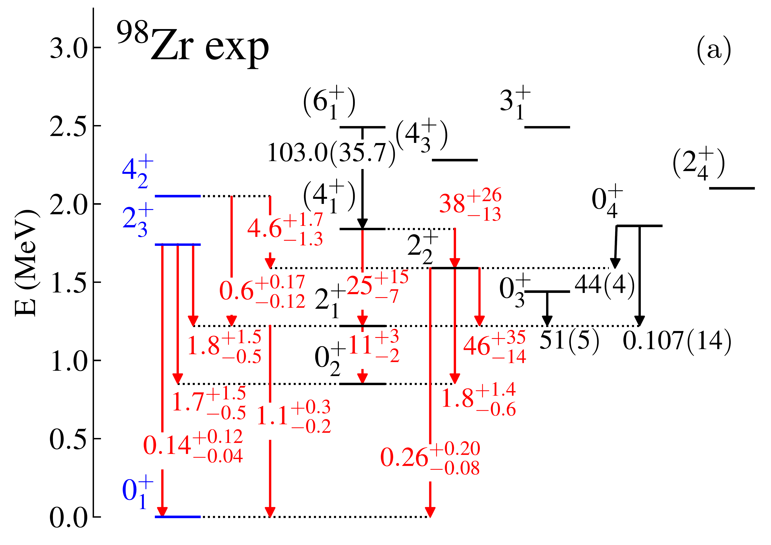
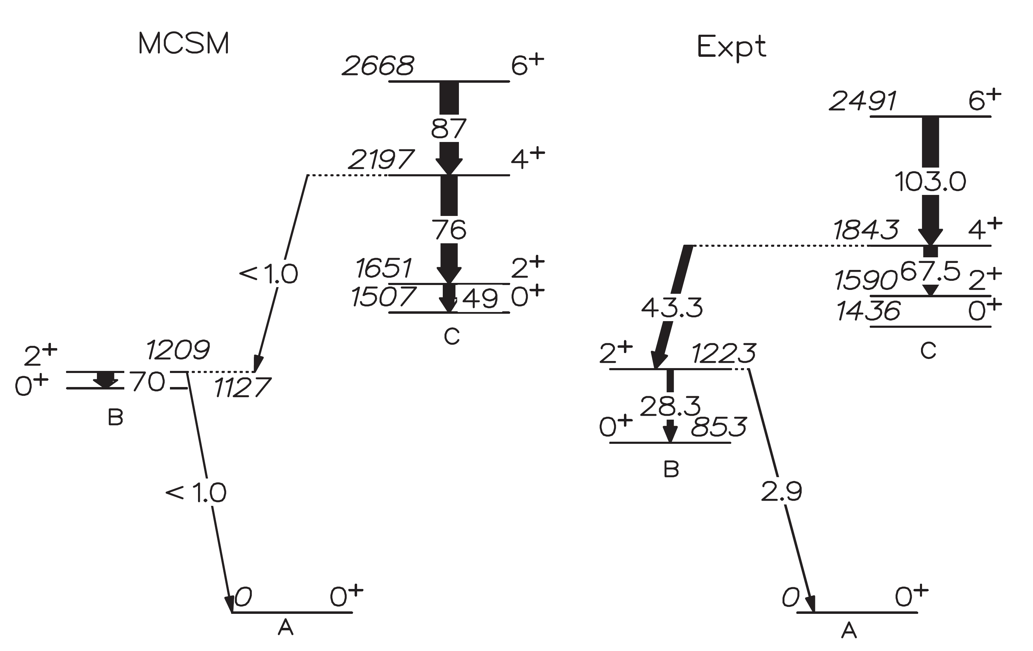
Insufficient knowledge to distinguish interpretations
⁹⁸Zr – lifetimes measured in ⁹Be induced fission of ²³⁸U, and ⁹⁶Zr+¹⁸O 2p transfer reaction
Singh et al. favoured multiple shape coexistence with deformed band structures, Karayonchev et al. favoured a multiphonon-like structure with configuration mixing
Knowledge of excited 0⁺ configurations in N > 60 Zr and Sr isotopes very limited
V. Karayonchev et al., PRC 102, 064314 (2020)
Substantial differences in both measured lifetimes, and assignments/interpretations
P. Singh et al., PRL 121, 192501 (2018)

Slide 18
Extending studies of the Sr-Zr isotopes
Need to map the low-spin configurations past N=60 transition point
  We can reach ⁹⁸Sr, ¹⁰⁰Zr with existing beams and achieve high-statistics data sets
ARIEL advantage – the required Sr, Rb beams are close to the lower mass fission peak, enabling us to push well past N=60

Slide 19
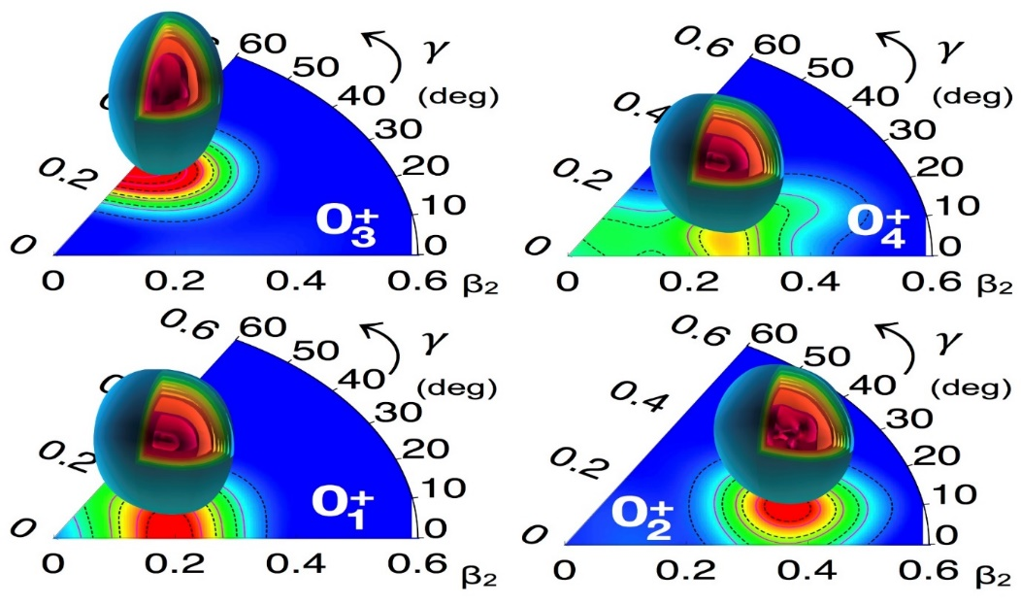
Energy systematics Cd isotopes
“Blue” states – the original “intruder” band, triaxial shape in ^{110,112}Cd from BMF calculations
“Red” states – oblate band in ^{110,112}Cd from BMF calculations
The presumed shapes are based on systematics and similarities of decay properties – but become increasingly uncertain towards the neutron rich isotopes

Slide 20
Energy systematics Cd isotopes
What is happening with the 0₂⁺ state in ¹²⁰Cd? If a recent measurement is correct, it undergoes a significant drop in energy in ¹²⁰Cd.
There are no firm candidates for these configurations beyond ¹²⁰Cd – the 0₂⁺ state in ¹²²Cd would match the energy of the 0₃⁺ in ¹²⁰Cd
No candidates for excited 0⁺ states in ¹²⁴Cd and heavier
Above mid-neutron-shell we do not have a good understanding of the structure

Slide 21
Recent results on ¹⁸⁶Pb – elucidating triple shape coexistence
A spectroscopic tour de force, using γγ and γe⁻ spectroscopy with recoil decay tagging at Jyvaskyla, observed the weak, in-band 2₁⁺→ 0₂⁺ transition establishing the 0₂⁺ state as the head of the prolate band with B(E2; 2₁⁺→ 0₂⁺ ) = 190(80) W.u.
Results indicated small mixing of 0₂⁺ and 0₃⁺ states
Ojala et al, Nature Communications 5, 213 (2022)

Slide 22
Shape coexistence well established in Hg isotopes
Difference in mean-squared charge radii for Hg show odd-even staggering – large changes in ground state deformation observed
Energy systematics of deformed intruder states display “typical” parabolic dependence on valence neutron number
Information on excited 0⁺ states drops dramatically outside region that can be probed with two-nucleon-transfer reactions
  population cross section in many reactions, especially HI fusion evaporation, often extremely small
  Is there another configuration as in the Pb isotopes and triple shape coexistence?
Garrett, Zielińska, & Clement, PPNP 124, 103931 (2022)

Slide 23
There are a wide variety of open nuclear structure questions – ARIEL facility with increased reach, and especially multi-user capability, will enable studies to address these questions
While my focus was on shape-coexistence in even-even, studies of odd-A vital to establish and track single-particle structures
A coordinated approach with experiments at other facilities (e.g., transfer or Coulomb excitation at TIGRESS, measurements at ISOLDE or FRIB, etc.) will reap enormous benefits
Systematics, systematics, systematics,…
  It’s not stamp collecting, this is often where the physics lies!
… but don’t get caught up in doing mediocre experiments on a dozen nuclei instead of outstanding measurements on a few

Slide 25
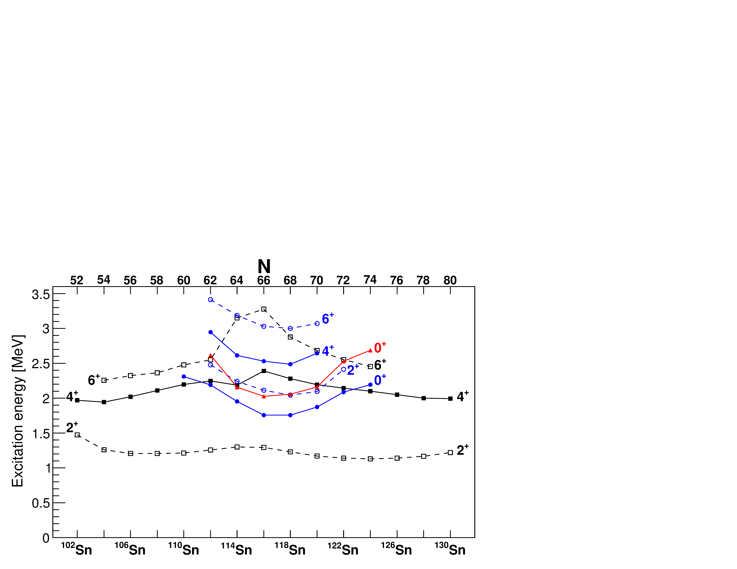
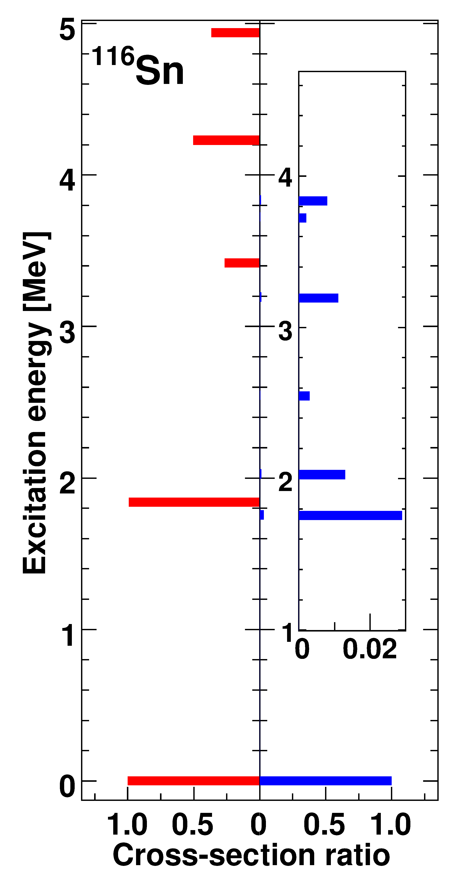
Example of the data for deformed 2p-2h “intruder” bands at closed shells – ¹¹⁶Sn
Sn isotopes have characteristic parabolic pattern to excitation energies
Normally, the two-nucleon-transfer is dominated by gs-to-gs transitions – typically > 95% of L=0 strength
Near Z = 50, two-proton transfer strongly populates the 0₂⁺ state
neutron midshell
Garrett, Zielińska, & Clement, PPNP 124, 103931 (2022)
Appearance of rotational-like bands, with enhanced in-band B(E2) values, that stand out amongst spherical “shell-model” states
(³He,n)
(p,t)
Garrett, Zielińska, & Clement, PPNP 124, 103931 (2022)

Slide 26
Similarity of ⁹⁸Sr, ¹⁰⁰Zr structure
gsb appears to be well reproduced in MCSM
Less collectivity in 0₂⁺ band than predicted
B(E2) W.u.
10³ρ²(E0)
E. Clement et al., PRL 116, 022701 (2016), PRC 94, 054326 (2016).

Slide 27
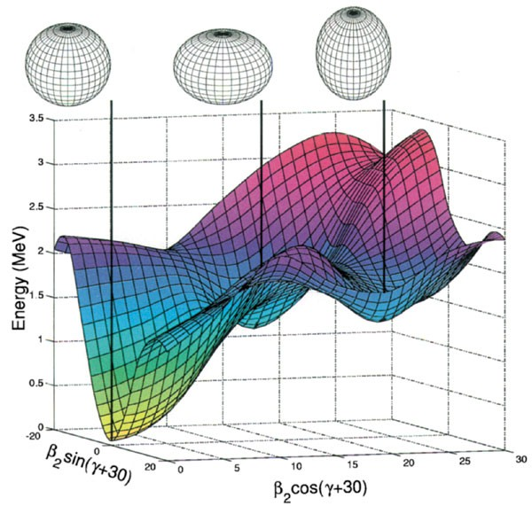
Triple shape coexistence in ¹⁸⁶Pb
¹⁸⁶Pb the famous example of multiple-shape coexistence
α-decay similar to α-transfer to gain information on 2p-2h enhancements
Andreyev et al., Nature 405, 430 (2000).

Slide 28
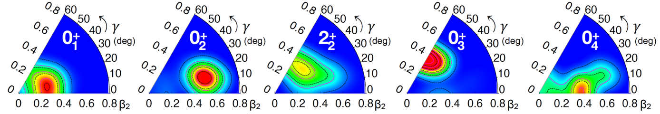
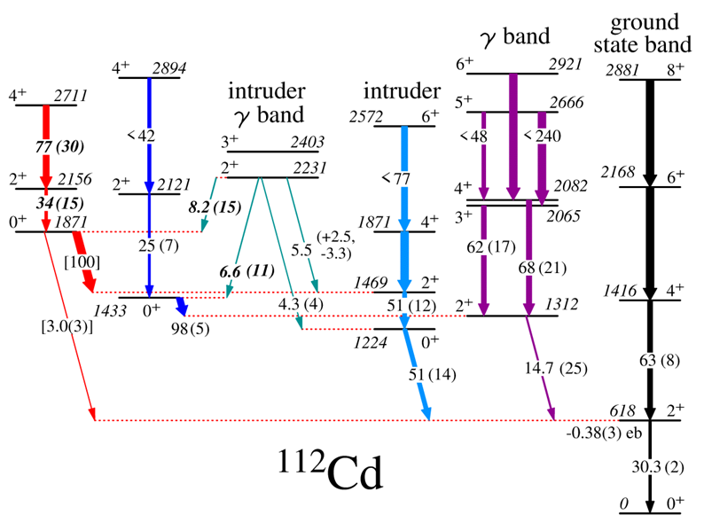
The “evolution” of the structure of the Cd isotopes
From spherical vibrators….
…to deformed with multiple shapes
Proposed states with phonon number up to N=6
Proposed four distinct shapes for the lowest four 0⁺ states

Slide 29
Organization of the ¹⁸⁸Hg level scheme
Using the extracted branching ratios, E2/M1 mixing ratios, absolute or relative B(E2) values determined
  Transitions labelled in absolute B(E2) in Wu (blue), or relative B(E2) (black italic), showing clear preference for in-band decays
New suggested 0₃⁺ band
New suggested “K=4” band
Known “prolate” band
Known “oblate” band
Confirmed “γ” band
>1.9
>0.7

Slide 30
Comparison to model calculations: E2 transitions
Transitions labelled in absolute B(E2) in Wu (blue), or relative B(E2) black italic),
>1.9
Experimental B(E2)
>0.7
“K=2”
“K=4”
“K=6”
Calculations by S. Peru
Mean field derived from HFB calculation using Gogny D1M interaction
GCM applied to yield 5-dimensional collective Hamiltonian – no restrictions to axial symmetry
States from calculations grouped into bands according to their spectroscopic properties
β=0.20γ=27°
Calculated B(E2)
β=0.20γ=35°
β=0.24γ=21°

Slide 31
γ-ray spectroscopy – a very versatile tool
Weak interaction tests e.g. studies of Fermi superallowed β-decay
  ⁶²Ga decay – beam rate of 6 – 12k/s, placement of γ-rays to 1 ppm level permits very sensitive tests related CKM matrix unitarity
    A.D. MacLean et al., PRC 102, 054325 (2020)
Nuclear structure investigations e.g. ⁷⁴Zn and N=40 “island of inversion”
  M. Rocchini et al., PRL 130, 122502 (2023)

Slide 32
Some recent work on the Zr isotopes
⁹⁶Zr – high resolution e⁻ scattering yielding B(E2;2₂⁺→ 0₁⁺) and comparisons with MCSM
⁹⁸Zr – lifetimes measured in ⁹Be induced fission of ²³⁸U, and ⁹⁶Zr+¹⁸O 2p transfer reaction
V. Karayonchev et al., PRC 102, 064314 (2020)
Substantial differences in both measured lifetimes, and assignments/interpretations
P. Singh et al., PRL 121, 192501 (2018)
C. Kremer et al., PRL 117, 172503 (2016)
⁹⁸Zr – Coulomb excitation of mass 98 beam placed limit on B(E2;2₁⁺→ 0₁⁺) value
W. Witt et al., PRC 98, 041302(R) (2018)

