Slide 1
Life Sciences
2025-2030 Five Year Plan
Aug 2nd, 2023
Paul Schaffer, PhD
Director, Life Sciences

Slide 2
Today’s presentation:
The Backdrop: LS Vision, Mission; The Team; Our Pillars
A Summary of Achievements: Infrastructure and Research
IAMI Status and Ramp-up
What’s coming: 2025-2030

Slide 3
Life Sciences Vision and Mission Statements
Vision Statement:
The Life Sciences Division will place TRIUMF as a global leader in the application of accelerator research toward the life sciences in a manner that derives maximum societal and economic benefit.
Mission Statement:
The Life Sciences Division at TRIUMF will innovate new accelerator technologies, isotopes and radiopharmaceuticals to better health, understand life and better the environment. The Division will leverage its core expertise to lead in our community as an interdisciplinary centre of excellence that enables ourselves, and our partners, with world-class people and state-of-the-art facilities.
3

Slide 4
Current Life Sciences Priorities
1) Build IAMI
2) Implement GMP capabilities – complete validation master plan
3) Grow/Enable Therapeutic Isotope Program
4) Deliver on our commitments (to our researchers and our partners)
These priorities are set via internal reviews, coupled with external peer evaluation (LSPEC)
Align with TRIUMF’s goals within:
Science and Technology
  Make ground-breaking discoveries across our multidisciplinary research portfolio
  Strengthen our position as a world-leading particle accelerator centre
People and Skills
  Become a hub for interdisciplinary education and training
  Inspire Canadians to discover and innovate
Innovation and Collaboration
  Translate science and technology into innovation
  Drive national and international collaboration in research, technology and innovation

Slide 5
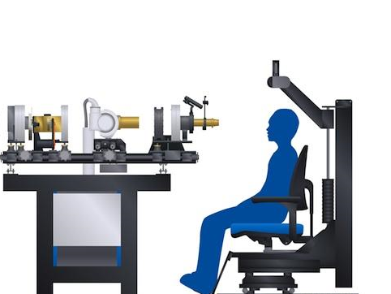
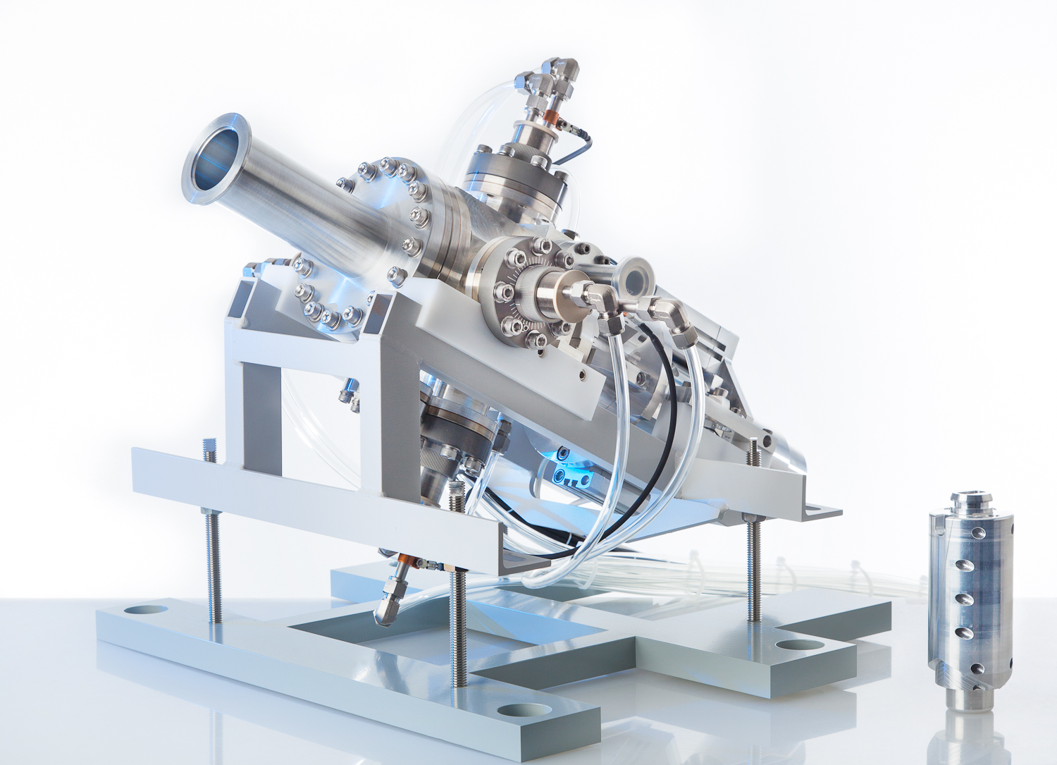
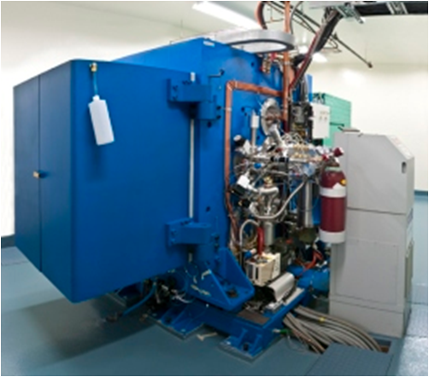
TRIUMF Life Sciences focuses on advancing accelerator-based technology for the development of isotopes that can improve life
Life Sciences
at TRIUMF
Applied Ion Beams
Nuclear Chemistry
Applied Isotopes

Slide 6
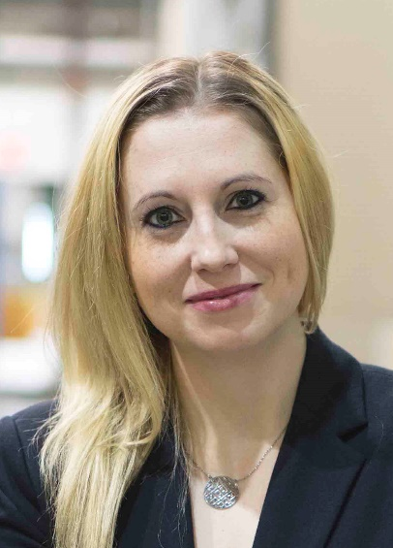
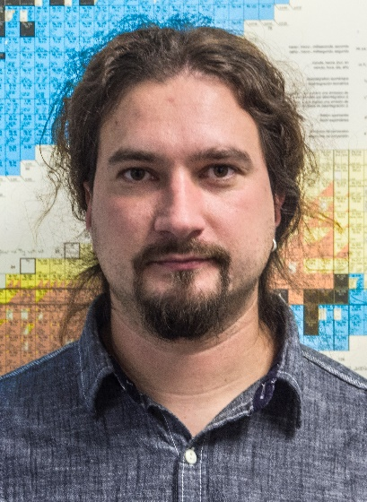
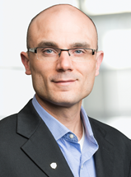
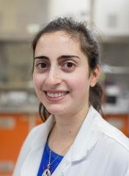
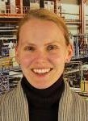
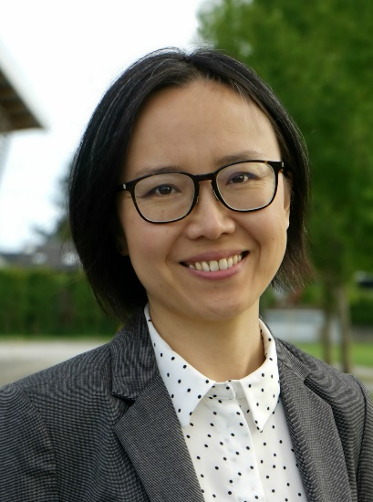
Life Sciences BAEs at TRIUMF
Applied Ion Beams
Nuclear Chemistry
Applied Isotopes
Monika
Stachura
(2016)
Cornelia
Hoehr
(2013)
Valery
Radchenko
(2016)
Paul
Schaffer
(2009)
Hua
Yang
(2020)
Caterina
Ramogida
(2018)
(joint SFU)

Slide 7
Structuring the Division for What’s Ahead
Director
Life Sciences
Infrastructure & Facilities
Research and Development Support
Research and Development
Radiopharmaceutical Operations
BAEs
PDFs
Affiliate Sci
Emeriti
Facility Support
Ops Engineering Support
R&D Engineering Support
R&D Biology Support
Production Support
Quality Assurance
Quality Control
R&D Chemistry Support
R&D Physics Support

Slide 8
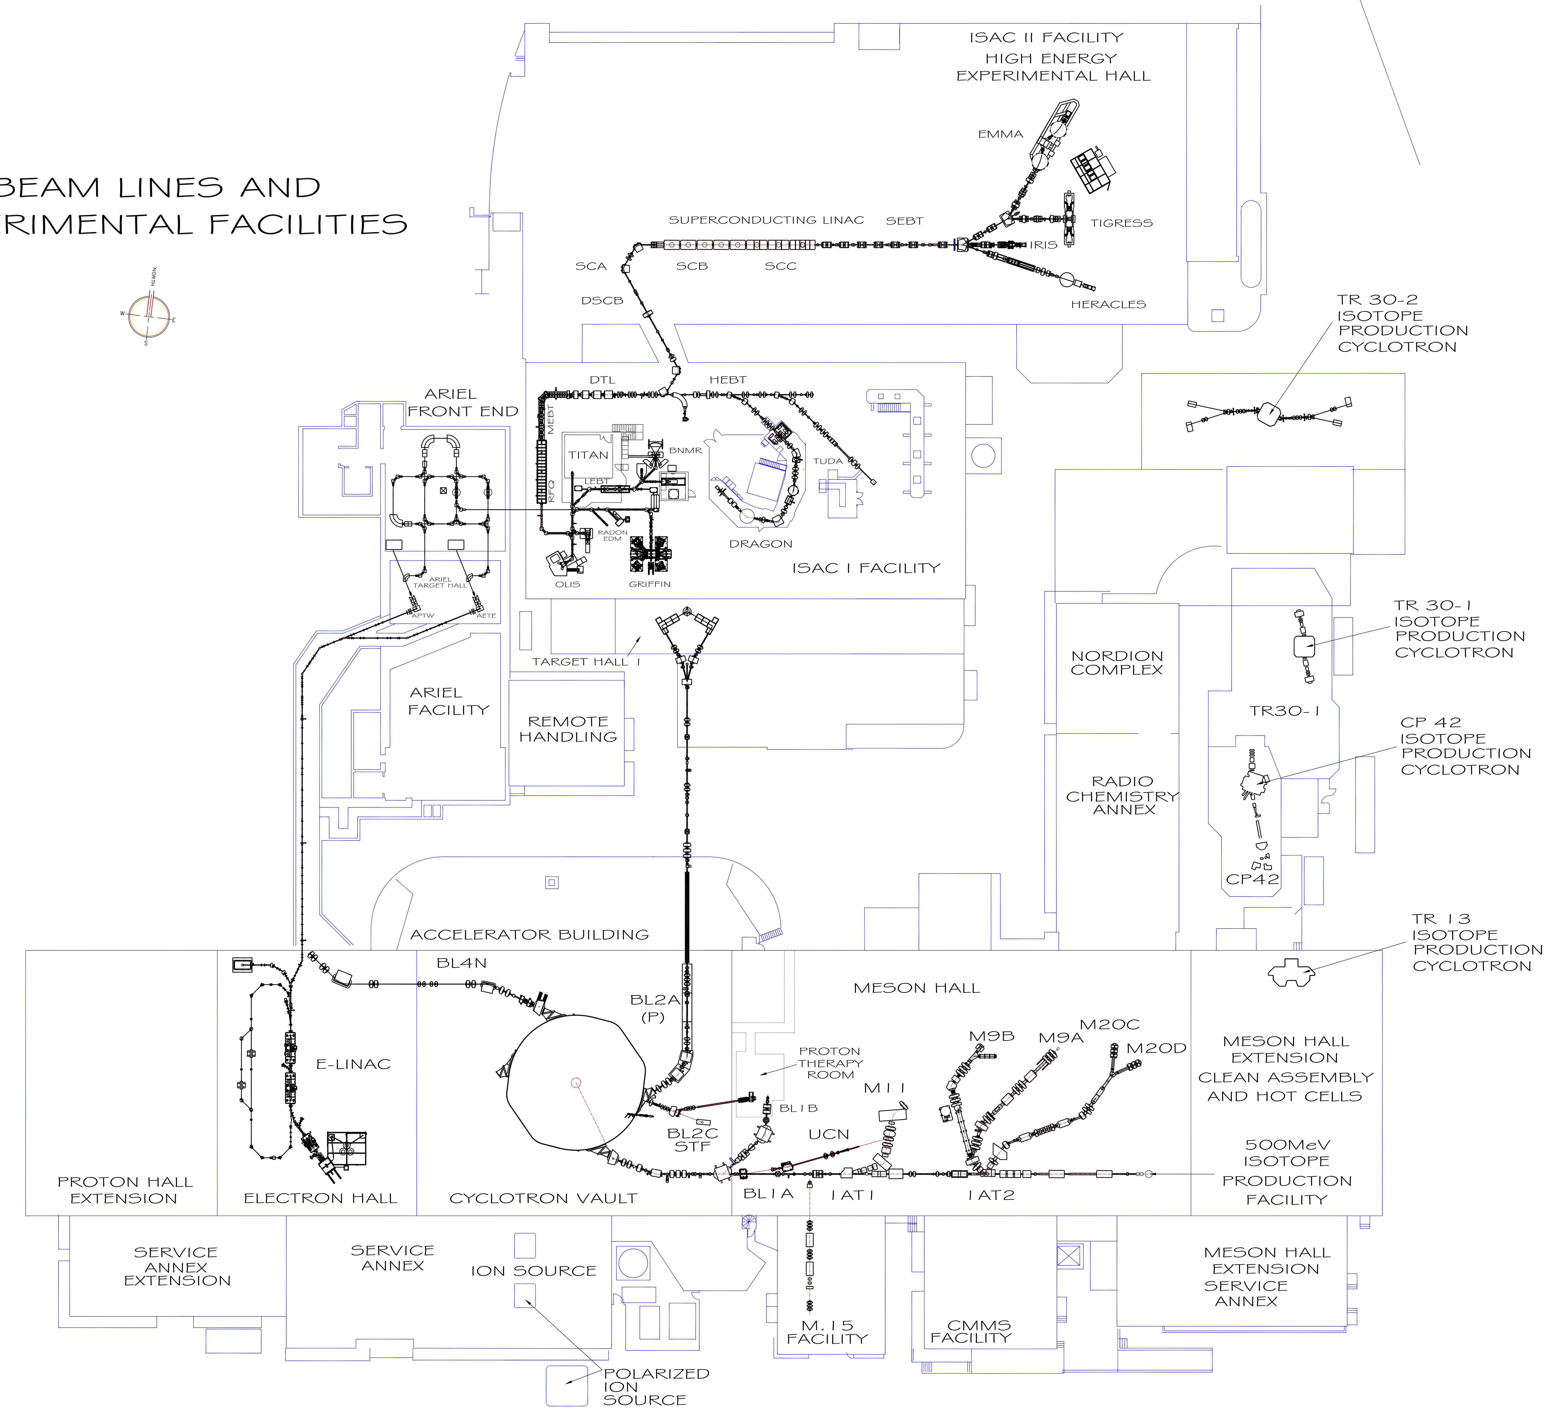
Life Sciences at TRIUMF
  Many applications derived from beams and isotopes obtained from 13 to 520 MeV machines
    Isotope production
    Radiochemistry
    Proton Therapy
    Bio-βNMR
  Other drivers: ARIEL, ISAC/ISOL
  Partnerships:
    UBC: Science, Pharmacy, Medicine, Engineering
    SFU: Science
    BC Cancer
    Fusion, BWXT
    …
BWXT
ARIEL
ISAC
IPF
IAMI

Slide 9
LS Facility Updates
P405: Symbiotic Medical Isotope
Production
P412: GMP Radiopharmaceutical
Upgrades
BWXT
ARIEL
P457: Isotope Production Facility
Nuclear Ventilation Upgrade
ISAC
P468: Biohazard Facility
P442, 471, 527, 550:
IAMI Buildout
IPF
IAMI

Slide 10
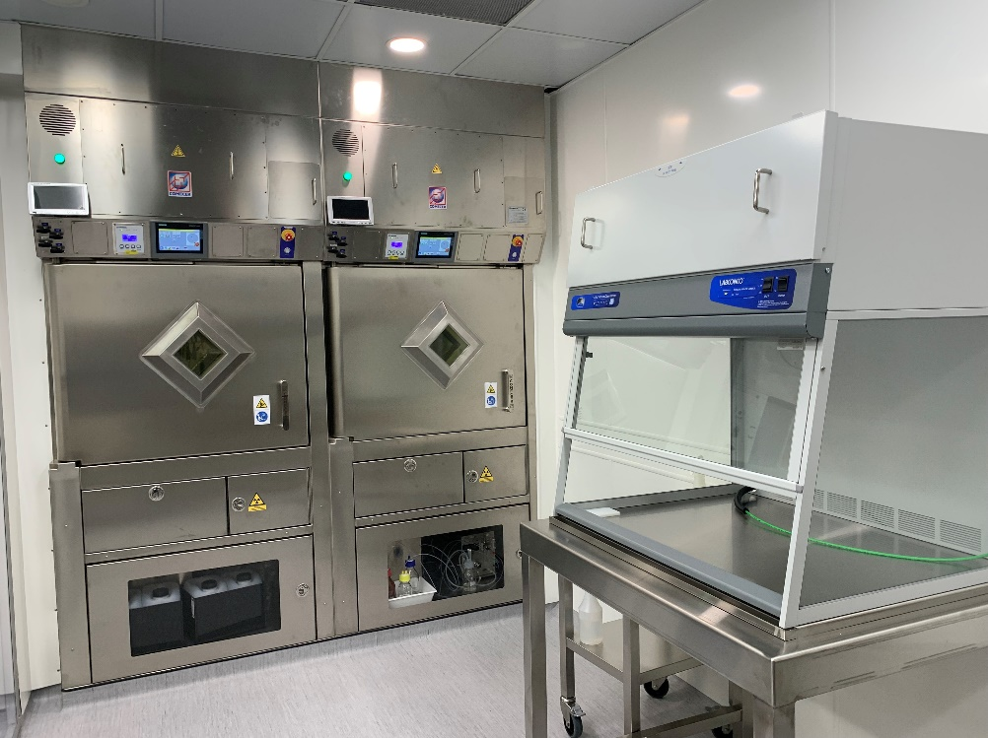
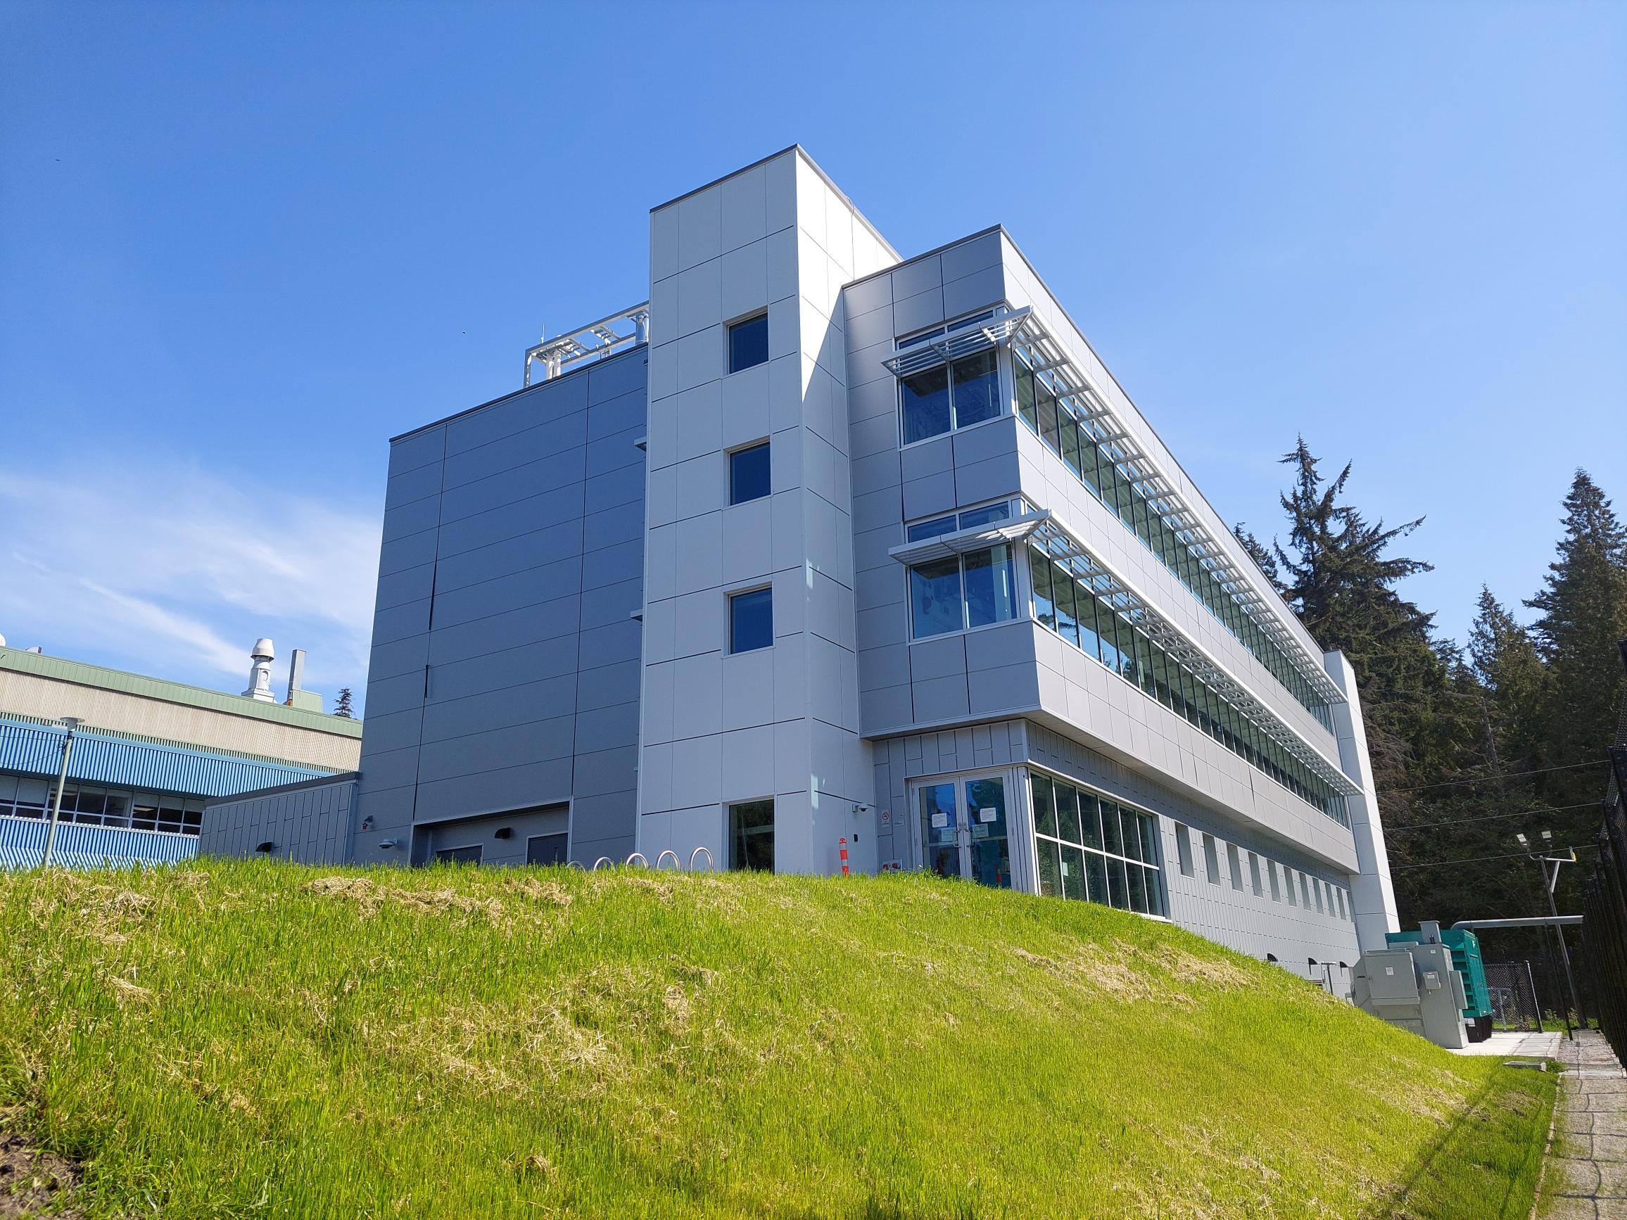
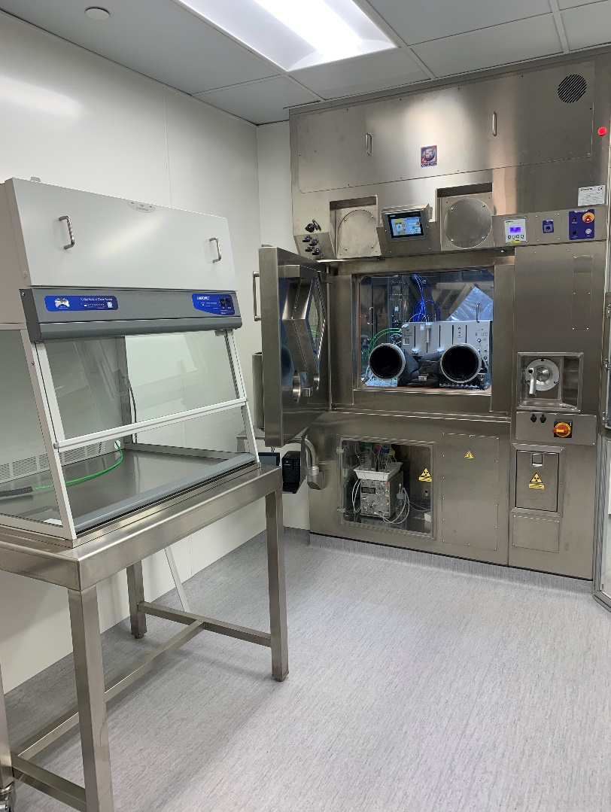
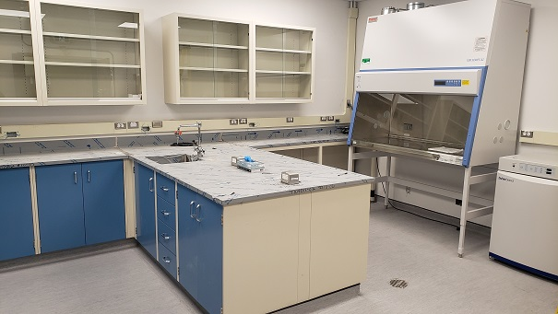
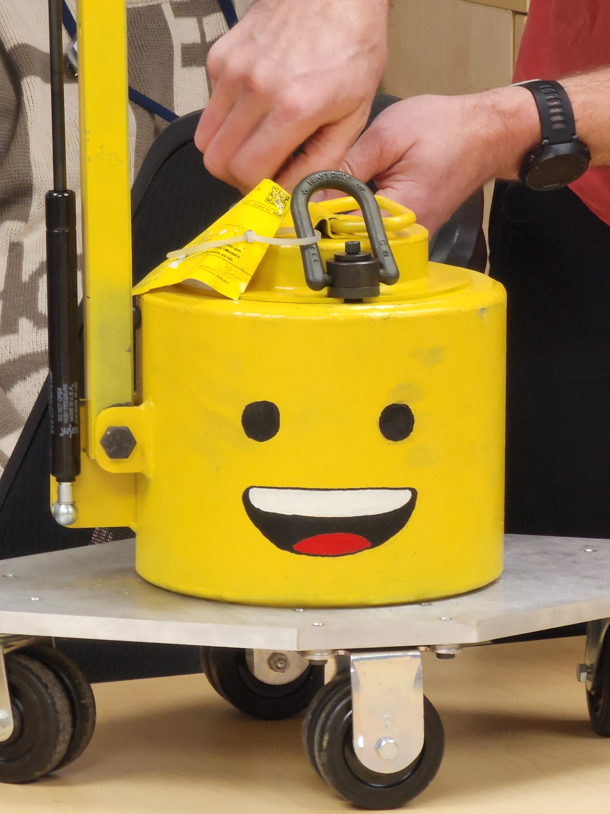


Facility Upgrades, Research Space for the Future
P457 – IPF vent upgrade
P412 – RCA 007 GMP upgrade
P442, 471, 527, 550 – IAMI
P468 – MHESA cell biology lab
Emmett!

Slide 11
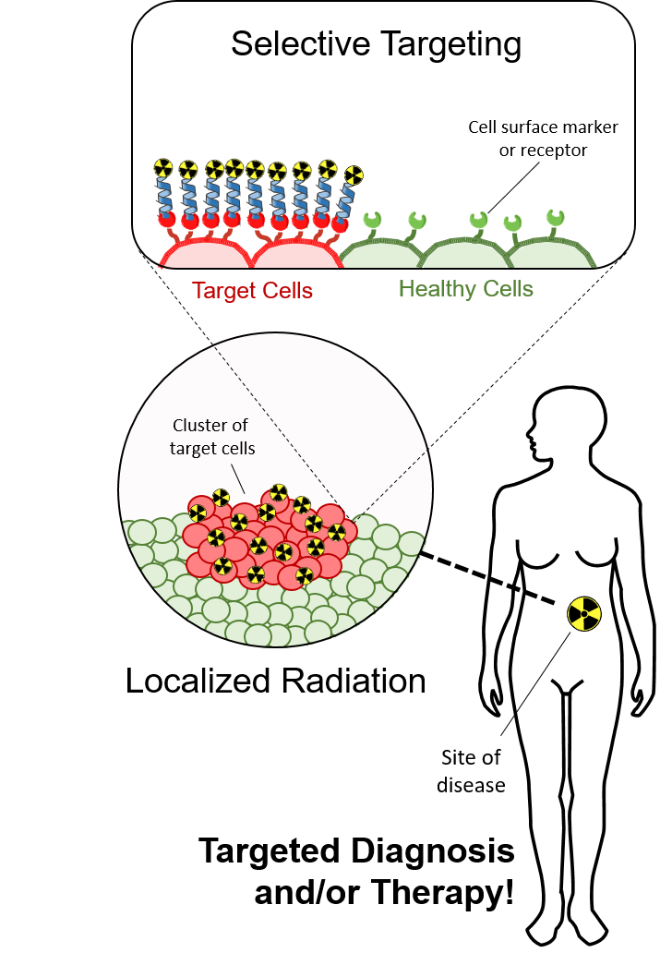
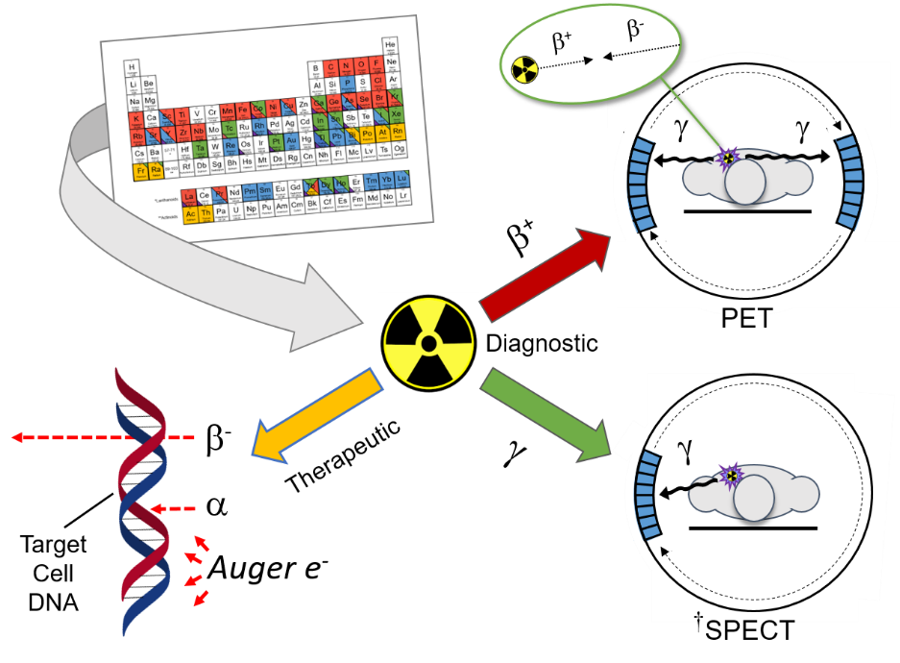
2025-2030: Applying Physics to Life
T. I. Kostelnik, C. Orvig Chem. Rev. 2019, 119, 902 invited for Metals in Medicine issue
JP Pouget et al. Nat. Rev. Clin. Oncol. 2011, 8, 720-734
SV Gudkov et al. Int. J. Mol. Sci. 2016, 17, 33
Notes:
Another pillar is radiochemistry and radiopharmaceutical development

Slide 12
2025-2030: Focus on Radiometals (Radchenko, Yang talks, Monday)
T.I. Kostelnik and C. Orvig, Chem. Rev. 2019, 119, 902-956
Notes:
One of the pillars of the TRIUMF Life Sciences program is medical isotope production…
Here you can see the many options available to us when considering research and application of radioisotopes in medicine

Slide 13
2025-2030: Focus on Radiometals (Radchenko, Yang talks, Monday)
TR13 MeV
Legacy machine operating at
ideal energy for many isotopes
24 MeV
Modern, high-intensity machine
that expands on TRIUMF’s
isotope repertoire
520 MeV (IPF, ISAC)
Globally unique machine that
provides access to equally
unique isotopes, applications
T.I. Kostelnik and C. Orvig, Chem. Rev. 2019, 119, 902-956

Slide 14
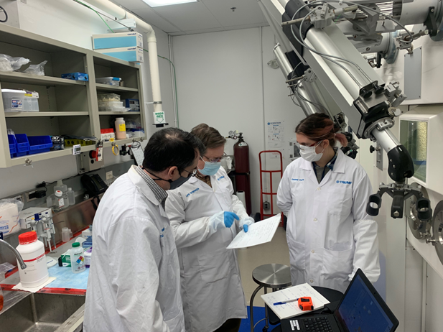
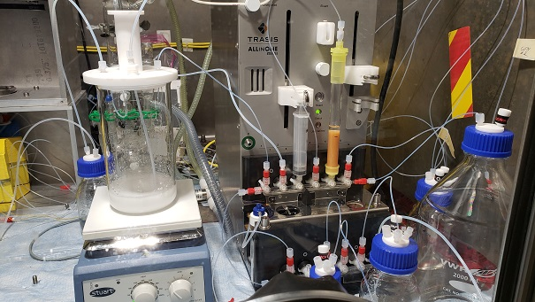
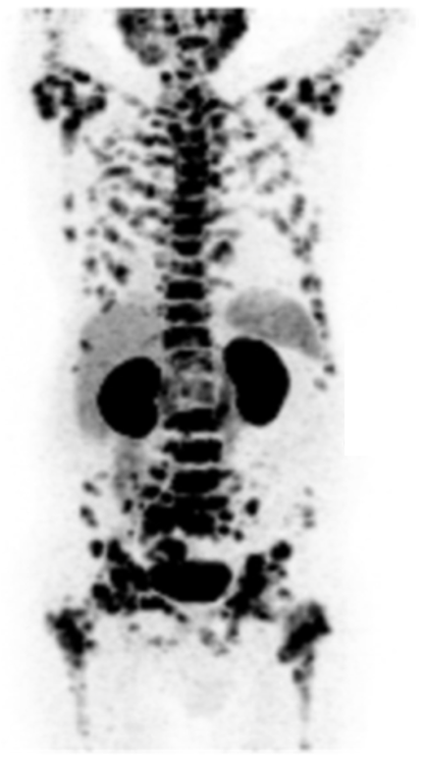
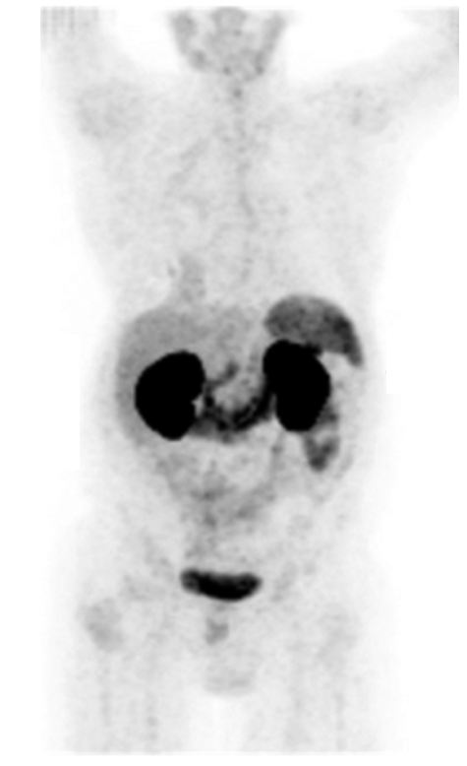
²²⁵Ac Production at TRIUMF (P476)
Objective
Establish, commission and demonstrate the performance of infrastructure, equipment, processes, and procedures required for safe, weekly production and quality control of Ac-225 from BL1A
Top Level Deliverables:​
Robust equipment/processes for routine thorium target radiochemical processing​
Ac-225 product quality control program​
Waste management program​
Radiochemistry lab facilities to support routine Ac-225 production
Previous campaigns:
2020 Irradiations: 3 targets for a total of 6,320 µAh
2021 Irradiations: 5 targets for a total of 28,900 µAh
2022 Irradiations: 4 targets for a total of 42,500 µAh
* Three additional targets planned for 2022 with a total of 37,500 µAh
**isolated over 12 GBq of direct production Ac-225 (decay corrected to EOB); and 1.4 GBq Ra-225 for generators (decay corrected to EOB).
*** generators were eluted 19 times for a total of 470 MBq of high purity Ac-225 for distribution to collaborators and TRIUMF researchers
2023 Campaign
Goal: Transition to regular/monthly ~100 MBq generator production
Develop and validate a robust QC process
Enable access to other radioisotopes produced as by-products from the spallation process. Examples include U-230, Pb-212, Th-227
Five-Year Plan
Prepare for NFRF-T effort (Caterina Ramogida – next talk)

Slide 15
Current ²³²Th-based ²²⁵Ac Production Trajectory at TRIUMF
Production gap
is emerging as a key risk
for clinical application

Slide 16
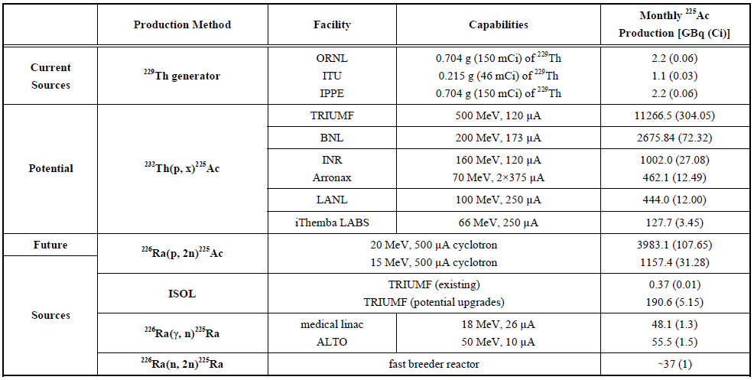
Other methods for ²²⁵Ac (P526)
*values for potential sources list estimates of maximum possible production at facilities that have dedicated stations for large-scale medical isotope production.
**Values listed for ²²⁶Ra targets assume a target mass of 1 g.
A Robertson et al. Curr Radiopharm. 2018, 11, 156-172

Slide 17


Beyond Ac-225
Diagnostic, Therapeutic and Theranostic Isotopes
²³²Th
500 MeV
protons
Spallation
process
Spallation mixture >300 isotopes
TRIUMF main cyclotron
Chemical separation
Low energy cyclotron
²²⁸Th (1.92 y)
²²⁵Ra (14.9 d)
²³⁰Pa (17.4 d)
Generator assembly
Radioactive decay
13-24 MeV
protons
²²⁴Ra (3.6 d)
²²⁵Ac (9.9 d)
²³⁰U (20.8 d)
²²⁰Rn (55.6 s)
²²¹Fr (4.9 m)
²²⁶Th (30.6 m)
Imaging isotopes
⁶⁸Ga (68 m)
⁸⁹Zr (78.4 h)
²⁰³Pb (51.9 h)
²¹⁶Po (0.145 s)
²¹⁷At (32.6 m)
²²²Ra (38 s)
²¹²Pb (10.64 h)
²¹³Bi (45.6 m)
²¹⁸Rn (35 ms)
²¹²Bi (60.6 m)
²¹³Po (3.7 µs)
²¹⁴Po (164 μs)
²⁰⁸Tl (3.05 min)
²¹²Po (0.3 µs)
²⁰⁹Pb (3.23 h)
²²⁰Pb (22.3 y)
²⁰⁸Pb (stable)
²⁰⁹Bi (10¹⁹ y)

Slide 18
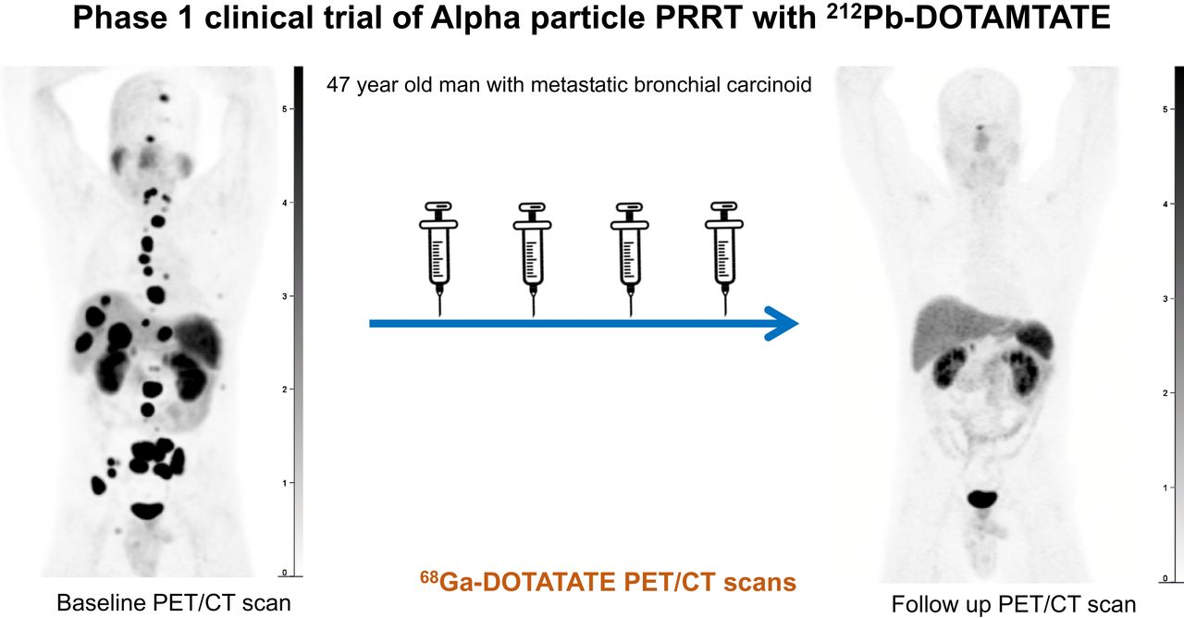
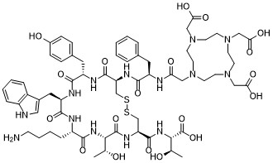
What’s next for Targeted Alpha Therapy?
  Applications for cancers typically found late (metastatic)
    Pancreatic, melanoma, ovarian, blood…
  Unmet need: establish patient dose based on target expression levels
  Leverage emerging tools, such as AI to:
    molecular target selection
    optimize drugs/pairings
    calculate injection amounts and frequency to optimize therapeutic response
  Non-cancer applications
    Bacterial/fungal infections,
    immune-based diseases
    …
6 cycles [²²⁵Ac]DOTATATE
4 cycles [²¹²Pb]DOTAMTATE
100-120 kBq/kg
2.50 MBq/kg
Ballal, S. et al. J. Nucl. Med. 2023,64,211.
Delpassand, E. et al. J. Nucl. Med. 2022,63,1326.
3

Slide 19
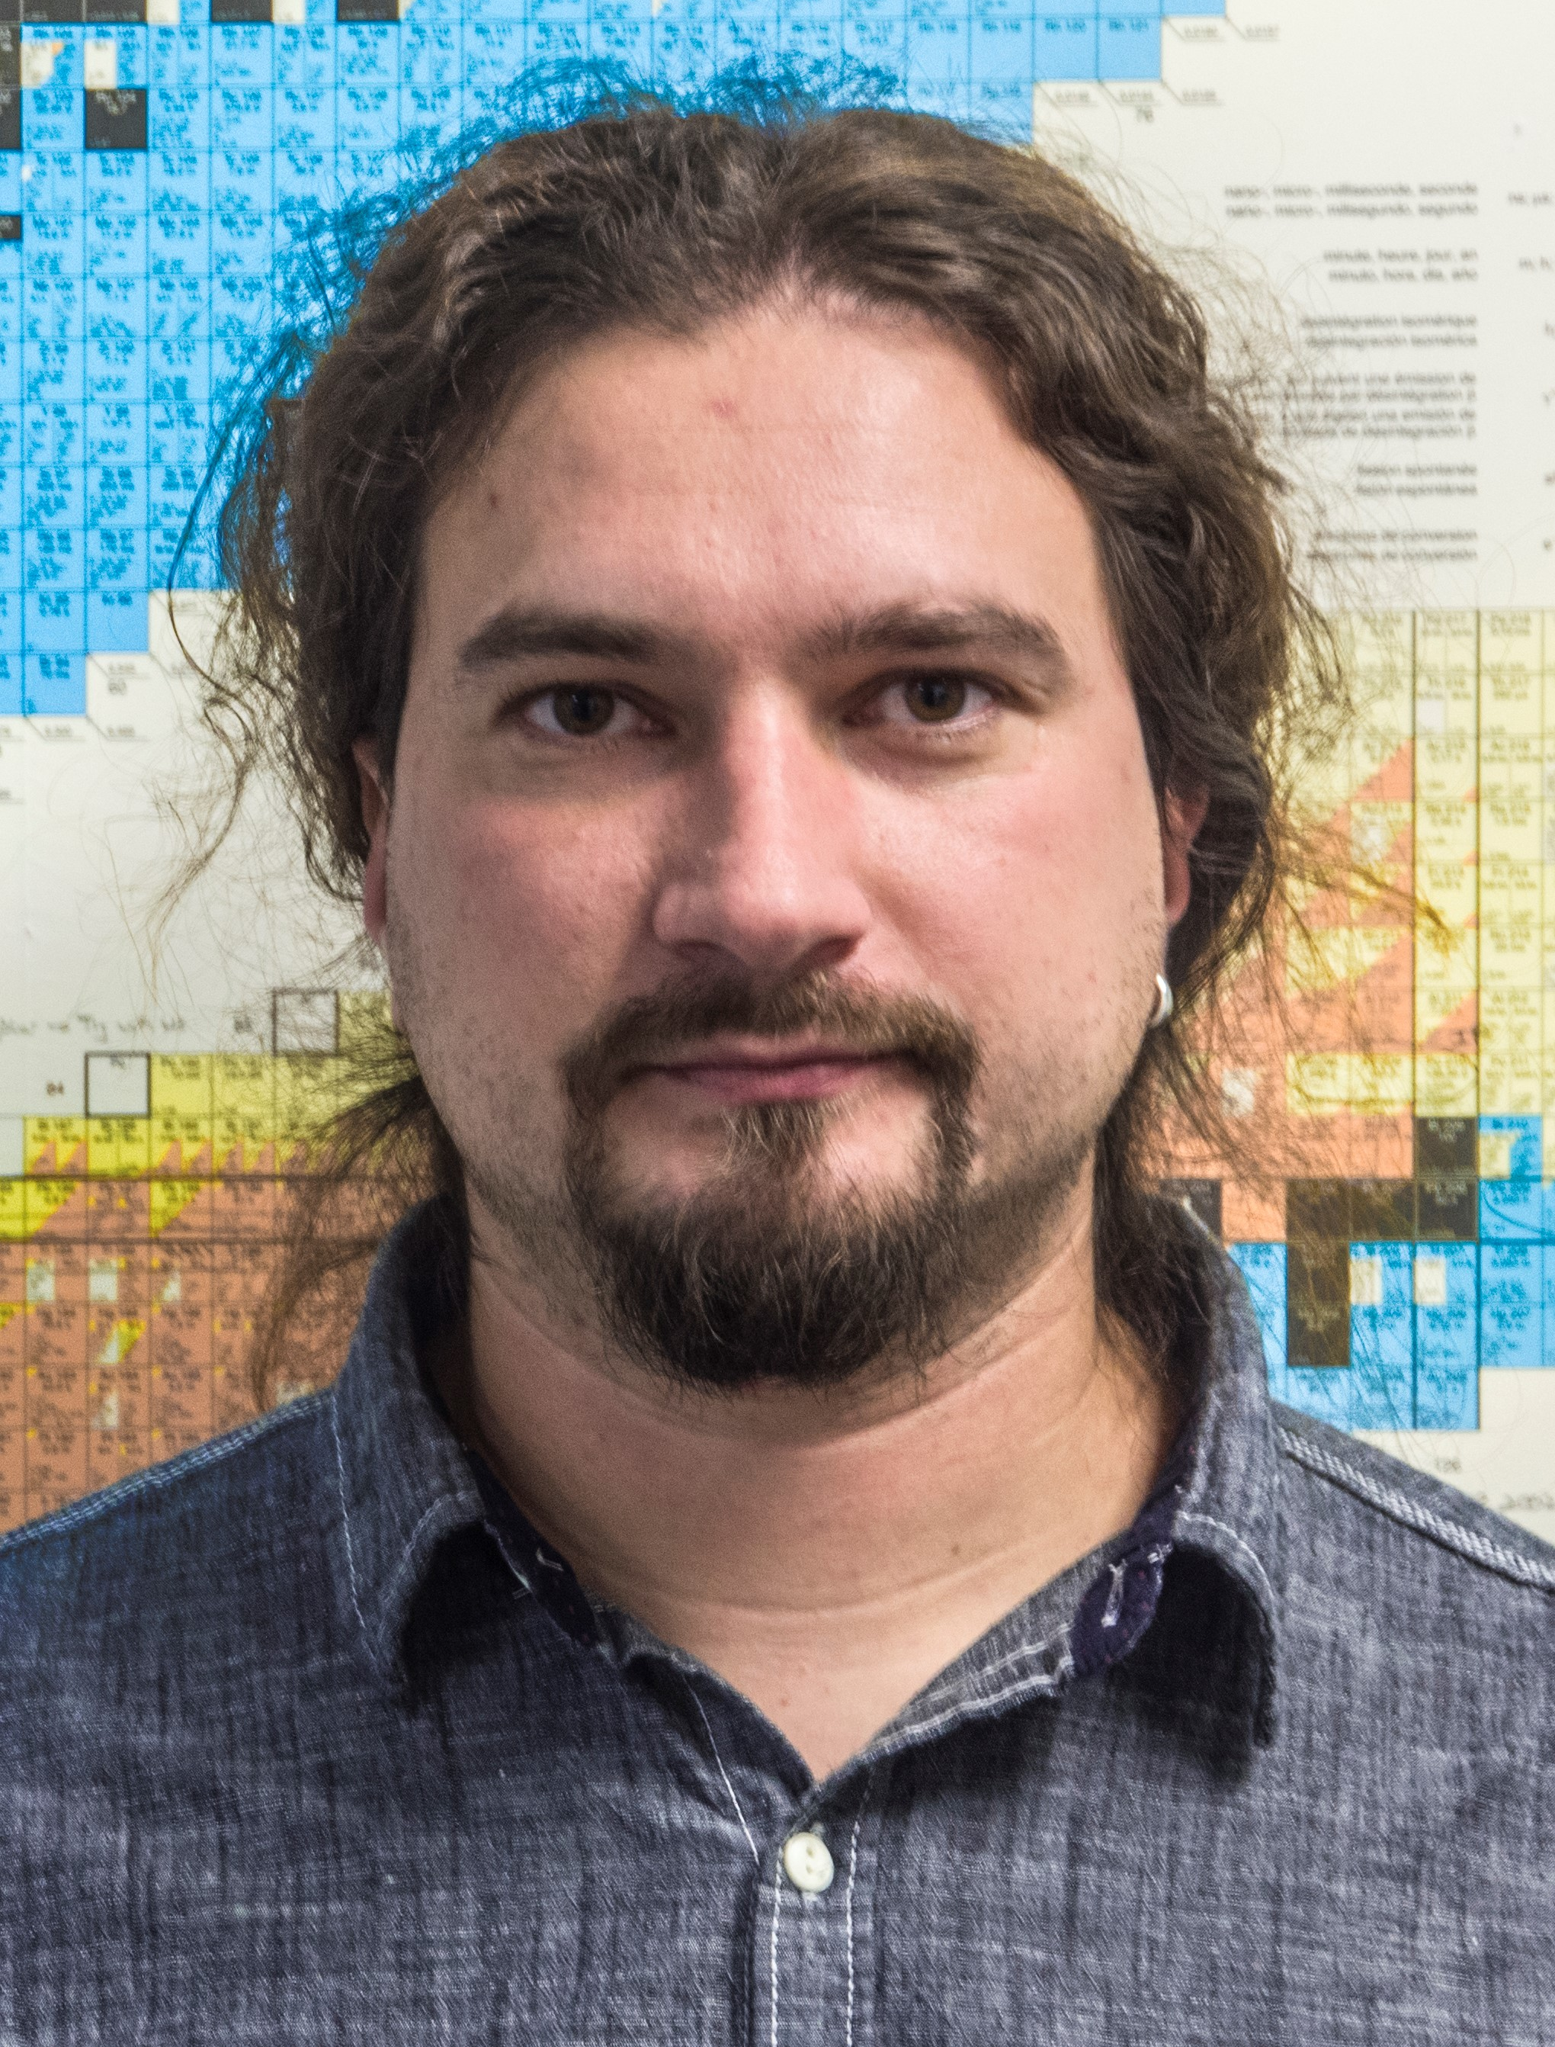
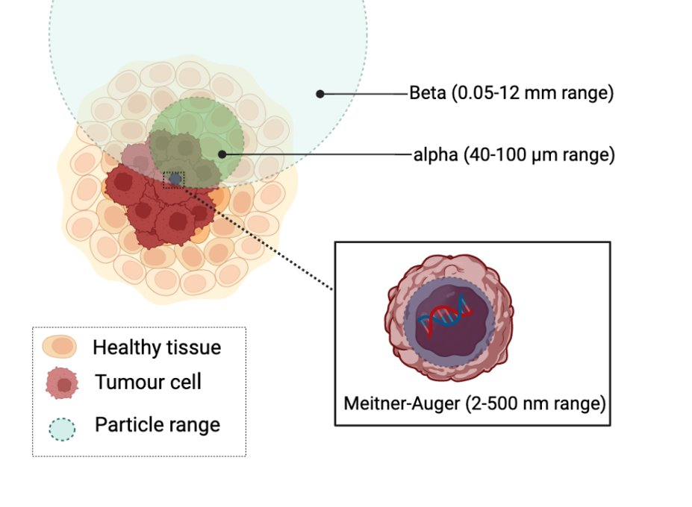
Radionuclide Therapy
is not limited to alpha-, beta- emitters
Auger-emitters:
^{58m}Co
⁷¹Ge
¹⁰³Pd
^{103m}Rh
¹⁶¹Tb
¹⁶⁵Er
¹⁹¹Os
²³⁹Np
…
  Continued pursuit of:
    Novel production methods
    Separation chemistry
    Chelate chemistry
    Applications
197
119
230
Hg
Sb
U
mercury
antimony
uranium
Filosofov D, et al. Nuc. Med. Biol. 2021, 94-95, 1-19

Slide 20
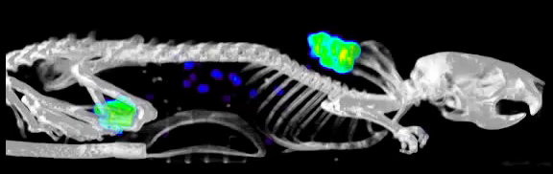
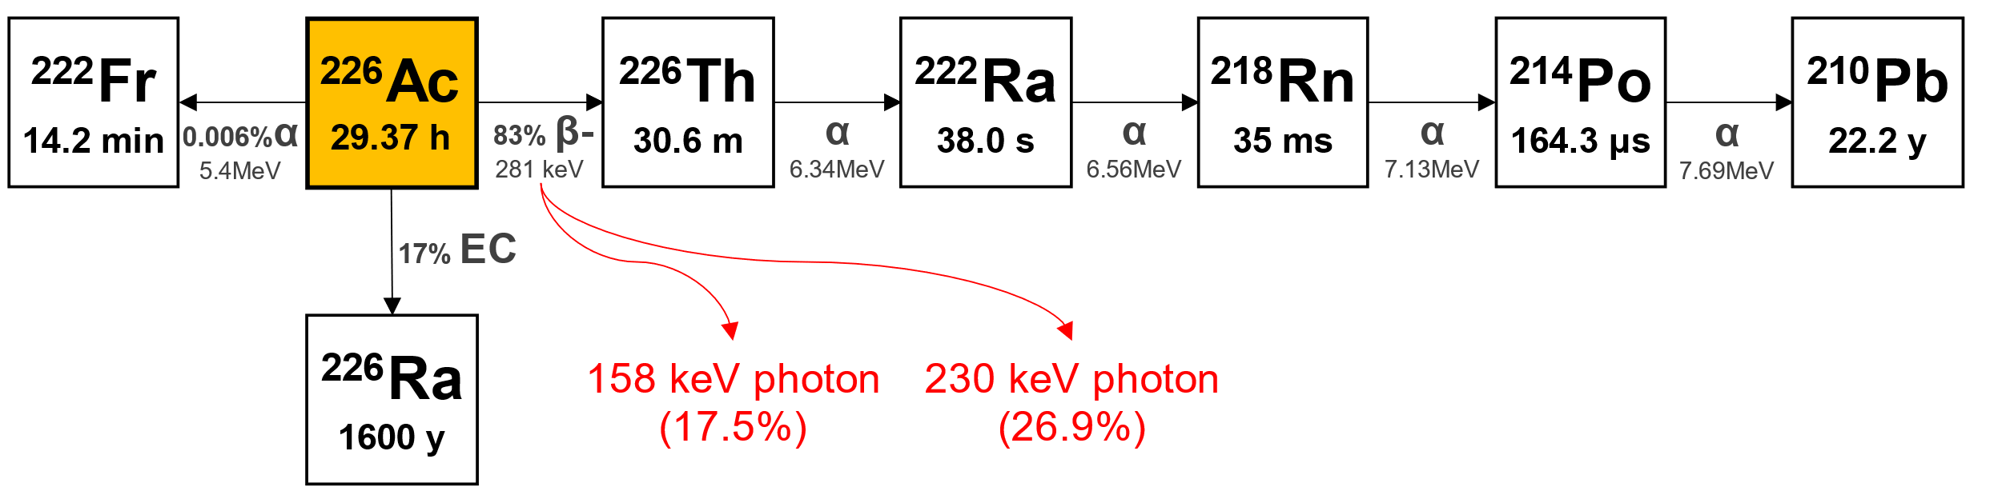
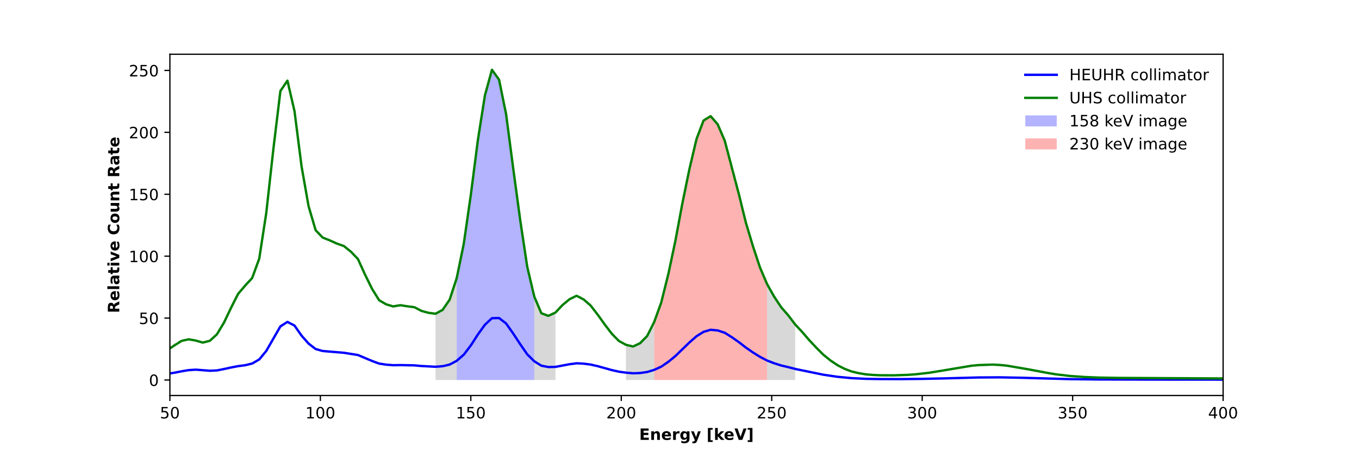
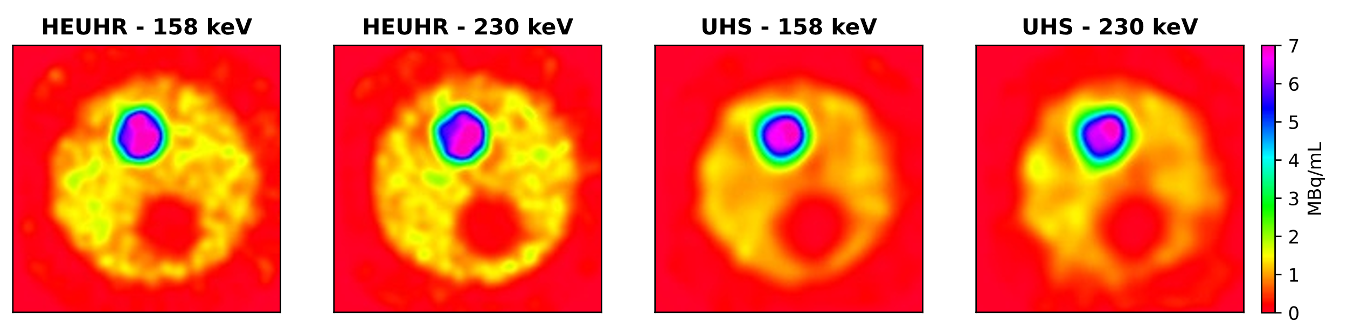
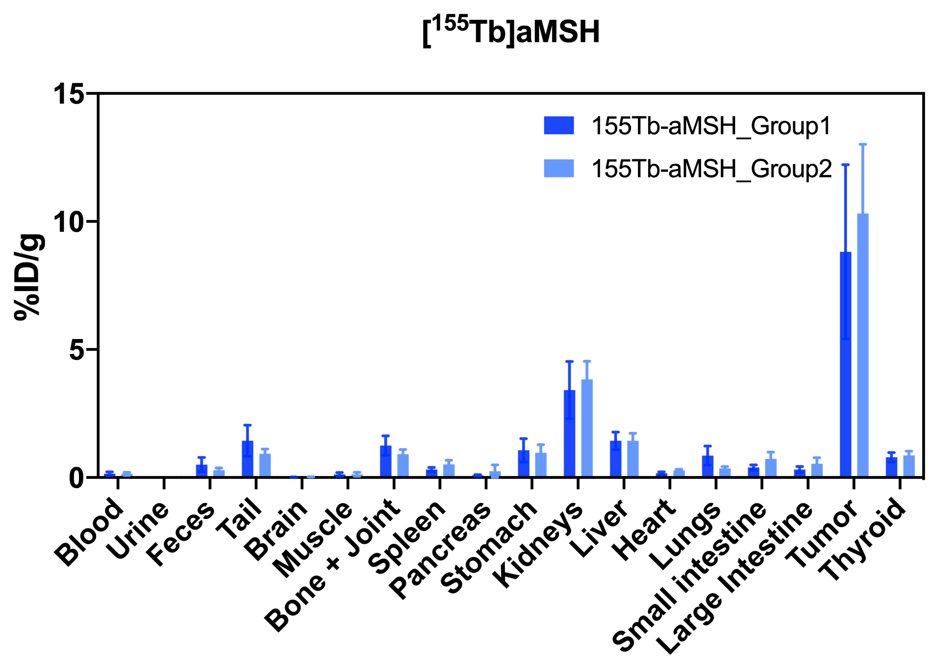
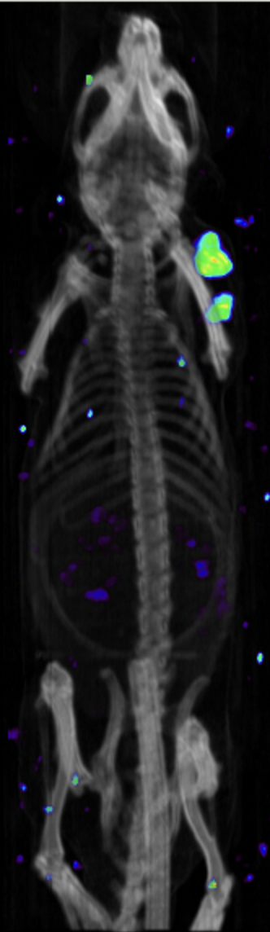

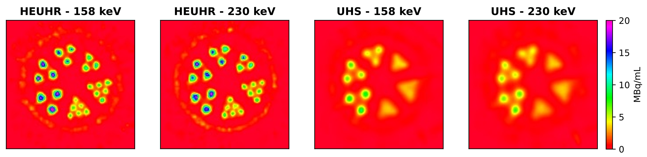
ISAC/ISOL for R&D into unconventional radionuclides
[¹⁵⁵Tb]Tb-crown-αMSH SPECT , 2h p.i.,
[¹⁵⁵Tb]Tb-crown-αMSH Biodistribution 2 h p.i.
High contrast images
Good tumour uptake
[²²⁶Ac]-crown-TATE Biodistribution 24 h p.i.

Slide 21
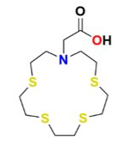
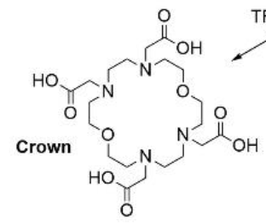
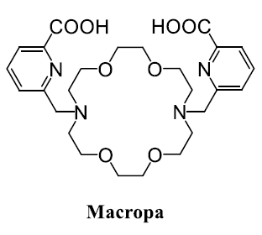
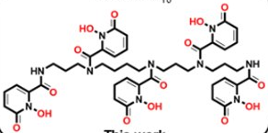
Radiopharmaceuticals Development
Macrocyclic chelates:
¹⁹⁷Hg
²²⁵Ac, ²¹³Bi, ¹⁵⁵Tb, ¹⁷⁷Lu
Different metals have different bond requirements
Continued pursuit of optimized chelates for Gen 4 radiopharmaceuticals:
  Novel synthesis, labeling
  Ideal conditions: low conc (<10⁻⁶M), fast (minutes), neutral pH, ambient temp.
  Bifunctional molecular ‘handle’ to enable controlled conjugation to targeting agents
Acyclic chelates:
²²⁵Ac, ²¹³Bi, ²⁵⁵Tb, ¹⁷⁷Lu

Slide 22
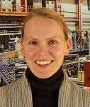
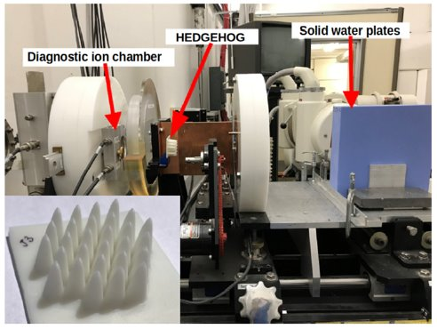
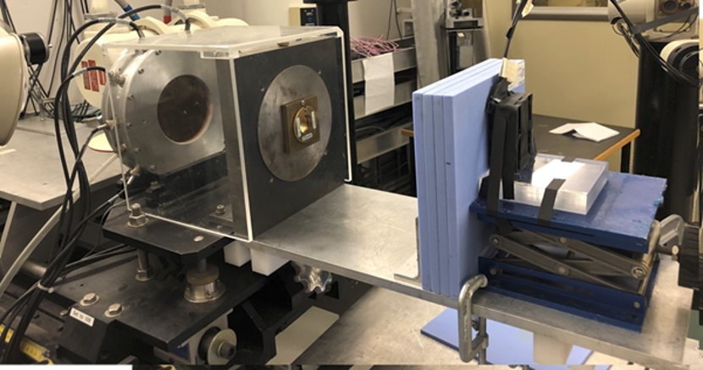
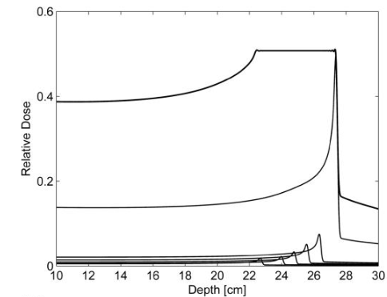
Proton (and photon) FLASH at TRIUMF
Continue building on decades of PT experience at TRIUMF
Goal: research ways to enhance therapeutic index for proton therapy
  Use FLASH effect: deliver therapeutic dose to target tissue in minimal time; spare surrounding healthy tissue
Measure irradiation effects on cell cultures
Develop novel technologies that provide real time feedback on dose delivery (see fiber work C Hoehr talk Monday)
  Apply to relevant adjacencies (i.e. isotope production tgts)
Continue to nurture international collaborations inherent to the effort
Notes:
What I have now, and I’ll mention some of the next steps

Slide 23
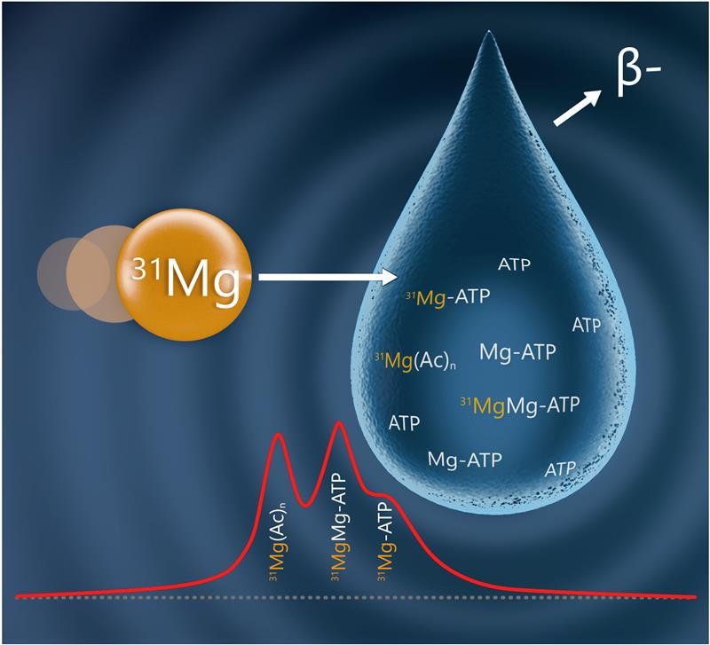
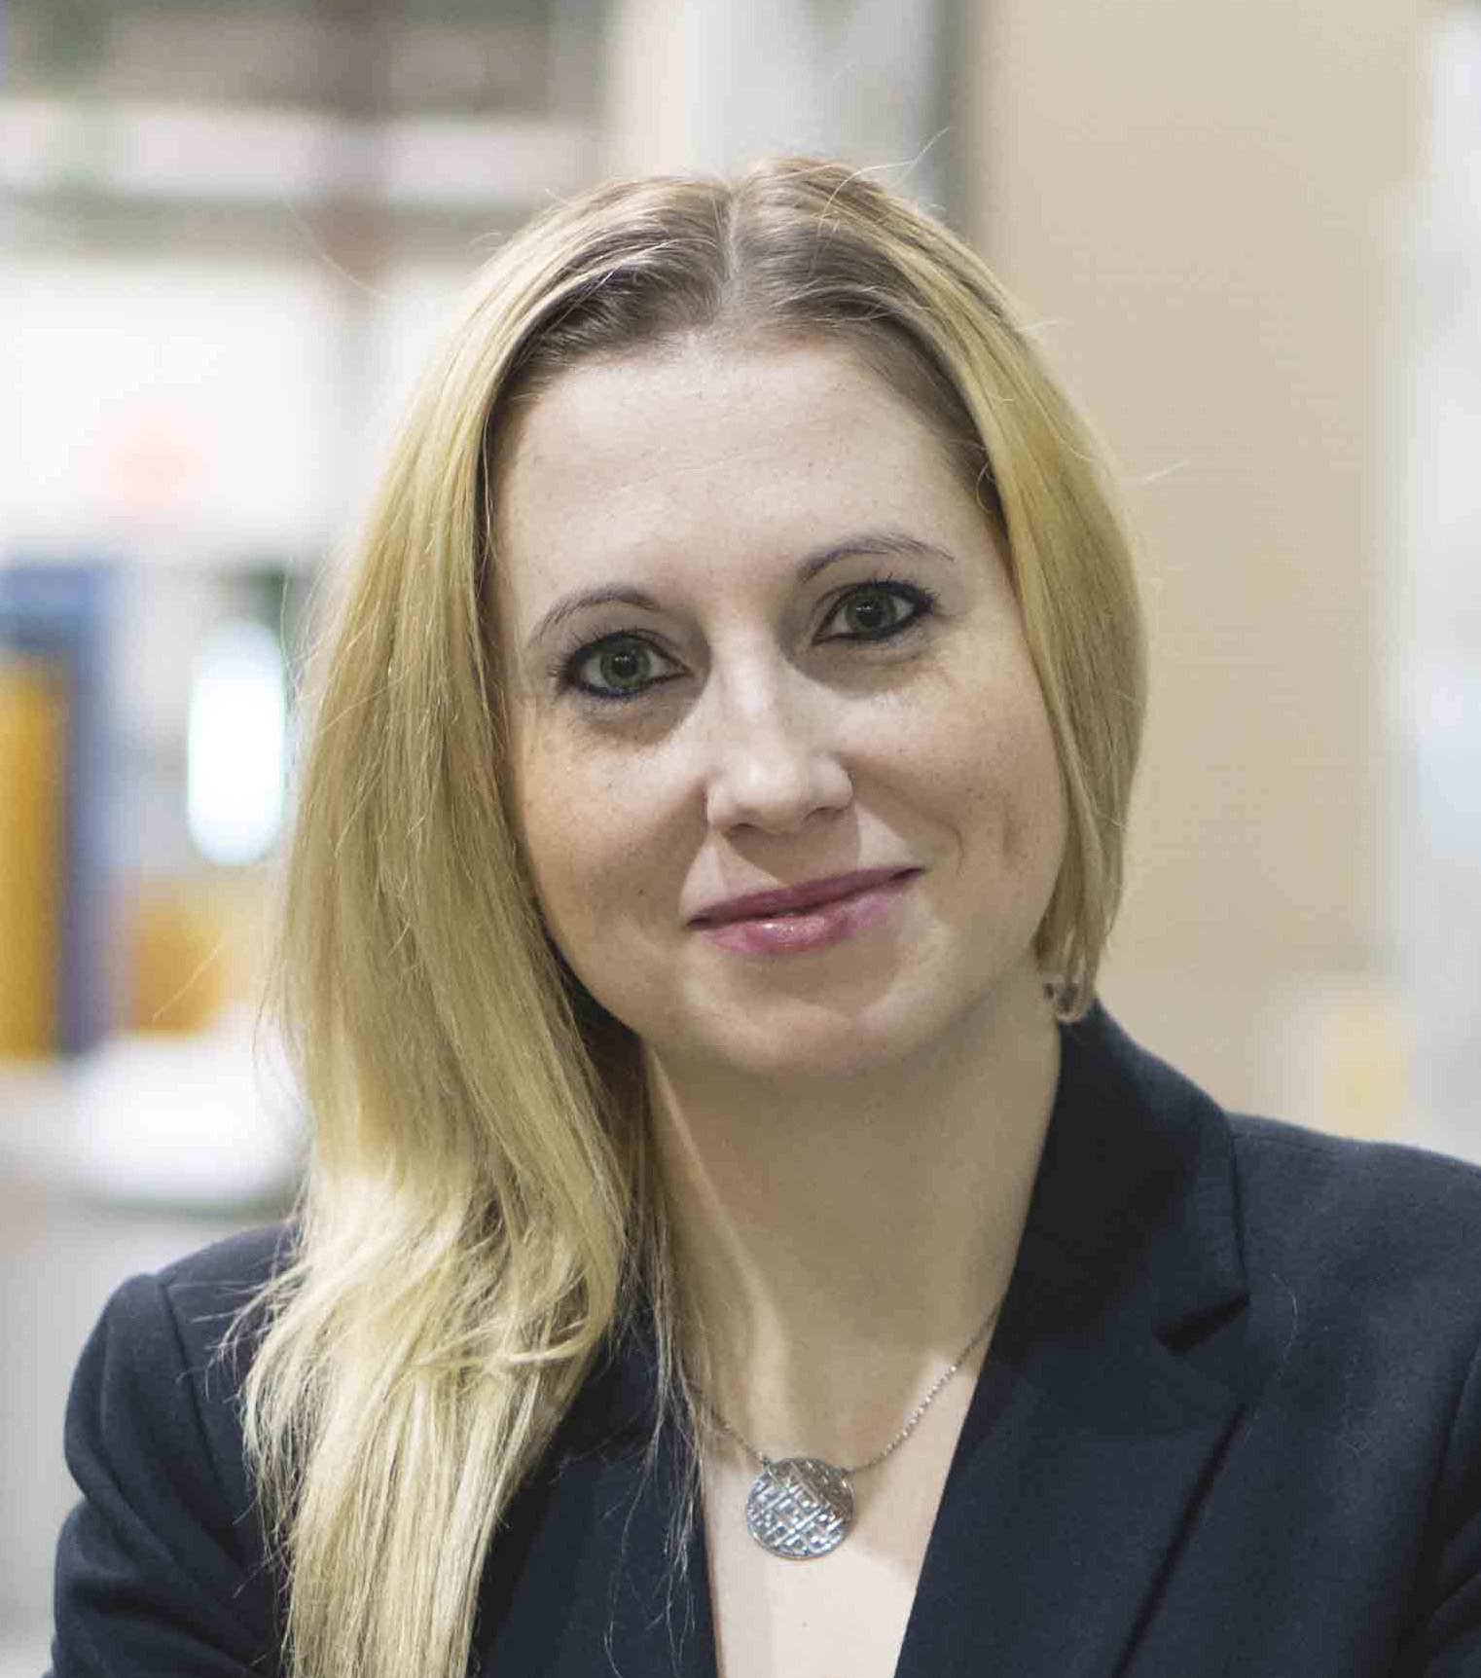
Bio-βNMR at TRIUMF
Current interests:
³¹Mg + ⁸Li (routine)
^{58/74}Cu (under development)
^{226,230}Ac (under development)
Attributes:
Unique, high-impact science;
International collaboration;
Private sector interest;
Threats: beam availability

Slide 24
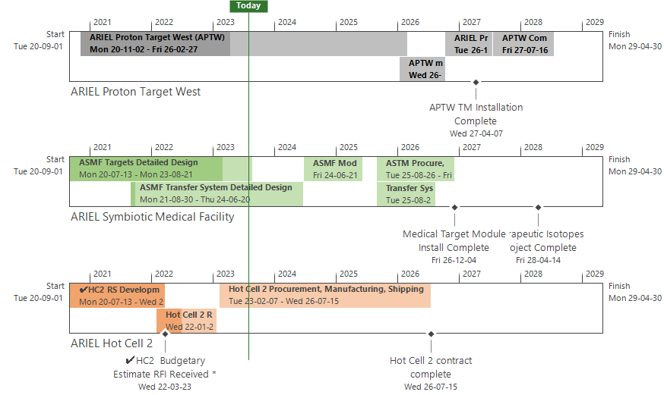
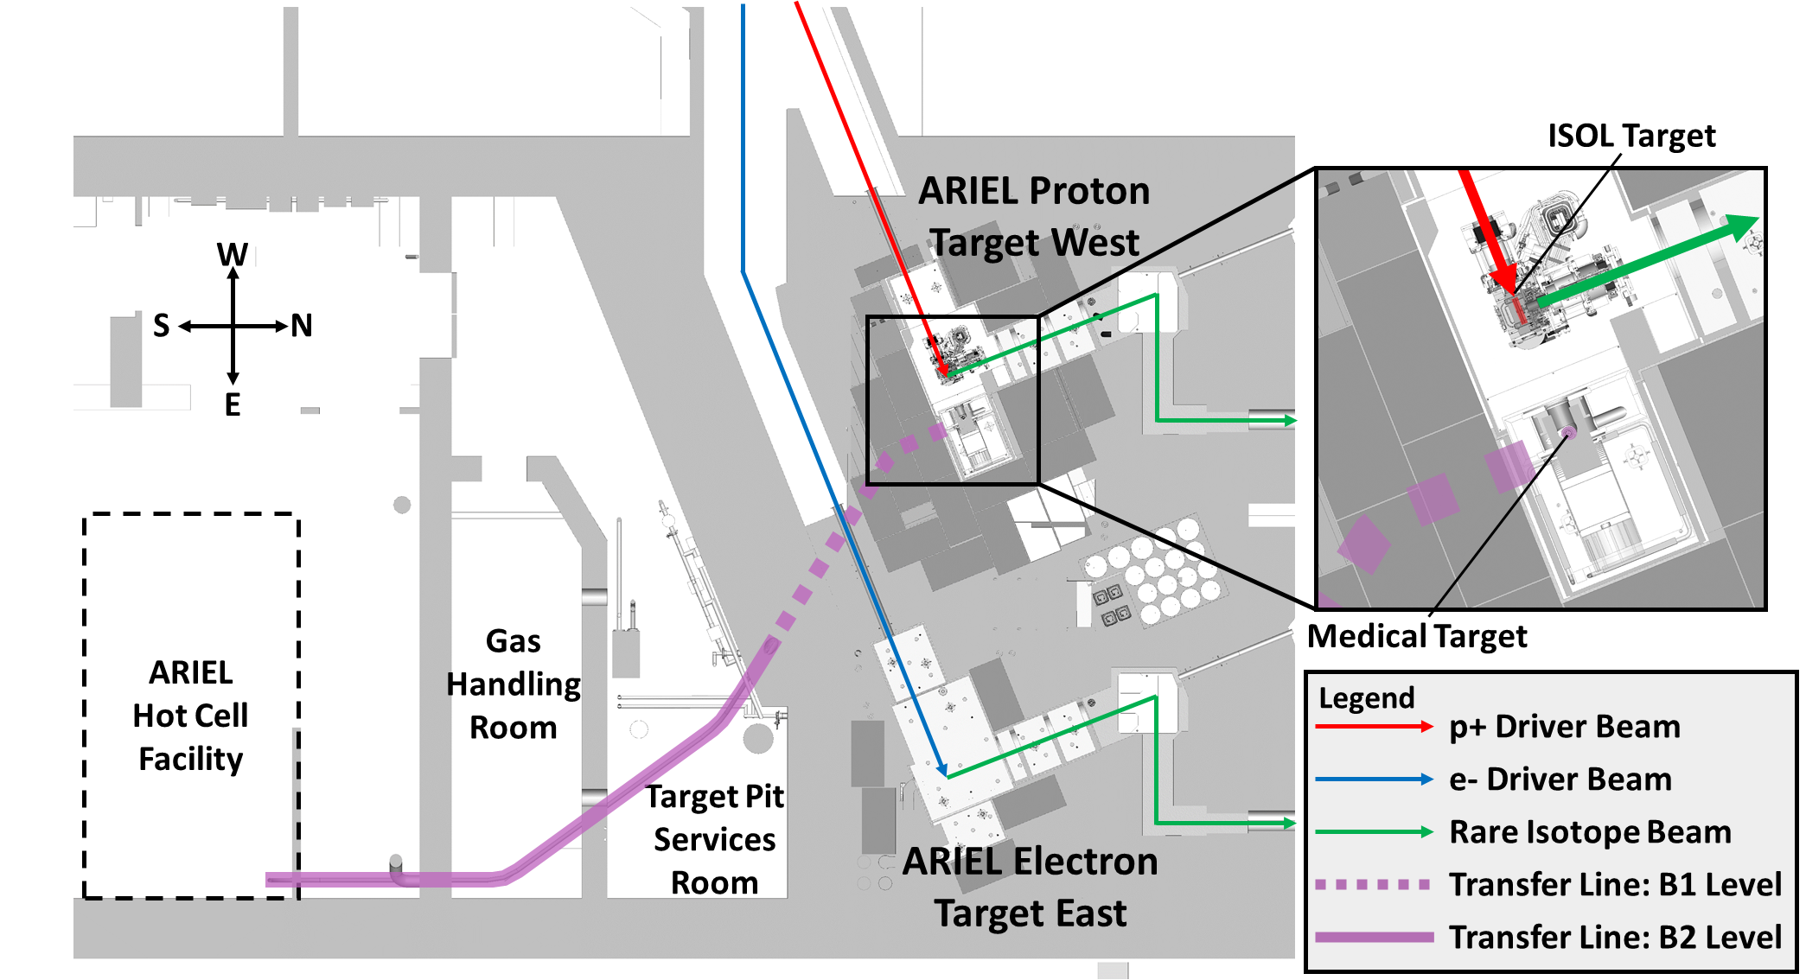

Complete ARIEL (P405 – Symbiotic Isotope Production)
Design efforts underway:
Development effort paced with APTW
  RFI for Hot cell 2 completed
  Re-baseline from updated cost estimates
ASMF Targets Design development
  Medical Target testing complete
  Feasibility testing of Target Module being underway
Team:
Hiring of Qualified personnel is proving to be challenging
AMSF scope being split into technical WBS leadership
  Medical Module → P353 Target Stations
  Transfer System → P424 Target Hall Infrastructure
  Hot Cell Integration → P487 Hot Cell
5YR Outlook
Implementation of promised scope in CFI to continue as planned
Integration of processing of Medical targets inside Hot Cell 1
Therapeutic Isotope Commissioning planned for October 2027
Estimated project completion April 2028
Notes:
Key Points:
Updated cost estimates received from HC2 RFI activity
Estimated costs significantly over budget due to inflation in the past 3 years.
Re-baseline of promised scope being evaluated with the funding available
Efforts underway to develop implementation plan with updates costs for integration of intended scope within HC1
P405 being transitioned into a technical leadership WBS model with sub-modules being integrated into respective ARIEL modules
Medical targets and Module -> P353 (Target Modules- Thomas Day Goodacre)
Transfer line and pneumatic transfer system -> P424 (Target Hall Infrastructure- Mike Vogel)
Hot Cell and Medical Target Processing -> P487 (Hot Cell 1- Adam Newsome)
We have had difficulties in hiring and retaining HQP, especially engineering, as a result of which the project is behind schedule (10 months and counting).
Outlook
Development effort being paced with APTW development
Commissioning planned for October of 2027
Project completion date (estimated): April 2028

Slide 25
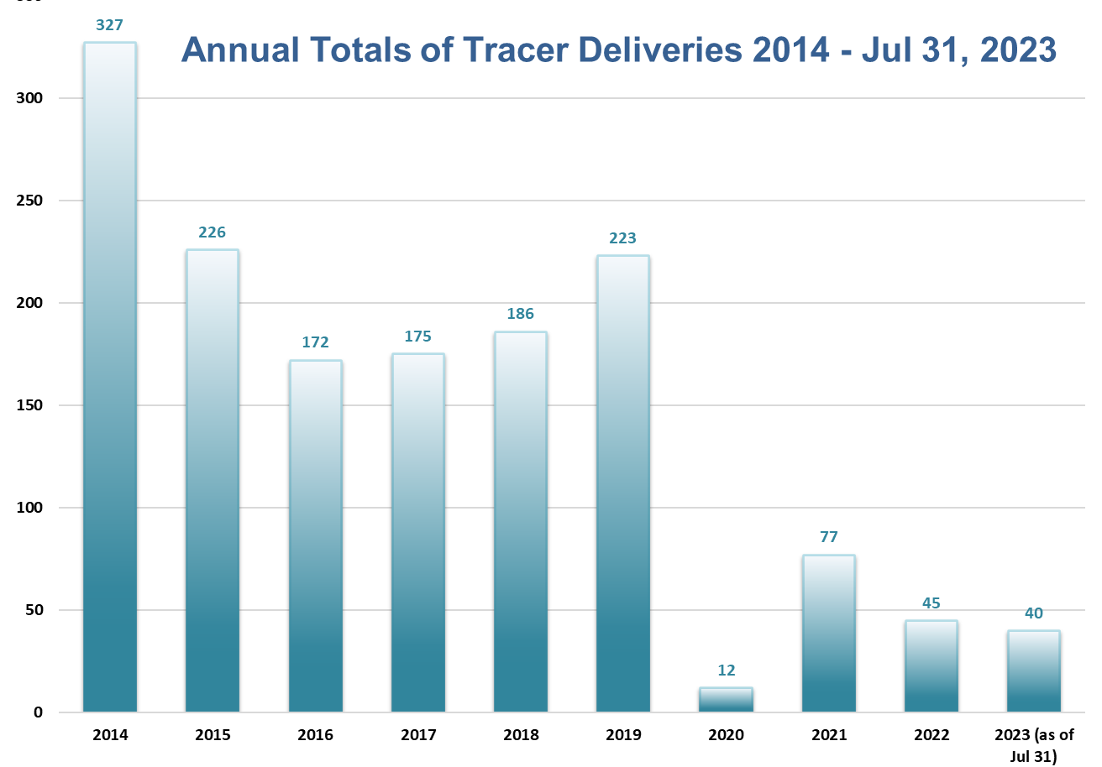
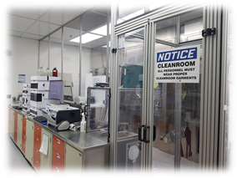
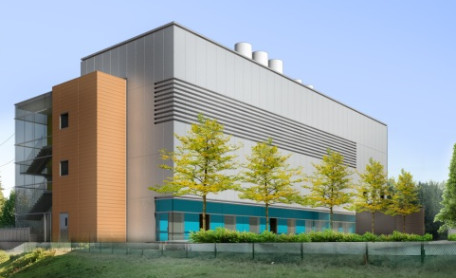
UBC; BC Cancer tracer supply
Status on Tracer deliveries:
  Deliveries of [¹¹C] tracers to UBC resumed in January 2021
  Low demand for tracers continues to be challenging
  TRIUMF has met production reliability targets that were mutually agreed upon
  BC Cancer no longer utilizing F-DOPA as a clinical tracer
    Replaced with [⁶⁸Ga]DOTATOC
Status on advancing GMP compliance:
  265 GMP documents released (over 80 documents have gone through multiple releases)
  All tracer production is now performed under GMP conditions
  Continuous improvements have been made on the implementation of GMP processes.
    (100 Change Controls, 64 CAPAs have been filed and put into effect since 2021 Jan)
  New GMP Lab 007 coming online soon pending Engineering Services close-out
Getting ready for the IAMI era
Clean lab for F-18 radiotracer production.
Tc-99m production Implementation to support PHSA.
Ac-225 production to collaborate with Fusion and other commercial partners.

Slide 26


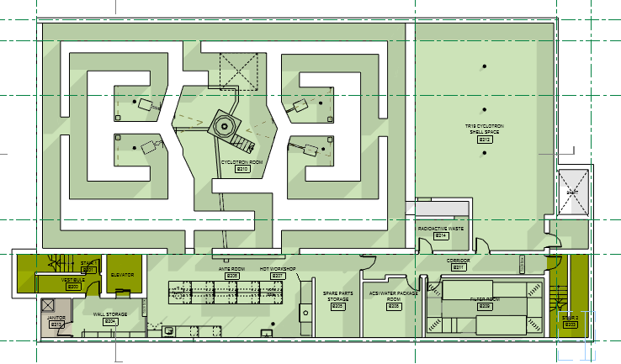
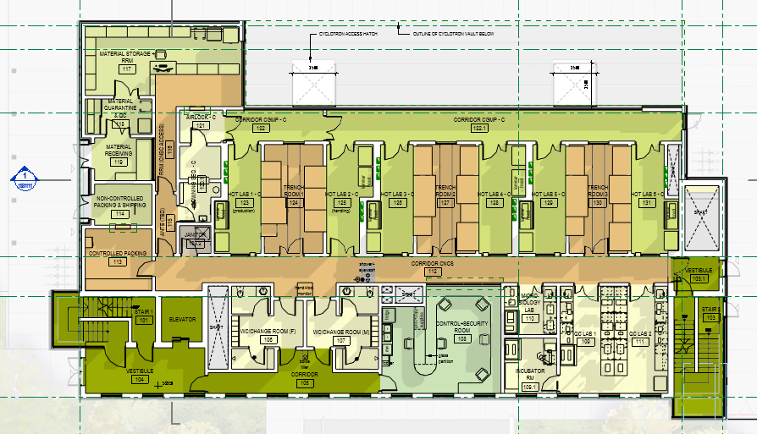
IAMI (P442)
includes P471, P550, P527
  Construction substantially complete
  BC Provincial Health Authority will be placing 2nd cyclotron in facility; additional lab space to support expanding provincial PET program
  Additional funding requests continue in discussion with provincial funding ministries
  If all remaining funding materializes, expect operations to commence in 2025
Notes:
P471 notes: 2 liquid targets procured, installation by ACSI concurrent with TR24
procurement for components for1 solid target station underway; gate 3 passed March 2022 Target station installation by Dec 2022
;

Slide 27
IAMI (P442)
includes P471, P550, P527
  Construction substantially complete
  BC Provincial Health Authority will be placing 2nd cyclotron in facility; additional lab space to support expanding provincial PET program
  Additional funding requests continue in discussion with provincial funding ministries
Notes:
P471 notes: 2 liquid targets procured, installation by ACSI concurrent with TR24
procurement for components for1 solid target station underway; gate 3 passed March 2022 Target station installation by Dec 2022
;

Slide 28
IAMI: Operations Model
Current proposal (pending full review, ratification by TRIUMF Board, Partners):
Operations and Governance will evolve through phases: Start-up through to Full Ops
Start-up operations occur in an integrated fashion within an existing, albeit modified Life Sciences organization. Operations supported by TRIUMF and partners;
Full operations are initiated once IAMI crosses a legal, financial or administrative threshold that has yet to be determined
Governance will be achieved through a Steering Committee that will recommend resource allocation to meet IAMI program objectives, including balance between R&D and revenue-generating activities
Next steps:
  Ratification of Operating and Governance Models
  Finalization of Business Plan – collaborate with TRIUMF Innovations

Slide 29
Proposed IAMI Start-up Governance
Science Advisory Committee (LSPEC?)
TRIUMF Executive Director
IAMI Steering Committee
Meets annually
Advises on new areas, global trends
Meets quarterly
Sets strategic direction/priorities
Ensures alignment of operations
Discusses/resolves issues from Ops
Director
Life Sciences
IAMI Operations Committee
IAMI Steering Committee composition (in principle):
  appointees (incl. chair) from TRIUMF, BCC and UBC
Director
IAMI Operations
Meets monthly
Manages/coordinates scheduling, operations
Facilities communications
Discusses and resolves issues
Status:
1) Phase 1 Lease and Operating Agreements are being finalized
2) LOU and LOI for expanded efforts are signed
3) Business and operating plans are being updated now that partner activities are becoming more well defined
4) Steering and Operating Committee Terms of References are finalized
5) Services Agreement for expanded effort has been drafted and is under review
6) Sublease for expanded effort is being drafted

Slide 30



NFRF-Transformation: Rare Isotopes to Transform Cancer Therapy
$23.7 mil over 6 years
NPI: Bénard (UBC/BC Cancer)
Co-PI: Ramogida (SFU/TRIUMF)
TRIUMF Team: Hoehr, Radchenko, Schaffer, Yang
Notes:
NFRF-T is a >$23mil effort over 6 years. A cross-Canada collaboration of scientists and clinicians from >10 facilities.
Research in 5 intersecting Aims which cover all aspects of radiopharmaceutical development from “beamline” to bedside, including social and health economic impacts. TRIUMF will play a key role in the production of medically relevant isotopes such as Ac-225, Pb-212, Bi-213, and supply of the isotopes to reach clinical demand. We will cement Canada as a technology exporter rather than importer, and secure an arsenal of powerful new targeted therapies to treat Canadians suffering from metastatic cancer.

Slide 31
Summary
The Life Sciences Division is nearing completion of several major facility buildouts and renovations
Current strategic priorities remain as IAMI, ARIEL, therapeutic isotopes
Future initiatives to continue focusing on building LS capabilities and infrastructure; leveraging both to foster strategic partnerships
  Includes operating IAMI, ARIEL
  investing in:
    BL1A
    Expansion of TRIUMF’s isotope, radiochemistry and radiopharmaceutical portfolio
    Strategic directions re: FLASH, bio βNMR

Slide 32
Our 20 Year Vision for Life Sciences
Think Big
Pursue Creative, Impactful Science
TRIUMF is inherently multidisciplinary and translational, brining together science, creativity, innovation and novel infrastructure; encouraging and inviting collaborators from around the world to answer some of life’s most difficult questions.
Be Different
Apply Physics to Life
TRIUMF Life Sciences will be an engine that applies accelerator science toward the study of life – in order to derive maximum societal benefit.
TRIUMF has globally unique infrastructure, rare talent, and an innovative mindset to better life for all.
Be Bold
Train and Send Forth World-Class Talent
Creative, impactful research will be woven into the cultural fabric of TRIUMF Life Sciences; training a generation of innovative thought and technology leaders to work collaboratively across disciplines to ask tough questions and derive elegant answers.

Slide 33





Thank you
www.triumf.ca
Follow us @TRIUMFLab

Slide 34

Replace BL1A
Objective: replace, enhance functionality of BL1A
Next step: 2023 CFI Infrastructure Fund application not successful!
Title: TRIUMF High-Energy Accelerator Proton Irradiation Experiments (THErAPIE)
$28+M budget ($9.7M from CFI) involving 9 institutions across 4 provinces
  Two Research Programs:
    Radioisotopes & Radiopharmaceuticals
      Isotope production, radiochemistry,
      generators, radiopharmaceuticals
    Quantum Chemistry & Materials
      Quantum materials, green chemistry,
      new energy technologies

Slide 35



FLASH Proton and X-ray Therapy (P490)
Objective: establish go/no-go for larger-scale infrastructure investment at TRIUMF
Current Status: Feasibility (NFRF-Exploration grant) with animal studies underway
Next steps: prepare CFI application (2025)
Notes:
Currently two bNMR spectrometers in the ISAC-I hall: high-field bNMR spectrometer (9T), and low-field bNQR spectrometer (230 G). Both of them are optimized for experiments in high vacuum (ultra clean environment for materials science applications). None of the existing spectrometers is is compatible with experiments in aqueous solutions. The pending CFI applications is for building a novel bNMR spectrometer dedicated to and optimized for biological, chemical and medicinal applications.
In meantime, we are using the existing infrastructure to run experiments with ionic liquids (salts that are molten at room temperature), like EMIM-Ac. Over the past 5 years we used bNMR to study different salts and biomolecules in EMIM-Ac. The above picture shows how we use the existing high-field spectrometer to carry out expeirments with liquids (very limited applications, but still doable).

Slide 36
Expand bio-β-NMR (P382, P464)
Objective: enhance bio-βNMR infrastructure at TRIUMF
Next steps: prepare CFI application (2025)
7T bNMR
bio-β-NMR spectrometer
P464 (POLARIS)
P382 (bio-β-NMR)
3T bNMR
SMuRF spectrometer
0.2T bNMR spectrometer
(CMMS, PSD)
4e
4e
CMMS spectrometers
4e
9T bNMR spectrometer
(CMMS, PSD)
CFI 2025
Existing at ISAC-I
ISAC-I RIB
(Accelerator Div)
Polarizer
(Accelerator Div)
Notes:
Currently two bNMR spectrometers in the ISAC-I hall: high-field bNMR spectrometer (9T), and low-field bNQR spectrometer (230 G). Both of them are optimized for experiments in high vacuum (ultra clean environment for materials science applications). None of the existing spectrometers is is compatible with experiments in aqueous solutions. The pending CFI applications is for building a novel bNMR spectrometer dedicated to and optimized for biological, chemical and medicinal applications.
In meantime, we are using the existing infrastructure to run experiments with ionic liquids (salts that are molten at room temperature), like EMIM-Ac. Over the past 5 years we used bNMR to study different salts and biomolecules in EMIM-Ac. The above picture shows how we use the existing high-field spectrometer to carry out expeirments with liquids (very limited applications, but still doable).

