Slide 1
Wutharath Chin, Claudine Crépin-Gilbert Julie Douady, Benoit Gervais, Erwan Hochard, Emmanuelle Jacquet, Raphael Photopoulos Chloé Malbrunot Benoit Darquié, Mathieu Manceau, Hemanth Dinesan
Cesium atoms embedded in cryogenic argon for electron EDM measurement
Thomas Battard, Daniel Comparat, Sébastian Lahs

Slide 2
Outline
EDM worldwide → why EDM
Why in cryogenic solid: EDMMA project (Cs in Ar)
Experimental setup: Cs absorption spectra
Possible trapping sites: stability study
Line position
Line broadening
Possible improvement

Slide 3
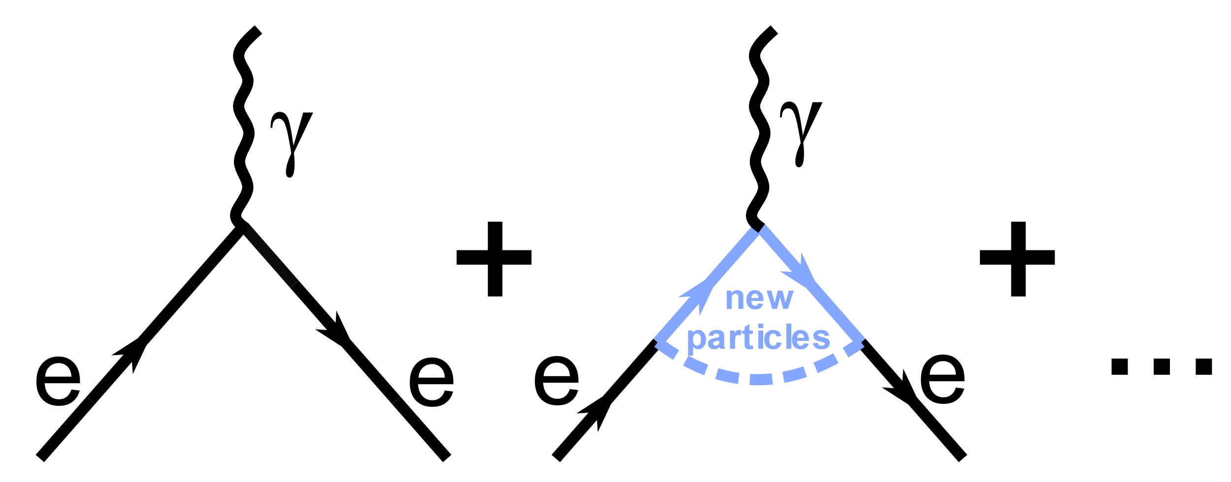
electron-EDM: P and T violation CPT→ CP violation (can explain matter/antimatter asymmetry: Sakharov)
Conserved parity P (r → -r)
Time reversal T (t→ -t)
Charge conjugaison C (q→-q)
+
-
T
P
-
electric
charge
EDM
electron charge
distribution?
+

Slide 4
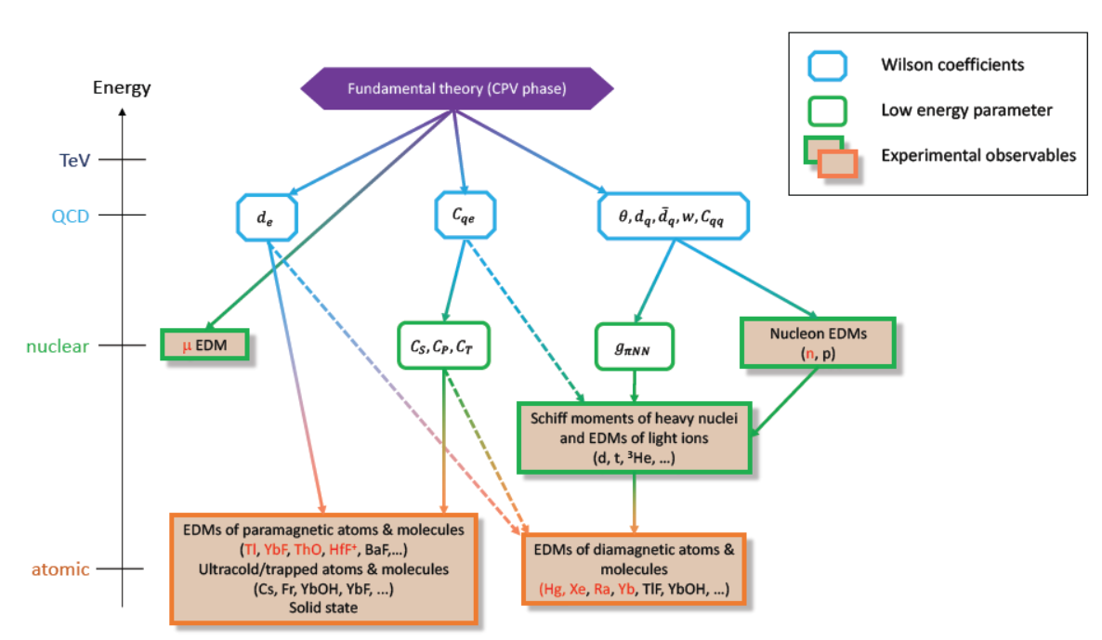
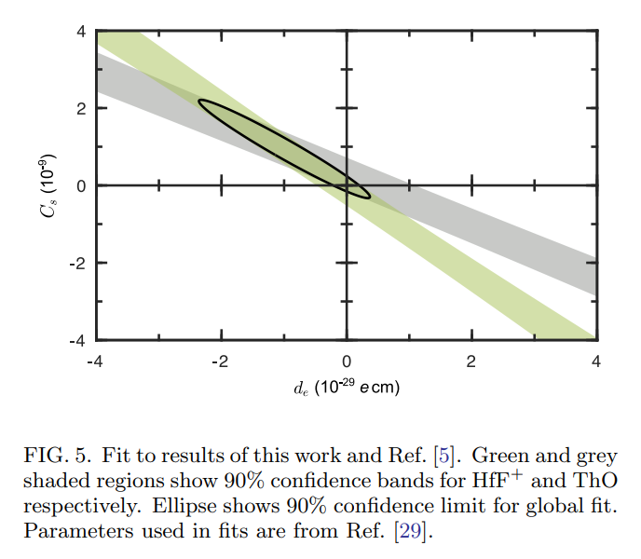
Link between high energy and (very)low energy physics
https://arxiv.org/pdf/2212.11841.pdf
Blum, T., Winter, P., Bhattacharya, T., Chen, T. Y., Cirigliano, V., DeMille, D., ... & Semertzidis, Y. K. Fundamental Physics in Small Experiments. arXiv preprint arXiv:2209.08041.

Slide 5
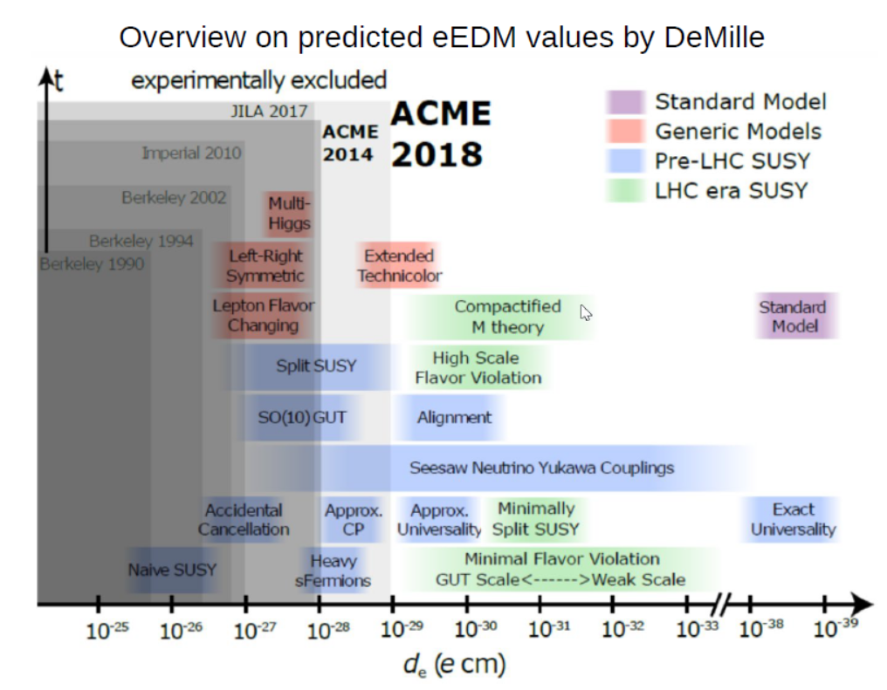
Predicted electron electric dipole moments
(compiled by D. DeMille)
A new bound on the electron’s electric dipole moment (X-mass 2022 JILA with HfF⁺)
Super high energy physics with table top experiments
0.05 0.5 5 50 500 5000
One loop (TeV)
0.005 0.05 0.5 5 50 500
Two loops (TeV)

Slide 6
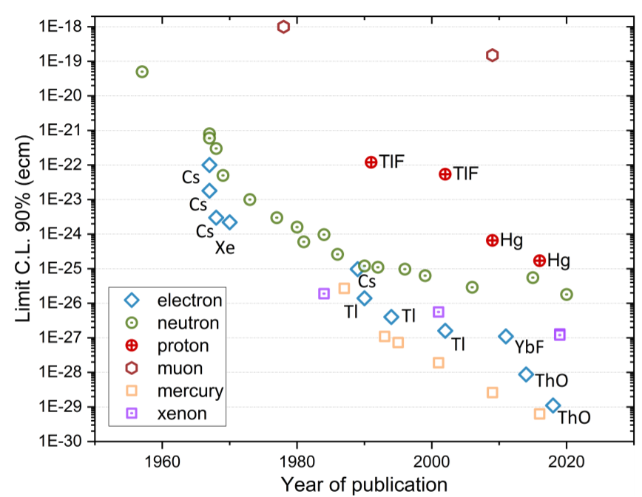
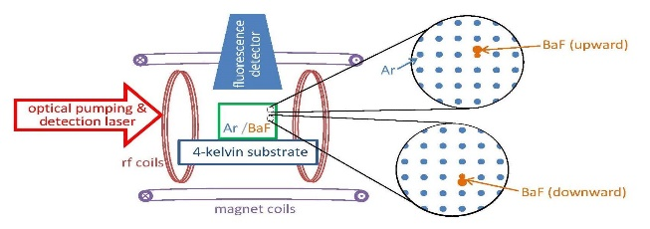
EDM status and project
Ideal
N big
τ long
Particle | N_{T} time integrated | Time τ [s] | Polarization ε | Eff. Field E_{eff} (V/cm) | EDM e.cm
Cs | 10¹⁴ | 0.015 | 0.7 | 5 10⁵ | 1 10⁻²⁶
ThO | 10¹³ | 0.002 | 0.1 | 10¹¹ | 10⁻²⁹
HgF⁺ | 10¹⁷ | 3 | 0.8 | 2 10¹⁰ | 4 10⁻³⁰
Some EDM history
Electron EDM
predictions
Particle | N_{T} time integrated | Time τ [s] | Polarization ε | Eff. Field E_{eff} (V/cm) | EDM e.cm
Atoms (Cs) in matrix | 10¹⁶ | 0.01 | 0.1 | 10⁶ | 6 10⁻²⁷
 | 10²⁰ | 1 | 1 | 10⁹ | 6 10⁻³⁵
Molecule in matrix | 10¹⁸ | 0.1 | 0.1 | 10¹⁰ | 6 10⁻³³
 | 10²¹ | 1 | 1 | 10¹¹ | 10⁻³⁷
Ni–Zn
ferrite
GdIG
GGG
Eu_{0.5}Ba_{0.5}TiO₃
Beyond
Standard Models
Standard Model
~10⁻³⁸ ecm
Kirch, K., & Schmidt-Wellenburg, P. Search for electric dipole moments.
http://www.yorku.ca/edmcubed/

Slide 7
H=-d.E_{eff} (laboratory field E_{lab} 10kV/cm)
Schiff’s theorem
Need mixed state
Ex: Atoms 1st order (Perturbation Stark effect)
Cs
Ex: Molecule aligned on field

Slide 8
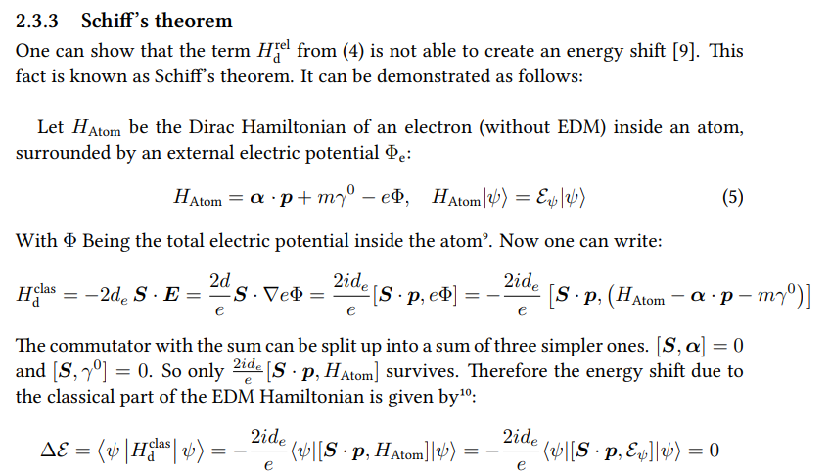

Slide 9
Method | System | NT | τ (s) | ε | Eeff (V/cm) | EDM (e.cm)
Atom | Cs | 10¹⁸ - 10²² | 10⁻³ - 1 | 0,1 - 1 | 10⁶ - 10⁹ | 10⁻²⁷ - 10⁻³⁶
Molecule | BaF | 10²⁰ | 0,1 | 0,1 | 10¹⁰ | 10⁻³⁴
Solid | Eu0,5Ba0,5TiO3 | 10²⁵ | 0,2 | <10⁻¹⁰ | 10⁷ | 6.10⁻²⁵
Gas | ThO HgF⁺ | 10¹³ 10⁷ | 2.10⁻³ 3 | 0,1 0,8 | 10¹¹ 10⁷ | 10⁻²⁹ 4 10⁻³⁰

Slide 10
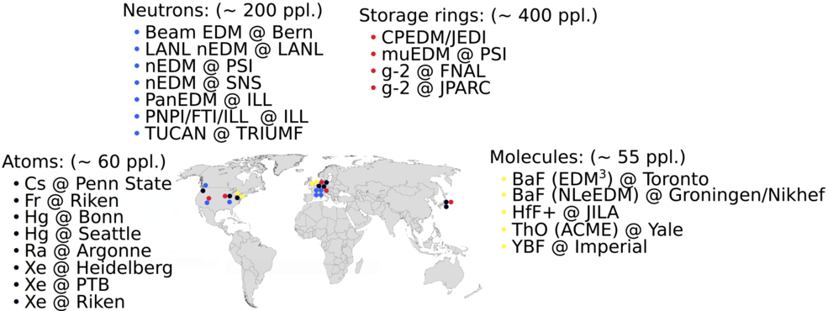
EDM – worldwide (gas phase)
https://www.psi.ch/en/nedm/edms-world-wide
In 2020

Slide 11
Outline
EDM worldwide → why EDM
Why in cryogenic solid: EDMMA project (Cs in Ar)
Experimental setup: Cs absorption spectra
Possible trapping sites: stability study
Line position
Line broadening
Possible improvement

Slide 12
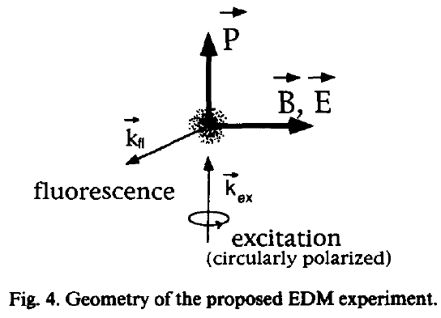
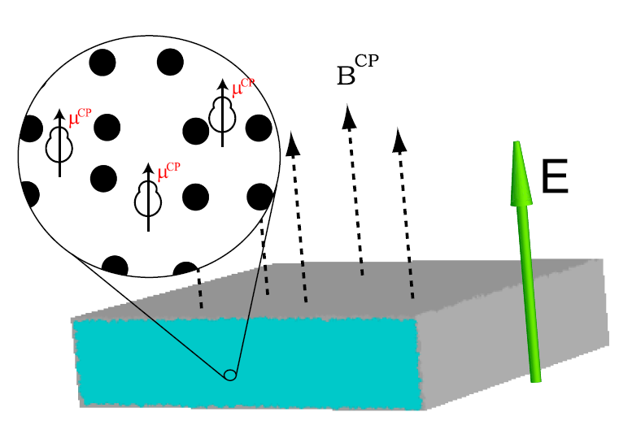
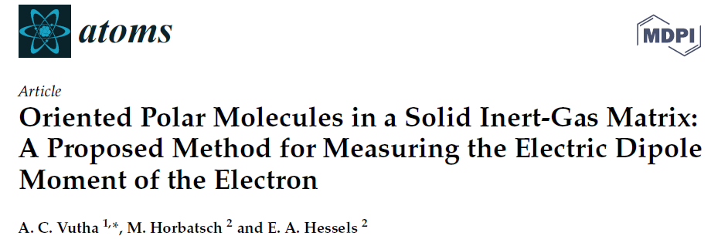
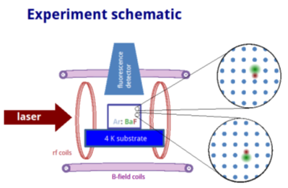
Using cryogenic matrix: An old idea
1987
BaF
YbF
…

Slide 13
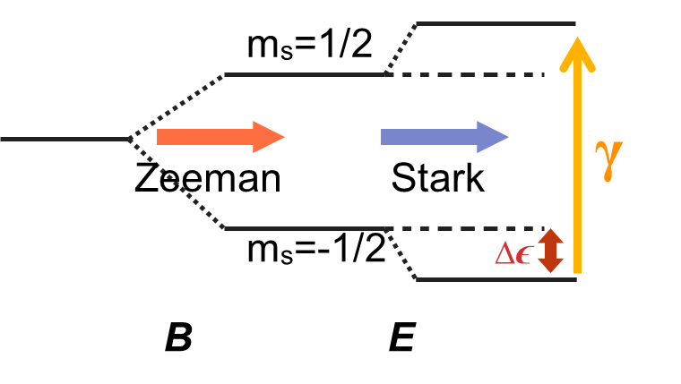
eEDM in solid state systems
year | sample | eEDM limit in e·cm | method
1961 | KCr- & NH4-(SO4)2 12H2O | de < 10⁻¹³ | EPR spectroscopy | Δ Energy = -d.E_{eff}
1963 | Al2O3:Cr & MgO:Cr | de = (1 ± 4.6)x10⁻¹⁶ | EPR spectroscopy
1979 | Nickel-Zink-Ferrite | de = (8.1 ± 11.6)x10⁻²³ | Magnetometry
2004 | GdIG | de = (2 ± 3)x10⁻²⁴ | Voltage measurement | B field, align spin → dipole → Create +/- charges
2011 | GGG | de = (-5.57 ± 7.98stat ± 0.12syst)x10⁻²⁵ | Magnetometry | E field, align dipole→ Spin → Create B field
2012 | Eu0.5Ba0.5TiO3 | de = (-1.07 ± 3.06stat ± 1.74syst)x10⁻²⁵ | Magnetometry
d_{e} // µ
Broken symmetry -> magnetoelectric

Slide 14
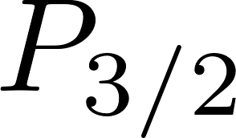
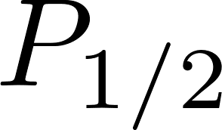
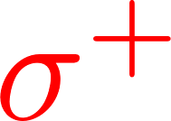
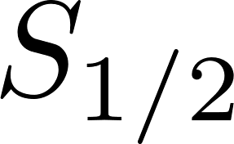
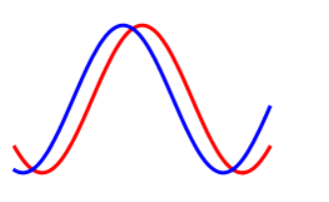
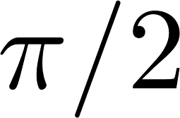
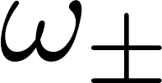
Spin precession
align by optical pumping + coherence
USE ATOMS (circular)
Optical pumping (alignement)
Precession
Readout
population
t
T₁ (population) ~1 s
T₂ (coherence, phase) ~0.1 s (for Cs)
t
B
B
B
1) 2) 3)
E_{eff}
S
S
y
S
y
x
x
-E_{eff}
x
Phys. Rev. A 100, 063419 (2019)

Slide 15
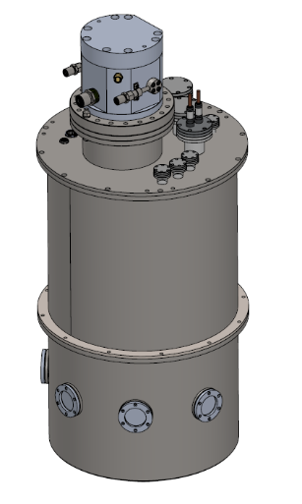
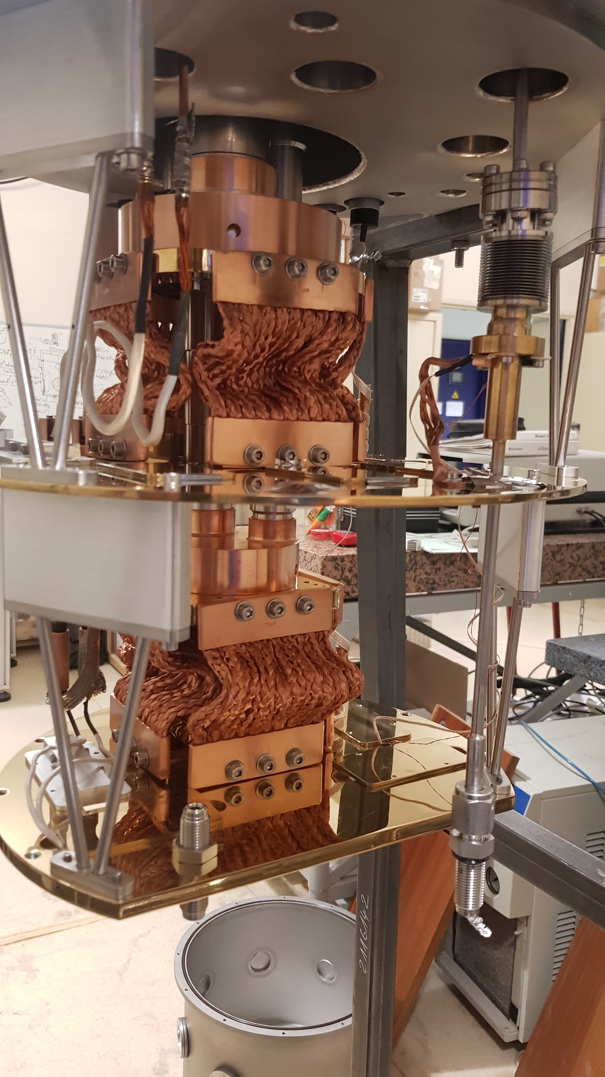
LAC
ISMO (cryogenic matrix)
LPL (RF metrology)
CIMAP (theory matrix)
Substitution
Cryostat
Magnetic
coils
HV
E
analyze
4 vacancies
+ insertion
pump
probe lasers
mycryofirm
RF
coils
Cs
Inert gaz
Fluorescence
More particles N,
Trapped long time τ
Spin : aligned, polarised + optical manipulation (diagnostics)

Slide 16
Outline
EDM worldwide → why EDM
Why in cryogenic solid: EDMMA project (Cs in Ar)
Experimental setup: Cs absorption spectra
Possible trapping sites: stability study
Line position
Line broadening
Possible improvement

Slide 17
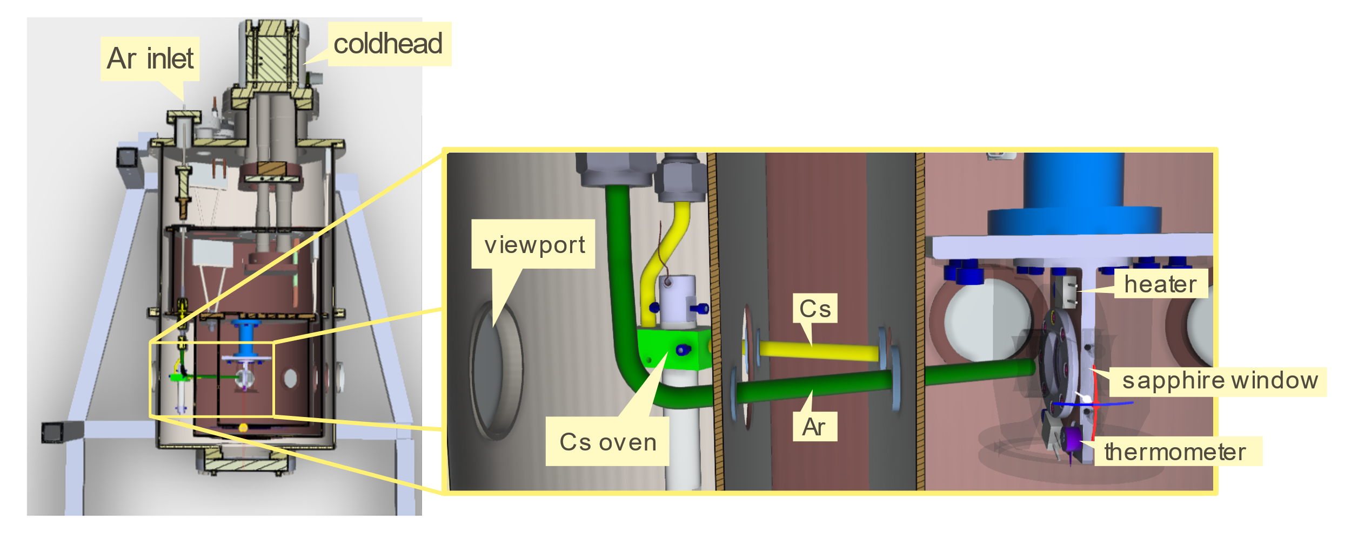
Experimental setup

Slide 18
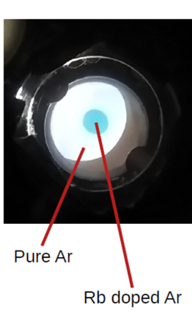
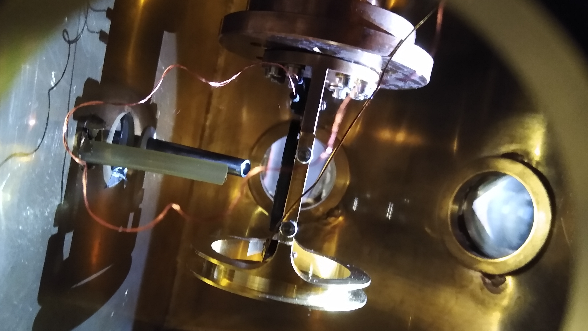
Ar tube
Cs tube
Sapphire windows
Cs or Rb dispenser

Slide 19
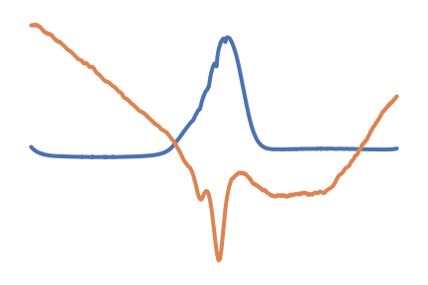
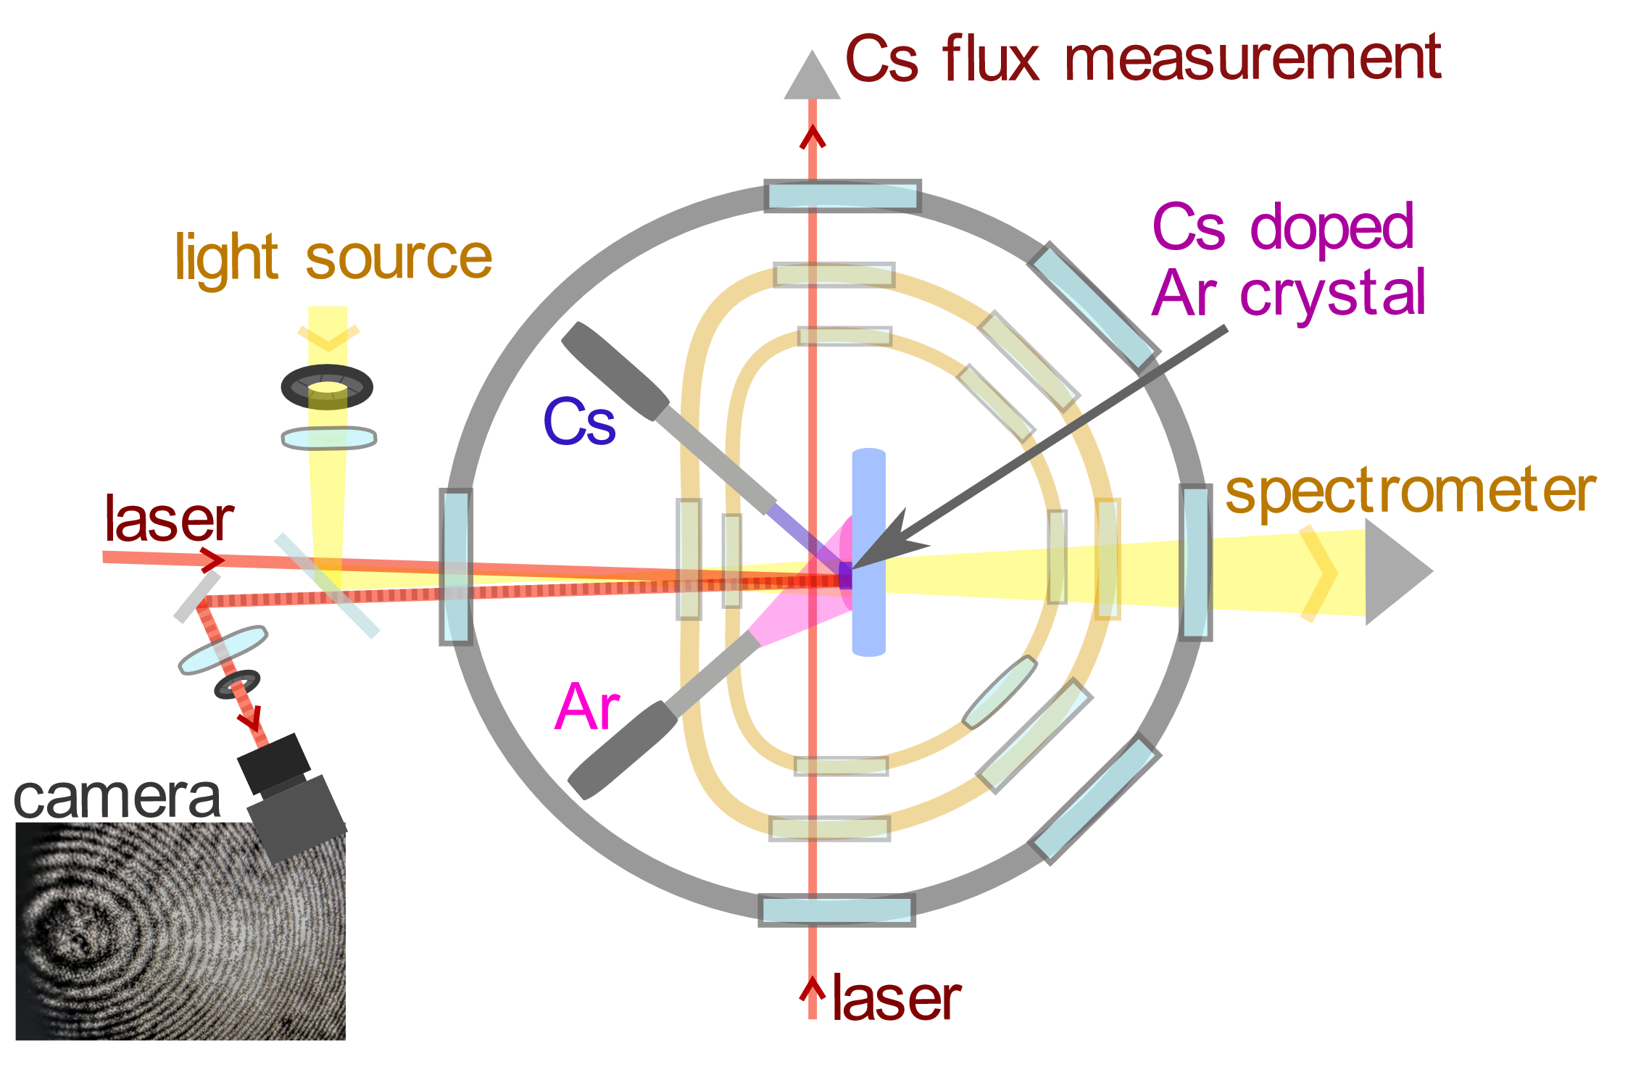
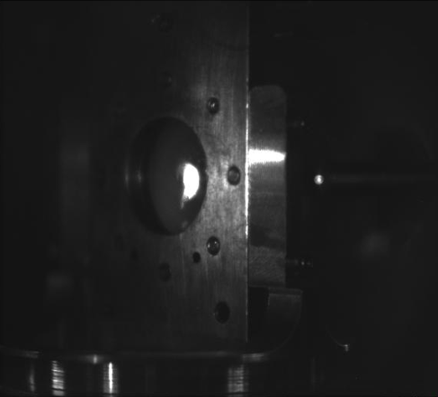
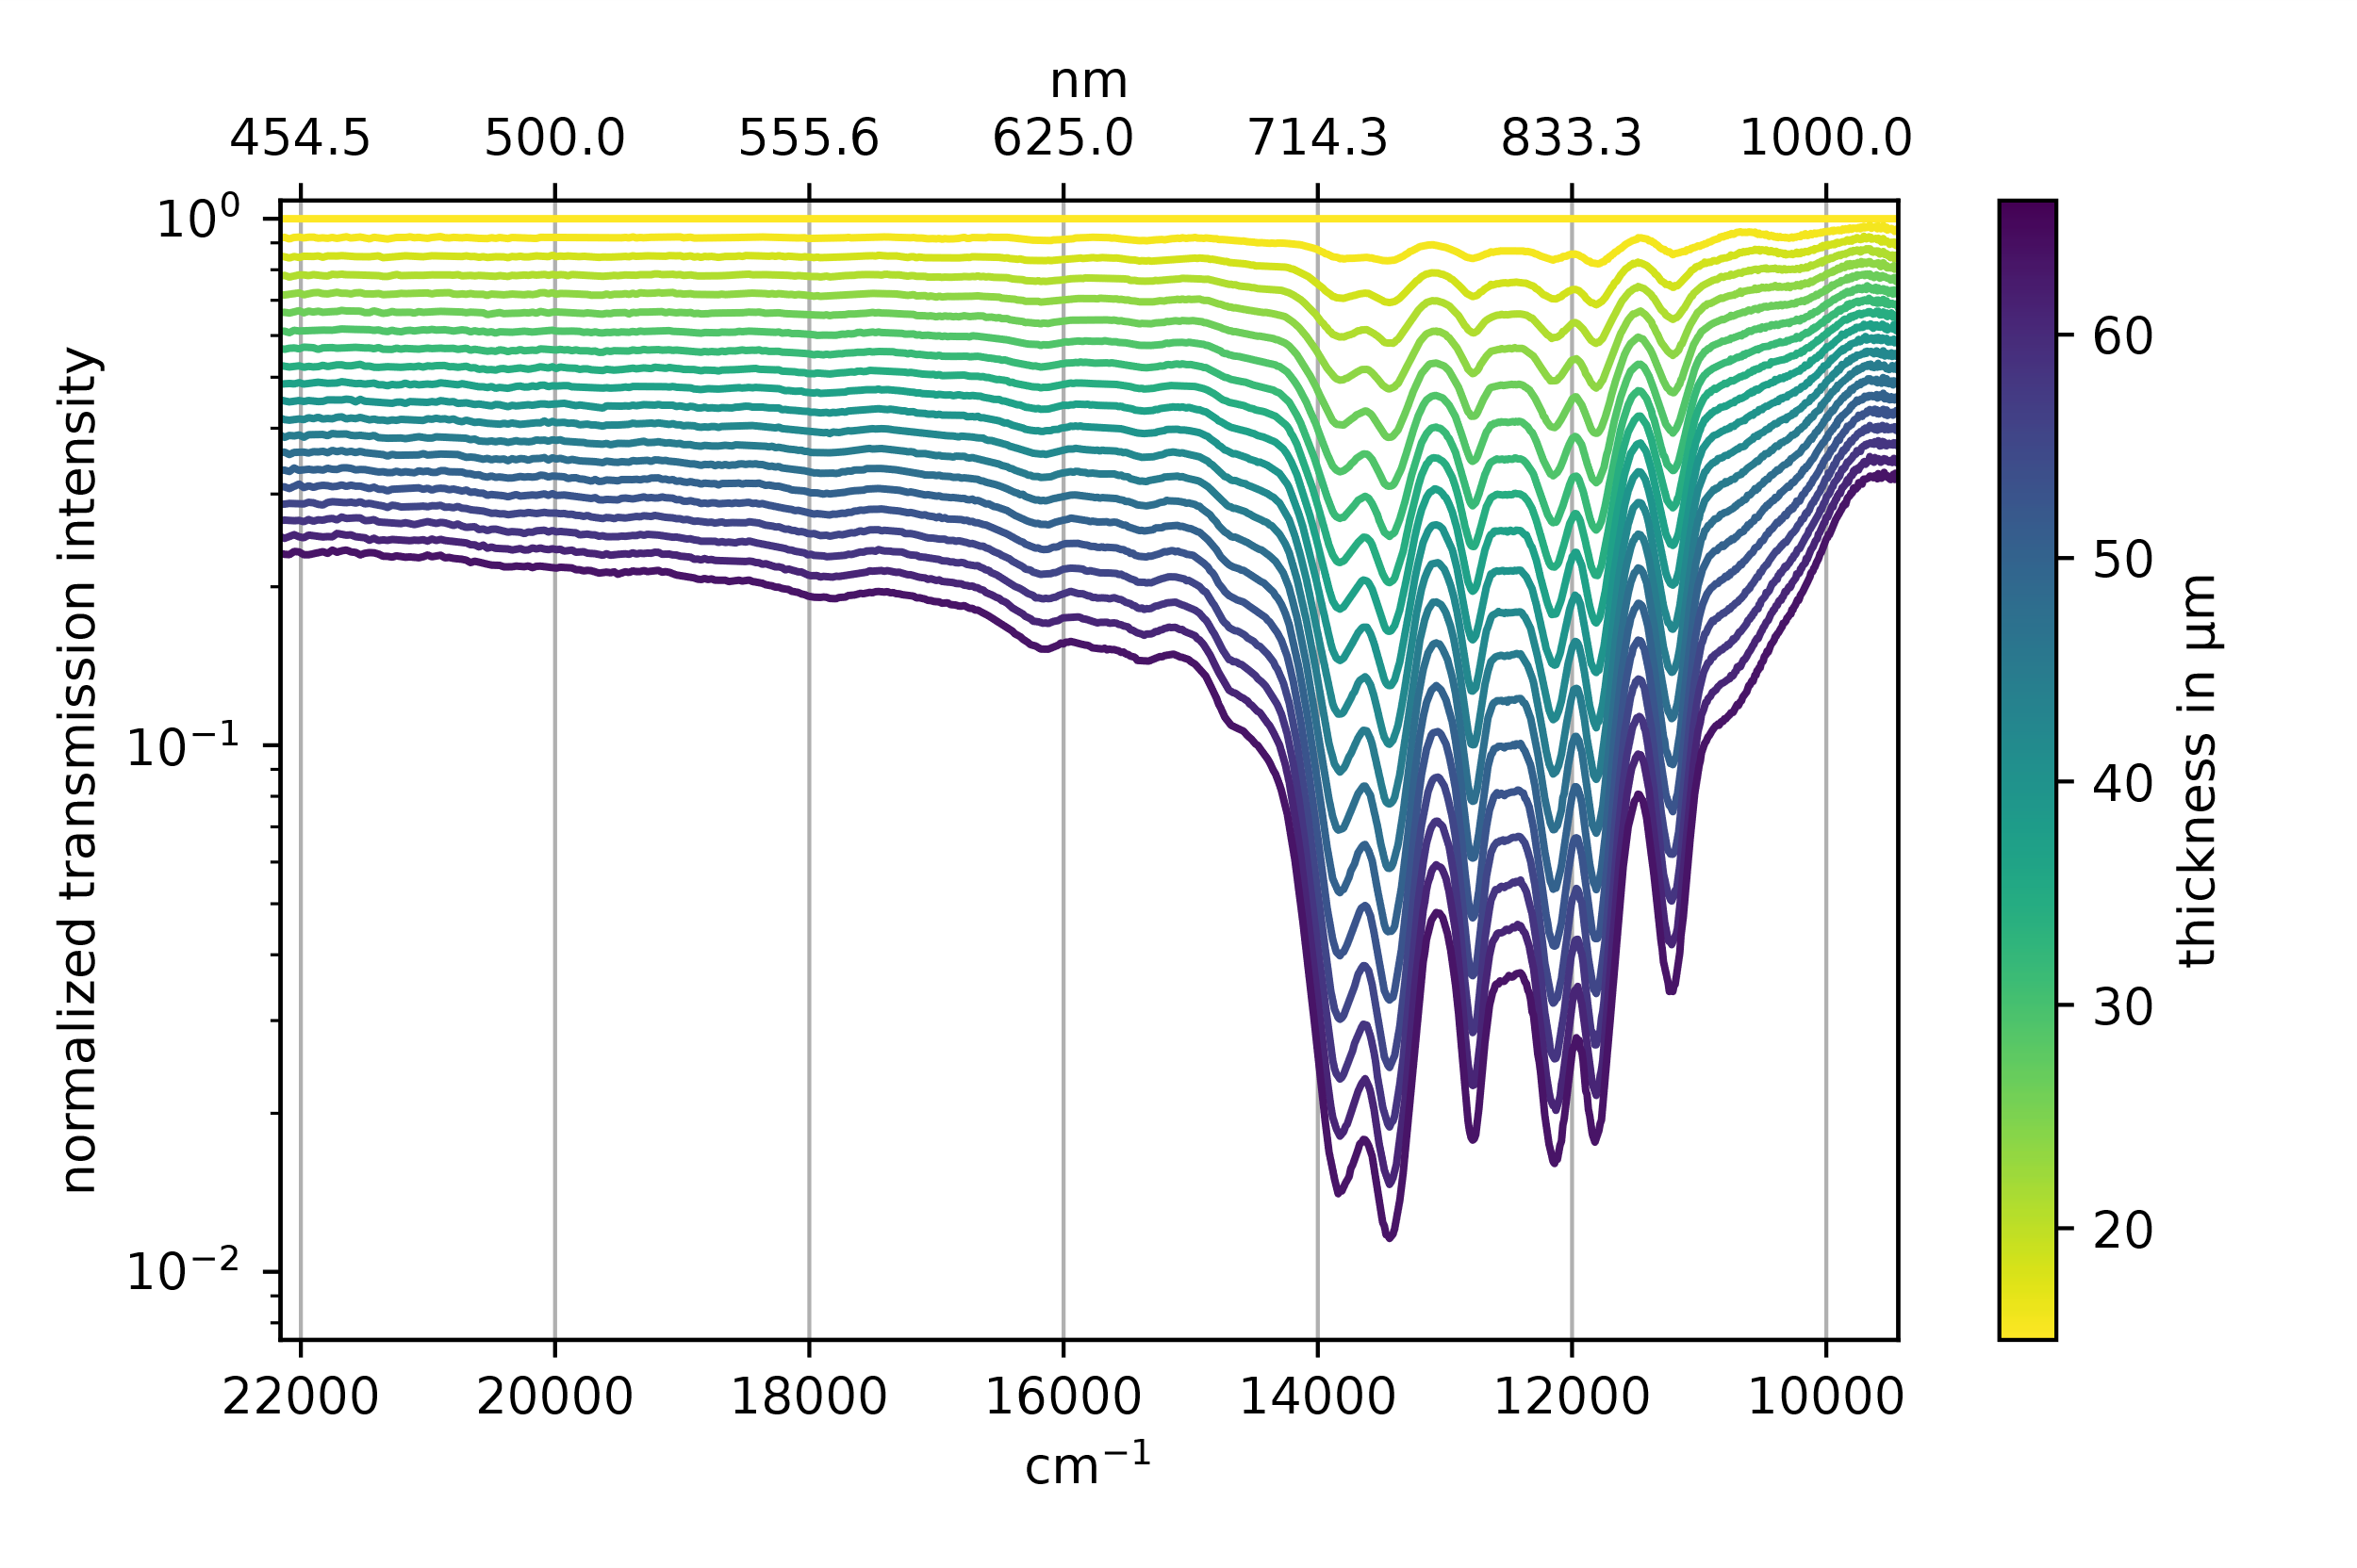
→ NCs ≈ 10¹⁸
Oscilloscope
Transmission
Cs in argon
Fizeau interferometer
Matrix growth
λ/2 every fringes

Slide 20
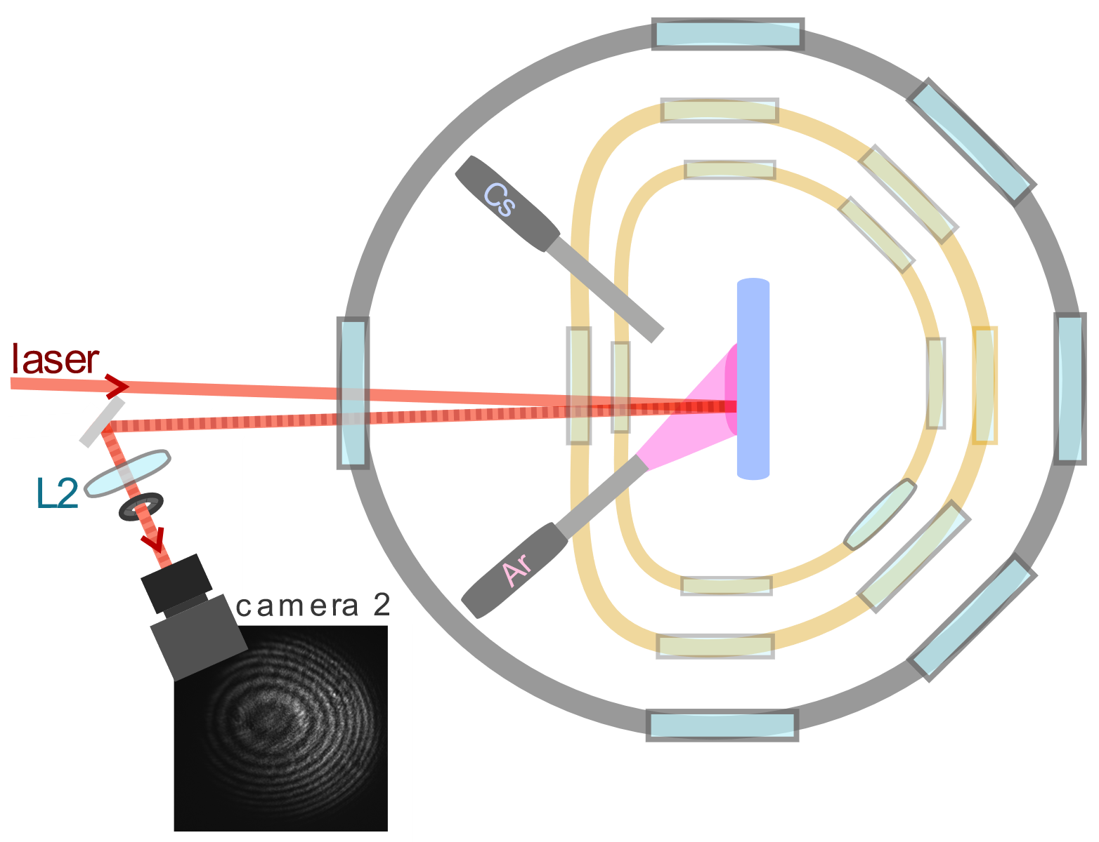
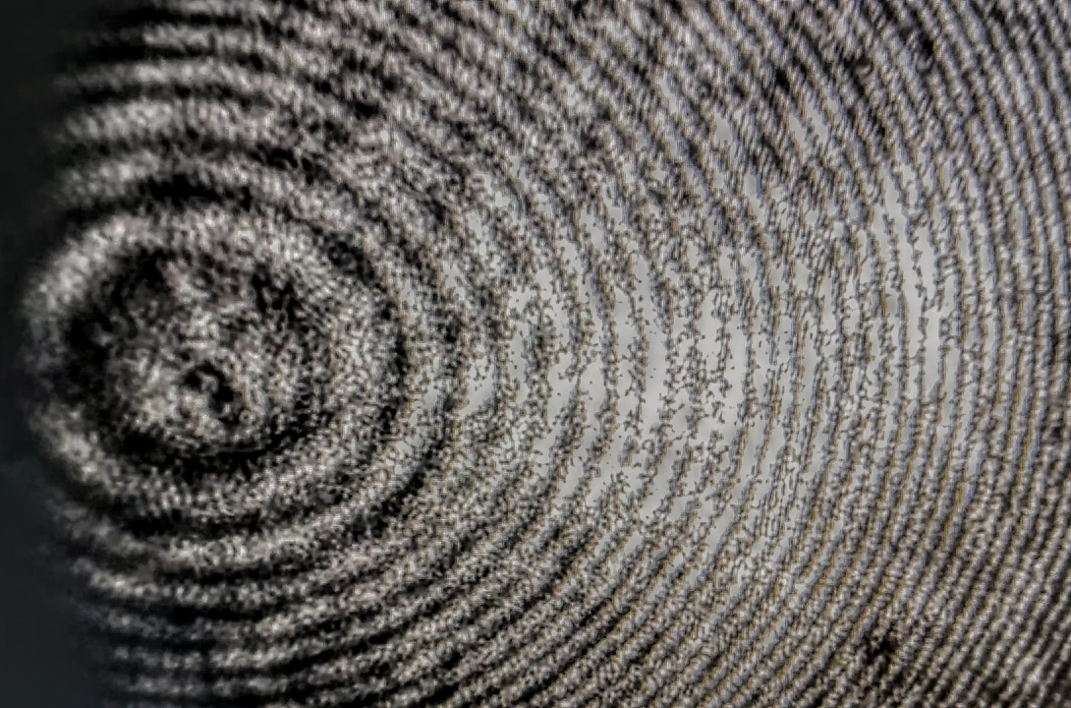
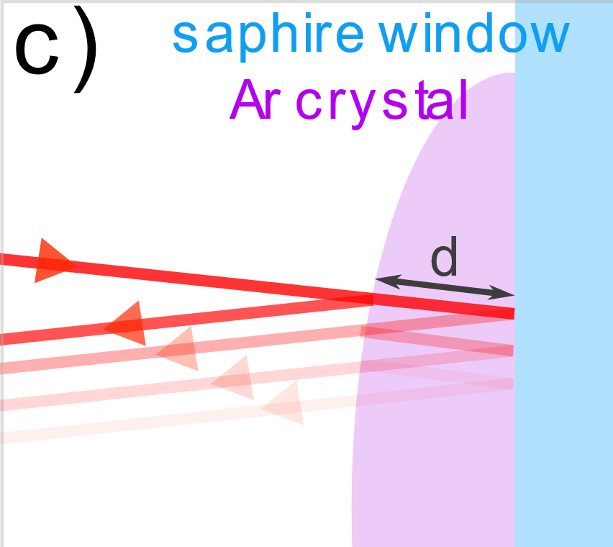
Crystal thickness and quality
Growth rate ≈ 1μm/min

Slide 21
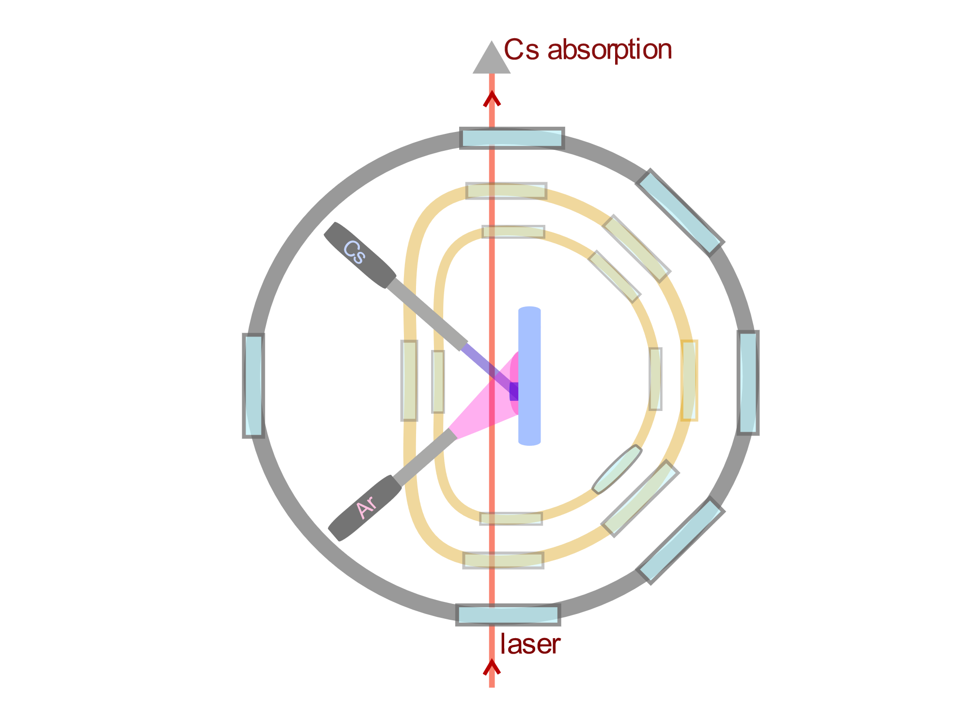
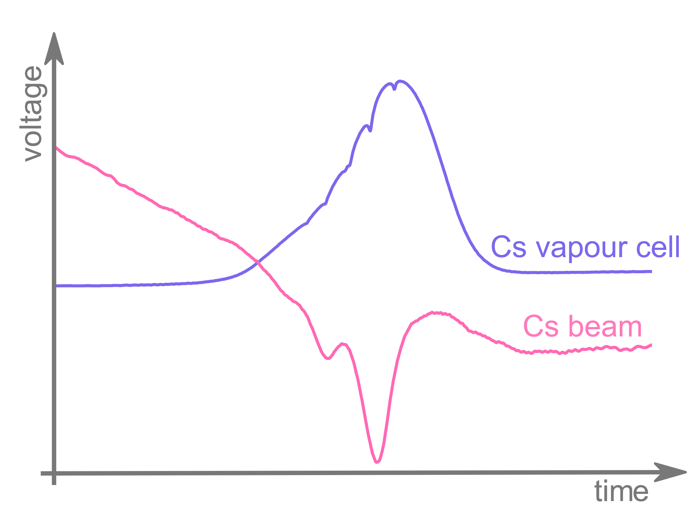
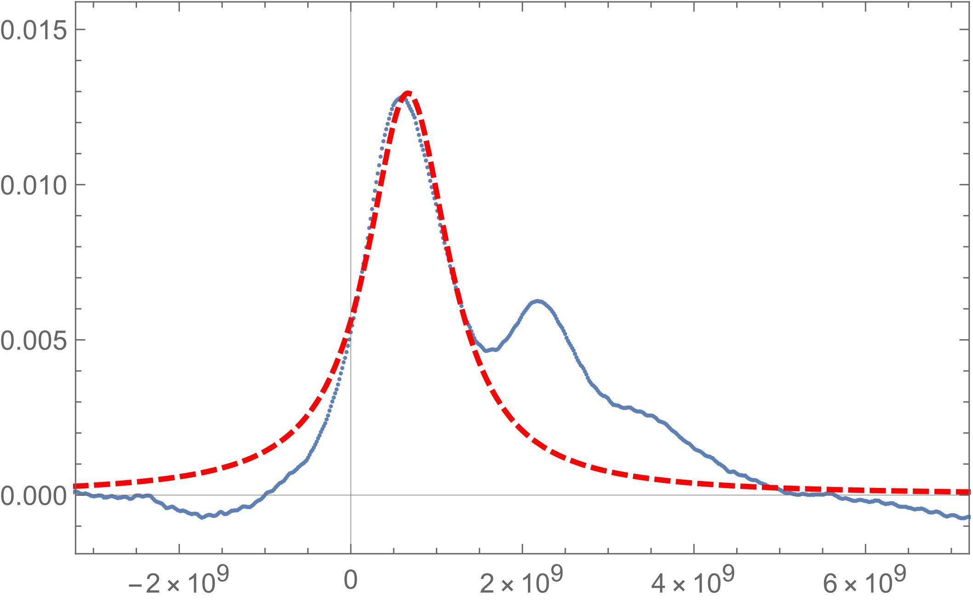
Cs flux measurement
In Ar crystal ~10¹⁸ per cm³
Cs in Ar at Similar distance (10nm) than dislocations!
Effusive beam model, broadening by Doppler effect

Slide 23
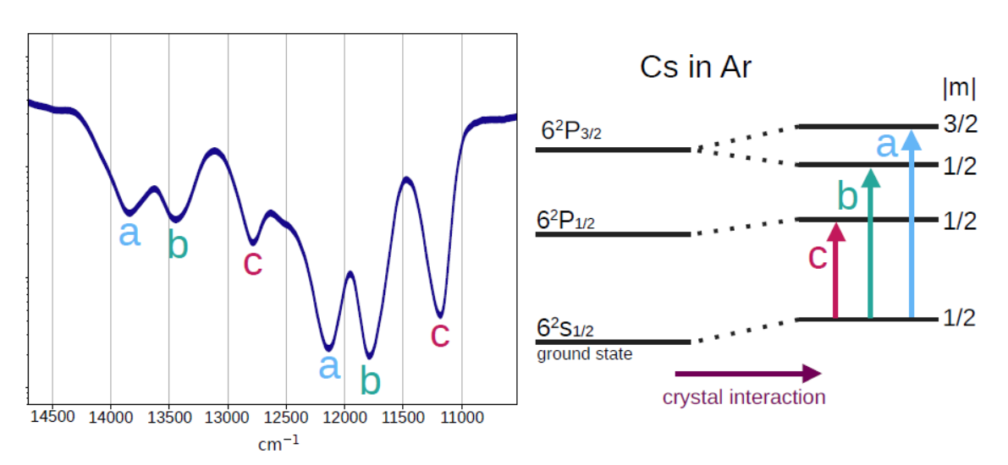
Interpretation of
Cs spectrum
Probably 2 different
Trapping sites
Gas phase Cs(6s)—Cs(6p_{J})
852nm 894nm

Slide 24
Outline
EDM worldwide → why EDM
Why in cryogenic solid: EDMMA project (Cs in Ar)
Experimental setup: Cs absorption spectra
Possible trapping sites: stability study
Line position
Line broadening
Possible improvement

Slide 25
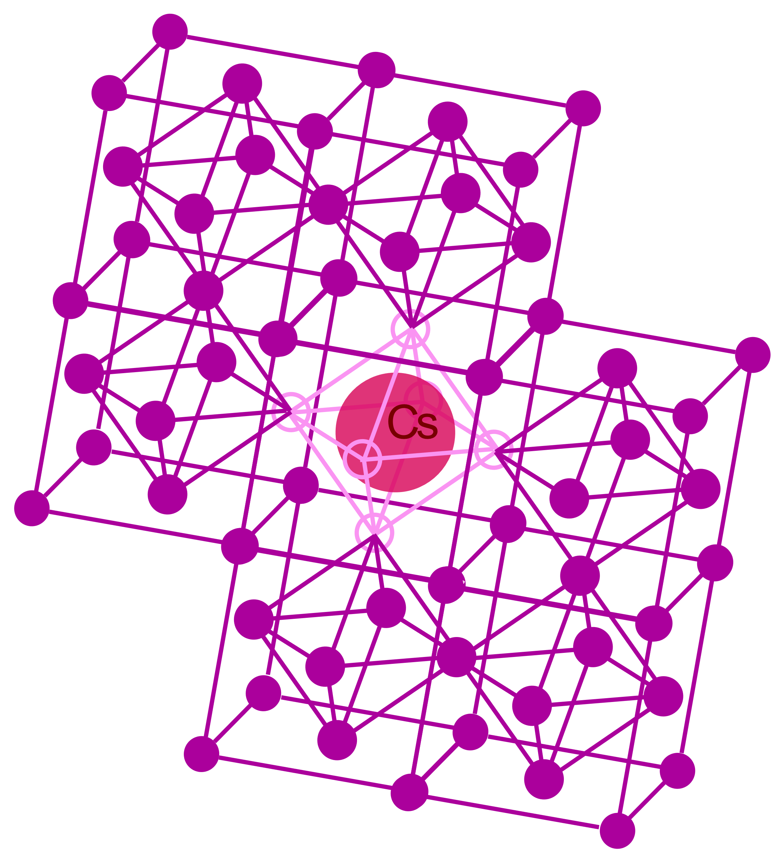
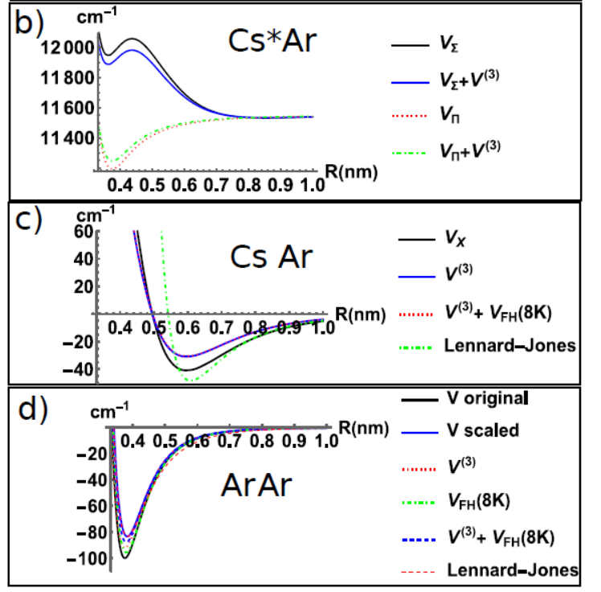
Ar-Ar and Cs-Ar Pair wise potential approximation
X,Y,Z
Ar
N ~ 1000 atoms
n vacancies

Slide 26
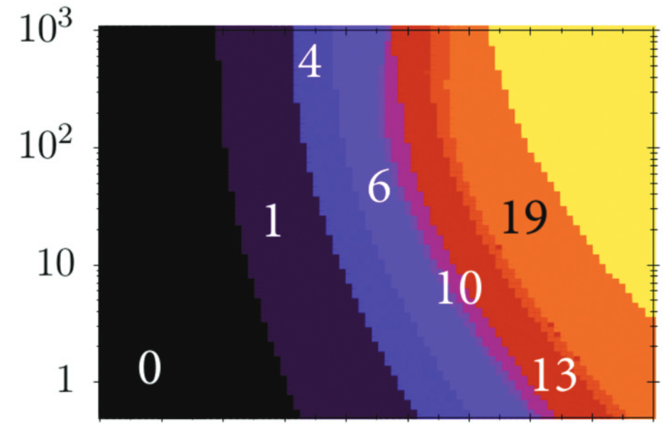
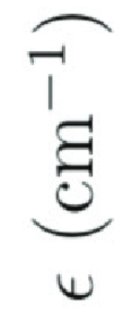
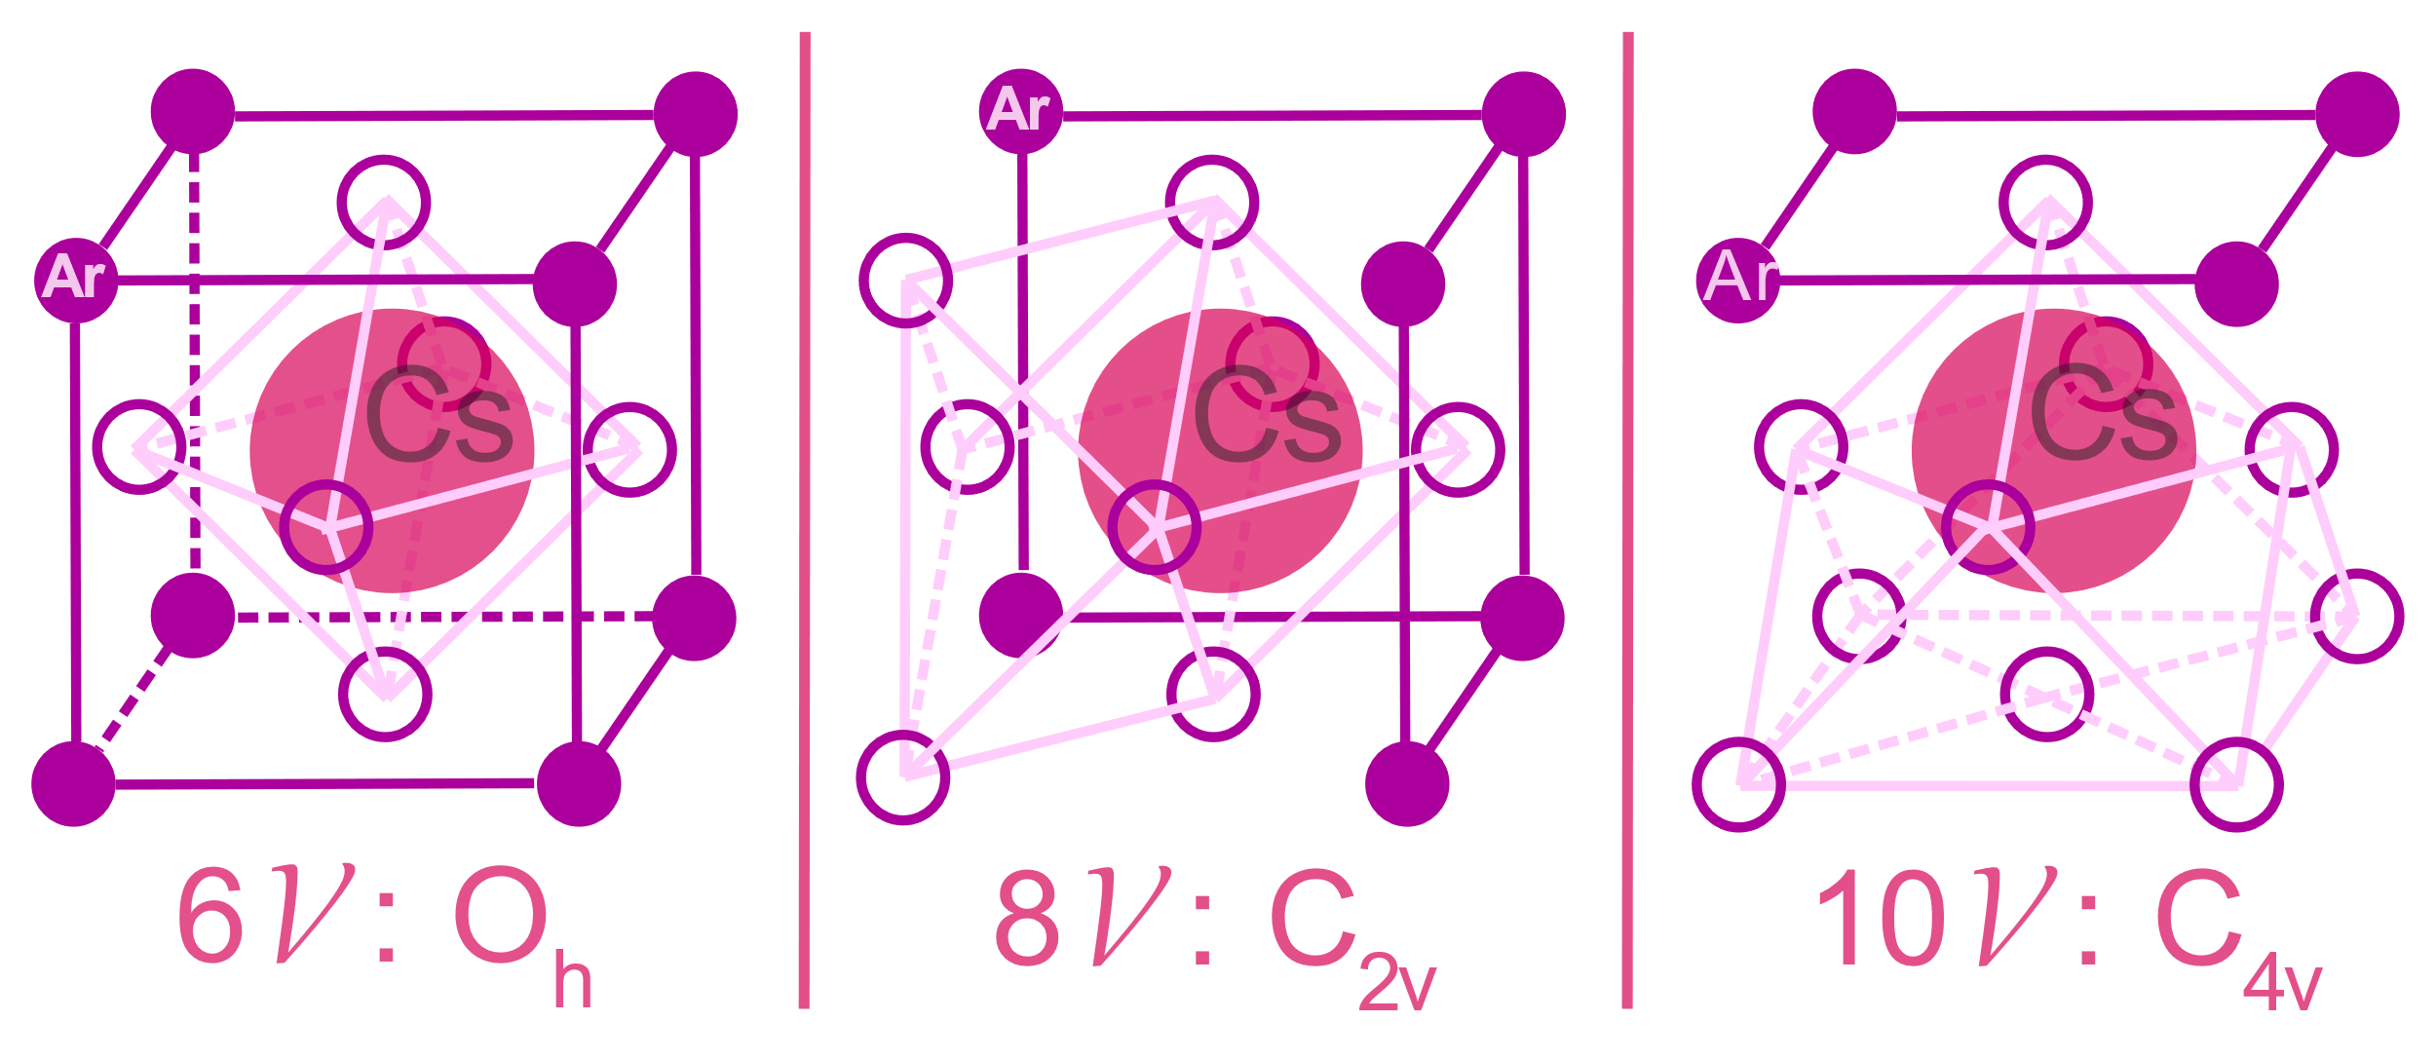
Most probable trapping sites (n=6,8,10 vacancies)?
Free energy of trapping sites in fcc argon for different Lennard-Jones-potentials
#vacancies
VLJ between Cs and Ar
G. K. Ozerov, D. S. Bezrukov, and
A. A. Buchachenko, Phys. Rev. B 103, 184110 (2021)

Slide 27
Different magneto-electric couplings
α:
β & γ:
Orthogonal E-B-mixing
Orthogonal E-B-mixing
zero

Slide 28
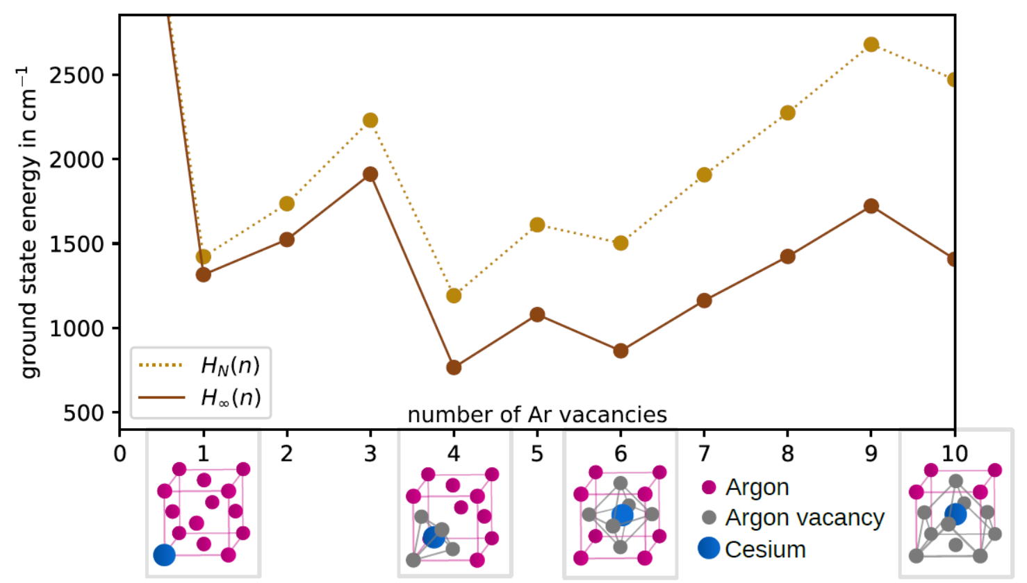
Stability diagram
Accomodation energy: system (Cs+Ar) energy – energy of the pure Ar crystal
4(T_{d}) 6 (O_{h})
Convex stability (ex: 5+5 → 4 +6) → 4 vacancies or 6 vacancies

Slide 29
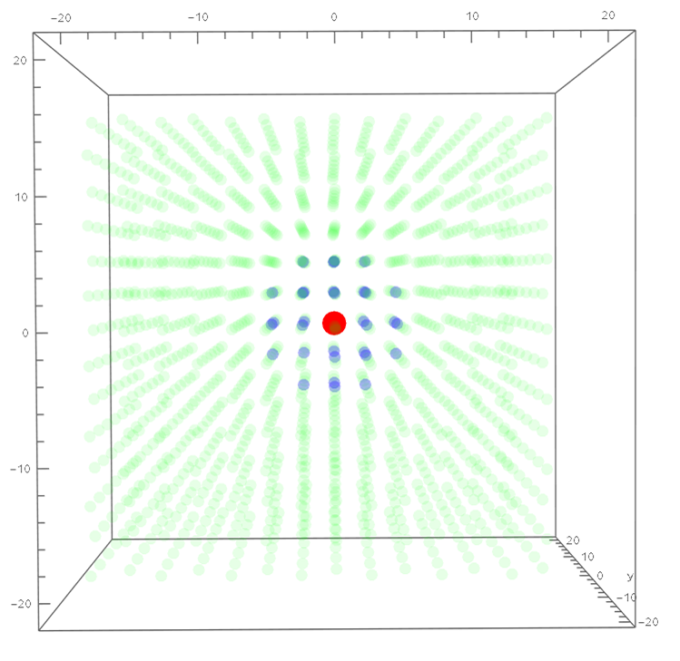
Optimizing the Ar and Cs positions to minimize the energy → frozen shell
First order
Derivative calculated by finite difference
GRADIENT DESCENT
Second order
New positions

Slide 30
Outline
EDM worldwide → why EDM
Why in cryogenic solid: EDMMA project (Cs in Ar)
Experimental setup: Cs absorption spectra
Possible trapping sites: stability study
Line position
Line broadening
Possible improvement

Slide 31
Cs(6s and 6p) - Ar potential approximation
X,Y,Z
Ar
Cs(6s) - Ar
Cs(6p m) - Ar
5.31 ångström

Slide 32
Potential curves Zero point energy, Third order correction

Slide 33
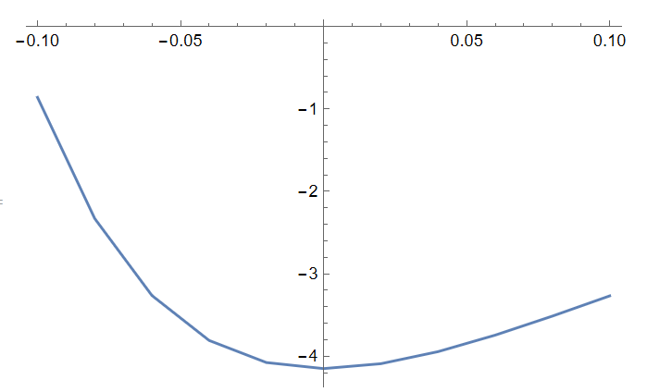
Zero point energy
5.21 + δ a (Angström) real 5.31
Real 645
Quantification of the Ar motion
Frequency ~ 94 K ~ 65 cm⁻¹
Feynman-Hibbs effective correction to a pair potential
between ground state atoms:
Is the Gaussian width of quantum particles

Slide 34
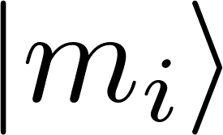
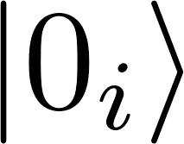
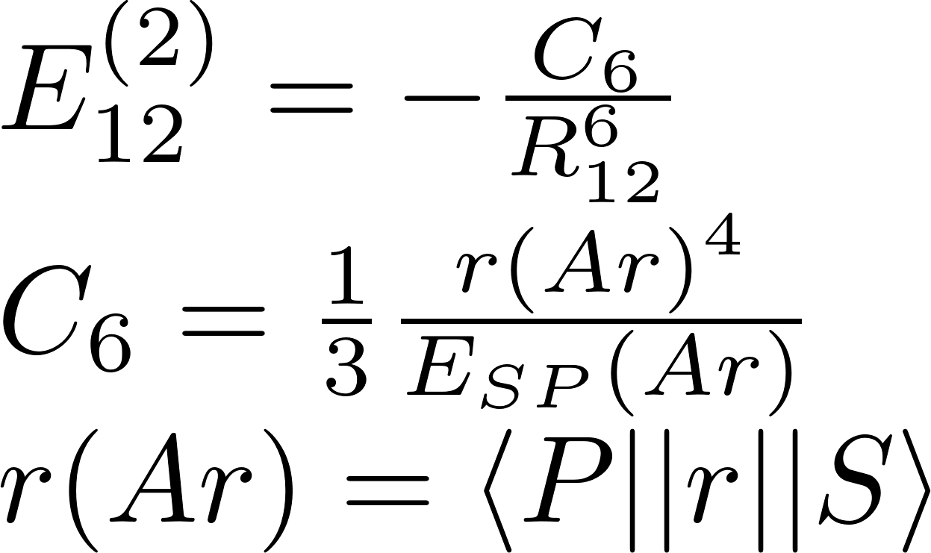
Third order (triple atom interaction)
Ar (4p)
Ar (4s)
Ar (3p⁶)
So up to second order E= Sum_ij E(i,j) = pair-wise (two body) approximation
long-range
Third order
θ₂
2
long-range
1
θ₁
θ₃
Axilord-Teller-Muto (1943)
Bell 1970 for different ground state atoms
3

Slide 35
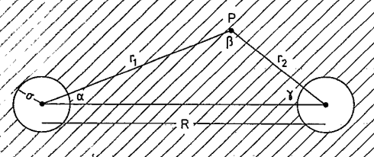
Effective 2-body potentials
Marcelli-Wang-Sadus
+ Yoshi muto 1943 !
V=
Sum over atom 3
we replace the sum by an integral assuming Ar atoms uniformly distributed with the Ar solid density
1
2
Miracle:
the cut off parameter does not enter the result
The final result is proportional to the two-body potential
→ OK for Ar-Ar (same as scaled potential) . I generalze for Cs-Ar

Slide 36
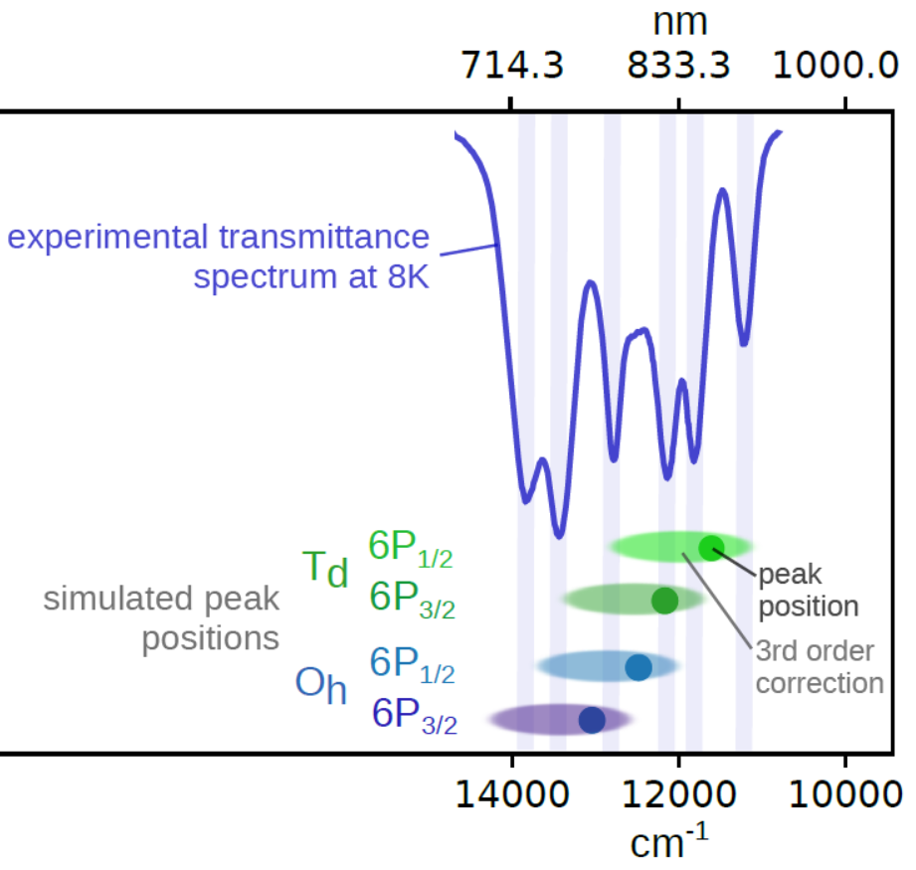
Reasonable line positions for 4(T_{d}) – 6 (O_{h})
Sensitive to potentials + third order correction
Oh(6) blue shift
Td(4)~0 shift

Slide 37
Outline
EDM worldwide → why EDM
Why in cryogenic solid: EDMMA project (Cs in Ar)
Experimental setup: Cs absorption spectra
Possible trapping sites: stability study
Line position
Line broadening
Possible improvement

Slide 38
Jahn-Teller Dynamical (thermal) effect → Broadening and splitting
Crystal field
1st order in excited state
Tx10
Tx10
Semi-classical Franck-Condon approximation
Tx10

Slide 39
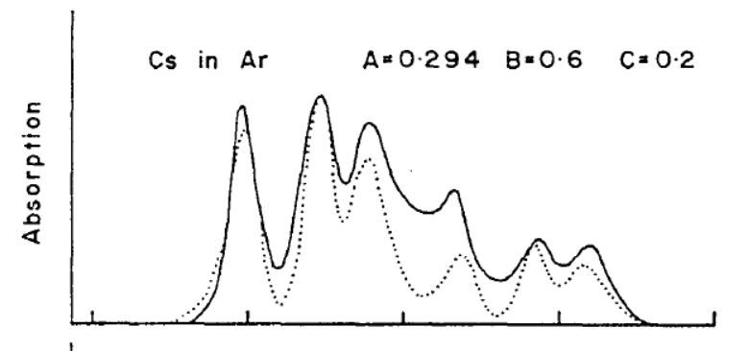
Crystal Field theory: effectif coupling parameters
Sum over Ar

Slide 40
Classical (Mulliken) Simulation
V_{e}
V_{g}
Normal mode Q
Experiment
Theory for 4 and 6 vacancies

Slide 41
Semi-Classical (Reflexion approximation)
Experiment
Theory

Slide 42
Outline
EDM worldwide → why EDM
Why in cryogenic solid: EDMMA project (Cs in Ar)
Experimental setup: Cs absorption spectra
Possible trapping sites: stability study
Line broadening simulation
Possible improvement

Slide 43
Conclusion
Cs in Ar seems promising for EDM measurment below 10⁻³⁰ e.cm → new physics
In solid state systems, there can be dangerous mixing terms. But not present in O_{h}(6 vacancies)
Absorption spectra shows that multiple trapping sites are present at the same time. Is it Td (4 vacnacies) + Oh (6 vacancies) chat about hcp phase ?
Next steps
Energy
Magnetic circular dichroism (MCD)
g_Lande, spin-orbit, lattice structure
6p
More absorption (temperature dependence)
Fluorescence measurment
Temperature dependance
Magnetic circular dichroisme
Optical pumping
Electron Spin Resonance → Spin coherence
Magneto electric effects E/B coupling
σ⁺ / σ⁻
6s
F=4
Electron spin resonance (ESR)
(hyperfine + Zeeman effect)
F=3
Nuclear coordinates
Other atoms (Li, Na, K, Rb, Cs)
Other gaz (Kr, Xe, para-H₂ ) → move to EDM, axions
B field

Slide 44
That’s it for now

Slide 45
http://www.lac.universite-paris-saclay.fr/Data/Stages/2022/1
Sébastian LAHS (Master thesis, Germany): Cs in a cryogenic matrix

Slide 46
Particles 2023, 6(1), 385-398

Slide 47
PHYSICAL REVIEW A 105, 040101 (2022)

Slide 48
Blum, T., Winter, P., Bhattacharya, T., Chen, T. Y., Cirigliano, V., DeMille, D., ... & Semertzidis, Y. K. (2022). Fundamental Physics in Small Experiments. arXiv preprint arXiv:2209.08041.

