Slide 1
Particle Physics and Scientific Computing
Oliver Stelzer-Chilton, Reda Tafirout (on behalf of the departments)
ACOT Meeting, May 2023

Slide 2
Particle Physics Department
Particle Physics – O. Stelzer-Chilton
Deputy – M. Hartz
I. Trigger M. Vetterli (SFU)
O. Stelzer-Chilton D. Gingrich (UofA)
M. Swiatlowski P. Savard (UofT)
B. Stelzer (SFU) G. Azuelos (UdeM, emeritus)
A. Konaka D. Karlen (UVic)
M. Hartz (with IPMU) X. Li
W. Rau (with MI). J-M. Poutissou (emeritus)
K. Clark (with Queens, MI) T. Brunner (McGill)
S. Yen (emeritus)
M. Fujiwara T. Numao (emeritus)
R. Picker D. Gill (emeritus)
C. Malbrunot R. Helmer (emeritus)
A. Olin (emeritus)
Monthly meetings inclusive to
Particle Physics,
Theory,
Science Technology
and Scientific Computing
department members
Dark Matter Forum Meetings
Science and Technology Seminars
Quantum Forum Meetings
Affiliated Scientists
S. Bhadra (YorkU)
D. Bryman (UBC)
M. Hasinoff (UBC)
R. McPherson (UVic)
S. Oser (UBC)
T. Momose (UBC)
W. Van Oers (Manitoba)
R. Thompson (Calgary)
B. Pointon (BCIT)
M. Danninger (SFU)
P. De Perio (IPMU/Tokyo)

Slide 3
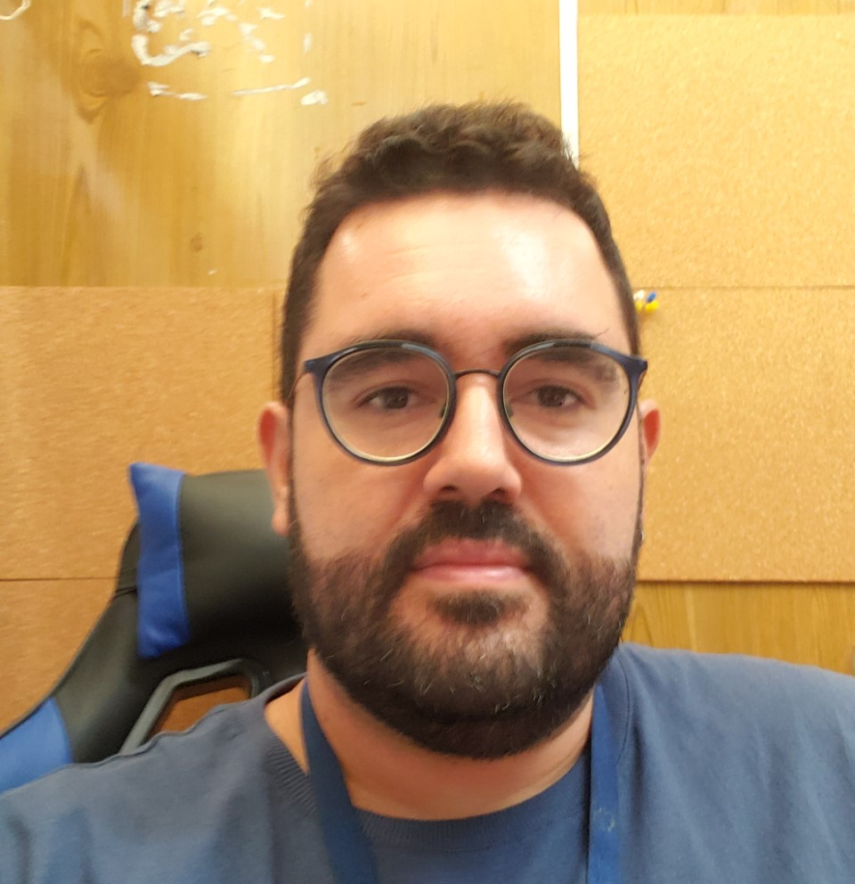
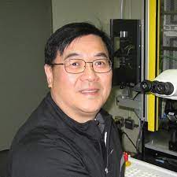
Particle Physics Personnel news
New BAE Rodrigo Lage Sacramento will start in August, pending visa process
Professor at University of Rio de Janeiro
Research on ALPHA, atomic fountains
Interest in HAICU
Scintillator Shop Supervisor / Detector Development Chapman Lim
Retired from TRIUMF end of April
Hired for ATLAS-ITK and nEXO projects using CFI funds starting May 1st
New Tech for UCN
Interviews at BCIT
Candidate hired (with Accelerator Division)
Start date June 4th

Slide 4
Particle Physics within the Physical Sciences Division
The departments of Particle Physics, Science & Technology and Scientific Computing address the areas:
High Energy Frontier
Neutrinos and Dark Matter
Precision Tests of Fundamental Interactions
Lead in Scientific Discovery through focus projects
Projects where we are involved in all areas
detector design/construction, operations, data analysis
Ensure critical mass is established, maintain leadership in all areas
Current experiments
ATLAS, T2K/Hyper-K, ALPHA, TUCAN, SuperCDMS
New experiments expected to reach that point in the future
DarkLight, nEXO
HAICU (experimental space identified)
PIONEER (Gate 0 approved)

Slide 5
Enable Particle Physics in Canada and Abroad
TRIUMF is part of a network of laboratories and partner institutions
Leverage TRIUMF key expertise in accelerator, computing, detector and DAQ technologies
Unique expertise in e.g. cryomodules, SiPM, TPC, gaseous detectors, DAQ, etc…
Support for Accelerator and Engineering, Science Technology and Computing are crucial
New group PHORWARD: Technology focus on single photon detector and noble liquids applied to physics on weak decay (PIONEER and nEXO) and dark matter (DEAP, DarkSide, and ARGO)
SNOLAB: detector, facility and DAQ systems through Science and Technology involvement
-> SuperCDMS, nEXO, ARGO, DEAP, SNO+
CERN: In kind contributions to LHC and HL-LHC, share in detector upgrades -> ATLAS, ALPHA
KEK/J-PARC: beam monitoring accelerator contributions
share in detector upgrades -> T2K/Hyper-K
Gran Sasso: DAQ systems -> DarkSide
Future involvement
Ocean Networks Canada: -> P-One

Slide 6
Peer Review Committee
Plenary session Tuesday November 29th
Particle Physics – Isabel Trigger
Parallel sessions on Wednesday November 30th
Theory – Dave McKeen
Science and Technology + Detector development – Beatrice Franke
High Energy Frontier – Max Swiatlowski
Neutrinos and Dark Matter – Mark Hartz
Precision Tests of Fundamental Interactions – Ruediger Picker
Scientific Computing + Data Science – Wojtek Fedorko

Slide 7
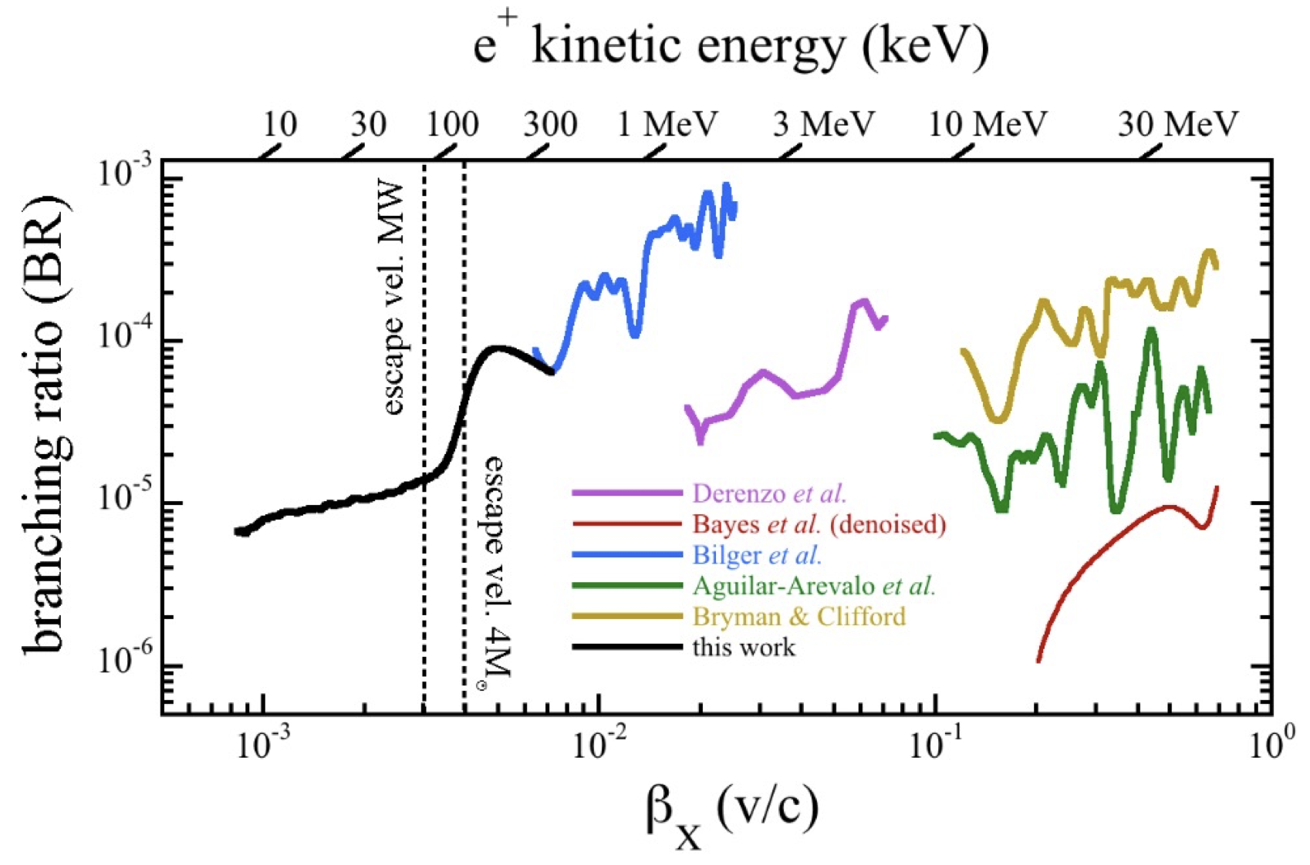
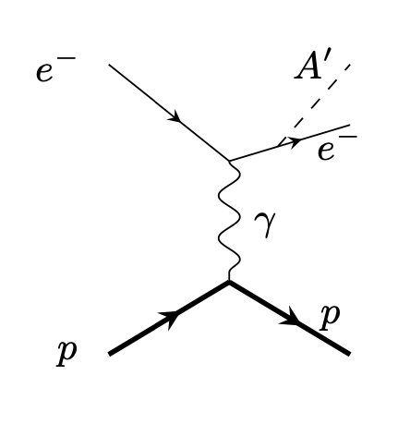
3rd Particle Physics - EEC
Tuesday April 18th 8am – 2pm
Five contributions
UCN/TUCAN Status Report
DarkLight Status Report
Search for Cosmologically Relevant Boson in μ⁺ Decay Status Report
Letter of Intent: PENeLOPE neutron lifetime measurement – Use of future 2nd port of UCN port
Letter of Intent: π⁺ lifetime measurement – Improve on systematic for PIONEER
Committee:
Natalie Roe (LBNL) chair
Concettina Sfienti (Mainz)
Deborah Harris (York/FNAL)
Ralf Kaiser (ICTP)
Natalia Toro (SLAC)
Dave McKeen
Makoto Fujiwara
Oliver Stelzer-Chilton (ex officio)

Slide 8
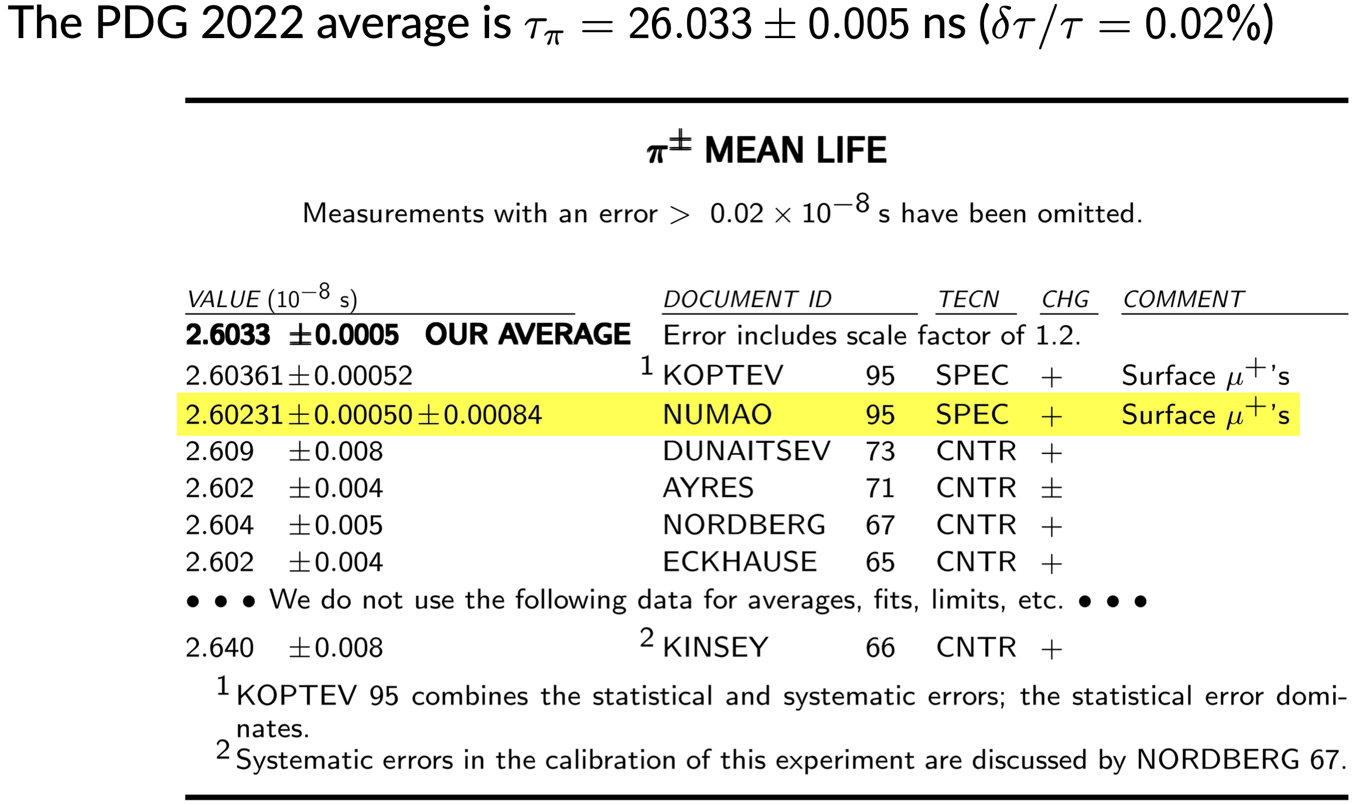
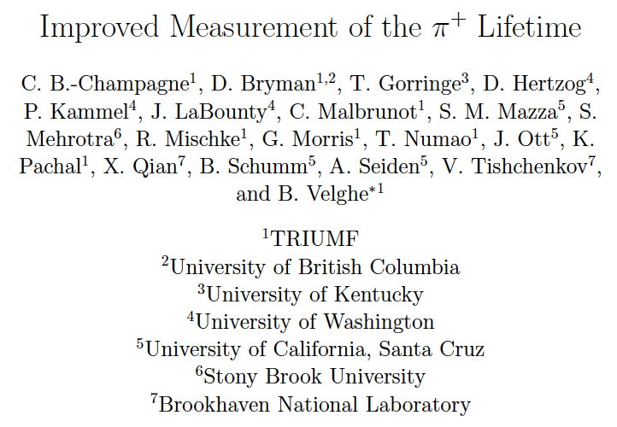
3rd Particle Physics - EEC
Letter of Intent: π⁺ lifetime measurement – high priority
A 0.01% π⁺ lifetime measurement is important in overall systematics budget for
Extract the π⁺ lifetime from the surface muon yield of a production target
TRIUMF excellent place to carry out this measurement with extensive local μSR expertise

Slide 9
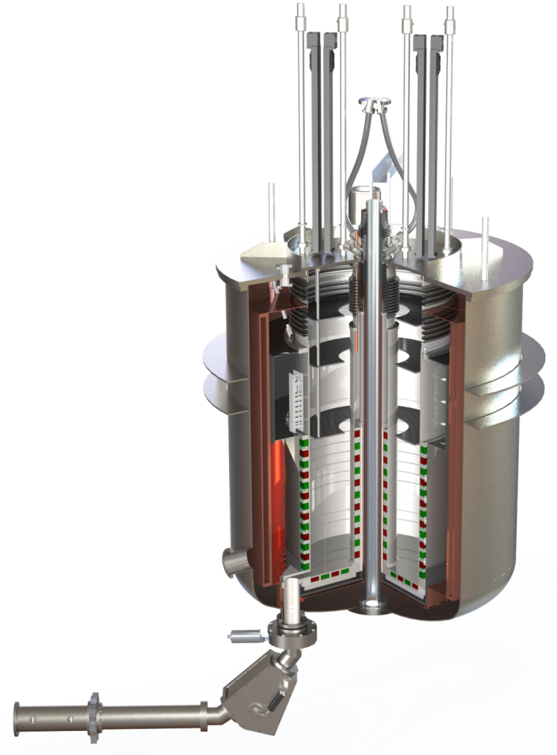
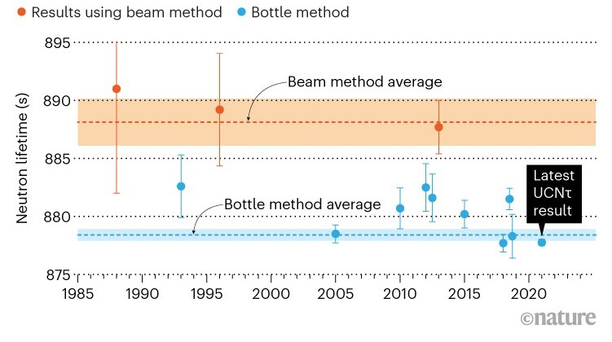
3rd Particle Physics - EEC
Letter of Intent: neutron lifetime measurement – medium priority
PENeLOPE (Precision Experiment on the Neutron Lifetime
Operating on Proton Extraction)
Using magneto gravitational storage in a superconducting
magnet developed at TU Munich
<0.1s measurement seems within reach
Received Gate 0 approval

Slide 10
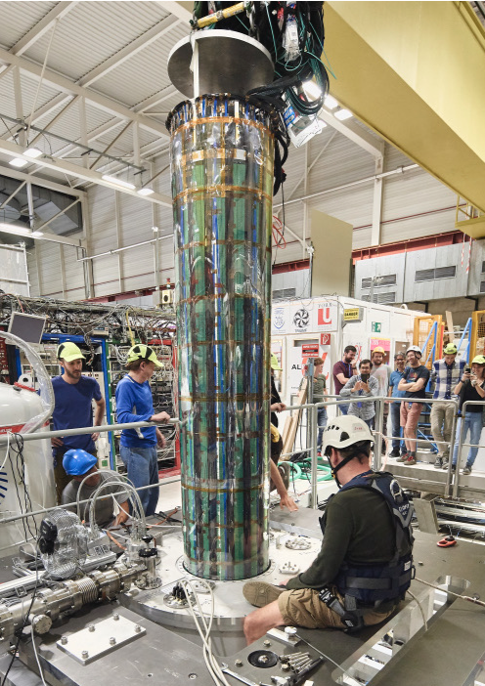
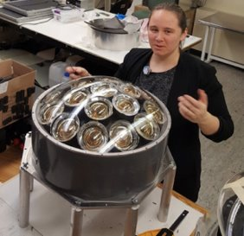
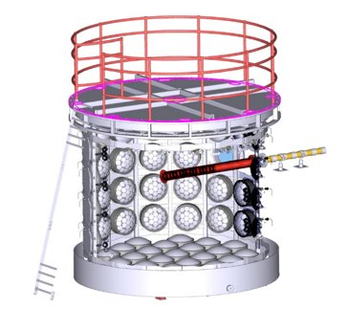
ALPHA
Particle Physics Highlights
Hyper-K
Water Cherenkov Test Experiment (WCTE) approved by CERN Research Board, expected operation in 2024
Development and testing of prototypes for multi-PMT proceeding well
TRIUMF led formation of WatChMaL machine learning effort for water Cherenkov detectors​
Commissioning of ALPHA-g
First data being analyzed

Slide 11
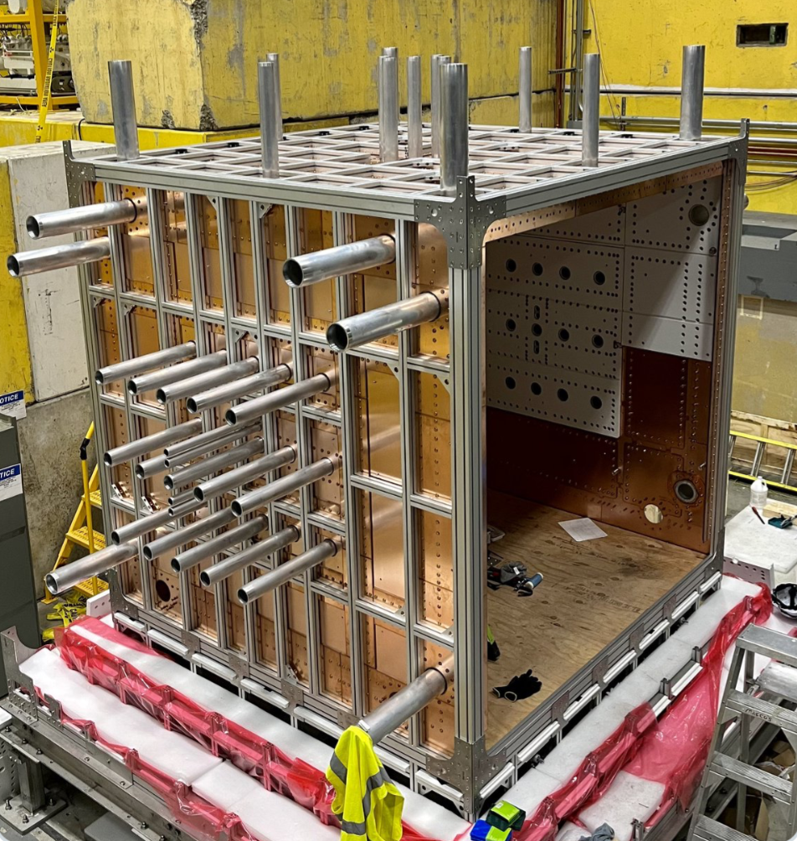
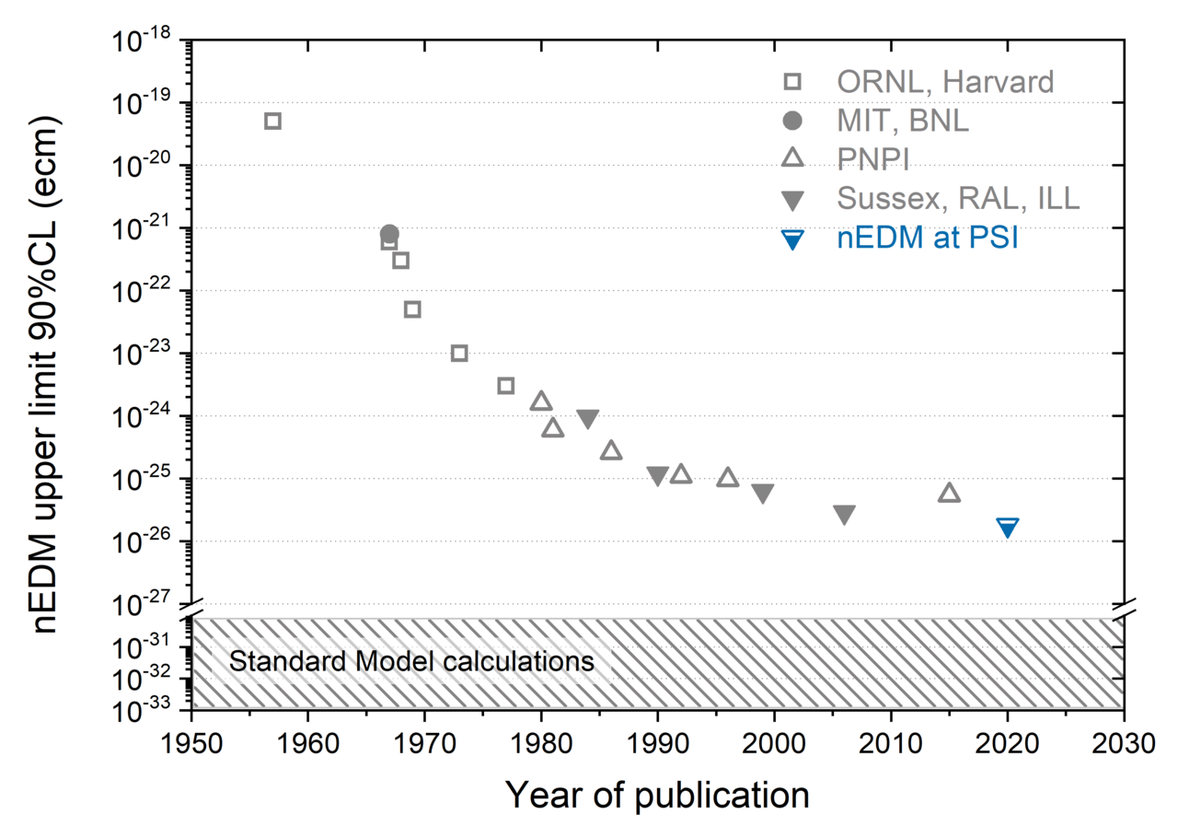
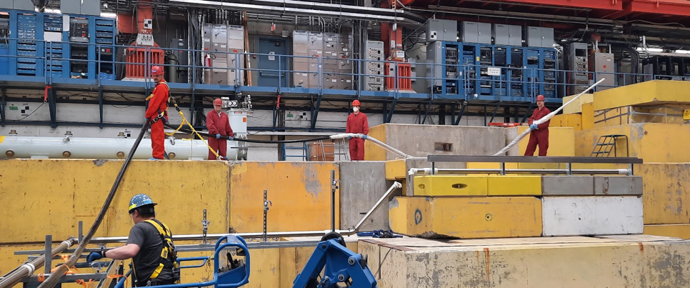
Search for a neutron electric dipole moment (EDM) with a sensitivity of 10⁻²⁷ e cm
UCN
Progress towards the world’s strongest ultracold neutron source
Liquid He transfer & return lines tested
EDM storage cell tests at J-PARC completed
Magnetically Shielded Room for EDM experiment taking shape
Liquid helium transfer line

Slide 12
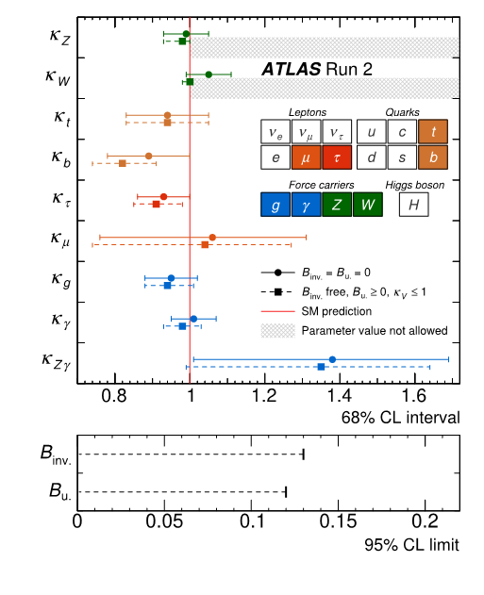
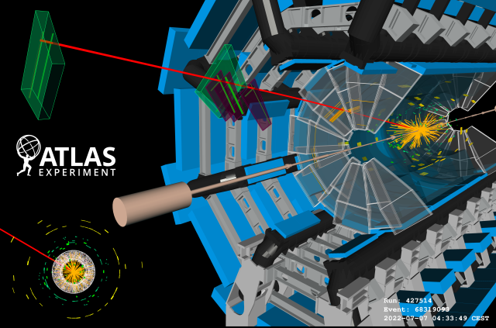
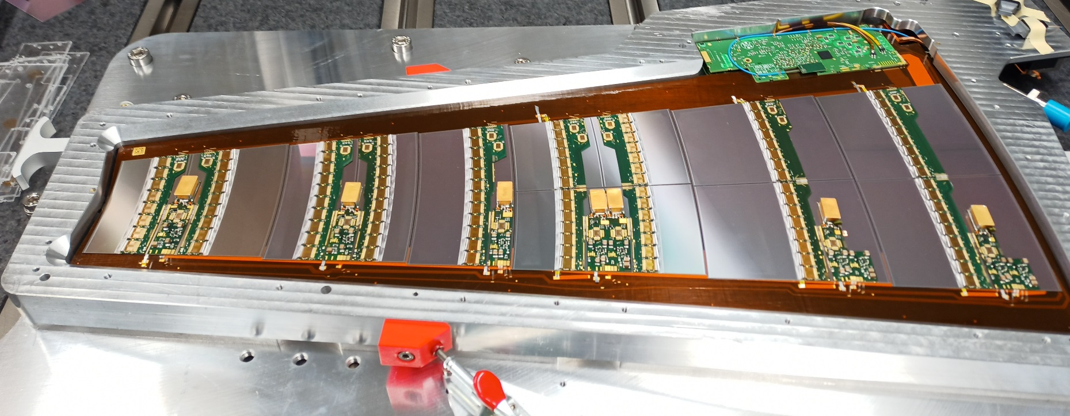
New Small Wheels
ATLAS
LHC Run 3 has started in 2022 and the New Small Wheels are starting to take data
First ATLAS ITK production petal with all modules assembled in Vancouver!
Milestone measurements of Higgs boson properties,
couplings to matter​
10 Year anniversary
paper in nature
50% of sensor probing completed!

Slide 13
CFI Proposals submitted in Particle Physics
These are prepared in collaboration with the university PI’s and often TRIUMF co-PI’s
ATLAS Tier-1 Centre $6.6M (total project $16.5M)
Refresh of hardware and expansion for the HL-LHC
Hyper-K $6.4M (add total)
200 mPMTs, photogrammetry calibration and
water quality monitoring equipment
DarkLight $2.8M (total project $7.0M total)
SRF cavity for 50 MeV upgrade
P-One $5.9M (total project $14.8M)
Six instrumented mooring lines for neutrino telescope at Ocean Network Canada (OCN)
nEXO $12M
Liquid Xenon detectors (TRIUMF part SiPM characterization)
ARGO $10M
Liquid Argon detectors (TRIUMF part UV single photon SiPM)
Will find out in June what is funded

Slide 14
Five-Year Planning
Task forces completed ~2 page summaries of the New Initiatives
Summary
Detector Development Center
Center for Quantum Sensing & Precision Physics
Conference & Learning Center
AI Center
Physical Sciences Division Retreat on June 2nd
Updates from experiments and projects
Discussion on new centers
Existing Quantum research vs new in Quantum Center
Complementarity of Science & Technology Department vs Detector Center

Slide 15
From PSD retreat: Hiring Priorities in Particle Physics
Baseline highest priority for 2025-2030
TUCAN (1+)
Hyper-K (succession)
Strengthening Science & Technology capabilities (2+ A&P)
Growth area (depending on funding and green light for the projects - not ranked)
Astro-particle / nEXO / DarkSide-20k (SNOLAB connection)
PIONEER (secure critical mass)
P-One (potentially big local experiment)
Future Collider (joint-position with university)
UCN (joint-position with university)
Quantum/Precision (joint-position with university)
New hires (P&S scientist + technical expertise for newly proposed centers)
flat-flat
+10%
Blue sky

Slide 16
Connecting to the Community
Summer Schools
TRISEP (together with Perimeter Institute and SNOLAB)
GRIDS (together with MacDonald Institute)

Slide 17
Connecting to the Community

Slide 18
Summary
International Peer Review in November went well
Excellent track record on designing, enabling and extracting science from Particle Physics experiments (see Research Highlights in parallel session and Poster Session)
Particle Physics together with Science and Technology and Scientific Computing is fully engaged in shaping the present and future of TRIUMF
Departmental / Divisional planning for next 5-year plan with guidance from the 20-year vision
New initiatives discussed in dedicated task forces wrote 2-pager as input to the division
BAE hire for ALPHA completed
Technician for UCN (together Accelerator division) hired
BAE/A&P request for UCN moved into the next Five-Year
Finalizing 2023 Goals and Objectives

Slide 19
Thank you Merci
www.triumf.ca
Follow us @TRIUMFLab

