Slide 1
Scientific Computing Department
Common umbrella for existing activities:
Big data & Distributed Computing (ATLAS Tier-1) (R. Tafirout)
Machine Learning & Quantum Information Systems (W. Fedorko)
Head / Deputy: R. Tafirout / W. Fedorko
Tier-1:
A. De Silva X. Liu
R. Debhandari D. Qing
F. Fernandez Galindo Y. Shin
V. Kondratenko A. Wong
QML: Javier Toledo (RA)
Affiliated Scientists:
C. Senko (Waterloo)
R. Islam (Waterloo)
P. Haljan (Simon Fraser)
J. Sirker (Manitoba)

Slide 2
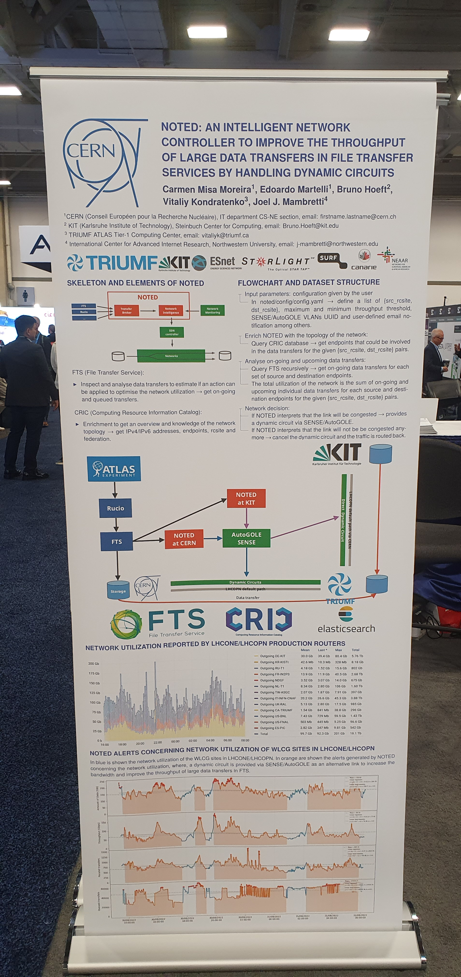
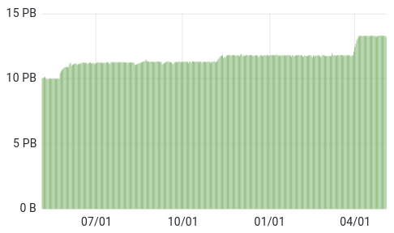
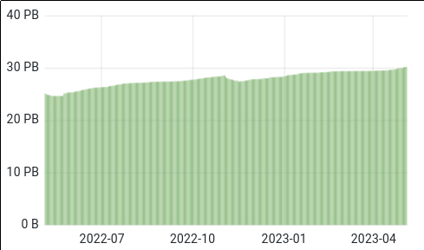
ATLAS Tier-1
Successful collaboration between labs and network providers
Software-Defined Networking: NOTED (Network Optimized for Transfer of Experimental Data) for on-demand dynamic circuit provisioning
Demo boot set up at Supercomputing 2022 conference (Nov. 13-18, Dallas)
Additional data traffic injected between TRUMF/SFU and CERN, and between TRIUMF/SFU and KIT, on top of normal production traffic.
Smooth operations overall / power outage incident on Dec. 21 (snow storm)
disk utilization
tape utilization

Slide 3
Scientific Computing: Leadership in Machine Learning and Quantum Computing
Supporting projects and enhancing science output across PSD and Accelerator Division. (Hyper-K, ATLAS, NA62, ALFA, SuperCDMS, ISAC)
Including cutting edge (Quantum – assisted ML)
Public results in last 6 months:
NA62 ("Improved calorimetric particle identification in NA62 using machine learning techniques");
More publications in the pipeline ISAC, HyperK, QML/ATLAS
Securing research funds and Fostering national and international collaboration:
NRC Applied Quantum Computing Challenge program
$400k/2 years
w/ M. Swiatlowski (TRIUMF), B. Stelzer (SFU/TRIUMF); R. Melko (Perimeter), O. Stelzer-Chilton (TRIUMF), A. Lister (UBC), C. Gay (UBC), E. Paquet (NRC)
RA hired (J. Toledo)
Helmholtz Association / HAICU collaboration
Training HQP (7 PD, 3 grads, 5 coops/ug)
Hosting UBC Master of Data Science (w/ D. Bryman / NA62)

Slide 4
Scientific Computing Next Five-Year Planning
ATLAS Tier-1 & distributed computing (dedicated project & scope)
Existing personnel complement throughout 2025-2030 for continuing 24x7 operations
2 FTEs to be hired soon on a temporary basis (funded by CFI IF 2020 capital award)
(work on HL-LHC computing challenges)
ML, AI and QC applications (gaining significant traction with concrete benefits)
Goals:
Enhance TRIUMF science program, research output and operational excellence
Expand connections with universities, national and international partners
Consultation process with various stakeholders on-going since the summer (multiple divisions and departments), and discussions with national & international partners
Alignment with TRIUMF 20-Year Vision and currently proposed initiatives
Scenarios:
Flat-flat budget scenario: remain at the current 1 FTE level (limited projects/oversubscribed)
+10%: an additional 1 FTE to provide support for additional projects and divisions
Bluesky scenario: ML/AI centre of excellence with a broad range of support with substantial benefits and maximum impact to the entire TRIUMF program.

