Slide 1
Particle Physics Faculty Meeting
Agenda
News/Update
SciTech Succession hires (Nigel)
Update from P-ONE (Matthias)

Slide 2
News
ACOT
Generally went well
Last in person meeting for YKK - completes term

Slide 3
News
Science Week
Meeting with director on Tuesday afternoon
BAE meeting / discussion about student salaries

Slide 4
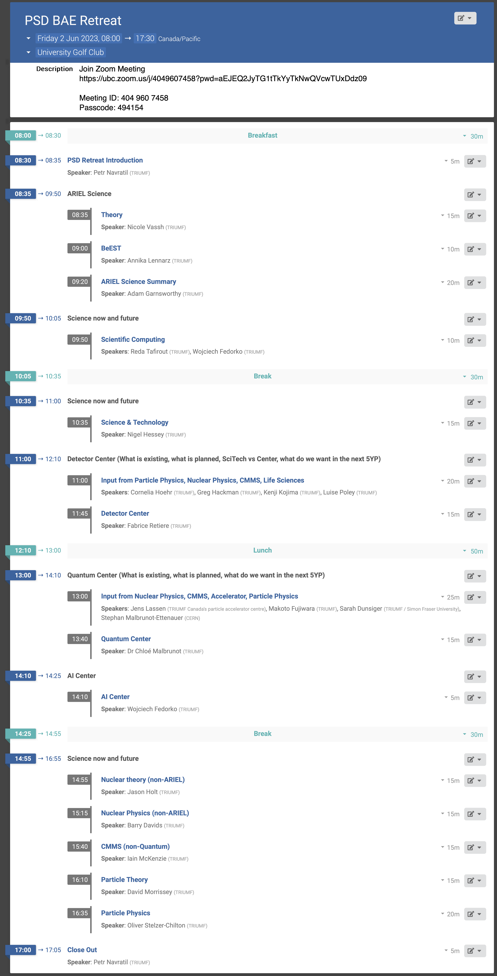
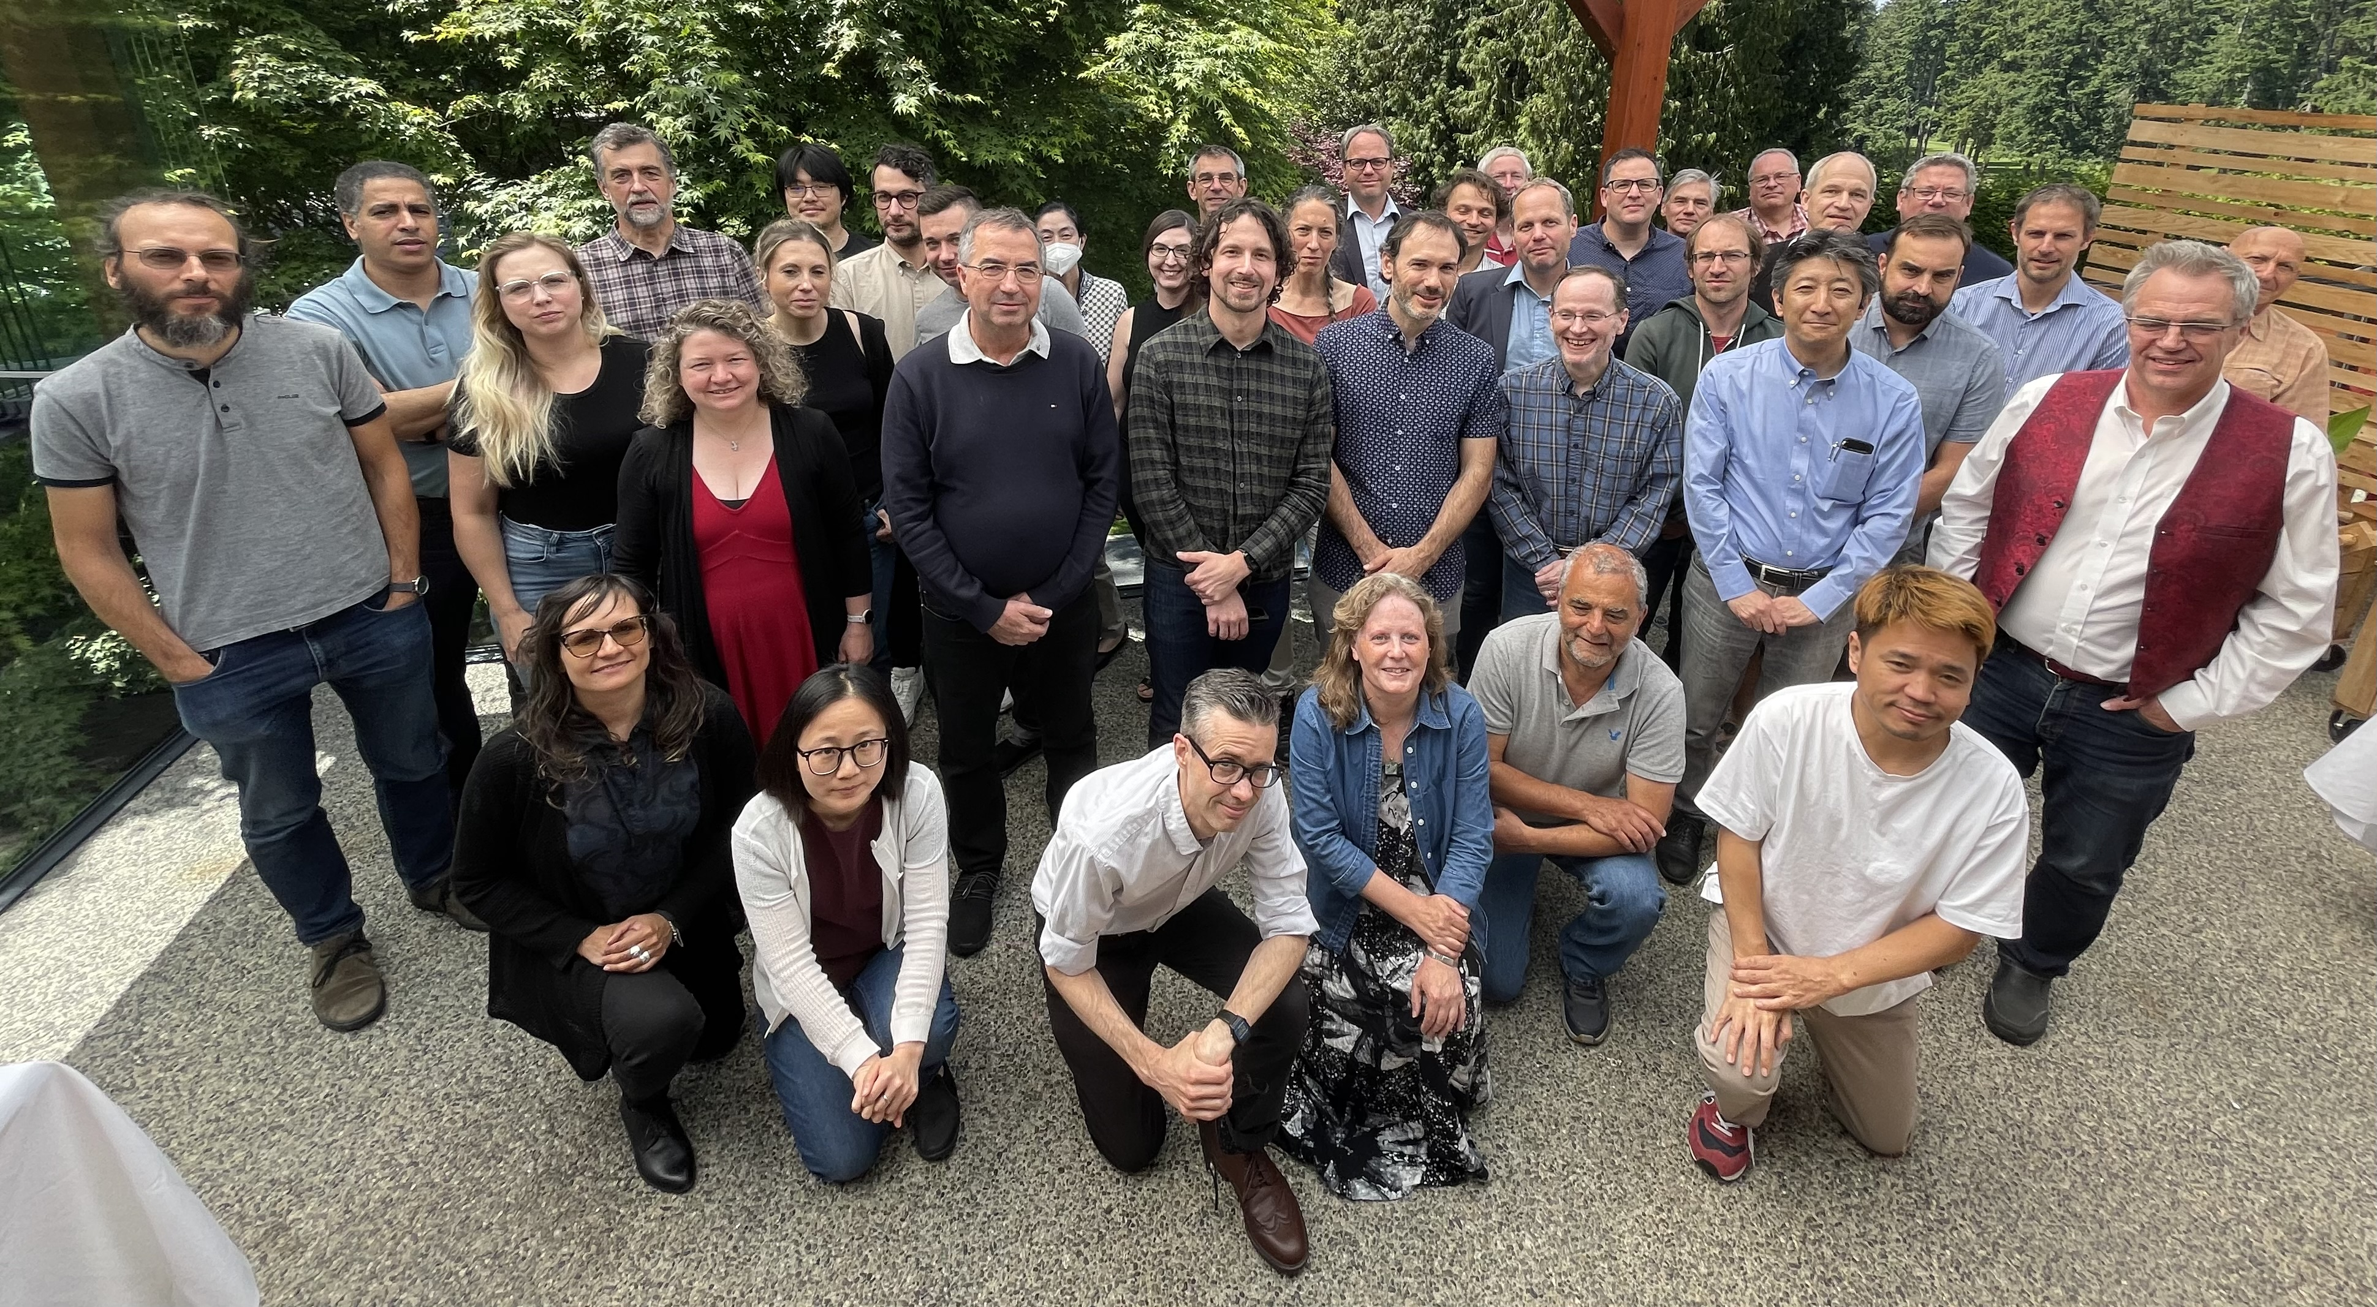
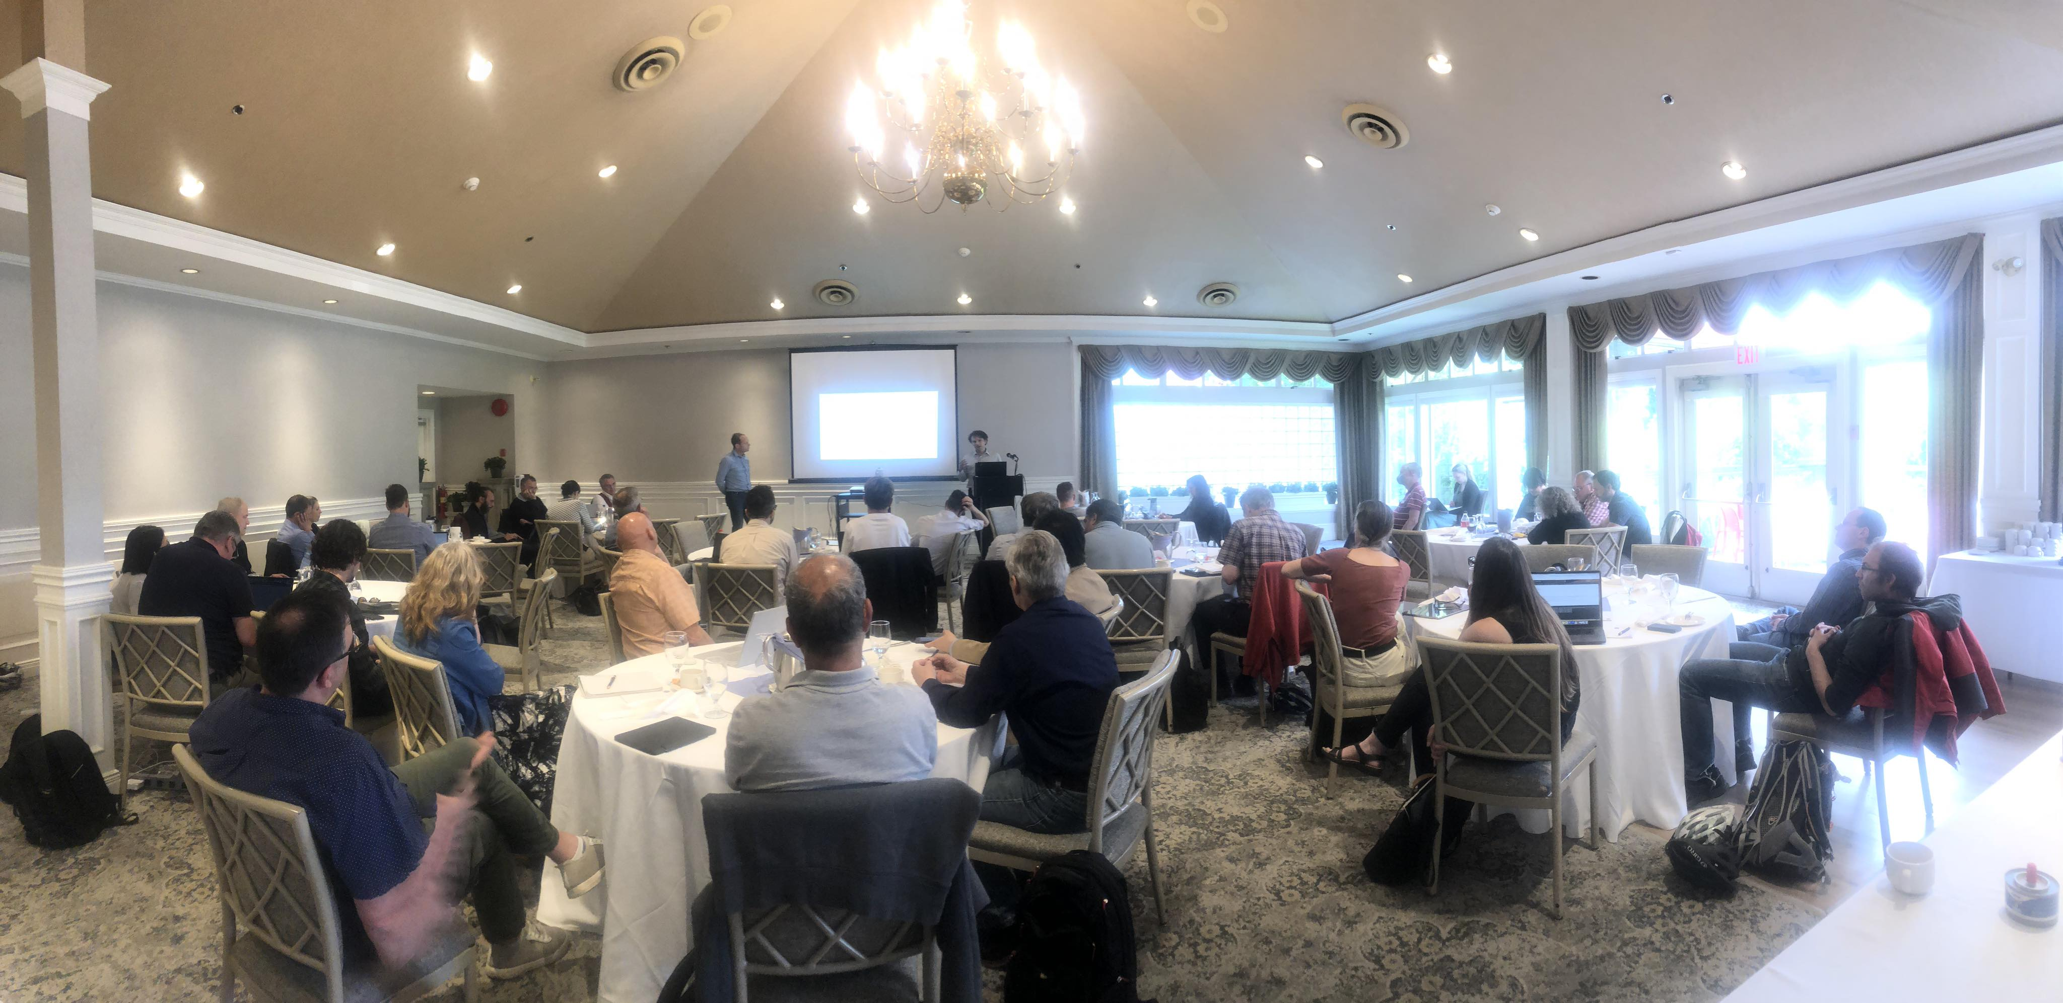
Physical Sciences
BAE retreat on Friday June 2nd at the University Golf Club
Dense program with good discussions
Focus on ongoing science, proposed detector, quantum & AI centers, ARIEL science opportunities
Almost 50 participants
PSD BAEs and P&S scientists plus invited BAEs from other divisions
Joined by Nigel Smith in the afternoon

Slide 5
IPP AGM at CAP
Mike Rooney added contributions from TRIUMF
“TRIUMF 5 Year Plan Physical Sciences Division Perspectives”
To cover general 5YP but in particular new initiatives / centers
Center for detector development (with SciTech, Nuclear, CMMS & Life Sciences)
Center for AMO/Quantum/Precision/physics (HAICU, radioactive molecules, UCN…), across Particle & Nuclear Physics departments
Talk based on ~2 page summaries
Summary (illustrated by hypothetical new building)
Detector Development Center
Center for Quantum Sensing & Precision Physics
Conference & Learning Center
AI Center

Slide 6
News
P3 in full swing, please complete if you have not done so!
Goals and Objectives
Overarching 5YP goals
Divisional goals
Departments add Objectives

Slide 7
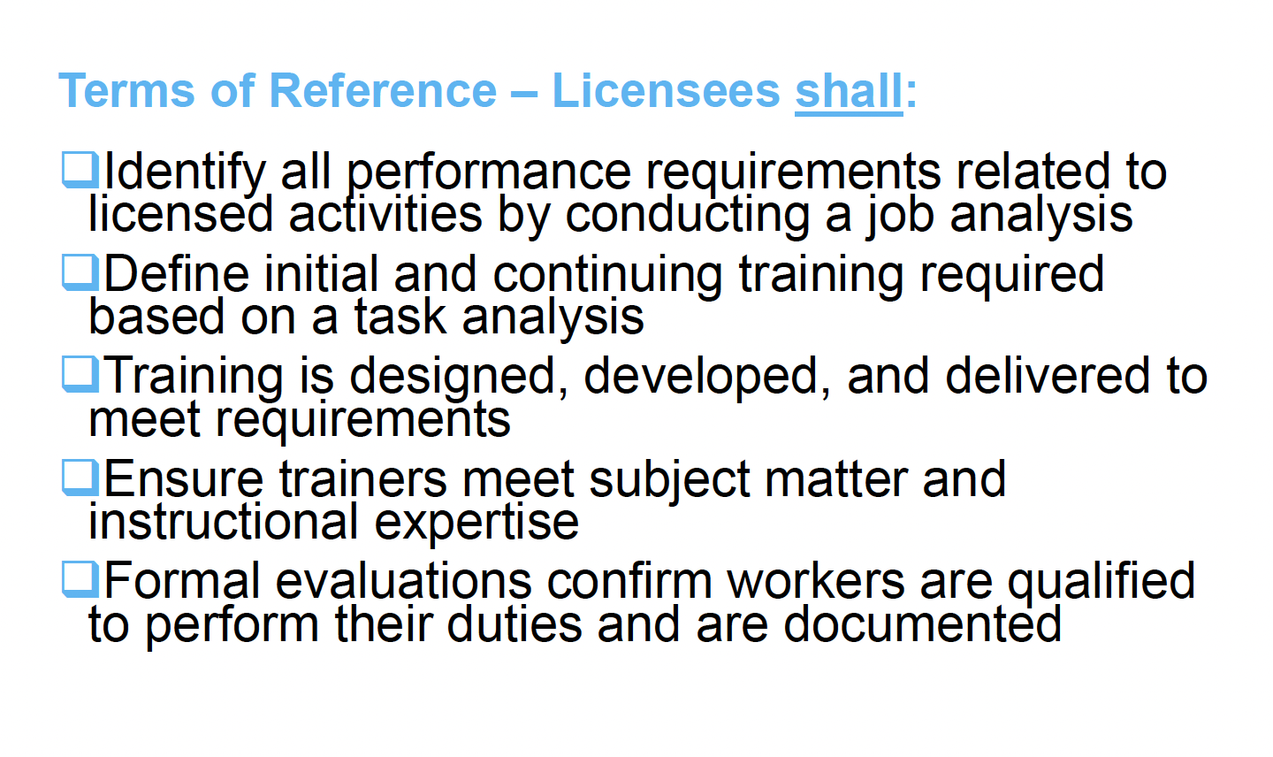
Training
Next CNSC visit will focus on training
Communication to the organization to be issued once CNSC has issued official notice
usually 1 month before planned visit

Slide 8
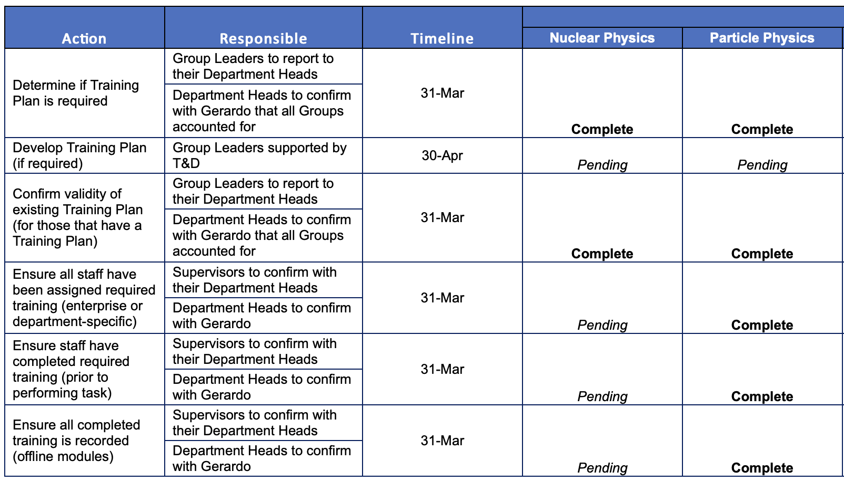
Training
Identified:
ITK
Hyper-K
UCN (done)
Existing training plans
https://documents.triumf.ca/docushare/dsweb/View/Collection-22051

Slide 9
AOB

Slide 10
Next Meeting
July 13th

