Slide 1
Particle Physics Faculty Meeting
Agenda
LAPS Implementation Pilot (Pedro)
News/Update
Roundtable

Slide 2
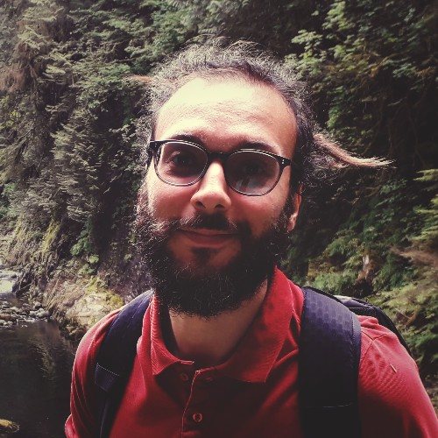
BAE Hire
ALPHA BAE position filled
Andrea Capra is the successful candidate
Postdoc at TRIUMF since 2016 in
working on ALPHA(-g) and Darkside-20k
PhD from York University in 2016

Slide 3
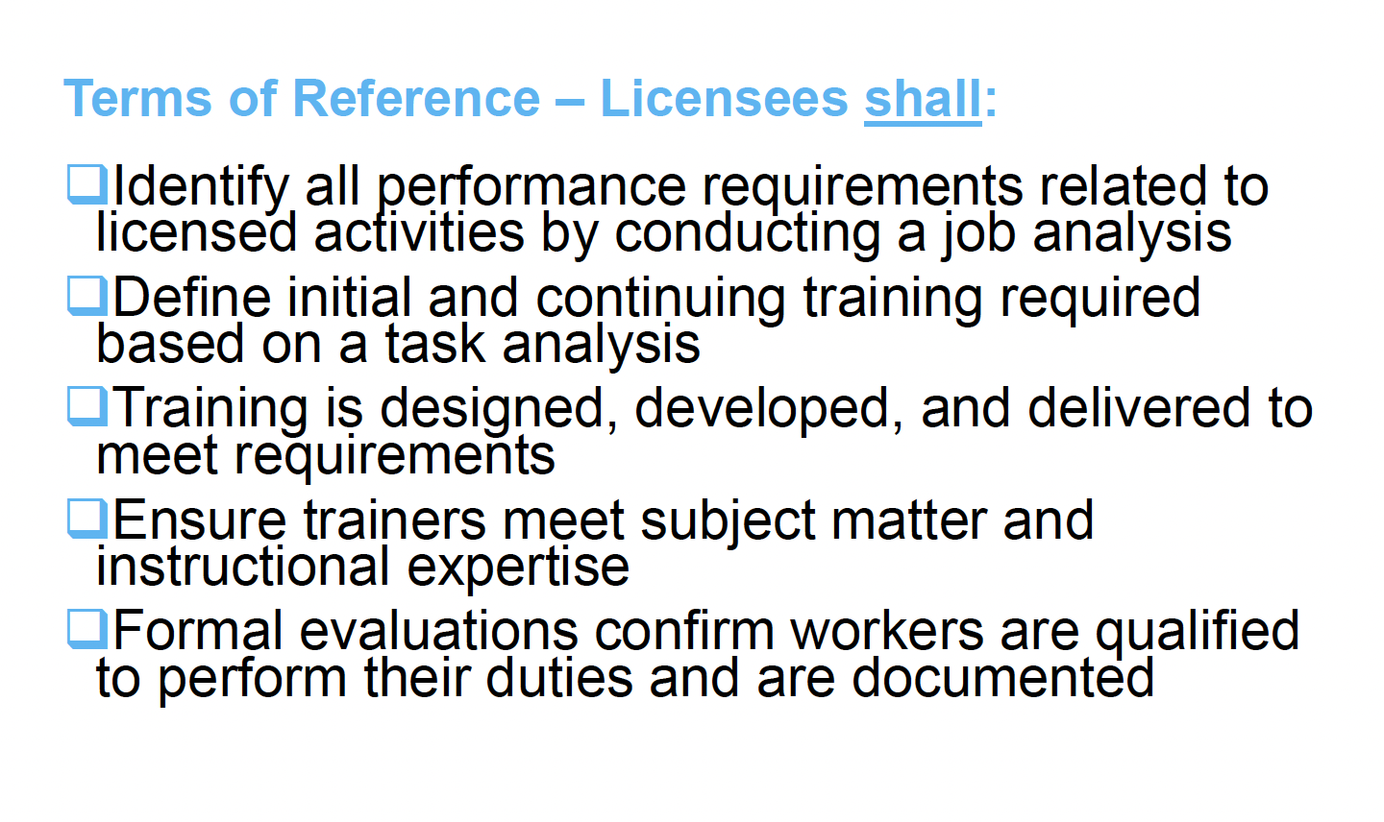
Training
Next CNSC visit will focus on training
Communication to the organization to be issued once CNSC has issued official notice
usually 1 month before planned visit

Slide 4
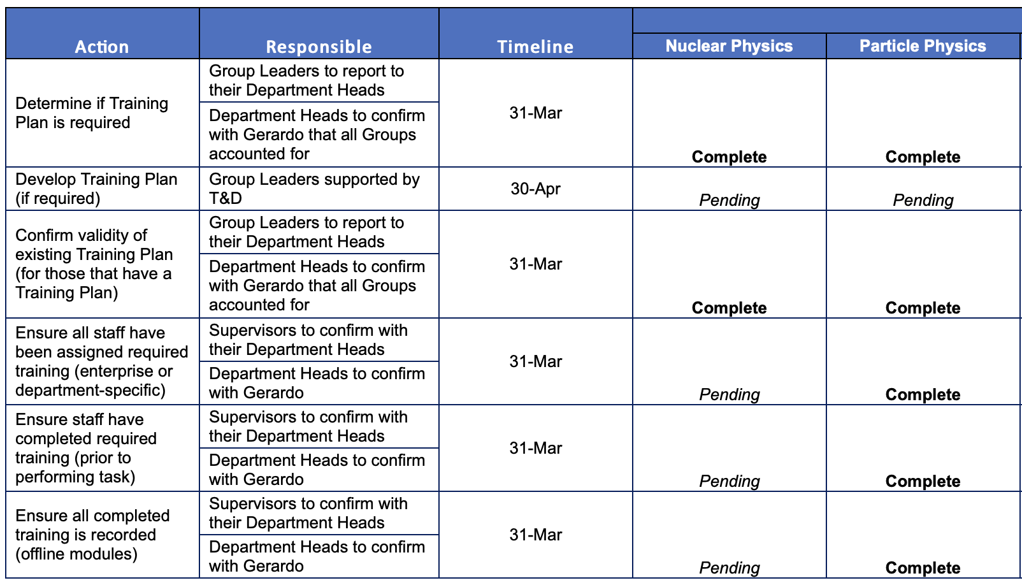
Training
Identified:
ITK
Hyper-K (in progress)
UCN (done)
Existing training plans
https://documents.triumf.ca/docushare/dsweb/View/Collection-22051

Slide 5
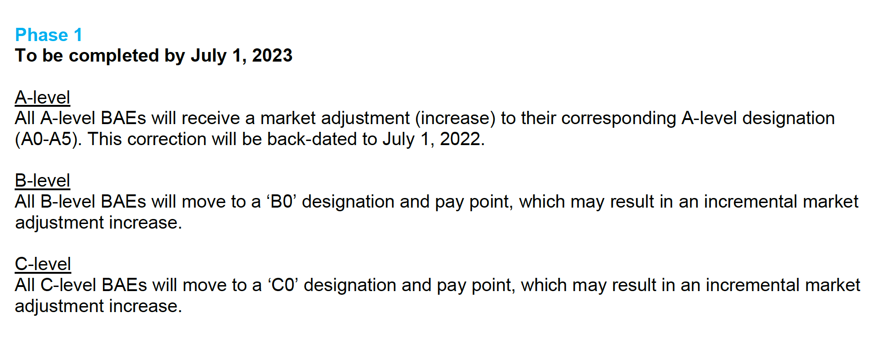
Compensation
Salary increases
$1300 + 3%
Not for BAE’s because of recent and ongoing market adjustment
One time merit increase for “above and beyond” performers

Slide 6
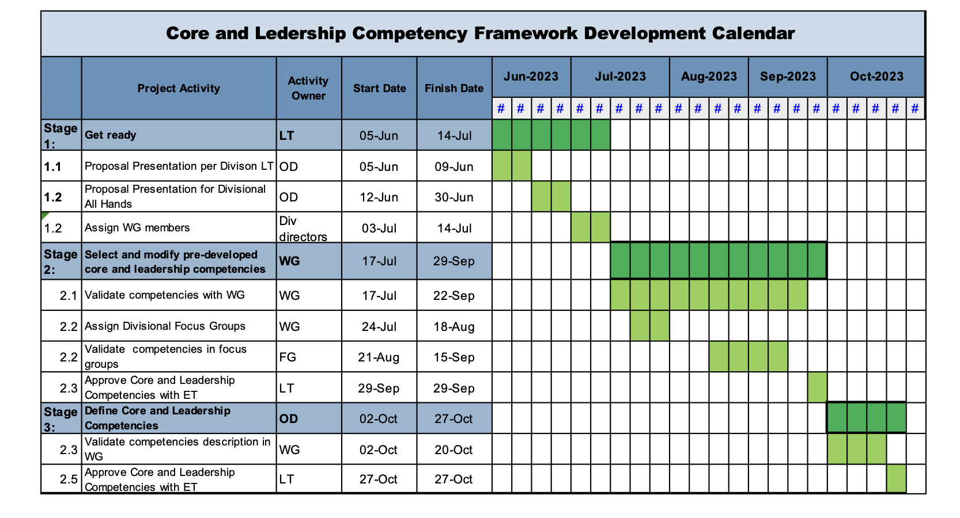
Critical Jobs

Slide 7
News
It’s Particle Physics turn to present at the SMM
If you have not done so already, please send Mark your slides
From Mark
Please share any personnel updates, research highlights, etc. by Friday. You can directly add updates to the slide template at
PPD_SMM_Updates_20230718.pptx
If you have not submitted your P3 yet, please do so asap
Meeting with HR tomorrow to streamline the form for BAE’s

Slide 8
CFI Proposals submitted in Particle Physics
These are prepared in collaboration with the university PI’s and often TRIUMF co-PI’s
ATLAS Tier-1 Centre $6.6M (total project $16.5M)
Refresh of hardware and expansion for the HL-LHC
Hyper-K $6.4M (add total)
200 mPMTs, photogrammetry calibration and
water quality monitoring equipment
DarkLight $2.8M (total project $7.0M total)
SRF cavity for 50 MeV upgrade
P-One $5.9M (total project $14.8M)
Six instrumented mooring lines for neutrino telescope at Ocean Network Canada (OCN)
nEXO $12M
Liquid Xenon detectors (TRIUMF part SiPM characterization)
ARGO $10M
Liquid Argon detectors (TRIUMF part UV single photon SiPM)
Found out in June what was funded

Slide 9
IPP AGM at CAP
Mike Rooney added contributions from TRIUMF
“TRIUMF 5 Year Plan”
To cover general 5YP but in particular new initiatives / centers
Center for detector development (with SciTech, Nuclear, CMMS & Life Sciences)
Center for AMO/Quantum/Precision/physics (HAICU, radioactive molecules, UCN…), across Particle & Nuclear Physics departments
AI Center
Talk based on ~2 page summaries
Nigel Smith presented on our behalf link here
Five Year Plan
2030 Science highlights link here
Thanks to everyone who already added a paragraph, there are a few missing

Slide 10
AOB

Slide 11
Round Table
ATLAS
T2K/HyperK
TUCAN
ALPHA
SuperCDMS
DarkLight
n-EXO / PHORWARD
PIONEER
NA62
P-One
SNO+
HALO
g-2
Belle
Theory

Slide 12
Next Meeting
Aug 10th

